Slide 1
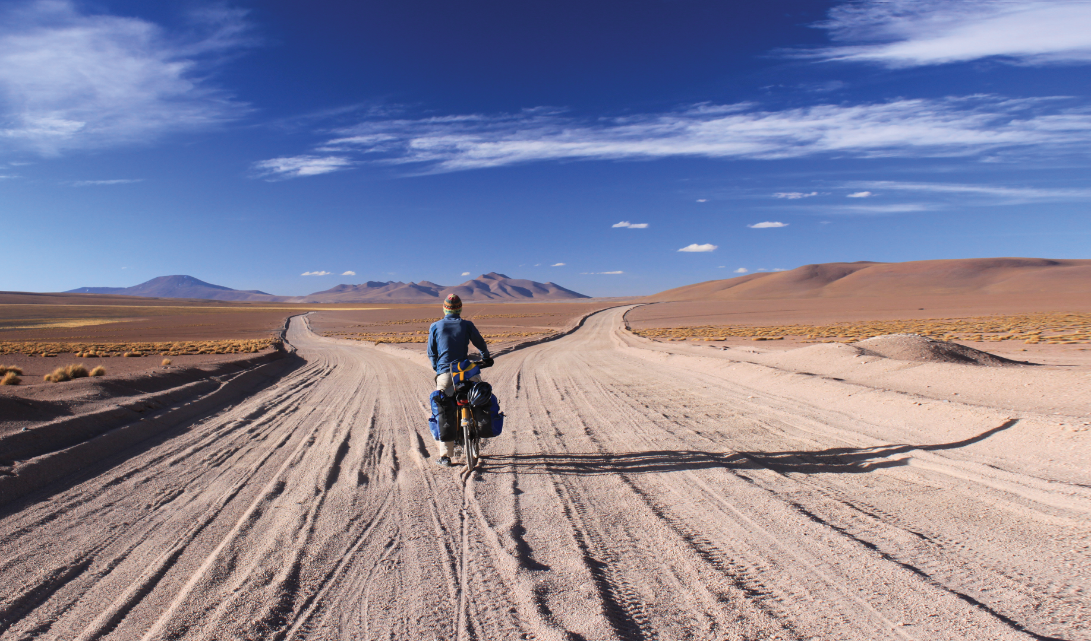


Unit 12:
DECISION
_______________________________________________________________________________________________________________________________________________________________________________________________________________________
National Geographic Learning, a Cengage Company. © 2022 Cengage Learning, Inc. ALL RIGHTS RESERVED. This presentation tool is for teaching purpose only. May not be scanned, copied or duplicated, or posted to a publicly accessible website, in whole or in part.

Slide 2
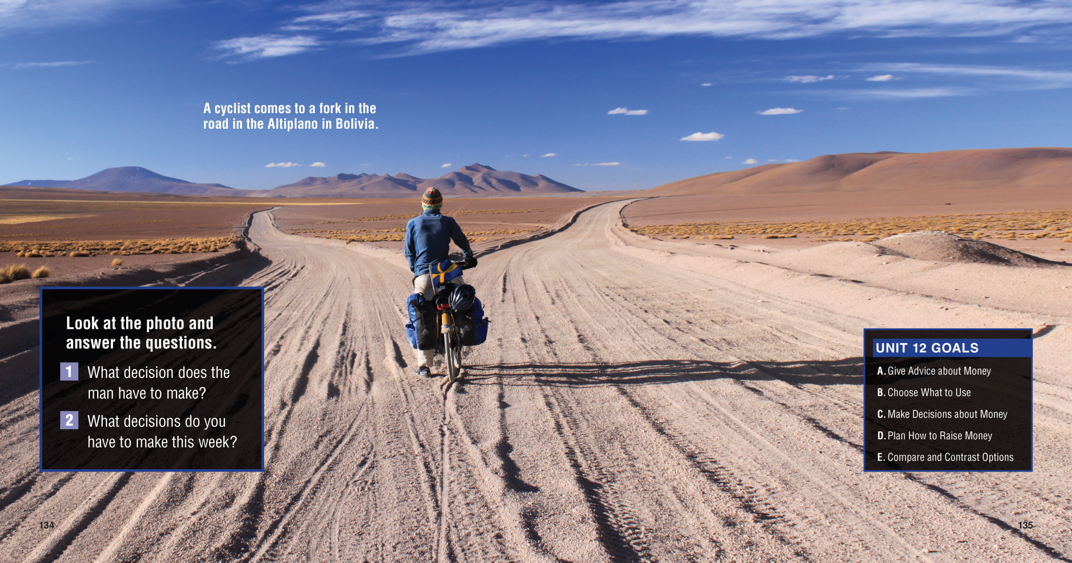

Slide 3
UNIT 12
DECISIONS
OVERVIEW
What are decisions?
Choices
Judgements
Conclusions
Conclusions
Decision /dɪˈsɪʒn/ (n): a conclusion or resolution reached after consideration.
_______________________________________________________________________________________________________________________________________________________________________________________________________________________
National Geographic Learning, a Cengage Company. © 2022 Cengage Learning, Inc. ALL RIGHTS RESERVED. This presentation tool is for teaching purpose only. May not be scanned, copied or duplicated, or posted to a publicly accessible website, in whole or in part.

Slide 4
UNIT 12
DECISIONS
OVERVIEW
Do you know?
One study suggests that an average adult makes around 35,000 decisions every single day!
_______________________________________________________________________________________________________________________________________________________________________________________________________________________
National Geographic Learning, a Cengage Company. © 2022 Cengage Learning, Inc. ALL RIGHTS RESERVED. This presentation tool is for teaching purpose only. May not be scanned, copied or duplicated, or posted to a publicly accessible website, in whole or in part.

Slide 5
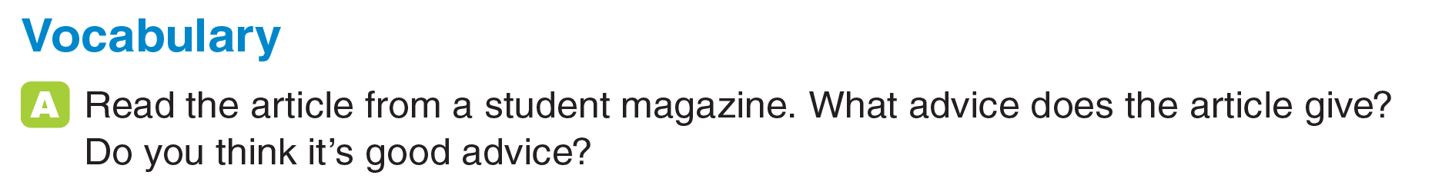
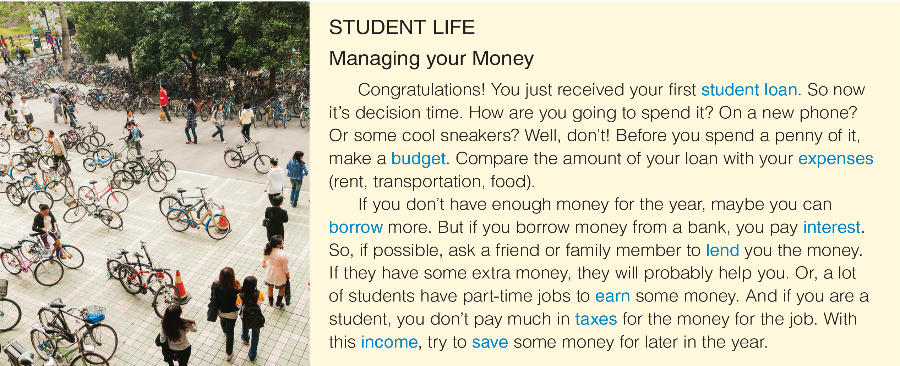
UNIT 12
DECISIONS
VOCABULARY
_______________________________________________________________________________________________________________________________________________________________________________________________________________________
National Geographic Learning, a Cengage Company. © 2022 Cengage Learning, Inc. ALL RIGHTS RESERVED. This presentation tool is for teaching purpose only. May not be scanned, copied or duplicated, or posted to a publicly accessible website, in whole or in part.

Slide 6
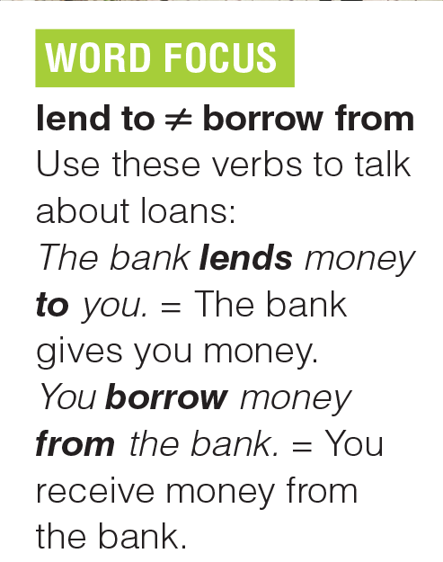
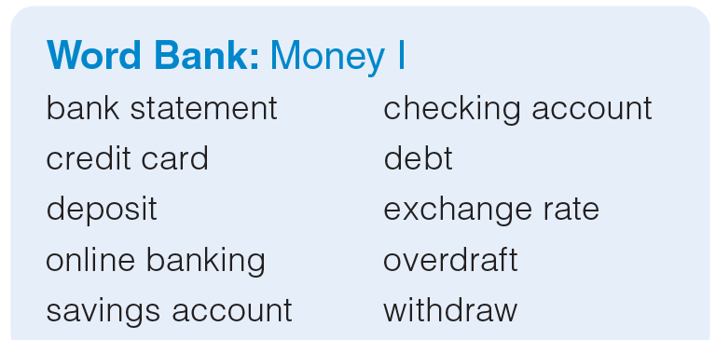
UNIT 12
DECISIONS
VOCABULARY
_______________________________________________________________________________________________________________________________________________________________________________________________________________________
National Geographic Learning, a Cengage Company. © 2022 Cengage Learning, Inc. ALL RIGHTS RESERVED. This presentation tool is for teaching purpose only. May not be scanned, copied or duplicated, or posted to a publicly accessible website, in whole or in part.

Slide 7
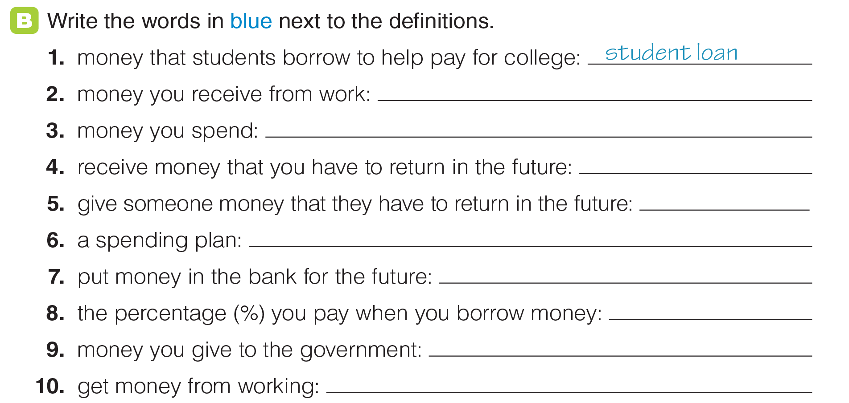
UNIT 12
DECISIONS
VOCABULARY
income
expenses
borrow
lend
budget
save
interest
taxes
earn
_______________________________________________________________________________________________________________________________________________________________________________________________________________________
National Geographic Learning, a Cengage Company. © 2022 Cengage Learning, Inc. ALL RIGHTS RESERVED. This presentation tool is for teaching purpose only. May not be scanned, copied or duplicated, or posted to a publicly accessible website, in whole or in part.

Slide 8
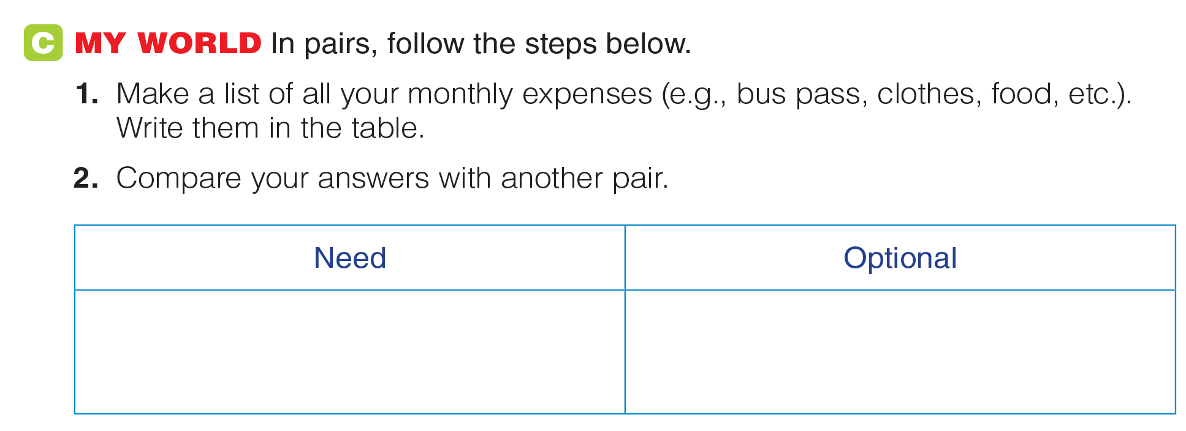
UNIT 12
DECISIONS
VOCABULARY
_______________________________________________________________________________________________________________________________________________________________________________________________________________________
National Geographic Learning, a Cengage Company. © 2022 Cengage Learning, Inc. ALL RIGHTS RESERVED. This presentation tool is for teaching purpose only. May not be scanned, copied or duplicated, or posted to a publicly accessible website, in whole or in part.

Slide 9
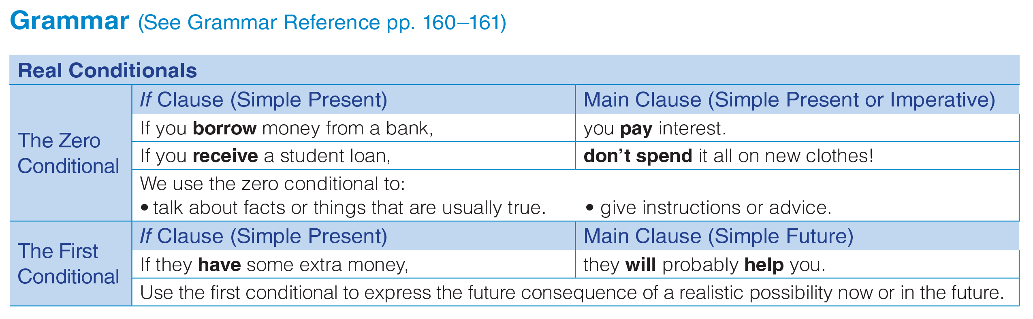
UNIT 12
DECISIONS
GRAMMAR
_______________________________________________________________________________________________________________________________________________________________________________________________________________________
National Geographic Learning, a Cengage Company. © 2022 Cengage Learning, Inc. ALL RIGHTS RESERVED. This presentation tool is for teaching purpose only. May not be scanned, copied or duplicated, or posted to a publicly accessible website, in whole or in part.

Slide 10
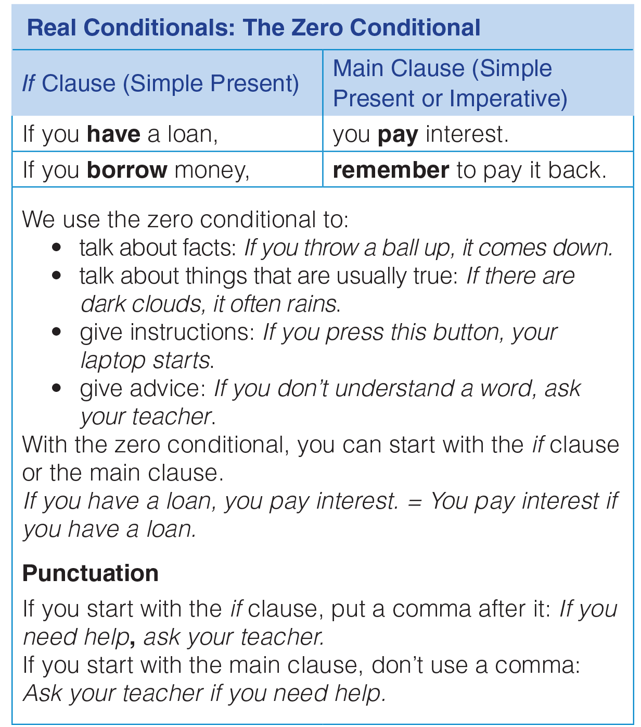
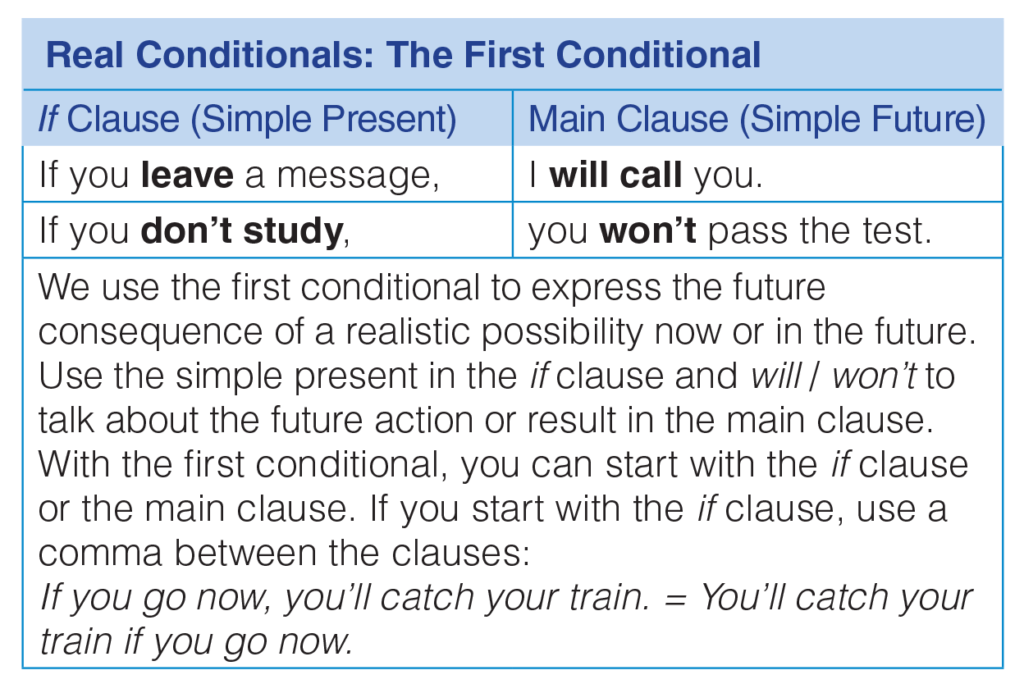
UNIT 12
DECISIONS
GRAMMAR
_______________________________________________________________________________________________________________________________________________________________________________________________________________________
National Geographic Learning, a Cengage Company. © 2022 Cengage Learning, Inc. ALL RIGHTS RESERVED. This presentation tool is for teaching purpose only. May not be scanned, copied or duplicated, or posted to a publicly accessible website, in whole or in part.

Slide 11
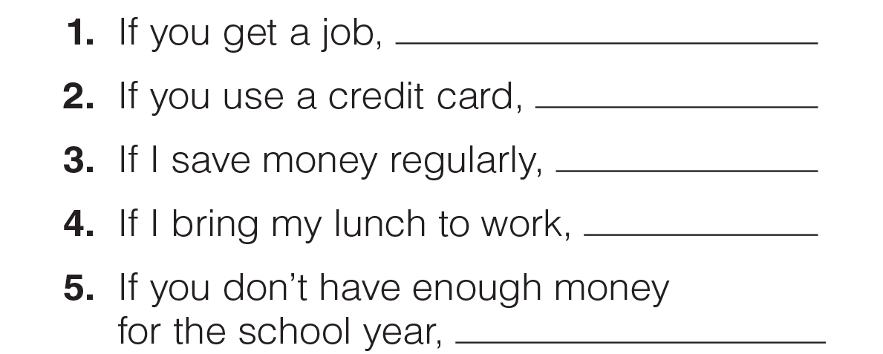
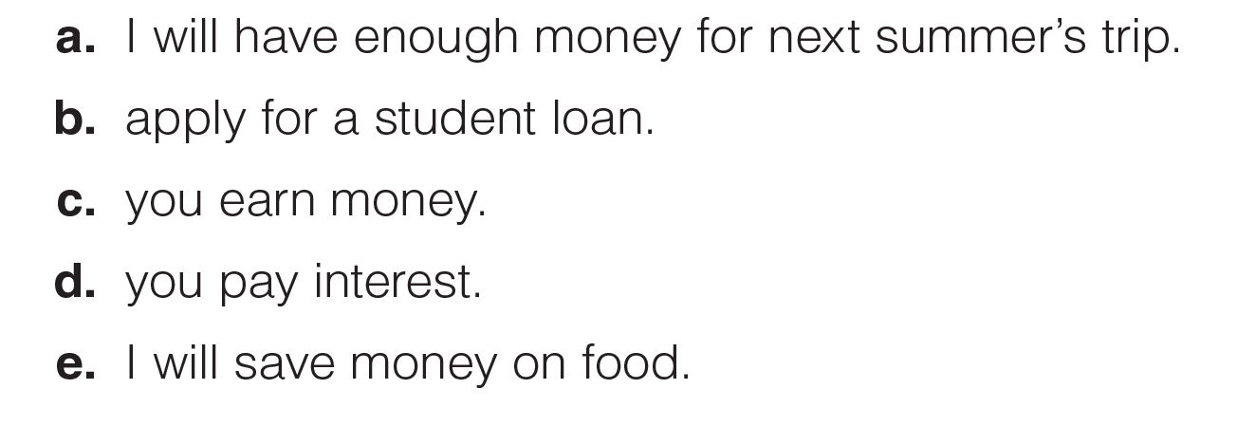
UNIT 12
DECISIONS
GRAMMAR
c
Zero conditional
d
Zero conditional
a
First conditional
e
First conditional
b
Zero conditional
_______________________________________________________________________________________________________________________________________________________________________________________________________________________
National Geographic Learning, a Cengage Company. © 2022 Cengage Learning, Inc. ALL RIGHTS RESERVED. This presentation tool is for teaching purpose only. May not be scanned, copied or duplicated, or posted to a publicly accessible website, in whole or in part.

Slide 12
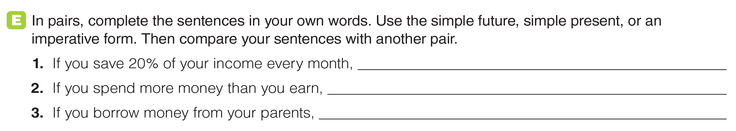
UNIT 12
DECISIONS
GRAMMAR
_______________________________________________________________________________________________________________________________________________________________________________________________________________________
National Geographic Learning, a Cengage Company. © 2022 Cengage Learning, Inc. ALL RIGHTS RESERVED. This presentation tool is for teaching purpose only. May not be scanned, copied or duplicated, or posted to a publicly accessible website, in whole or in part.

Slide 13
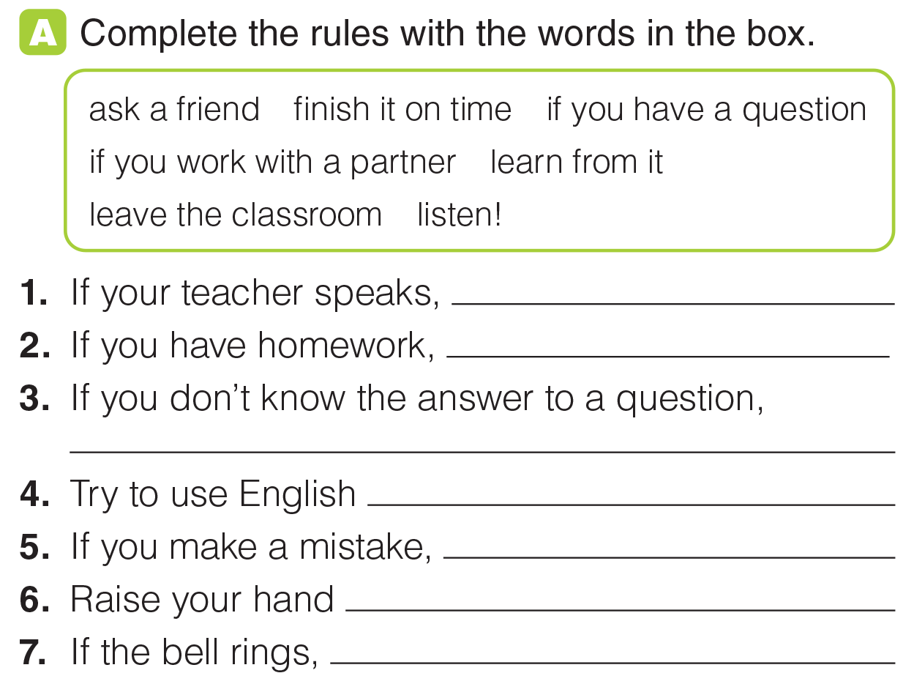
UNIT 12
DECISIONS
GRAMMAR
listen!
finish it on time.
ask a friend.
if you work with a partner.
learn from it.
if you have a question.
leave the classroom.
_______________________________________________________________________________________________________________________________________________________________________________________________________________________
National Geographic Learning, a Cengage Company. © 2022 Cengage Learning, Inc. ALL RIGHTS RESERVED. This presentation tool is for teaching purpose only. May not be scanned, copied or duplicated, or posted to a publicly accessible website, in whole or in part.

Slide 14
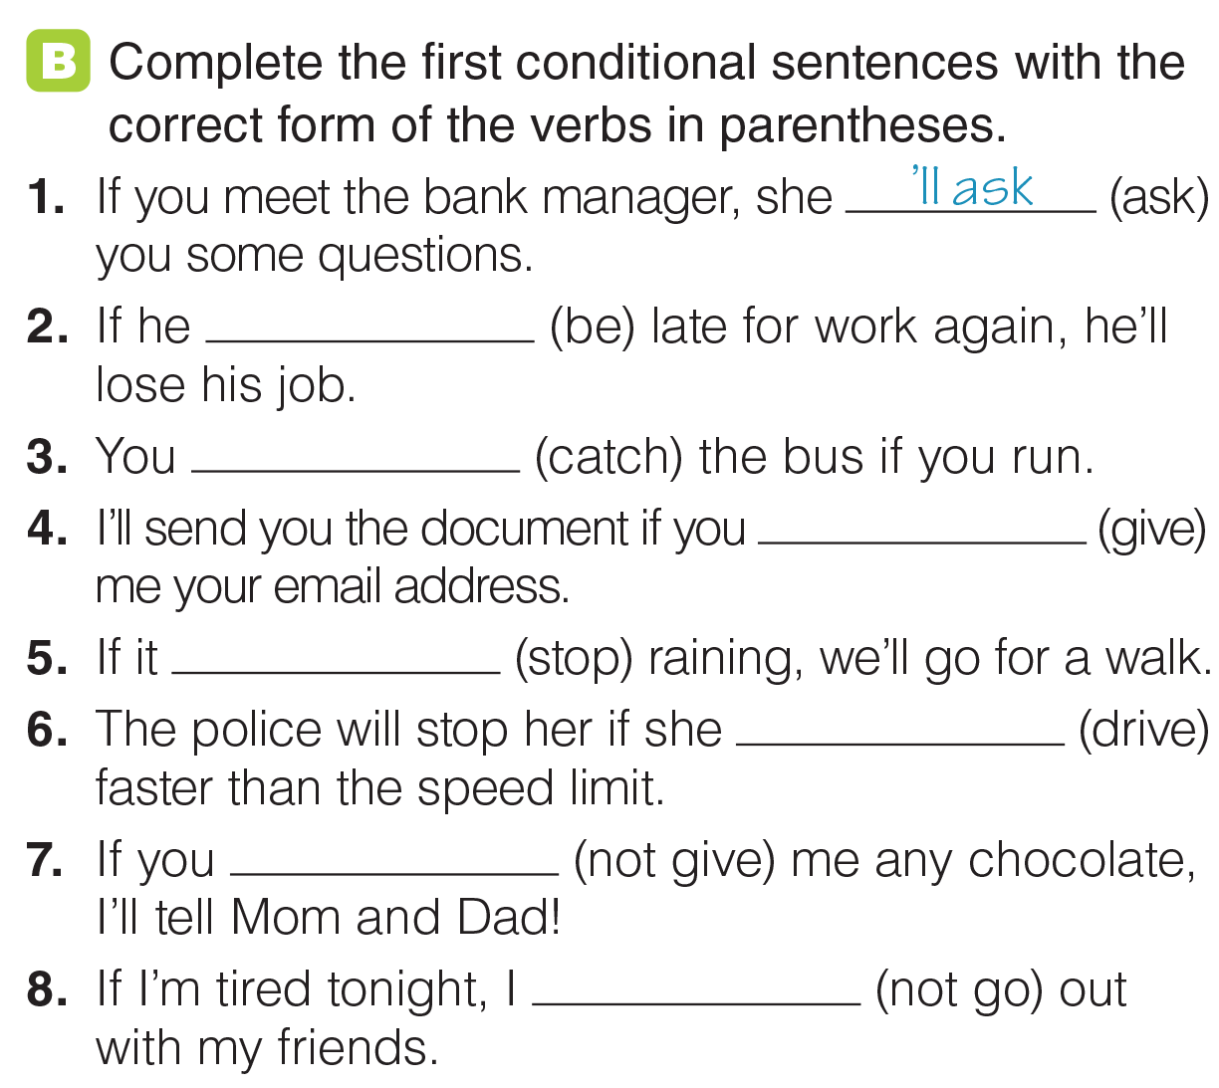
UNIT 12
DECISIONS
GRAMMAR
‘s
‘ll catch
give
stops
drives
don’t give
won’t go
_______________________________________________________________________________________________________________________________________________________________________________________________________________________
National Geographic Learning, a Cengage Company. © 2022 Cengage Learning, Inc. ALL RIGHTS RESERVED. This presentation tool is for teaching purpose only. May not be scanned, copied or duplicated, or posted to a publicly accessible website, in whole or in part.

Slide 15

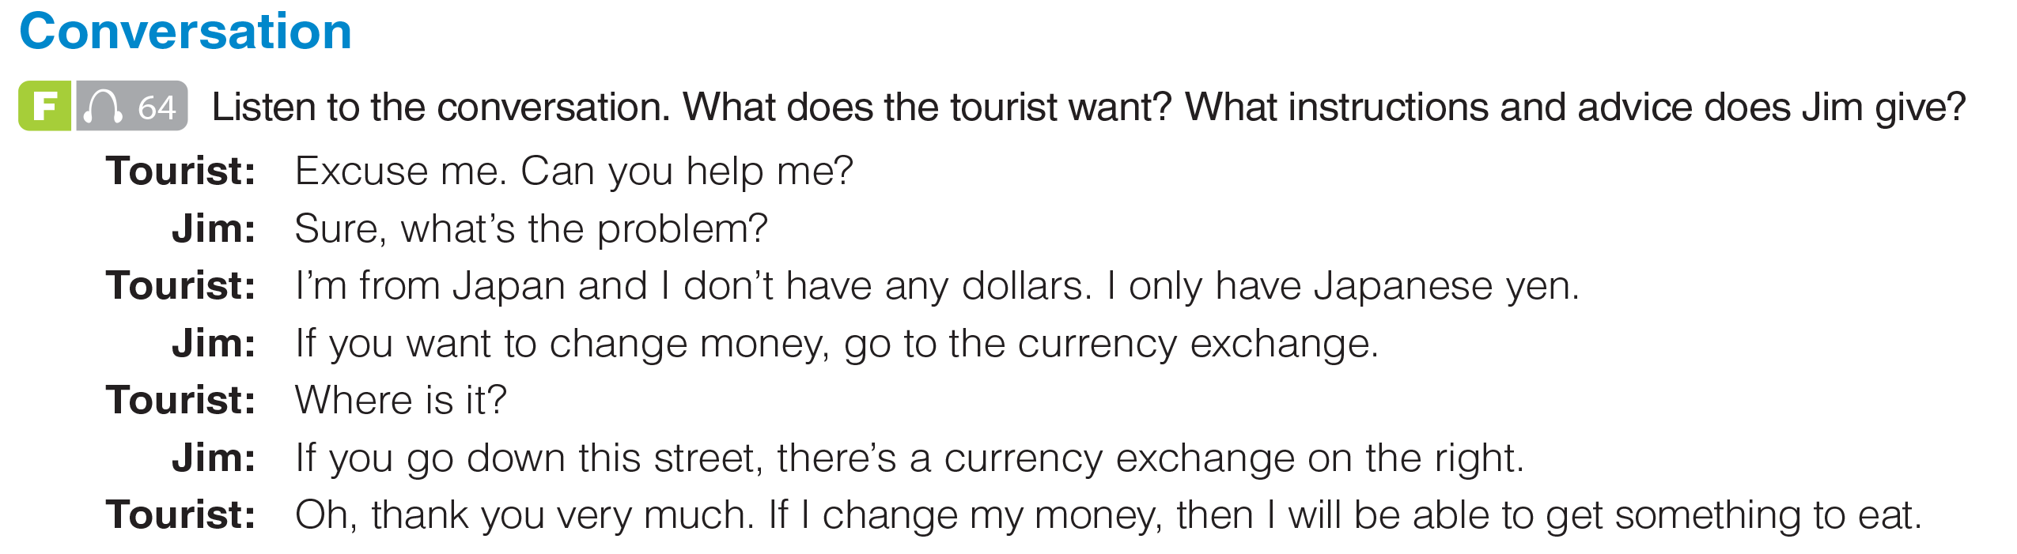
UNIT 12
DECISIONS
CONVERSATION
=> The tourist wants to change yen into dollars. Jim tells her to go to the currency exchange. It’s down the street and on the right.
_______________________________________________________________________________________________________________________________________________________________________________________________________________________
National Geographic Learning, a Cengage Company. © 2022 Cengage Learning, Inc. ALL RIGHTS RESERVED. This presentation tool is for teaching purpose only. May not be scanned, copied or duplicated, or posted to a publicly accessible website, in whole or in part.

Slide 16
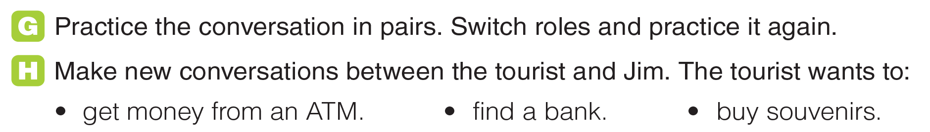
UNIT 12
DECISIONS
GRAMMAR
_______________________________________________________________________________________________________________________________________________________________________________________________________________________
National Geographic Learning, a Cengage Company. © 2022 Cengage Learning, Inc. ALL RIGHTS RESERVED. This presentation tool is for teaching purpose only. May not be scanned, copied or duplicated, or posted to a publicly accessible website, in whole or in part.

Slide 17
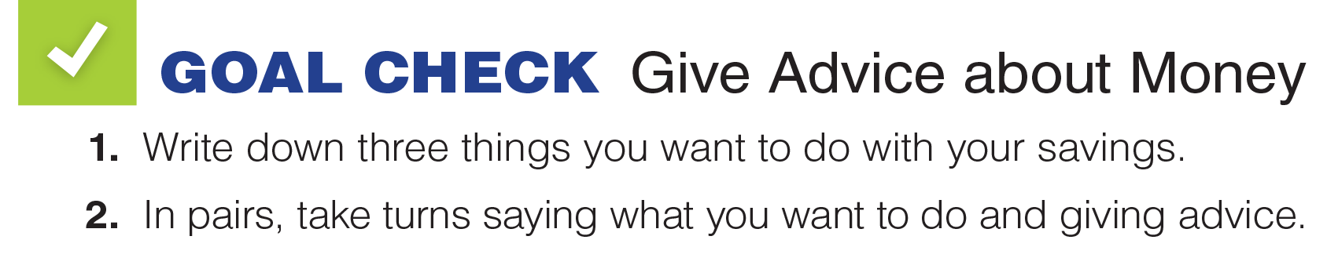
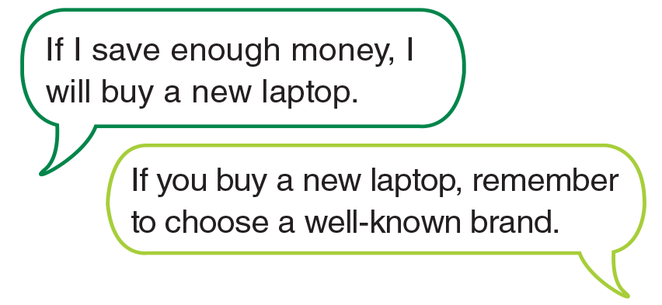
UNIT 12
DECISIONS
GOAL CHECK

Slide 18
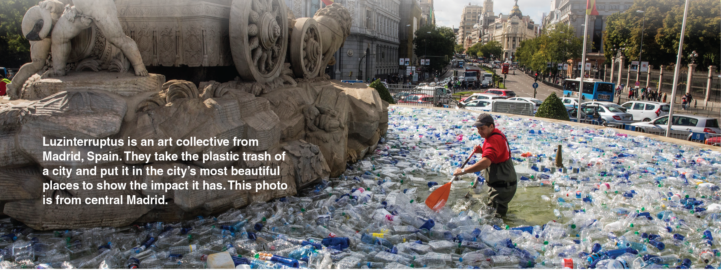
THE REAL WORLD
WHAT'S YOUR FAVORITE BAND?
LISTENING
UNIT 1
DECISIONS
UNIT 12
_______________________________________________________________________________________________________________________________________________________________________________________________________________________
National Geographic Learning, a Cengage Company. © 2022 Cengage Learning, Inc. ALL RIGHTS RESERVED. This presentation tool is for teaching purpose only. May not be scanned, copied or duplicated, or posted to a publicly accessible website, in whole or in part.

Slide 19
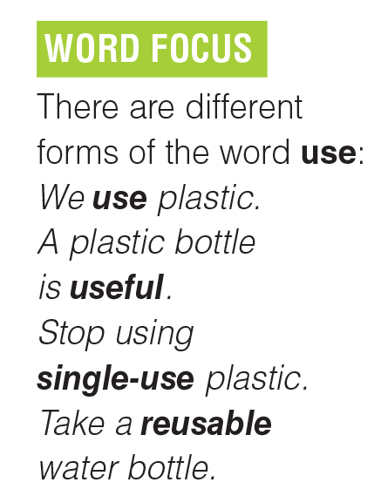
UNIT 12
DECISIONS
LISTENING
use is a verb;
useful, single-use, and reusable are all adjectives.
• As a verb, it is pronounced /ju:z/.
• But as a noun, it is pronounced /ju:s/.
_______________________________________________________________________________________________________________________________________________________________________________________________________________________
National Geographic Learning, a Cengage Company. © 2022 Cengage Learning, Inc. ALL RIGHTS RESERVED. This presentation tool is for teaching purpose only. May not be scanned, copied or duplicated, or posted to a publicly accessible website, in whole or in part.

Slide 20


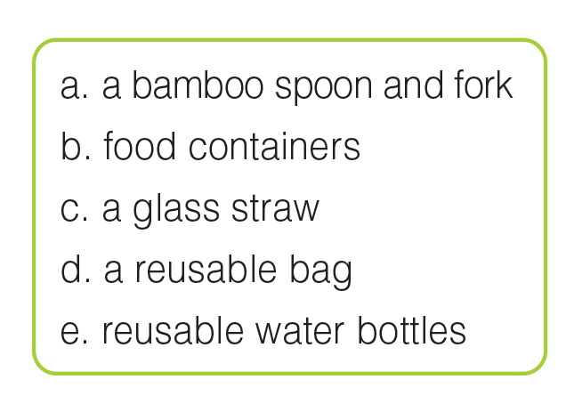
UNIT 12
DECISIONS
LISTENING
a
d
b
e
c
_______________________________________________________________________________________________________________________________________________________________________________________________________________________
National Geographic Learning, a Cengage Company. © 2022 Cengage Learning, Inc. ALL RIGHTS RESERVED. This presentation tool is for teaching purpose only. May not be scanned, copied or duplicated, or posted to a publicly accessible website, in whole or in part.

Slide 21
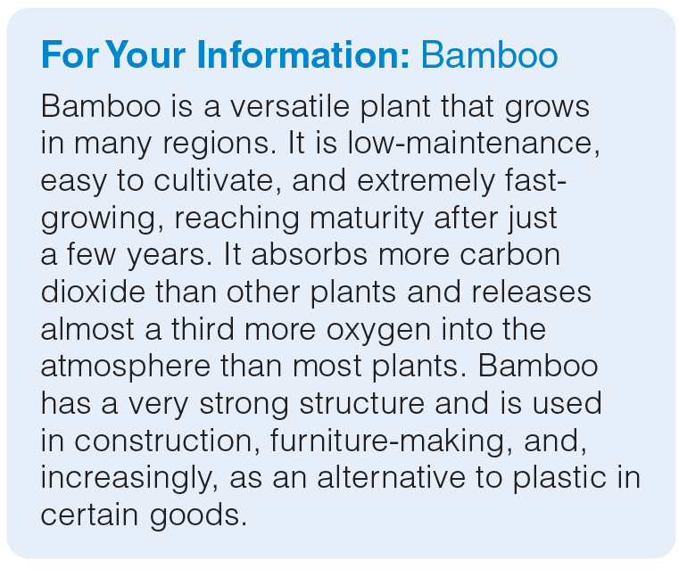
UNIT 12
DECISIONS
LISTENING
_______________________________________________________________________________________________________________________________________________________________________________________________________________________
National Geographic Learning, a Cengage Company. © 2022 Cengage Learning, Inc. ALL RIGHTS RESERVED. This presentation tool is for teaching purpose only. May not be scanned, copied or duplicated, or posted to a publicly accessible website, in whole or in part.

Slide 22
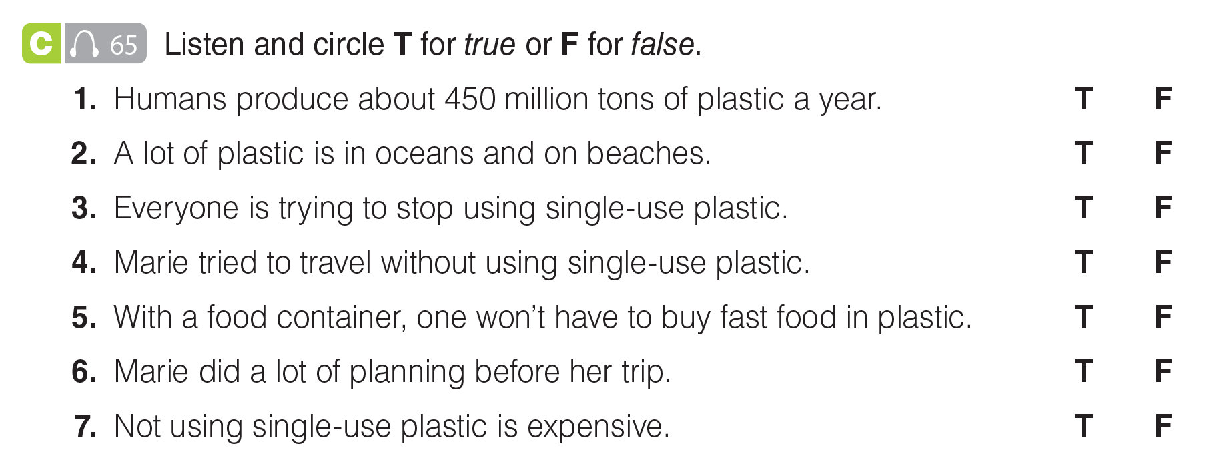
THE REAL WORLD
WHAT'S YOUR FAVORITE BAND?
LISTENING
UNIT 1
DECISIONS
UNIT 12
_______________________________________________________________________________________________________________________________________________________________________________________________________________________
National Geographic Learning, a Cengage Company. © 2022 Cengage Learning, Inc. ALL RIGHTS RESERVED. This presentation tool is for teaching purpose only. May not be scanned, copied or duplicated, or posted to a publicly accessible website, in whole or in part.

Slide 23
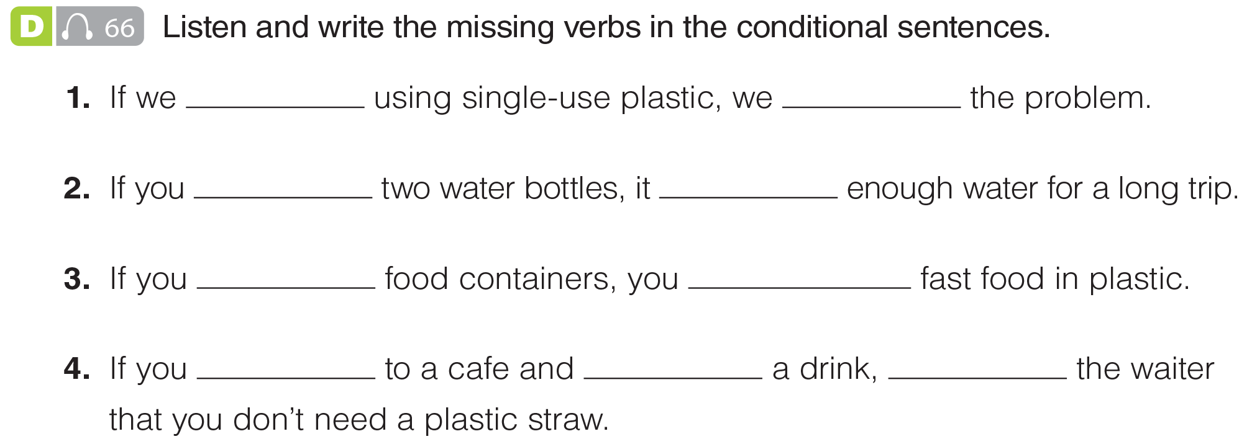
UNIT 12
DECISIONS
LISTENING
stop
will solve
pack
’s
carry
won’t have to
go
order
tell
_______________________________________________________________________________________________________________________________________________________________________________________________________________________
National Geographic Learning, a Cengage Company. © 2022 Cengage Learning, Inc. ALL RIGHTS RESERVED. This presentation tool is for teaching purpose only. May not be scanned, copied or duplicated, or posted to a publicly accessible website, in whole or in part.

Slide 24
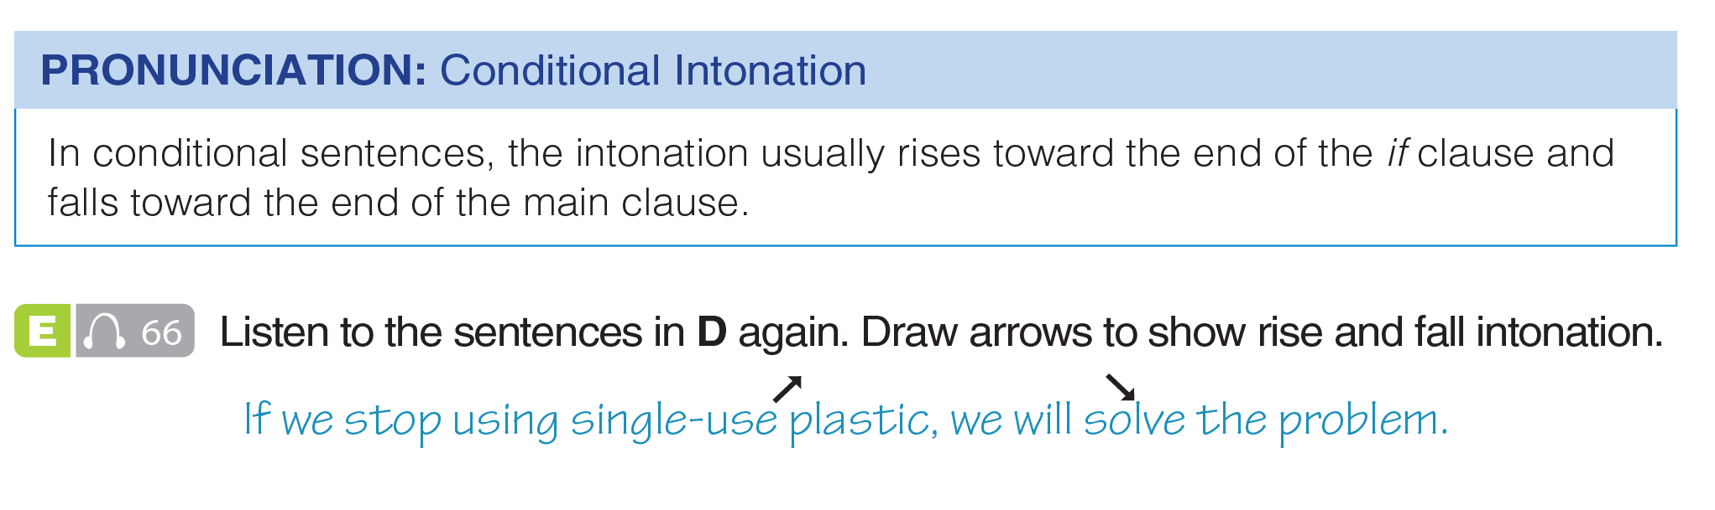
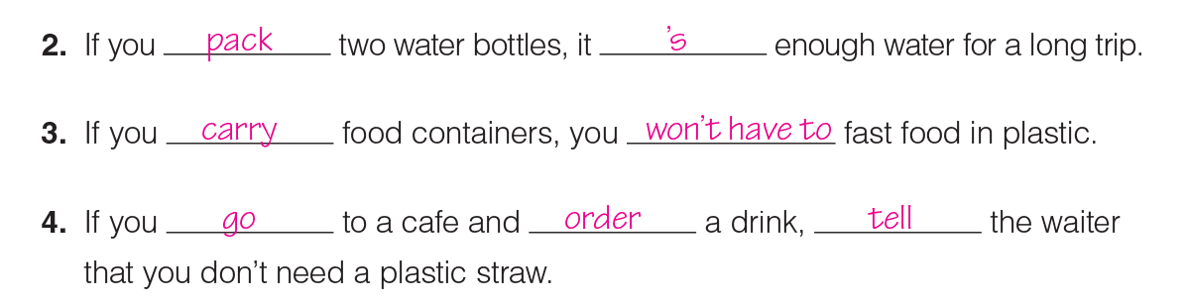
UNIT 12
DECISIONS
PRONUNCIATION
_______________________________________________________________________________________________________________________________________________________________________________________________________________________
National Geographic Learning, a Cengage Company. © 2022 Cengage Learning, Inc. ALL RIGHTS RESERVED. This presentation tool is for teaching purpose only. May not be scanned, copied or duplicated, or posted to a publicly accessible website, in whole or in part.

Slide 25
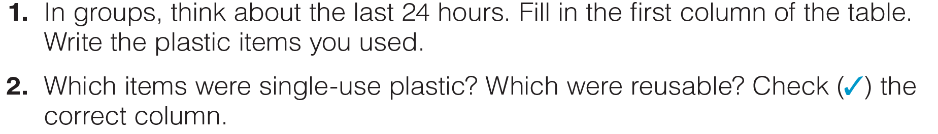
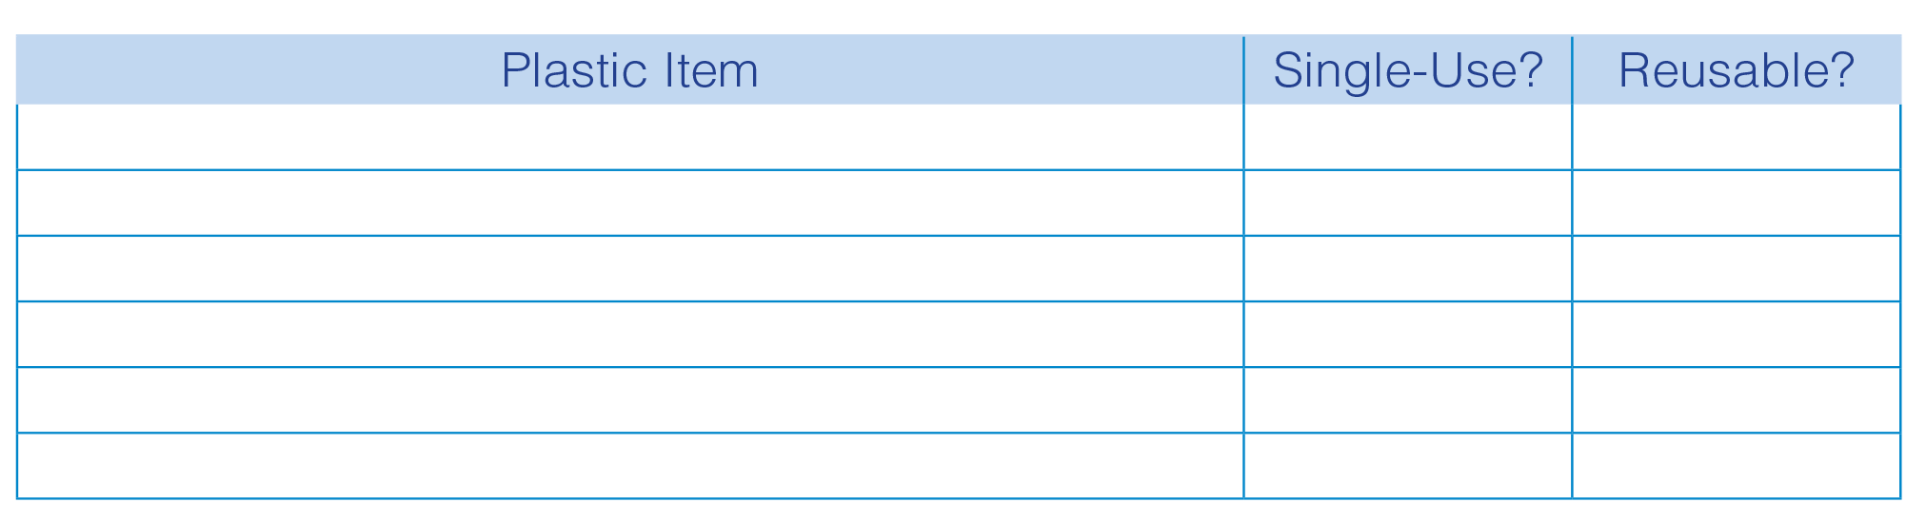
UNIT 12
DECISIONS
GOAL CHECK
_______________________________________________________________________________________________________________________________________________________________________________________________________________________
National Geographic Learning, a Cengage Company. © 2022 Cengage Learning, Inc. ALL RIGHTS RESERVED. This presentation tool is for teaching purpose only. May not be scanned, copied or duplicated, or posted to a publicly accessible website, in whole or in part.

Slide 26
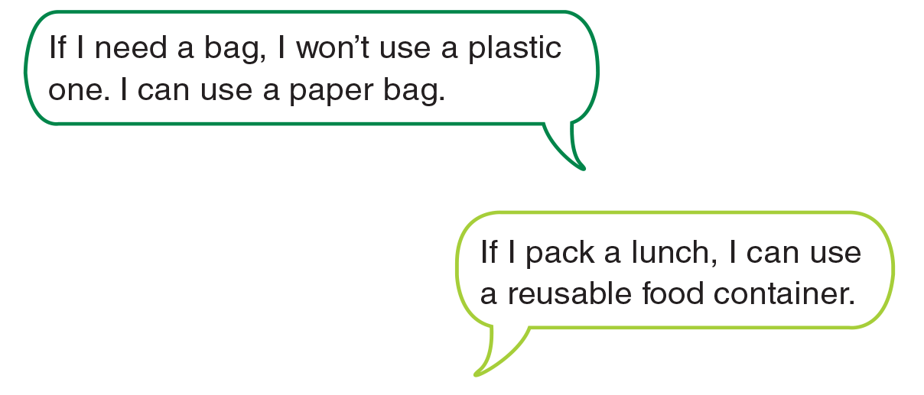
UNIT 12
DECISIONS
GOAL CHECK
_______________________________________________________________________________________________________________________________________________________________________________________________________________________
National Geographic Learning, a Cengage Company. © 2022 Cengage Learning, Inc. ALL RIGHTS RESERVED. This presentation tool is for teaching purpose only. May not be scanned, copied or duplicated, or posted to a publicly accessible website, in whole or in part.

Slide 27
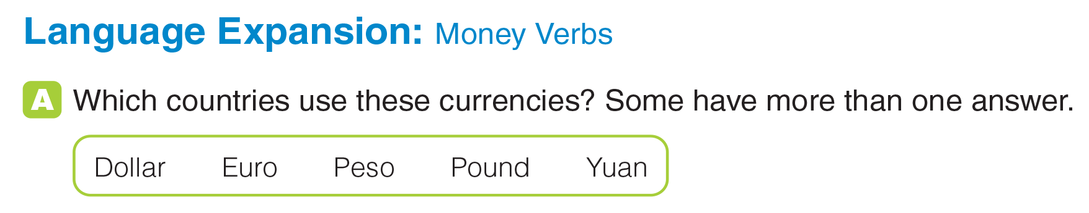
UNIT 12
DECISIONS
LANGUAGE EXPANSION
Dollar: US, Australia, etc.;
Euro: France, Germany, etc.;
Peso: Mexico, Chile, etc.;
Pound: UK;
Yuan: China
_______________________________________________________________________________________________________________________________________________________________________________________________________________________
National Geographic Learning, a Cengage Company. © 2022 Cengage Learning, Inc. ALL RIGHTS RESERVED. This presentation tool is for teaching purpose only. May not be scanned, copied or duplicated, or posted to a publicly accessible website, in whole or in part.

Slide 28
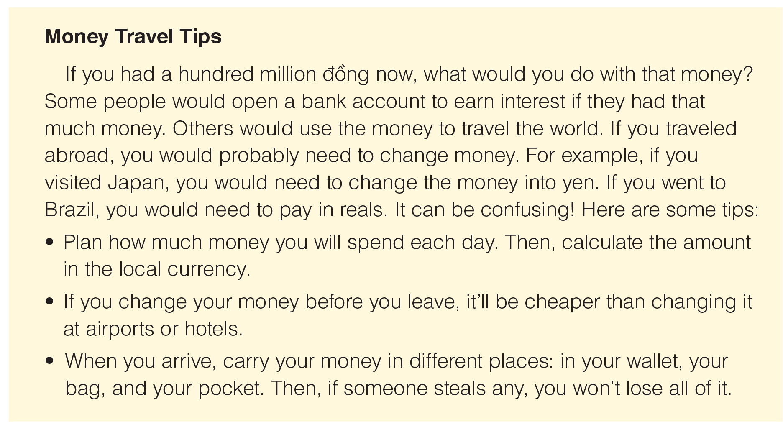
UNIT 12
DECISIONS
LANGUAGE EXPANSION

Slide 29
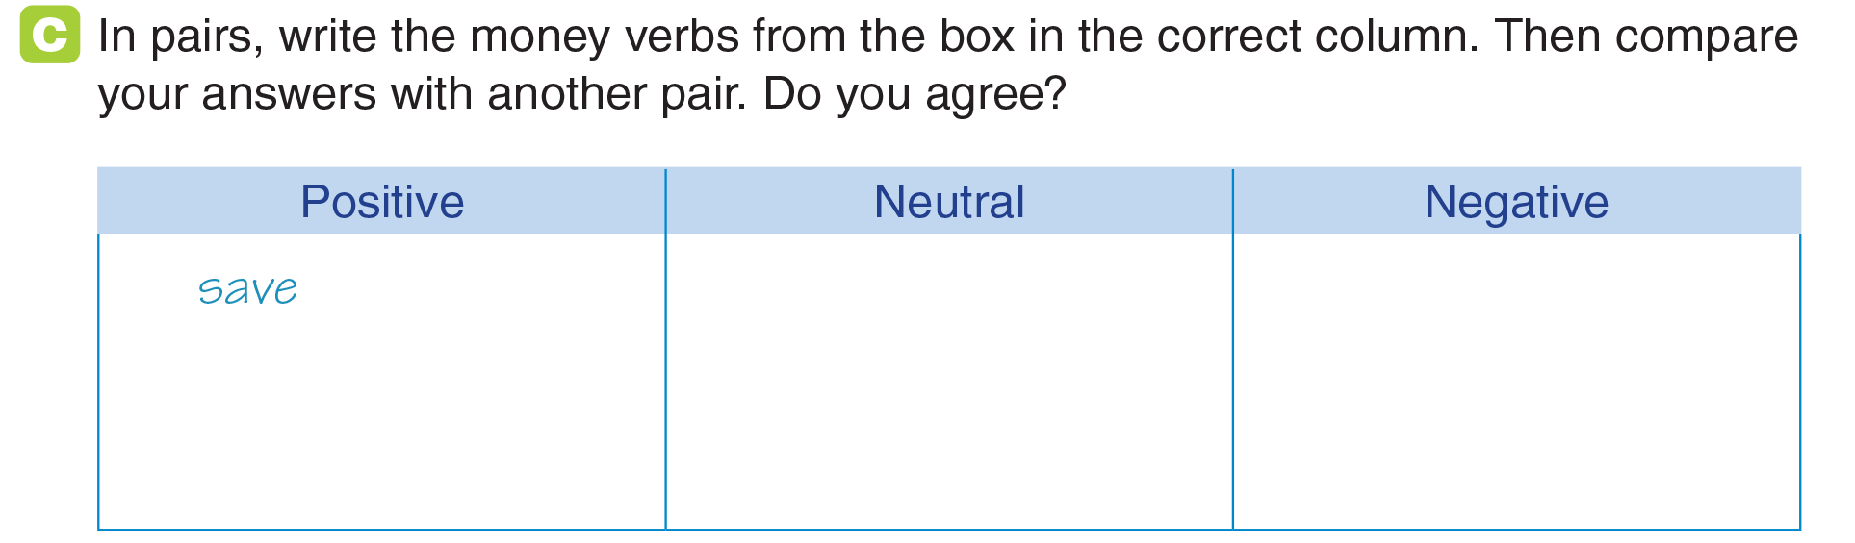
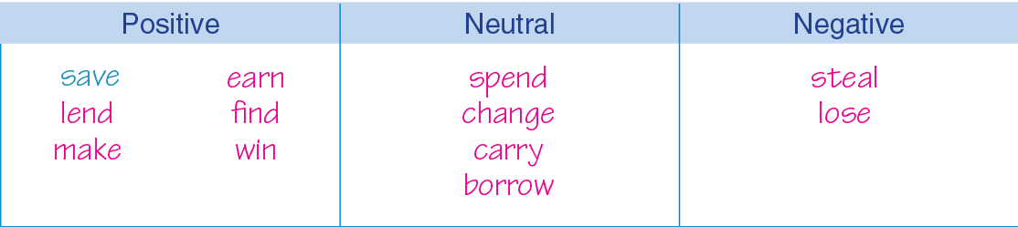
UNIT 12
DECISIONS
LANGUAGE EXPANSION
borrow carry change earn find lend
lose make save spend steal win
_______________________________________________________________________________________________________________________________________________________________________________________________________________________
National Geographic Learning, a Cengage Company. © 2022 Cengage Learning, Inc. ALL RIGHTS RESERVED. This presentation tool is for teaching purpose only. May not be scanned, copied or duplicated, or posted to a publicly accessible website, in whole or in part.
Notes:
khung đáp án đè lên khung chưa có đáp án, đã chỉnh hiệu ứng

Slide 30
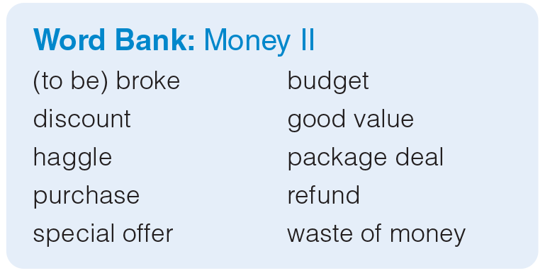
UNIT 12
DECISIONS
LANGUAGE EXPANSION
_______________________________________________________________________________________________________________________________________________________________________________________________________________________
National Geographic Learning, a Cengage Company. © 2022 Cengage Learning, Inc. ALL RIGHTS RESERVED. This presentation tool is for teaching purpose only. May not be scanned, copied or duplicated, or posted to a publicly accessible website, in whole or in part.

Slide 31
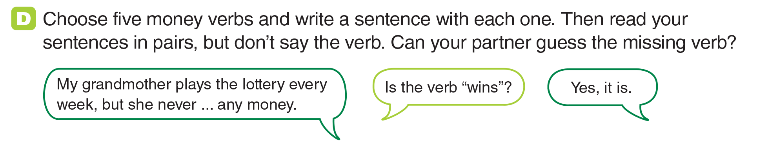
UNIT 12
DECISIONS
LANGUAGE EXPANSION
_______________________________________________________________________________________________________________________________________________________________________________________________________________________
National Geographic Learning, a Cengage Company. © 2022 Cengage Learning, Inc. ALL RIGHTS RESERVED. This presentation tool is for teaching purpose only. May not be scanned, copied or duplicated, or posted to a publicly accessible website, in whole or in part.

Slide 32
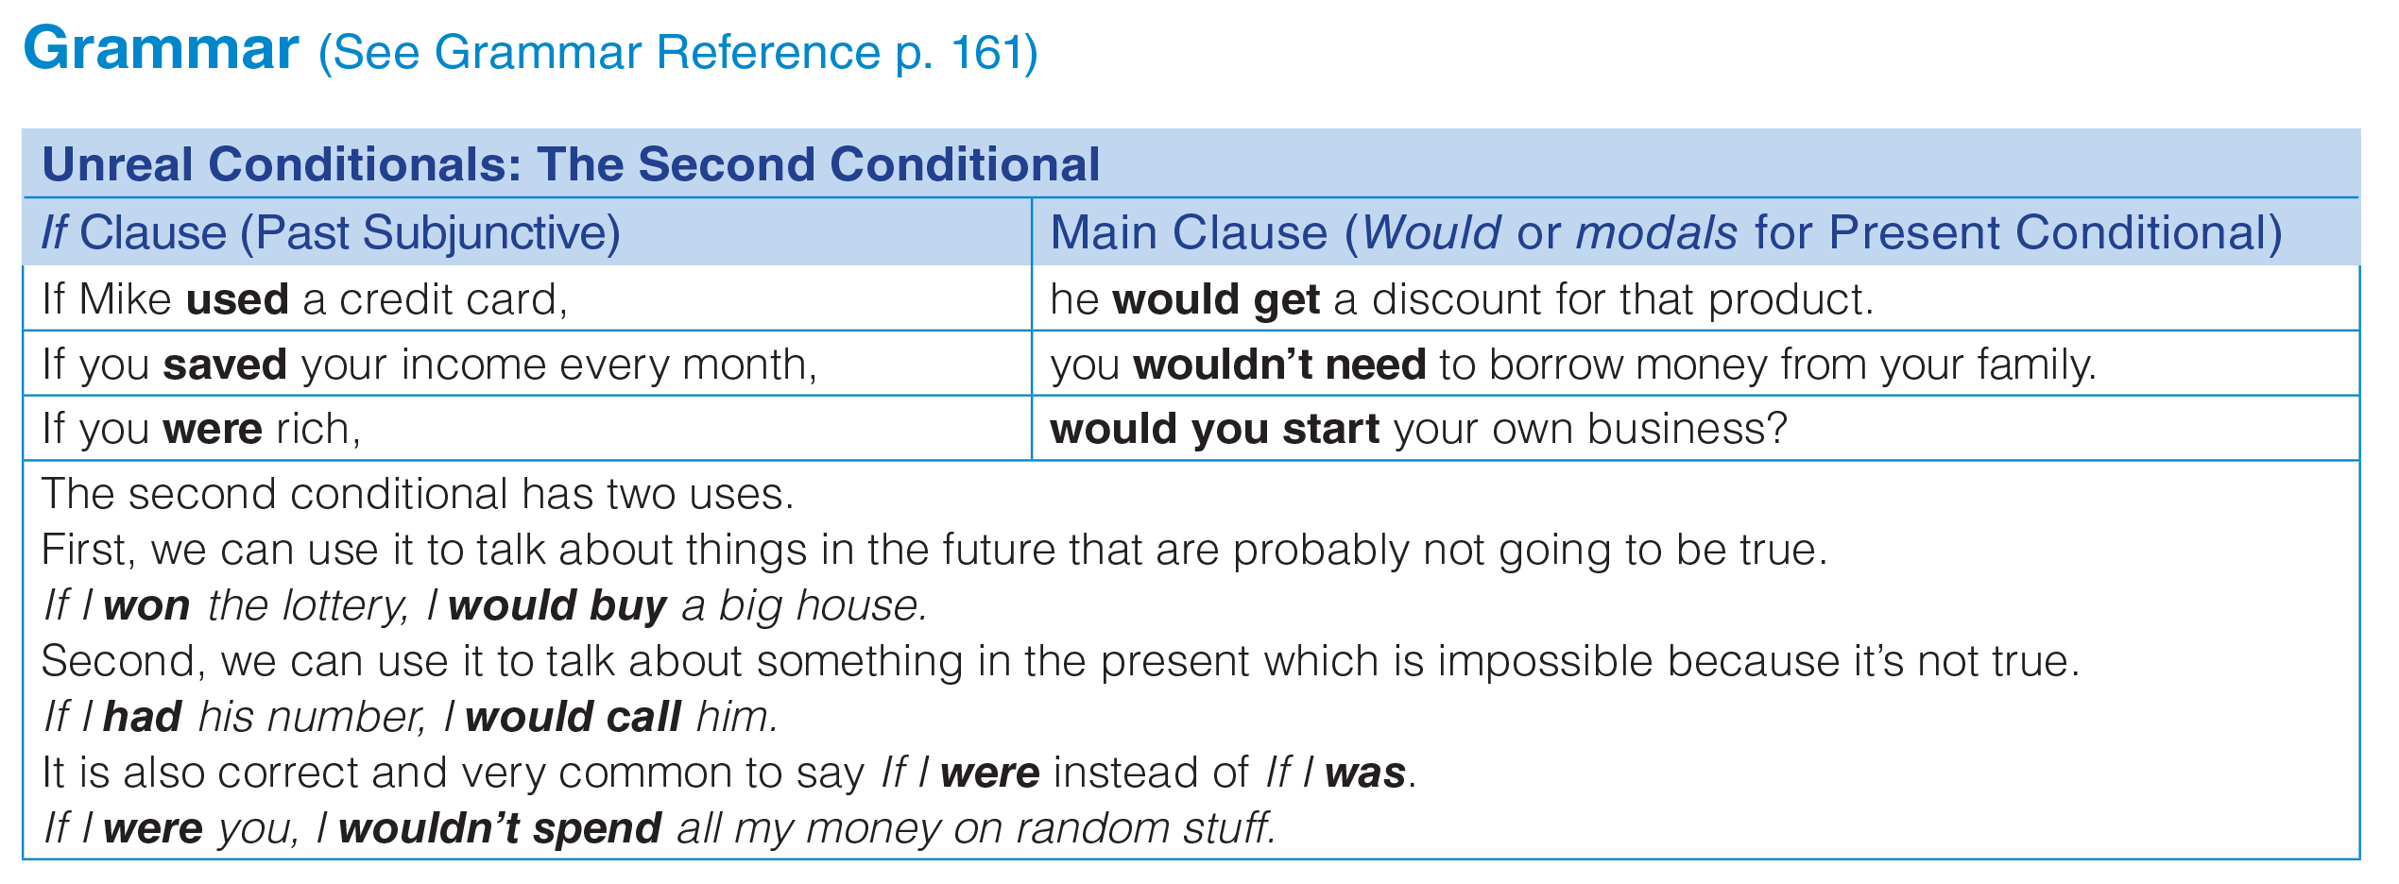
UNIT 12
DECISIONS
GRAMMAR
_______________________________________________________________________________________________________________________________________________________________________________________________________________________
National Geographic Learning, a Cengage Company. © 2022 Cengage Learning, Inc. ALL RIGHTS RESERVED. This presentation tool is for teaching purpose only. May not be scanned, copied or duplicated, or posted to a publicly accessible website, in whole or in part.

Slide 33
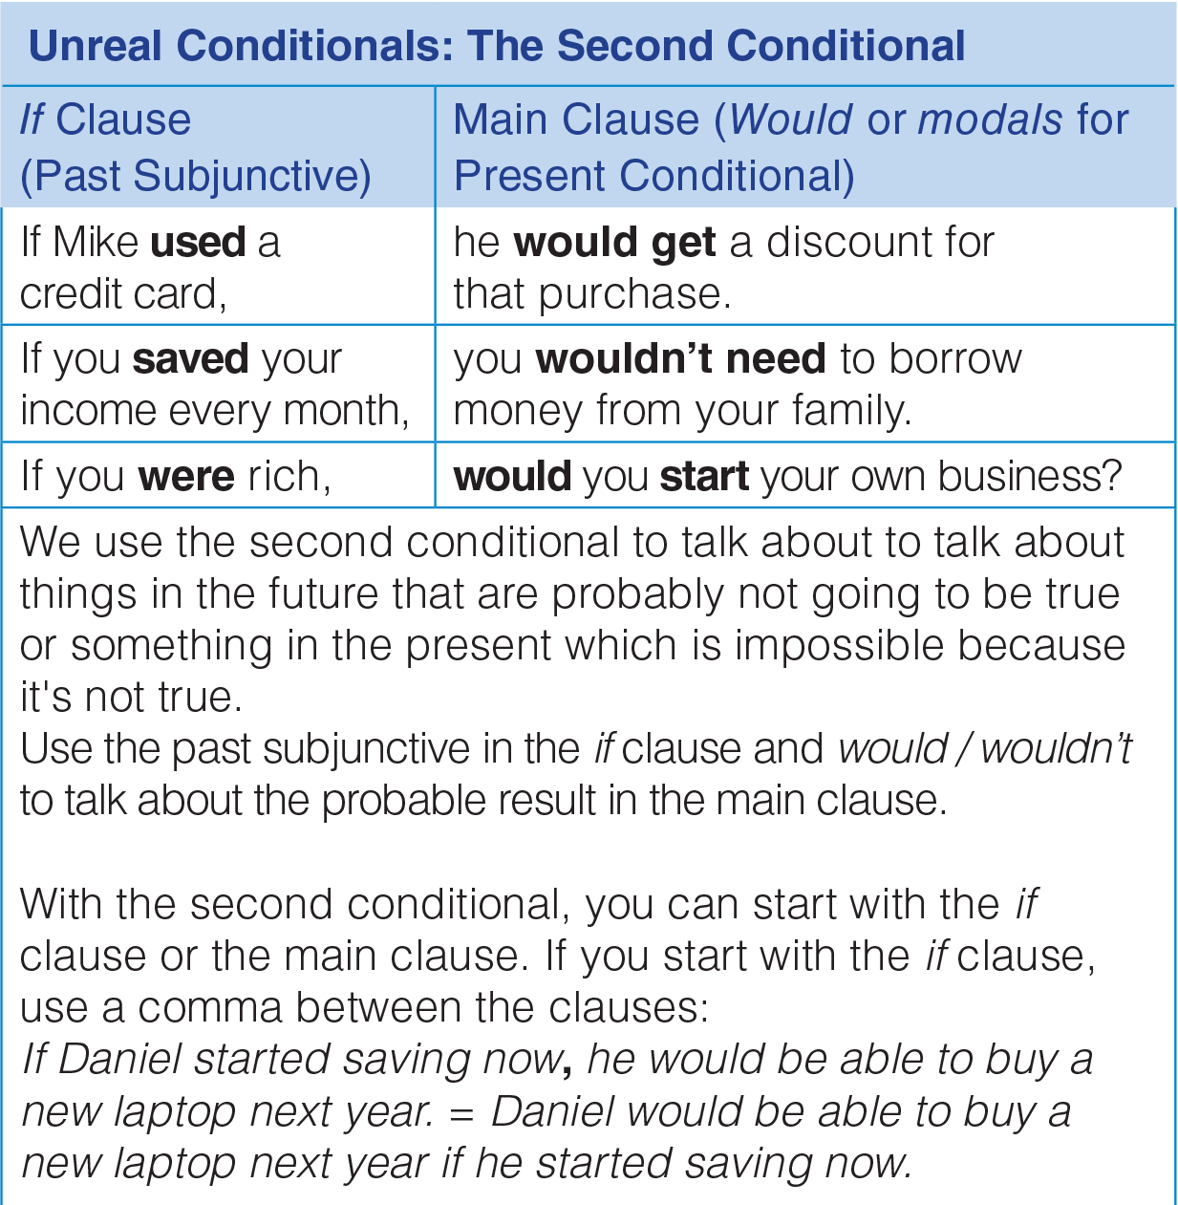
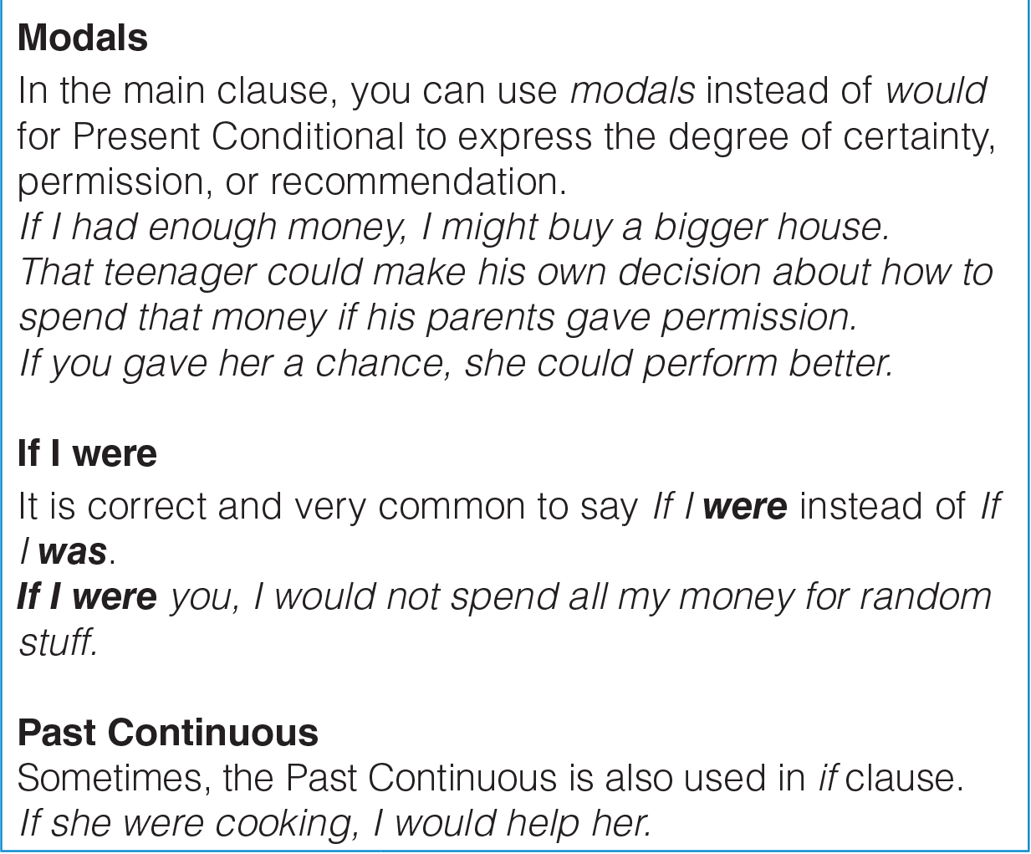
UNIT 12
DECISIONS
GRAMMAR
_______________________________________________________________________________________________________________________________________________________________________________________________________________________
National Geographic Learning, a Cengage Company. © 2022 Cengage Learning, Inc. ALL RIGHTS RESERVED. This presentation tool is for teaching purpose only. May not be scanned, copied or duplicated, or posted to a publicly accessible website, in whole or in part.

Slide 34
UNIT 12
DECISIONS
GRAMMAR
Grammar: Unreal Conditionals: The Second Conditional
We use the second conditional to talk about things in the future that are probably not going to be true or something in the present which is impossible because it’s not true.
To make a second conditional sentence, we use the simple past in the if clause and would + bare infinitive in the main clause. As an alternative to would, we can complete the second part of a second conditional sentence with could or might.
If I studied harder, I could get a scholarship
_______________________________________________________________________________________________________________________________________________________________________________________________________________________
National Geographic Learning, a Cengage Company. © 2022 Cengage Learning, Inc. ALL RIGHTS RESERVED. This presentation tool is for teaching purpose only. May not be scanned, copied or duplicated, or posted to a publicly accessible website, in whole or in part.

Slide 35
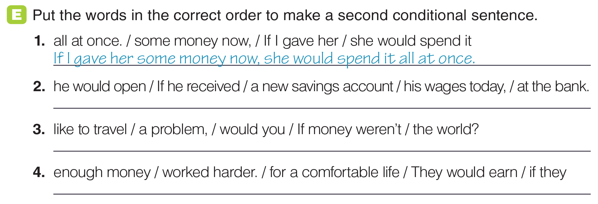
UNIT 12
DECISIONS
GRAMMAR
If he received his wages today, he would open a new savings account at the bank.
If money weren’t a problem, would you like to travel the world?
They would earn enough money for a comfortable life if they worked harder.
_______________________________________________________________________________________________________________________________________________________________________________________________________________________
National Geographic Learning, a Cengage Company. © 2022 Cengage Learning, Inc. ALL RIGHTS RESERVED. This presentation tool is for teaching purpose only. May not be scanned, copied or duplicated, or posted to a publicly accessible website, in whole or in part.

Slide 36
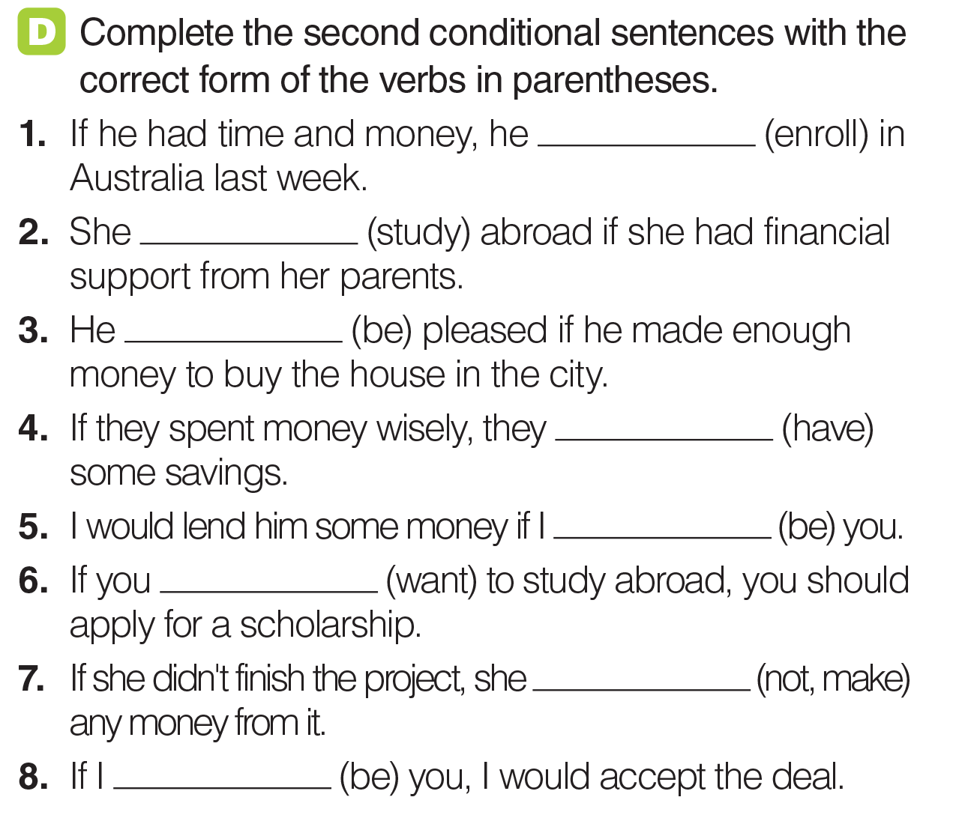
UNIT 12
DECISIONS
GRAMMAR
would enroll
would study
would be
would have
were
want
wouldn’t make
were
_______________________________________________________________________________________________________________________________________________________________________________________________________________________
National Geographic Learning, a Cengage Company. © 2022 Cengage Learning, Inc. ALL RIGHTS RESERVED. This presentation tool is for teaching purpose only. May not be scanned, copied or duplicated, or posted to a publicly accessible website, in whole or in part.

Slide 37
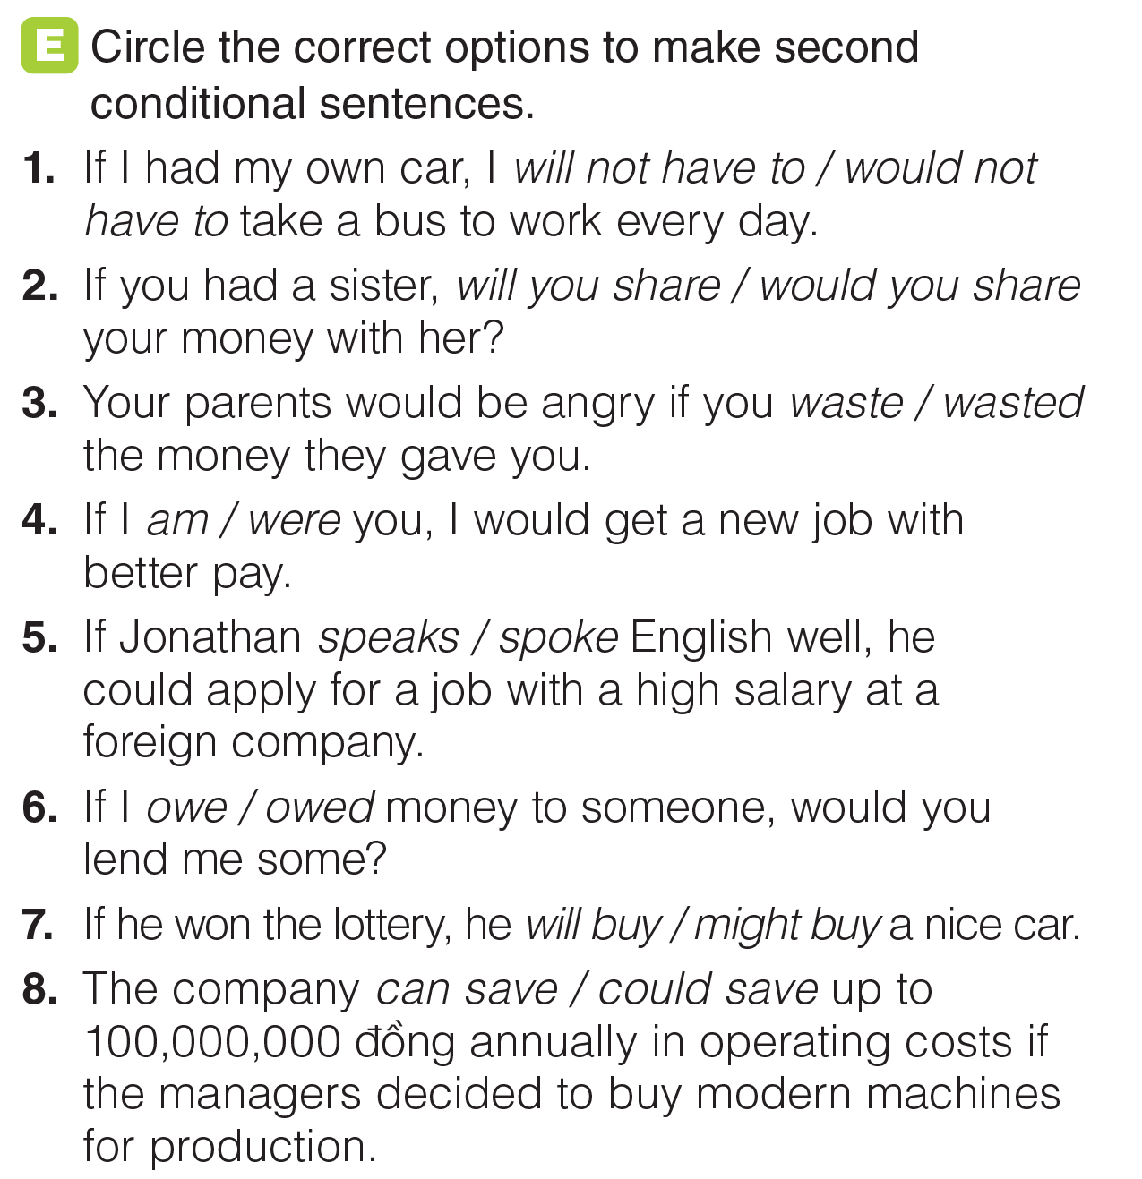
UNIT 12
DECISIONS
GRAMMAR
_______________________________________________________________________________________________________________________________________________________________________________________________________________________
National Geographic Learning, a Cengage Company. © 2022 Cengage Learning, Inc. ALL RIGHTS RESERVED. This presentation tool is for teaching purpose only. May not be scanned, copied or duplicated, or posted to a publicly accessible website, in whole or in part.

Slide 38
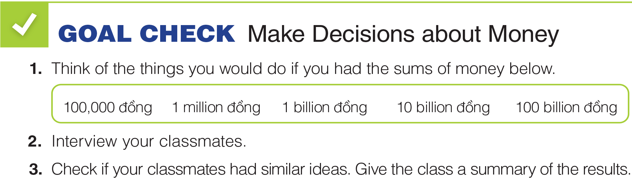
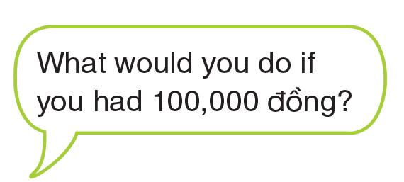
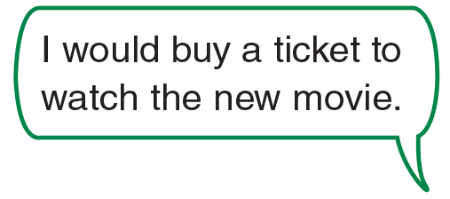
UNIT 12
DECISIONS
GOAL CHECK
_______________________________________________________________________________________________________________________________________________________________________________________________________________________
National Geographic Learning, a Cengage Company. © 2022 Cengage Learning, Inc. ALL RIGHTS RESERVED. This presentation tool is for teaching purpose only. May not be scanned, copied or duplicated, or posted to a publicly accessible website, in whole or in part.

Slide 39
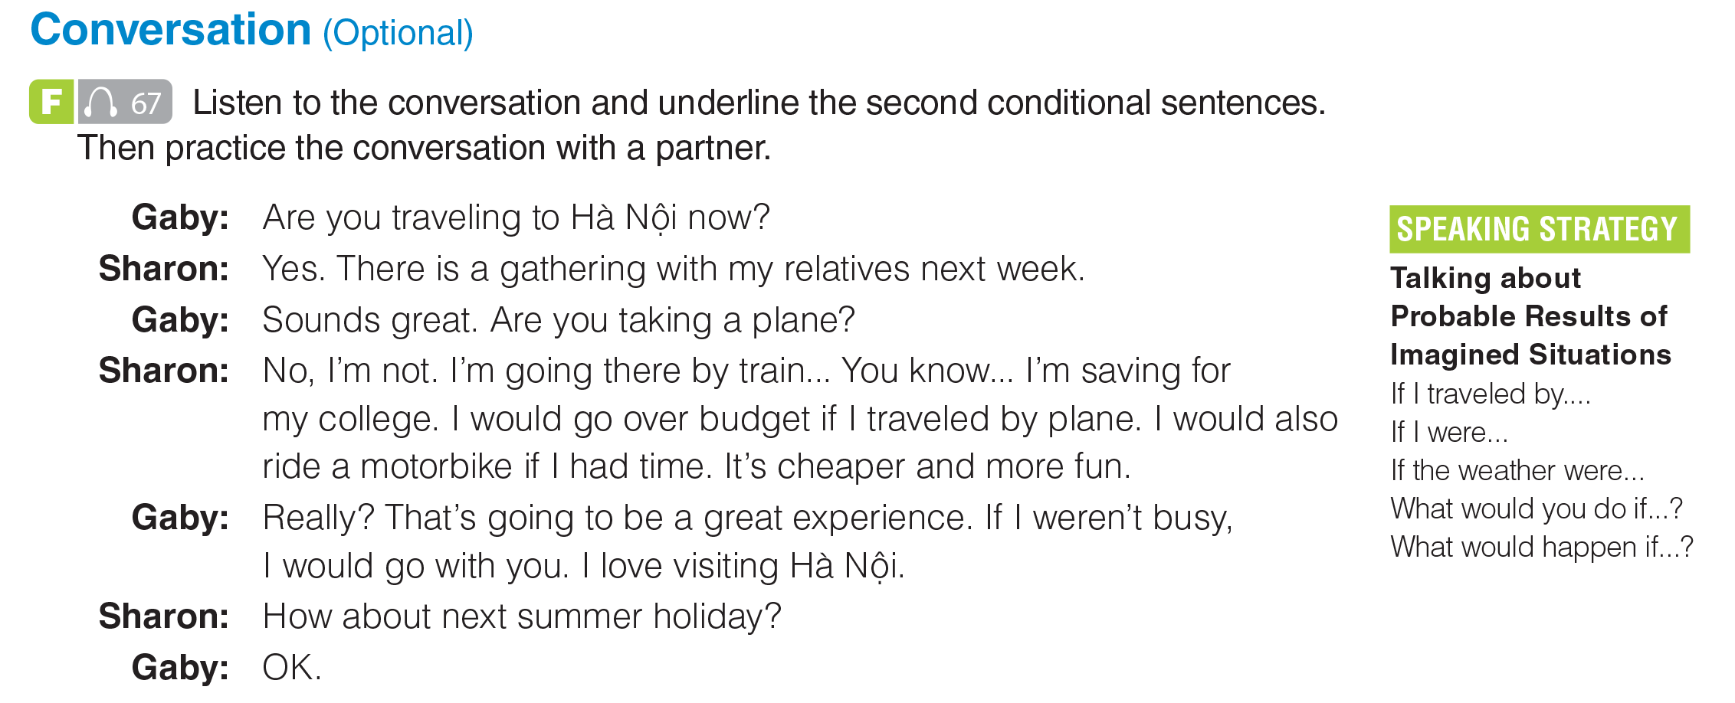

UNIT 12
DECISIONS
CONVERSATION
_______________________________________________________________________________________________________________________________________________________________________________________________________________________
National Geographic Learning, a Cengage Company. © 2022 Cengage Learning, Inc. ALL RIGHTS RESERVED. This presentation tool is for teaching purpose only. May not be scanned, copied or duplicated, or posted to a publicly accessible website, in whole or in part.

Slide 40
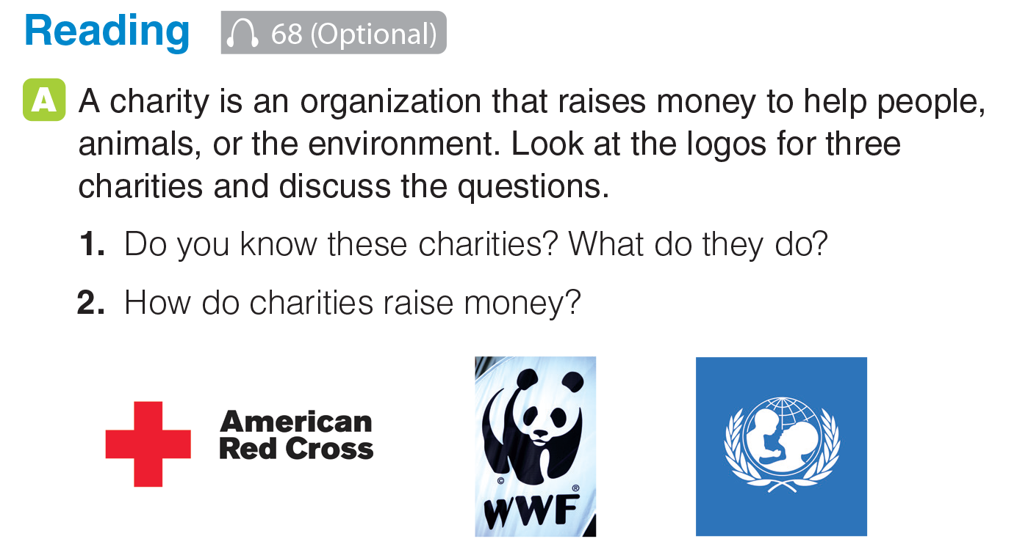
UNIT 12
DECISIONS
READING
_______________________________________________________________________________________________________________________________________________________________________________________________________________________
National Geographic Learning, a Cengage Company. © 2022 Cengage Learning, Inc. ALL RIGHTS RESERVED. This presentation tool is for teaching purpose only. May not be scanned, copied or duplicated, or posted to a publicly accessible website, in whole or in part.

Slide 41

UNIT 12
DECISIONS
READING
Red Cross of Việt Nam
SOS Children's Villages Việt Nam
HCMC Child Welfare Association
Việt Nam Assistance for the Handicapped (VNAH)
Operation Smile
_______________________________________________________________________________________________________________________________________________________________________________________________________________________
National Geographic Learning, a Cengage Company. © 2022 Cengage Learning, Inc. ALL RIGHTS RESERVED. This presentation tool is for teaching purpose only. May not be scanned, copied or duplicated, or posted to a publicly accessible website, in whole or in part.

Slide 42

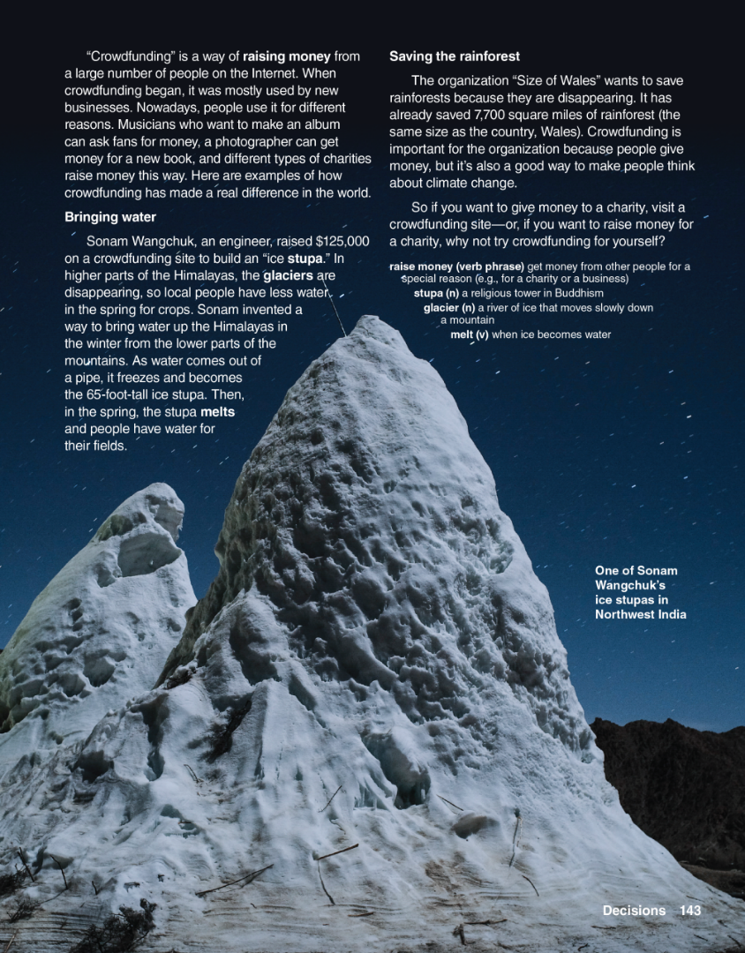
UNIT 12
DECISIONS
READING
_______________________________________________________________________________________________________________________________________________________________________________________________________________________
National Geographic Learning, a Cengage Company. © 2022 Cengage Learning, Inc. ALL RIGHTS RESERVED. This presentation tool is for teaching purpose only. May not be scanned, copied or duplicated, or posted to a publicly accessible website, in whole or in part.

Slide 43
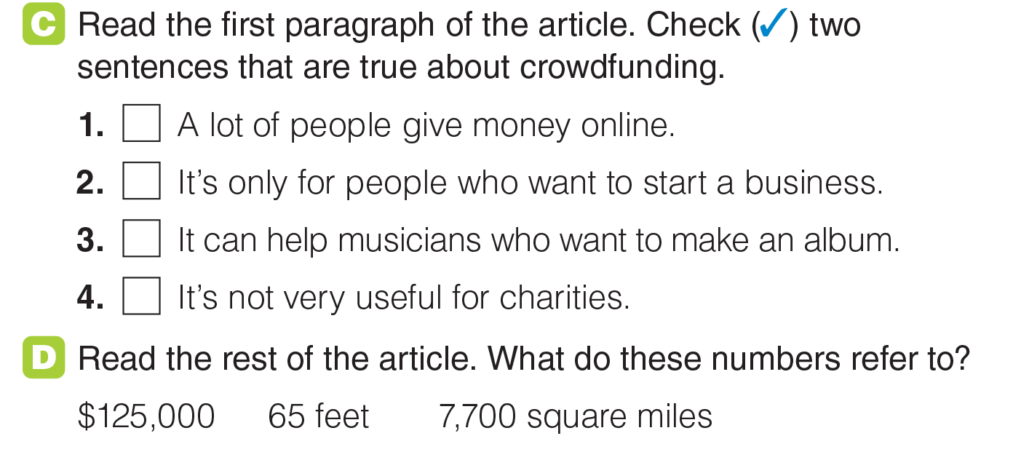
UNIT 12
DECISIONS
READING
✓
✓
_______________________________________________________________________________________________________________________________________________________________________________________________________________________
National Geographic Learning, a Cengage Company. © 2022 Cengage Learning, Inc. ALL RIGHTS RESERVED. This presentation tool is for teaching purpose only. May not be scanned, copied or duplicated, or posted to a publicly accessible website, in whole or in part.

Slide 44

UNIT 12
DECISIONS
READING
He built an
ice stupa.
People have water in the spring for their fields.
It helps save the rainforests and makes people think about the problem of climate change.
The rainforests are disappearing
_______________________________________________________________________________________________________________________________________________________________________________________________________________________
National Geographic Learning, a Cengage Company. © 2022 Cengage Learning, Inc. ALL RIGHTS RESERVED. This presentation tool is for teaching purpose only. May not be scanned, copied or duplicated, or posted to a publicly accessible website, in whole or in part.

Slide 45

UNIT 12
DECISIONS
GOAL CHECK
_______________________________________________________________________________________________________________________________________________________________________________________________________________________
National Geographic Learning, a Cengage Company. © 2022 Cengage Learning, Inc. ALL RIGHTS RESERVED. This presentation tool is for teaching purpose only. May not be scanned, copied or duplicated, or posted to a publicly accessible website, in whole or in part.

Slide 46

UNIT 12
DECISIONS
COMMUNICATION
University
To go abroad
Major
Future Career
To get married
_______________________________________________________________________________________________________________________________________________________________________________________________________________________
National Geographic Learning, a Cengage Company. © 2022 Cengage Learning, Inc. ALL RIGHTS RESERVED. This presentation tool is for teaching purpose only. May not be scanned, copied or duplicated, or posted to a publicly accessible website, in whole or in part.

Slide 47

UNIT 12
DECISIONS
COMMUNICATION
_______________________________________________________________________________________________________________________________________________________________________________________________________________________
National Geographic Learning, a Cengage Company. © 2022 Cengage Learning, Inc. ALL RIGHTS RESERVED. This presentation tool is for teaching purpose only. May not be scanned, copied or duplicated, or posted to a publicly accessible website, in whole or in part.

Slide 48


UNIT 12
DECISIONS
COMMUNICATION
_______________________________________________________________________________________________________________________________________________________________________________________________________________________
National Geographic Learning, a Cengage Company. © 2022 Cengage Learning, Inc. ALL RIGHTS RESERVED. This presentation tool is for teaching purpose only. May not be scanned, copied or duplicated, or posted to a publicly accessible website, in whole or in part.

Slide 49
UNIT 12
DECISIONS
COMMUNICATION
_______________________________________________________________________________________________________________________________________________________________________________________________________________________
National Geographic Learning, a Cengage Company. © 2022 Cengage Learning, Inc. ALL RIGHTS RESERVED. This presentation tool is for teaching purpose only. May not be scanned, copied or duplicated, or posted to a publicly accessible website, in whole or in part.

Slide 50


UNIT 12
DECISIONS
WRITING
_______________________________________________________________________________________________________________________________________________________________________________________________________________________
National Geographic Learning, a Cengage Company. © 2022 Cengage Learning, Inc. ALL RIGHTS RESERVED. This presentation tool is for teaching purpose only. May not be scanned, copied or duplicated, or posted to a publicly accessible website, in whole or in part.

Slide 51

UNIT 12
DECISIONS
WRITING
_______________________________________________________________________________________________________________________________________________________________________________________________________________________
National Geographic Learning, a Cengage Company. © 2022 Cengage Learning, Inc. ALL RIGHTS RESERVED. This presentation tool is for teaching purpose only. May not be scanned, copied or duplicated, or posted to a publicly accessible website, in whole or in part.

Slide 52
UNIT 12
DECISIONS
WRITING
_______________________________________________________________________________________________________________________________________________________________________________________________________________________
National Geographic Learning, a Cengage Company. © 2022 Cengage Learning, Inc. ALL RIGHTS RESERVED. This presentation tool is for teaching purpose only. May not be scanned, copied or duplicated, or posted to a publicly accessible website, in whole or in part.

Slide 53

UNIT 12
DECISIONS
WRITING
_______________________________________________________________________________________________________________________________________________________________________________________________________________________
National Geographic Learning, a Cengage Company. © 2022 Cengage Learning, Inc. ALL RIGHTS RESERVED. This presentation tool is for teaching purpose only. May not be scanned, copied or duplicated, or posted to a publicly accessible website, in whole or in part.

Slide 54

UNIT 12
DECISIONS
GOAL CHECK
_______________________________________________________________________________________________________________________________________________________________________________________________________________________
National Geographic Learning, a Cengage Company. © 2022 Cengage Learning, Inc. ALL RIGHTS RESERVED. This presentation tool is for teaching purpose only. May not be scanned, copied or duplicated, or posted to a publicly accessible website, in whole or in part.

