Slide 1


Unit 2
I Like Food

Slide 2
Unit 2:
I Like Food
Lesson 1

Slide 3
UNIT 2
I LIKE FOOD
English Time Chant
English, (clap) English, (clap)
English (clap) today! (clap, clap)
English, (clap) English, (clap)
Hip, hip, (clap) hooray! (clap, clap)

Slide 4


UNIT 2
I LIKE FOOD
Let’s guess!
What is this?
Apple
It’s food.
Notes:
Put a few real or toy food items in a bag and hold it up for students. Tell students what they are as you hold each one up.
Say [An Apple].
Shake the bag, open it a little, and smell the contents (if using real food).
Close the bag and shake it again.
Ask What’s in the bag?
Students should say [An apple].
Walk around the room and invite several students to put a hand inside the bag and feel the items without looking. Have students guess what is in the bag.
They should name it or draw a picture if they don’t know the word.
Then, open the bag and pour out all the items onto a desk or table.
Point to the items and say Food! Look. Food!
Have students say the word food several times.
Ask What is our next unit about?
Say It’s about food! Let’s look.

Slide 5

UNIT 2
I LIKE FOOD
What do you see?
A mother, a father,
a daughter
Food
Notes:
Help students open their books to p. 16.
Say Look. Food! Mmmm!
Write food on the board and have students repeat it.
Say I like food.
Draw a happy face on the board.
Have students look at the photo and say everything they can about it. Ask questions to encourage discussion.
For example, ask:
– What do you see?
Students should say [A mother, a father, a daughter, a table, food].
– What colors do you see?
Students should say [Black, yellow, white, orange, green].
– Does the girl like the food?
Students should say Yes.
– Do you like the food?
Students should say [Yes/No].

Slide 6
UNIT 2
I LIKE FOOD
What color do you see?
Black, yellow, white, orange, green
Notes:
Help students open their books to p. 16.
Say Look. Food! Mmmm!
Write food on the board and have students repeat it.
Say I like food.
Draw a happy face on the board.
Have students look at the photo and say everything they can about it. Ask questions to encourage discussion.
For example, ask:
– What do you see?
Students should say [A mother, a father, a daughter, a table, food].
– What colors do you see?
Students should say [Black, yellow, white, orange, green].
– Does the girl like the food?
Students should say Yes.
– Do you like the food?
Students should say [Yes/No].

Slide 7
UNIT 2
I LIKE FOOD
Does the girl like the food?
Yes
Do you like the food?
Yes
No
Notes:
Help students open their books to p. 16.
Say Look. Food! Mmmm!
Write food on the board and have students repeat it.
Say I like food.
Draw a happy face on the board.
Have students look at the photo and say everything they can about it. Ask questions to encourage discussion.
For example, ask:
– What do you see?
Students should say [A mother, a father, a daughter, a table, food].
– What colors do you see?
Students should say [Black, yellow, white, orange, green].
– Does the girl like the food?
Students should say Yes.
– Do you like the food?
Students should say [Yes/No].

Slide 8
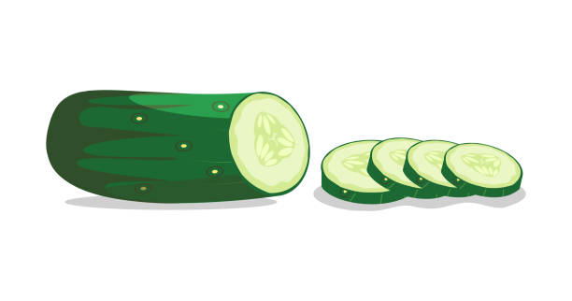
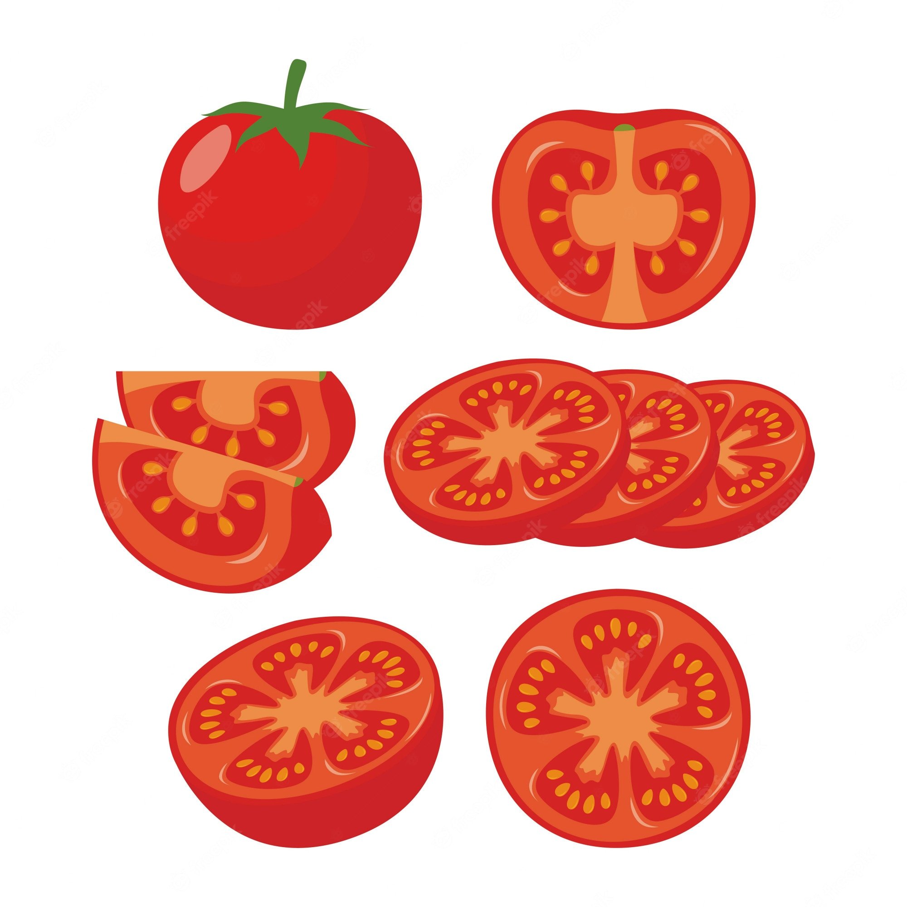
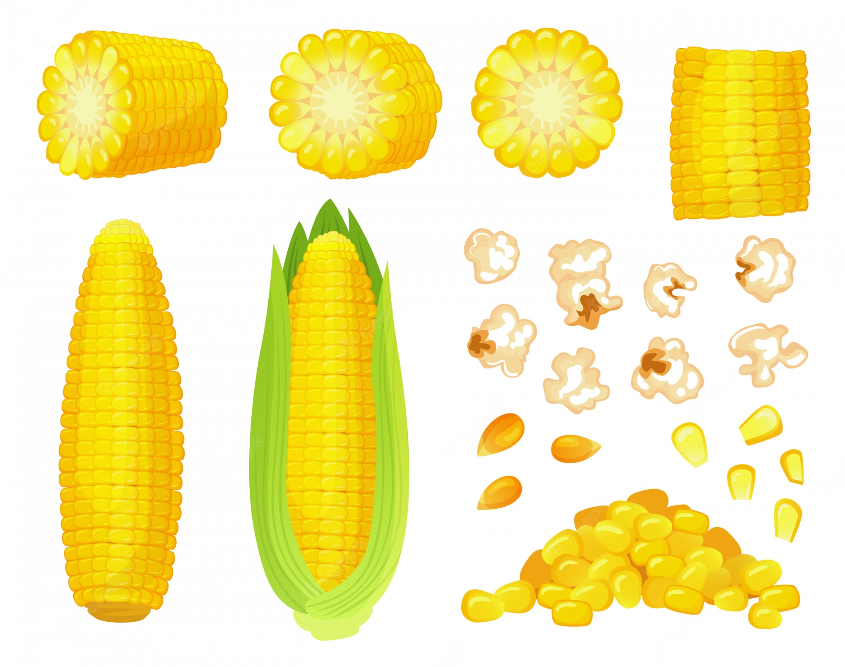
UNIT 2
I LIKE FOOD
This food is green, orange, and yellow!
cucumber
tomato
corn
This is salad.
Notes:
Point to the bowl of salad the girl is holding in the photo and say Look, this food is green, orange, and yellow! Explain to your students that the food is called salad, and that it can be made with different ingredients. Explain that the green food is cucumber, the orange food is tomato, and the yellow food is corn.

Slide 9

UNIT 2
I LIKE FOOD
Do you see any white food?
Rice
Do you like rice?
Notes:
Say Look at the other food on the table. Can you see any food that is white?
Students should say Yes.
Point to the rice in the bowls. Say That’s rice!
Write the word rice on the board and draw a happy face and a sad face under the word. Ask Do you like rice? as you point to the happy face.
Students should say [Yes/No].
Make a check under the happy face for each student who says “Yes” and an “X” under the sad face for each student who says “No.” Find out how many students in the class like rice.

Slide 10
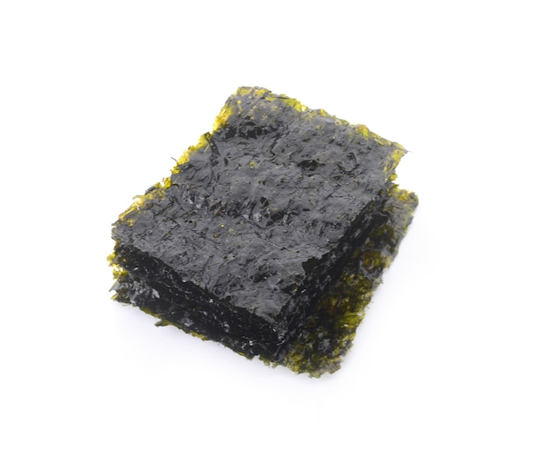
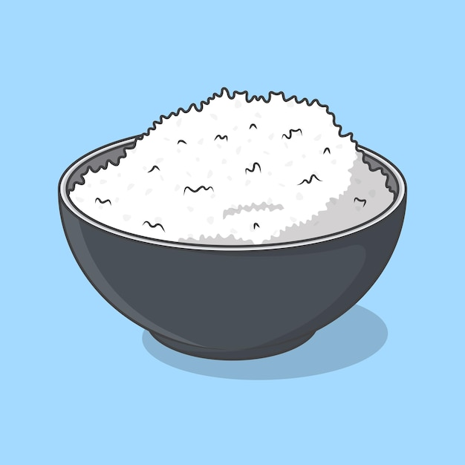
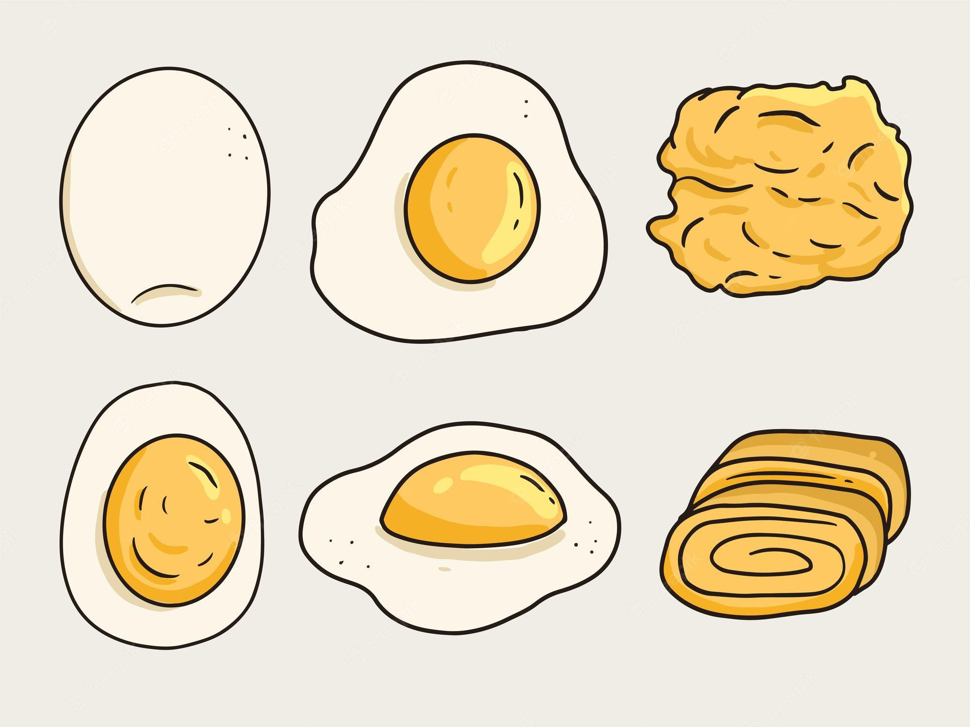
UNIT 2
I LIKE FOOD
This food is black, white, and yellow!
seaweed
rice
egg
This is sushi.
Notes:
Point out the plate of sushi on the table and explain that it is also made of rice, as well as seaweed, and egg.

Slide 11
UNIT 2
I LIKE FOOD
Let’s chant
I like food. (clap)
Yes, I do! (clap)
I like food. (clap)
We do, too! (clap)
Notes:
Say the chant once while students listen. Say it again and have them repeat it after you, clapping their hands after each sentence.
Practice the chant until everyone feels confident, and then have students chant, clap, and march around the room.
Chant:
I like food. (clap) Yes, I do! (clap)
I like food. (clap) We do, too! (clap)
If time allows, ask students to name different types of food and use it to replace food in the chant.

Slide 12
UNIT 2
I LIKE FOOD
Goodbye Chant
Good work, class.
Hip hip, hooray!
Goodbye for now.
Have a nice day!
Notes:
Say Good job today class. Now let’s chant.
Lead the class in the Goodbye chant.

Slide 13
UNIT 2
I LIKE FOOD
Let’s check!
Do you like this?
Notes:
Can students talk about food preferences?
Take out the food items that were used at the beginning of class.
As students leave the classroom, point to an item and ask Do you like [bananas]?
Students should say Yes/No.

Slide 14
UNIT 2
I LIKE FOOD
Thank you!

Slide 15
Unit 2:
I Like Food
Lesson 2

Slide 16
UNIT 2
I LIKE FOOD
English Time Chant
English, (clap) English, (clap)
English (clap) today! (clap, clap)
English, (clap) English, (clap)
Hip, hip, (clap) hooray! (clap, clap)

Slide 17
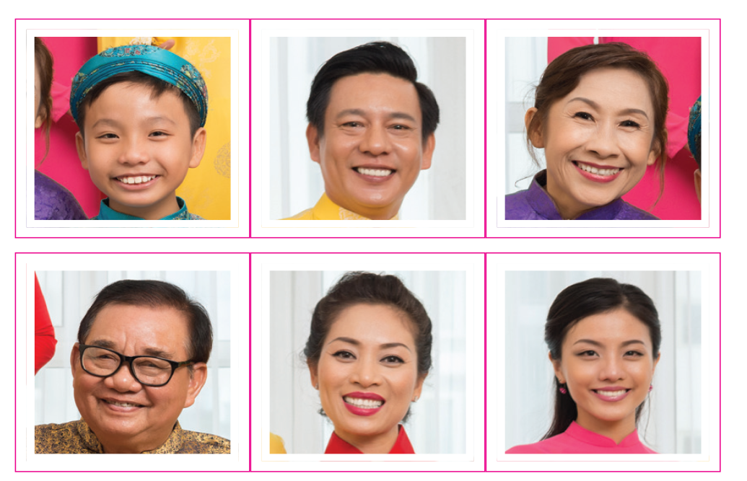
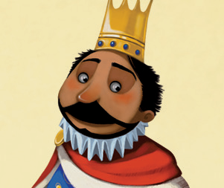
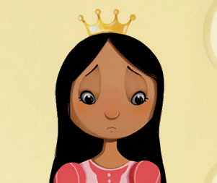
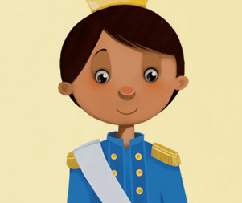
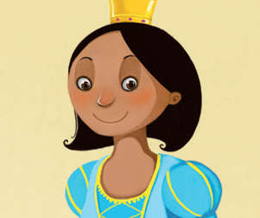
UNIT 2
I LIKE FOOD
Let’s Review
Who’s it?
It’s ____.
Notes:
Get ready eight to ten pictures for words that you want to review from Grade 1 or Unit 1.
Show the students a picture.
Say Look at the picture. What is it? Tell me the word.
Students should say [Crown].
If necessary, model the activity first to make sure all students understand what to do.
Say Good job! Now let’s learn some new words. Let’s learn about food.

Slide 18
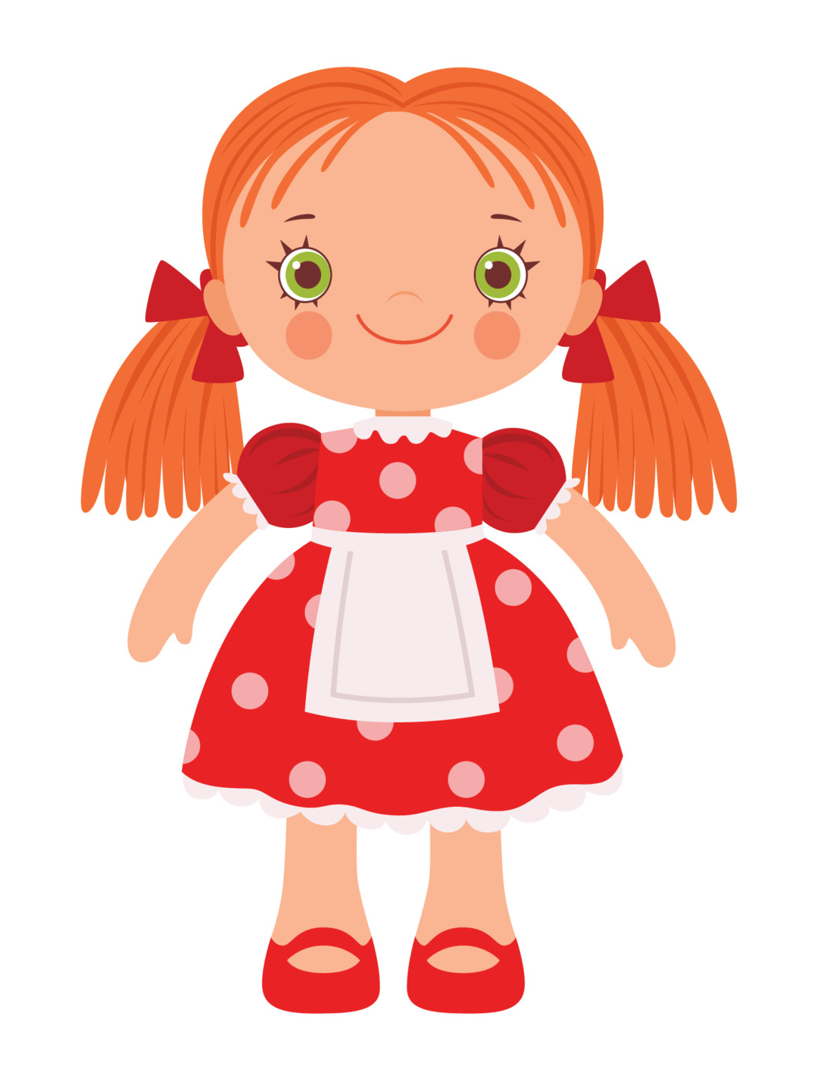



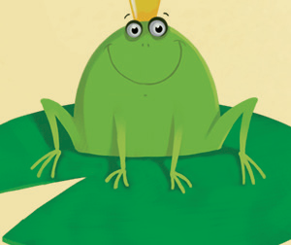

UNIT 2
I LIKE FOOD
Let’s Review
What’s it?
It’s ____.
Notes:
Get ready eight to ten pictures for words that you want to review from Grade 1 or Unit 1.
Show the students a picture.
Say Look at the picture. What is it? Tell me the word.
Students should say [Crown].
If necessary, model the activity first to make sure all students understand what to do.
Say Good job! Now let’s learn some new words. Let’s learn about food.

Slide 19
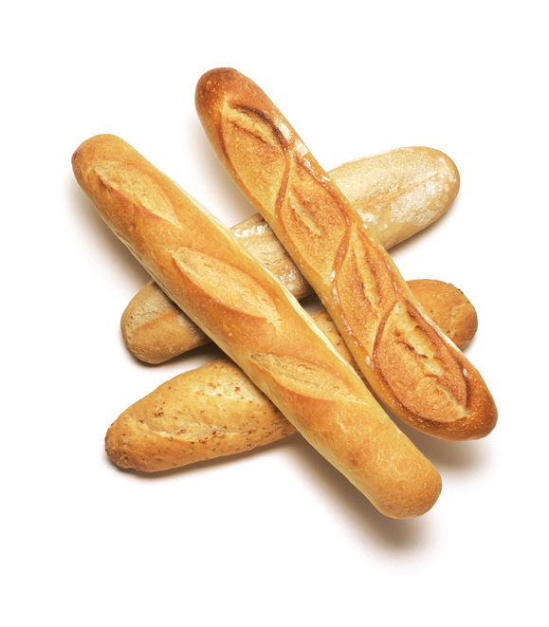
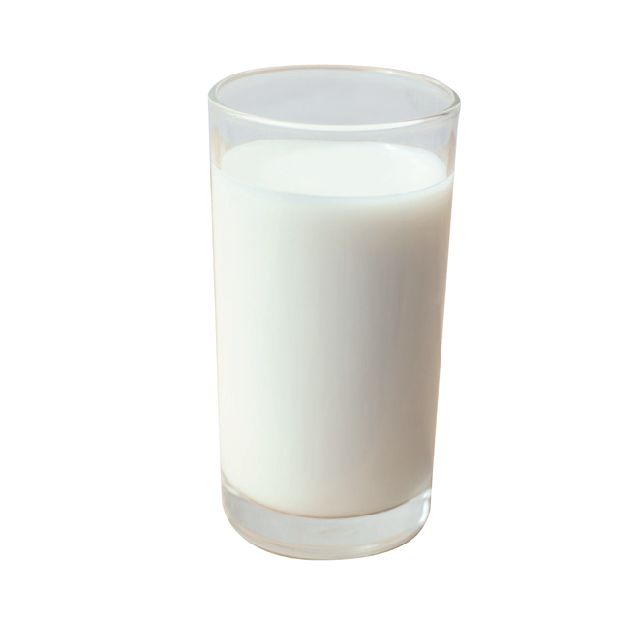
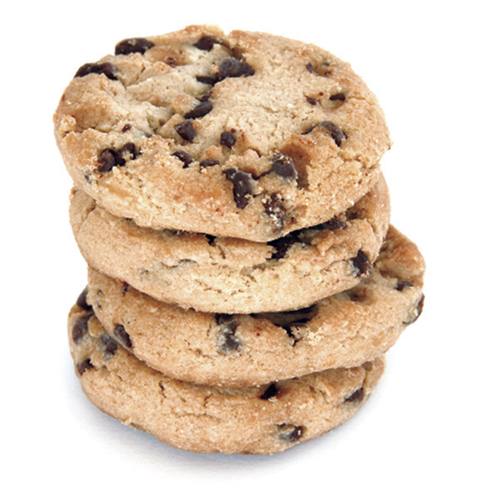

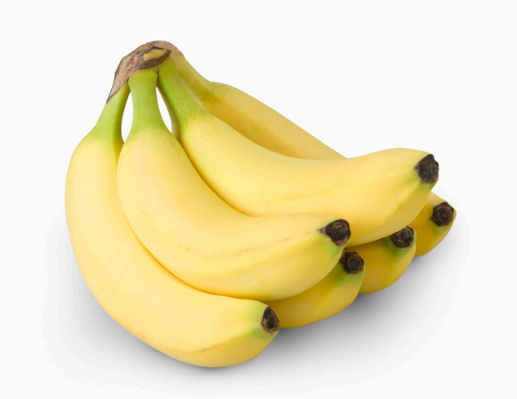
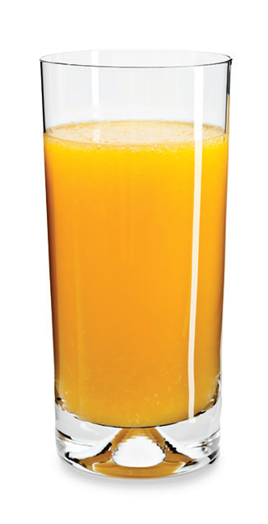
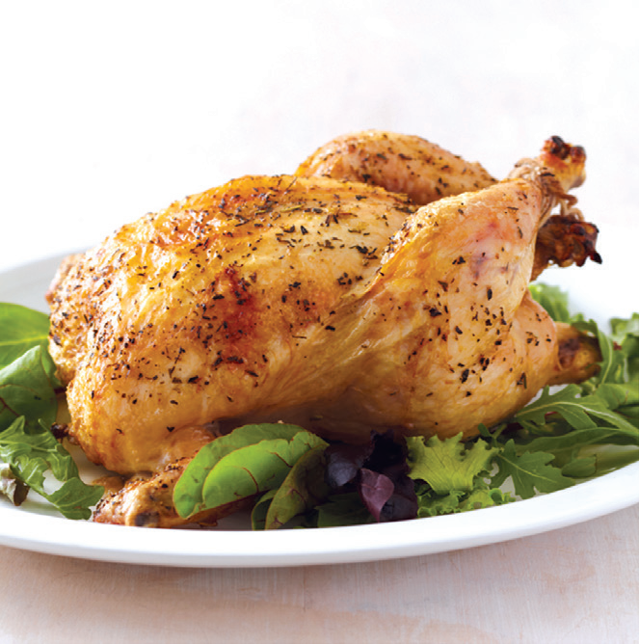
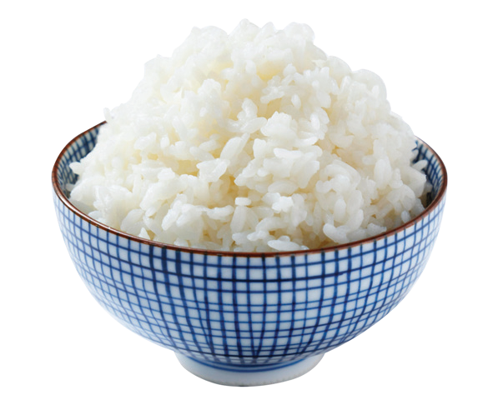
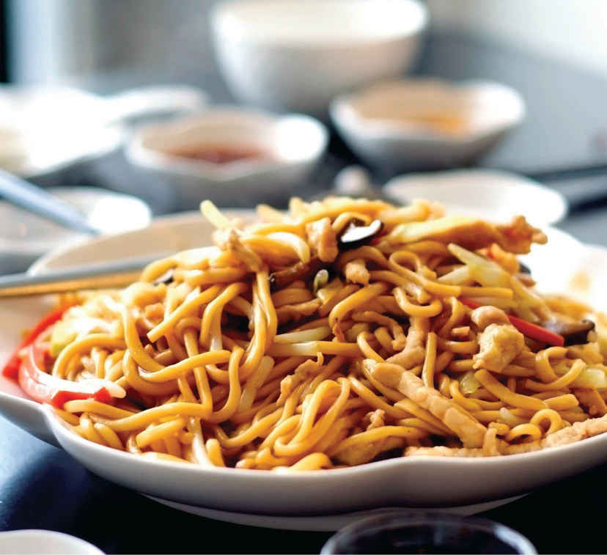
UNIT 2
I LIKE FOOD
Repeat after me
bananas
bread
milk
cookies
water
orange juice
rice
chicken
noodles
Notes:
Have students open their books to p. 17.
Say Look. Find a yellow food.
Point. Walk around the room to check that students are pointing to the bananas in their books.
Say Listen and say Bananas. Bananas.
Have students repeat after you. Then repeat this for each of the other foods and drinks.
Note
Since water has no color, you may want to teach clear as a descriptive word.

Slide 20
UNIT 2
I LIKE FOOD
Find a color
bananas
bread
milk
cookies
water
orange juice
rice
chicken
noodles
Notes:
Put students in pairs.
Say Look at page 17.
In their pairs, ask one student to name a color while the other student points to a food or drink with that color. If necessary, model the activity with a student.

Slide 21
UNIT 2
I LIKE FOOD
Touch the picture
bananas
bread
milk
cookies
water
orange juice
rice
chicken
noodles
Notes:
Make picture cards for each vocabulary word and place them in different places on the board. Make sure the pictures are placed where students can reach them.
Have students form groups and line up at the back of the room. Then give each group a fly swatter.
Model the activity by doing the following:
Sat Listen. Bananas.
Walk quickly to the board with a fly swatter and tap the picture of bananas.
Make sure students understand that one person from each group should walk quickly to the board the same time and tap the picture of the word you say. The first student to tap the correct picture wins a point for his or her group, and the group with the most points is the winner.
Play the game and continue until all the pictures have been identified.

Slide 22

UNIT 2
I LIKE FOOD
1
Listen and point. TR: B35
bananas
bread
milk
cookies
water
orange juice
rice
chicken
noodles
Notes:
1 Say OK, class. Ready? Let’s do Activity 1. Listen and point to the food.
Play TR: B35 once through. Allow students a few seconds to find the correct picture for each item. Then play the track a second time. Walk around the room to check that students are pointing to the correct image for each vocabulary word.

Slide 23
UNIT 2
I LIKE FOOD
Point and say
bananas
bread
milk
cookies
water
orange juice
rice
chicken
noodles
Notes:
Say Now it’s time to point and say.
Have students form groups of four. Have them open their books to p. 17. Ask one student in each group to point to a picture and say the correct word. The other group members should then point to the same picture and repeat the word. Have students take turns pointing to the images and saying words.
If necessary, model the activity with three students first. As the groups are working, walk around the room to check that students are pointing to the images and saying the correct words.

Slide 24
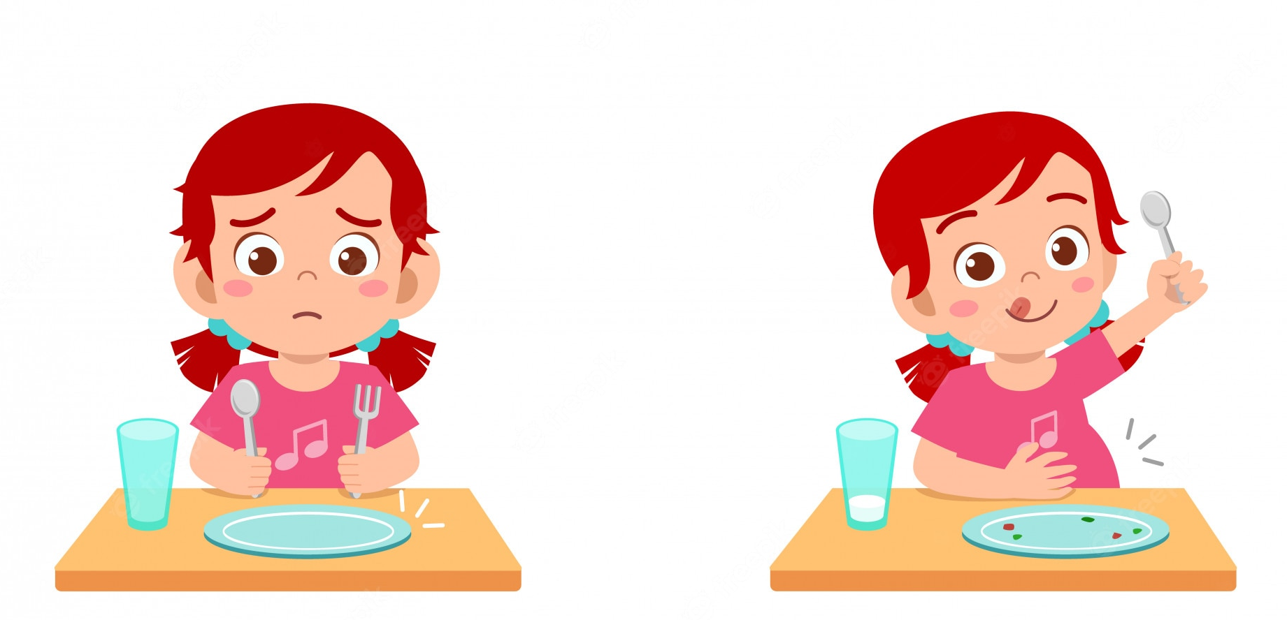

UNIT 2
I LIKE FOOD
It’s lunch time
What do you want to eat?
Let’s draw your food!
Notes:
Say It’s time for lunch. What do you want?
Students should say I want [chicken]. I want [rice].
Give students a paper plate each. Ask students to draw three or four food and drink items on their plates. Then have them show their plate to a partner and say what they want. Walk around the room to listen to students’ conversations and check that the correct foods are on their plates.

Slide 25
UNIT 2
I LIKE FOOD
Goodbye Chant
Good work, class.
Hip hip, hooray!
Goodbye for now.
Have a nice day!
Notes:
Say Good job today class. Now let’s chant.
Lead the class in the Goodbye chant.

Slide 26

UNIT 2
I LIKE FOOD
Let’s check!
What food is it?
Notes:
Can students identify and name foods and drinks?
Point to the pictures of food on p. 17 and have students name them.

Slide 27
UNIT 2
I LIKE FOOD
It’s ____.
bananas
bread
milk
cookies
water
orange juice
rice
chicken
noodles
Notes:
(Click the picture to show the word)
Can students identify and name foods and drinks?
Point to the pictures of food on p. 17 and have students name them.

Slide 28
UNIT 2
I LIKE FOOD
Thank you!

Slide 29
Unit 2:
I Like Food
Lesson 3

Slide 30
UNIT 2
I LIKE FOOD
English Time Chant
English, (clap) English, (clap)
English (clap) today! (clap, clap)
English, (clap) English, (clap)
Hip, hip, (clap) hooray! (clap, clap)

Slide 31
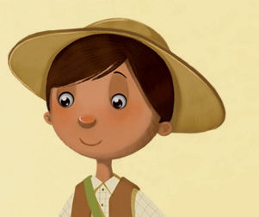
UNIT 2
I LIKE FOOD
Let’s Review
Who’s it?
It’s ____.
Notes:
Get ready eight to ten pictures for words that you want to review from Grade 1 or Unit 1.
Show the students a picture.
Say Look at the picture. What is it? Tell me the word.
Students should say [Crown].
If necessary, model the activity first to make sure all students understand what to do.
Say Good job! Now let’s learn some new words. Let’s learn about food.

Slide 32


UNIT 2
I LIKE FOOD
Let’s Review
What’s it?
It’s ____.
Notes:
Get ready eight to ten pictures for words that you want to review from Grade 1 or Unit 1.
Show the students a picture.
Say Look at the picture. What is it? Tell me the word.
Students should say [Crown].
If necessary, model the activity first to make sure all students understand what to do.
Say Good job! Now let’s learn some new words. Let’s learn about food.

Slide 33
UNIT 2
I LIKE FOOD
2
Point and say.
bananas
bread
milk
cookies
water
orange juice
rice
chicken
noodles
Notes:
2 Have students open their books to p. 17.
Play TR: B35 once through and ask students to listen and point to the correct picture for each item.
Read out items at random and ask students to point to the correct picture.
Say [Milk].
Students should point to the picture of milk.

Slide 34
UNIT 2
I LIKE FOOD
Point and say
bananas
bread
milk
cookies
water
orange juice
rice
chicken
noodles
Notes:
Have students form groups of four. Say Now it’s time to point and say.
Have students take turns pointing to images and saying words.
Student A should point to the picture of [bread] and says [Bread].
The other students in Student A’s group should point to the picture and say [Bread].
If necessary, model the activity with three students first.
As the groups are working, walk around the room to check that students are pointing to the images and saying the correct words.

Slide 35

UNIT 2
I LIKE FOOD
Tic-tac-toe
Team X
Team O
Notes:
On the board, draw a large grid with nine spaces. Tape or stick one of the Unit 2 pictures in each of the spaces.
Review how tic-tac-toe is played. Explain that the two teams should compete to be the first to get a vertical, horizontal, and diagonal line of three Xs or Os in a row.
However, in this version, teams cannot mark an X or O until they have identified the picture in the space.
For example, the first space has a picture of bread. Team X wants to mark that space. In order to do so, they must first identify the picture as bread. If they are correct, remove the picture and write an X in the space. If they are not correct, leave the picture in its place. Then it is Team O’s turn.
Say Let’s play a game. We need two teams.
Divide the class into two teams.
Say to one team You are Team X.
Say to the other team You are Team O. Team X, you want to get 3 Xs in a row. Team O, you want to get 3 Os in a row.
If necessary, demonstrate how 3 Xs and 3 Os can be written in vertical horizontal, and diagonal rows on the board.
Say In your team, you choose a picture and say the word. If you are right, I take off the picture and write an X or O. If you are wrong, I don’t write your X or O.
Model taking a turn before students begin to make sure that everyone understands how to play.

Slide 36
UNIT 2
I LIKE FOOD
Tic-tac-toe
Notes:
On the board, draw a large grid with nine spaces. Tape or stick one of the Unit 2 pictures in each of the spaces.
Review how tic-tac-toe is played. Explain that the two teams should compete to be the first to get a vertical, horizontal, and diagonal line of three Xs or Os in a row.
However, in this version, teams cannot mark an X or O until they have identified the picture in the space.
For example, the first space has a picture of bread. Team X wants to mark that space. In order to do so, they must first identify the picture as bread. If they are correct, remove the picture and write an X in the space. If they are not correct, leave the picture in its place. Then it is Team O’s turn.
Say Let’s play a game. We need two teams.
Divide the class into two teams.
Say to one team You are Team X.
Say to the other team You are Team O. Team X, you want to get 3 Xs in a row. Team O, you want to get 3 Os in a row.
If necessary, demonstrate how 3 Xs and 3 Os can be written in vertical horizontal, and diagonal rows on the board.
Say In your team, you choose a picture and say the word. If you are right, I take off the picture and write an X or O. If you are wrong, I don’t write your X or O.
Model taking a turn before students begin to make sure that everyone understands how to play.

Slide 37
UNIT 2
I LIKE FOOD
Goodbye Chant
Good work, class.
Hip hip, hooray!
Goodbye for now.
Have a nice day!
Notes:
Say Good job today class. Now let’s chant.
Lead the class in the Goodbye chant.

Slide 38
UNIT 2
I LIKE FOOD
Let’s check!
What food is it?
Notes:
Can students identify and name foods and drinks?
Point to the pictures of food on p. 17 and have students name them.

Slide 39
UNIT 2
I LIKE FOOD
It’s ____.
bananas
bread
milk
cookies
water
orange juice
rice
chicken
noodles
Notes:
(Click the picture to show the word)
Can students identify and name foods and drinks?
Point to the pictures of food on p. 17 and have students name them.

Slide 40
UNIT 2
I LIKE FOOD
Thank you!

Slide 41
Unit 2:
I Like Food
Lesson 4

Slide 42
UNIT 2
I LIKE FOOD
English Time Chant
English, (clap) English, (clap)
English (clap) today! (clap, clap)
English, (clap) English, (clap)
Hip, hip, (clap) hooray! (clap, clap)

Slide 43

UNIT 2
I LIKE FOOD
Let’s review
I have _____.
Notes:
Give each student an envelope with Unit 2 pictures or words inside.
Have each student reach in and pull out a card with a picture or word, which he or she cannot show to anyone.
On the board, write the sentence stem I have _________.
Practice a sentence or two with students.
Students should say I have [bananas]. I have [milk].
Say Stand up. Walk. Find other students with your picture or word, and then stand together.
Model the activity, if necessary. Make sure students say what they have rather than showing their cards to each other. Students should get into groups with the same food card.
When everyone is standing in groups, check students’ cards to be sure they’re all the same.

Slide 44

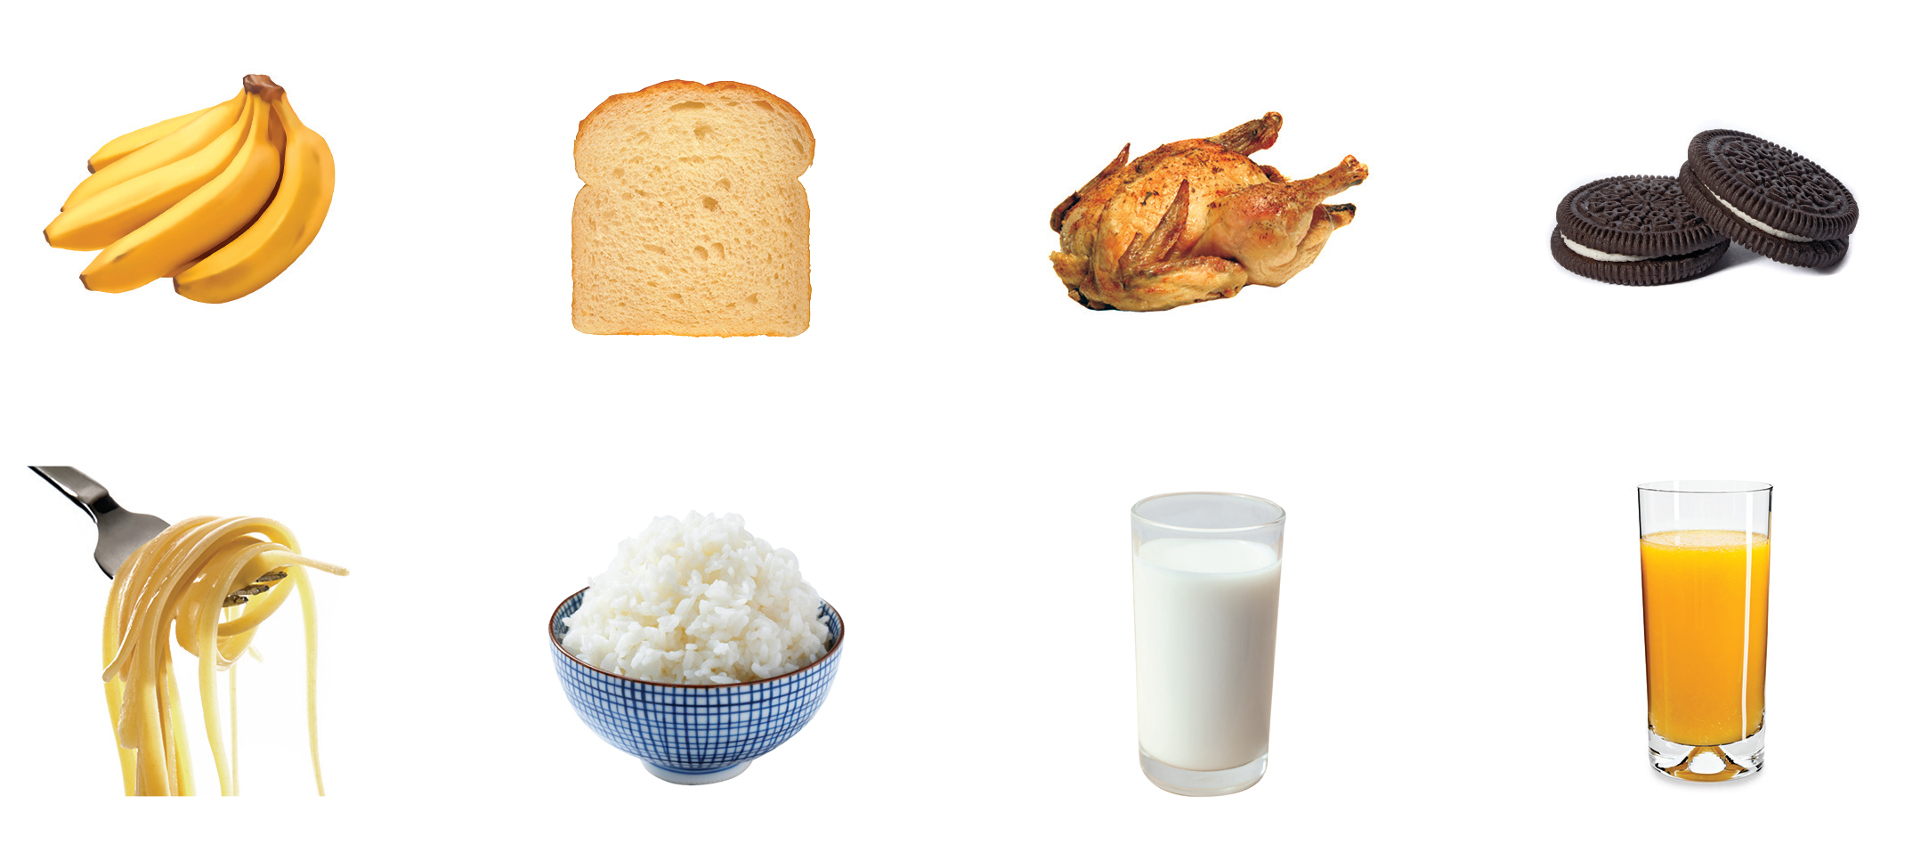
UNIT 2
I LIKE FOOD
Notes:
3 Help students open their books to p. 18.
Say Let’s do Activity 3.
Listen and circle. Play TR: B36.
Pause after the first item and ask Do you see bananas?
Students should point to the picture of bananas.
Model circling the item, and have students do the same.
Continue playing the track and pause after each item to allow students time to circle it.

Slide 45
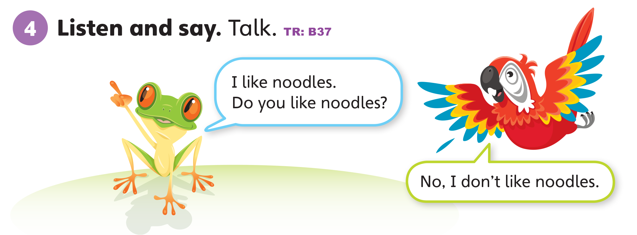
UNIT 2
I LIKE FOOD
Notes:
4 Have students look at the mascots on p. 18.
Point to Freddy the Frog, and ask Who’s this?
Students should say It’s Freddy.
Say Yes, it’s Freddy.
Point to Polly the Parrot and ask What’s her name?
Students should say It’s Polly.
Say Yes, it’s Polly. Freddy and Polly are talking about food. Let’s listen.
Play TR: B37.

Slide 46
UNIT 2
I LIKE FOOD
Do you like this?
I like bananas.
Notes:
Draw a happy face and a sad face on the board. Stand by the happy face.
Hold up two bananas (or two cookies) and say I like [bananas]. I do! I like [bananas].
Move over to the sad face. Hold up a glass of milk or water and say I don’t like [milk]. I don’t. I don’t like [milk].
Check for understanding. Encourage students to respond with Yes, you do or No, you don’t.
Ask Do I like [bananas]?
Students should say Yes, you do. You like [bananas].
Ask Do I like [milk]?
Students should say No, you don’t. You don’t like [milk].

Slide 47
UNIT 2
I LIKE FOOD
Do you like this?
I don’t like milk.
Notes:
Draw a happy face and a sad face on the board. Stand by the happy face.
Hold up two bananas (or two cookies) and say I like [bananas]. I do! I like [bananas].
Move over to the sad face. Hold up a glass of milk or water and say I don’t like [milk]. I don’t. I don’t like [milk].
Check for understanding. Encourage students to respond with Yes, you do or No, you don’t.
Ask Do I like [bananas]?
Students should say Yes, you do. You like [bananas].
Ask Do I like [milk]?
Students should say No, you don’t. You don’t like [milk].

Slide 48
UNIT 2
I LIKE FOOD
Do you like this?
Yes, I do.
No, I don’t.
bananas
bread
milk
cookies
water
orange juice
rice
chicken
noodles
Notes:
Have students form groups of three.
Model the activity with yourself and two students.
Point to one of the food pictures and say I like [orange juice]. Ask Do you like [orange juice]?
Students should say [Yes. / Yes, I do. / Yes, I like [orange juice.]
Have students answer the question and help them to extend their responses. For example, instead of saying Yes, a student may say Yes, I do. Once the student is comfortable saying Yes, I do, encourage them to say Yes, I like [orange juice]. Do the same to elicit a negative response.
When everyone understands what to do, point to each picture, and allow students to say what they like and don’t like.

Slide 49

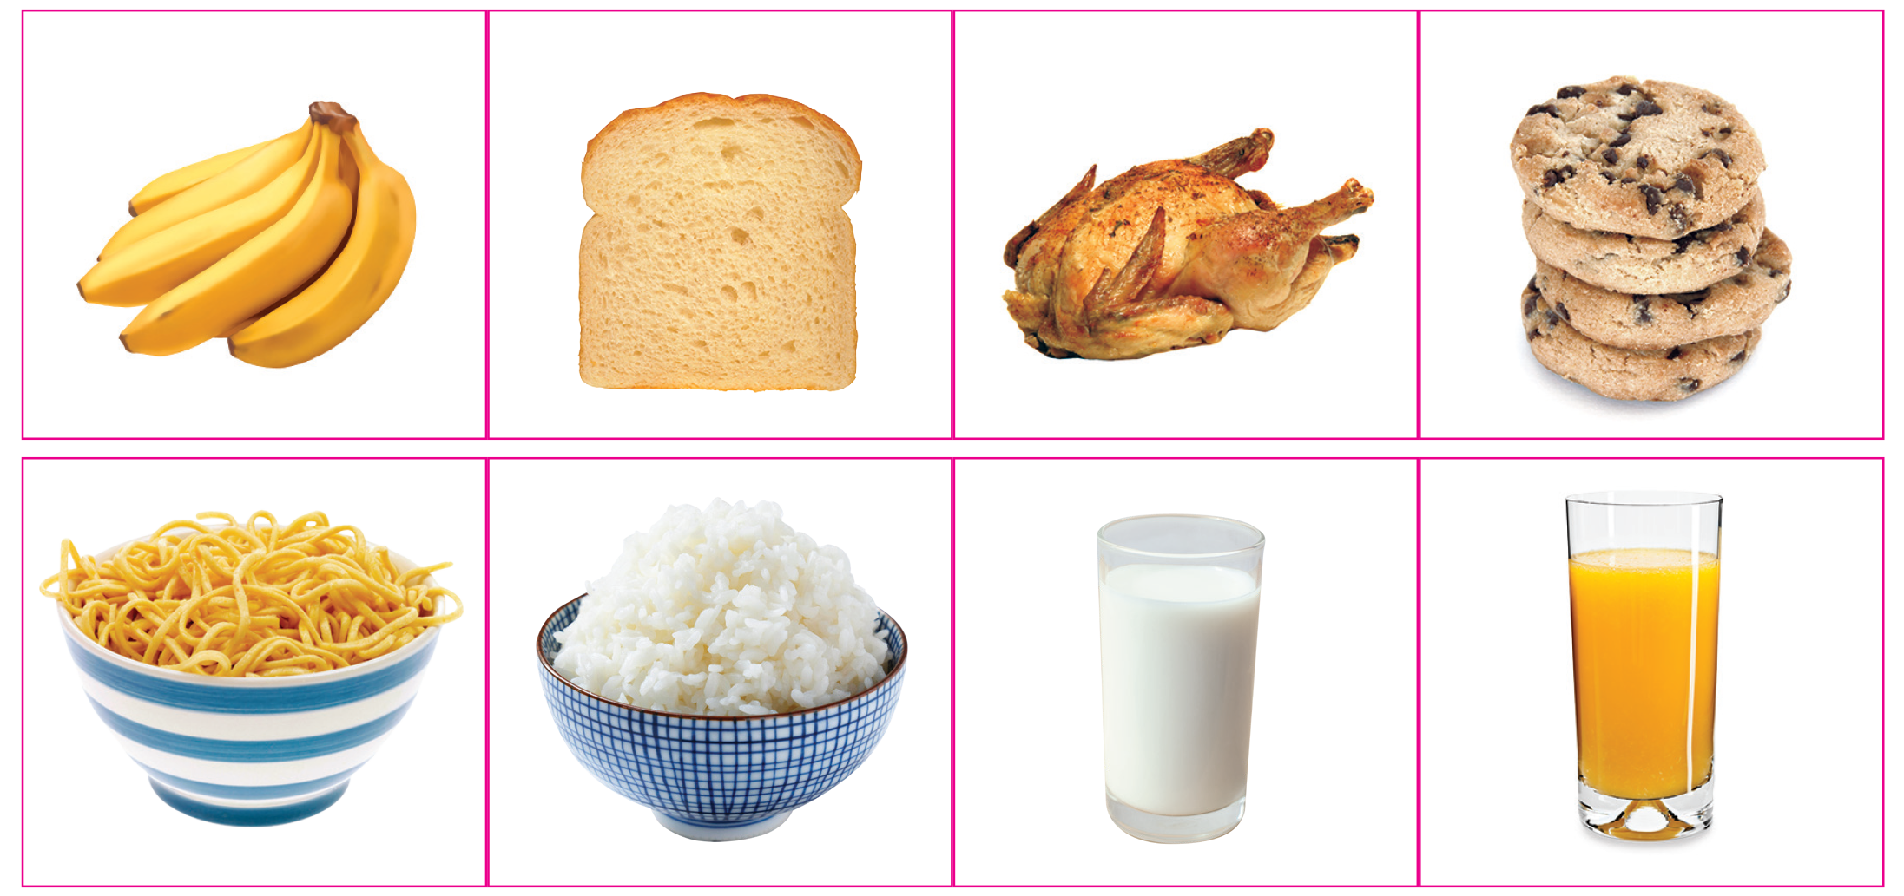
UNIT 2
I LIKE FOOD
Notes:
5 Say Now let’s do a sticker activity.
Have them form pairs. Have one student begin by choosing a sticker and placing it in the appropriate space.
If the first students says I like [bread], have the student paste the sticker in the “happy face” space in their own book.
The second student then sticks the same bread sticker according to their own likes and dislikes in their own book.
The second student chooses the next sticker to talk about.
Students should take out their Unit 2 stickers and place them in the appropriate spaces. They should continue taking turns until they have finished using all their stickers.

Slide 50

UNIT 2
I LIKE FOOD
I like ______.
I don’t like ______.
Notes:
5 Say Now let’s do a sticker activity.
Have them form pairs. Have one student begin by choosing a sticker and placing it in the appropriate space.
If the first students says I like [bread], have the student paste the sticker in the “happy face” space in their own book.
The second student then sticks the same bread sticker according to their own likes and dislikes in their own book.
The second student chooses the next sticker to talk about.
Students should take out their Unit 2 stickers and place them in the appropriate spaces. They should continue taking turns until they have finished using all their stickers.

Slide 51
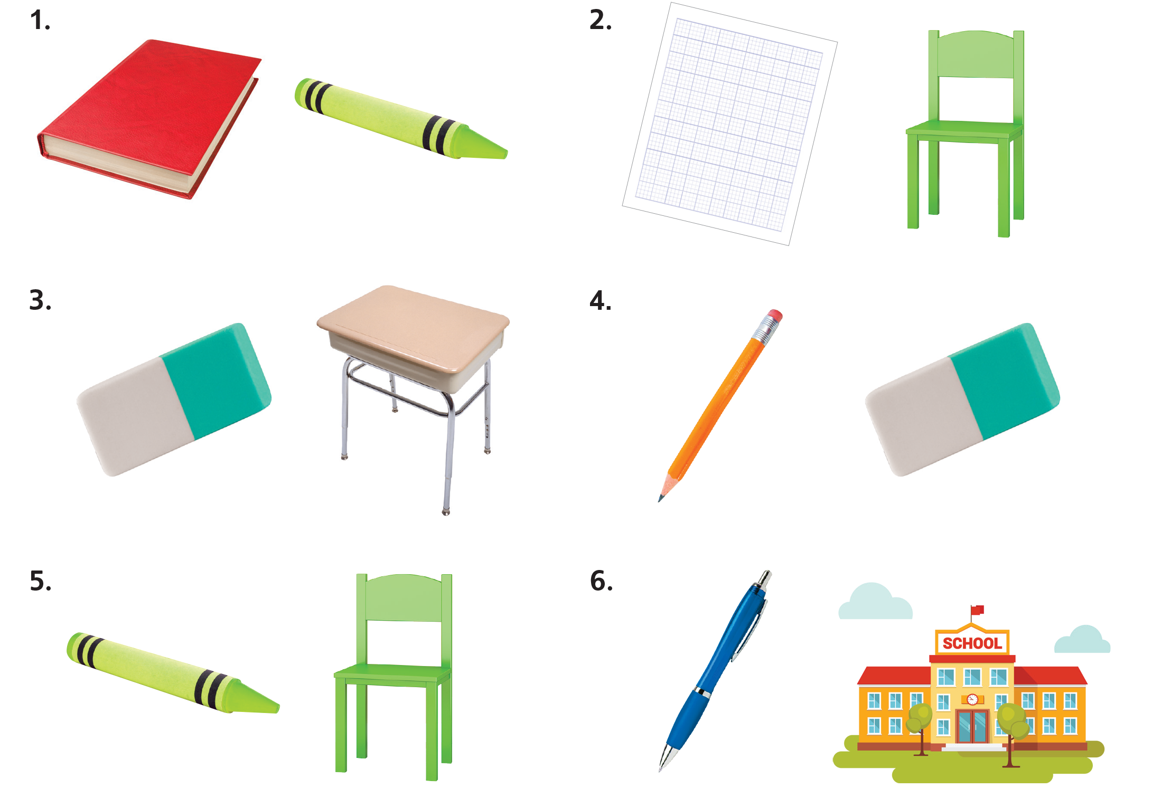
UNIT 2
I LIKE FOOD
What do you like?
I like _______.
Notes:
Show pictures of school supplies, toys, and food. As you hold up two pictures from the same category, students will say which of the two they like more.
Model the activity. Hold up [crayons] an [pencils].
Say I like [pencils].
Call on two or three students and have them say which of the two items they like more.
Students should say I like [crayons].
Logical pairings include crayons/pencils, pens/pencils, dolls/robots, cars/trucks, balls/balloons, kites/balloons, bananas/cookies, bread/cookies, milk/orange juice, water/milk, noodles/rice.

Slide 52
UNIT 2
I LIKE FOOD
What do you like?
I like _______.
Notes:
Show pictures of school supplies, toys, and food. As you hold up two pictures from the same category, students will say which of the two they like more.
Model the activity. Hold up [crayons] an [pencils].
Say I like [pencils].
Call on two or three students and have them say which of the two items they like more.
Students should say I like [crayons].
Logical pairings include crayons/pencils, pens/pencils, dolls/robots, cars/trucks, balls/balloons, kites/balloons, bananas/cookies, bread/cookies, milk/orange juice, water/milk, noodles/rice.

Slide 53
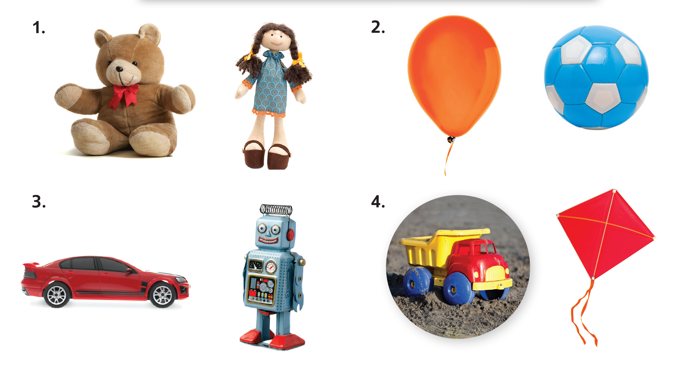
UNIT 2
I LIKE FOOD
What do you like?
I like _______.
Notes:
Show pictures of school supplies, toys, and food. As you hold up two pictures from the same category, students will say which of the two they like more.
Model the activity. Hold up [crayons] an [pencils].
Say I like [pencils].
Call on two or three students and have them say which of the two items they like more.
Students should say I like [crayons].
Logical pairings include crayons/pencils, pens/pencils, dolls/robots, cars/trucks, balls/balloons, kites/balloons, bananas/cookies, bread/cookies, milk/orange juice, water/milk, noodles/rice.

Slide 54
UNIT 2
I LIKE FOOD
What do you like?
I like _______.
Notes:
Show pictures of school supplies, toys, and food. As you hold up two pictures from the same category, students will say which of the two they like more.
Model the activity. Hold up [crayons] an [pencils].
Say I like [pencils].
Call on two or three students and have them say which of the two items they like more.
Students should say I like [crayons].
Logical pairings include crayons/pencils, pens/pencils, dolls/robots, cars/trucks, balls/balloons, kites/balloons, bananas/cookies, bread/cookies, milk/orange juice, water/milk, noodles/rice.

Slide 55
UNIT 2
I LIKE FOOD
What do you like?
I like _______.
Notes:
Show pictures of school supplies, toys, and food. As you hold up two pictures from the same category, students will say which of the two they like more.
Model the activity. Hold up [crayons] an [pencils].
Say I like [pencils].
Call on two or three students and have them say which of the two items they like more.
Students should say I like [crayons].
Logical pairings include crayons/pencils, pens/pencils, dolls/robots, cars/trucks, balls/balloons, kites/balloons, bananas/cookies, bread/cookies, milk/orange juice, water/milk, noodles/rice.

Slide 56
UNIT 2
I LIKE FOOD
What do you like?
I like _______.
Notes:
Show pictures of school supplies, toys, and food. As you hold up two pictures from the same category, students will say which of the two they like more.
Model the activity. Hold up [crayons] an [pencils].
Say I like [pencils].
Call on two or three students and have them say which of the two items they like more.
Students should say I like [crayons].
Logical pairings include crayons/pencils, pens/pencils, dolls/robots, cars/trucks, balls/balloons, kites/balloons, bananas/cookies, bread/cookies, milk/orange juice, water/milk, noodles/rice.

Slide 57
UNIT 2
I LIKE FOOD
What do you like?
I like _______.
Notes:
Show pictures of school supplies, toys, and food. As you hold up two pictures from the same category, students will say which of the two they like more.
Model the activity. Hold up [crayons] an [pencils].
Say I like [pencils].
Call on two or three students and have them say which of the two items they like more.
Students should say I like [crayons].
Logical pairings include crayons/pencils, pens/pencils, dolls/robots, cars/trucks, balls/balloons, kites/balloons, bananas/cookies, bread/cookies, milk/orange juice, water/milk, noodles/rice.

Slide 58
UNIT 2
I LIKE FOOD
What do you like?
I like _______.
Notes:
Show pictures of school supplies, toys, and food. As you hold up two pictures from the same category, students will say which of the two they like more.
Model the activity. Hold up [crayons] an [pencils].
Say I like [pencils].
Call on two or three students and have them say which of the two items they like more.
Students should say I like [crayons].
Logical pairings include crayons/pencils, pens/pencils, dolls/robots, cars/trucks, balls/balloons, kites/balloons, bananas/cookies, bread/cookies, milk/orange juice, water/milk, noodles/rice.

Slide 59
UNIT 2
I LIKE FOOD
What do you like?
I like _______.
Notes:
Show pictures of school supplies, toys, and food. As you hold up two pictures from the same category, students will say which of the two they like more.
Model the activity. Hold up [crayons] an [pencils].
Say I like [pencils].
Call on two or three students and have them say which of the two items they like more.
Students should say I like [crayons].
Logical pairings include crayons/pencils, pens/pencils, dolls/robots, cars/trucks, balls/balloons, kites/balloons, bananas/cookies, bread/cookies, milk/orange juice, water/milk, noodles/rice.

Slide 60
UNIT 2
I LIKE FOOD
What do you like?
I like _______.
Notes:
Show pictures of school supplies, toys, and food. As you hold up two pictures from the same category, students will say which of the two they like more.
Model the activity. Hold up [crayons] an [pencils].
Say I like [pencils].
Call on two or three students and have them say which of the two items they like more.
Students should say I like [crayons].
Logical pairings include crayons/pencils, pens/pencils, dolls/robots, cars/trucks, balls/balloons, kites/balloons, bananas/cookies, bread/cookies, milk/orange juice, water/milk, noodles/rice.

Slide 61
UNIT 2
I LIKE FOOD
What do you like?
I like _______.
Notes:
Show pictures of school supplies, toys, and food. As you hold up two pictures from the same category, students will say which of the two they like more.
Model the activity. Hold up [crayons] an [pencils].
Say I like [pencils].
Call on two or three students and have them say which of the two items they like more.
Students should say I like [crayons].
Logical pairings include crayons/pencils, pens/pencils, dolls/robots, cars/trucks, balls/balloons, kites/balloons, bananas/cookies, bread/cookies, milk/orange juice, water/milk, noodles/rice.

Slide 62
UNIT 2
I LIKE FOOD
Goodbye Chant
Good work, class.
Hip hip, hooray!
Goodbye for now.
Have a nice day!
Notes:
Say Good job today class. Now let’s chant.
Lead the class in the Goodbye chant.

Slide 63
UNIT 2
I LIKE FOOD
Let’s check!
What do you like?
I like ______.
I don’t like ______.
Notes:
Can students identify and name foods, and use I like and I don’t like to express food likes and dislikes?
Have students point to pictures of food and drink, identify them, and say whether they like or don’t like them.

Slide 64
UNIT 2
I LIKE FOOD
Thank you!

Slide 65
Unit 2:
I Like Food
Lesson 5

Slide 66
UNIT 2
I LIKE FOOD
English Time Chant
English, (clap) English, (clap)
English (clap) today! (clap, clap)
English, (clap) English, (clap)
Hip, hip, (clap) hooray! (clap, clap)

Slide 67
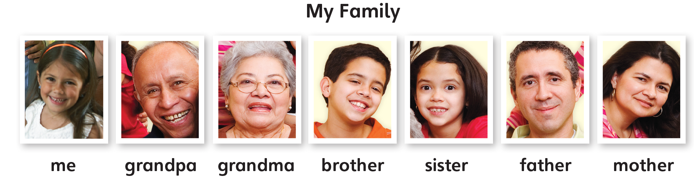
UNIT 2
I LIKE FOOD
Let’s Review
Who’s it?
It’s ____.
Notes:
Choose a total of 18 pictures from Unit 1–2 and Grade 1. Show any three pictures. Say a vocabulary word for one of the pictures and have students point to the correct picture.
Repeat a total of six times, using three different pictures each time.

Slide 68
UNIT 2
I LIKE FOOD
Let’s Review
What’s it?
It’s ____.
Notes:
Choose a total of 18 pictures from Unit 1–2 and Grade 1. Show any three pictures. Say a vocabulary word for one of the pictures and have students point to the correct picture.
Repeat a total of six times, using three different pictures each time.

Slide 69
UNIT 2
I LIKE FOOD
Let’s Review
What’s it?
It’s ____.
Notes:
Choose a total of 18 pictures from Unit 1–2 and Grade 1. Show any three pictures. Say a vocabulary word for one of the pictures and have students point to the correct picture.
Repeat a total of six times, using three different pictures each time.

Slide 70

UNIT 2
I LIKE FOOD
New Word
Notes:
Say Circle as you draw a circle on the board.
Have students repeat. Call on a few students to come to the board and draw circles.
Hold up a circular item, such as a CD, and say Circle. Then do the same for the word Square.
Note
If you want to draw a perfect circle on the board, hold the chalk/whiteboard marker behind you and move your arm in a circular motion.

Slide 71
UNIT 2
I LIKE FOOD
New Word
Notes:
Say Circle as you draw a circle on the board.
Have students repeat. Call on a few students to come to the board and draw circles.
Hold up a circular item, such as a CD, and say Circle. Then do the same for the word Square.
Note
If you want to draw a perfect circle on the board, hold the chalk/whiteboard marker behind you and move your arm in a circular motion.

Slide 72
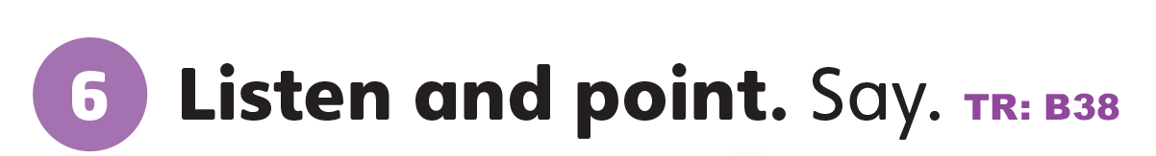
UNIT 2
I LIKE FOOD
What color do you see?
Yellow
Green
Notes:
6 Have students open their books to p. 19. Point to the Activity 6.
Ask What colors do you see?
Students should say Yellow and green.
Say Yes, yellow and green. A yellow circle. A green square.
Say Now let’s listen. Then, point and say.
Play TR: B38 once. Repeat if necessary.
Students should point to the pictures and say the words.
Point randomly to the circle or square. Ask What is it?
Call on several students to respond.
Students should say A circle / A square.
Say Good job!
Have students name some items that are circular. Ask if any of those circles are also yellow, e.g. the sun. Then have students name some items that are square.

Slide 73
UNIT 2
I LIKE FOOD
What is it?
Notes:
6 Have students open their books to p. 19. Point to the Activity 6.
Ask What colors do you see?
Students should say Yellow and green.
Say Yes, yellow and green. A yellow circle. A green square.
Say Now let’s listen. Then, point and say.
Play TR: B38 once. Repeat if necessary.
Students should point to the pictures and say the words.
Point randomly to the circle or square. Ask What is it?
Call on several students to respond.
Students should say A circle / A square.
Say Good job!
Have students name some items that are circular. Ask if any of those circles are also yellow, e.g. the sun. Then have students name some items that are square.

Slide 74


UNIT 2
I LIKE FOOD
Notes:
7 Ask What color is the circle?
Students should say Pink.
Say Take out your crayons. Let’s listen and color.
Play item one in TR: B39. Make sure students understand that they will choose a circle or a square each time and color it based on what they hear.
Continue playing TR: B39, pausing after each item to allow students time to color it.

Slide 75
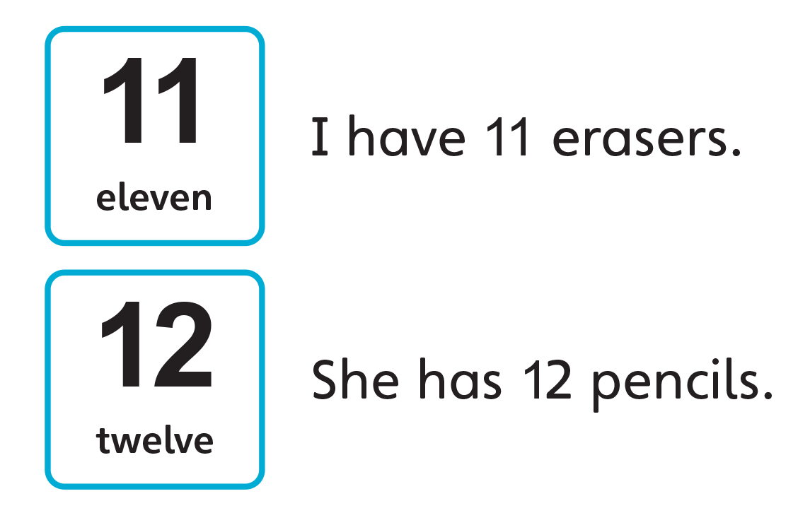

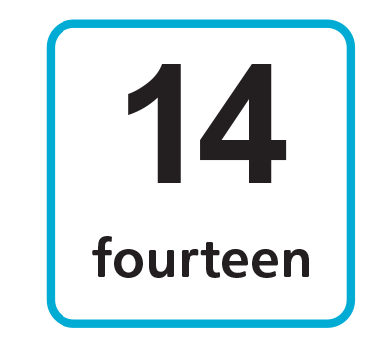
UNIT 2
I LIKE FOOD
What numbers come after 10?
Notes:
8 Ask the class to tell you the numbers that come after 10. Ask What numbers come after 10?
Students should say Eleven, twelve, thirteen, fourteen.

Slide 76
UNIT 2
I LIKE FOOD
I want 11 cookies.
You have 12 bananas.
bananas
bread
milk
cookies
water
orange juice
rice
chicken
noodles
Notes:
Write the sentence stems I want… and You have… on the board. Point to the pictures and words on p. 17 and make simple sentences using the numbers 1–14.
Students should say [I want eleven cookies.]

Slide 77
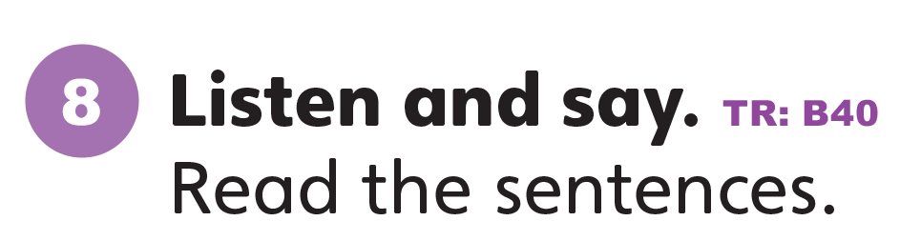
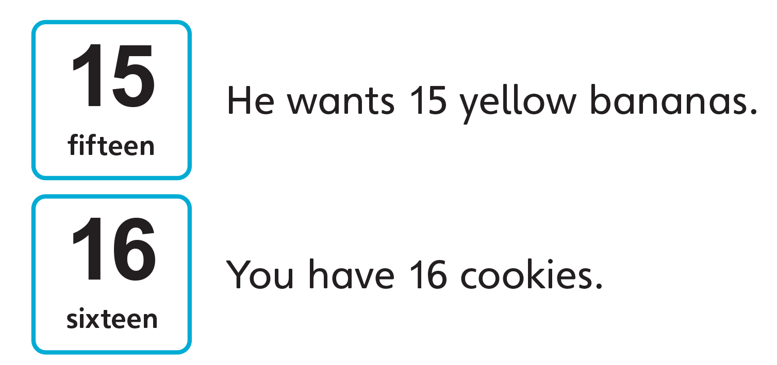
UNIT 2
I LIKE FOOD
Notes:
Have students look at Activity 8. Ask What comes after 14?
Students should say Fifteen. Sixteen.
Say Let’s listen. Repeat the numbers you hear.
Students should say Fifteen. Sixteen.
Play TR: B40.
Call on a few students to read the sentences aloud.

Slide 78

UNIT 2
I LIKE FOOD
Let’s draw
Draw something using circles and squares
Notes:
Say Draw something using circles and squares.
If students are not sure what to draw, give suggestions such as the moon, a house, or a robot. They should draw pictures using squares and circles.
Have students share their drawings with a partner and talk about them.
Students should say This is [a robot].

Slide 79
UNIT 2
I LIKE FOOD
Goodbye Chant
Good work, class.
Hip hip, hooray!
Goodbye for now.
Have a nice day!
Notes:
Say Good job today class. Now let’s chant.
Lead the class in the Goodbye chant.

Slide 80

UNIT 2
I LIKE FOOD
Let’s check!
Let’s draw
circles and squares
Notes:
Can students identify and name circles and squares?
Have students draw, color, and count a number of circles and squares.

Slide 81
UNIT 2
I LIKE FOOD
Thank you!

Slide 82
Unit 2:
I Like Food
Lesson 6

Slide 83
UNIT 2
I LIKE FOOD
English Time Chant
English, (clap) English, (clap)
English (clap) today! (clap, clap)
English, (clap) English, (clap)
Hip, hip, (clap) hooray! (clap, clap)

Slide 84
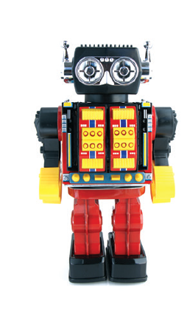
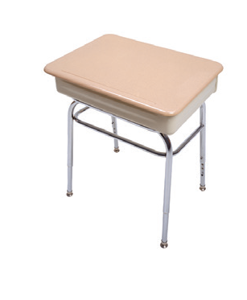
UNIT 2
I LIKE FOOD
Let’s Review
What’s it?
It’s ____.
Notes:
Choose a total of 18 pictures from Unit 1–2 and Grade 1. Show any three pictures. Say a vocabulary word for one of the pictures and have students point to the correct picture.
Repeat a total of six times, using three different pictures each time.

Slide 85
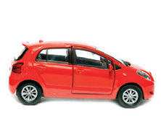

UNIT 2
I LIKE FOOD
Let’s Review
What’s it?
It’s ____.
Notes:
Choose a total of 18 pictures from Unit 1–2 and Grade 1. Show any three pictures. Say a vocabulary word for one of the pictures and have students point to the correct picture.
Repeat a total of six times, using three different pictures each time.

Slide 86
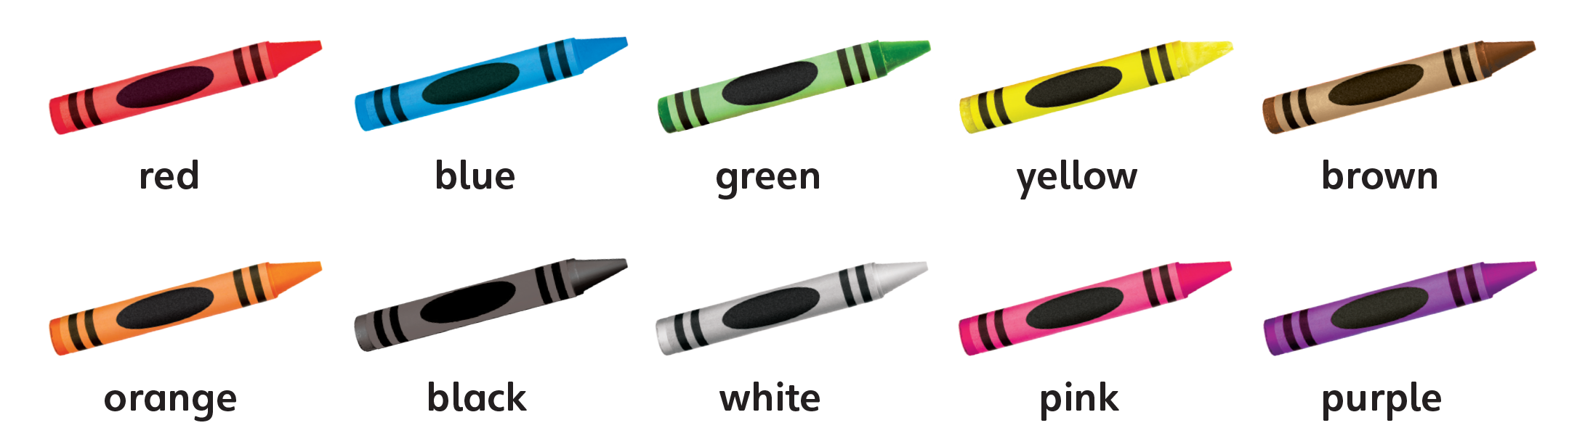
UNIT 2
I LIKE FOOD
Let’s Review
What color is it?
It’s ____.
Notes:
Choose a total of 18 pictures from previous units and Grade 1. Show any three pictures.
Say a vocabulary word for one of the pictures and have students point to the correct picture.
Repeat a total of six times, using three different pictures each time.

Slide 87
UNIT 2
I LIKE FOOD
What is it?
Notes:
Say Open your book to p. 19.
Point to the circle or square at random. Ask What is it?
Call on several students to respond.
Students should say It’s a circle/square.
Say Good job!

Slide 88
UNIT 2
I LIKE FOOD
What number is it?
Notes:
Point to the numbers 15 and 16 at random.
Ask What number is this?
Students should say Fifteen/Sixteen.
Call on several students to respond.

Slide 89


UNIT 2
I LIKE FOOD
How many ______?
15 squares
5 white squares
16 circles
6 orange circles
Notes:
9 Say Now it’s time for Activity 9. Let’s listen, count, and say.
Play TR: B41. Pause after each item to allow students time to count and answer.

Slide 90

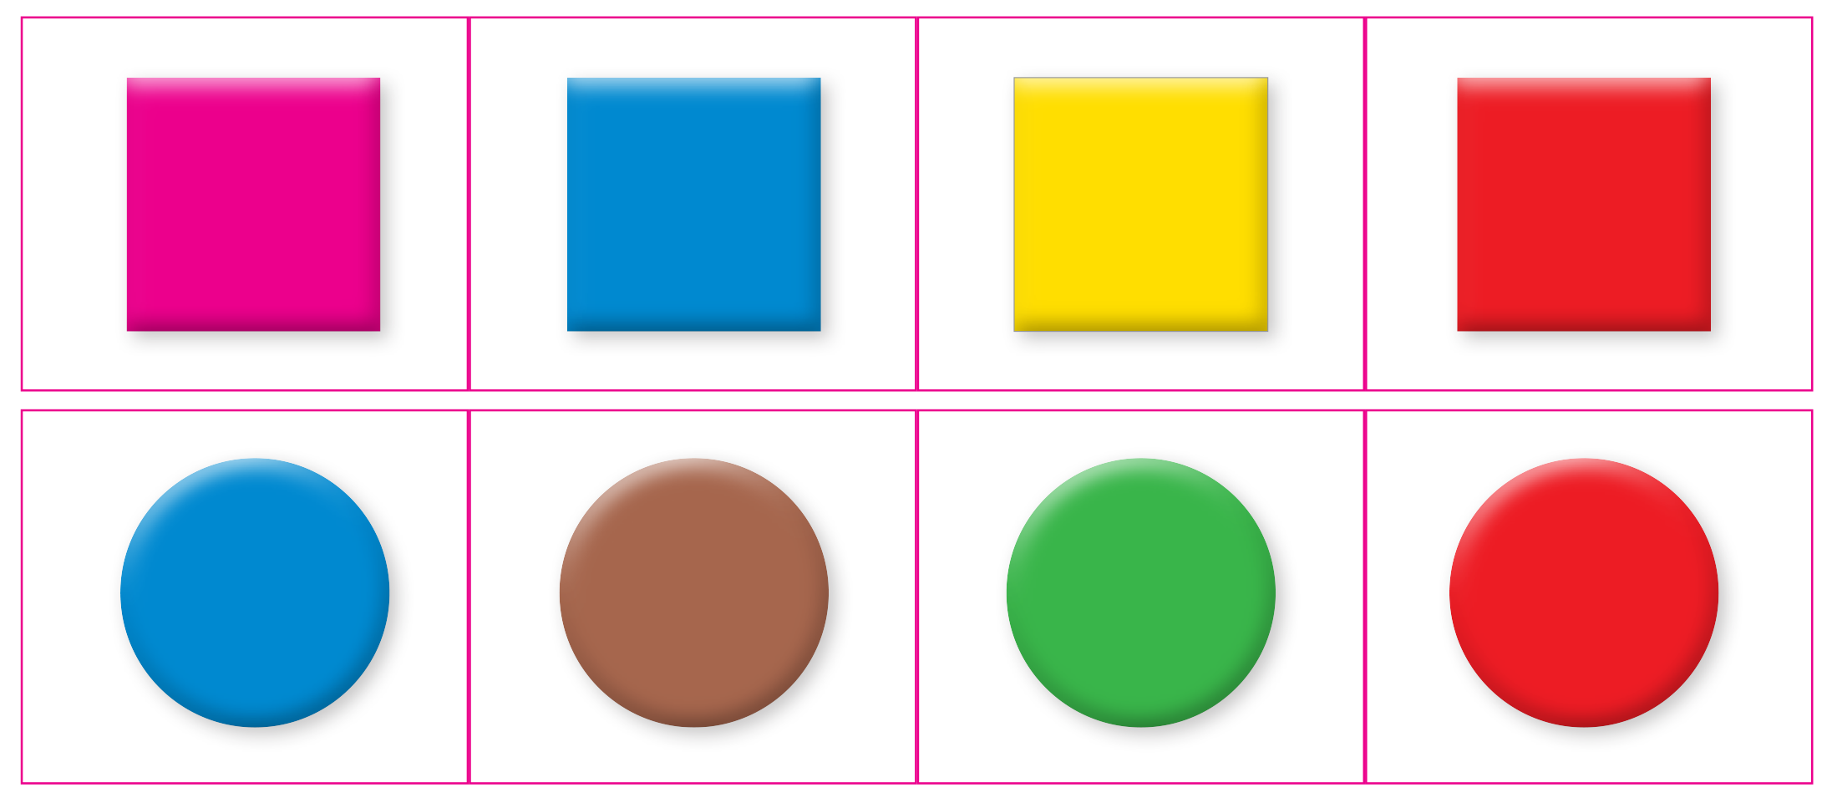
UNIT 2
I LIKE FOOD
Notes:
10 Say Now let’s do a sticker activity.
Have students stick the stickers on poster board. Then have them cut out the cards.
Say Let’s listen and put the cards in order.
Model the activity first, if necessary.
Play TR: B42. As students listen and order their cards according to the dialogue, walk around the room and check their work. Provide help as needed.

Slide 91
UNIT 2
I LIKE FOOD
Notes:
10 Say Now let’s do a sticker activity.
Have students stick the stickers on poster board. Then have them cut out the cards.
Say Let’s listen and put the cards in order.
Model the activity first, if necessary.
Play TR: B42. As students listen and order their cards according to the dialogue, walk around the room and check their work. Provide help as needed.

Slide 92
UNIT 2
I LIKE FOOD
Let’s play!
Memory chain
I have a red circle.
I have a red circle.
He has a blue square.
Notes:
Have students use their cards from Activity 10 to play a memory chain game.
First, review I have _____ and he/she has _____ with students.
Then model the activity. For example, hold up a card
with a red circle and say I have a red circle.
Have a student hold up a card with a blue square so that the class can see it. Say I have a red circle. He has a blue square.
Have another student hold up a card with a green circle. Say I have a red circle. He has a blue square. She has a green circle.
Have students form groups of five or six. Have students choose a card.
Make sure that students look only at their own cards. Call on one student in each group to begin by saying what color and shape is on his or her card.
Students should say I have [a blue circle].
Have students continue, going around the circle to the right, adding on the new information each time.
Students should try to remember what cards one another has.
Find out if the last student can remember everyone’s cards.

Slide 93
UNIT 2
I LIKE FOOD
Let’s play!
Memory chain
Notes:
Have students use their cards from Activity 10 to play a memory chain game.
First, review I have _____ and he/she has _____ with students.
Then model the activity. For example, hold up a card
with a red circle and say I have a red circle.
Have a student hold up a card with a blue square so that the class can see it. Say I have a red circle. He has a blue square.
Have another student hold up a card with a green circle. Say I have a red circle. He has a blue square. She has a green circle.
Have students form groups of five or six. Have students choose a card.
Make sure that students look only at their own cards. Call on one student in each group to begin by saying what color and shape is on his or her card.
Students should say I have [a blue circle].
Have students continue, going around the circle to the right, adding on the new information each time.
Students should try to remember what cards one another has.
Find out if the last student can remember everyone’s cards.

Slide 94
UNIT 2
I LIKE FOOD
Goodbye Chant
Good work, class.
Hip hip, hooray!
Goodbye for now.
Have a nice day!
Notes:
Say Good job today class. Now let’s chant.
Lead the class in the Goodbye chant.

Slide 95
UNIT 2
I LIKE FOOD
Let’s check!
Let’s draw
circles and squares
Notes:
Can students identify and name circles and squares?
Have students draw, color, and count a number of circles and squares.

Slide 96
UNIT 2
I LIKE FOOD
Thank you!

Slide 97
Unit 2:
I Like Food
Lesson 7

Slide 98
UNIT 2
I LIKE FOOD
English Time Chant
English, (clap) English, (clap)
English (clap) today! (clap, clap)
English, (clap) English, (clap)
Hip, hip, (clap) hooray! (clap, clap)

Slide 99
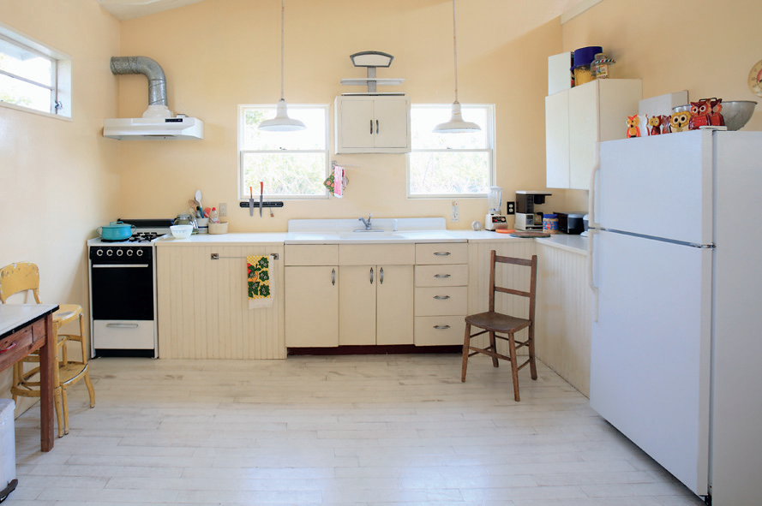
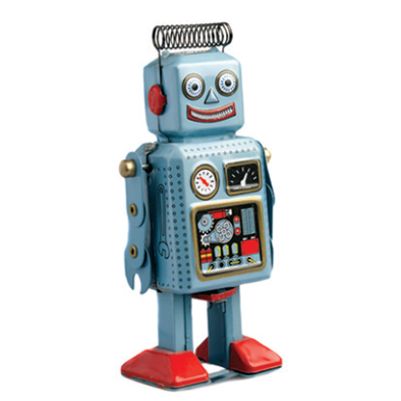
UNIT 2
I LIKE FOOD
What’s missing?
kitchen
a chair
an eraser
a robot
brown
red
a pen
Notes:
Say We’re going to play What’s Missing?
Write on the board twelve words containing target sounds from Units 1–2 or Grade 1, such as chair, kitchen, brown, pen, eraser, red, robot.
Have students study the words for a minute or two.
Next, have students stand up and turn their backs to the board. Remove one of the words.
Have students turn around and try to identify the missing word.
Students should say [Chair].
Pay attention to their pronunciation of the target sounds and words.

Slide 100
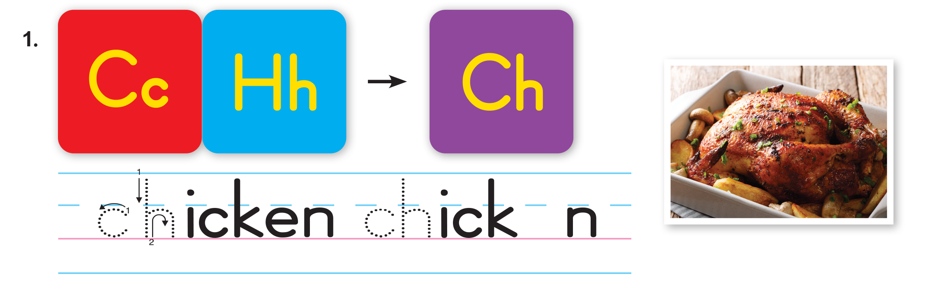
UNIT 2
I LIKE FOOD
The sound of English
Notes:
11 Say Let’s listen to new sounds.
Play TR: B43. Ask students to repeat each sound or word they hear.
Say Chicken has the /tʃ/ sound. Have students repeat the sound and the word. Then, ask students to raise their hands when they hear /tʃ/. Remind them that
the sound can be heard anywhere in the word. Say the following words: Chair, chicken, juice, purple, square, lunch.
Students should raise their hands when they hear chair, chicken, and lunch.

Slide 101
UNIT 2
I LIKE FOOD
Which has the /tʃ/ sound?
✓
✓
CHAIR
CHICKEN
JUICE
PURPLE
SQUARE
LUNCH
✓
Notes:
11 Say Let’s listen to new sounds.
Play TR: B43. Ask students to repeat each sound or word they hear.
Say Chicken has the /tʃ/ sound. Have students repeat the sound and the word. Then, ask students to raise their hands when they hear /tʃ/. Remind them that
the sound can be heard anywhere in the word. Say the following words: Chair, chicken, juice, purple, square, lunch.
Students should raise their hands when they hear chair, chicken, and lunch.

Slide 102

UNIT 2
I LIKE FOOD
The sound of English
Notes:
Say Water has the /r/ sound. Have students repeat the sound and the word. Then, ask students to raise their hands when they hear /r/. Say the following
words: Cookie, brother, red, doll, rice, prince, water.
Students should raise their hands when they hear brother, red, rice, prince, and water.

Slide 103
UNIT 2
I LIKE FOOD
Which has the /r/ sound?
✓
✓
COOKIE
BROTHER
RED
DOLL
RICE
PRINCE
WATER
✓
✓
✓
Notes:
Say Water has the /r/ sound. Have students repeat the sound and the word. Then, ask students to raise their hands when they hear /r/. Say the following
words: Cookie, brother, red, doll, rice, prince, water.
Students should raise their hands when they hear brother, red, rice, prince, and water.

Slide 104
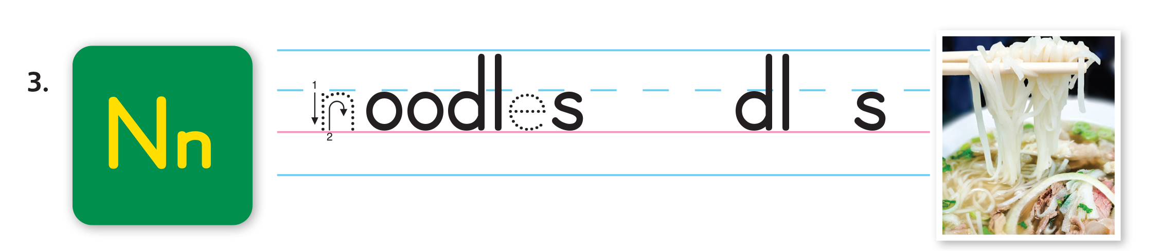
UNIT 2
I LIKE FOOD
The sound of English
Notes:
Say Noodles has the /n/ sound. Have students repeat the sound and the word. Then, ask students to raise their hands when they hear /n/. Say the following
words: Nice, water, pen, noodles, no.
Students should raise their hands when they hear nice, pen, noodles, and no.

Slide 105
UNIT 2
I LIKE FOOD
Which has the /n/ sound?
✓
✓
KITE
KING
PEN
SIT
BOOK
✓
Notes:
Say Noodles has the /n/ sound. Have students repeat the sound and the word. Then, ask students to raise their hands when they hear /n/. Say the following
words: Nice, water, pen, noodles, no.
Students should raise their hands when they hear nice, pen, noodles, and no.

Slide 106
UNIT 2
I LIKE FOOD
Do you have /tʃ/, /r/, or /n/ in your name?
Notes:
If there are students in your class with /tʃ/, /r/, or /n/ in their names, point them out. For example, say Rukia. What sounds do you hear in Rukia’s name?
Students should say /r/.

Slide 107
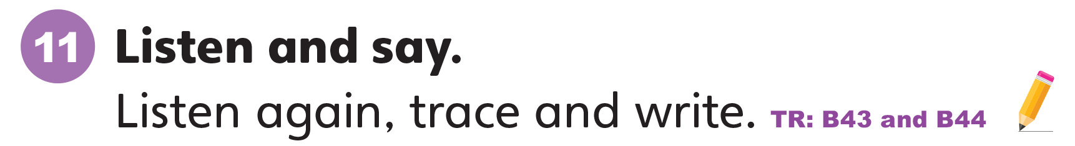
UNIT 2
I LIKE FOOD
Notes:
Write Cc on the board. Ask What letter is this?
Then write Hh on the board. Ask What letter is this?
Then say The letter c together with the letter h makes the sound /tʃ/.
Have students make the /tʃ/ sound.
Ask students to open their books to p. 20. Then say Let’s learn to pronounce /tʃ/. Listen and repeat what you hear.
Play TR: B43. Have students follow along with the track by looking at Activity 11 and pointing to the letters and words. Play the track again and have students repeat the sounds as they point to the letters and words.

Slide 108
UNIT 2
I LIKE FOOD
Let’s Say
CHICKEN
Notes:
Write Cc on the board. Ask What letter is this?
Then write Hh on the board. Ask What letter is this?
Then say The letter c together with the letter h makes the sound /tʃ/.
Have students make the /tʃ/ sound.
Ask students to open their books to p. 20. Then say Let’s learn to pronounce /tʃ/. Listen and repeat what you hear.
Play TR: B43. Have students follow along with the track by looking at Activity 11 and pointing to the letters and words. Play the track again and have students repeat the sounds as they point to the letters and words.

Slide 109
UNIT 2
I LIKE FOOD
Notes:
Write Cc on the board. Ask What letter is this?
Then write Hh on the board. Ask What letter is this?
Then say The letter c together with the letter h makes the sound /tʃ/.
Have students make the /tʃ/ sound.
Ask students to open their books to p. 20. Then say Let’s learn to pronounce /tʃ/. Listen and repeat what you hear.
Play TR: B43. Have students follow along with the track by looking at Activity 11 and pointing to the letters and words. Play the track again and have students repeat the sounds as they point to the letters and words.

Slide 110
UNIT 2
I LIKE FOOD
Let’s Say
WATER
Notes:
Write Cc on the board. Ask What letter is this?
Then write Hh on the board. Ask What letter is this?
Then say The letter c together with the letter h makes the sound /tʃ/.
Have students make the /tʃ/ sound.
Ask students to open their books to p. 20. Then say Let’s learn to pronounce /tʃ/. Listen and repeat what you hear.
Play TR: B43. Have students follow along with the track by looking at Activity 11 and pointing to the letters and words. Play the track again and have students repeat the sounds as they point to the letters and words.

Slide 111
UNIT 2
I LIKE FOOD
Notes:
Write Cc on the board. Ask What letter is this?
Then write Hh on the board. Ask What letter is this?
Then say The letter c together with the letter h makes the sound /tʃ/.
Have students make the /tʃ/ sound.
Ask students to open their books to p. 20. Then say Let’s learn to pronounce /tʃ/. Listen and repeat what you hear.
Play TR: B43. Have students follow along with the track by looking at Activity 11 and pointing to the letters and words. Play the track again and have students repeat the sounds as they point to the letters and words.

Slide 112
UNIT 2
I LIKE FOOD
Let’s Say
KING
Notes:
Write Cc on the board. Ask What letter is this?
Then write Hh on the board. Ask What letter is this?
Then say The letter c together with the letter h makes the sound /tʃ/.
Have students make the /tʃ/ sound.
Ask students to open their books to p. 20. Then say Let’s learn to pronounce /tʃ/. Listen and repeat what you hear.
Play TR: B43. Have students follow along with the track by looking at Activity 11 and pointing to the letters and words. Play the track again and have students repeat the sounds as they point to the letters and words.

Slide 113
UNIT 2
I LIKE FOOD
Let’s Trace
Notes:
Draw Ch and ch in dotted outline on the board. Say Let’s trace the letters ch. Model tracing over the outline. Then say Look at the word and picture for
chicken again. Listen to the sound /tʃ/ and use your pencil to trace the letters ch.
Play TR: B44 and stop after chicken. Make sure students trace ch two times for chicken and fill in the missing e to complete the word chicken. Call on volunteers to say the word aloud.
Repeat the activity for r and n and play the rest of TR: B44.

Slide 114
UNIT 2
I LIKE FOOD
Let’s Trace
Notes:
Draw Ch and ch in dotted outline on the board. Say Let’s trace the letters ch. Model tracing over the outline. Then say Look at the word and picture for
chicken again. Listen to the sound /tʃ/ and use your pencil to trace the letters ch.
Play TR: B44 and stop after chicken. Make sure students trace ch two times for chicken and fill in the missing e to complete the word chicken. Call on volunteers to say the word aloud.
Repeat the activity for r and n and play the rest of TR: B44.

Slide 115
UNIT 2
I LIKE FOOD
Let’s Trace
Notes:
Draw Ch and ch in dotted outline on the board. Say Let’s trace the letters ch. Model tracing over the outline. Then say Look at the word and picture for
chicken again. Listen to the sound /tʃ/ and use your pencil to trace the letters ch.
Play TR: B44 and stop after chicken. Make sure students trace ch two times for chicken and fill in the missing e to complete the word chicken. Call on volunteers to say the word aloud.
Repeat the activity for r and n and play the rest of TR: B44.

Slide 116
UNIT 2
I LIKE FOOD
Goodbye Chant
Good work, class.
Hip hip, hooray!
Goodbye for now.
Have a nice day!
Notes:
Say Good job today class. Now let’s chant.
Lead the class in the Goodbye chant.

Slide 117

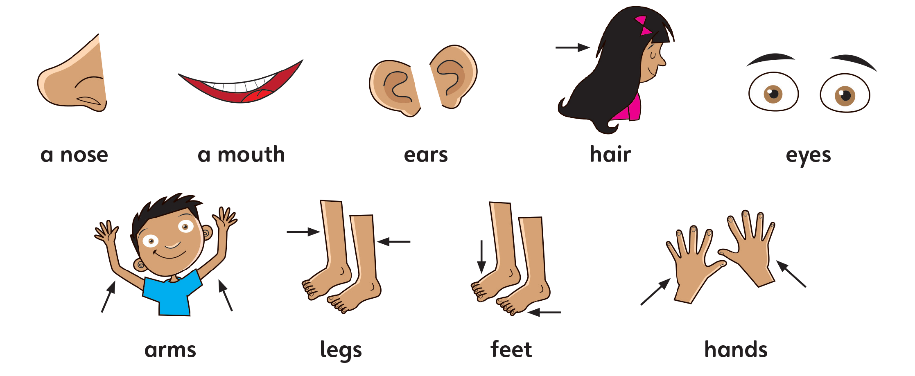
UNIT 2
I LIKE FOOD
Let’s check!
Let’s Say
Notes:
Can students recognize and pronounce the sounds: /tʃ/ as in chicken, /n/ as in noodles, and /r/ as in water correctly?
Point to words or pictures of chicken, chair, noodles, nose, rice, and robot. Have students say the words.

Slide 118
UNIT 2
I LIKE FOOD
Thank you!

Slide 119
Unit 2:
I Like Food
Lesson 8

Slide 120
UNIT 2
I LIKE FOOD
English Time Chant
English, (clap) English, (clap)
English (clap) today! (clap, clap)
English, (clap) English, (clap)
Hip, hip, (clap) hooray! (clap, clap)

Slide 121
UNIT 2
I LIKE FOOD
The sound of English
Notes:
11 Say Let’s listen to new sounds.
Play TR: B43. Ask students to repeat each sound or word they hear.
Say Chicken has the /tʃ/ sound. Have students repeat the sound and the word. Then, ask students to raise their hands when they hear /tʃ/. Remind them that
the sound can be heard anywhere in the word. Say the following words: Chair, chicken, juice, purple, square, lunch.
Students should raise their hands when they hear chair, chicken, and lunch.

Slide 122
UNIT 2
I LIKE FOOD
Which has the /tʃ/ sound?
✓
✓
CHAIR
CHICKEN
JUICE
PURPLE
SQUARE
LUNCH
✓
Notes:
11 Say Let’s listen to new sounds.
Play TR: B43. Ask students to repeat each sound or word they hear.
Say Chicken has the /tʃ/ sound. Have students repeat the sound and the word. Then, ask students to raise their hands when they hear /tʃ/. Remind them that
the sound can be heard anywhere in the word. Say the following words: Chair, chicken, juice, purple, square, lunch.
Students should raise their hands when they hear chair, chicken, and lunch.

Slide 123
UNIT 2
I LIKE FOOD
The sound of English
Notes:
Say Water has the /r/ sound. Have students repeat the sound and the word. Then, ask students to raise their hands when they hear /r/. Say the following
words: Cookie, brother, red, doll, rice, prince, water.
Students should raise their hands when they hear brother, red, rice, prince, and water.

Slide 124
UNIT 2
I LIKE FOOD
Which has the /r/ sound?
✓
✓
COOKIE
BROTHER
RED
DOLL
RICE
PRINCE
WATER
✓
✓
✓
Notes:
Say Water has the /r/ sound. Have students repeat the sound and the word. Then, ask students to raise their hands when they hear /r/. Say the following
words: Cookie, brother, red, doll, rice, prince, water.
Students should raise their hands when they hear brother, red, rice, prince, and water.

Slide 125
UNIT 2
I LIKE FOOD
The sound of English
Notes:
Say Noodles has the /n/ sound. Have students repeat the sound and the word. Then, ask students to raise their hands when they hear /n/. Say the following
words: Nice, water, pen, noodles, no.
Students should raise their hands when they hear nice, pen, noodles, and no.

Slide 126
UNIT 2
I LIKE FOOD
Which has the /n/ sound?
✓
✓
KITE
KING
PEN
SIT
BOOK
✓
Notes:
Say Noodles has the /n/ sound. Have students repeat the sound and the word. Then, ask students to raise their hands when they hear /n/. Say the following
words: Nice, water, pen, noodles, no.
Students should raise their hands when they hear nice, pen, noodles, and no.

Slide 127
UNIT 2
I LIKE FOOD
Do you have /tʃ/, /r/, or /n/ in your name?
Notes:
If there are students in your class with /tʃ/, /r/, or /n/ in their names, point them out. For example, say Rukia. What sounds do you hear in Rukia’s name?
Students should say /r/.

Slide 128
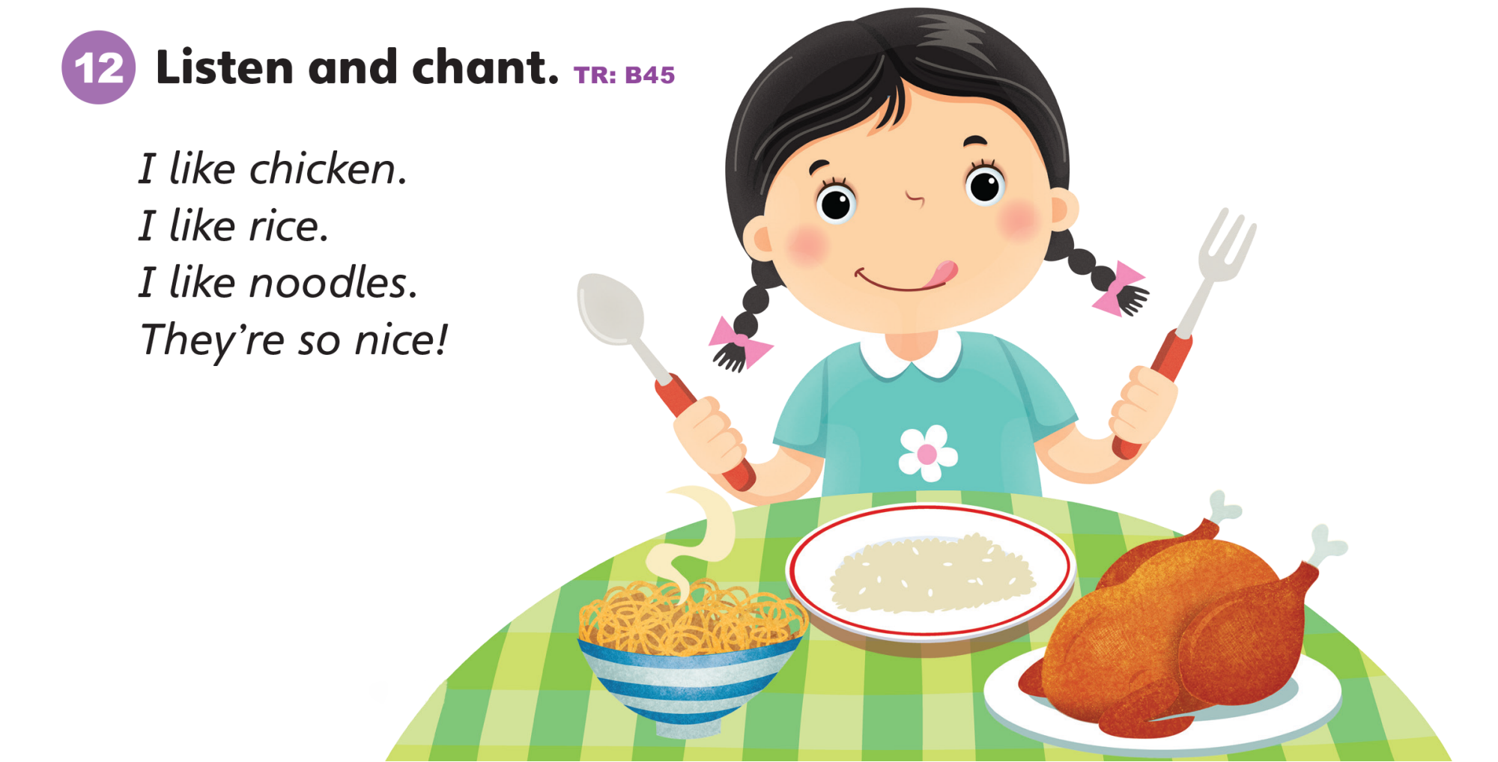
UNIT 2
I LIKE FOOD
Notes:
12 Say Look at Activity 12. Look at the picture. What do you see?
Have students say all they can about the picture.
Also teach the word chopsticks.
Students should say The girl likes [rice].
Say Now let’s listen.
Play TR: B45 twice while students just listen.
Point out and pronounce words in the chant that have the target sounds.
Have students repeat them. Play TR: B45 a third time, and have students say the chant. Repeat it until students feel confident in saying the chant.

Slide 129
UNIT 2
I LIKE FOOD
Let’s Play
Find your friend
Notes:
Make mini picture cards for the target sounds and use a string to make picture necklaces for each student.
Use a paper clip to attach each card to string, or punch holes in the top two corners of each card and pull the string through the holes.
Have students walk around the room, look at the pictures, and group themselves by target sound: /tʃ/, /n/, and /r/.
Say Stand up. Walk and look at the pictures. Find students with the same sound as you. Make a group.
Student should then walk around the room and find other students with pictures which have the same sound.
Model the activity. Put on a necklace and find other students who have the same target sound.
Say I have [noodles]. [Maria] has [nose]. [Ricardo] has [nine]. We are a group.
Make sure students pay attention to beginning, middle, and final sounds to form their groups.

Slide 130
UNIT 2
I LIKE FOOD
Let’s chant
Let’s eat!
I want _____.
I have _____.
Notes:
Do the chants as a call-and-response activity.
Have students form two groups.
Group 1 chants the whole chant using I want.
In response, group 2 chants the whole chant using I have.
Finally, both groups chant the whole chant together using Let’s eat.
You may want students to hold up pictures of chicken, rice, and noodles as they chant.
On the board, write I want _____ in one section.
Say the chant again, using this sentence frame instead of I like _____.
Have students say the chant with you. Do this again
with I have _____ and Let’s eat _____.

Slide 131
UNIT 2
I LIKE FOOD
Goodbye Chant
Good work, class.
Hip hip, hooray!
Goodbye for now.
Have a nice day!
Notes:
Say Good job today class. Now let’s chant.
Lead the class in the Goodbye chant.

Slide 132
UNIT 2
I LIKE FOOD
Let’s check!
Let’s Say
Notes:
Can students recognize and pronounce the sounds: /tʃ/ as in chicken, /n/ as in noodles, and /r/ as in water correctly?
Point to words or pictures of chicken, chair, noodles, nose, rice, and robot. Have students say the words.

Slide 133
UNIT 2
I LIKE FOOD
Thank you!

Slide 134
Unit 2:
I Like Food
Lesson 9

Slide 135
UNIT 2
I LIKE FOOD
English Time Chant
English, (clap) English, (clap)
English (clap) today! (clap, clap)
English, (clap) English, (clap)
Hip, hip, (clap) hooray! (clap, clap)

Slide 136
UNIT 2
I LIKE FOOD
Odd man out!
Notes:
Say Today, we’re going to play the game Odd Man Out.
Prepare six envelopes, each of which contains five cut-outs or pictures.
Four of the images in each envelope belong to the same vocabulary group, such as toys, family, rooms in a house, food, and so on.
The fifth picture belongs to a different group. For example, an envelope could contain images of a doll, truck, robot, kite, and banana.
The “odd man out” is the banana, as all the other words are toys, and banana is a food. Each of the envelopes should contain different images and
categories.
Choose a set of five pictures to display for students. Four out of the five should belong to the same category (such as toys, food, etc.).
The fifth picture should belong to a different category. For example, a group of five could include pencil, eraser, noodles, pen, and crayon. Call on students to
pick out the picture that doesn’t belong in the same category as the others. Repeat this a few times, being sure to use different pictures each time.
Challenge!
Have students explain their choice.
Students should say It’s [food]. I don’t use it in school.

Slide 137
UNIT 2
I LIKE FOOD
Odd man out!
Notes:
Say Today, we’re going to play the game Odd Man Out.
Prepare six envelopes, each of which contains five cut-outs or pictures.
Four of the images in each envelope belong to the same vocabulary group, such as toys, family, rooms in a house, food, and so on.
The fifth picture belongs to a different group. For example, an envelope could contain images of a doll, truck, robot, kite, and banana.
The “odd man out” is the banana, as all the other words are toys, and banana is a food. Each of the envelopes should contain different images and
categories.
Choose a set of five pictures to display for students. Four out of the five should belong to the same category (such as toys, food, etc.).
The fifth picture should belong to a different category. For example, a group of five could include pencil, eraser, noodles, pen, and crayon. Call on students to
pick out the picture that doesn’t belong in the same category as the others. Repeat this a few times, being sure to use different pictures each time.
Challenge!
Have students explain their choice.
Students should say It’s [food]. I don’t use it in school.

Slide 138
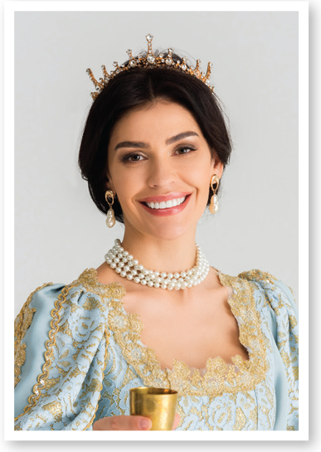
UNIT 2
I LIKE FOOD
Odd man out!
Notes:
Say Today, we’re going to play the game Odd Man Out.
Prepare six envelopes, each of which contains five cut-outs or pictures.
Four of the images in each envelope belong to the same vocabulary group, such as toys, family, rooms in a house, food, and so on.
The fifth picture belongs to a different group. For example, an envelope could contain images of a doll, truck, robot, kite, and banana.
The “odd man out” is the banana, as all the other words are toys, and banana is a food. Each of the envelopes should contain different images and
categories.
Choose a set of five pictures to display for students. Four out of the five should belong to the same category (such as toys, food, etc.).
The fifth picture should belong to a different category. For example, a group of five could include pencil, eraser, noodles, pen, and crayon. Call on students to
pick out the picture that doesn’t belong in the same category as the others. Repeat this a few times, being sure to use different pictures each time.
Challenge!
Have students explain their choice.
Students should say It’s [food]. I don’t use it in school.

Slide 139
UNIT 2
I LIKE FOOD
Odd man out!
Notes:
Say Today, we’re going to play the game Odd Man Out.
Prepare six envelopes, each of which contains five cut-outs or pictures.
Four of the images in each envelope belong to the same vocabulary group, such as toys, family, rooms in a house, food, and so on.
The fifth picture belongs to a different group. For example, an envelope could contain images of a doll, truck, robot, kite, and banana.
The “odd man out” is the banana, as all the other words are toys, and banana is a food. Each of the envelopes should contain different images and
categories.
Choose a set of five pictures to display for students. Four out of the five should belong to the same category (such as toys, food, etc.).
The fifth picture should belong to a different category. For example, a group of five could include pencil, eraser, noodles, pen, and crayon. Call on students to
pick out the picture that doesn’t belong in the same category as the others. Repeat this a few times, being sure to use different pictures each time.
Challenge!
Have students explain their choice.
Students should say It’s [food]. I don’t use it in school.

Slide 140
UNIT 2
I LIKE FOOD
Odd man out!
Notes:
Say Today, we’re going to play the game Odd Man Out.
Prepare six envelopes, each of which contains five cut-outs or pictures.
Four of the images in each envelope belong to the same vocabulary group, such as toys, family, rooms in a house, food, and so on.
The fifth picture belongs to a different group. For example, an envelope could contain images of a doll, truck, robot, kite, and banana.
The “odd man out” is the banana, as all the other words are toys, and banana is a food. Each of the envelopes should contain different images and
categories.
Choose a set of five pictures to display for students. Four out of the five should belong to the same category (such as toys, food, etc.).
The fifth picture should belong to a different category. For example, a group of five could include pencil, eraser, noodles, pen, and crayon. Call on students to
pick out the picture that doesn’t belong in the same category as the others. Repeat this a few times, being sure to use different pictures each time.
Challenge!
Have students explain their choice.
Students should say It’s [food]. I don’t use it in school.

Slide 141
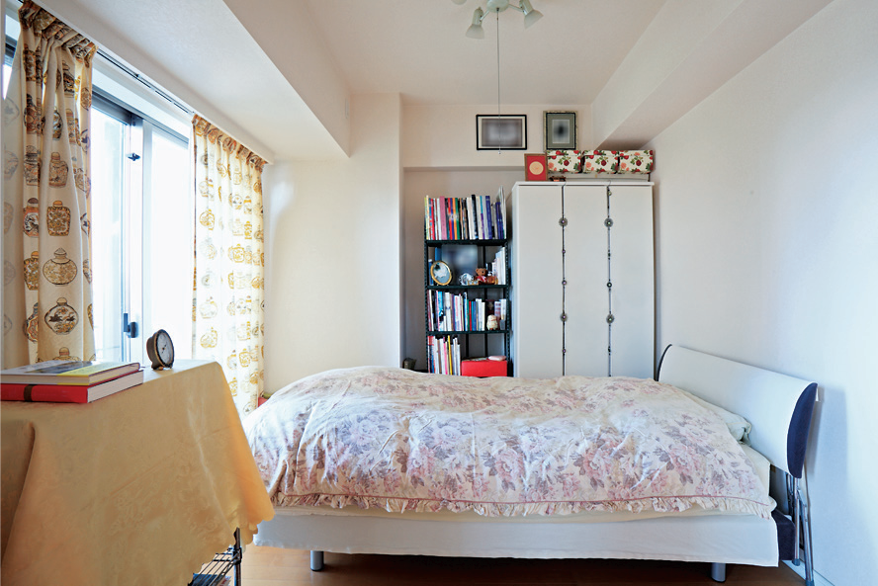
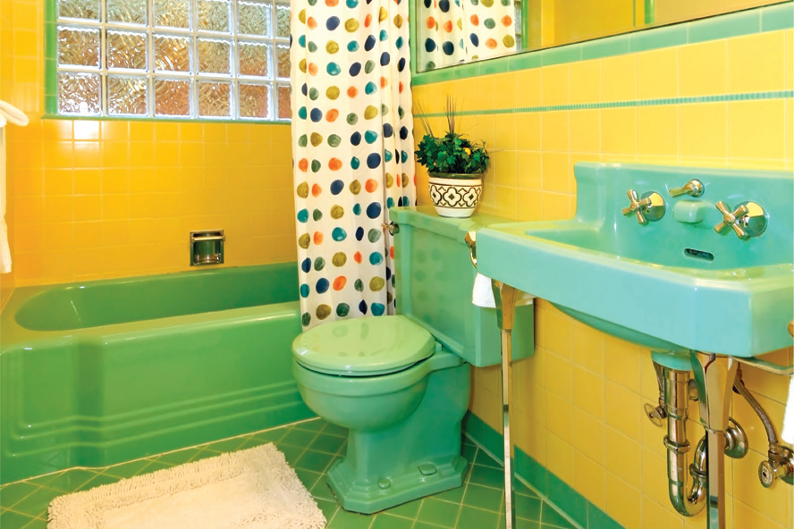
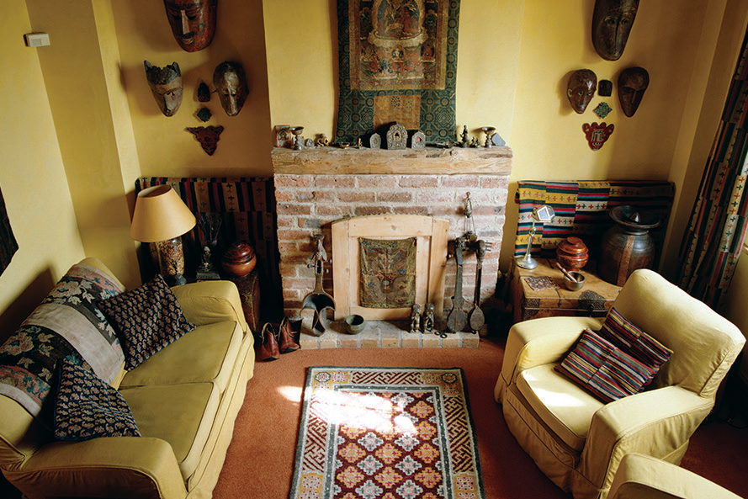
UNIT 2
I LIKE FOOD
Odd man out!
Notes:
Say Today, we’re going to play the game Odd Man Out.
Prepare six envelopes, each of which contains five cut-outs or pictures.
Four of the images in each envelope belong to the same vocabulary group, such as toys, family, rooms in a house, food, and so on.
The fifth picture belongs to a different group. For example, an envelope could contain images of a doll, truck, robot, kite, and banana.
The “odd man out” is the banana, as all the other words are toys, and banana is a food. Each of the envelopes should contain different images and
categories.
Choose a set of five pictures to display for students. Four out of the five should belong to the same category (such as toys, food, etc.).
The fifth picture should belong to a different category. For example, a group of five could include pencil, eraser, noodles, pen, and crayon. Call on students to
pick out the picture that doesn’t belong in the same category as the others. Repeat this a few times, being sure to use different pictures each time.
Challenge!
Have students explain their choice.
Students should say It’s [food]. I don’t use it in school.

Slide 142

UNIT 2
I LIKE FOOD
Let’s have a picnic!
Notes:
Hold up a blanket or tablecloth. Hold up a picnic basket. Hold up real or plastic food items.
Say Let’s have a picnic!
Put the blanket or tablecloth on a desk, a table, or the floor. Open the picnic basket and take out the food.
Have students say the words for any foods they know.
Students should say [Bananas].
Say Time to eat!

Slide 143


UNIT 2
I LIKE FOOD
What’s this?
How many ants are there?
Bananas
4 ants
Notes:
13 Say Let’s read about a picnic.
Have students open their books to p. 21. Encourage them to say everything they can about the illustrations by asking questions. For example, ask What’s this? What colors do you see? How many [ants]?
Students should say [Bananas/Yellow bananas/Four ants].
Teach the word apples.
Have students listen as you play TR: B46 or read the story once.
Point to the pictures and use gestures to help with meaning.

Slide 144
UNIT 2
I LIKE FOOD
What color do you see?
Yellow bananas
Notes:
13 Say Let’s read about a picnic.
Have students open their books to p. 21. Encourage them to say everything they can about the illustrations by asking questions. For example, ask What’s this? What colors do you see? How many [ants]?
Students should say [Bananas/Yellow bananas/Four ants].
Teach the word apples.
Have students listen as you play TR: B46 or read the story once.
Point to the pictures and use gestures to help with meaning.

Slide 145
UNIT 2
I LIKE FOOD
Notes:
13 Say Let’s read about a picnic.
Have students open their books to p. 21. Encourage them to say everything they can about the illustrations by asking questions. For example, ask What’s this? What colors do you see? How many [ants]?
Students should say [Bananas/Yellow bananas/Four ants].
Teach the word apples.
Have students listen as you play TR: B46 or read the story once.
Point to the pictures and use gestures to help with meaning.

Slide 146
UNIT 2
I LIKE FOOD
Let’s read
Notes:
Play TR: B46 or read the story a second time.
Encourage students to point to pictures and use gestures as you read. Allow them to ask questions and make comments on the story.
Play TR: B46 or read the story a third time. This time, play the audio or read aloud one sentence at a time.
Have the students repeat each sentence after you as they track the print in the story with their fingers.
Pay attention to stress, rhythm, and intonation as you read.
Divide students into four groups. Have each group read the text from each panel.
If time permits, rotate the reading so that all groups get to read the text from all panels.
Alternatively, have volunteers act out the story.

Slide 147
UNIT 2
I LIKE FOOD
Notes:
14 Say I like the story! Hold up your book and point to the happy face.
Say I like the story. I circle the happy face. Model circling the happy face.
Gesture towards the students and ask Do you like the story? Have students choose a face and circle it.
Say Think about our other stories in Grade 1 and Unit 1. Think about this story.
Ask Which story is your favorite? Ask your partner.
Students should tell their partners what their favorite stories are.

Slide 148
UNIT 2
I LIKE FOOD
Let’s draw
What do you want at your picnic??
Notes:
Have students take out crayons and paper. Ask What do you want at your picnic? Draw.
Students should draw the foods they would want to eat at their own picnic.
If you see students drawing foods that aren’t from the unit, provide additional vocabulary to them.
When students finish, have them share their pictures in small groups.

Slide 149
UNIT 2
I LIKE FOOD
What foods are at a picnic?
Do you like picnics?
Notes:
Say Now we know about picnics and picnic food.
Ask What foods are at a picnic? Do you like picnics?
Students should say [Bananas. Yes].

Slide 150
UNIT 2
I LIKE FOOD
Goodbye Chant
Good work, class.
Hip hip, hooray!
Goodbye for now.
Have a nice day!
Notes:
Say Good job today class. Now let’s chant.
Lead the class in the Goodbye chant.

Slide 151

UNIT 2
I LIKE FOOD
Let’s check!
Let’s review
Notes:
Can students listen to and understand a story?
Read aloud A Picnic. Then ask What do they like? (apples, bananas, bread, cookies).
Can students also recognize target vocabulary in context?
Say each of the Unit 2 vocabulary words, and have students raise their hands when they hear a word that was included in the text or illustrations in the story (bananas, bread, cookies, orange juice, chicken).

Slide 152
UNIT 2
I LIKE FOOD
Thank you!

