Slide 1

Unit Review

Slide 2
Units 1–2
Review

Slide 3
English Time Chant
English, (clap) English, (clap)
English (clap) today! (clap, clap)
English, (clap) English, (clap)
Hip, hip, (clap) hooray! (clap, clap)
Notes:
Say Good morning/afternoon, class. How are you
today?
Get students ready to use the English Time chant.
Lead the class in the chant.

Slide 4
Let’s make the counter
Notes:
Say Today, we’re going to play a game.
Have them open their books to pp. 22–23.
Have students find the pictures of the two-colored counter on p. 23. Read the text aloud and explain what it means to move 1 or 2 spaces.

Slide 5
Toss the counter
= 1 space
= 2 spaces
Notes:
Say Today, we’re going to play a game.
Have them open their books to pp. 22–23.
Have students find the pictures of the two-colored counter on p. 23. Read the text aloud and explain what it means to move 1 or 2 spaces.

Slide 6
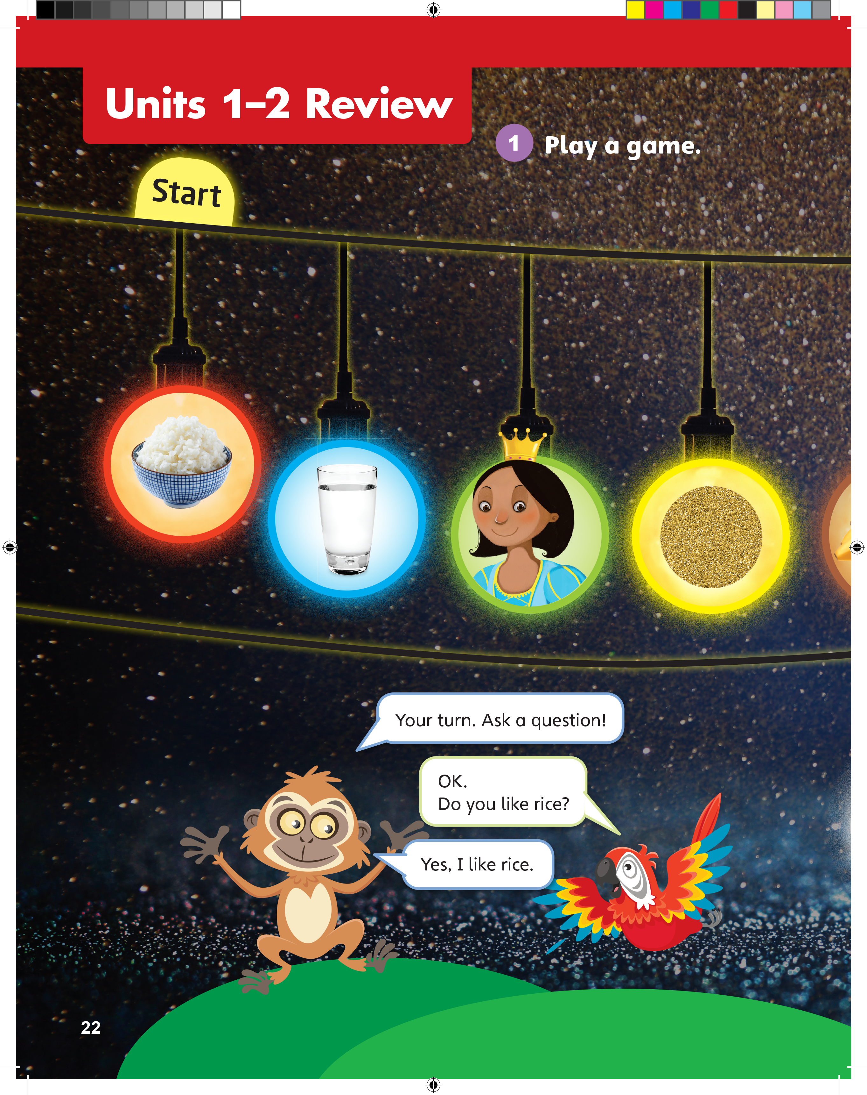
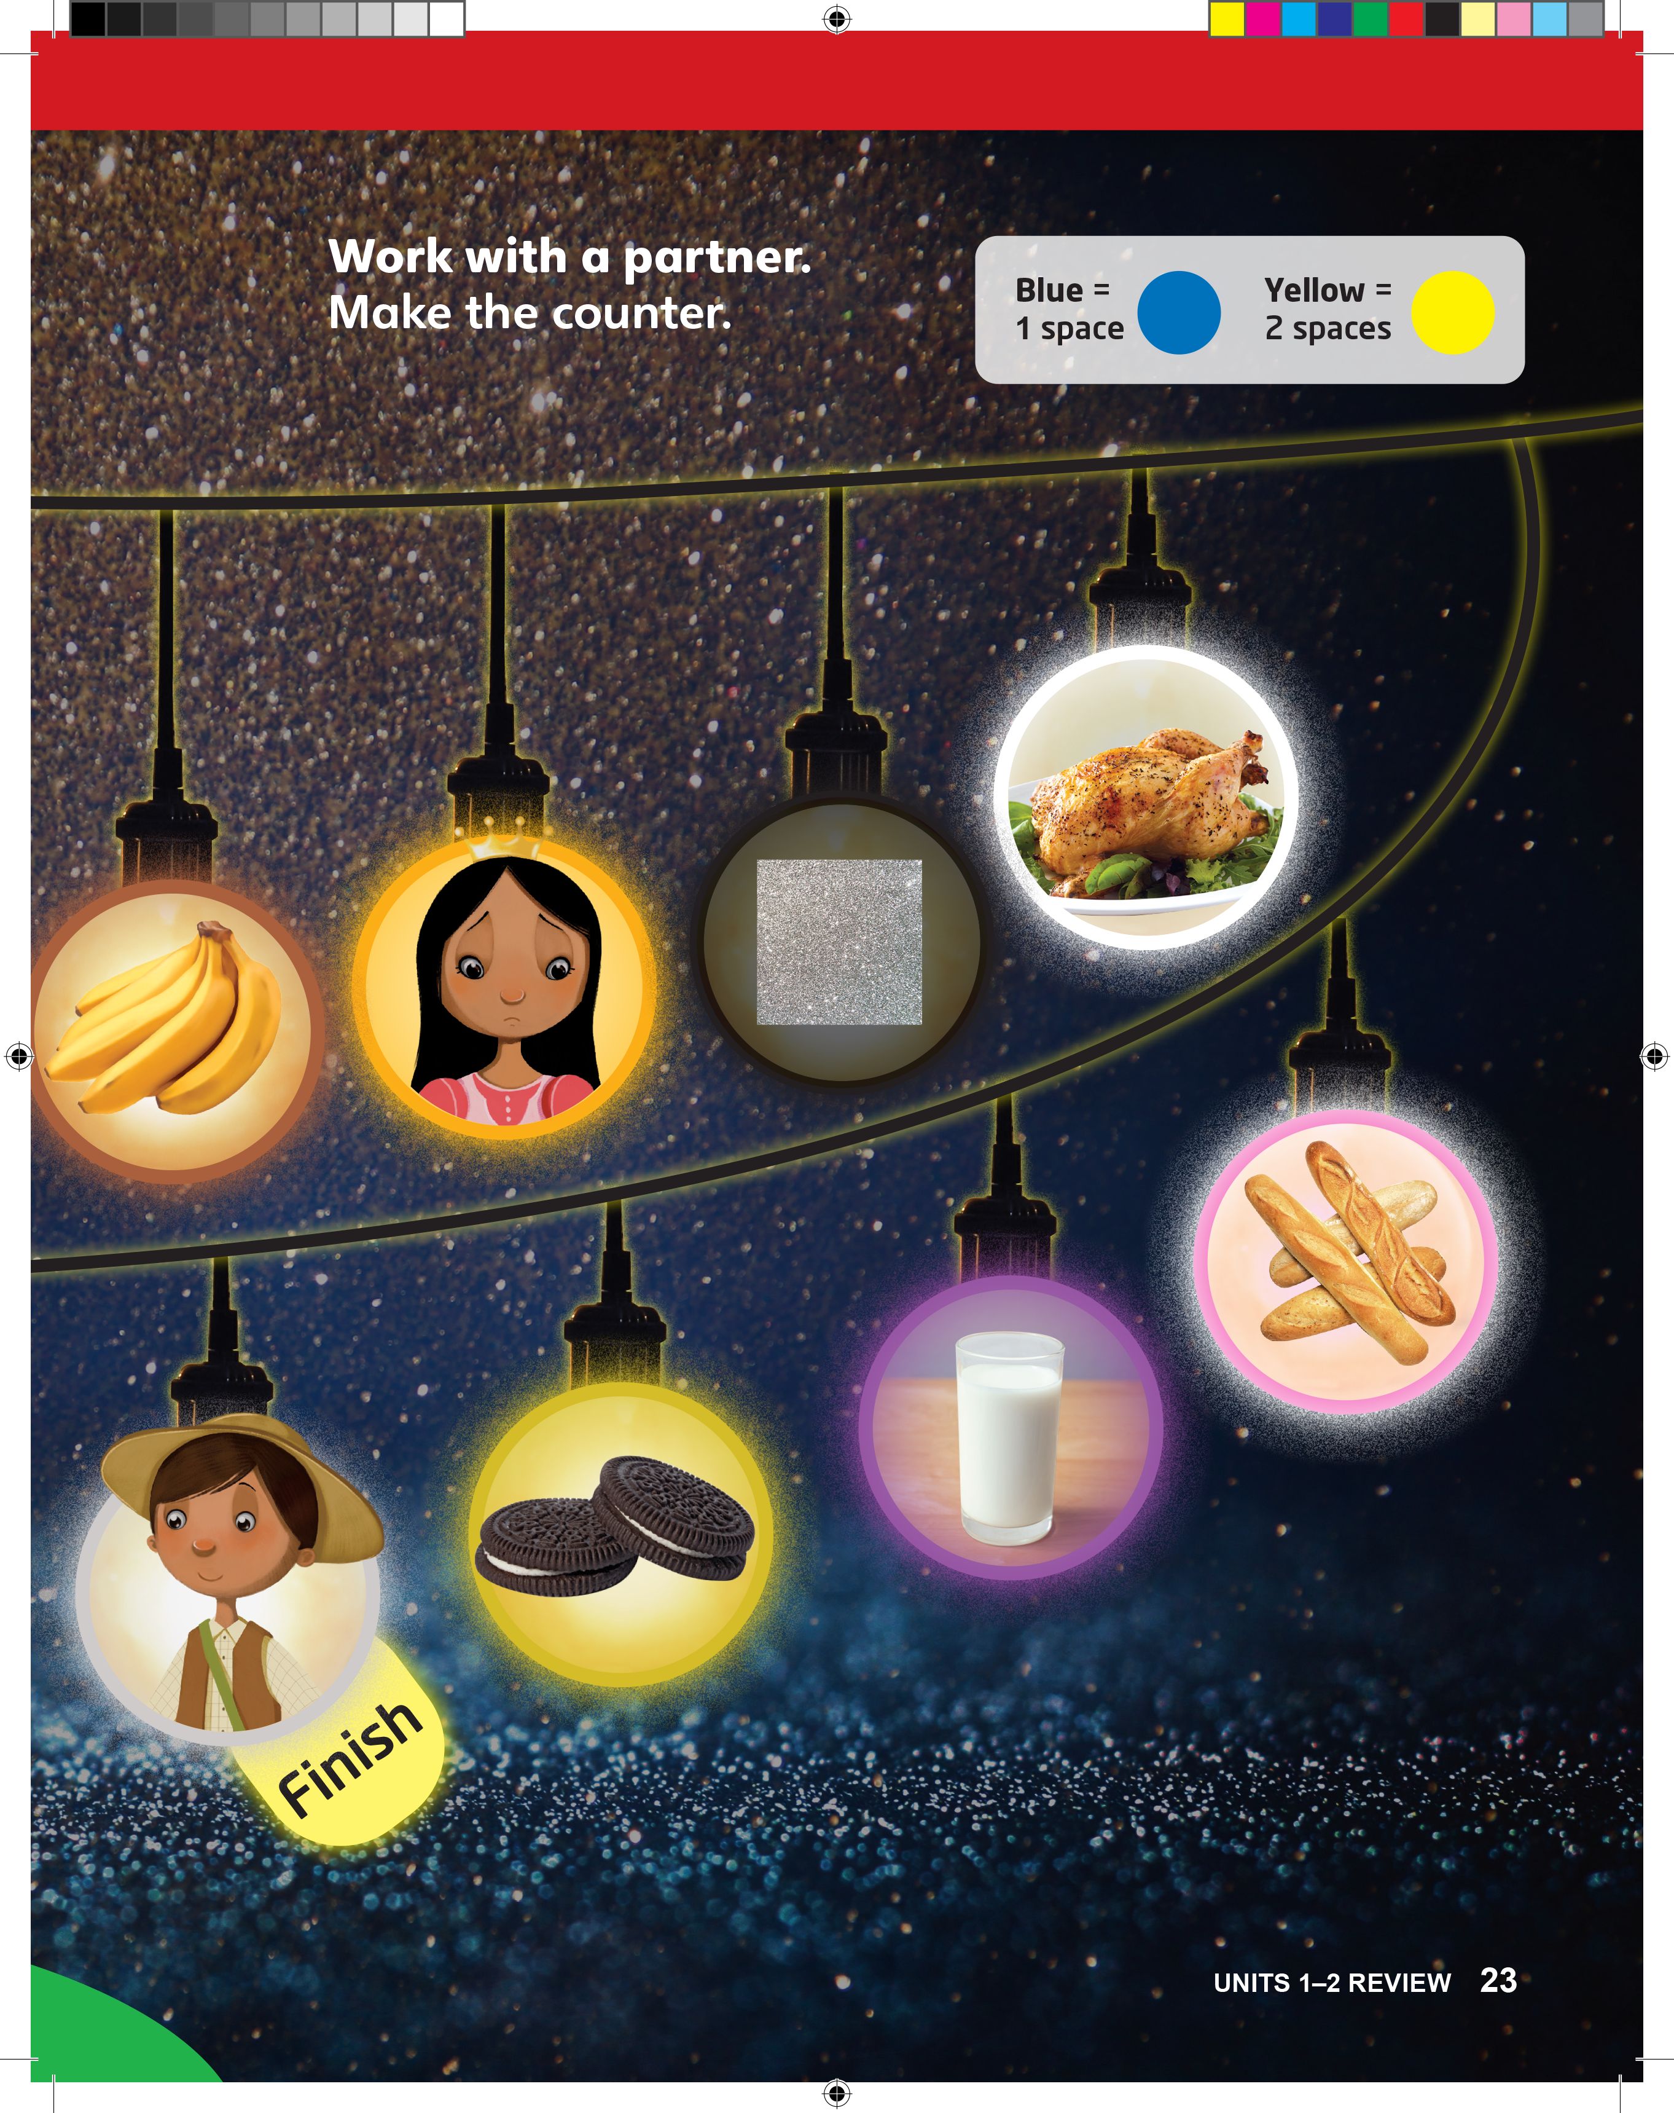
Do you like rice?
Notes:
Model playing the game.
Point to a student and say Play with me, please.
Toss the counter. If it shows blue, say Blue.
Show students how both the student’s and your playing pieces must be placed on the word Start on p. 22 before the game can begin.
Move your playing piece one space forward and ask your partner a question using the word rice, white, or red. For example, ask Do you like rice?
Students should say Yes, I like rice. / No, I don’t like rice.
Model taking turns.
Flip the counter to show the yellow side. Have your partner move their own playing piece forward by two spaces.
Prompt the student to say Yellow and then ask you a question using the word water.
Students should say [Do you like water?]
Remind students that the questions can be about themselves, other people, or even other things.

Slide 7
Ask and Answer
What is it? It’s __________.
Who is it? It’s __________.
What are they? They’re __________.
Is it a _______? Yes, it is. / No, it isn’t.
What color is it? It’s __________.
Do you like _____? Yes, I do. / No, I don’t.
Notes:
Model playing the game.
Point to a student and say Play with me, please.
Toss the counter. If it shows blue, say Blue.
Show students how both the student’s and your playing pieces must be placed on the word Start on p. 22 before the game can begin.
Move your playing piece one space forward and ask your partner a question using the word rice, white, or red. For example, ask Do you like rice?
Students should say Yes, I like rice. / No, I don’t like rice.
Model taking turns.
Flip the counter to show the yellow side. Have your partner move their own playing piece forward by two spaces.
Prompt the student to say Yellow and then ask you a question using the word water.
Students should say [Do you like water?]
Remind students that the questions can be about themselves, other people, or even other things.

Slide 8
Notes:
Then say Now it’s your turn. Play! Take turns. When it’s your turn, move one or two spaces. Then ask a question based on what you see.
Have students play the game in pairs. Give two playing pieces to each pair. Remind them that they can make questions using anything that they see in
the picture.
Monitor pairs as they play the game. Make sure that both the student asking the question and the student answering the question have a chance to use and review the vocabulary words.
Make sure students understand that they should keep moving along the game route until they reach the word Finish.
If students need help thinking of questions, write examples on the board for them.

Slide 9

Let’s Review
Let’s do some excersises.
Notes:
Tell students that they are going to review and revise what they have learnt so far by doing some written exercises.
Have students open up their books to pp. 24–25. Go through each activity first and answer any questions they might have about how to do the activities.
Have students try them on their own.

Slide 10
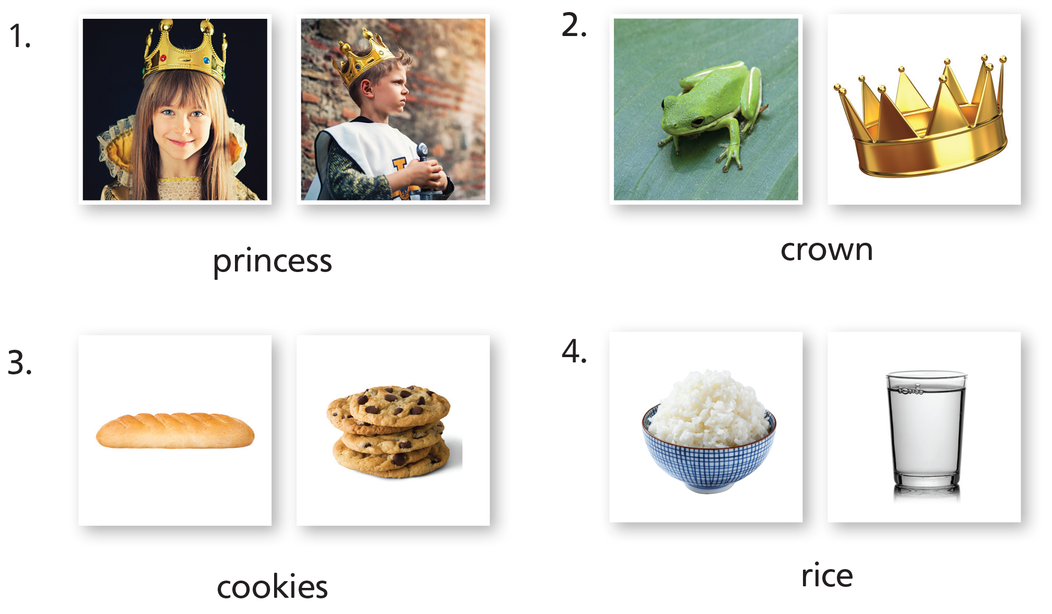
Notes:
Tell students that they are going to review and revise what they have learnt so far by doing some written exercises.
Have students open up their books to pp. 24–25. Go through each activity first and answer any questions they might have about how to do the activities.
Have students try them on their own.

Slide 11

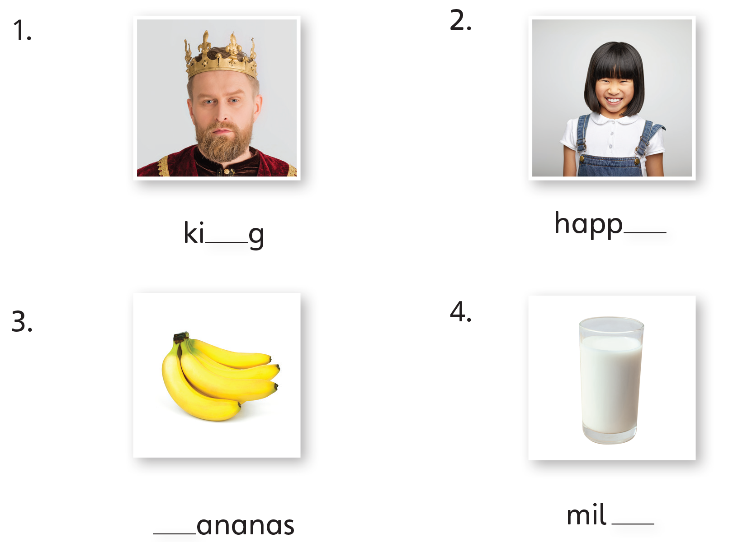
n
y
b
k
Notes:
Tell students that they are going to review and revise what they have learnt so far by doing some written exercises.
Have students open up their books to pp. 24–25. Go through each activity first and answer any questions they might have about how to do the activities.
Have students try them on their own.

Slide 12

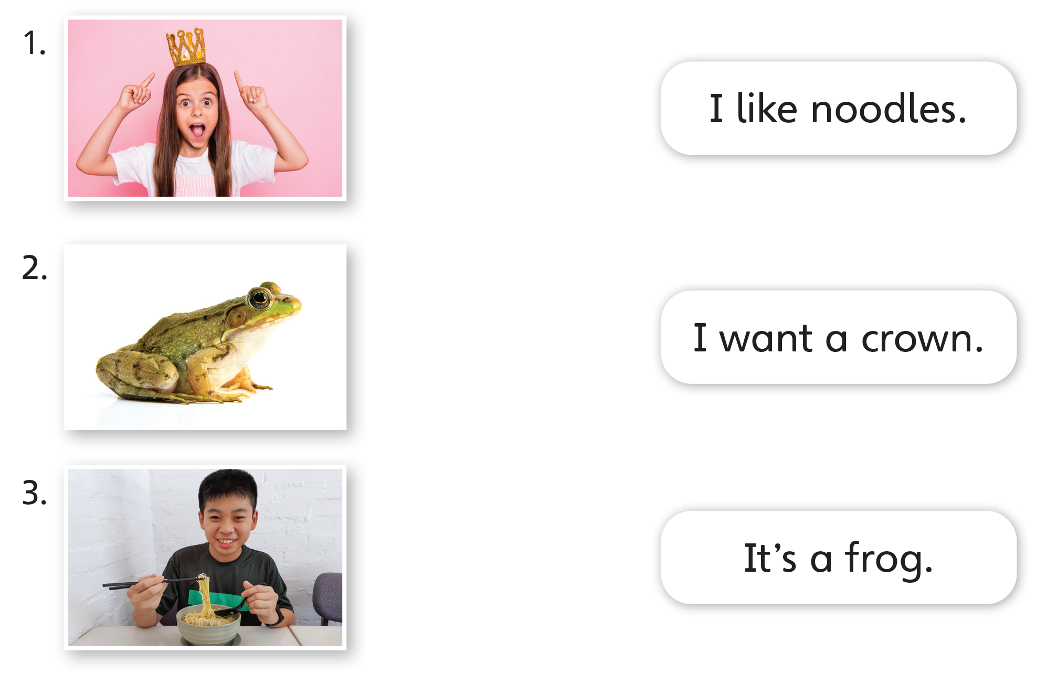
Notes:
Tell students that they are going to review and revise what they have learnt so far by doing some written exercises.
Have students open up their books to pp. 24–25. Go through each activity first and answer any questions they might have about how to do the activities.
Have students try them on their own.

Slide 13

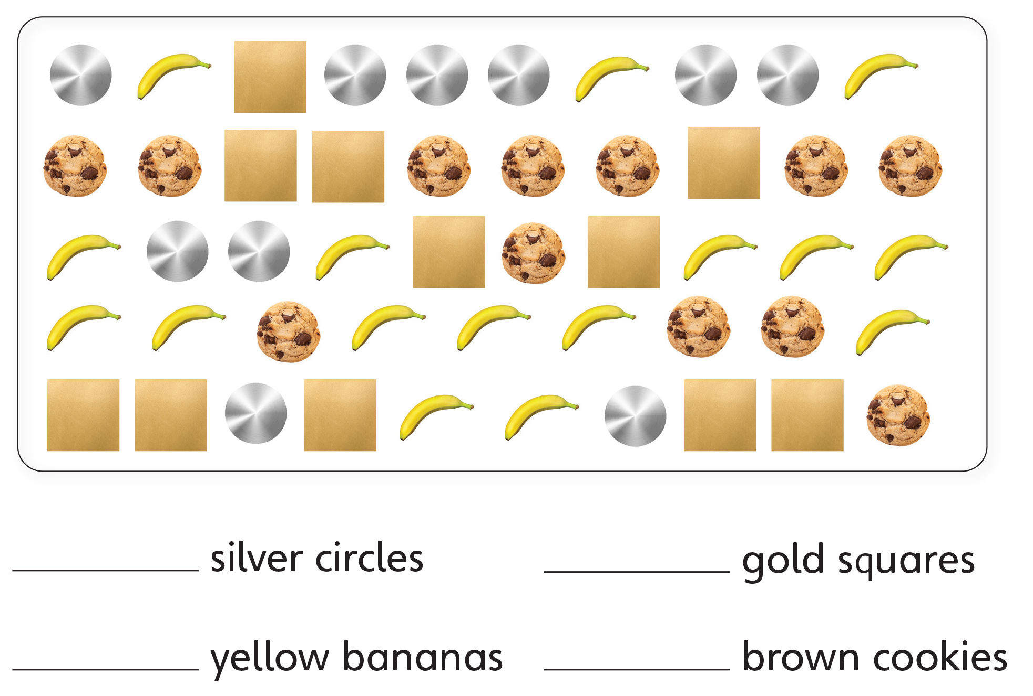
10
11
16
12
Notes:
Tell students that they are going to review and revise what they have learnt so far by doing some written exercises.
Have students open up their books to pp. 24–25. Go through each activity first and answer any questions they might have about how to do the activities.
Have students try them on their own.

Slide 14
Goodbye Chant
Good work, class.
Hip hip, hooray!
Goodbye for now.
Have a nice day!
Notes:
Say Nice work today, class. Now let’s chant.
Lead the class in the Goodbye chant.

Slide 15
Let’s Check
Make a sentence with
a word from Units 1–2.
Notes:
Can students remember and use the new words they’ve learnt?
As students leave the class, ask them to make a sentence with one word they remember from Units 1 and 2 (foods, drinks, colors, shapes, numbers, royalty, feelings).

Slide 16
Thank you!

Slide 17
Units 1–4
Review

Slide 18
English Time Chant
English, (clap) English, (clap)
English (clap) today! (clap, clap)
English, (clap) English, (clap)
Hip, hip, (clap) hooray! (clap, clap)
Notes:
Say Good morning/afternoon, class. How are you
today?
Get students ready to use the English Time chant.
Lead the class in the chant.

Slide 19
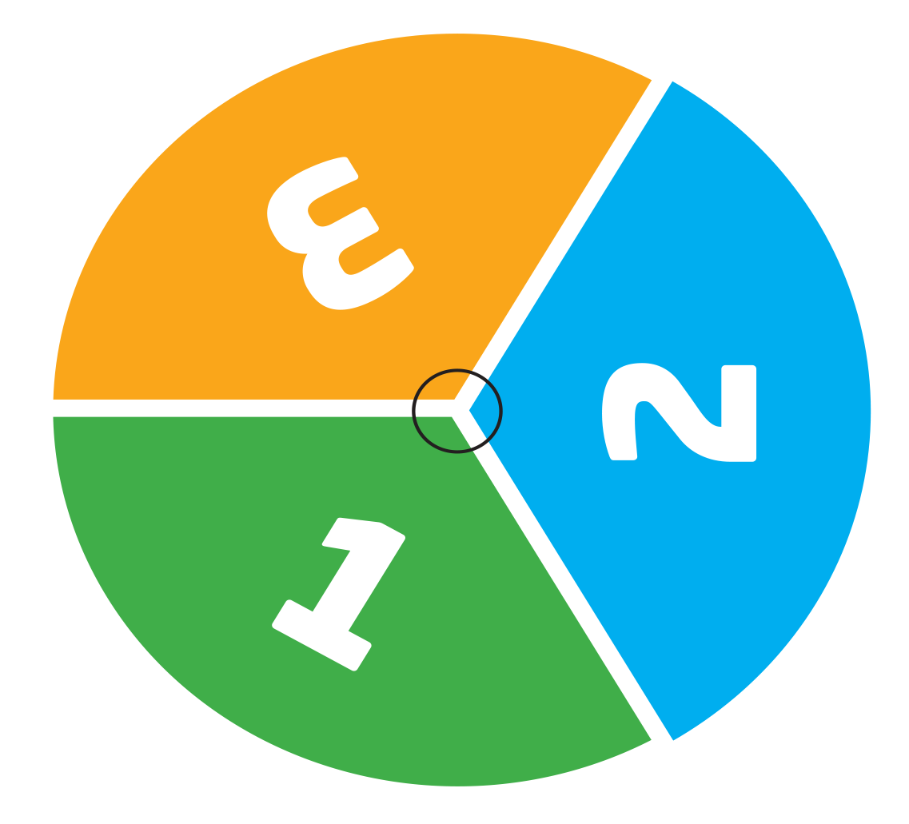
Let’s make!
Let’s make a spinner!
Notes:
Say Today, we’re going to play a game. First, let’s make the spinner.
Have students stick the spinner sticker onto poster board and cut it out to make the spinner. Make sure that students have a pencil and a paper clip to use for the spinner.
Students should make the spinner.

Slide 20
Spin the Spinner
1
= 1 space
2
= 2 spaces
3
= 3 spaces
Notes:
Say Today, we’re going to play a game. First, let’s make the spinner.
Have students stick the spinner sticker onto poster board and cut it out to make the spinner. Make sure that students have a pencil and a paper clip to use for the spinner.
Students should make the spinner.

Slide 21
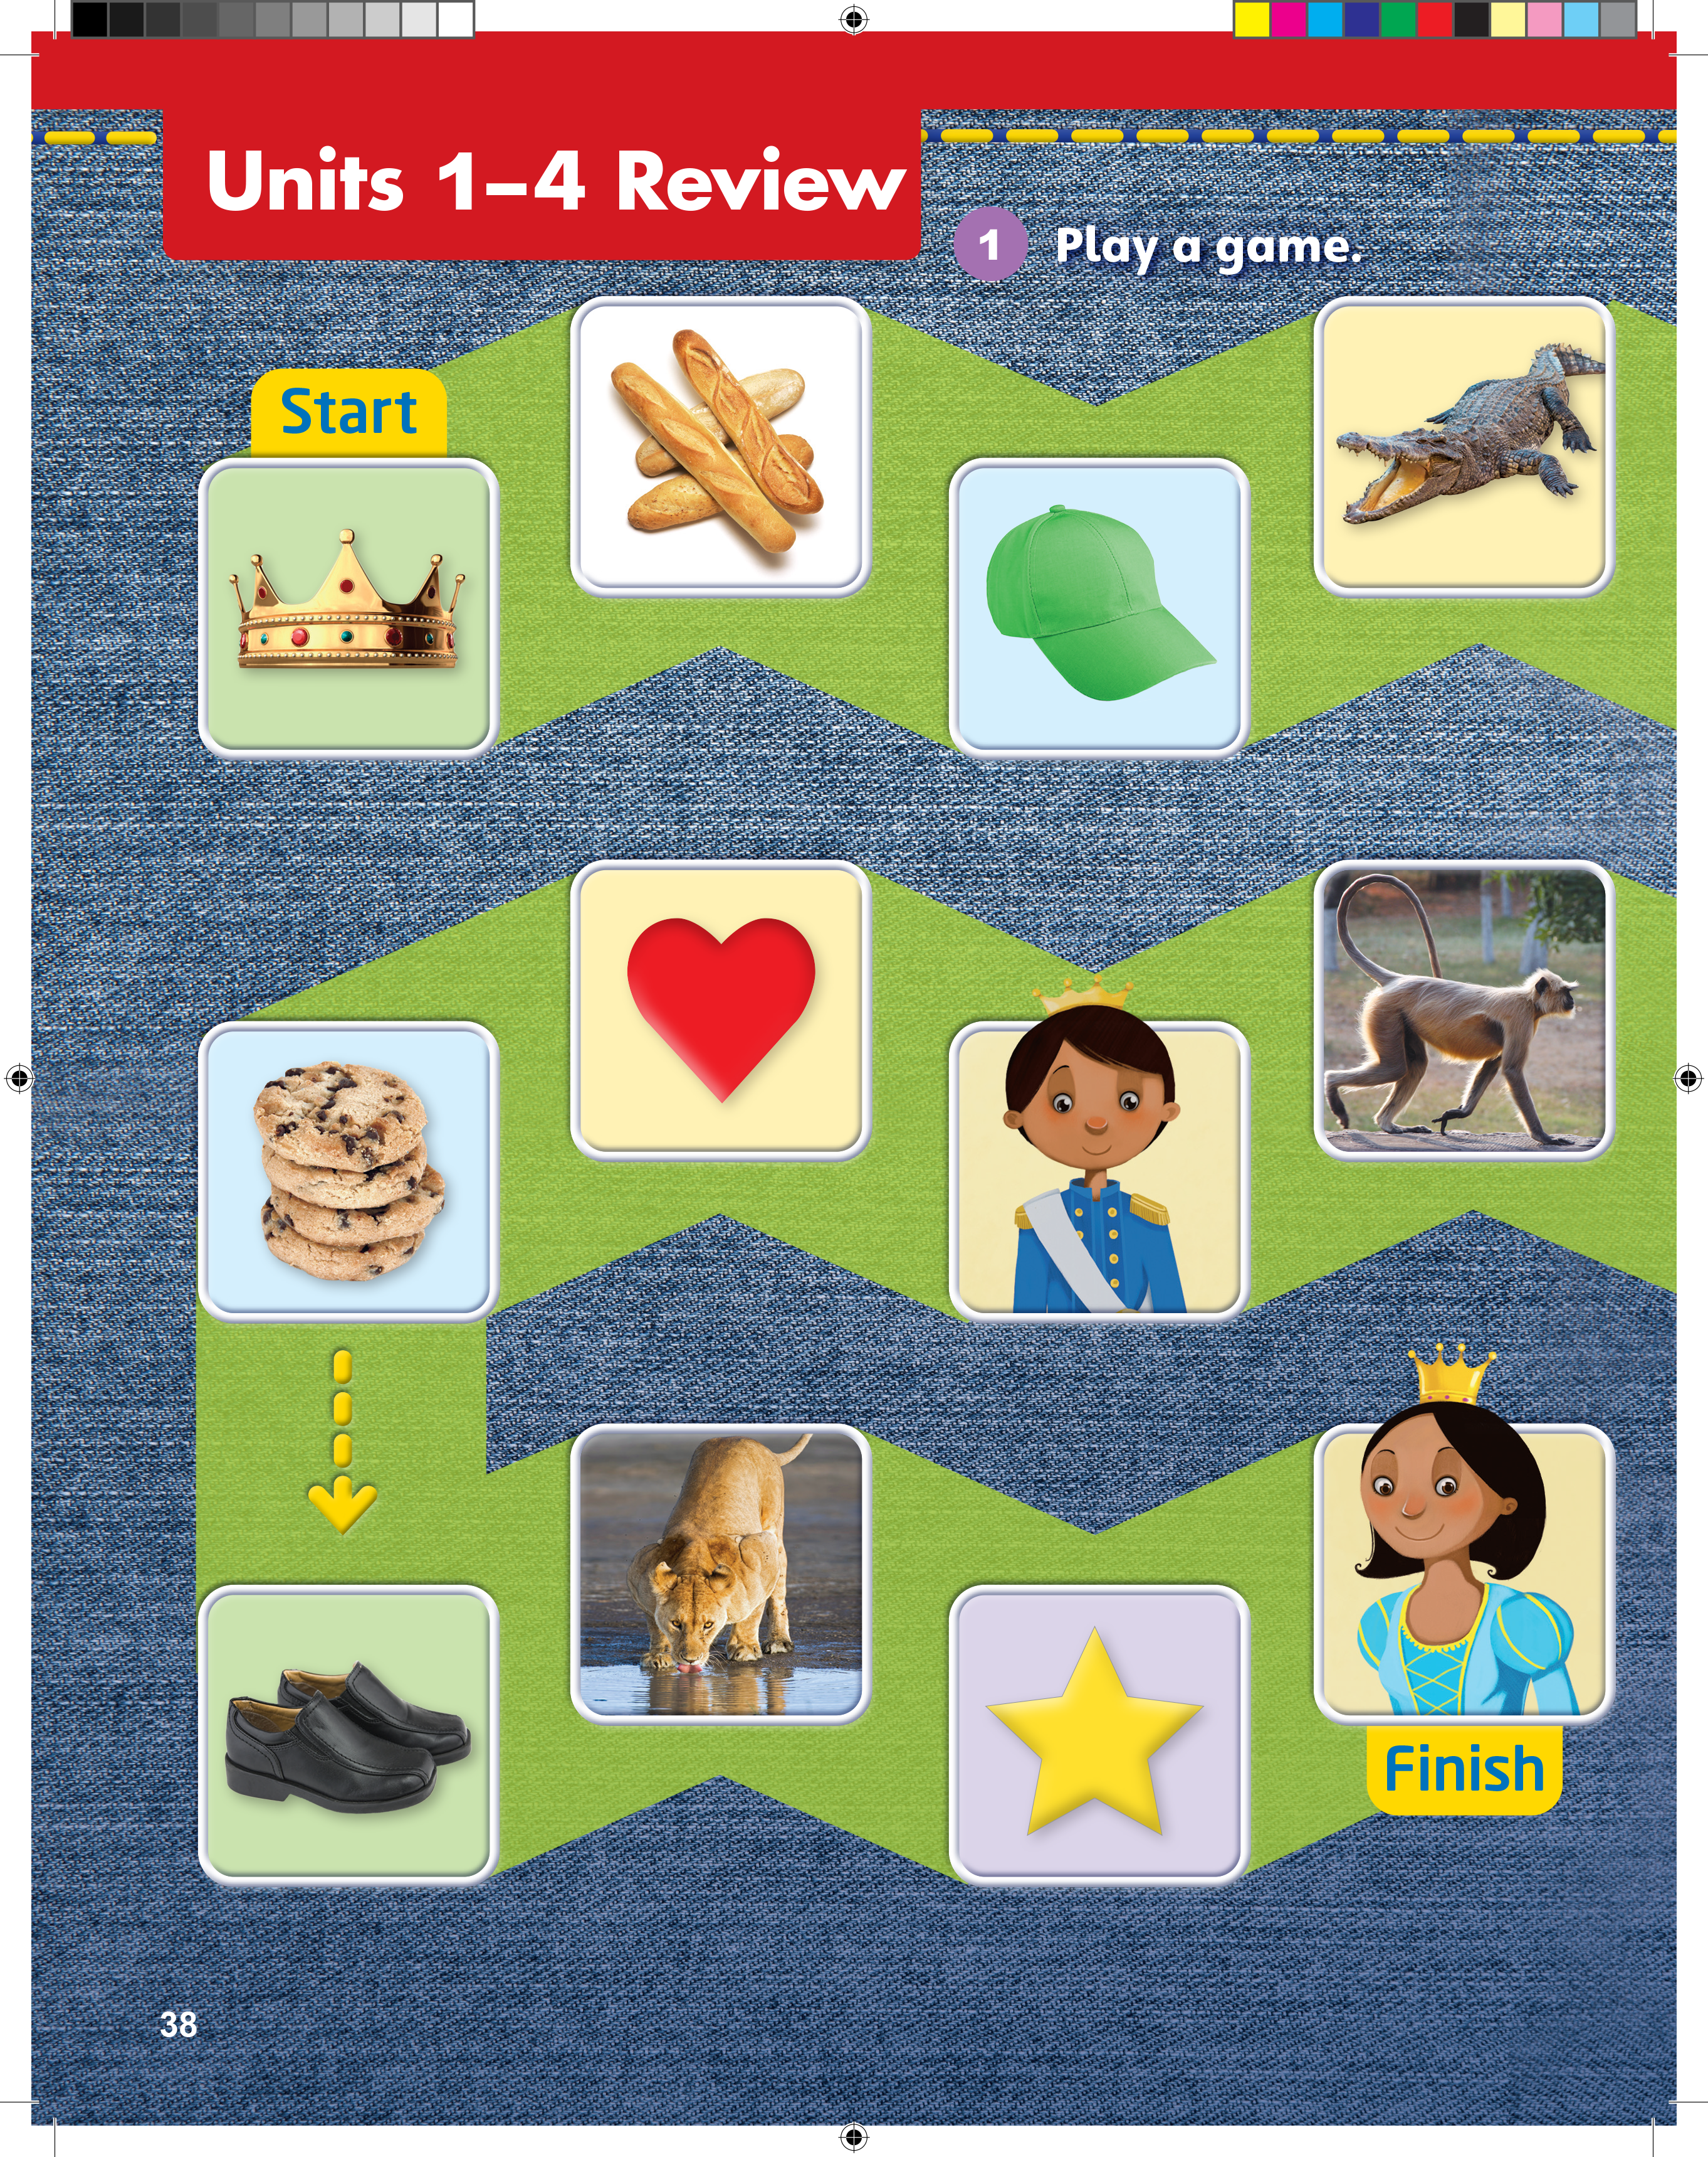
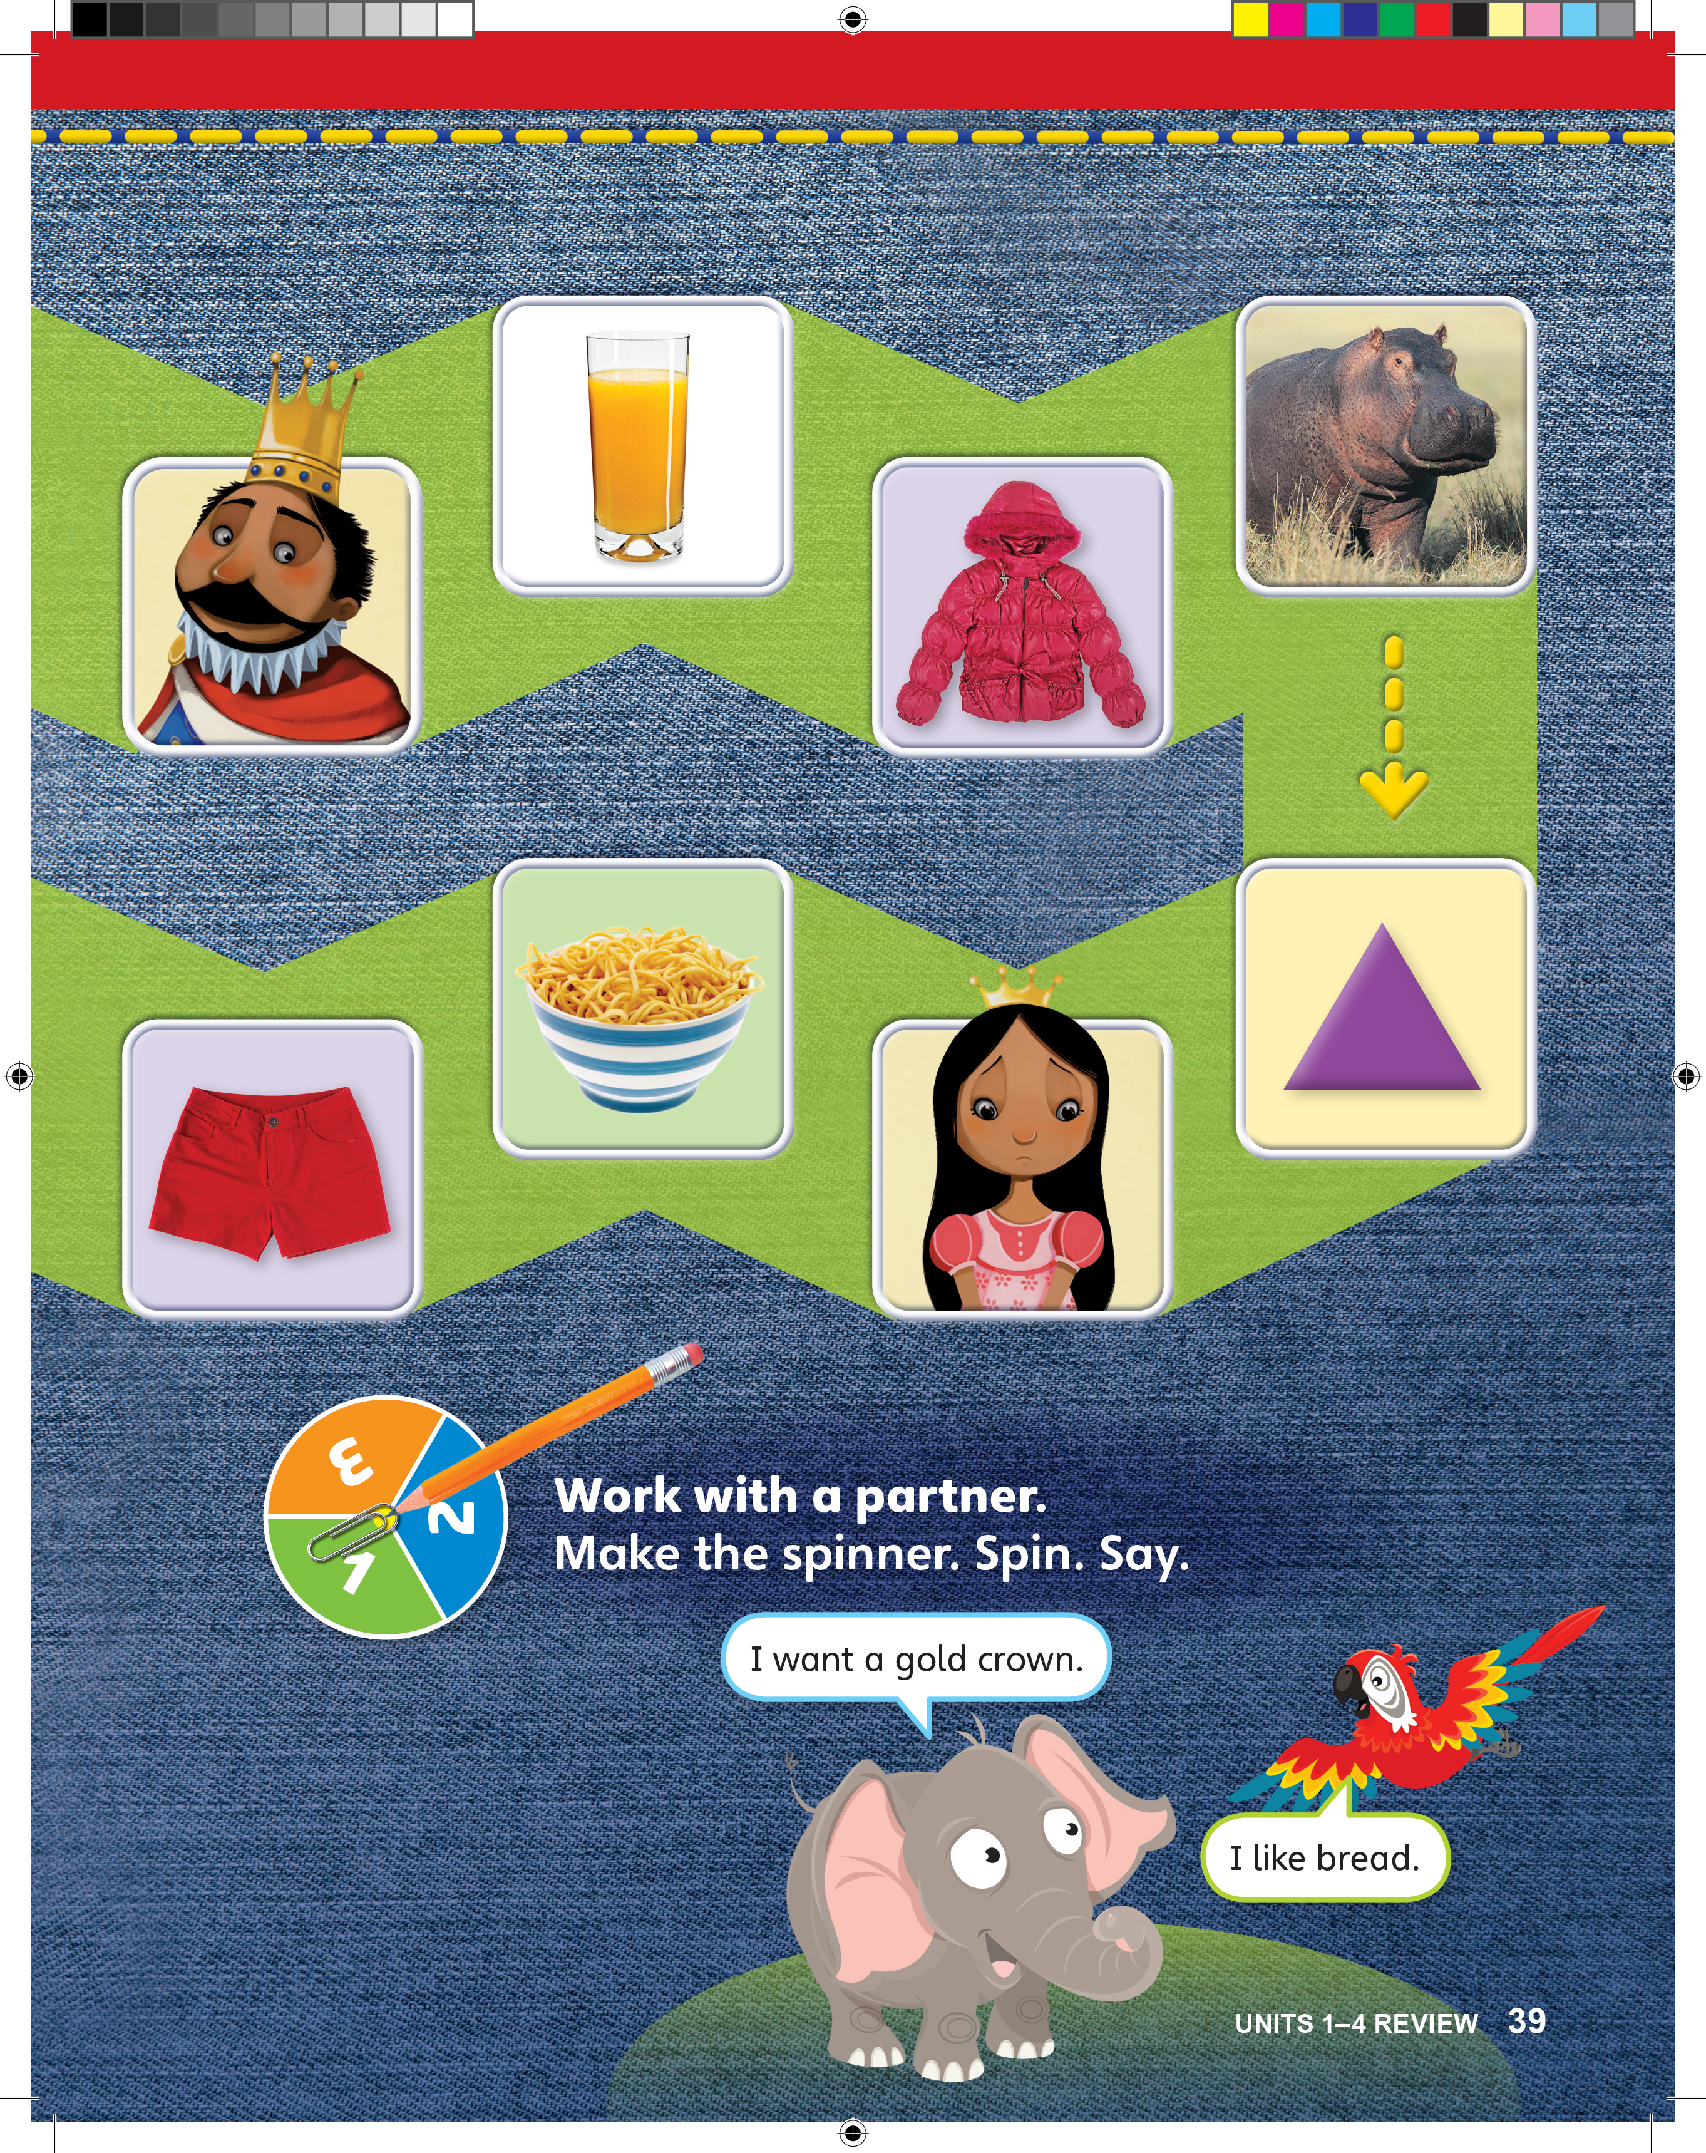
What is it?
It’s a gold crown.
Notes:
Help students open their books to pp. 38–39.
Point to the mascots on the bottom of p. 39. Point to each mascot and read what it says. Then, say Say a sentence for each picture. Use language you know.
Have students look at the game board. Point to the first space, and ask What is it?
Students should say It’s a gold crown.
Then, model language that students could use to talk about the gold crown.
For example, say I want a gold crown. I’m wearing a gold crown.
Students should say [I like gold crowns. / I don’t like gold crowns. / I have a gold crown.]
Point to the second space and ask What is it?
Students should say Bread.
Again, model language that students can use to talk about bread. For example, say I like bread. / I don’t like bread. Then, ask What else can we say about bread?
Students should say [I want bread. / I’m eating bread.]
Point to the third space. Ask What is it?
Students should say It’s a green hat.
Again, work with students to say things about the green hat.
Students should say [I like the green hat. / I don’t like green hats. / I’m wearing a green hat. / She’s wearing a green hat.]
Point to the fourth space. Say Look at the crocodile. The crocodile is opening its mouth.
Then, ask What else can we say about the crocodile?
Have students respond, using language such as I don’t like crocodiles and The crocodile is walking.
Point to the fifth space. Ask What can you say about the king? Have students respond, using language such as The king is sad and The king is wearing a
gold crown.

Slide 22
What is it?
It’s bread.
Notes:
Help students open their books to pp. 38–39.
Point to the mascots on the bottom of p. 39. Point to each mascot and read what it says. Then, say Say a sentence for each picture. Use language you know.
Have students look at the game board. Point to the first space, and ask What is it?
Students should say It’s a gold crown.
Then, model language that students could use to talk about the gold crown.
For example, say I want a gold crown. I’m wearing a gold crown.
Students should say [I like gold crowns. / I don’t like gold crowns. / I have a gold crown.]
Point to the second space and ask What is it?
Students should say Bread.
Again, model language that students can use to talk about bread. For example, say I like bread. / I don’t like bread. Then, ask What else can we say about bread?
Students should say [I want bread. / I’m eating bread.]
Point to the third space. Ask What is it?
Students should say It’s a green hat.
Again, work with students to say things about the green hat.
Students should say [I like the green hat. / I don’t like green hats. / I’m wearing a green hat. / She’s wearing a green hat.]
Point to the fourth space. Say Look at the crocodile. The crocodile is opening its mouth.
Then, ask What else can we say about the crocodile?
Have students respond, using language such as I don’t like crocodiles and The crocodile is walking.
Point to the fifth space. Ask What can you say about the king? Have students respond, using language such as The king is sad and The king is wearing a
gold crown.

Slide 23
What is it?
It’s a green hat.
Notes:
Help students open their books to pp. 38–39.
Point to the mascots on the bottom of p. 39. Point to each mascot and read what it says. Then, say Say a sentence for each picture. Use language you know.
Have students look at the game board. Point to the first space, and ask What is it?
Students should say It’s a gold crown.
Then, model language that students could use to talk about the gold crown.
For example, say I want a gold crown. I’m wearing a gold crown.
Students should say [I like gold crowns. / I don’t like gold crowns. / I have a gold crown.]
Point to the second space and ask What is it?
Students should say Bread.
Again, model language that students can use to talk about bread. For example, say I like bread. / I don’t like bread. Then, ask What else can we say about bread?
Students should say [I want bread. / I’m eating bread.]
Point to the third space. Ask What is it?
Students should say It’s a green hat.
Again, work with students to say things about the green hat.
Students should say [I like the green hat. / I don’t like green hats. / I’m wearing a green hat. / She’s wearing a green hat.]
Point to the fourth space. Say Look at the crocodile. The crocodile is opening its mouth.
Then, ask What else can we say about the crocodile?
Have students respond, using language such as I don’t like crocodiles and The crocodile is walking.
Point to the fifth space. Ask What can you say about the king? Have students respond, using language such as The king is sad and The king is wearing a
gold crown.

Slide 24
The crocodile is opening its mouth.
Notes:
Help students open their books to pp. 38–39.
Point to the mascots on the bottom of p. 39. Point to each mascot and read what it says. Then, say Say a sentence for each picture. Use language you know.
Have students look at the game board. Point to the first space, and ask What is it?
Students should say It’s a gold crown.
Then, model language that students could use to talk about the gold crown.
For example, say I want a gold crown. I’m wearing a gold crown.
Students should say [I like gold crowns. / I don’t like gold crowns. / I have a gold crown.]
Point to the second space and ask What is it?
Students should say Bread.
Again, model language that students can use to talk about bread. For example, say I like bread. / I don’t like bread. Then, ask What else can we say about bread?
Students should say [I want bread. / I’m eating bread.]
Point to the third space. Ask What is it?
Students should say It’s a green hat.
Again, work with students to say things about the green hat.
Students should say [I like the green hat. / I don’t like green hats. / I’m wearing a green hat. / She’s wearing a green hat.]
Point to the fourth space. Say Look at the crocodile. The crocodile is opening its mouth.
Then, ask What else can we say about the crocodile?
Have students respond, using language such as I don’t like crocodiles and The crocodile is walking.
Point to the fifth space. Ask What can you say about the king? Have students respond, using language such as The king is sad and The king is wearing a
gold crown.

Slide 25
Ask and Answer
What is it? It’s __________.
I want ______.
I like / don’t like _______. I have ________.
I’m wearing ________. I’m eating _______.
He/She is _________. ________ is ________.
Notes:
Help students open their books to pp. 38–39.
Point to the mascots on the bottom of p. 39. Point to each mascot and read what it says. Then, say Say a sentence for each picture. Use language you know.
Have students look at the game board. Point to the first space, and ask What is it?
Students should say It’s a gold crown.
Then, model language that students could use to talk about the gold crown.
For example, say I want a gold crown. I’m wearing a gold crown.
Students should say [I like gold crowns. / I don’t like gold crowns. / I have a gold crown.]
Point to the second space and ask What is it?
Students should say Bread.
Again, model language that students can use to talk about bread. For example, say I like bread. / I don’t like bread. Then, ask What else can we say about bread?
Students should say [I want bread. / I’m eating bread.]
Point to the third space. Ask What is it?
Students should say It’s a green hat.
Again, work with students to say things about the green hat.
Students should say [I like the green hat. / I don’t like green hats. / I’m wearing a green hat. / She’s wearing a green hat.]
Point to the fourth space. Say Look at the crocodile. The crocodile is opening its mouth.
Then, ask What else can we say about the crocodile?
Have students respond, using language such as I don’t like crocodiles and The crocodile is walking.
Point to the fifth space. Ask What can you say about the king? Have students respond, using language such as The king is sad and The king is wearing a
gold crown.

Slide 26
Notes:
Place students in pairs.
Have students place their game pieces before the first space. Note that students can choose to play in the same book, or if they prefer, they can each move their piece in their own book.
Have students spin to decide who goes first. On their turn, the student should spin and move the correct number of spaces indicated by the spinner. Once a student lands on a space, he or she must use the language models from Units 1–4 to say something about the item on that space.
Have students take turns spinning, moving their game pieces, and talking about the pictures. The student who gets to the end of the path first wins the game.
For extra practice, encourage students to play the game again, this time with a different partner.

Slide 27
Let’s Review
Let’s do some excersises.
Notes:
Tell students that they are going to review and revise what they have learnt so far by doing some written exercises.
Have students open up their books to pp. 24–25. Go through each activity first and answer any questions they might have about how to do the activities.
Have students try them on their own.

Slide 28
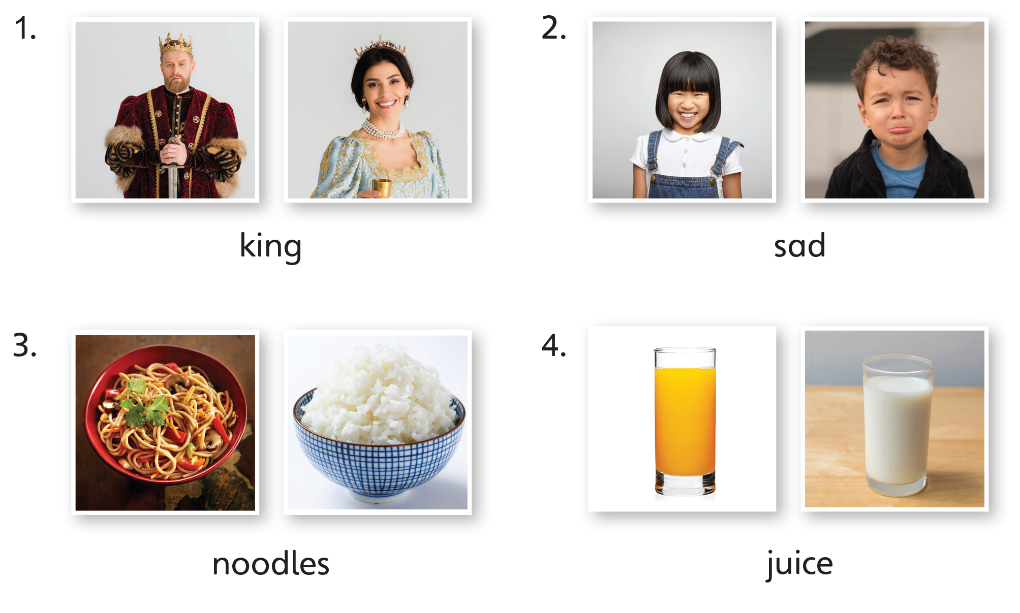
Notes:
Tell students that they are going to review and revise what they have learnt so far by doing some written exercises.
Have students open up their books to pp. 24–25. Go through each activity first and answer any questions they might have about how to do the activities.
Have students try them on their own.

Slide 29
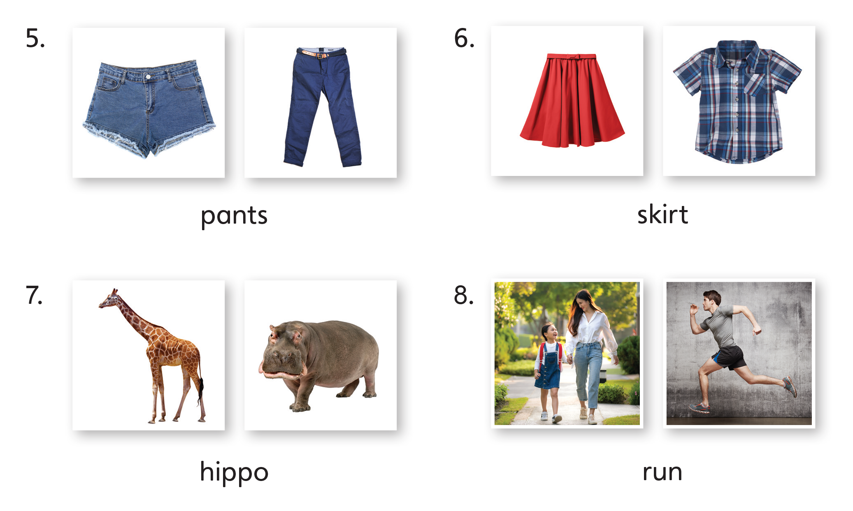
Notes:
Tell students that they are going to review and revise what they have learnt so far by doing some written exercises.
Have students open up their books to pp. 24–25. Go through each activity first and answer any questions they might have about how to do the activities.
Have students try them on their own.

Slide 30
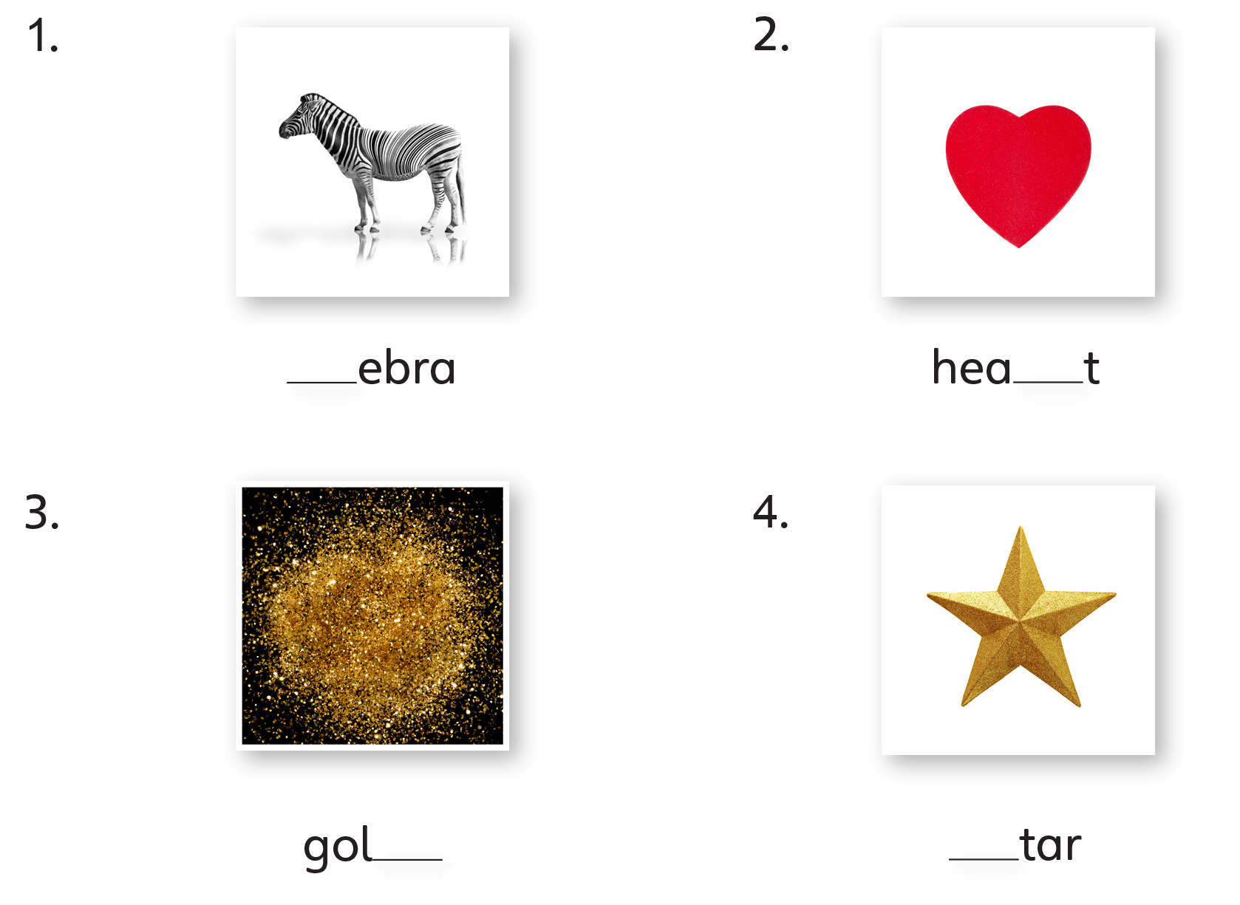
z
r
d
s
Notes:
Tell students that they are going to review and revise what they have learnt so far by doing some written exercises.
Have students open up their books to pp. 24–25. Go through each activity first and answer any questions they might have about how to do the activities.
Have students try them on their own.

Slide 31

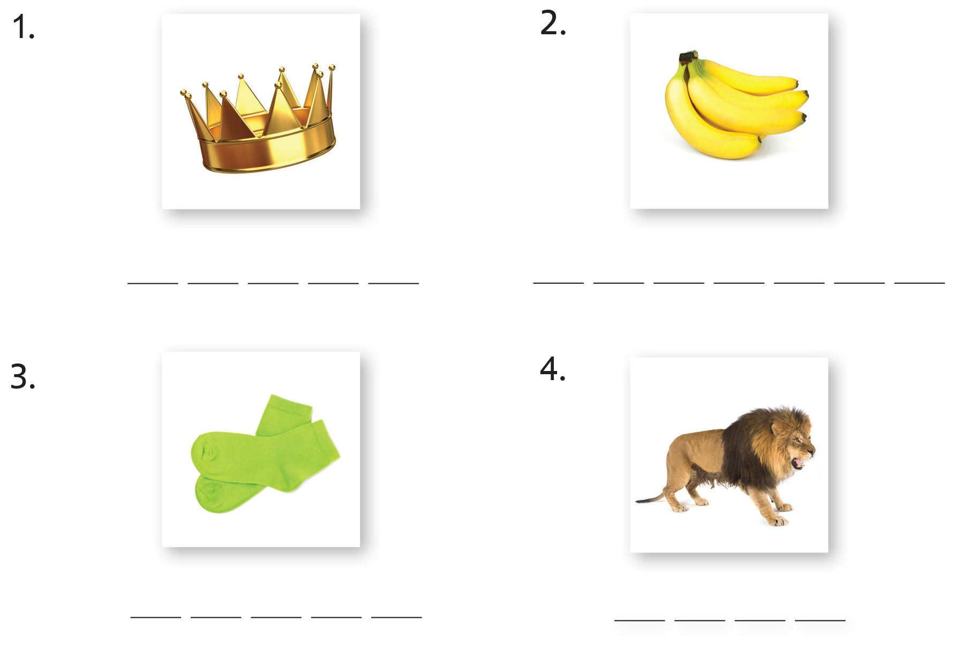
c r o w n
b a n a n a s
s o c k s
l i o n
Notes:
Tell students that they are going to review and revise what they have learnt so far by doing some written exercises.
Have students open up their books to pp. 24–25. Go through each activity first and answer any questions they might have about how to do the activities.
Have students try them on their own.

Slide 32
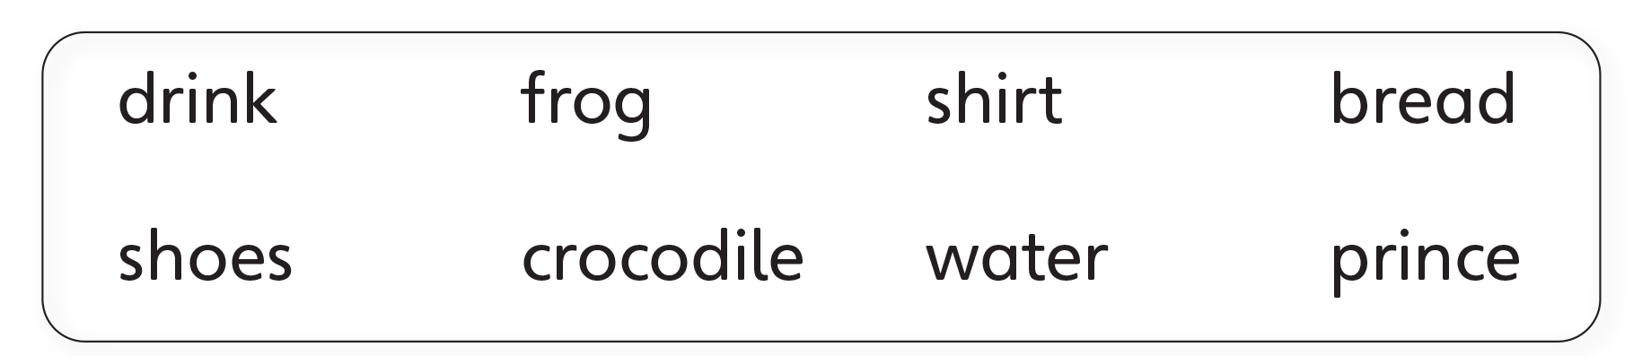
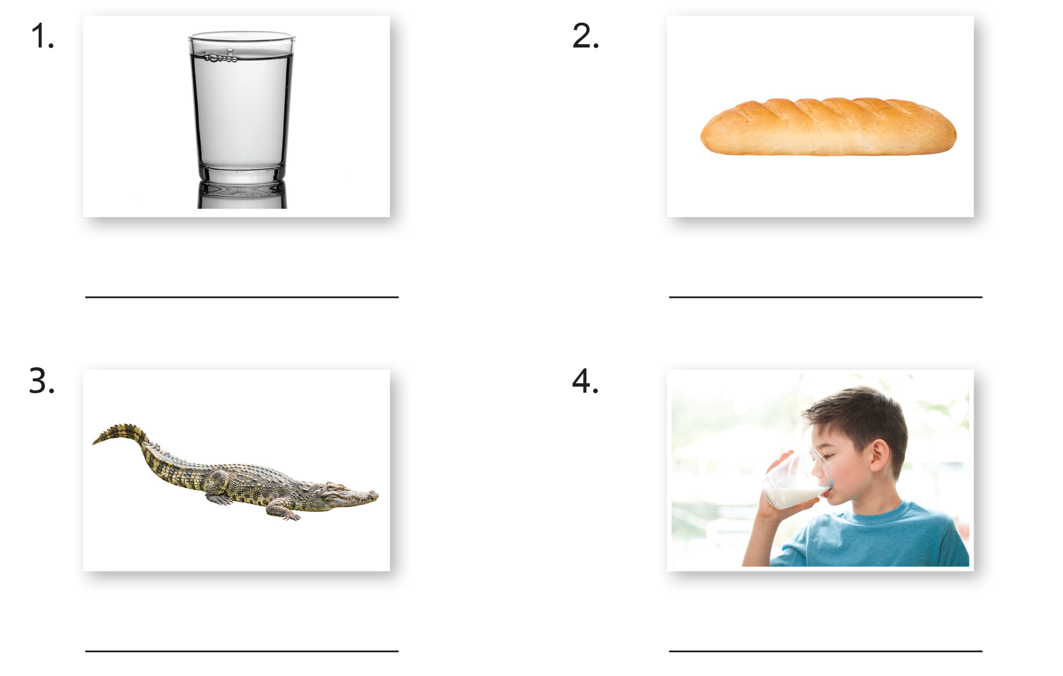
water
bread
Notes:
Tell students that they are going to review and revise what they have learnt so far by doing some written exercises.
Have students open up their books to pp. 24–25. Go through each activity first and answer any questions they might have about how to do the activities.
Have students try them on their own.

Slide 33
crocodile
drink
Notes:
Tell students that they are going to review and revise what they have learnt so far by doing some written exercises.
Have students open up their books to pp. 24–25. Go through each activity first and answer any questions they might have about how to do the activities.
Have students try them on their own.

Slide 34
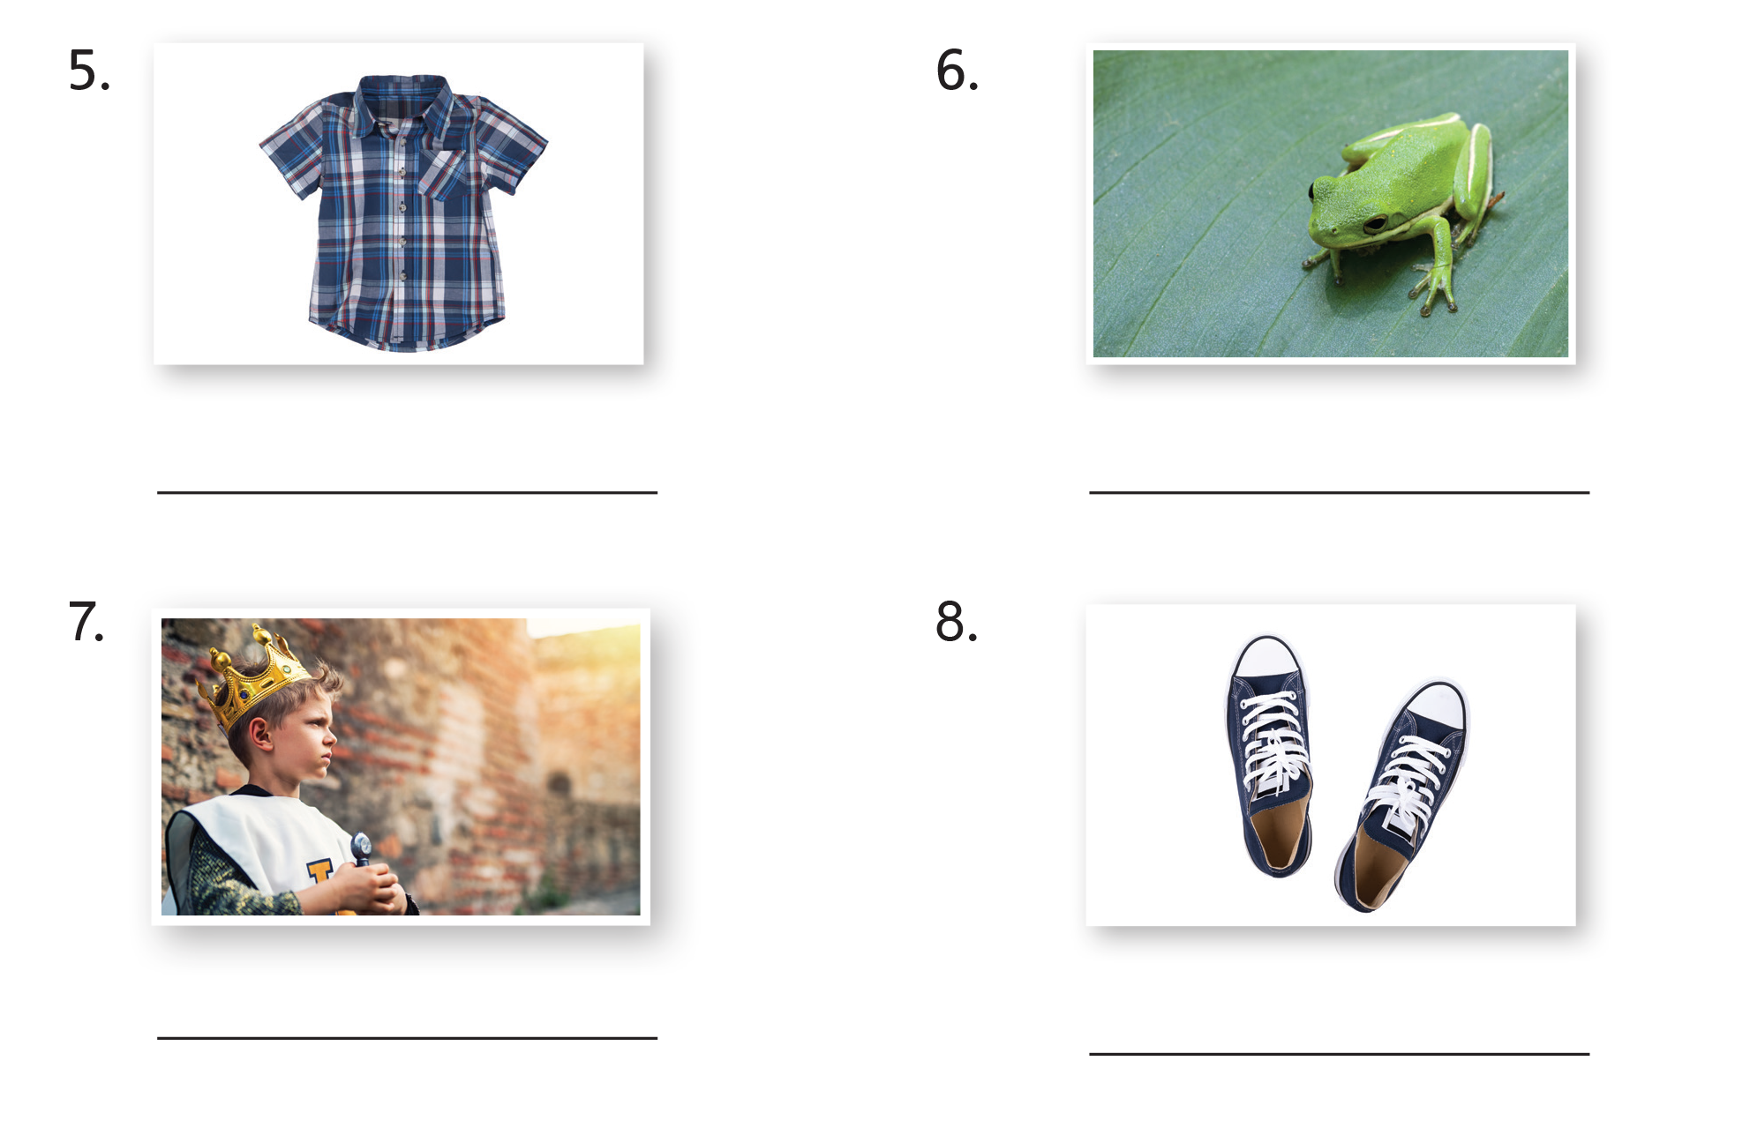
shirt
frog
Notes:
Tell students that they are going to review and revise what they have learnt so far by doing some written exercises.
Have students open up their books to pp. 24–25. Go through each activity first and answer any questions they might have about how to do the activities.
Have students try them on their own.

Slide 35
prince
shoes
Notes:
Tell students that they are going to review and revise what they have learnt so far by doing some written exercises.
Have students open up their books to pp. 24–25. Go through each activity first and answer any questions they might have about how to do the activities.
Have students try them on their own.

Slide 36

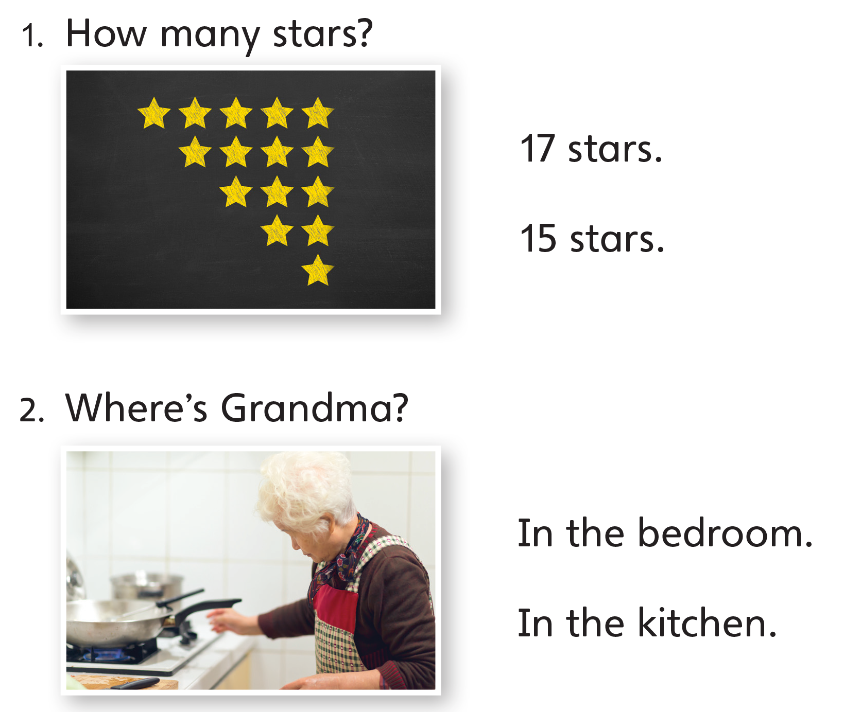
Notes:
Tell students that they are going to review and revise what they have learnt so far by doing some written exercises.
Have students open up their books to pp. 24–25. Go through each activity first and answer any questions they might have about how to do the activities.
Have students try them on their own.

Slide 37
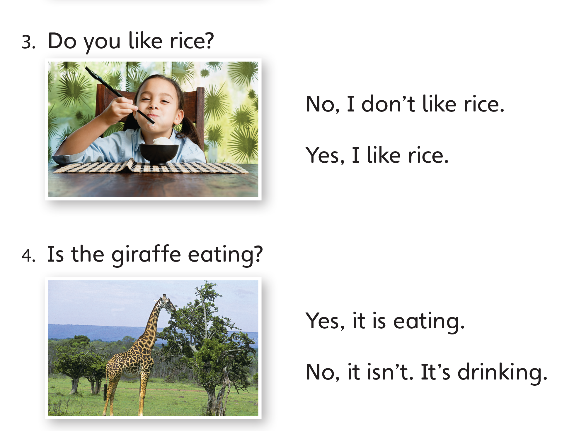
Notes:
Tell students that they are going to review and revise what they have learnt so far by doing some written exercises.
Have students open up their books to pp. 24–25. Go through each activity first and answer any questions they might have about how to do the activities.
Have students try them on their own.

Slide 38

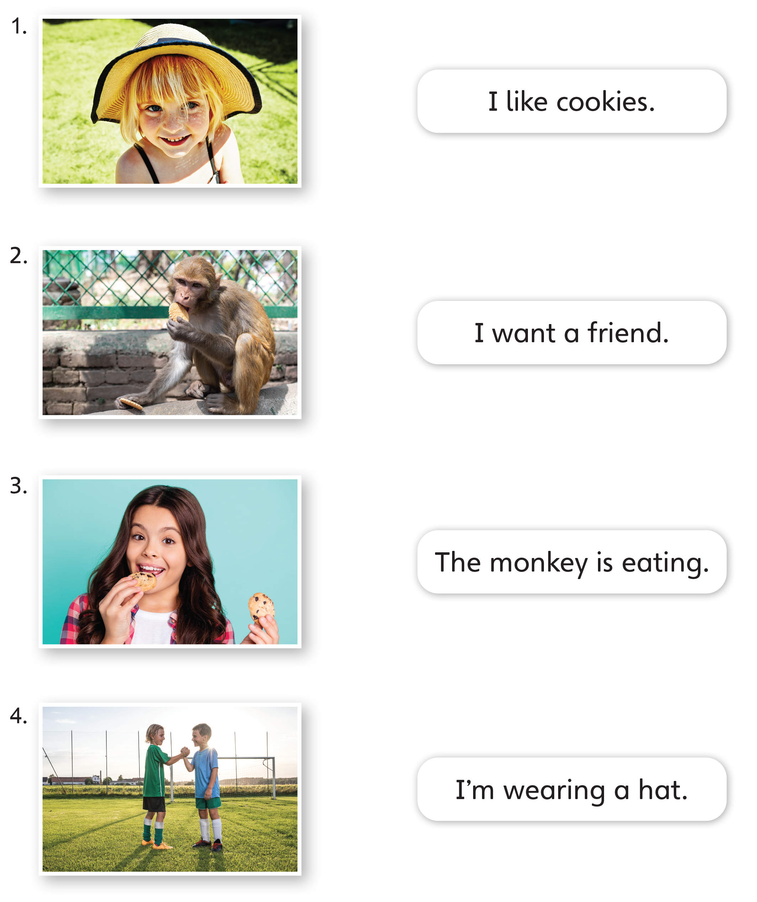
Notes:
Tell students that they are going to review and revise what they have learnt so far by doing some written exercises.
Have students open up their books to pp. 24–25. Go through each activity first and answer any questions they might have about how to do the activities.
Have students try them on their own.

Slide 39

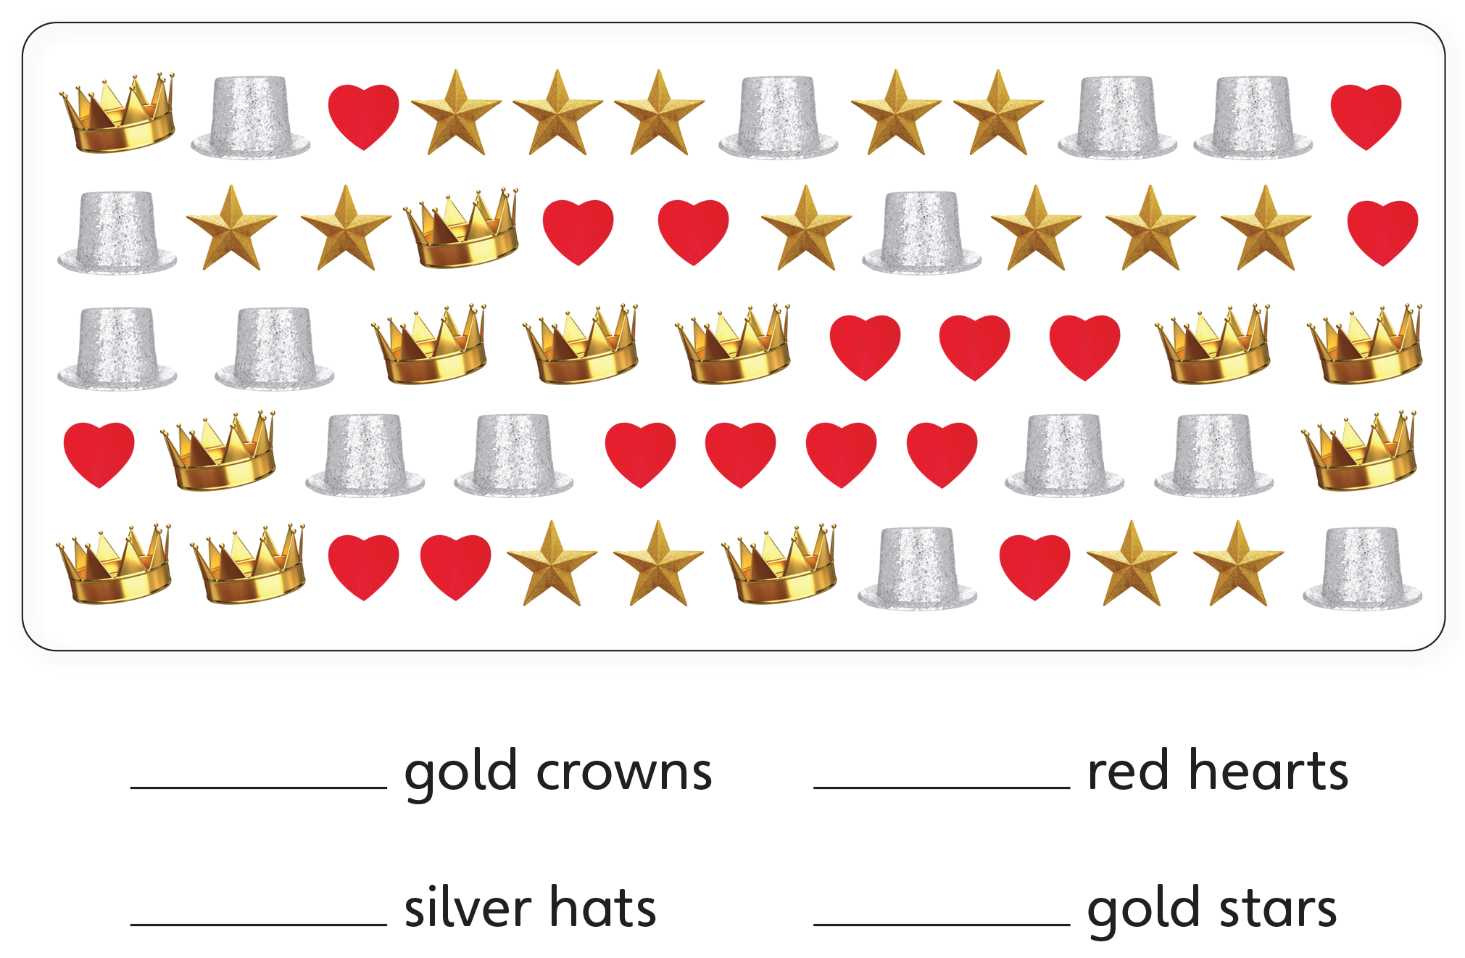
12
16
14
15
Notes:
Tell students that they are going to review and revise what they have learnt so far by doing some written exercises.
Have students open up their books to pp. 24–25. Go through each activity first and answer any questions they might have about how to do the activities.
Have students try them on their own.

Slide 40

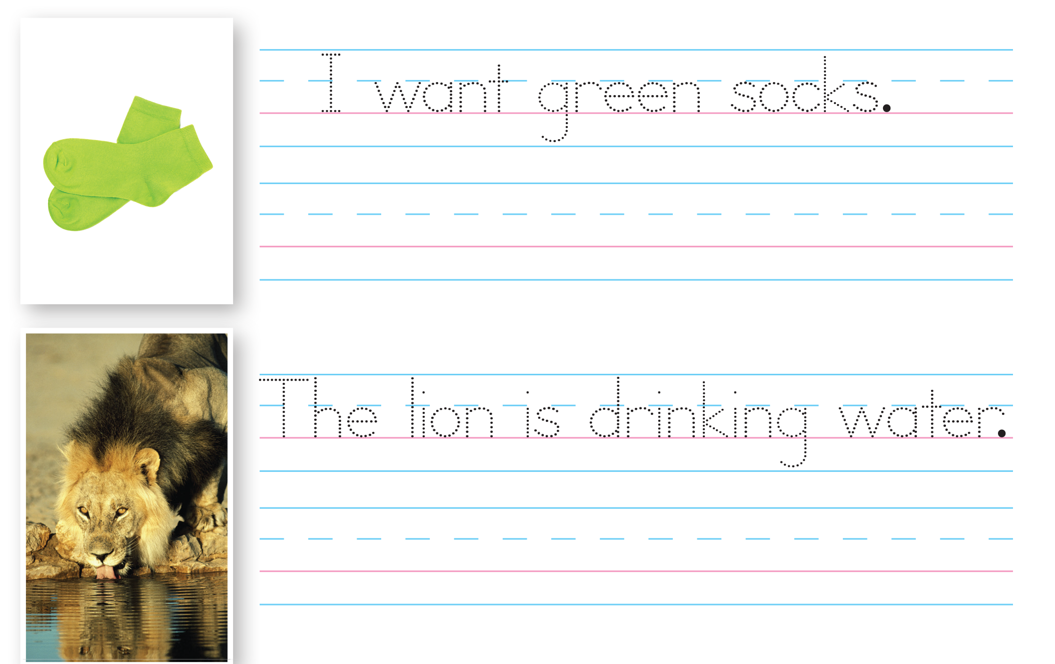
Notes:
Tell students that they are going to review and revise what they have learnt so far by doing some written exercises.
Have students open up their books to pp. 24–25. Go through each activity first and answer any questions they might have about how to do the activities.
Have students try them on their own.

Slide 41
Goodbye Chant
Good work, class.
Hip hip, hooray!
Goodbye for now.
Have a nice day!
Notes:
Say Nice work today, class. Now let’s chant.
Lead the class in the Goodbye chant.

Slide 42
Let’s Check
Make a sentence with
a word from Units 1–4.
Notes:
Can students remember and use the new words they’ve learnt?
As students leave the class, ask them to make a sentence with one word they remember from Units 1–4. These can include words related to foods, drinks, colors, shapes, numbers, royalty, feelings, clothing, animals, and actions.

Slide 43
Thank you!

