Slide 1


Unit 3
Clothes

Slide 2
Unit 3:
Clothes
Lesson 1

Slide 3
UNIT 3
CLOTHES
English Time Chant
English, (clap) English, (clap)
English (clap) today! (clap, clap)
English, (clap) English, (clap)
Hip, hip, (clap) hooray! (clap, clap)

Slide 4
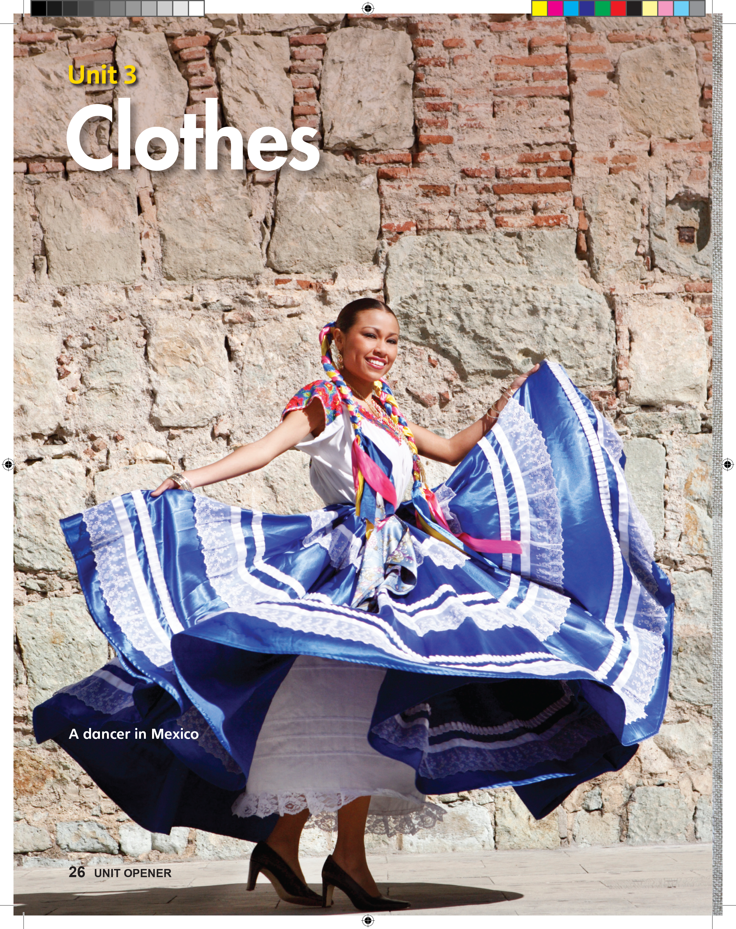
UNIT 3
CLOTHES
What color do you see?
White, blue, pink, yellow.
Notes:
Have students open their books to p. 26.
Point to the photo, and say Look! This girl is dancing.
Dance around a little to show the meaning of dancing, and say the word again.
Point to the girl’s clothes. Say Look at her hair and clothes! There are many different colors.
Ask students to identify the colors that they see.
Students should say White, blue, pink, yellow.

Slide 5
UNIT 3
CLOTHES
What body parts do you see?
Hands, arms, ears, hair.
Notes:
Hold up the book to p. 26 and have students answer the following questions using the photo:
Ask What body parts do you see?
Students should say Hands, arms, ears, hair.
Ask What color is her hair?
Students should say Black.
Point to the ribbons in her hair.
Say These are ribbons. What colors are they?
Students should say Red, blue, yellow.

Slide 6
UNIT 3
CLOTHES
What color is her hair?
Black.
Notes:
Hold up the book to p. 26 and have students answer the following questions using the photo:
Ask What body parts do you see?
Students should say Hands, arms, ears, hair.
Ask What color is her hair?
Students should say Black.
Point to the ribbons in her hair.
Say These are ribbons. What colors are they?
Students should say Red, blue, yellow.

Slide 7

UNIT 3
CLOTHES
These are ribbons. What colors are they?
These are hair ribbons.
Red, blue, yellow.
Notes:
Hold up the book to p. 26 and have students answer the following questions using the photo:
Ask What body parts do you see?
Students should say Hands, arms, ears, hair.
Ask What color is her hair?
Students should say Black.
Point to the ribbons in her hair.
Say These are ribbons. What colors are they?
Students should say Red, blue, yellow.

Slide 8

UNIT 3
CLOTHES
Let’s remember!
Is it right?
1. Is the girl sitting down?
✗
Notes:
Have students close their books and write the numbers 1–5 on a sheet of paper. Tell students that to answer yes, they should make a check next to the
number. To answer no, they should write an X.
Ask them simple memory questions about the photo:
1. Is the girl sitting down?
Students should write an X.
2. Is the girl’s dress red?
Students should write an X.
3. Is the girl’s hair black?
Students should make a check.
4. Can we see the girl’s mouth?
Students should write an X.
5. Are the girl’s arms up?
Students should make a check.
When you finish, have students open their books to p. 26 to check their work.
Repeat the questions, one at a time, and call on students to say the answer.

Slide 9
UNIT 3
CLOTHES
Let’s remember!
Is it right?
2. Is the girl’s dress red?
✗
Notes:
Have students close their books and write the numbers 1–5 on a sheet of paper. Tell students that to answer yes, they should make a check next to the
number. To answer no, they should write an X.
Ask them simple memory questions about the photo:
1. Is the girl sitting down?
Students should write an X.
2. Is the girl’s dress red?
Students should write an X.
3. Is the girl’s hair black?
Students should make a check.
4. Can we see the girl’s mouth?
Students should write an X.
5. Are the girl’s arms up?
Students should make a check.
When you finish, have students open their books to p. 26 to check their work.
Repeat the questions, one at a time, and call on students to say the answer.

Slide 10
UNIT 3
CLOTHES
Let’s remember!
Is it right?
3. Is the girl’s hair black?
✓
Notes:
Have students close their books and write the numbers 1–5 on a sheet of paper. Tell students that to answer yes, they should make a check next to the
number. To answer no, they should write an X.
Ask them simple memory questions about the photo:
1. Is the girl sitting down?
Students should write an X.
2. Is the girl’s dress red?
Students should write an X.
3. Is the girl’s hair black?
Students should make a check.
4. Can we see the girl’s mouth?
Students should write an X.
5. Are the girl’s arms up?
Students should make a check.
When you finish, have students open their books to p. 26 to check their work.
Repeat the questions, one at a time, and call on students to say the answer.

Slide 11
UNIT 3
CLOTHES
Let’s remember!
Is it right?
4. Can we see the girl’s mouth?
✗
Notes:
Have students close their books and write the numbers 1–5 on a sheet of paper. Tell students that to answer yes, they should make a check next to the
number. To answer no, they should write an X.
Ask them simple memory questions about the photo:
1. Is the girl sitting down?
Students should write an X.
2. Is the girl’s dress red?
Students should write an X.
3. Is the girl’s hair black?
Students should make a check.
4. Can we see the girl’s mouth?
Students should write an X.
5. Are the girl’s arms up?
Students should make a check.
When you finish, have students open their books to p. 26 to check their work.
Repeat the questions, one at a time, and call on students to say the answer.

Slide 12
UNIT 3
CLOTHES
Let’s remember!
Is it right?
5. Are the girl’s arms up?
✓
Notes:
Have students close their books and write the numbers 1–5 on a sheet of paper. Tell students that to answer yes, they should make a check next to the
number. To answer no, they should write an X.
Ask them simple memory questions about the photo:
1. Is the girl sitting down?
Students should write an X.
2. Is the girl’s dress red?
Students should write an X.
3. Is the girl’s hair black?
Students should make a check.
4. Can we see the girl’s mouth?
Students should write an X.
5. Are the girl’s arms up?
Students should make a check.
When you finish, have students open their books to p. 26 to check their work.
Repeat the questions, one at a time, and call on students to say the answer.

Slide 13
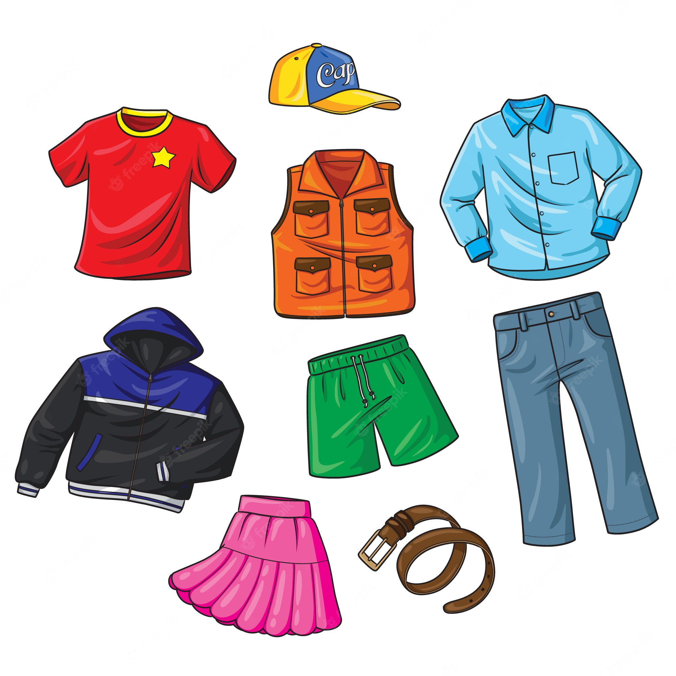
UNIT 3
CLOTHES
Her clothes have many colors.
These are clothes.
Notes:
Point to the girl on p. 26 as you say We see the girl’s clothes. Her clothes have many colors.
As you say clothes, point to her shirt and then to her skirt.
Hold up clothing items, such as a hat, a shirt, a dress, pants, socks, shoes, a coat, shorts, and a skirt.
As you hold them up, say These are clothes.

Slide 14
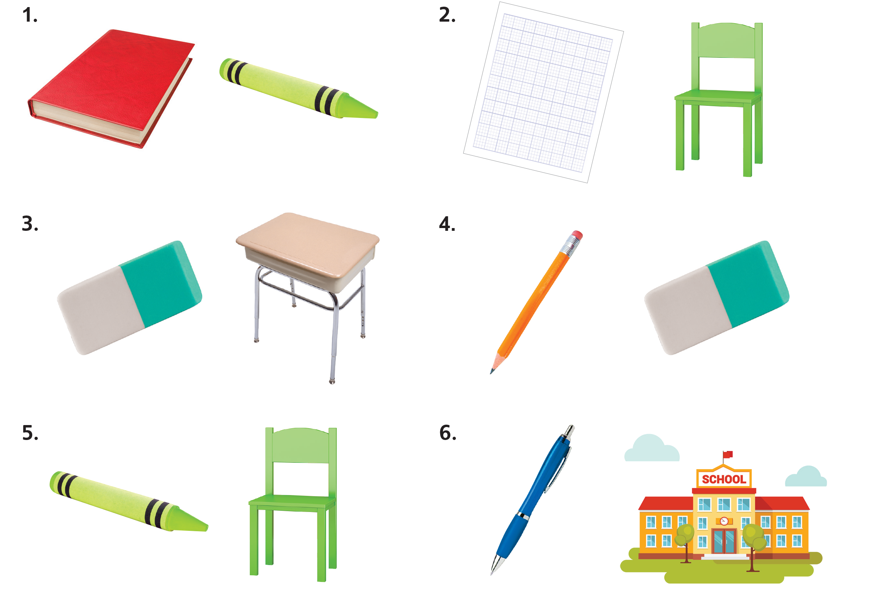



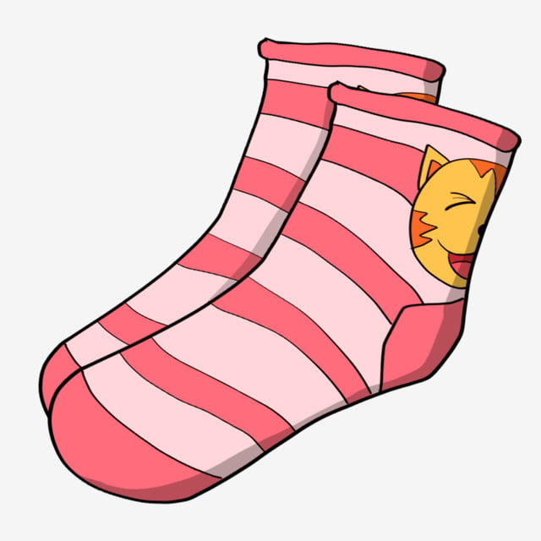
UNIT 3
CLOTHES
Let’s play!
Take out the clothes.
Notes:
When students aren’t looking, put a clothing item in a paper bag along with another item, such as a pencil, a ball, or a banana.
Say Take out the clothes.
Call on a student to reach in the bag, without looking, and pull out the clothing item.
Repeat this a few times, being sure to change the two items in the bag each time.

Slide 15
UNIT 3
CLOTHES
Goodbye Chant
Good work, class.
Hip hip, hooray!
Goodbye for now.
Have a nice day!
Notes:
Say Good job today class. Now let’s chant.
Lead the class in the Goodbye chant.

Slide 16
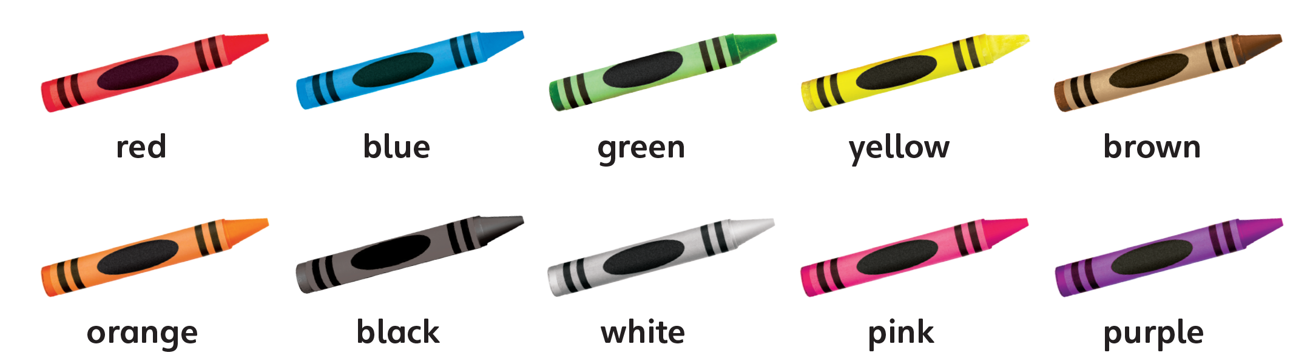
UNIT 3
CLOTHES
Let’s check!
What color is it?
Notes:
Can students identify different colors and describe things using colors?
As students leave the class, hold up the book and point to a different color. Have students name the color.

Slide 17
UNIT 3
CLOTHES
Thank you!

Slide 18
Unit 3:
Clothes
Lesson 2

Slide 19
UNIT 3
CLOTHES
English Time Chant
English, (clap) English, (clap)
English (clap) today! (clap, clap)
English, (clap) English, (clap)
Hip, hip, (clap) hooray! (clap, clap)

Slide 20
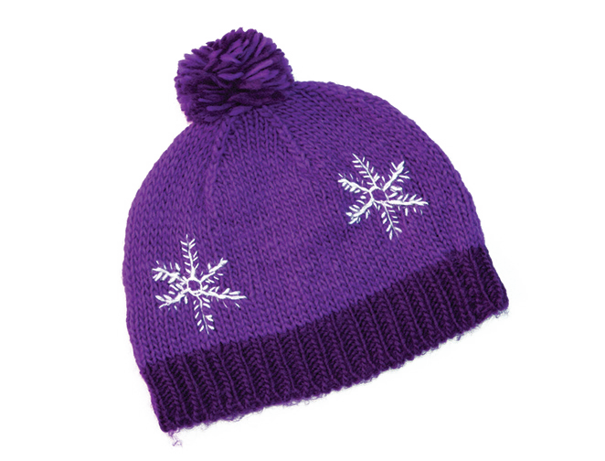
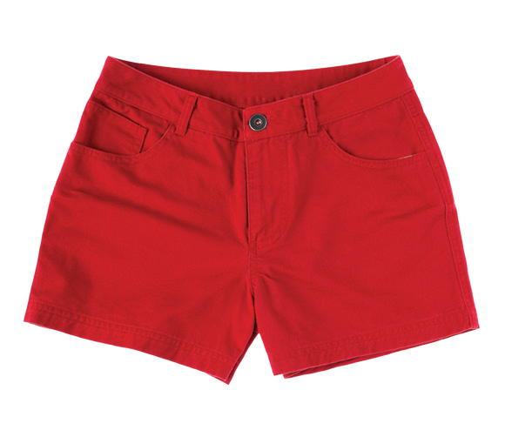
UNIT 3
CLOTHES
These are clothes
I have a hat.
I have shorts, too.
Notes:
Hold up p. 27 and point to the clothes.
Point to the clothes and say Look. These are clothes.
Then take out some clothing items that you’ve brought to class. Point to them and say These are clothes, too.
Hold up a winter hat and say Look, I have a hat.
Hold up a pair of shorts. Say I have shorts, too.
Repeat this with a coat and a shirt.

Slide 21
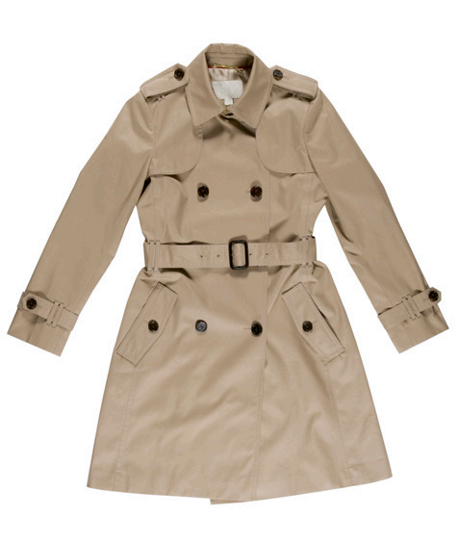
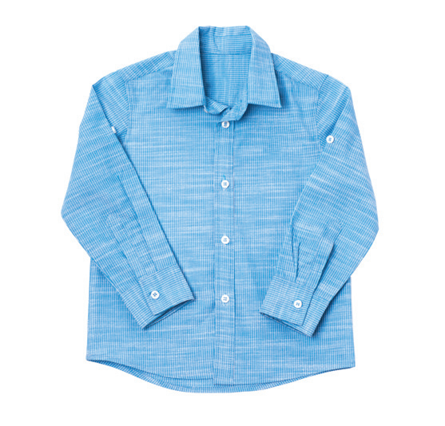
UNIT 3
CLOTHES
These are clothes
I have a hat.
I have a shirt, too.
Notes:
Hold up p. 27 and point to the clothes.
Point to the clothes and say Look. These are clothes.
Then take out some clothing items that you’ve brought to class. Point to them and say These are clothes, too.
Hold up a winter hat and say Look, I have a hat.
Hold up a pair of shorts. Say I have shorts, too.
Repeat this with a coat and a shirt.

Slide 22
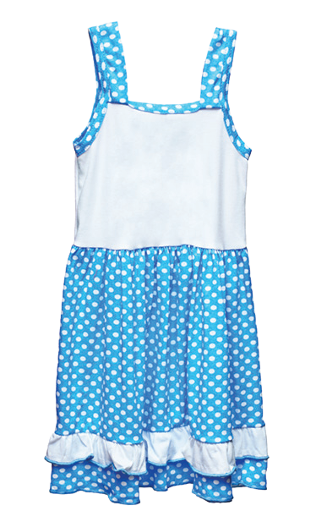
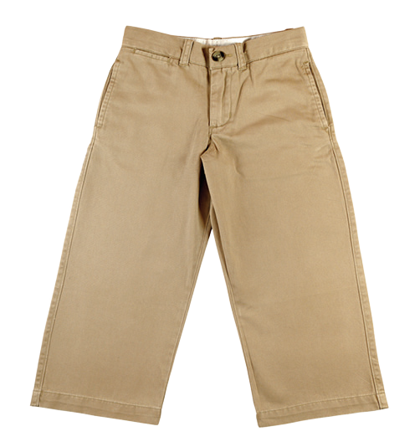
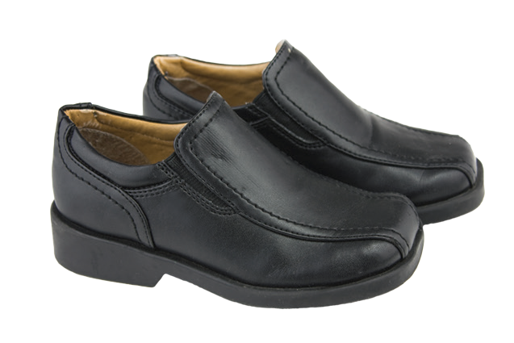
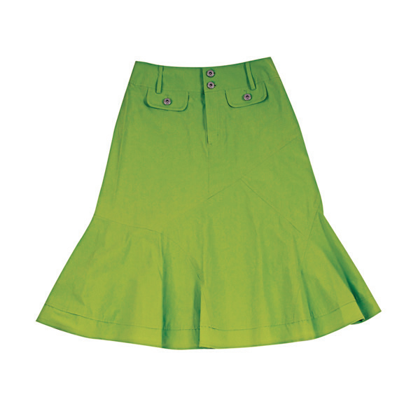
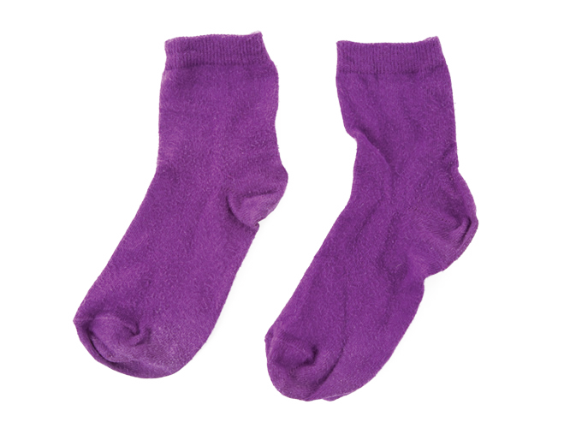
UNIT 3
CLOTHES
Repeat after me
a coat
a hat
a dress
pants
a shirt
shoes
shorts
a skirt
socks
Notes:
Have students open their books to p. 27.
Say Look at the clothes.
Hold up real examples of each of the clothing items, one at a time, and say aloud the word for each one. Have students repeat the word after you.
Hold each item up again. This time, ask Who has [pants] today?
Students should raise their hand if they are wearing [pants].
Each time, have students raise their hands if they are wearing the clothing item you say.
Repeat this until you have presented each of the new words.

Slide 23
UNIT 3
CLOTHES
Who has pants today?
a coat
a hat
a dress
pants
a shirt
shoes
shorts
a skirt
socks
Notes:
Have students open their books to p. 27.
Say Look at the clothes.
Hold up real examples of each of the clothing items, one at a time, and say aloud the word for each one. Have students repeat the word after you.
Hold each item up again. This time, ask Who has [pants] today?
Students should raise their hand if they are wearing [pants].
Each time, have students raise their hands if they are wearing the clothing item you say.
Repeat this until you have presented each of the new words.

Slide 24
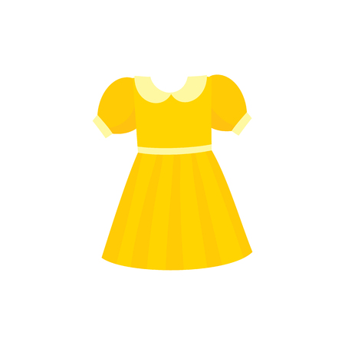
UNIT 3
CLOTHES
What am I wearing?
Do I have a dress today?
Notes:
Gesture toward your own clothing and ask students yes/no questions about what you’re wearing.
For example, ask Do I have [a dress] today? Do I have [shoes] today?
Students should say [Yes].

Slide 25

UNIT 3
CLOTHES
What am I wearing?
Do I have shoes today?
Notes:
Gesture toward your own clothing and ask students yes/no questions about what you’re wearing.
For example, ask Do I have [a dress] today? Do I have [shoes] today?
Students should say [Yes].

Slide 26
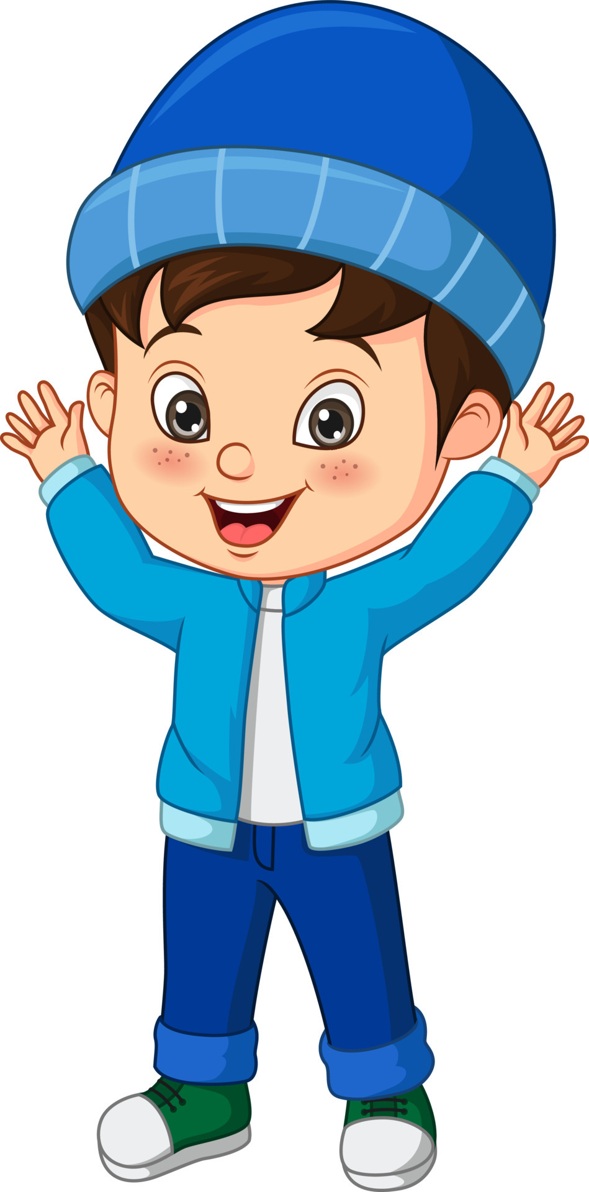
UNIT 3
CLOTHES
Where do I put on a hat?
On your head
Notes:
Put a hat on your head. Then, say I put the hat on my head, over my hair.
Hold up a pair of socks. Ask Where do I put socks?
Students should say On your feet.
Then, hold up a pair of pants, and ask Where do I put pants?
Students should say On your legs.
Note
If students need extra help, ask Do I put pants on my legs or on my arms?
Name different parts of the body, such as hair, arms, legs, and feet.
Students should say the clothing item(s) that cover that part of the body.
For example, a coat or a shirt covers the arms. A skirt or pants covers the legs.

Slide 27
UNIT 3
CLOTHES
Where do I put on pants?
On your legs
Notes:
Put a hat on your head. Then, say I put the hat on my head, over my hair.
Hold up a pair of socks. Ask Where do I put socks?
Students should say On your feet.
Then, hold up a pair of pants, and ask Where do I put pants?
Students should say On your legs.
Note
If students need extra help, ask Do I put pants on my legs or on my arms?
Name different parts of the body, such as hair, arms, legs, and feet.
Students should say the clothing item(s) that cover that part of the body.
For example, a coat or a shirt covers the arms. A skirt or pants covers the legs.

Slide 28
UNIT 3
CLOTHES
Where do I put on shoes?
On your feet
Notes:
Put a hat on your head. Then, say I put the hat on my head, over my hair.
Hold up a pair of socks. Ask Where do I put socks?
Students should say On your feet.
Then, hold up a pair of pants, and ask Where do I put pants?
Students should say On your legs.
Note
If students need extra help, ask Do I put pants on my legs or on my arms?
Name different parts of the body, such as hair, arms, legs, and feet.
Students should say the clothing item(s) that cover that part of the body.
For example, a coat or a shirt covers the arms. A skirt or pants covers the legs.

Slide 29

UNIT 3
CLOTHES
1
Listen and point. TR: B47
a coat
a hat
a dress
pants
a shirt
shoes
shorts
a skirt
socks
Notes:
1 Make sure students’ books are open to p. 27.
Say Now we will hear the words.
Listen and point. Model doing this. Play TR: B47.
Pause after the first word, and ask What word did you hear?
Students should say A coat.
Continue playing TR: B47 until students have pointed to each of the words.

Slide 30
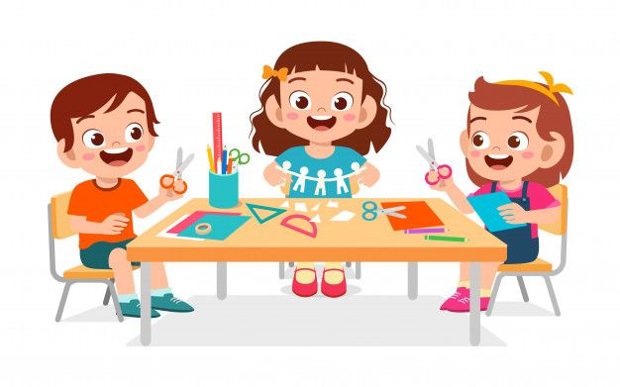
UNIT 3
CLOTHES
Let’s make
a catalogue for clothes.
Notes:
Have students sit at tables in small groups. Place scissors, glue, and old magazines or catalogues at each table.
Give each student two pieces of white paper. Have students fold the papers in half. As students work, walk around the room, and staple their folded papers
at the fold to create small books.
Say Let’s make a catalogue for clothes.
Hold up a clothing catalogue to help students understand the word catalogue.
Model cutting out a picture of one of the clothing items and pasting it to the inside of a small book.
Say Now you do it! Use all of the new words.
Students should make a clothing catalogue.
Have students cut out pictures for each of the clothing items and paste them inside their books. Give students crayons or markers to decorate the fronts of their catalogues.
Ask students to save their catalogues for the next lesson.

Slide 31
UNIT 3
CLOTHES
Goodbye Chant
Good work, class.
Hip hip, hooray!
Goodbye for now.
Have a nice day!
Notes:
Say Good job today class. Now let’s chant.
Lead the class in the Goodbye chant.

Slide 32

UNIT 3
CLOTHES
Let’s check!
What is it?
Notes:
Can students identify and name clothing items?
Point to pictures for clothing items, one at a time, and call on students to name the item.

Slide 33
UNIT 3
CLOTHES
It’s _____.
a coat
a hat
a dress
pants
a shirt
shoes
shorts
a skirt
socks
Notes:
(Click the picture to show the word)
Can students identify and name clothing items?
Point to pictures for clothing items, one at a time, and call on students to name the item.

Slide 34
UNIT 3
CLOTHES
Thank you!

Slide 35
Unit 3:
Clothes
Lesson 3

Slide 36
UNIT 3
CLOTHES
English Time Chant
English, (clap) English, (clap)
English (clap) today! (clap, clap)
English, (clap) English, (clap)
Hip, hip, (clap) hooray! (clap, clap)

Slide 37
UNIT 3
CLOTHES
2
Point and say.
a coat
a hat
a dress
pants
a shirt
shoes
shorts
a skirt
socks
Notes:
2 Hold up p. 27 and point to the clothes.
Point to the dress and say Look. That’s a dress.
Then, point to the dress on the left on p. 26 and say That’s a dress, too.
Say Let’s look at some other clothes.
Hold up a winter hat and say Look, this is a hat.
Hold up a pair of shorts. Say These are shorts.
Repeat this with a coat and a shirt.

Slide 38
UNIT 3
CLOTHES
Repeat after me
a coat
a hat
a dress
pants
a shirt
shoes
shorts
a skirt
socks
Notes:
Have students open their books to p. 27.
Say Look at the clothes.
Hold up real examples of each of the clothing items, one at a time, and say aloud the word for each one. Have students repeat the word after you.
Hold each item up again. This time, ask Who has [pants] today?
Students should raise their hand if they are wearing [pants].
Each time, have students raise their hands if they are wearing the clothing item you say.
Repeat this until you have presented each of the new words.

Slide 39
UNIT 3
CLOTHES
Who has pants today?
a coat
a hat
a dress
pants
a shirt
shoes
shorts
a skirt
socks
Notes:
Have students open their books to p. 27.
Say Look at the clothes.
Hold up real examples of each of the clothing items, one at a time, and say aloud the word for each one. Have students repeat the word after you.
Hold each item up again. This time, ask Who has [pants] today?
Students should raise their hand if they are wearing [pants].
Each time, have students raise their hands if they are wearing the clothing item you say.
Repeat this until you have presented each of the new words.

Slide 40
UNIT 3
CLOTHES
Ask and Answer
What are you wearing?
A hat.
Notes:
Place students in pairs.
Have them name a clothing item that their partner is wearing. The partner should touch or point to that clothing item on his or her own body.
Have students continue doing this until they have named all of the clothes that they are wearing.

Slide 41
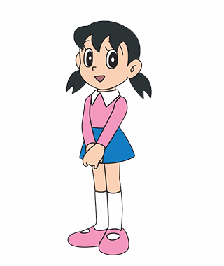
UNIT 3
CLOTHES
Ask and Answer
What are you wearing?
A skirt.
Notes:
Place students in pairs.
Have them name a clothing item that their partner is wearing. The partner should touch or point to that clothing item on his or her own body.
Have students continue doing this until they have named all of the clothes that they are wearing.

Slide 42
UNIT 3
CLOTHES
Let’s play
Place the cards in the right order.
Notes:
Have students work in pairs and give a set of picture cards to each pair.
Say In pairs, place the cards in the right order.
Name five clothing items, one at a time. For example, you can use the following patterns:
– shoes, a coat, a hat, pants, a skirt
– a dress, shorts, socks, a shirt, shoes
Have students work with a partner. Have them take turns naming five clothing items and having their partner put the correct cards on the desk in the order
that they hear.
Student A should say [A coat, a skirt, pants, a dress, shoes].
Student B should then put the cards according to that order.

Slide 43
UNIT 3
CLOTHES
Let’s play
Place the cards in the right order.
Notes:
Have students work in pairs and give a set of picture cards to each pair.
Say In pairs, place the cards in the right order.
Name five clothing items, one at a time. For example, you can use the following patterns:
– shoes, a coat, a hat, pants, a skirt
– a dress, shorts, socks, a shirt, shoes
Have students work with a partner. Have them take turns naming five clothing items and having their partner put the correct cards on the desk in the order
that they hear.
Student A should say [A coat, a skirt, pants, a dress, shoes].
Student B should then put the cards according to that order.

Slide 44
UNIT 3
CLOTHES
Let’s share
your catalouge
I don’t like the shoes.
I like the pants.
Notes:
Have students work in pairs and share their catalogues with their partners.
Model turning the pages of a completed catalogue and commenting on the clothes.
Point to one item in the catalogue and say I like the [pants]!
Point to another item and say I don’t like the [shoes].
Then, have pairs say what they like and don’t like in one another’s catalogue.
Help students to review colors by asking them to expand on their statements. For example, point to one item and say I like the [black pants]!

Slide 45
UNIT 3
CLOTHES
Can you find it?
What is it?
Is it a skirt?
Notes:
Display different clothing items around the class.
Say the name of a clothing item. Call on a student to find the clothing item you say and bring it to you. As he or she hands you the item, ask What is it?
The student should say It’s [a shirt].
Confirm that the student is correct by asking the class Is it [a shirt]?
Students should say Yes, it’s [a shirt].

Slide 46
UNIT 3
CLOTHES
Can you find it?
What is it?
Are these shoes?
Notes:
Display different clothing items around the class.
Say the name of a clothing item. Call on a student to find the clothing item you say and bring it to you. As he or she hands you the item, ask What is it?
The student should say It’s [a shirt].
Confirm that the student is correct by asking the class Is it [a shirt]?
Students should say Yes, it’s [a shirt].

Slide 47
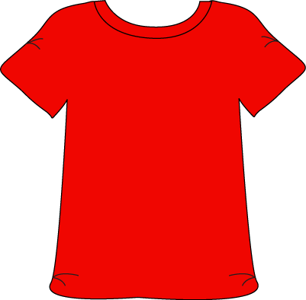
UNIT 3
CLOTHES
Can you find it?
What is it?
Is it a red shirt?
Notes:
Challenge!
Include two or three of the same item in different colors, and have students find the item using the color and the vocabulary word. For example, you can ask students to look for purple socks or brown shoes.

Slide 48
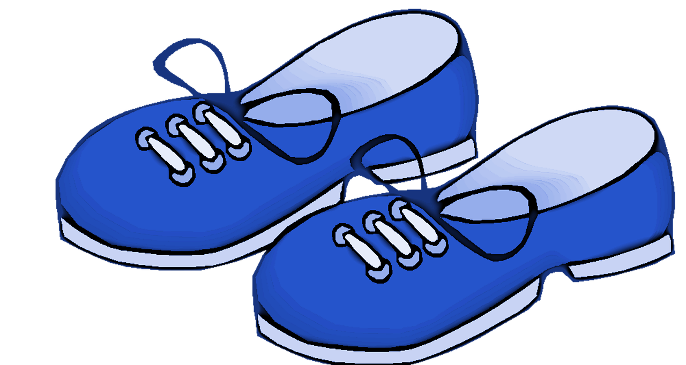
UNIT 3
CLOTHES
Can you find it?
What is it?
Are these
blue shorts?
Notes:
Challenge!
Include two or three of the same item in different colors, and have students find the item using the color and the vocabulary word. For example, you can ask students to look for purple socks or brown shoes.

Slide 49
UNIT 3
CLOTHES
Goodbye Chant
Good work, class.
Hip hip, hooray!
Goodbye for now.
Have a nice day!
Notes:
Say Good job today class. Now let’s chant.
Lead the class in the Goodbye chant.

Slide 50
UNIT 3
CLOTHES
Let’s check!
What is it?
Notes:
Can students identify and name clothing items?
Point to pictures for clothing items, one at a time, and call on students to name the item.

Slide 51
UNIT 3
CLOTHES
It’s _____.
a coat
a hat
a dress
pants
a shirt
shoes
shorts
a skirt
socks
Notes:
(Click the picture to show the word)
Can students identify and name clothing items?
Point to pictures for clothing items, one at a time, and call on students to name the item.

Slide 52
UNIT 3
CLOTHES
Thank you!

Slide 53
Unit 3:
Clothes
Lesson 4

Slide 54
UNIT 3
CLOTHES
English Time Chant
English, (clap) English, (clap)
English (clap) today! (clap, clap)
English, (clap) English, (clap)
Hip, hip, (clap) hooray! (clap, clap)

Slide 55

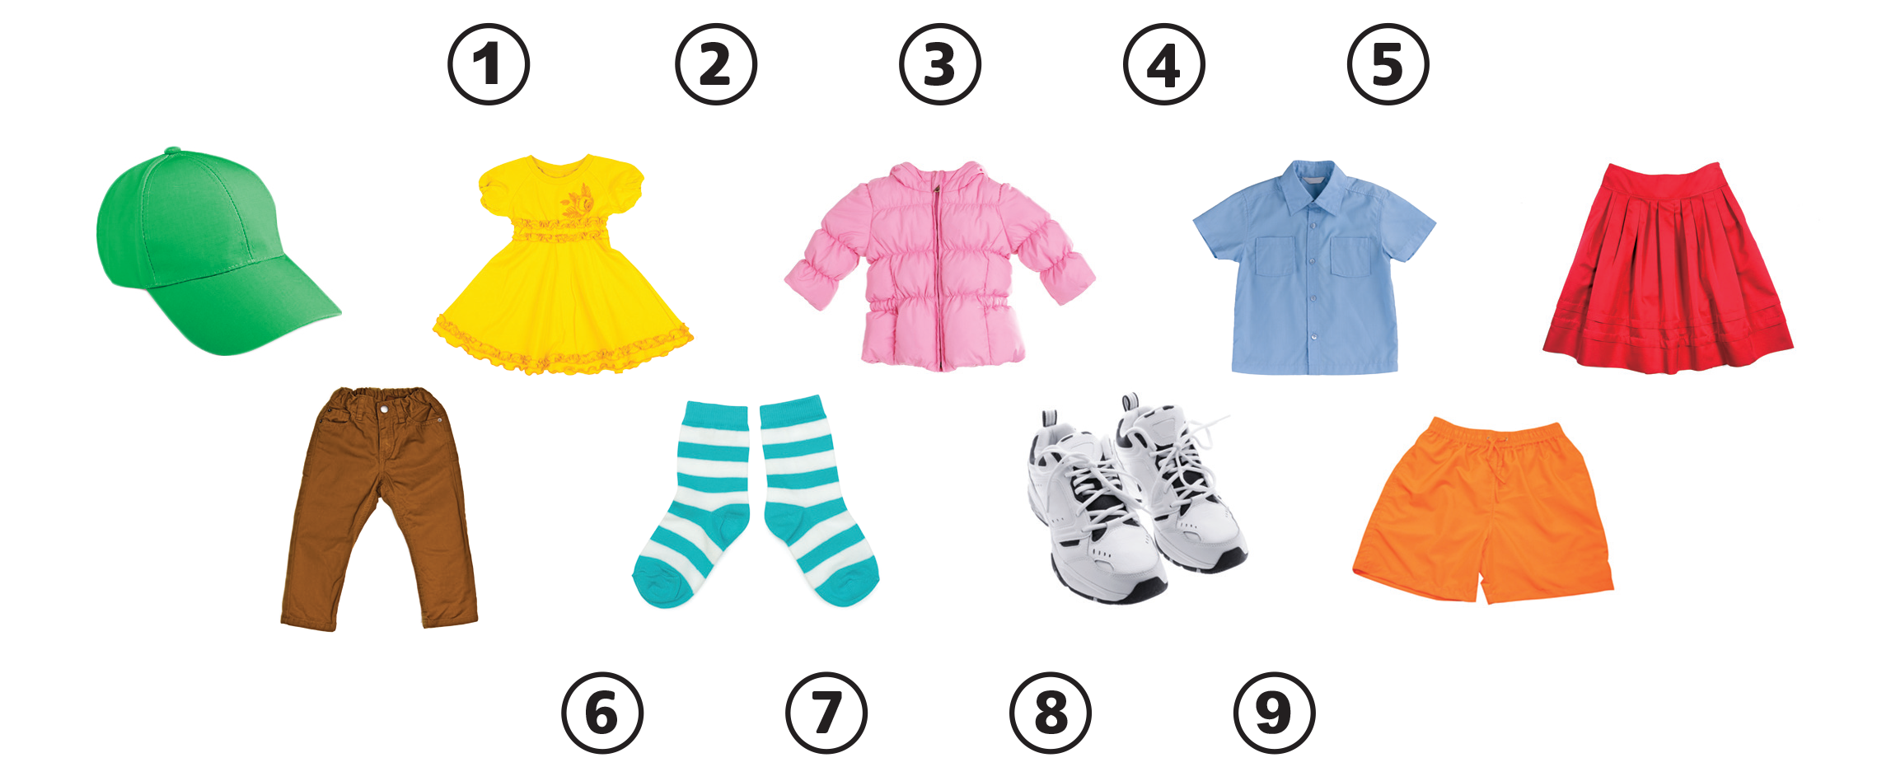
UNIT 3
CLOTHES
Notes:
3 Have students open their books to p. 28. Point to the number 1 and say Listen.
Play TR: B48. Pause after item one, and ask What is it?
Students should say A dress.
Model drawing a line from the number 1 to the dress.
Then, play the rest of TR: B48 and have students complete the activity.

Slide 56
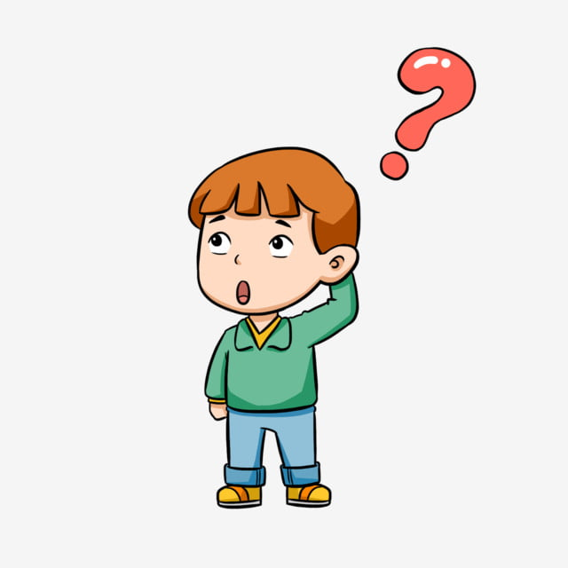
UNIT 3
CLOTHES
Let’s guess!
Who is it?
Is it ______?
He’s wearing green pants and a white shirt.
Notes:
Choose a student to describe and have students guess whom you’re talking about.
For example, say He’s wearing green pants and a white shirt.
Students should say It’s [Jakub]!
Repeat this until you have described three or four students’ clothing.
Note
If students wear uniforms, give a few students photos of people from a magazine.
Have students stand in the front of the room and hold the photos for everyone to see.
Describe the photos, and have the class identify the student who is holding it.

Slide 57
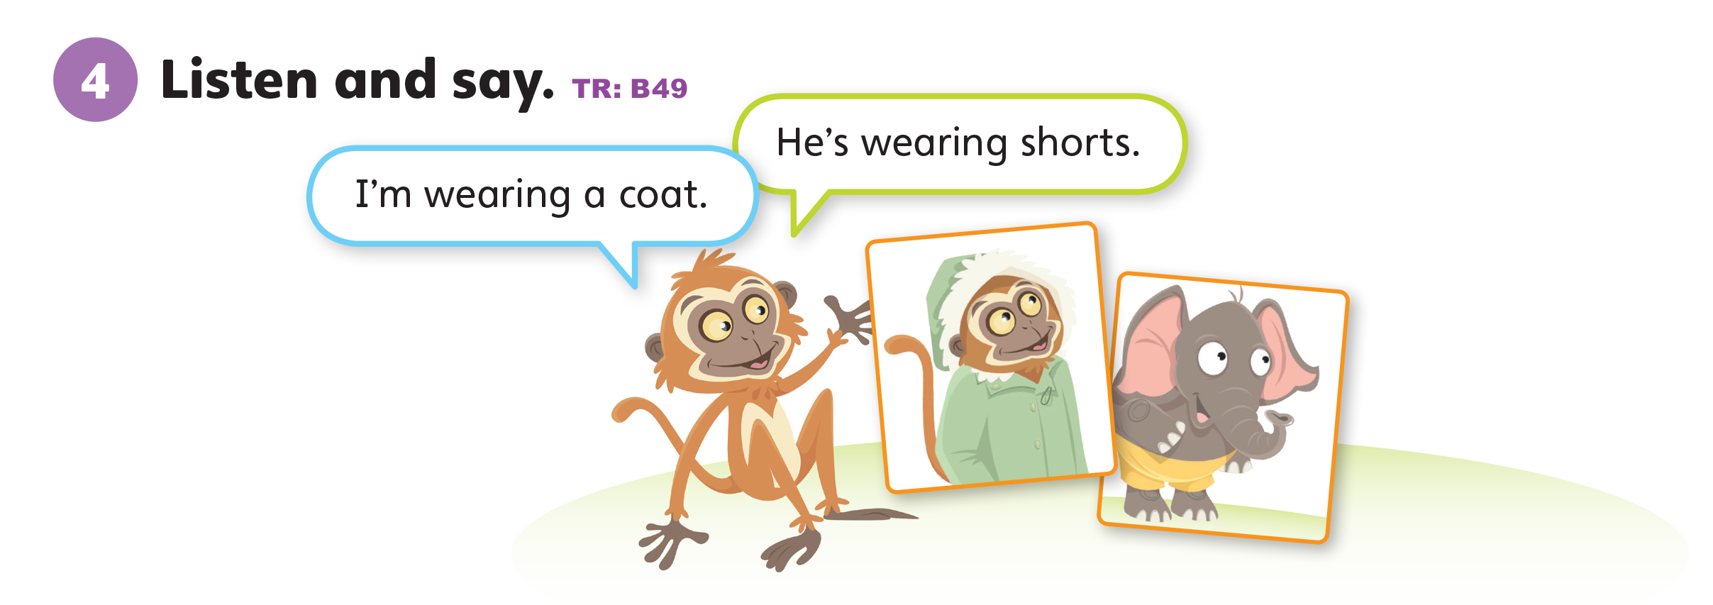
UNIT 3
CLOTHES
Notes:
4 Have students look at the mascots on p. 18.
Point to Freddy the Frog, and ask Who’s this?
Students should say It’s Freddy.
Say Yes, it’s Freddy.
Point to Polly the Parrot and ask What’s her name?
Students should say It’s Polly.
Say Yes, it’s Polly. Freddy and Polly are talking about food. Let’s listen.
Play TR: B37.

Slide 58
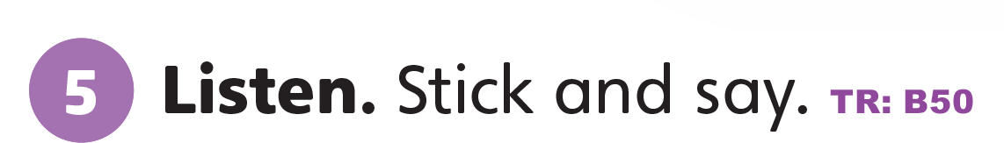
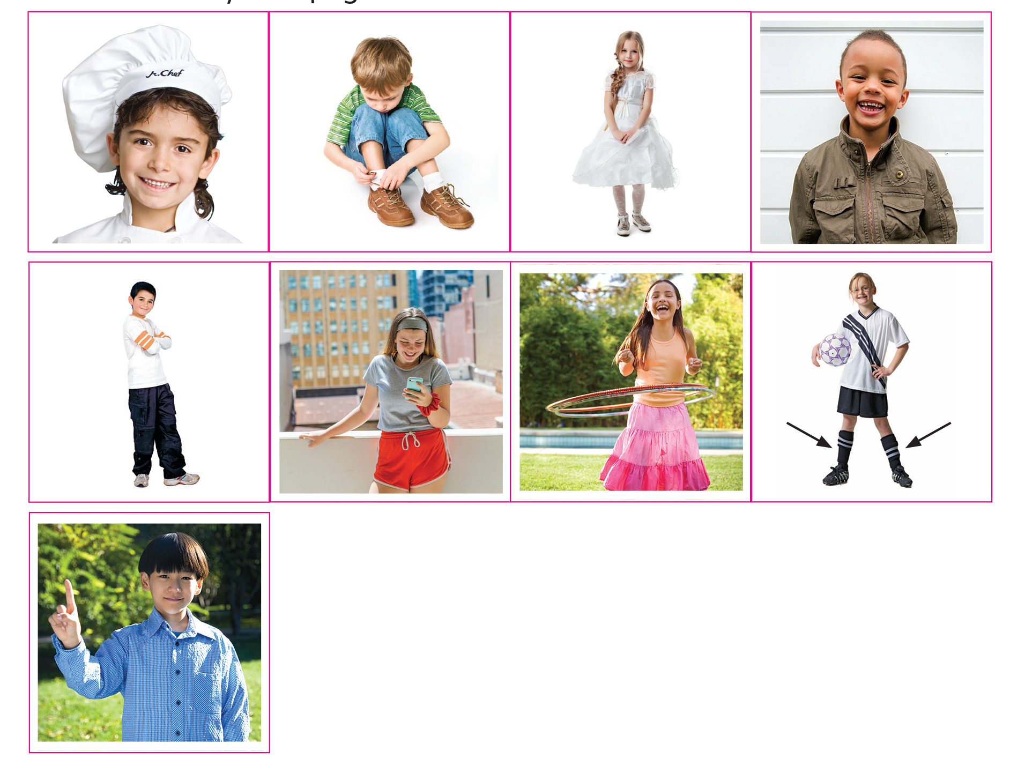
UNIT 3
CLOTHES
Notes:
5 Say Now let’s do a sticker activity.
Have them form pairs. Have one student begin by choosing a sticker and placing it in the appropriate space.
If the first students says I like [bread], have the student paste the sticker in the “happy face” space in their own book.
The second student then sticks the same bread sticker according to their own likes and dislikes in their own book.
The second student chooses the next sticker to talk about.
Students should take out their Unit 2 stickers and place them in the appropriate spaces. They should continue taking turns until they have finished using all their stickers.

Slide 59
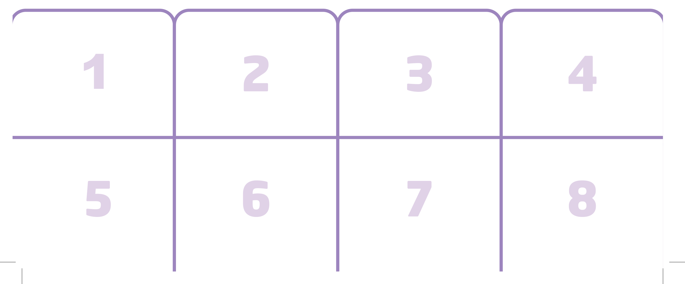
UNIT 3
CLOTHES
Notes:
5 Say Let’s do a sticker activity!
Show students the Unit 3 stickers in the back of the book.
Say Listen. Play TR: B50.
Pause after the first item, and then repeat it.
Say I’m wearing a brown coat.
Students should repeat the sentence.
Hold up the sticker page, and ask Where is the brown coat?
Students should peel the correct sticker and place it in the space with number 1.
Continue playing TR: B50, pausing after each item for students to repeat the sentence and place the sticker.

Slide 60
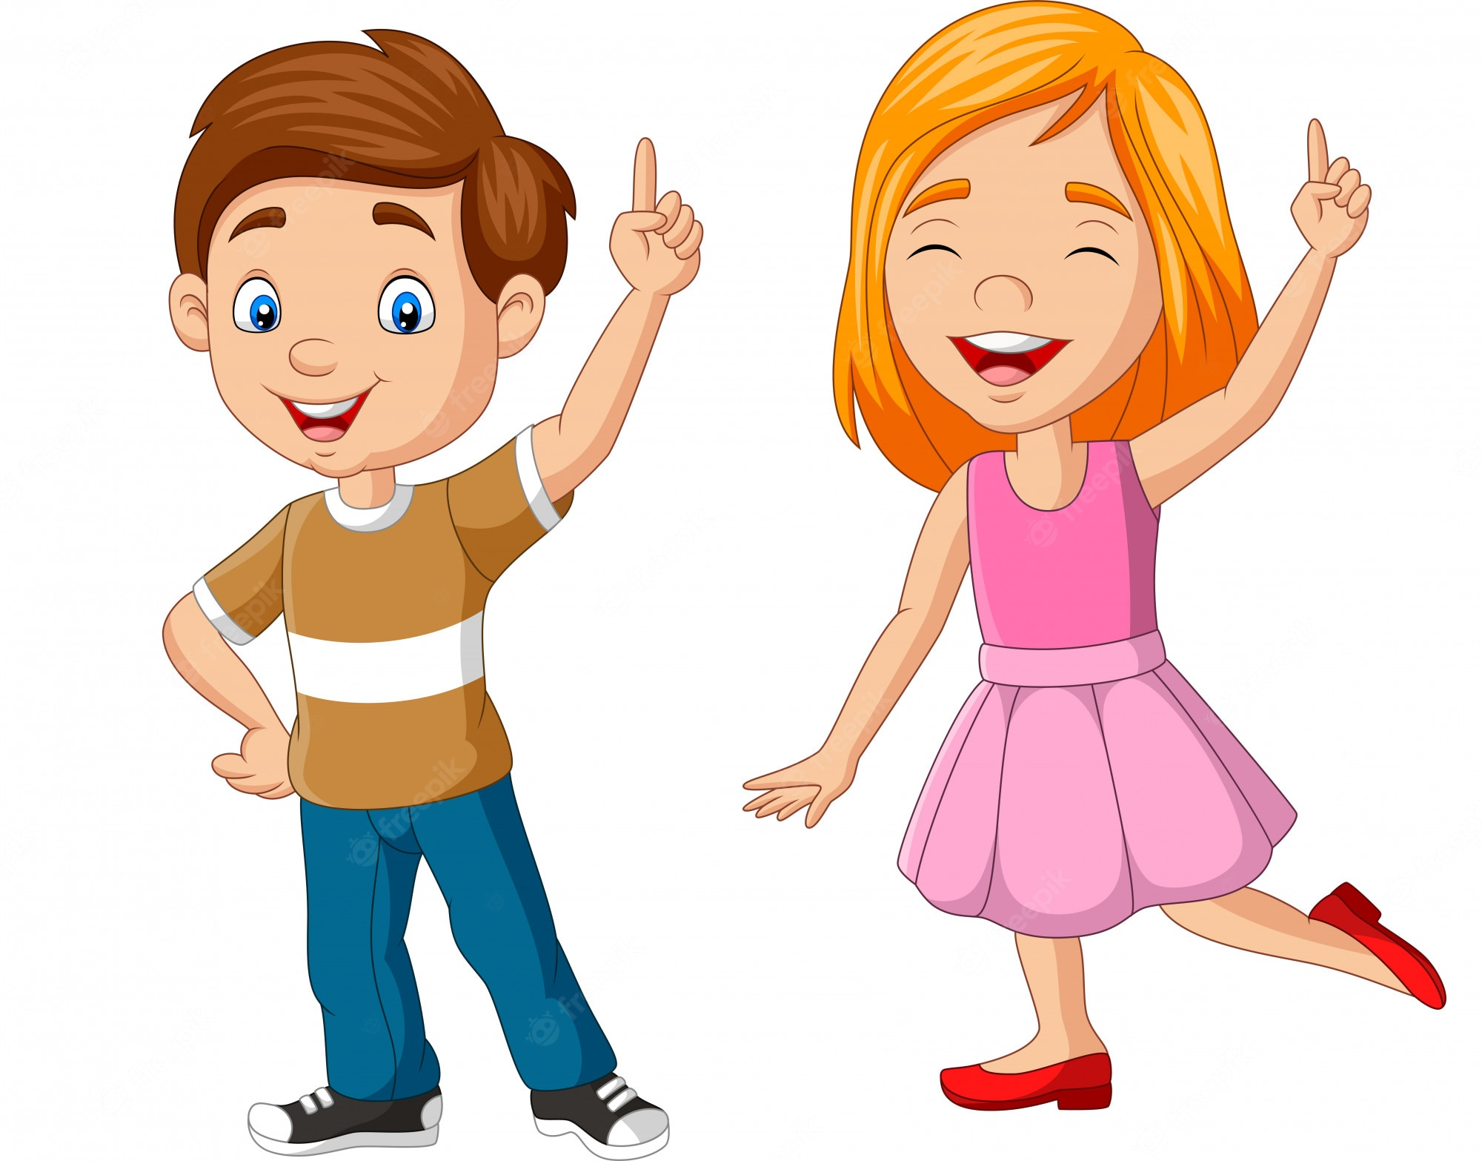
UNIT 3
CLOTHES
Tell me about
your partner
I’m wearing a skirt.
He’s wearing shoes.
Notes:
Divide the class into pairs. Have students tell their partners what they are wearing.
Students should say [I’m wearing a shirt.]
When students finish, call pairs to the front of the room.
This time, have each student describe his or her partner’s clothes.
Students should say [He’s/She’s] wearing [a shirt].

Slide 61
UNIT 3
CLOTHES
Goodbye Chant
Good work, class.
Hip hip, hooray!
Goodbye for now.
Have a nice day!
Notes:
Say Good job today class. Now let’s chant.
Lead the class in the Goodbye chant.

Slide 62
UNIT 3
CLOTHES
Let’s check!
What is it?
Notes:
Can students identify and name clothing items?
Point to pictures for clothing items, one at a time, and call on students to name the item.

Slide 63
UNIT 3
CLOTHES
It’s _____.
a coat
a hat
a dress
pants
a shirt
shoes
shorts
a skirt
socks
Notes:
(Click the picture to show the word)
Can students identify and name clothing items?
Point to pictures for clothing items, one at a time, and call on students to name the item.

Slide 64
UNIT 3
CLOTHES
Thank you!

Slide 65
Unit 3:
Clothes
Lesson 5

Slide 66
UNIT 3
CLOTHES
English Time Chant
English, (clap) English, (clap)
English (clap) today! (clap, clap)
English, (clap) English, (clap)
Hip, hip, (clap) hooray! (clap, clap)

Slide 67




UNIT 3
CLOTHES
Let’s play!
Find circle objects
How many circle?
Notes:
Place students in pairs. Give each pair one minute to find as many circle shapes in the classroom as they can.
Each time they find one, have them write a check on a piece of paper.
After one minute, ask How many circles do you see?
Students should count their check marks and say their answer.
Then, call on students to show you the circles they found.
Repeat this activity for squares.

Slide 68

UNIT 3
CLOTHES
New Word
Notes:
Say Rectangle as you draw a rectangle on the board.
Have students repeat the word.
Gesture toward the board, the door, your desk, or any other rectangular items in the class, and say Rectangle.
Have students repeat the word.
Repeat this for triangle.
Note
Since triangles are less likely to be found in your classroom, you may want to cut out a few triangles from paper and hang them around the room ahead of
time.

Slide 69
UNIT 3
CLOTHES
New Word
Notes:
Say Rectangle as you draw a rectangle on the board.
Have students repeat the word.
Gesture toward the board, the door, your desk, or any other rectangular items in the class, and say Rectangle.
Have students repeat the word.
Repeat this for triangle.
Note
Since triangles are less likely to be found in your classroom, you may want to cut out a few triangles from paper and hang them around the room ahead of
time.

Slide 70
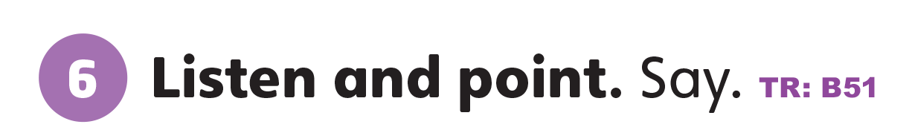
UNIT 3
CLOTHES
What color do you see?
Orange
Purple
Notes:
6 Point to Activity 6.
Ask What colors do you see?
Say There’s an orange rectangle. There’s a purple triangle.
Students should say Orange, purple.
Play TR: B51.
Students should repeat the words they hear.
Have students name some items that are rectangular. Then have students name some items that are triangular.

Slide 71
UNIT 3
CLOTHES
What is it?
Notes:
6 Point to Activity 6.
Ask What colors do you see?
Say There’s an orange rectangle. There’s a purple triangle.
Students should say Orange, purple.
Play TR: B51.
Students should repeat the words they hear.
Have students name some items that are rectangular. Then have students name some items that are triangular.

Slide 72


UNIT 3
CLOTHES
Notes:
7 Have students look at Activity 7.
Ask What color is the rectangle?
Students should say Green.
Make sure students have crayons on their desks.
Say Let’s listen and color.
Play TR: B52. Pause after the first item and say A green rectangle as you point to the completed example.
Continue playing TR: B52, pausing after each item for students to color it.

Slide 73
UNIT 3
CLOTHES
Let’s play!
Let’s make clothes.
Notes:
Cut out two circles, two squares, two triangles, and two rectangles from colored paper.
Have students work in pairs. Give a set of shapes to each pair of students.
Make copies of a drawing of a stick figure and give one to each pair. Describe an outfit, and have students use their shapes to “dress” the stick figure.
For example, say She’s wearing a shirt, a skirt, and a hat.
Students might put a square on as a shirt, a triangle as the skirt, and a rectangle for the hat.
Walk around and ask students about their work.
Students should say what shape each clothing item is.
Repeat this activity several times, using different clothing items each time.

Slide 74
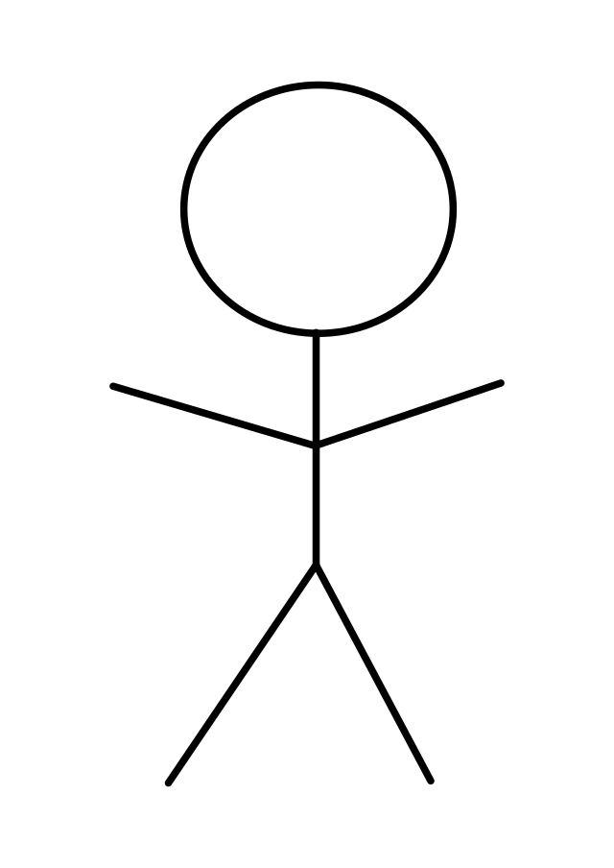
UNIT 3
CLOTHES
Let’s play!
She’s wearing a shirt, a skirt, and a hat.
Notes:
Cut out two circles, two squares, two triangles, and two rectangles from colored paper.
Have students work in pairs. Give a set of shapes to each pair of students.
Make copies of a drawing of a stick figure and give one to each pair. Describe an outfit, and have students use their shapes to “dress” the stick figure.
For example, say She’s wearing a shirt, a skirt, and a hat.
Students might put a square on as a shirt, a triangle as the skirt, and a rectangle for the hat.
Walk around and ask students about their work.
Students should say what shape each clothing item is.
Repeat this activity several times, using different clothing items each time.

Slide 75
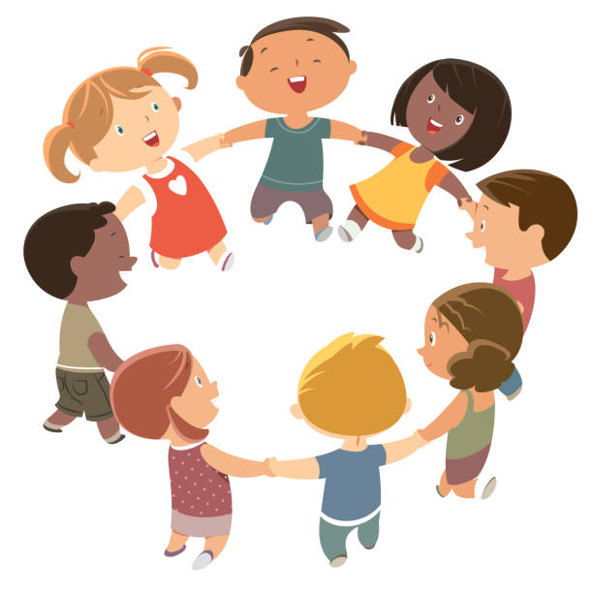
UNIT 3
CLOTHES
Let’s Review
How many shoes?
Notes:
Help the class to revise the numbers they have learnt by calling out the students in groups of 2 to 9.
Say [Maya. Derrick. Angela. Sophie. Joseph. Tom. Yiling. Claire. Rizuan.] How many shoes?
Students should say [Eighteen shoes].

Slide 76
UNIT 3
CLOTHES
Goodbye Chant
Good work, class.
Hip hip, hooray!
Goodbye for now.
Have a nice day!
Notes:
Say Good job today class. Now let’s chant.
Lead the class in the Goodbye chant.

Slide 77
UNIT 3
CLOTHES
Let’s check!
Let’s cut
rectangles and triangles
Notes:
Can students identify and name rectangles and triangles?
Give each student a piece of paper and scissors. Have them cut a rectangle and a triangle from the paper. Say each word and have them hold up the correct shape. Then, hold up each shape and call on students to name them.

Slide 78
UNIT 3
CLOTHES
Thank you!

Slide 79
Unit 3:
Clothes
Lesson 6

Slide 80
UNIT 3
CLOTHES
English Time Chant
English, (clap) English, (clap)
English (clap) today! (clap, clap)
English, (clap) English, (clap)
Hip, hip, (clap) hooray! (clap, clap)

Slide 81
UNIT 3
CLOTHES
Let’s make shapes
Stand up and
make a rectangle.
Notes:
Get students into groups.
Say Rectangle as you draw a rectangle on the board.
Students should say Rectangle.
Say Stand up and make a rectangle.
Students should make a rectangle by joining hands.
Repeat this for triangle.
Note
You can also name the groups different vocabulary words. For example, say [Shirts], make a triangle.
Note
You can also use shapes that students have learnt before. E.g., circle or square.

Slide 82
UNIT 3
CLOTHES
Let’s make shapes
Stand up and
make a triangle.
Notes:
Get students into groups.
Say Rectangle as you draw a rectangle on the board.
Students should say Rectangle.
Say Stand up and make a rectangle.
Students should make a rectangle by joining hands.
Repeat this for triangle.
Note
You can also name the groups different vocabulary words. For example, say [Shirts], make a triangle.
Note
You can also use shapes that students have learnt before. E.g., circle or square.

Slide 83
UNIT 3
CLOTHES
Let’s make shapes
Stand up and
make a square.
Notes:
Get students into groups.
Say Rectangle as you draw a rectangle on the board.
Students should say Rectangle.
Say Stand up and make a rectangle.
Students should make a rectangle by joining hands.
Repeat this for triangle.
Note
You can also name the groups different vocabulary words. For example, say [Shirts], make a triangle.
Note
You can also use shapes that students have learnt before. E.g., circle or square.

Slide 84
UNIT 3
CLOTHES
Let’s make shapes
Stand up and
make a circle.
Notes:
Get students into groups.
Say Rectangle as you draw a rectangle on the board.
Students should say Rectangle.
Say Stand up and make a rectangle.
Students should make a rectangle by joining hands.
Repeat this for triangle.
Note
You can also name the groups different vocabulary words. For example, say [Shirts], make a triangle.
Note
You can also use shapes that students have learnt before. E.g., circle or square.

Slide 85
UNIT 3
CLOTHES
How many rectangles?
18 rectangles
Notes:
Draw a variety of shapes on the board. Among these, include 18 rectangles.
Ask How many rectangles? Eighteen!
Students should say Eighteen rectangles.
Say Good job!
Play TR: B52 and ask students to repeat after the track.

Slide 86
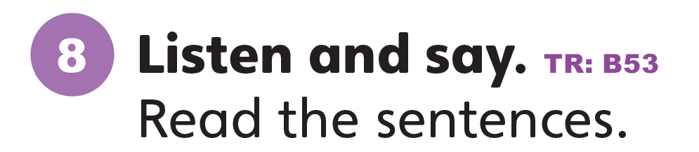
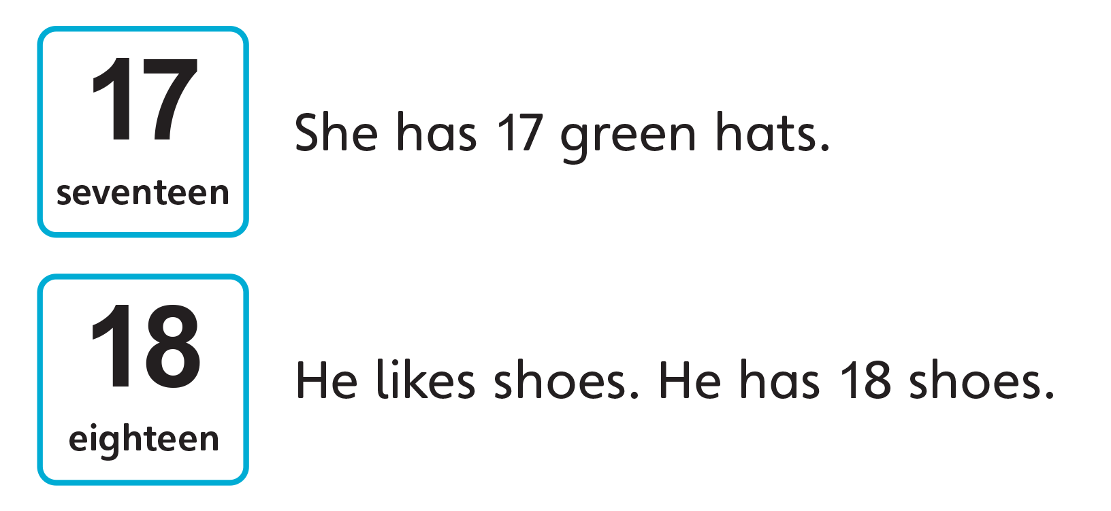
UNIT 3
CLOTHES
Notes:
8 Have students look at Activity 8.
Ask What comes after 16?
Students should say Seventeen. Eighteen.
Say That’s right! 17 and 18 come after 16.
Say Let’s listen. Repeat the numbers you hear.
Students should repeat the numbers.
Play TR: B53 and have students listen and repeat what they hear.
Point to the sentences and call on a few students to try reading them out.

Slide 87
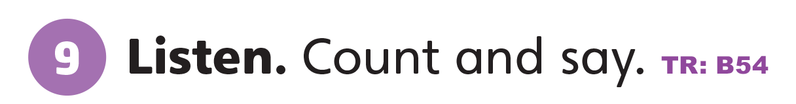
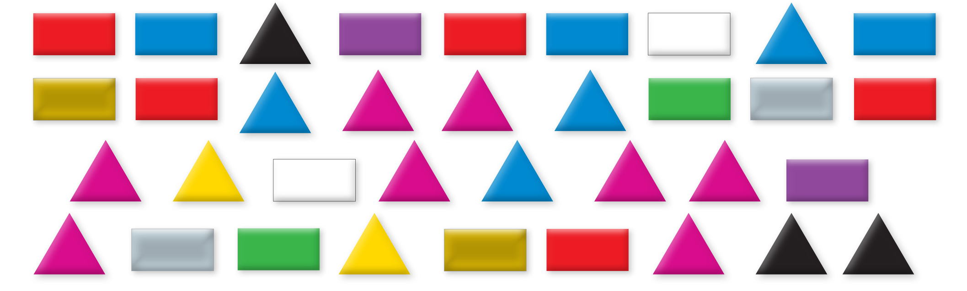
UNIT 3
CLOTHES
How many ______?
1. 18 rectangles
2. 5 red rectangles
3. 17 triangles
4. 8 pink triangles
Notes:
9 Say Listen. Play TR: B54 once without pausing.
Have students write the numbers 1–4 on a piece of paper. Play the audio again. This time, pause after each item to allow students time to count.
Students should count and write the correct shapes and numbers beside each number:
1. 18 rectangles
2. 5 red rectangles
3. 17 triangles
4. 8 pink triangles
When they finish, have students check their work by comparing their work with a partner.
Play the audio a third time for students to check their work. Ask students to read their answers to the class.

Slide 88
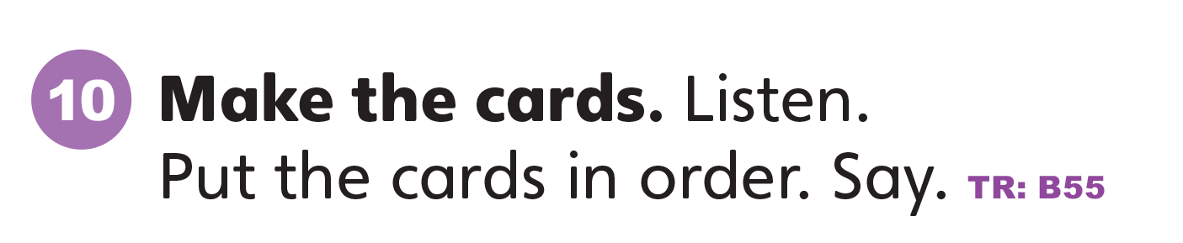
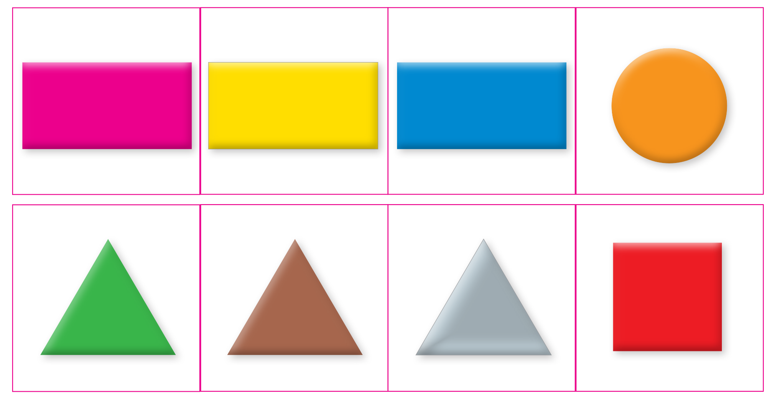
UNIT 3
CLOTHES
Notes:
10 Say Now let’s do a sticker activity.
Have students stick the stickers on poster board.
Then have them cut out the cards.
Say Let’s listen and put the cards in order.
Play TR: B55.
Pause after the first item, and ask What is it?
Students should say A yellow rectangle.
Have students put down the yellow rectangle on their desks.
Play the next item. Have students find the green triangle card and place it to the right of the rectangle.
Continue playing TR: B55 and have students place their cards in order from left to right. Walk around the room to provide help as needed.

Slide 89
UNIT 3
CLOTHES
Notes:
10 Say Now let’s do a sticker activity.
Have students stick the stickers on poster board.
Then have them cut out the cards.
Say Let’s listen and put the cards in order.
Play TR: B55.
Pause after the first item, and ask What is it?
Students should say A yellow rectangle.
Have students put down the yellow rectangle on their desks.
Play the next item. Have students find the green triangle card and place it to the right of the rectangle.
Continue playing TR: B55 and have students place their cards in order from left to right. Walk around the room to provide help as needed.

Slide 90
UNIT 3
CLOTHES
Remember the number and color
Notes:
Have students look at Activity 9 on p. 29 again.
Give them a moment to study the numbers and colors of the triangles and the rectangles.
Have them close their books. Tell students that you will be reading out five sentences. If the sentence is true, have students say Yes. If it’s false, have them say No.
Say the following five sentences:
- There are ten triangles.
Students should say No.
- There are eighteen rectangles.
Students should say Yes.
- There is a silver triangle.
Students should say No.
- There are six gold rectangles.
Students should say No.
- There are no silver triangles.
Students should say Yes.
Have students open their books again. Reread the sentences, and have students confirm their answers.

Slide 91
UNIT 3
CLOTHES
Let’s play!
Yes or No?
There are 10 triangles.
No
Notes:
Have students look at Activity 9 on p. 29 again.
Give them a moment to study the numbers and colors of the triangles and the rectangles.
Have them close their books. Tell students that you will be reading out five sentences. If the sentence is true, have students say Yes. If it’s false, have them say No.
Say the following five sentences:
- There are ten triangles.
Students should say No.
- There are eighteen rectangles.
Students should say Yes.
- There is a silver triangle.
Students should say No.
- There are six gold rectangles.
Students should say No.
- There are no silver triangles.
Students should say Yes.
Have students open their books again. Reread the sentences, and have students confirm their answers.

Slide 92
UNIT 3
CLOTHES
Let’s play!
Yes or No?
There are 18 rectangles.
Yes
Notes:
Have students look at Activity 9 on p. 29 again.
Give them a moment to study the numbers and colors of the triangles and the rectangles.
Have them close their books. Tell students that you will be reading out five sentences. If the sentence is true, have students say Yes. If it’s false, have them say No.
Say the following five sentences:
- There are ten triangles.
Students should say No.
- There are eighteen rectangles.
Students should say Yes.
- There is a silver triangle.
Students should say No.
- There are six gold rectangles.
Students should say No.
- There are no silver triangles.
Students should say Yes.
Have students open their books again. Reread the sentences, and have students confirm their answers.

Slide 93
UNIT 3
CLOTHES
Let’s play!
Yes or No?
There is a silver triangle.
No
Notes:
Have students look at Activity 9 on p. 29 again.
Give them a moment to study the numbers and colors of the triangles and the rectangles.
Have them close their books. Tell students that you will be reading out five sentences. If the sentence is true, have students say Yes. If it’s false, have them say No.
Say the following five sentences:
- There are ten triangles.
Students should say No.
- There are eighteen rectangles.
Students should say Yes.
- There is a silver triangle.
Students should say No.
- There are six gold rectangles.
Students should say No.
- There are no silver triangles.
Students should say Yes.
Have students open their books again. Reread the sentences, and have students confirm their answers.

Slide 94
UNIT 3
CLOTHES
Let’s play!
Yes or No?
There are 6 gold rectangles.
No
Notes:
Have students look at Activity 9 on p. 29 again.
Give them a moment to study the numbers and colors of the triangles and the rectangles.
Have them close their books. Tell students that you will be reading out five sentences. If the sentence is true, have students say Yes. If it’s false, have them say No.
Say the following five sentences:
- There are ten triangles.
Students should say No.
- There are eighteen rectangles.
Students should say Yes.
- There is a silver triangle.
Students should say No.
- There are six gold rectangles.
Students should say No.
- There are no silver triangles.
Students should say Yes.
Have students open their books again. Reread the sentences, and have students confirm their answers.

Slide 95
UNIT 3
CLOTHES
Let’s play!
Yes or No?
There are no silver triangles.
Yes
Notes:
Have students look at Activity 9 on p. 29 again.
Give them a moment to study the numbers and colors of the triangles and the rectangles.
Have them close their books. Tell students that you will be reading out five sentences. If the sentence is true, have students say Yes. If it’s false, have them say No.
Say the following five sentences:
- There are ten triangles.
Students should say No.
- There are eighteen rectangles.
Students should say Yes.
- There is a silver triangle.
Students should say No.
- There are six gold rectangles.
Students should say No.
- There are no silver triangles.
Students should say Yes.
Have students open their books again. Reread the sentences, and have students confirm their answers.

Slide 96
UNIT 3
CLOTHES
Goodbye Chant
Good work, class.
Hip hip, hooray!
Goodbye for now.
Have a nice day!
Notes:
Say Good job today class. Now let’s chant.
Lead the class in the Goodbye chant.

Slide 97
UNIT 3
CLOTHES
Let’s check!
Let’s cut
rectangles and triangles
Notes:
Can students identify and name rectangles and triangles?
Give each student a piece of paper and scissors. Have them cut a rectangle and a triangle from the paper. Say each word and have them hold up the correct shape. Then, hold up each shape and call on students to name them.

Slide 98
UNIT 3
CLOTHES
Thank you!

Slide 99
Unit 3:
Clothes
Lesson 7

Slide 100
UNIT 3
CLOTHES
English Time Chant
English, (clap) English, (clap)
English (clap) today! (clap, clap)
English, (clap) English, (clap)
Hip, hip, (clap) hooray! (clap, clap)

Slide 101
UNIT 3
CLOTHES
What words begin with the same sound?
✓
A COAT
A DRESS
A HAT
A SHIRT
PANTS
SHOES
SHORTS
SOCKS
✓
✓
Notes:
Slowly say the Unit 3 vocabulary, emphasizing the beginning sounds of each word.
Say A coat, a dress, a hat, pants, shoes, a shirt, shorts, a skirt, socks
Then, ask What words begin with the same sound?
Students should say Shoes, shirt, shorts.

Slide 102
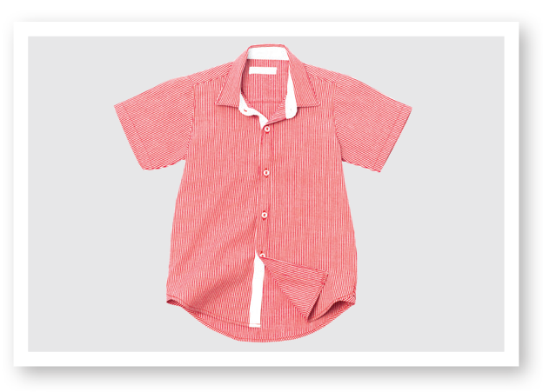

UNIT 3
CLOTHES
The Sound of English
Notes:
11 Say Let’s listen to new sounds.
Play TR: B56. Have students repeat each sound or word they hear.
Say Shirt has the /ʃ/ sound. Have students repeat the sound and the word. Then, ask students to raise their hands when they hear /ʃ/. Remind them that the sound can be heard anywhere in the word. Say the following words: Shorts, socks, she, shirt, dress.
Students should raise their hands when they hear shorts, she, shirt.

Slide 103
UNIT 3
CLOTHES
Which has the ʃ/ sound?
✓
✓
SHORTS
SOCKS
SHE
SHIRT
DRESS
✓
Notes:
11 Say Let’s listen to new sounds.
Play TR: B56. Have students repeat each sound or word they hear.
Say Shirt has the /ʃ/ sound. Have students repeat the sound and the word. Then, ask students to raise their hands when they hear /ʃ/. Remind them that the sound can be heard anywhere in the word. Say the following words: Shorts, socks, she, shirt, dress.
Students should raise their hands when they hear shorts, she, shirt.

Slide 104

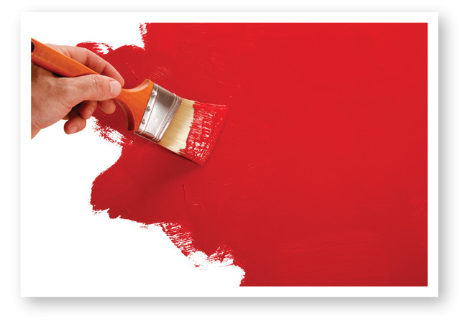
UNIT 3
CLOTHES
The Sound of English
Notes:
Say Red has the /d/ sound. Have students repeat the sound and the word. Then, ask students to raise their hands when they hear /d/. Say the following words: Write, up, dog, do, arm, bread.
Students should raise their hands when they hear dog, do, bread.

Slide 105
UNIT 3
CLOTHES
Which has the /d/ sound?
✓
WRITE
UP
DOG
DO
ARM
BREAD
✓
✓
Notes:
Say Red has the /d/ sound. Have students repeat the sound and the word. Then, ask students to raise their hands when they hear /d/. Say the following words: Write, up, dog, do, arm, bread.
Students should raise their hands when they hear dog, do, bread.

Slide 106

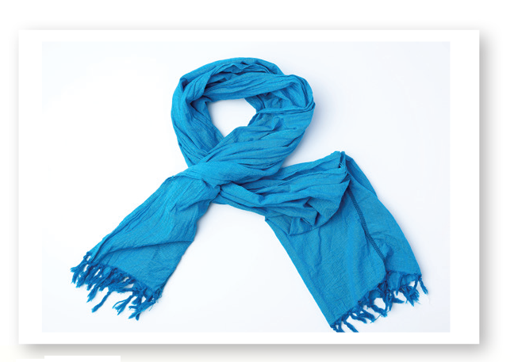
UNIT 3
CLOTHES
The Sound of English
Notes:
Say Scarf has the /f/ sound. Have students repeat the sound and the word. Then, ask students to raise their hands when they hear /f/. Say the following words: Frog, queen, father, fish, scarf.
Students should raise their hands when they hear frog, father, fish, scarf.

Slide 107
UNIT 3
CLOTHES
Which has the /f/ sound?
✓
✓
FROG
QUEEN
FATHER
FISH
SCARF
✓
✓
Notes:
Say Scarf has the /f/ sound. Have students repeat the sound and the word. Then, ask students to raise their hands when they hear /f/. Say the following words: Frog, queen, father, fish, scarf.
Students should raise their hands when they hear frog, father, fish, scarf.

Slide 108
UNIT 3
CLOTHES
Do you have /ʃ/, /d/, or /f/ in your name?
Notes:
If there are students in your class with /ʃ/, /d/, or /f/ in their names, point them out. For example, say Sheldon. What sounds do you hear in Sheldon’s name? Students should say /ʃ/, /d/.

Slide 109
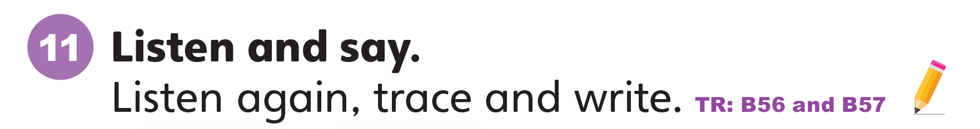
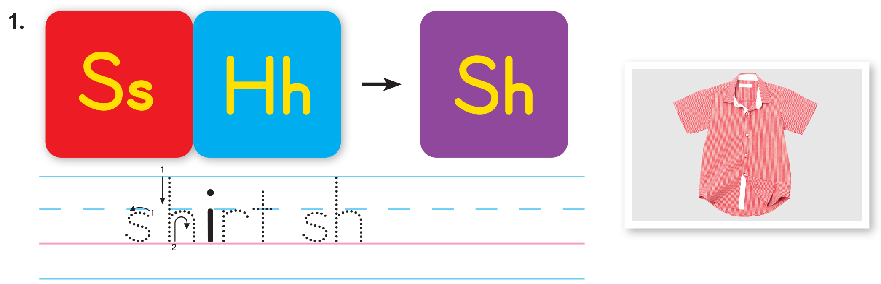
UNIT 3
CLOTHES
Notes:
Write Ss on the board. Ask What letter is this?
Students should say S.
Then write Hh on the board. Ask What letter is this?
Students should say H.
Then say The letter s together with the letter h makes the sound /ʃ/. Have students make the /ʃ/ sound.
Students should say /ʃ/.
Ask students to open their books to p. 30. Then say Let’s learn to pronounce /ʃ/. Listen and repeat what you hear.
Play TR: B56.
Have students follow along with the track by looking at Activity 11 and pointing to the letters and words.
Students should point to the letters and words as they listen.
Play the track again and have students repeat the /ʃ/ sound.
Repeat the activity for /d/ and /f/.

Slide 110

UNIT 3
CLOTHES
Let’s Say
SHIRT
Notes:
Write Ss on the board. Ask What letter is this?
Students should say S.
Then write Hh on the board. Ask What letter is this?
Students should say H.
Then say The letter s together with the letter h makes the sound /ʃ/. Have students make the /ʃ/ sound.
Students should say /ʃ/.
Ask students to open their books to p. 30. Then say Let’s learn to pronounce /ʃ/. Listen and repeat what you hear.
Play TR: B56.
Have students follow along with the track by looking at Activity 11 and pointing to the letters and words.
Students should point to the letters and words as they listen.
Play the track again and have students repeat the /ʃ/ sound.
Repeat the activity for /d/ and /f/.

Slide 111
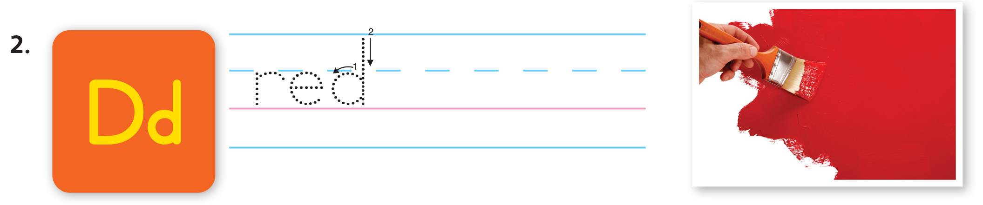
UNIT 3
CLOTHES
Notes:
Write Ss on the board. Ask What letter is this?
Students should say S.
Then write Hh on the board. Ask What letter is this?
Students should say H.
Then say The letter s together with the letter h makes the sound /ʃ/. Have students make the /ʃ/ sound.
Students should say /ʃ/.
Ask students to open their books to p. 30. Then say Let’s learn to pronounce /ʃ/. Listen and repeat what you hear.
Play TR: B56.
Have students follow along with the track by looking at Activity 11 and pointing to the letters and words.
Students should point to the letters and words as they listen.
Play the track again and have students repeat the /ʃ/ sound.
Repeat the activity for /d/ and /f/.

Slide 112
UNIT 3
CLOTHES
Let’s Say
RED
Notes:
Write Ss on the board. Ask What letter is this?
Students should say S.
Then write Hh on the board. Ask What letter is this?
Students should say H.
Then say The letter s together with the letter h makes the sound /ʃ/. Have students make the /ʃ/ sound.
Students should say /ʃ/.
Ask students to open their books to p. 30. Then say Let’s learn to pronounce /ʃ/. Listen and repeat what you hear.
Play TR: B56.
Have students follow along with the track by looking at Activity 11 and pointing to the letters and words.
Students should point to the letters and words as they listen.
Play the track again and have students repeat the /ʃ/ sound.
Repeat the activity for /d/ and /f/.

Slide 113
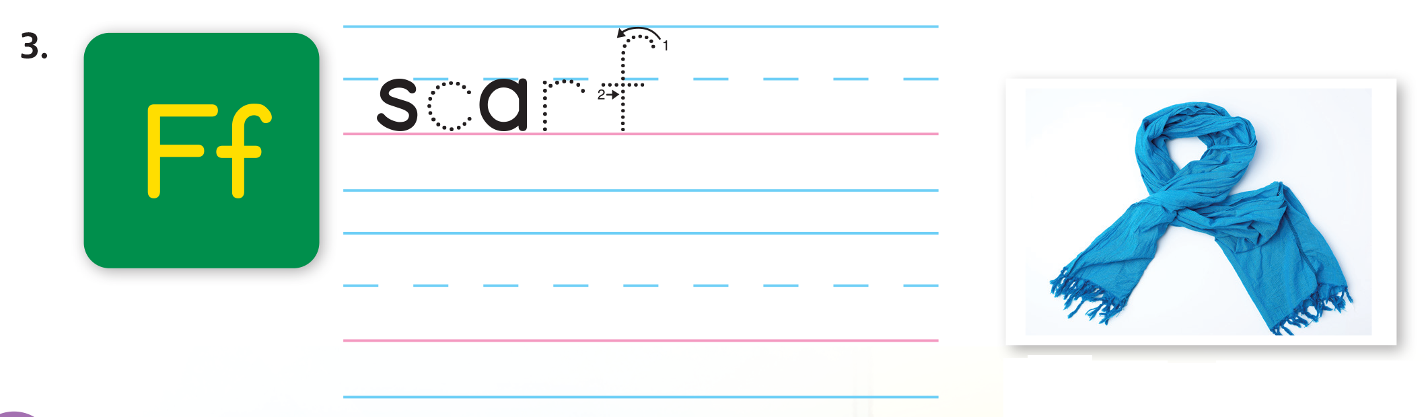
UNIT 3
CLOTHES
Notes:
Write Ss on the board. Ask What letter is this?
Students should say S.
Then write Hh on the board. Ask What letter is this?
Students should say H.
Then say The letter s together with the letter h makes the sound /ʃ/. Have students make the /ʃ/ sound.
Students should say /ʃ/.
Ask students to open their books to p. 30. Then say Let’s learn to pronounce /ʃ/. Listen and repeat what you hear.
Play TR: B56.
Have students follow along with the track by looking at Activity 11 and pointing to the letters and words.
Students should point to the letters and words as they listen.
Play the track again and have students repeat the /ʃ/ sound.
Repeat the activity for /d/ and /f/.

Slide 114
UNIT 3
CLOTHES
Let’s Say
SCARF
Notes:
Write Ss on the board. Ask What letter is this?
Students should say S.
Then write Hh on the board. Ask What letter is this?
Students should say H.
Then say The letter s together with the letter h makes the sound /ʃ/. Have students make the /ʃ/ sound.
Students should say /ʃ/.
Ask students to open their books to p. 30. Then say Let’s learn to pronounce /ʃ/. Listen and repeat what you hear.
Play TR: B56.
Have students follow along with the track by looking at Activity 11 and pointing to the letters and words.
Students should point to the letters and words as they listen.
Play the track again and have students repeat the /ʃ/ sound.
Repeat the activity for /d/ and /f/.

Slide 115
UNIT 3
CLOTHES
Let’s Trace
Notes:
Draw Sh and sh in dotted outline on the board.
Say Let’s trace the letters sh. Model tracing over the outline. Then say Look at the word and picture for shirt again. Listen to the sound /ʃ/ and use your
pencil to trace the letters sh.
Play TR: B57 and stop after shirt. Make sure students trace sh two times for shirt, and then trace and complete writing the whole word shirt.
Call on volunteers to say the word aloud.
Students should say the word Shirt.
Repeat the activity for d and f and play the rest of TR: B57.

Slide 116
UNIT 3
CLOTHES
Let’s Trace
Notes:
Draw Sh and sh in dotted outline on the board.
Say Let’s trace the letters sh. Model tracing over the outline. Then say Look at the word and picture for shirt again. Listen to the sound /ʃ/ and use your
pencil to trace the letters sh.
Play TR: B57 and stop after shirt. Make sure students trace sh two times for shirt, and then trace and complete writing the whole word shirt.
Call on volunteers to say the word aloud.
Students should say the word Shirt.
Repeat the activity for d and f and play the rest of TR: B57.

Slide 117
UNIT 3
CLOTHES
Let’s Trace
Notes:
Draw Sh and sh in dotted outline on the board.
Say Let’s trace the letters sh. Model tracing over the outline. Then say Look at the word and picture for shirt again. Listen to the sound /ʃ/ and use your
pencil to trace the letters sh.
Play TR: B57 and stop after shirt. Make sure students trace sh two times for shirt, and then trace and complete writing the whole word shirt.
Call on volunteers to say the word aloud.
Students should say the word Shirt.
Repeat the activity for d and f and play the rest of TR: B57.

Slide 118
UNIT 3
CLOTHES
Goodbye Chant
Good work, class.
Hip hip, hooray!
Goodbye for now.
Have a nice day!
Notes:
Say Good job today class. Now let’s chant.
Lead the class in the Goodbye chant.

Slide 119
UNIT 3
CLOTHES
Let’s check!
Let’s Say
Notes:
Can students identify and make the /ʃ/, /d/, and /f/ sounds?
Display pictures for shirt, red and scarf. Make a target sound, and have students point to the picture and say the word that has the sound they hear.

Slide 120
UNIT 3
CLOTHES
Thank you!

Slide 121
Unit 3:
Clothes
Lesson 8

Slide 122
UNIT 3
CLOTHES
English Time Chant
English, (clap) English, (clap)
English (clap) today! (clap, clap)
English, (clap) English, (clap)
Hip, hip, (clap) hooray! (clap, clap)

Slide 123
UNIT 3
CLOTHES
The Sound of English
Notes:
11 Say Let’s listen to new sounds.
Play TR: B56. Have students repeat each sound or word they hear.
Say Shirt has the /ʃ/ sound. Have students repeat the sound and the word. Then, ask students to raise their hands when they hear /ʃ/. Remind them that the sound can be heard anywhere in the word. Say the following words: Shorts, socks, she, shirt, dress.
Students should raise their hands when they hear shorts, she, shirt.

Slide 124
UNIT 3
CLOTHES
Which has the ʃ/ sound?
✓
✓
SHORTS
SOCKS
SHE
SHIRT
DRESS
✓
Notes:
11 Say Let’s listen to new sounds.
Play TR: B56. Have students repeat each sound or word they hear.
Say Shirt has the /ʃ/ sound. Have students repeat the sound and the word. Then, ask students to raise their hands when they hear /ʃ/. Remind them that the sound can be heard anywhere in the word. Say the following words: Shorts, socks, she, shirt, dress.
Students should raise their hands when they hear shorts, she, shirt.

Slide 125
UNIT 3
CLOTHES
The Sound of English
Notes:
Say Red has the /d/ sound. Have students repeat the sound and the word. Then, ask students to raise their hands when they hear /d/. Say the following words: Write, up, dog, do, arm, bread.
Students should raise their hands when they hear dog, do, bread.

Slide 126
UNIT 3
CLOTHES
Which has the /d/ sound?
✓
WRITE
UP
DOG
DO
ARM
BREAD
✓
✓
Notes:
Say Red has the /d/ sound. Have students repeat the sound and the word. Then, ask students to raise their hands when they hear /d/. Say the following words: Write, up, dog, do, arm, bread.
Students should raise their hands when they hear dog, do, bread.

Slide 127
UNIT 3
CLOTHES
The Sound of English
Notes:
Say Scarf has the /f/ sound. Have students repeat the sound and the word. Then, ask students to raise their hands when they hear /f/. Say the following words: Frog, queen, father, fish, scarf.
Students should raise their hands when they hear frog, father, fish, scarf.

Slide 128
UNIT 3
CLOTHES
Which has the /f/ sound?
✓
✓
FROG
QUEEN
FATHER
FISH
SCARF
✓
✓
Notes:
Say Scarf has the /f/ sound. Have students repeat the sound and the word. Then, ask students to raise their hands when they hear /f/. Say the following words: Frog, queen, father, fish, scarf.
Students should raise their hands when they hear frog, father, fish, scarf.

Slide 129
UNIT 3
CLOTHES
Do you have /ʃ/, /d/, or /f/ in your name?
Notes:
If there are students in your class with /ʃ/, /d/, or /f/ in their names, point them out. For example, say Sheldon. What sounds do you hear in Sheldon’s name? Students should say /ʃ/, /d/.

Slide 130
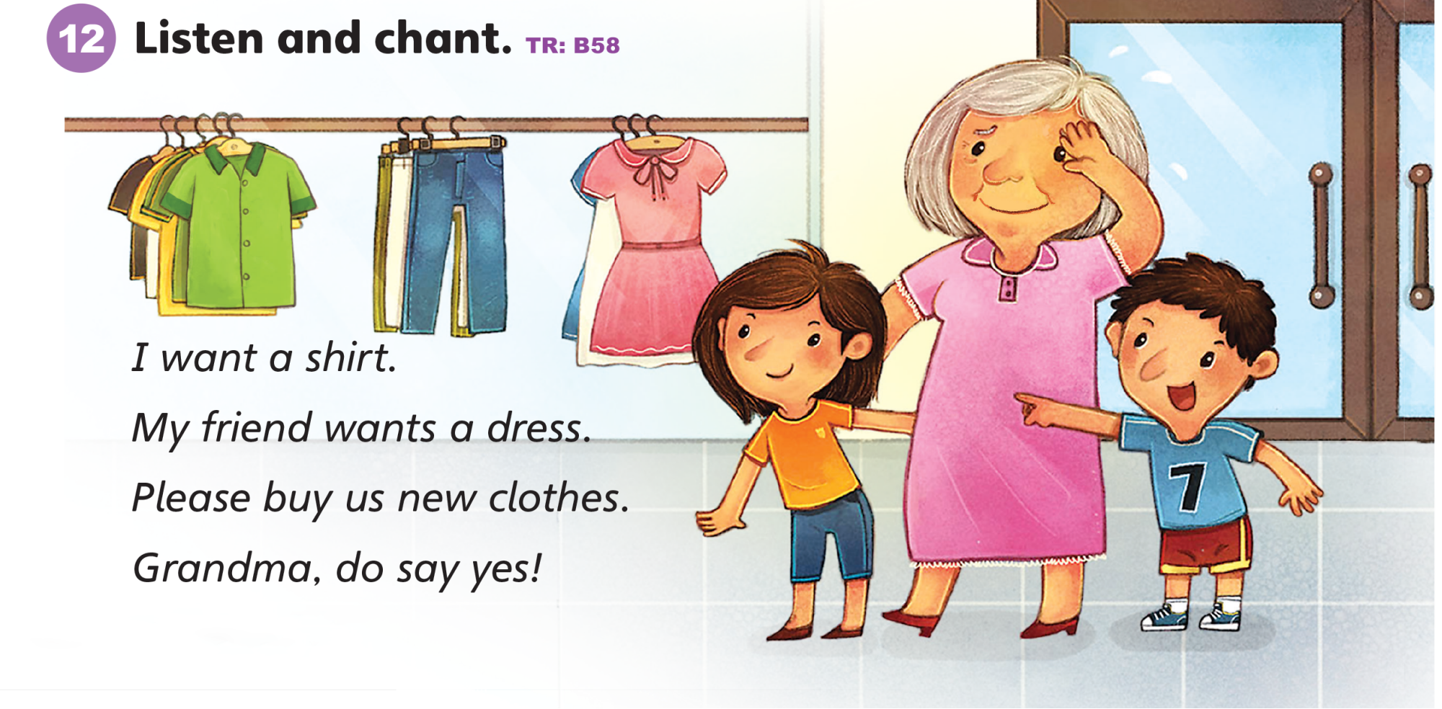
UNIT 3
CLOTHES
Notes:
12 Say Let’s listen to a chant.
Play TR: B58 two times.
Students should repeat the chant line by line.
Play TR: B58 a third time and have students repeat the chant.
Make the /ʃ/, /d/, and /f/ sounds. Have students raise their hands when they hear /ʃ/, /d/, and /f/.
Say Friend ends with /d/ but it also starts with /f/. Raise your hand when you first hear it, put it down, and then raise it again.
Then say the chant again as a class.
Students should chant and raise their hands when they hear shirt, dress, do, and friend.

Slide 131
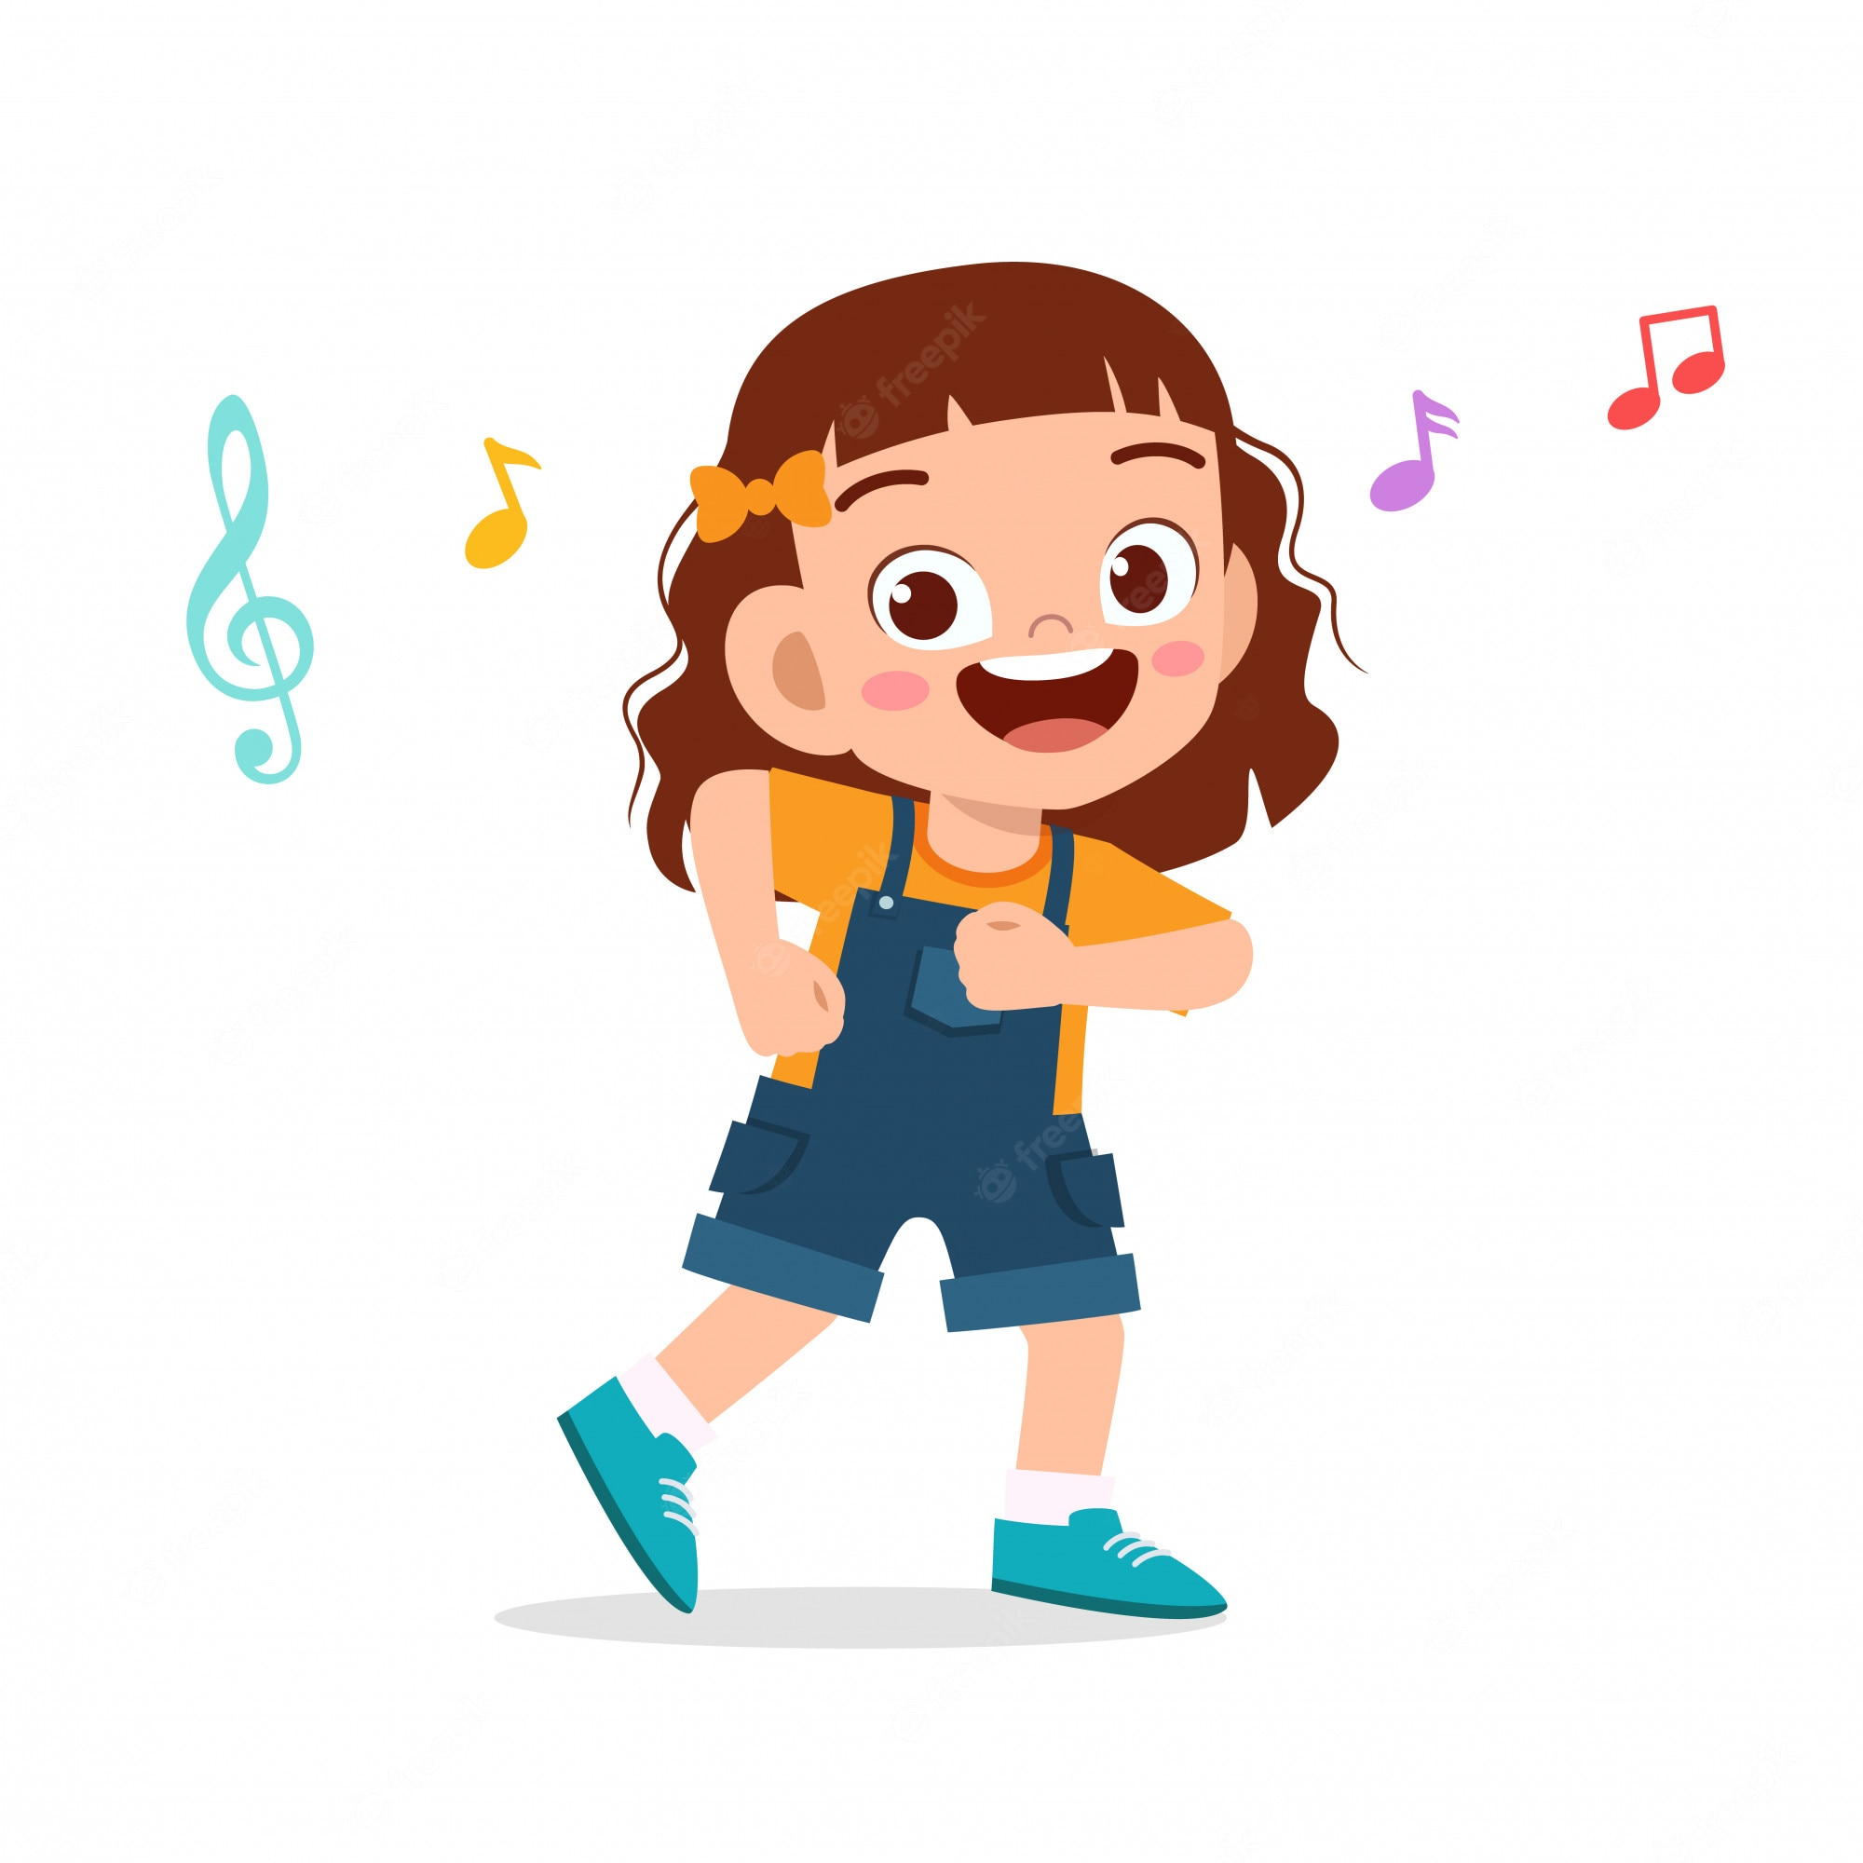
UNIT 3
CLOTHES
Let’s Play
Watch me dance
What new sound do you hear in dance?
You do it!
/d/
Notes:
Say Watch me dance.
Dance on the spot. Say the word dance again. Have students repeat the word a few times.
Students should say Dance.
Ask What new sound do you hear in dance?
Students should say /d/.
Say You do it! Have students say the word dance as they dance on the spot.
Students should say Dance.

Slide 132
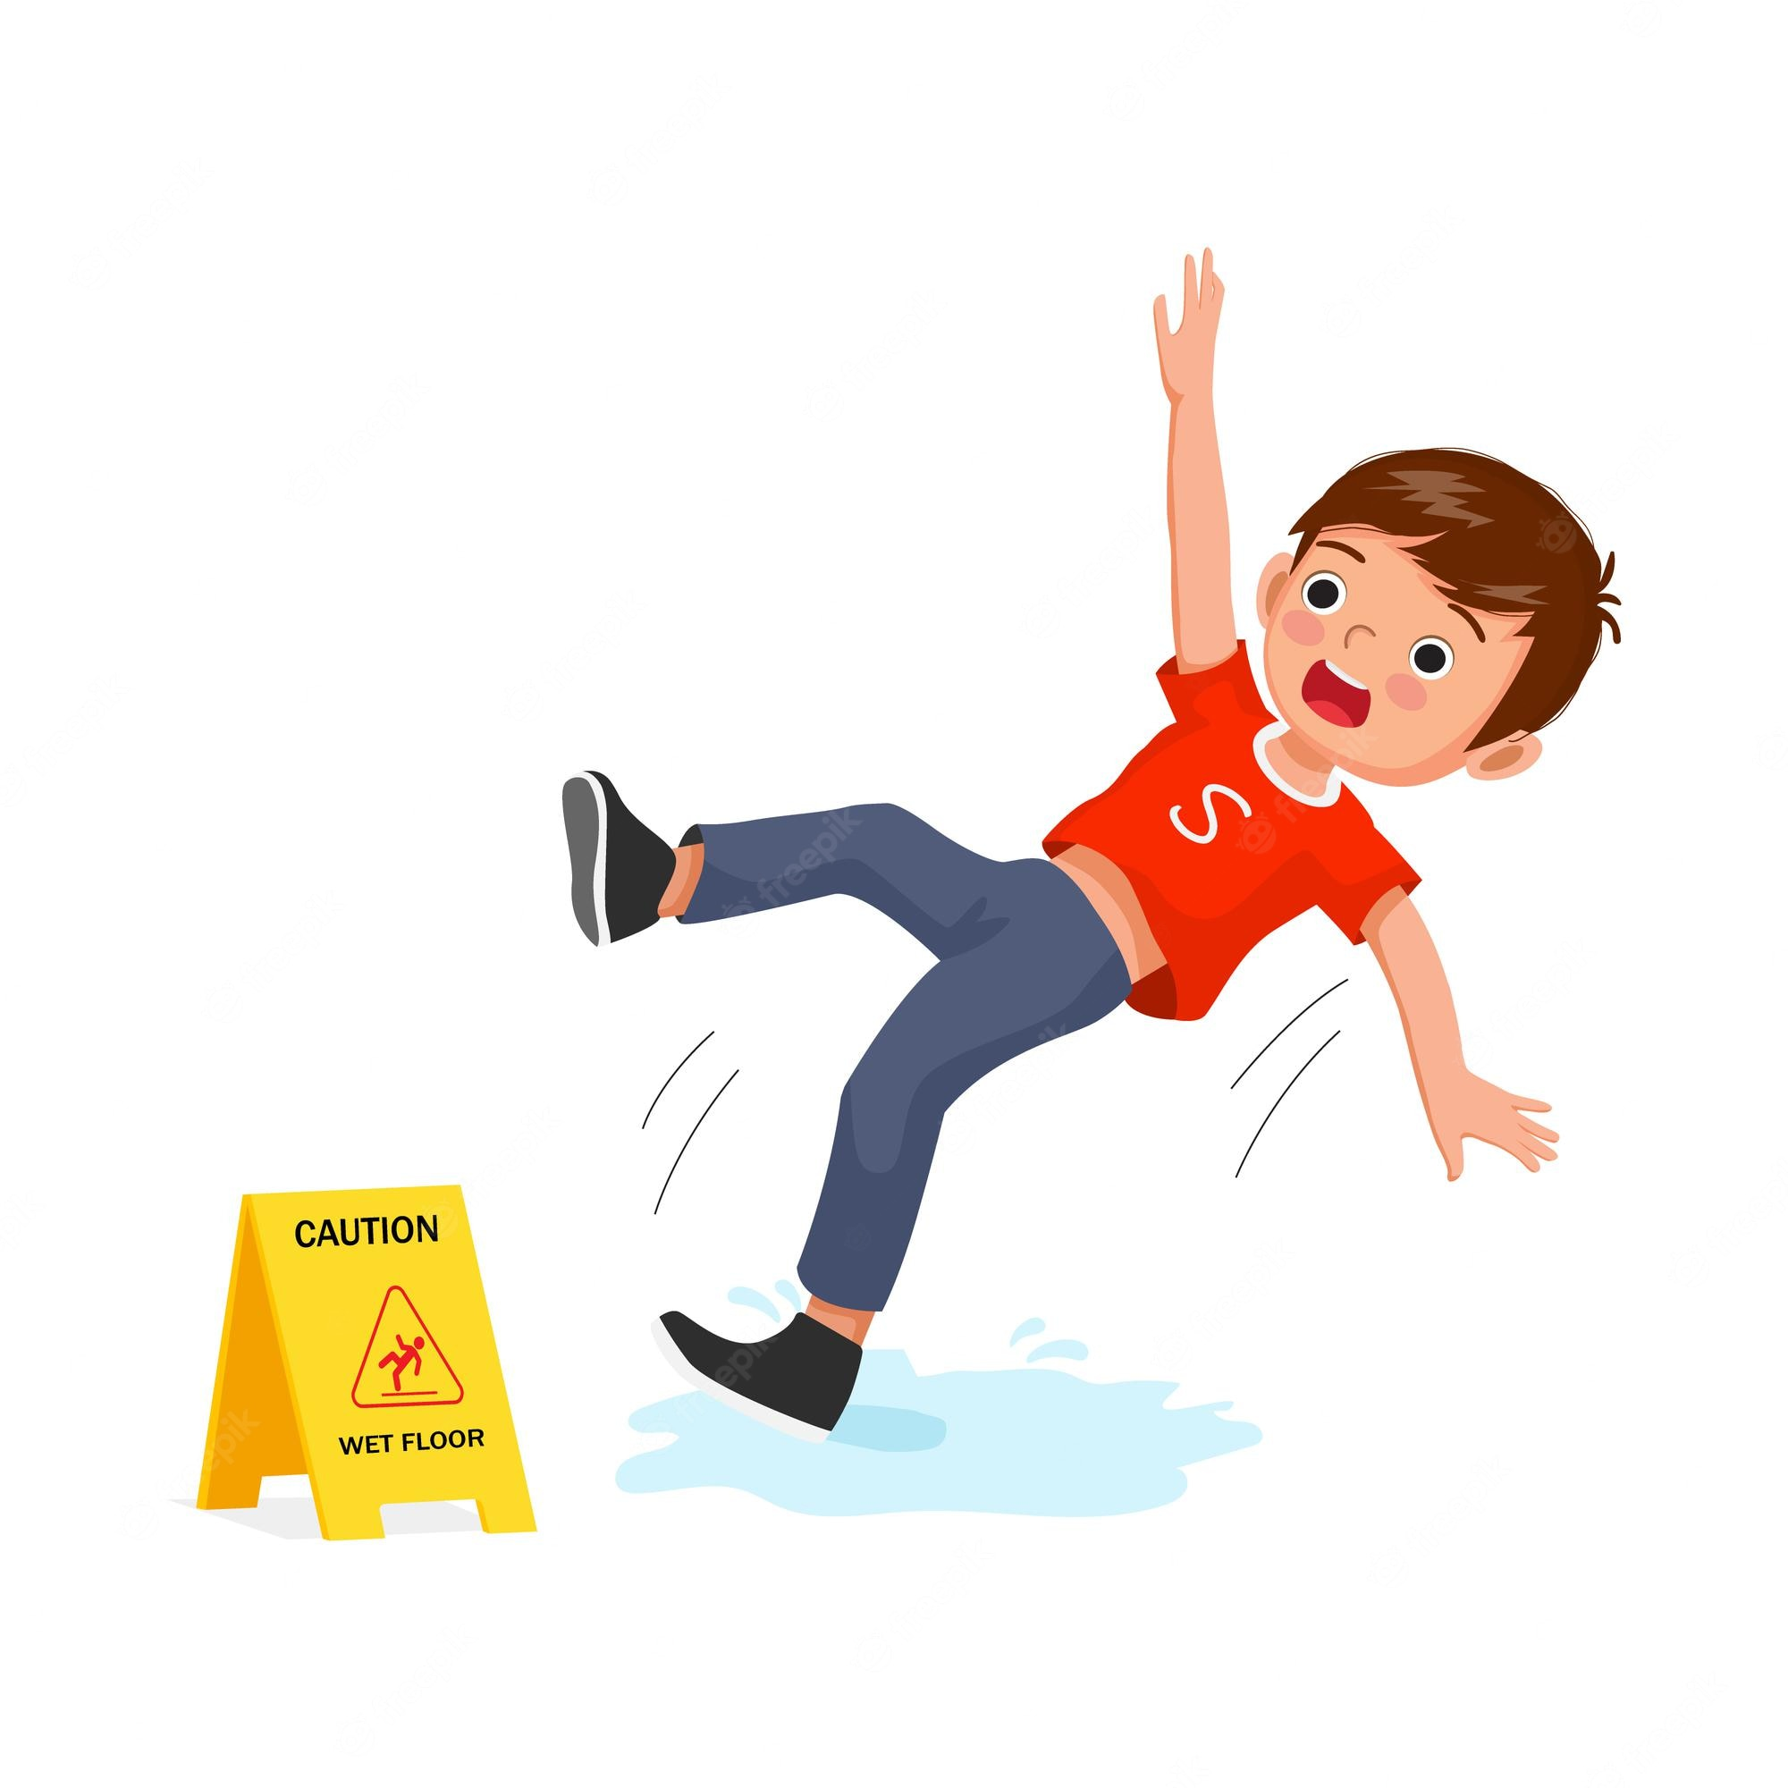
UNIT 3
CLOTHES
Let’s Play
Watch me fall
What new sound do you hear in dance?
You do it!
/f/
Notes:
Say Watch me fall.
Show students how to pretend to fall by throwing your hands up and crouching quickly. Then say the word fall and have students repeat the word a few times.
Students should say Fall.
Ask What new sound do you hear in fall?
Students should say /f/.
Have students mimic the action as they say the word fall.
Students should say Fall as they fall.

Slide 133
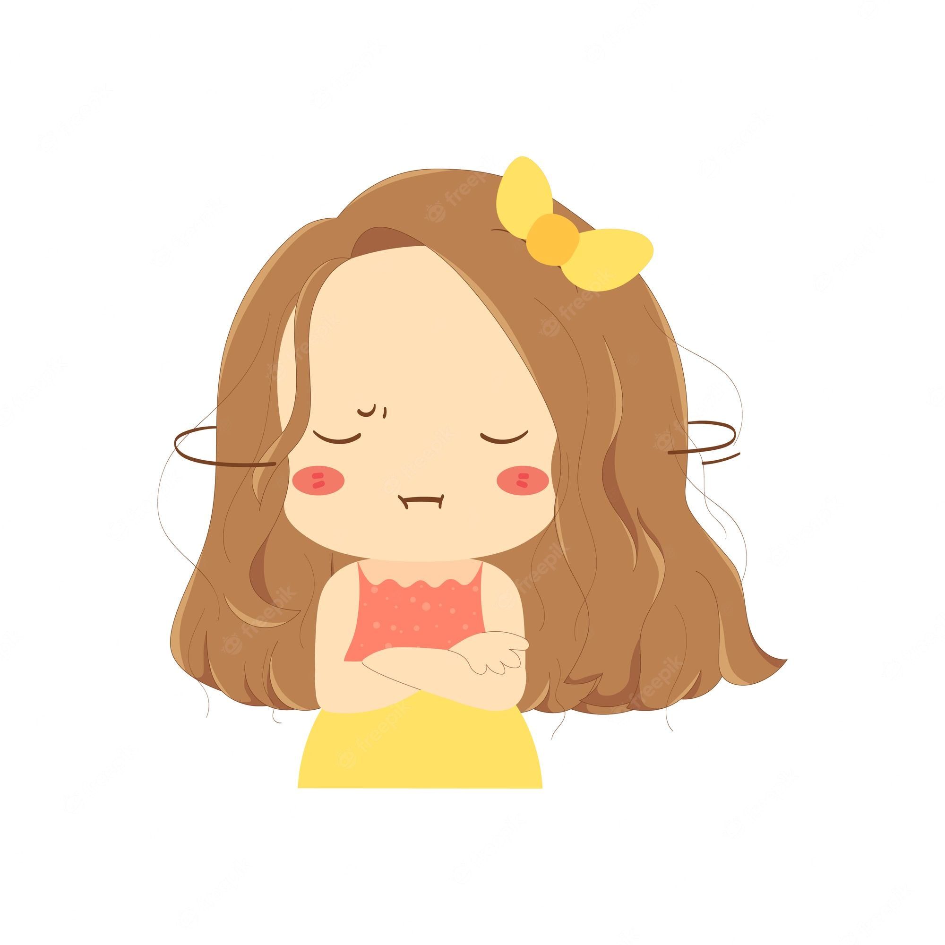
UNIT 3
CLOTHES
Let’s Play
Watch me shake
What new sound do you hear in dance?
You do it!
/ʃ/
Notes:
Say Watch me shake.
Show students how to shake your body. Then, say the word shake again. Have students repeat the word a few times.
Students should say Shake.
Ask What new sound do you hear in shake?
Students should say /ʃ/.
Have students shake as they say the word shake.
Students should say Shake as they shake their bodies.

Slide 134
UNIT 3
CLOTHES
Let’s play
Dance
Fall
Shake
Notes:
(Click the picture to show the word)
Play music, and have students get up and move around. Call out a sound, and have students say the word and do the correct move. For example, call out /ʃ/ and have students say Shake! and shake their bodies. Call out a different sound every 20 seconds or so and have students say the correct words and do the correct moves.

Slide 135
UNIT 3
CLOTHES
Let’s chant
I want shoes.
Father wants pants.
Please buy new clothes.
Mother, do say yes!
Notes:
Call on a few students to say the chant again, using different clothes and family member names. For example, a student might say I want shoes. Father
wants pants. Please buy new clothes. Mother, do say yes!

Slide 136
UNIT 3
CLOTHES
Goodbye Chant
Good work, class.
Hip hip, hooray!
Goodbye for now.
Have a nice day!
Notes:
Say Good job today class. Now let’s chant.
Lead the class in the Goodbye chant.

Slide 137
UNIT 3
CLOTHES
Let’s check!
Let’s Say
Notes:
Can students identify and make the /ʃ/, /d/, and /f/ sounds?
Display pictures for shirt, red and scarf. Make a target sound, and have students point to the picture and say the word that has the sound they hear.

Slide 138
UNIT 3
CLOTHES
Thank you!

Slide 139
Unit 3:
Clothes
Lesson 9

Slide 140
UNIT 3
CLOTHES
English Time Chant
English, (clap) English, (clap)
English (clap) today! (clap, clap)
English, (clap) English, (clap)
Hip, hip, (clap) hooray! (clap, clap)

Slide 141
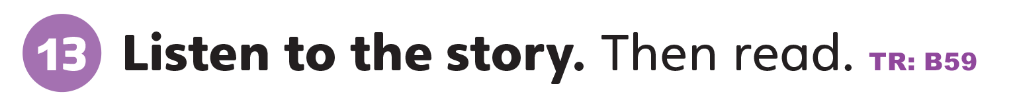
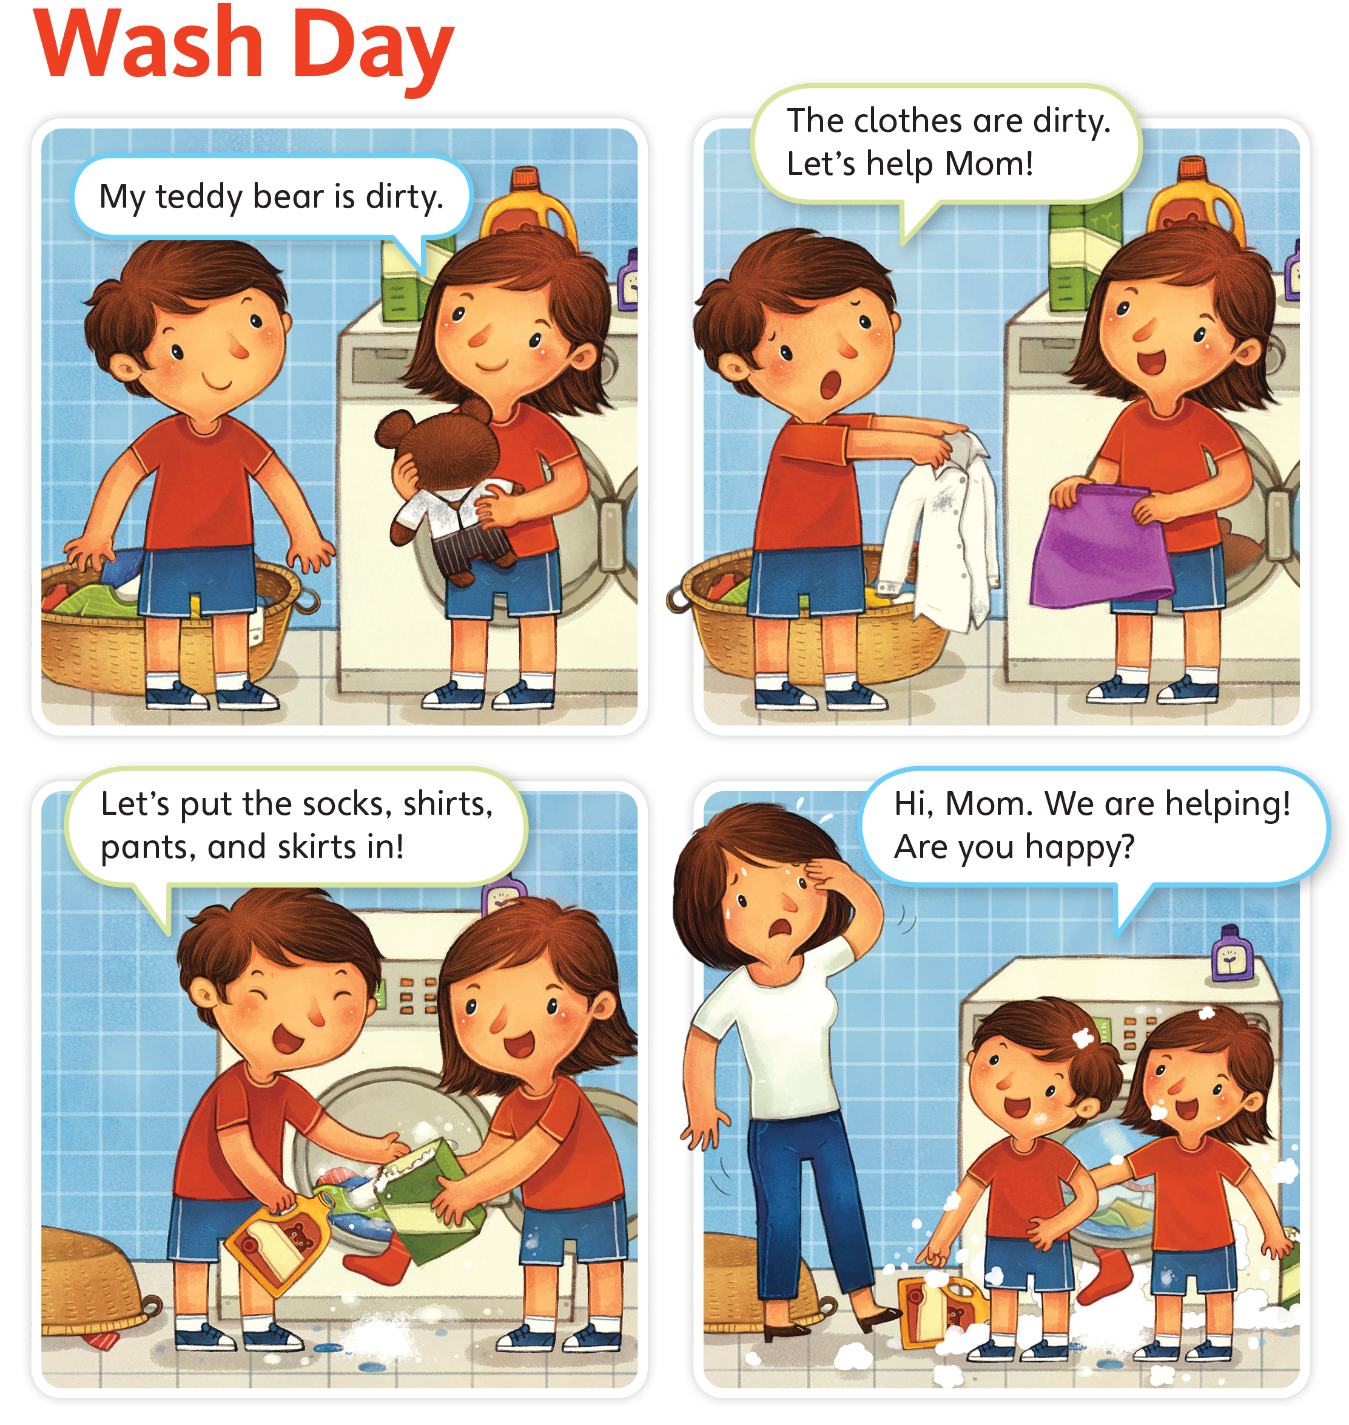
UNIT 3
CLOTHES
The children are washing clothes.
Does your father wash clothes?
In your house, does your mother wash clothes?
Do you wash clothes?
Notes:
Say This story is called Wash Day!
Point to each of the panels on p. 31 as you say The children are washing clothes.
Ask students In your house, does your mother wash clothes?
Students should raise their hands if the answer is yes.
Ask the other students Does your father wash clothes? Do you wash clothes? until you have a response from each student.
Students should raise their hands if the answer is yes to these questions.

Slide 142
UNIT 3
CLOTHES
Who is in the story?
A brother, a sister,
a mother.
What does she want to wash?
A teddy bear.
Notes:
Have students open their book to p. 31.
Ask the following questions:
Ask Who is in the story?
Students should say A brother, a sister, a mother.
Point to the first panel, and ask What does she want to wash?
Students should say A teddy bear.

Slide 143
UNIT 3
CLOTHES
What clothes are they washing? What colors are the clothes?
A red sock,
a white shirt, a purple skirt.
Notes:
Ask What clothes are they washing? What colors are the clothes?
Students should say A red sock, a white shirt, a purple skirt.
Point to the girl, and ask What’s she wearing?
Students should say A red shirt, blue shorts, white socks, blue shoes.

Slide 144
UNIT 3
CLOTHES
What’s she wearing?
A red shirt, blue shorts, white socks, blue shoes.
Notes:
Point to the girl, and ask What’s she wearing?
Students should say A red shirt, blue shorts, white socks, blue shoes.

Slide 145
UNIT 3
CLOTHES
What’s the mother wearing?
A white shirt, blue pants, brown shoes.
Notes:
Ask What’s the mother wearing?
Students should say A white shirt, blue pants, brown shoes.

Slide 146
UNIT 3
CLOTHES
Is the mother happy?
No.
Notes:
Ask Is the mother happy?
Students should say No.

Slide 147
UNIT 3
CLOTHES
Notes:
13 Say Let’s read the story.
Play TR: B59. As the story plays, point to each panel.
Play TR: B59 a second time. This time, have students point to each panel as they hear the story.
Divide students into four groups. Have each group read the text from each panel. If time permits, allow all groups to read the text from all four panels.
Alternatively, have volunteers act out the story.

Slide 148
UNIT 3
CLOTHES
The children want to help their mother.
Do you help your mother or father?
Notes:
Say The children want to help their mother.
Emphasize the word help.
Ask Do you help your mother or father?
Students should raise their hands if they help their mother or father.
Say The children help. They wash the clothes to help. What do you do?
Students should act out what they do to help at home.
Watch them, and then name the action for the class. For example, if a child acts out picking up toys, say [Juana] helps. She picks up her toys.
Say Look at the clothes. Point to the clothes in the story on p. 31.
Each time, say She has [a white shirt]. Do you have [a white shirt]?
Students should say I [have/don’t have] [a white shirt].
Ask students to think of three things that are the same in the story and in their lives. For example, students may say I have a teddy bear. My mother has brown hair. I have blue shorts.

Slide 149
UNIT 3
CLOTHES
The children help. They wash the clothes to help.
What do you do?
Notes:
Say The children want to help their mother.
Emphasize the word help.
Ask Do you help your mother or father?
Students should raise their hands if they help their mother or father.
Say The children help. They wash the clothes to help. What do you do?
Students should act out what they do to help at home.
Watch them, and then name the action for the class. For example, if a child acts out picking up toys, say [Juana] helps. She picks up her toys.
Say Look at the clothes. Point to the clothes in the story on p. 31.
Each time, say She has [a white shirt]. Do you have [a white shirt]?
Students should say I [have/don’t have] [a white shirt].
Ask students to think of three things that are the same in the story and in their lives. For example, students may say I have a teddy bear. My mother has brown hair. I have blue shorts.

Slide 150
UNIT 3
CLOTHES
She has a white shirt.
Do you have a white shirt?
Notes:
Say The children want to help their mother.
Emphasize the word help.
Ask Do you help your mother or father?
Students should raise their hands if they help their mother or father.
Say The children help. They wash the clothes to help. What do you do?
Students should act out what they do to help at home.
Watch them, and then name the action for the class. For example, if a child acts out picking up toys, say [Juana] helps. She picks up her toys.
Say Look at the clothes. Point to the clothes in the story on p. 31.
Each time, say She has [a white shirt]. Do you have [a white shirt]?
Students should say I [have/don’t have] [a white shirt].
Ask students to think of three things that are the same in the story and in their lives. For example, students may say I have a teddy bear. My mother has brown hair. I have blue shorts.

Slide 151

UNIT 3
CLOTHES
Notes:
14 Say I like the story! Hold up your book and point to the happy face.
Say I like the story. I circle the happy face. Model circling the happy face.
Gesture towards the students and ask Do you like the story? Have students choose a face and circle it.
Say Think about our other stories in Grade 1 and Unit 1. Think about this story.
Ask Which story is your favorite? Ask your partner.
Students should tell their partners what their favorite stories are.

Slide 152

UNIT 3
CLOTHES
When is your mother or father not happy? When is she or he happy? Draw!
Notes:
Give each student a piece of paper and ask the students to fold it in half.
Point to the fourth panel of the story on p. 31. Say The mother is not happy.
Ask When is your mother or father not happy? When is she or he happy? Draw!
Students should draw a picture of themselves doing something that does not make their [mother] happy on one half of the paper, and then something that
does make her happy on the other half.
Have students share their drawings with the class.

Slide 153


UNIT 3
CLOTHES
Let’s put the clothes in the story in the machine.
Notes:
Place a box in the front of the room. Say This is the washing machine.
Set out a teddy bear, a hat, a shirt, a coat, pants, a skirt, socks, shoes, shorts, and a dress.
Call on a student to come to the front of the room and put the clothes from the story into the “washing machine.”
When he or she finishes, take each item from the box, hold it up, and ask Is this right? Is there [a coat] in the story?
Students should say [Yes.]

Slide 154
UNIT 3
CLOTHES
Is this right? Is there ____ in the story?
Notes:
Place a box in the front of the room. Say This is the washing machine.
Set out a teddy bear, a hat, a shirt, a coat, pants, a skirt, socks, shoes, shorts, and a dress.
Call on a student to come to the front of the room and put the clothes from the story into the “washing machine.”
When he or she finishes, take each item from the box, hold it up, and ask Is this right? Is there [a coat] in the story?
Students should say [Yes.]

Slide 155
UNIT 3
CLOTHES
Goodbye Chant
Good work, class.
Hip hip, hooray!
Goodbye for now.
Have a nice day!
Notes:
Say Good job today class. Now let’s chant.
Lead the class in the Goodbye chant.

Slide 156

UNIT 3
CLOTHES
Let’s check!
Let’s review
Notes:
Can students listen to and understand a story?
Read Wash Day. Then, ask Is the mother happy? Are the children happy?
Students should say No, she isn’t. / Yes, they are.
Can students recognize target vocabulary in context?
Call on students to name the clothing items that the children put into the washing machine.

Slide 157
UNIT 3
CLOTHES
Is the mother happy?
No.
Notes:
Can students listen to and understand a story?
Read Wash Day. Then, ask Is the mother happy? Are the children happy?
Students should say No, she isn’t. / Yes, they are.
Can students recognize target vocabulary in context?
Call on students to name the clothing items that the children put into the washing machine.

Slide 158
UNIT 3
CLOTHES
What’s this?
It’s a _______.
Notes:
Place a box in the front of the room. Say This is the washing machine.
Set out a teddy bear, a hat, a shirt, a coat, pants, a skirt, socks, shoes, shorts, and a dress.
Call on a student to come to the front of the room and put the clothes from the story into the “washing machine.”
When he or she finishes, take each item from the box, hold it up, and ask Is this right? Is there [a coat] in the story?
Students should say [Yes.]

Slide 159
UNIT 3
CLOTHES
Thank you!

