Slide 1


Unit 4
Animals

Slide 2
Unit 4:
Animals
Lesson 1

Slide 3
UNIT 4
ANIMALS
English Time Chant
English, (clap) English, (clap)
English (clap) today! (clap, clap)
English, (clap) English, (clap)
Hip, hip, (clap) hooray! (clap, clap)

Slide 4
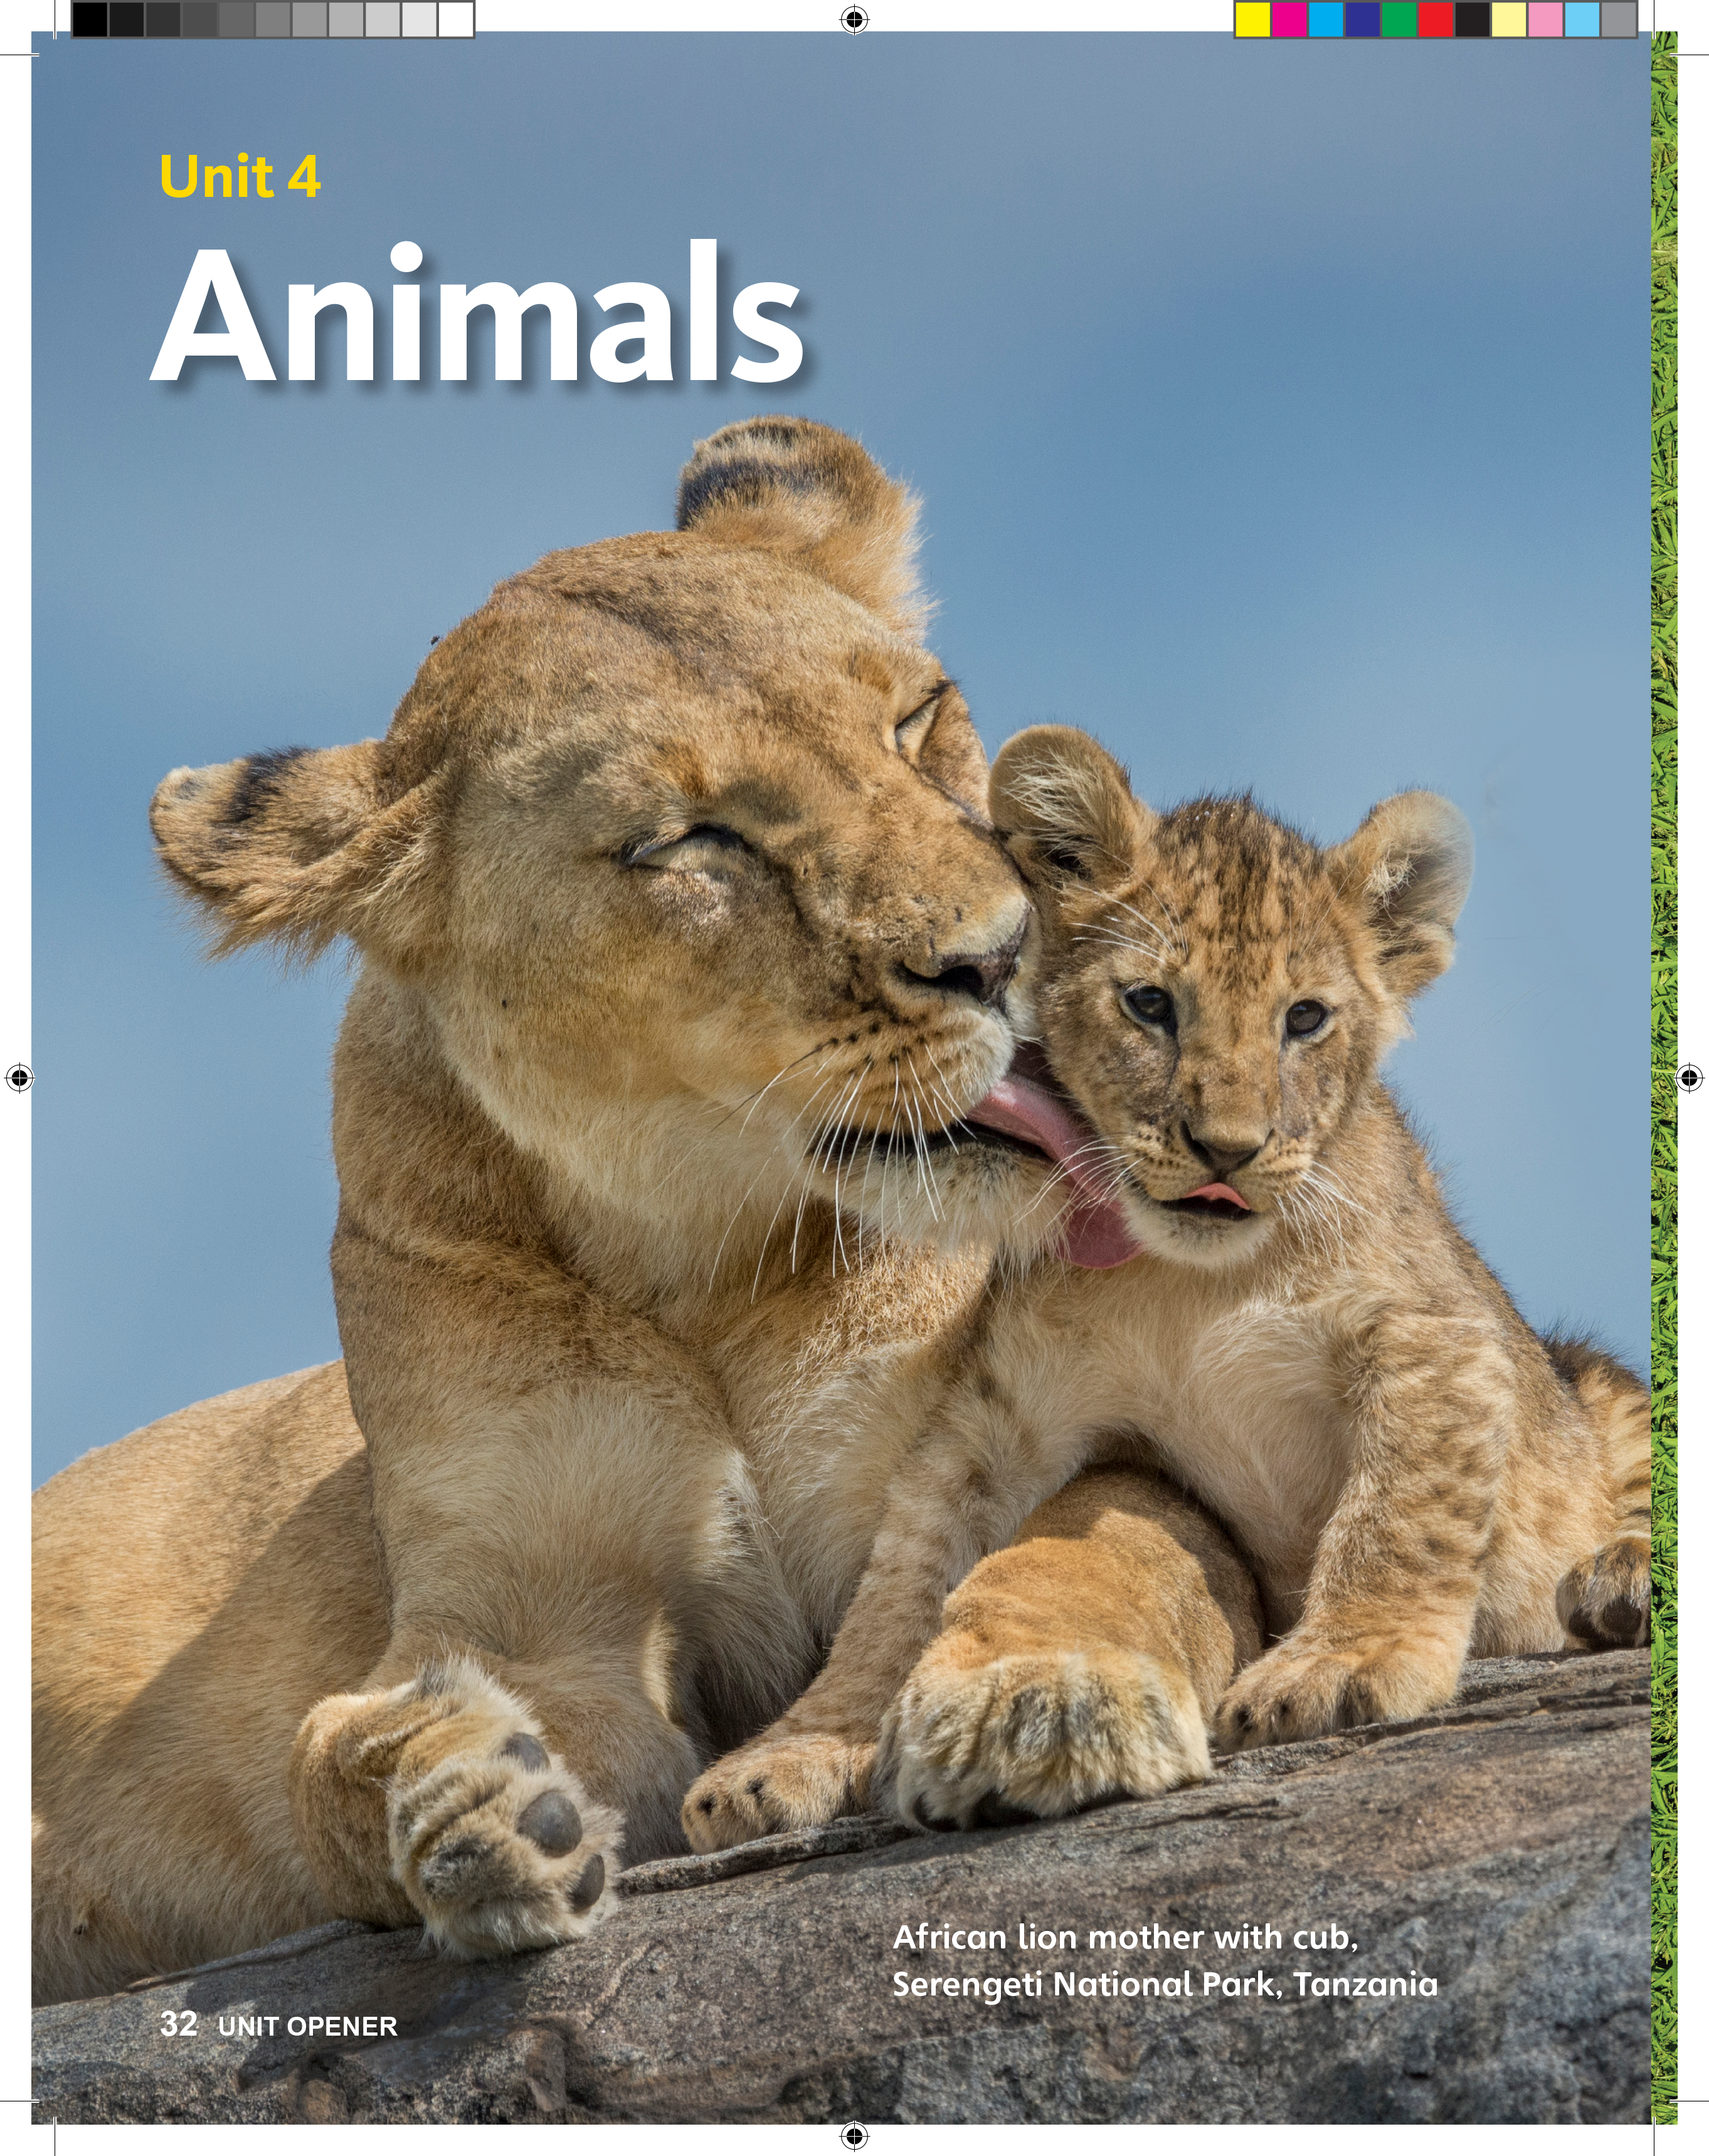
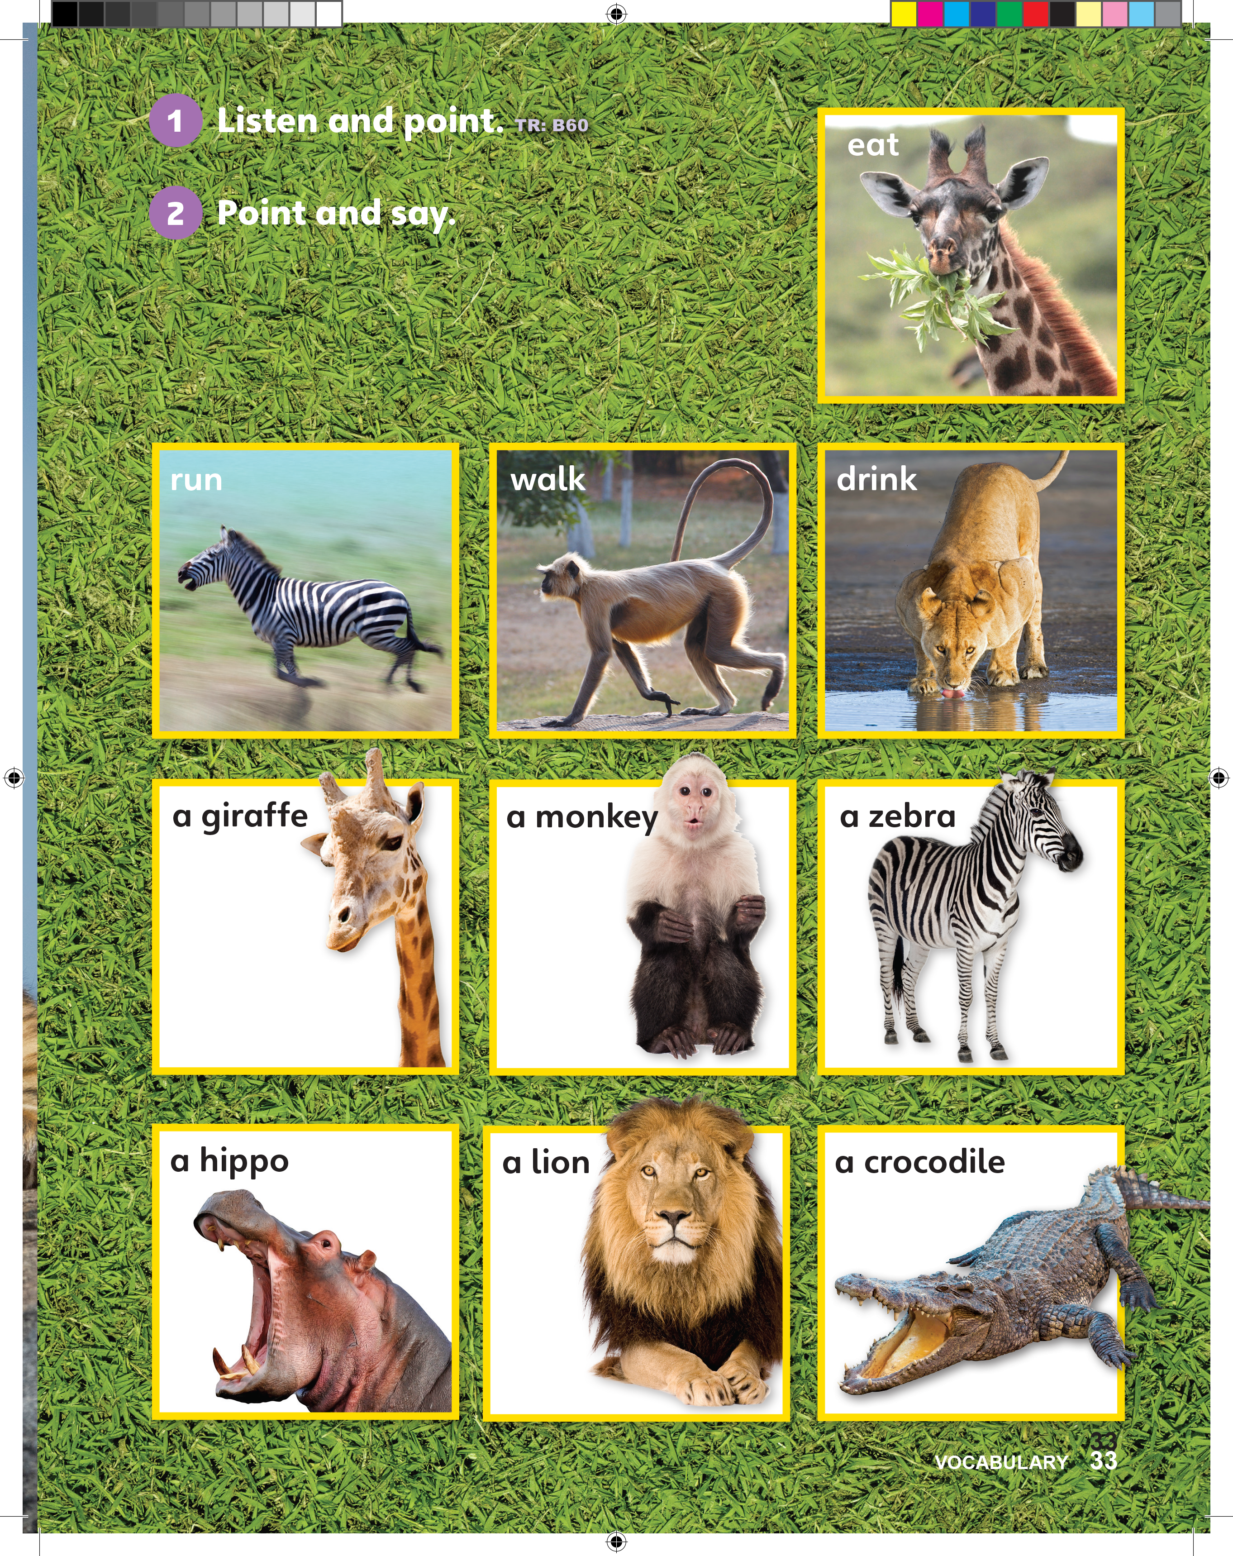
Notes:
Say In this unit, we are going to learn about animals.
Hold up the book to p. 33 to show the animals.

Slide 5

UNIT 4
ANIMALS
Let’s draw an animal
Do you have an animal at home?
Notes:
Say In this unit, we are going to learn about animals.
Hold up the book to p. 33 to show the animals.
Ask Do you have an animal at home?
Students should say Yes/No.
Have students draw their pets if they have one, or draw pets that they would like to have.
Give each student a piece of paper and some crayons.
Note
If students do not have a pet, have them draw animals that live outside their house, such as a bird or a rabbit.
When they finish, have students share their pictures. As you look at each picture, name the animal.
For example, say [Isaias] has a cat. [Sara] has a dog.

Slide 6
UNIT 4
ANIMALS
How many lions are there?
2
Are the lions standing up?
No
Notes:
Say Open your books to p. 32.
Point to the photo and say Look! These are lions.
Hold up your book and turn the page to p. 33.
Point to the lion at the bottom of the page. Say This is a lion, too!
Turn back to pp. 32, and have students look at the photo. Ask the following questions:
- How many lions are there?
Students should say Two.
- Are the lions standing up?
Students should say No.
- What colors are the lions?
Students should say [Brown and yellow/white].
- What parts of the lions’ bodies do you see?
Students should say Ears, eyes, nose, mouth, feet, and legs.
- Is the baby lion with its mother or its father?
Students should say Mother.
Note
If students do not answer correctly, point to the adult lion on pp. 32, and say Girl. Point to the lion on p. 33 and say Boy. Then, say Boy lions have more hair.

Slide 7
UNIT 4
ANIMALS
What colors are the lions?
Brown and yellow
What parts of the lions’ bodies do you see?
Ears, eyes, nose, mouth, feet, and legs.
Notes:
Say Open your books to p. 32.
Point to the photo and say Look! These are lions.
Hold up your book and turn the page to p. 33.
Point to the lion at the bottom of the page. Say This is a lion, too!
Turn back to pp. 32, and have students look at the photo. Ask the following questions:
- How many lions are there?
Students should say Two.
- Are the lions standing up?
Students should say No.
- What colors are the lions?
Students should say [Brown and yellow/white].
- What parts of the lions’ bodies do you see?
Students should say Ears, eyes, nose, mouth, feet, and legs.
- Is the baby lion with its mother or its father?
Students should say Mother.
Note
If students do not answer correctly, point to the adult lion on pp. 32, and say Girl. Point to the lion on p. 33 and say Boy. Then, say Boy lions have more hair.

Slide 8
UNIT 4
ANIMALS
Is the baby lion with its mother or its father?
Mother
Notes:
Say Open your books to p. 32.
Point to the photo and say Look! These are lions.
Hold up your book and turn the page to p. 33.
Point to the lion at the bottom of the page. Say This is a lion, too!
Turn back to pp. 32, and have students look at the photo. Ask the following questions:
- How many lions are there?
Students should say Two.
- Are the lions standing up?
Students should say No.
- What colors are the lions?
Students should say [Brown and yellow/white].
- What parts of the lions’ bodies do you see?
Students should say Ears, eyes, nose, mouth, feet, and legs.
- Is the baby lion with its mother or its father?
Students should say Mother.
Note
If students do not answer correctly, point to the adult lion on pp. 32, and say Girl. Point to the lion on p. 33 and say Boy. Then, say Boy lions have more hair.

Slide 9

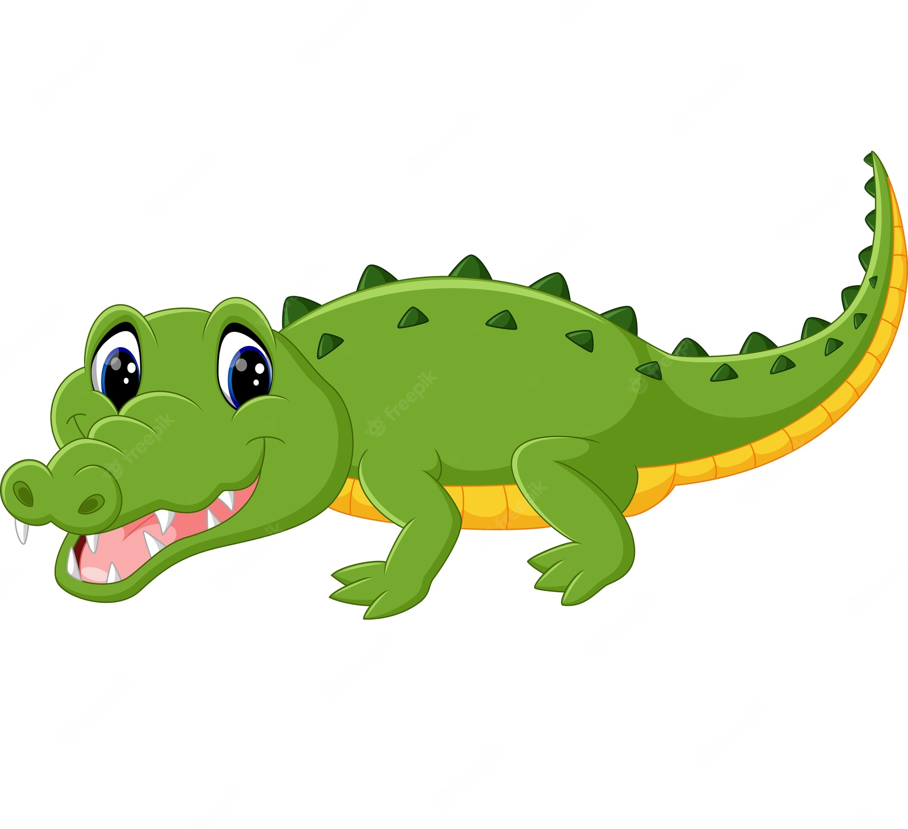
UNIT 4
ANIMALS
Can you guess?
What animal am I?
Notes:
Pretend to be one of the animals. For example, hold your arms together, and make a loud roaring sound. Have students point to the lion picture.
Continue to make the roaring sound as you walk around the room, checking that students are pointing to the correct picture.
Next, open your arms in front of you like a crocodile’s jaws.
Students should point to the crocodile picture.
Repeat this with different actions, until students have pointed to each of the pictures.
Challenge!
Call on a student to perform the action for his or her classmates.

Slide 10
UNIT 4
ANIMALS
Goodbye Chant
Good work, class.
Hip hip, hooray!
Goodbye for now.
Have a nice day!
Notes:
Say Good job today class. Now let’s chant.
Lead the class in the Goodbye chant.

Slide 11
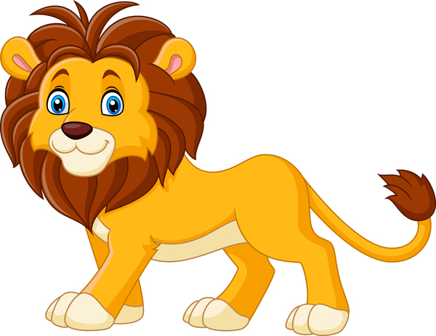
UNIT 4
ANIMALS
Let’s check!
What color is the lion?
Brown and yellow
Notes:
Can students identify animals? As students leave the class, point to the pictures in the book and ask them individually for previous vocabulary.
For example, ask:
- What color is the lion?
Students should say Brown, yellow.
- How many legs does a lion have?
Students should say Four.

Slide 12
UNIT 4
ANIMALS
Let’s check!
How many legs does a lion have?
4
Notes:
Can students identify animals? As students leave the class, point to the pictures in the book and ask them individually for previous vocabulary.
For example, ask:
- What color is the lion?
Students should say Brown, white.
- How many legs does a lion have?
Students should say Four.

Slide 13
UNIT 4
ANIMALS
Thank you!

Slide 14
Unit 4:
Animals
Lesson 2

Slide 15
UNIT 4
ANIMALS
English Time Chant
English, (clap) English, (clap)
English (clap) today! (clap, clap)
English, (clap) English, (clap)
Hip, hip, (clap) hooray! (clap, clap)

Slide 16

UNIT 4
ANIMALS
These are animals.
Notes:
Say Open your book to p. 33.
Hold up your book to p. 33. Point to each of the animals and say These are animals.

Slide 17
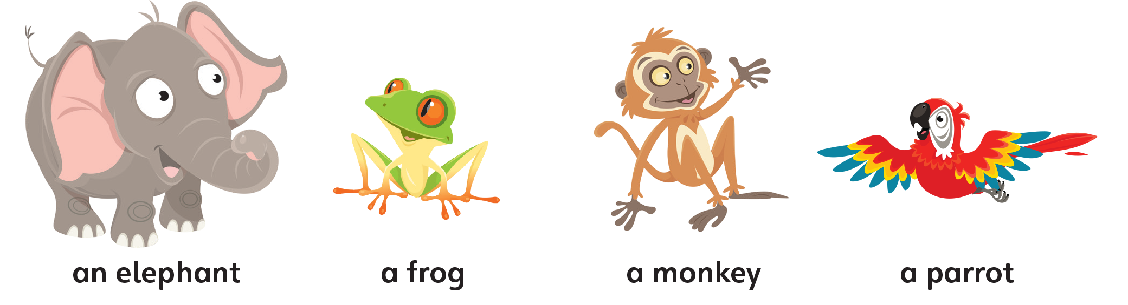
UNIT 4
ANIMALS
These are animals.
Notes:
Point to each of the mascots on p. 34 and p. 28, one at a time, and say These are animals, too.

Slide 18
UNIT 4
ANIMALS
What animal is this?
A frog
Notes:
Point to Freddy the frog and ask What animal is this?
Students should say A frog.
Point to Polly the parrot and say This is a parrot.
Repeat this with Eddie the elephant.
Then, point to Mia the monkey and say This is a monkey.
Point to the monkey on p. 33, and say This is a monkey, too!

Slide 19
UNIT 4
ANIMALS
This is a parrot.
Notes:
Point to Polly the parrot and say This is a parrot.

Slide 20
UNIT 4
ANIMALS
This is an elephant.
Notes:
Repeat this with Eddie the elephant.

Slide 21
UNIT 4
ANIMALS
This is a monkey.
Notes:
.
Then, point to Mia the monkey and say This is a monkey.

Slide 22
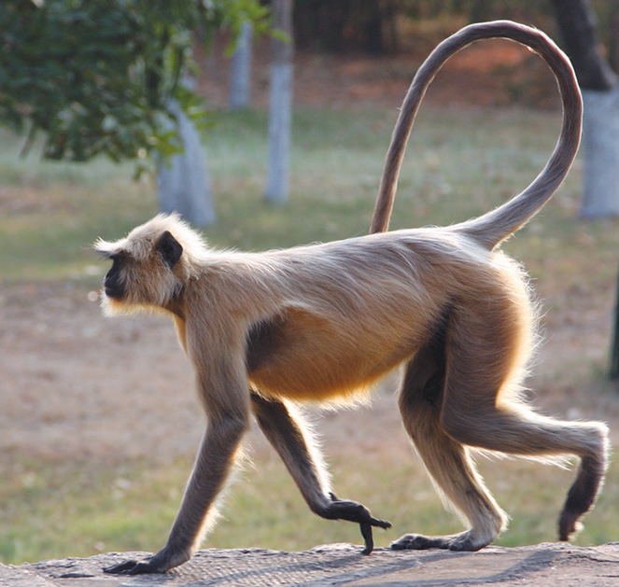
UNIT 4
ANIMALS
This is a monkey, too!
Notes:
Point to the monkey on p. 33, and say This is a monkey, too!

Slide 23
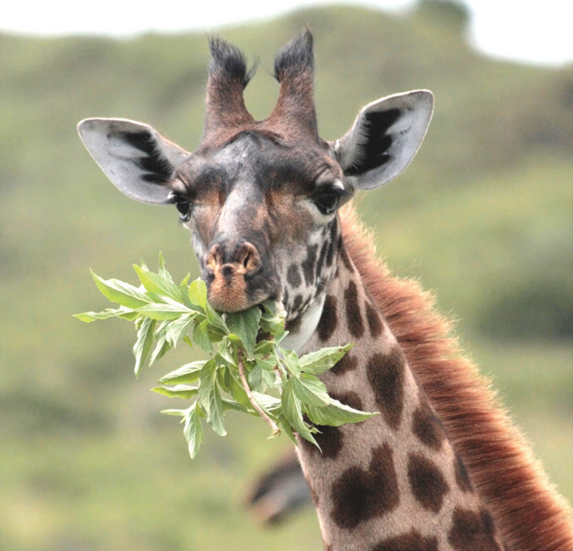
UNIT 4
ANIMALS
This is a giraffe
Notes:
Say Look at the animals.
Point to the giraffe at the top of p. 33 and say This is a giraffe.
Point to the giraffe in the middle of p. 33 and have students say the word with you.
Continue pointing to each of the animals on p. 33, say the name of each animal two times, and have students say the names of the animals.

Slide 24
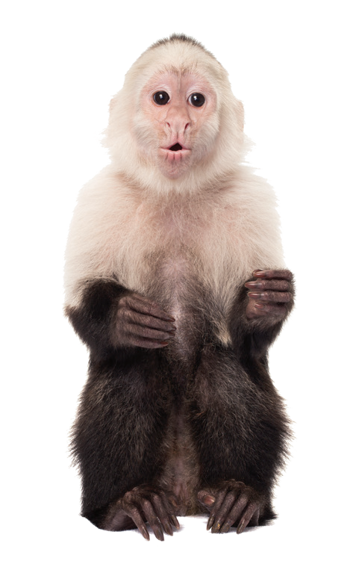
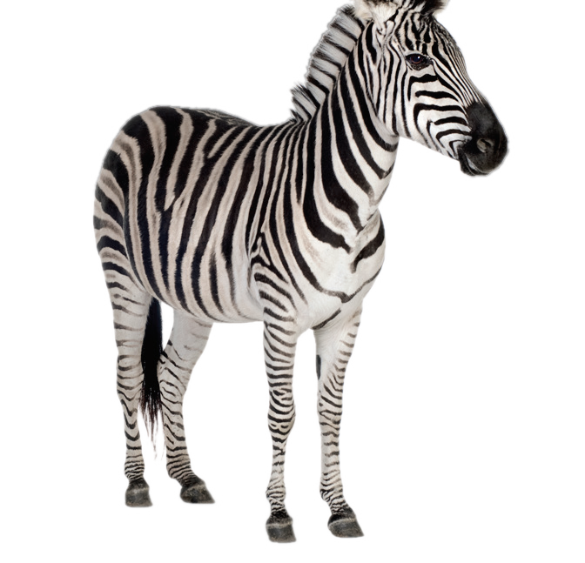
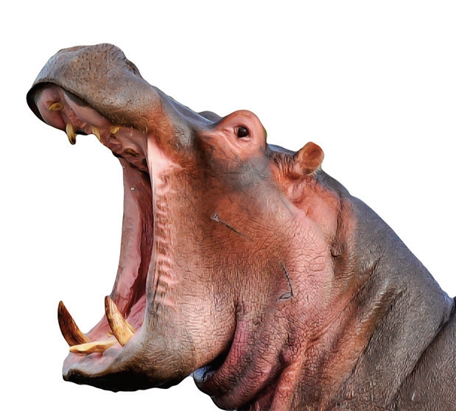
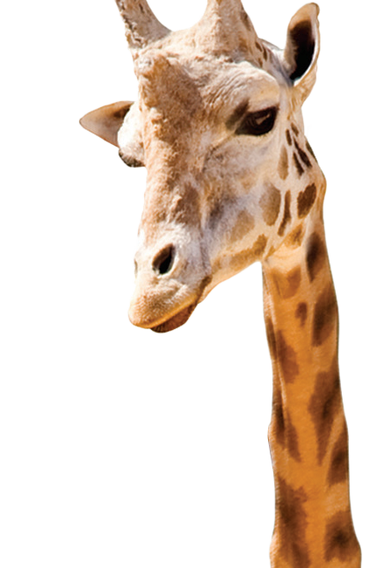
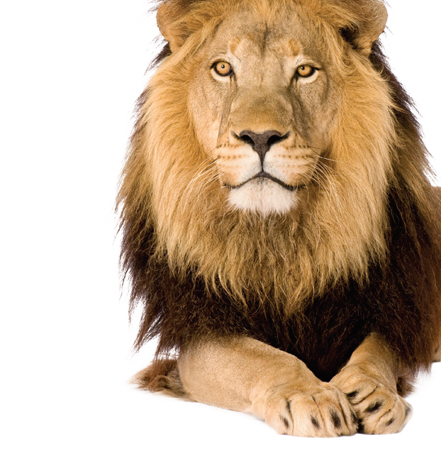
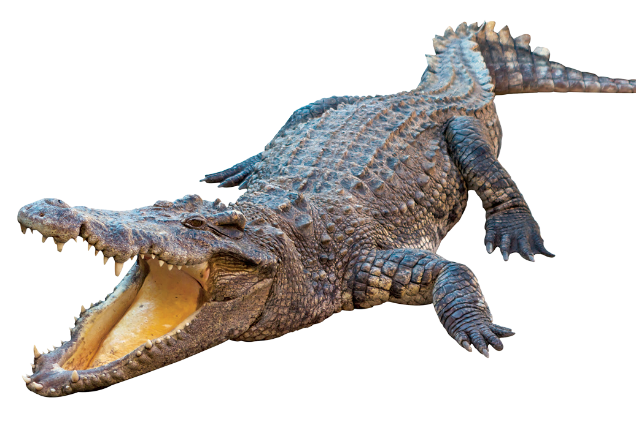
UNIT 4
ANIMALS
Repeat after me
a giraffe
a monkey
a zebra
a hippo
a lion
a crocodile
Notes:
Say Look at the animals.
Point to the giraffe at the top of p. 33 and say This is a giraffe.
Point to the giraffe in the middle of p. 33 and have students say the word with you.
Continue pointing to each of the animals on p. 33, say the name of each animal two times, and have students say the names of the animals.

Slide 25

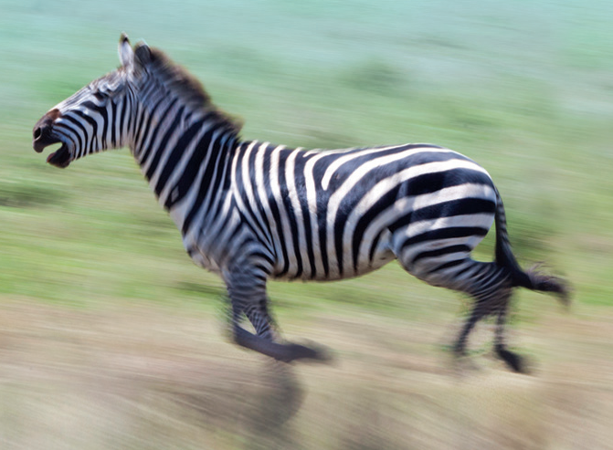
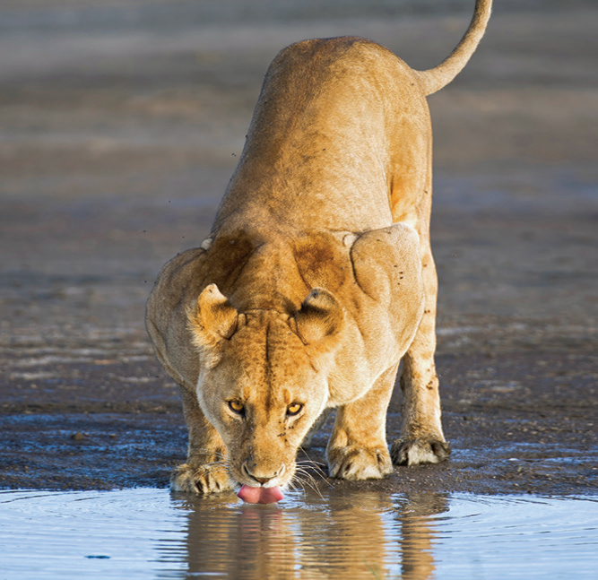
UNIT 4
ANIMALS
1
Listen and point. TR: B60
eat
run
walk
drink
a giraffe
a hippo
a monkey
a zebra
a lion
a crocodile
Notes:
1 Say Now we will hear the words. Listen and point.
Model doing this. Play TR: B60.
Pause after the first word, and ask What word did you hear?
Students should say Eat.
Model pointing to the giraffe eating on p. 33, and have students point to it, too.
Continue playing TR: B60 until students have pointed to each of the words.

Slide 26
UNIT 4
ANIMALS
What is it?
Animal
Action
a hippo
a monkey
a giraffe
eat
run
a zebra
a crocodile
a lion
walk
drink
Notes:
Before class begins, prepare a T-chart.
Print out a copy of the T-chart, and write the word Animals at the top of the left-hand column. Write Actions at the top of the right-hand column. Make enough copies so that each student has a prepared chart. Give each student a copy of the prepared T-chart.
Hold one up, and point to the word Animals in the left-hand column.
Say We are learning words for animals. Tell me an animal.
Students should say [Bird].
Then, point to the word Actions in the right-hand column, and say We are learning words for actions, too. Eat, drink, walk, and run are all actions.
Make a set of Unit 4 picture cards for each student beforehand. Pass a set to each student.
Hold up the picture card for hippo and say the word.
Ask Is a hippo an animal or an action?
Students should say An animal.
Say That’s right! A hippo is an animal.
Model gluing the hippo card in the left-hand column.
Do the same with the drink picture card, modelling how to glue it in the right-hand column. Say Now you do it!
Say Put the words in the correct column.
When they finish, check their work.
Challenge!
If students are ready, have them write the words on their T-charts by copying the words from p. 33.

Slide 27
UNIT 4
ANIMALS
What animal is this?
a giraffe
a monkey
a zebra
It’s a zebra. It’s black and white.
a hippo
a lion
a crocodile
Notes:
Point to the Unit 4 pictures, one at a time. For each animal, call on a student to name the animal and describe it by color.
For example, a student might say It’s a zebra. It’s black and white.

Slide 28
UNIT 4
ANIMALS
Goodbye Chant
Good work, class.
Hip hip, hooray!
Goodbye for now.
Have a nice day!
Notes:
Say Good job today class. Now let’s chant.
Lead the class in the Goodbye chant.

Slide 29

UNIT 4
ANIMALS
Let’s check!
What animal is it?
Notes:
Can students identify animals?
Point to pictures for the animals, one at a time. Call on students to name each animal.

Slide 30
UNIT 4
ANIMALS
What animal is this?
It’s a zebra. It’s black and white.
Notes:
Can students identify animals?
Point to pictures for the animals, one at a time. Call on students to name each animal.

Slide 31
UNIT 4
ANIMALS
What animal is this?
It’s a monkey. It’s black and white.
Notes:
Can students identify animals?
Point to pictures for the animals, one at a time. Call on students to name each animal.

Slide 32
UNIT 4
ANIMALS
What animal is this?
It’s a giraffe. It’s yellow and brown.
Notes:
Can students identify animals?
Point to pictures for the animals, one at a time. Call on students to name each animal.

Slide 33
UNIT 4
ANIMALS
What animal is this?
It’s a hippo.
It’s pink and black.
Notes:
Can students identify animals?
Point to pictures for the animals, one at a time. Call on students to name each animal.

Slide 34
UNIT 4
ANIMALS
What animal is this?
It’s a crocodile. It’s black.
Notes:
Can students identify animals?
Point to pictures for the animals, one at a time. Call on students to name each animal.

Slide 35
UNIT 4
ANIMALS
What animal is this?
It’s a lion.
It’s brown and yellow.
Notes:
Can students identify animals?
Point to pictures for the animals, one at a time. Call on students to name each animal.

Slide 36
UNIT 4
ANIMALS
Thank you!

Slide 37
Unit 4:
Animals
Lesson 3

Slide 38
UNIT 4
ANIMALS
English Time Chant
English, (clap) English, (clap)
English (clap) today! (clap, clap)
English, (clap) English, (clap)
Hip, hip, (clap) hooray! (clap, clap)

Slide 39
UNIT 4
ANIMALS
These are animals.
Notes:
Say Open your book to p. 33.
Hold up your book to p. 33. Point to each of the animals and say These are animals.
Point to the mascots, one at a time. Each time, ask Is this [a frog] or [a monkey]?
Students should say [A frog].
Continue practicing this until students are familiar with the animal names.

Slide 40
UNIT 4
ANIMALS
These are animals.
Notes:
Say Open your book to p. 33.
Hold up your book to p. 33. Point to each of the animals and say These are animals.
Point to the mascots, one at a time. Each time, ask Is this [a frog] or [a monkey]?
Students should say [A frog].
Continue practicing this until students are familiar with the animal names.

Slide 41
UNIT 4
ANIMALS
Is this a frog or
a monkey?
A frog
Notes:
Say Open your book to p. 33.
Hold up your book to p. 33. Point to each of the animals and say These are animals.
Point to the mascots, one at a time. Each time, ask Is this [a frog] or [a monkey]?
Students should say [A frog].
Continue practicing this until students are familiar with the animal names.

Slide 42
UNIT 4
ANIMALS
An elephant
Is this a parrot or
an elephant?
Notes:
Say Open your book to p. 33.
Hold up your book to p. 33. Point to each of the animals and say These are animals.
Point to the mascots, one at a time. Each time, ask Is this [a frog] or [a monkey]?
Students should say [A frog].
Continue practicing this until students are familiar with the animal names.

Slide 43
UNIT 4
ANIMALS
A monkey
Is this a parrot or
a monkey?
Notes:
Say Open your book to p. 33.
Hold up your book to p. 33. Point to each of the animals and say These are animals.
Point to the mascots, one at a time. Each time, ask Is this [a frog] or [a monkey]?
Students should say [A frog].
Continue practicing this until students are familiar with the animal names.

Slide 44
UNIT 4
ANIMALS
A parrot
Is this a parrot or
a frog?
Notes:
Say Open your book to p. 33.
Hold up your book to p. 33. Point to each of the animals and say These are animals.
Point to the mascots, one at a time. Each time, ask Is this [a frog] or [a monkey]?
Students should say [A frog].
Continue practicing this until students are familiar with the animal names.

Slide 45

UNIT 4
ANIMALS
The lion is drinking water.
Let’s drink water, too.
Notes:
Say Look at the animals.
Point to the lion near the top of p. 33 and say Look. The lion is drinking water.
Give each student a cup. Walk around the room to fill each cup with water.
Say Let’s drink water, too.
Students should say Drink! and then drink the water.

Slide 46
UNIT 4
ANIMALS
The zebra is running.
The monkey is walking.
Notes:
Say Look at the animals.
Point to the lion near the top of p. 33 and say Look. The lion is drinking water.
Give each student a cup. Walk around the room to fill each cup with water.
Say Let’s drink water, too.
Students should say Drink! and then drink the water.

Slide 47
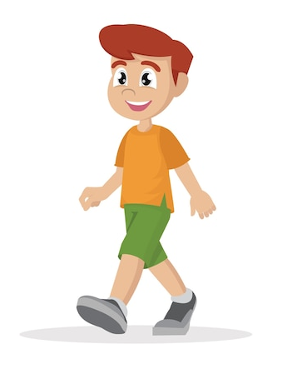
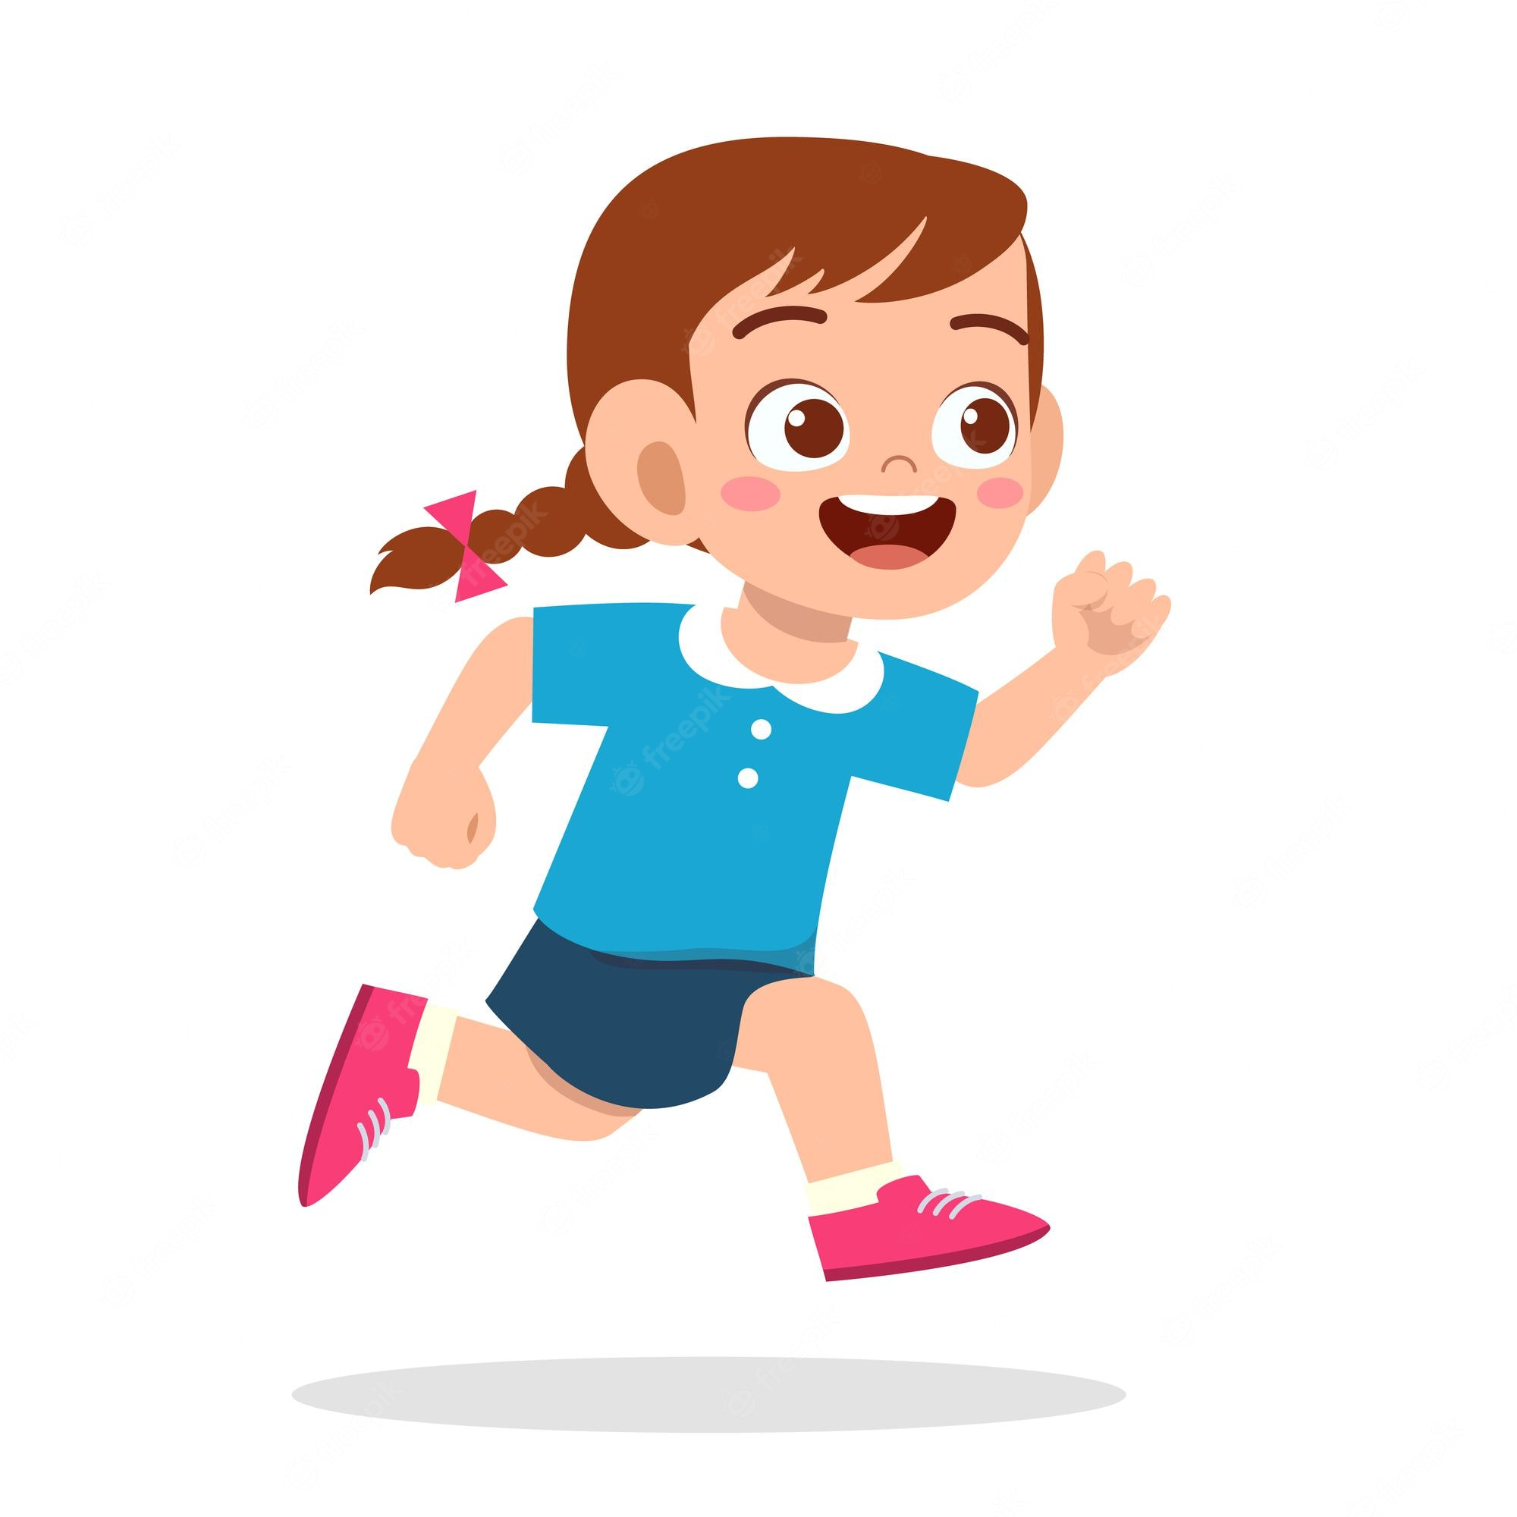
UNIT 4
ANIMALS
Do the action!
Walk
Run
Notes:
(Click the picture to show the word)
Go to one side of the room, and model running to the other side, as you say Run. Repeat this with walk.
Clear a path in the center of the room.
Students should line up on one side of the room, with the first student at one side of the path.
Say Run! and have that student run along the path.
Students should run only when they hear the teacher give the instruction.
When he or she reaches the end, ask Run or walk?
Students should say Run.
Call on the next student to walk along the path.
Repeat this, mixing up the order of run and walk, until each student has had a turn.

Slide 48
UNIT 4
ANIMALS
2
What animal is eating?
Point and say.
eat
run
walk
drink
a giraffe
a monkey
a zebra
a hippo
a lion
a crocodile
Notes:
2 Place students in pairs.
Have them take turns pointing to a photo for a word on p. 33 for their partner to say.
When students finish, ask What animal is [eating]? Repeat this for the other action words.
Students should say [A giraffe].

Slide 49
UNIT 4
ANIMALS
2
What animal is running?
Point and say.
eat
run
walk
drink
a giraffe
a monkey
a zebra
a hippo
a lion
a crocodile
Notes:
2 Place students in pairs.
Have them take turns pointing to a photo for a word on p. 33 for their partner to say.
When students finish, ask What animal is [eating]? Repeat this for the other action words.
Students should say [A giraffe].

Slide 50
UNIT 4
ANIMALS
2
What animal is drinking?
Point and say.
eat
run
walk
drink
a giraffe
a monkey
a zebra
a hippo
a lion
a crocodile
Notes:
2 Place students in pairs.
Have them take turns pointing to a photo for a word on p. 33 for their partner to say.
When students finish, ask What animal is [eating]? Repeat this for the other action words.
Students should say [A giraffe].

Slide 51
UNIT 4
ANIMALS
2
What animal is walking?
Point and say.
eat
run
walk
drink
a giraffe
a monkey
a zebra
a hippo
a lion
a crocodile
Notes:
2 Place students in pairs.
Have them take turns pointing to a photo for a word on p. 33 for their partner to say.
When students finish, ask What animal is [eating]? Repeat this for the other action words.
Students should say [A giraffe].

Slide 52

UNIT 4
ANIMALS
Eat, Freddy.
Notes:
Point to a picture of Freddy the Frog and hold up a cracker. Say Eat, Freddy and make the frog “eat” the cracker, by holding the food up to its mouth and
making an eating sound.
Hold up a cup. Say Drink, Freddy. Have the frog “drink” from the cup as you make a drinking noise with your mouth.
Give each student a cup (or have them reuse their empty water cups) and a cracker or other small snack.
Say Make Freddy eat.
Students should hold up the cracker and make eating sounds as though the frog is eating the cracker.
Point to a picture of Mia the monkey. Say Make Mia drink.
Students should hold up the cup and make drinking noises as though the monkey is drinking from the cup.
Repeat this with the other two mascots and the actions of running and walking.

Slide 53
UNIT 4
ANIMALS
Drink, Freddy.
Notes:
Point to a picture of Freddy the Frog and hold up a cracker. Say Eat, Freddy and make the frog “eat” the cracker, by holding the food up to its mouth and
making an eating sound.
Hold up a cup. Say Drink, Freddy. Have the frog “drink” from the cup as you make a drinking noise with your mouth.
Give each student a cup (or have them reuse their empty water cups) and a cracker or other small snack.
Say Make Freddy eat.
Students should hold up the cracker and make eating sounds as though the frog is eating the cracker.
Point to a picture of Mia the monkey. Say Make Mia drink.
Students should hold up the cup and make drinking noises as though the monkey is drinking from the cup.
Repeat this with the other two mascots and the actions of running and walking.

Slide 54
UNIT 4
ANIMALS
Drink, Polly.
Notes:
Point to a picture of Freddy the Frog and hold up a cracker. Say Eat, Freddy and make the frog “eat” the cracker, by holding the food up to its mouth and
making an eating sound.
Hold up a cup. Say Drink, Freddy. Have the frog “drink” from the cup as you make a drinking noise with your mouth.
Give each student a cup (or have them reuse their empty water cups) and a cracker or other small snack.
Say Make Freddy eat.
Students should hold up the cracker and make eating sounds as though the frog is eating the cracker.
Point to a picture of Mia the monkey. Say Make Mia drink.
Students should hold up the cup and make drinking noises as though the monkey is drinking from the cup.
Repeat this with the other two mascots and the actions of running and walking.

Slide 55
UNIT 4
ANIMALS
Walk, Mia.
Notes:
Point to a picture of Freddy the Frog and hold up a cracker. Say Eat, Freddy and make the frog “eat” the cracker, by holding the food up to its mouth and
making an eating sound.
Hold up a cup. Say Drink, Freddy. Have the frog “drink” from the cup as you make a drinking noise with your mouth.
Give each student a cup (or have them reuse their empty water cups) and a cracker or other small snack.
Say Make Freddy eat.
Students should hold up the cracker and make eating sounds as though the frog is eating the cracker.
Point to a picture of Mia the monkey. Say Make Mia drink.
Students should hold up the cup and make drinking noises as though the monkey is drinking from the cup.
Repeat this with the other two mascots and the actions of running and walking.

Slide 56
UNIT 4
ANIMALS
Run, Eddy.
Notes:
Point to a picture of Freddy the Frog and hold up a cracker. Say Eat, Freddy and make the frog “eat” the cracker, by holding the food up to its mouth and
making an eating sound.
Hold up a cup. Say Drink, Freddy. Have the frog “drink” from the cup as you make a drinking noise with your mouth.
Give each student a cup (or have them reuse their empty water cups) and a cracker or other small snack.
Say Make Freddy eat.
Students should hold up the cracker and make eating sounds as though the frog is eating the cracker.
Point to a picture of Mia the monkey. Say Make Mia drink.
Students should hold up the cup and make drinking noises as though the monkey is drinking from the cup.
Repeat this with the other two mascots and the actions of running and walking.

Slide 57
UNIT 4
ANIMALS
Let’s play
WALK
RUN
EAT
DRINK
Walk, Mia.
Run, Freddie.
Eat, Eddy.
Drink, Polly.
Notes:
Divide students into groups of four and have them pretend to be the mascots.
Have group members take turns giving commands for the mascots, such as Walk, Freddy or Run, Mia.
Students should take turns giving commands and following them.
Have students repeat this until all of the words have been practiced. As they work, walk around the room to watch them.
Stop at each group to check understanding. Give a command, and have students respond.

Slide 58
UNIT 4
ANIMALS
What animal is this?
a giraffe
a monkey
a zebra
It’s a zebra. It’s black and white.
a hippo
a lion
a crocodile
Notes:
Point to the Unit 4 pictures, one at a time. For each animal, call on a student to name the animal and describe it by color.
For example, a student might say It’s a zebra. It’s black and white.

Slide 59
UNIT 4
ANIMALS
What animal is this?
What is it doing?
eat
run
It’s a giraffe. It’s eating.
walk
drink
Notes:
For each action, have students name the animal and the action.

Slide 60
UNIT 4
ANIMALS
Goodbye Chant
Good work, class.
Hip hip, hooray!
Goodbye for now.
Have a nice day!
Notes:
Say Good job today class. Now let’s chant.
Lead the class in the Goodbye chant.

Slide 61
UNIT 4
ANIMALS
Let’s check!
What am I doing?
Notes:
Can students talk about actions that people and animals do?
Model doing (or pretending to do) each of the actions, and have students say what you are doing.

Slide 62
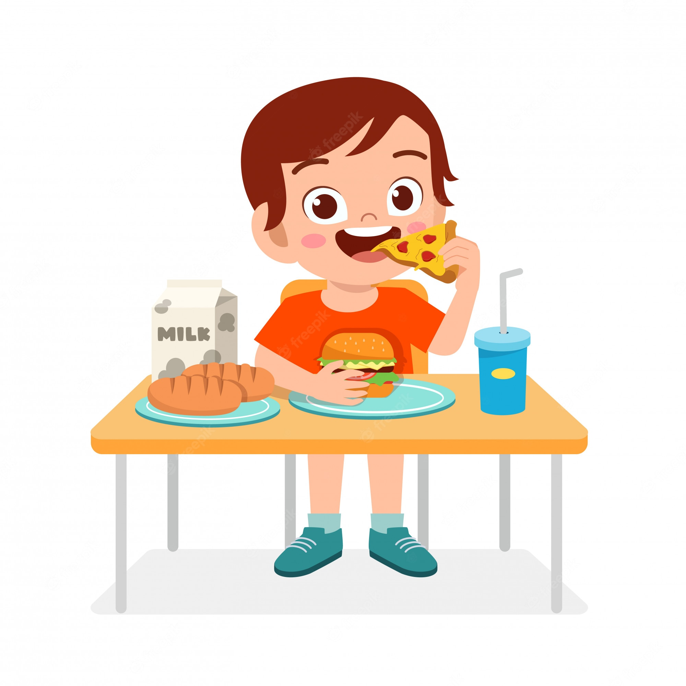
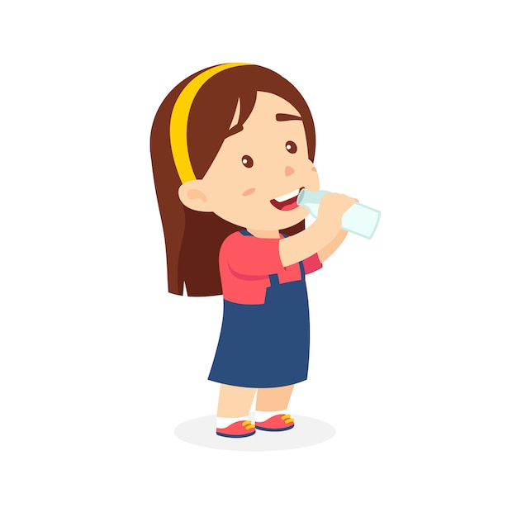
UNIT 4
ANIMALS
What am I doing?
Walk
Eat
Run
Drink
Notes:
(Click the picture to show the word)
Can students talk about actions that people and animals do?
Model doing (or pretending to do) each of the actions, and have students say what you are doing.

Slide 63
UNIT 4
ANIMALS
Thank you!

Slide 64
Unit 4:
Animals
Lesson 4

Slide 65
UNIT 4
ANIMALS
English Time Chant
English, (clap) English, (clap)
English (clap) today! (clap, clap)
English, (clap) English, (clap)
Hip, hip, (clap) hooray! (clap, clap)

Slide 66

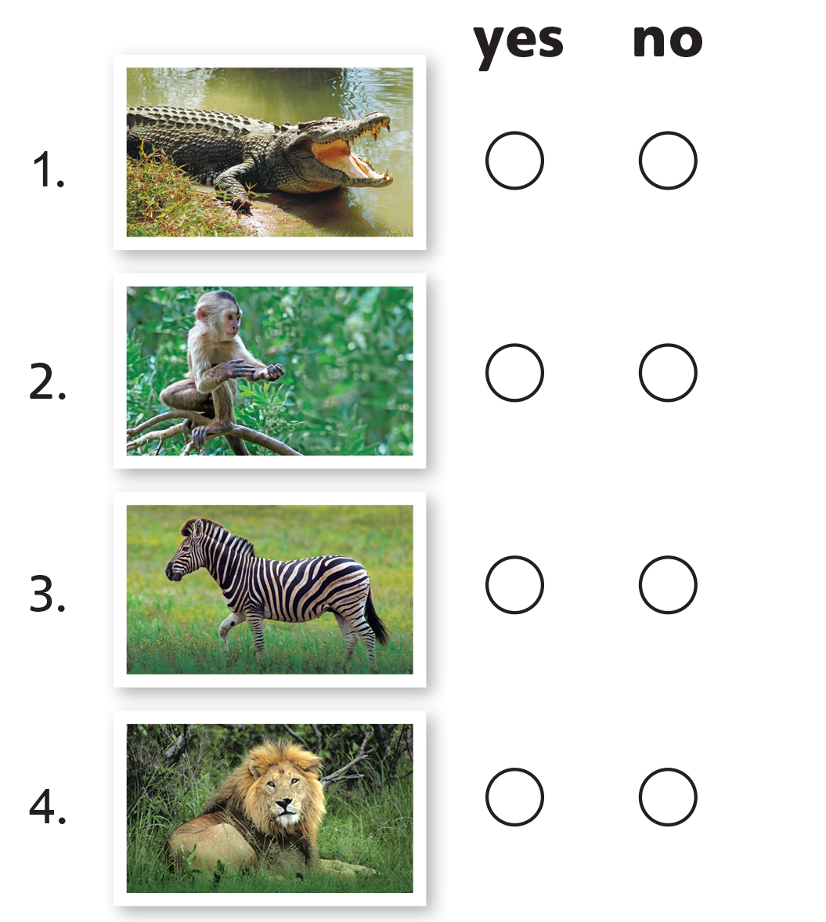
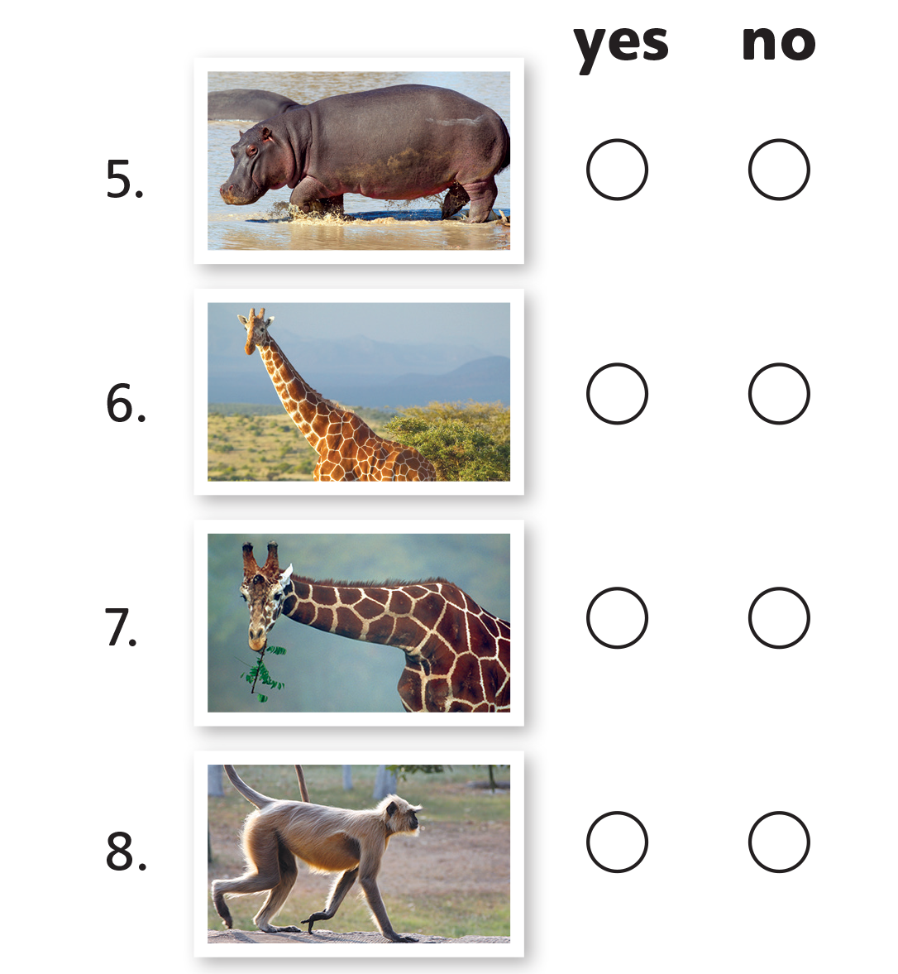
UNIT 4
ANIMALS
✓
✓
✓
✓
✓
✓
✓
✓
Notes:
3 Write the words yes and no on the board.
Call on a student to come to the board. Say Show me yes.
The student should point to the word yes on the board.
Repeat this for no.
Point to Activity 3 and say Listen. Play TR: B61.
Pause after item one and repeat the sentence and say It’s a lion.
Point to the picture of the crocodile for item one and say the sentence again.
Ask Yes or no?
Students should say No.
Say No, it’s not a lion. It’s a crocodile.
Model checking no. Then, play the rest of TR: B61.
Students should complete the activity.
When students finish, check their work.

Slide 67
UNIT 4
ANIMALS
WALKING
WALK
I’m walking.
Notes:
Write the action words on the board: eat, drink, run, walk. Then, do one of the actions. Walk across the room. Say I’m walking.
Pretend to eat, and say I’m eating.
Repeat this with running and drinking.
Next to each of the action words on the board, write that same word with the
-ing ending: eating, drinking, running, walking.

Slide 68
UNIT 4
ANIMALS
RUNNING
RUN
I’m running.
Notes:
Write the action words on the board: eat, drink, run, walk. Then, do one of the actions. Walk across the room. Say I’m walking.
Pretend to eat, and say I’m eating.
Repeat this with running and drinking.
Next to each of the action words on the board, write that same word with the
-ing ending: eating, drinking, running, walking.

Slide 69
UNIT 4
ANIMALS
EATING
EAT
I’m eating.
Notes:
Write the action words on the board: eat, drink, run, walk. Then, do one of the actions. Walk across the room. Say I’m walking.
Pretend to eat, and say I’m eating.
Repeat this with running and drinking.
Next to each of the action words on the board, write that same word with the
-ing ending: eating, drinking, running, walking.

Slide 70
UNIT 4
ANIMALS
DRINKING
DRINK
I’m drinking.
Notes:
Write the action words on the board: eat, drink, run, walk. Then, do one of the actions. Walk across the room. Say I’m walking.
Pretend to eat, and say I’m eating.
Repeat this with running and drinking.
Next to each of the action words on the board, write that same word with the
-ing ending: eating, drinking, running, walking.

Slide 71
UNIT 4
ANIMALS
Let’s chant!
Walk
Walking, walking, walking.
Notes:
Have students stand up at their desks. Say Walk.
Model walking in place, and have students do it, too.
Then, chant Walking, walking, walking as you walk in place.
Students should repeat the chant and walk in place.
Pretend to eat with a fork and knife, as you chant Eating, eating, eating.
Students should repeat Eating, eating, eating as they pretend to eat.
Note
If students feel more comfortable using a spoon and chopsticks, do this action instead.
Repeat this with drinking and running.
Stop doing the actions and give students commands to chant and do the actions. Revise all four of the action words.

Slide 72
UNIT 4
ANIMALS
Let’s chant!
Eat
Eating, eating, eating.
Notes:
Have students stand up at their desks. Say Walk.
Model walking in place, and have students do it, too.
Then, chant Walking, walking, walking as you walk in place.
Students should repeat the chant and walk in place.
Pretend to eat with a fork and knife, as you chant Eating, eating, eating.
Students should repeat Eating, eating, eating as they pretend to eat.
Note
If students feel more comfortable using a spoon and chopsticks, do this action instead.
Repeat this with drinking and running.
Stop doing the actions and give students commands to chant and do the actions. Revise all four of the action words.

Slide 73
UNIT 4
ANIMALS
Let’s chant!
Drink
Drinking, drinking, drinking.
Notes:
Have students stand up at their desks. Say Walk.
Model walking in place, and have students do it, too.
Then, chant Walking, walking, walking as you walk in place.
Students should repeat the chant and walk in place.
Pretend to eat with a fork and knife, as you chant Eating, eating, eating.
Students should repeat Eating, eating, eating as they pretend to eat.
Note
If students feel more comfortable using a spoon and chopsticks, do this action instead.
Repeat this with drinking and running.
Stop doing the actions and give students commands to chant and do the actions. Revise all four of the action words.

Slide 74
UNIT 4
ANIMALS
Let’s chant!
Run
Running, running, running.
Notes:
Have students stand up at their desks. Say Walk.
Model walking in place, and have students do it, too.
Then, chant Walking, walking, walking as you walk in place.
Students should repeat the chant and walk in place.
Pretend to eat with a fork and knife, as you chant Eating, eating, eating.
Students should repeat Eating, eating, eating as they pretend to eat.
Note
If students feel more comfortable using a spoon and chopsticks, do this action instead.
Repeat this with drinking and running.
Stop doing the actions and give students commands to chant and do the actions. Revise all four of the action words.

Slide 75
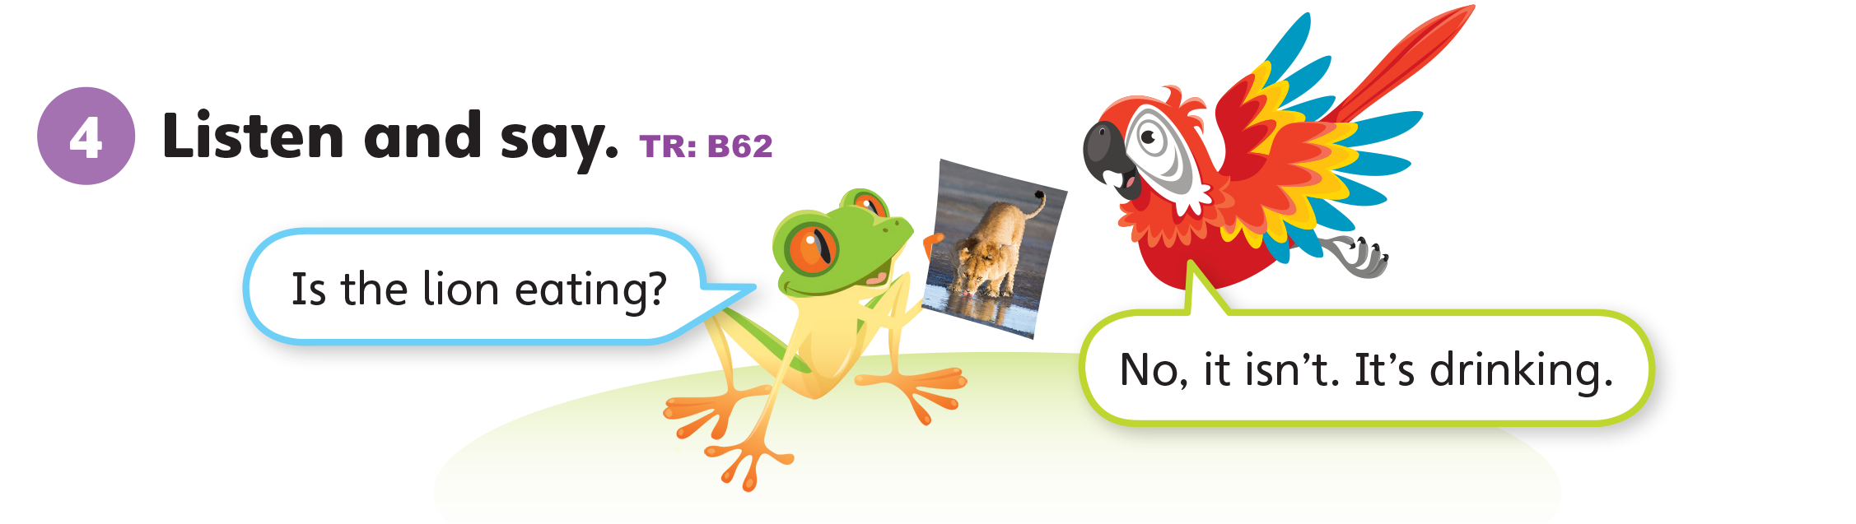
UNIT 4
ANIMALS
Notes:
4 Point to the mascots on p. 34.
Say Let’s listen.
Play TR: B62.
Play the track again, pausing the audio after each sentence for students to repeat what they have heard.

Slide 76
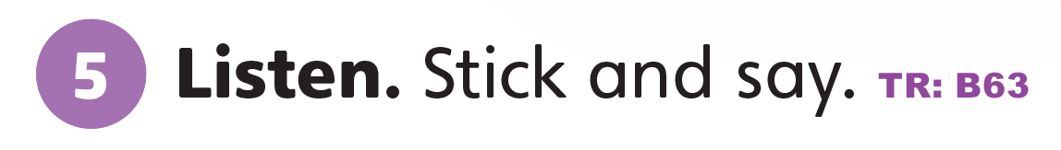
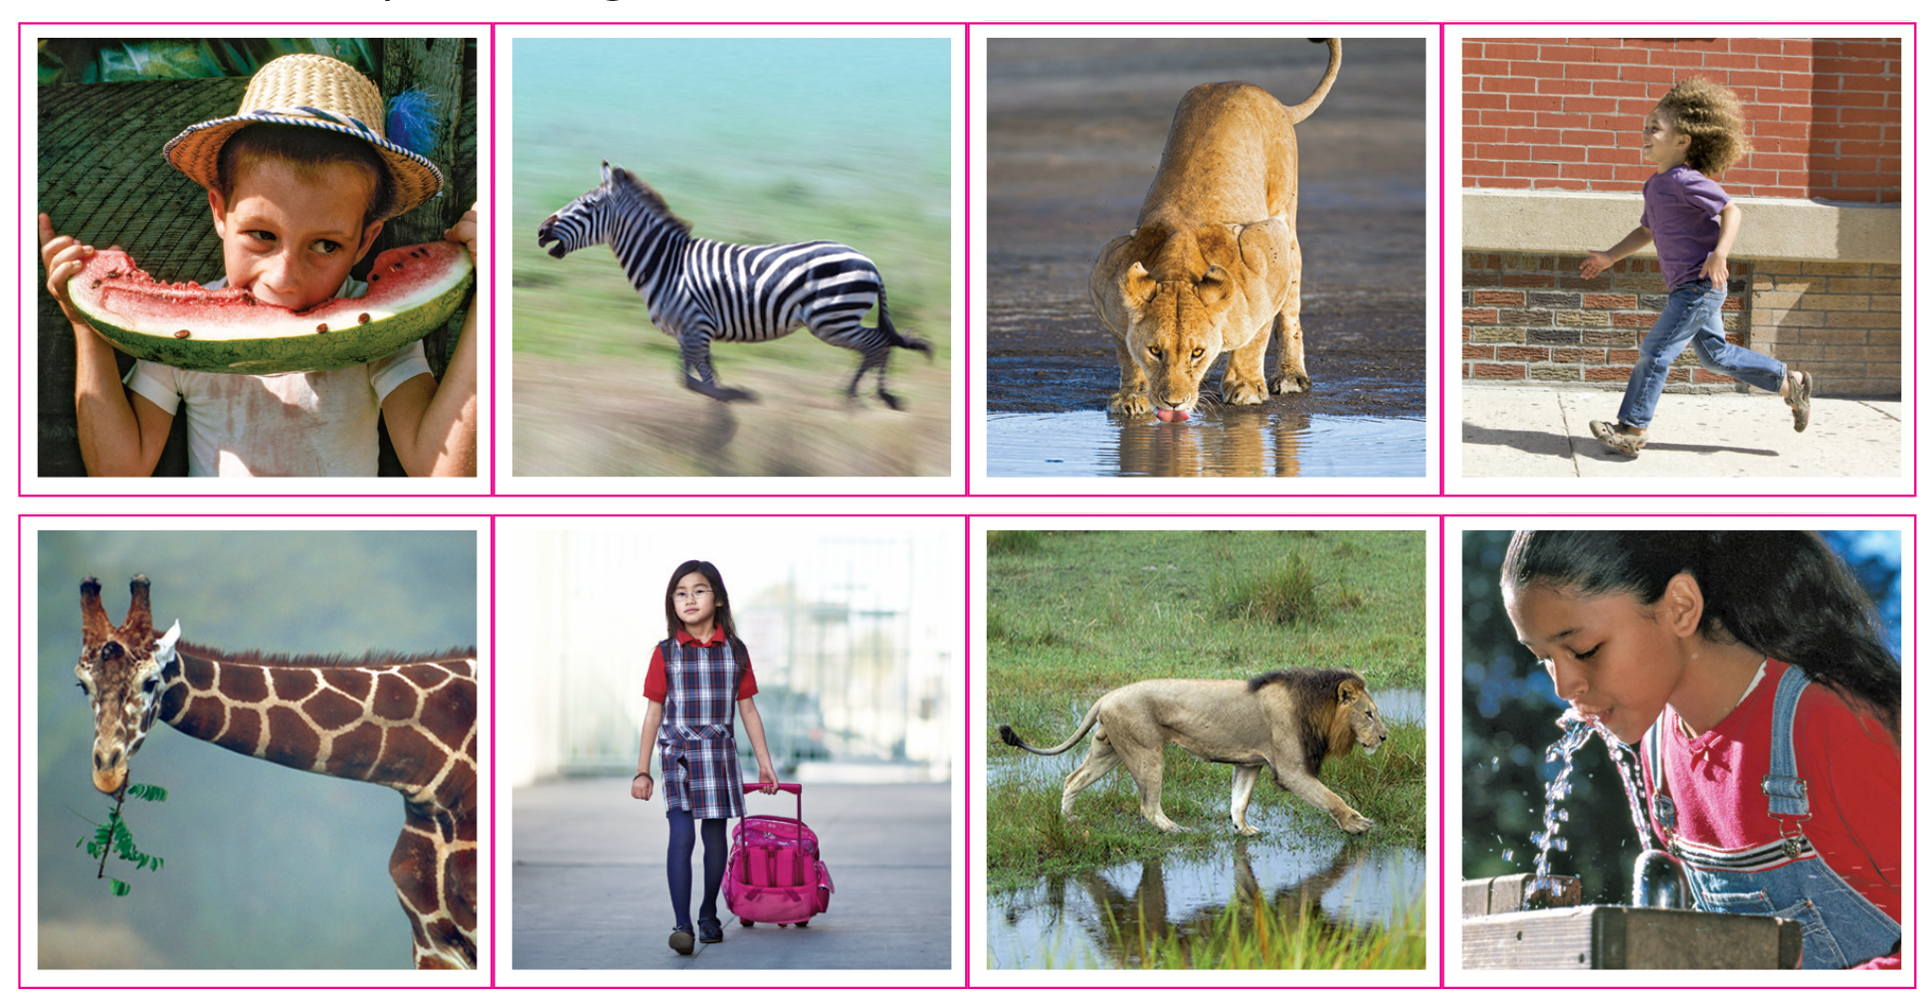
UNIT 4
ANIMALS
Notes:
5 Say Let’s do a sticker activity!
Show students the Unit 4 stickers in the back of the book. Say Listen. Play
TR: B63.
Pause after the first question and answer, and ask What is the lion doing?
Students should say Walking.
Hold up the sticker page, and point to the lion in the top row. Ask Is this lion walking?
Students should say No, it isn’t. It’s drinking.
Say Show me the other lion.
Students should point to the lion in the bottom row.
Ask Is this lion walking?
Students should say Yes.
Say Yes, that’s right. Let’s stick it on number 1.
Students should place the correct sticker in the right place.
Continue playing TR: B63, pausing after each item for students to repeat each question and answer set.
When students finish, review their work.

Slide 77
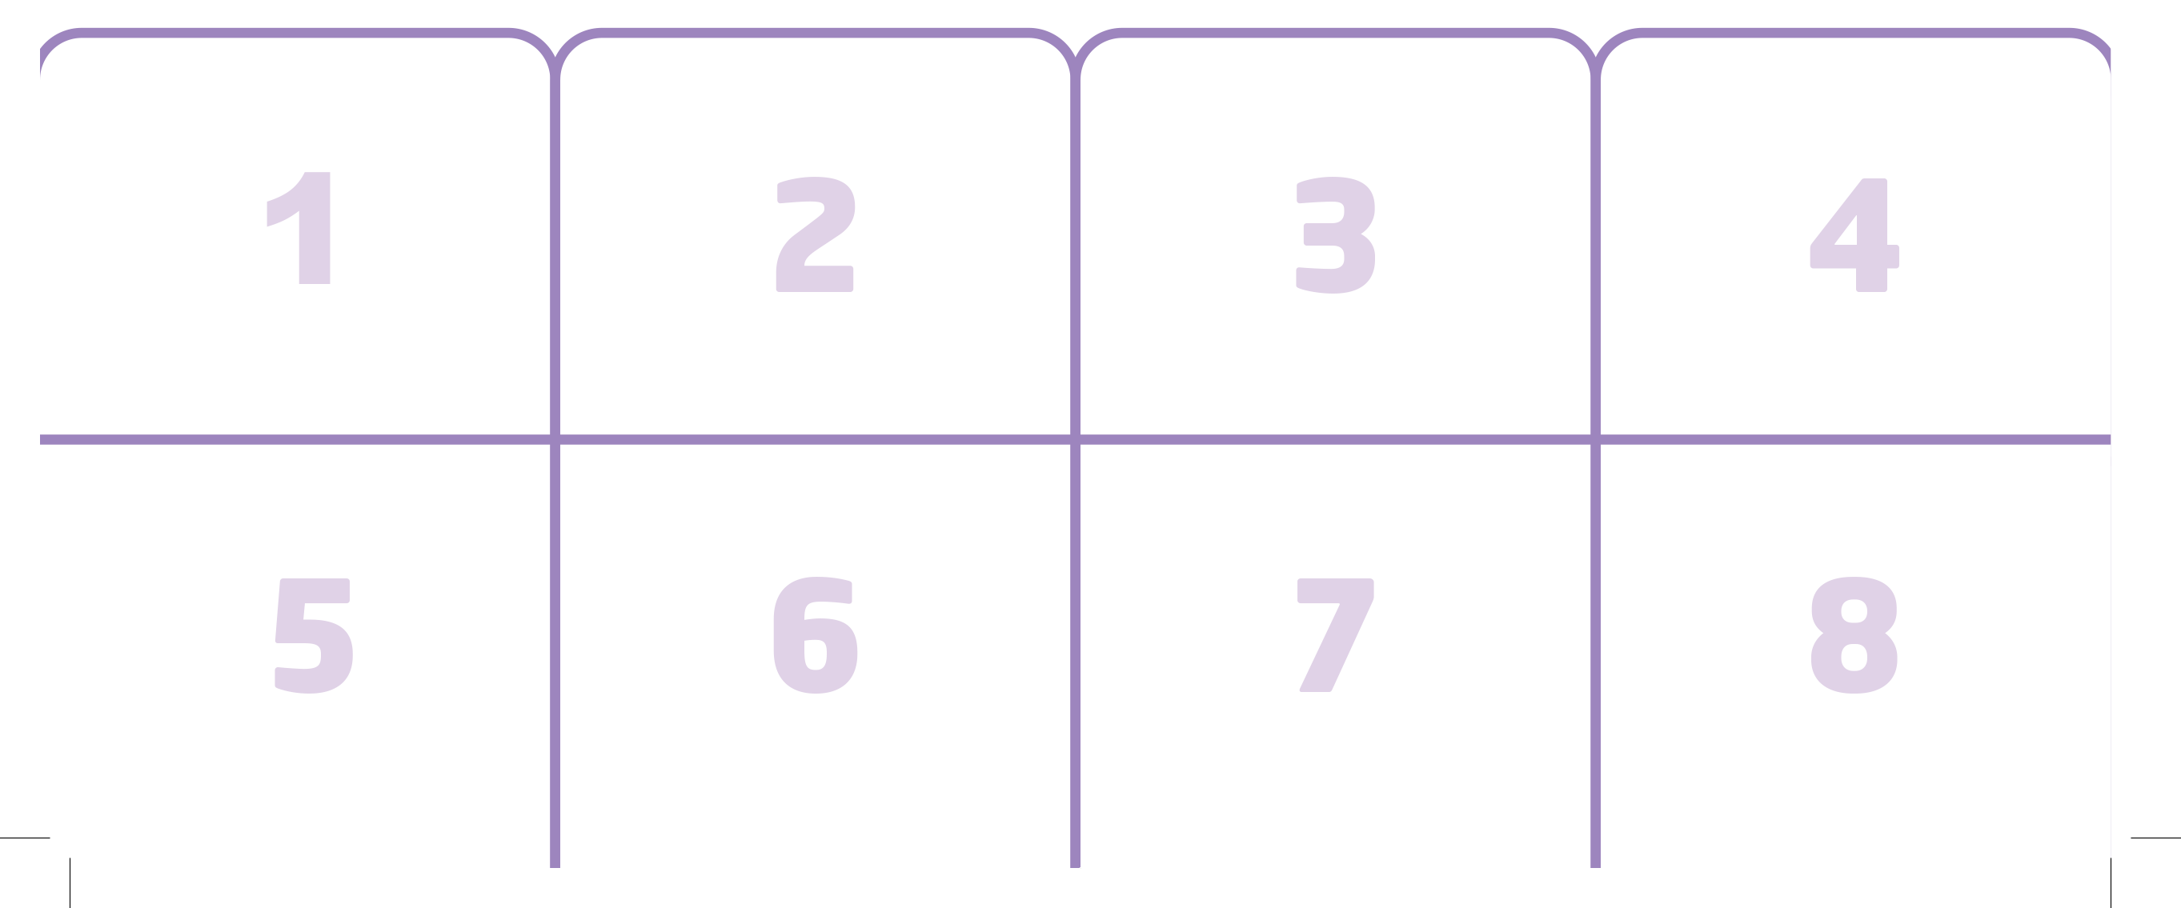
UNIT 4
ANIMALS
Notes:
5 Say Let’s do a sticker activity!
Show students the Unit 4 stickers in the back of the book. Say Listen. Play
TR: B63.
Pause after the first question and answer, and ask What is the lion doing?
Students should say Walking.
Hold up the sticker page, and point to the lion in the top row. Ask Is this lion walking?
Students should say No, it isn’t. It’s drinking.
Say Show me the other lion.
Students should point to the lion in the bottom row.
Ask Is this lion walking?
Students should say Yes.
Say Yes, that’s right. Let’s stick it on number 1.
Students should place the correct sticker in the right place.
Continue playing TR: B63, pausing after each item for students to repeat each question and answer set.
When students finish, review their work.

Slide 78
UNIT 4
ANIMALS
What is he/she doing?
Is she eating?
No, she isn’t. She’s running.
Notes:
Call on a student to come to the front of the room. Whisper an action in his or her ear.
Have the student perform that action. For example, whisper Run and have the student run in place.
Ask the class Is [she] eating?
Students should say No, [she] isn’t. [She’s] running.
Repeat this a few times, with different students doing the actions each time.

Slide 79
UNIT 4
ANIMALS
Is the giraffe running?
No, it isn’t.
Notes:
Point to the pictures for eat, drink, run, and walk.
Ask a question that will get a no answer for each picture.
For example, ask Is the giraffe running?
Students should say [No, it isn’t.]

Slide 80
UNIT 4
ANIMALS
Is the zebra eating?
No, it isn’t.
Notes:
Point to the pictures for eat, drink, run, and walk.
Ask a question that will get a no answer for each picture.
For example, ask Is the giraffe running?
Students should say [No, it isn’t.]

Slide 81
UNIT 4
ANIMALS
Is the lion walking?
No, it isn’t.
Notes:
Point to the pictures for eat, drink, run, and walk.
Ask a question that will get a no answer for each picture.
For example, ask Is the giraffe running?
Students should say [No, it isn’t.]

Slide 82
UNIT 4
ANIMALS
Is the monkey drinking?
No, it isn’t.
Notes:
Point to the pictures for eat, drink, run, and walk.
Ask a question that will get a no answer for each picture.
For example, ask Is the giraffe running?
Students should say [No, it isn’t.]

Slide 83
UNIT 4
ANIMALS
Goodbye Chant
Good work, class.
Hip hip, hooray!
Goodbye for now.
Have a nice day!
Notes:
Say Good job today class. Now let’s chant.
Lead the class in the Goodbye chant.

Slide 84
UNIT 4
ANIMALS
Let’s check!
What is it doing?
Notes:
Can students identify and name clothing items?
Point to pictures for clothing items, one at a time, and call on students to name the item.

Slide 85
UNIT 4
ANIMALS
Is the giraffe running?
No, it isn’t.
It’s eating.
Notes:
Can students talk about actions that people and animals do?
Hold up the book to p. 33. Point to the action photos and ask questions.
For example, ask Is the giraffe drinking?
Students should respond using language they have learnt [No, it isn’t. It’s eating.]

Slide 86
UNIT 4
ANIMALS
Is the zebra eating?
No, it isn’t.
It’s running.
Notes:
Point to the pictures for eat, drink, run, and walk.
Ask a question that will get a no answer for each picture.
For example, ask Is the giraffe running?
Students should say [No, it isn’t.]

Slide 87
UNIT 4
ANIMALS
Is the lion walking?
No, it isn’t.
It’s drinking.
Notes:
Point to the pictures for eat, drink, run, and walk.
Ask a question that will get a no answer for each picture.
For example, ask Is the giraffe running?
Students should say [No, it isn’t.]

Slide 88
UNIT 4
ANIMALS
Is the monkey drinking?
No, it isn’t.
It’s walking.
Notes:
Point to the pictures for eat, drink, run, and walk.
Ask a question that will get a no answer for each picture.
For example, ask Is the giraffe running?
Students should say [No, it isn’t.]

Slide 89
UNIT 4
ANIMALS
Thank you!

Slide 90
Unit 4:
Animals
Lesson 5

Slide 91
UNIT 4
ANIMALS
English Time Chant
English, (clap) English, (clap)
English (clap) today! (clap, clap)
English, (clap) English, (clap)
Hip, hip, (clap) hooray! (clap, clap)

Slide 92
UNIT 4
ANIMALS
What shape is it?
It’s a square.
Notes:
Hold up a large square cut out of poster board.
Ask What shape is this?
Students should say A square.
Turn the square so that one of its corners points to the ceiling, and tape the square to the board.

Slide 93
UNIT 4
ANIMALS
It’s a circle.
What shape is it?
Notes:
Hold up a large circle cut out of poster board, and ask What shape is this?
Students should say A circle.
Still holding the circle up, cut it in half.

Slide 94
UNIT 4
ANIMALS
New Word
This is a heart.
Notes:
Tape each of the semi-circles to the board so that they are touching the top sides of the square, forming a heart shape. Then, say Look. This is a heart.

Slide 95
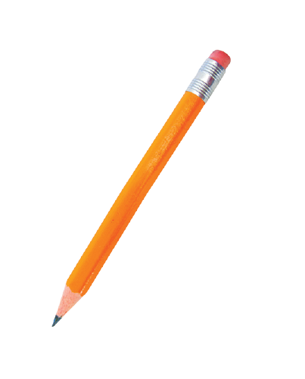

UNIT 4
ANIMALS
New Word
Notes:
Say Heart as you point to the heart on the board.
Students should say Heart.
Point to the heart on p. 35.
Then, point to the star, and say Star.
Students should say Star.
Draw ten stars on the board. Call on a student to count them.
Students should count the stars and say Ten stars.

Slide 96
UNIT 4
ANIMALS
New Word
Notes:
Say Heart as you point to the heart on the board.
Students should say Heart.
Point to the heart on p. 35.
Then, point to the star, and say Star.
Students should say Star.
Draw ten stars on the board. Call on a student to count them.
Students should count the stars and say Ten stars.

Slide 97
UNIT 4
ANIMALS
How many stars?
10 stars
Notes:
Say Heart as you point to the heart on the board.
Students should say Heart.
Point to the heart on p. 35.
Then, point to the star, and say Star.
Students should say Star.
Draw ten stars on the board. Call on a student to count them.
Students should count the stars and say Ten stars.

Slide 98
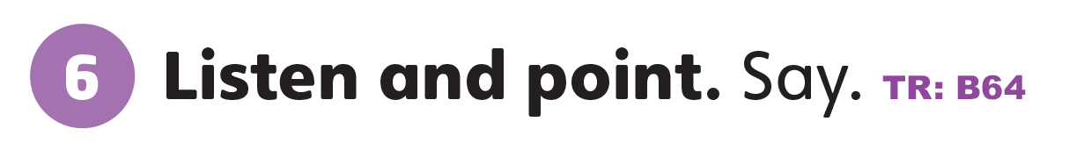
UNIT 4
ANIMALS
What color do you see?
Red
Yellow
Notes:
6 Point to Activity 6.
Ask What colors do you see?
Students should say Red, yellow.
Say There’s a red heart. There’s a yellow star.
Play TR: B64 and have students repeat the words.
Have students name some items that are heart-shaped. Then have students name some items that are star-shaped, and if any of them are yellow.

Slide 99
UNIT 4
ANIMALS
What is it?
Notes:
6 Point to Activity 6.
Ask What colors do you see?
Students should say Red, yellow.
Say There’s a red heart. There’s a yellow star.
Play TR: B64 and have students repeat the words.
Have students name some items that are heart-shaped. Then have students name some items that are star-shaped, and if any of them are yellow.

Slide 100


UNIT 4
ANIMALS
Notes:
7 Point to Activity 7.
Ask What color is the heart?
Students should say Pink.
Make sure students have pink, blue and purple crayons on their desks. Say Let’s listen and color.
Play TR: B65. Pause after the first item, and say A pink heart as you point to the completed example.
Continue playing TR: B65, pausing after each item for students to color it.

Slide 101
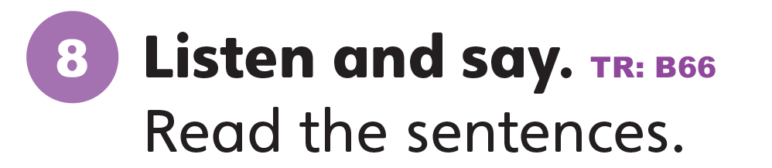
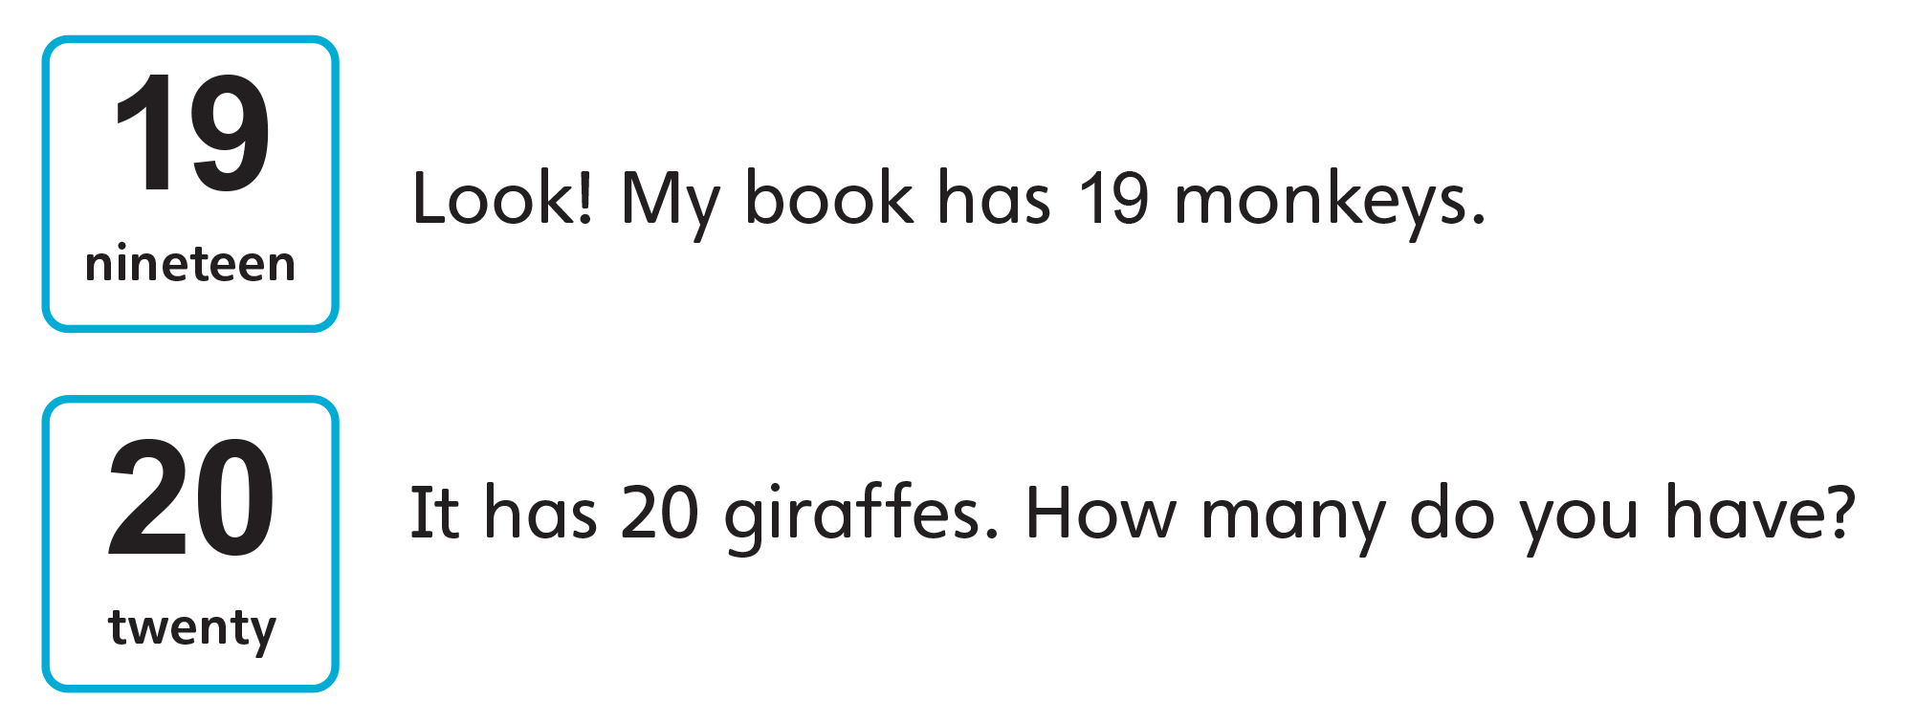
UNIT 4
ANIMALS
Notes:
8 Have students look at Activity 8. Ask What comes after 18?
Say Let’s listen. Repeat the numbers you hear.
Students should say Nineteen. Twenty.
Play TR: B66 and have students listen and repeat what they hear.
Point to the sentences and call on a few students to try reading them out.

Slide 102
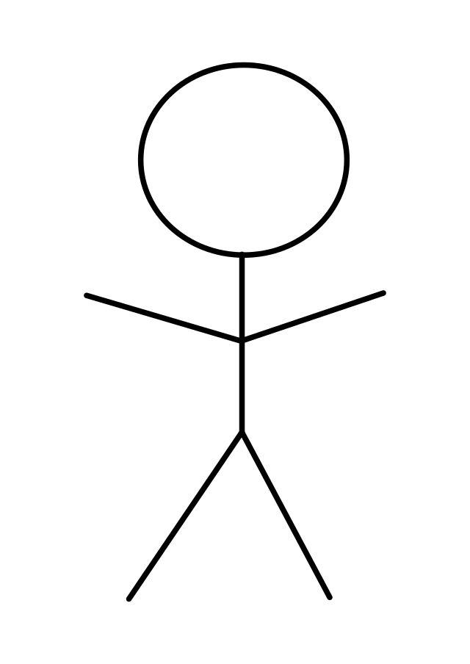
UNIT 4
ANIMALS
Let’s play!
She’s wearing a shirt, a skirt, and a hat.
Notes:
Cut out two circles, two squares, two triangles, and two rectangles from colored paper.
Have students work in pairs. Give a set of shapes to each pair of students.
Make copies of a drawing of a stick figure and give one to each pair. Describe an outfit, and have students use their shapes to “dress” the stick figure.
For example, say She’s wearing a shirt, a skirt, and a hat.
Students might put a square on as a shirt, a triangle as the skirt, and a rectangle for the hat.
Walk around and ask students about their work.
Students should say what shape each clothing item is.
Repeat this activity several times, using different clothing items each time.

Slide 103
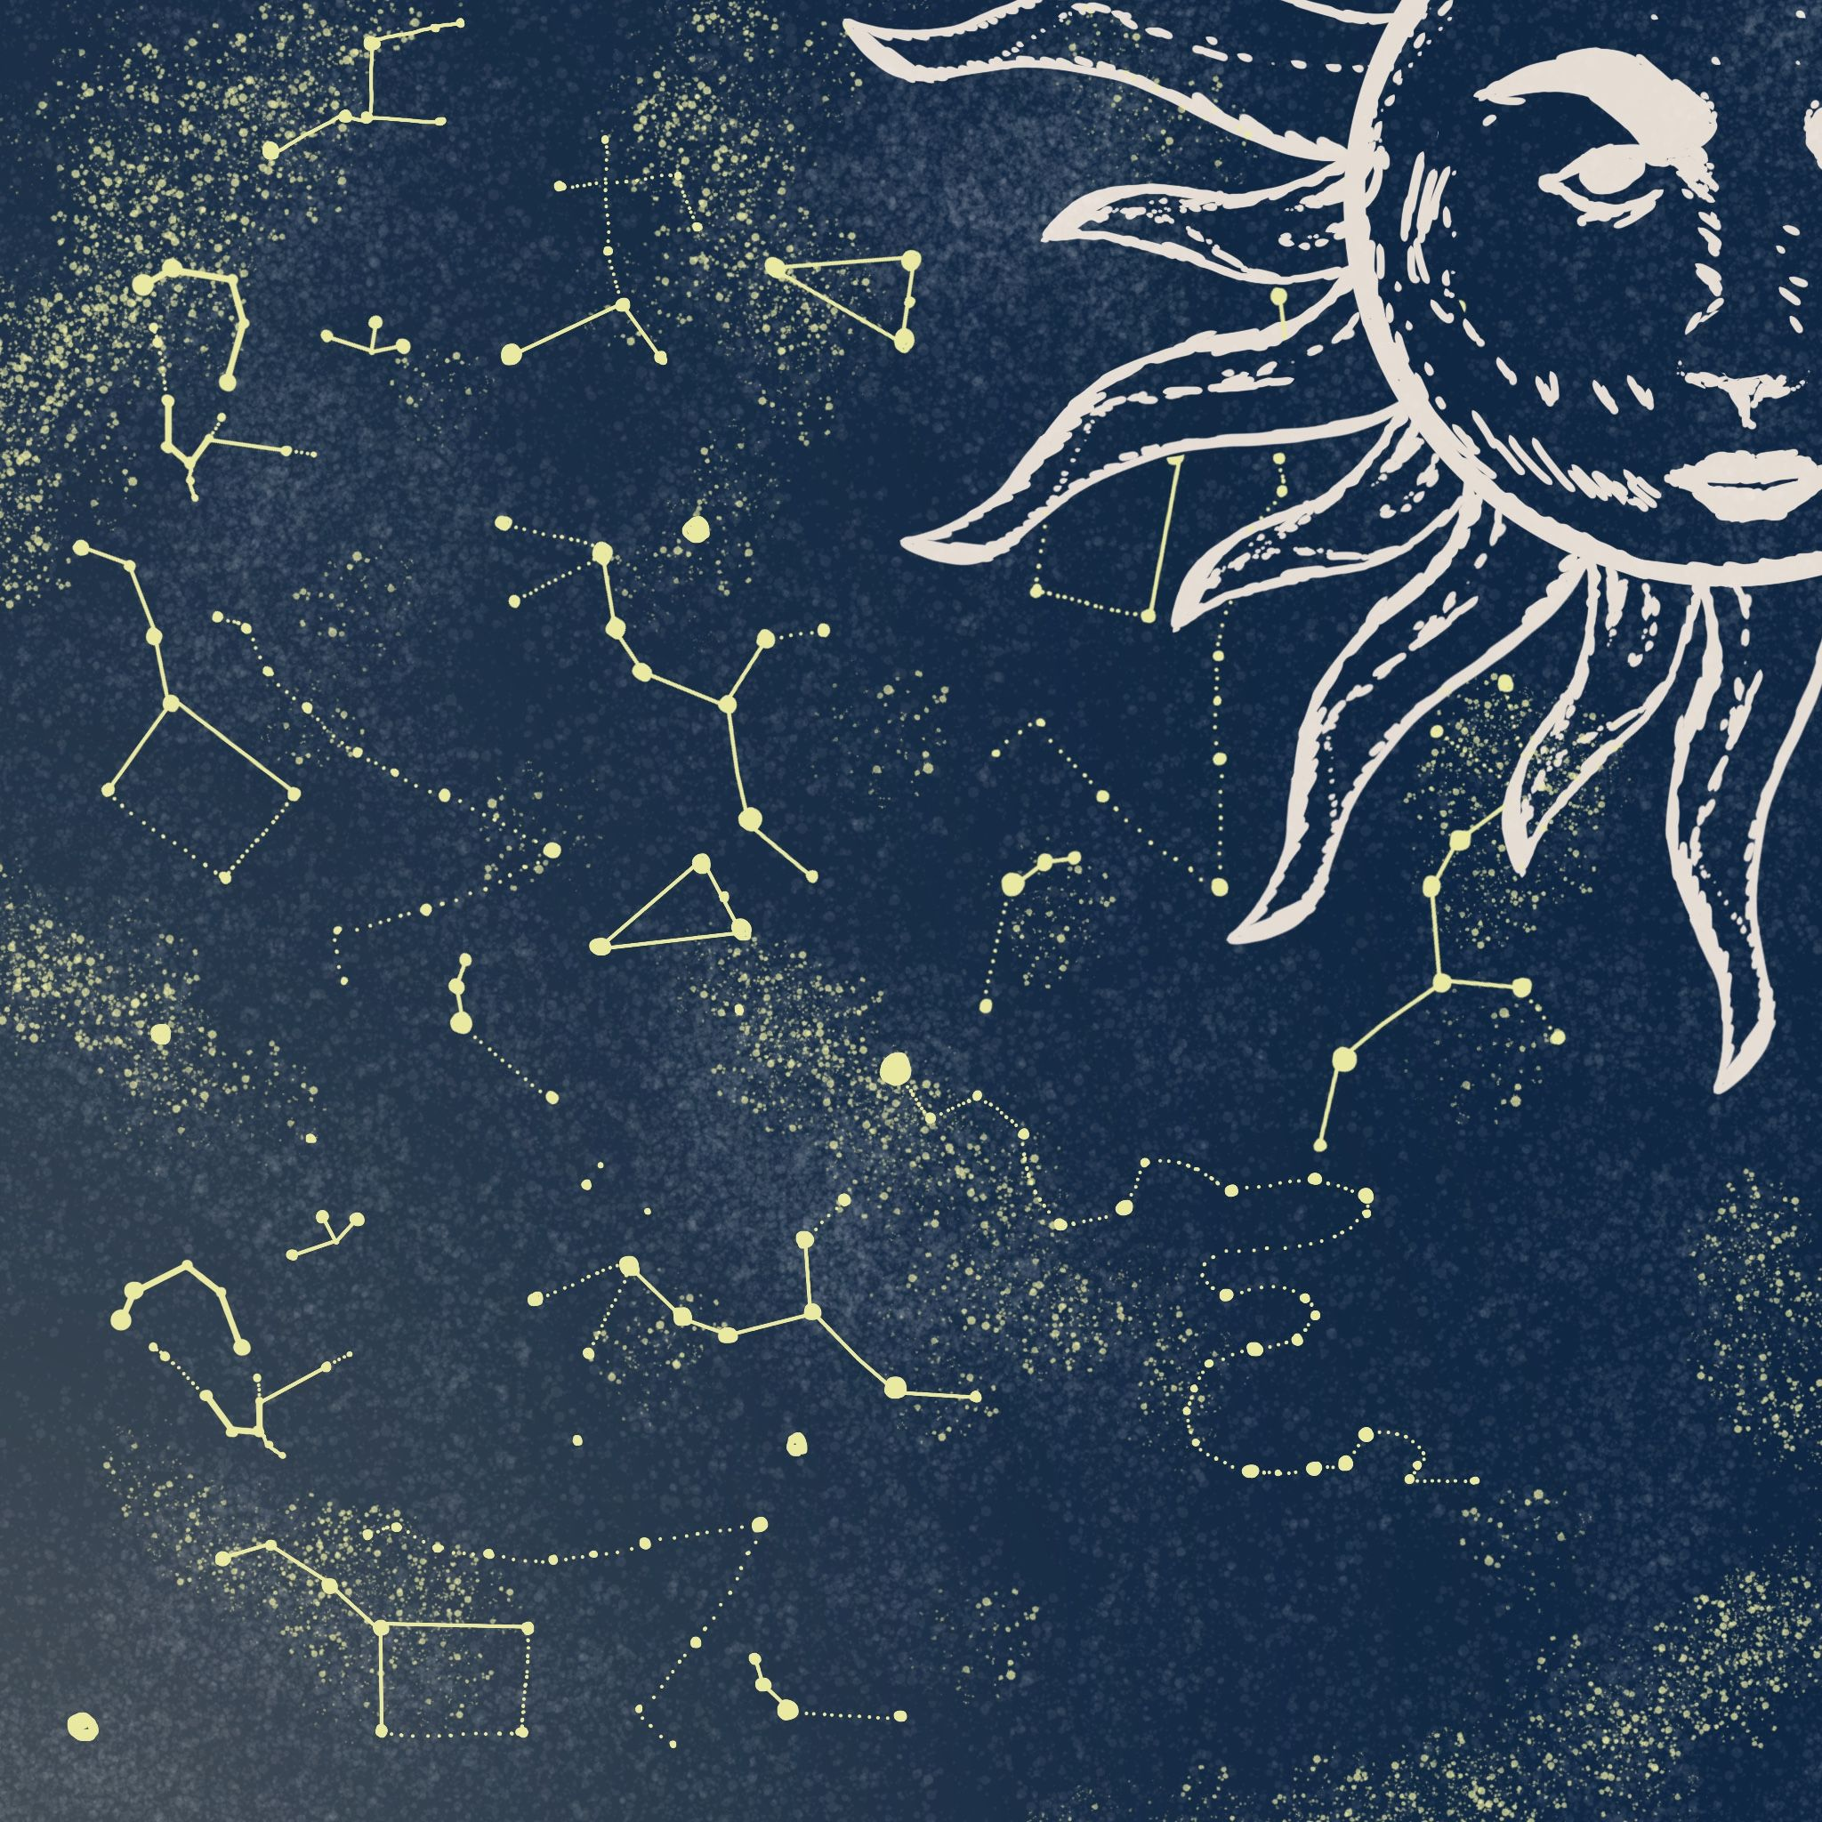
UNIT 4
ANIMALS
Group of stars
Notes:
Show students a photo or diagram of a constellation in the night sky.
Say This is a group of stars. Look at how it makes a picture.
Give students a piece of black construction paper and chalk.
Model doing this with a simple picture, such as a kite.
Students should draw stars to form a constellation in the night sky.
After a few moments, collect students’ pictures. Hold up a few of them and have others guess what the picture is.

Slide 104
UNIT 4
ANIMALS
Let’s draw!
Let’s draw something from the star
Notes:
Show students a photo or diagram of a constellation in the night sky.
Say This is a group of stars. Look at how it makes a picture.
Give students a piece of black construction paper and chalk.
Model doing this with a simple picture, such as a kite.
Students should draw stars to form a constellation in the night sky.
After a few moments, collect students’ pictures. Hold up a few of them and have others guess what the picture is.

Slide 105
UNIT 4
ANIMALS
Goodbye Chant
Good work, class.
Hip hip, hooray!
Goodbye for now.
Have a nice day!
Notes:
Say Good job today class. Now let’s chant.
Lead the class in the Goodbye chant.

Slide 106
UNIT 4
ANIMALS
Let’s check!
What shape is it?
It’s a heart.
Notes:
Can students identify and name hearts and stars?
Hold up the book to p. 35. Point to the heart and star pictures, and have students name each shape.

Slide 107
UNIT 4
ANIMALS
Let’s check!
What shape is it?
It’s a star.
Notes:
Can students identify and name hearts and stars?
Hold up the book to p. 35. Point to the heart and star pictures, and have students name each shape.

Slide 108
UNIT 4
ANIMALS
Thank you!

Slide 109
Unit 4:
Animals
Lesson 6

Slide 110
UNIT 4
ANIMALS
English Time Chant
English, (clap) English, (clap)
English (clap) today! (clap, clap)
English, (clap) English, (clap)
Hip, hip, (clap) hooray! (clap, clap)

Slide 111
UNIT 4
ANIMALS
What shape is it?
It’s a square.
Notes:
Hold up a large square cut out of poster board.
Ask What shape is this?
Students should say A square.
Turn the square so that one of its corners points to the ceiling, and tape the square to the board.
Cut out five triangle pieces. Point to one and ask What shape is this?
Students should say A triangle.
Tape each of the triangles to the board so that they form a star shape.
Say Look. This is a star.
Students should say A star.

Slide 112
UNIT 4
ANIMALS
It’s a triangle.
What shape is it?
Notes:
Hold up a large square cut out of poster board.
Ask What shape is this?
Students should say A square.
Turn the square so that one of its corners points to the ceiling, and tape the square to the board.
Cut out five triangle pieces. Point to one and ask What shape is this?
Students should say A triangle.
Tape each of the triangles to the board so that they form a star shape.
Say Look. This is a star.
Students should say A star.

Slide 113
UNIT 4
ANIMALS
New Word
This is a star.
Notes:
Hold up a large square cut out of poster board.
Ask What shape is this?
Students should say A square.
Turn the square so that one of its corners points to the ceiling, and tape the square to the board.
Cut out five triangle pieces. Point to one and ask What shape is this?
Students should say A triangle.
Tape each of the triangles to the board so that they form a star shape.
Say Look. This is a star.
Students should say A star.

Slide 114
UNIT 4
ANIMALS
What is it?
Notes:
6 Point to Activity 6.
Ask What colors do you see?
Students should say Red, yellow.
Say There’s a red heart. There’s a yellow star.
Play TR: B64 and have students repeat the words.
Have students name some items that are heart-shaped. Then have students name some items that are star-shaped, and if any of them are yellow.

Slide 115
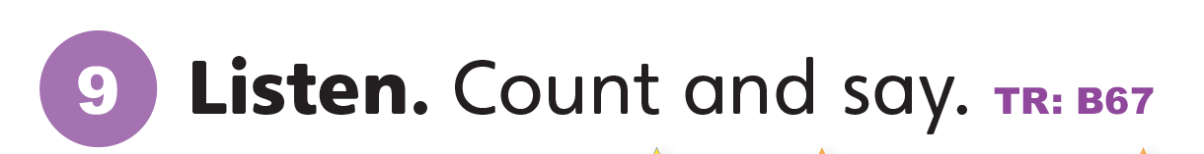

UNIT 4
ANIMALS
How many ______?
1. 19 hearts
2. 7 red hearts
3. 20 stars
6 orange stars
Notes:
9 Say Listen.
Play TR: B67 once without pausing. Then play the audio again.
This time, pause after each question for students to count and write the correct number.
Students should write numbers 1–4 for the four questions on a piece of paper.
Then they should count and write the answers to each question.
When they finish, review their work as a class.

Slide 116

UNIT 4
ANIMALS
Notes:
10 Say Now let’s do a sticker activity. Have students stick the stickers on poster board. Then have them cut out the cards.
Say Listen. Put the cards in order.
Play TR: B68. Pause after the first item, and ask What is it?
Students should say A green star.
Continue playing TR: B68 as students place their cards in order from left to right. Walk around the room, providing help as needed.

Slide 117
UNIT 4
ANIMALS
Notes:
10 Say Now let’s do a sticker activity. Have students stick the stickers on poster board. Then have them cut out the cards.
Say Listen. Put the cards in order.
Play TR: B68. Pause after the first item, and ask What is it?
Students should say A green star.
Continue playing TR: B68 as students place their cards in order from left to right. Walk around the room, providing help as needed.

Slide 118
UNIT 4
ANIMALS
Goodbye Chant
Good work, class.
Hip hip, hooray!
Goodbye for now.
Have a nice day!
Notes:
Say Good job today class. Now let’s chant.
Lead the class in the Goodbye chant.

Slide 119
UNIT 4
ANIMALS
Let’s check!
What shape is it?
It’s a heart.
Notes:
Can students identify and name hearts and stars?
Hold up the book to p. 35. Point to the heart and star pictures, and have students name each shape.

Slide 120
UNIT 4
ANIMALS
Let’s check!
What shape is it?
It’s a star.
Notes:
Can students identify and name hearts and stars?
Hold up the book to p. 35. Point to the heart and star pictures, and have students name each shape.

Slide 121
UNIT 4
ANIMALS
Thank you!

Slide 122
Unit 4:
Animals
Lesson 7

Slide 123
UNIT 4
ANIMALS
English Time Chant
English, (clap) English, (clap)
English (clap) today! (clap, clap)
English, (clap) English, (clap)
Hip, hip, (clap) hooray! (clap, clap)

Slide 124
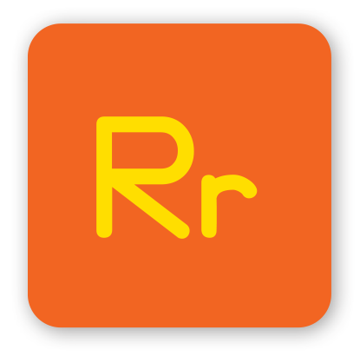
UNIT 4
ANIMALS
Do you know any words that have the /r/ sound?
RED
READ
RICE
ROOM
CROWN
BREAD
GIRAFFE
ZEBRA
Notes:
Say We know many sounds in English. Let’s review the sounds we know.
Make the /r/ sound, and have students make it as well. Call on a few students to give you words that they know.
Say Do you know any words that have the /r/ sound? What are they?
Students should say [Red, read, room, rice, crown, bread, giraffe, zebra].
Repeat this with other sounds taught in previous units.

Slide 125
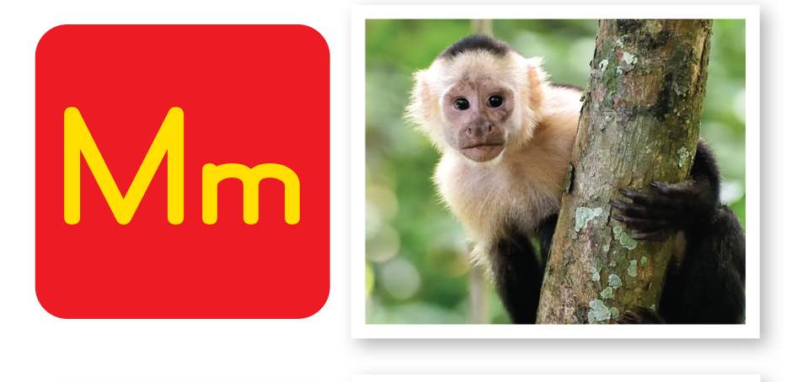
UNIT 4
ANIMALS
The Sound of English
Notes:
Say Monkey has the /m/ sound. Have students repeat the sound and the word. Then, say the following words, and have students raise their hands when they hear /m/: bathroom, mother, king, milk, bananas, gold, crown.
Students should raise their hands when they hear bathroom, mother, milk.

Slide 126
UNIT 4
ANIMALS
Which has the /m/ sound?
✓
✓
BATHROOM
MOTHER
KING
MILK
BANANAS
GOLD
CROWN
✓
Notes:
Say Monkey has the /m/ sound. Have students repeat the sound and the word. Then, say the following words, and have students raise their hands when they hear /m/: bathroom, mother, king, milk, bananas, gold, crown.
Students should raise their hands when they hear bathroom, mother, milk.

Slide 127
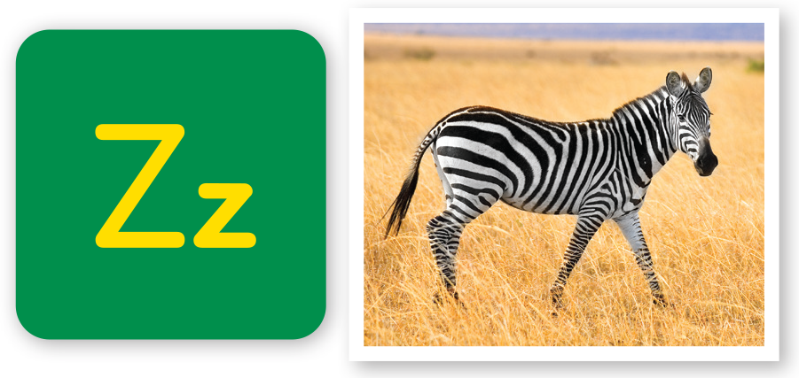
UNIT 4
ANIMALS
The Sound of English
Notes:
Say Zebra has the /z/ sound. Have students repeat the sound and the word. Then, say An -s at the end of some words can make a /z/ sound. Give the
examples of brothers, eyes, and chairs.
Students should repeat the words, emphasizing the /z/ at the end of each word.

Slide 128
UNIT 4
ANIMALS
An -s at the end of some words can make a /z/ sound.
BROTHERS
EYES
CHAIRS
Notes:
Say Zebra has the /z/ sound. Have students repeat the sound and the word. Then, say An -s at the end of some words can make a /z/ sound. Give the
examples of brothers, eyes, and chairs.
Students should repeat the words, emphasizing the /z/ at the end of each word.

Slide 129
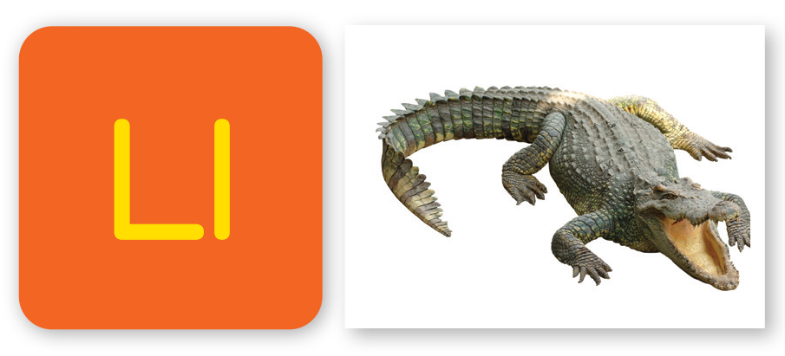
UNIT 4
ANIMALS
The Sound of English
Notes:
Say Crocodile has the /l/ sound. Have students repeat the sound and the word. Then, say the following words, and have students raise their hands
when they hear /l/: hippo, orange juice, silver, noodle, shirt, princess, lion, ball. Remind students that sounds can appear at the start, in the middle, or at
the end of a word.
Students should raise their hands when they hear silver, noodle, lion, ball.

Slide 130
UNIT 4
ANIMALS
Which has the /l/ sound?
✓
✓
HIPPO
ORANGE JUICE
SILVER
NOODLE
SHIRT
PRINCESS
LION
BALL
✓
✓
Notes:
Say Crocodile has the /l/ sound. Have students repeat the sound and the word. Then, say the following words, and have students raise their hands
when they hear /l/: hippo, orange juice, silver, noodle, shirt, princess, lion, ball. Remind students that sounds can appear at the start, in the middle, or at
the end of a word.
Students should raise their hands when they hear silver, noodle, lion, ball.

Slide 131
UNIT 4
ANIMALS
Do you have /m/, /z/, or /l/ in your name?
Notes:
If there are students in your class with /m/, /z/, or /l/ in their names, point them out. For example, say Melissa. What sounds do you hear in Melissa’s name?
Students should say /m/, /l/.

Slide 132
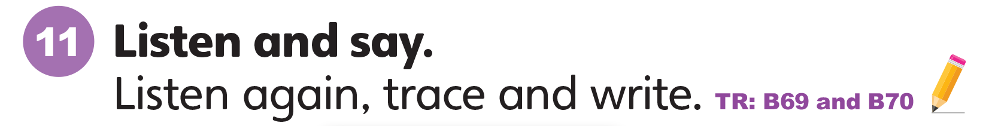
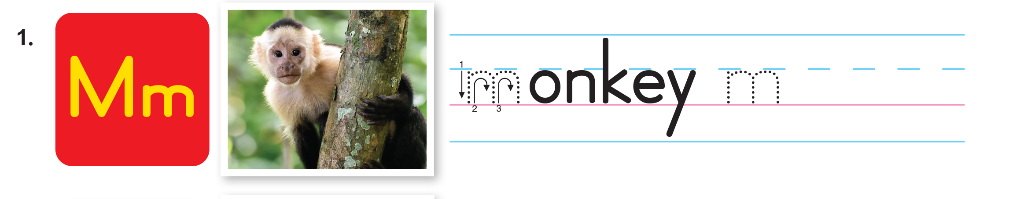
UNIT 4
ANIMALS
Notes:
11 Write Mm on the board. Ask What letter is this? Then say The letter m makes the sound /m/.
Have students make the /m/ sound.
Students should say /m/.
Ask students to open their books to p. 36. Then say Let’s learn to pronounce /m/. Listen and repeat what you hear.
Students should say /m/.
Play TR: B69.
Have students follow along with the track by looking at Activity 11 and pointing to the letters and words.
Play the track again and have students repeat the sounds.

Slide 133

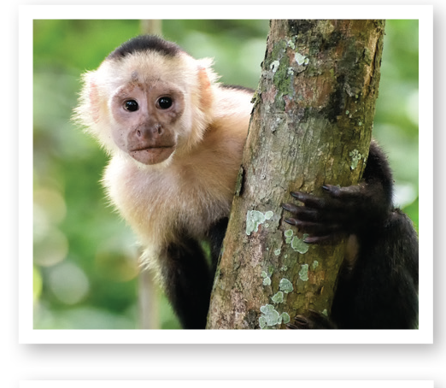
UNIT 4
ANIMALS
Let’s Say
MONKEY
Notes:
11 Write Mm on the board. Ask What letter is this? Then say The letter m makes the sound /m/.
Have students make the /m/ sound.
Students should say /m/.
Ask students to open their books to p. 36. Then say Let’s learn to pronounce /m/. Listen and repeat what you hear.
Students should say /m/.
Play TR: B69.
Have students follow along with the track by looking at Activity 11 and pointing to the letters and words.
Play the track again and have students repeat the sounds.

Slide 134
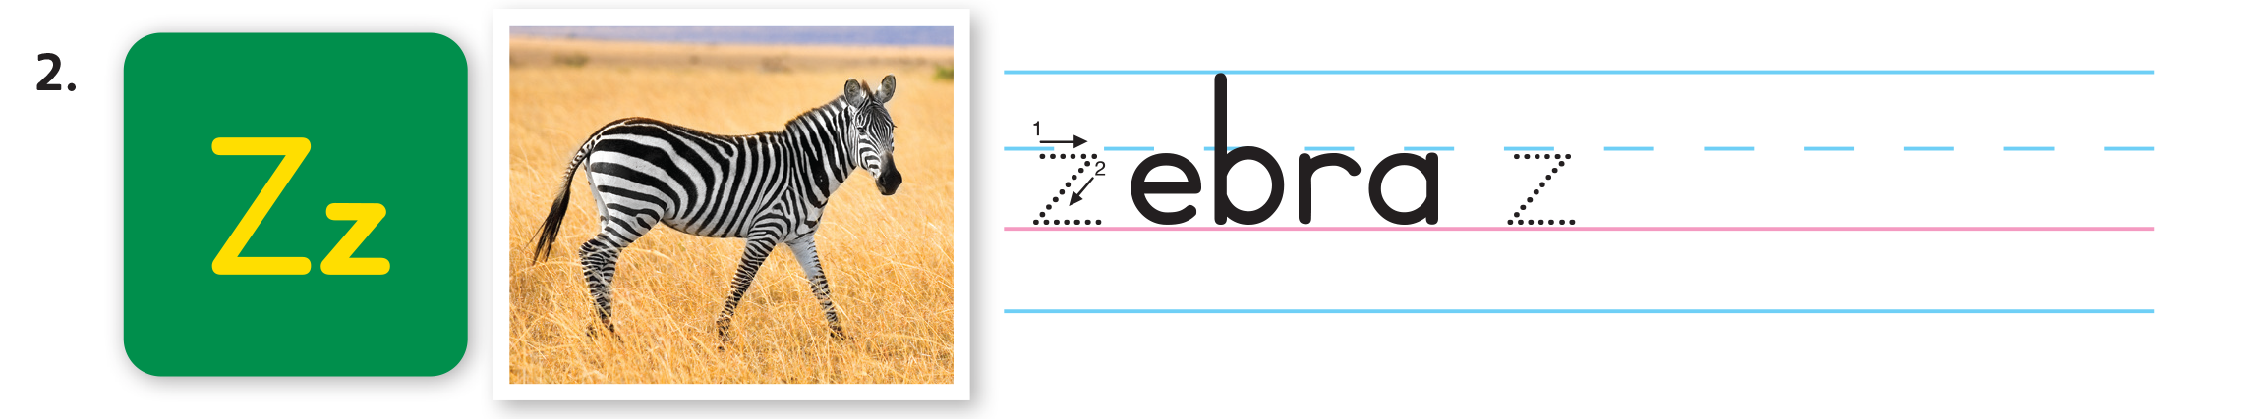
UNIT 4
ANIMALS
Notes:
11 Write Mm on the board. Ask What letter is this? Then say The letter m makes the sound /m/.
Have students make the /m/ sound.
Students should say /m/.
Ask students to open their books to p. 36. Then say Let’s learn to pronounce /m/. Listen and repeat what you hear.
Students should say /m/.
Play TR: B69.
Have students follow along with the track by looking at Activity 11 and pointing to the letters and words.
Play the track again and have students repeat the sounds.

Slide 135

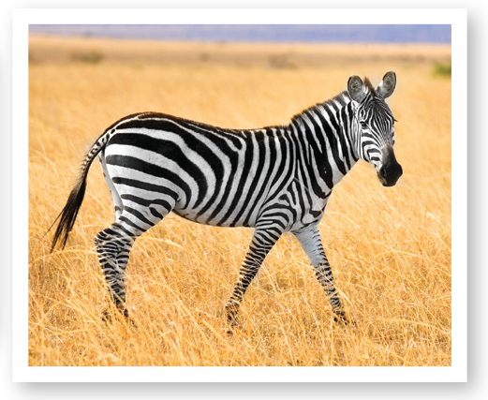
UNIT 4
ANIMALS
Let’s Say
ZEBRA
Notes:
11 Write Mm on the board. Ask What letter is this? Then say The letter m makes the sound /m/.
Have students make the /m/ sound.
Students should say /m/.
Ask students to open their books to p. 36. Then say Let’s learn to pronounce /m/. Listen and repeat what you hear.
Students should say /m/.
Play TR: B69.
Have students follow along with the track by looking at Activity 11 and pointing to the letters and words.
Play the track again and have students repeat the sounds.

Slide 136
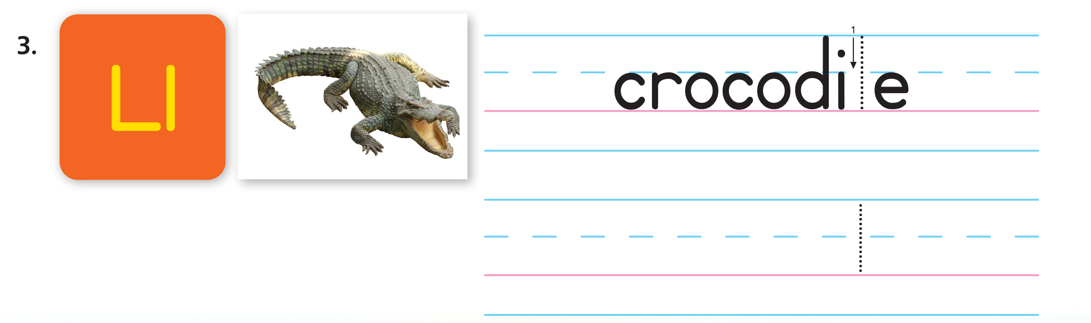
UNIT 4
ANIMALS
Notes:
11 Write Mm on the board. Ask What letter is this? Then say The letter m makes the sound /m/.
Have students make the /m/ sound.
Students should say /m/.
Ask students to open their books to p. 36. Then say Let’s learn to pronounce /m/. Listen and repeat what you hear.
Students should say /m/.
Play TR: B69.
Have students follow along with the track by looking at Activity 11 and pointing to the letters and words.
Play the track again and have students repeat the sounds.

Slide 137

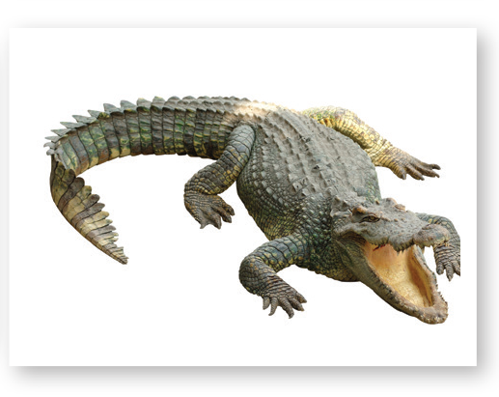
UNIT 4
ANIMALS
Let’s Say
CROCODILE
Notes:
11 Write Mm on the board. Ask What letter is this? Then say The letter m makes the sound /m/.
Have students make the /m/ sound.
Students should say /m/.
Ask students to open their books to p. 36. Then say Let’s learn to pronounce /m/. Listen and repeat what you hear.
Students should say /m/.
Play TR: B69.
Have students follow along with the track by looking at Activity 11 and pointing to the letters and words.
Play the track again and have students repeat the sounds.

Slide 138
UNIT 4
ANIMALS
Let’s Trace
Notes:
Draw Mm in dotted outline on the board. Say Let’s trace the letter m.
Model tracing over the outline. Then say Look at the word and picture for monkey again. Listen to the sound /m/ and use your pencil to trace the letter m.
Play TR: B70 and stop after monkey. Make sure students trace m for monkey, and then trace and complete writing the whole word monkey.
Call on volunteers to say the word aloud.
Students should say Monkey.
Repeat the activity for z and l and play the rest of TR: B70.

Slide 139
UNIT 4
ANIMALS
Let’s Trace
Notes:
Draw Mm in dotted outline on the board. Say Let’s trace the letter m.
Model tracing over the outline. Then say Look at the word and picture for monkey again. Listen to the sound /m/ and use your pencil to trace the letter m.
Play TR: B70 and stop after monkey. Make sure students trace m for monkey, and then trace and complete writing the whole word monkey.
Call on volunteers to say the word aloud.
Students should say Monkey.
Repeat the activity for z and l and play the rest of TR: B70.

Slide 140
UNIT 4
ANIMALS
Let’s Trace
Notes:
Draw Mm in dotted outline on the board. Say Let’s trace the letter m.
Model tracing over the outline. Then say Look at the word and picture for monkey again. Listen to the sound /m/ and use your pencil to trace the letter m.
Play TR: B70 and stop after monkey. Make sure students trace m for monkey, and then trace and complete writing the whole word monkey.
Call on volunteers to say the word aloud.
Students should say Monkey.
Repeat the activity for z and l and play the rest of TR: B70.

Slide 141
UNIT 4
ANIMALS
Goodbye Chant
Good work, class.
Hip hip, hooray!
Goodbye for now.
Have a nice day!
Notes:
Say Good job today class. Now let’s chant.
Lead the class in the Goodbye chant.

Slide 142
UNIT 4
ANIMALS
Let’s check!
Let’s say
Notes:
Can students identify and make the /m/, /z/, and /l/ sounds?
Make each of the target sounds and call on students to give a word or words with that sound.

Slide 143
UNIT 4
ANIMALS
Thank you!

Slide 144
Unit 4:
Animals
Lesson 8

Slide 145
UNIT 4
ANIMALS
English Time Chant
English, (clap) English, (clap)
English (clap) today! (clap, clap)
English, (clap) English, (clap)
Hip, hip, (clap) hooray! (clap, clap)

Slide 146
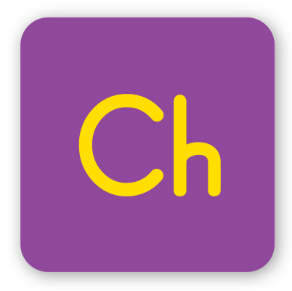
UNIT 4
ANIMALS
Do you know any words that have the /tʃ/ sound?
CHICKEN
CHAIR
TOUCH
LUNCH
Notes:
Say We know many sounds in English. Let’s review the sounds we know.
Make the /tʃ/ sound, and have students make it as well.
Call on a few students to give you words that they know with /tʃ/.
Students should say [Chicken, chair, touch, lunch].
Repeat this with other sounds taught in previous units.

Slide 147
UNIT 4
ANIMALS
The Sound of English
Notes:
Say Let’s listen to new sounds.
Play TR: B69. Pause after each word for students to repeat the sound and the word.
Say Monkey has the /m/ sound. Have students repeat the sound and the word. Then, say the following words, and have students raise their hands when they hear /m/: bathroom, mother, king, milk, bananas, gold, crown.
Students should raise their hands when they hear bathroom, mother, milk.
Repeat for the other sounds.

Slide 148
UNIT 4
ANIMALS
Which has the /m/ sound?
✓
✓
BATHROOM
MOTHER
KING
MILK
BANANAS
GOLD
CROWN
✓
Notes:
Say Let’s listen to new sounds.
Play TR: B69. Pause after each word for students to repeat the sound and the word.
Say Monkey has the /m/ sound. Have students repeat the sound and the word. Then, say the following words, and have students raise their hands when they hear /m/: bathroom, mother, king, milk, bananas, gold, crown.
Students should raise their hands when they hear bathroom, mother, milk.
Repeat for the other sounds.

Slide 149
UNIT 4
ANIMALS
The Sound of English
Notes:
Say Let’s listen to new sounds.
Play TR: B69. Pause after each word for students to repeat the sound and the word.
Say Monkey has the /m/ sound. Have students repeat the sound and the word. Then, say the following words, and have students raise their hands when they hear /m/: bathroom, mother, king, milk, bananas, gold, crown.
Students should raise their hands when they hear bathroom, mother, milk.
Repeat for the other sounds.

Slide 150
UNIT 4
ANIMALS
An -s at the end of some words can make a /z/ sound.
BROTHERS
EYES
CHAIRS
Notes:
Say Let’s listen to new sounds.
Play TR: B69. Pause after each word for students to repeat the sound and the word.
Say Monkey has the /m/ sound. Have students repeat the sound and the word. Then, say the following words, and have students raise their hands when they hear /m/: bathroom, mother, king, milk, bananas, gold, crown.
Students should raise their hands when they hear bathroom, mother, milk.
Repeat for the other sounds.

Slide 151
UNIT 4
ANIMALS
The Sound of English
Notes:
Say Let’s listen to new sounds.
Play TR: B69. Pause after each word for students to repeat the sound and the word.
Say Monkey has the /m/ sound. Have students repeat the sound and the word. Then, say the following words, and have students raise their hands when they hear /m/: bathroom, mother, king, milk, bananas, gold, crown.
Students should raise their hands when they hear bathroom, mother, milk.
Repeat for the other sounds.

Slide 152
UNIT 4
ANIMALS
Which has the /l/ sound?
✓
✓
HIPPO
ORANGE JUICE
SILVER
NOODLE
SHIRT
PRINCESS
LION
BALL
✓
✓
Notes:
Say Let’s listen to new sounds.
Play TR: B69. Pause after each word for students to repeat the sound and the word.
Say Monkey has the /m/ sound. Have students repeat the sound and the word. Then, say the following words, and have students raise their hands when they hear /m/: bathroom, mother, king, milk, bananas, gold, crown.
Students should raise their hands when they hear bathroom, mother, milk.
Repeat for the other sounds.

Slide 153
UNIT 4
ANIMALS
Do you have /m/, /z/, or /l/ in your name?
Notes:
If there are students in your class with /m/, /z/, or /l/ in their names, point them out. For example, say Melissa. What sounds do you hear in Melissa’s name?
Students should say /m/, /l/.

Slide 154
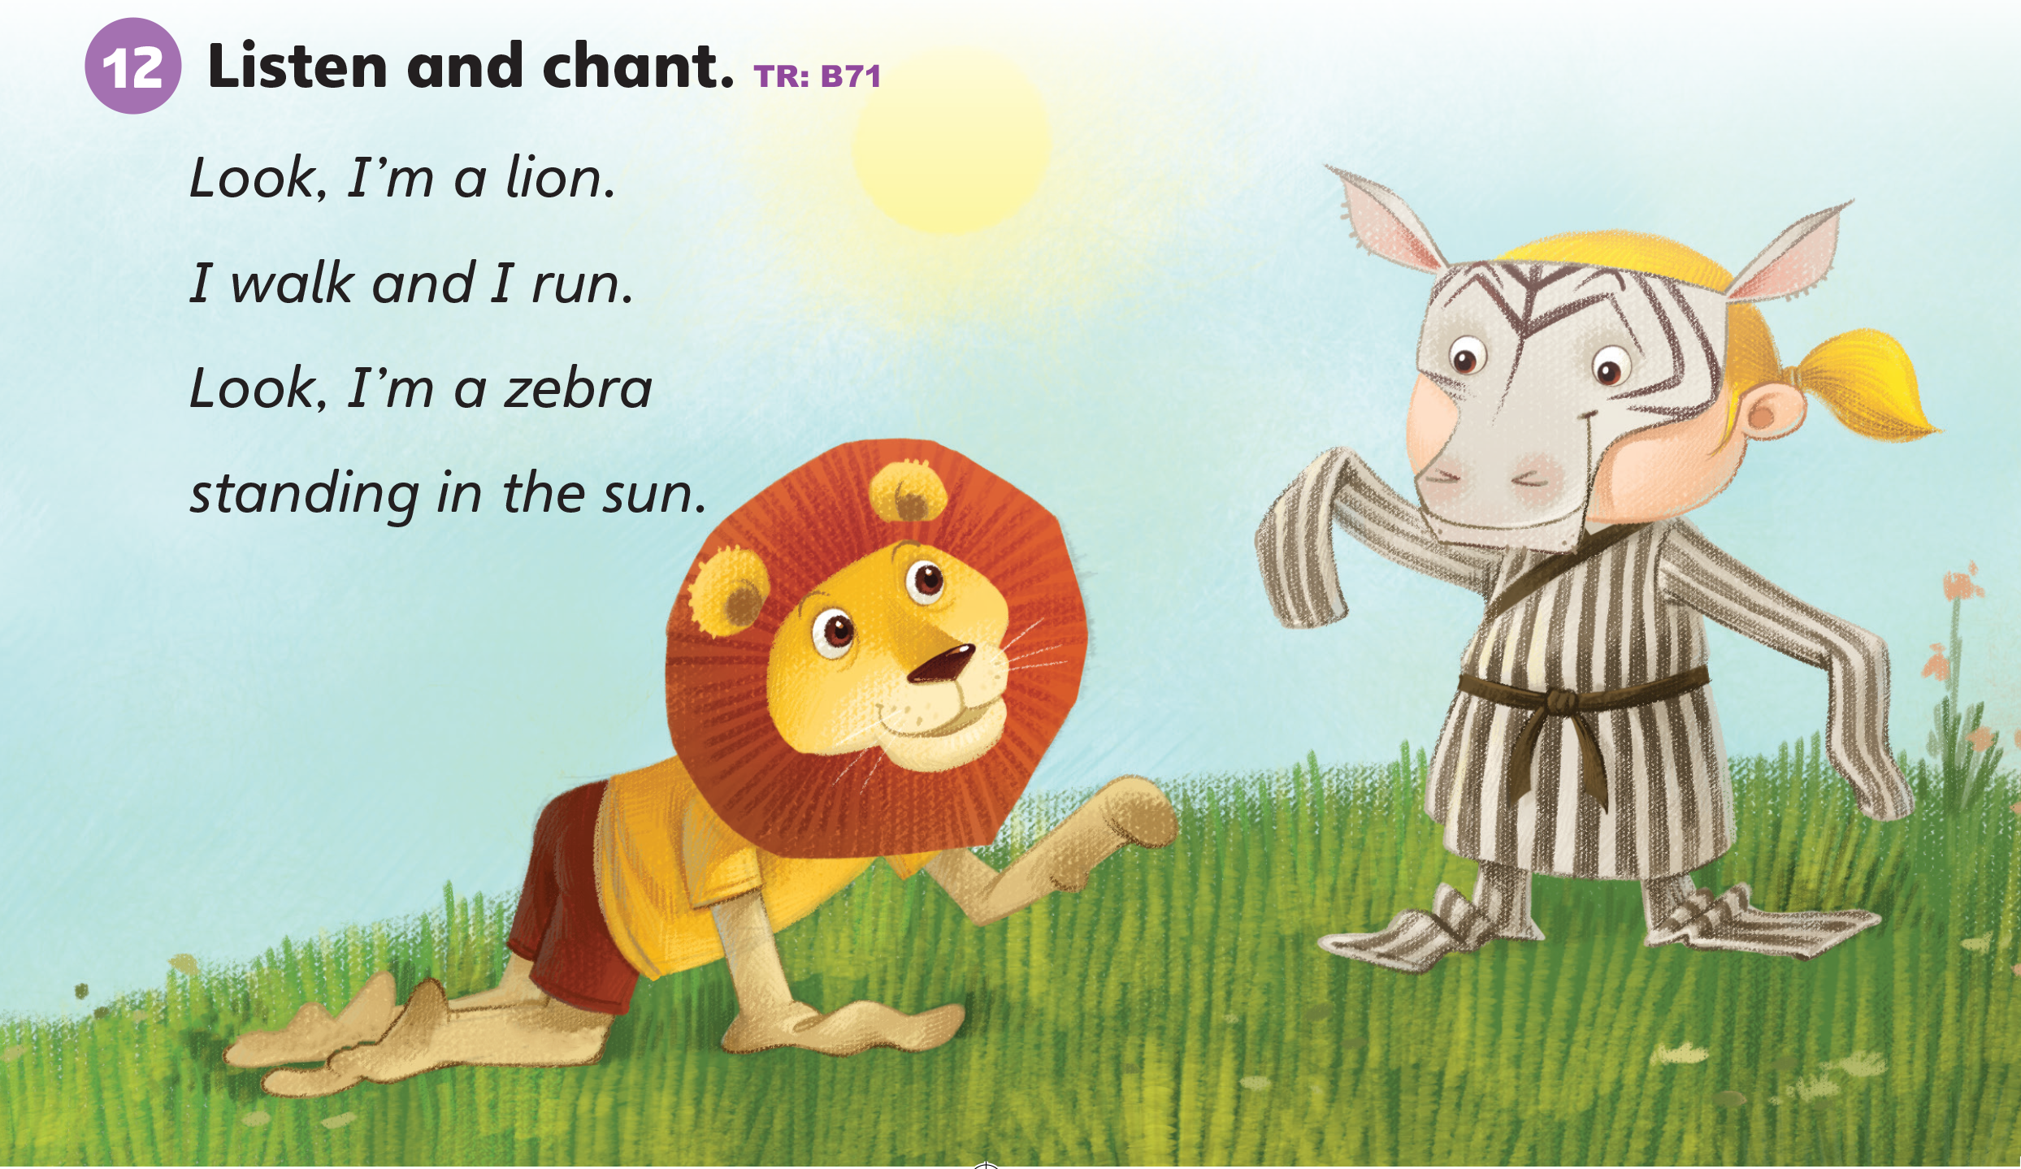
UNIT 4
ANIMALS
Notes:
12 Say Let’s listen to a chant.
Play TR: B71 two times. Have students listen to the chant.
Play TR: B71 a third time and have students repeat the chant. Make the /m/ sound.
Say the chant again as a class.
Have students raise their hands when they say /m/.
Repeat this with /z/ and /l/.
Students should raise hands when they say I’m, look, lion, and zebra.

Slide 155
UNIT 4
ANIMALS
/m/ sound
/z/ sound
/z/ sound
Let’s chant
There’s a lion lying in the room!
He’s not in the zoo.
I’m running upstairs!
What about you?
Notes:
Say the following: There’s a lion lying in the room! He’s not in the zoo. I’m running upstairs! What about you?
Repeat this a few times.
Have students raise their hands when they hear the target sounds of /m/, /z/, and /l/.
Students should raise their hands when they hear:
/m/: room, I’m;
/z/: zoo, upstairs;
/l/: lion, lying

Slide 156
UNIT 4
ANIMALS
Let’s draw
There’s a lion in the kitchen! I’m running upstairs!
Notes:
Make sure that students have paper and crayons.
Say There’s a lion in the kitchen! I’m running upstairs!
Ask students to draw this scene, show their pictures to their partner, and describe it to one another.
Call on several students to share their pictures with the class.

Slide 157
UNIT 4
ANIMALS
Notes:
Divide the class into two groups again. This time switch the groups and say You will be the lion. Say to the other You will be the zebra.
Have students in the lion group say the first two lines of the chant together, walking and running in place as they say the words walk and run.
Then, have the zebra group say the last two lines together, holding their arms out to take in the sun’s rays as they say standing in the sun.
Students should repeat the chant a few times, saying it faster each time.

Slide 158
UNIT 4
ANIMALS
Goodbye Chant
Good work, class.
Hip hip, hooray!
Goodbye for now.
Have a nice day!
Notes:
Say Good job today class. Now let’s chant.
Lead the class in the Goodbye chant.

Slide 159
UNIT 4
ANIMALS
Do you know any word with /m/, /z/, or /l/ sound?
Notes:
Can students identify and make the /m/, /z/, and /l/ sounds?
Make each of the target sounds and call on students to give a word or words with that sound.

Slide 160
UNIT 4
ANIMALS
Thank you!

Slide 161
Unit 4:
Animals
Lesson 9

Slide 162
UNIT 4
ANIMALS
English Time Chant
English, (clap) English, (clap)
English (clap) today! (clap, clap)
English, (clap) English, (clap)
Hip, hip, (clap) hooray! (clap, clap)

Slide 163
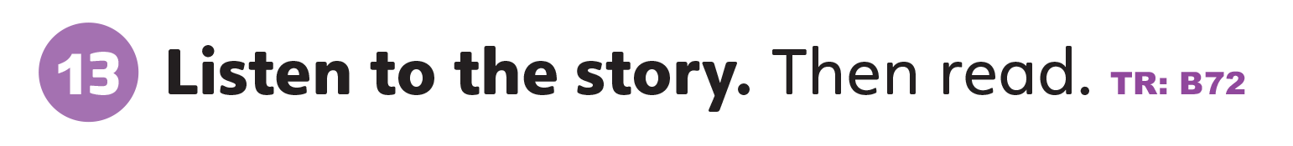
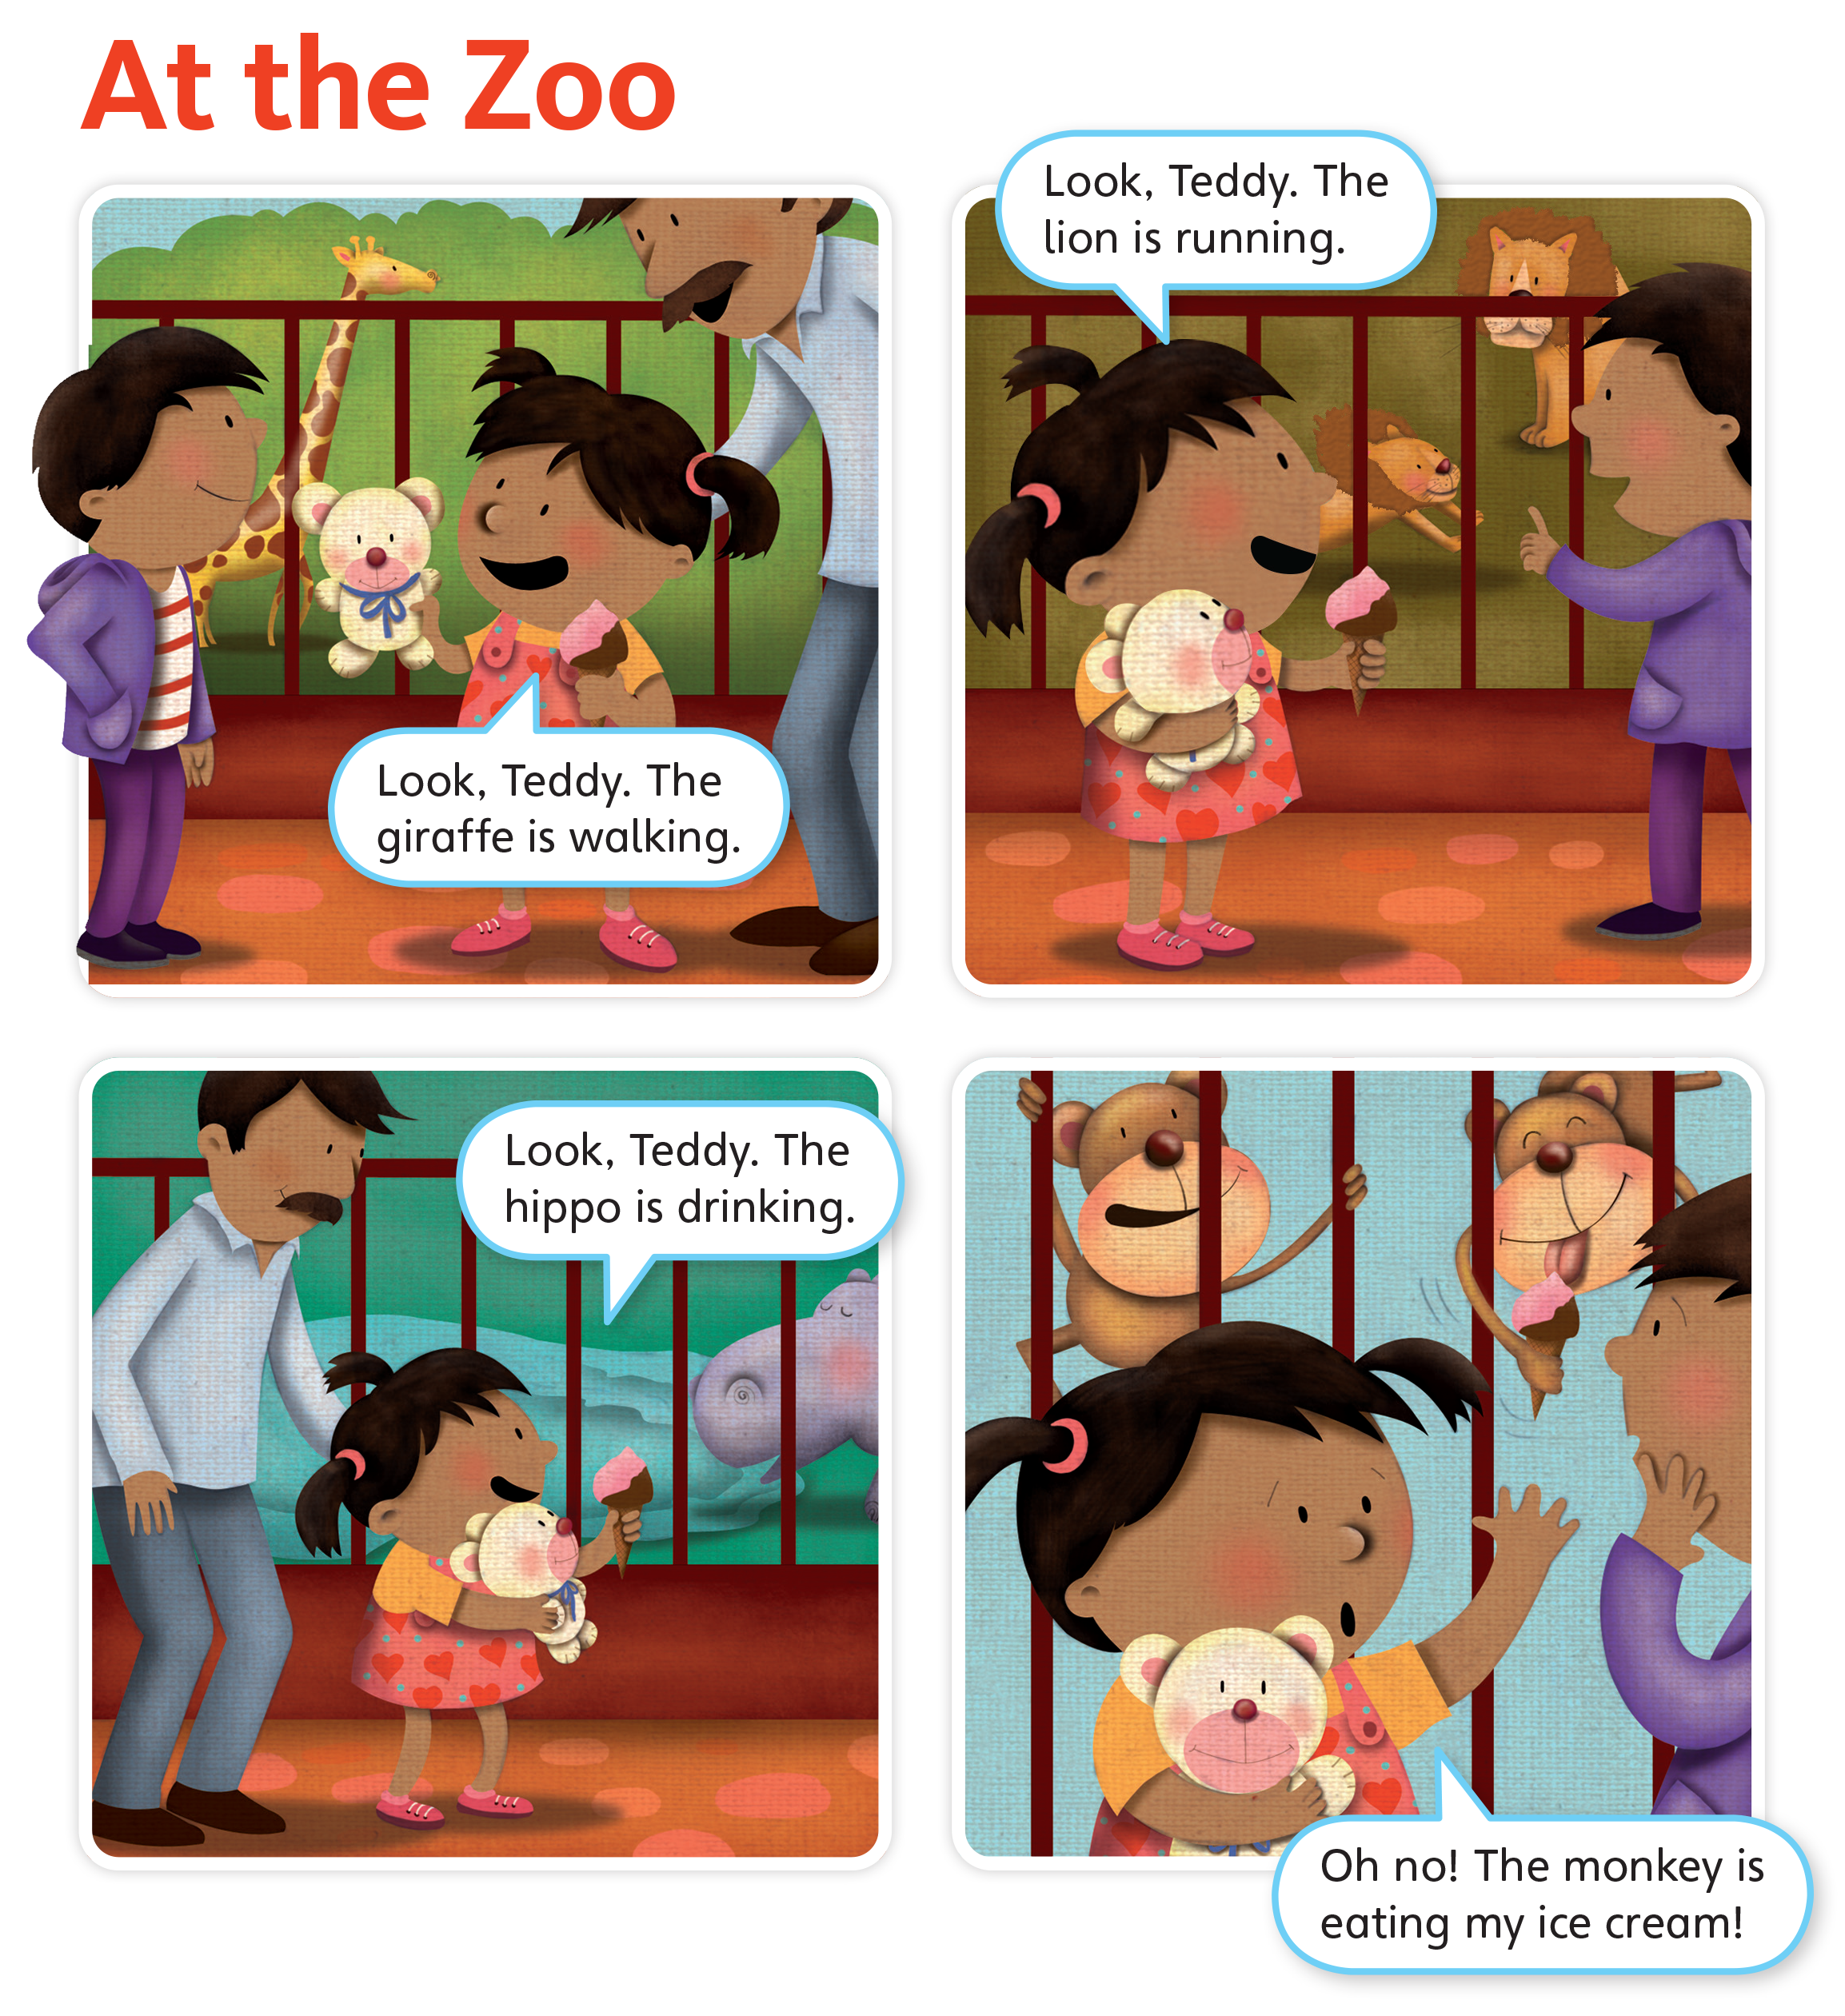
UNIT 4
ANIMALS
Do you like the zoo?
What animals do you see at the zoo?
Yes
Elephant, frog, parrot, giraffe, hippo, lion, snake, bear,...
Notes:
Say Open your books to p. 37. This story is called At the Zoo. Look at the panels.
Ask students Do you like the zoo?
Students should say [Yes].
Call on a few students to respond. Then, ask What animals do you see at the zoo?
Students should name animals they know.
Make a list of the animals that students name. Review words like elephant, frog, and parrot, as well. Teach students words for other animals that they might think of, such as tigers or snakes.

Slide 164
UNIT 4
ANIMALS
Who is in the story?
A brother,
a sister,
a father.
What toy does the girl have?
A teddy bear
Notes:
Point to the different panels and ask Who is in the story?
Students should say A brother, a sister, a father.
Ask What toy does the girl have?
Students should say A teddy bear.
Ask What animals are at the zoo?
Students should say Giraffe, lions, hippo, monkeys.

Slide 165
UNIT 4
ANIMALS
What animals are at the zoo?
Giraffe, lions, hippo, monkeys.
Notes:
Point to the different panels and ask Who is in the story?
Students should say A brother, a sister, a father.
Ask What toy does the girl have?
Students should say A teddy bear.
Ask What animals are at the zoo?
Students should say Giraffe, lions, hippo, monkeys.

Slide 166
UNIT 4
ANIMALS
Notes:
13 Point to the teddy bear and the ice cream cone in the girl’s hands. Say The girl has a teddy bear. She is showing the animals to her teddy bear. She has ice cream, too.
Say Now, let’s read the story.
Play TR: B72. Students should point to each panel as they hear the story.
Play TR: B72 a second time.

Slide 167
UNIT 4
ANIMALS
The girl is talking to her teddy bear. She says, “Look, Teddy!”
The _______
is ________.
Notes:
Say The girl is talking to her teddy bear. She says, “Look, Teddy!”
Students should repeat Look, Teddy!
Make sure students use the same stress and intonation that you do. Point out the phrase in each of the first three panels. Then write the sentence frame on the board: The _______ is ________.

Slide 168
UNIT 4
ANIMALS
Is this a giraffe? What is it?
A lion
Notes:
Point to second panel in the story, and ask Is this a giraffe? What is it?
Students should say A lion.
Ask Is the lion walking? Call on a student to answer using the language No, it isn’t. It’s running.
Say That’s right. The lion is running.
As you say this, point to the sentence frame on the board.

Slide 169
UNIT 4
ANIMALS
No, it isn’t.
It’s running.
Is the lion walking?
The lion is running.
Notes:
Point to second panel in the story, and ask Is this a giraffe? What is it?
Students should say A lion.
Ask Is the lion walking? Call on a student to answer using the language No, it isn’t. It’s running.
Say That’s right. The lion is running.
As you say this, point to the sentence frame on the board.

Slide 170
UNIT 4
ANIMALS
What is the hippo doing?
The hippo is drinking.
Notes:
Point to the third panel, and ask What is the hippo doing?
Students should answer using the sentence frame: The hippo is drinking.
Then, repeat the activity using the fourth panel.

Slide 171
UNIT 4
ANIMALS
What is the monkey doing?
The monkey is eating ice cream.
Notes:
Point to the third panel, and ask What is the hippo doing?
Students should answer using the sentence frame: The hippo is drinking.
Then, repeat the activity using the fourth panel.

Slide 172
UNIT 4
ANIMALS
Notes:
Point to each panel again and read the story.
Then have students read the story chorally.
When students get to the fourth panel, model saying Oh no! with great exaggeration. Have students do the same, as they repeat the last phrase of the story with you.
If time permits, have volunteers act out the story.

Slide 173
UNIT 4
ANIMALS
What is
the animal doing?
Is _____ __ing?
No, it isn’t. The _______
is_________.
Notes:
Place students in pairs. Have students take turns asking questions about the panel, using the language model for Unit 4.
Point out that students should ask a question that would lead to a no answer.
Students should say Is the [giraffe] [eating]?
Then, their partner should answer the question using the language they have learnt.
The students’ partners should say No, it isn’t. It’s [walking].
Have pairs do this for each of the four panels. Encourage students to be creative in their questions. For example, students might ask Is the hippo drinking orange juice? or Is the monkey eating noodles?
When students finish, call on each pair to say a question and answer set for the class.

Slide 174

UNIT 4
ANIMALS
Notes:
14 Say I like the story!
Hold up your book and point to the happy face. Say I like the story. I circle the happy face.
Model circling the happy face. Then, gesture toward the students and ask Do you like the story?
Students should say [Yes], then choose the correct face and circle it.
Call on a few students to share their responses.

Slide 175
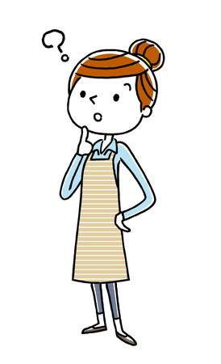
UNIT 4
ANIMALS
Let’s remember
What animal is walking?
The giraffe is walking.
Notes:
Have students close their books. Call on them to answer questions about the story.
Ask the following questions:
- What animal is walking?
Students should say The giraffe is walking.
- What does the girl have?
Students should say A teddy bear.
- What animal eats her ice cream?
Students should say A monkey.

Slide 176
UNIT 4
ANIMALS
Let’s remember
What does the girl have?
A teddy bear
Notes:
Have students close their books. Call on them to answer questions about the story.
Ask the following questions:
- What animal is walking?
Students should say The giraffe is walking.
- What does the girl have?
Students should say A teddy bear.
- What animal eats her ice cream?
Students should say A monkey.

Slide 177
UNIT 4
ANIMALS
Let’s remember
What animal eats her ice cream?
A monkey
Notes:
Have students close their books. Call on them to answer questions about the story.
Ask the following questions:
- What animal is walking?
Students should say The giraffe is walking.
- What does the girl have?
Students should say A teddy bear.
- What animal eats her ice cream?
Students should say A monkey.

Slide 178
UNIT 4
ANIMALS
Goodbye Chant
Good work, class.
Hip hip, hooray!
Goodbye for now.
Have a nice day!
Notes:
Say Good job today class. Now let’s chant.
Lead the class in the Goodbye chant.

Slide 179

UNIT 4
ANIMALS
Let’s check!
Let’s review
Notes:
Can students listen to and understand a story and recognize target vocabulary in context?
Read At the Zoo. Then, ask What does the monkey do?
Students should say It’s eating.
Call on students to name the animals that the girl sees at the zoo.
Student should say Giraffe, lion, hippo, monkey.

Slide 180
UNIT 4
ANIMALS
What does the monkey do?
It’s eating.
Notes:
Can students listen to and understand a story and recognize target vocabulary in context?
Read At the Zoo. Then, ask What does the monkey do?
Students should say It’s eating.
Call on students to name the animals that the girl sees at the zoo.
Student should say Giraffe, lion, hippo, monkey.

Slide 181
UNIT 4
ANIMALS
What animals do you see at the zoo?
Giraffe, lion, hippo, monkey.
Notes:
Can students listen to and understand a story and recognize target vocabulary in context?
Read At the Zoo. Then, ask What does the monkey do?
Students should say It’s eating.
Call on students to name the animals that the girl sees at the zoo.
Student should say Giraffe, lion, hippo, monkey.

Slide 182
UNIT 4
ANIMALS
Thank you!

