Slide 1

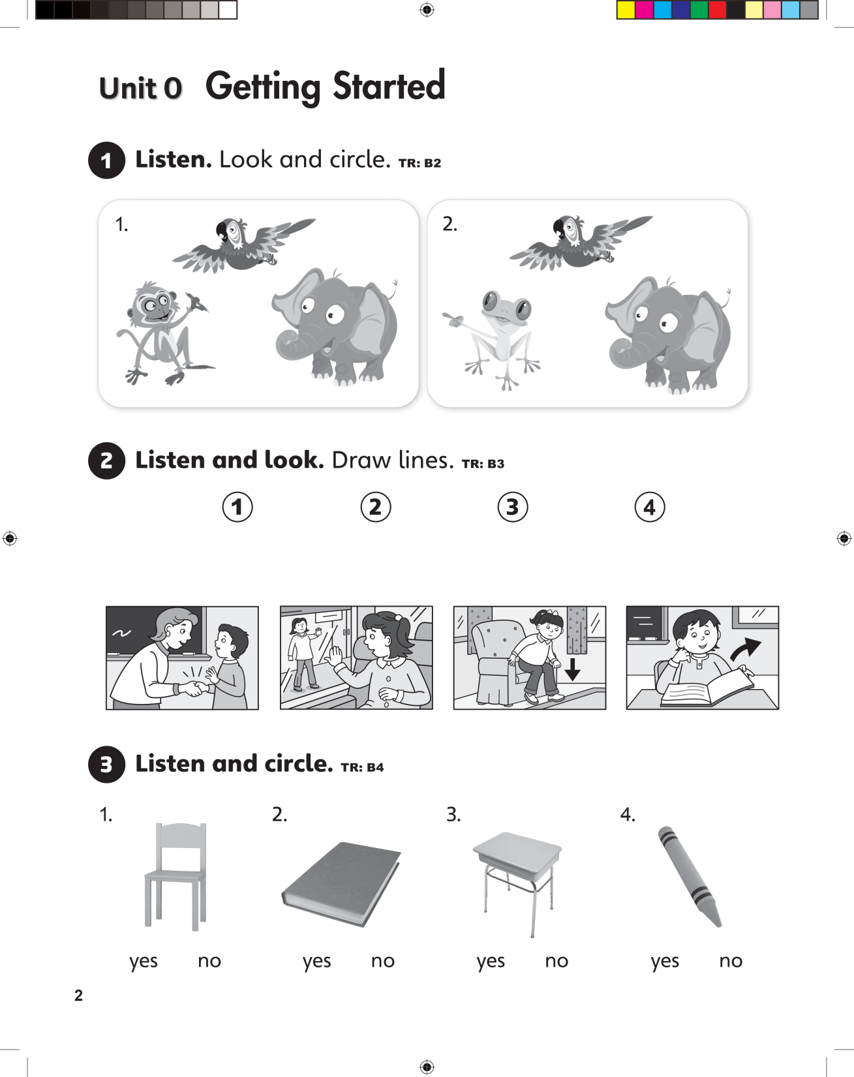

UNIT 0
GET STARTED

Slide 2
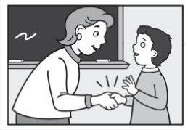
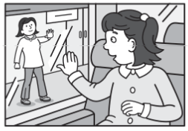
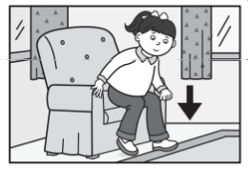
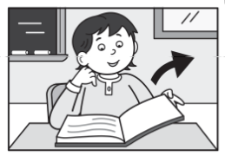
UNIT 0
GET STARTED

Slide 3
UNIT 0
GET STARTED

Slide 4
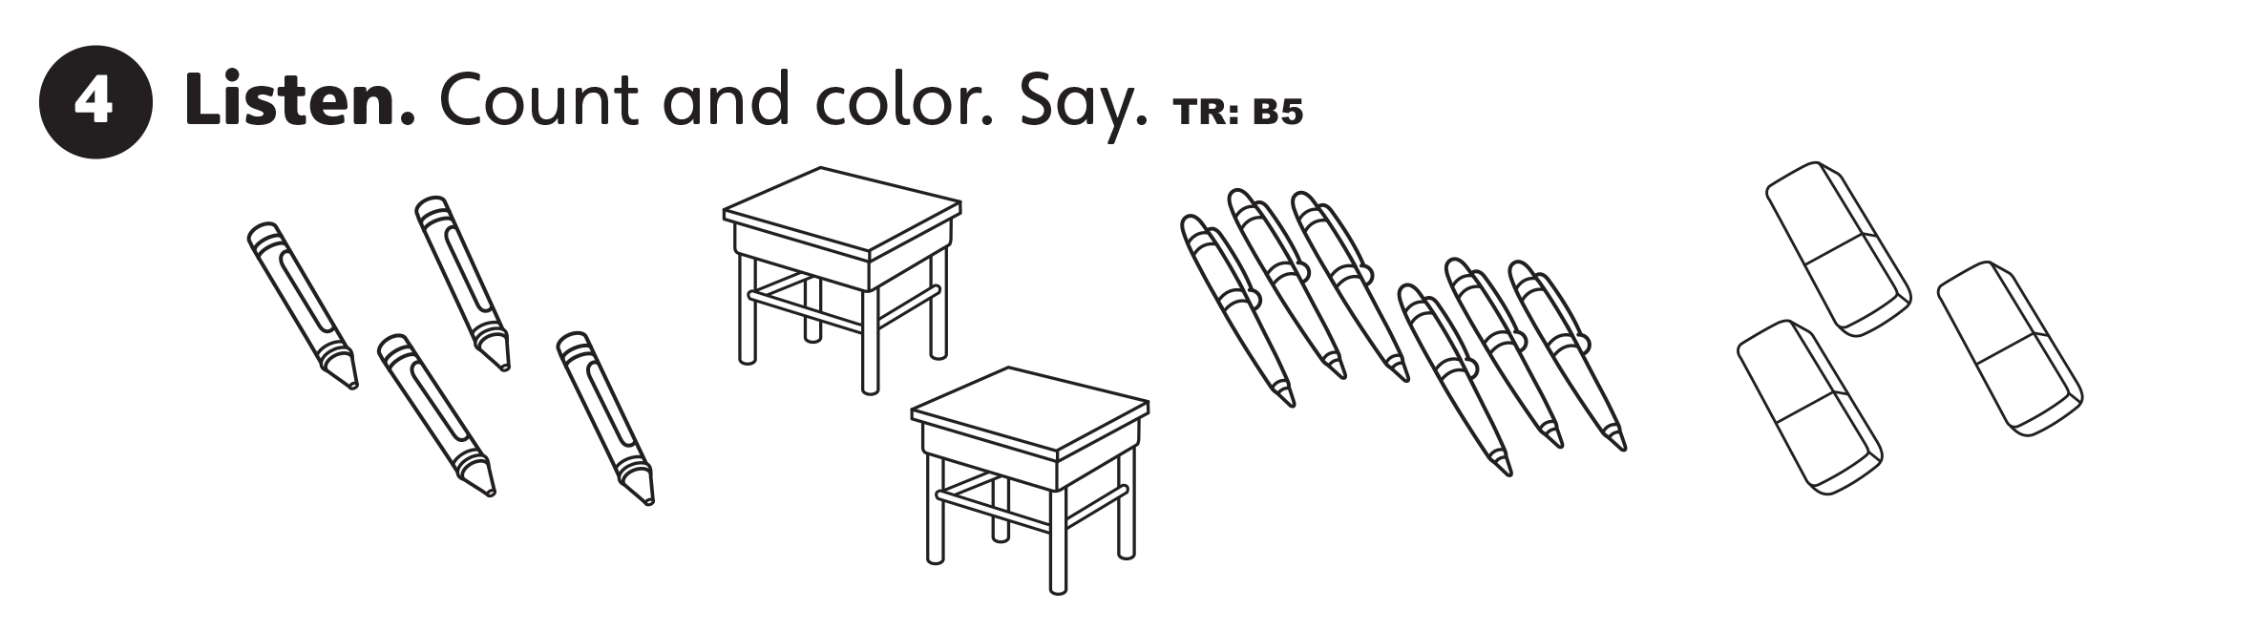
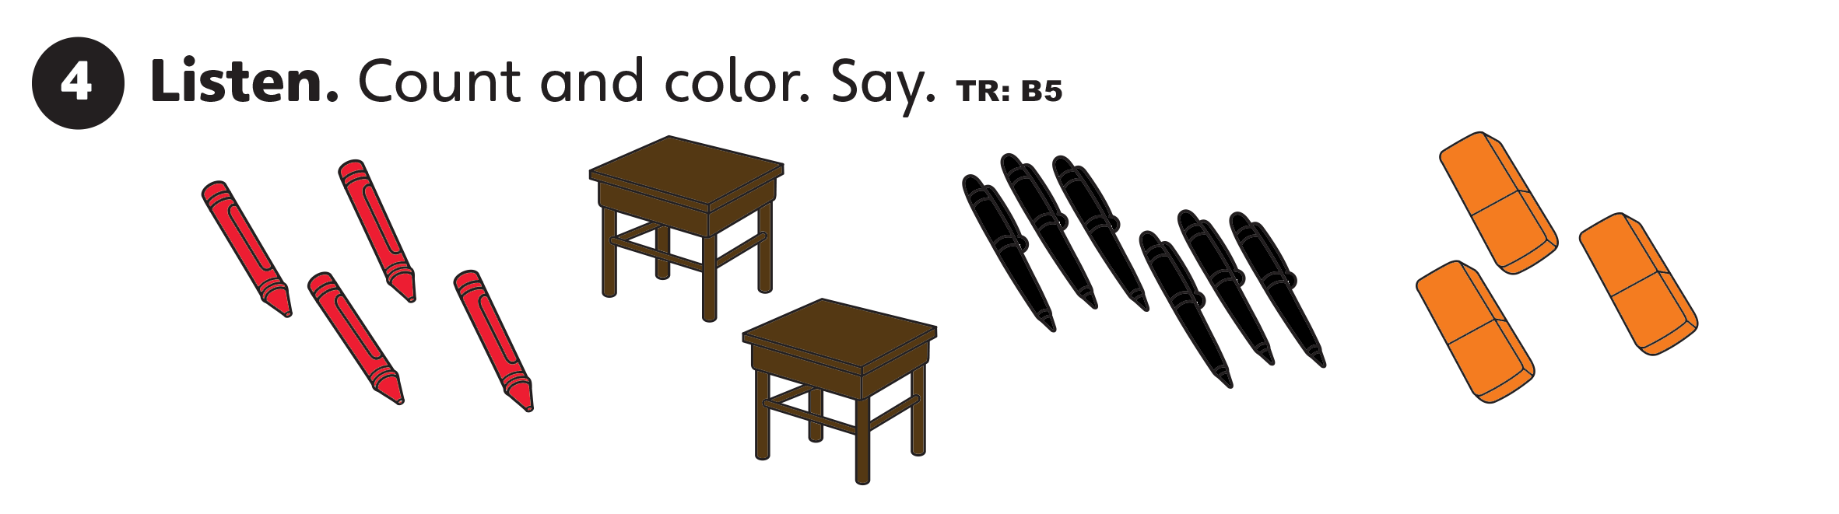
UNIT 0
GET STARTED

Slide 5
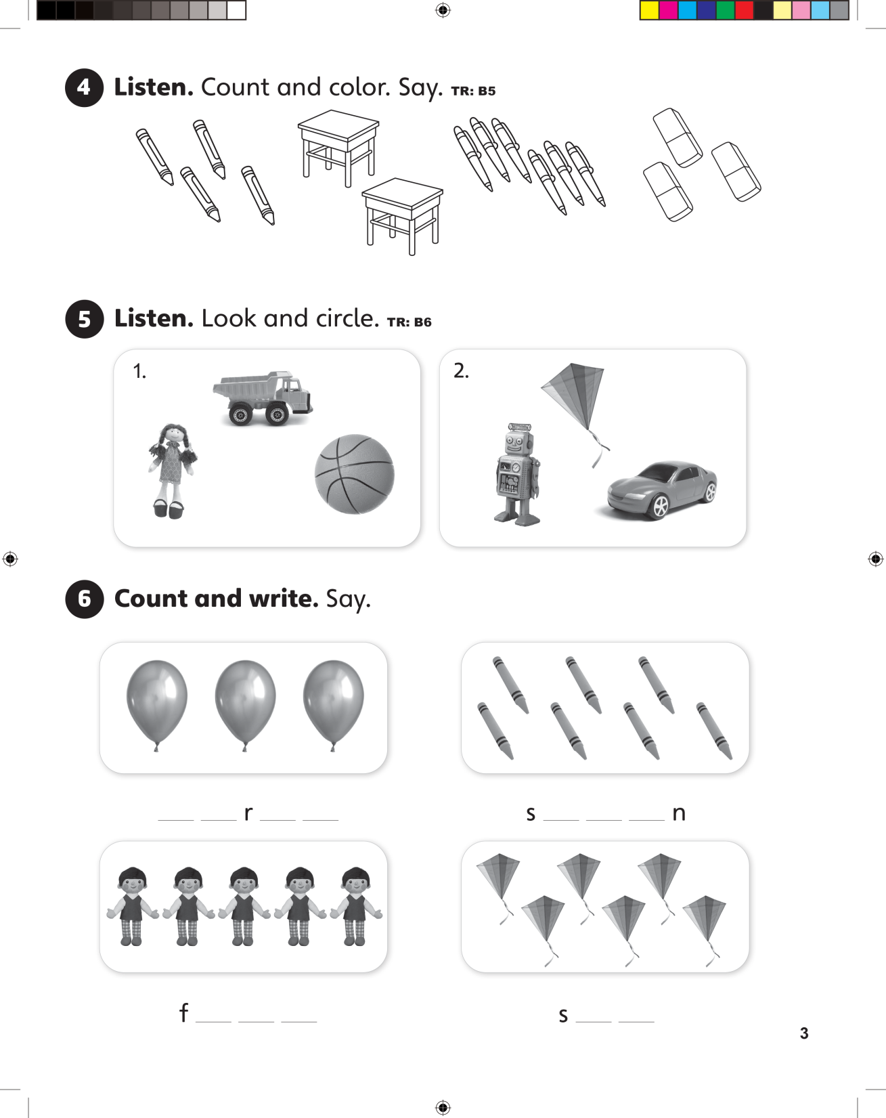
UNIT 0
GET STARTED

Slide 6
UNIT 0
GET STARTED
t h e e
e v e
i v e
i x

Slide 7
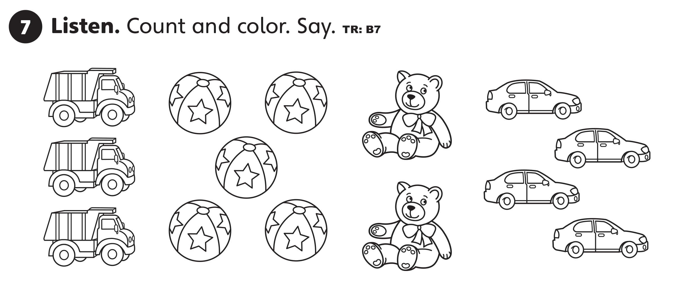
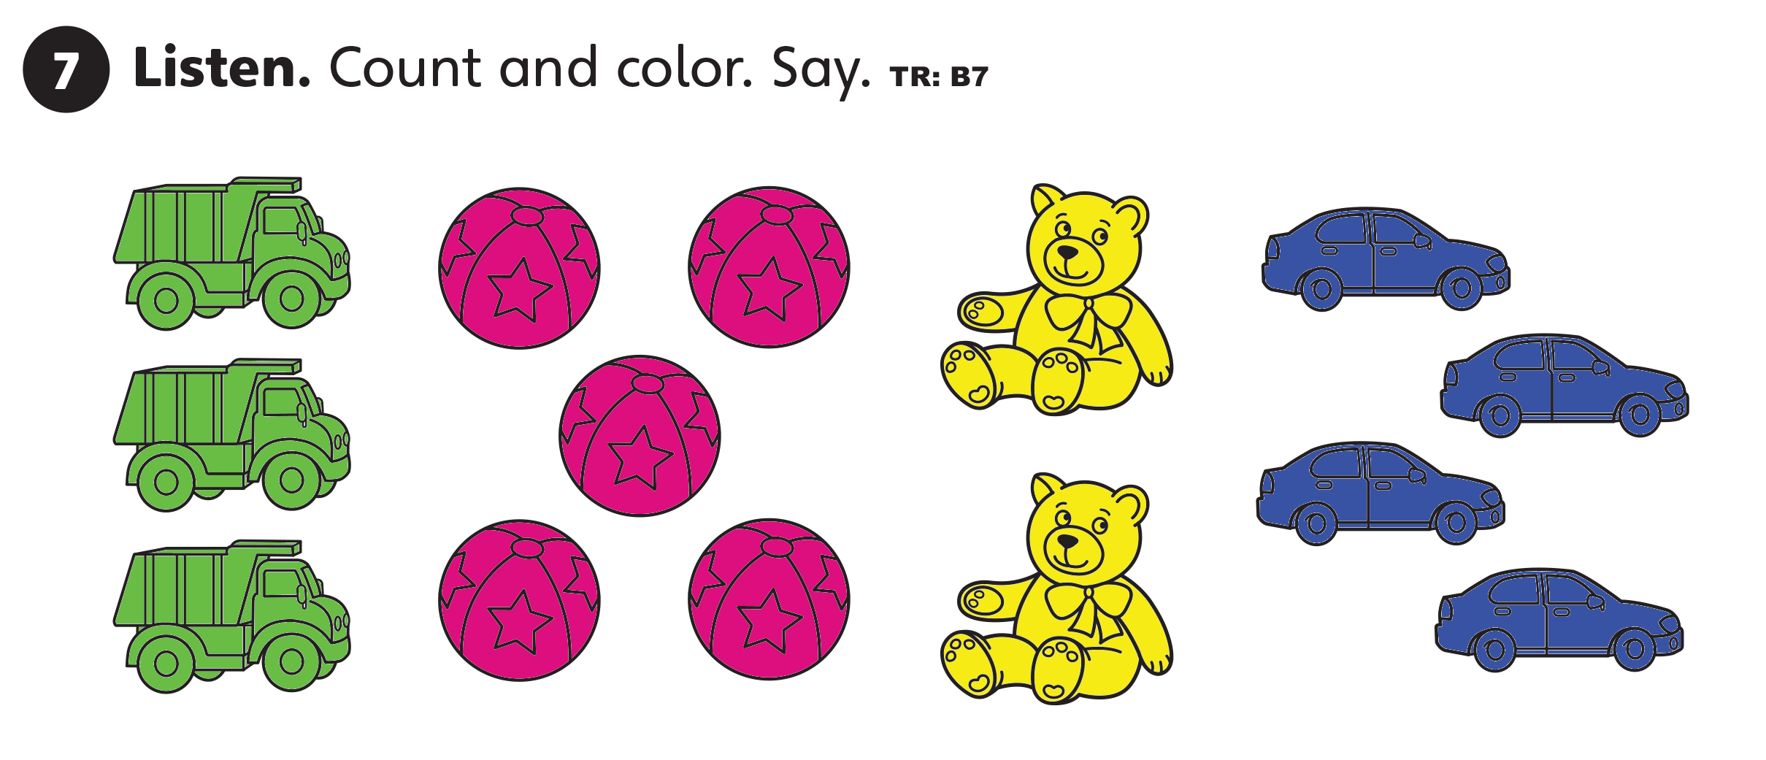
UNIT 0
GET STARTED

Slide 8
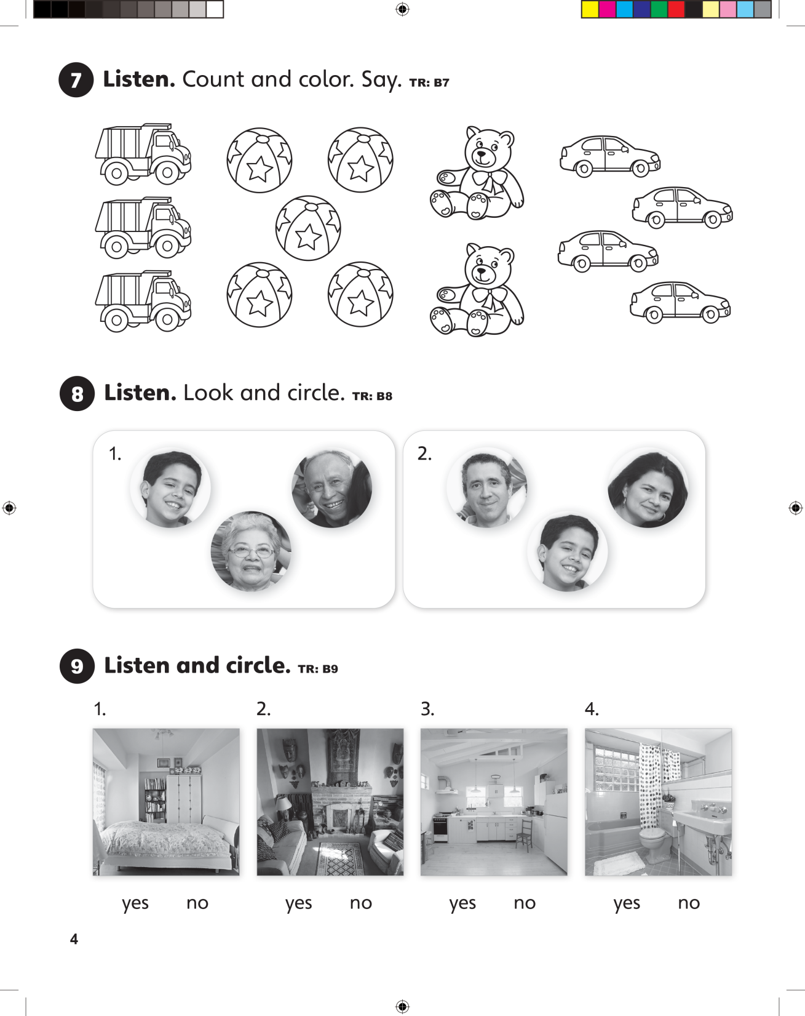
UNIT 0
GET STARTED

Slide 9
UNIT 0
GET STARTED

Slide 10
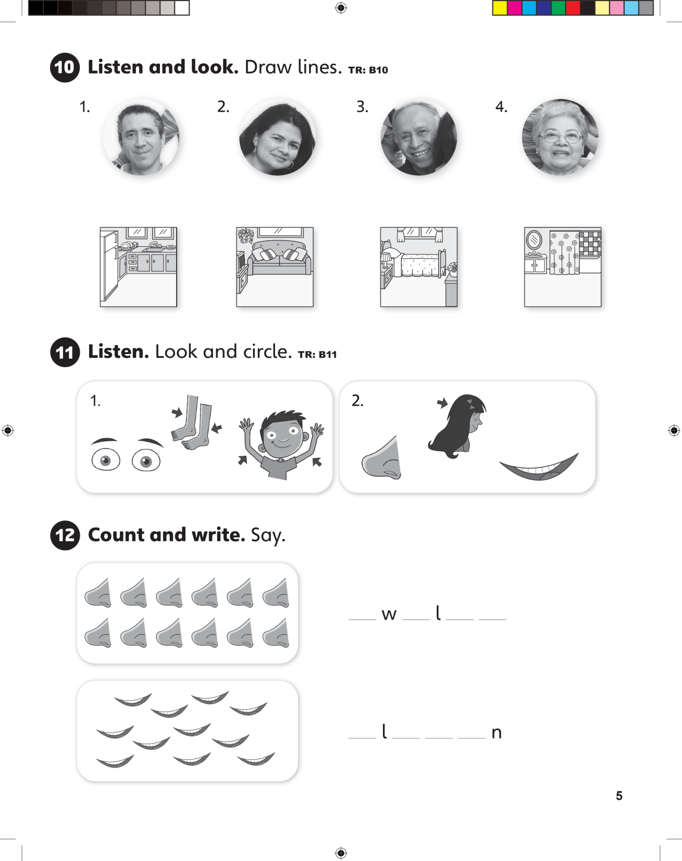
UNIT 0
GET STARTED

Slide 11
UNIT 0
GET STARTED

Slide 12
UNIT 0
GET STARTED
t e v e
e e v e

Slide 13
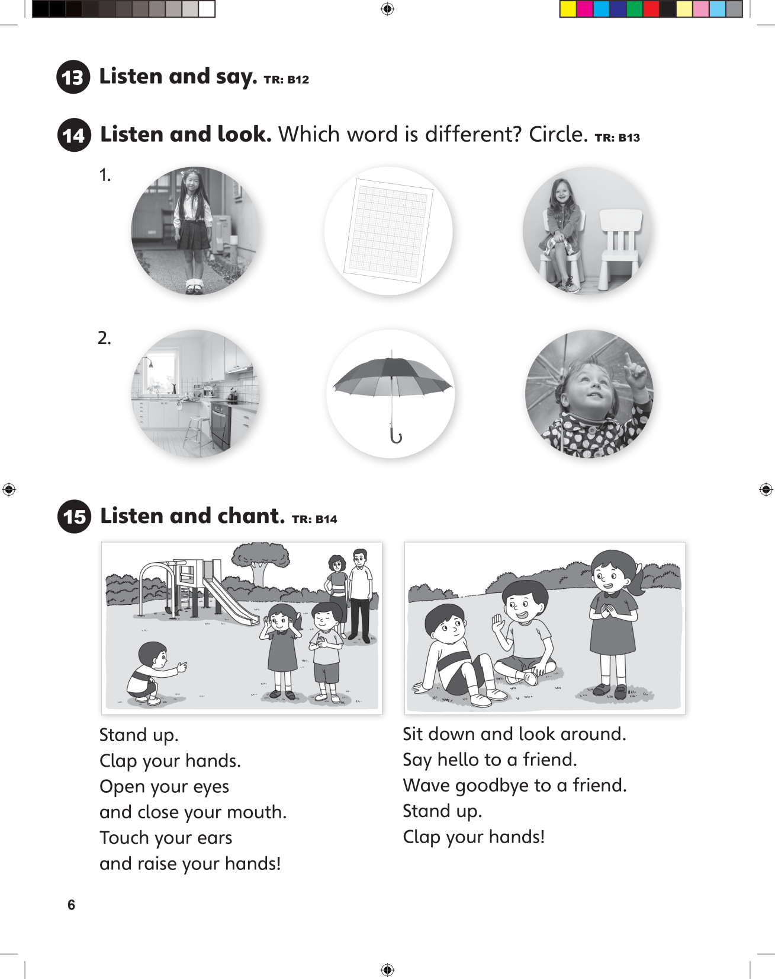
UNIT 0
GET STARTED

Slide 14
UNIT 0
GET STARTED

Slide 15
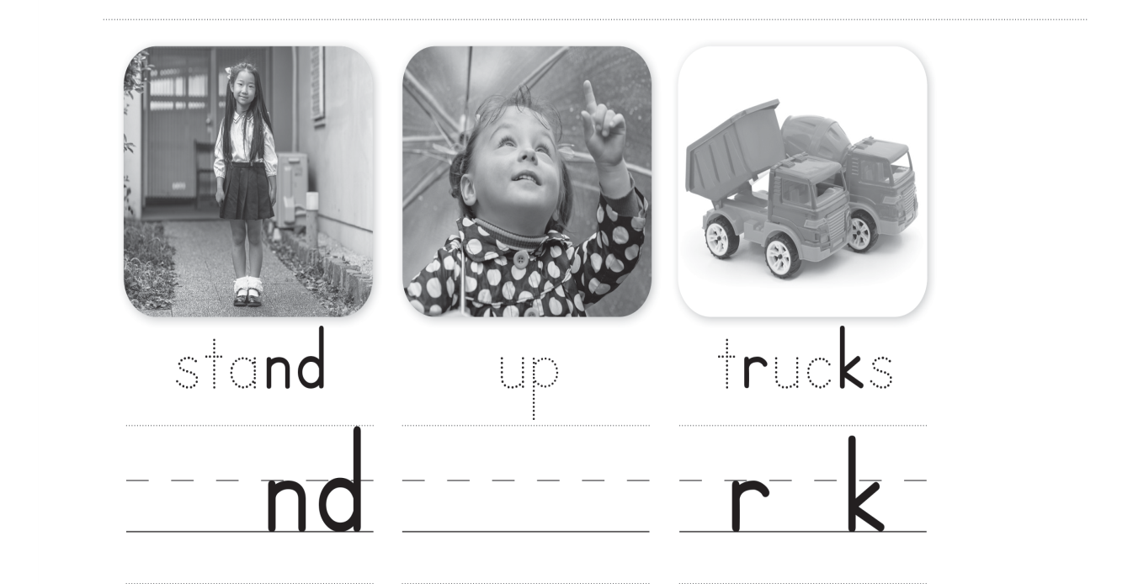

UNIT 0
GET STARTED

