Slide 1

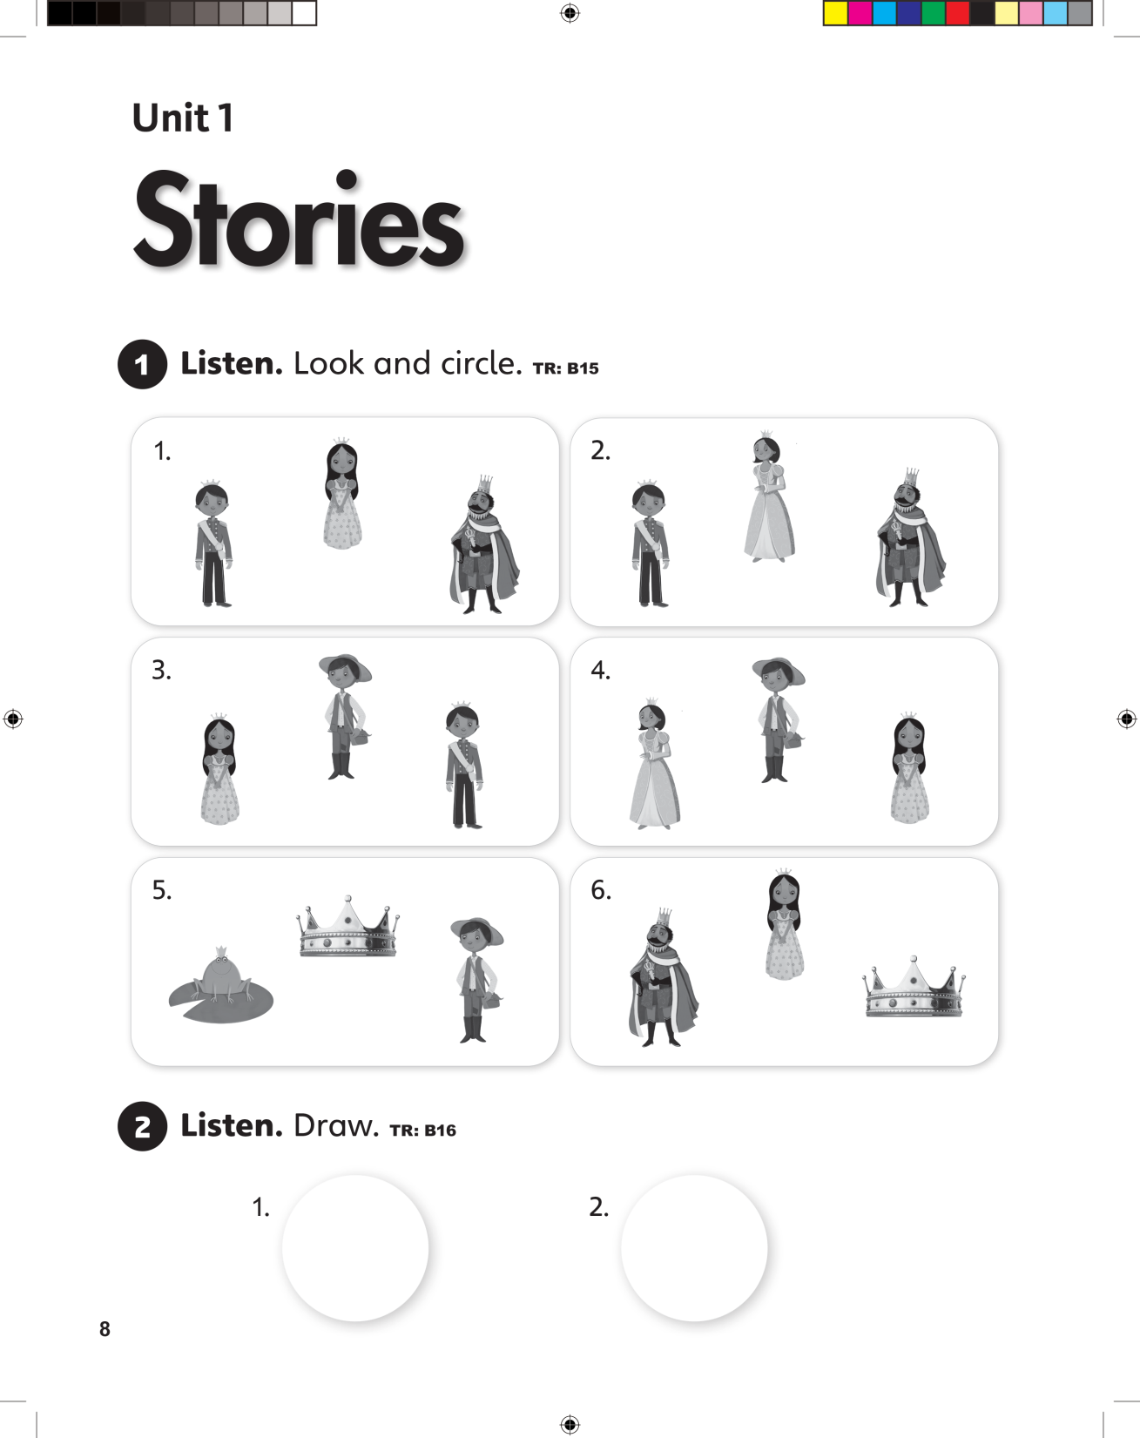

UNIT 1
STORIES

Slide 2
UNIT 1
STORIES

Slide 3
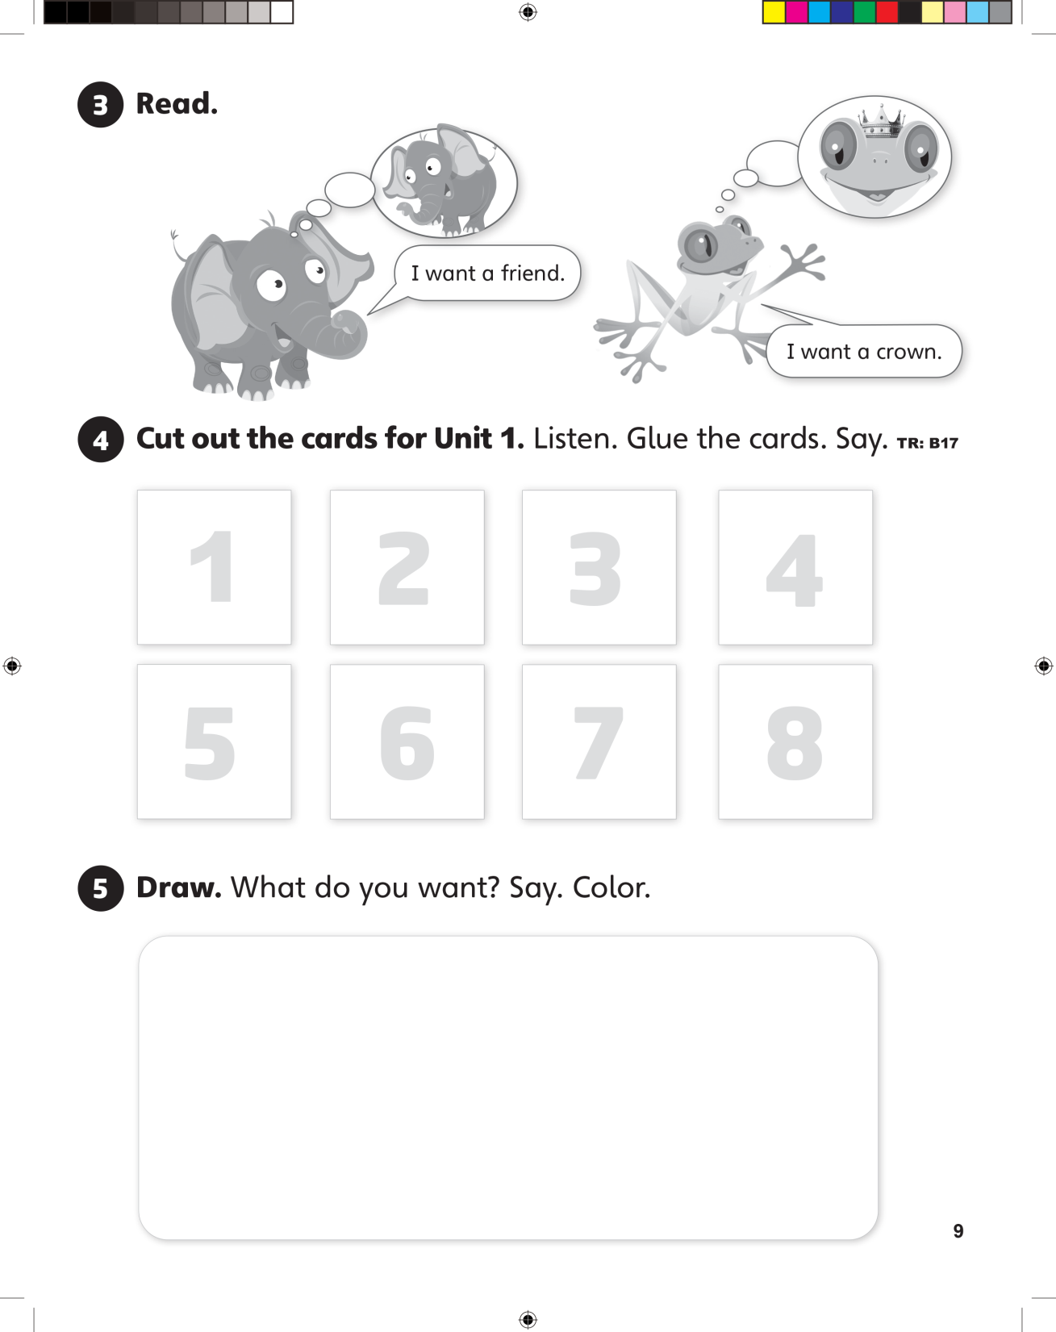
UNIT 1
STORIES

Slide 4
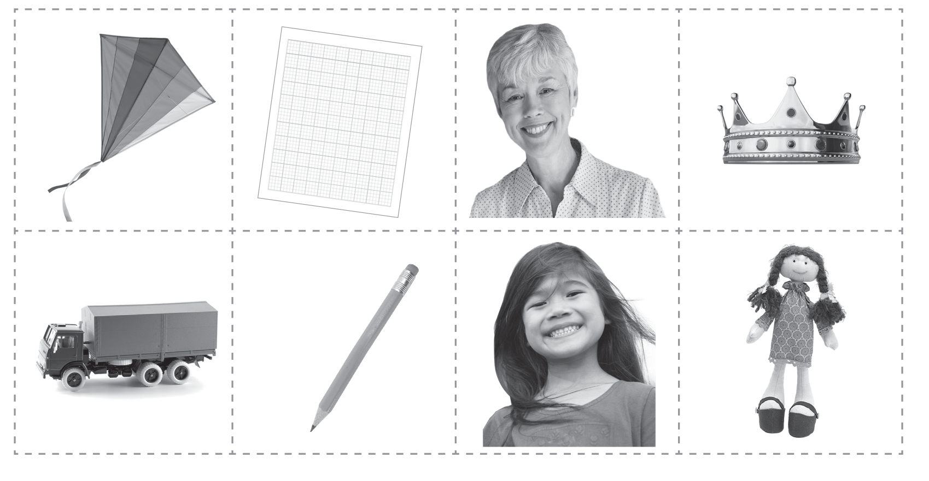
UNIT 1
STORIES

Slide 5
UNIT 1
STORIES

Slide 6
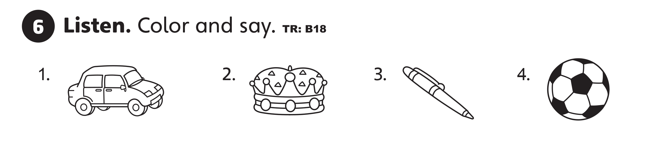
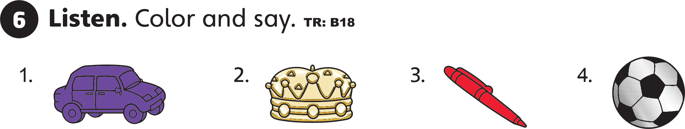
UNIT 1
STORIES

Slide 7
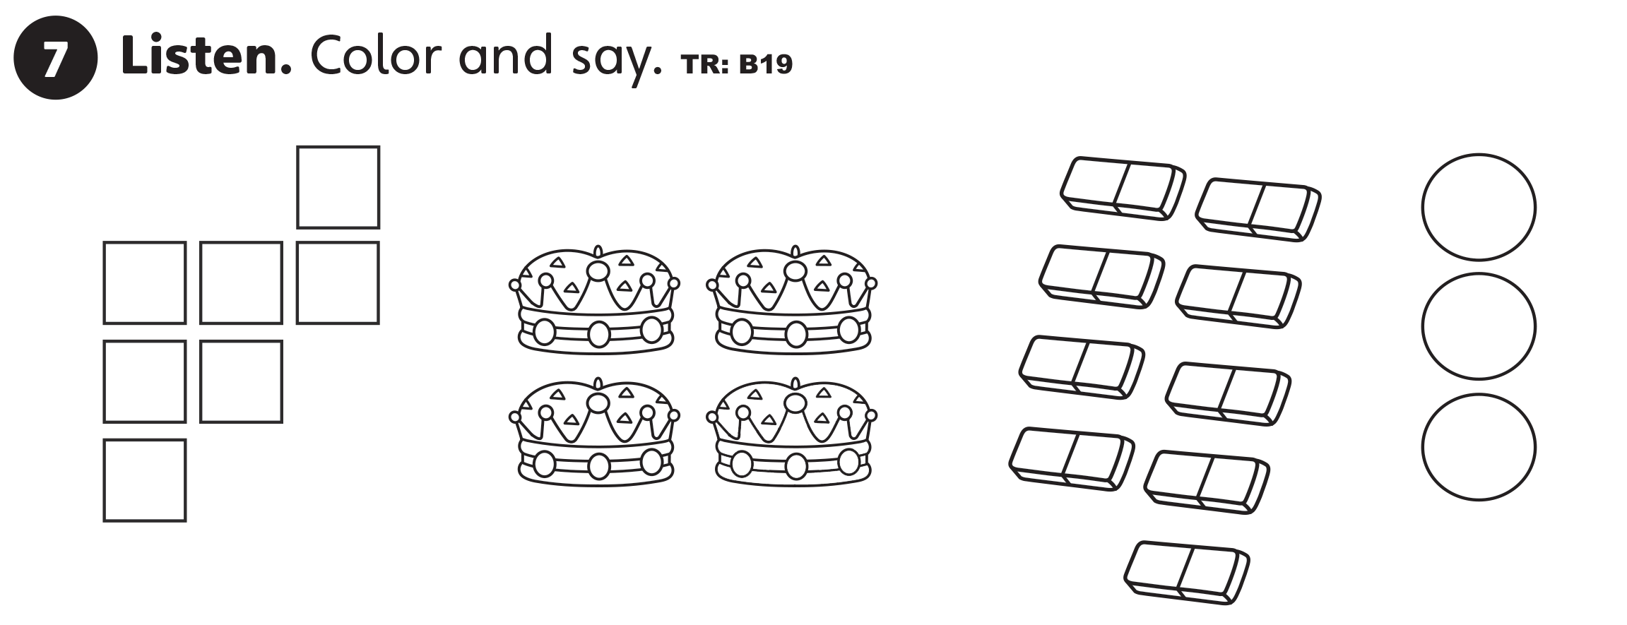
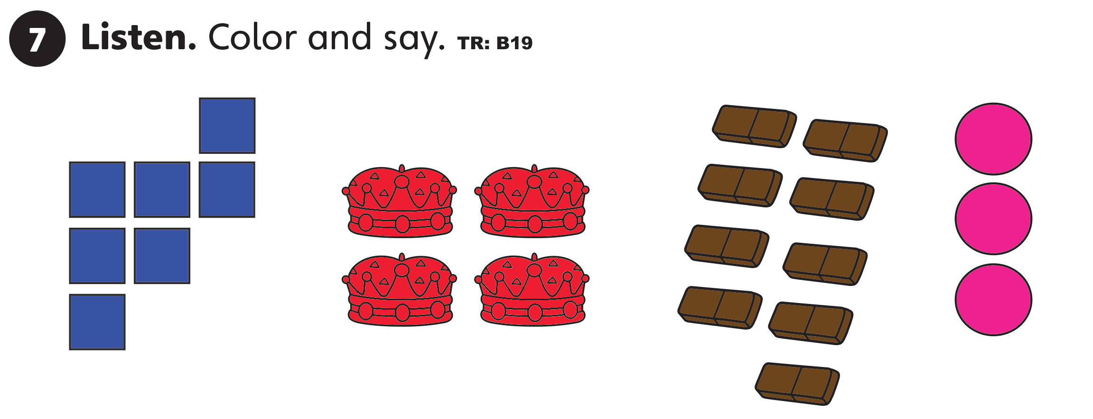
UNIT 1
STORIES

Slide 8
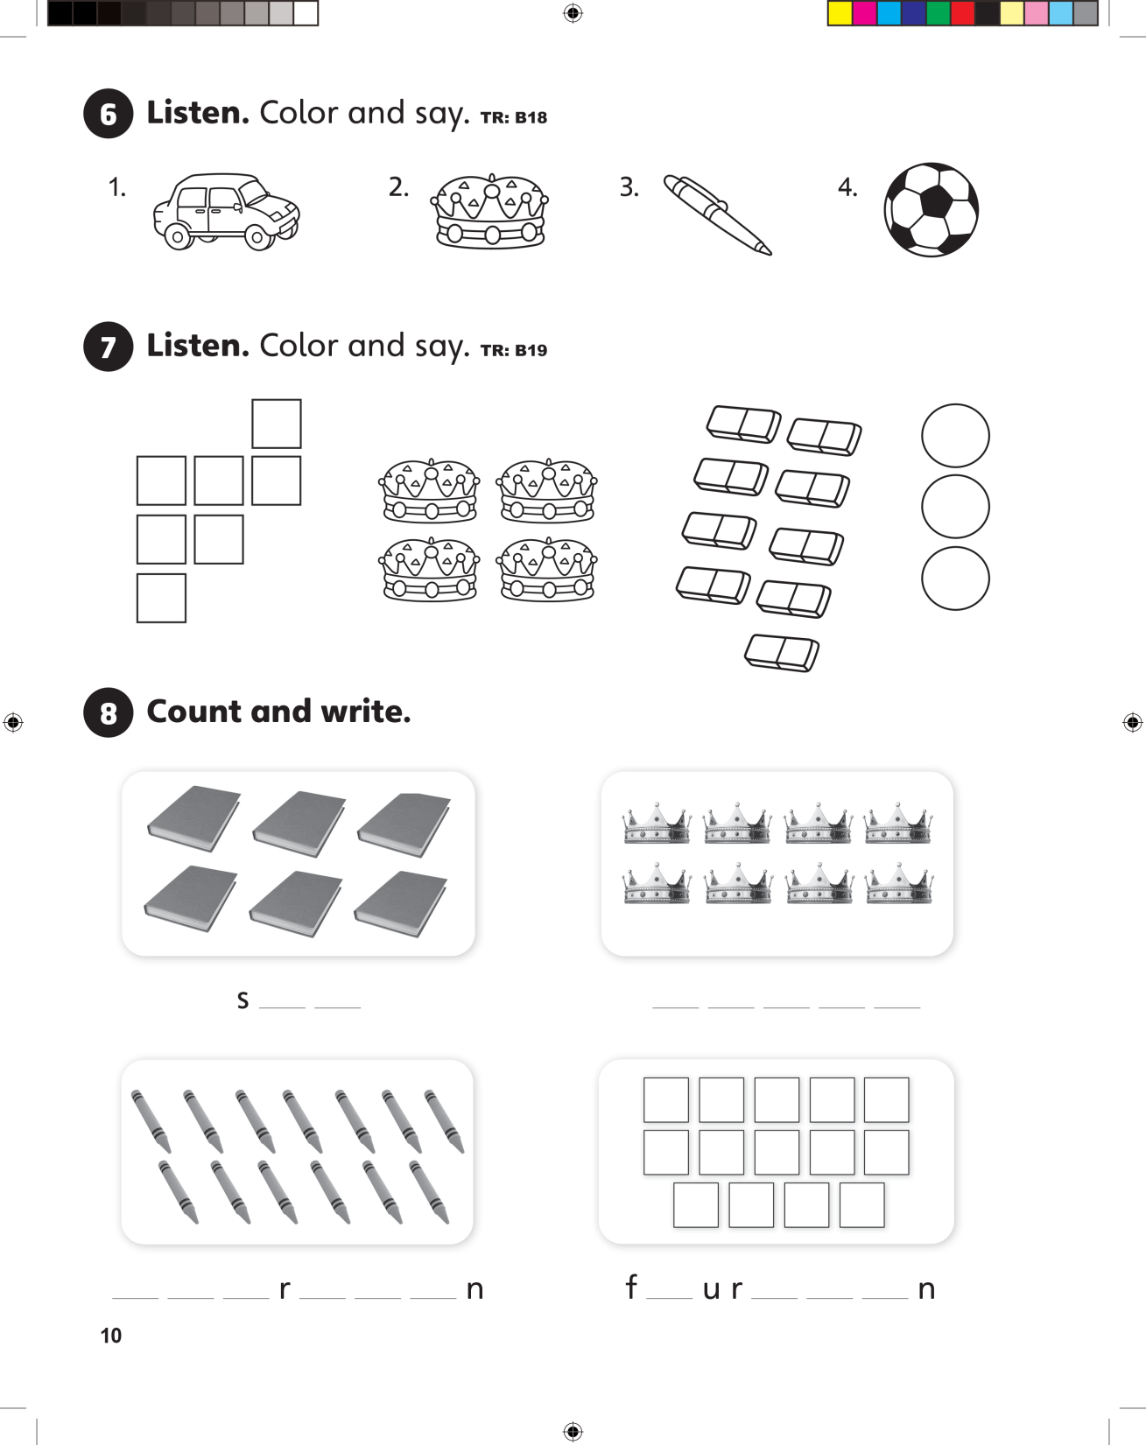
UNIT 1
STORIES
i x
e i g h t

Slide 9
UNIT 1
STORIES
t h i t e e
o t e e

Slide 10
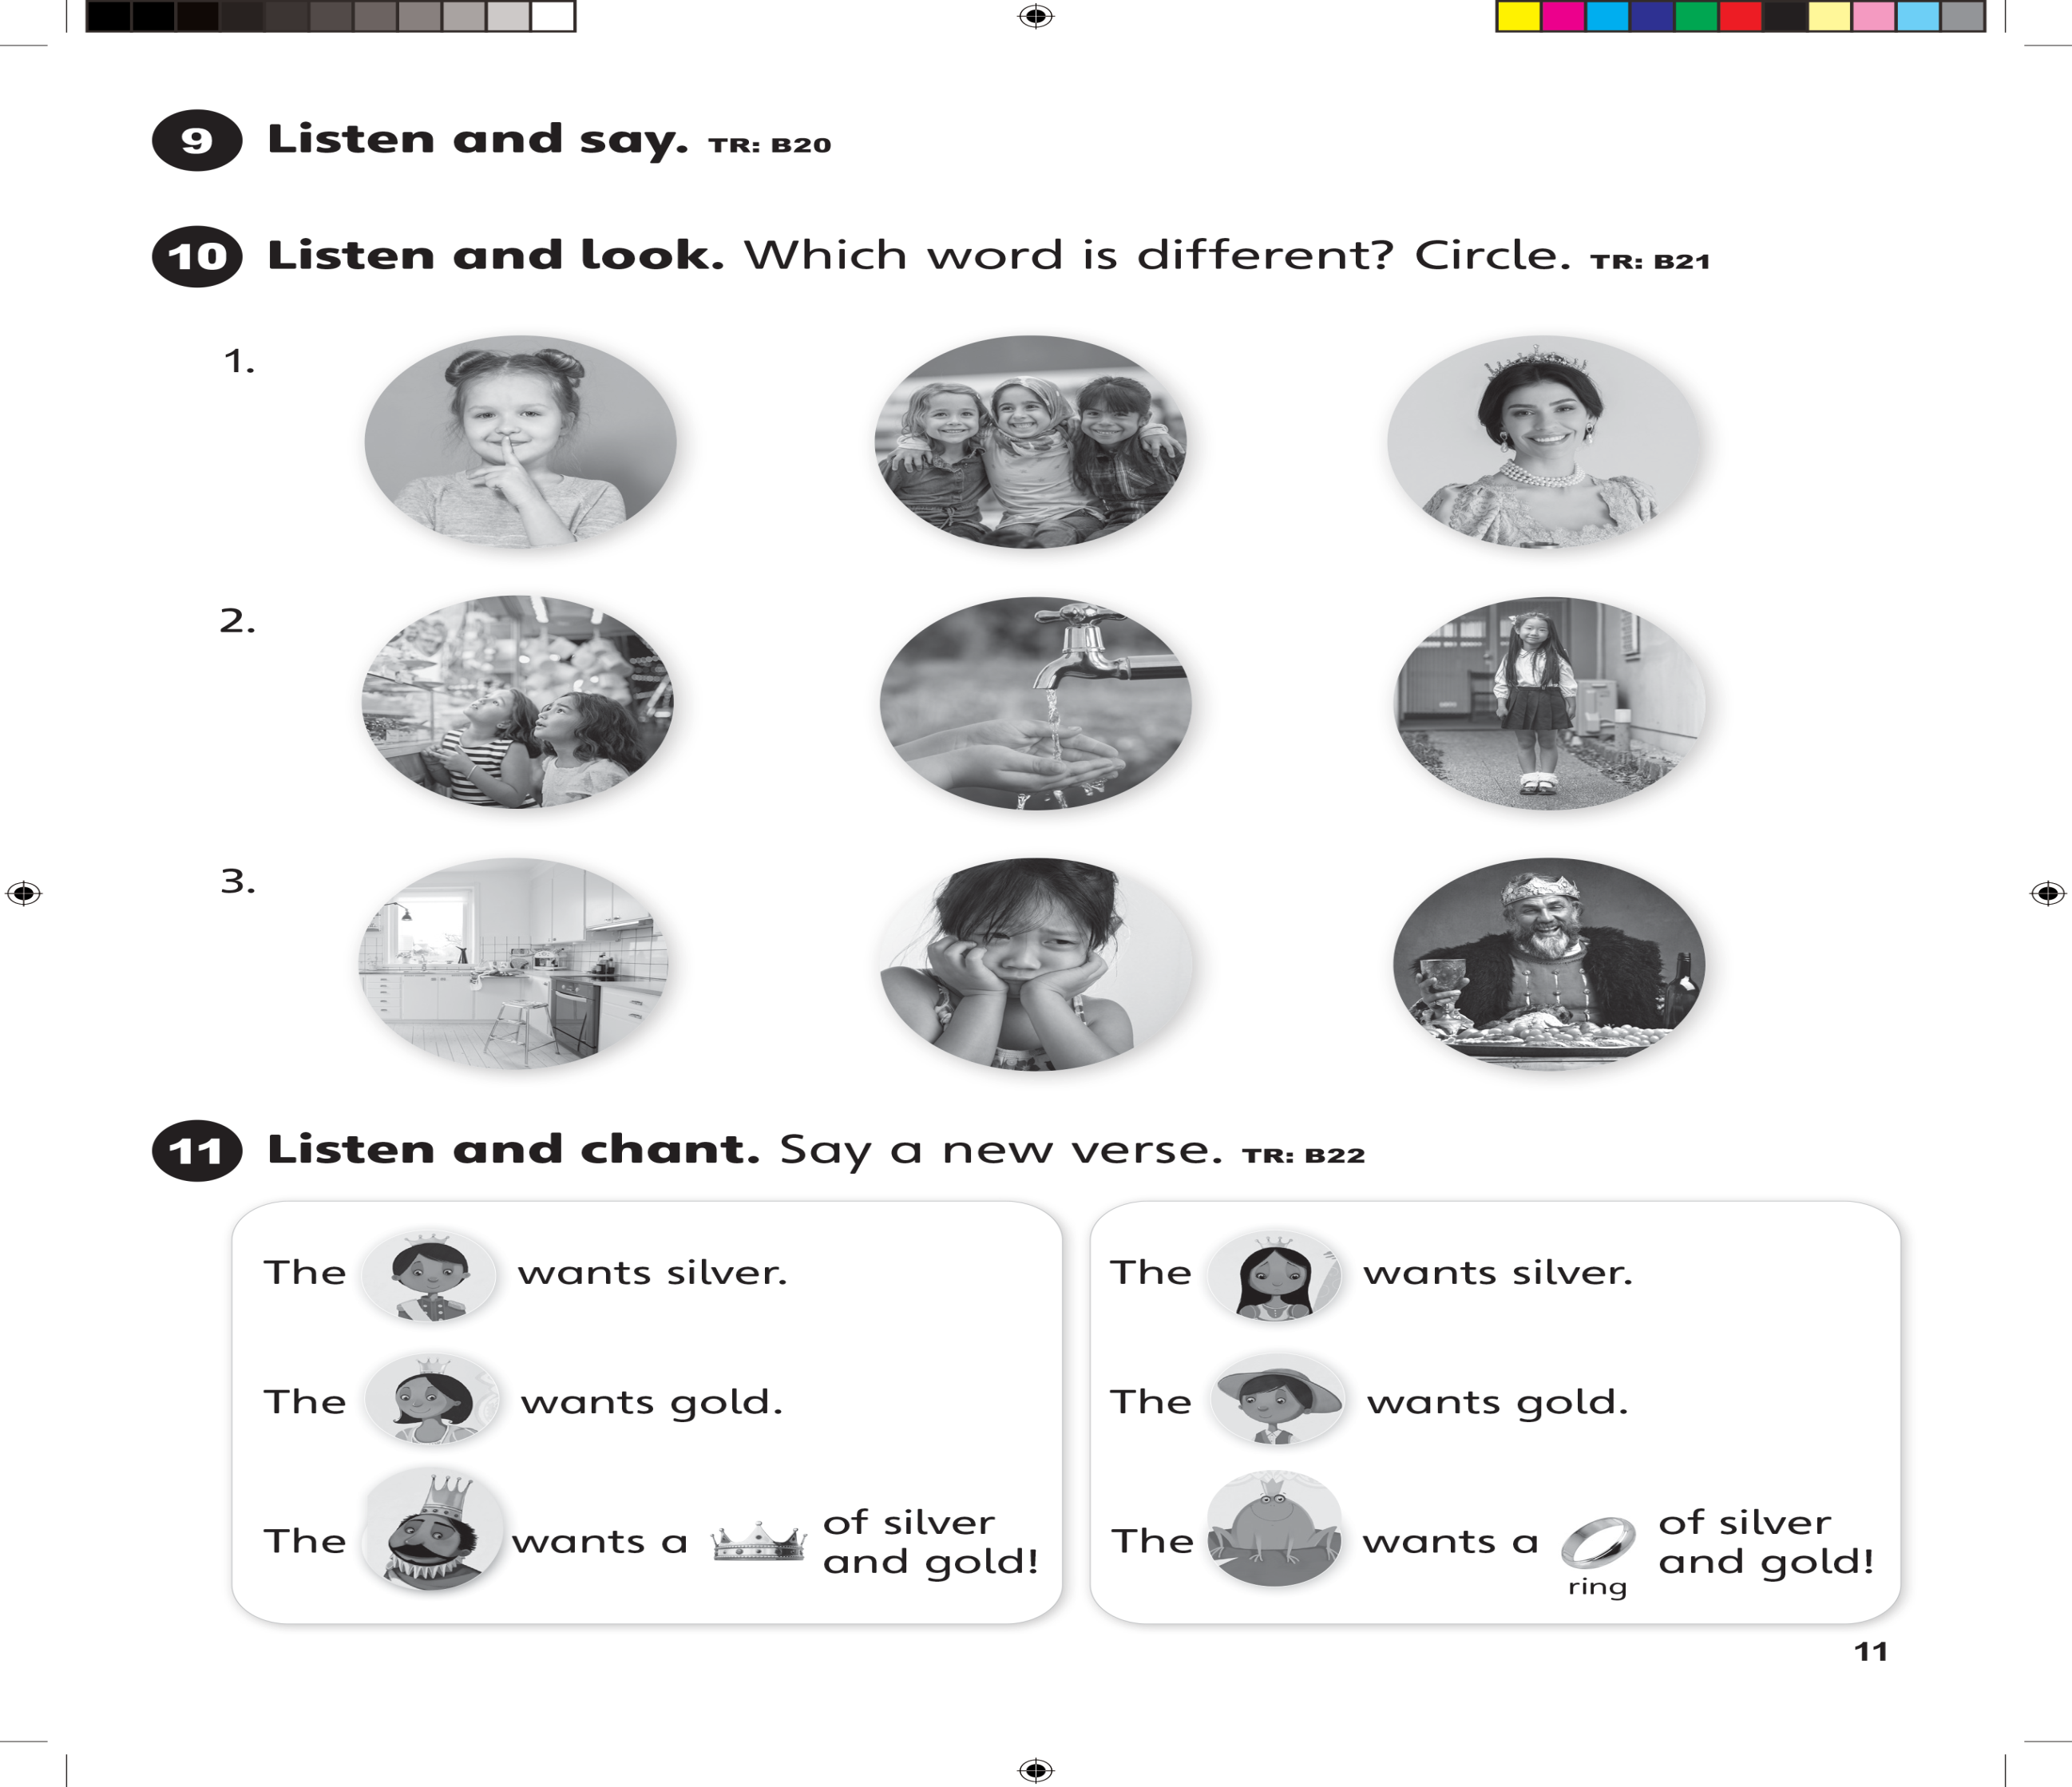
UNIT 1
STORIES

Slide 11

UNIT 1
STORIES

Slide 12
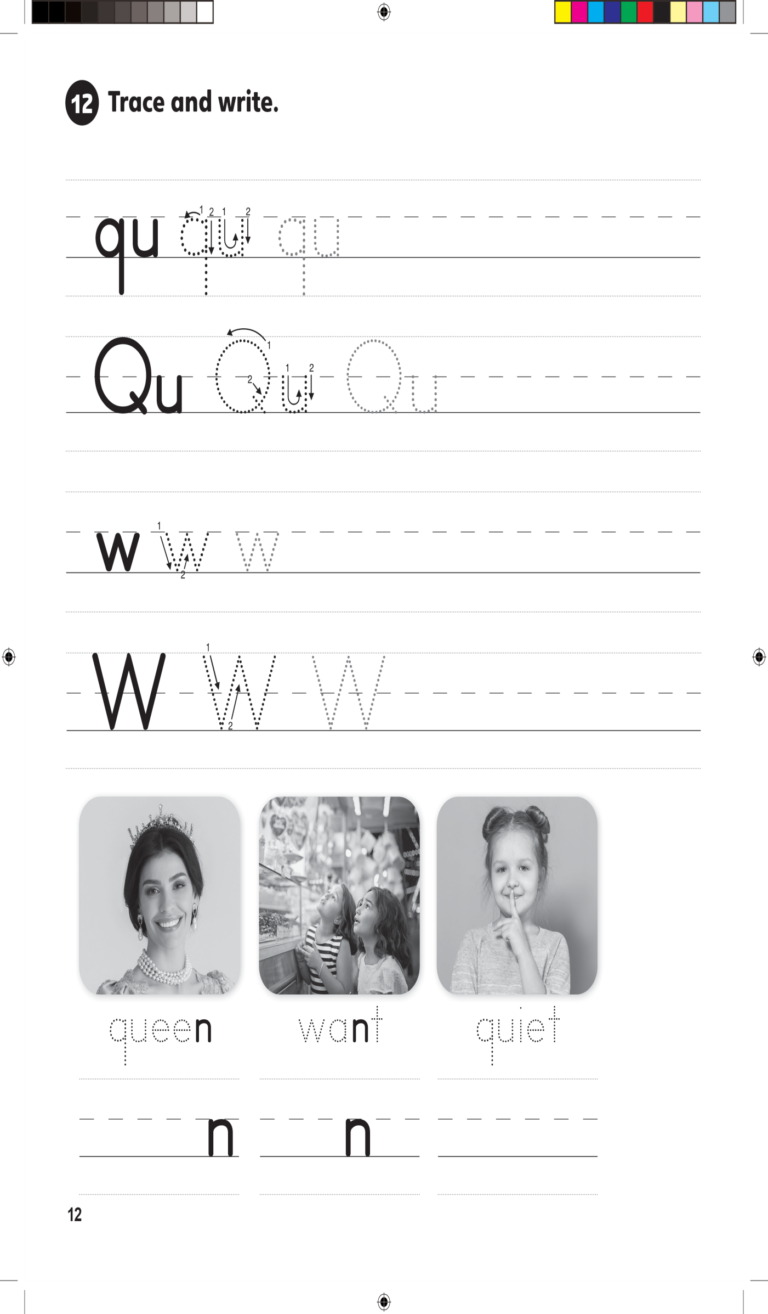

UNIT 1
STORIES

Slide 13
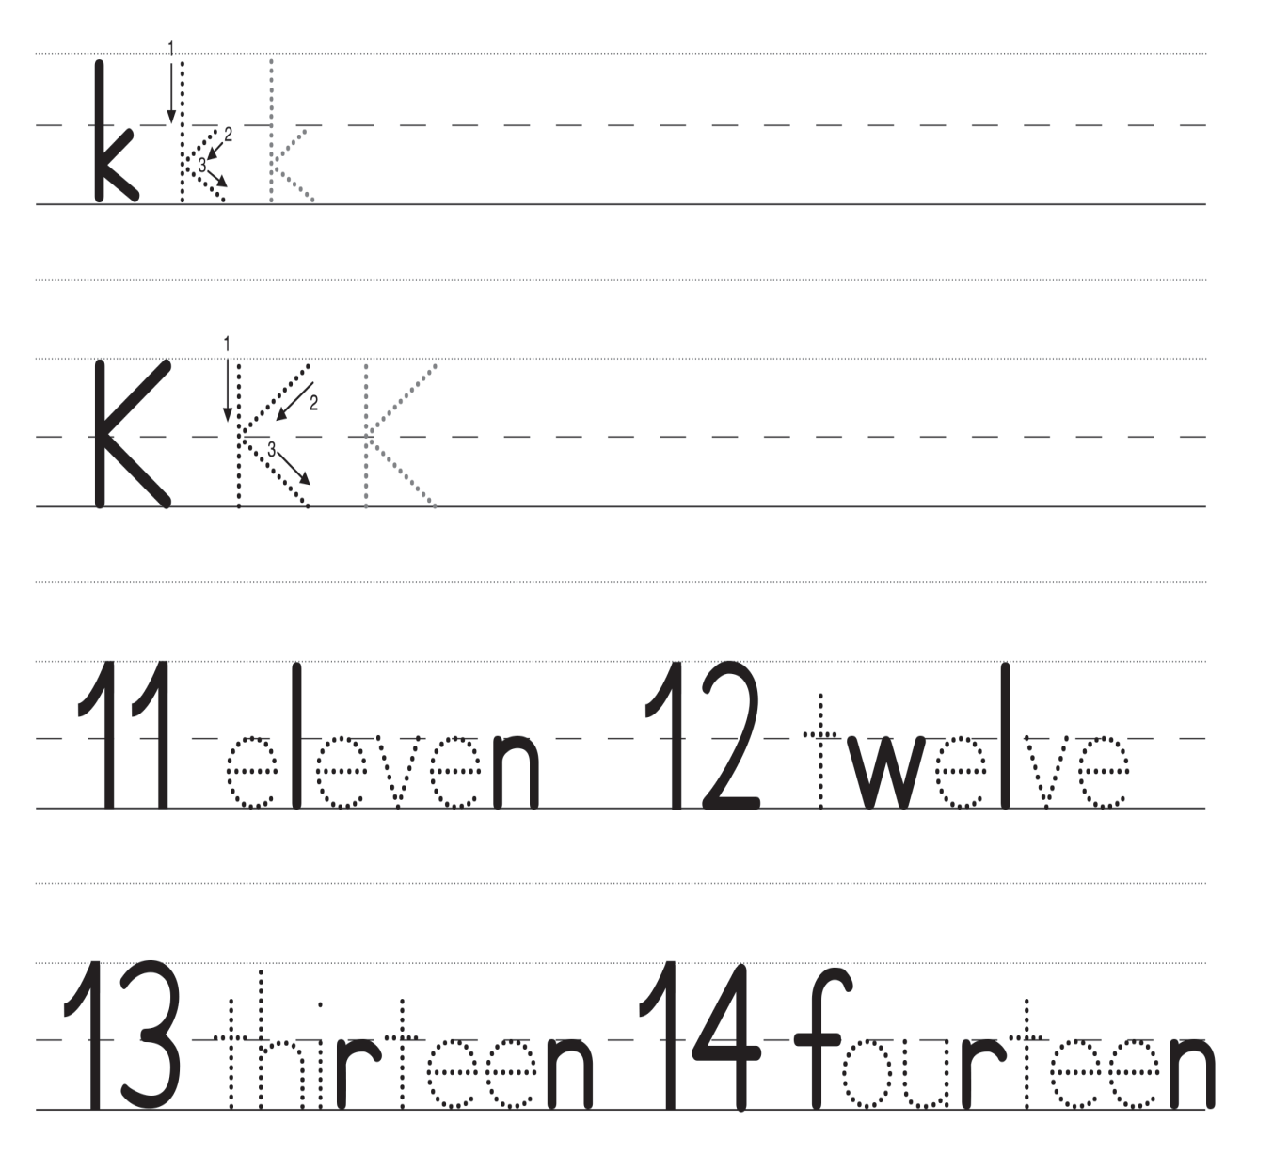
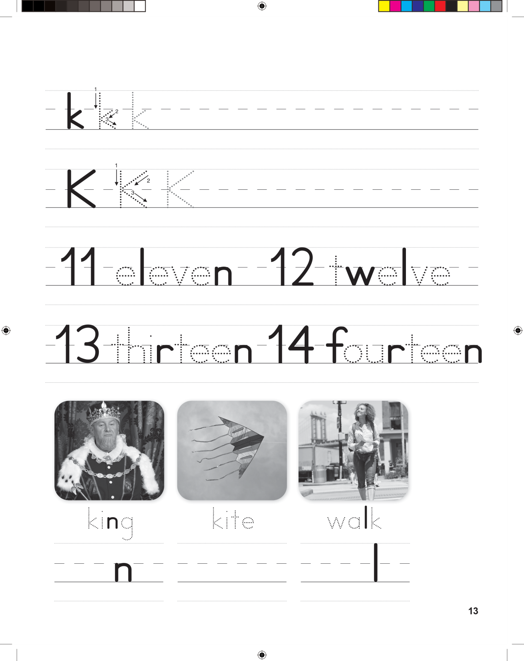
UNIT 1
STORIES

