Slide 1
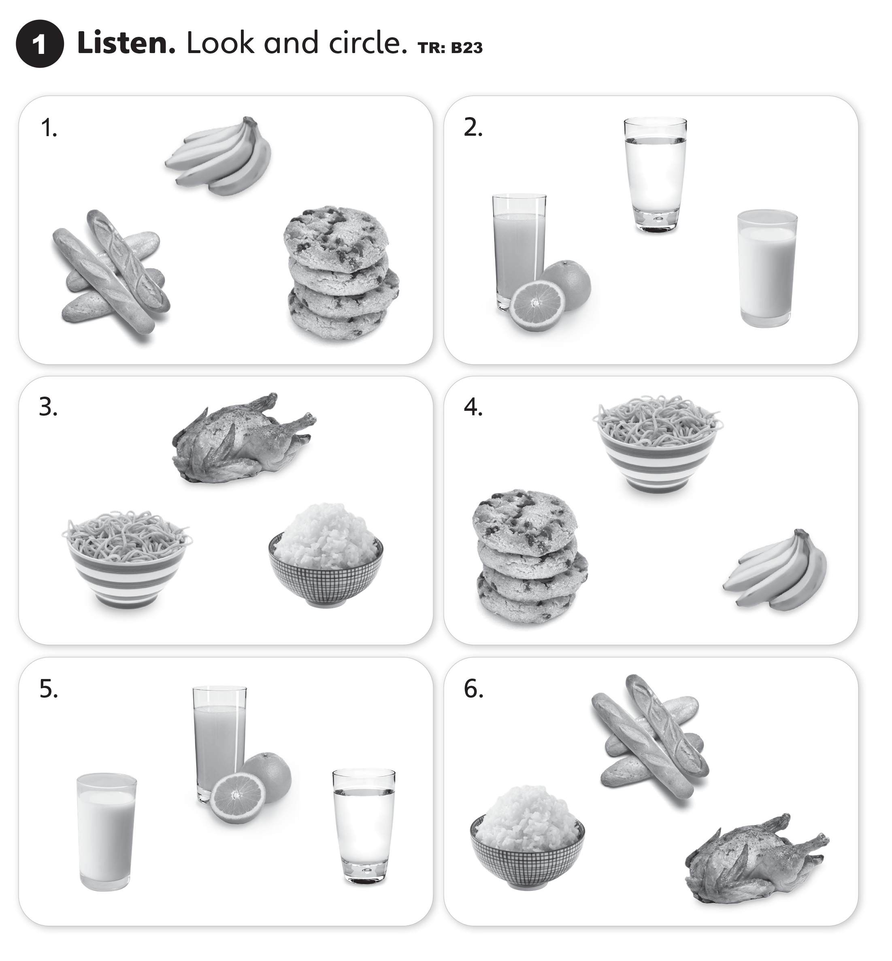

UNIT 2
I LIKE FOOD

Slide 2
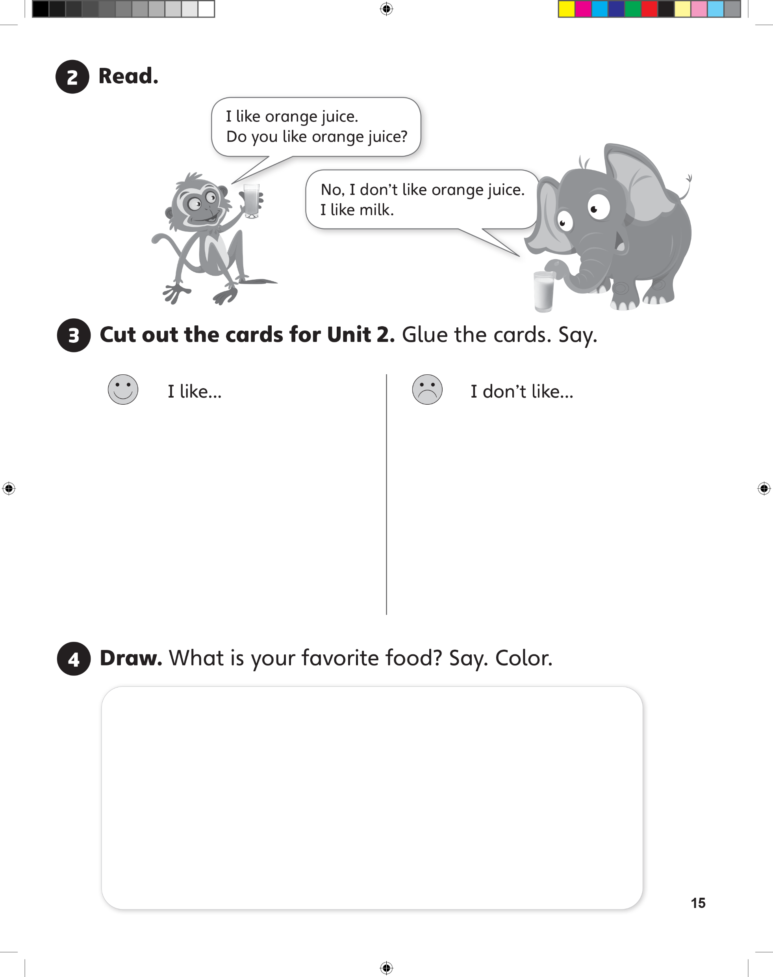
UNIT 2
I LIKE FOOD

Slide 3
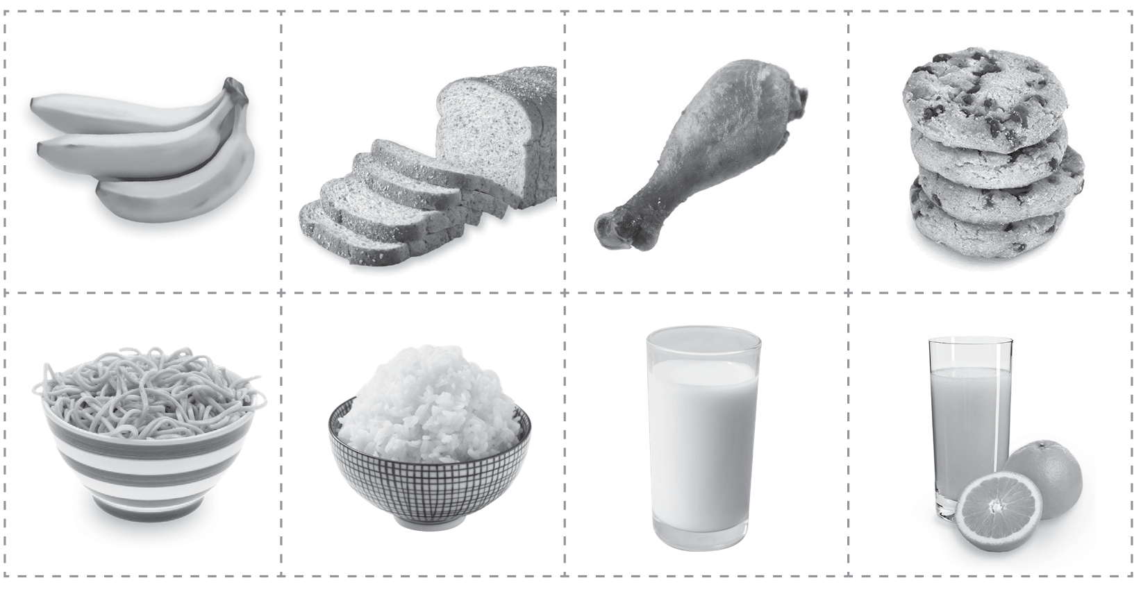
UNIT 2
I LIKE FOOD

Slide 4
UNIT 2
I LIKE FOOD

Slide 5
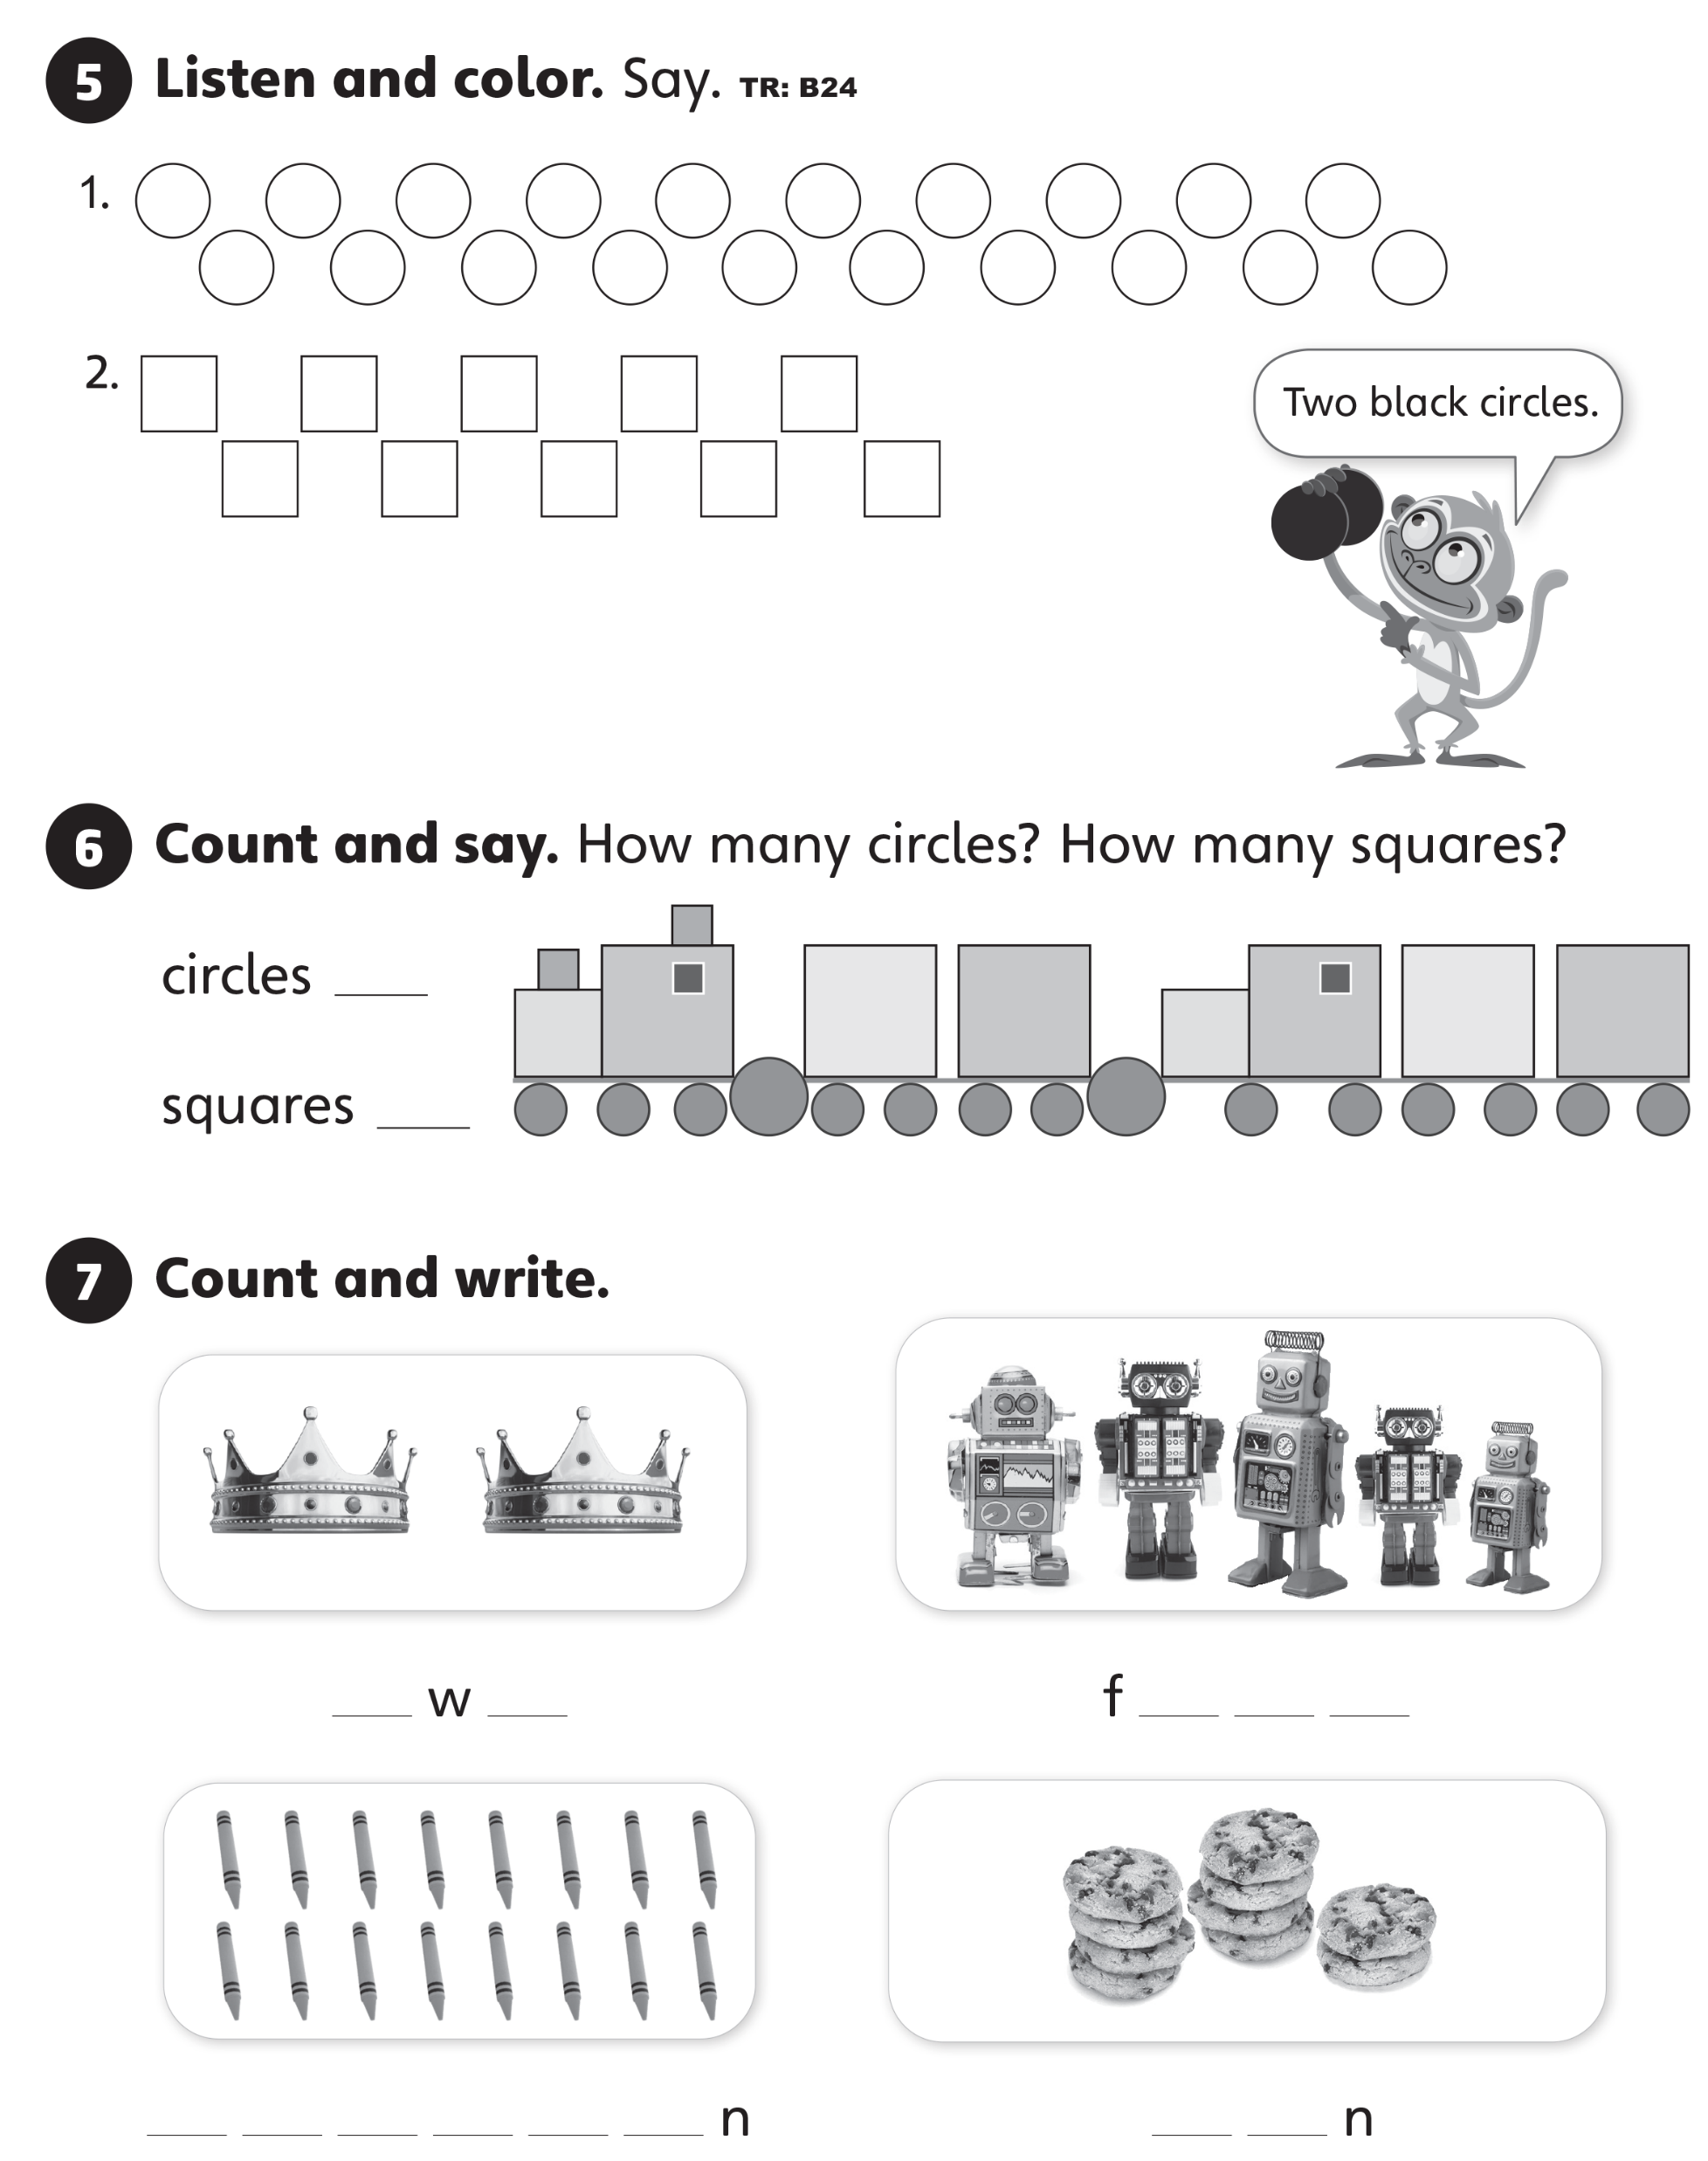
UNIT 2
I LIKE FOOD

Slide 6
UNIT 2
I LIKE FOOD
15
12

Slide 7
UNIT 2
I LIKE FOOD
t o
i v e
s i x t e e
t e

Slide 8
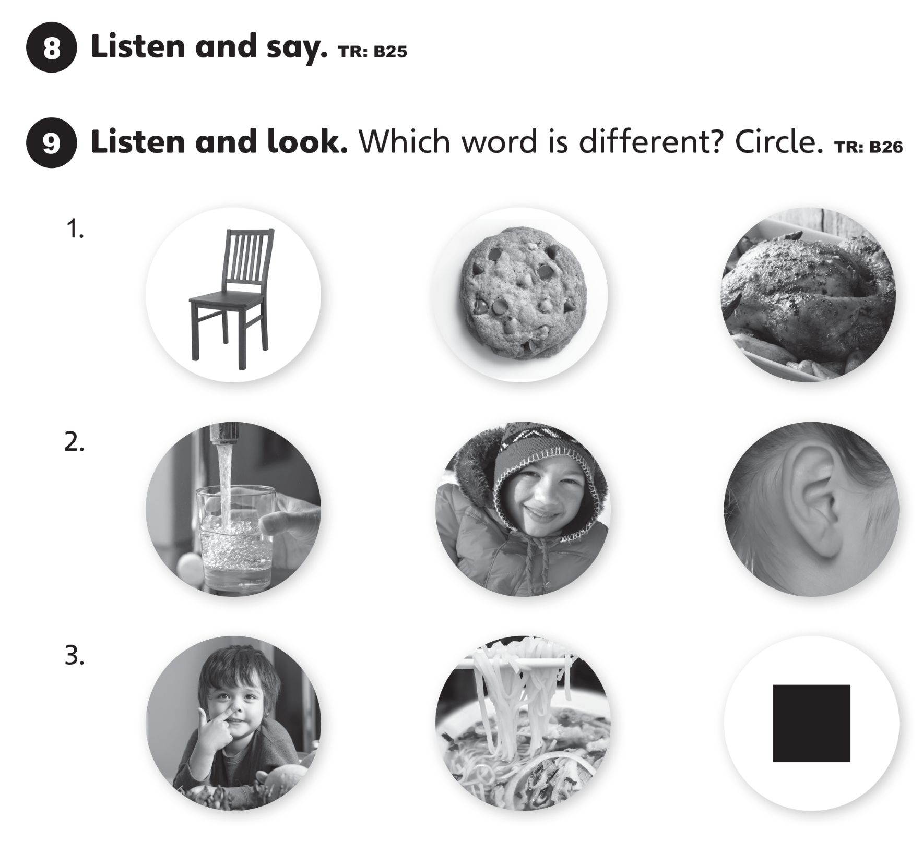
UNIT 2
I LIKE FOOD

Slide 9

UNIT 2
I LIKE FOOD

Slide 10
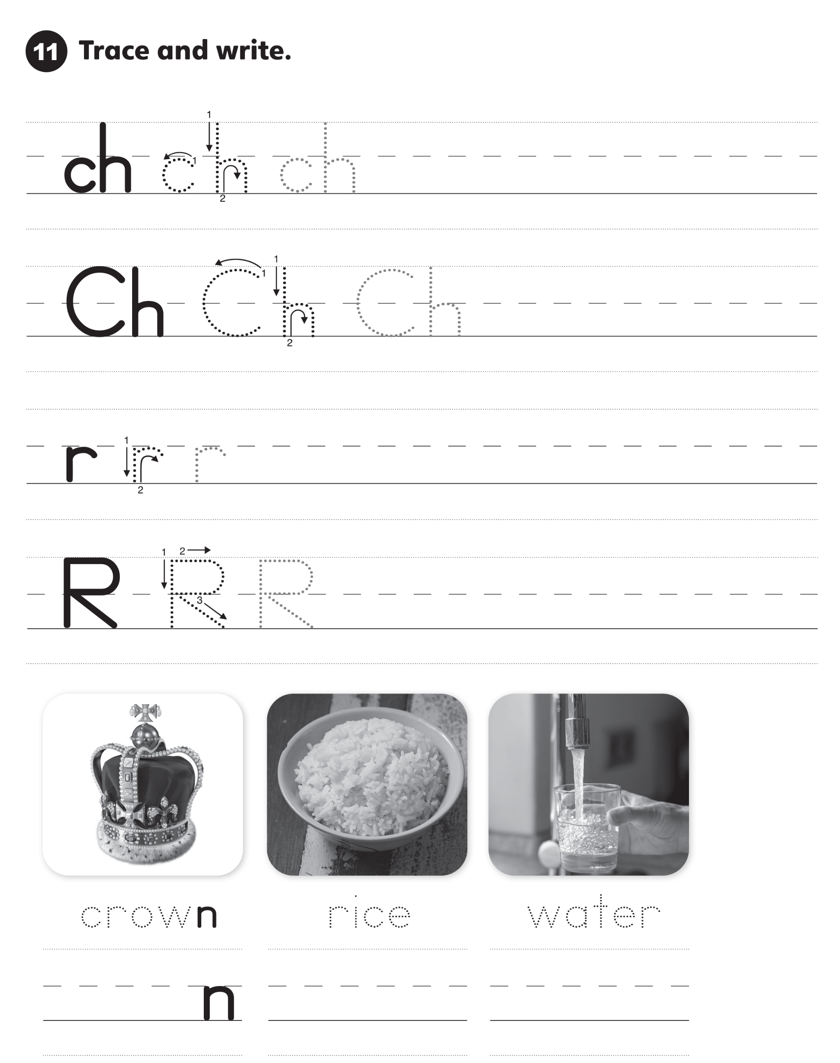
UNIT 2
I LIKE FOOD

Slide 11
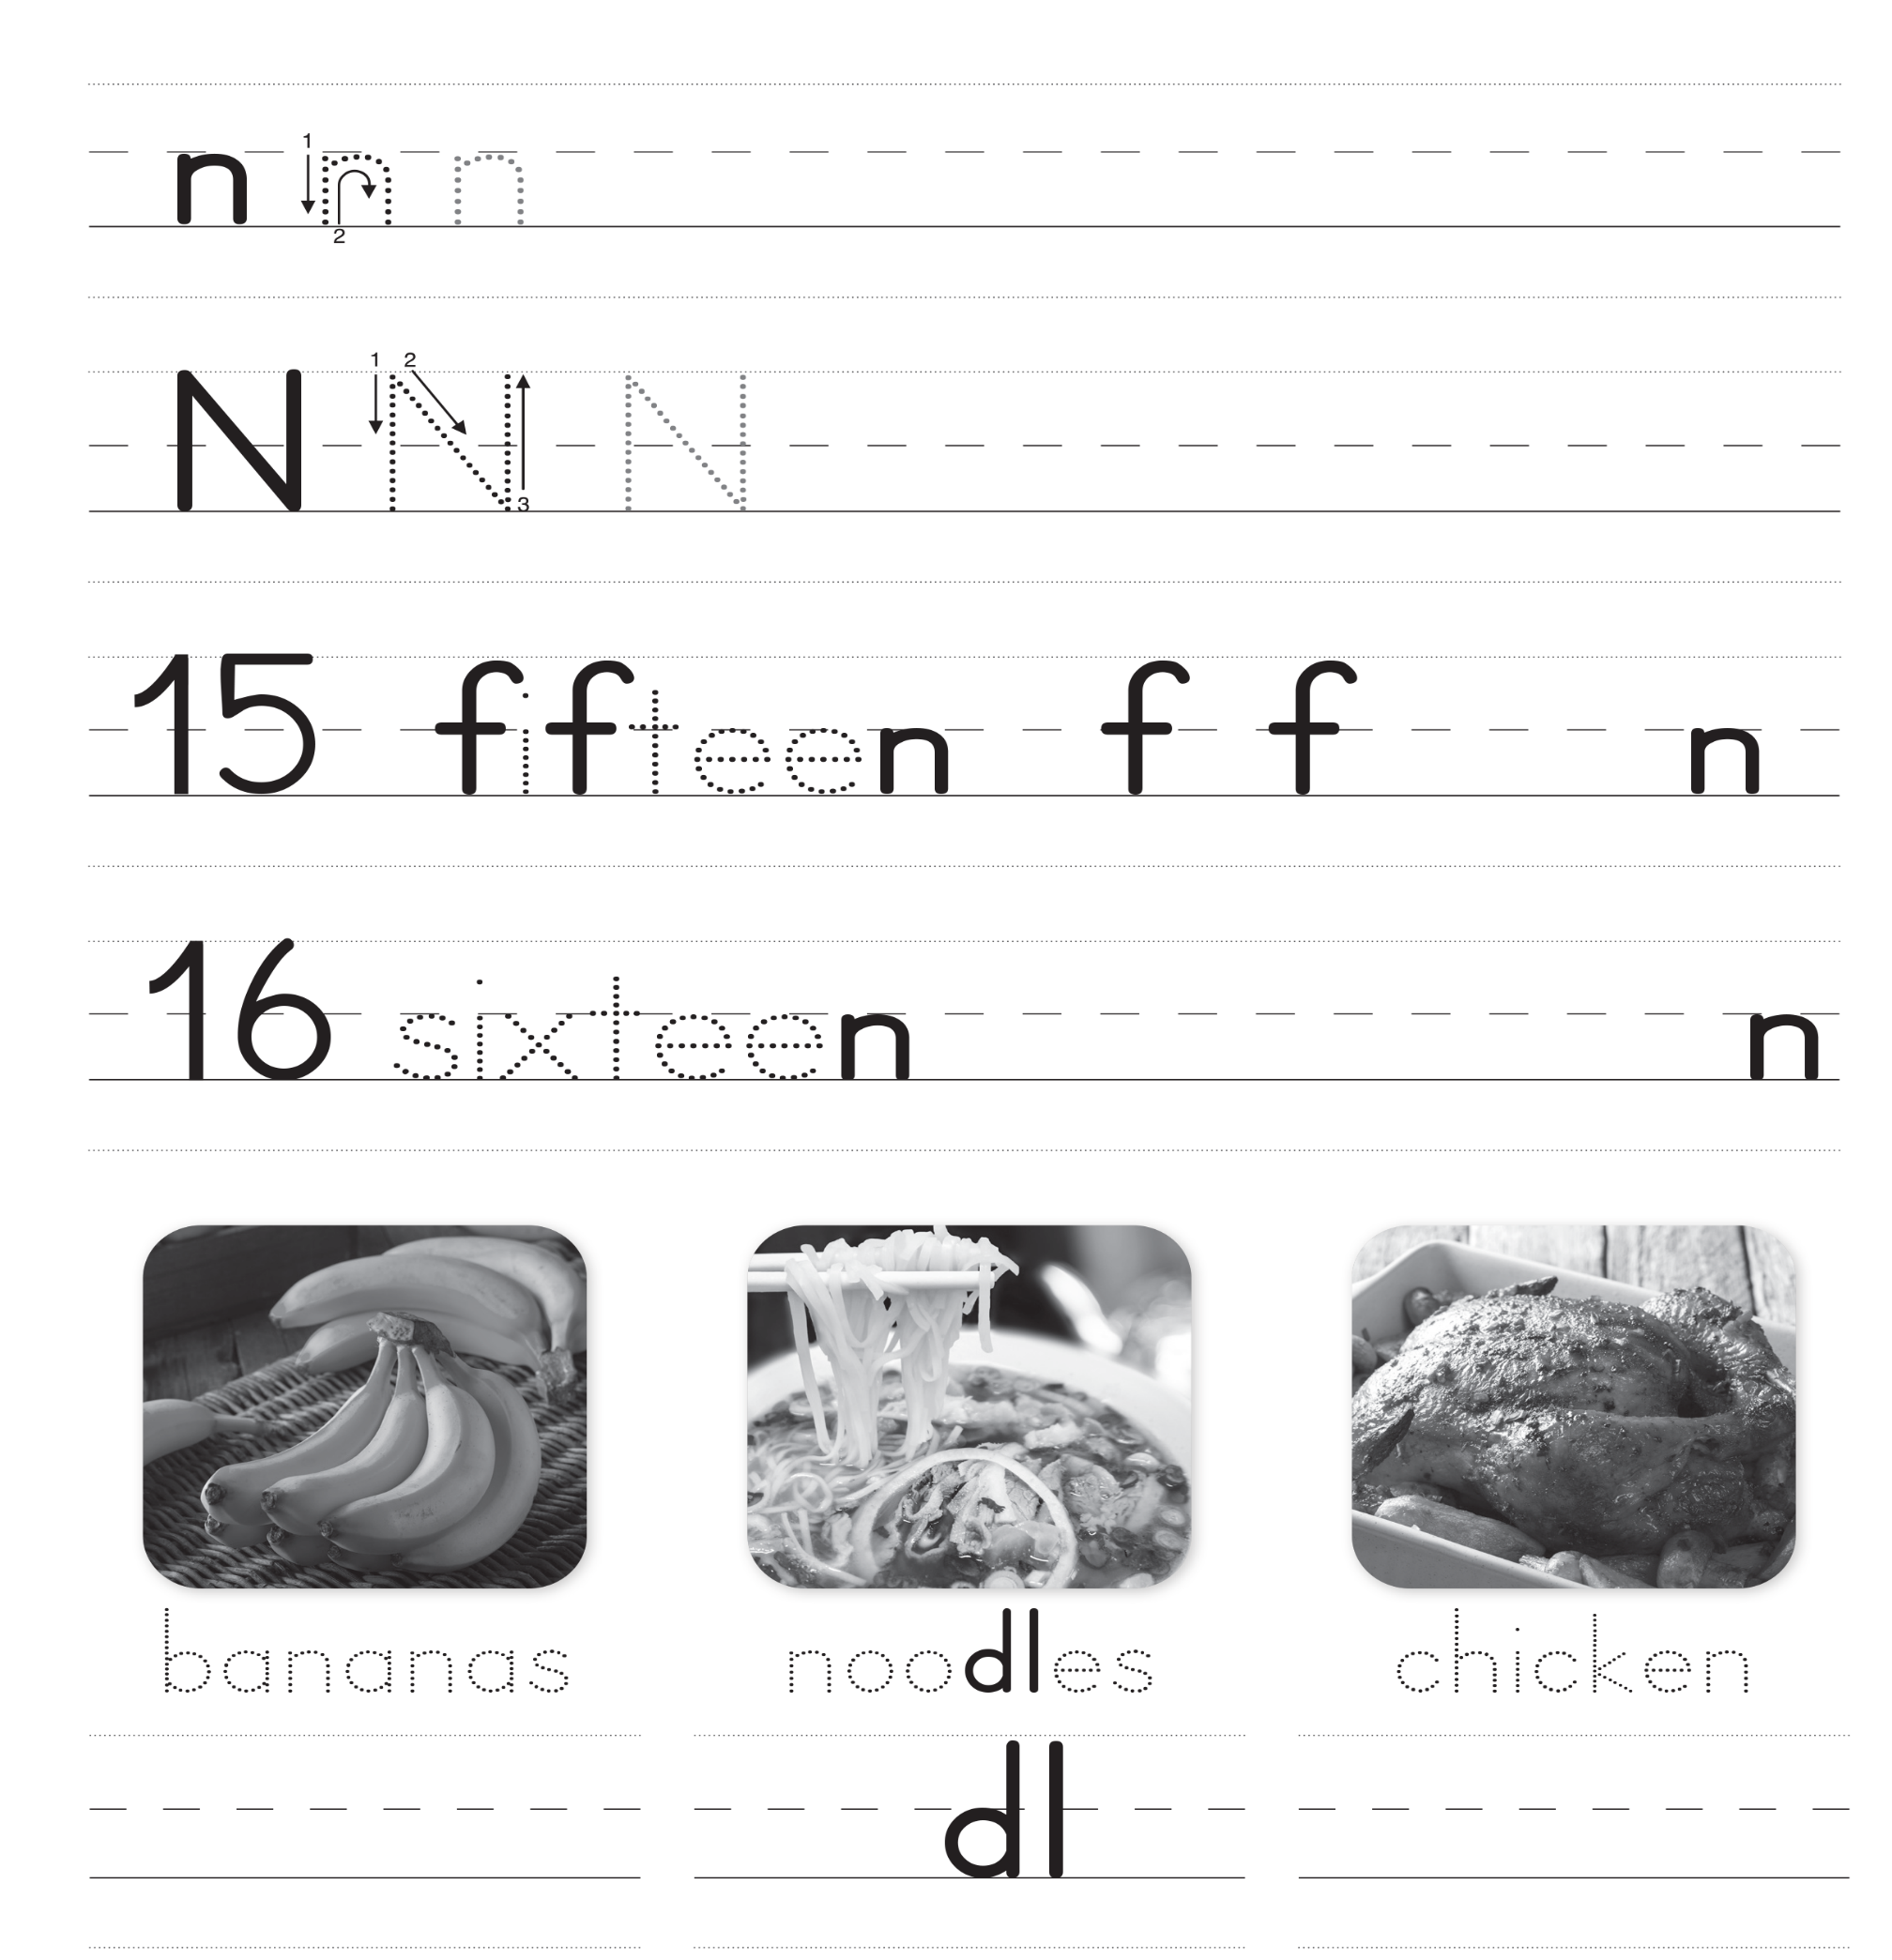
UNIT 2
I LIKE FOOD

