Slide 1

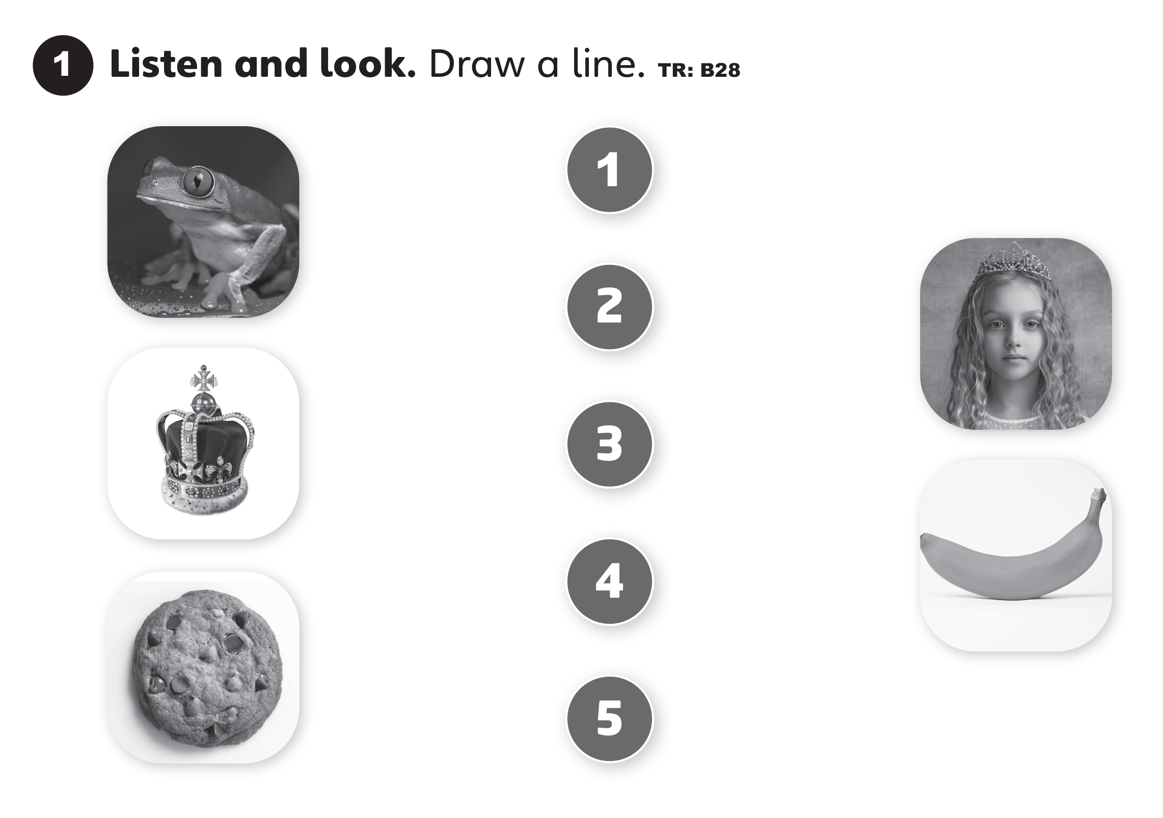

UNITS 1–2 REVIEWS

Slide 2
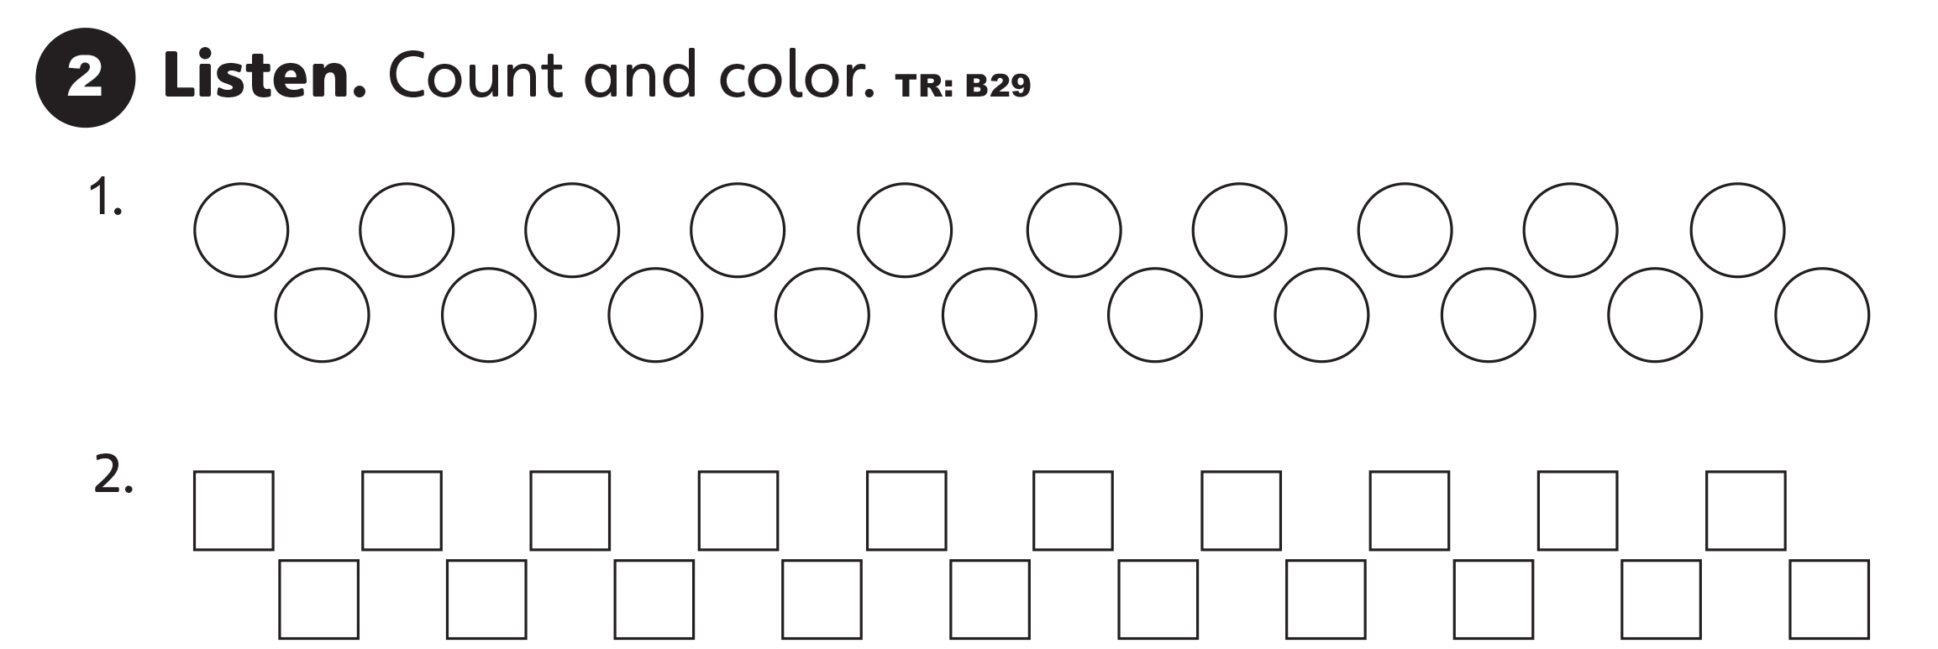
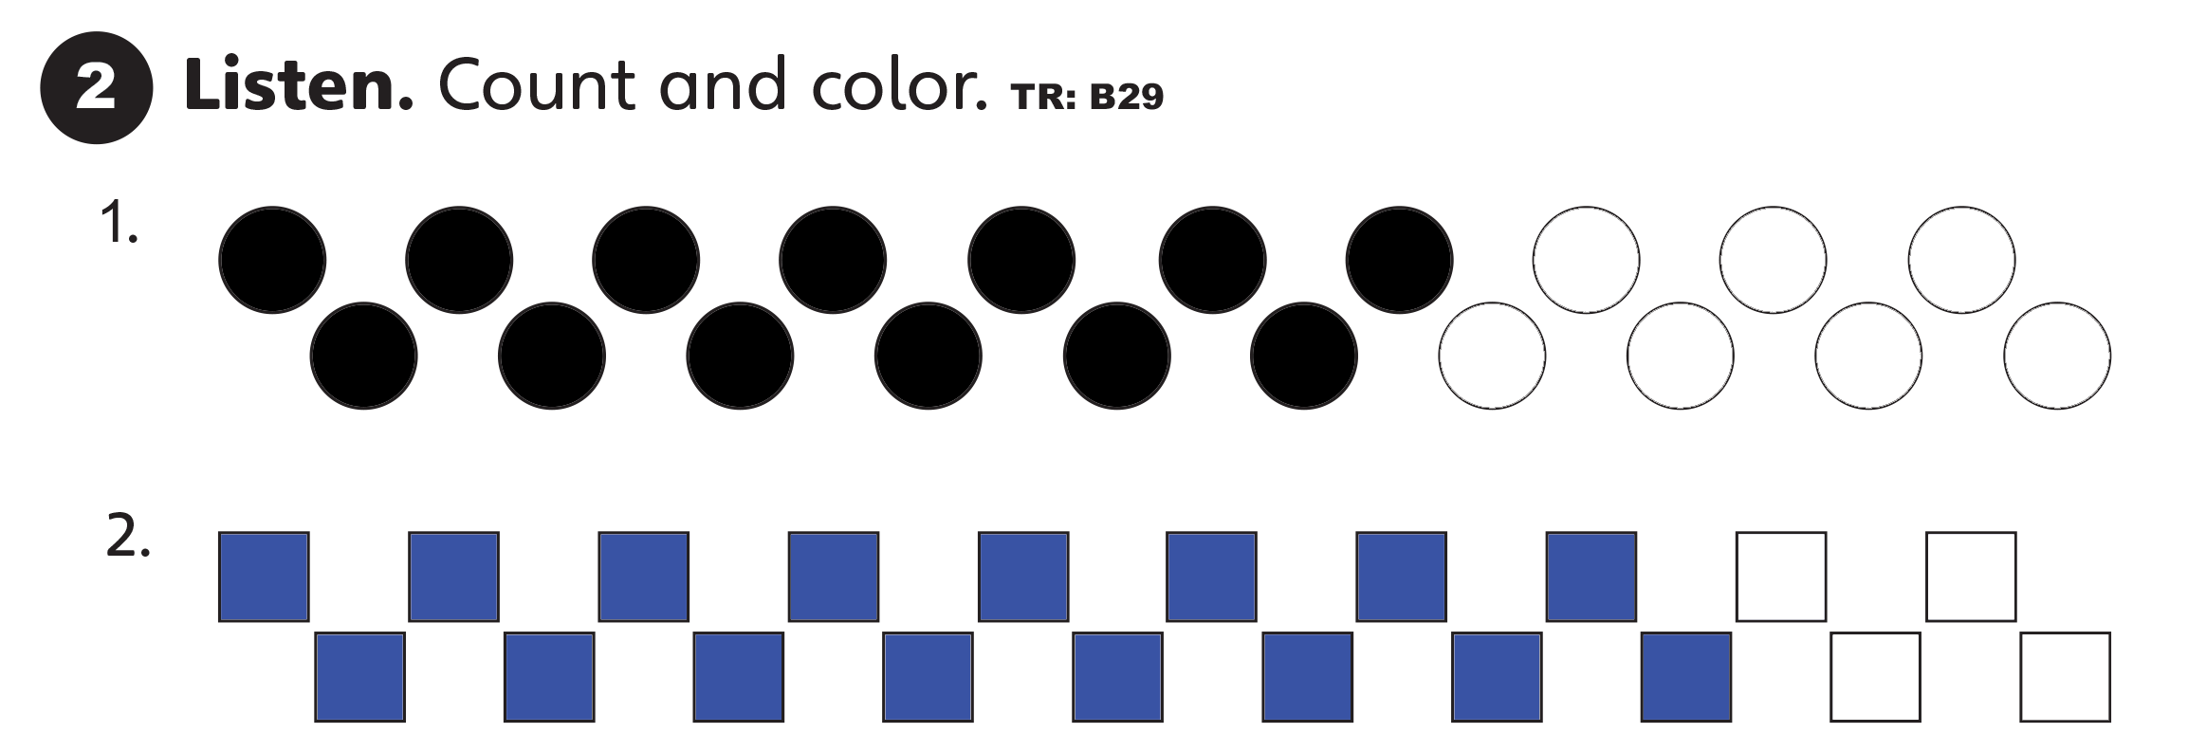
UNITS 1–2 REVIEWS

Slide 3
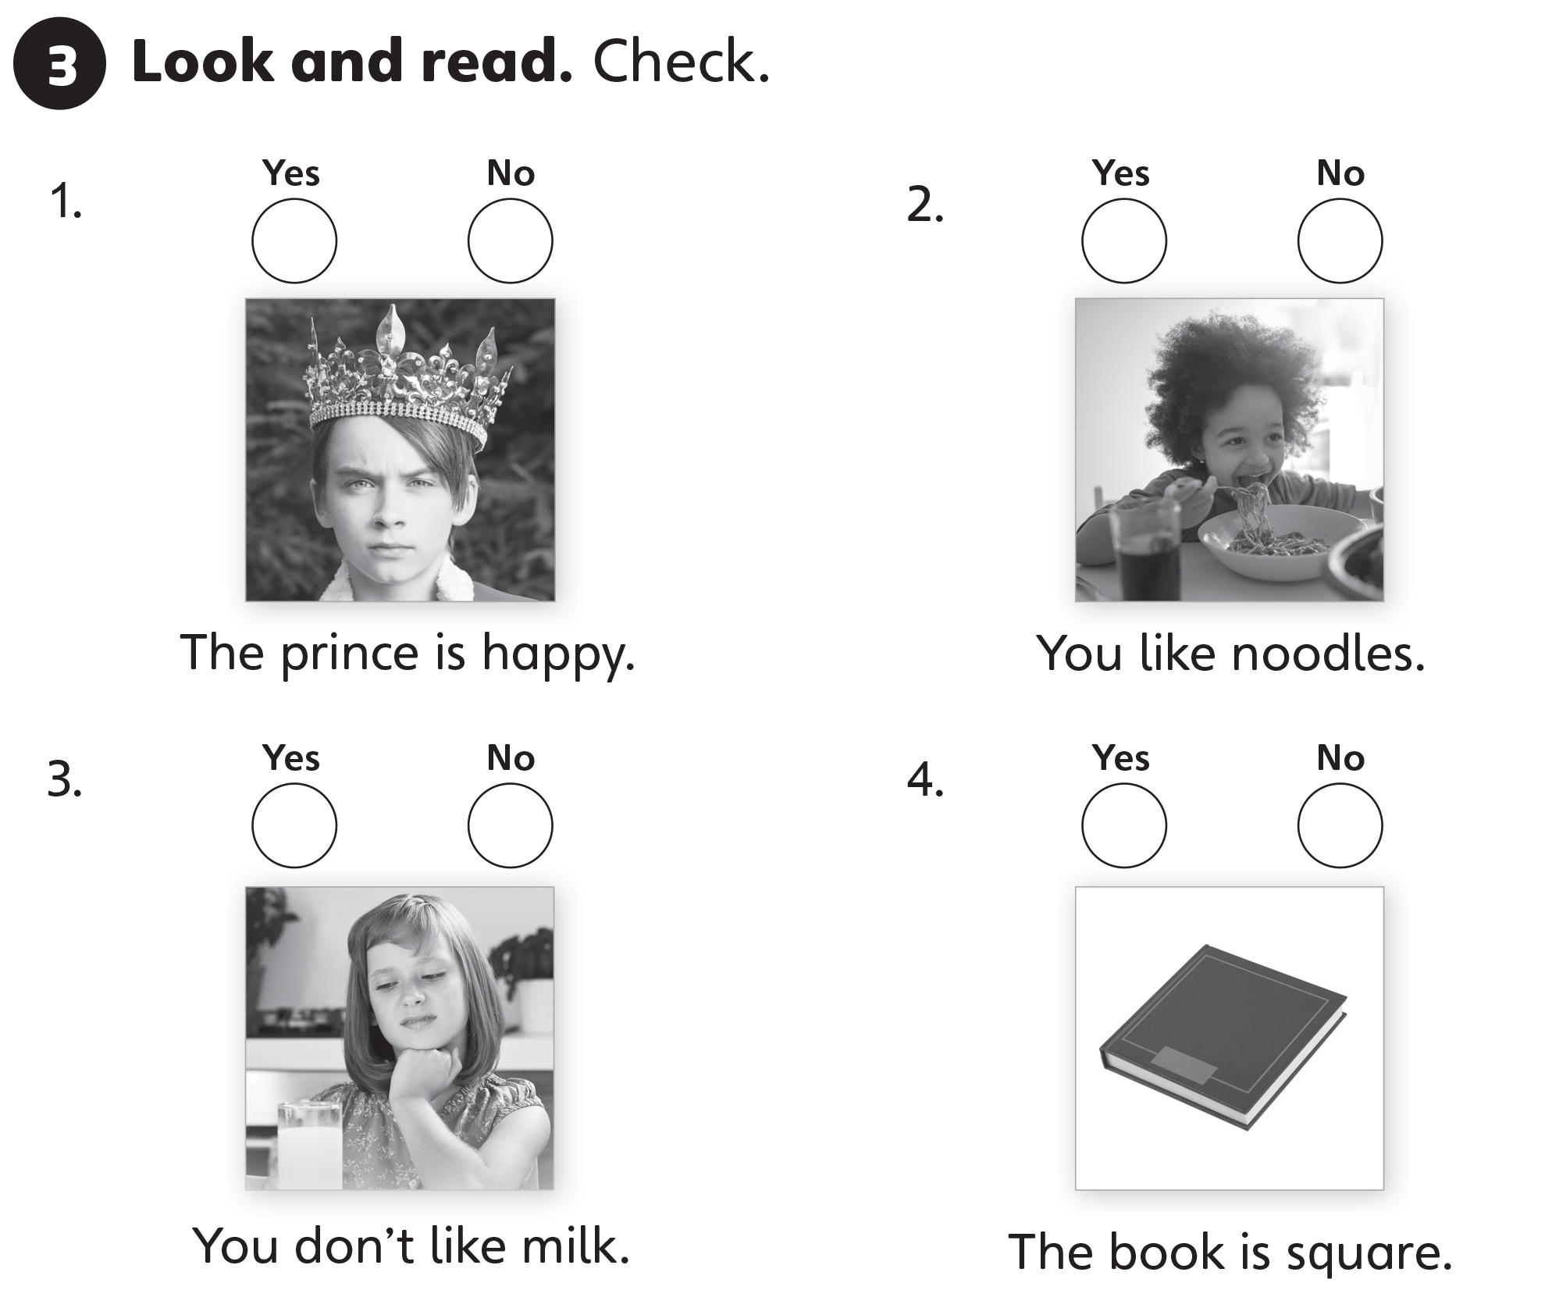
UNITS 1–2 REVIEWS



Slide 4
UNITS 1–2 REVIEWS



Slide 5
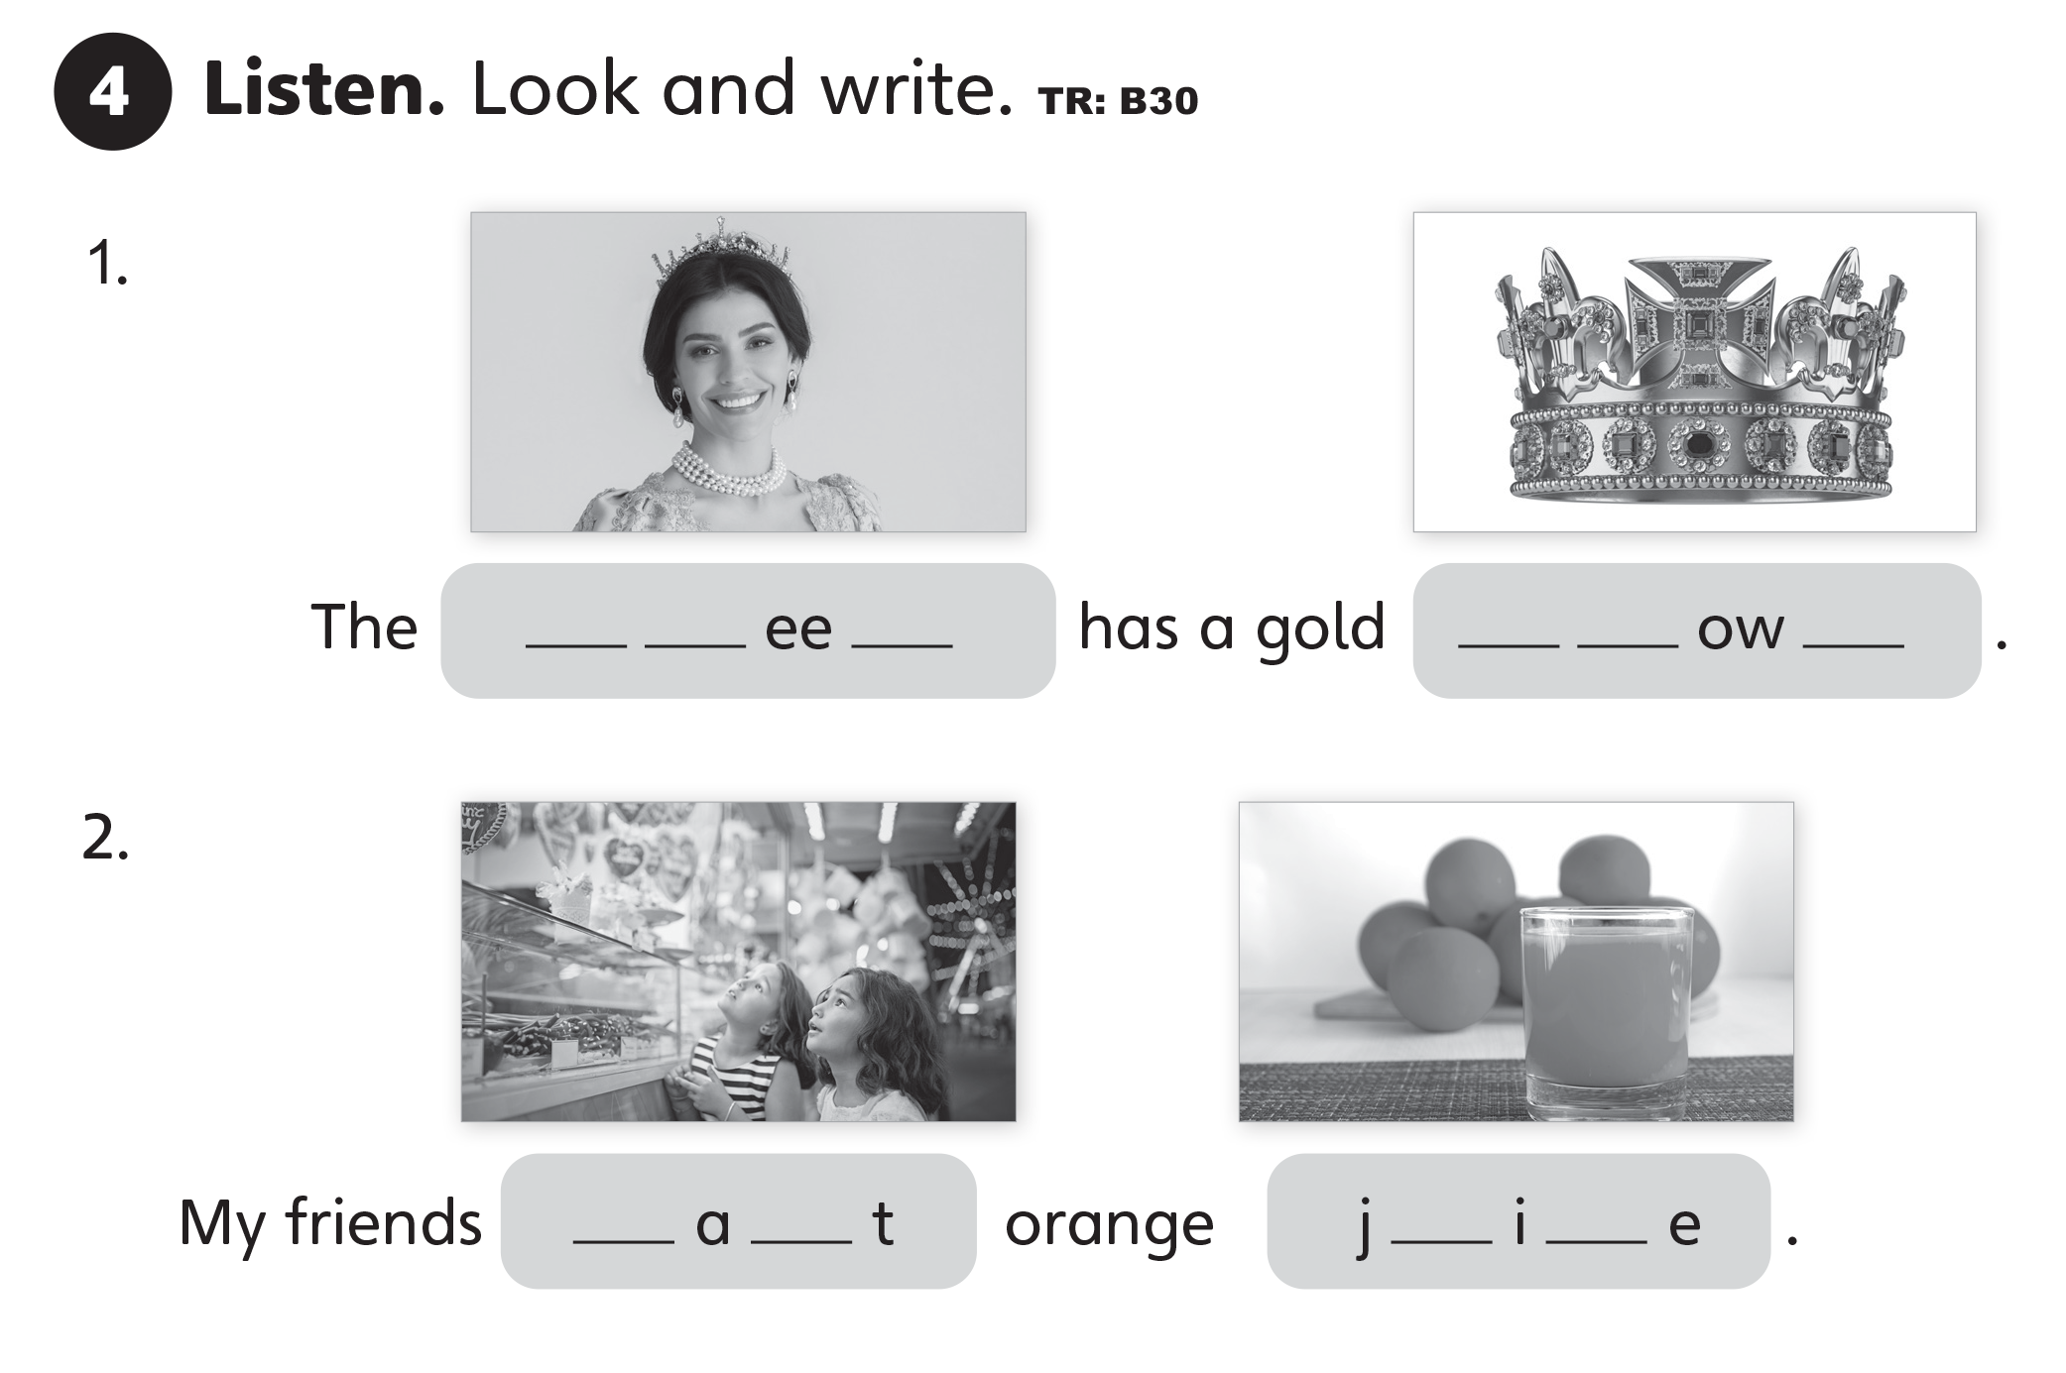
UNITS 1–2 REVIEWS
q u n
c r n
w n
u c

