Slide 1

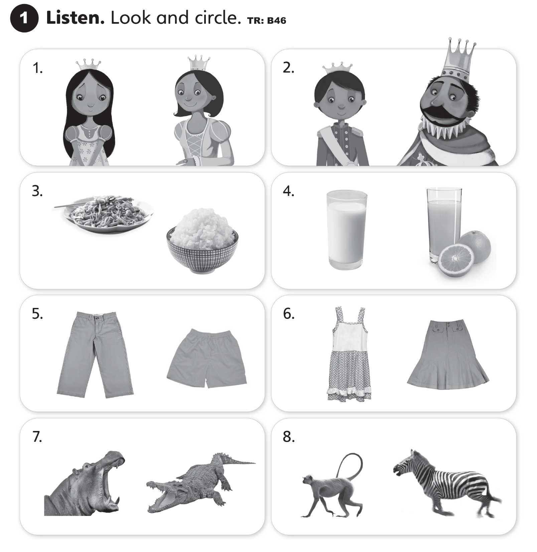

UNITS 1–4 REVIEWS

Slide 2
UNITS 1–4 REVIEWS

Slide 3
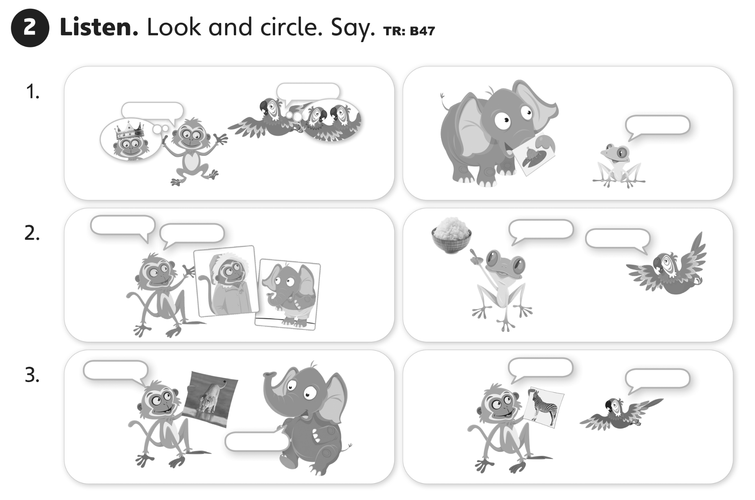
UNITS 1–4 REVIEWS

Slide 4


UNITS 1–4 REVIEWS

Slide 5
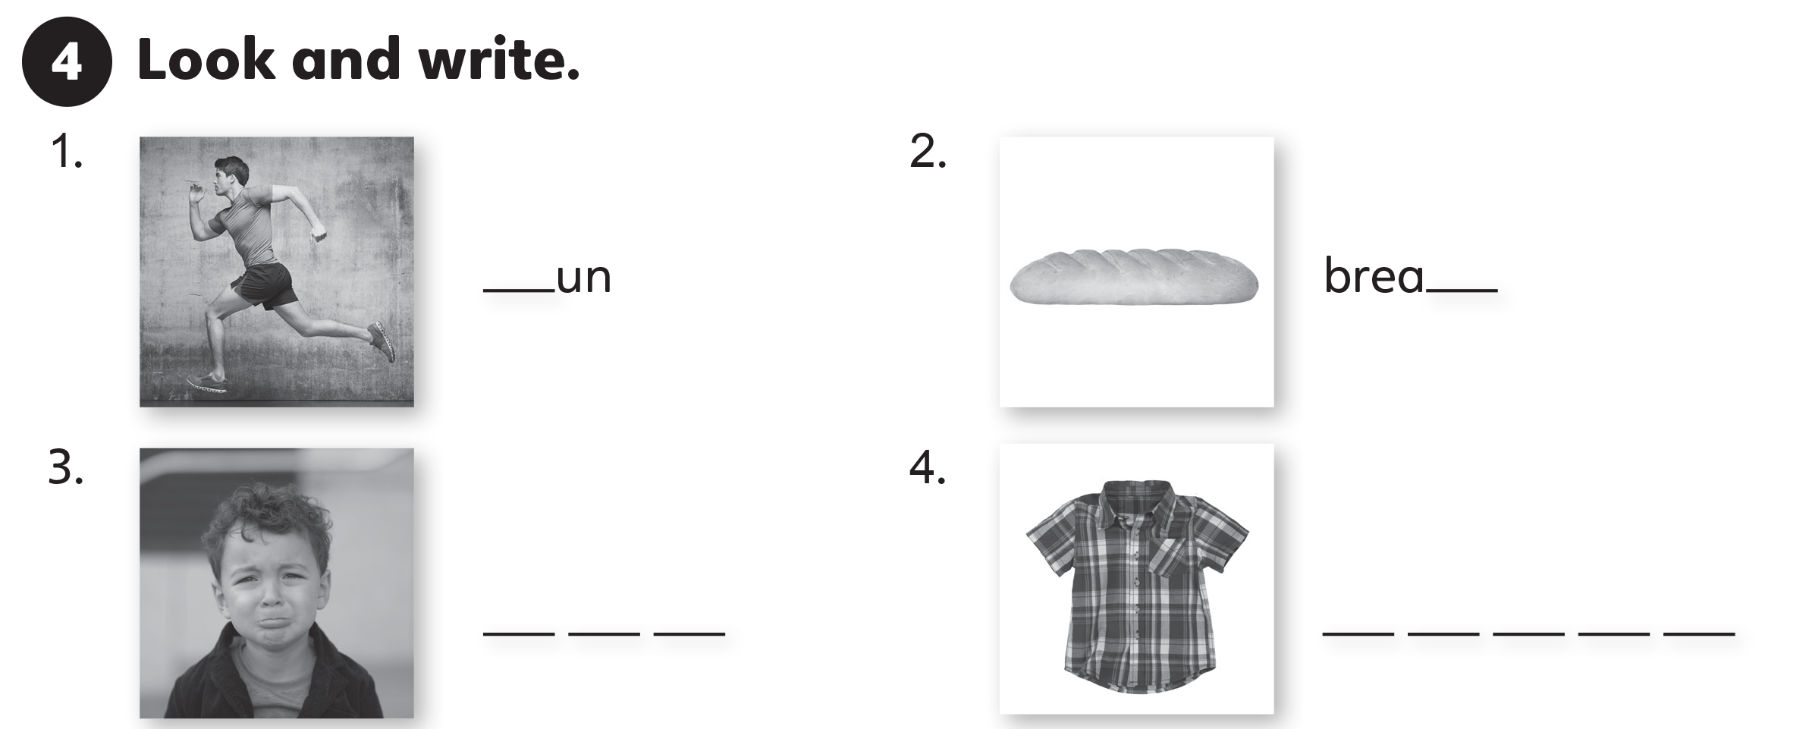
UNITS 1–4 REVIEWS
r
d
s a d
s h i r t

