Slide 1

Unit 0
Getting Started

Slide 2
Unit 0:
Getting Started
Lesson 1

Slide 3


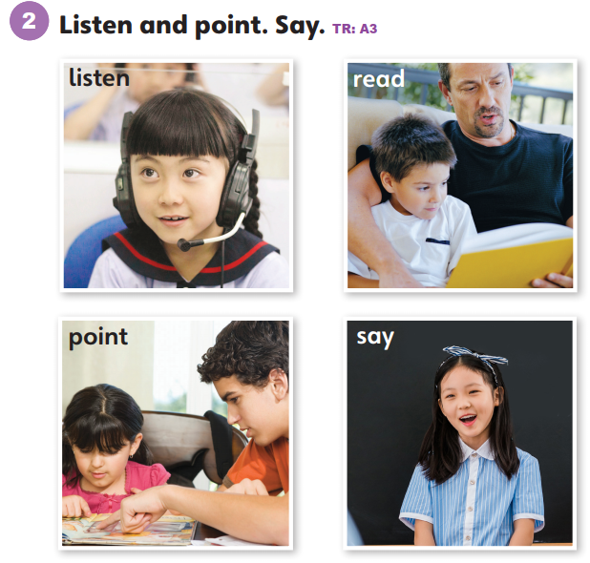

Slide 4
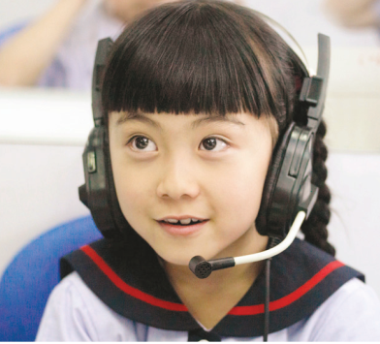
listen
/ˈlɪsn/

Slide 5
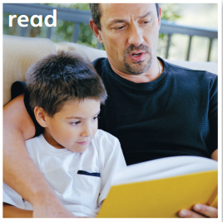
read
/riːd/

Slide 6
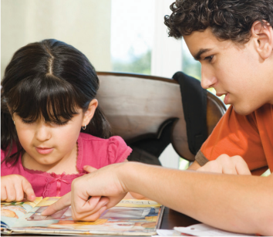
point
/pɔɪnt/

Slide 7
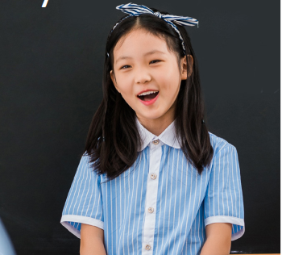
say
/seɪ/

Slide 9
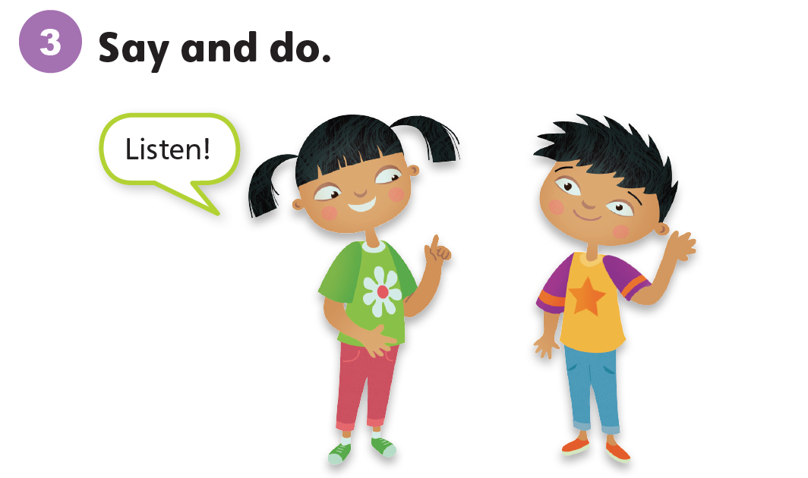

Slide 10
Unit 0:
Getting Started
Lesson 2

Slide 11

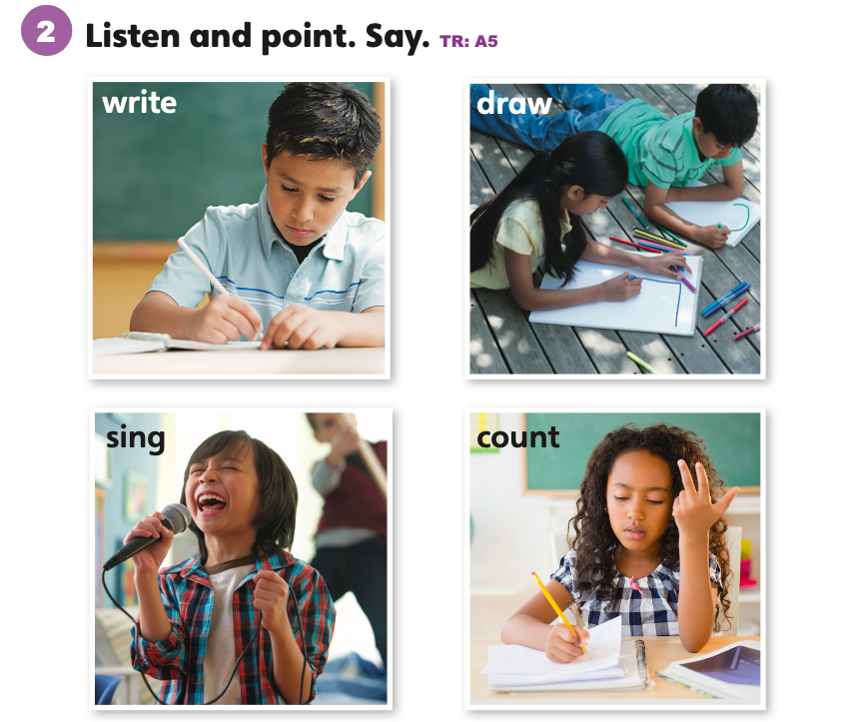

Slide 12

write
/raɪt/

Slide 13
draw
/drɔː/

Slide 14
sing
/sɪŋ/

Slide 15
count
/kaʊnt/

Slide 17
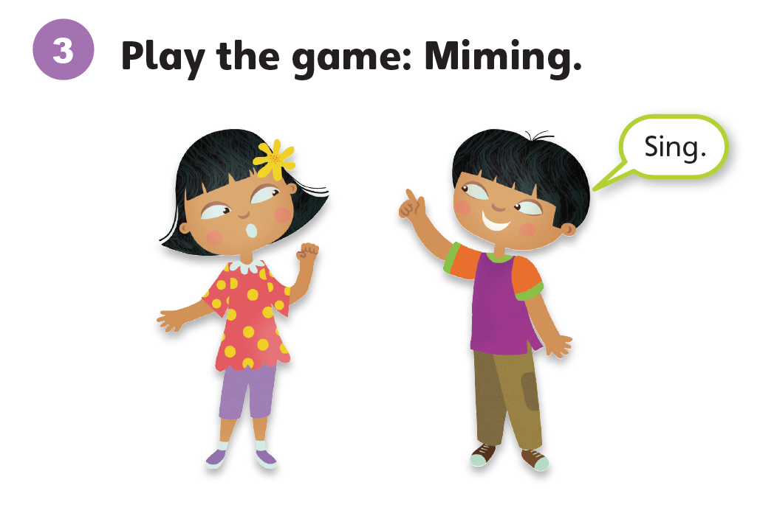

Slide 18
Unit 0:
Getting Started
Lesson 3

Slide 19
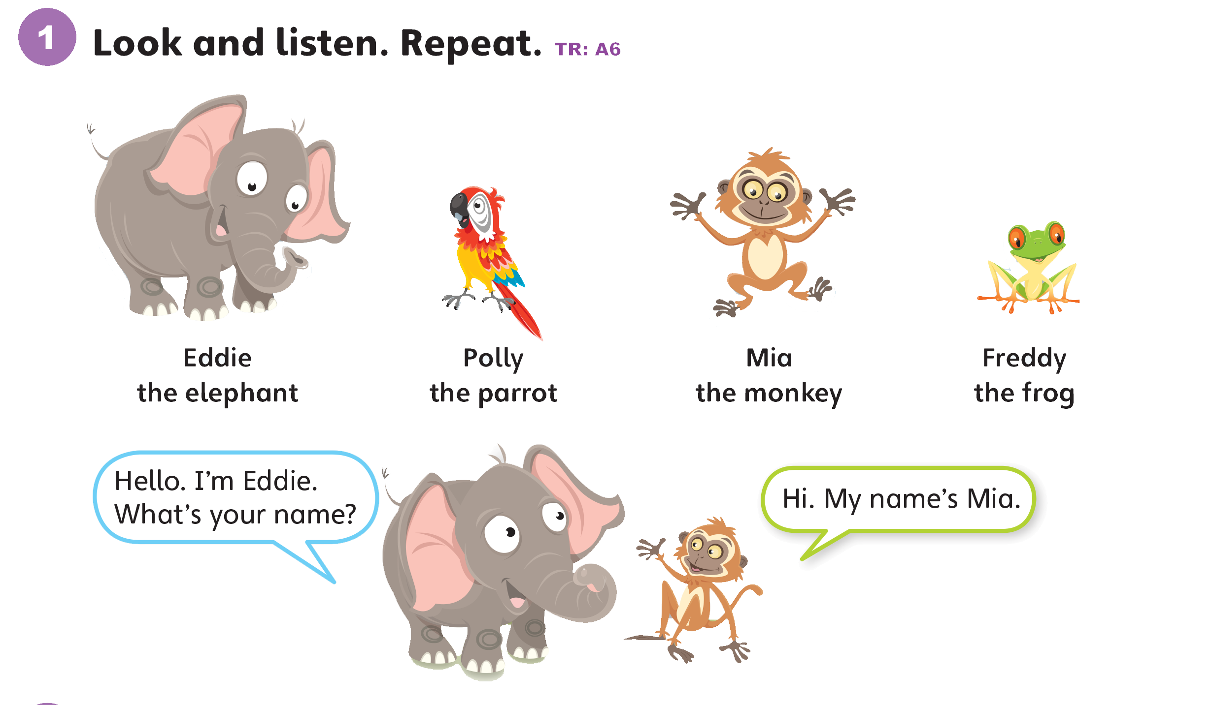

Slide 20
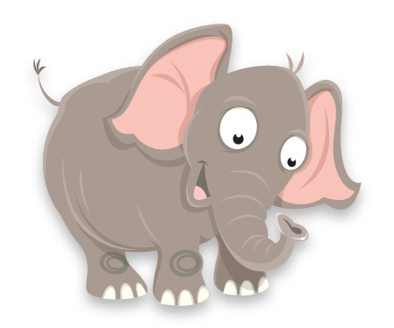
Eddie the elephant
/ˈedi/ /ði/ /ˈelɪfənt/

Slide 21
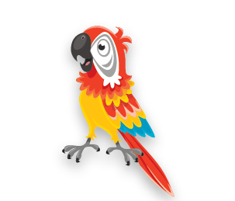
Polly the parrot
/ˈpɑːli/ /ðə//ˈpærət/

Slide 22
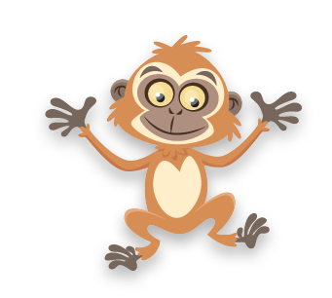
Mia the monkey
/ˈmiːə/ /ðə/ /ˈmʌŋki/

Slide 23
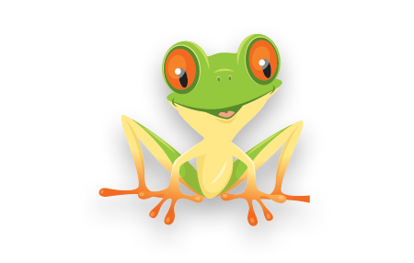
Freddy the frog
/ˈfredi/ /ðə/ /frɑːɡ/

Slide 24
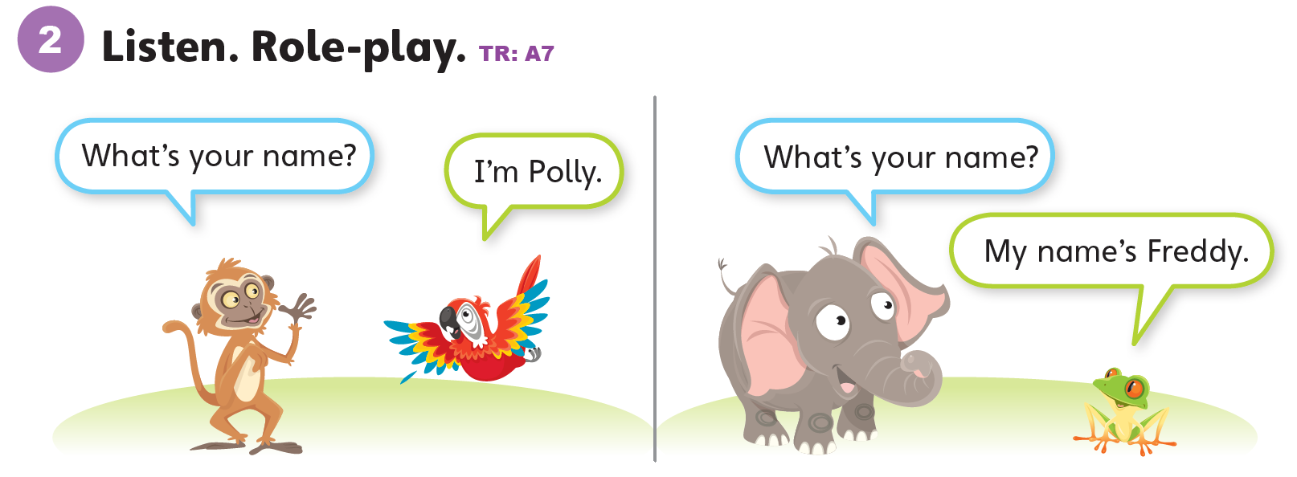

Slide 25
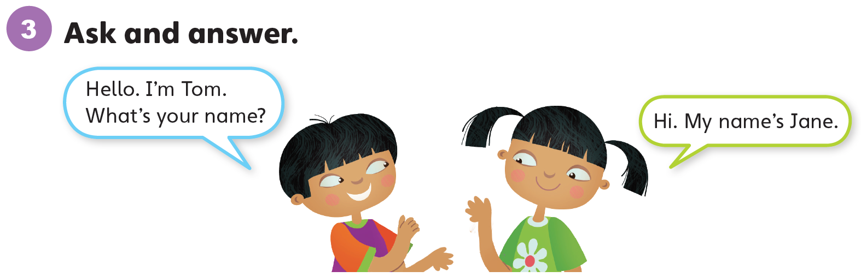

Slide 26
Unit 0:
Getting Started
Lesson 4

Slide 27
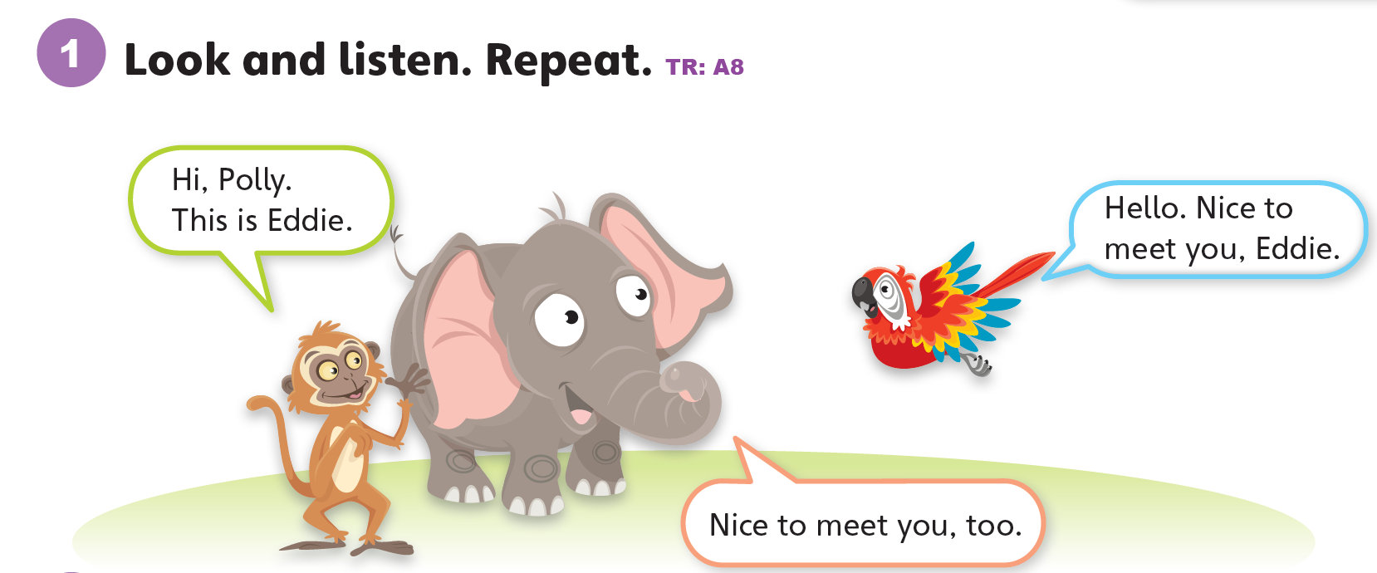

Slide 28
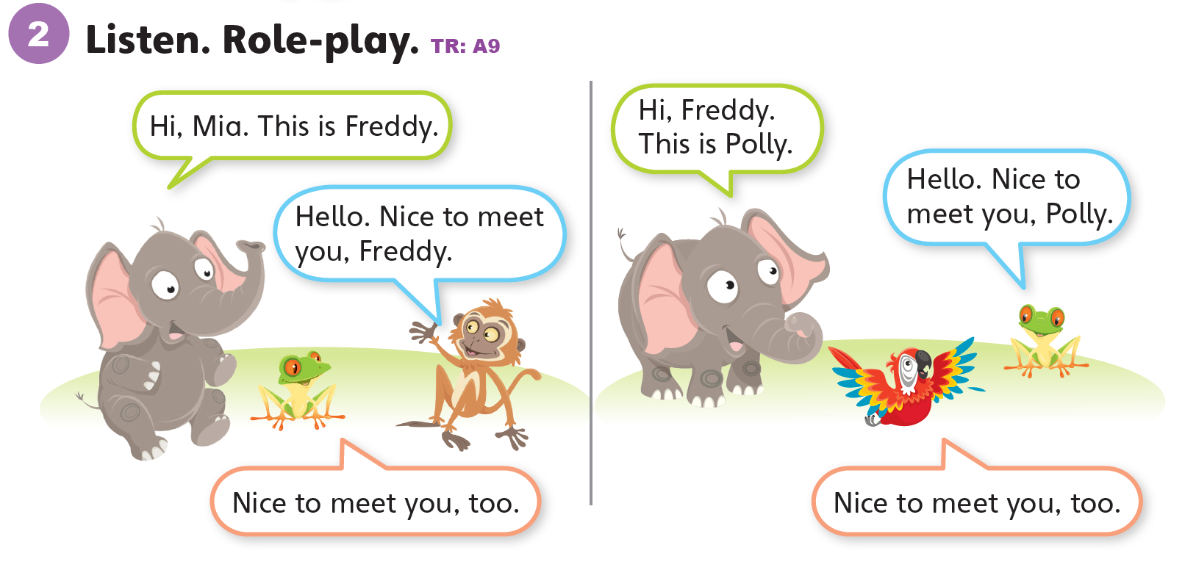

Slide 29
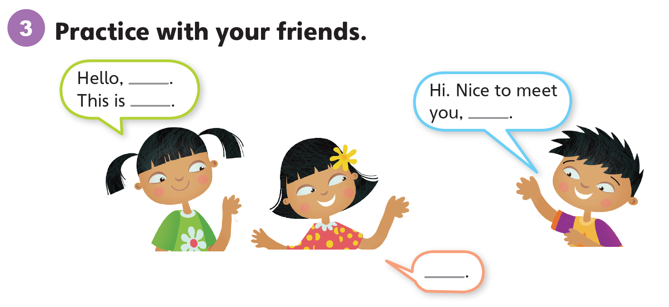

Slide 30
Unit 0:
Getting Started
Lesson 5

Slide 31
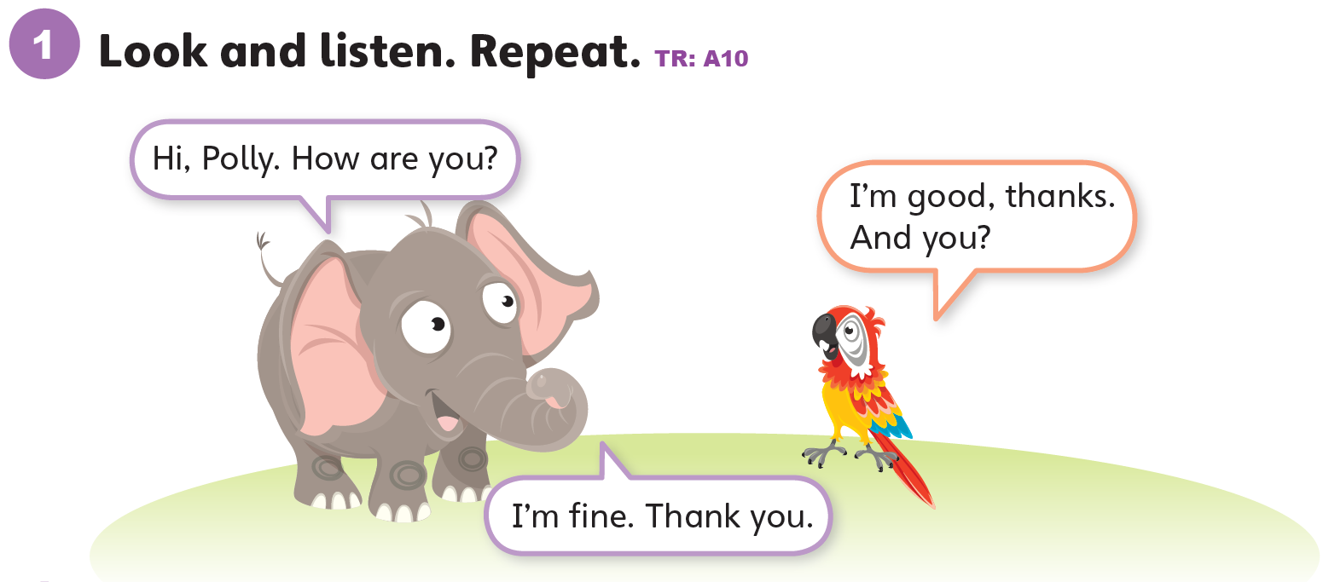

Slide 32
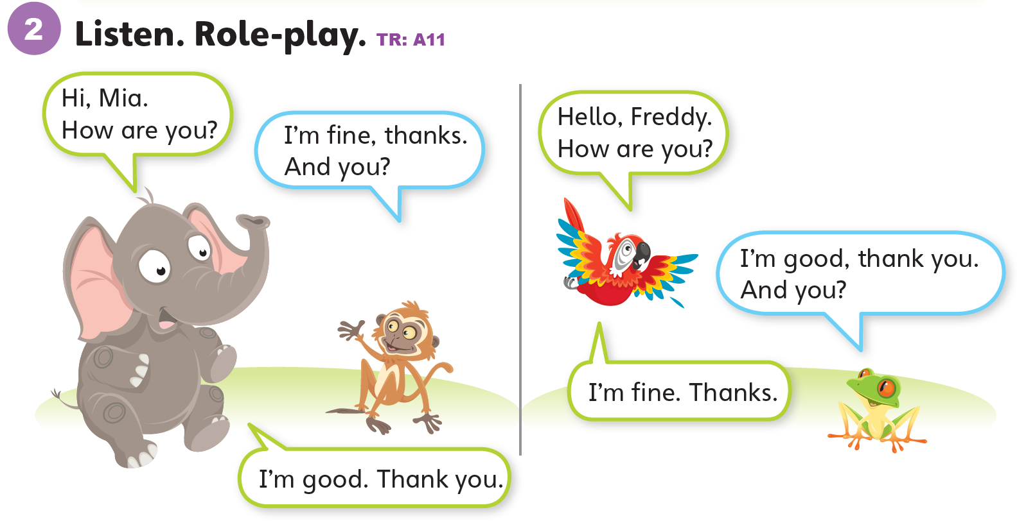

Slide 33
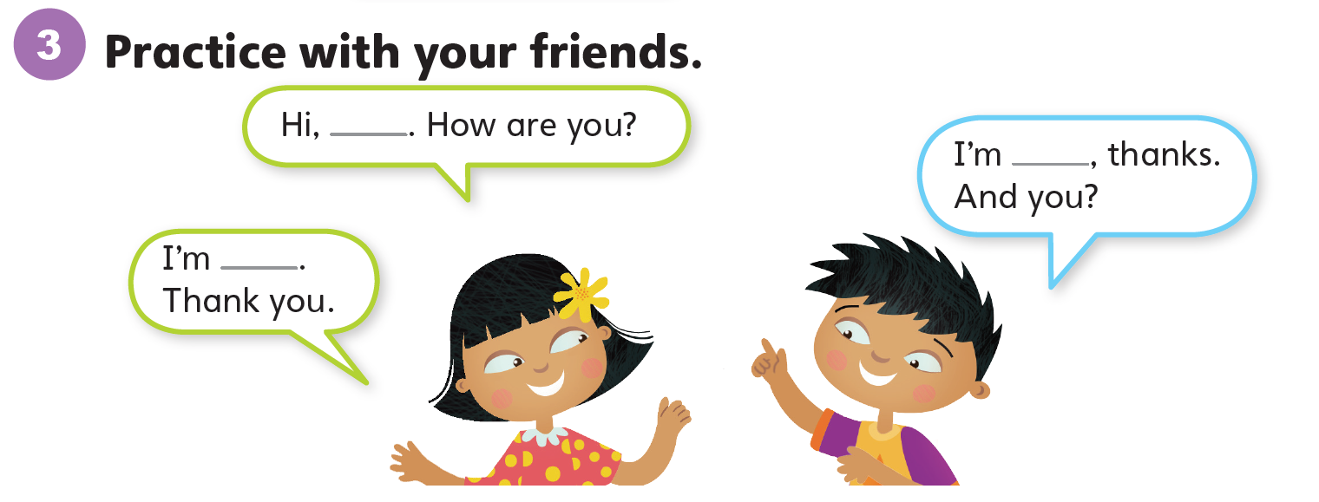

Slide 34
Unit 0:
Getting Started
Lesson 6

Slide 35
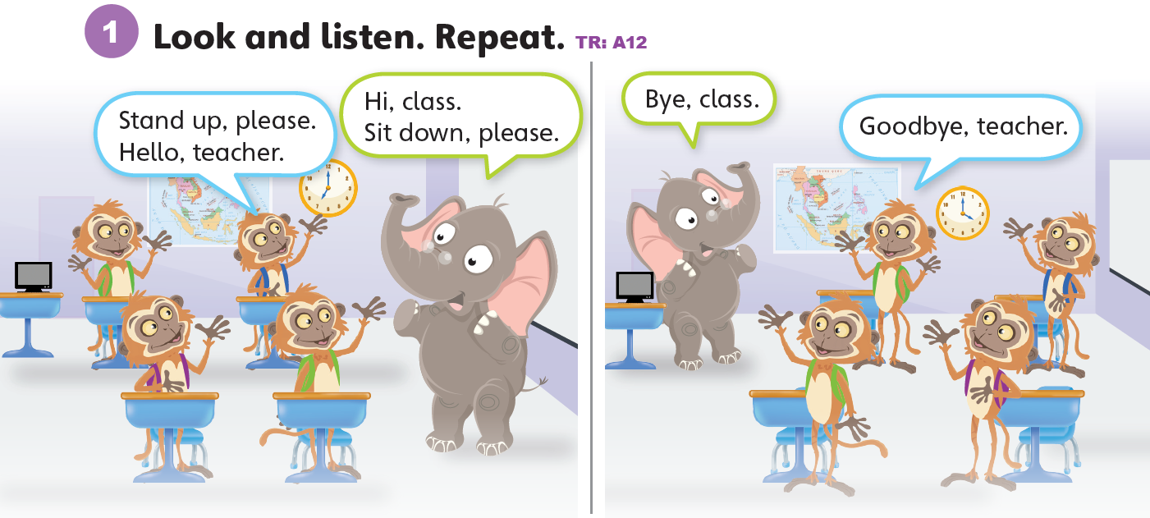

Slide 36
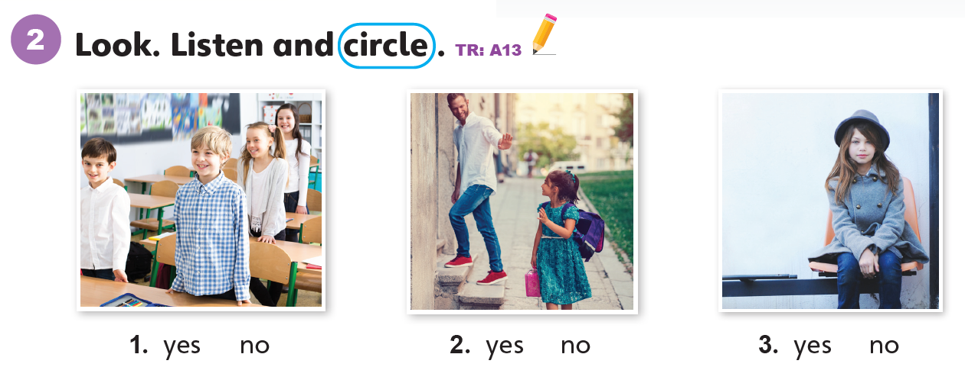

Slide 37
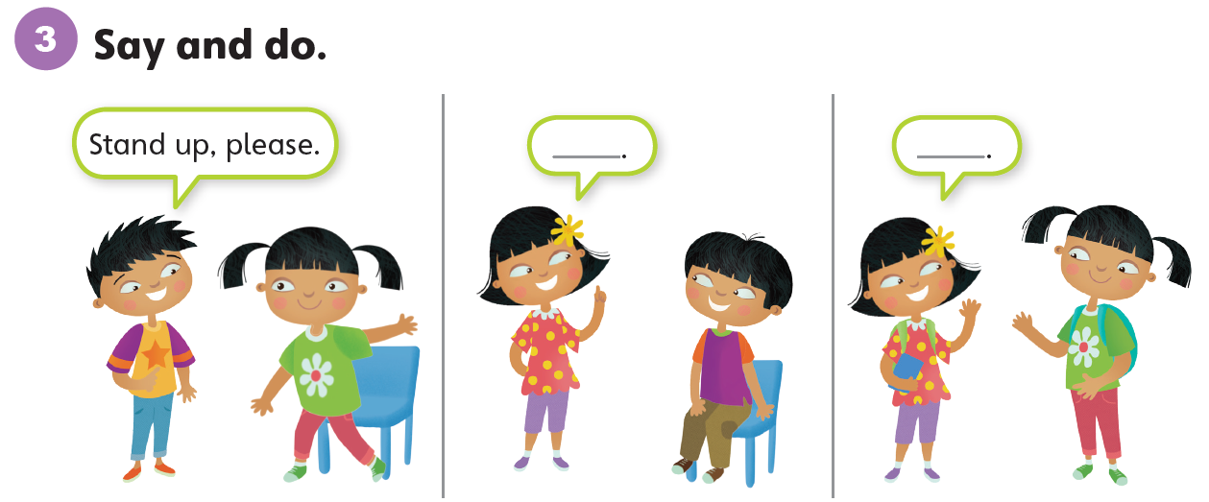

Slide 38
Unit 0:
Getting Started
Lesson 7

Slide 39
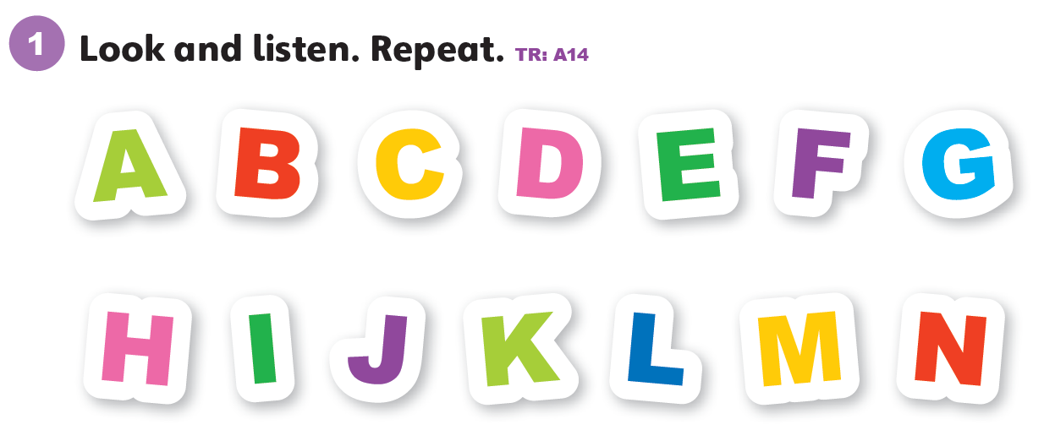

Slide 40
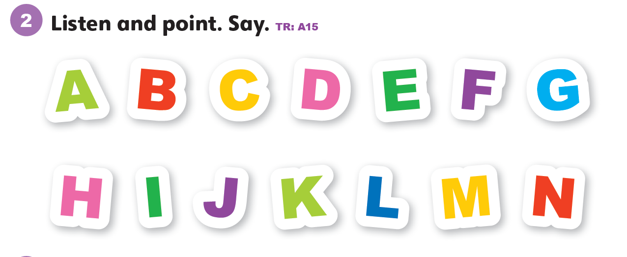

Slide 41
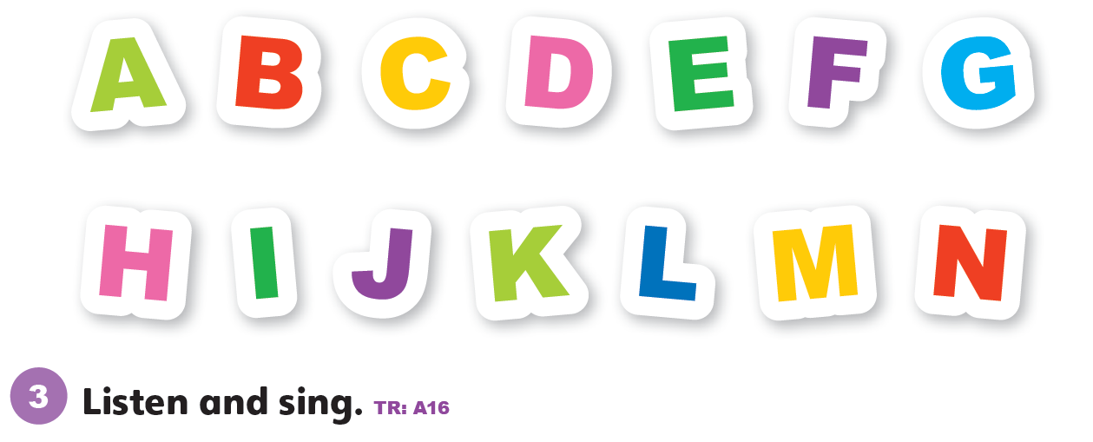

Slide 42
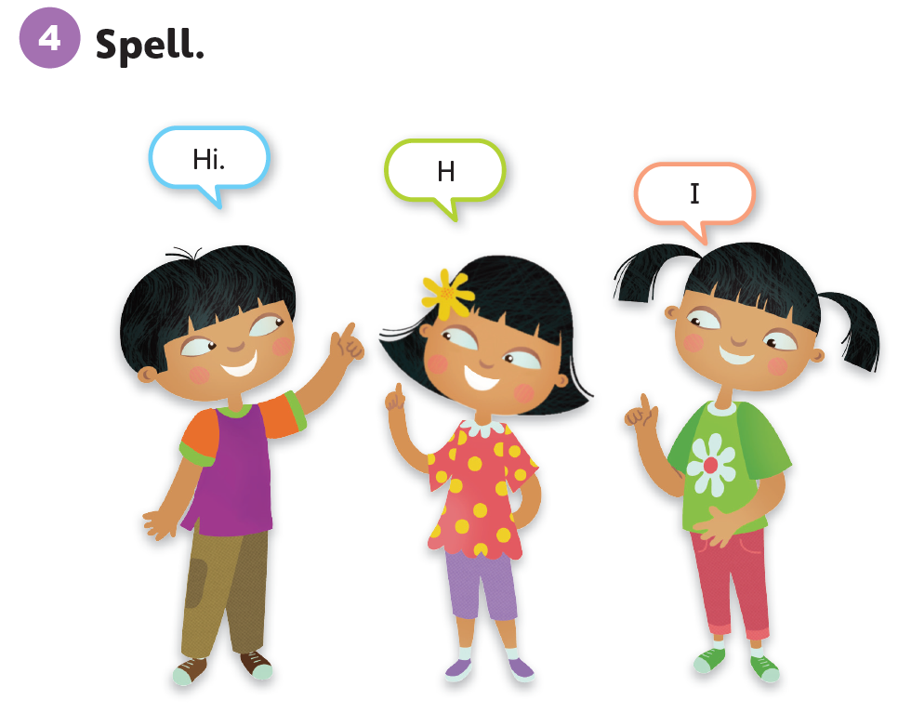

Slide 43
Unit 0:
Getting Started
Lesson 8

Slide 44
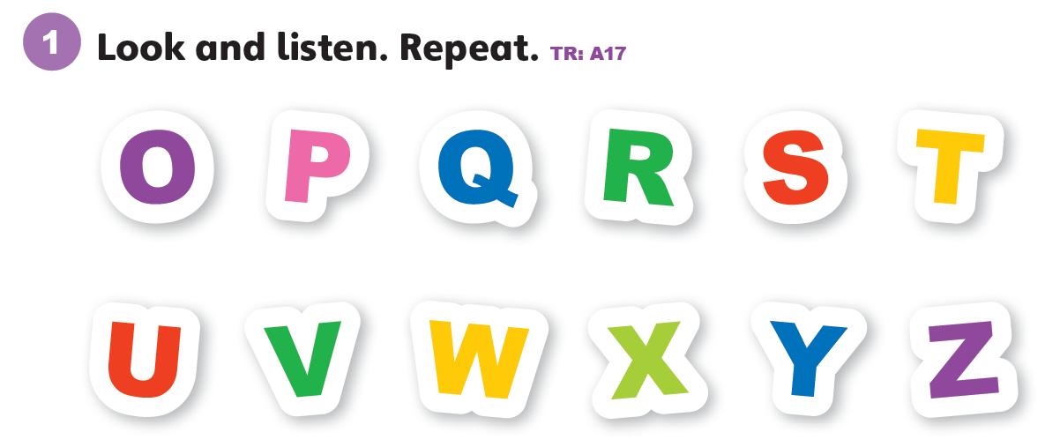

Slide 45
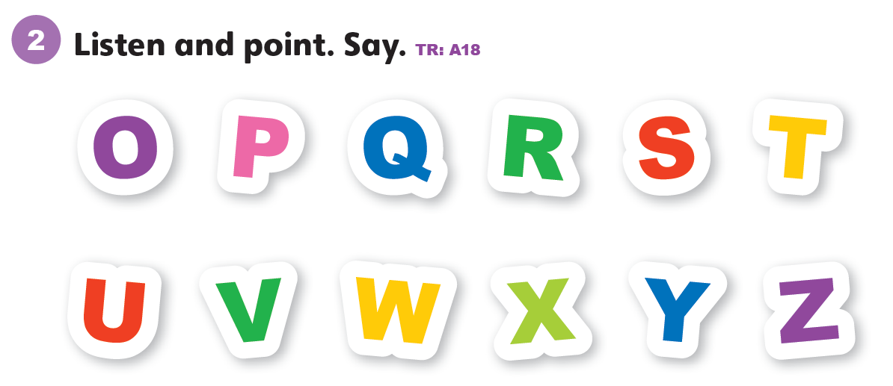

Slide 46
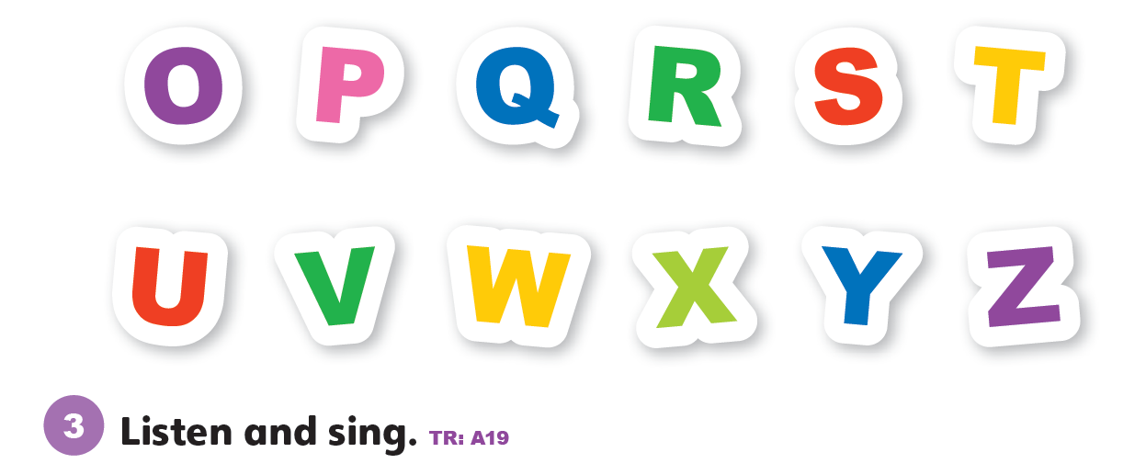

Slide 47
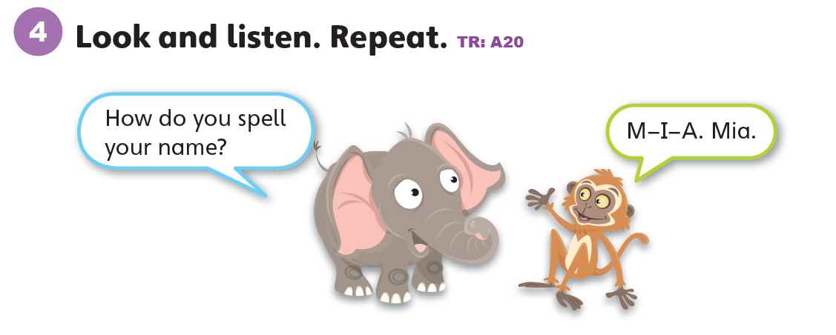

Slide 48
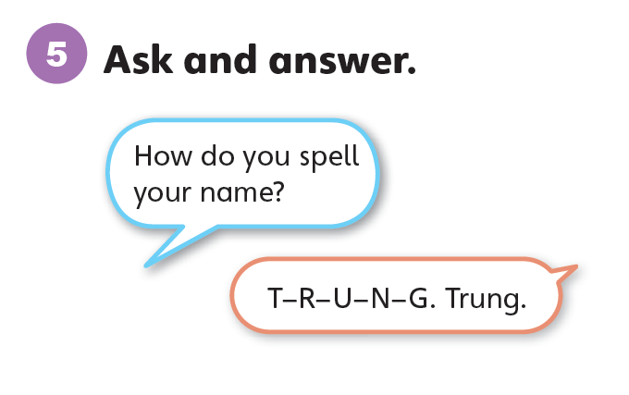

Slide 49
Unit 0:
Getting Started
Lesson 9

Slide 50
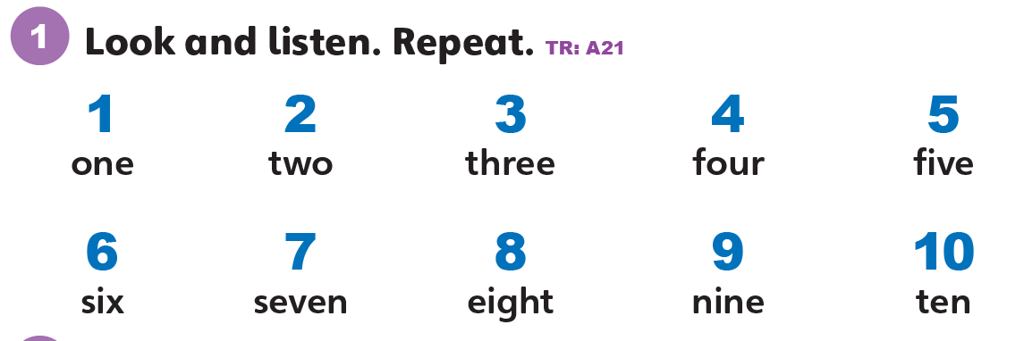

Slide 51
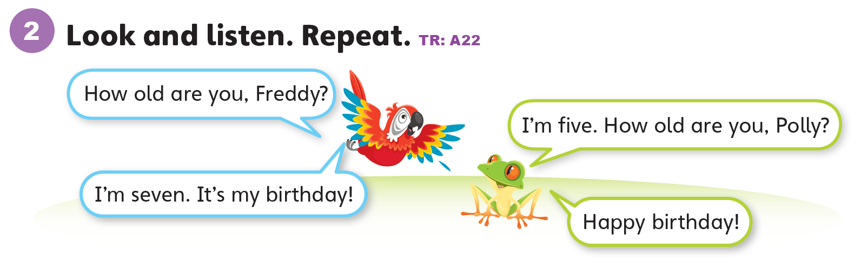

Slide 52
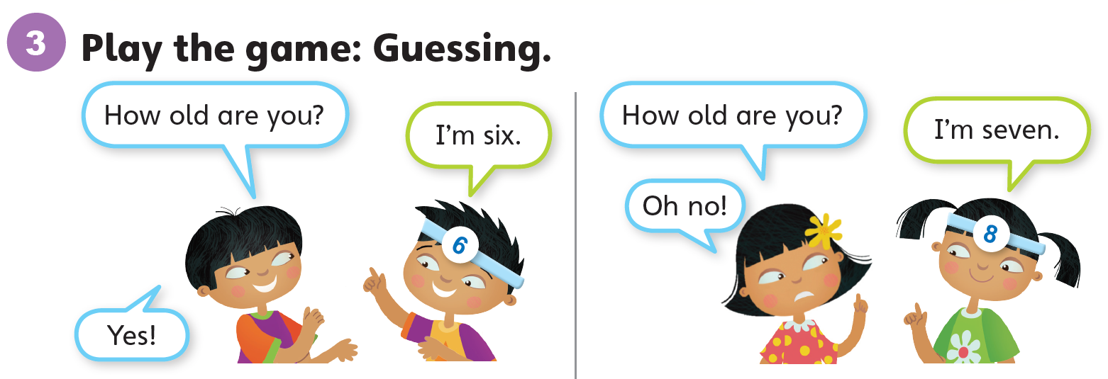

Slide 53
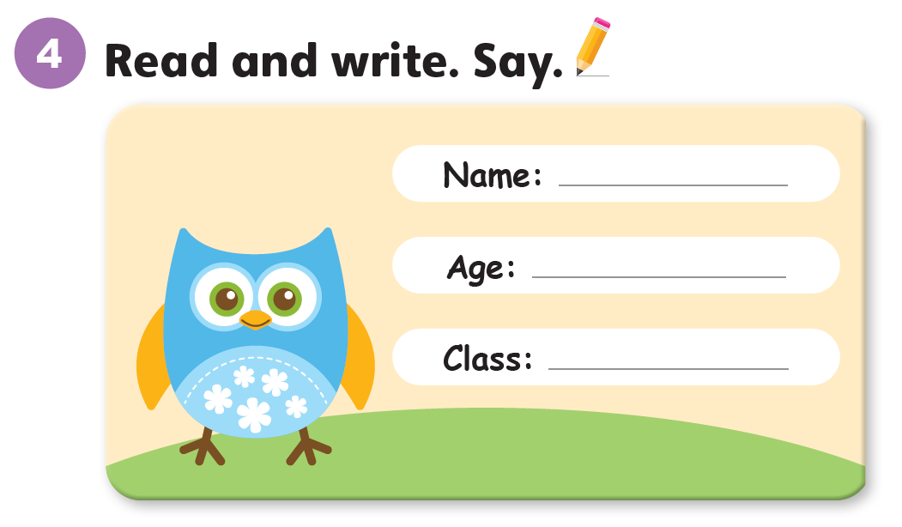

Slide 54
Unit 0:
Getting Started
Lesson 10

Slide 55
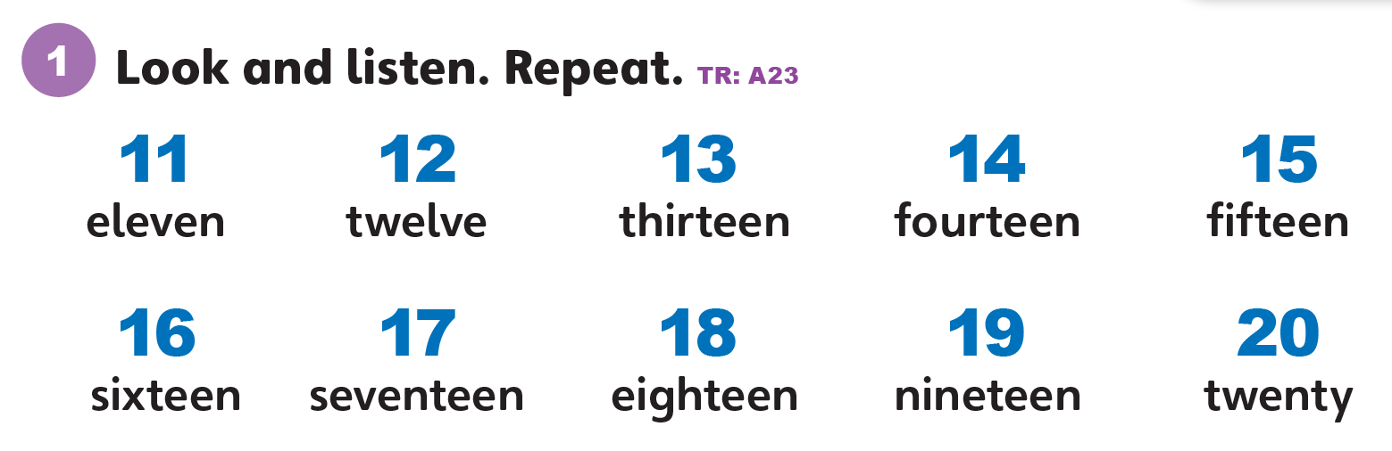

Slide 56
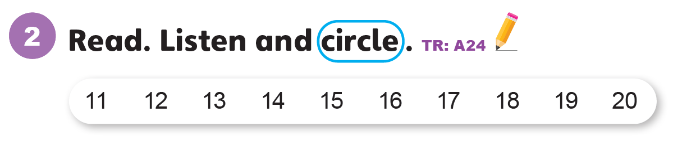

Slide 57
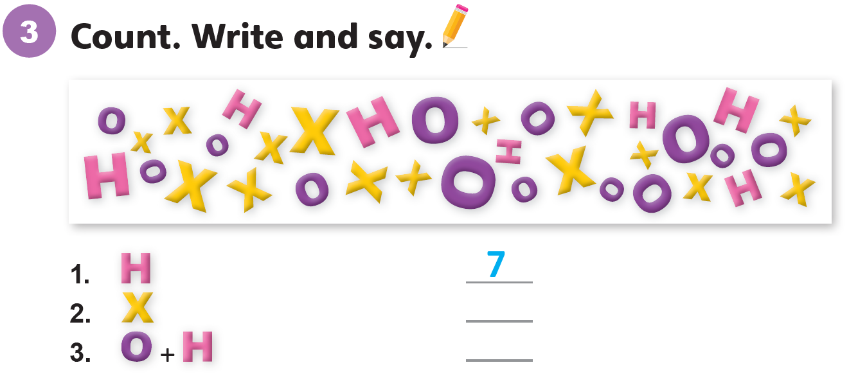
15
20

Slide 58
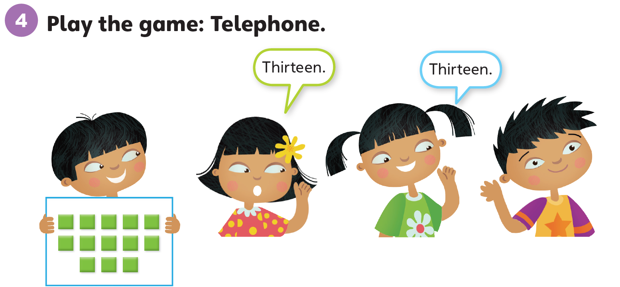

Slide 59
Unit 0:
Getting Started
Lesson 11

Slide 60
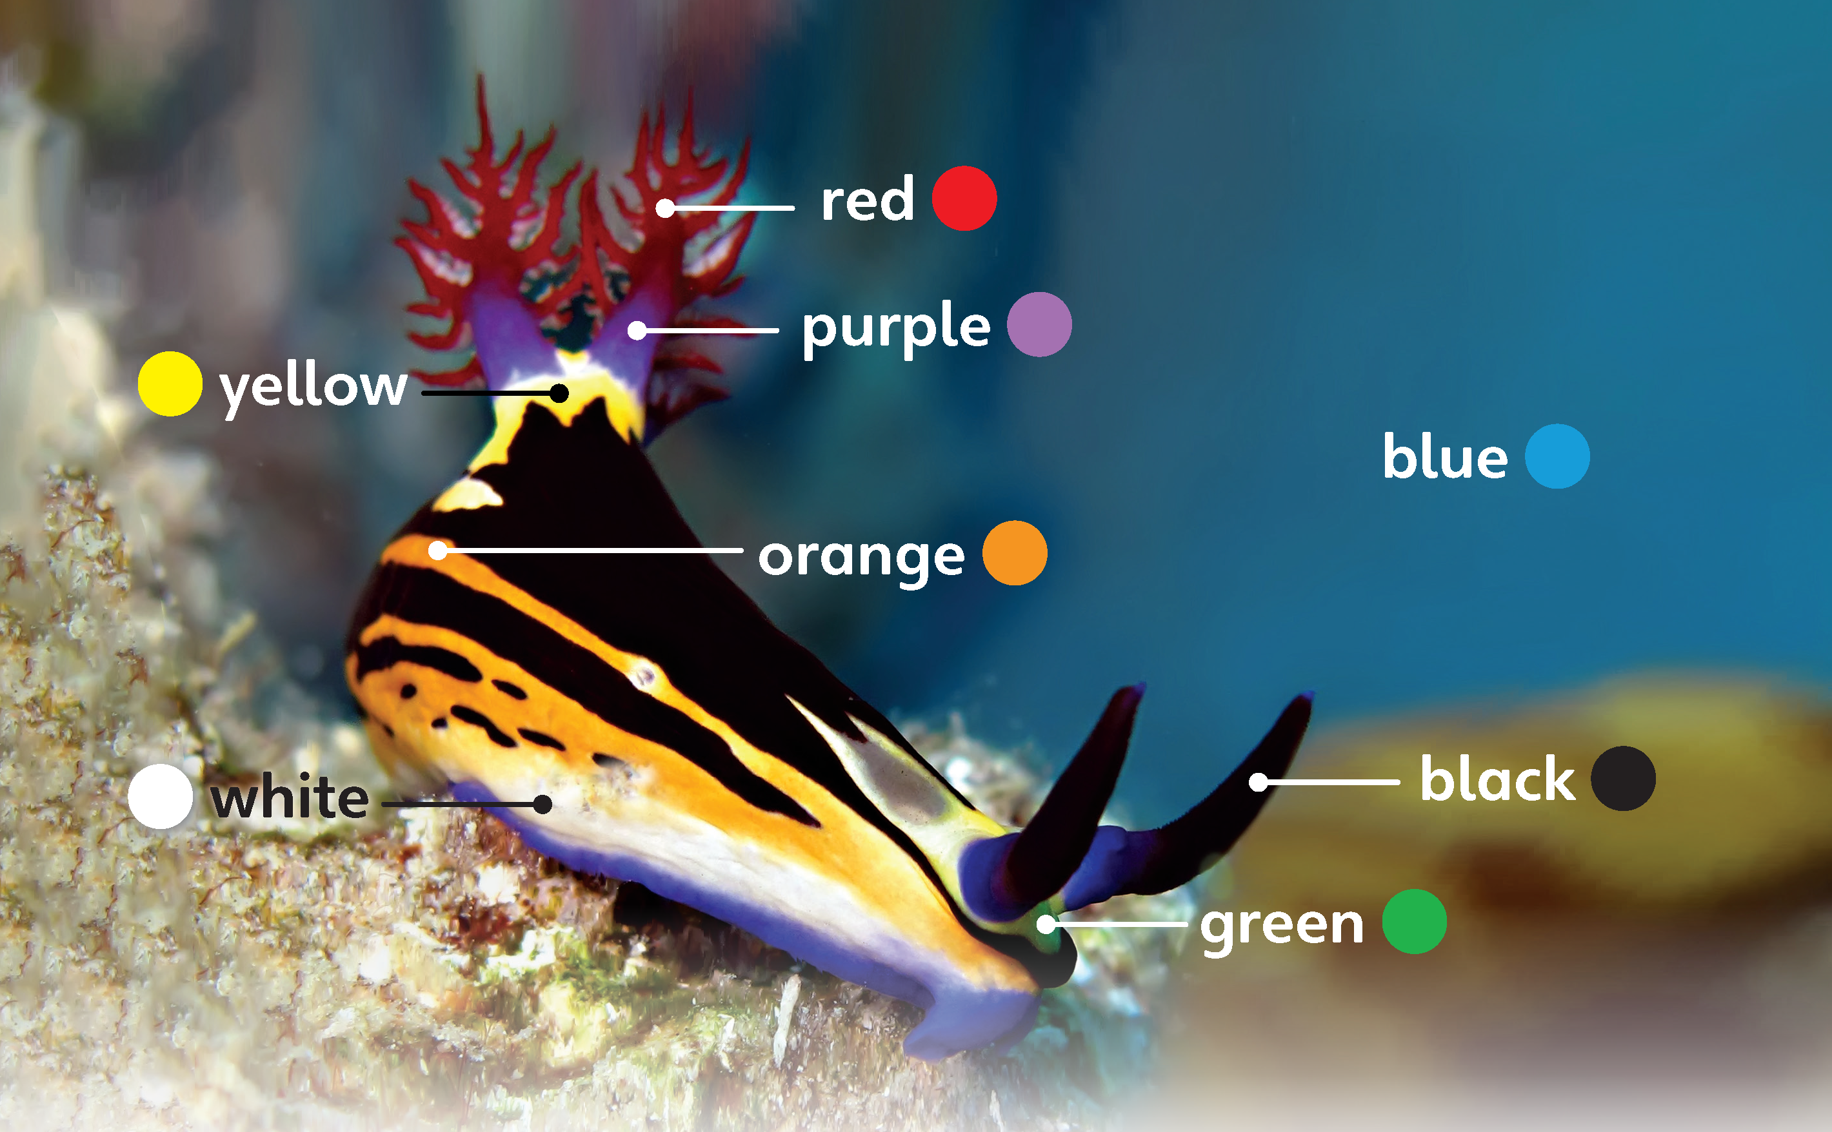
1
Look and listen. Repeat.
TR: A25

Slide 61
2
Listen and point. Say.
TR: A26

Slide 62
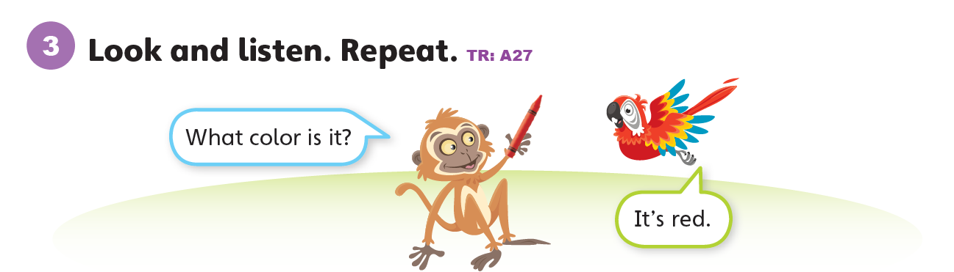

Slide 63
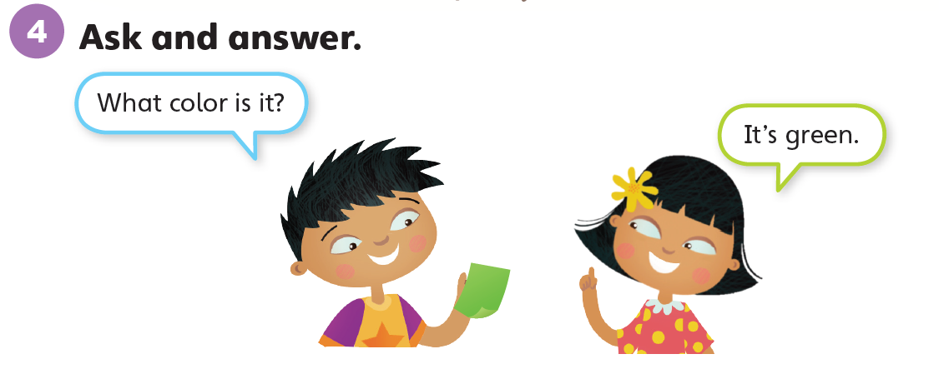

Slide 64
Thank you!

