Slide 1
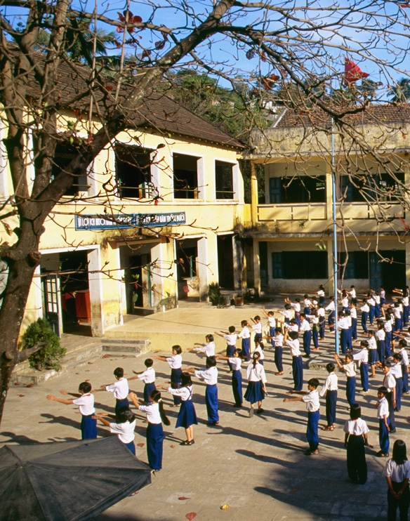
Unit 1
My Classroom

Slide 2
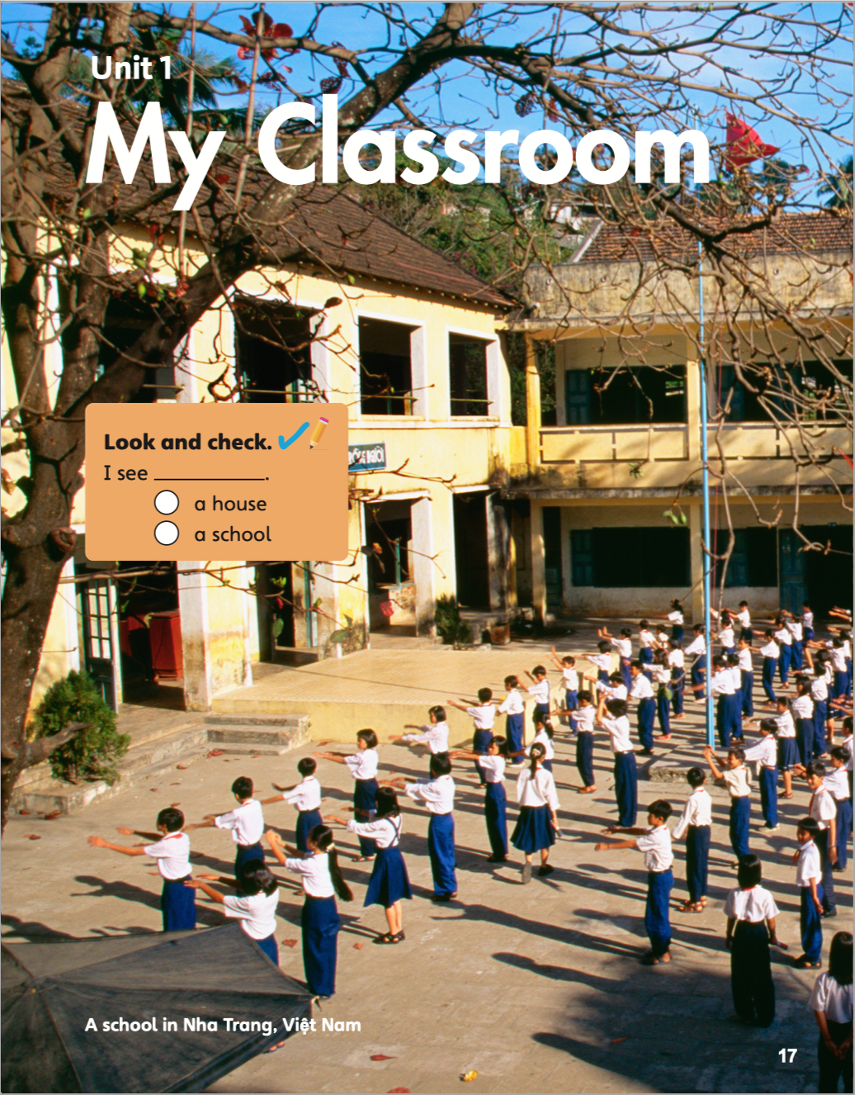


I see _____________.
a house
a school

Slide 3
Unit 1:
My Classroom
Lesson 1

Slide 4

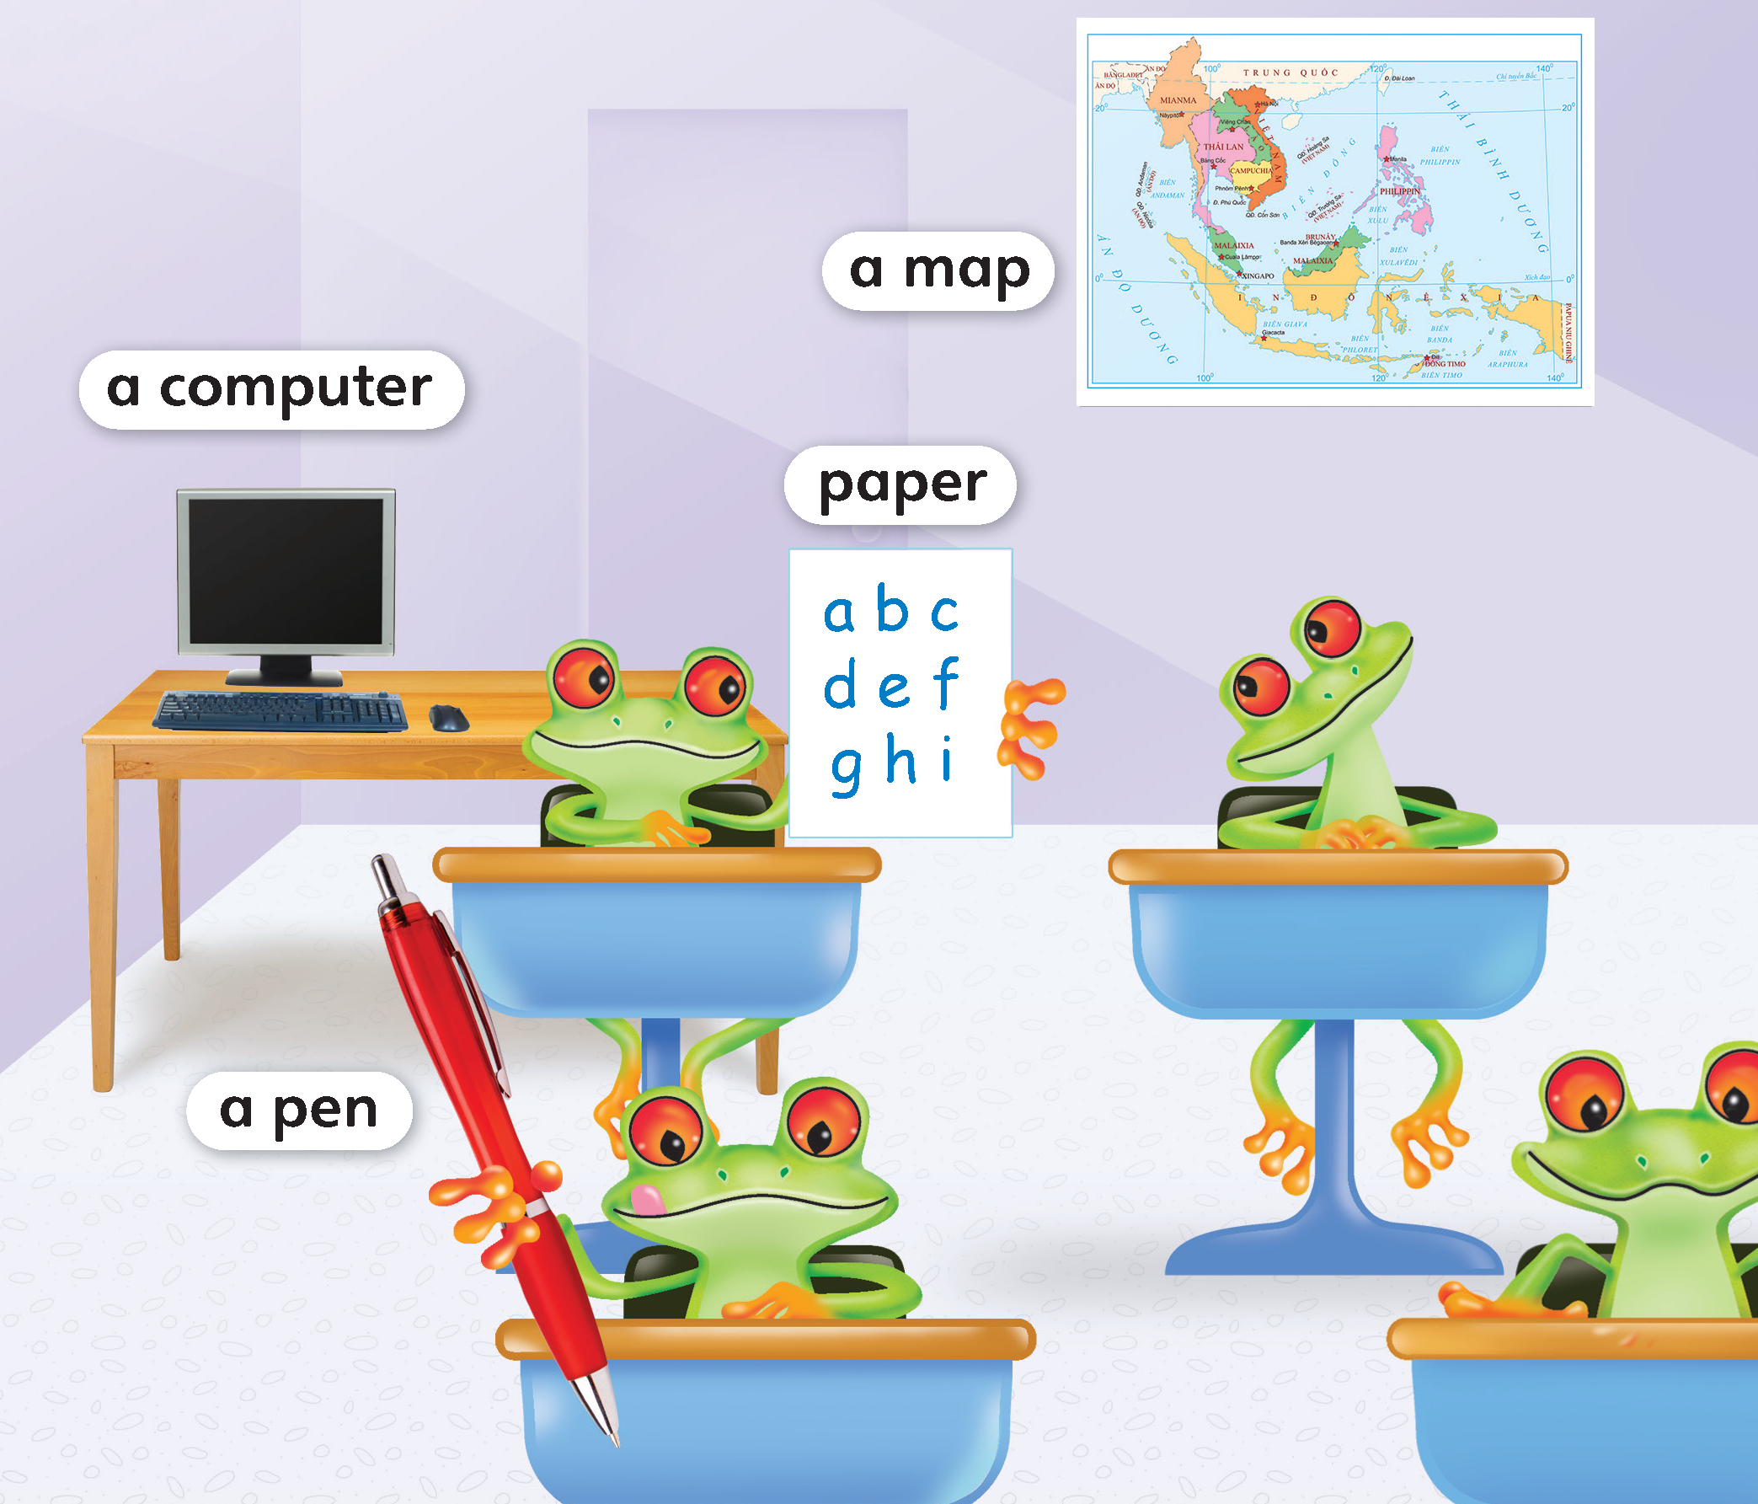
1
Look and listen. Repeat.
TR: A28

Slide 5
a computer
/ə/ /kəmˈpjuːtər/

Slide 6
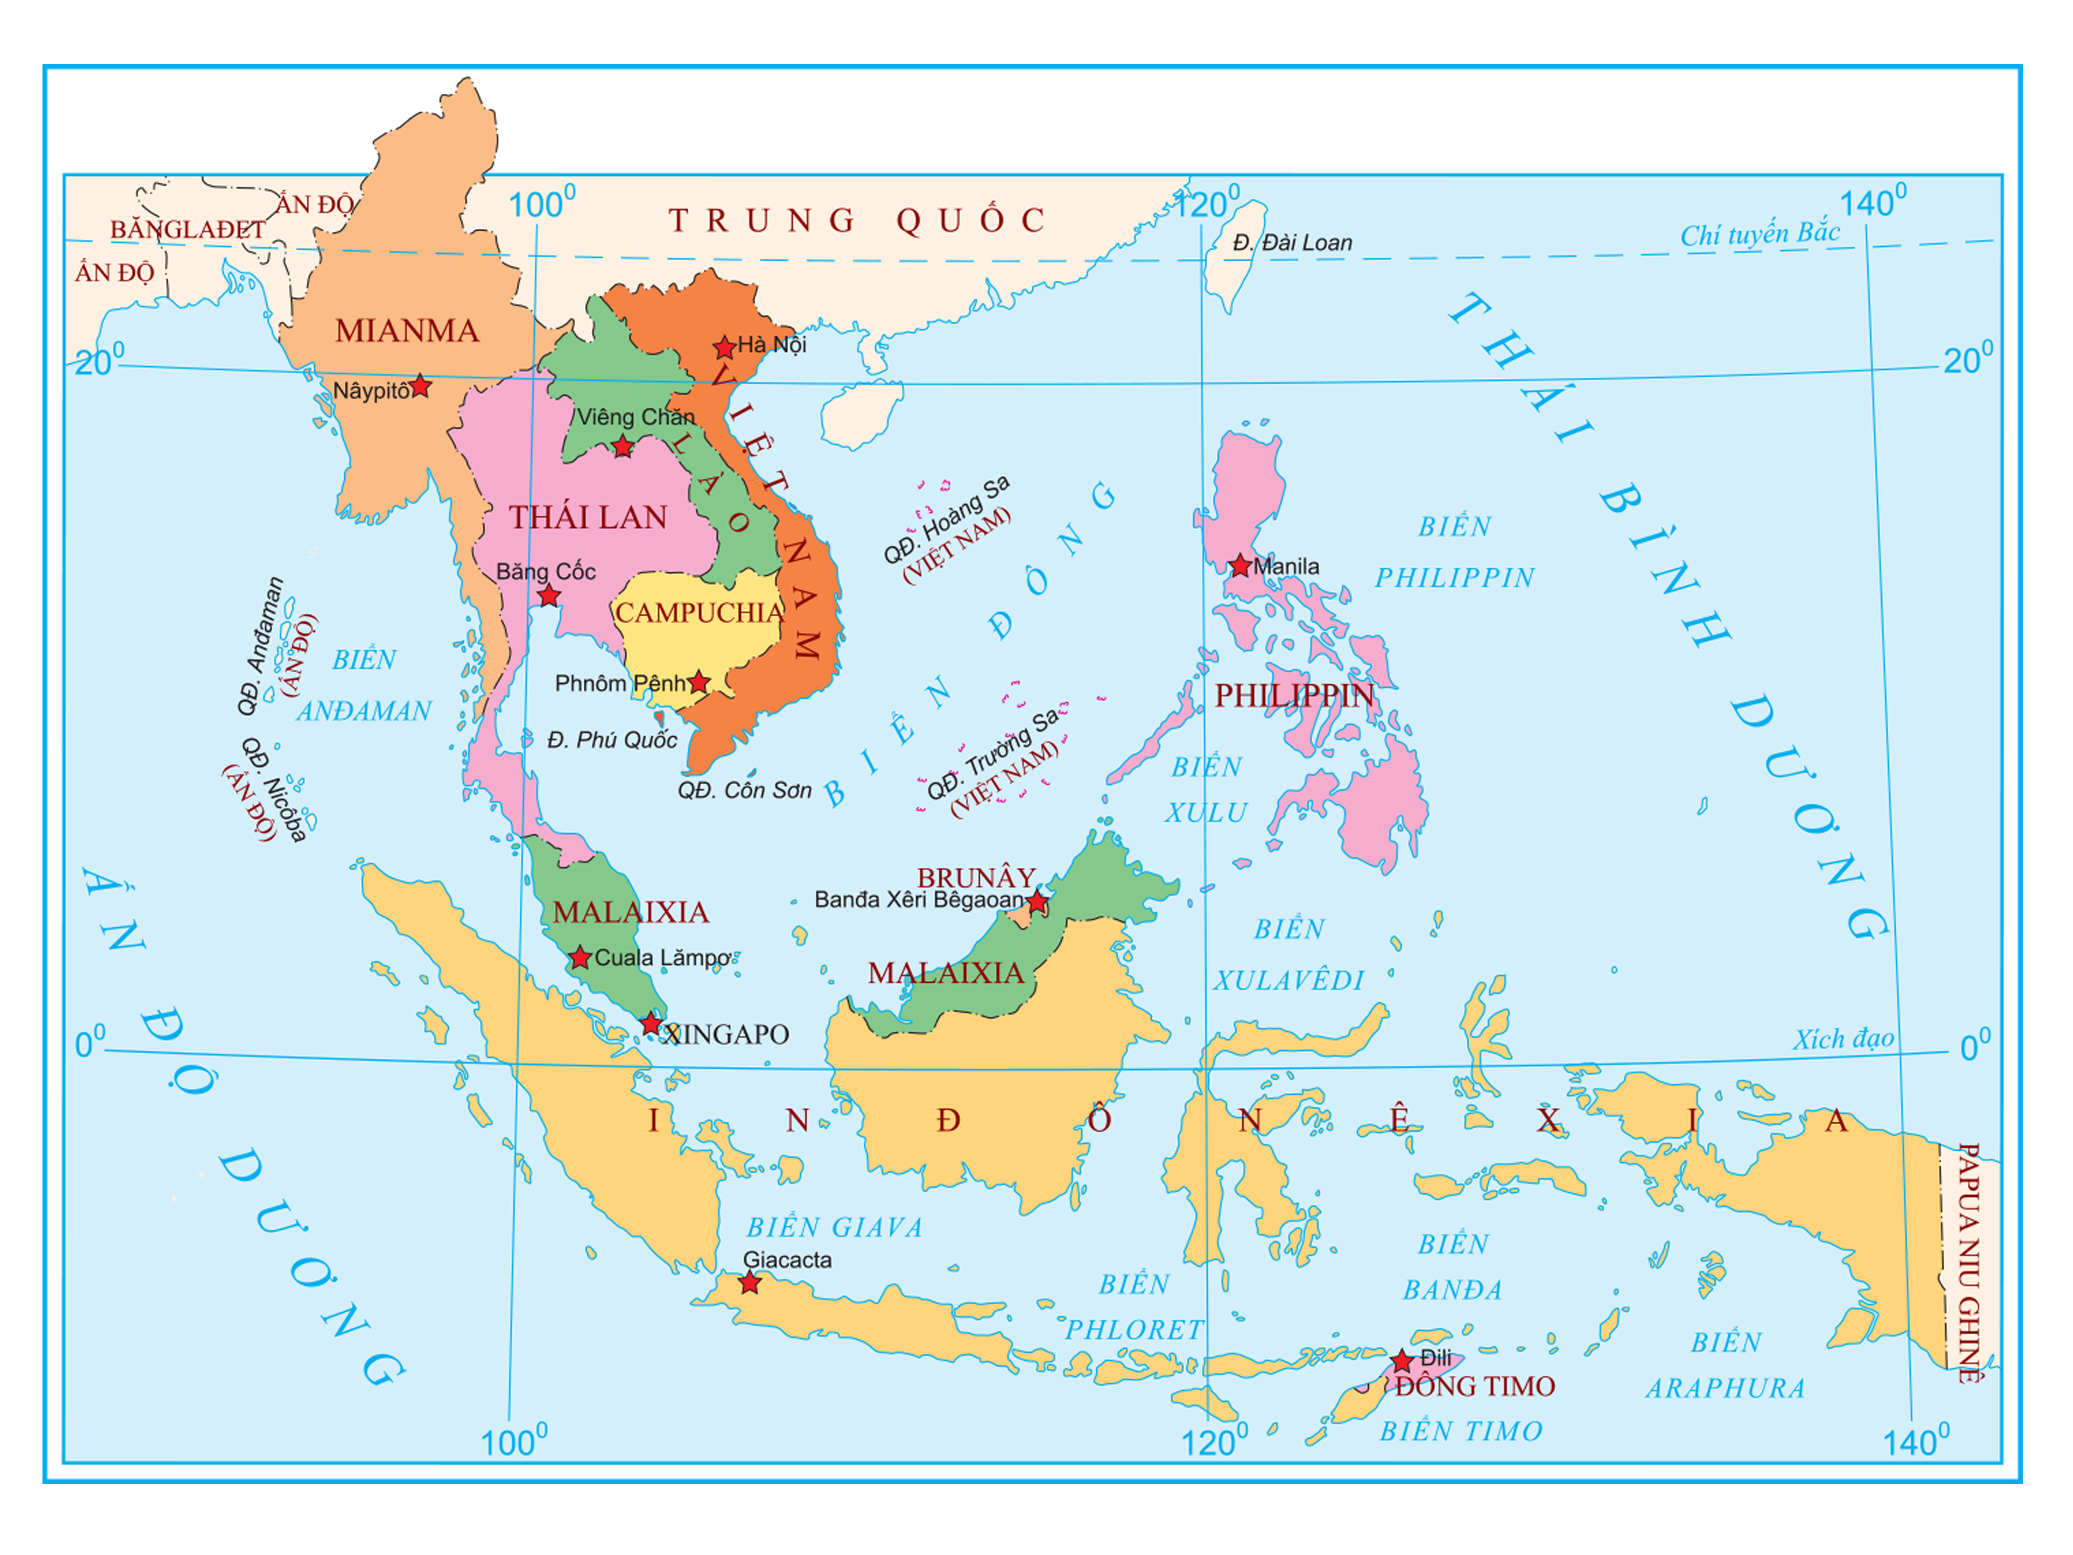
a map
/ə/ /mæp/

Slide 7
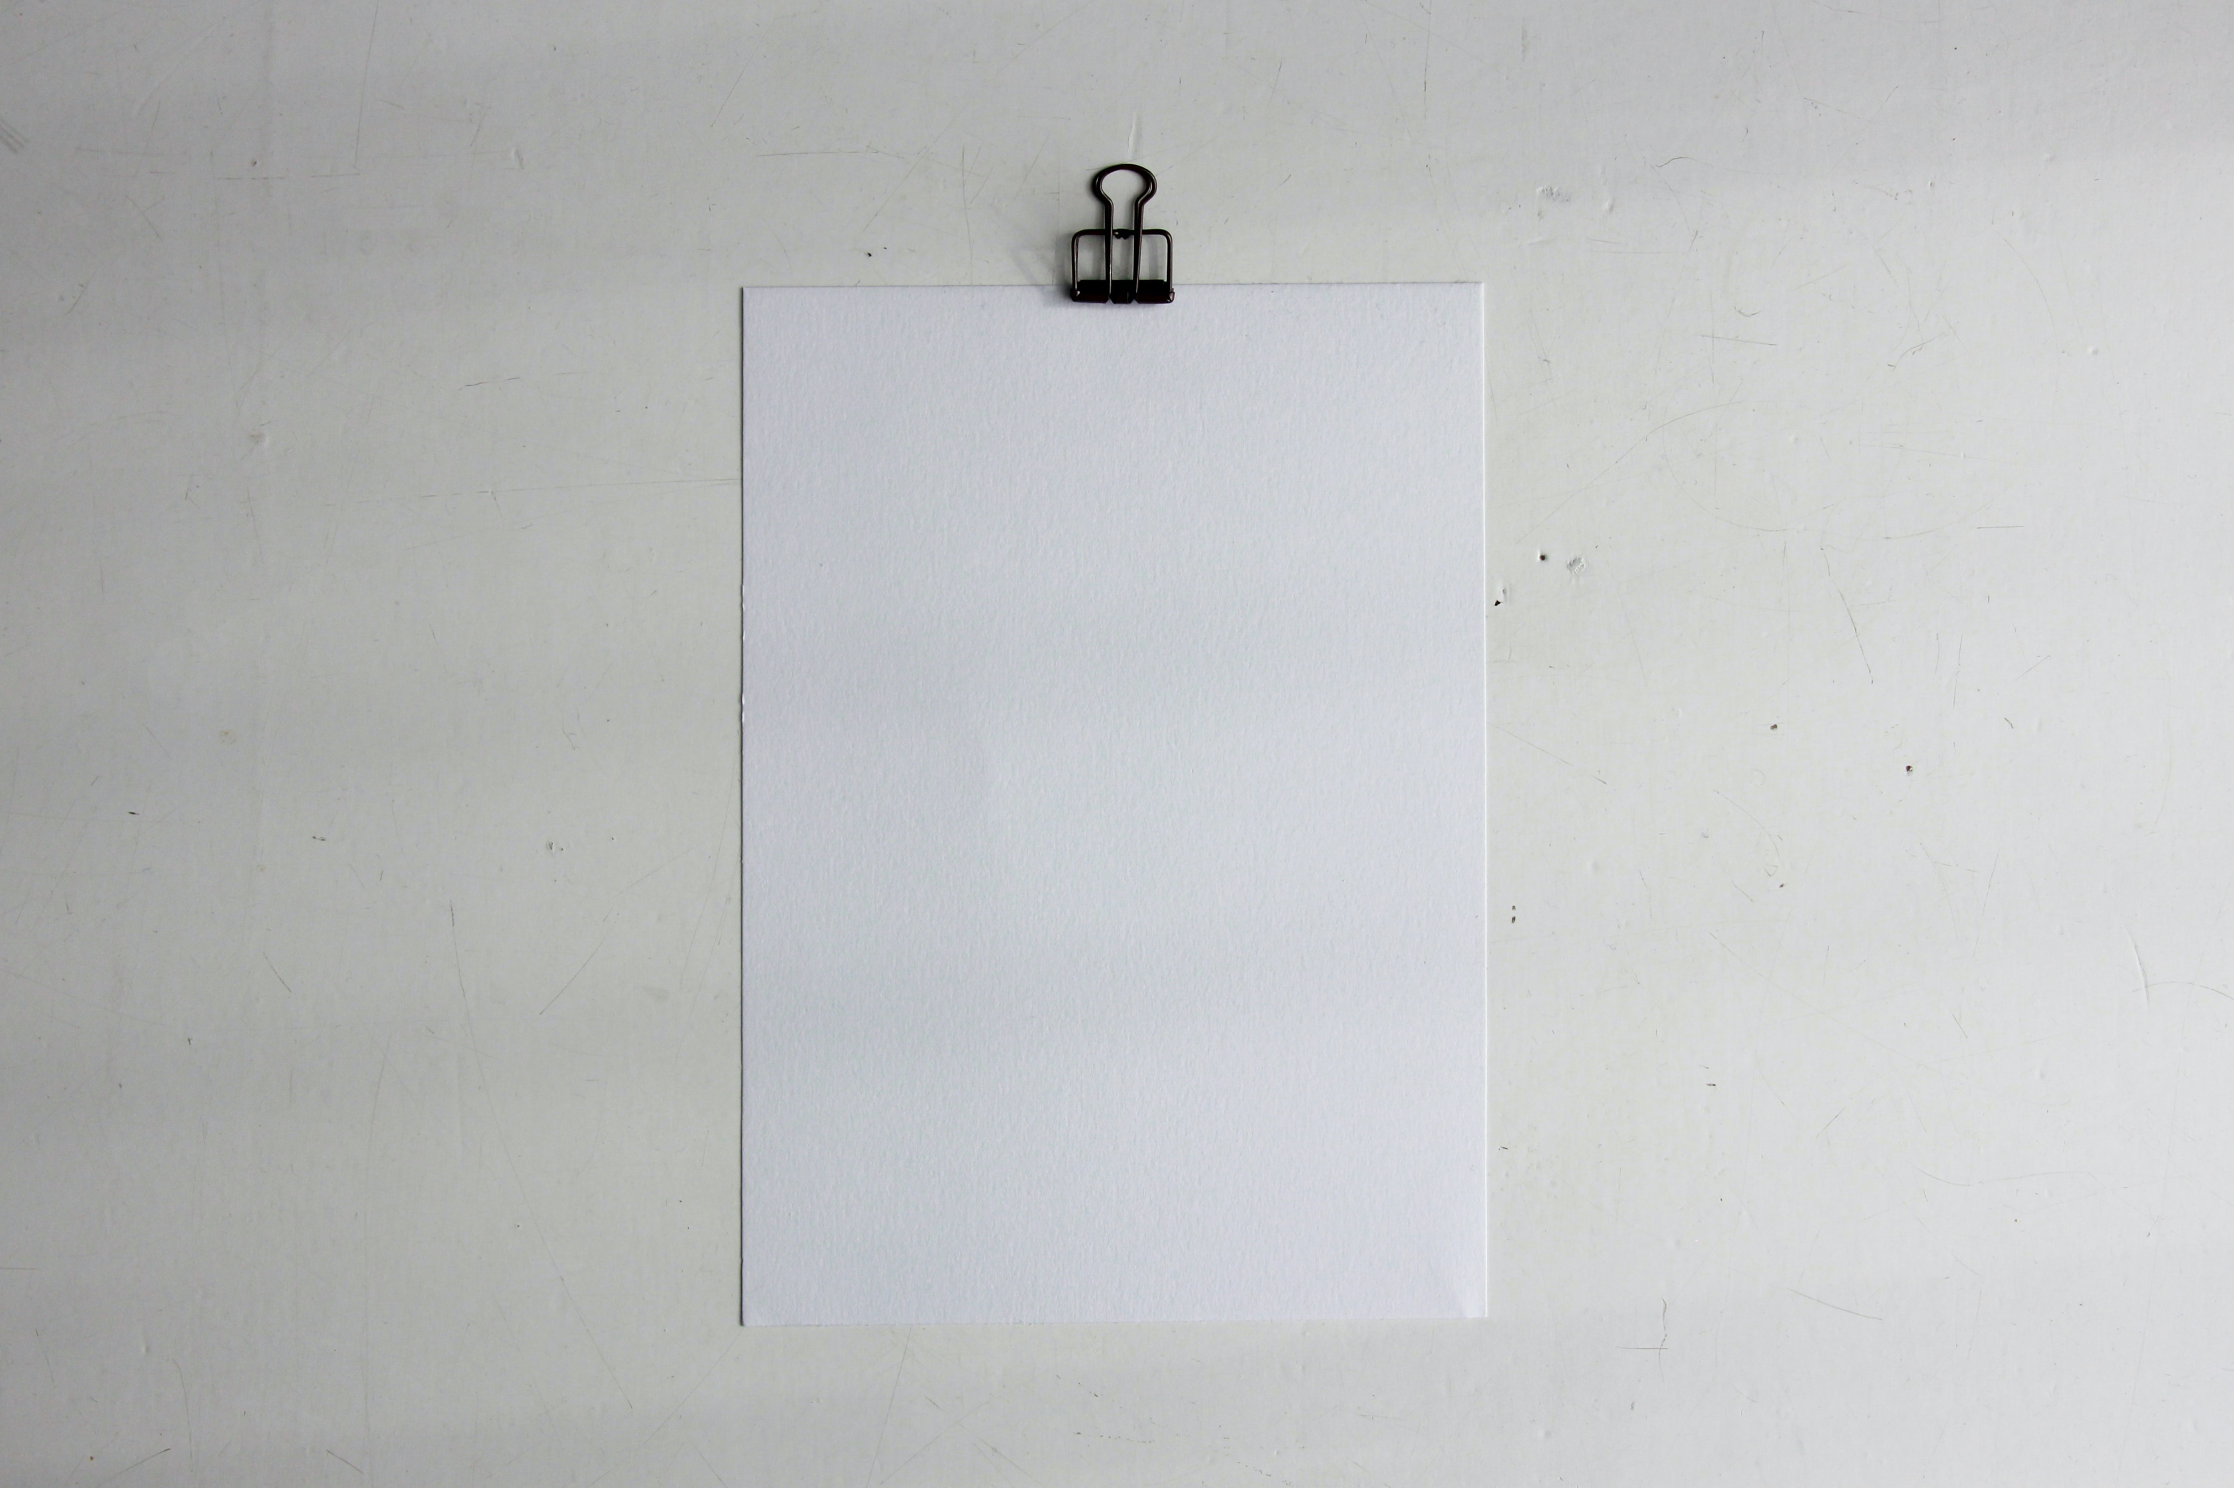
paper
/ˈpeɪpər/

Slide 8
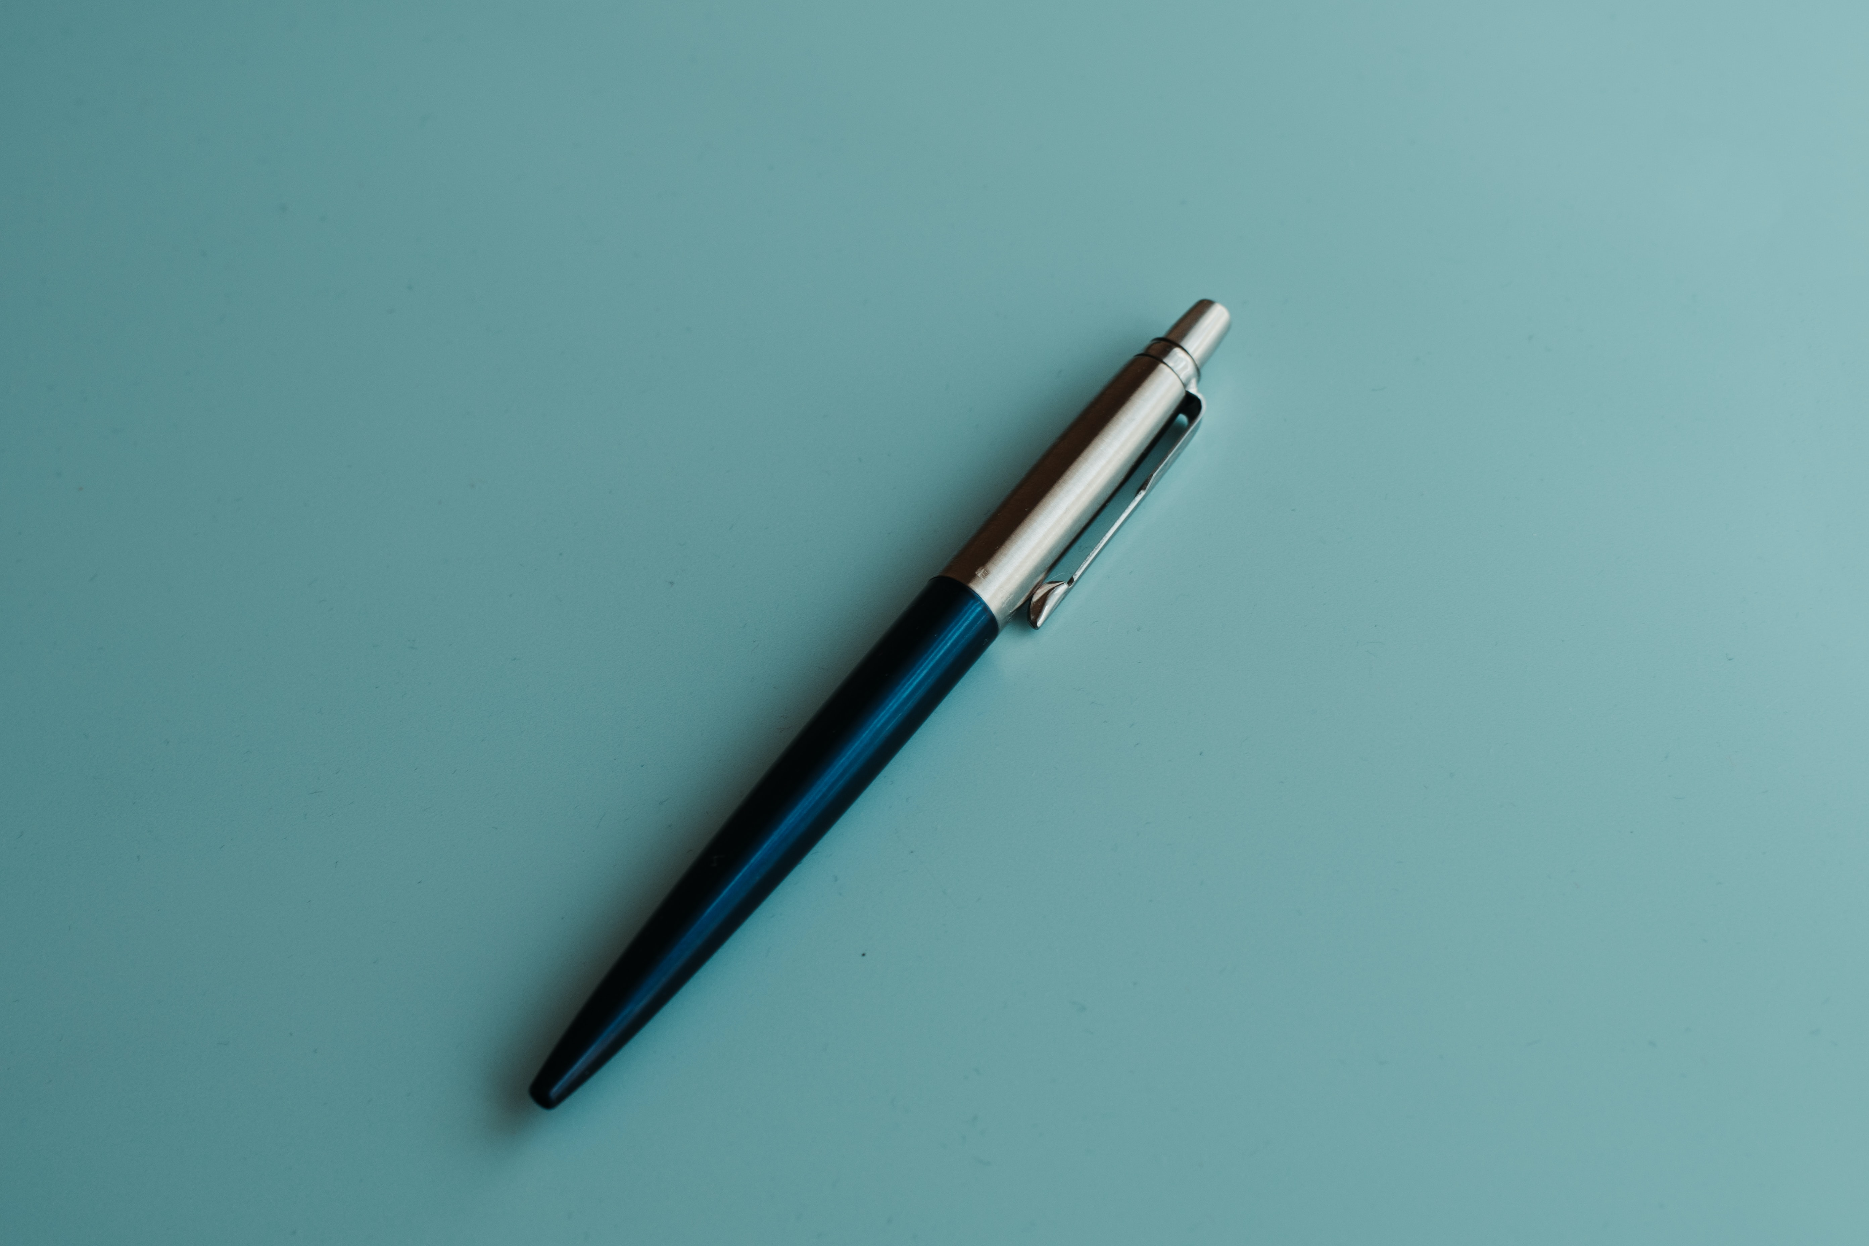
a pen
/ə/ /pen/

Slide 9
2
Listen and point. Say.
TR: A29

Slide 10
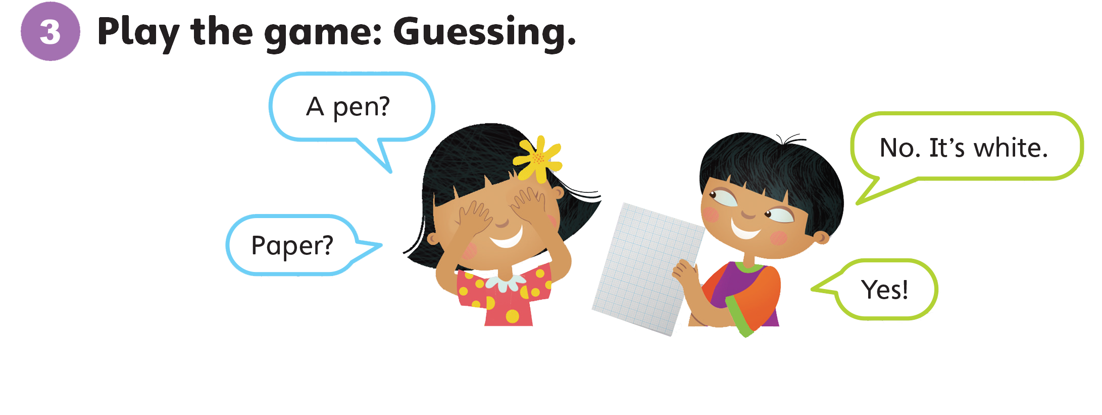

Slide 11
Unit 1:
My Classroom
Lesson 2

Slide 12

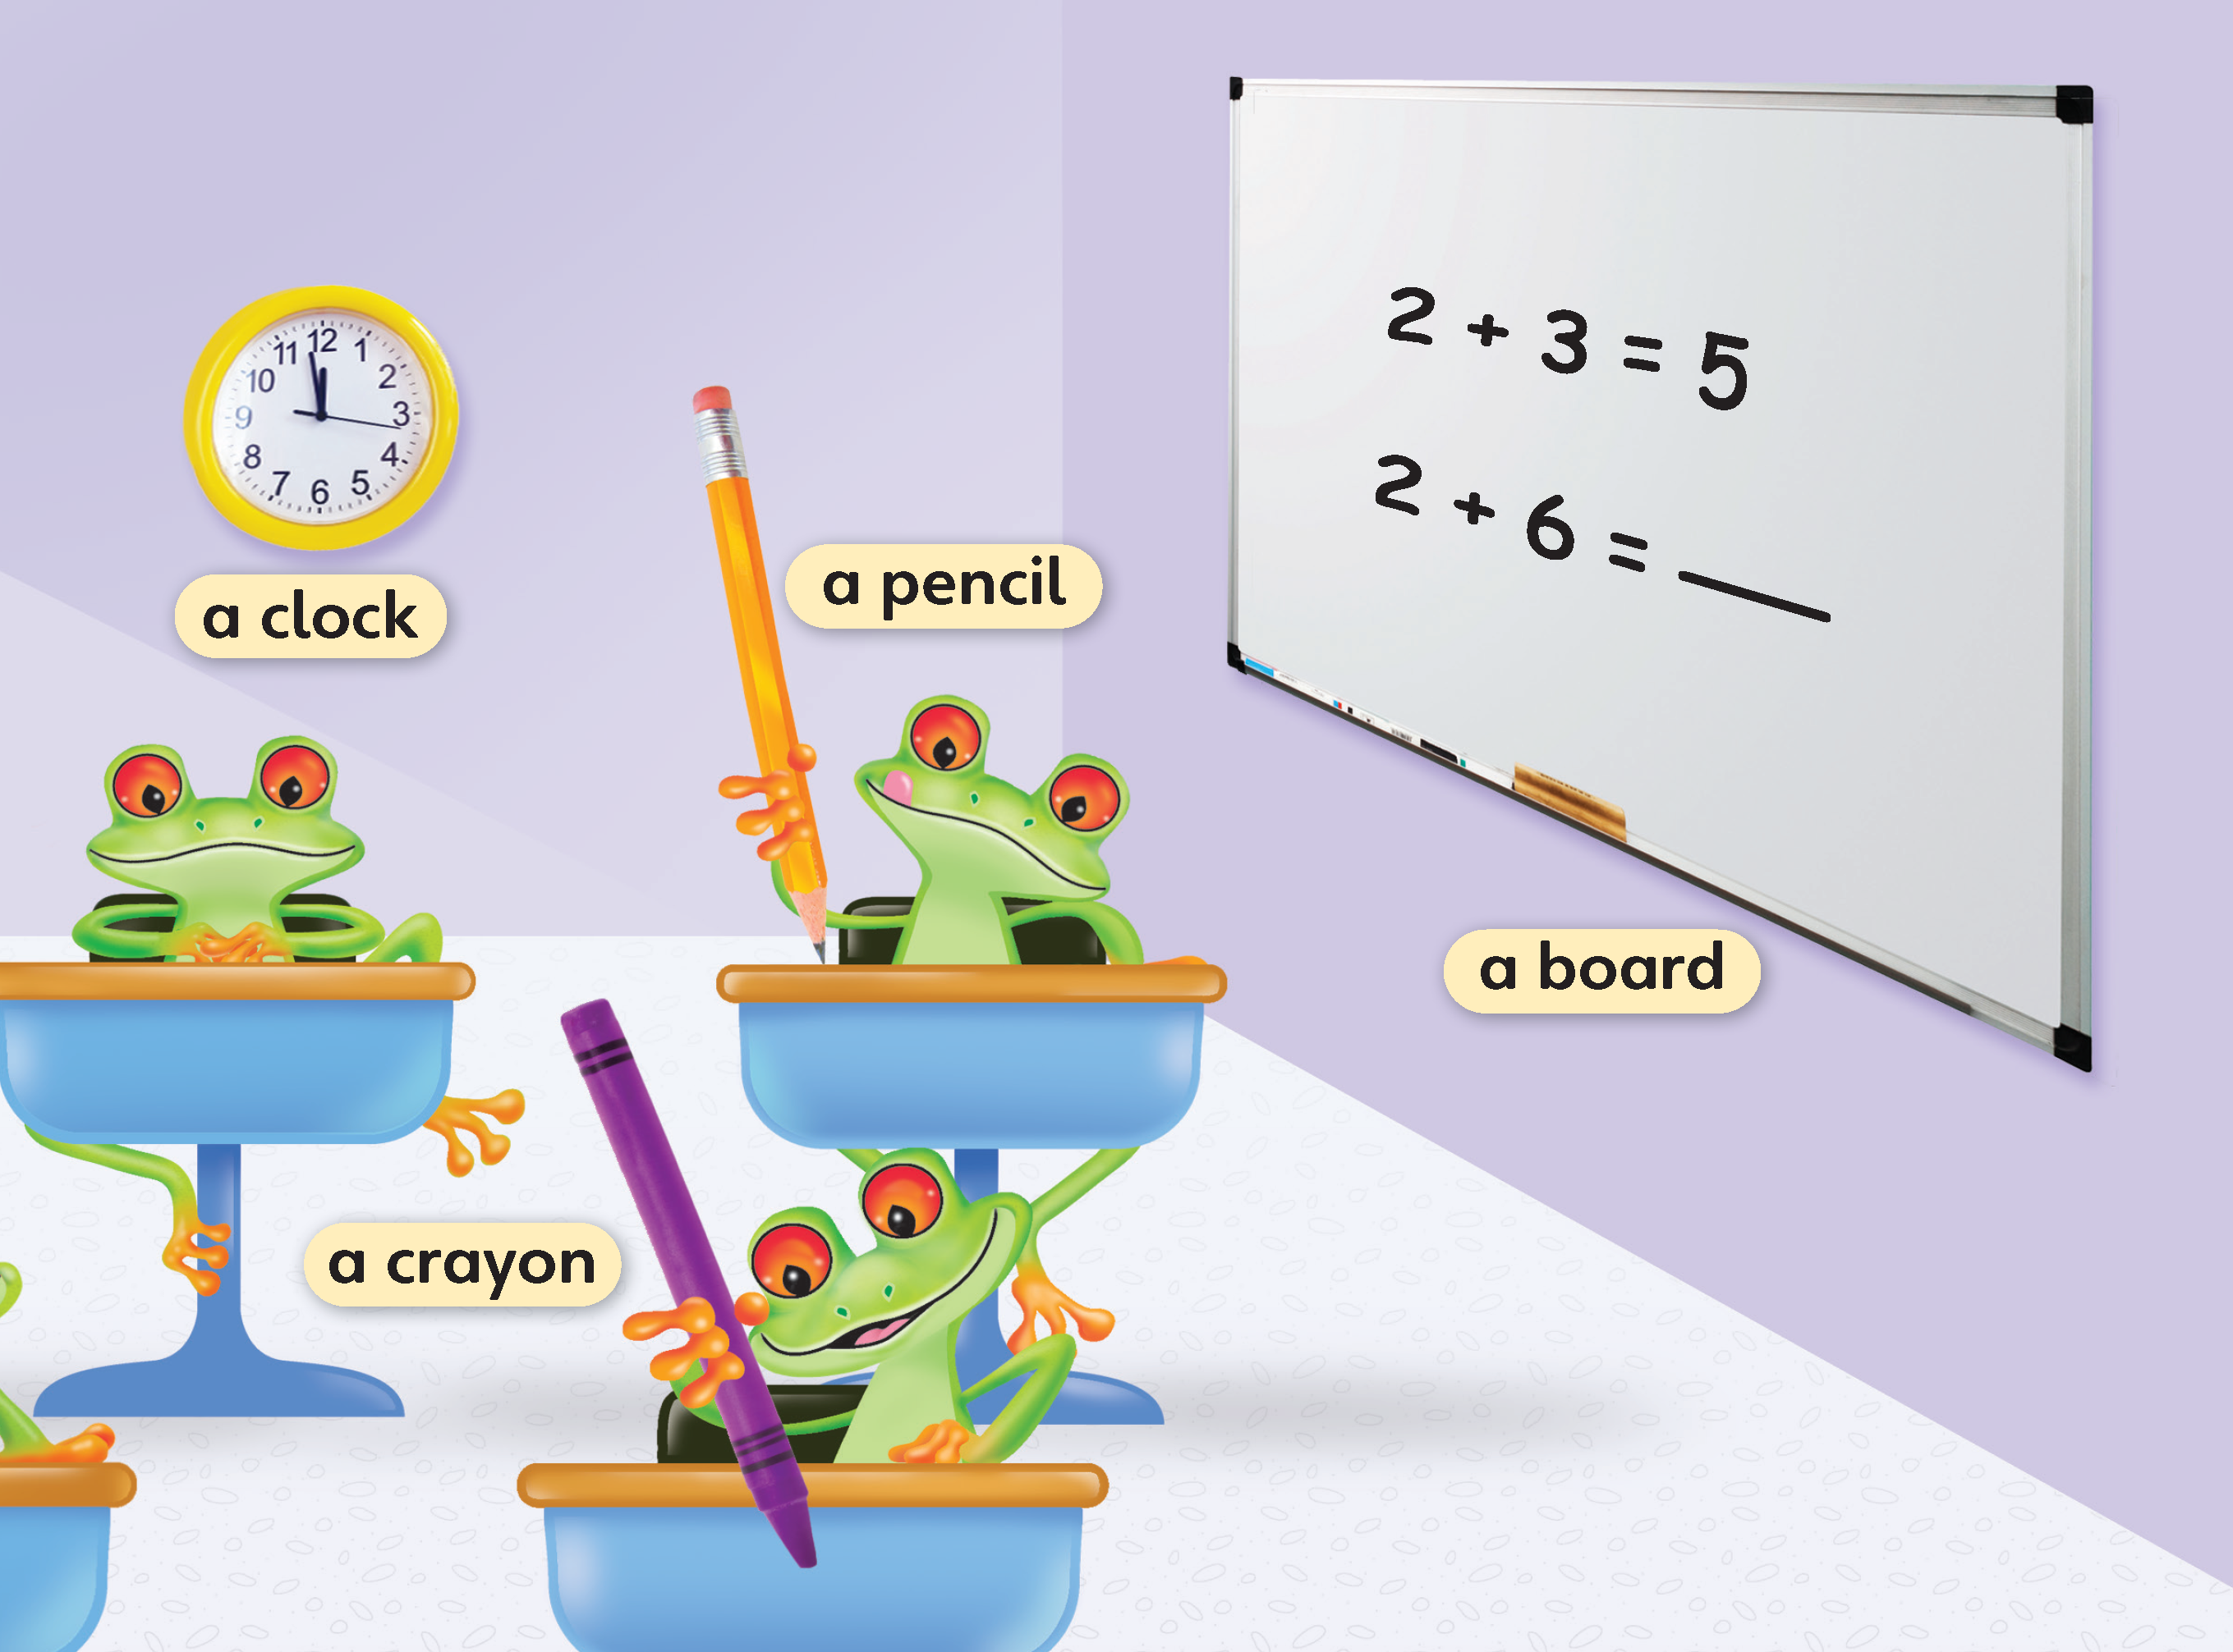
1
Look and listen. Repeat.
TR: A30

Slide 13

a clock
/ə/ /klɒk/

Slide 14
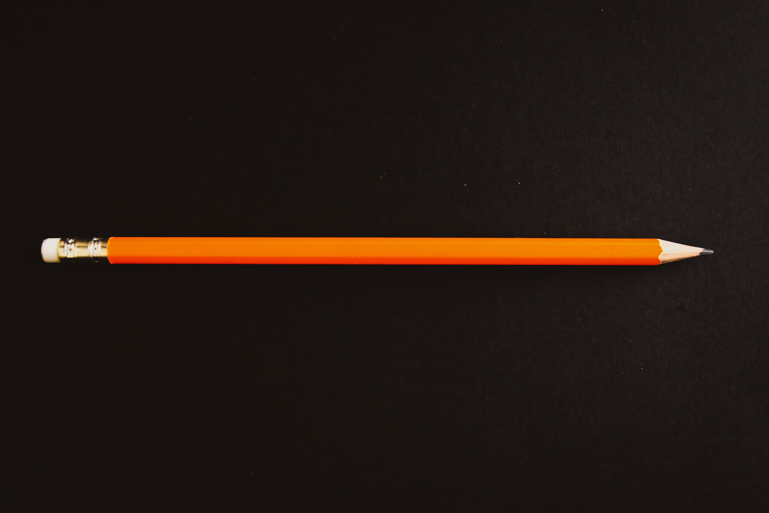
a pencil
/ə/ /ˈpensl/

Slide 15
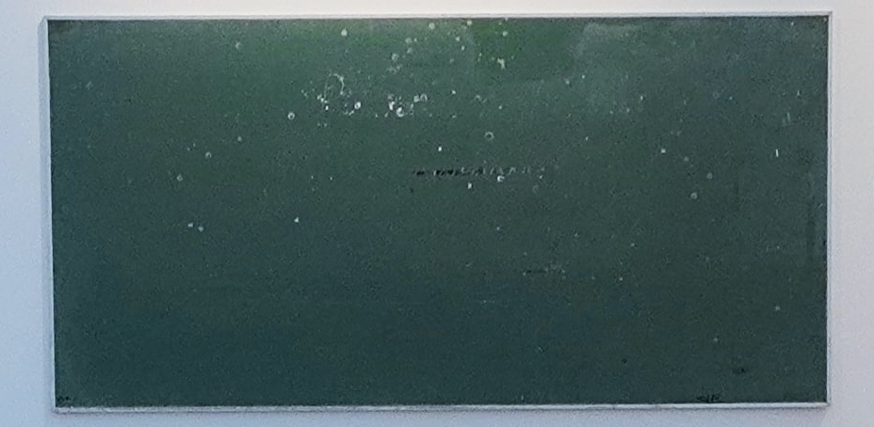
a board
/ə/ /bɔːrd/

Slide 16
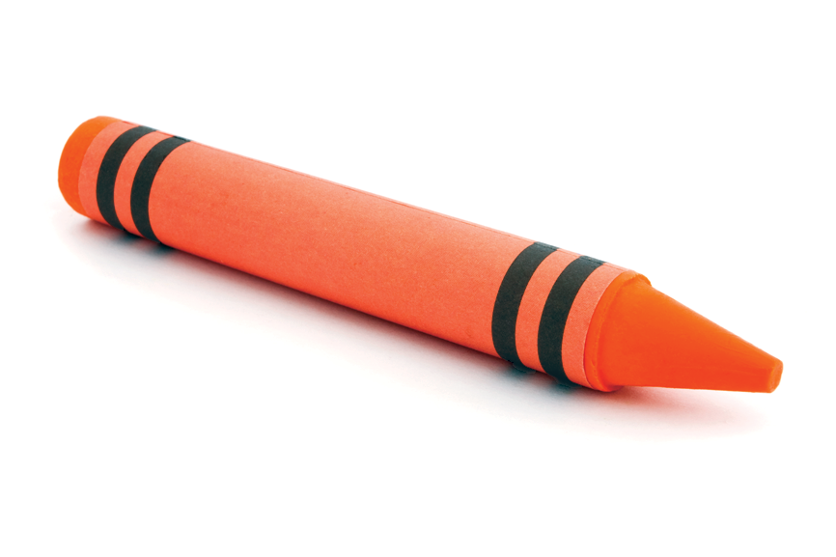
a crayon
/ə/ /ˈkreɪɑːn/

Slide 17
2
Listen and point. Say.
TR: A31

Slide 18
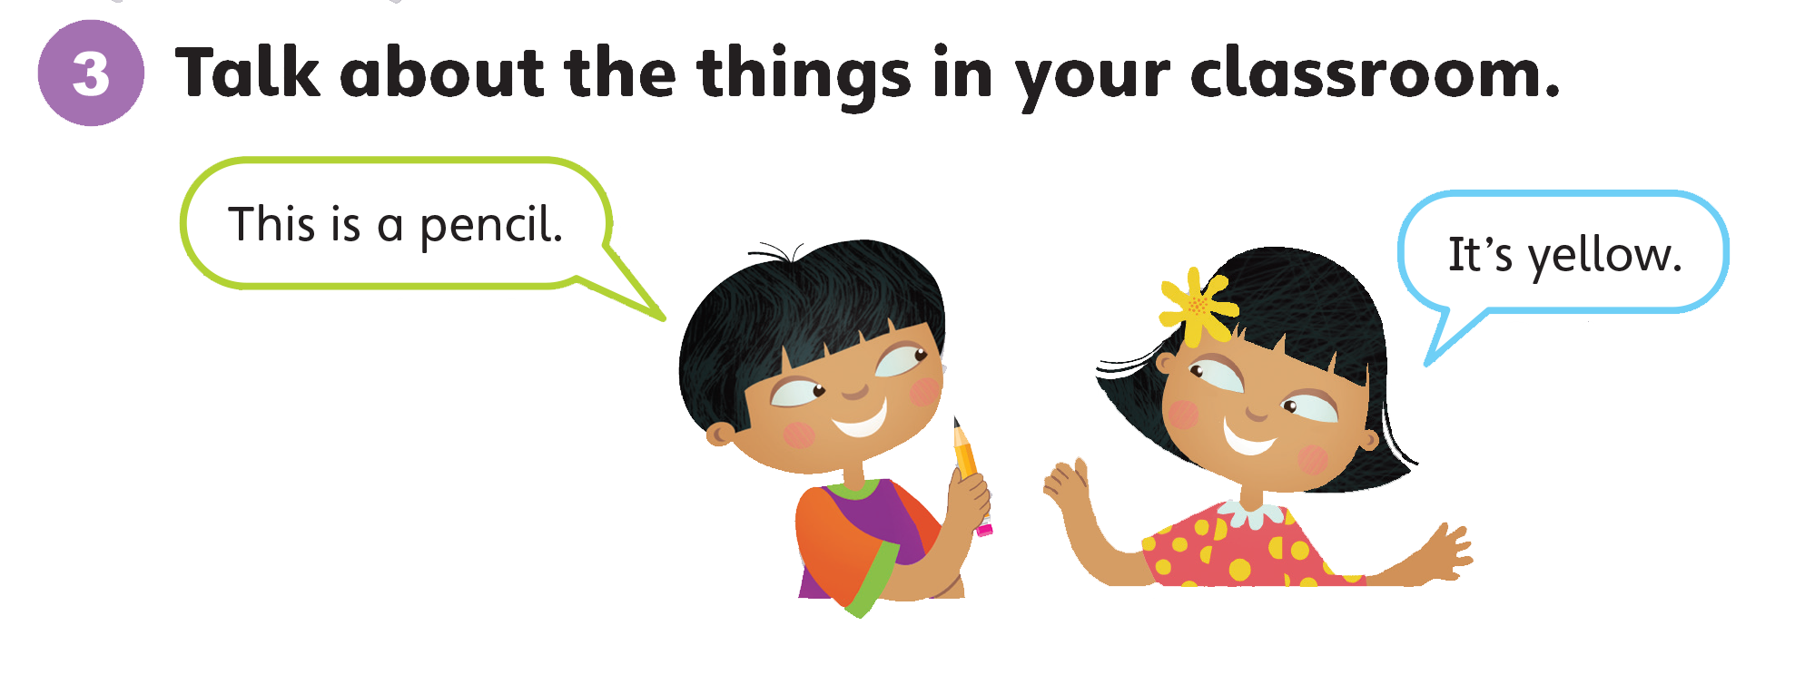

Slide 19
Unit 1:
My Classroom
Lesson 3

Slide 20
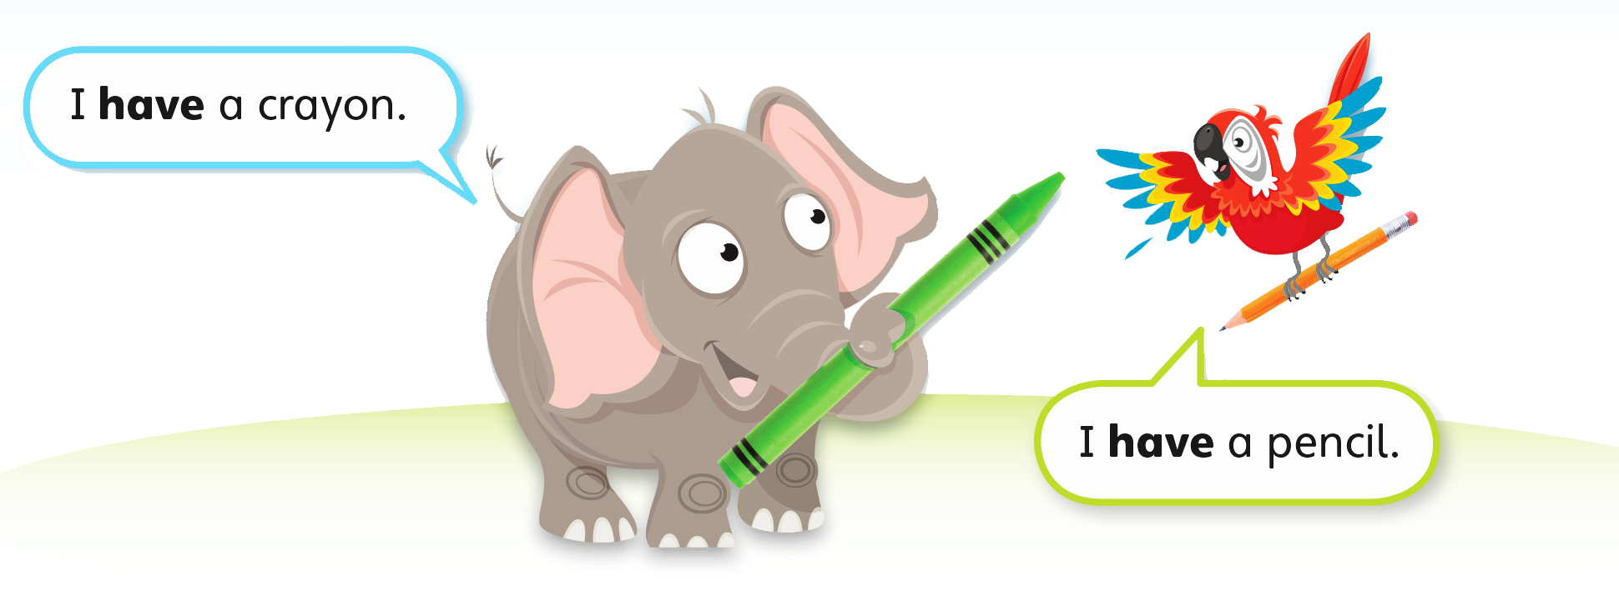
1
Look and listen. Repeat. TR: A32

Slide 21
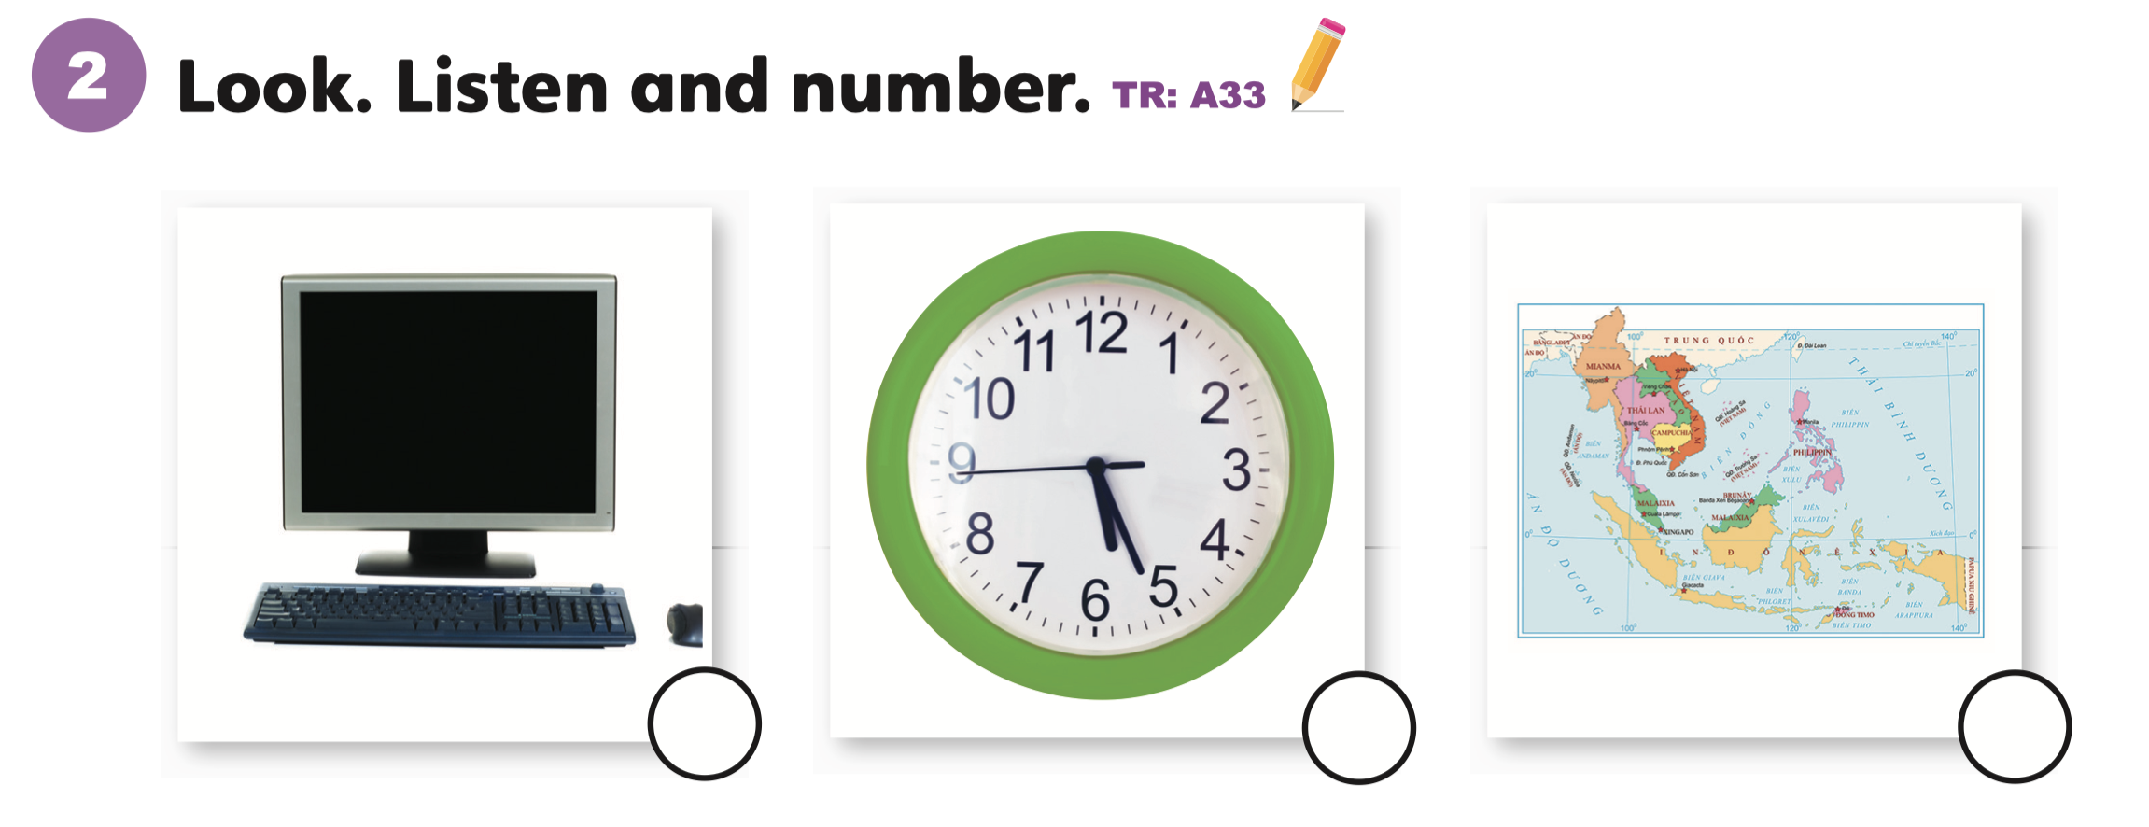
2
1
3

Slide 22
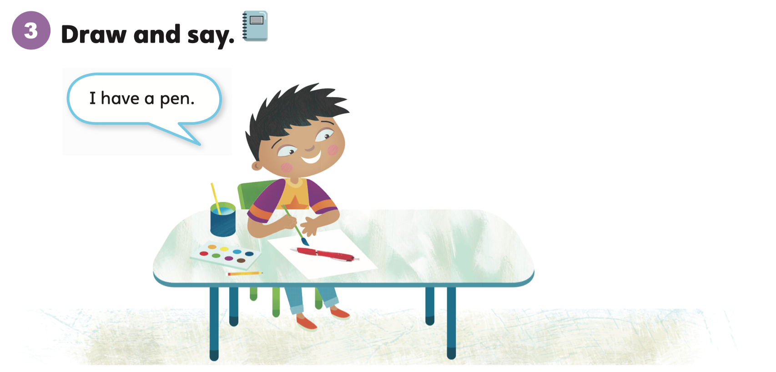

Slide 23
Unit 1:
My Classroom
Lesson 4

Slide 24
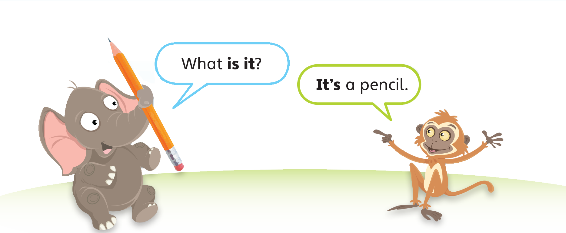
1
Look and listen. Repeat. TR: A34

Slide 25
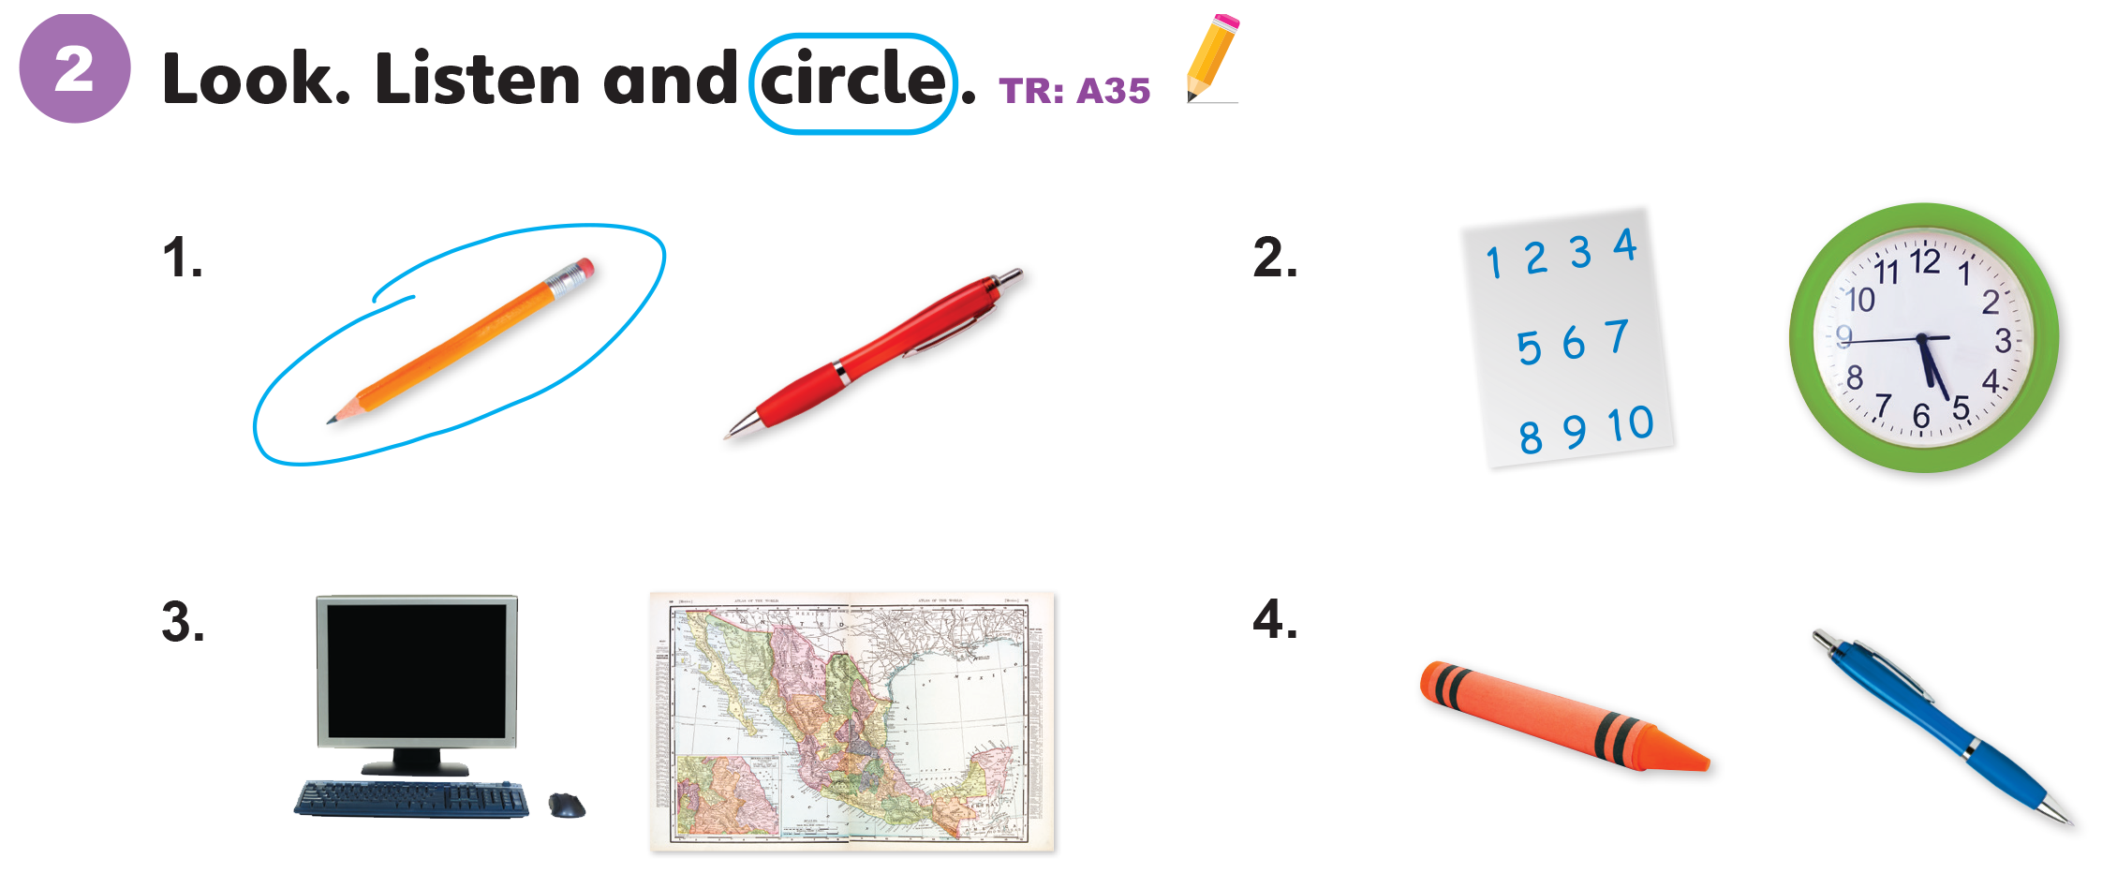

Slide 26
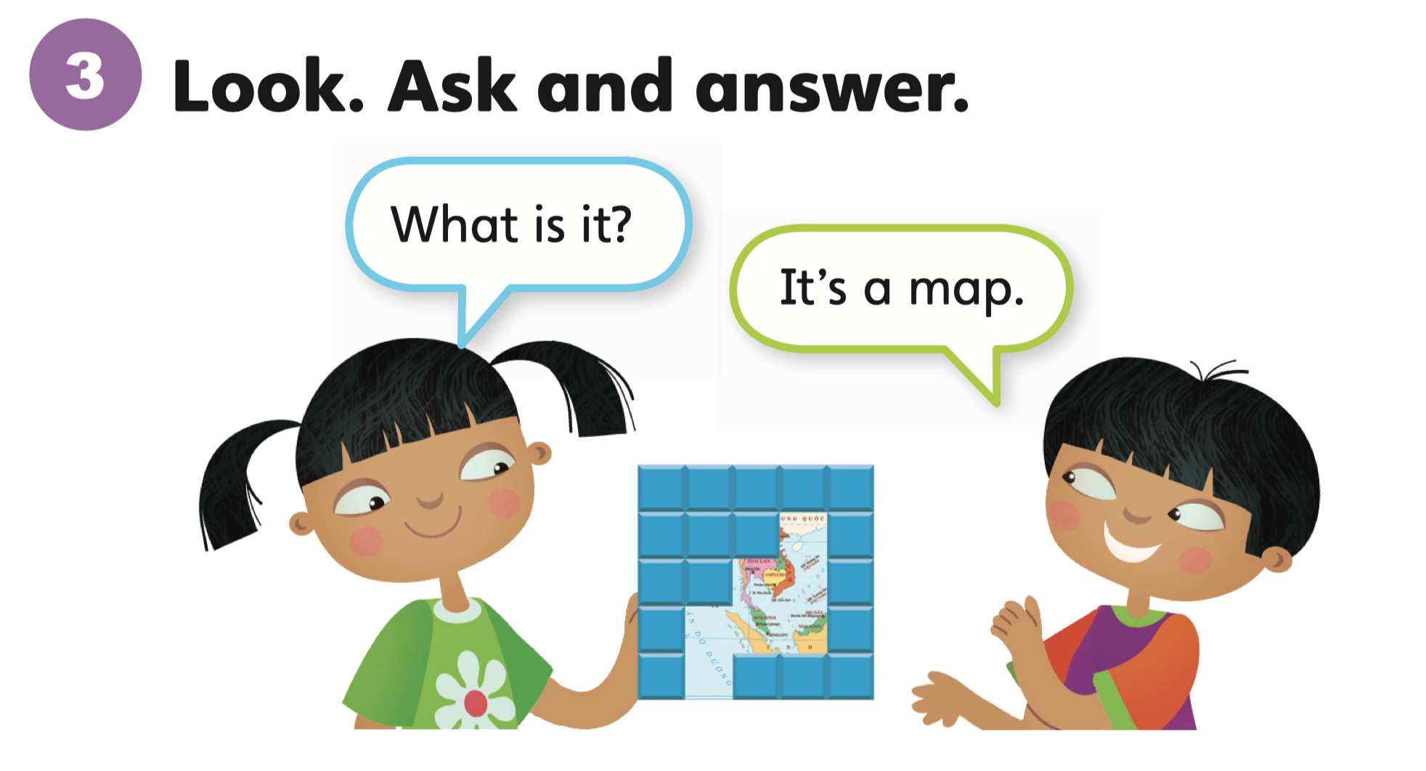

Slide 27

What is it?
It’s a _____.

Slide 28
Unit 1:
My Classroom
Lesson 5

Slide 29
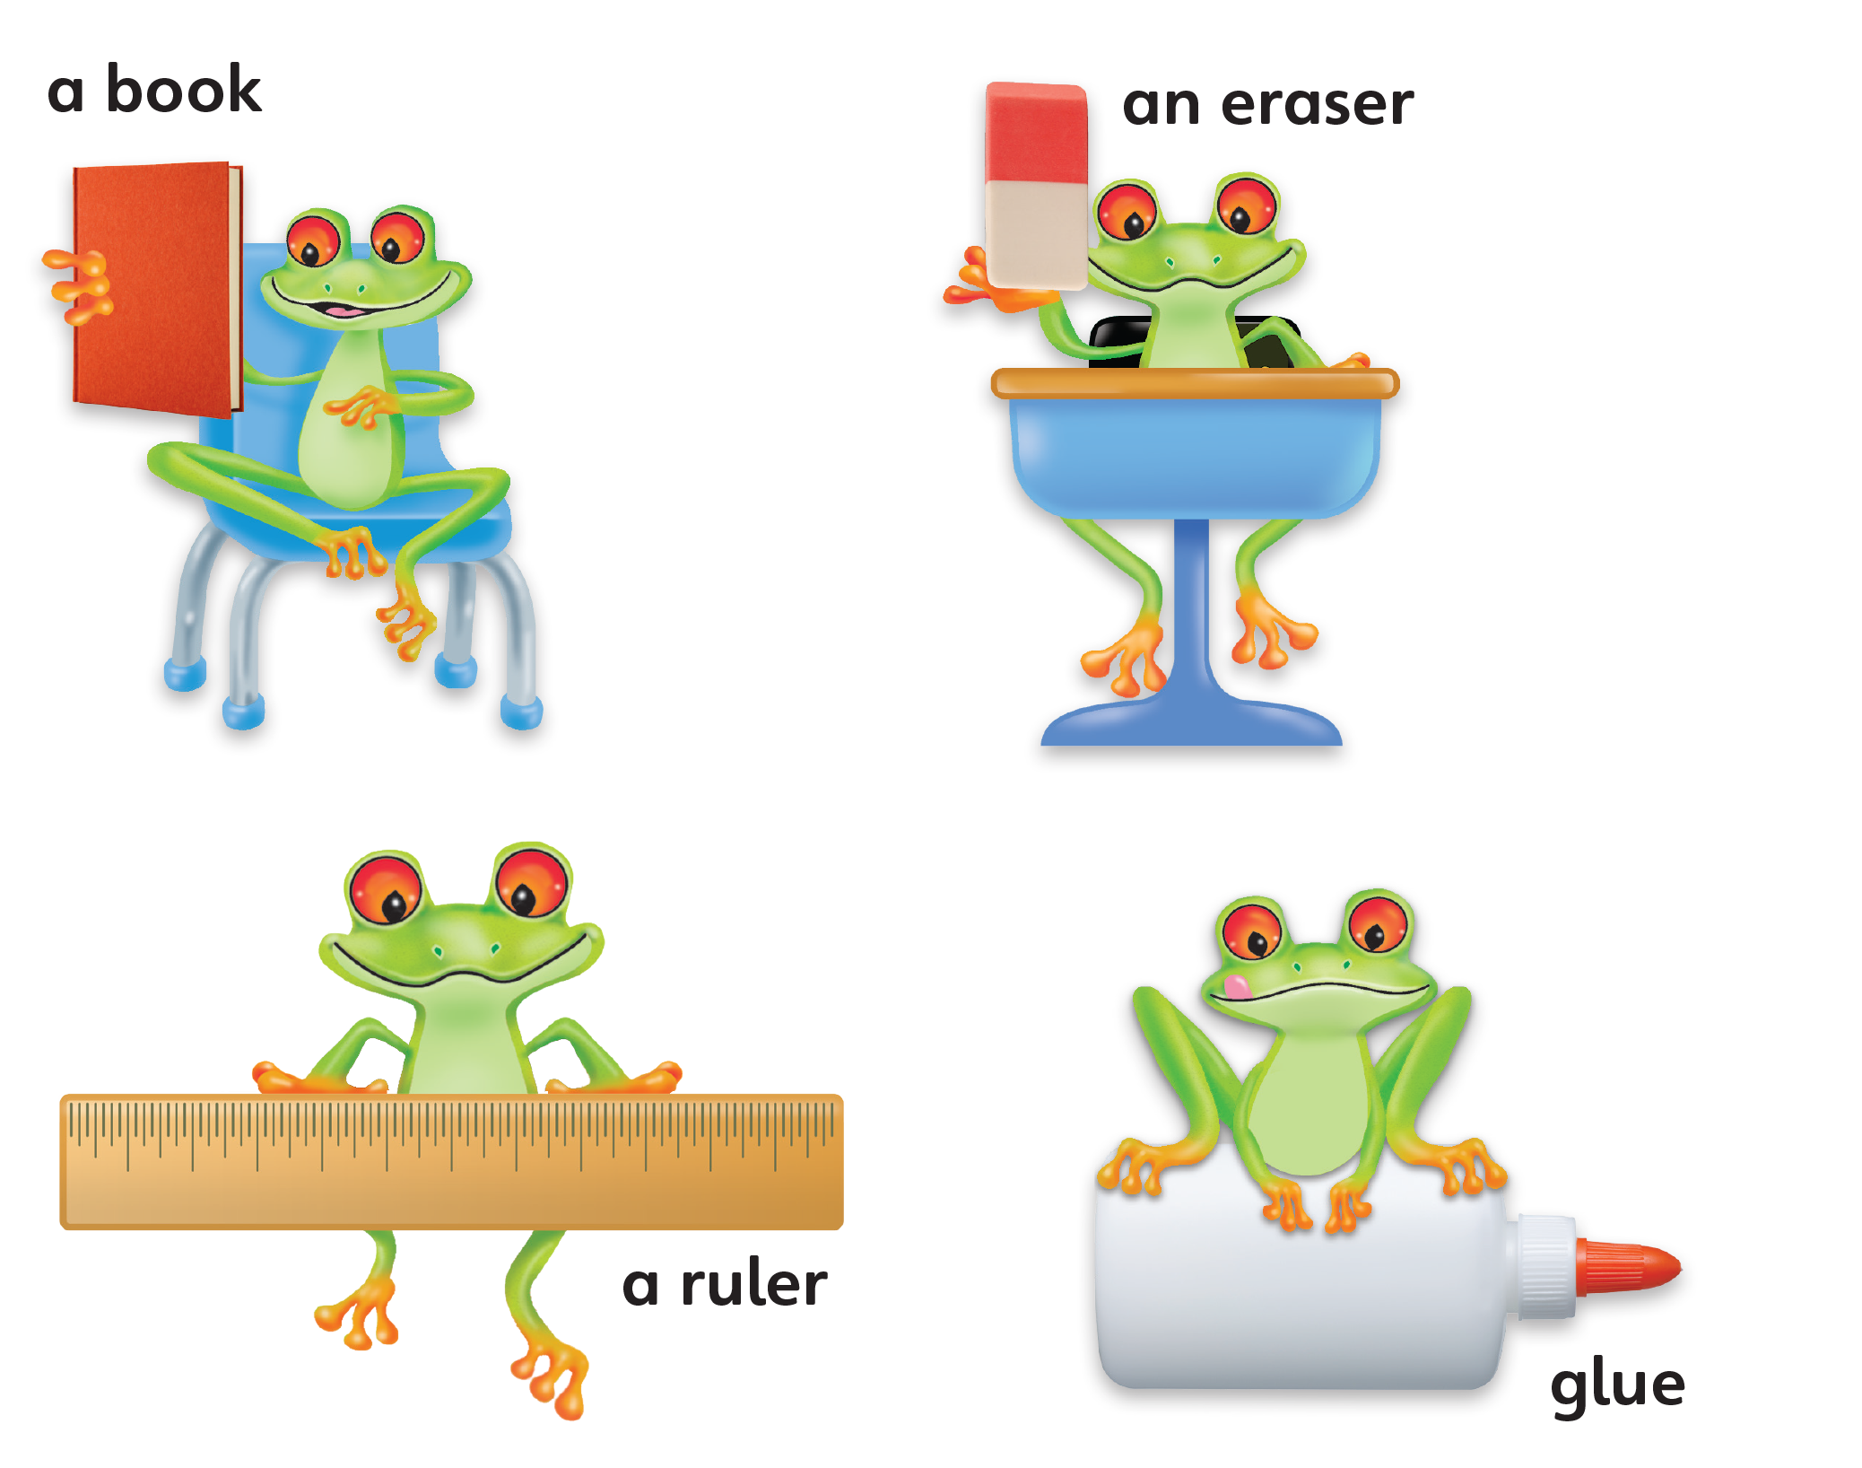
1
Look and listen. Repeat. TR: A36

Slide 30

a book
/ə/ /bʊk/

Slide 31

an eraser
/æn/ /ɪˈreɪsər/

Slide 32

a ruler
/ə/ /ˈruːlər/

Slide 33
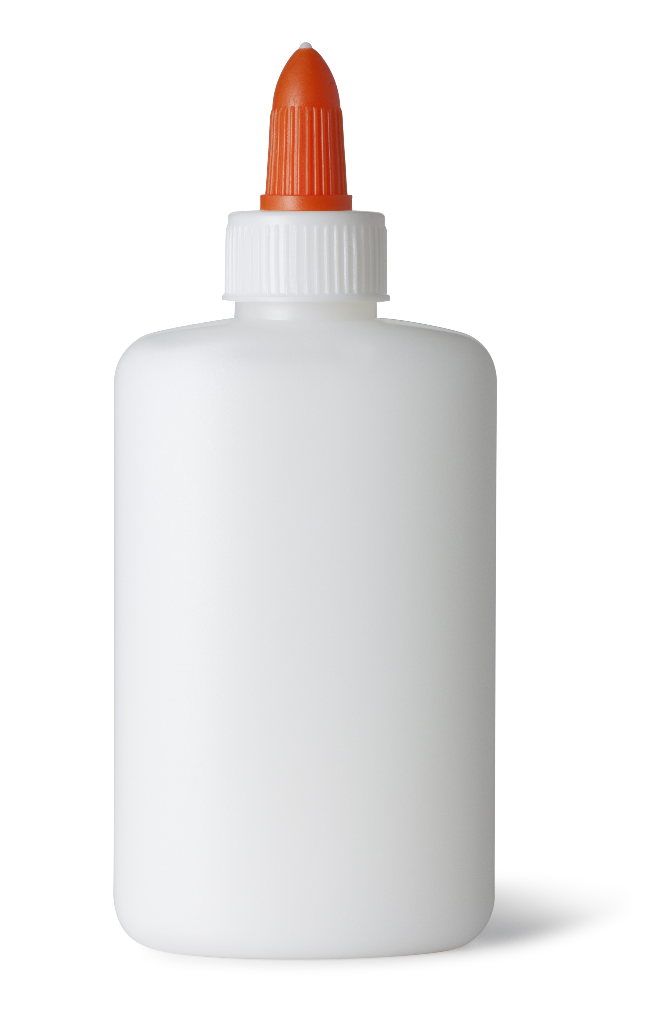
glue
/ɡluː/

Slide 34
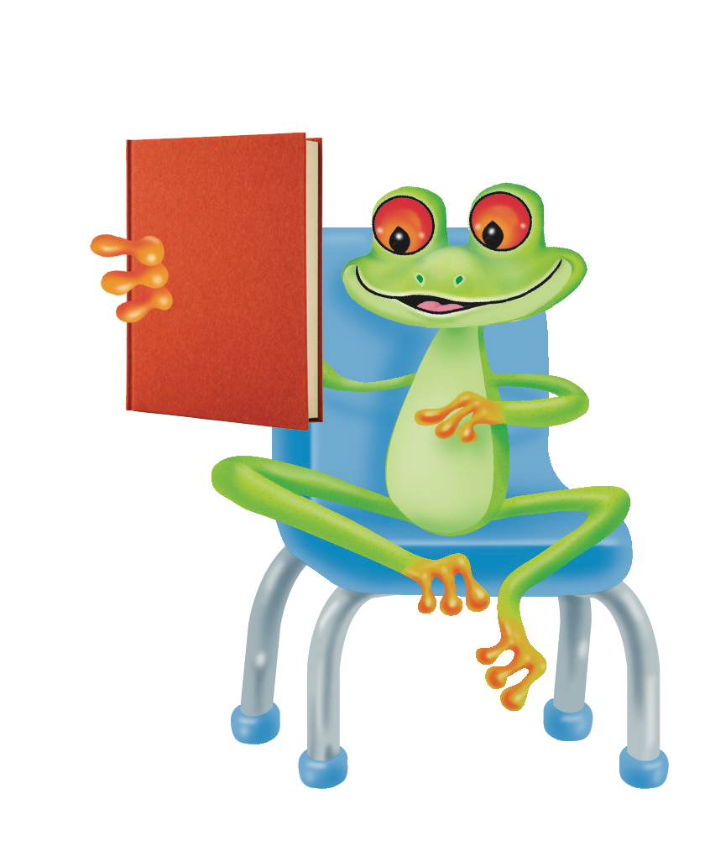

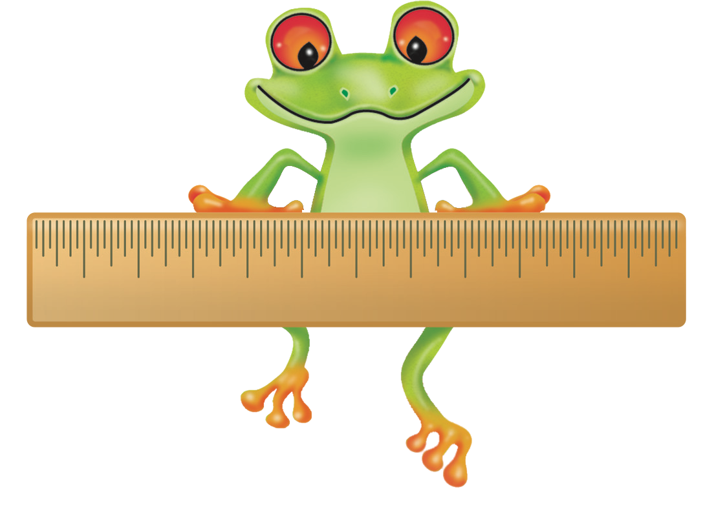

2
Point and say.
a book
an eraser
a ruler
glue

Slide 36
Unit 1:
My Classroom
Lesson 6

Slide 37
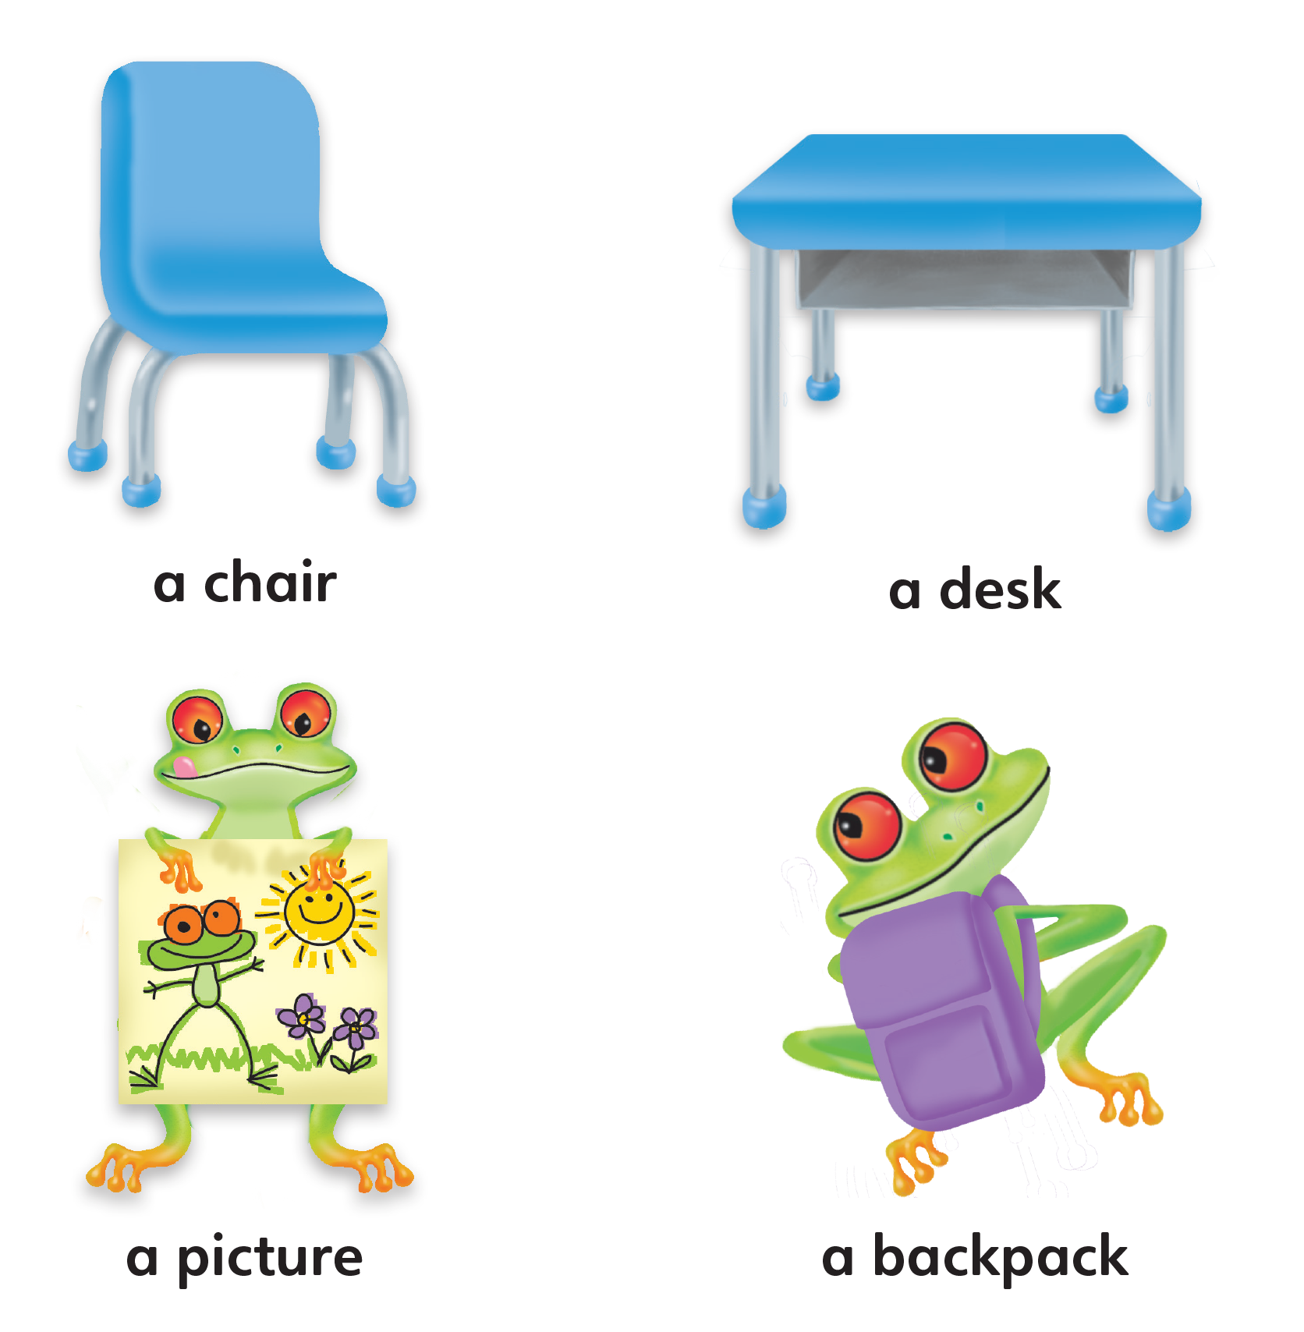
1
Look and listen. Repeat. TR: A37

Slide 38
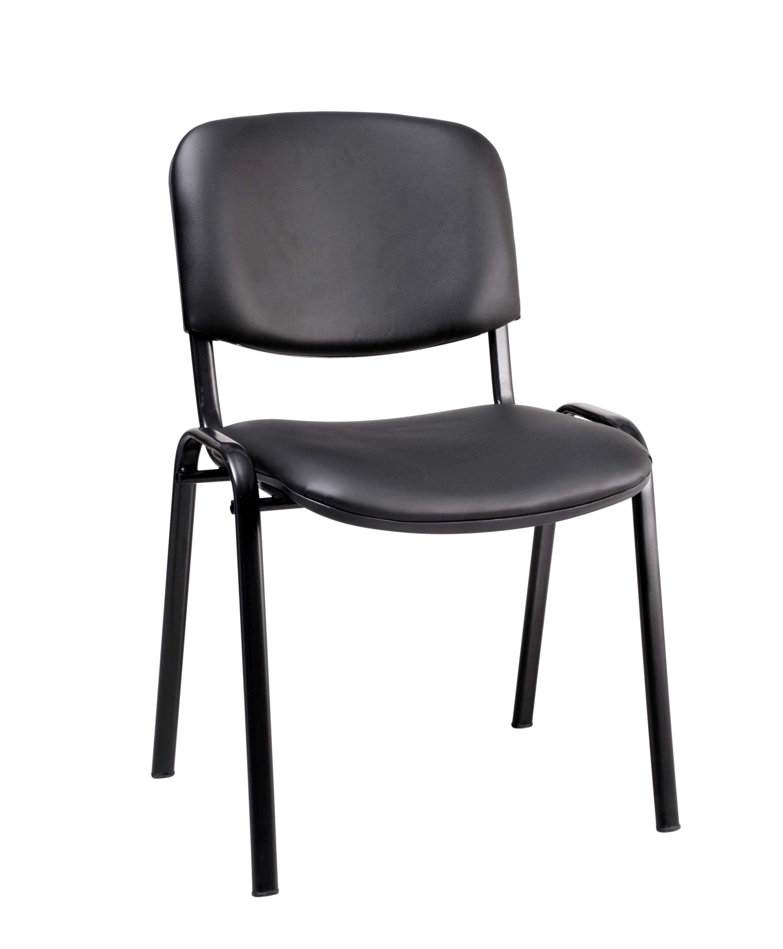
a chair
/ə/ /tʃer/

Slide 39
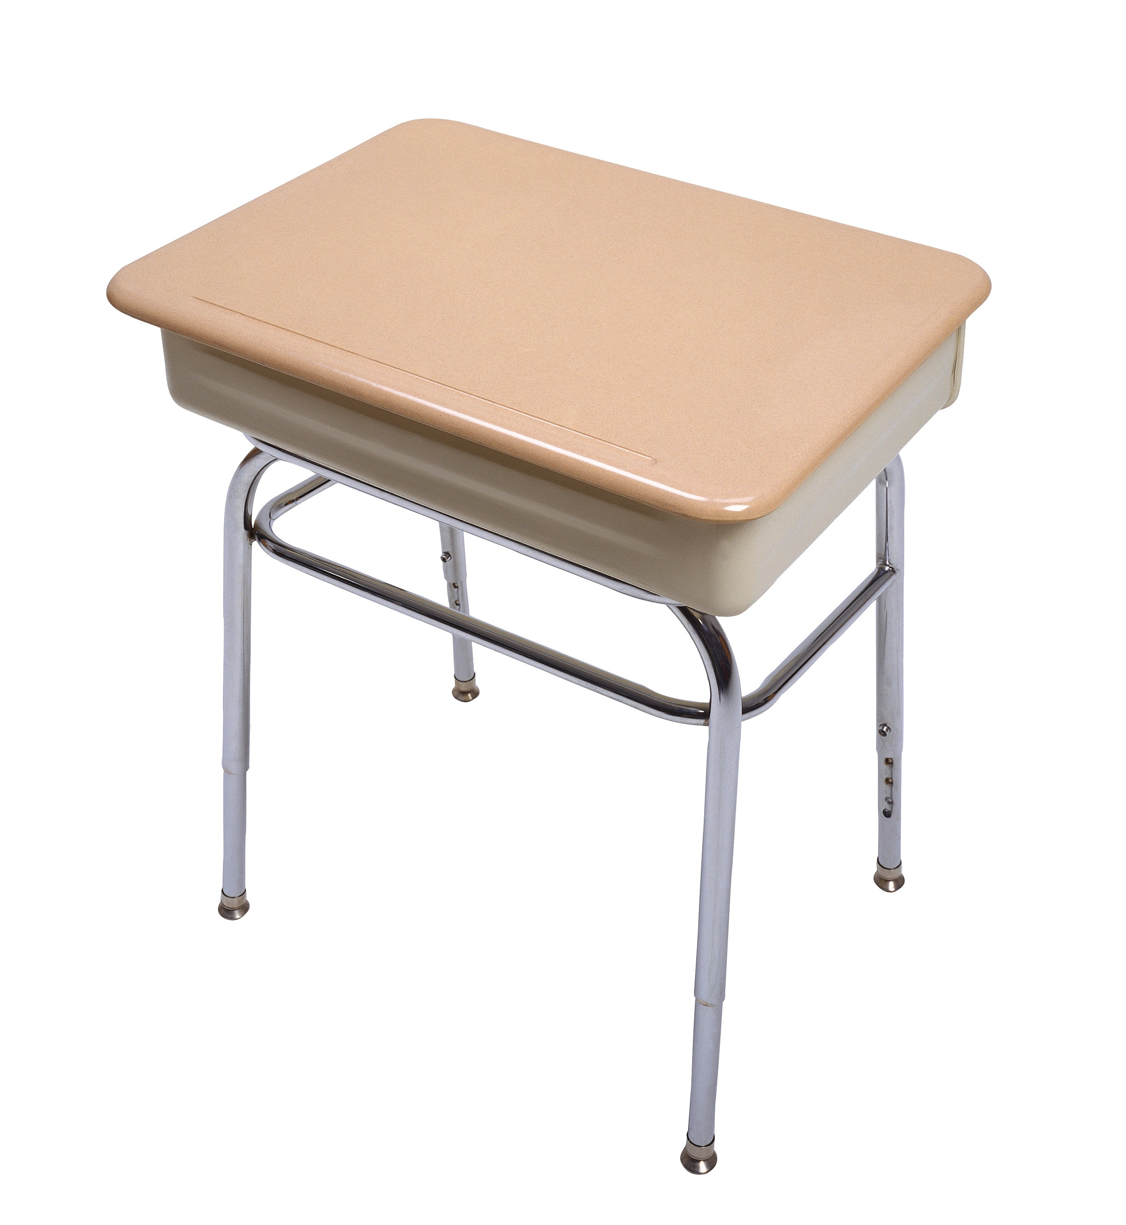
a desk
/ə/ /desk/

Slide 40
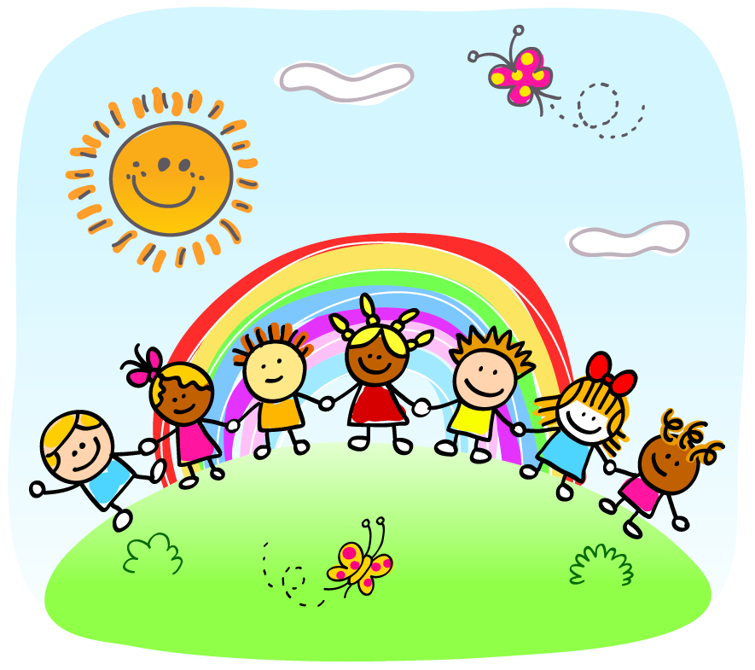
a picture
/ə/ /ˈpɪktʃər/

Slide 41
a backpack
/ə/ /ˈbækpæk/

Slide 42
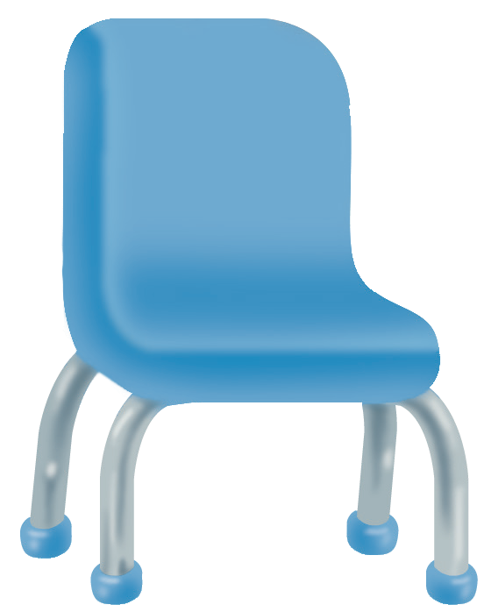
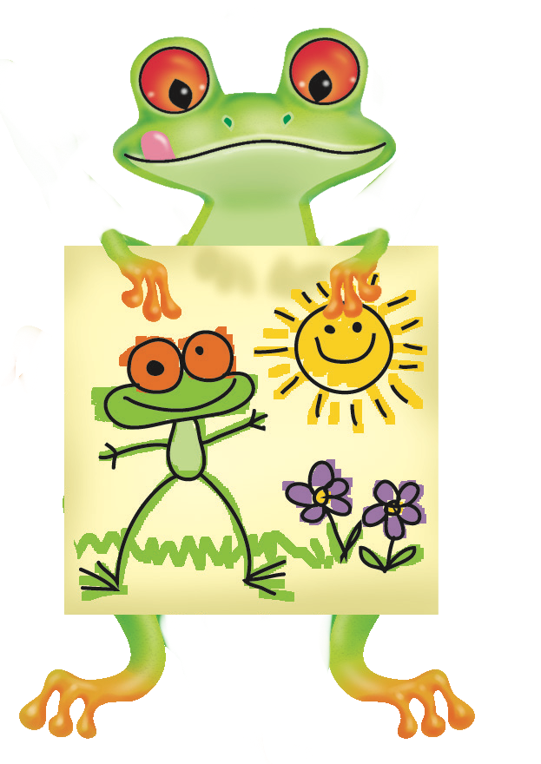

2
Point and say.
a chair
a desk
a picture
a backpack

Slide 44
Unit 1:
My Classroom
Lesson 7

Slide 45
1
Look and listen. Repeat. TR: A38

Slide 48
Unit 1:
My Classroom
Lesson 8

Slide 49
1
Look and listen. Repeat. TR: A40

Slide 50
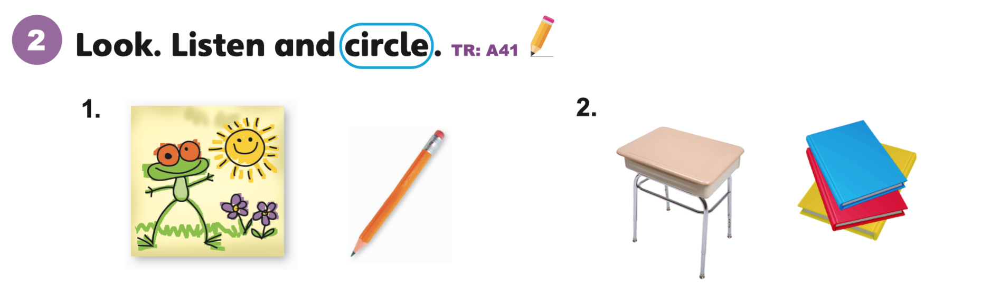

Slide 51
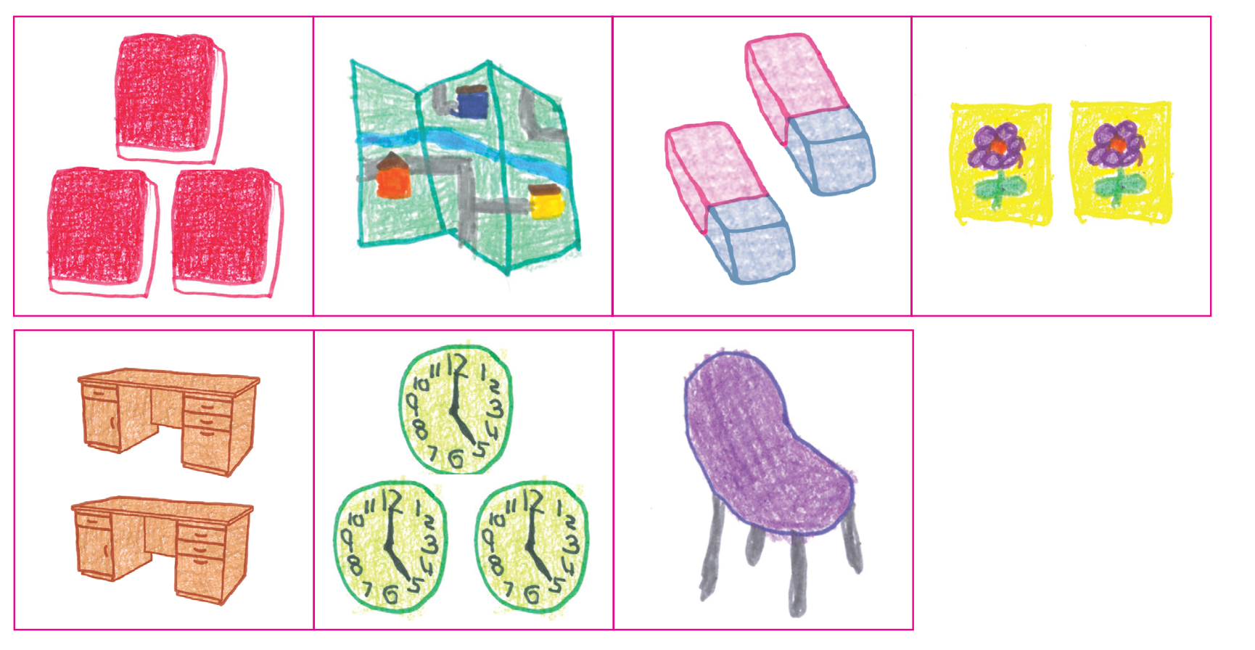

Slide 52
Unit 1:
My Classroom
Lesson 9

Slide 53
1
Listen and repeat. TR: A42
oo
  school
  too

Slide 54
2
Listen and sing. TR: A43
This is my school.
This is your school.
This is my school.
I like my school.

Slide 55
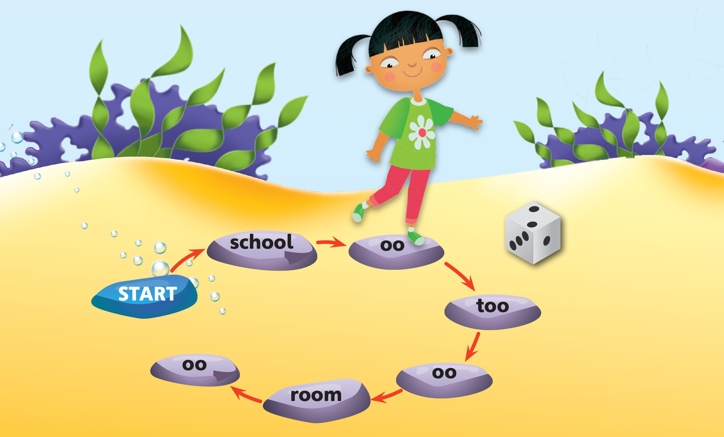
3
Play the game: Stepping Stones.

Slide 56
Unit 1:
My Classroom
Lesson 10

Slide 57
1
Listen and repeat. TR: A44
p
b
  pen
  paper
book
  bye

Slide 58
2
Listen and chant. TR: A45
I have my red backpack,
and I have my board.
I have glue and paper.
Come and look!
I have my computer,
and I have my pen.
I have books and pencils.
Come and look!

Slide 59
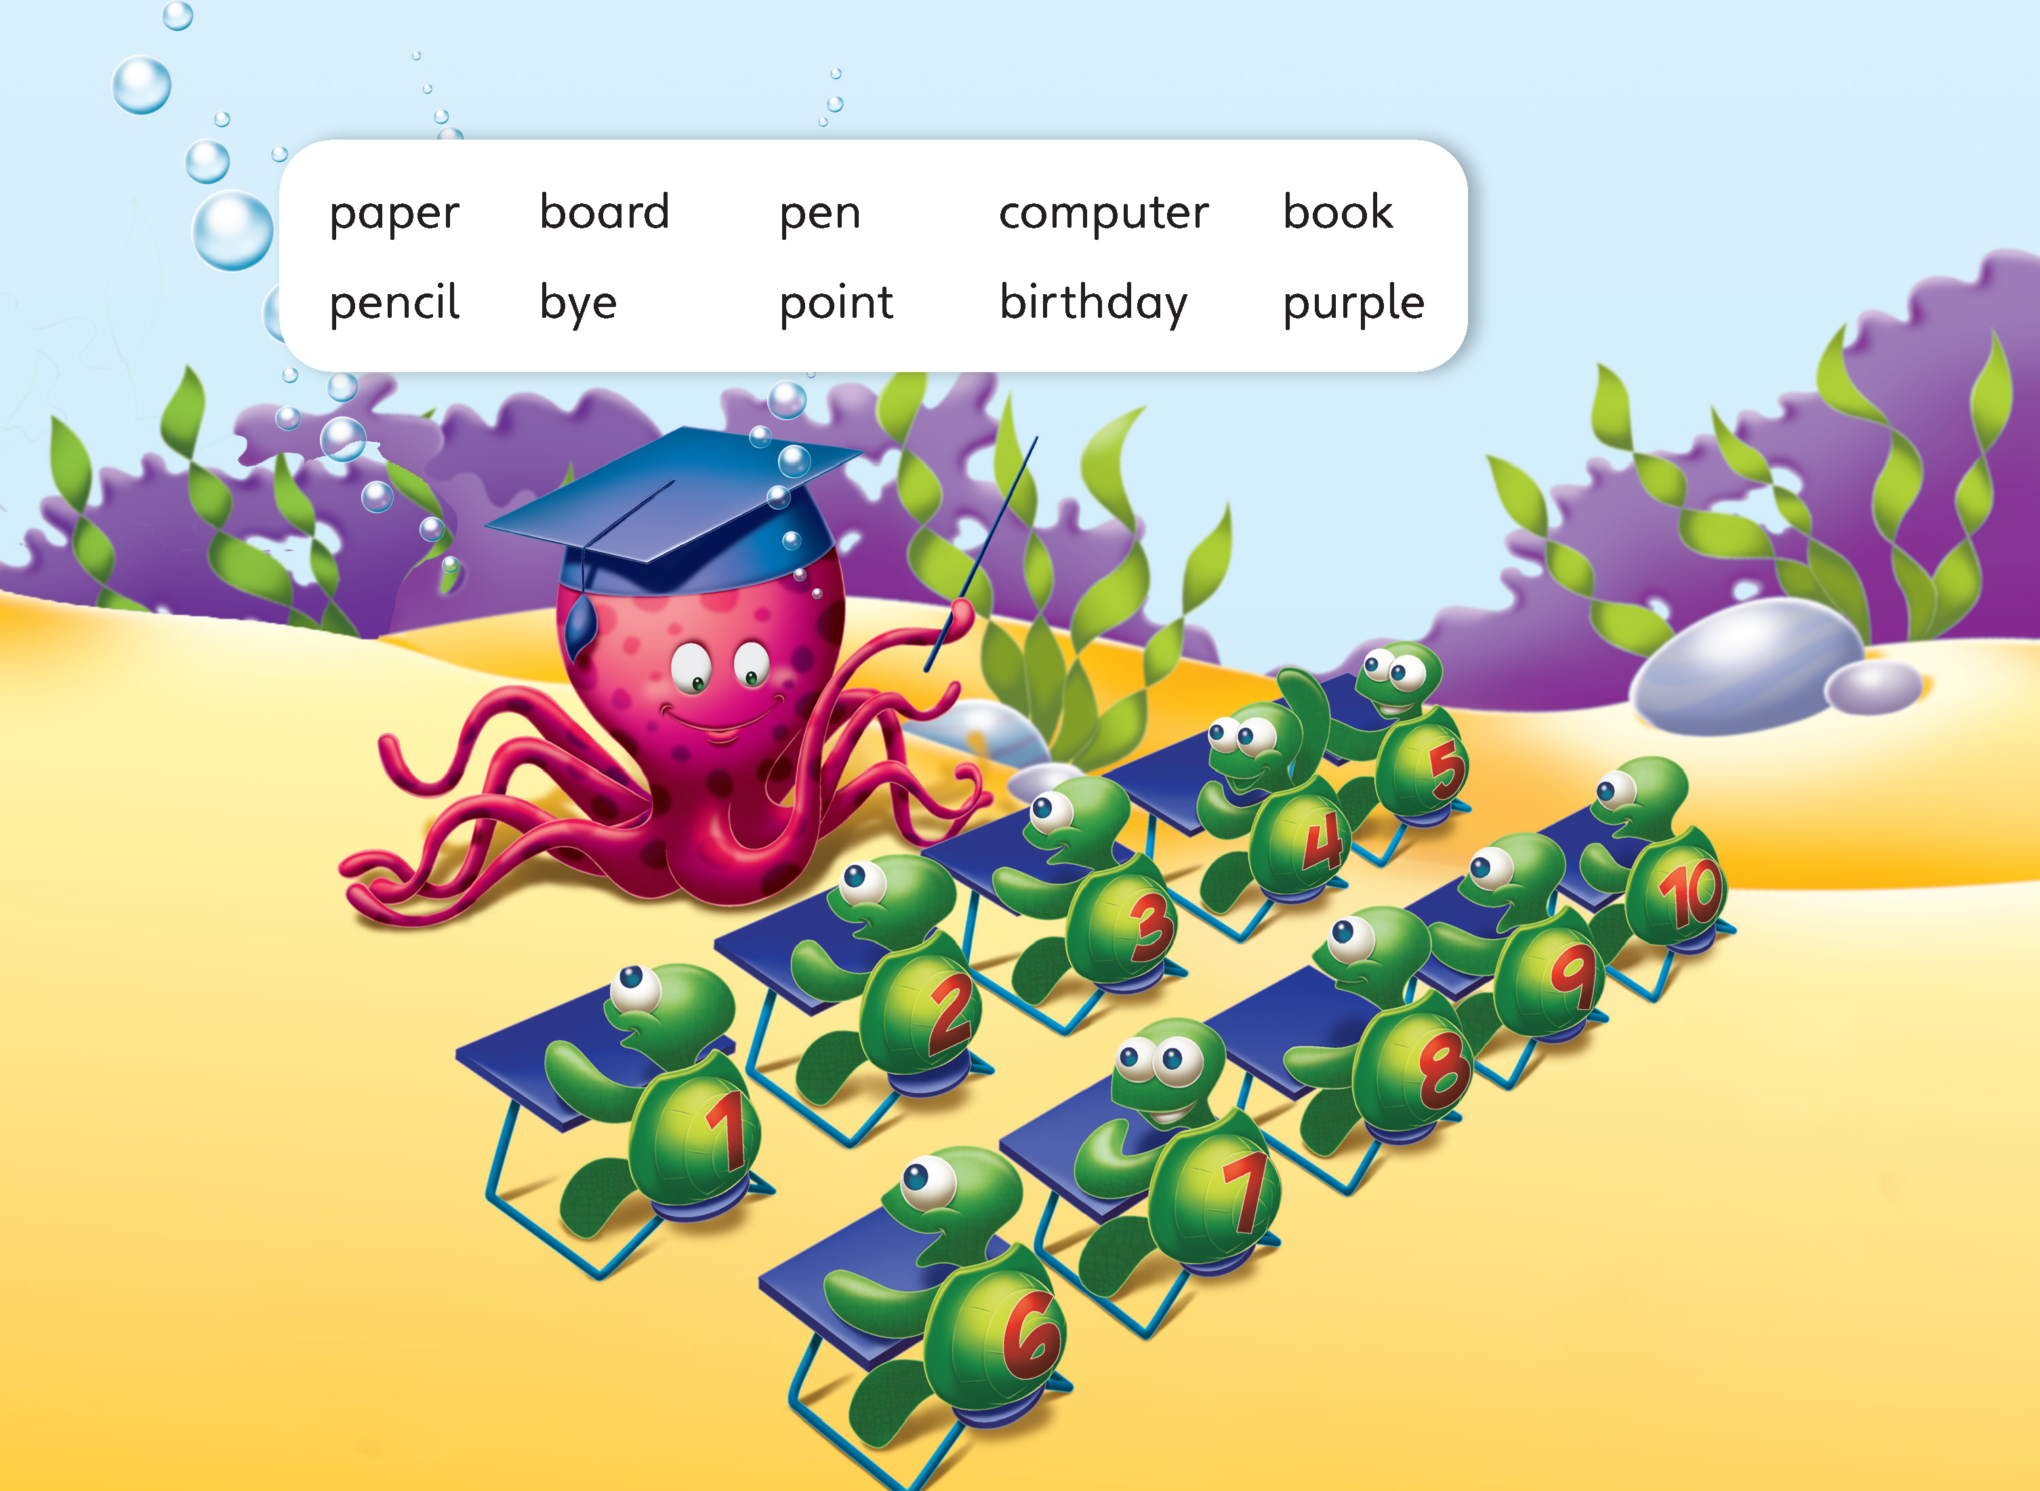
3
Play the game: Bingo. Use the words in the box.

Slide 60
Unit 1:
My Classroom
Lesson 11

Slide 61
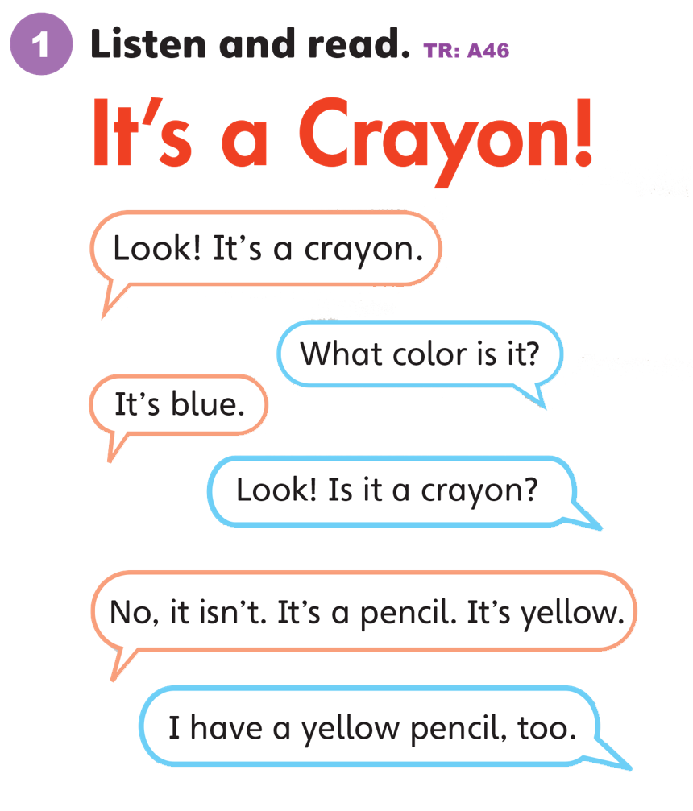

Slide 62
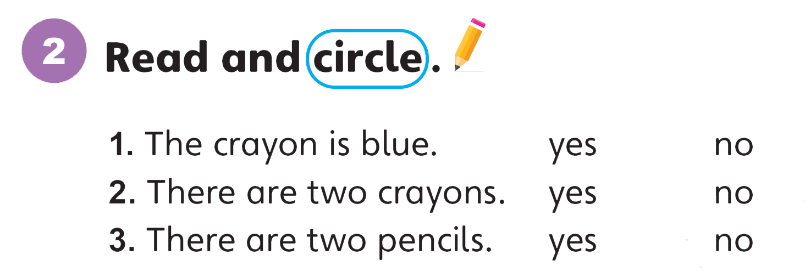

Slide 63
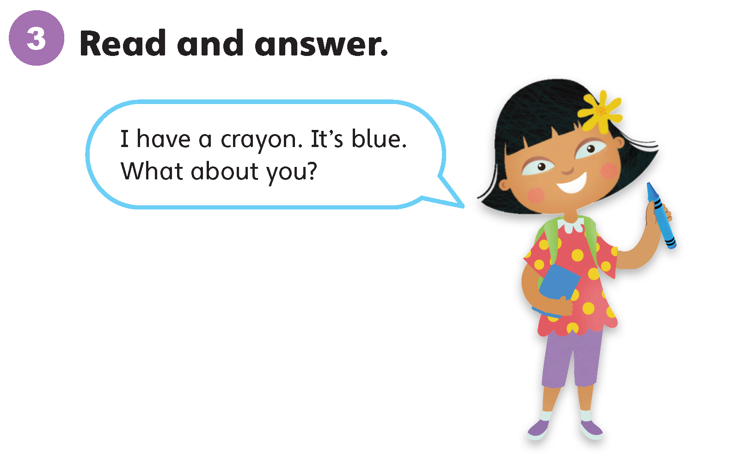

Slide 64
Unit 1:
My Classroom
Lesson 12

Slide 65
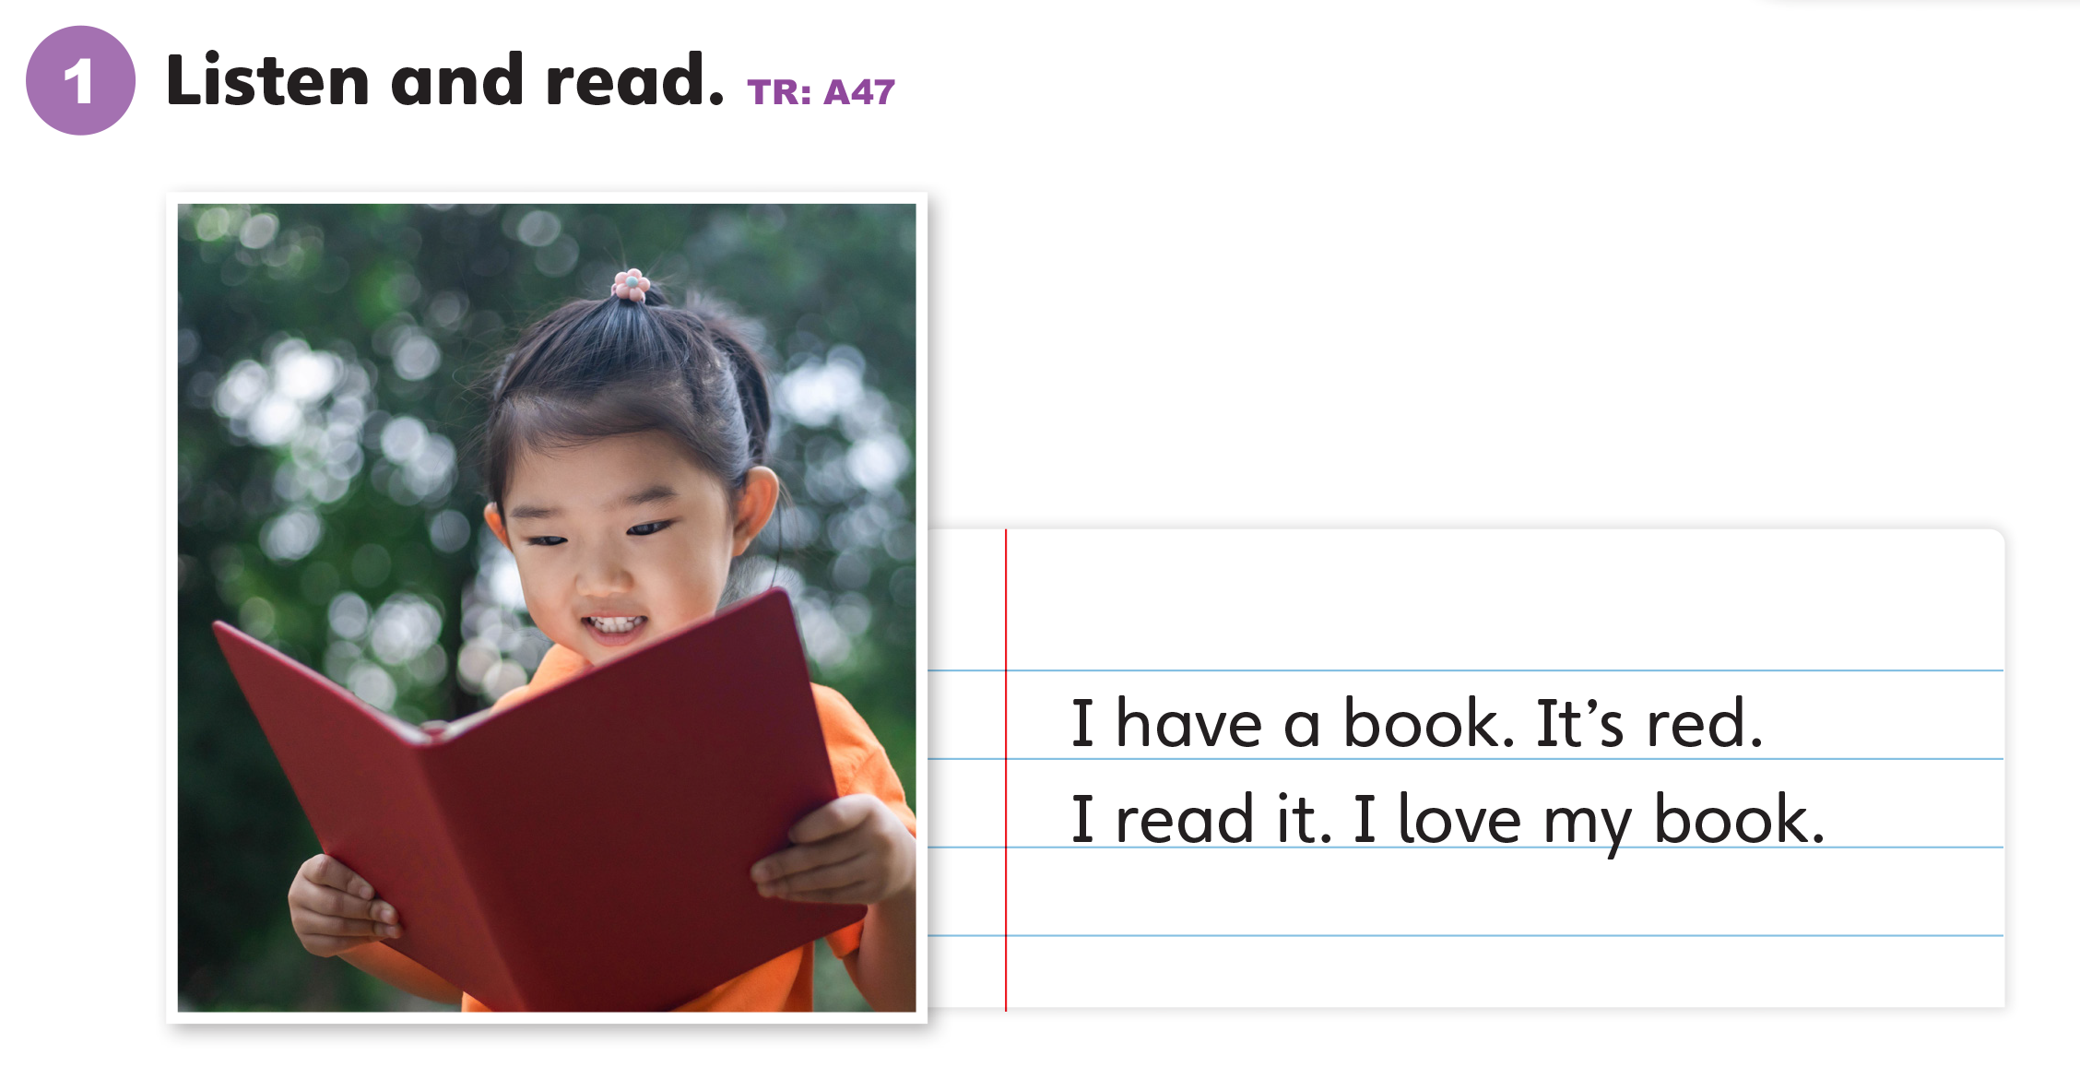

Slide 66
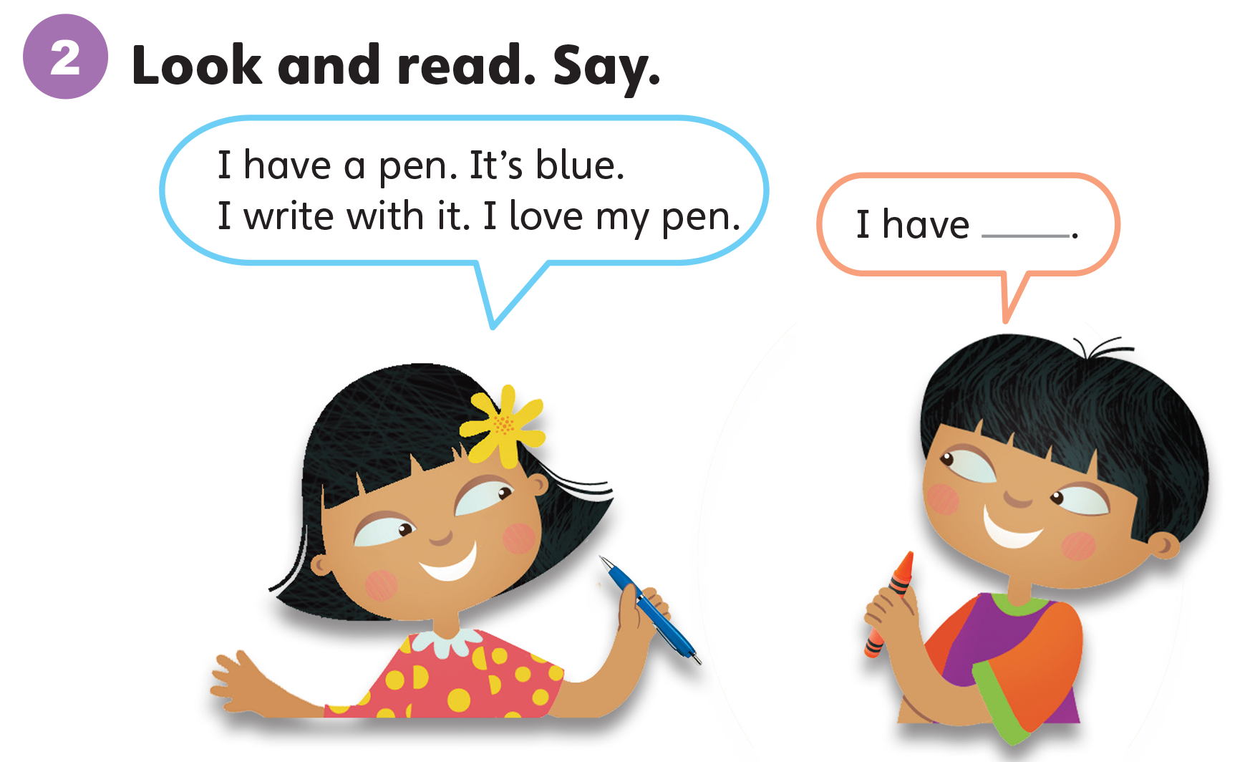

Slide 67
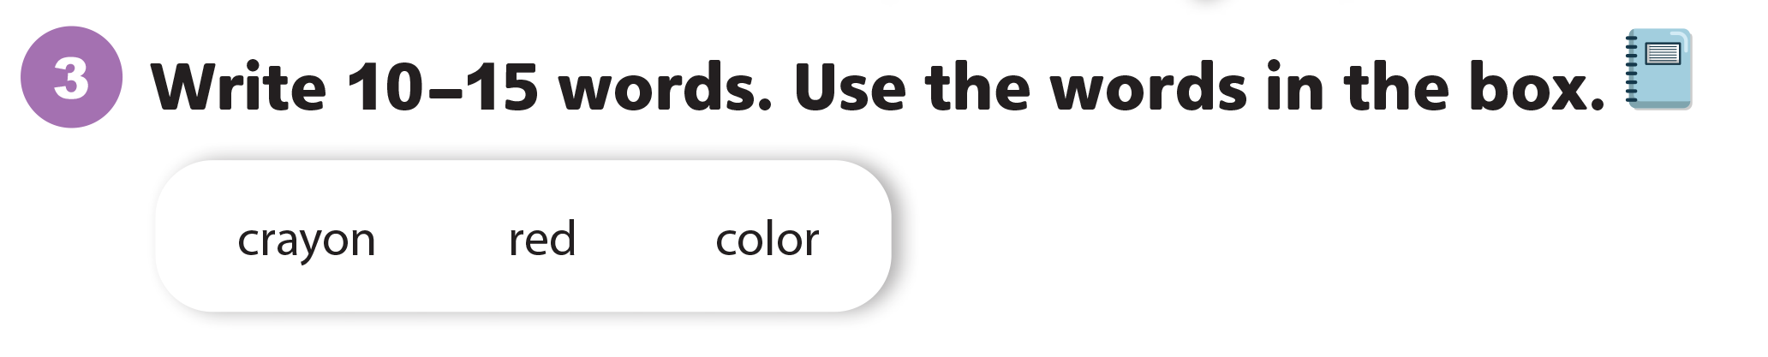
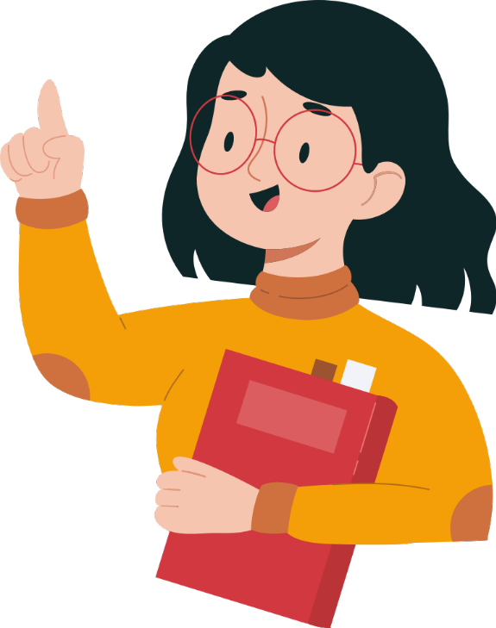

Slide 68
Unit 1:
My Classroom
Value

Slide 69
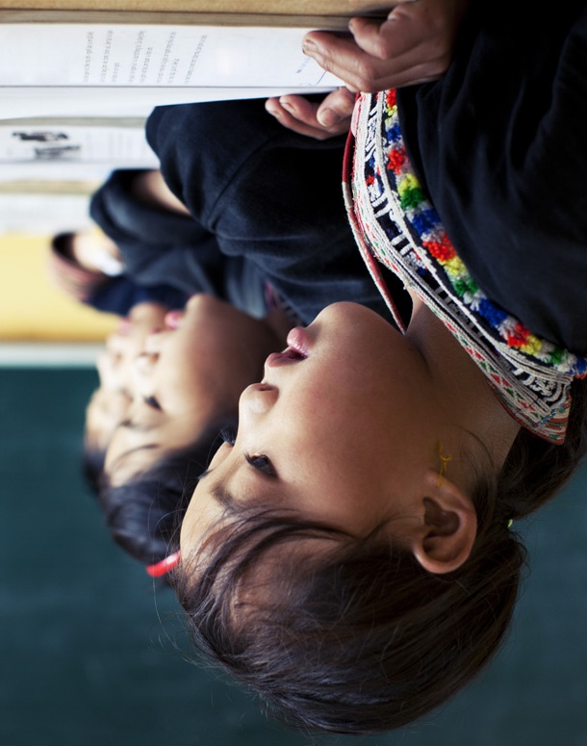
1
Look and listen. Repeat. TR: A48
Work hard in school.
I listen. I talk. I read. I write.
I work hard in school.

Slide 70
Work hard in school.
2
Think. What do you do in school?

Slide 71
Work hard in school.
3
Share.
I read. I draw. I sing.
I work hard in school.

Slide 72
Thank you!

