Slide 1
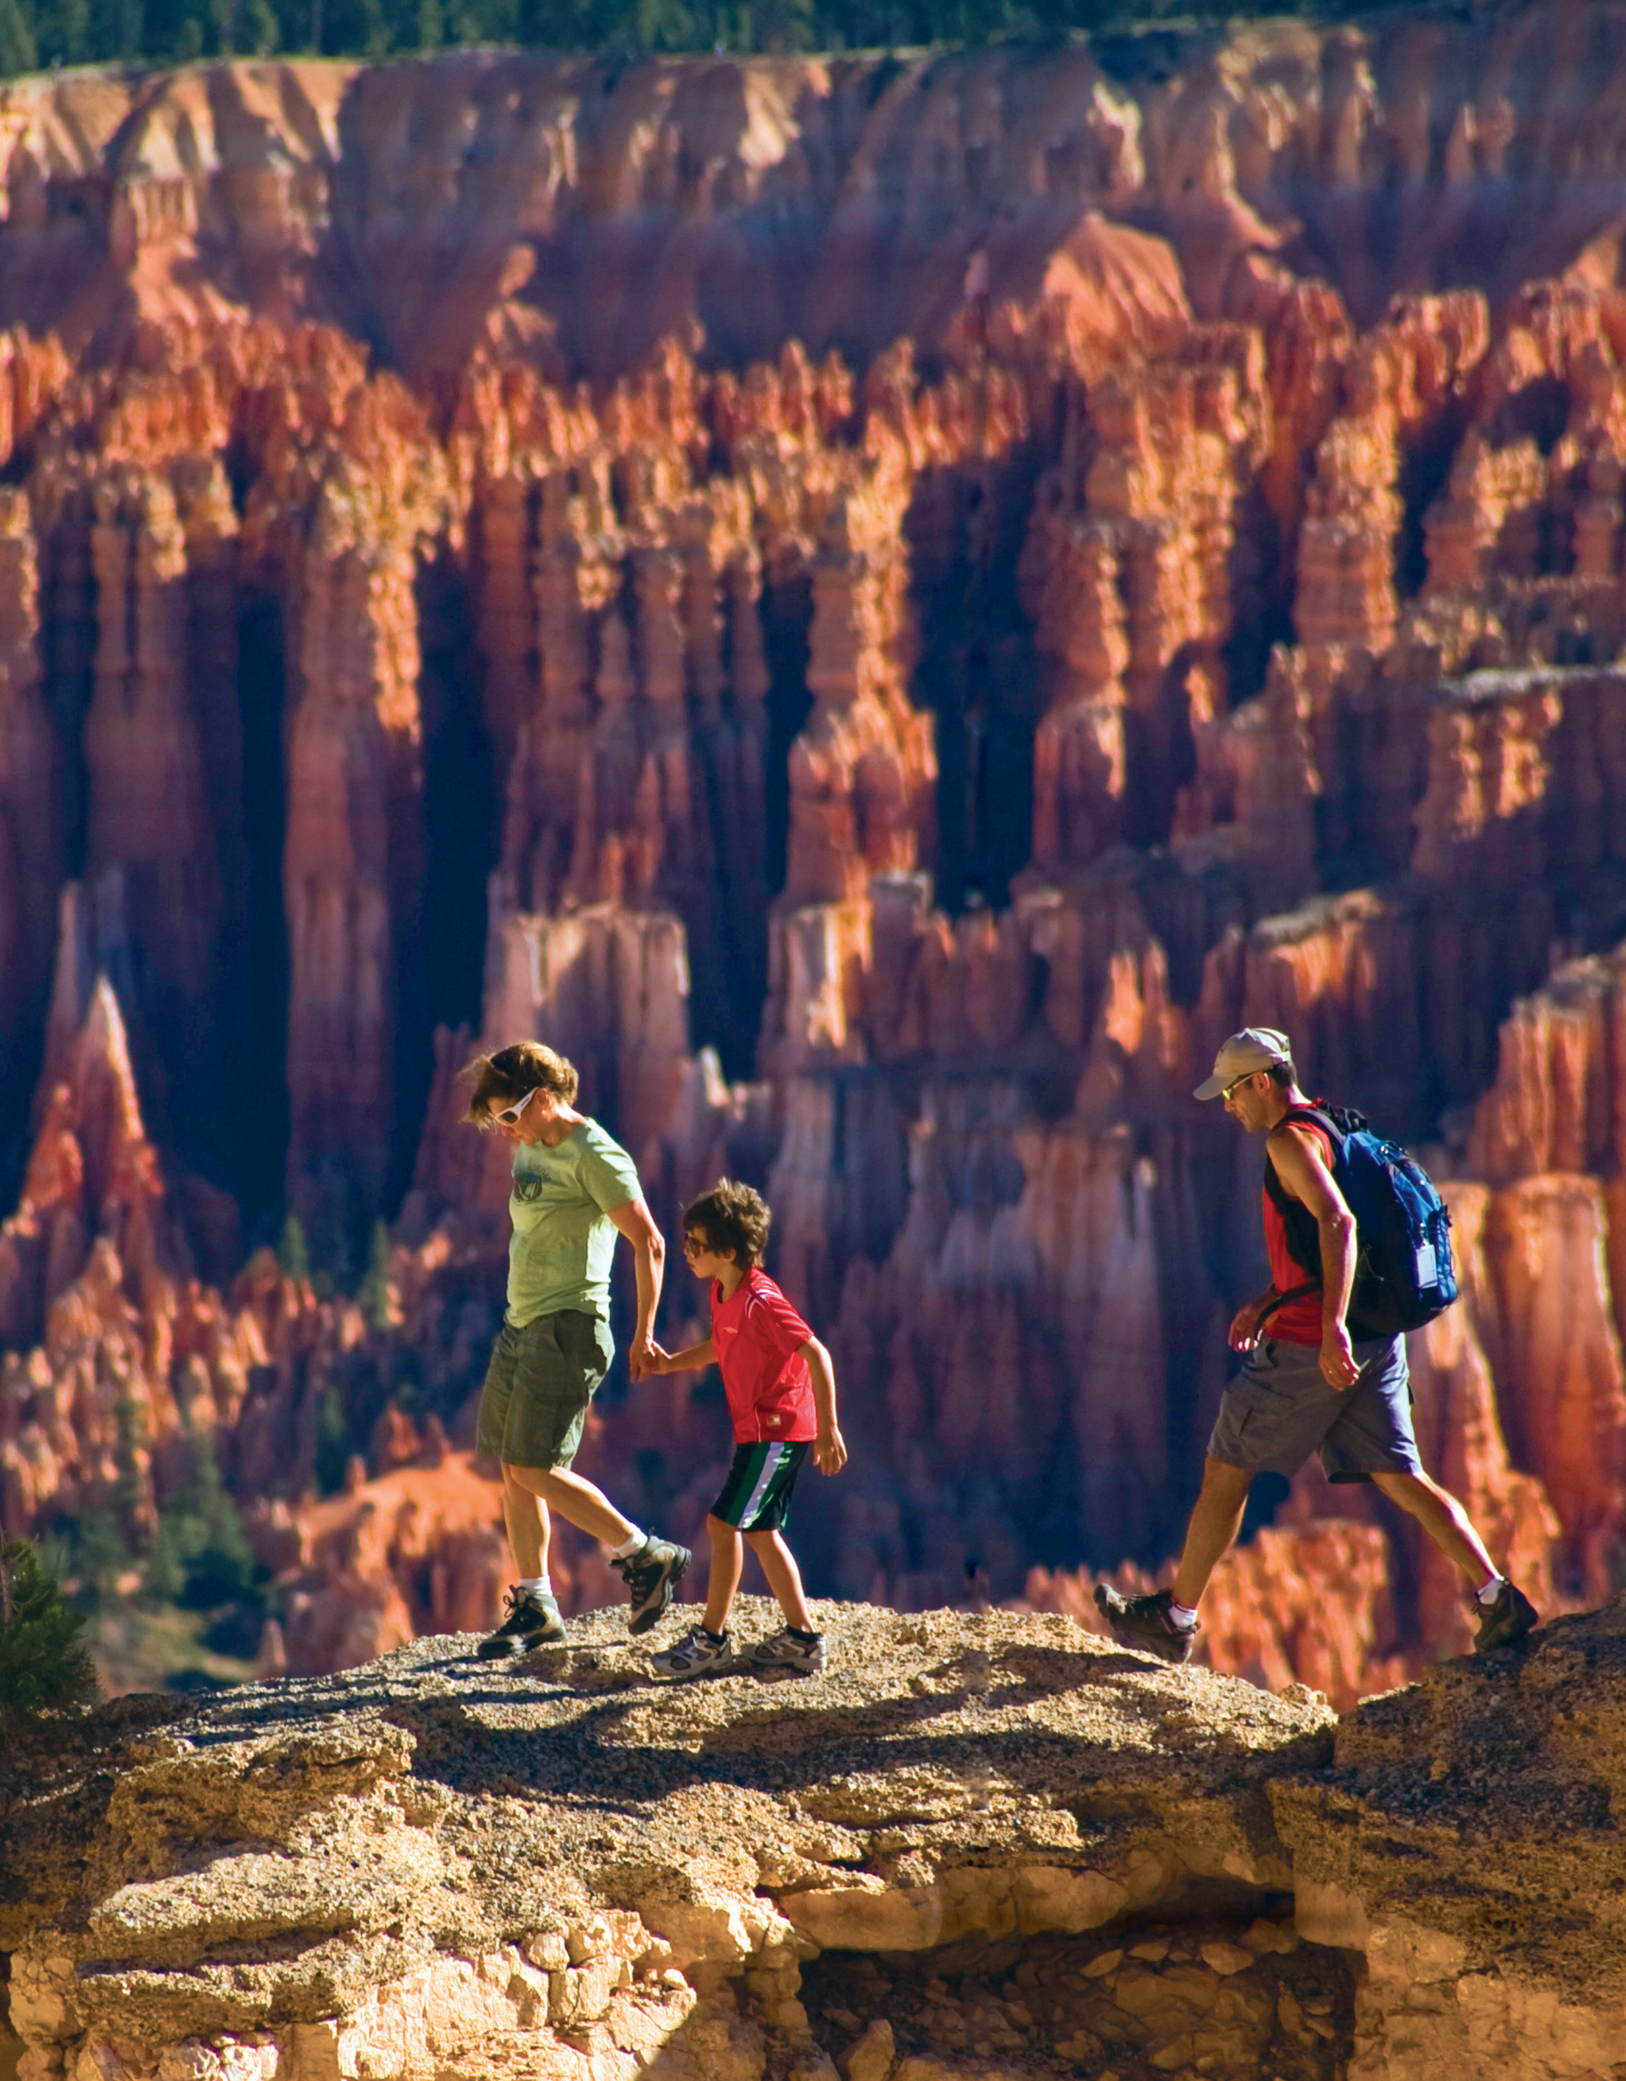
Unit 3
My Family

Slide 2
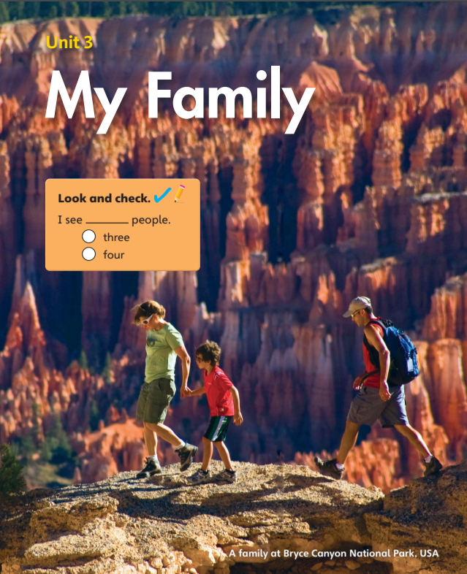


I see ______ people.
three
four

Slide 3
Unit 3:
My Family
Lesson 1

Slide 4

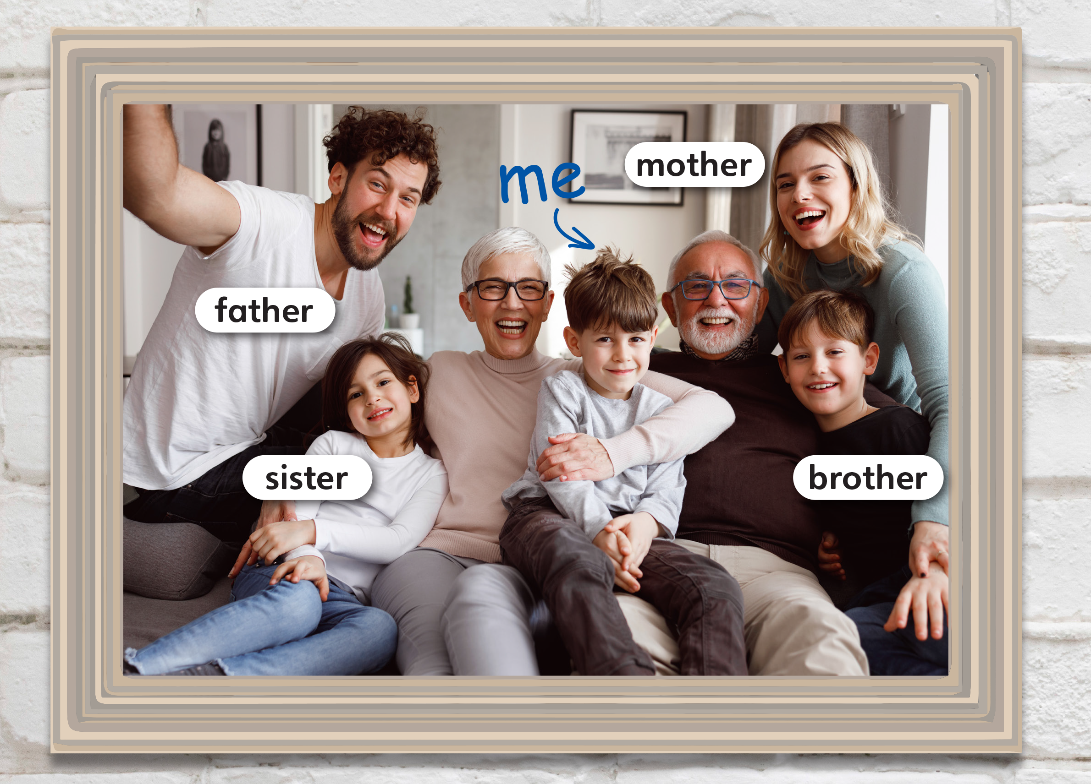
1
Look and listen. Repeat.
TR: A72

Slide 5
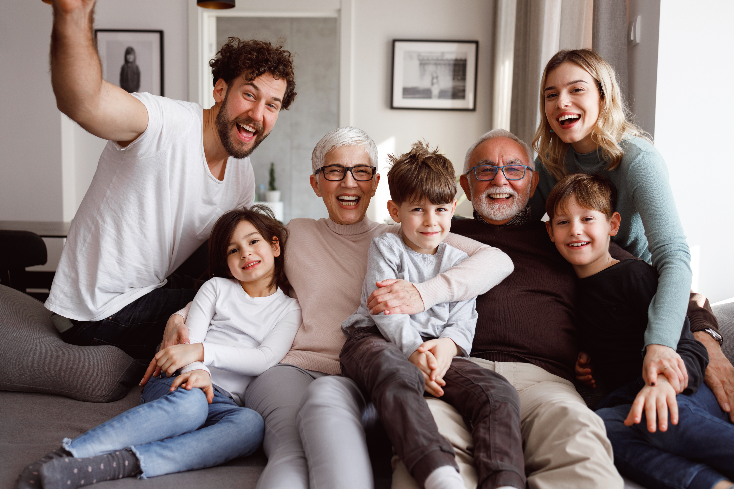
father
/ˈfɑːðər/

Slide 6
mother
/ˈmʌðər/

Slide 7
sister
/ˈsɪstər/

Slide 8
brother
/ˈbrʌðər/

Slide 9
2
Listen and point. Say.
TR: A73

Slide 10

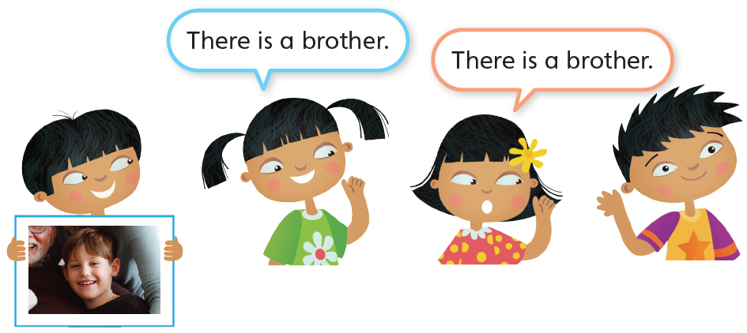

Slide 11
Unit 3:
My Family
Lesson 2

Slide 12
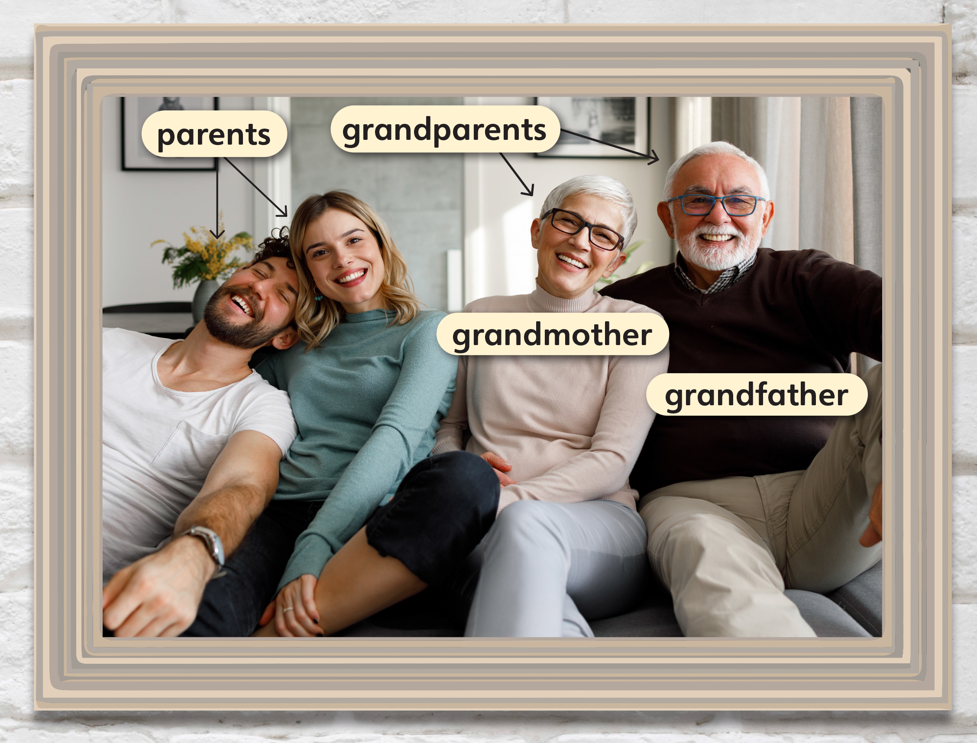
1
Look and listen. Repeat.
TR: A74

Slide 13
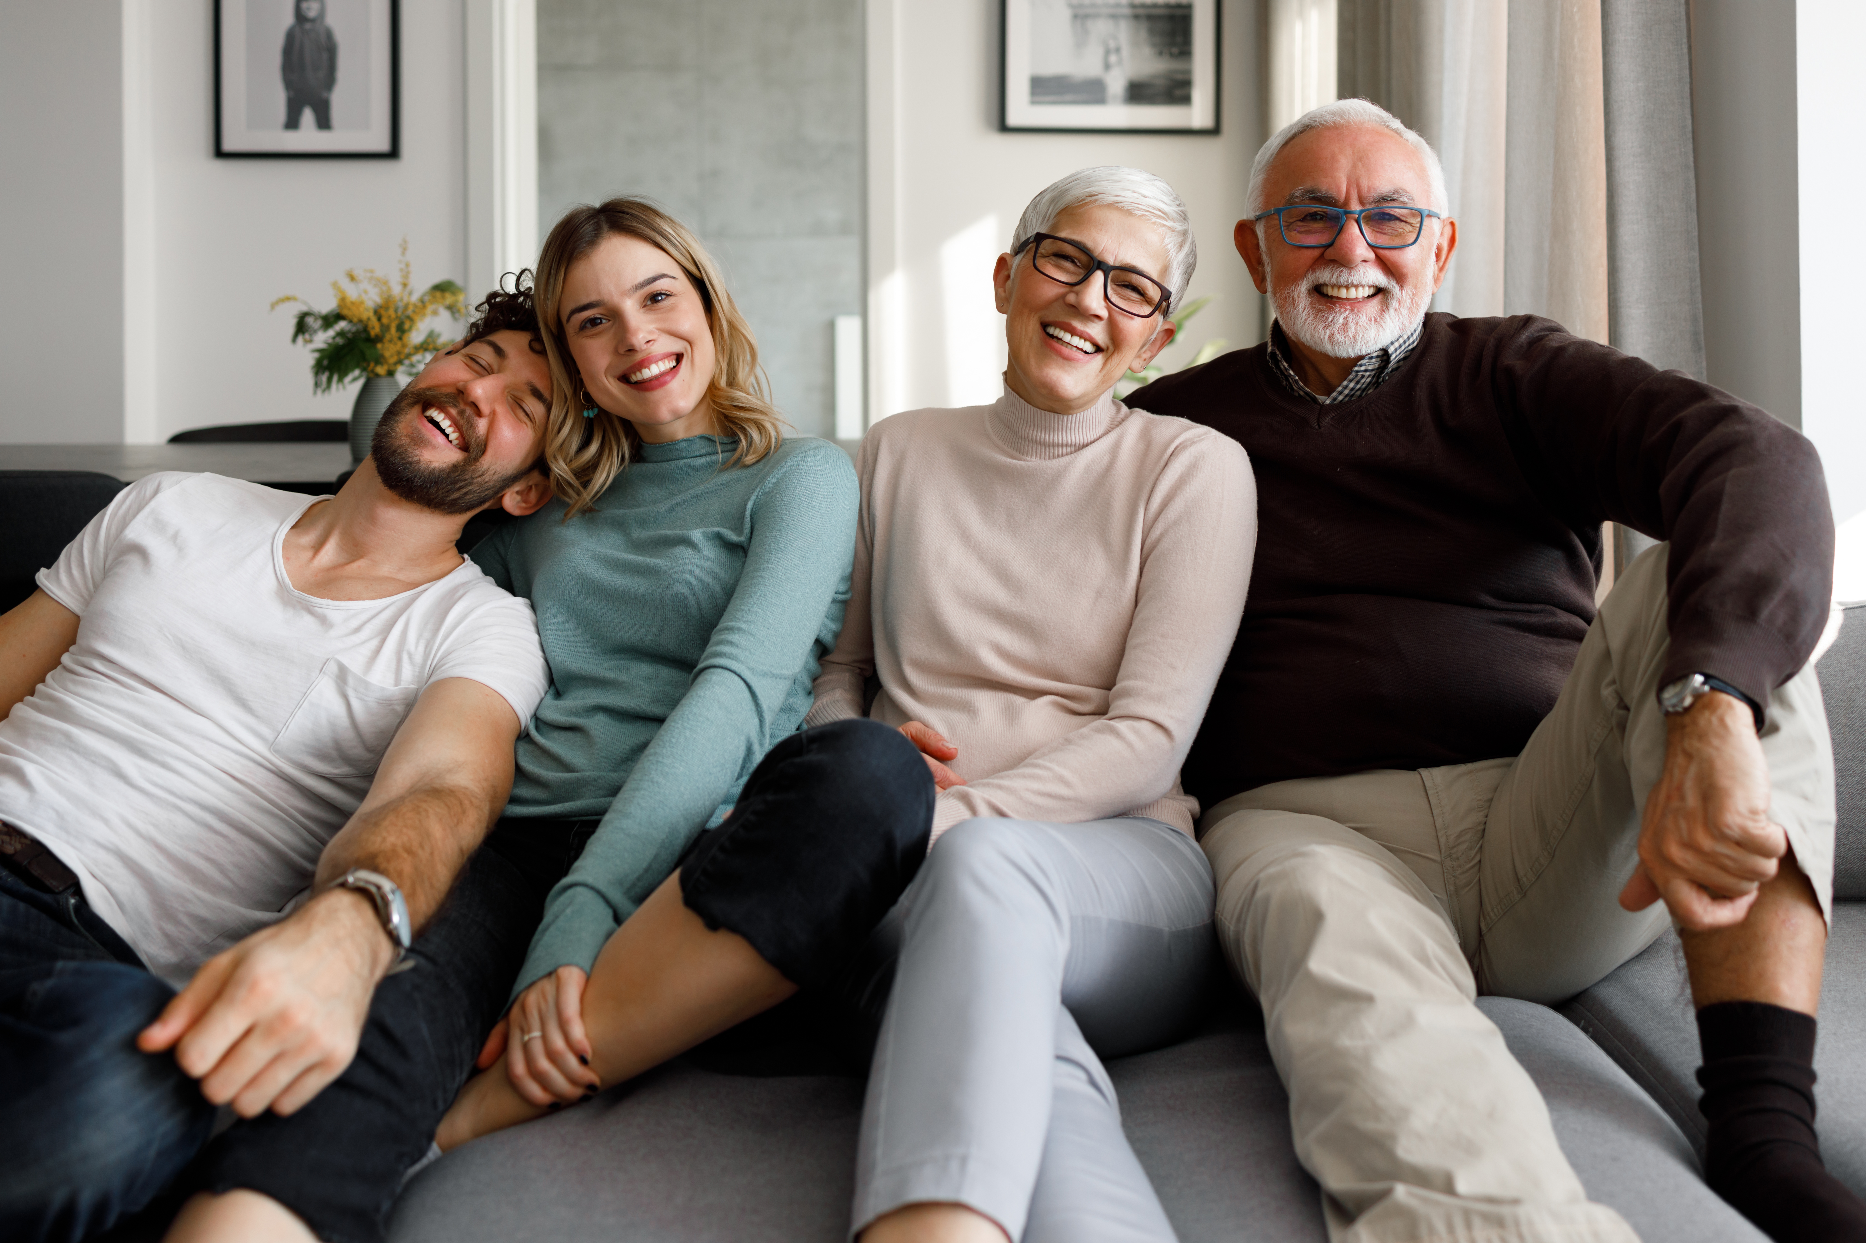
parents
/ˈperənts/

Slide 14
grandparents
/ˈɡrænperənts/

Slide 15
grandmother
/ˈɡrænmʌðər/

Slide 16
grandfather
/ˈɡrænfɑːðər/

Slide 17
2
Listen and point. Say.
TR: A75

Slide 18
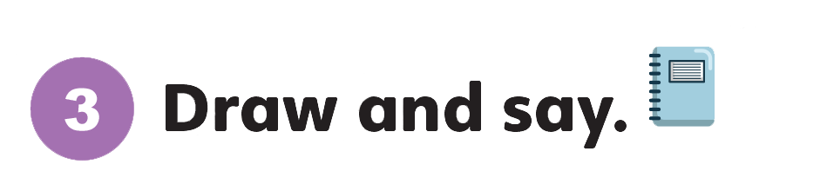
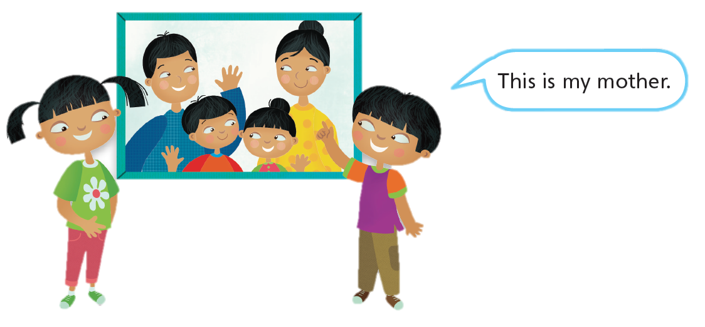

Slide 19
Unit 3:
My Family
Lesson 3

Slide 20
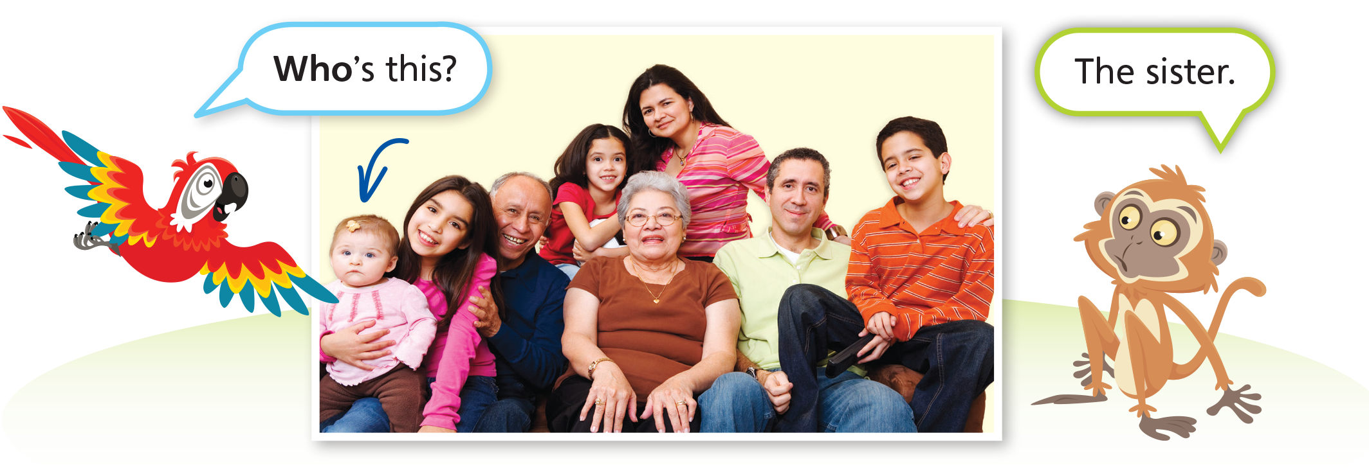
1
Look and listen. Repeat. TR: A76

Slide 21
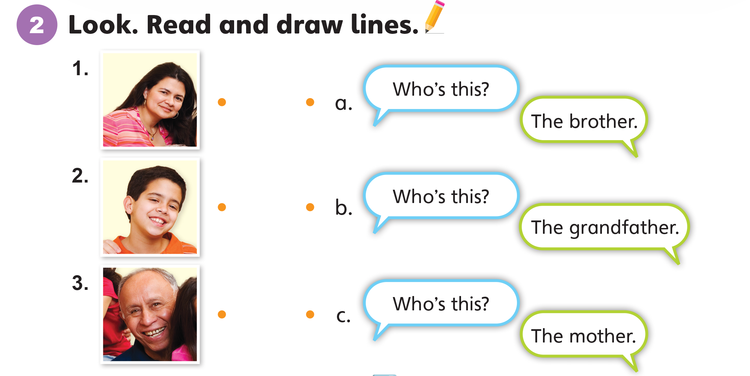

Slide 22
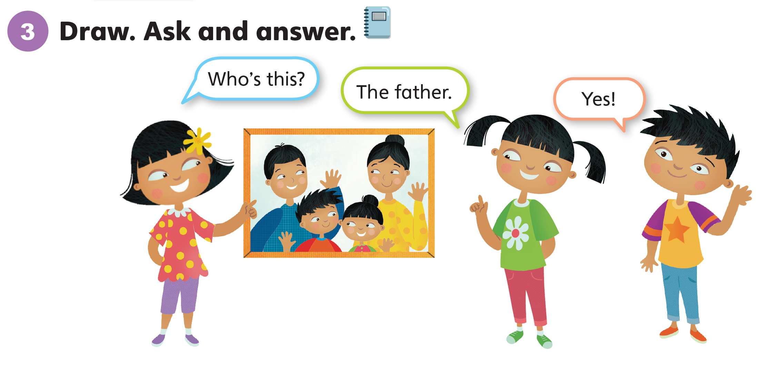

Slide 23
Unit 3:
My Family
Lesson 4

Slide 24
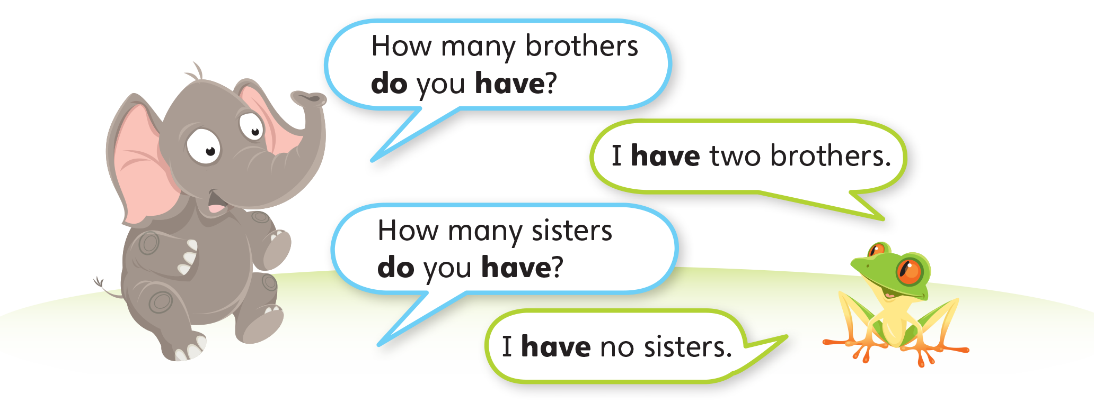
1
Look and listen. Repeat. TR: A77

Slide 25
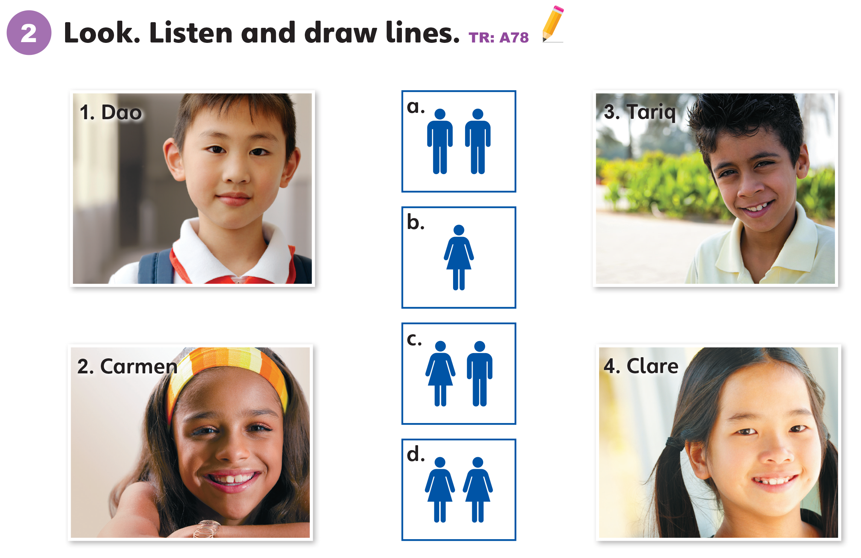

Slide 26
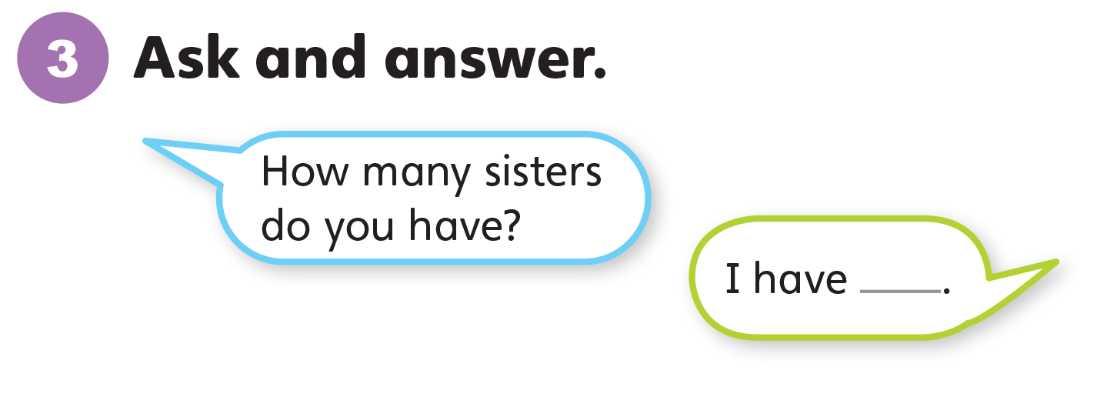

Slide 27
Unit 3:
My Family
Lesson 5

Slide 28
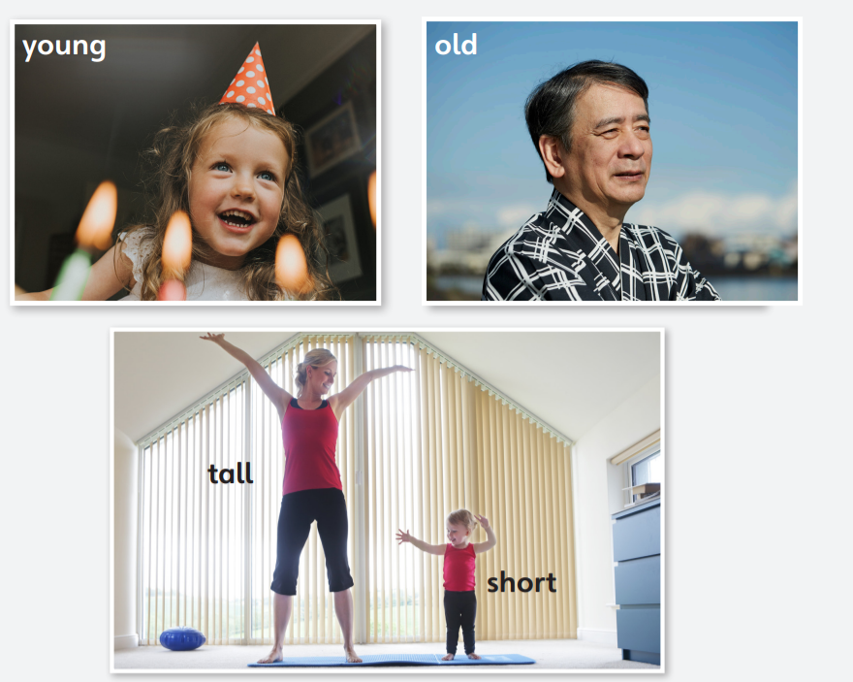
1
Look and listen. Repeat. TR: A79

Slide 29
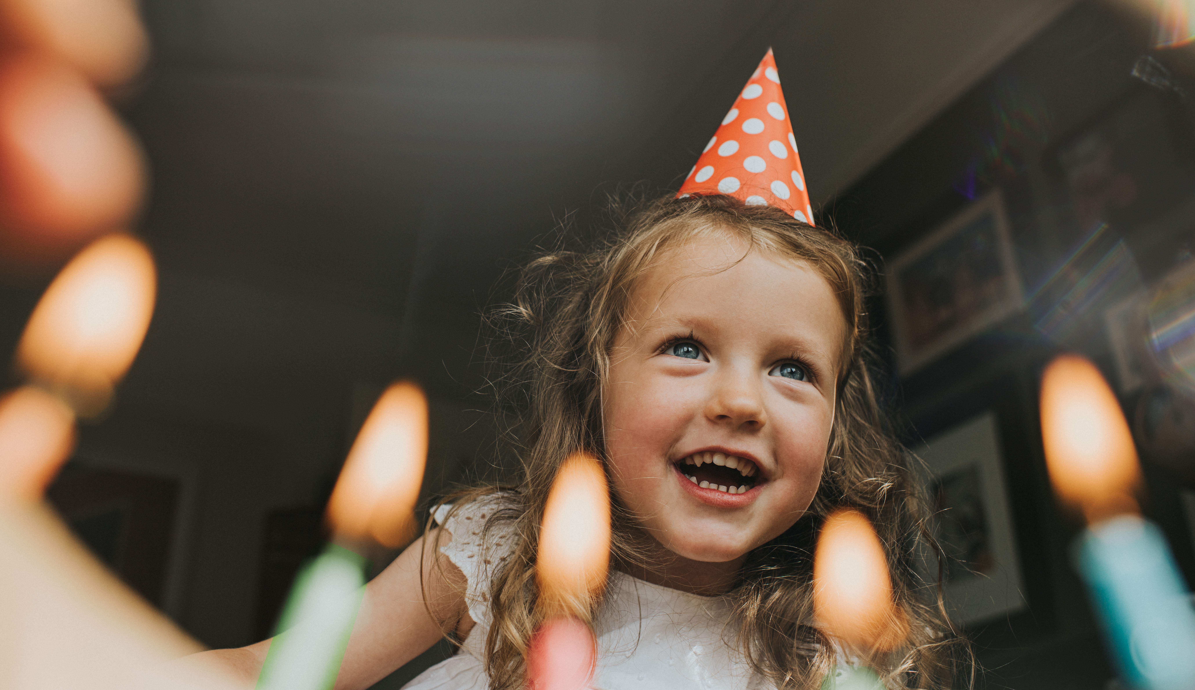
young
/jʌŋ/

Slide 30
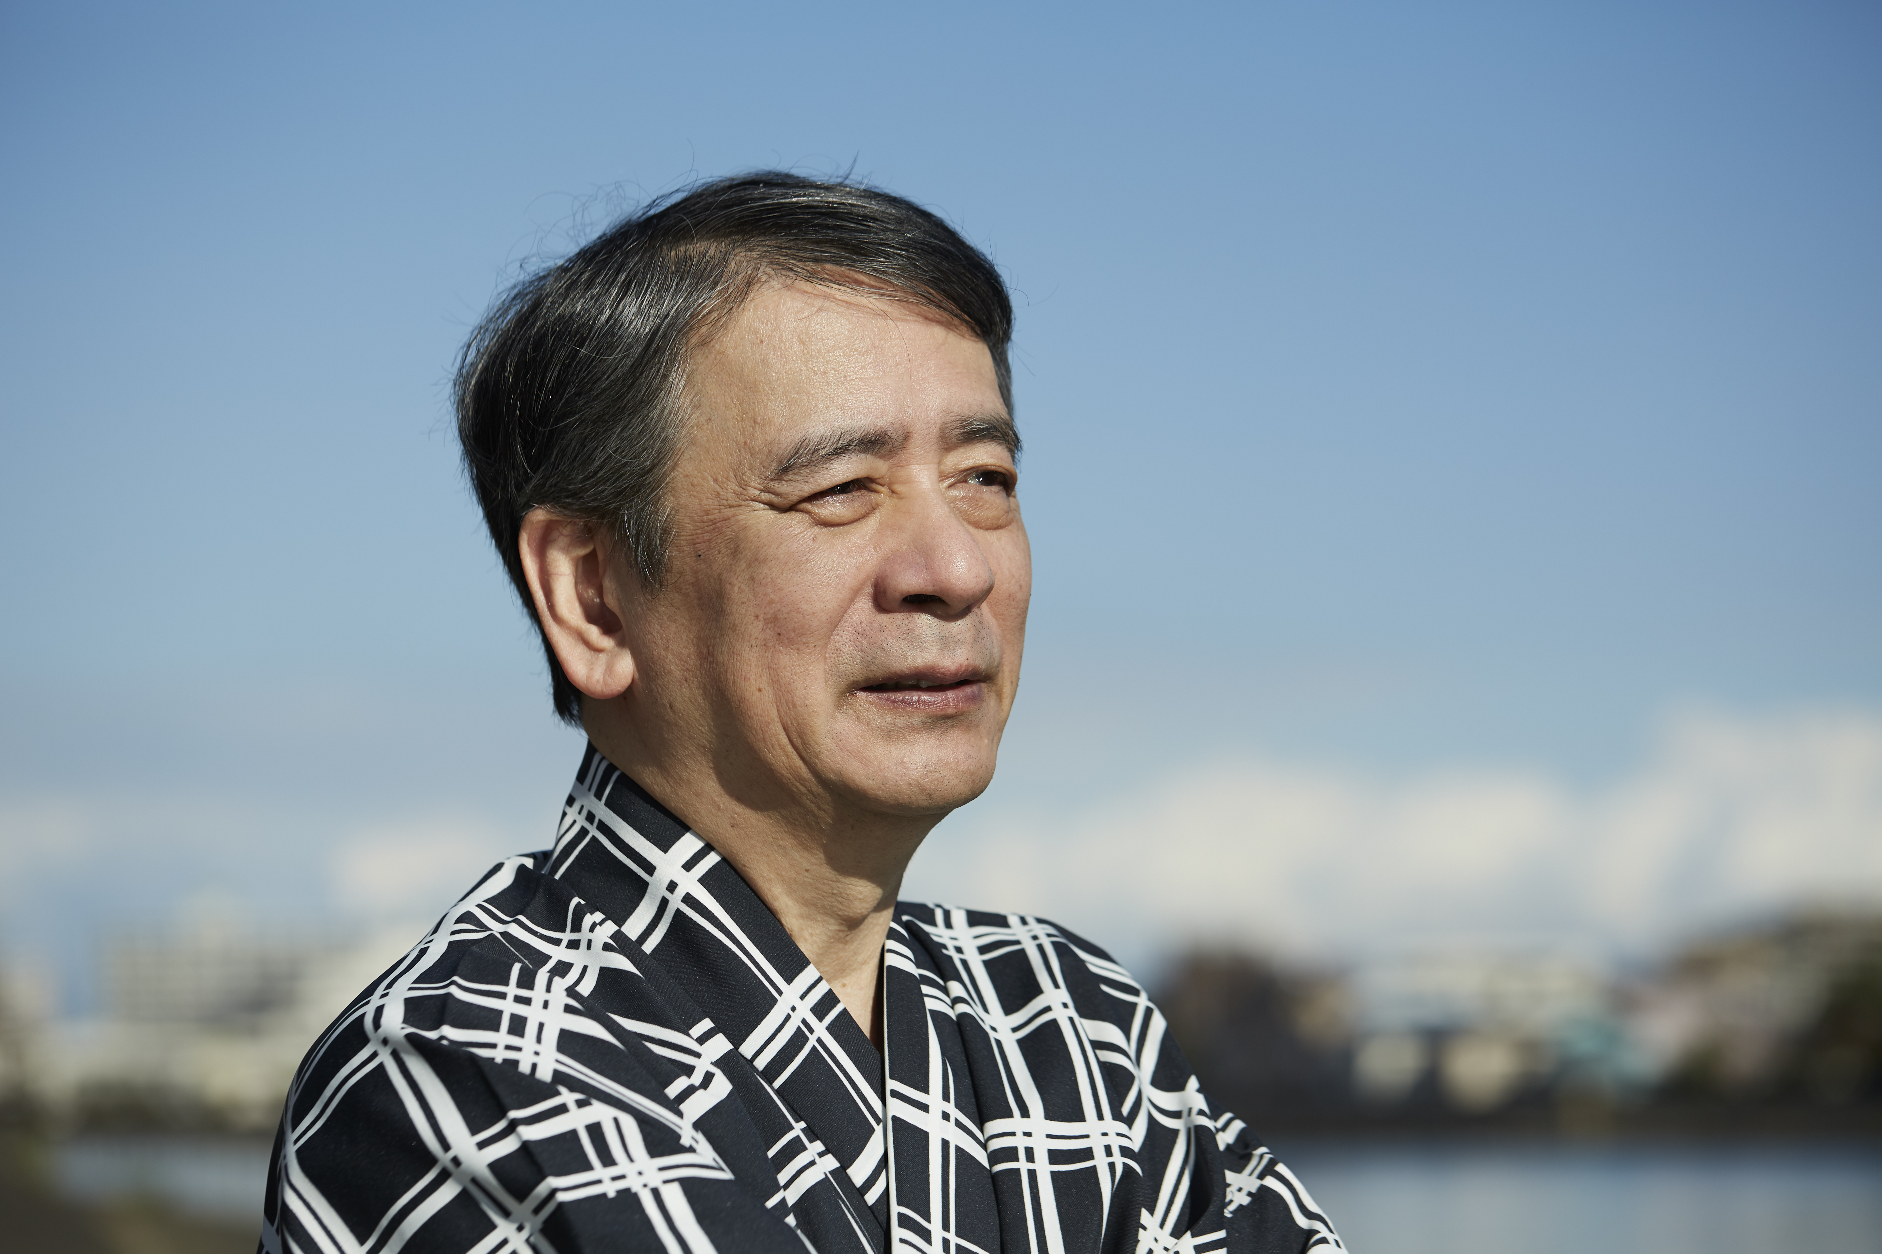
old
/əʊld/

Slide 31
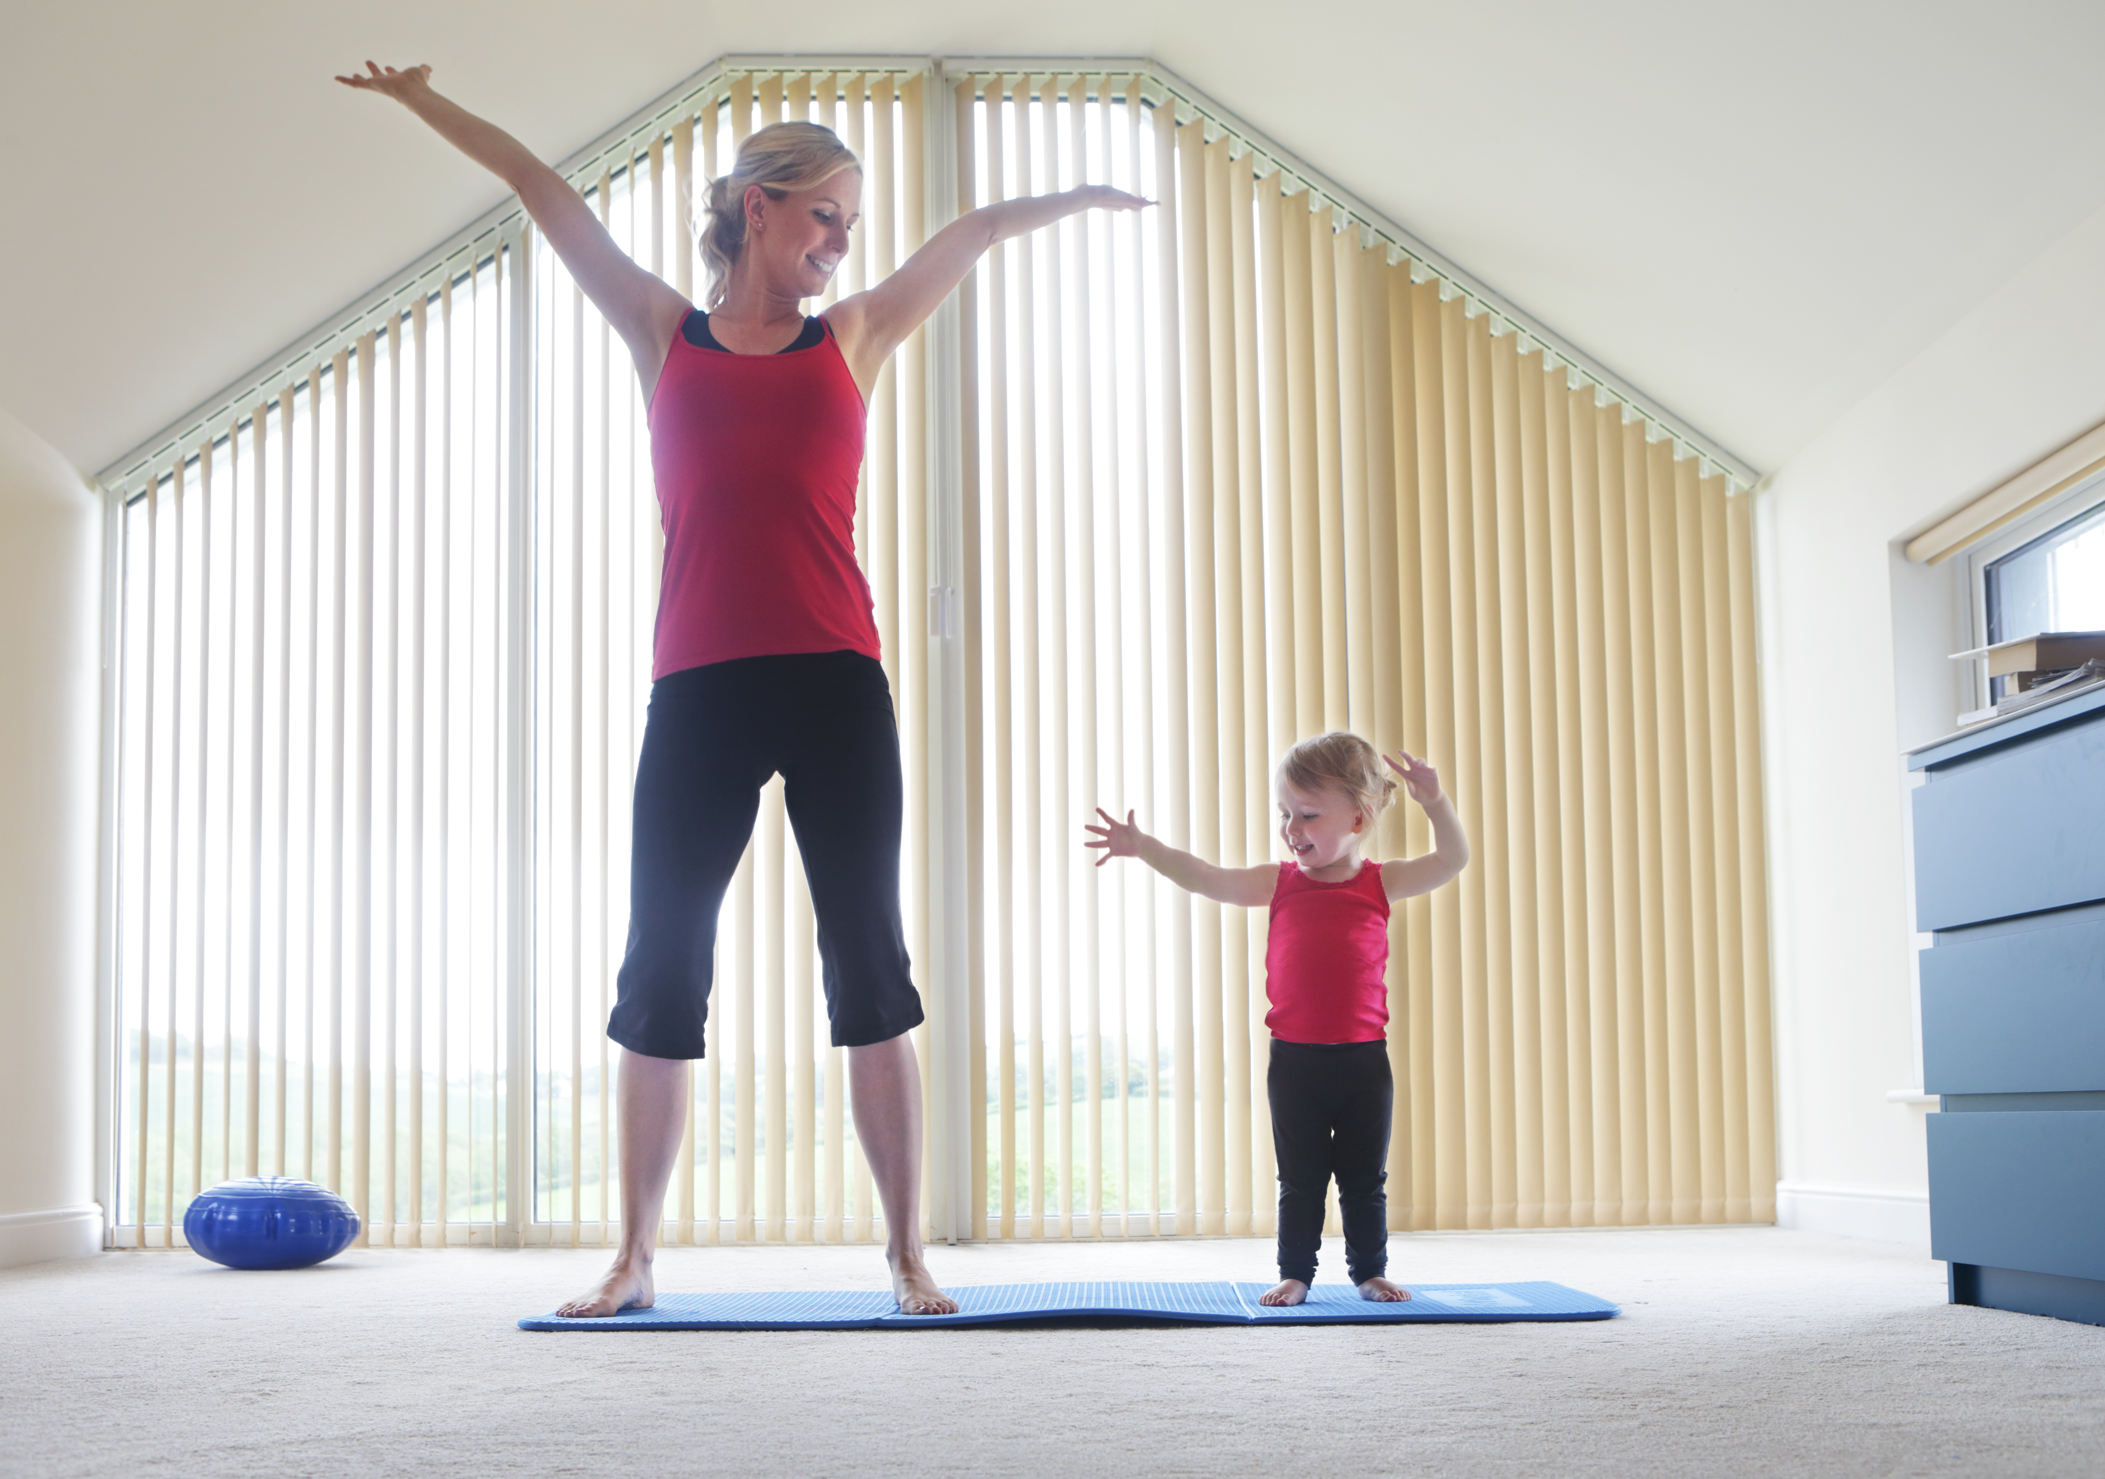
tall
/tɔːl/

Slide 32
short
/ʃɔːrt/

Slide 33
2
Point and say.
young
old
tall
short

Slide 34
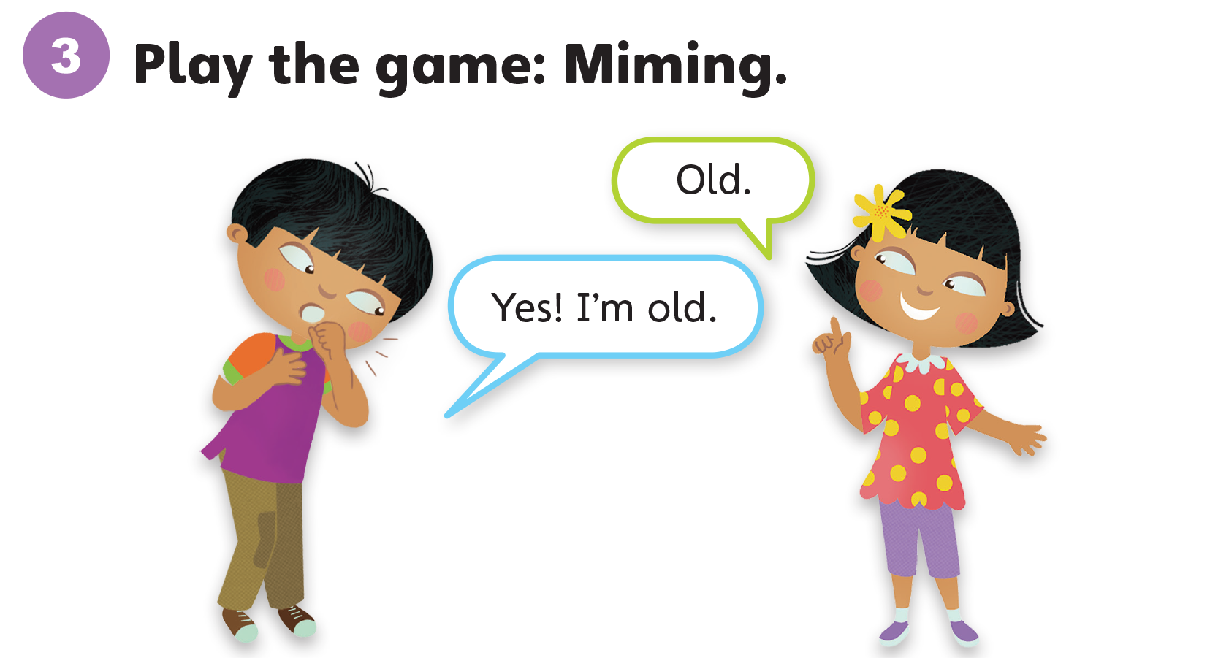

Slide 35
Unit 3:
My Family
Lesson 6

Slide 36
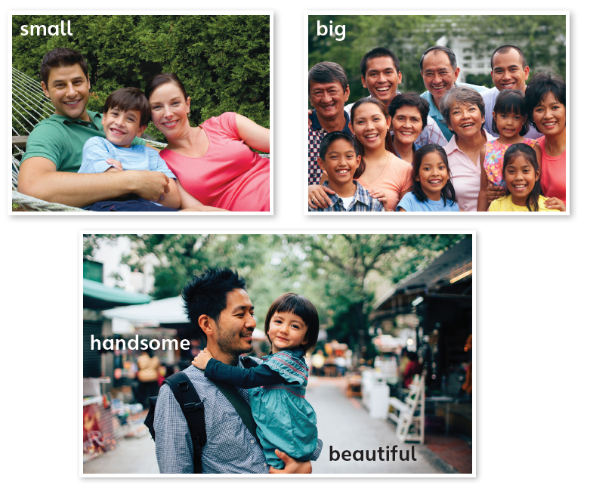
1
Look and listen. Repeat. TR: A80

Slide 37
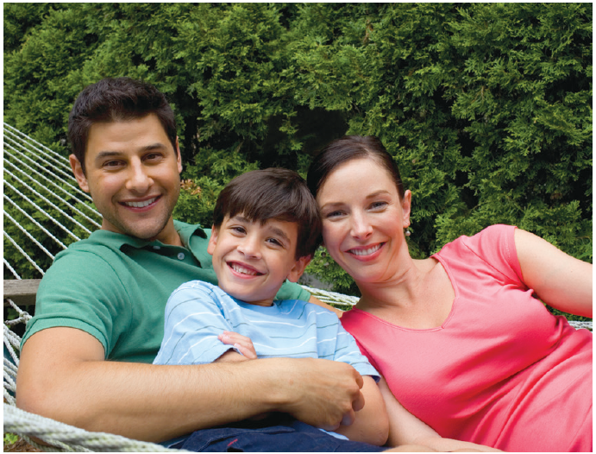
small
/smɔːl/

Slide 38
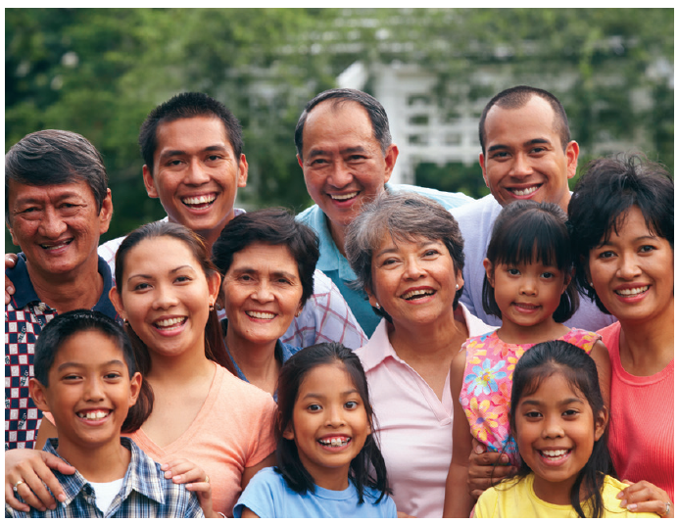
big
/bɪɡ/

Slide 39
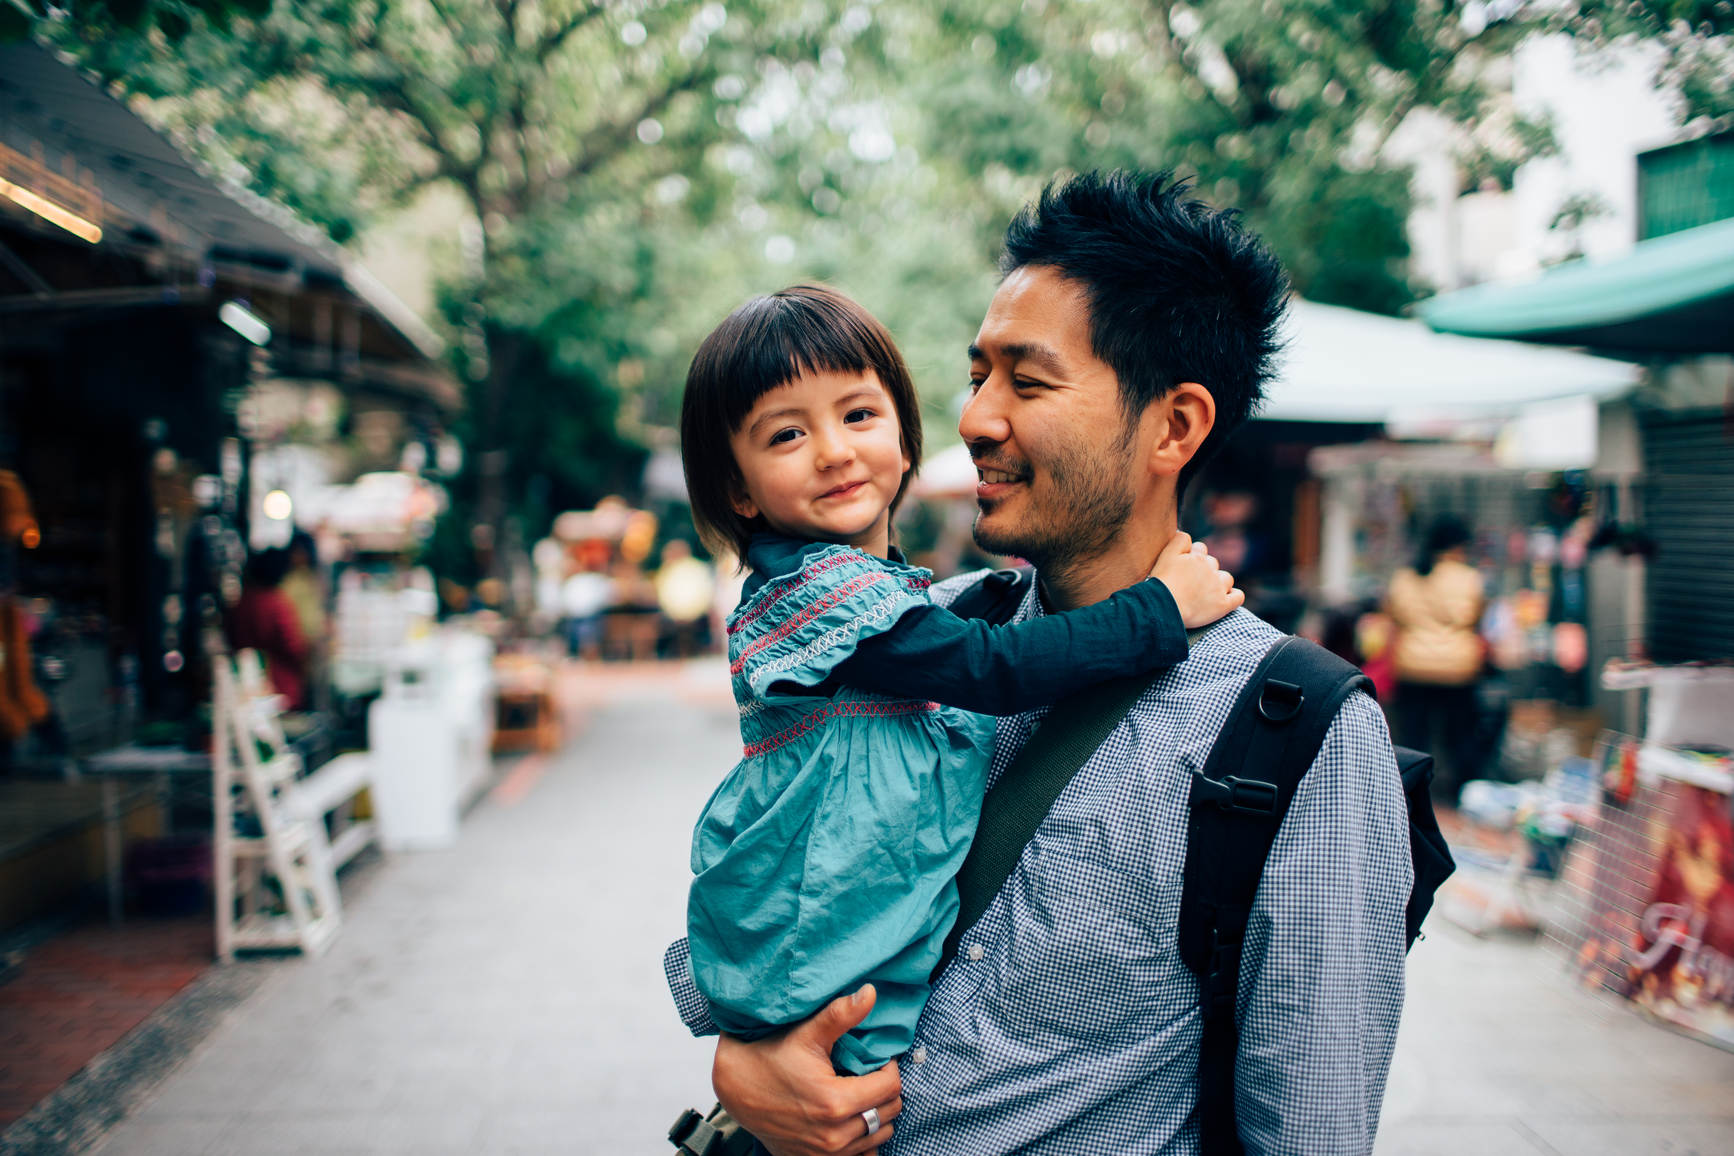
handsome
/ˈhænsəm/

Slide 40
beautiful
/ˈbjuːtɪfl/

Slide 41
2
Point and say.
small
big
handsome
beautiful

Slide 42
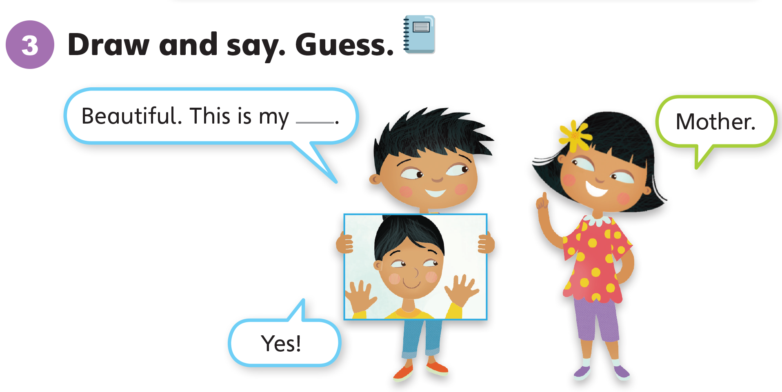

Slide 43
Unit 3:
My Family
Lesson 7

Slide 44
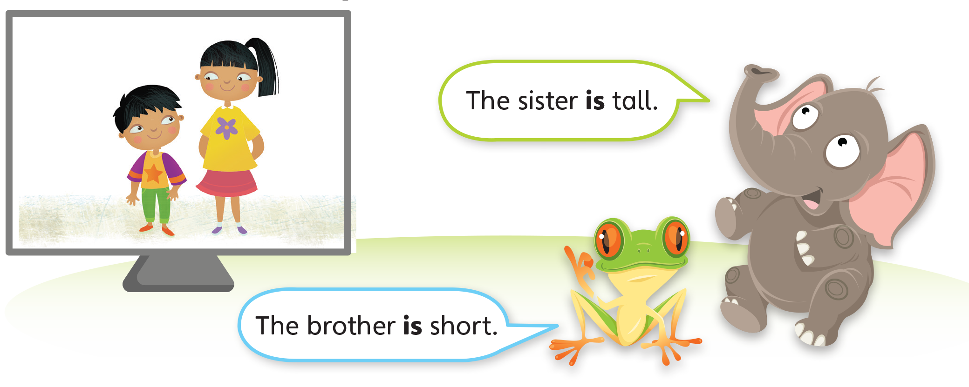
1
Look and listen. Repeat. TR: A81

Slide 45
is old
is big

Slide 46
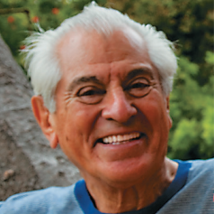
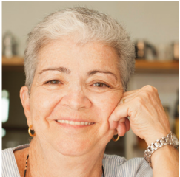
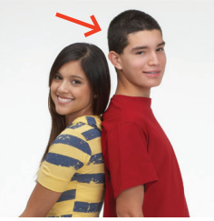
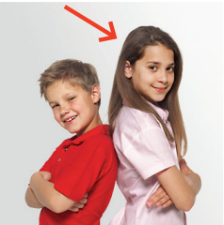
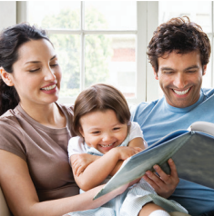
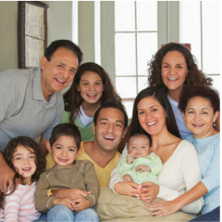

Slide 47
Unit 3:
My Family
Lesson 8

Slide 48
1
Look and listen. Repeat. TR: A82

Slide 49
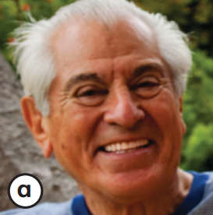
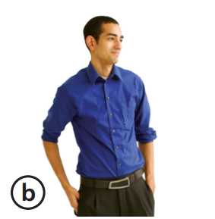
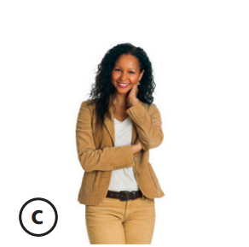
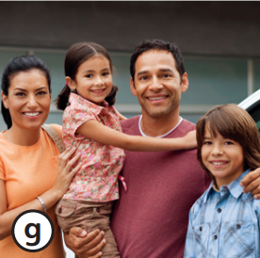

Slide 51
Unit 3:
My Family
Lesson 9

Slide 52
1
Listen and repeat. TR: A84
f
  family
  father

Slide 53
2
Listen and sing. TR: A85
Do you have a big family?
Do you have a big family?
Do you have a big family?
Yes, my family is big!
There are two boys in my family.
There are two girls in my family.
There are six people in my family.
And I love them all!
Some are short. And some are tall.
I have a big family. And I love them all!
I love them all! I love them all!

Slide 54
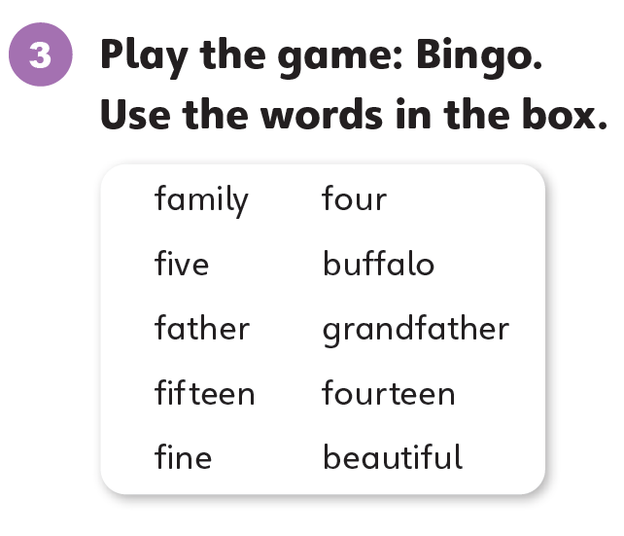
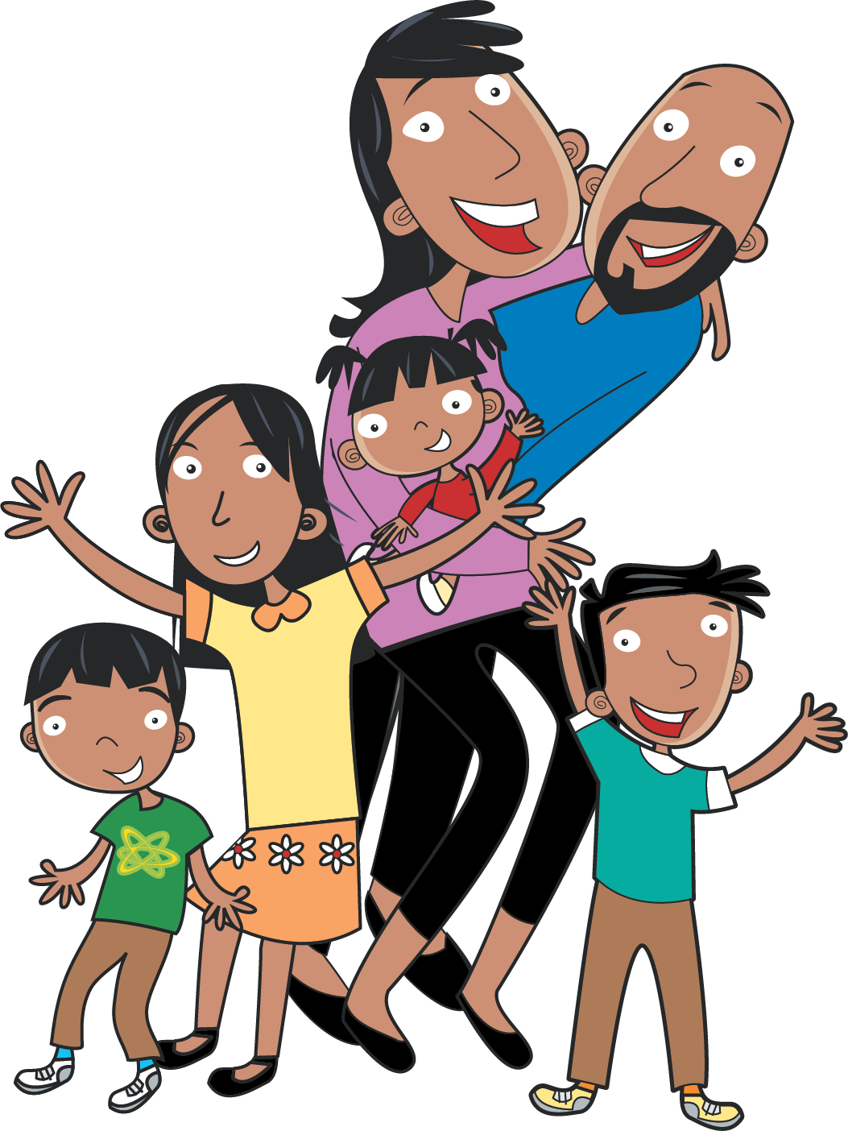

Slide 55
Unit 3:
My Family
Lesson 10

Slide 56
1
Listen and repeat. TR: A86
s
sh
  some
  sister
  short
  bush

Slide 57
2
Listen and chant. TR: A87
This is my sister.
My sister is short.
Sit with my sister.
Sing some songs!
This is my sister.
My sister is short.
Play with my sister.
Sing some songs!

Slide 58
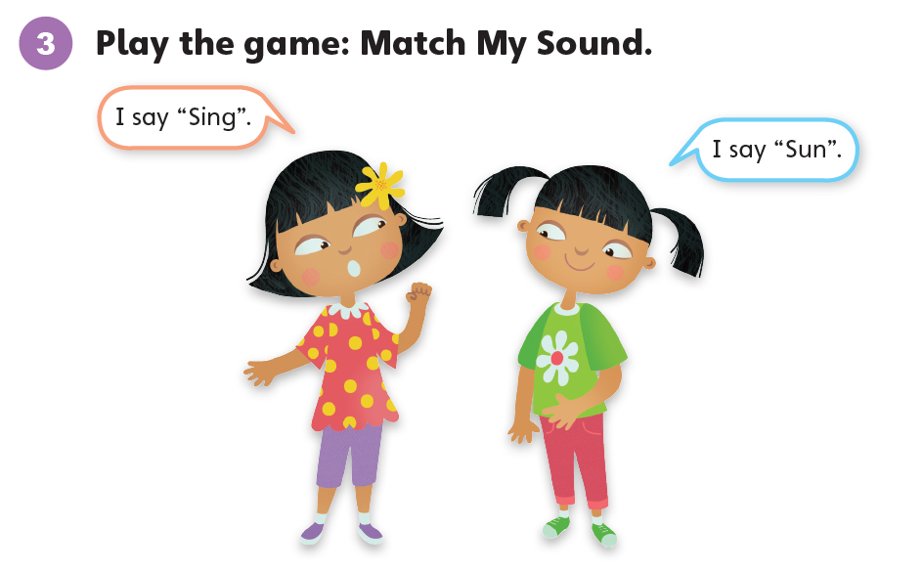

Slide 59
Unit 3:
My Family
Lesson 11

Slide 60
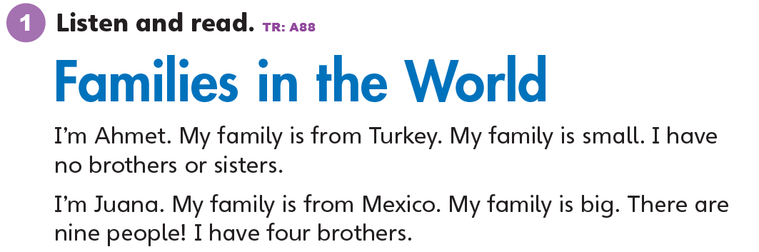

Slide 61
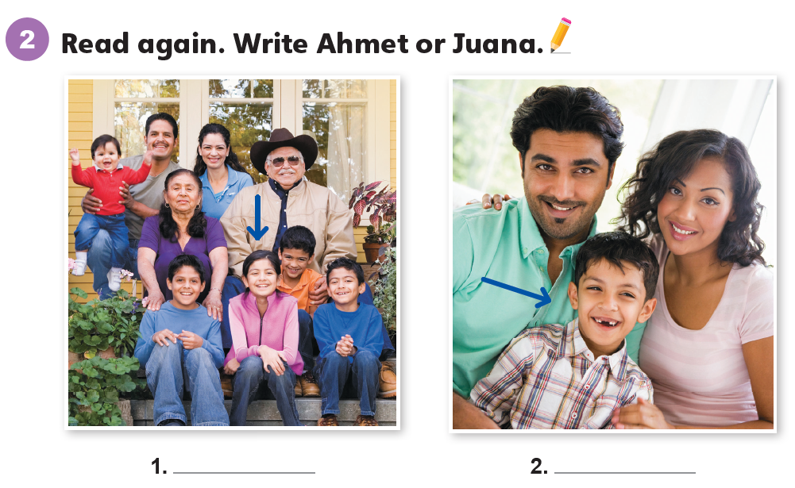
Juana
Ahmet

Slide 62
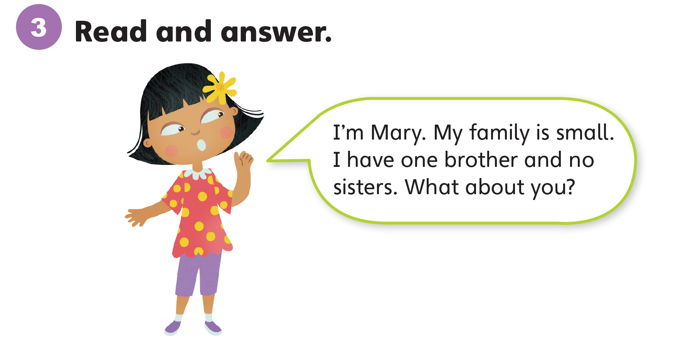

Slide 63
Unit 3:
My Family
Lesson 12

Slide 64
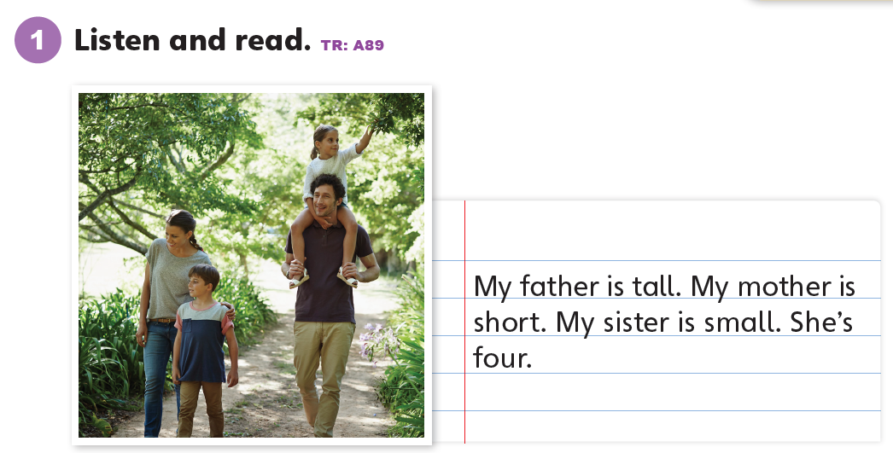

Slide 65
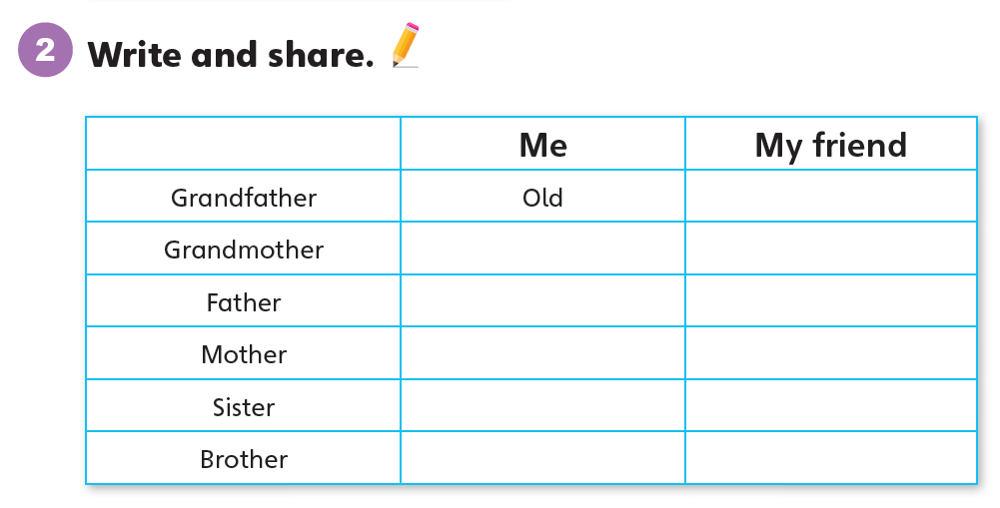

Slide 66
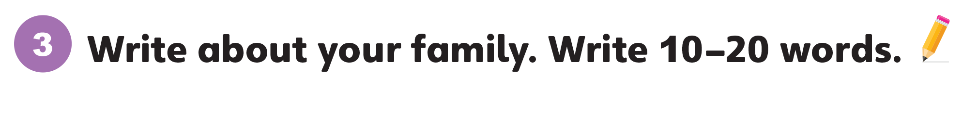
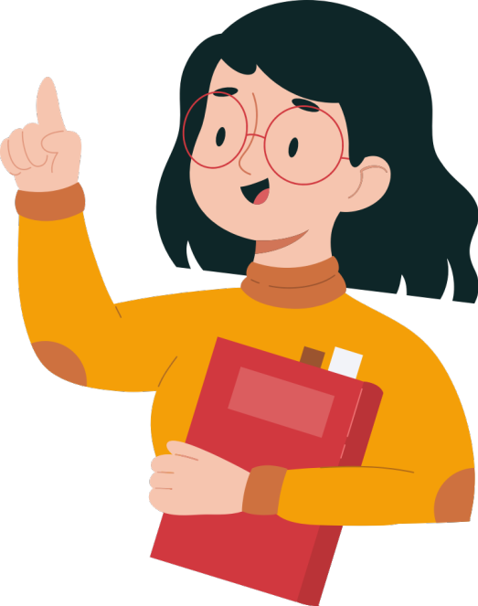

Slide 67
Unit 3:
My Family
Value

Slide 68
1
Look and listen. Repeat. TR: A90
Love your family.
I love my small family. We work and we play.

Slide 69
Love your family.
2
Think. What do you do with your family?

Slide 70
Love your family.
3
Share.
I love my big family.
We draw and we sing.

Slide 71
Thank you!

