Slide 1

Unit 4
My House

Slide 2
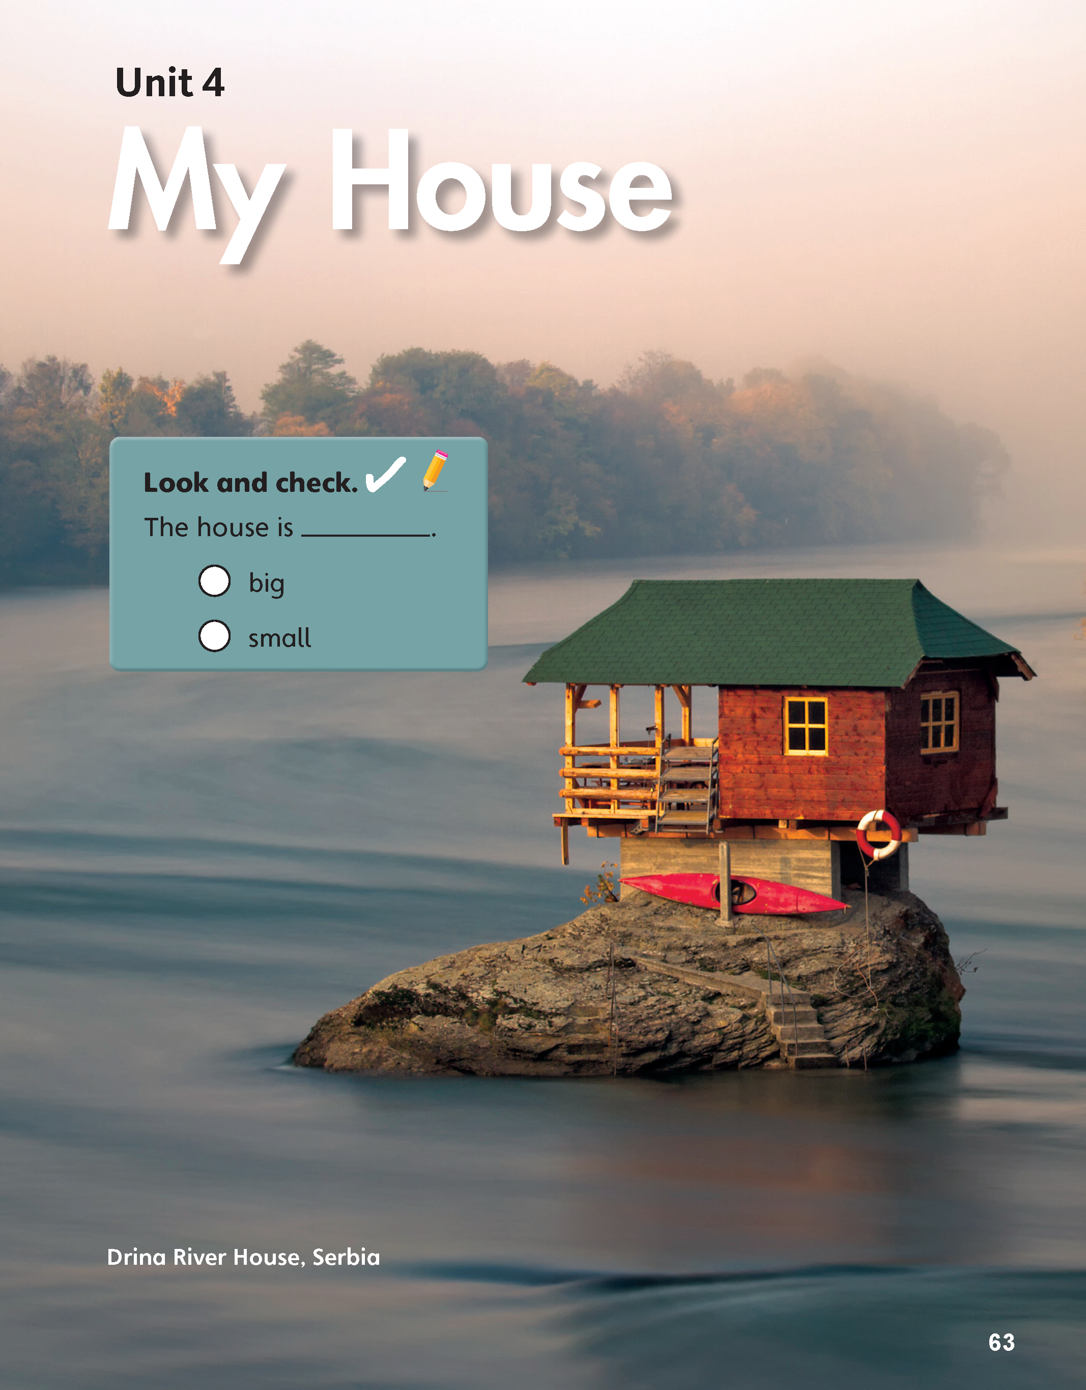


The house is ____.
big
small

Slide 3
Unit 4:
My House
Lesson 1

Slide 4

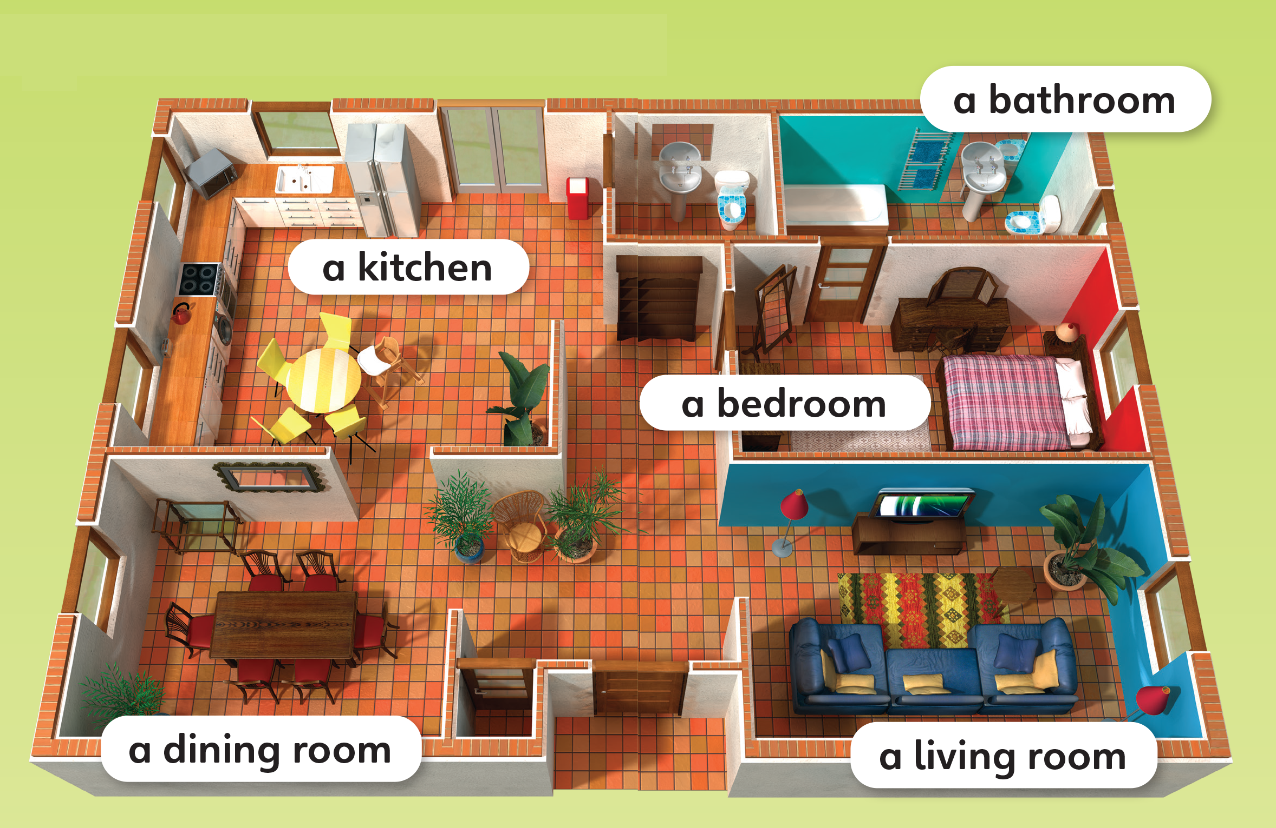
1
Look and listen. Repeat.
TR: B1

Slide 5
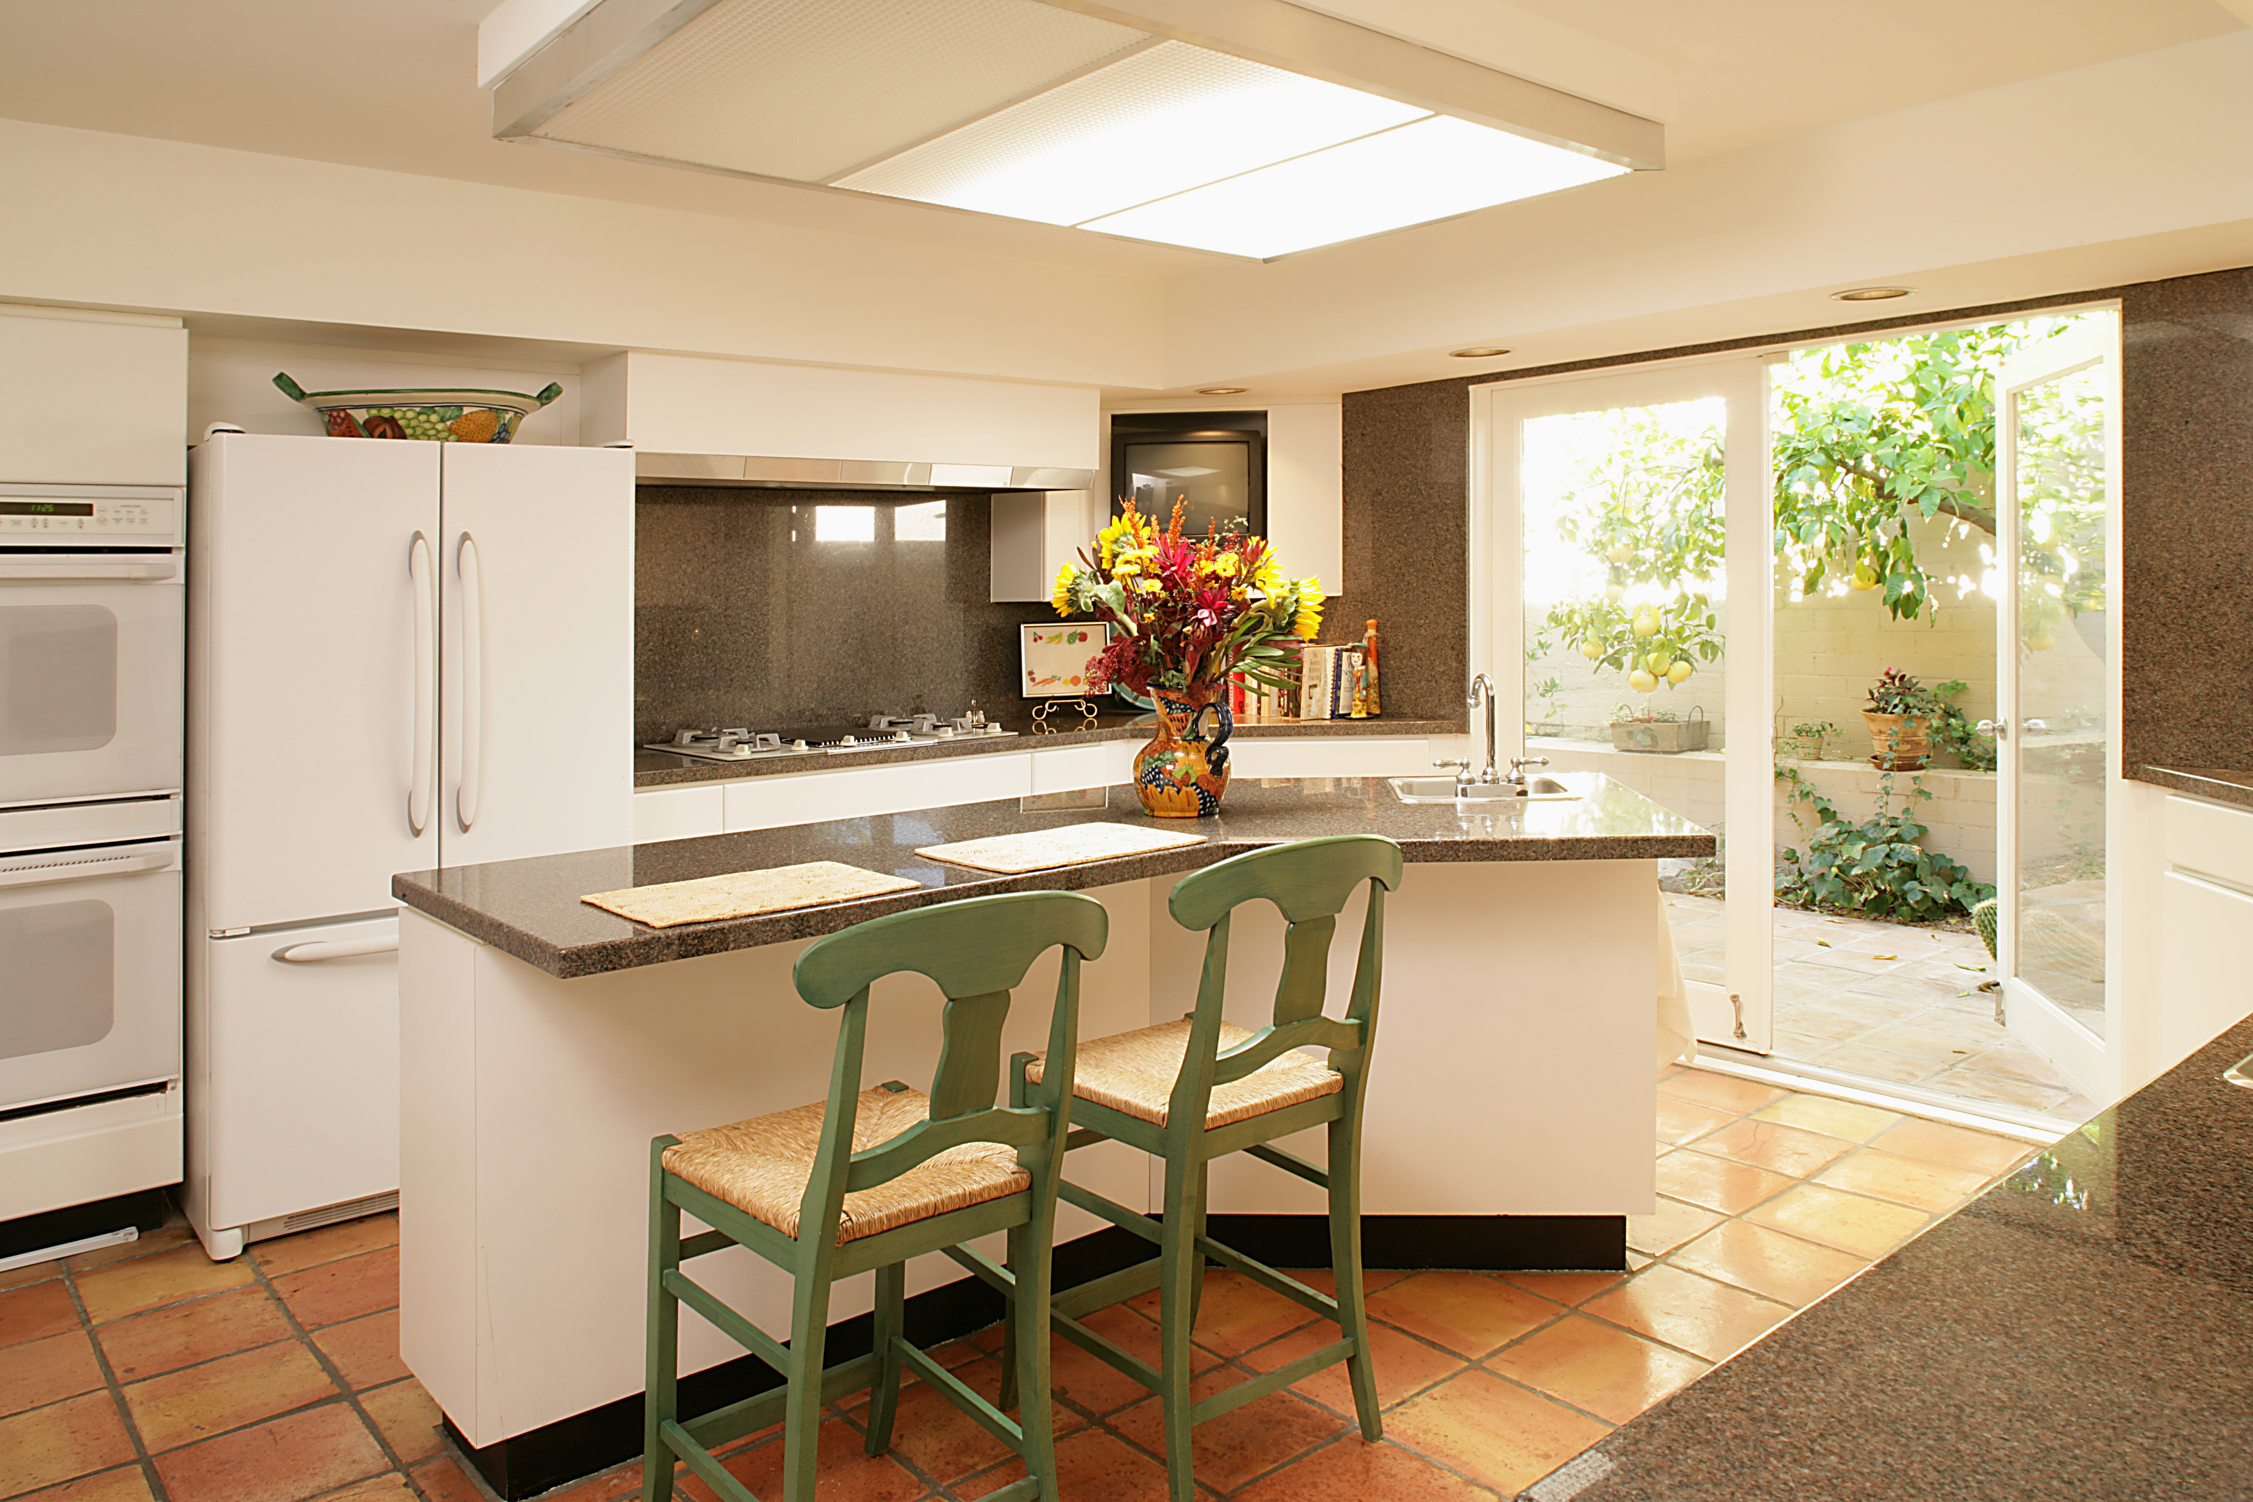
a kitchen
/ə/ /ˈkɪtʃɪn/

Slide 6
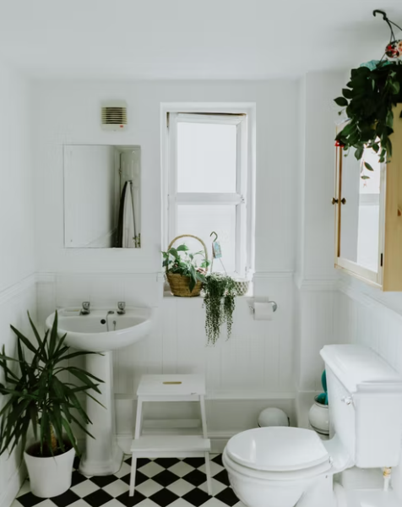
a bathroom
/ə/ /ˈbæθruːm/

Slide 7
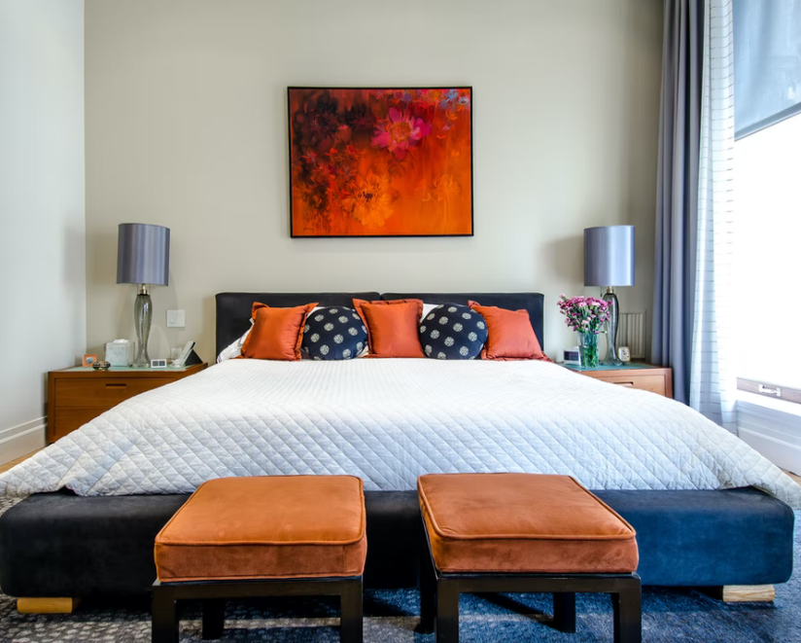
a bedroom
/ə/ /ˈbedruːm/

Slide 8
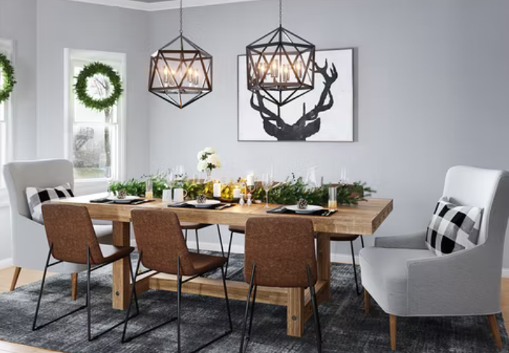
a dining room
/ə/ /ˈdaɪnɪŋ ruːm/

Slide 9
a living room
/ə/ /ˈlɪvɪŋ ruːm/

Slide 10
2
Listen and point. Say.
TR: B2

Slide 11
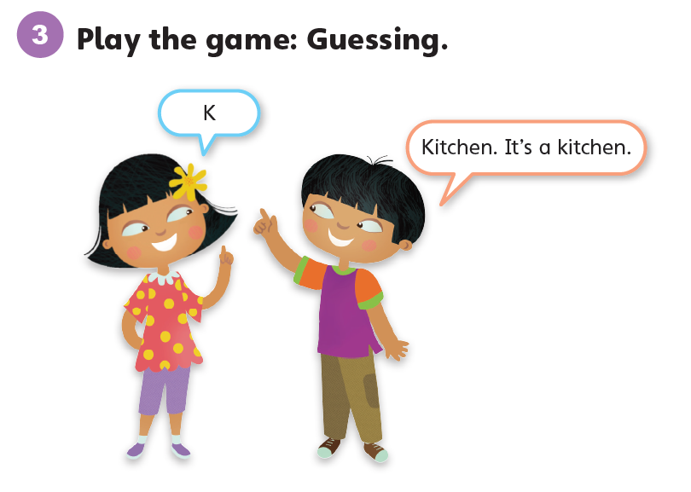

Slide 12
Unit 4:
My House
Lesson 2

Slide 13
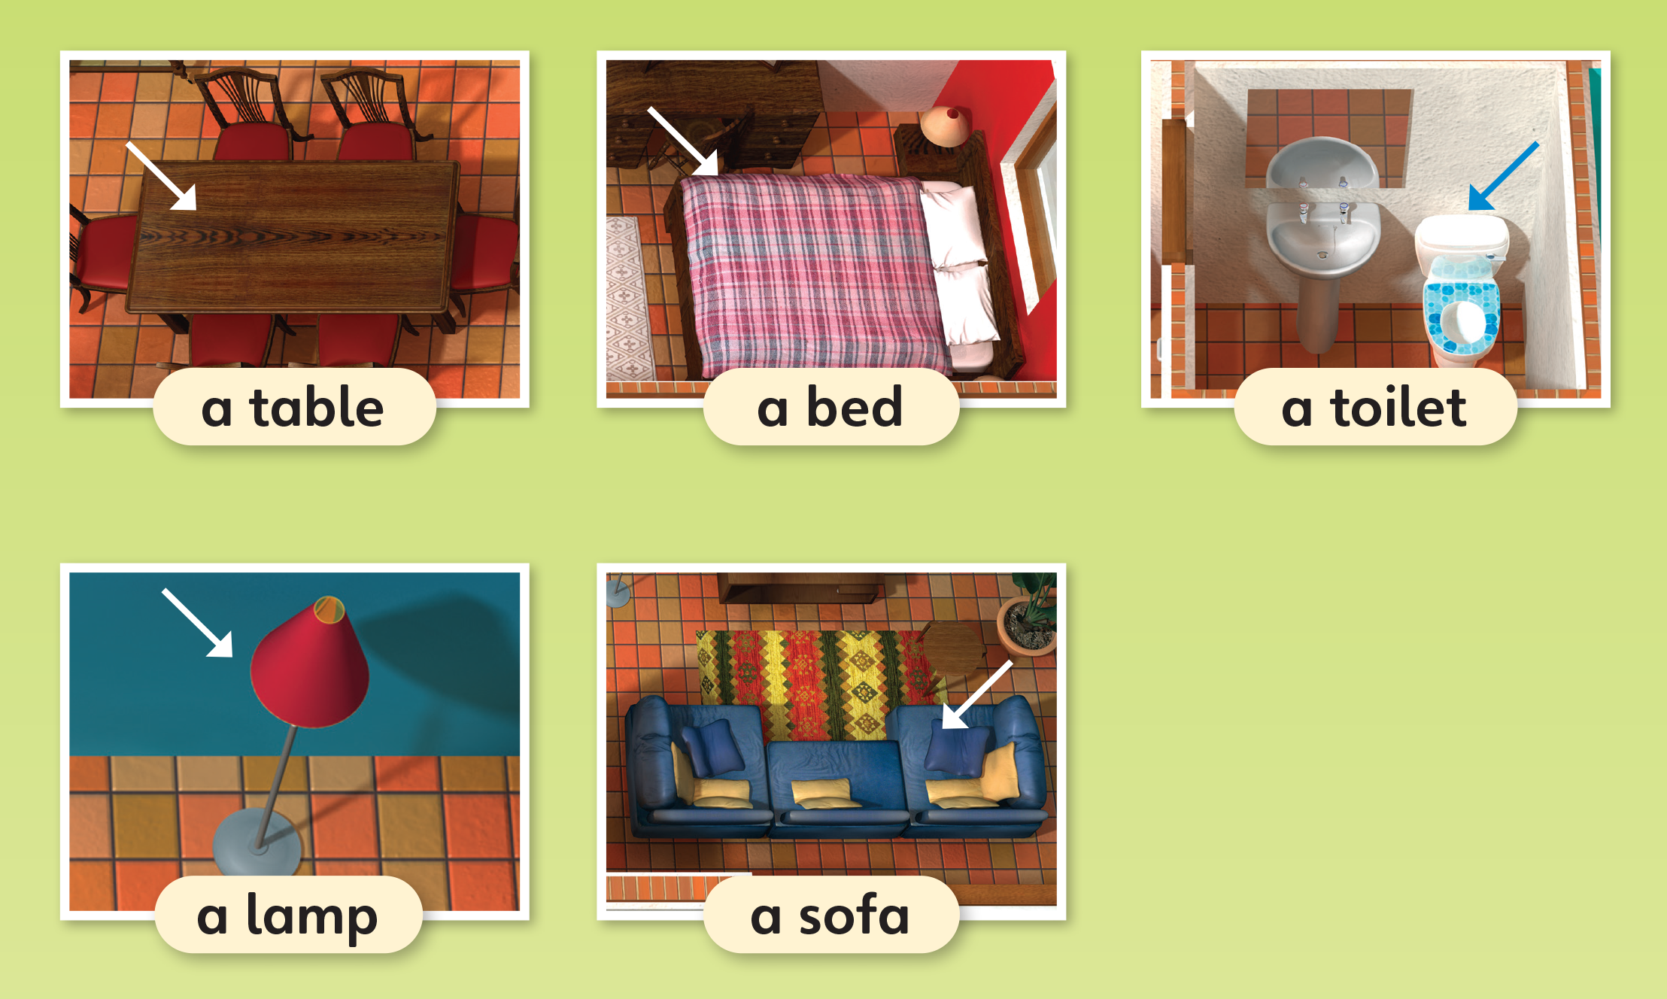
1
Look and listen. Repeat.
TR: B3

Slide 14
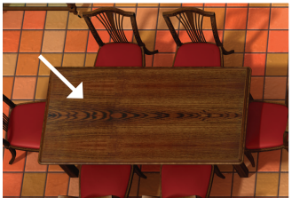
a table
/ə/ /ˈteɪbl/

Slide 15
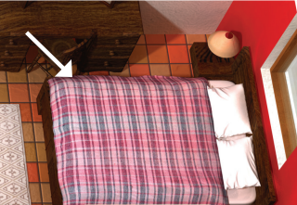
a bed
/ə/ /bed/

Slide 16
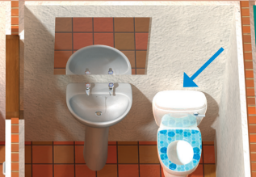
a toilet
/ə/ /ˈtɔɪlət/

Slide 17
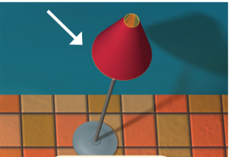
a lamp
/ə/ /læmp/

Slide 18
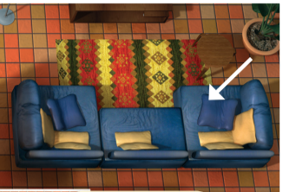
a sofa
/ə/ /ˈsəʊfə/

Slide 19
2
Listen and point. Say.
TR: B4

Slide 20
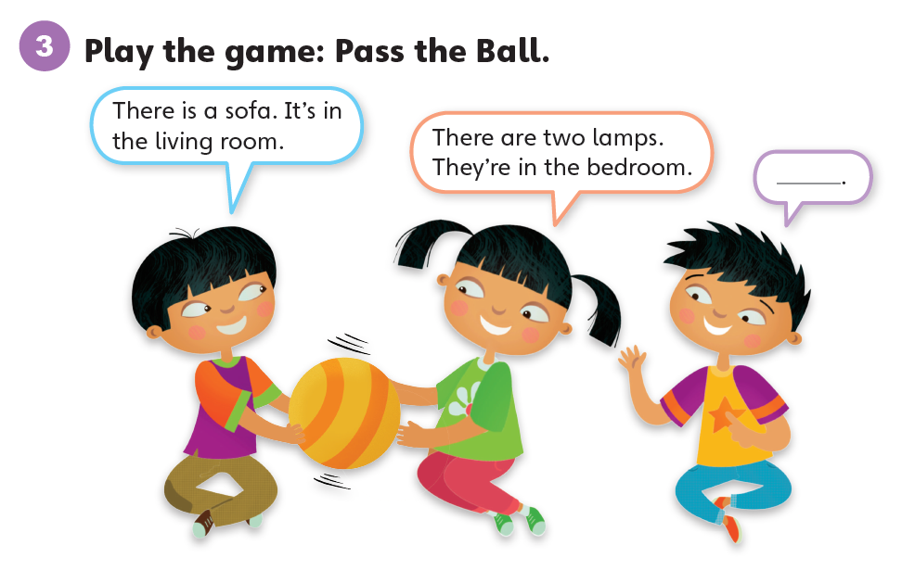

Slide 21
Unit 4:
My House
Lesson 3

Slide 22
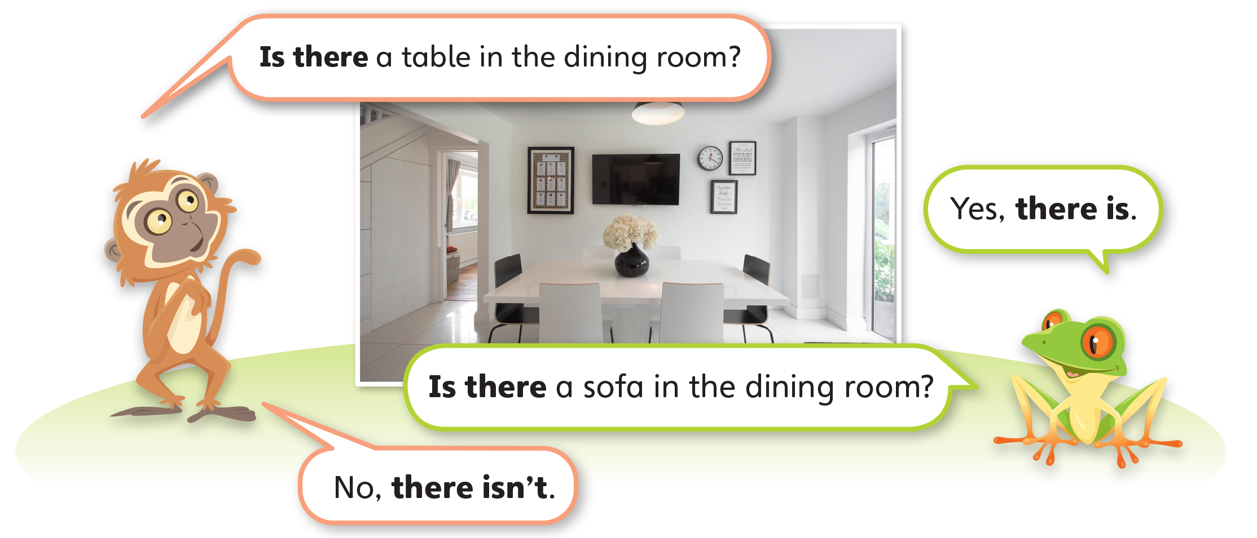
1
Look and listen. Repeat. TR: B5

Slide 23
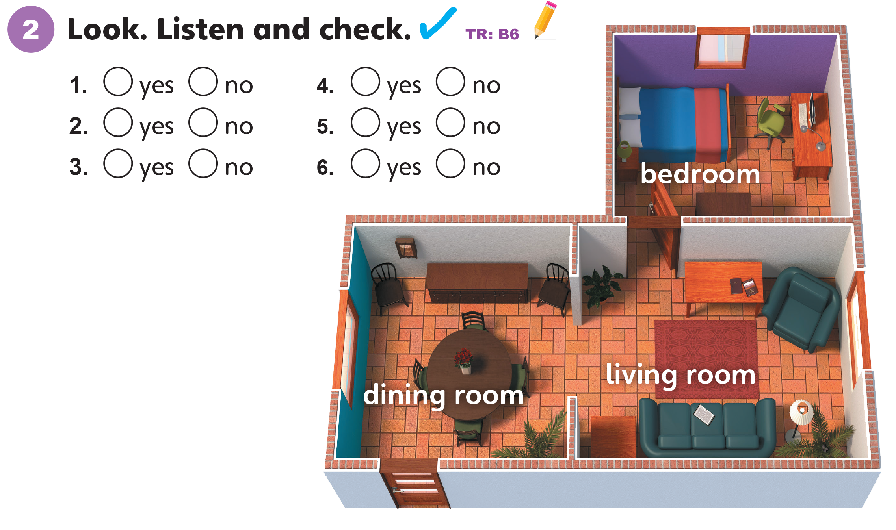

Slide 24
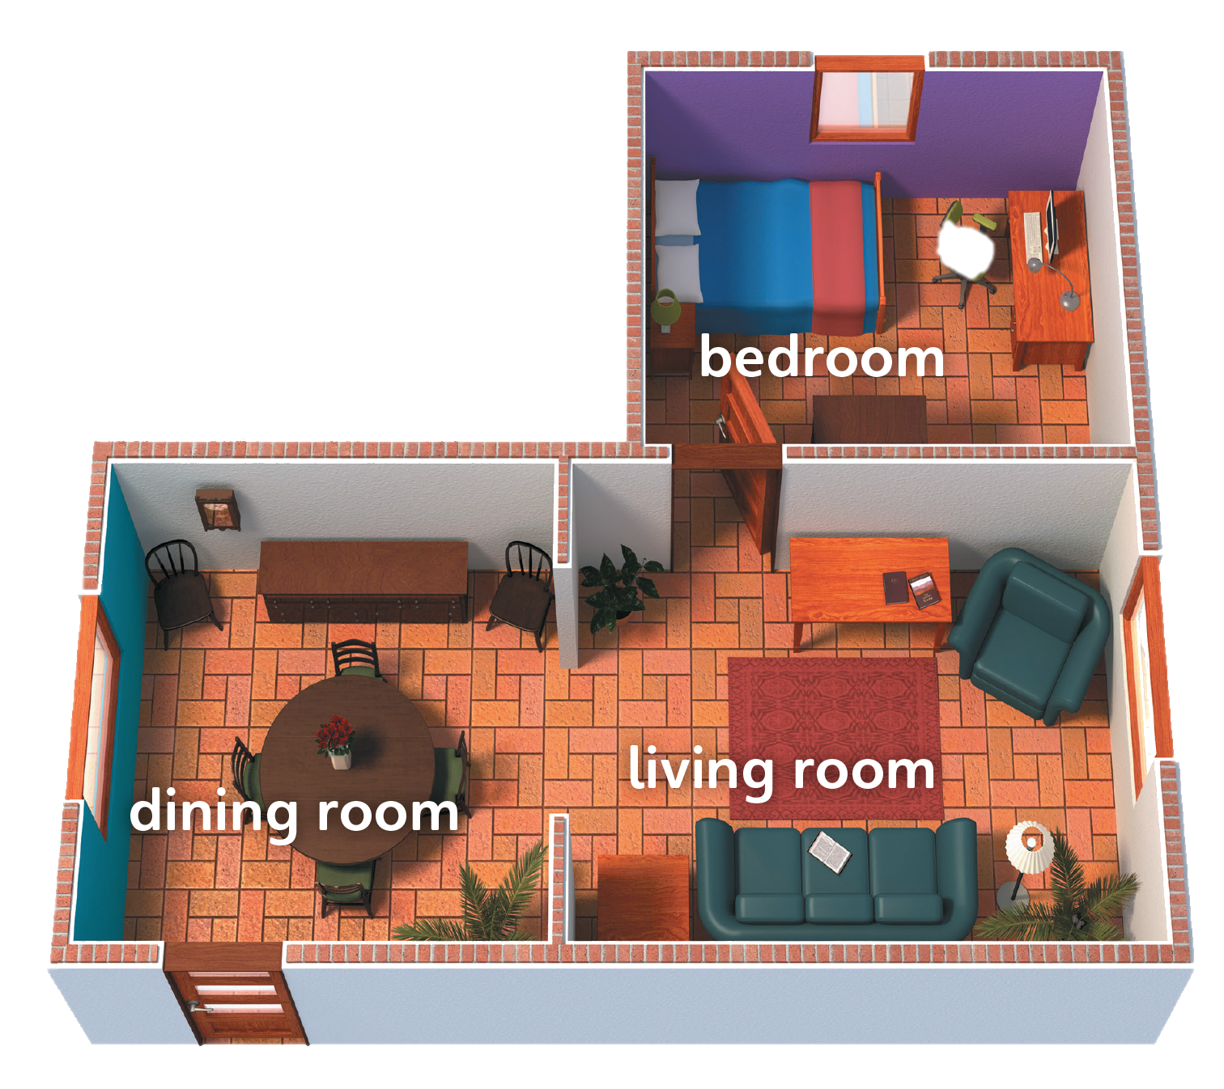
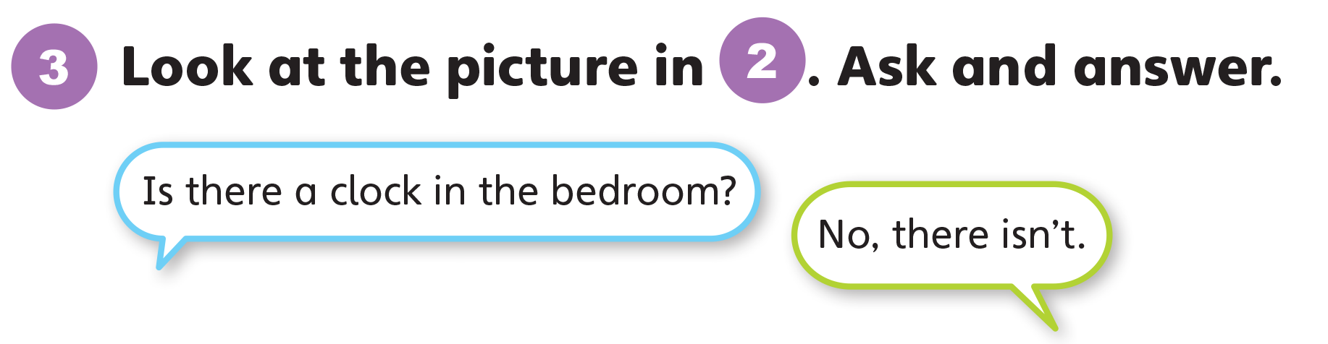

Slide 25
Unit 4:
My House
Lesson 4

Slide 26
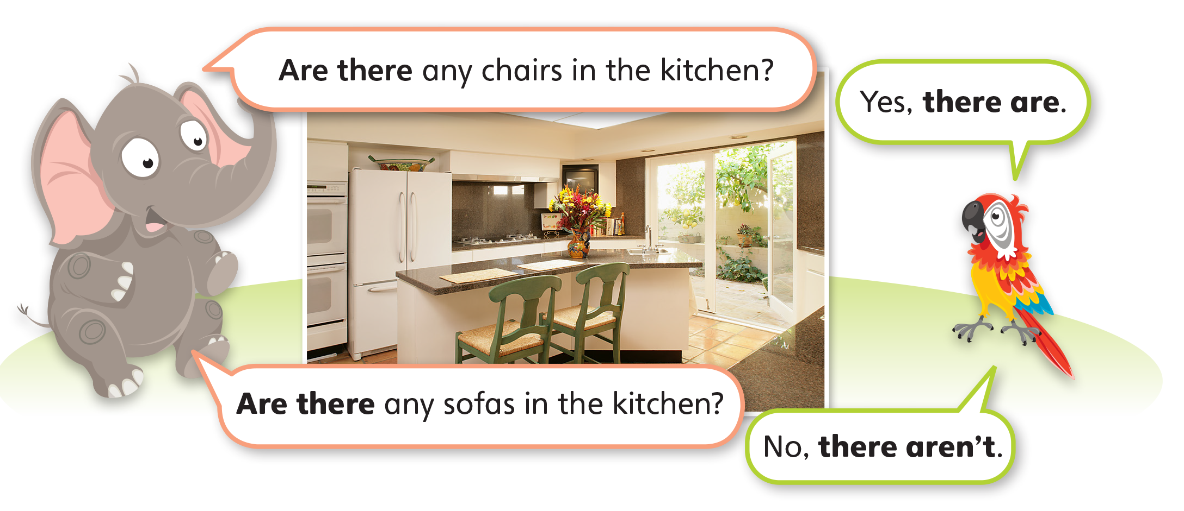
1
Look and listen. Repeat. TR: B7

Slide 27
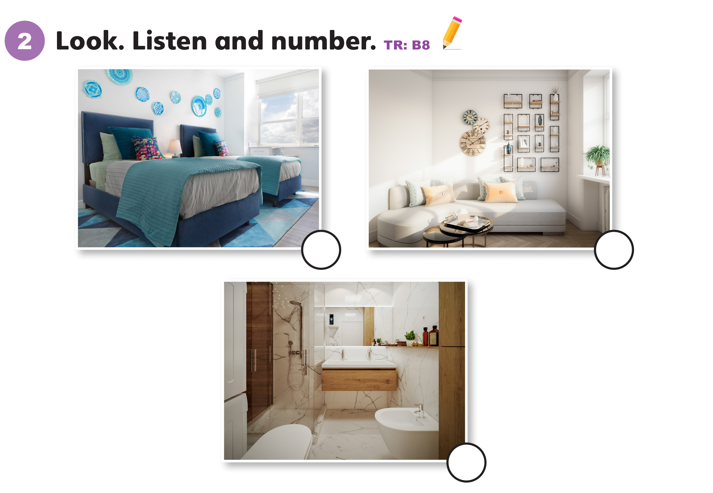
2
1
3

Slide 28
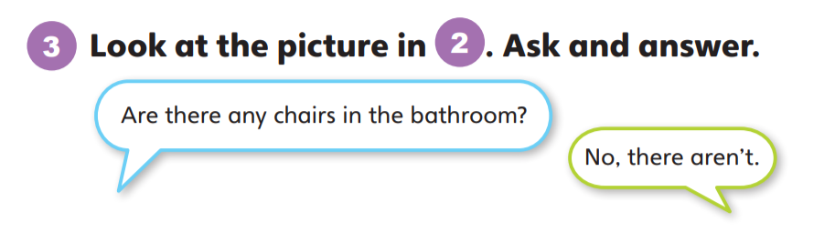
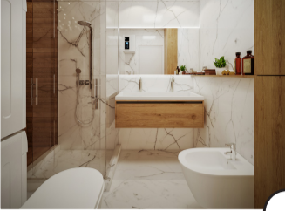
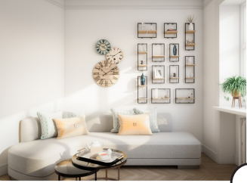
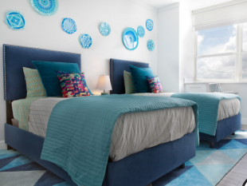

Slide 29
Unit 4:
My House
Lesson 5

Slide 30
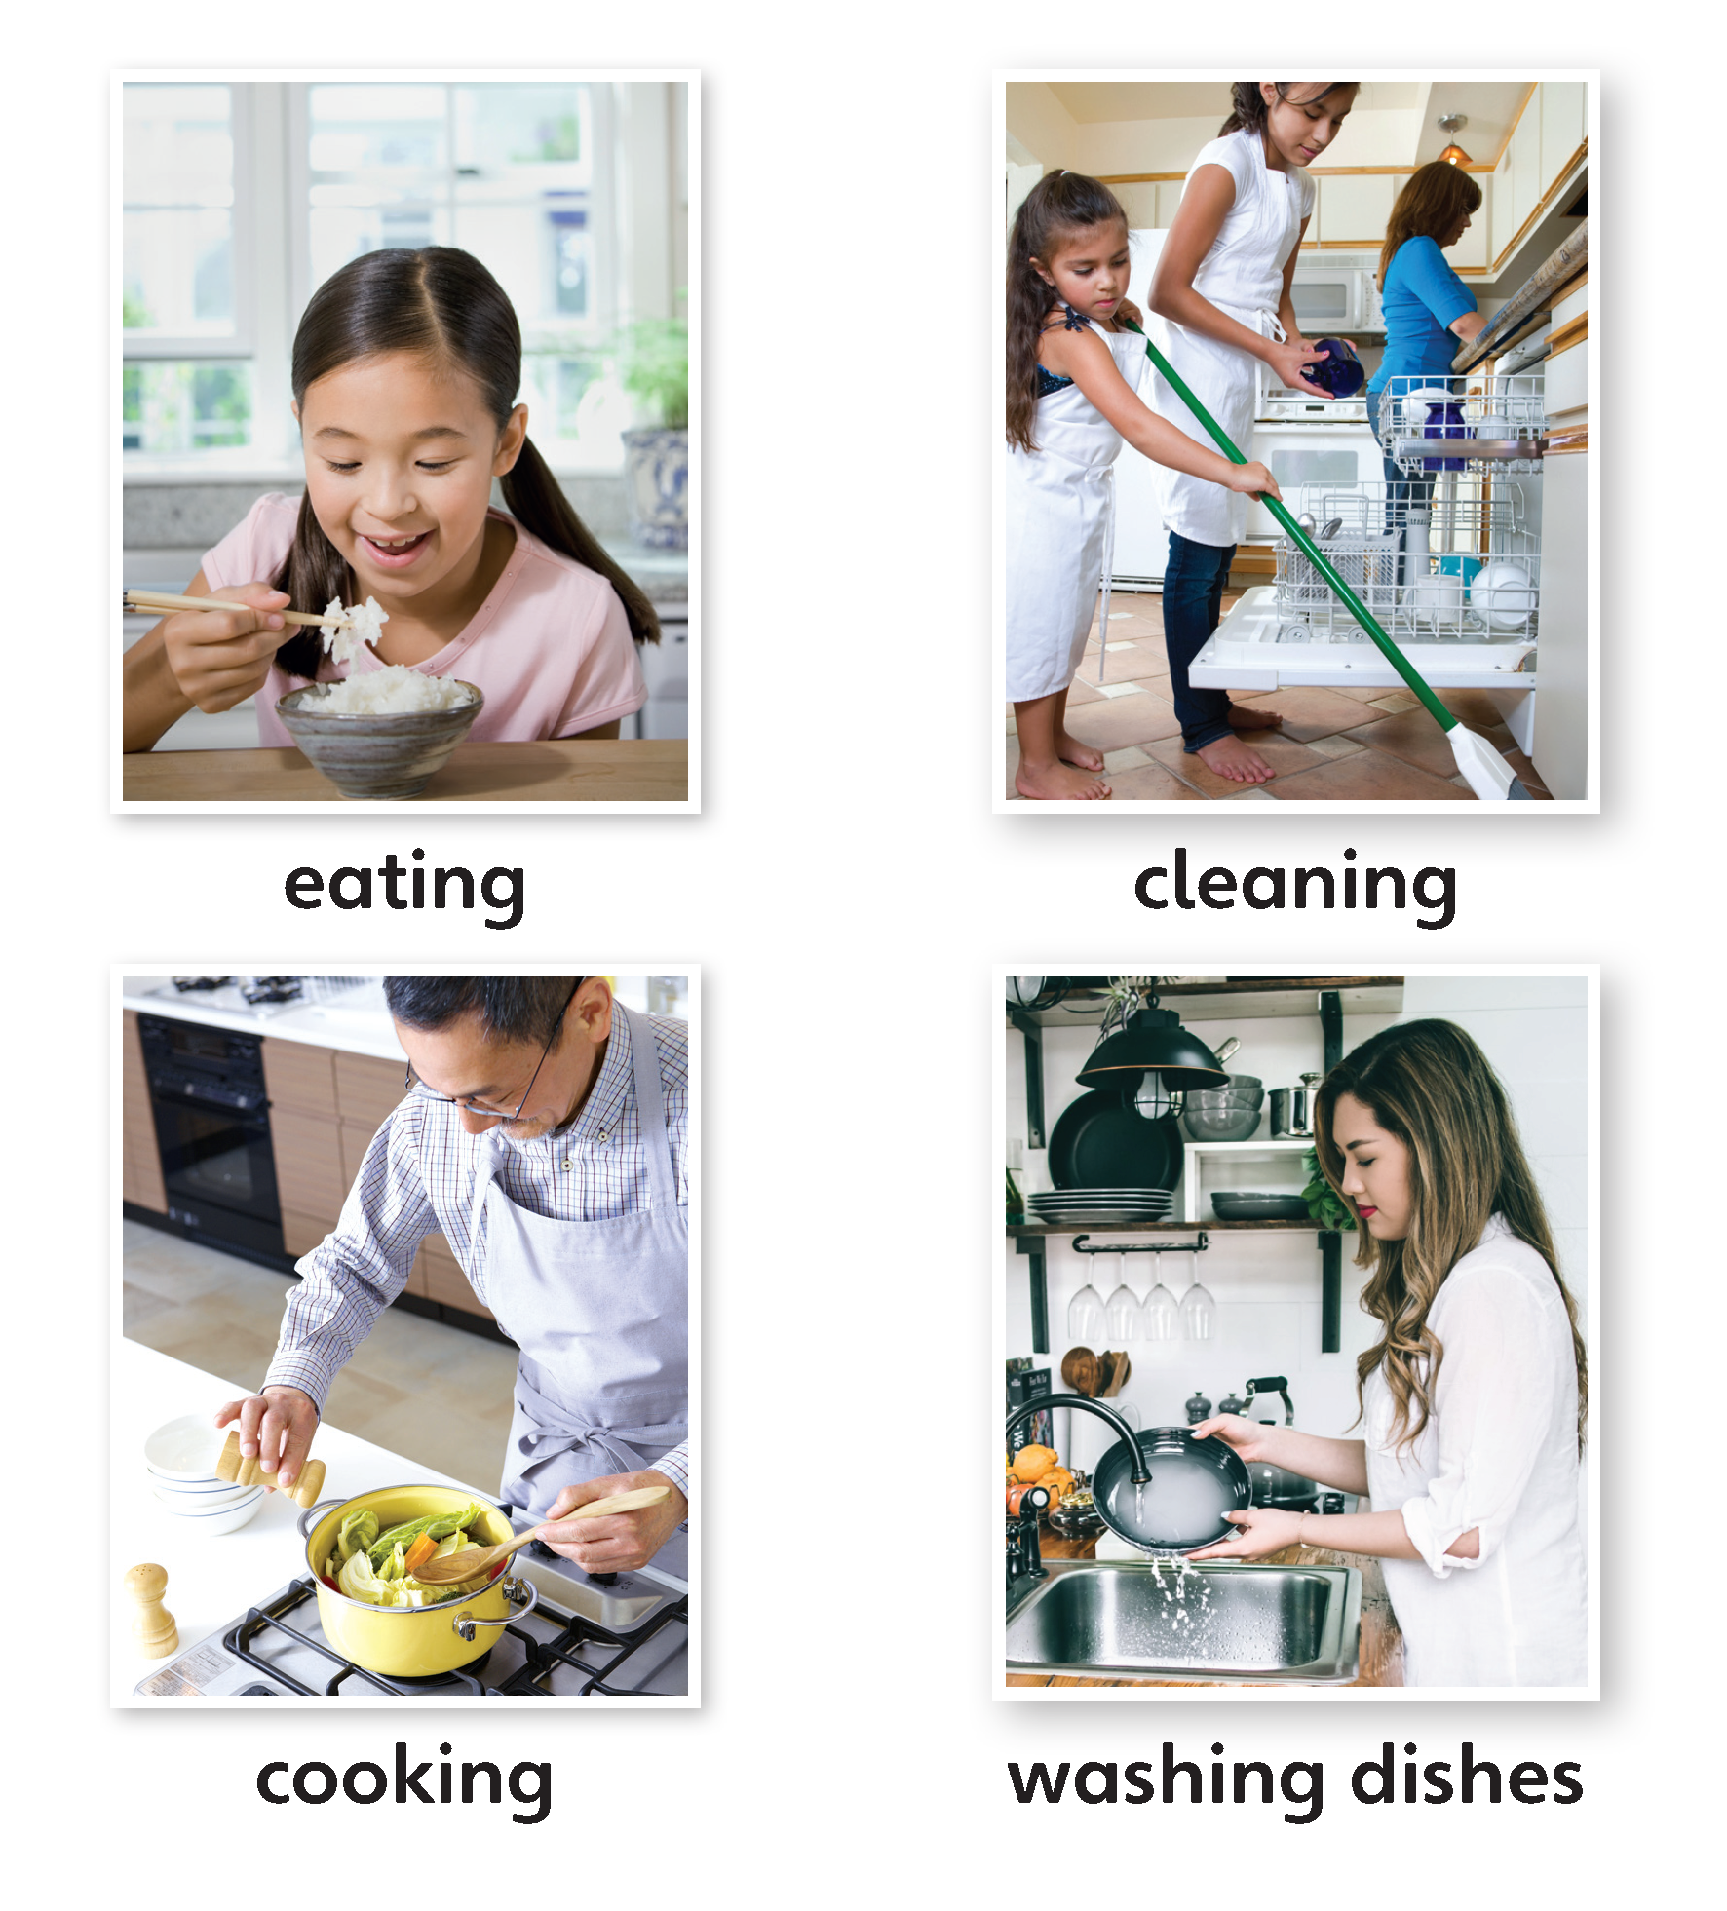
1
Look and listen. Repeat. TR: B9

Slide 31
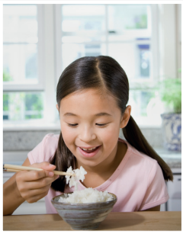
eating
/ˈiːtɪŋ/

Slide 32
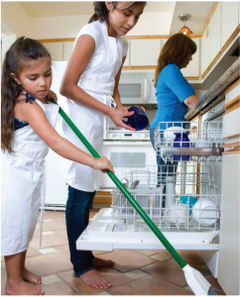
cleaning
/ˈkliːnɪŋ/

Slide 33
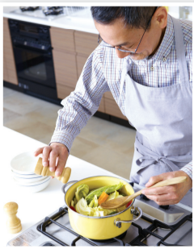
cooking
/ˈkʊkɪŋ/

Slide 34
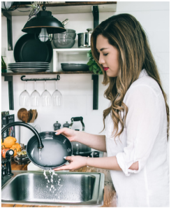
washing dishes
/ˈwɑːʃɪŋ/ /ˈdɪʃɪz/

Slide 35
2
Point and say.
eating
cleaning
cooking
washing dishes

Slide 36
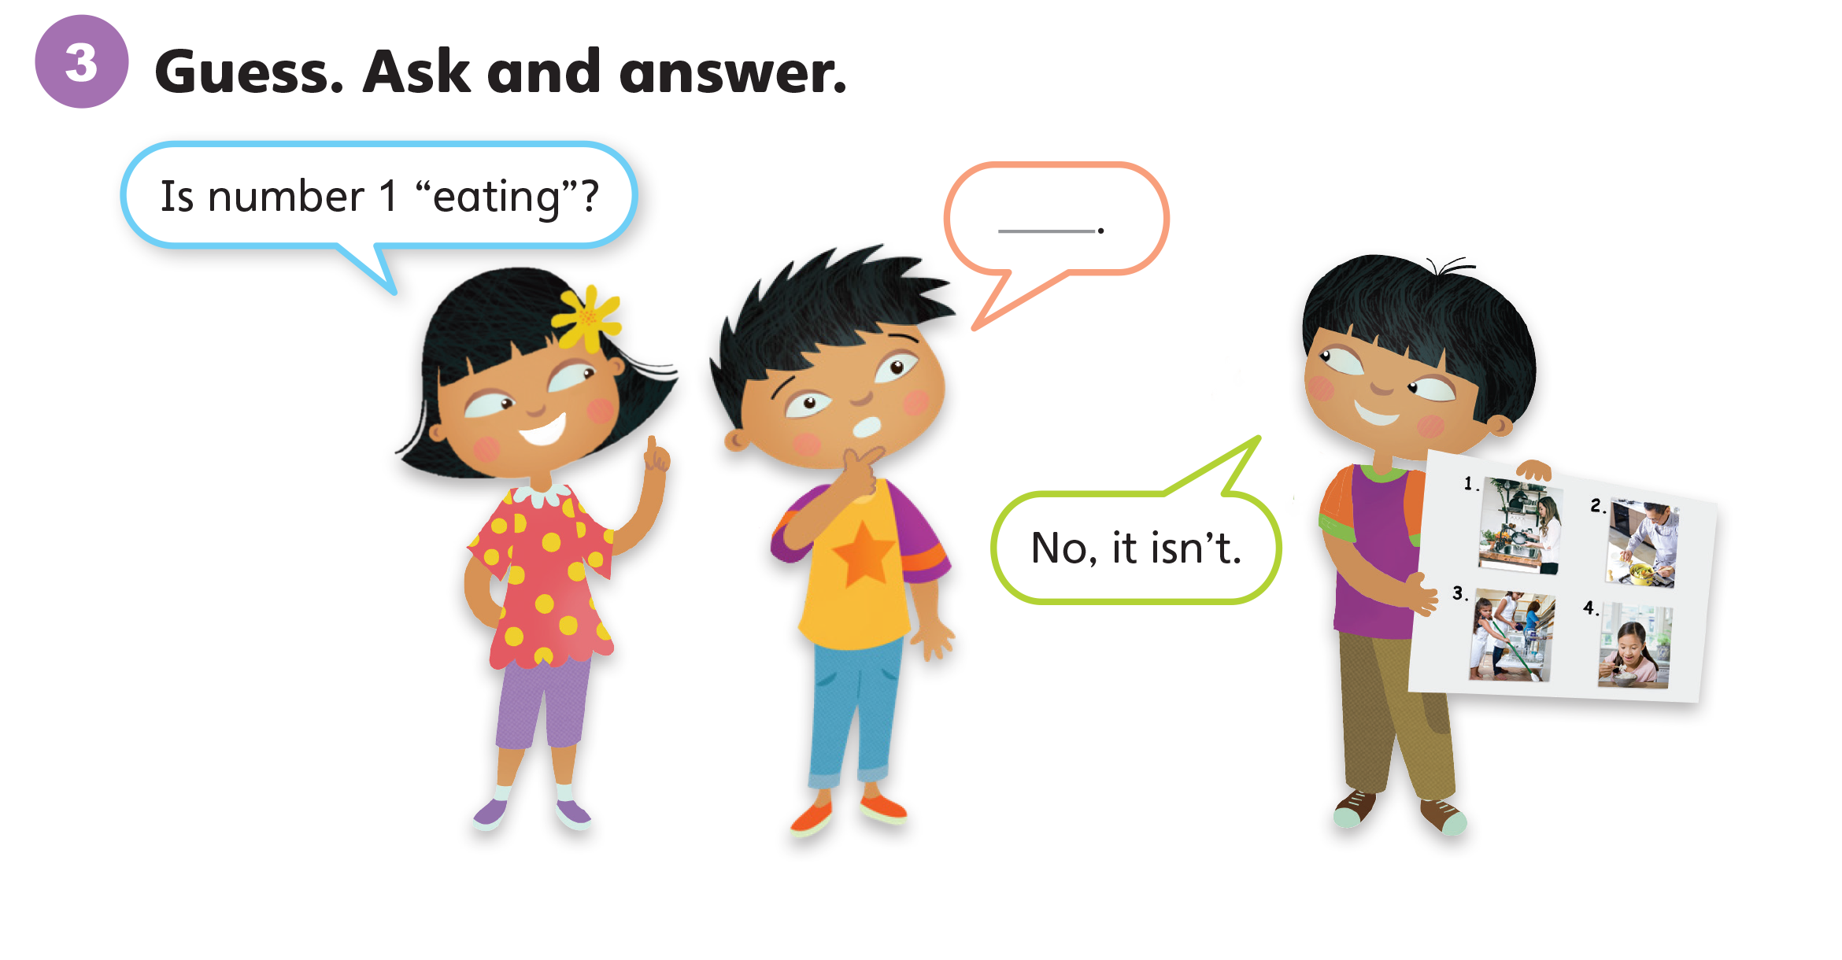

Slide 37
Unit 4:
My House
Lesson 6

Slide 38
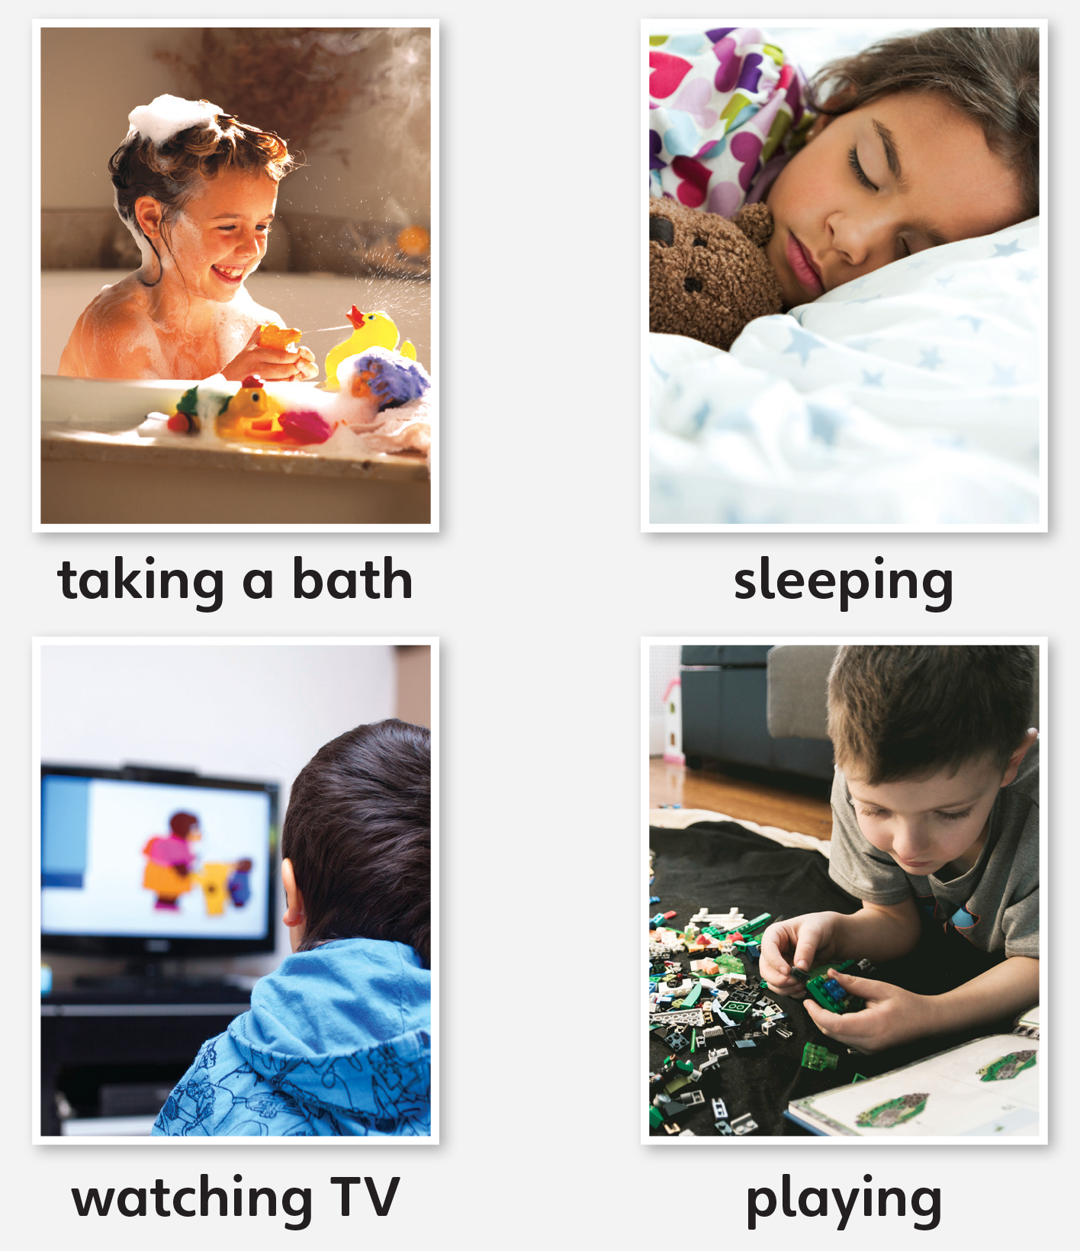
1
Look and listen. Repeat. TR: B10

Slide 39
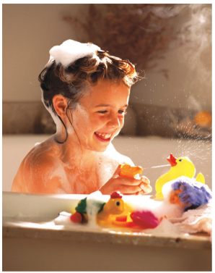
taking a bath
/teɪkɪŋ/ /ə/ /bæθ/

Slide 40

sleeping
/ˈsliːpɪŋ/

Slide 41
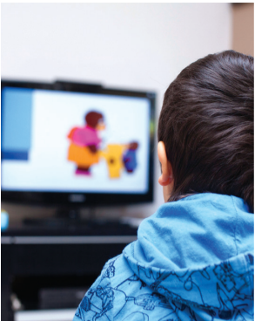
watching TV
/ˈwɑːtʃɪŋ/ /ˌtiːˈviː/

Slide 42
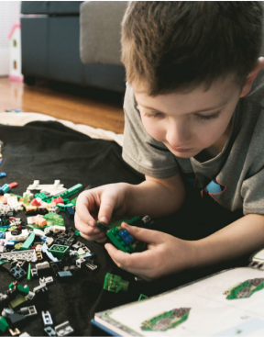
playing
/ˈpleɪɪŋ/

Slide 43
2
Point and say.
taking a bath
sleeping
watching TV
playing

Slide 44
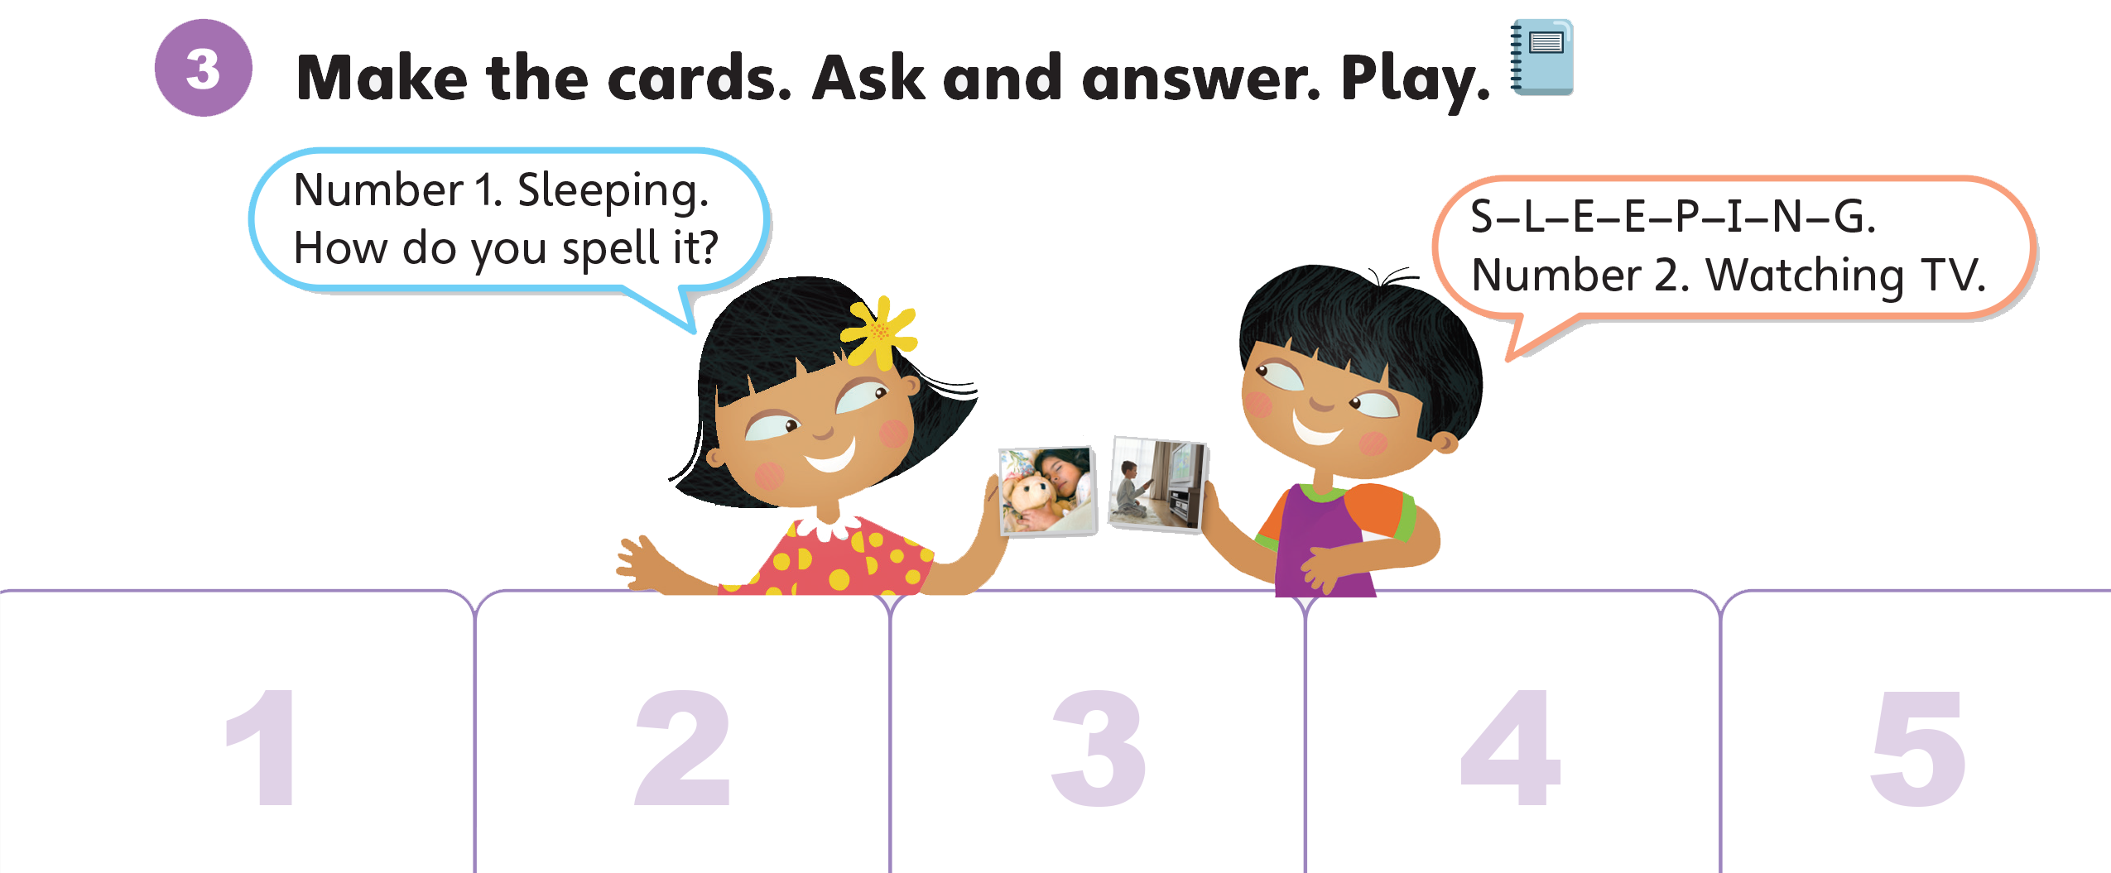


Slide 45
Unit 4:
My House
Lesson 7

Slide 46
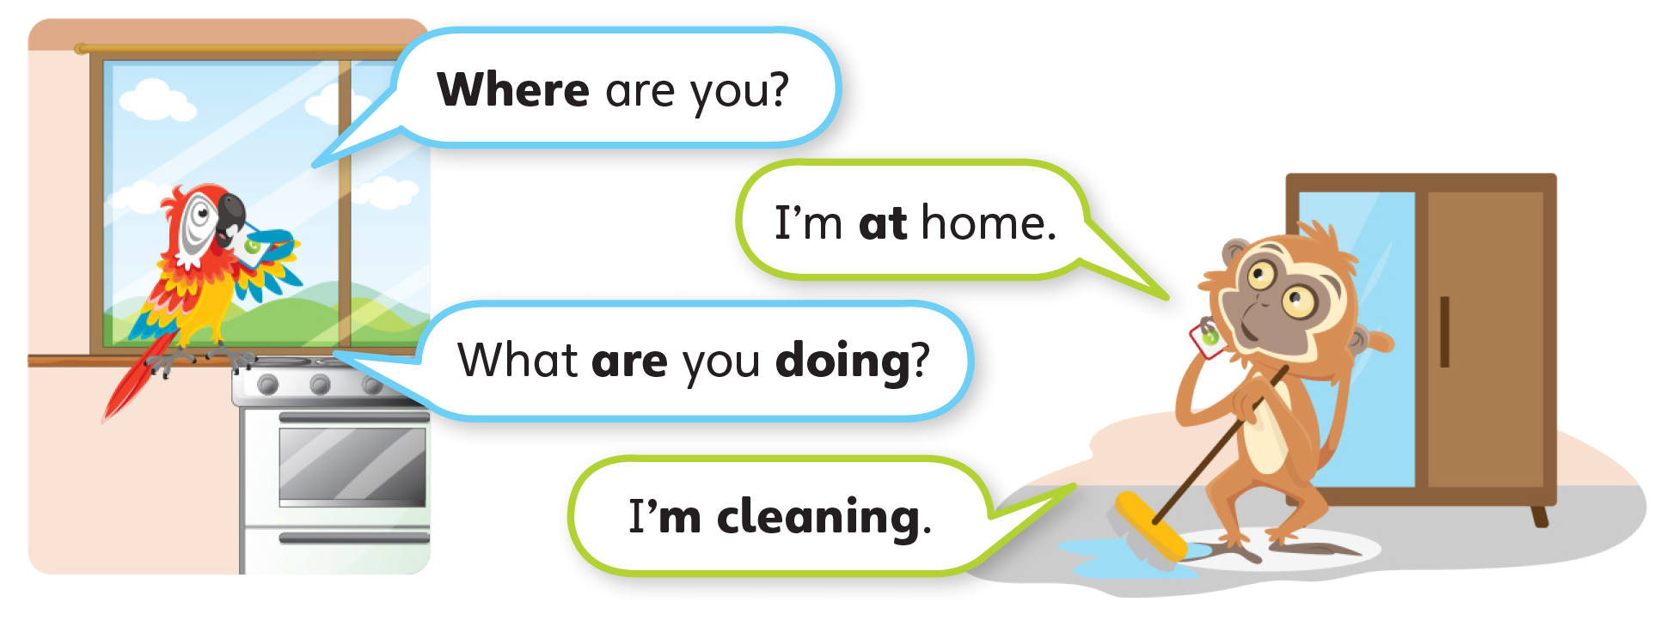
1
Look and listen. Repeat. TR: B11

Slide 47
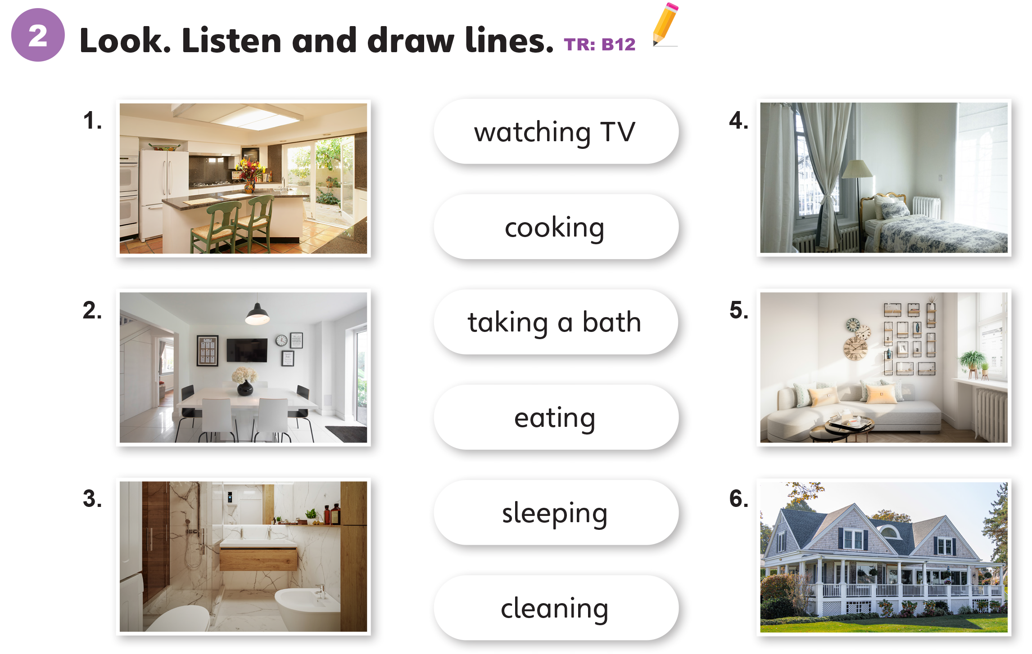

Slide 48
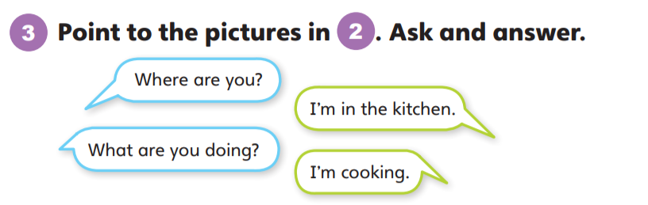

Slide 49
Unit 4:
My House
Lesson 8

Slide 50
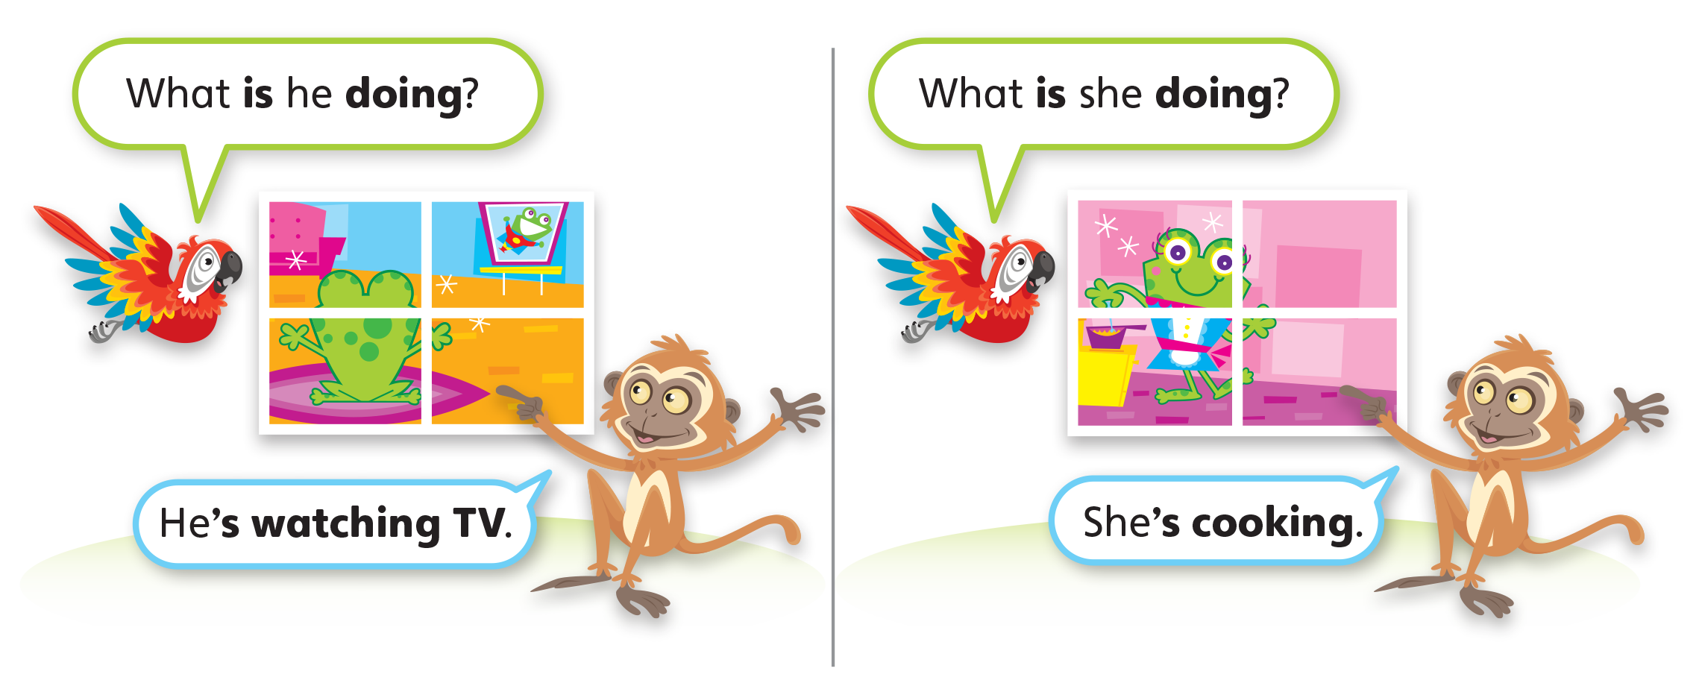
1
Look and listen. Repeat. TR: B13

Slide 51
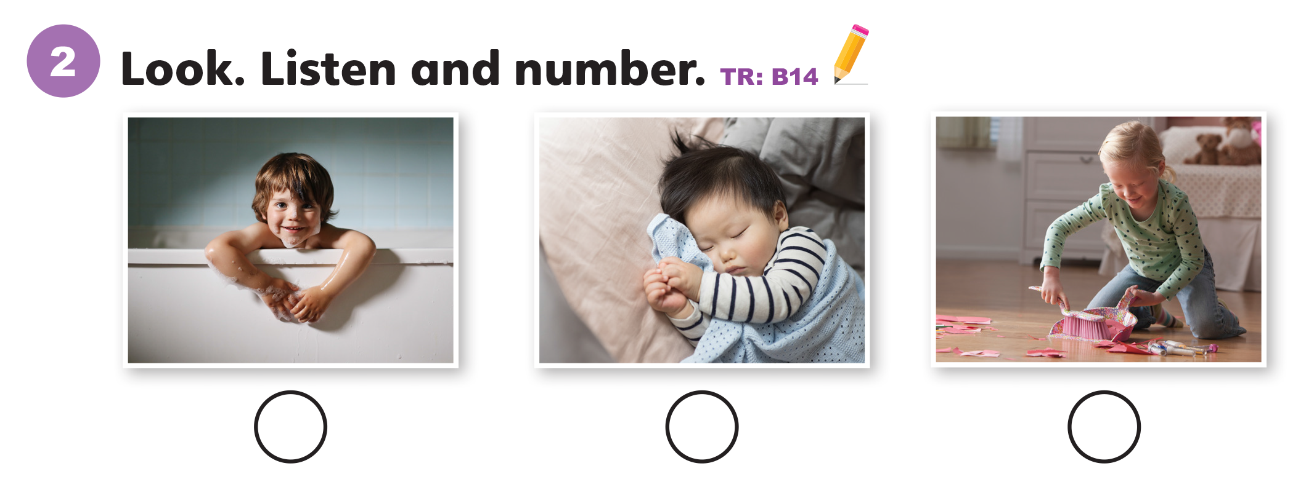
2
3
1

Slide 52
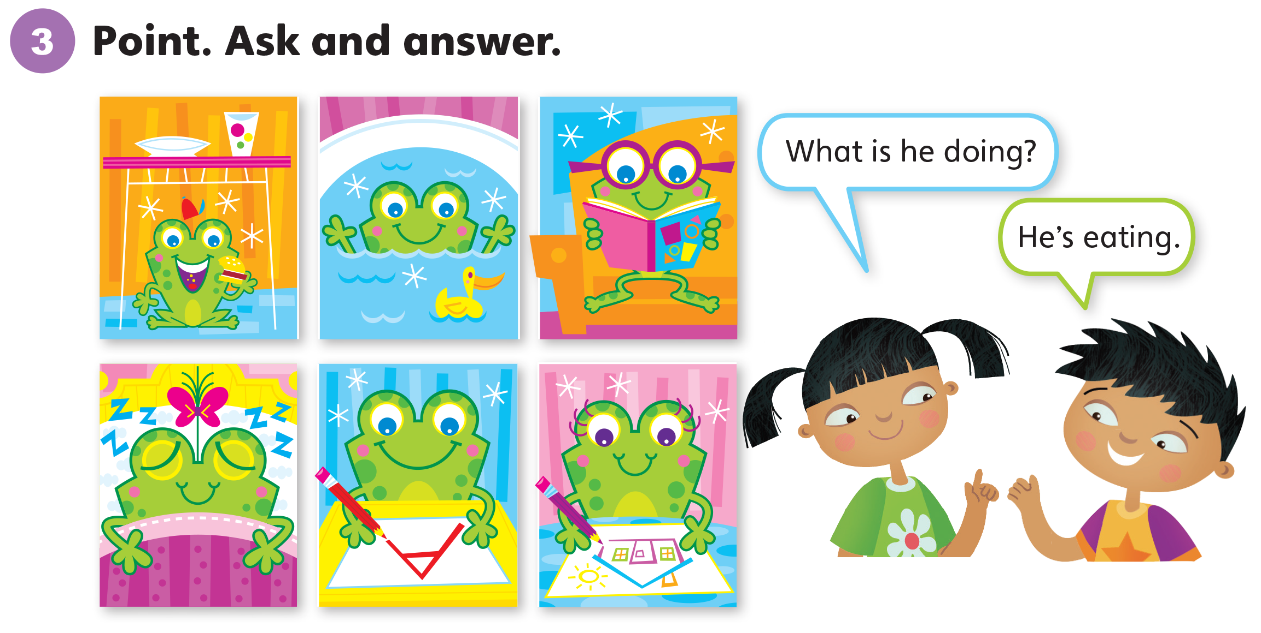

Slide 53
Unit 4:
My House
Lesson 9

Slide 54
1
Listen and repeat. TR: B15
o
  sofa
  home

Slide 55
2
Listen and sing. TR: B16
Where do you sleep?
I sleep in the bedroom.
Is there a bed?
Yes, there is.
At home, my home, at home, where I live.

Slide 56
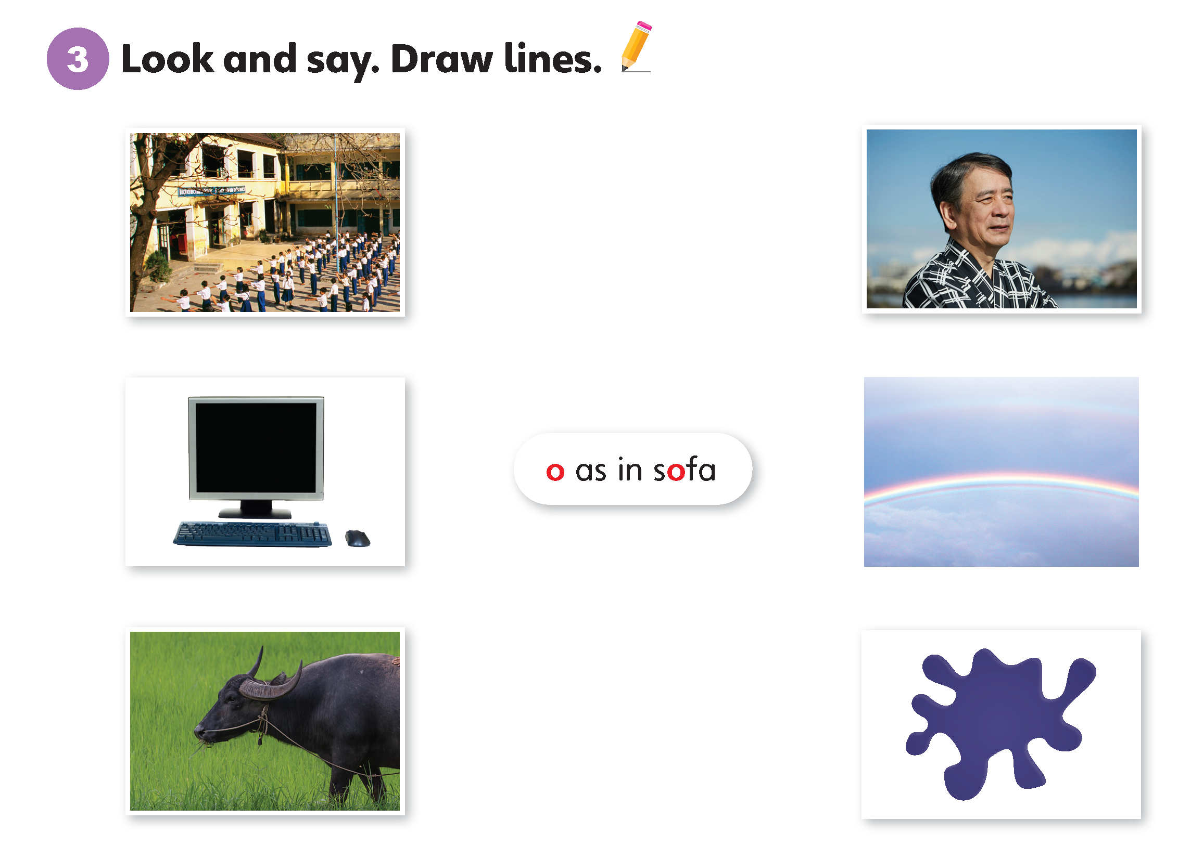

Slide 57
Unit 4:
My House
Lesson 10

Slide 58
1
Listen and repeat. TR: B17
ou
oi
  house
  cloud
  toilet
  point

Slide 59
2
Listen and chant. TR: B18
Where do you sleep?
I sleep on the cloud.
Is there a toilet?
No, no, there isn’t.
Where do you sleep?
I sleep on the cloud.
I am the moon. I like my cloud.
Point to the moon. Point to the cloud.
Point to the moon. Point to the cloud.

Slide 60
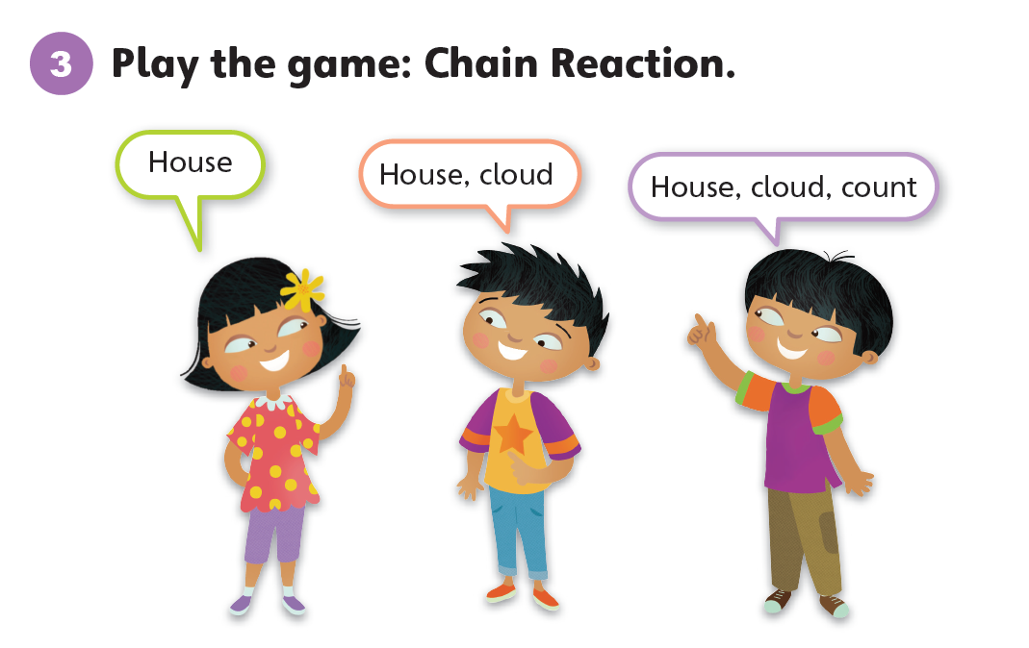

Slide 61
Unit 4:
My House
Lesson 11

Slide 62
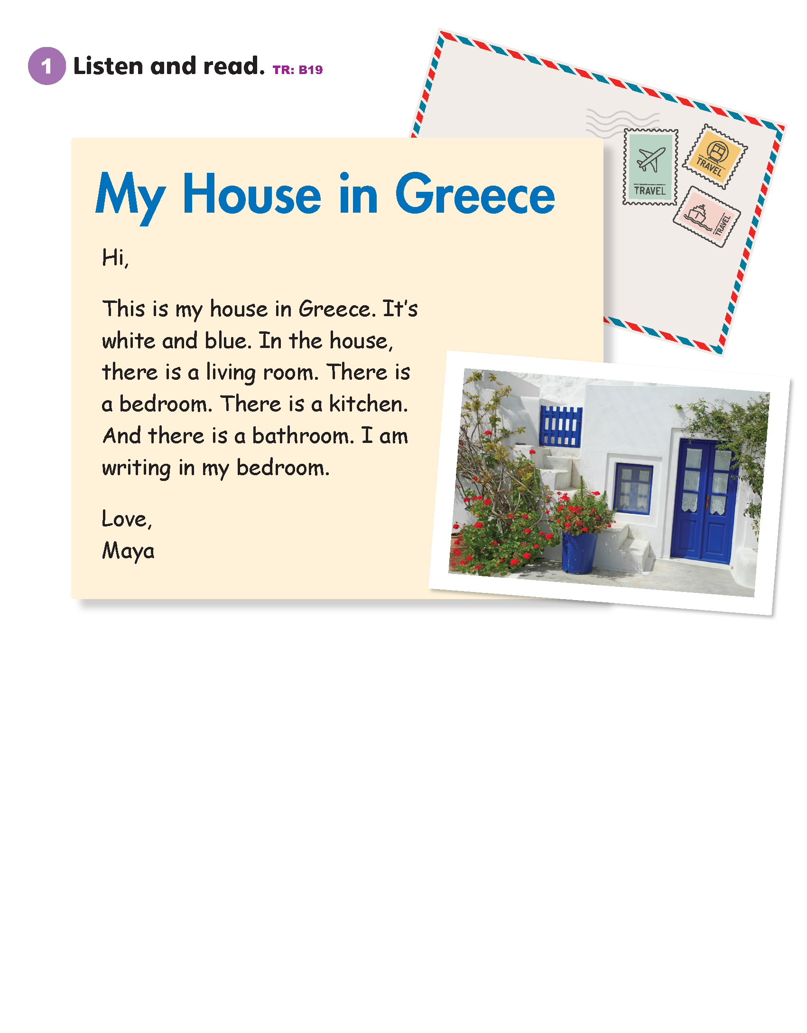

Slide 63
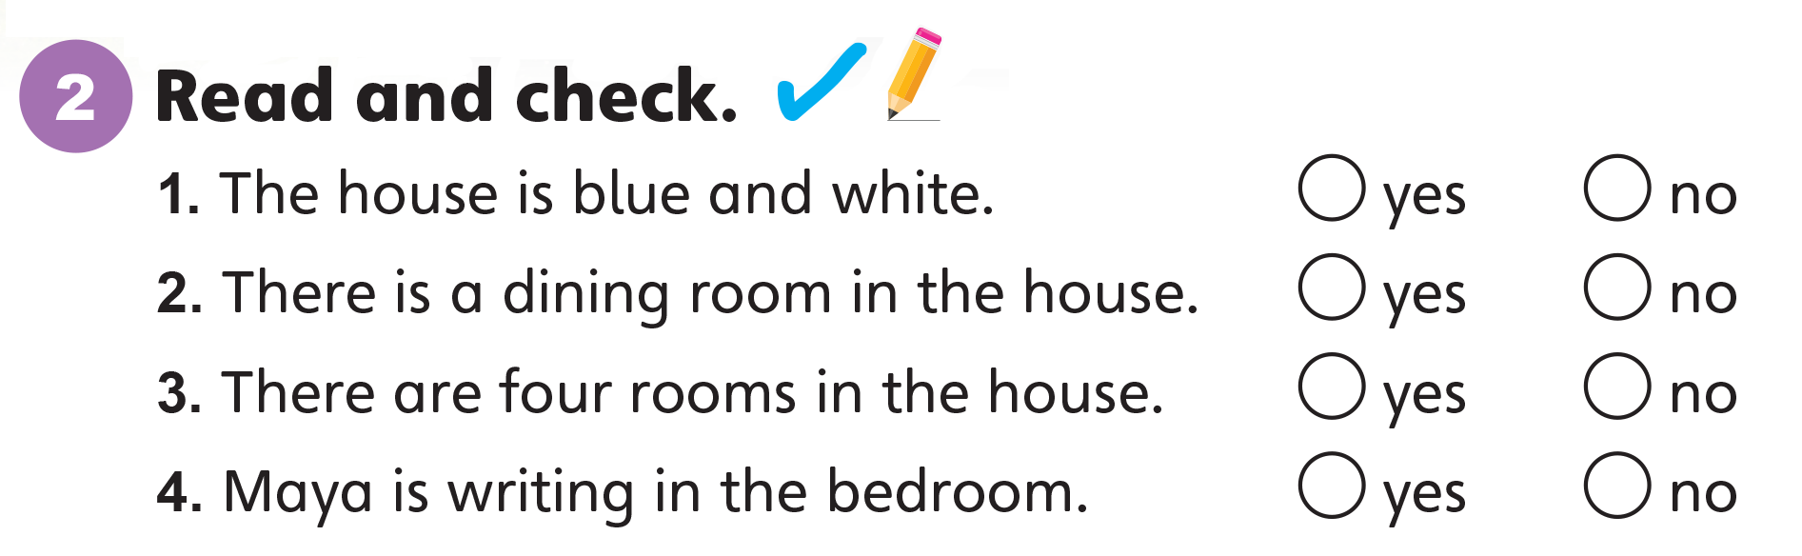

Slide 64
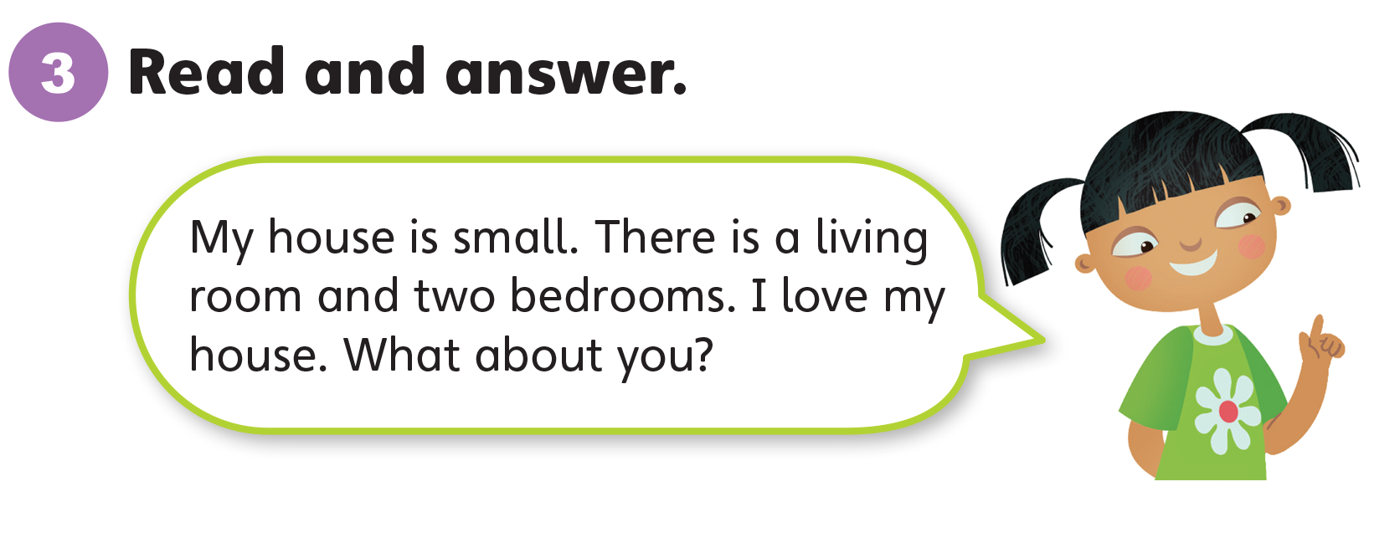

Slide 65
Unit 4:
My House
Lesson 12

Slide 66
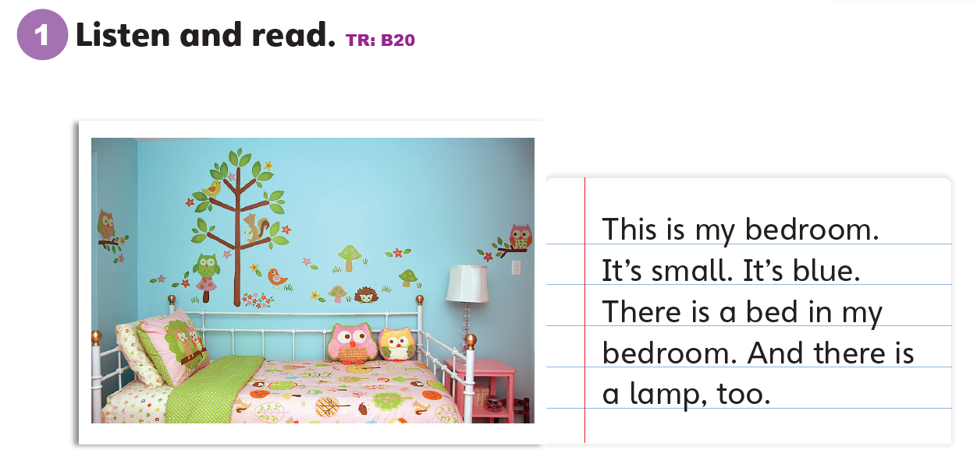

Slide 67
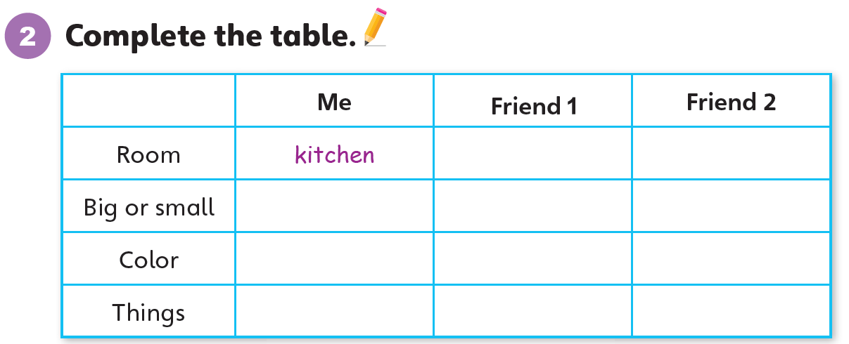

Slide 68


Slide 69
Unit 4:
My House
Value

Slide 70
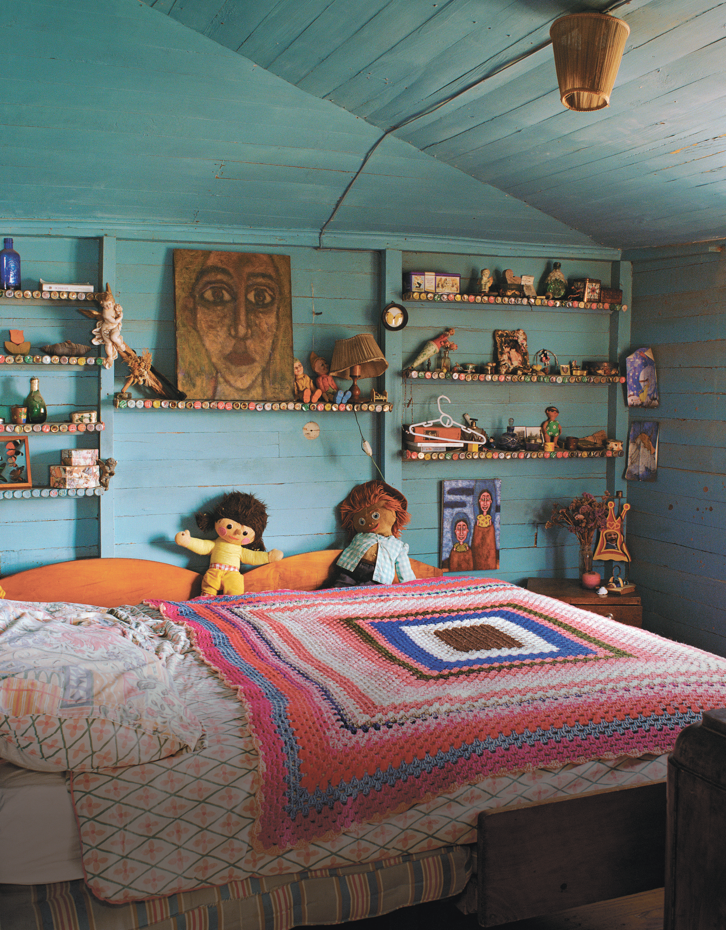
1
Look and listen. Repeat. TR: B21
Be neat.
I sleep in my bedroom. I love it. I clean it.

Slide 71
Be neat.
2
Think. What do you do at home?

Slide 72
Be neat.
3
Share.
I eat in my kitchen.
I love it. I clean it.

Slide 73
Thank you!

