Slide 1
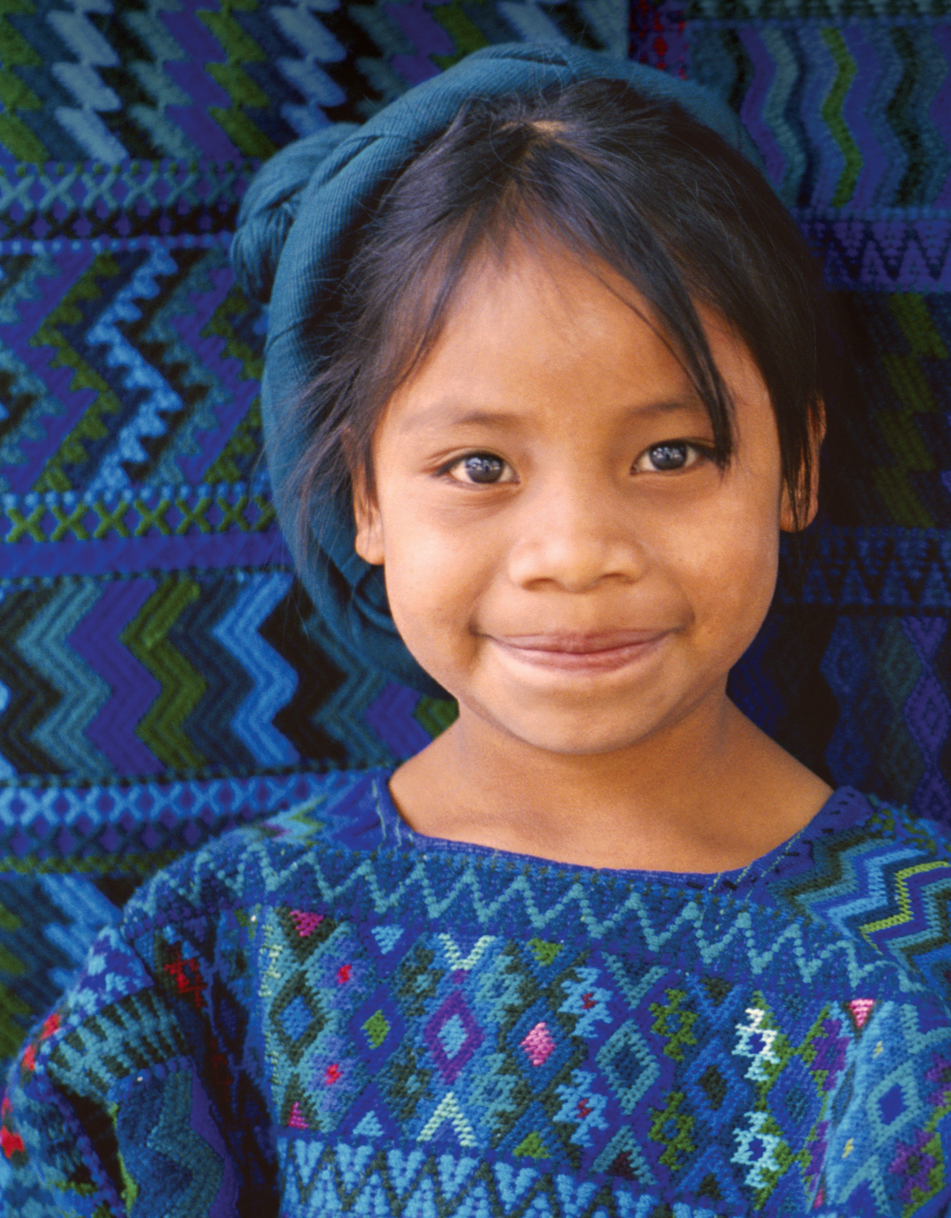
Unit 5
Cool Clothes

Slide 2
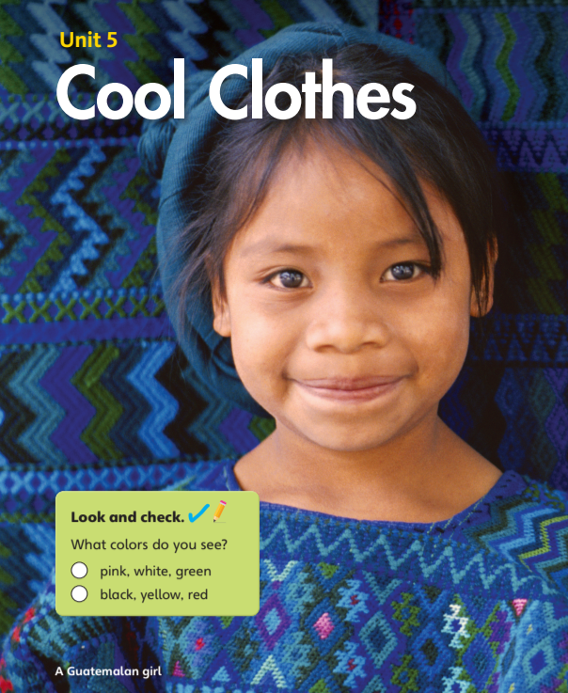


What colors do you see?
pink, white, green
black, yellow, red

Slide 3
Unit 5:
Cool Clothes
Lesson 1

Slide 4

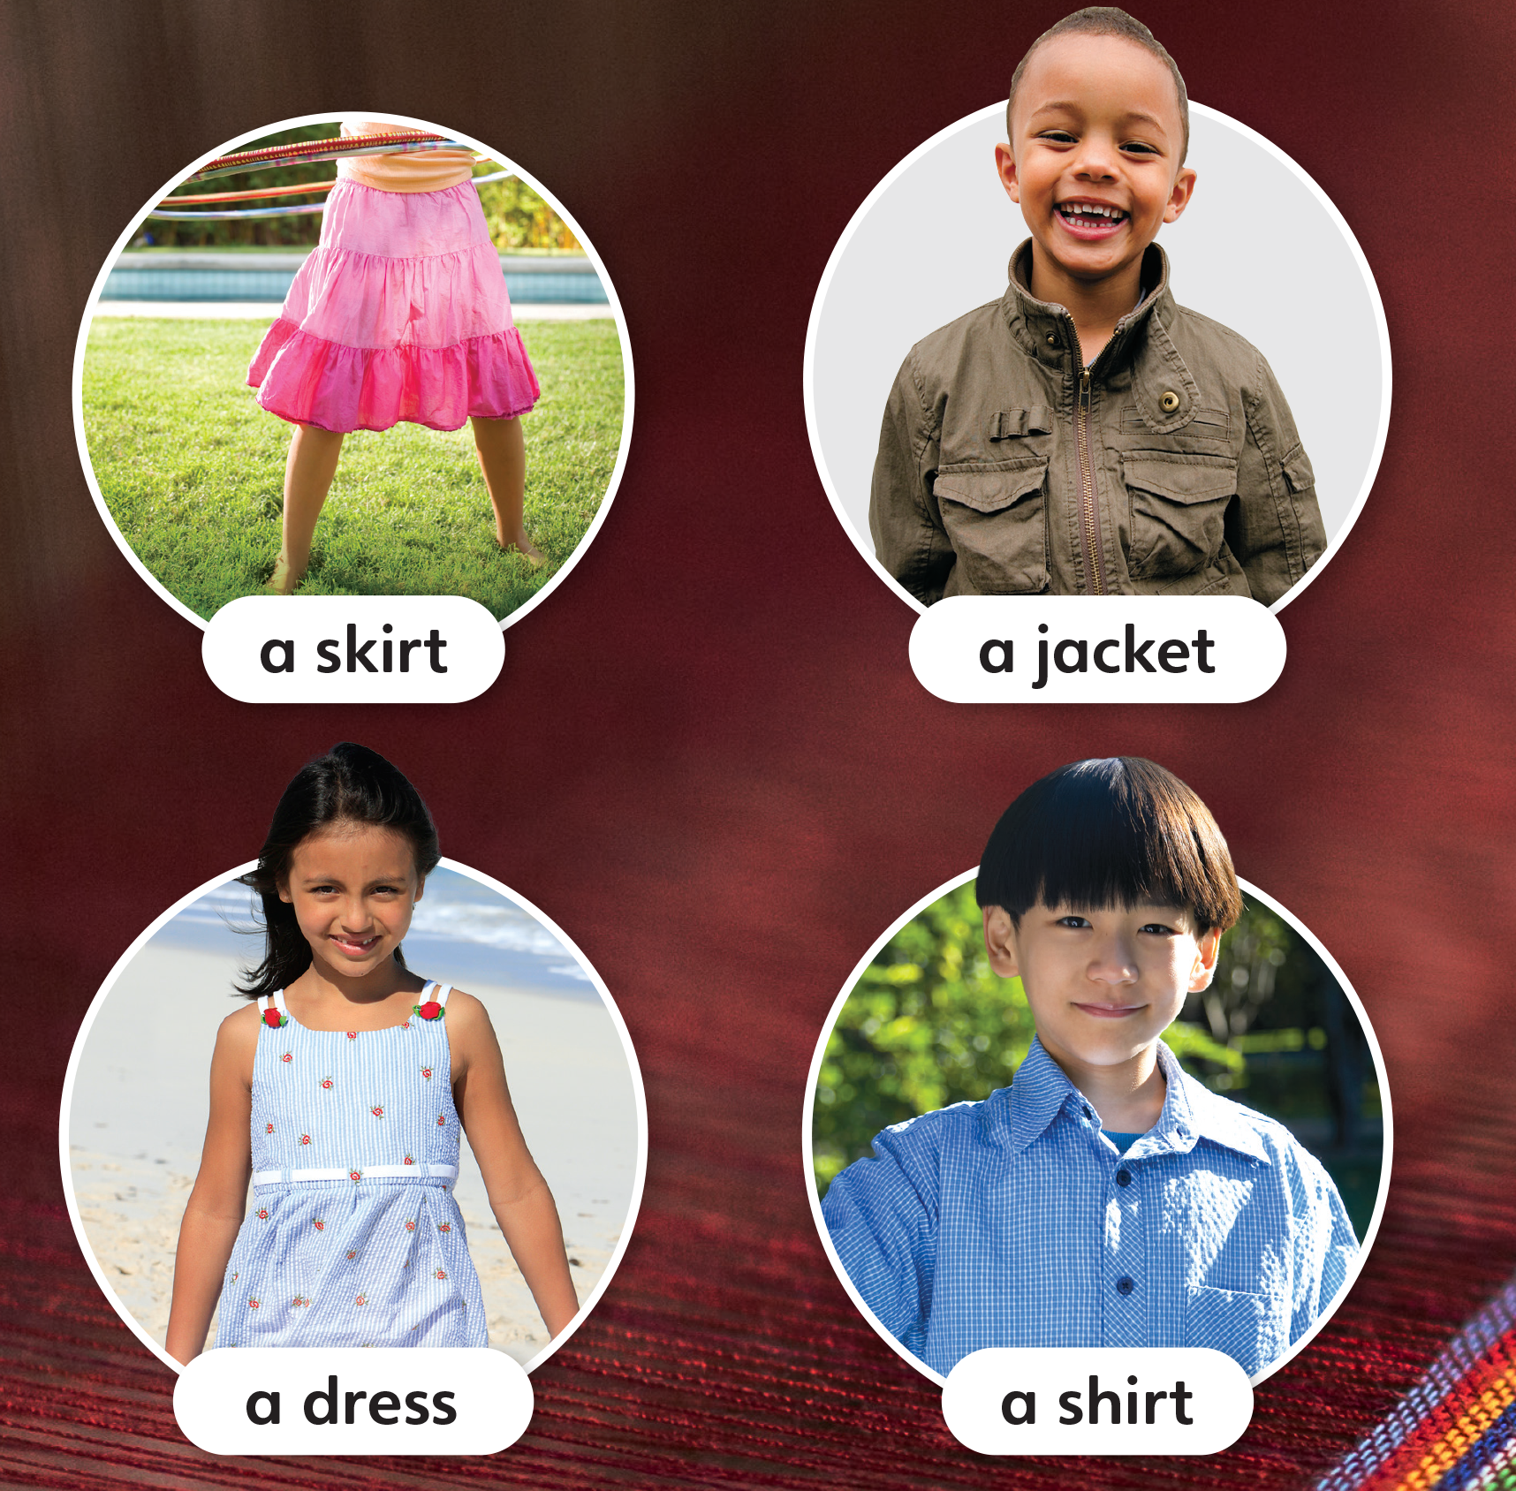
1
Look and listen. Repeat.
TR: B26

Slide 5
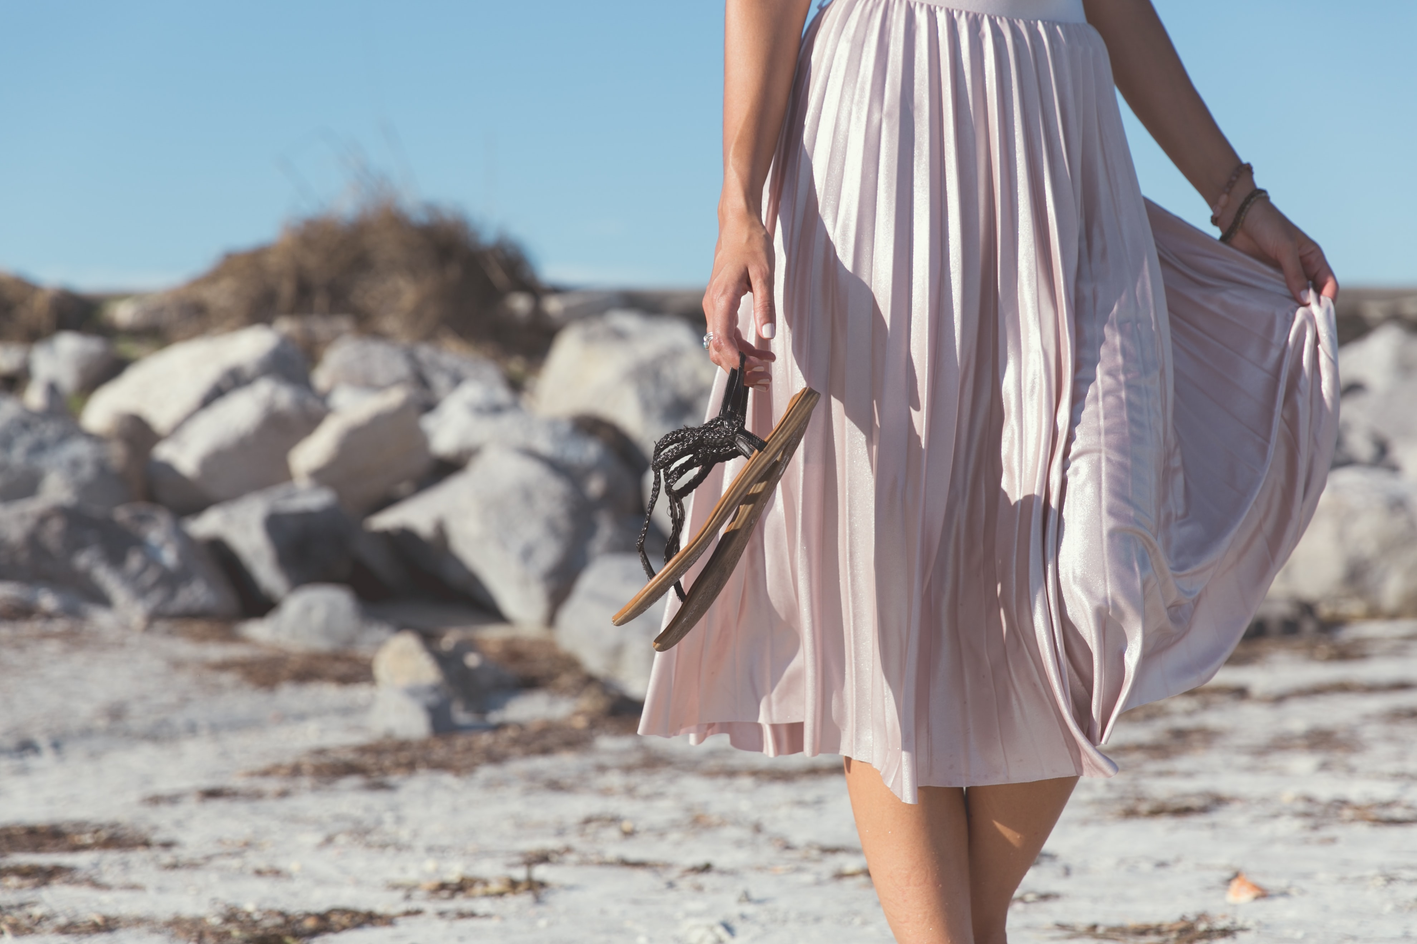
a skirt
/ə/ /skɜːrt/

Slide 6
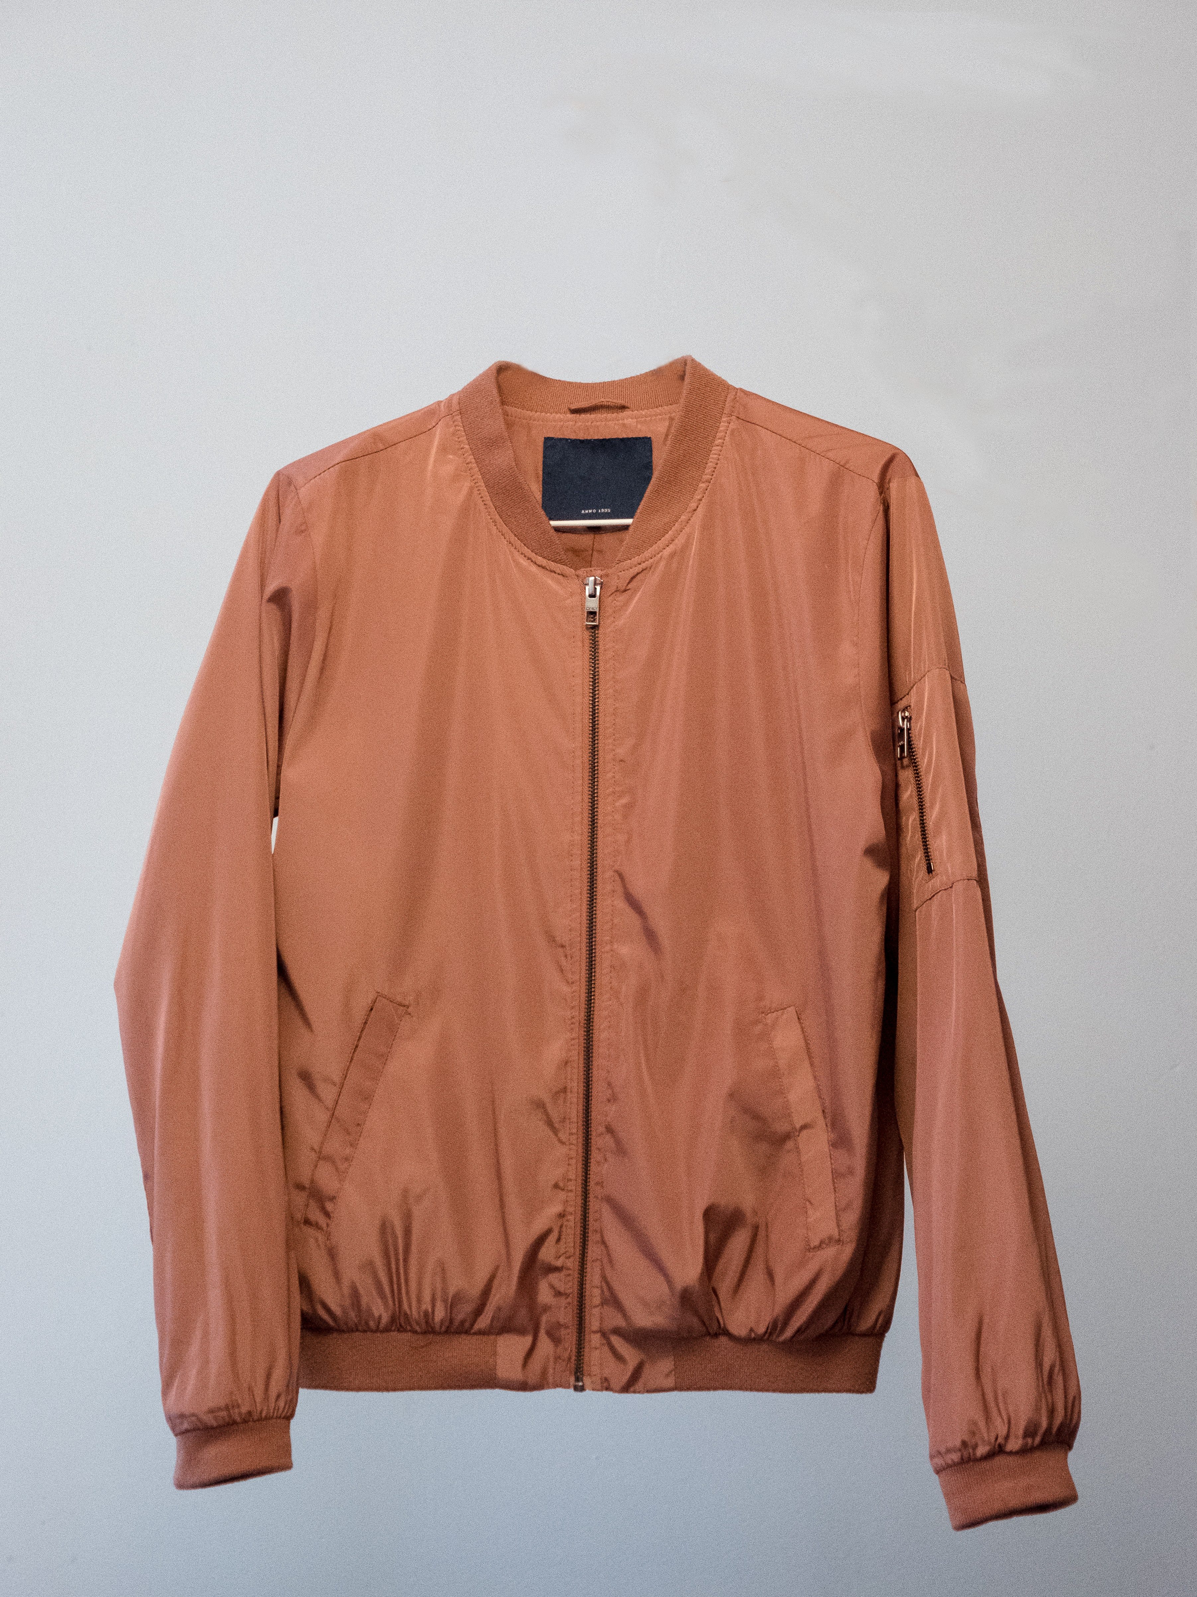
a jacket
/ə/ /ˈdʒækɪt/

Slide 7
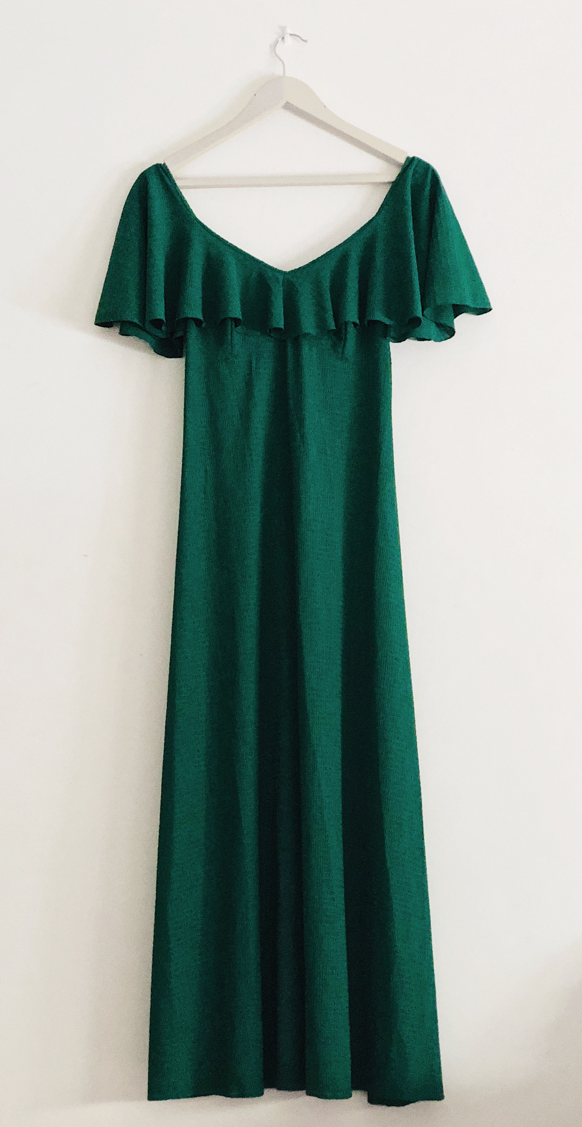
a dress
/ə/ /dres/

Slide 8
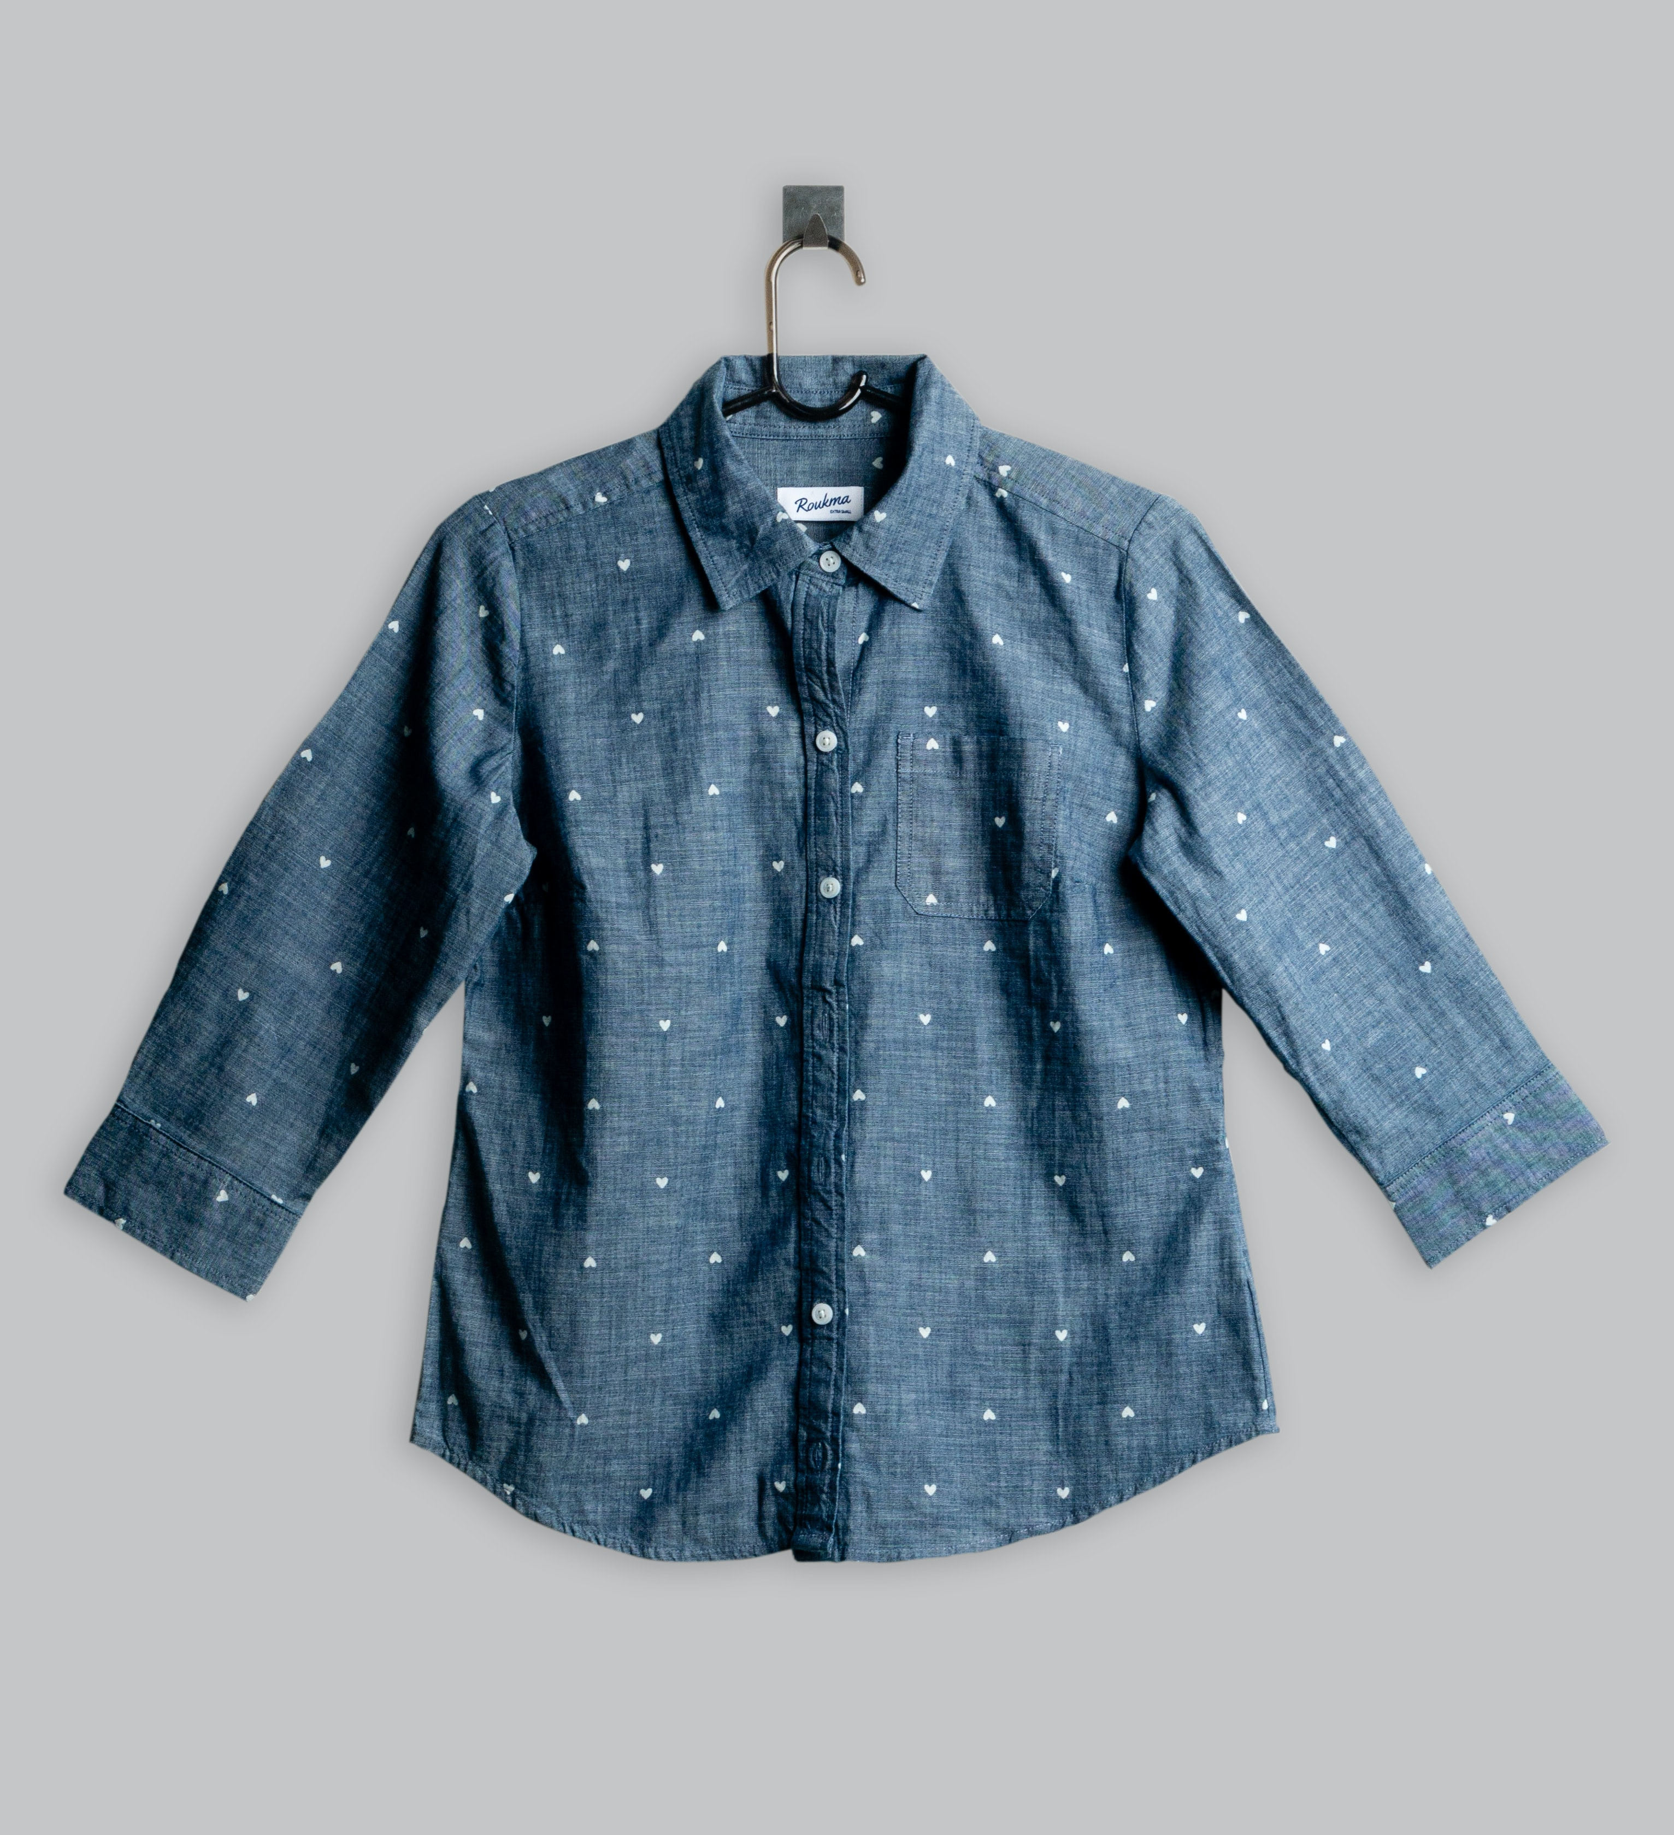
a shirt
/ə/ /ʃɜːrt/

Slide 9
2
Listen and point. Say.
TR: B27

Slide 10
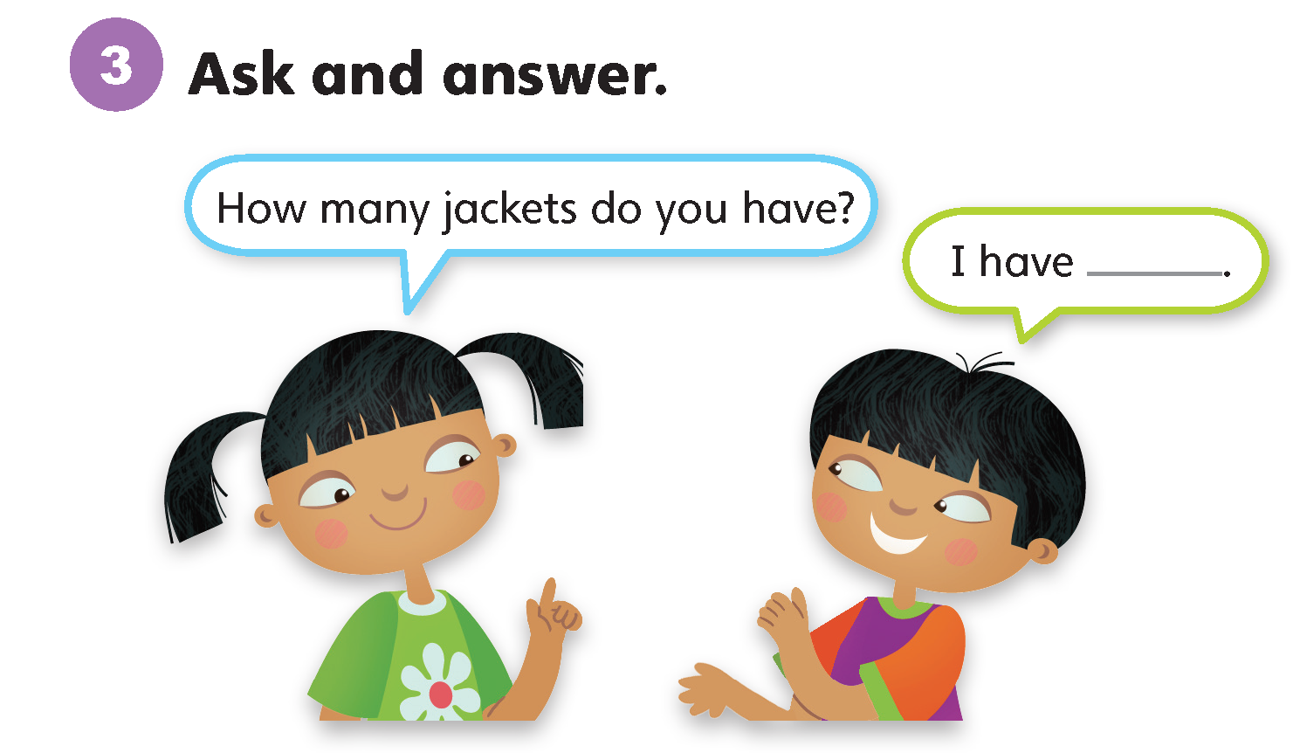

Slide 11
Unit 5:
Cool Clothes
Lesson 2

Slide 12
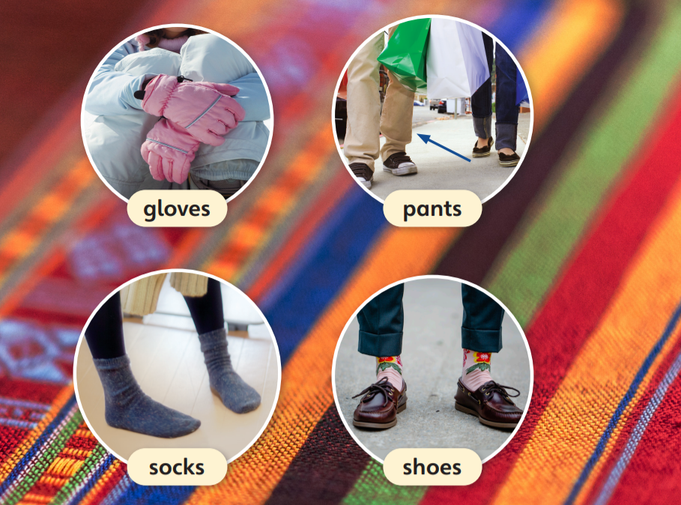
1
Look and listen. Repeat.
TR: B28

Slide 13
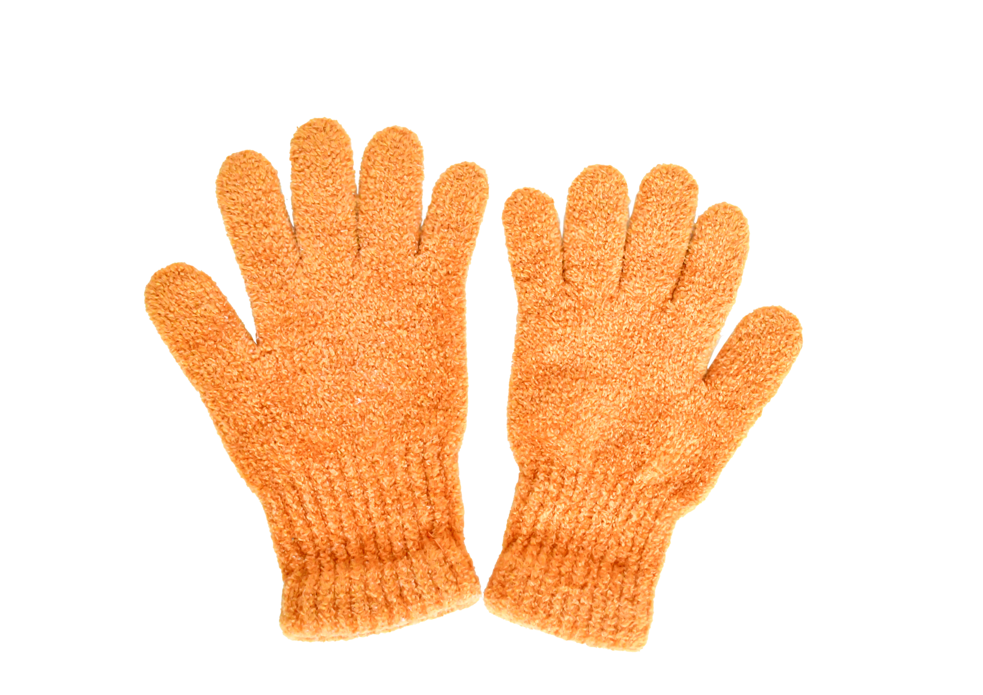
gloves
/ɡlʌvz/

Slide 14
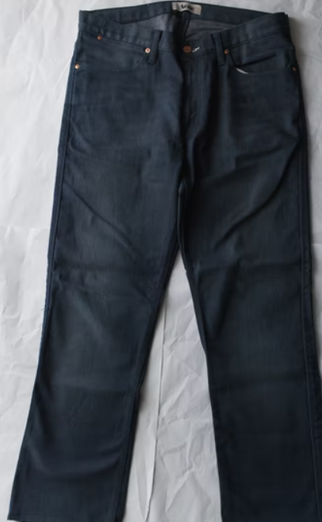
pants
/pænts/

Slide 15
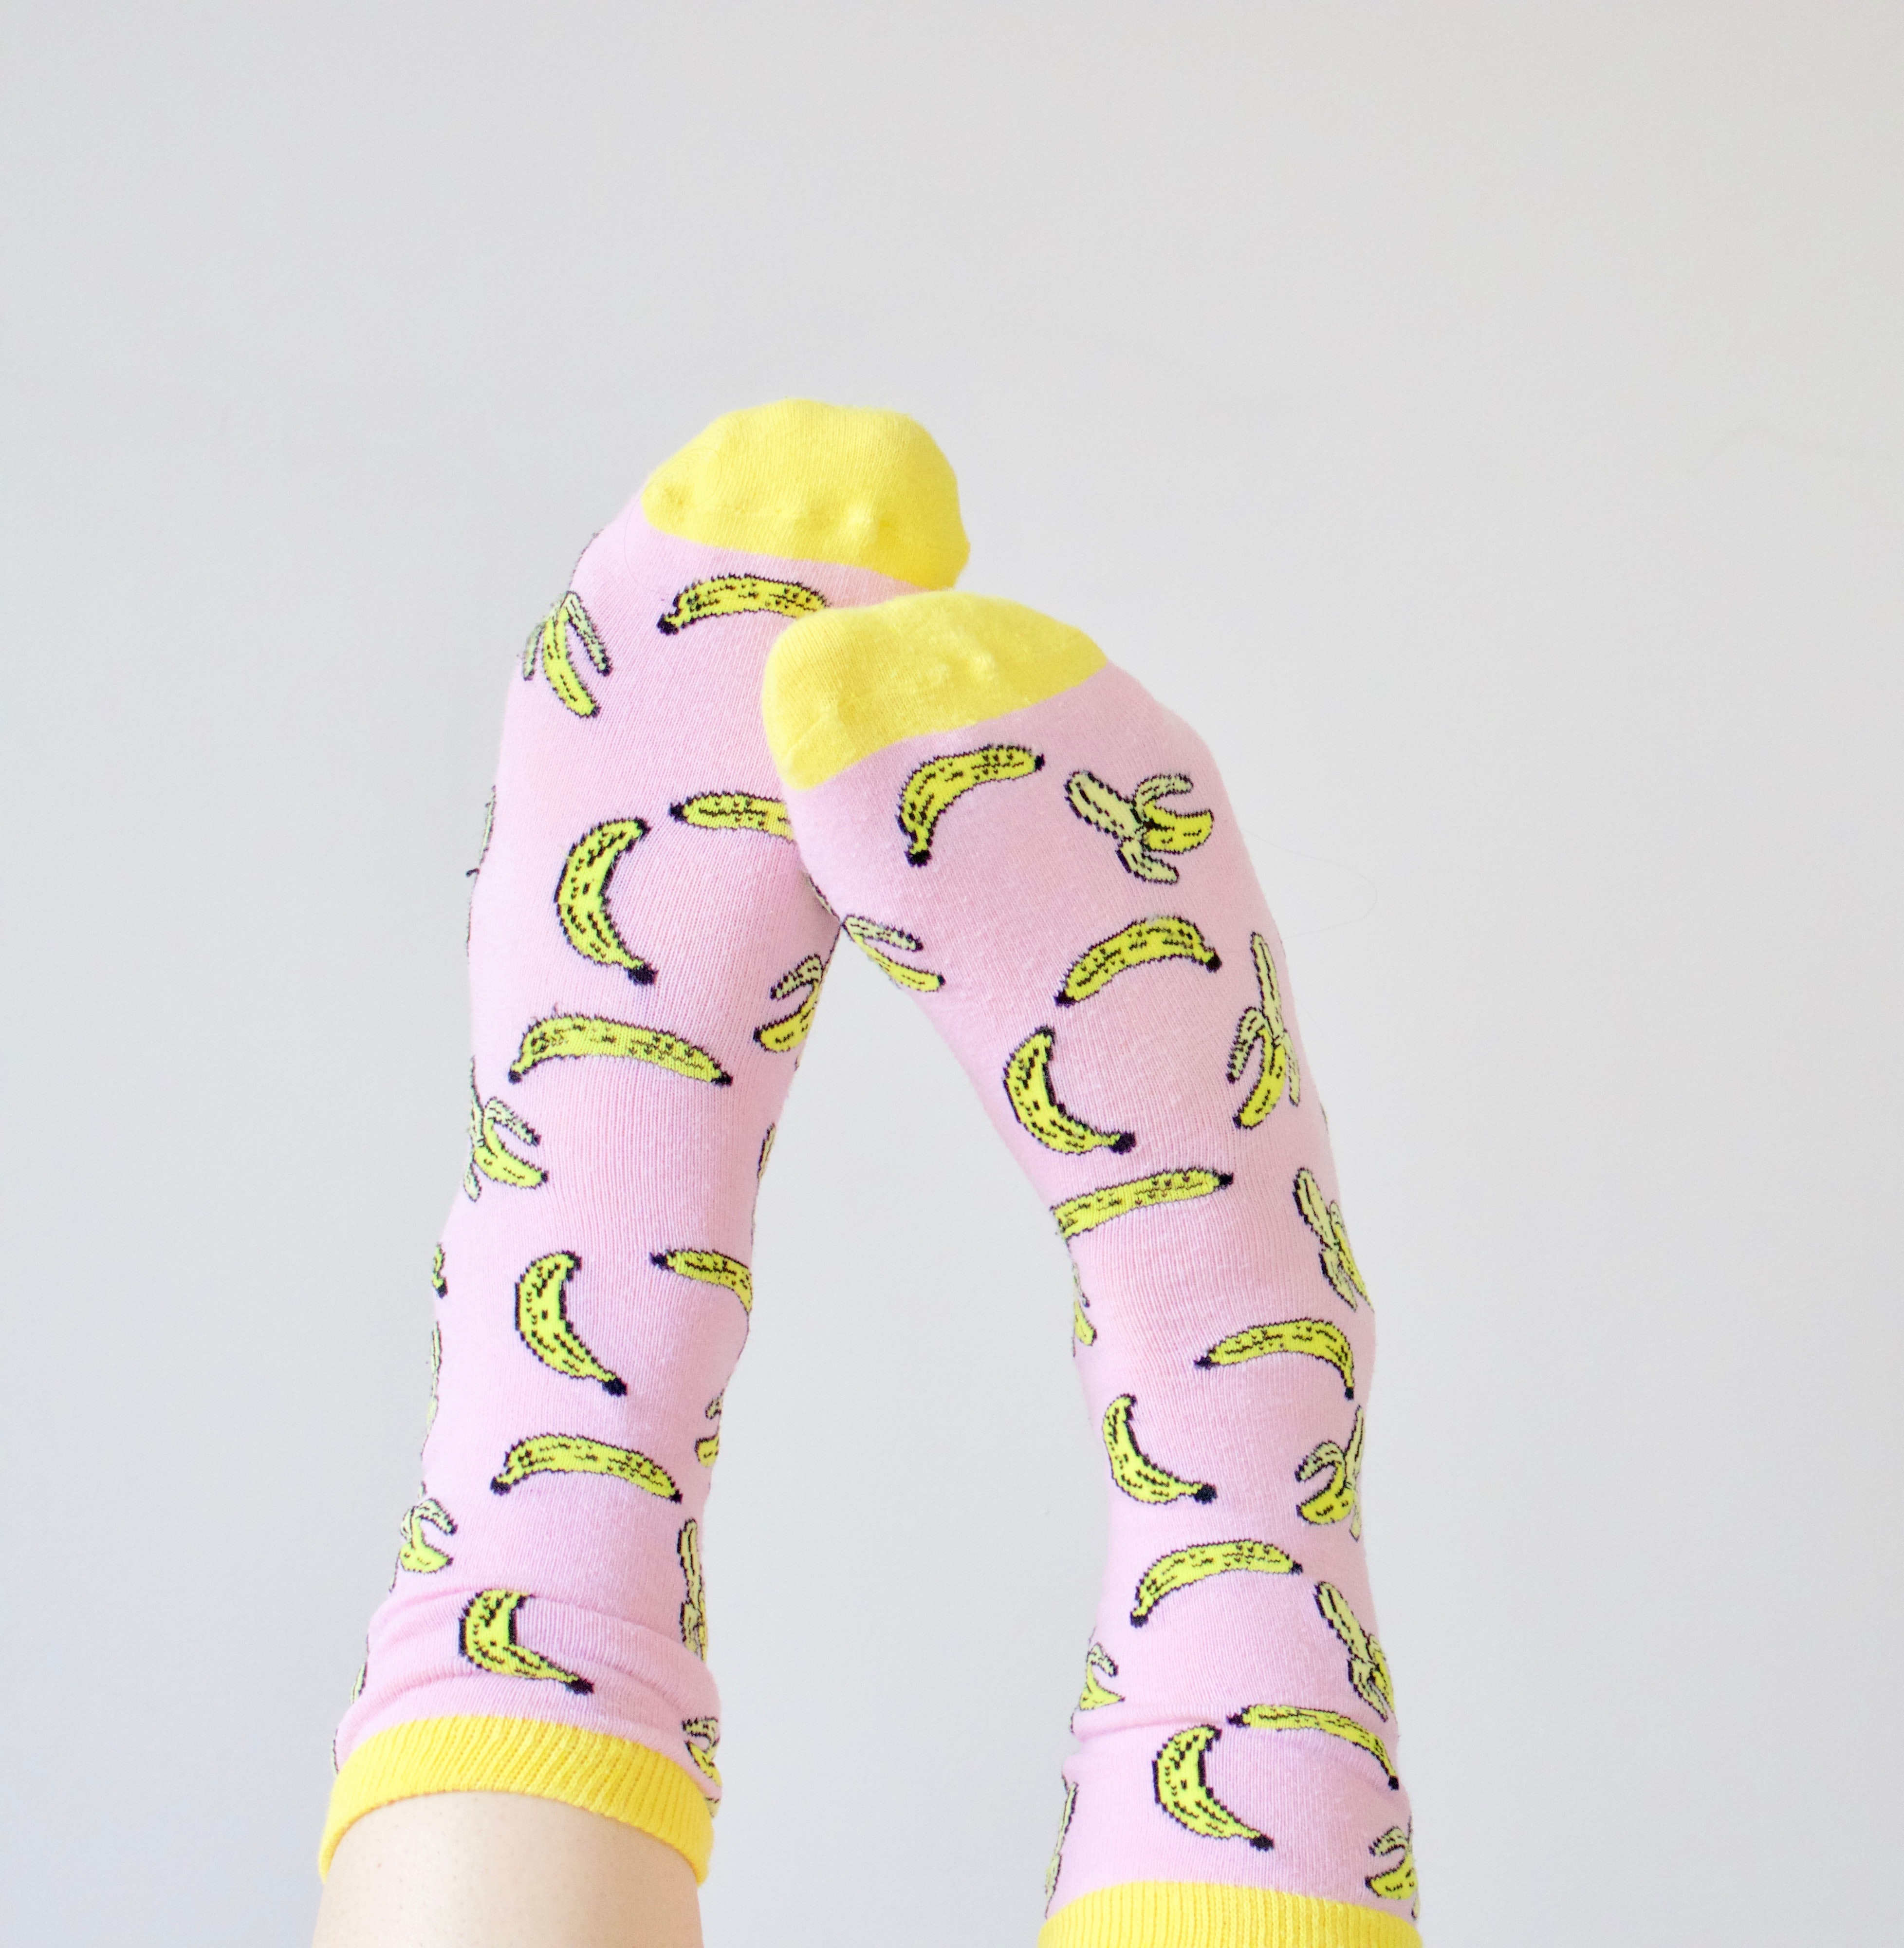
socks
/sɑːks/

Slide 16
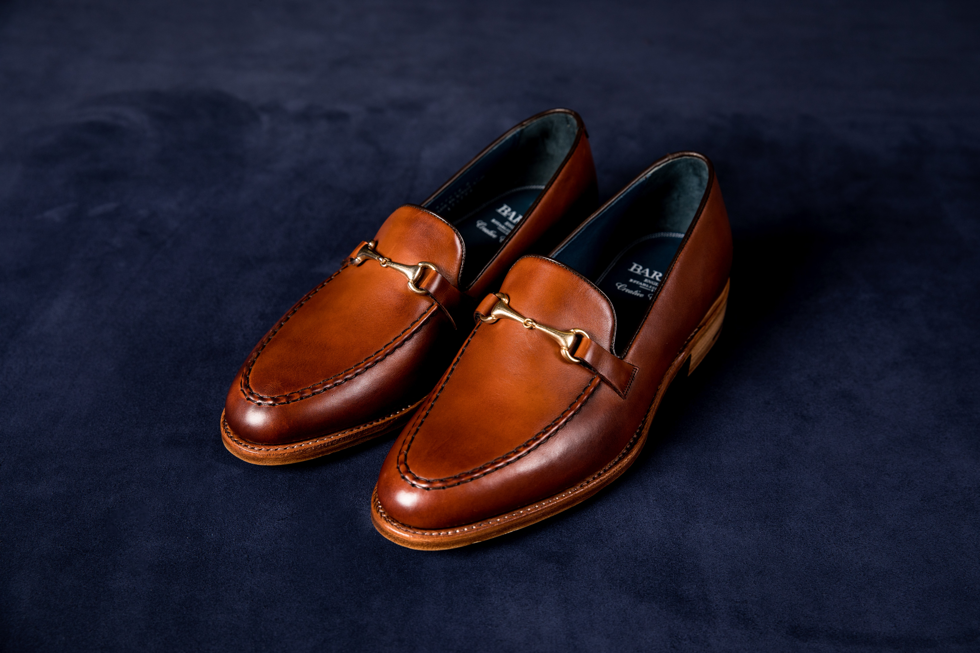
shoes
/ʃuːz/

Slide 17
2
Listen and point. Say.
TR: B29

Slide 18
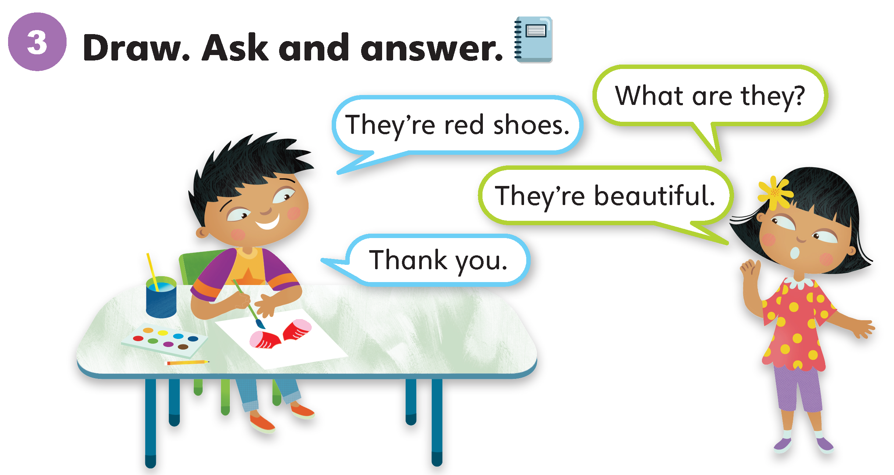

Slide 19
Unit 5:
Cool Clothes
Lesson 3

Slide 20
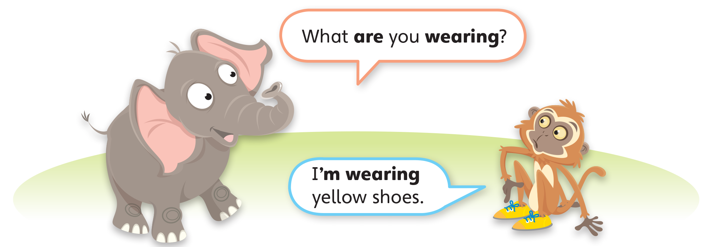
1
Look and listen. Repeat. TR: B30

Slide 21
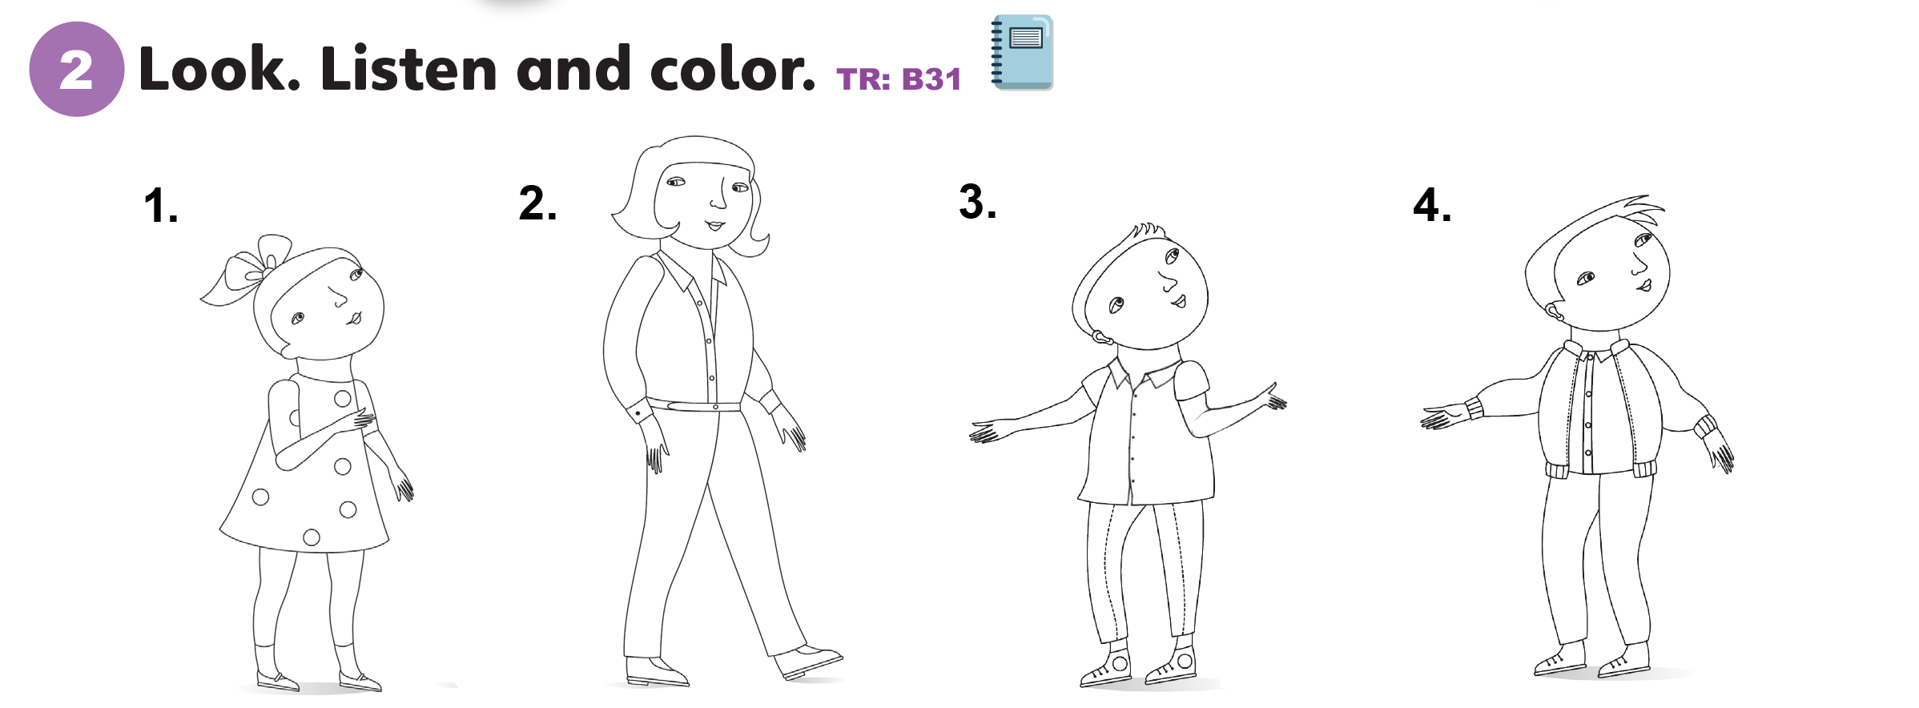
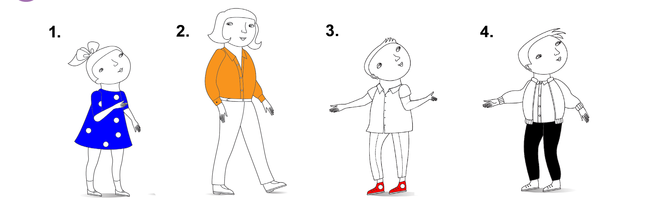

Slide 22
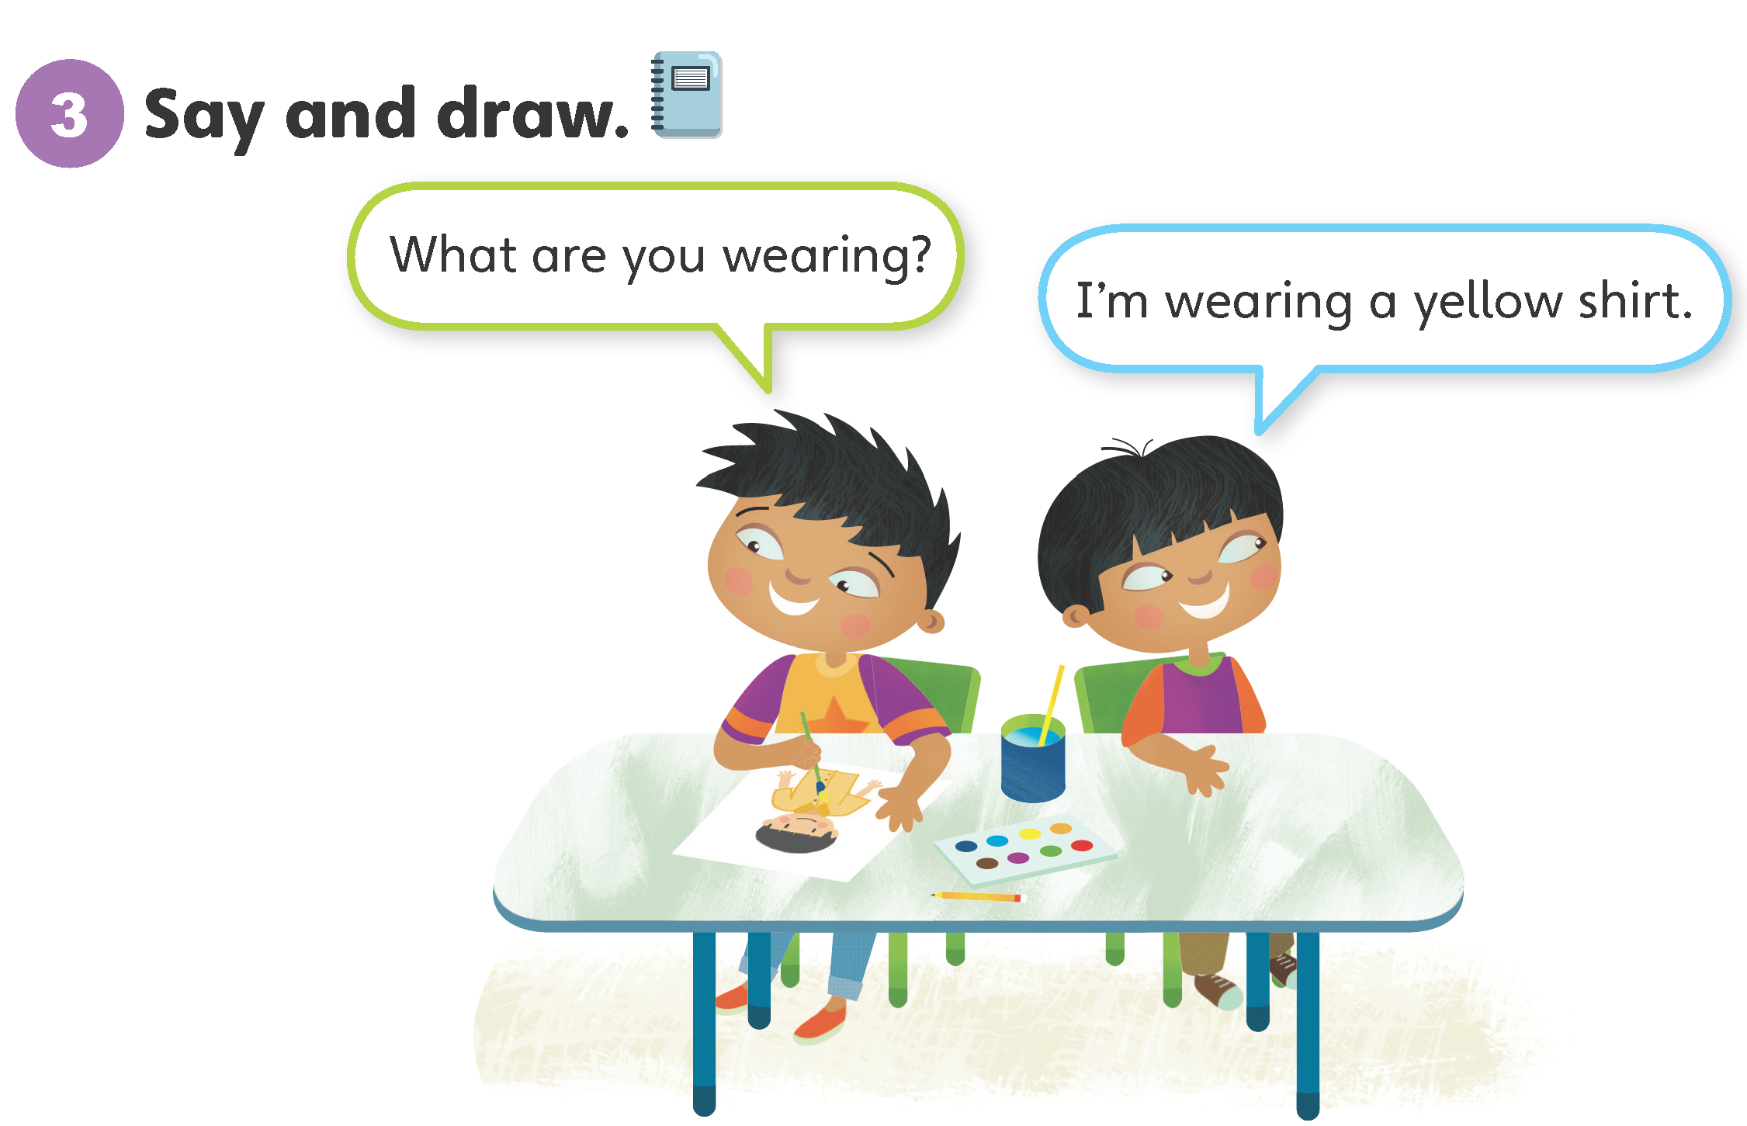

Slide 23
Unit 5:
Cool Clothes
Lesson 4

Slide 24
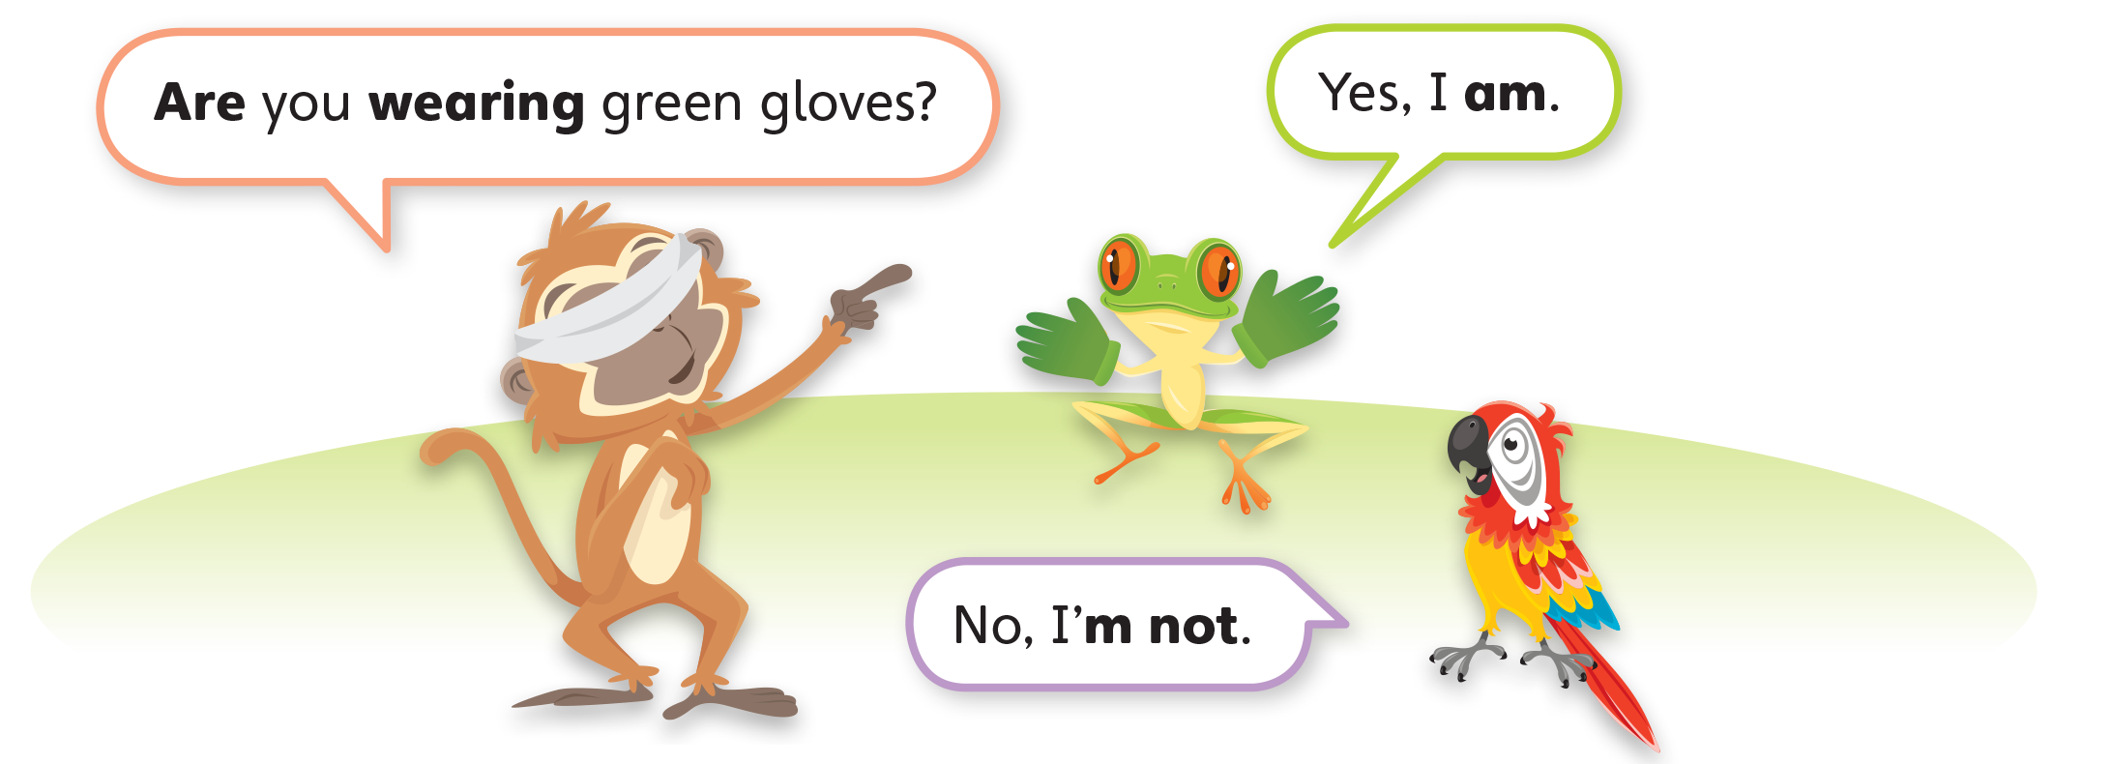
1
Look and listen. Repeat. TR: B32

Slide 25
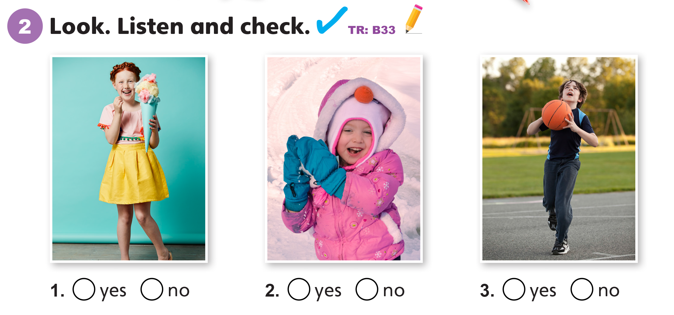

Slide 26
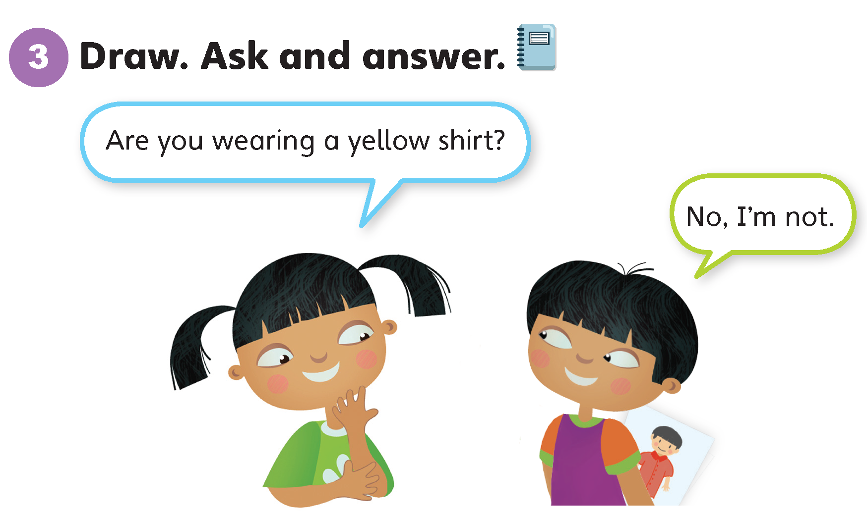

Slide 27
Unit 5:
Cool Clothes
Lesson 5

Slide 28
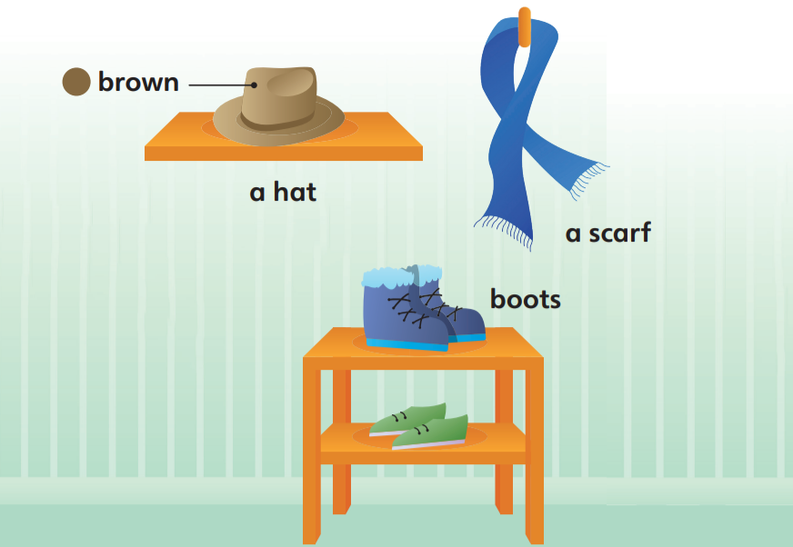
1
Look and listen. Repeat. TR: B34

Slide 29
brown
/braʊn/

Slide 30
a hat
/ə/ /hæt/

Slide 31
a scarf
/ə/ /skɑːrf/

Slide 32
boots
/buːts/

Slide 33
2
Point and say.
brown
a hat
a scarf
boots

Slide 35
Unit 5:
Cool Clothes
Lesson 6

Slide 36
1
Look and listen. Repeat. TR: B35

Slide 37
a shelf
/ə/ /ʃelf/

Slide 38
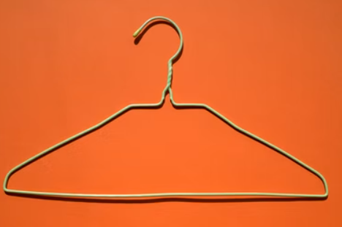
a hanger
/ə/ /ˈhæŋər/

Slide 39
a closet
/ə/ /ˈklɑːzɪt/

Slide 40

pink
/pɪŋk/

Slide 41
2
Point and say.
a shelf
a hanger
a closet
pink

Slide 43
Unit 5:
Cool Clothes
Lesson 7

Slide 44
1
Look and listen. Repeat. TR: B36

Slide 45
2
3
1

Slide 46
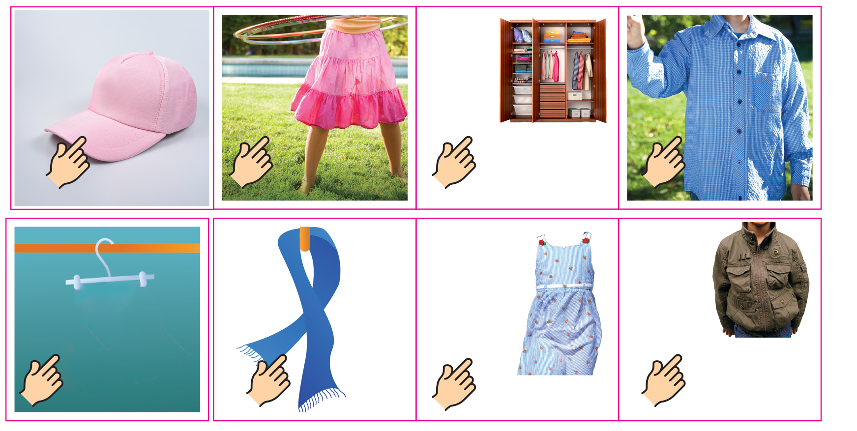
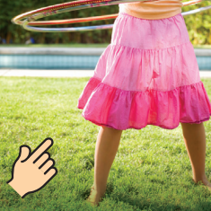
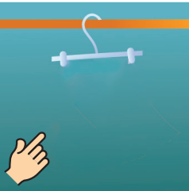

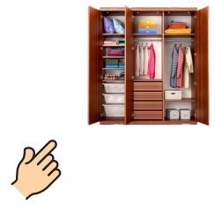
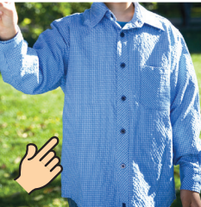
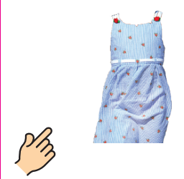

Slide 47
Unit 5:
Cool Clothes
Lesson 8

Slide 48
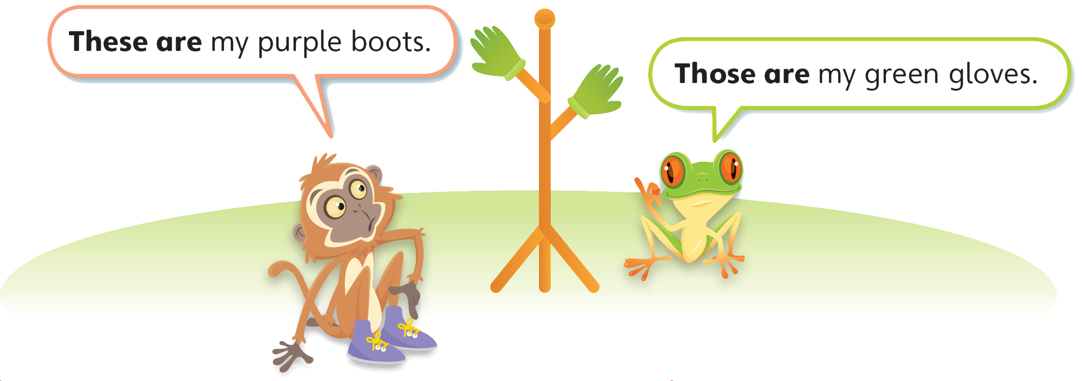
1
Look and listen. Repeat. TR: B38

Slide 49
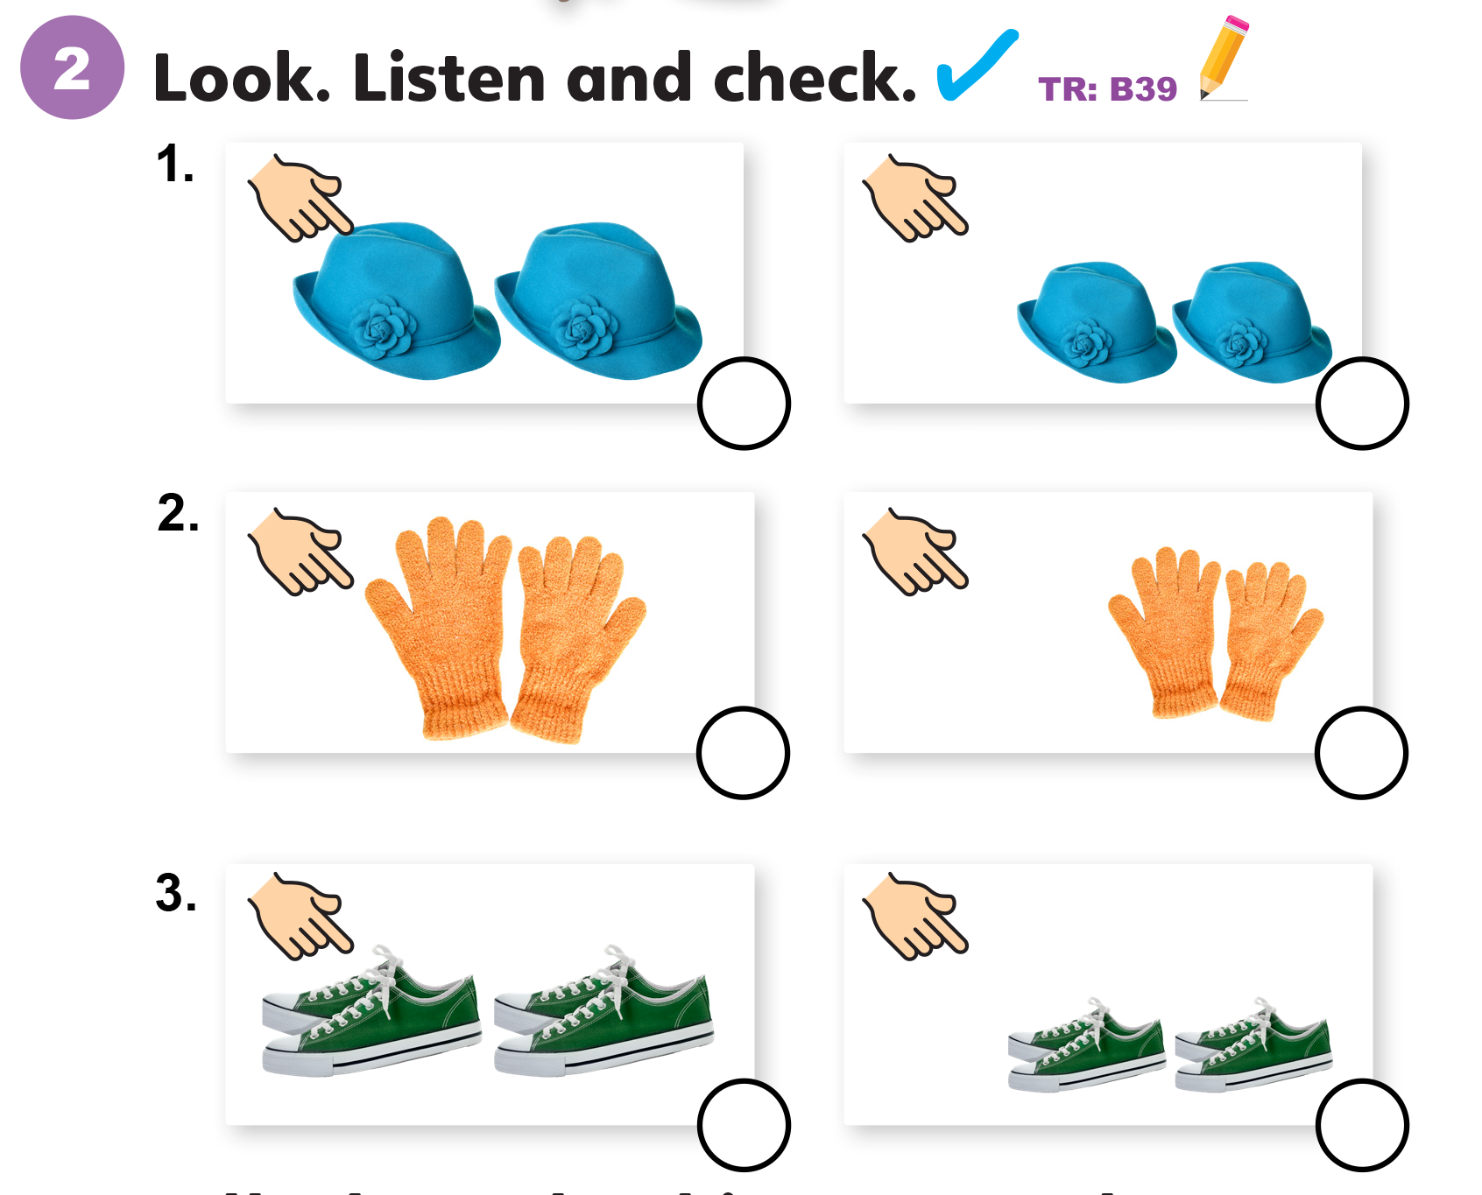

Slide 50
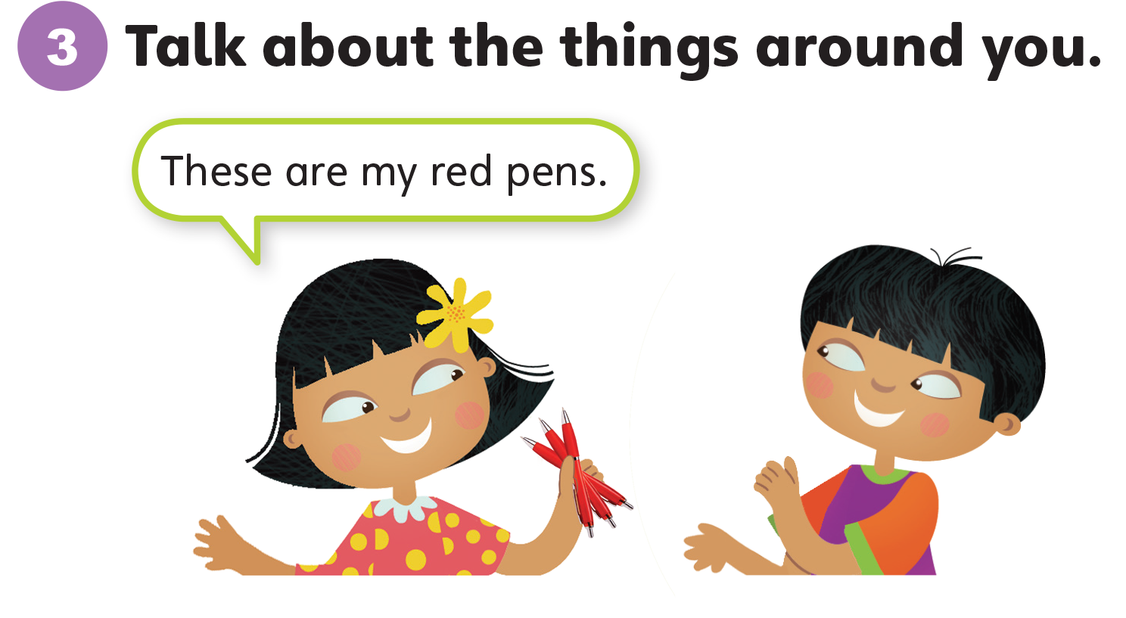

Slide 51
Unit 5:
Cool Clothes
Lesson 9

Slide 52
1
Listen and repeat. TR: B40
l
w
  like
  look
  wear
  watch

Slide 53
2
Listen and sing. TR: B41
What are you wearing?
What are you wearing?
I’m wearing my brown shoes,
and I really like them.
What are you wearing?
What are you wearing?
I’m wearing my purple pants,
and I really like them.
I like my shoes!
I like my pants!
I like my shirt!
I like my skirt!

Slide 54
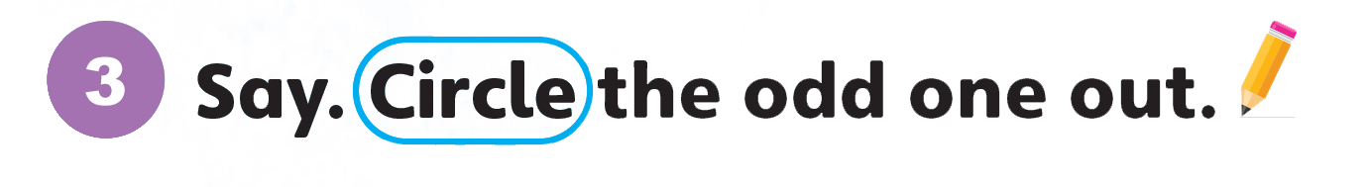
3
Say. Draw lines.
color
word
lamp
l as in look
w as in watch
wash
listen
wear

Slide 55
Unit 5:
Cool Clothes
Lesson 10

Slide 56
1
Listen and repeat. TR: B42
h
sk
  hat
  house
  skirt
  desk

Slide 57
2
Listen and chant. TR: B43
Hat, hat, hat.
The hat is on the desk.
Skirt, skirt, skirt.
The skirt is on the desk.
Oh no!
Hat, hat, hat.
The hat is in the closet.
Skirt, skirt, skirt.
The skirt is in the closet.
Hooray!

Slide 58
1.
skirt
sky
books
2.
home
chair
house

Slide 59
Unit 5:
Cool Clothes
Lesson 11

Slide 60
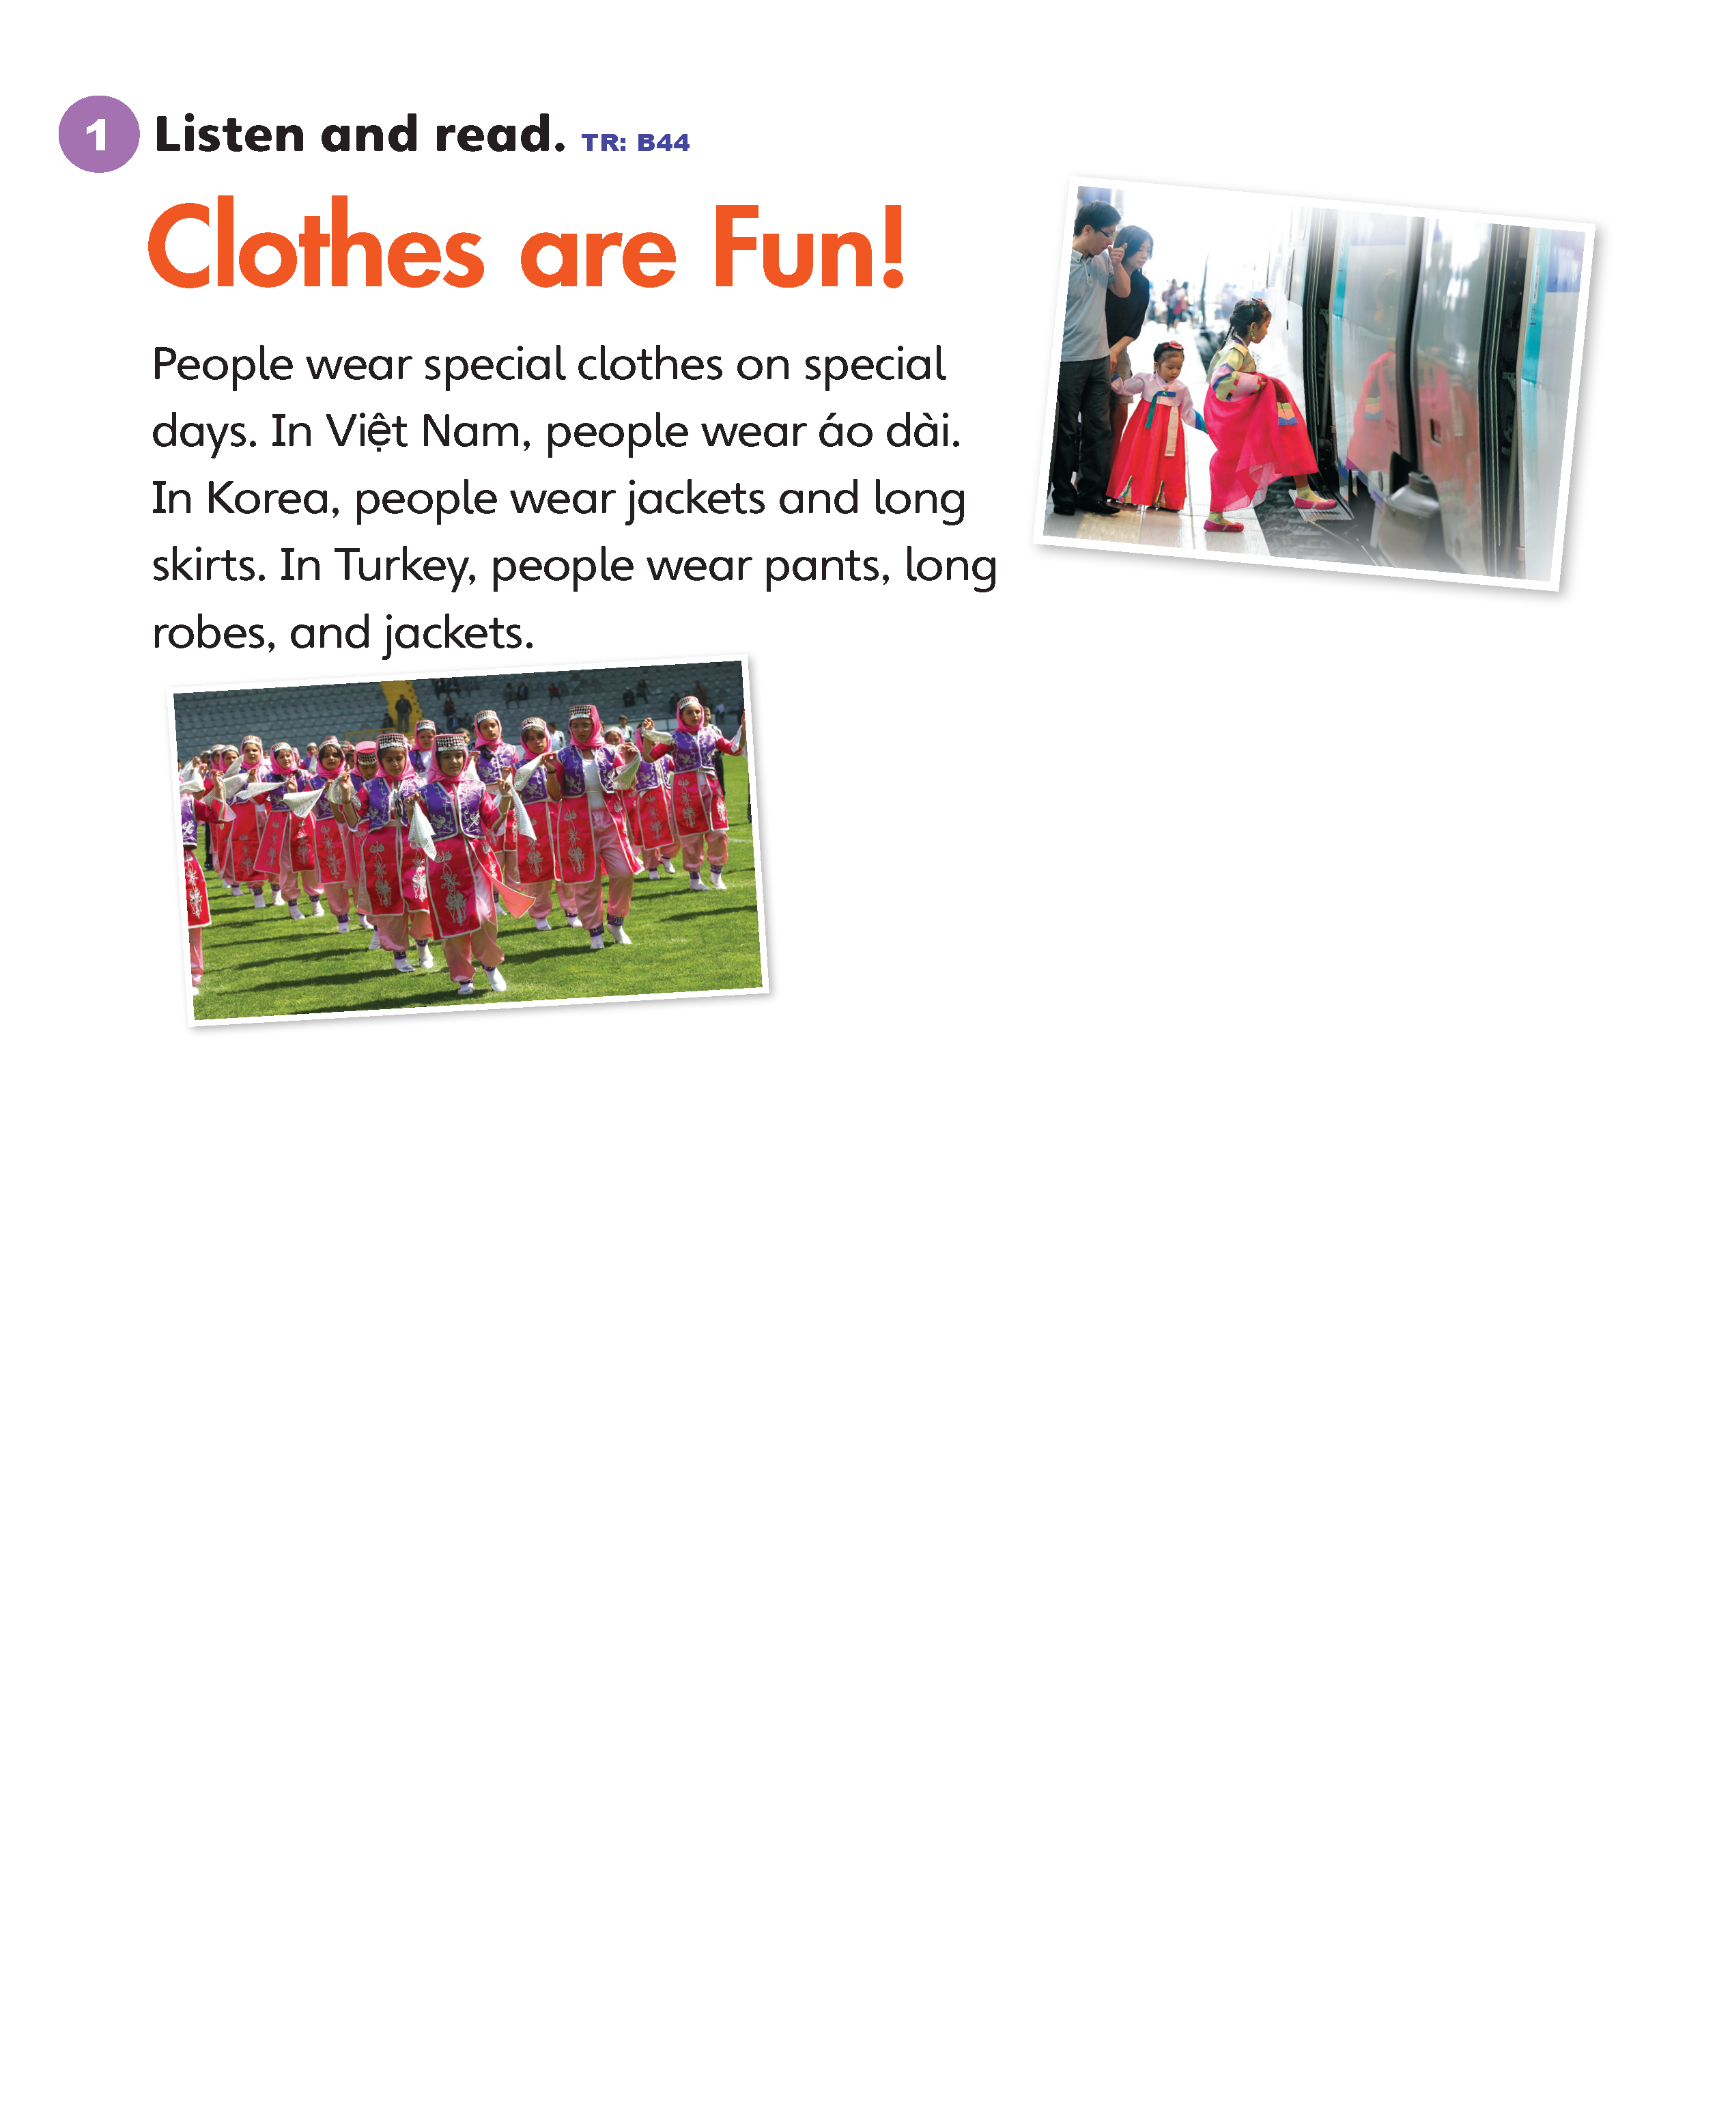
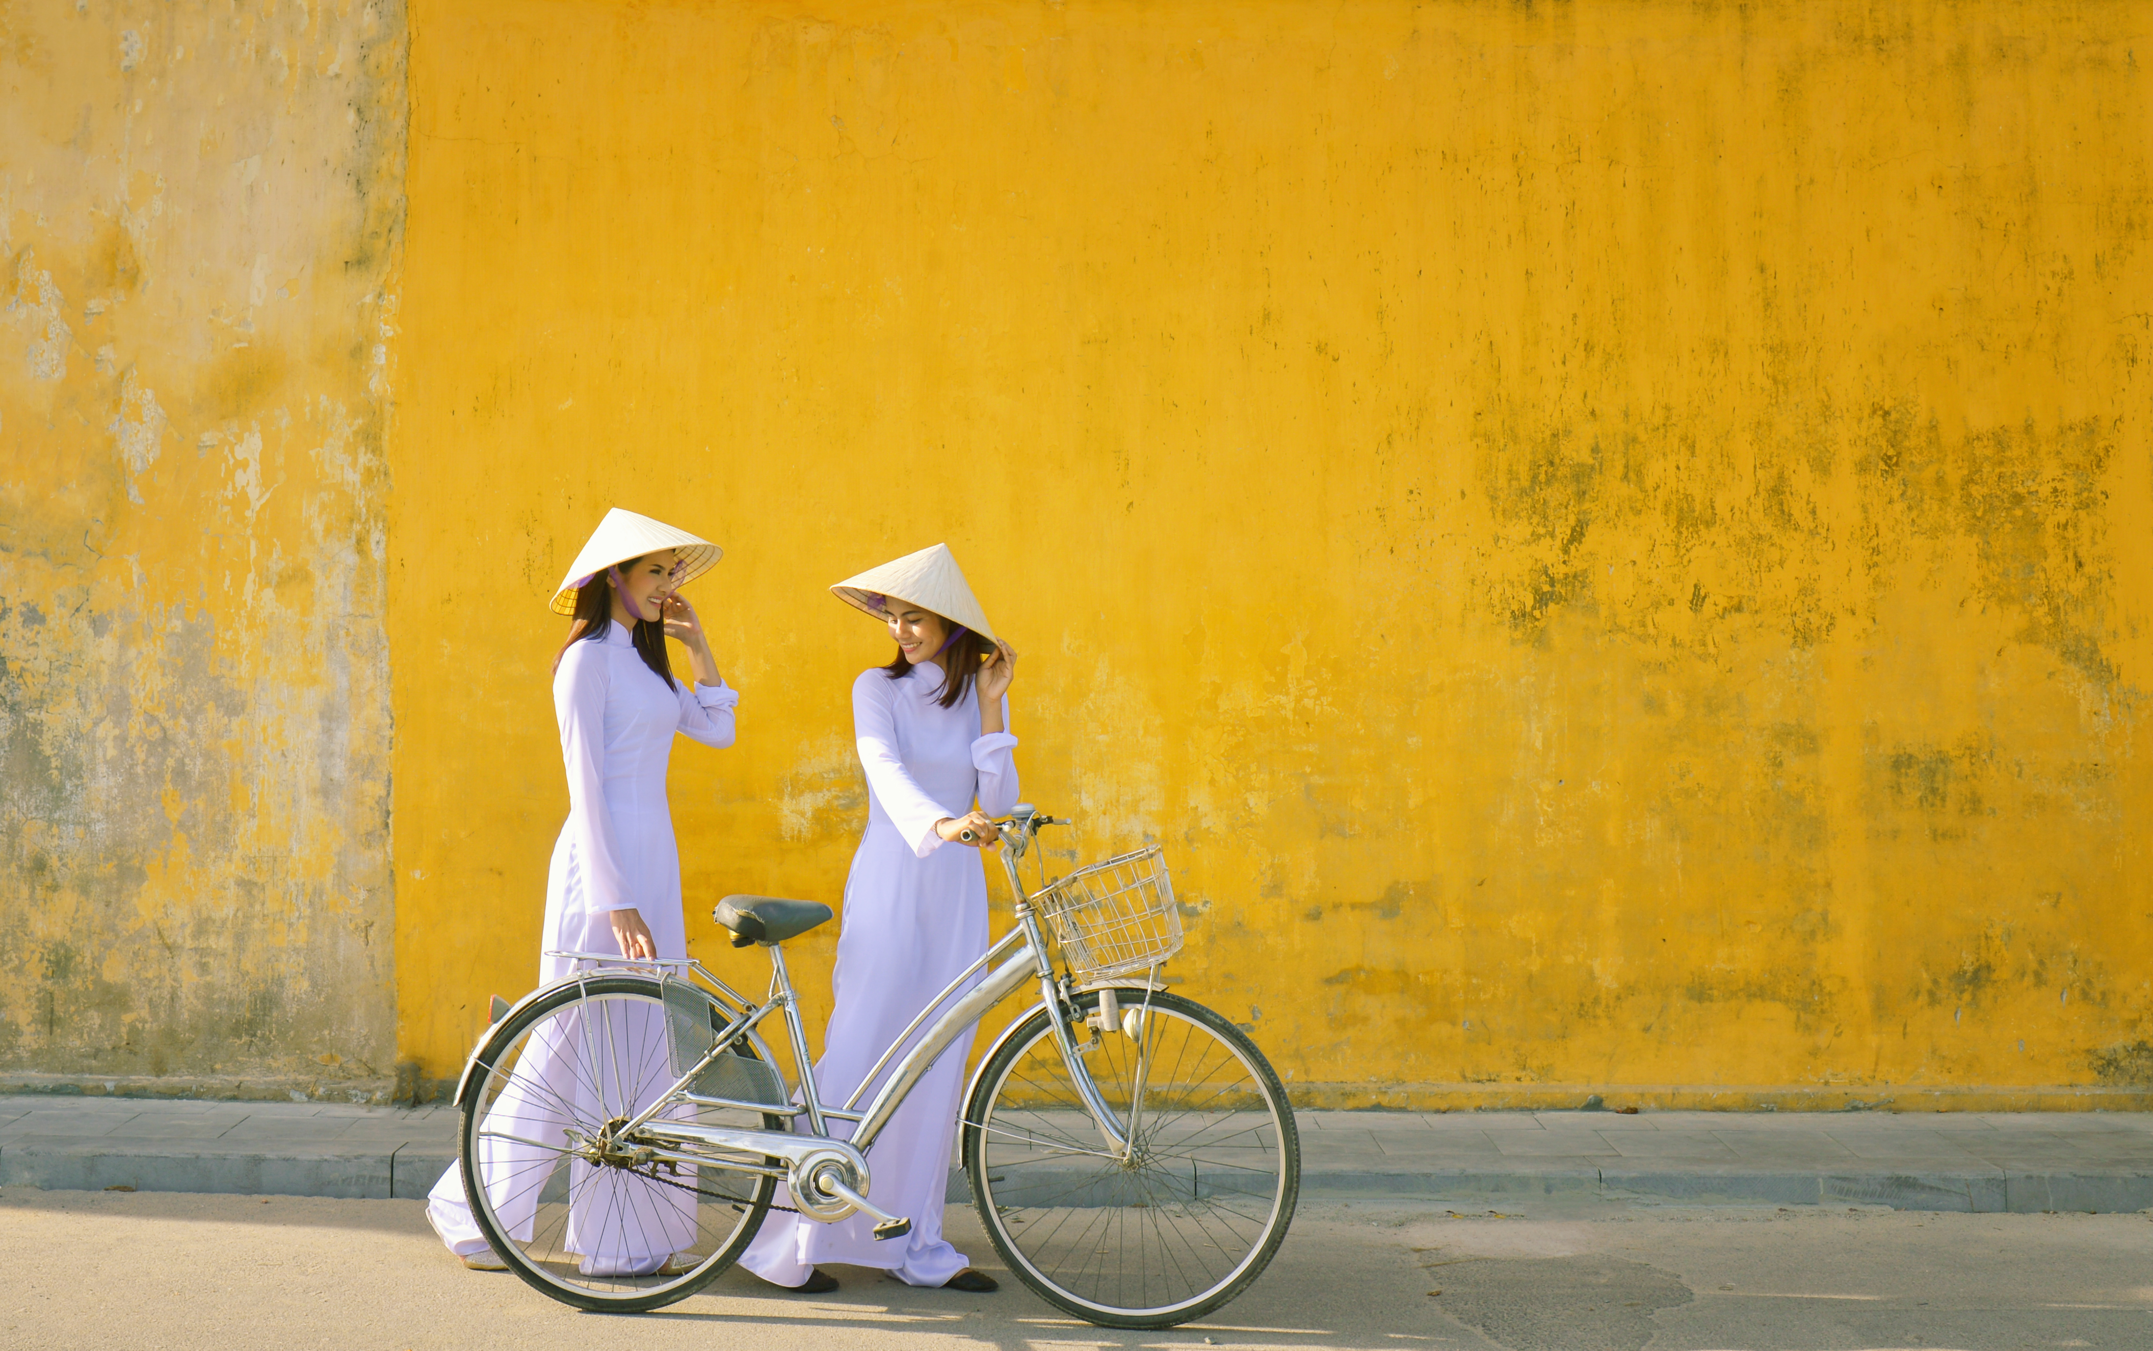

Slide 63
Unit 5:
Cool Clothes
Lesson 12

Slide 66
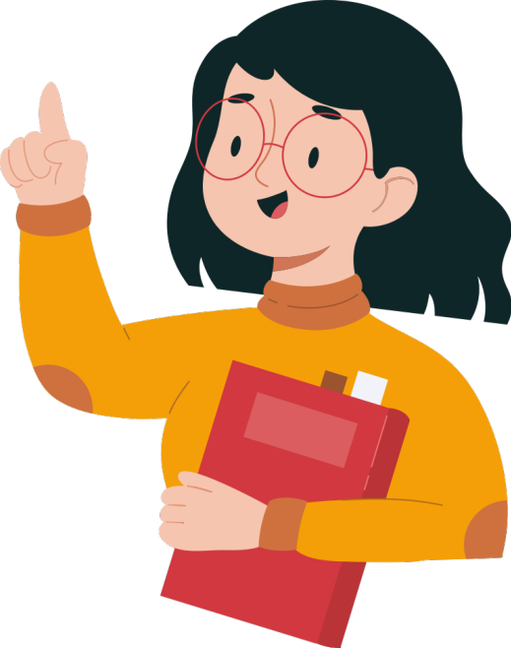

Slide 67
Unit 5:
Cool Clothes
Value

Slide 68
1
Look and listen. Repeat. TR: B46
Take care of your clothes.
I love my clothes. I take care of them. I clean them.

Slide 69
Take care of your clothes.
2
Think. How do you take care of your clothes?

Slide 70
Take care of your clothes.
3
Share.
I love my shoes. I take care of them. I clean them.

Slide 71
Thank you!

