Slide 1
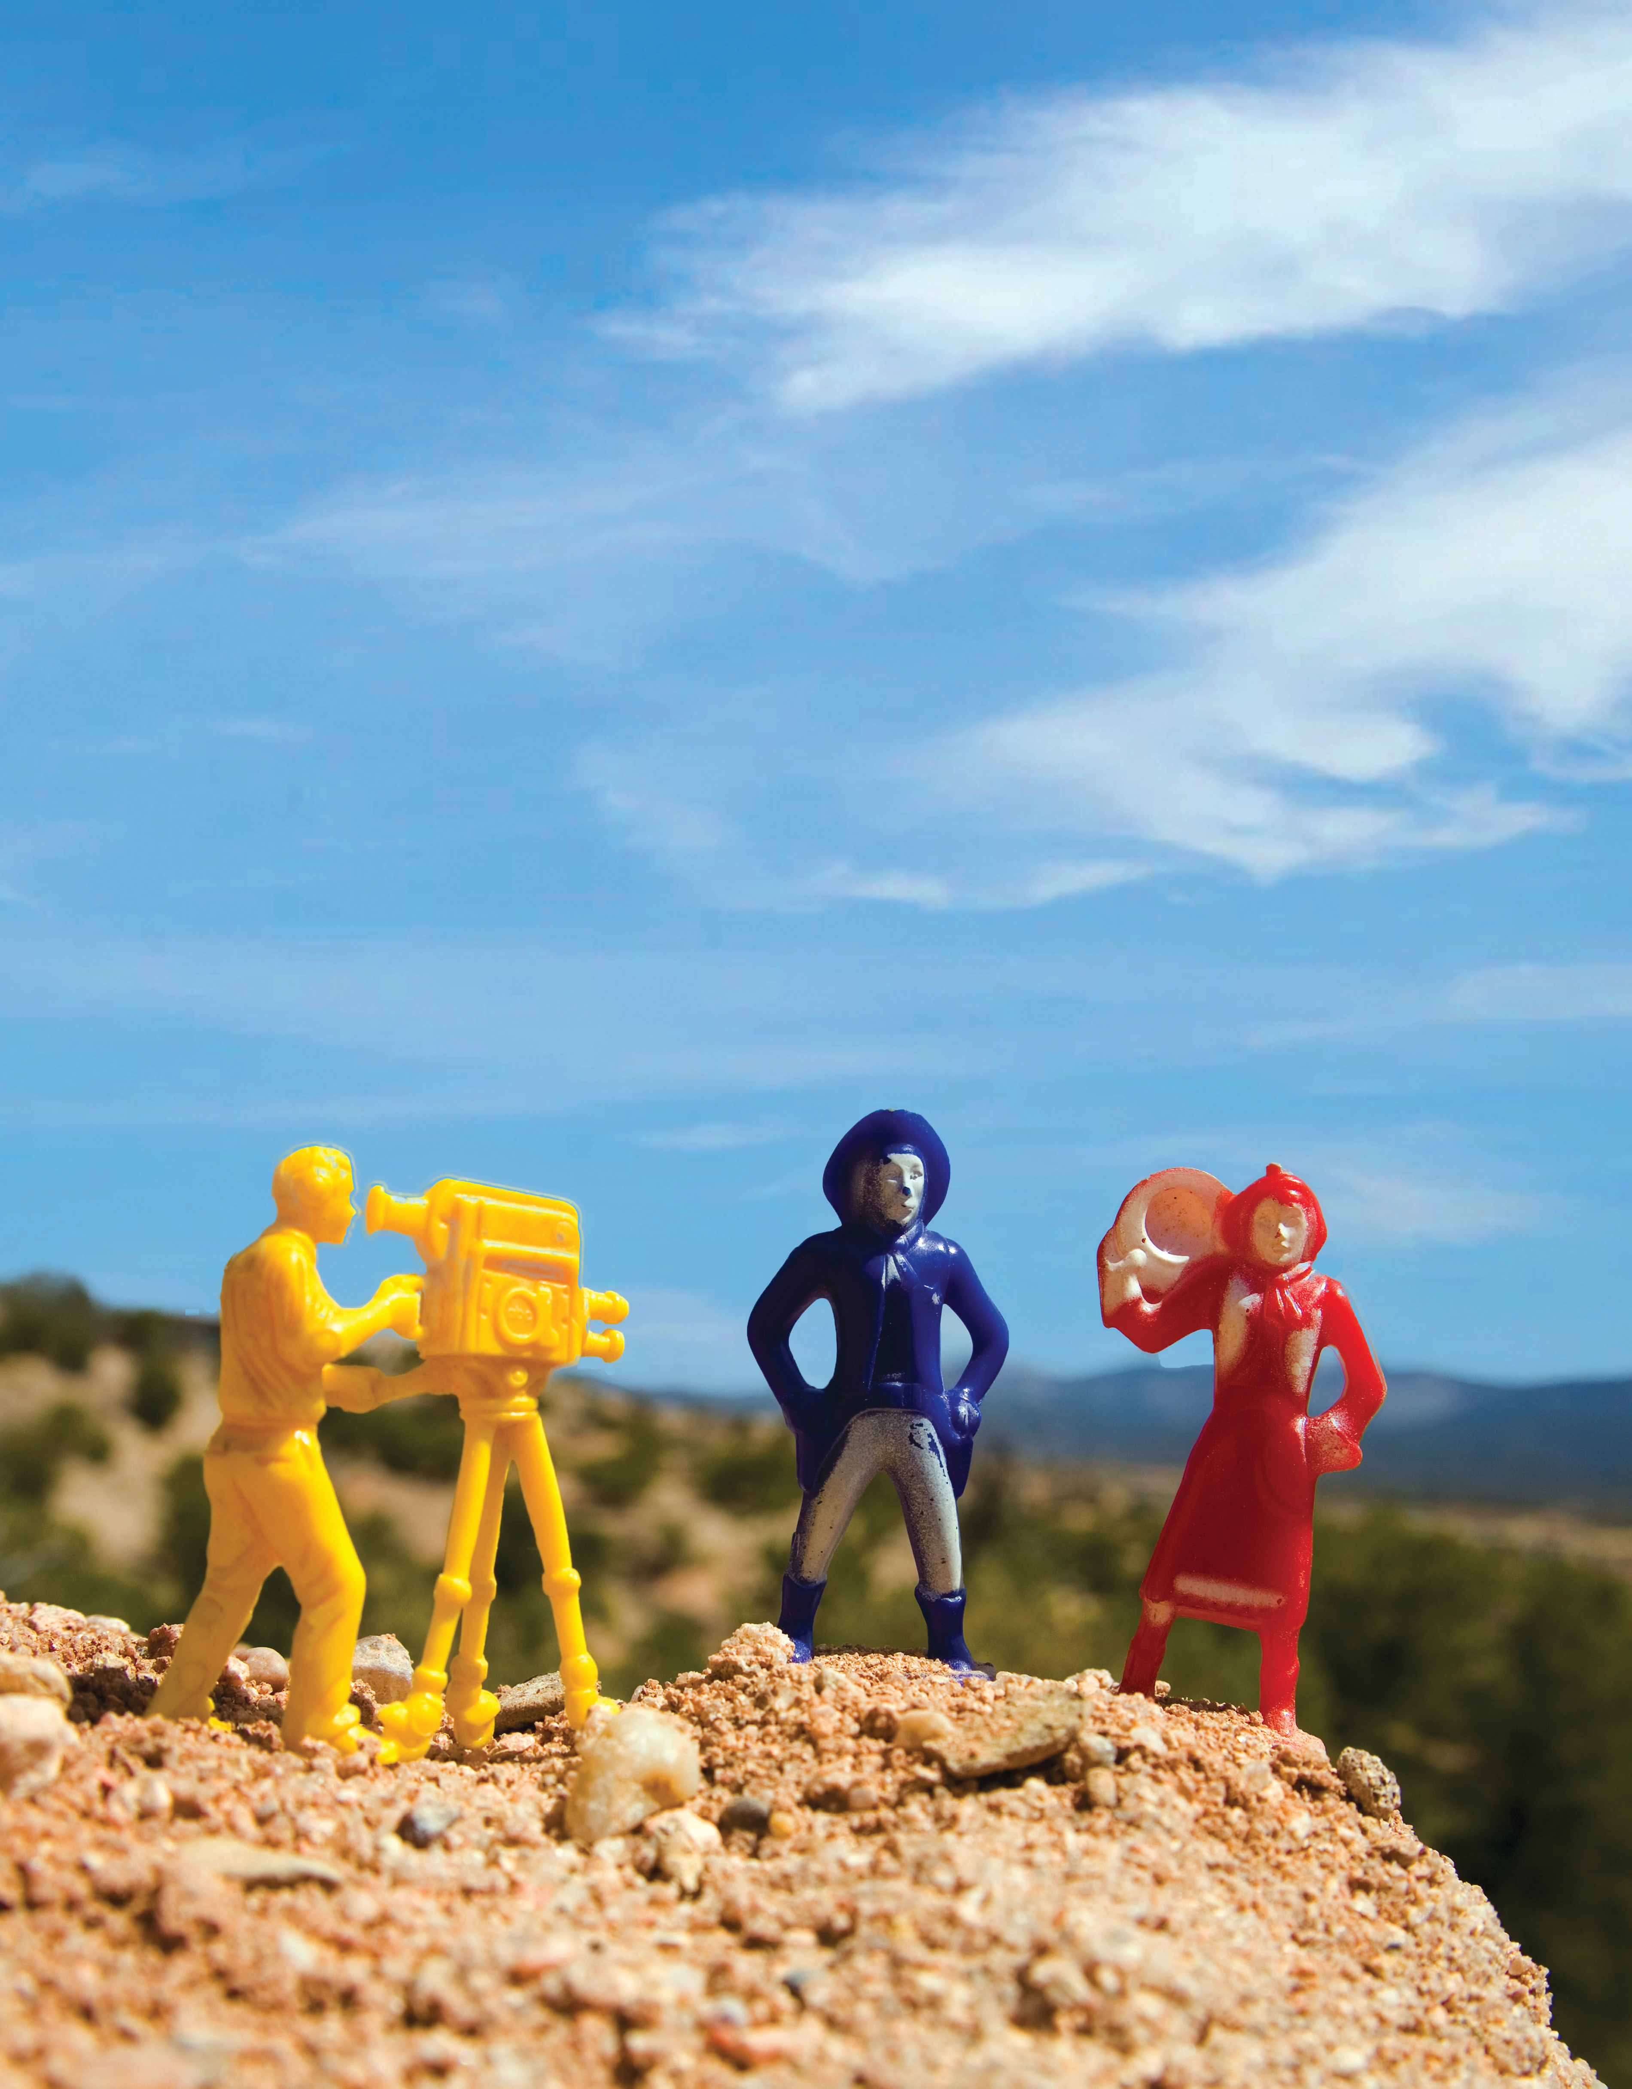
Unit 6
My Toys

Slide 2
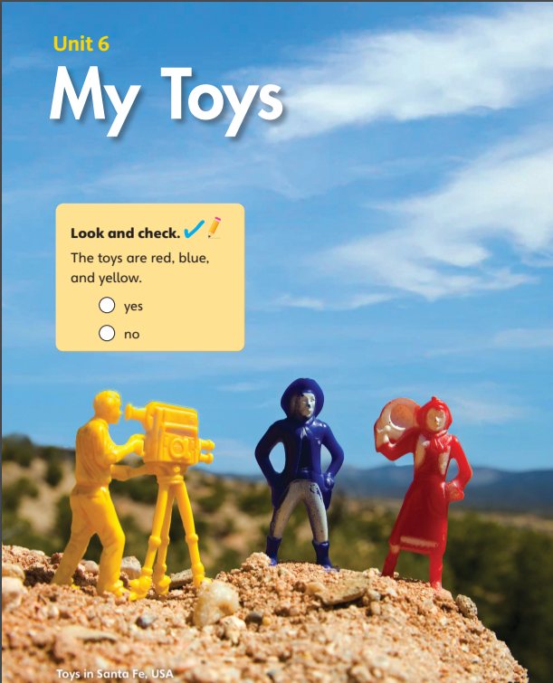

The toys are red, blue, and yellow.
yes
no

Slide 3
Unit 6:
My Toys
Lesson 1

Slide 4

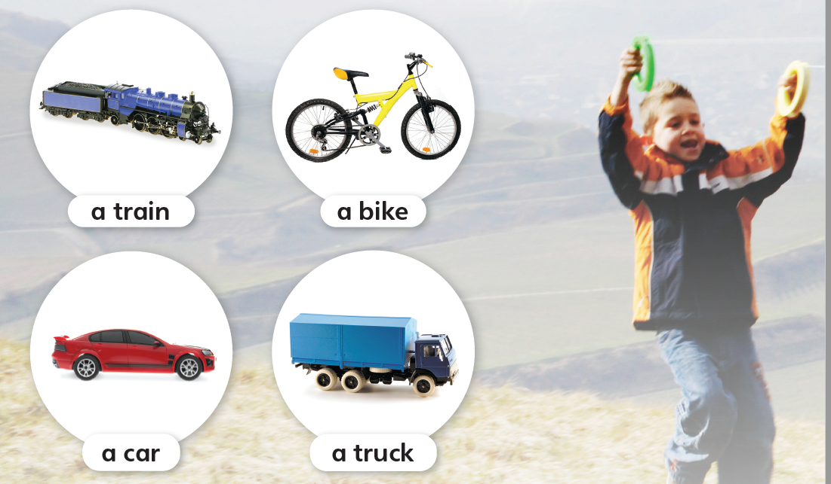
1
Look and listen. Repeat.
TR: B47

Slide 5
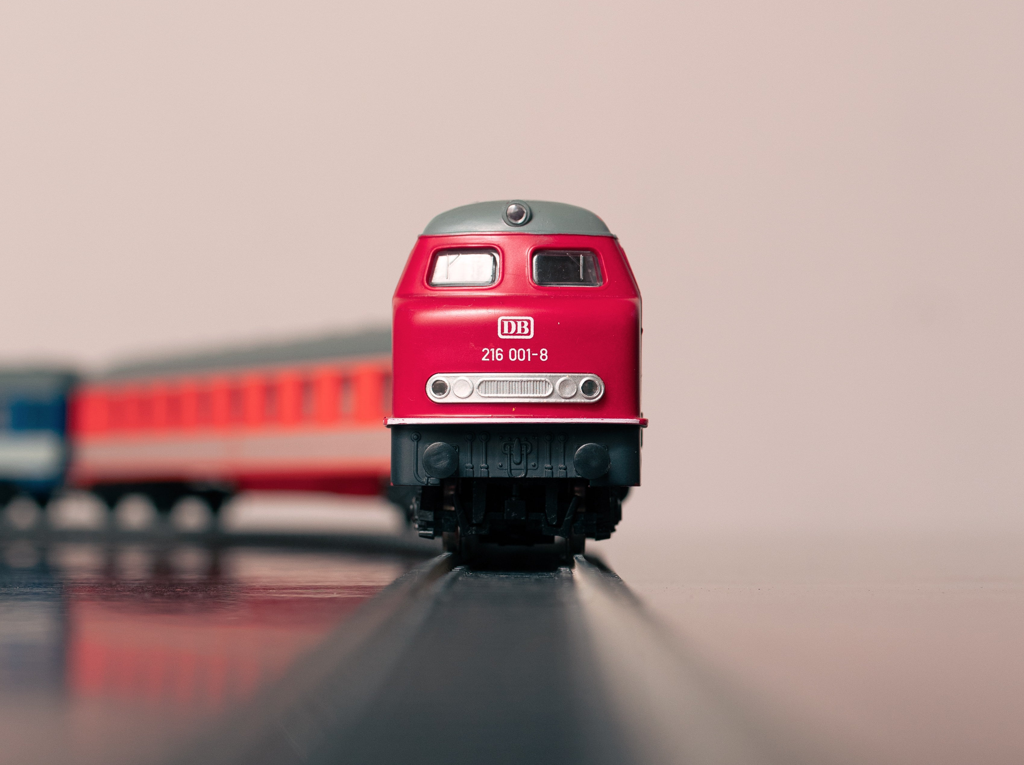
a train
/ə/ /treɪn/

Slide 6
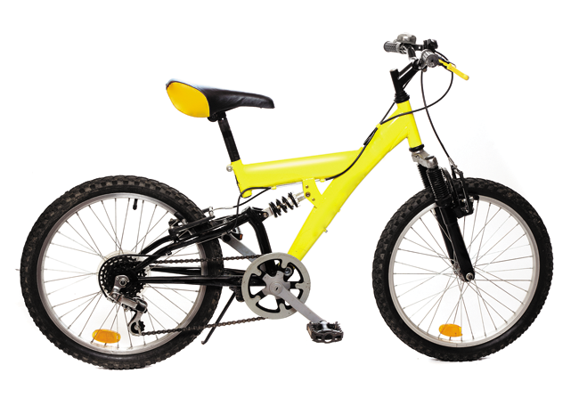
a bike
/ə/ /baɪk/

Slide 7
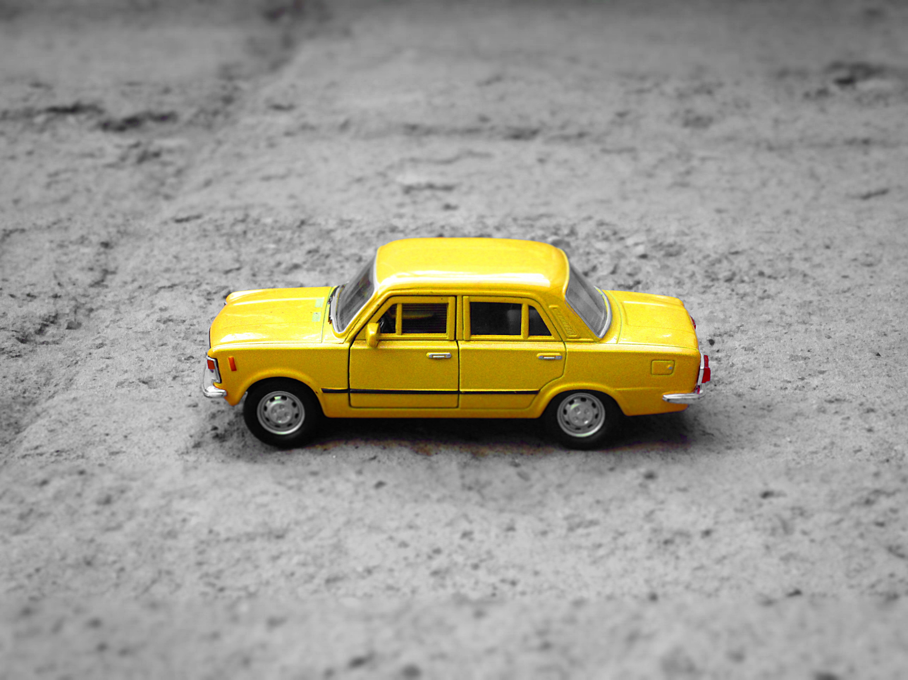
a car
/ə/ /kɑːr/

Slide 8
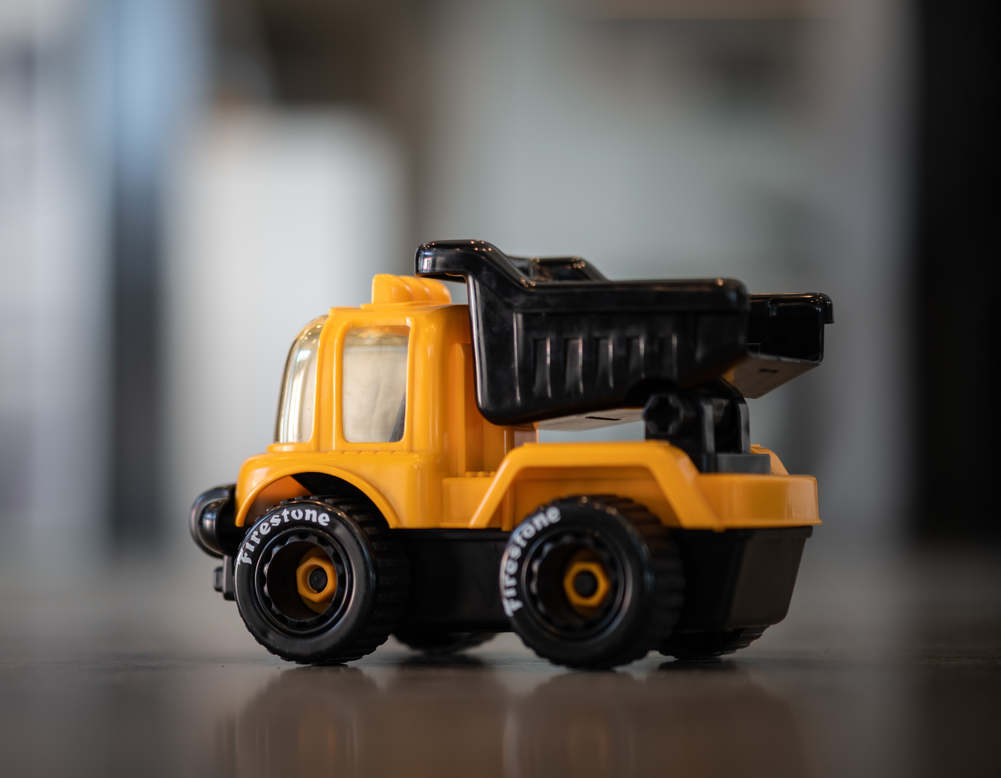
a truck
/ə/ /trʌk/

Slide 9
2
Listen and point. Say.
TR: B48

Slide 10
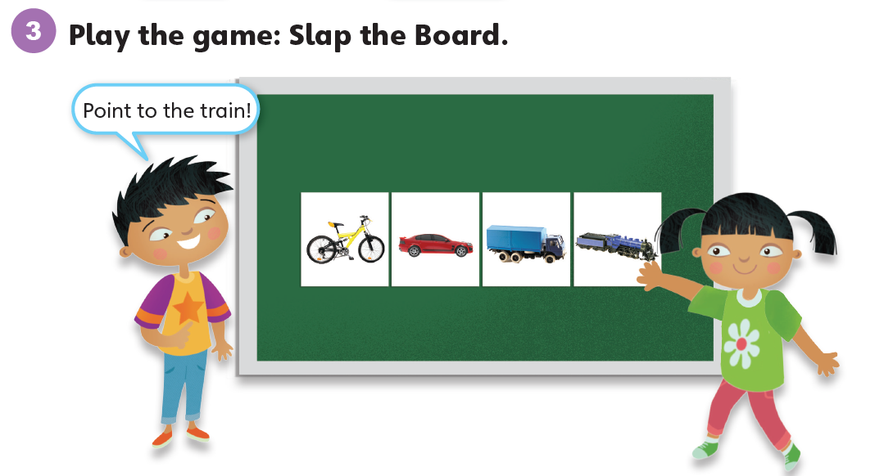

Slide 11
Unit 6:
My Toys
Lesson 2

Slide 12
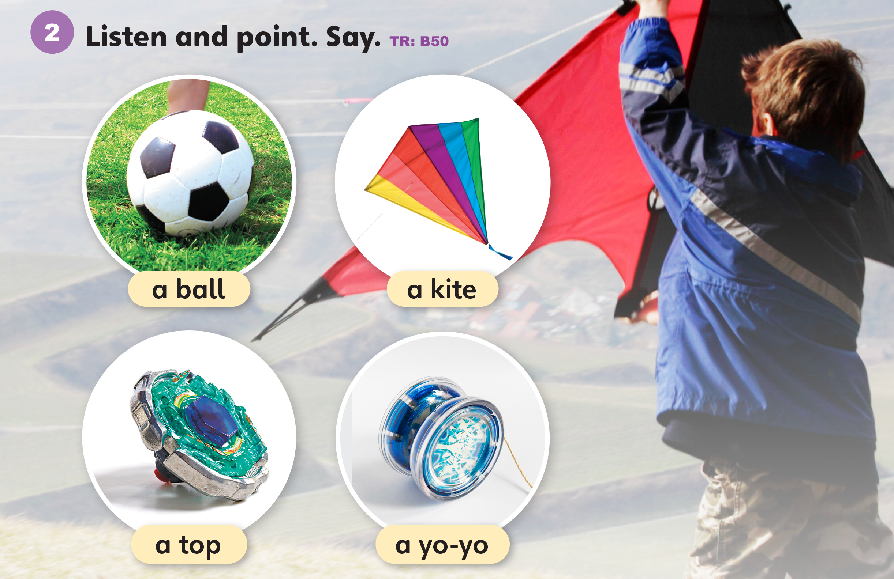
1
Look and listen. Repeat.
TR: B49

Slide 13
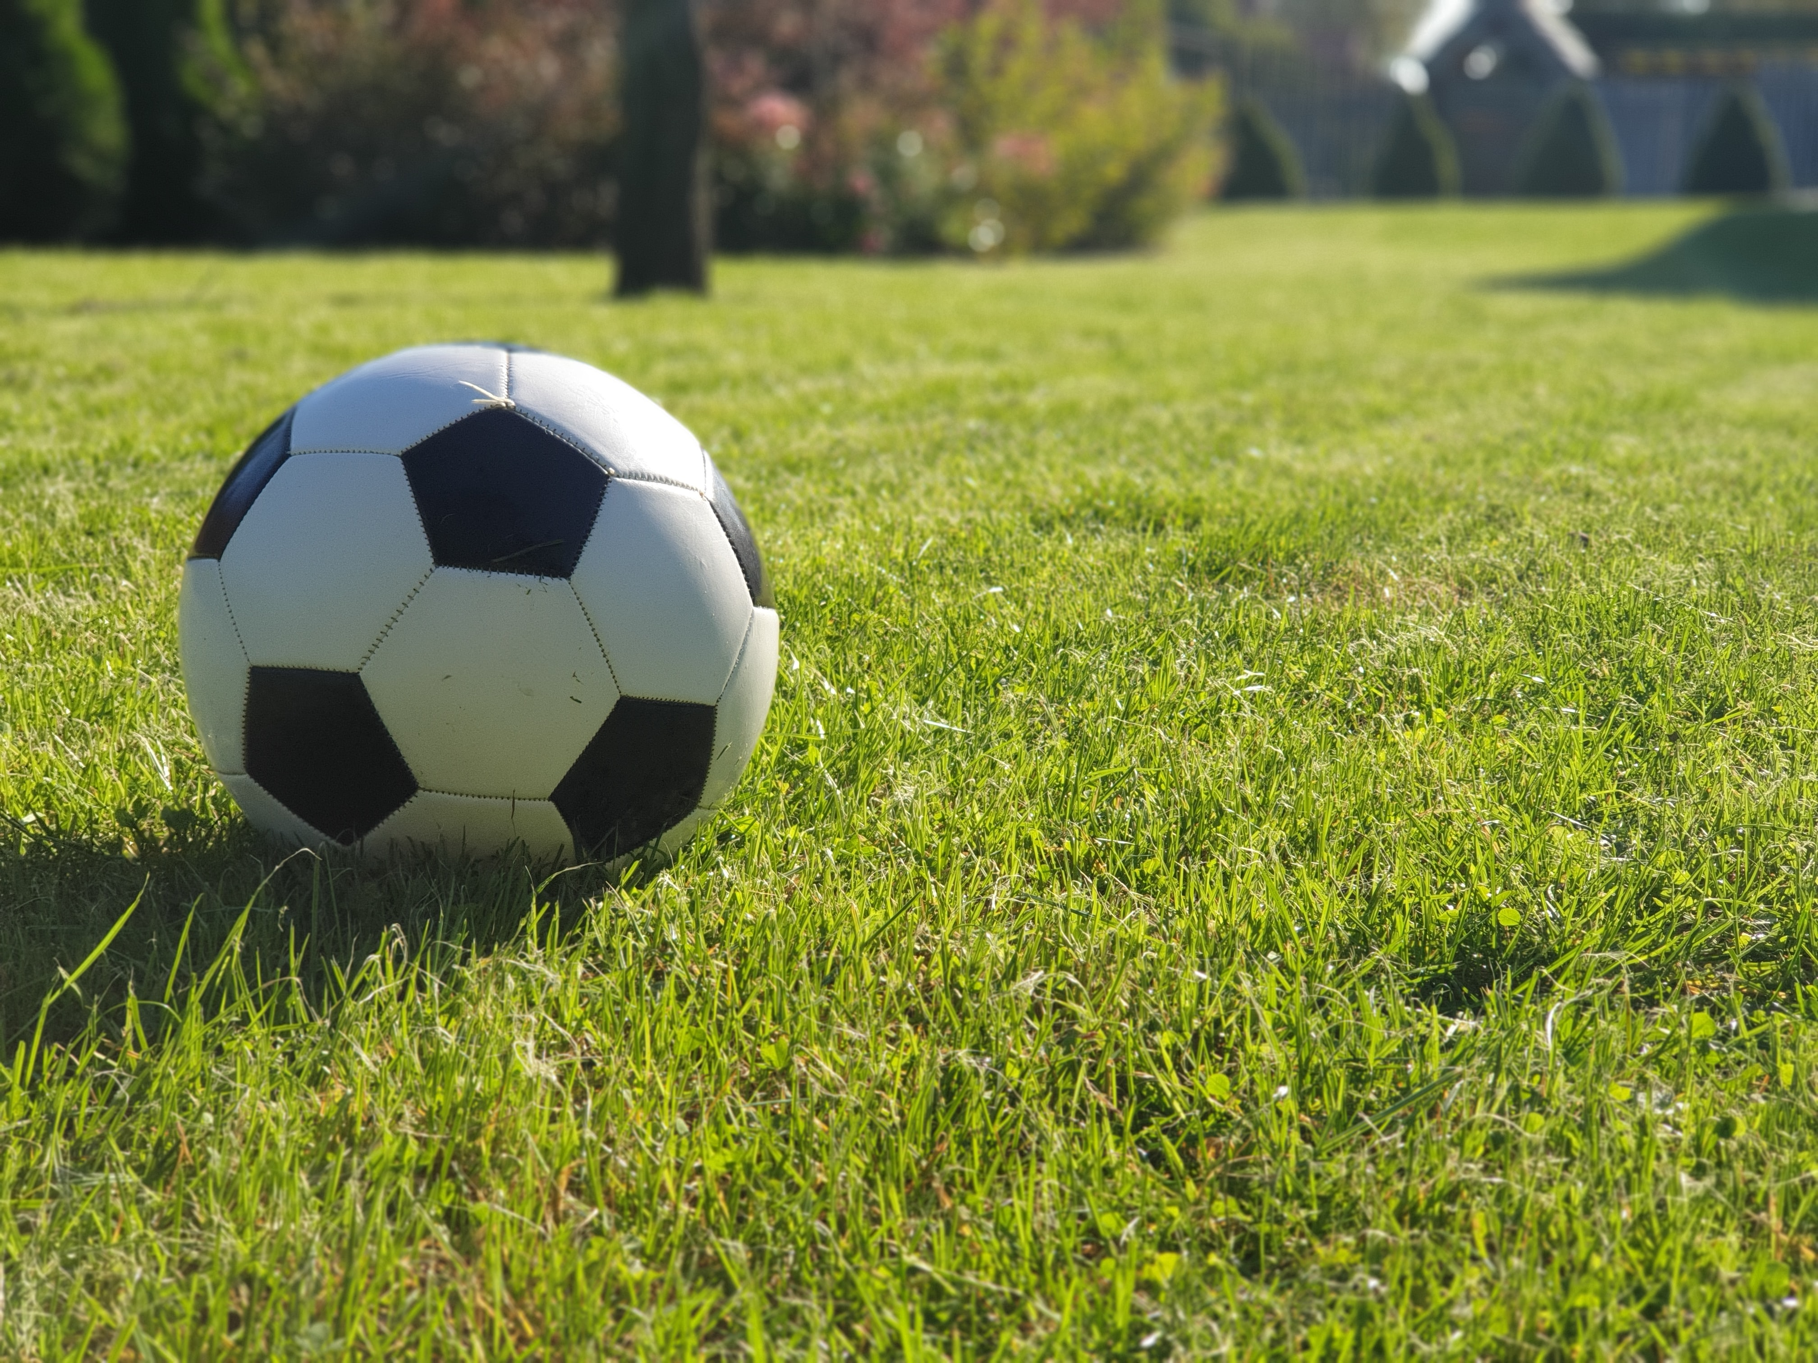
a ball
/ə/ /bɔːl/

Slide 14

a kite
/ə/ /kaɪt/

Slide 15
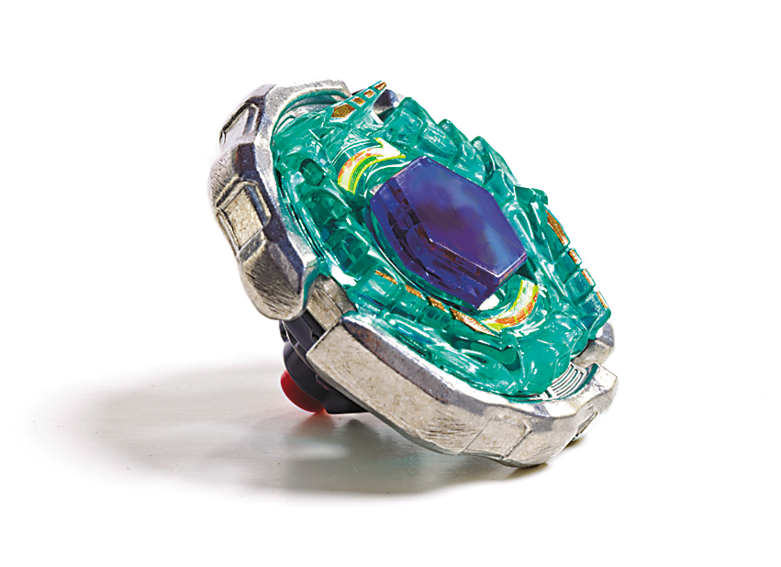
a top
/ə/ /tɑːp/

Slide 16
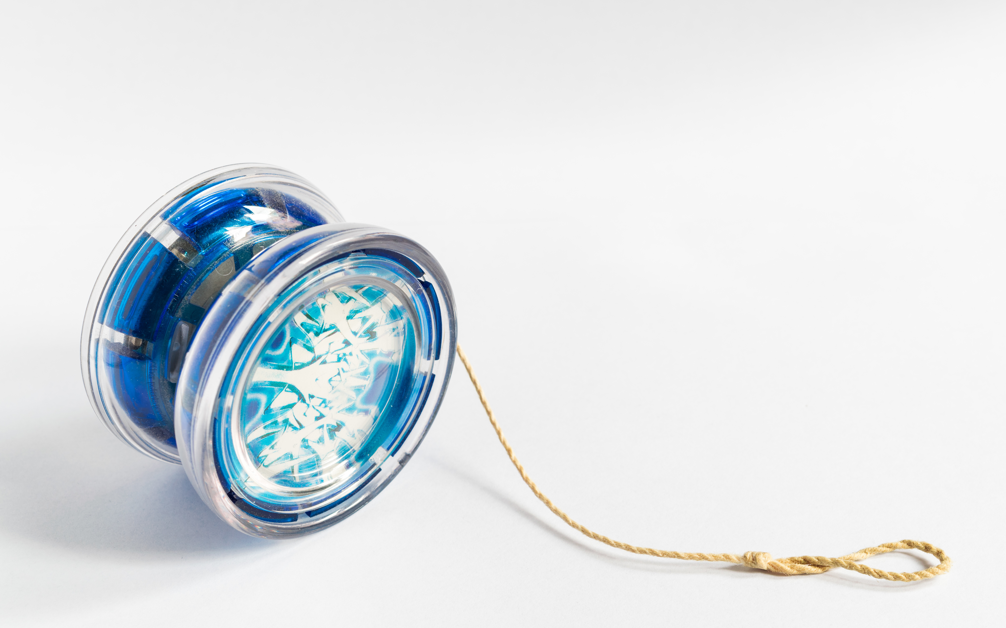
a yo-yo
/ə/ /ˈjəʊ jəʊ/

Slide 17
2
Listen and point. Say.
TR: B50

Slide 18
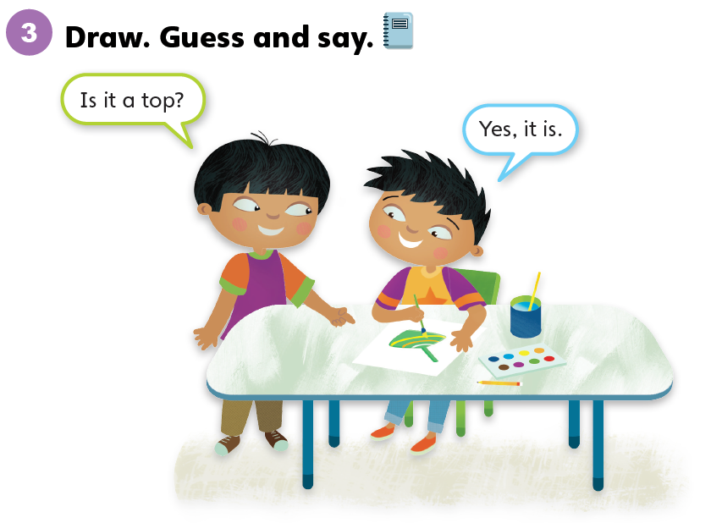

Slide 19
Unit 6:
My Toys
Lesson 3

Slide 20
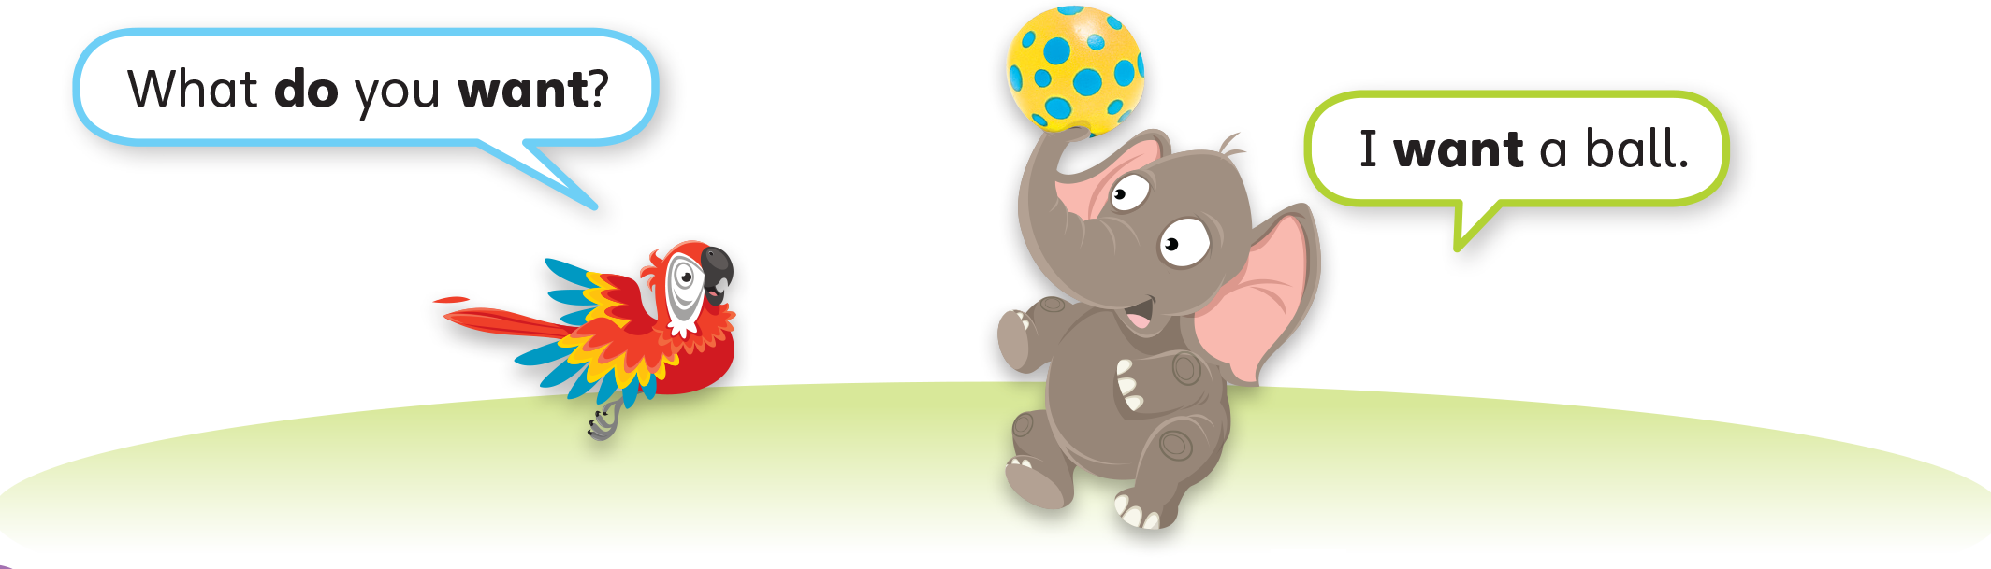
1
Look and listen. Repeat. TR: B51

Slide 21
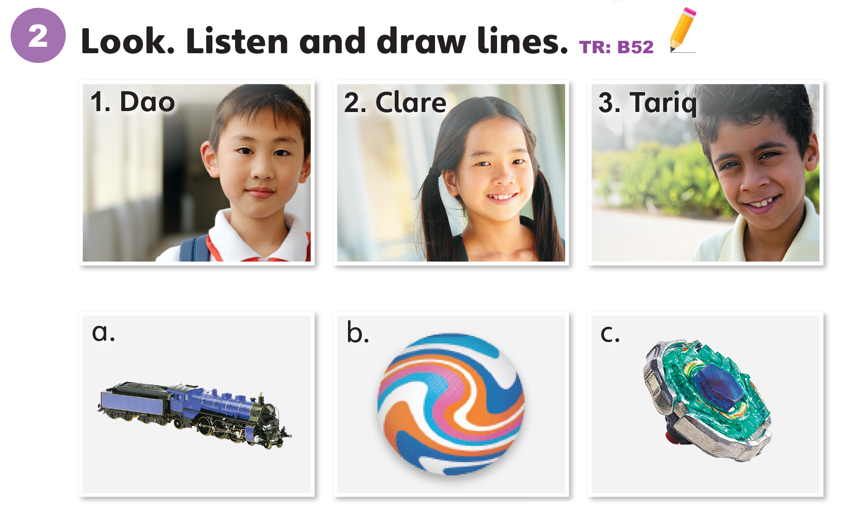

Slide 22
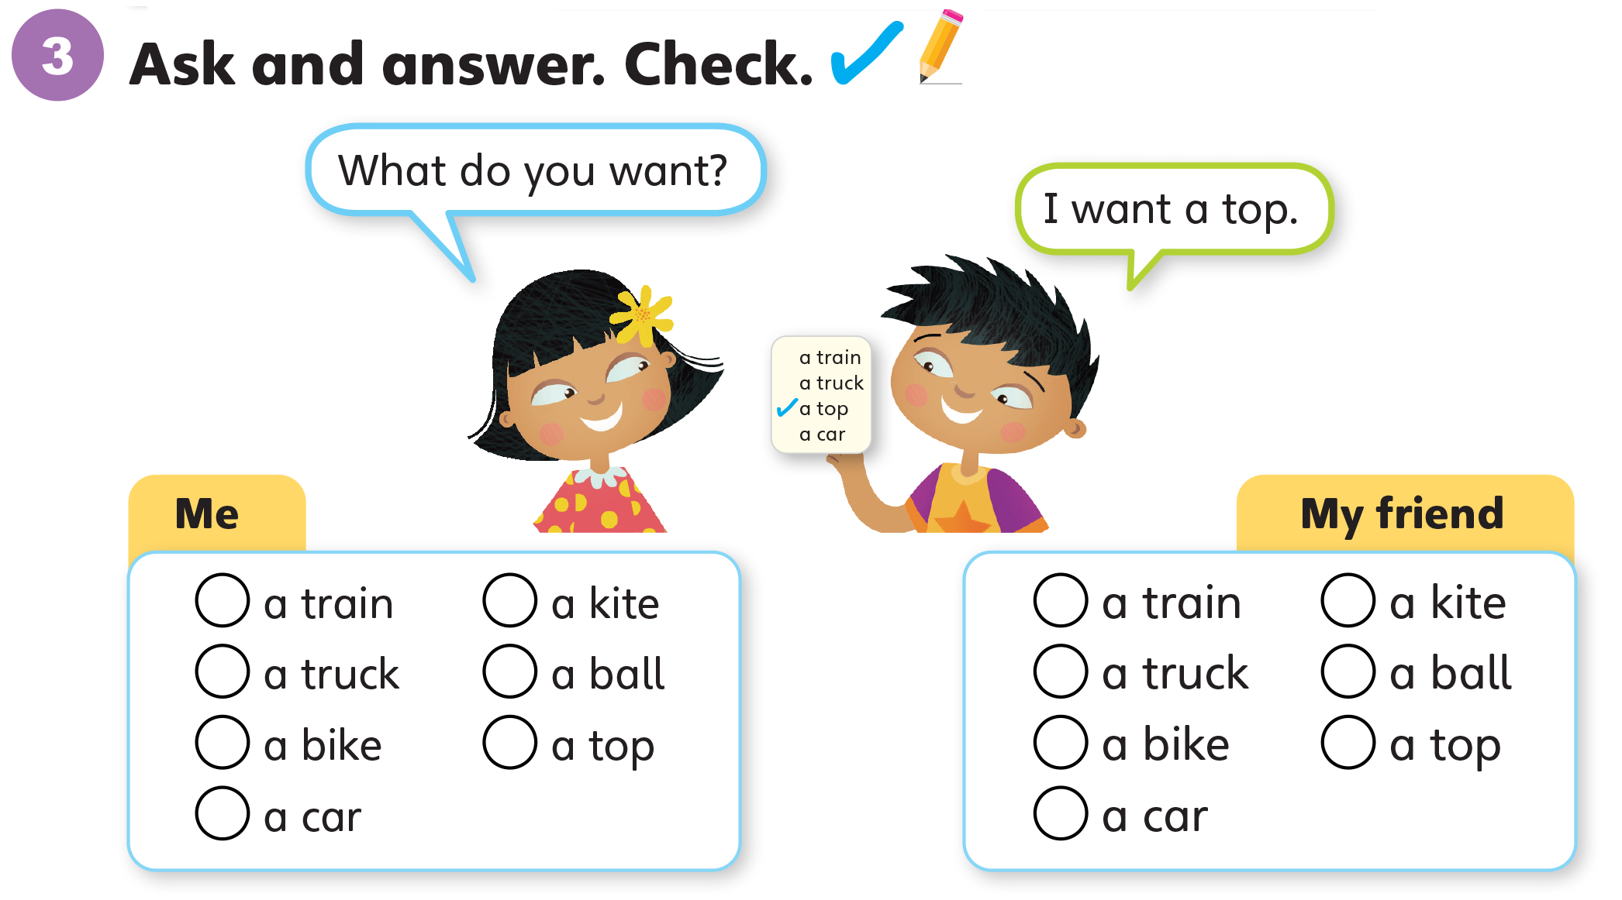

Slide 23
Unit 6:
My Toys
Lesson 4

Slide 24
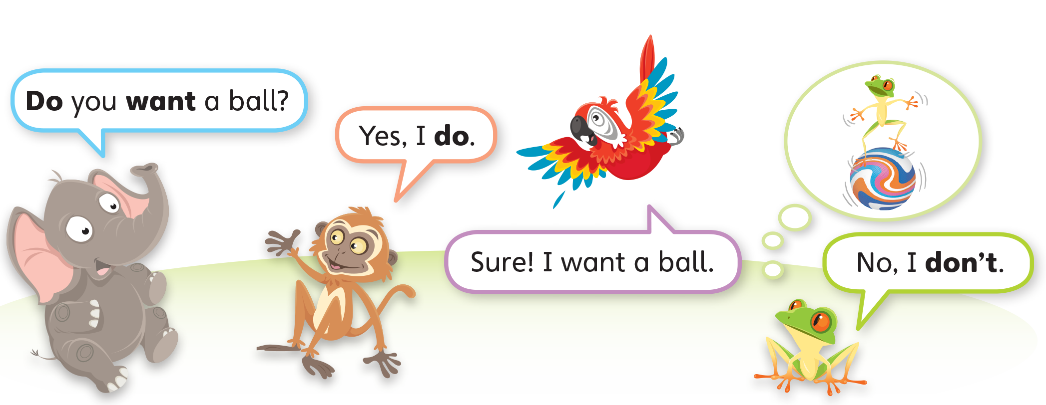
1
Look and listen. Repeat. TR: B53

Slide 25
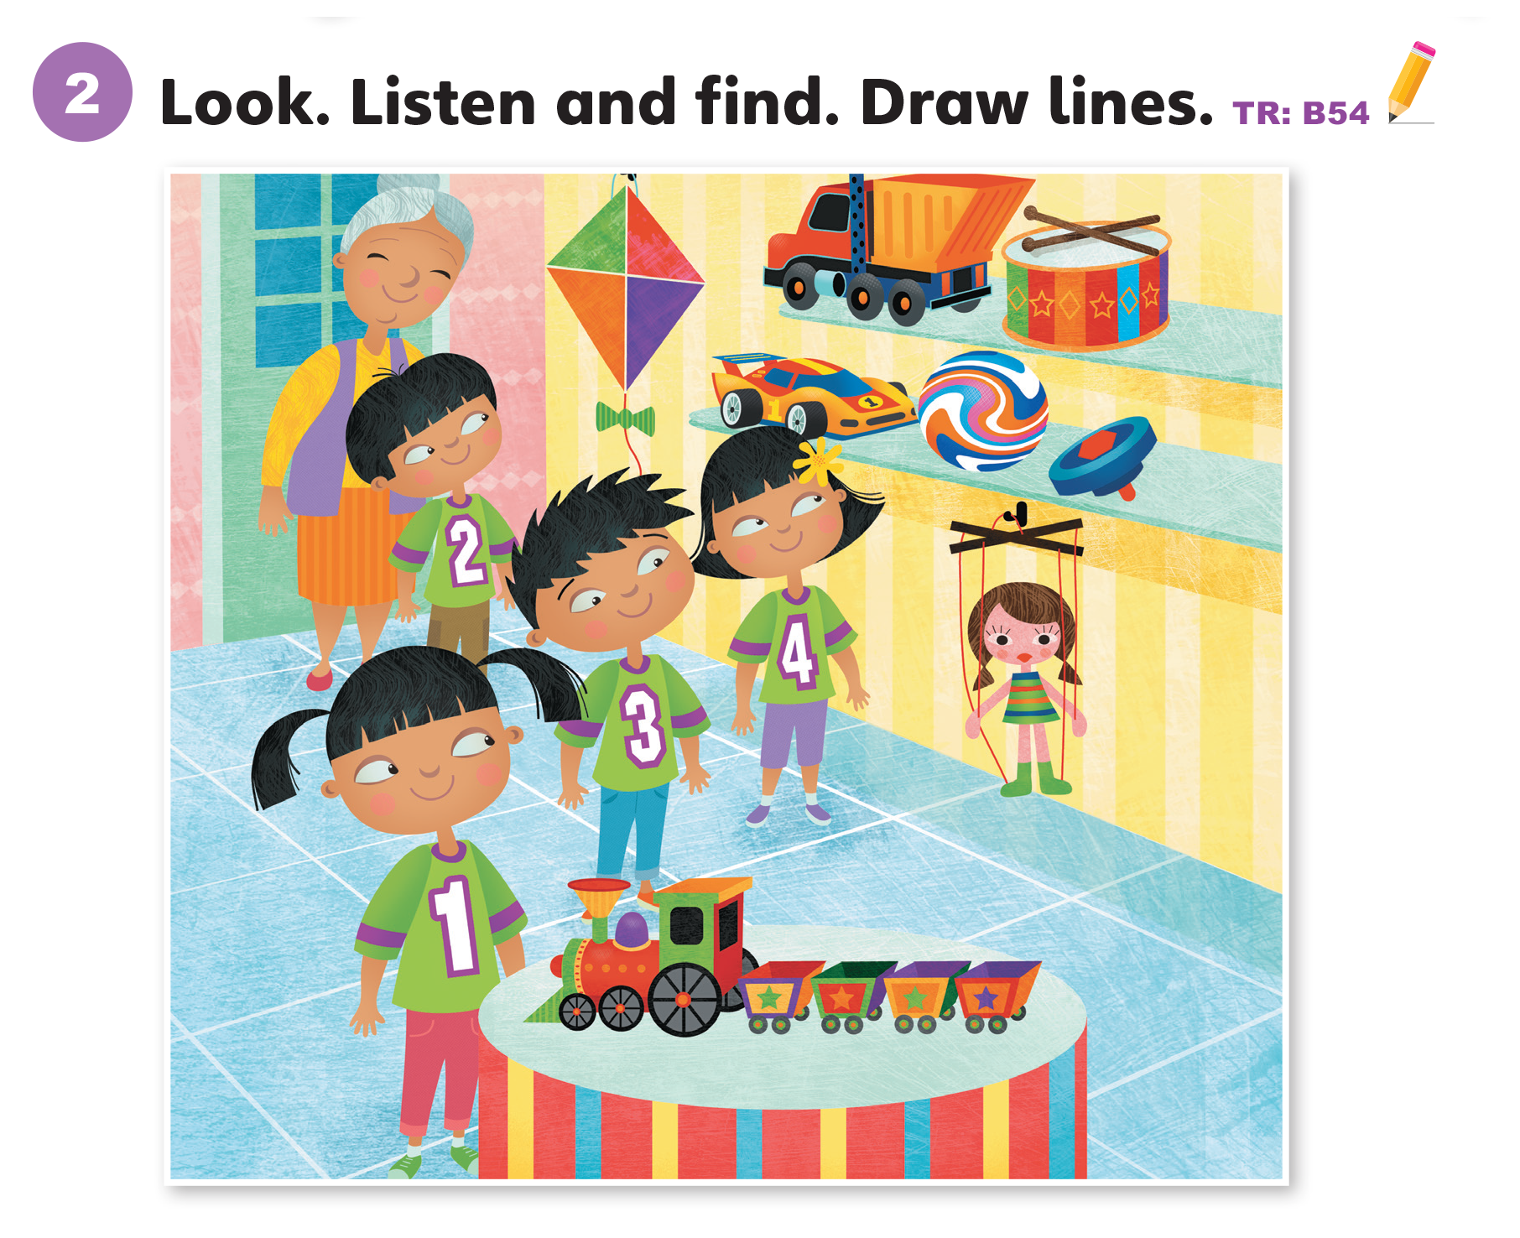

Slide 26
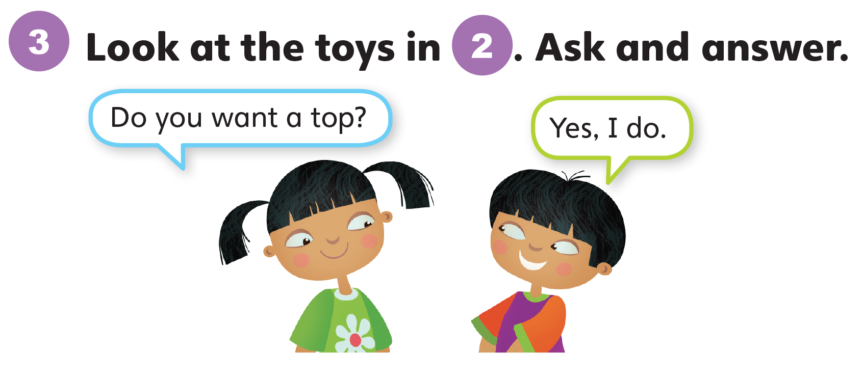
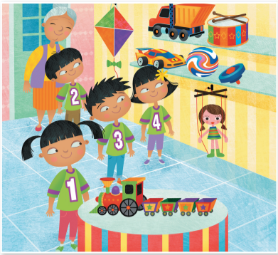

Slide 27
Unit 6:
My Toys
Lesson 5

Slide 28
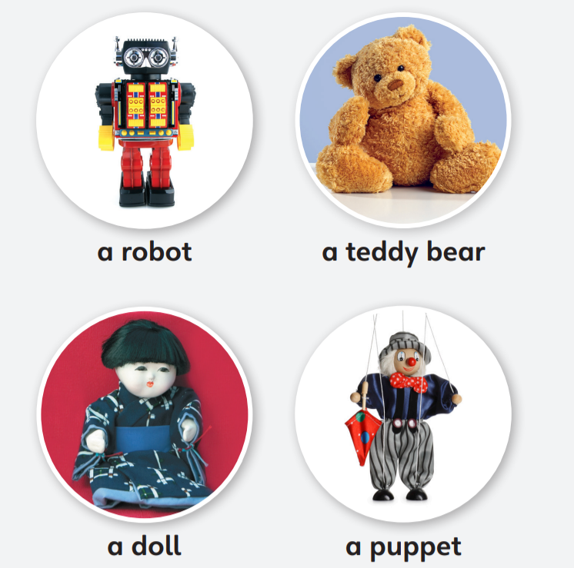
1
Look and listen. Repeat. TR: B55

Slide 29
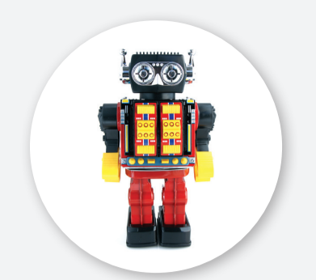
a robot
/ə/ /ˈrəʊbɑːt/

Slide 30
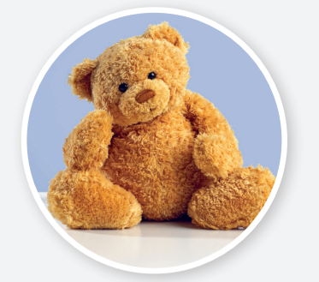
a teddy bear
/ə/ /ˈtedi ber/

Slide 31
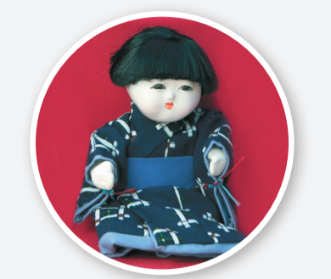
a doll
/ə/ /dɑːl/

Slide 32
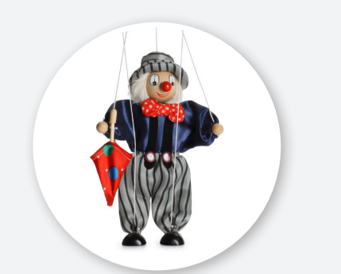
a puppet
/ə/ /ˈpʌpɪt/

Slide 33
2
Point and say.
a robot
a teddy bear
a doll
a puppet

Slide 34
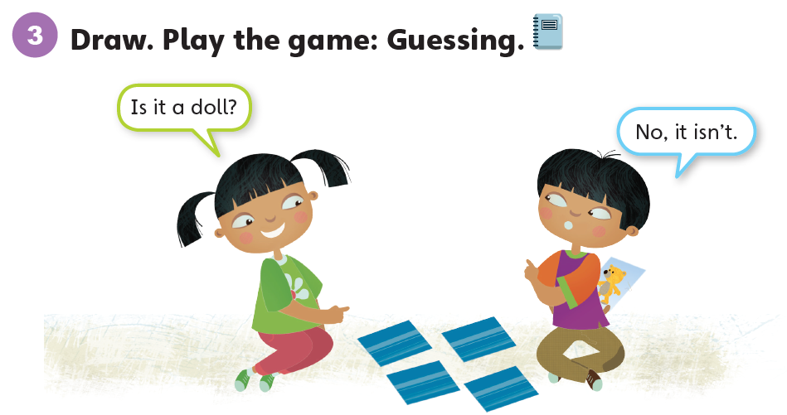

Slide 35
Unit 6:
My Toys
Lesson 6

Slide 36
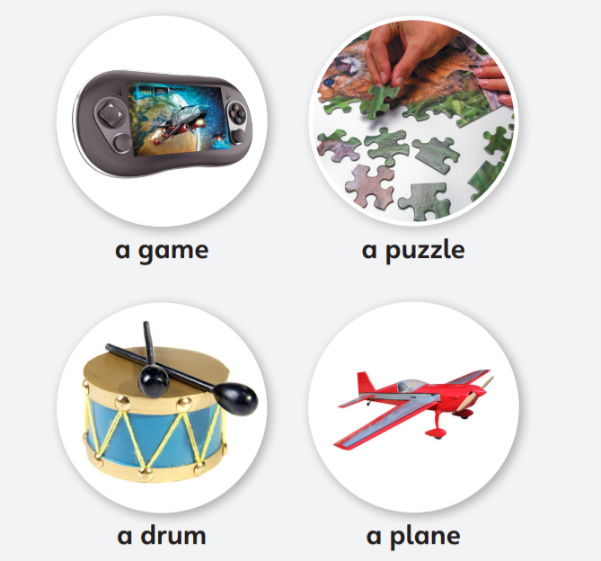
1
Look and listen. Repeat. TR: B56

Slide 37
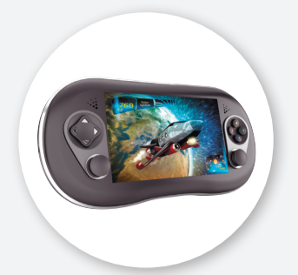
a game
/ə/ /ɡeɪm/

Slide 38
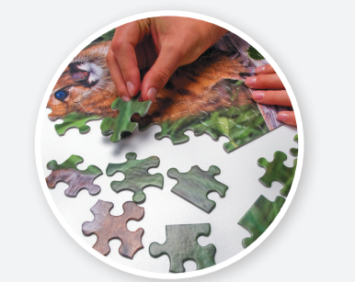
a puzzle
/ə/ /ˈpʌzl/

Slide 39
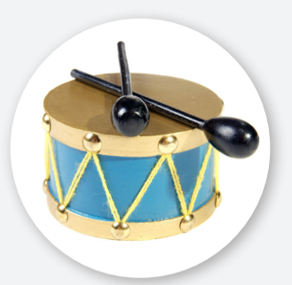
a drum
/ə/ /drʌm/

Slide 40
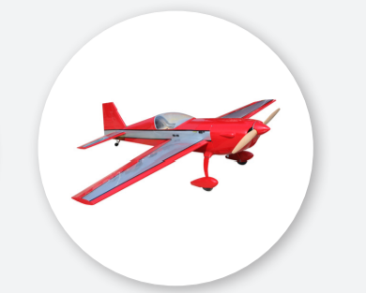
a plane
/ə/ /pleɪn/

Slide 41
2
Point and say.
a game
a puzzle
a drum
a plane

Slide 42
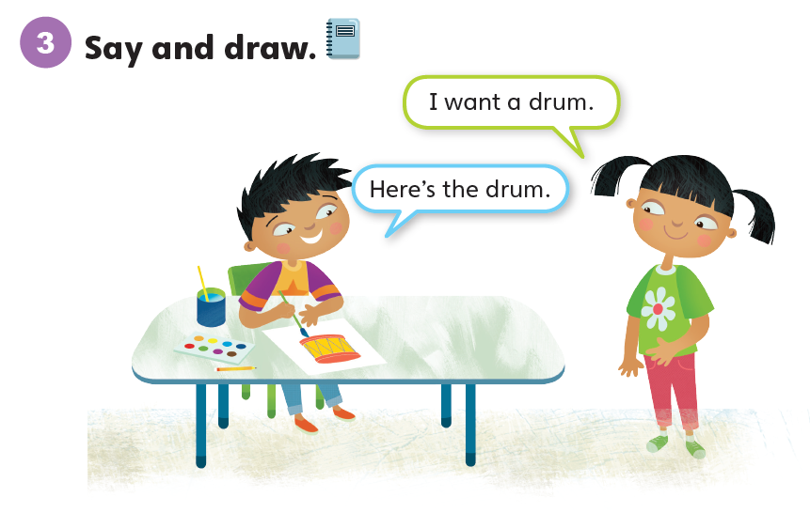

Slide 43
Unit 6:
My Toys
Lesson 7

Slide 44
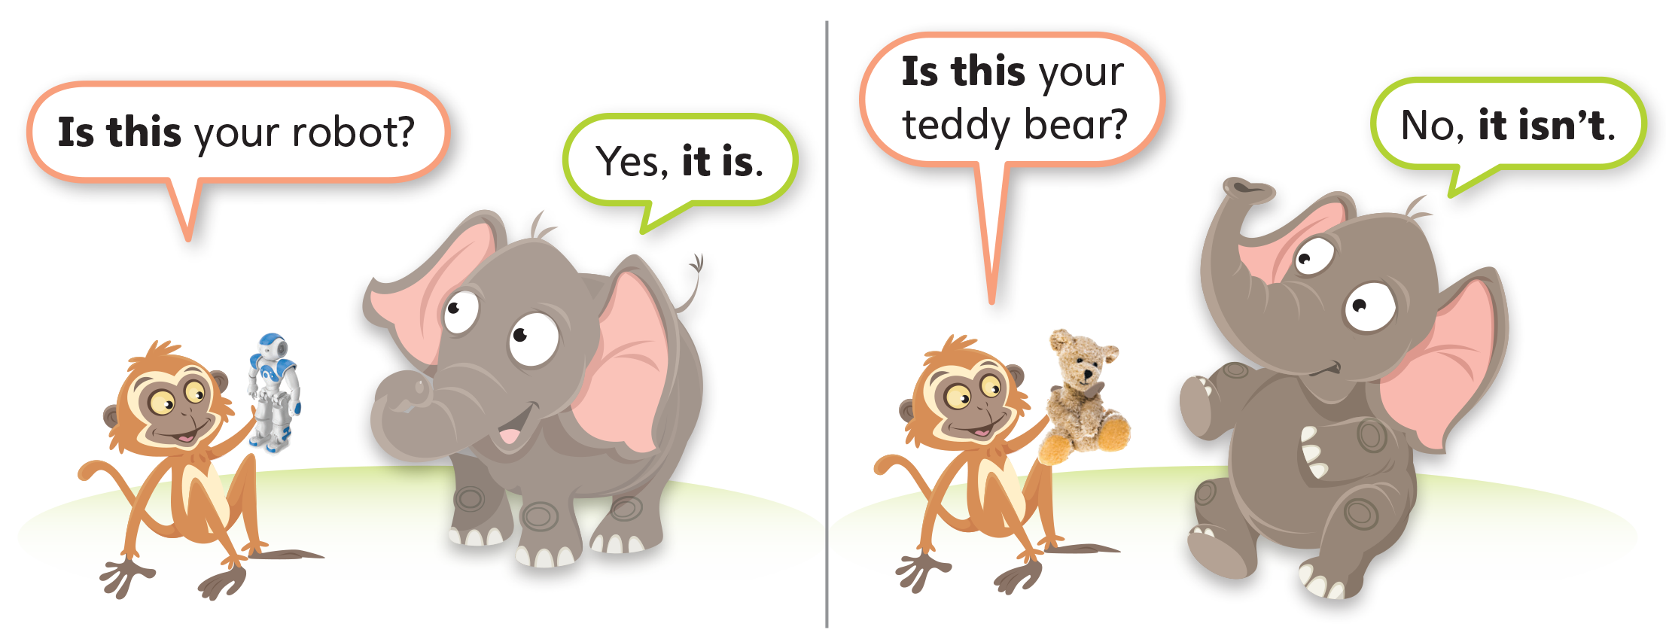
1
Look and listen. Repeat. TR: B57

Slide 45
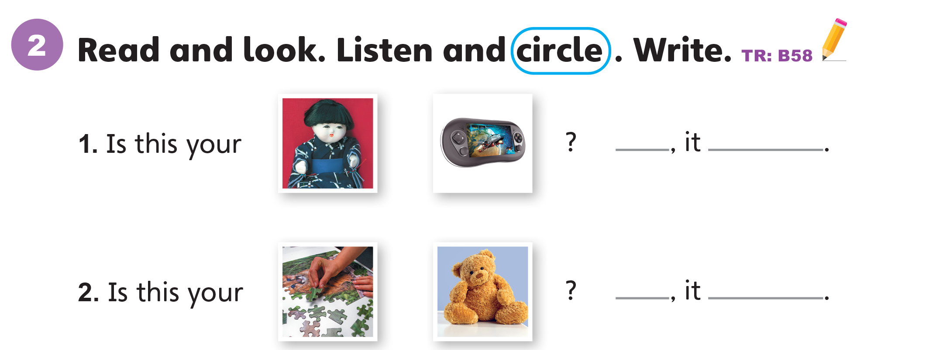
No
isn’t
Yes
is

Slide 46
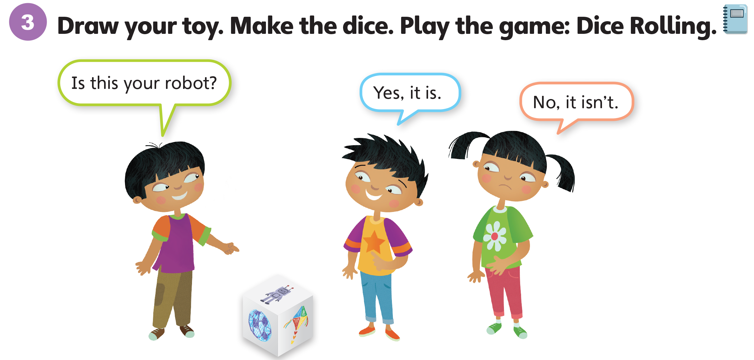

Slide 47
Unit 6:
My Toys
Lesson 8

Slide 48
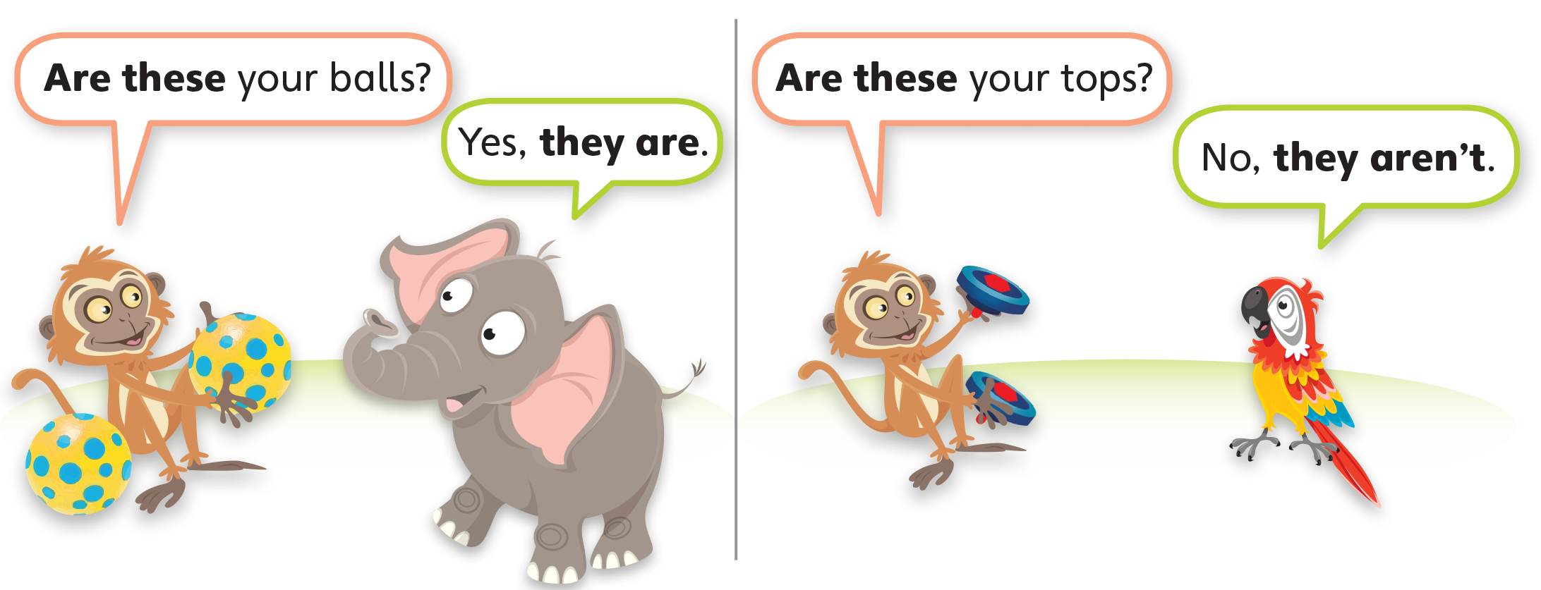
1
Look and listen. Repeat. TR: B59

Slide 49
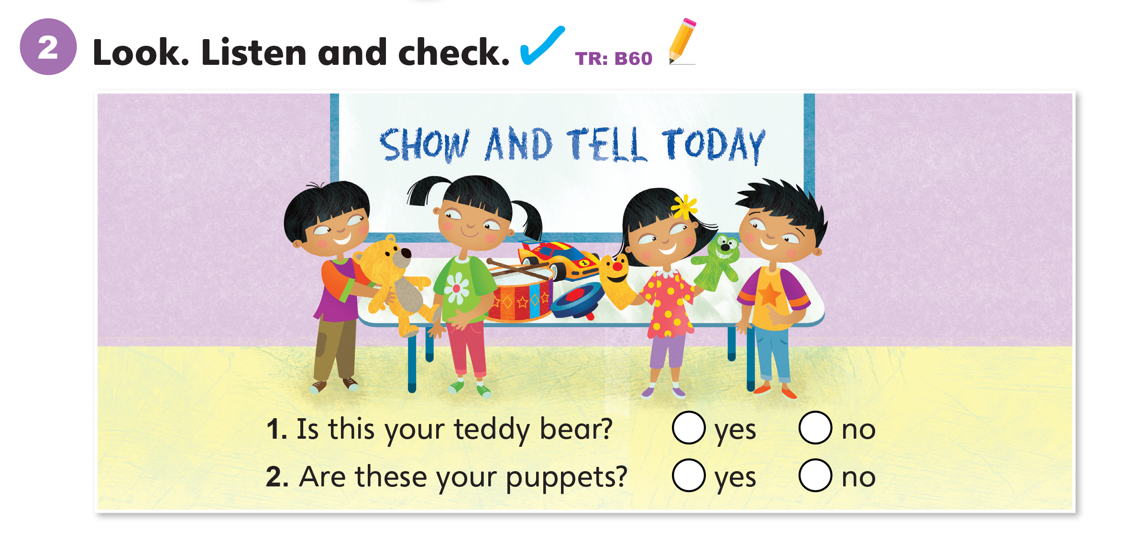

Slide 50
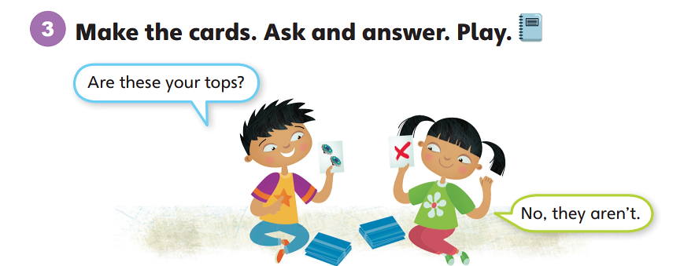
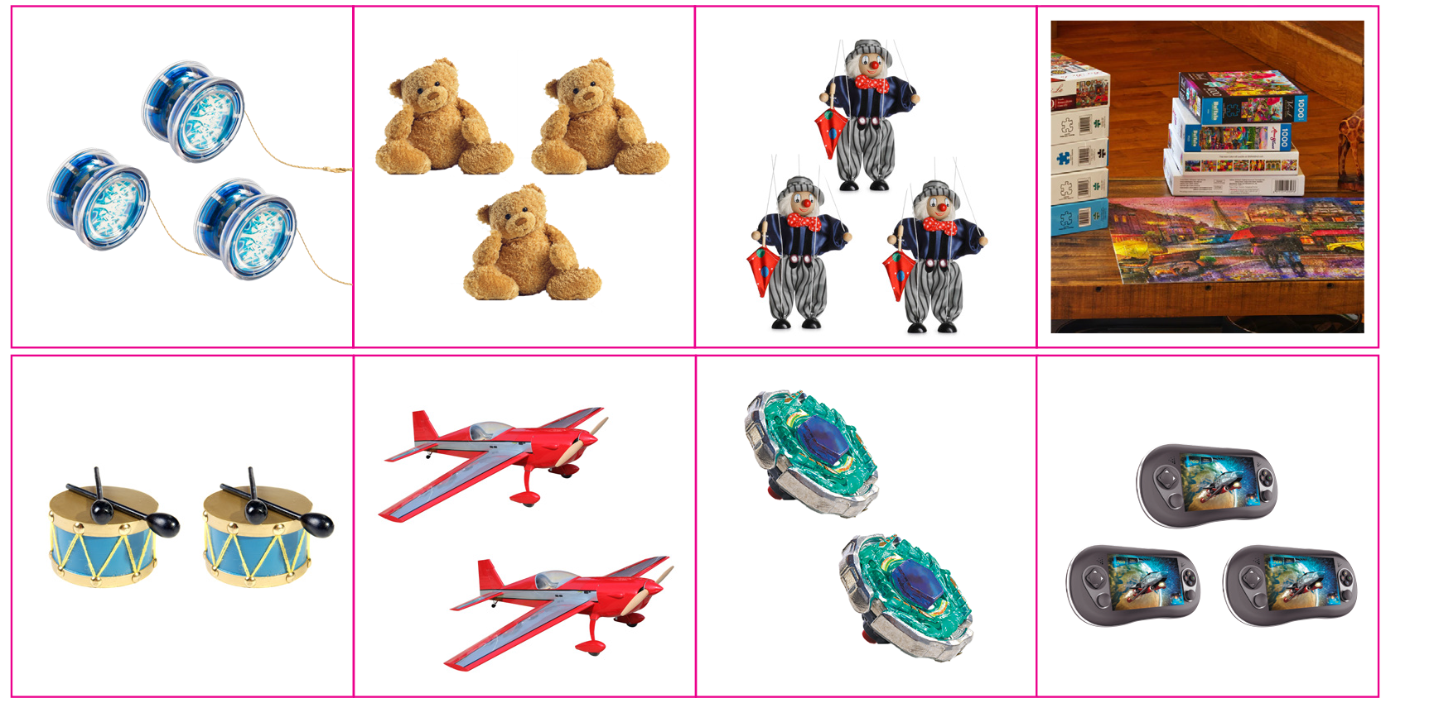

Slide 51
Unit 6:
My Toys
Lesson 9

Slide 52
1
Listen and repeat. TR: B61
t
d
  toy
  robot
  doll
  bed

Slide 53
2
Listen and sing. TR: B62
Is this your robot? Robot, robot, robot.
Yes, it is. It’s my toy.
Is this your doll? Doll, doll, doll.
Yes, it is. It’s my toy.
Are these your dogs? Are these your toys?
They’re my dogs. But they aren’t my toys.
They’re my pets.

Slide 54
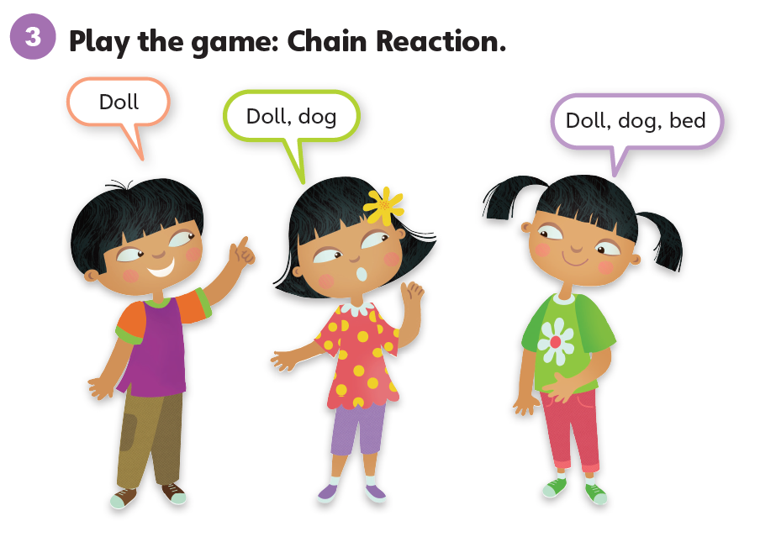

Slide 55
Unit 6:
My Toys
Lesson 10

Slide 56
1
Listen and repeat. TR: B63
a_e
ure
game
  plane
  sure

Slide 57
2
Listen and chant. TR: B64
Do you want a game?
Sure, sure, sure!
Come and play with my game!
Do you want a plane?
Sure, sure, sure!
Come and play with my plane!

Slide 58
3
Say. Circle the odd one out.
1.
name
game
ball
2.
sure
glue
blue

Slide 59
Unit 6:
My Toys
Lesson 11

Slide 60
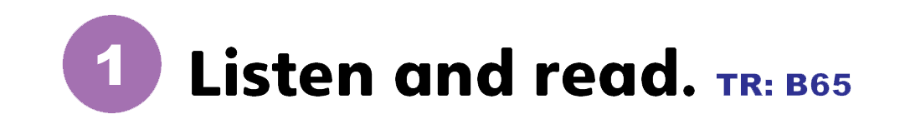
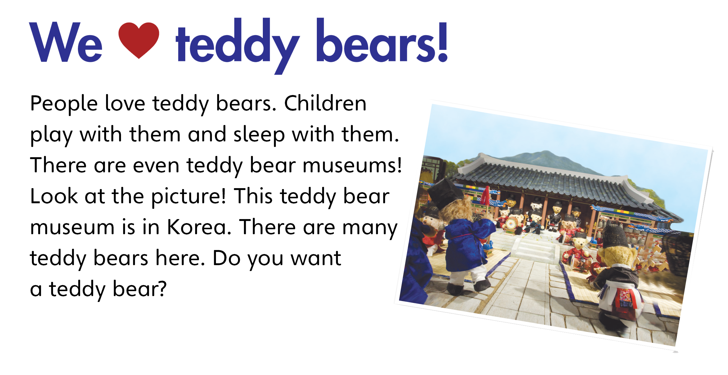

Slide 61
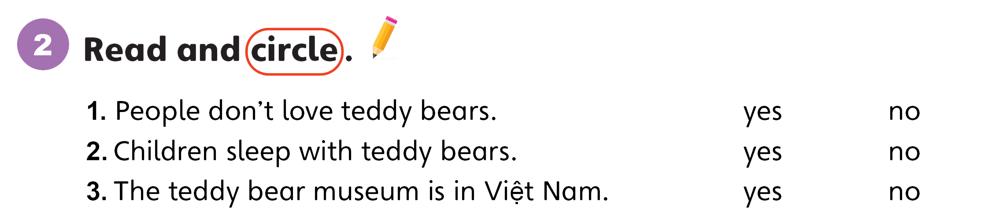

Slide 62
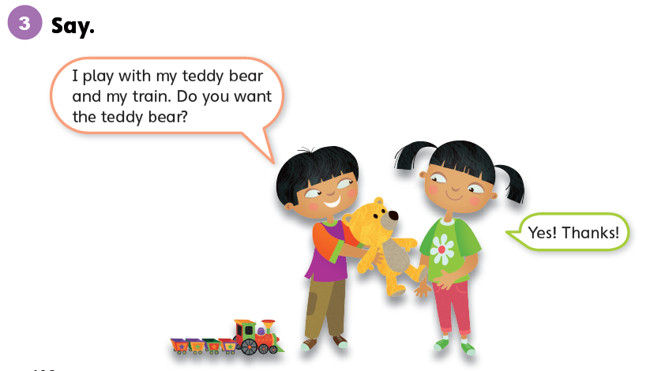

Slide 63
Unit 6:
My Toys
Lesson 12

Slide 64
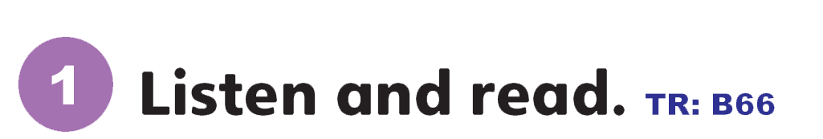
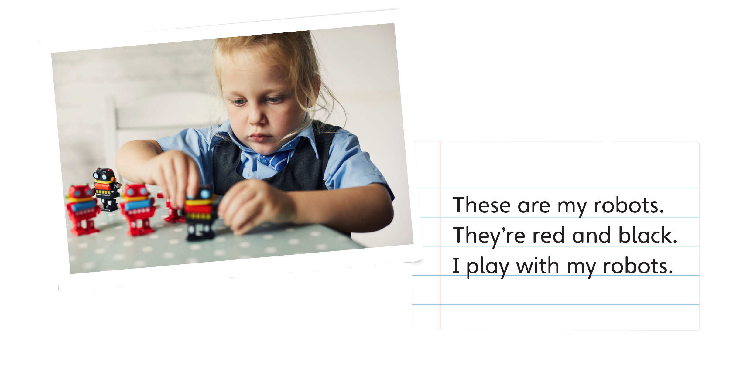

Slide 65
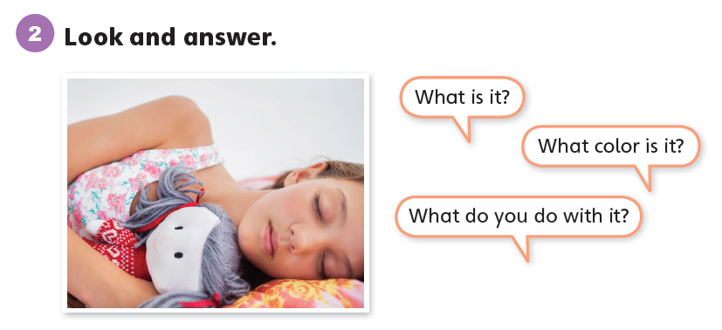

Slide 66

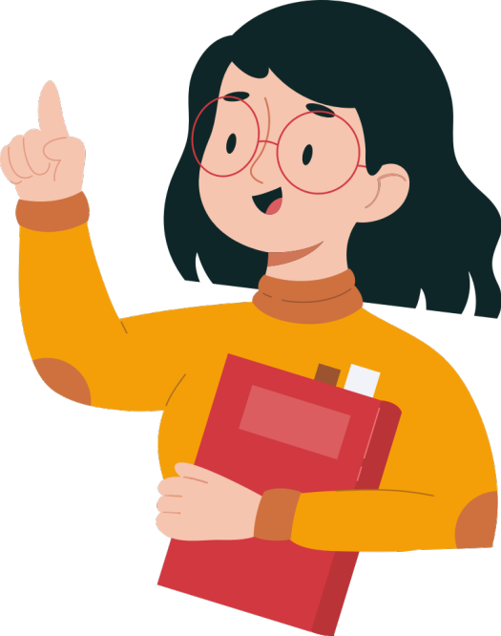

Slide 67
Unit 6:
My Toys
Value

Slide 68
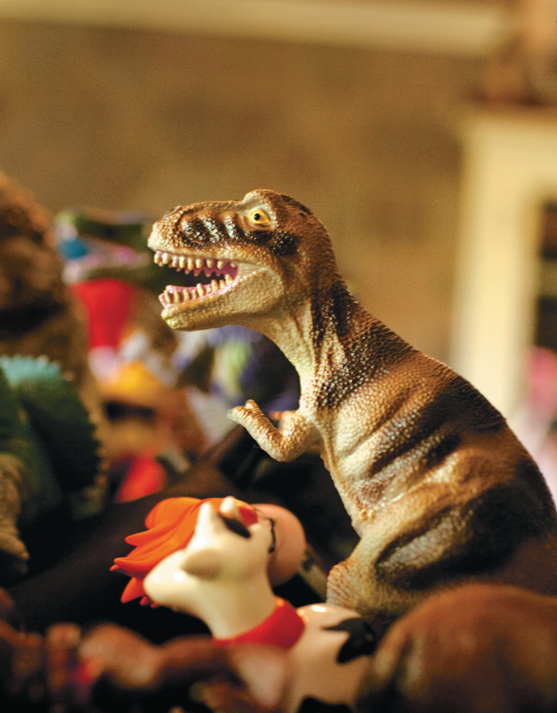
1
Look and listen. Repeat. TR: B67
Share your toys.
I share my toys with my friends. We play together.

Slide 69
Share your toys.
2
Think. What do you share with your friends?

Slide 70
Share your toys.
3
Share.
I share my games with my friends. We play together.

Slide 71
Thank you!

