Slide 1
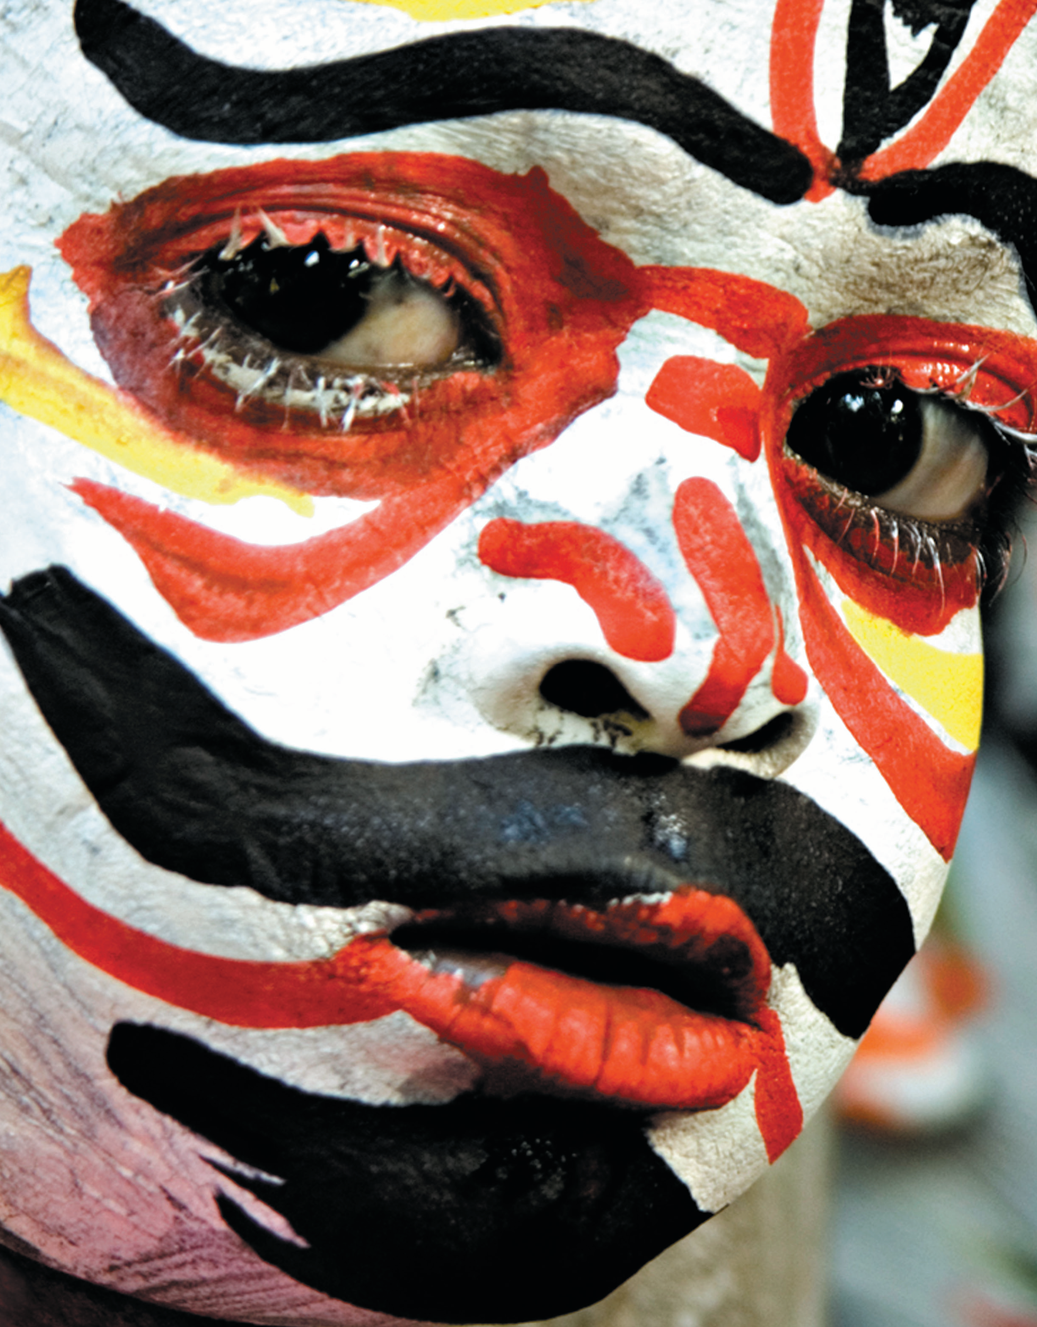
Unit 7
My Body

Slide 2
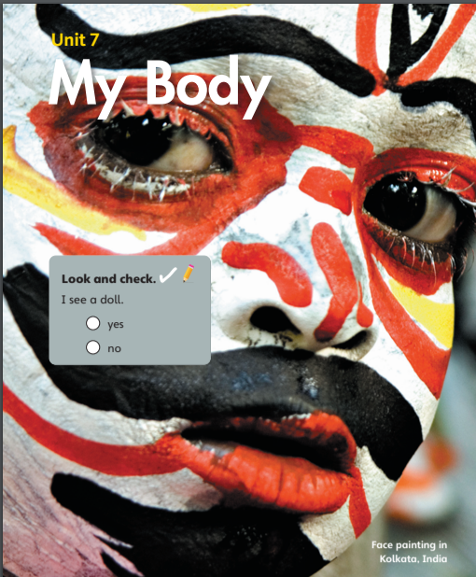

I see a doll.
yes
no

Slide 3
Unit 7:
My Body
Lesson 1

Slide 4

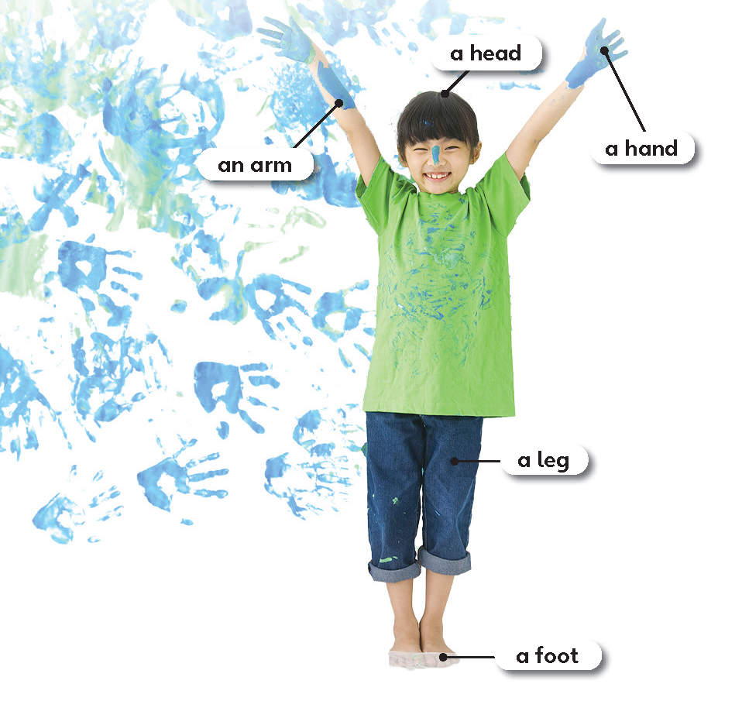
1
Look and listen. Repeat.
TR: B69

Slide 5
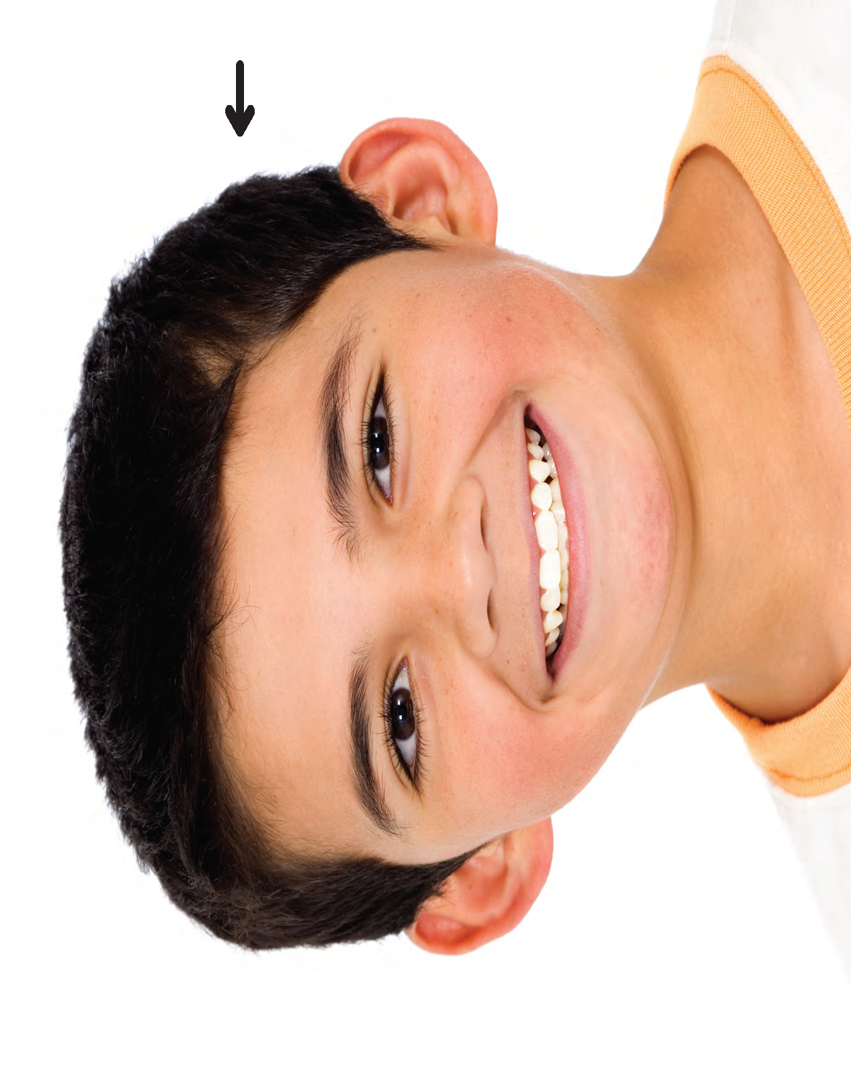
a head
/ə/ /hed/

Slide 6
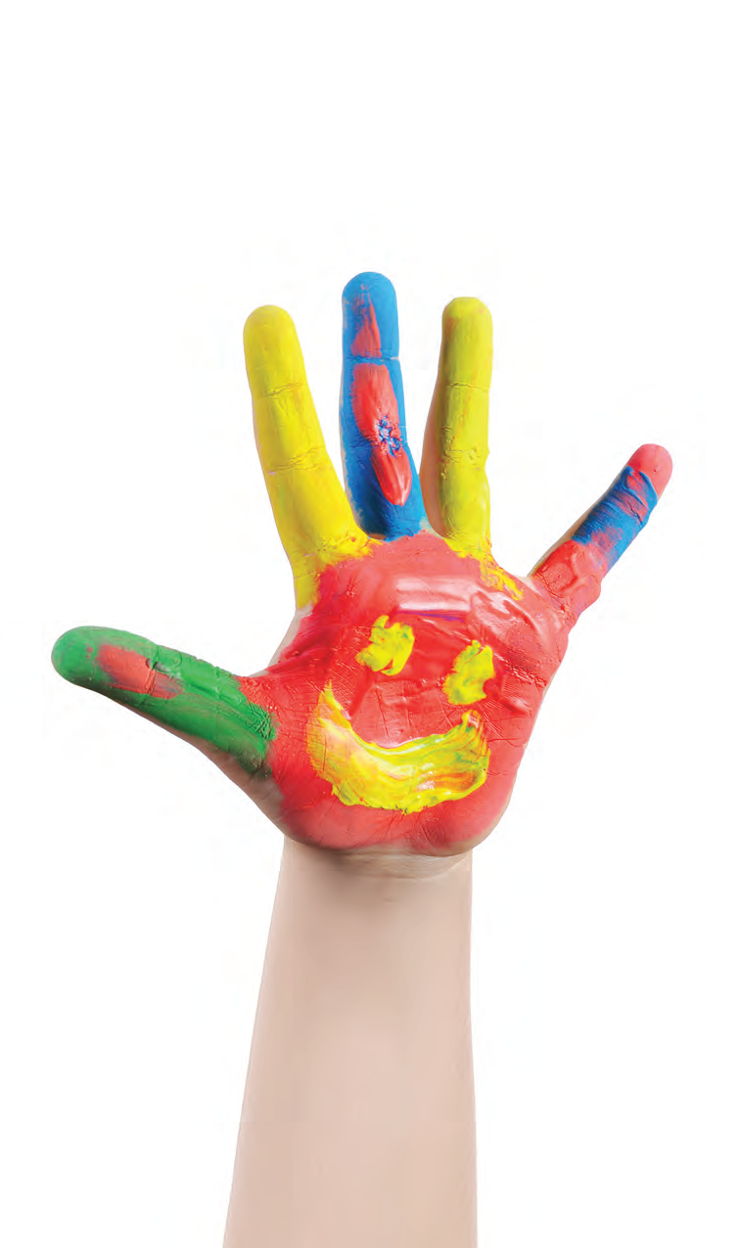
a hand
/ə/ /hænd/

Slide 7

an arm
/ən/ /ɑːrm/

Slide 8
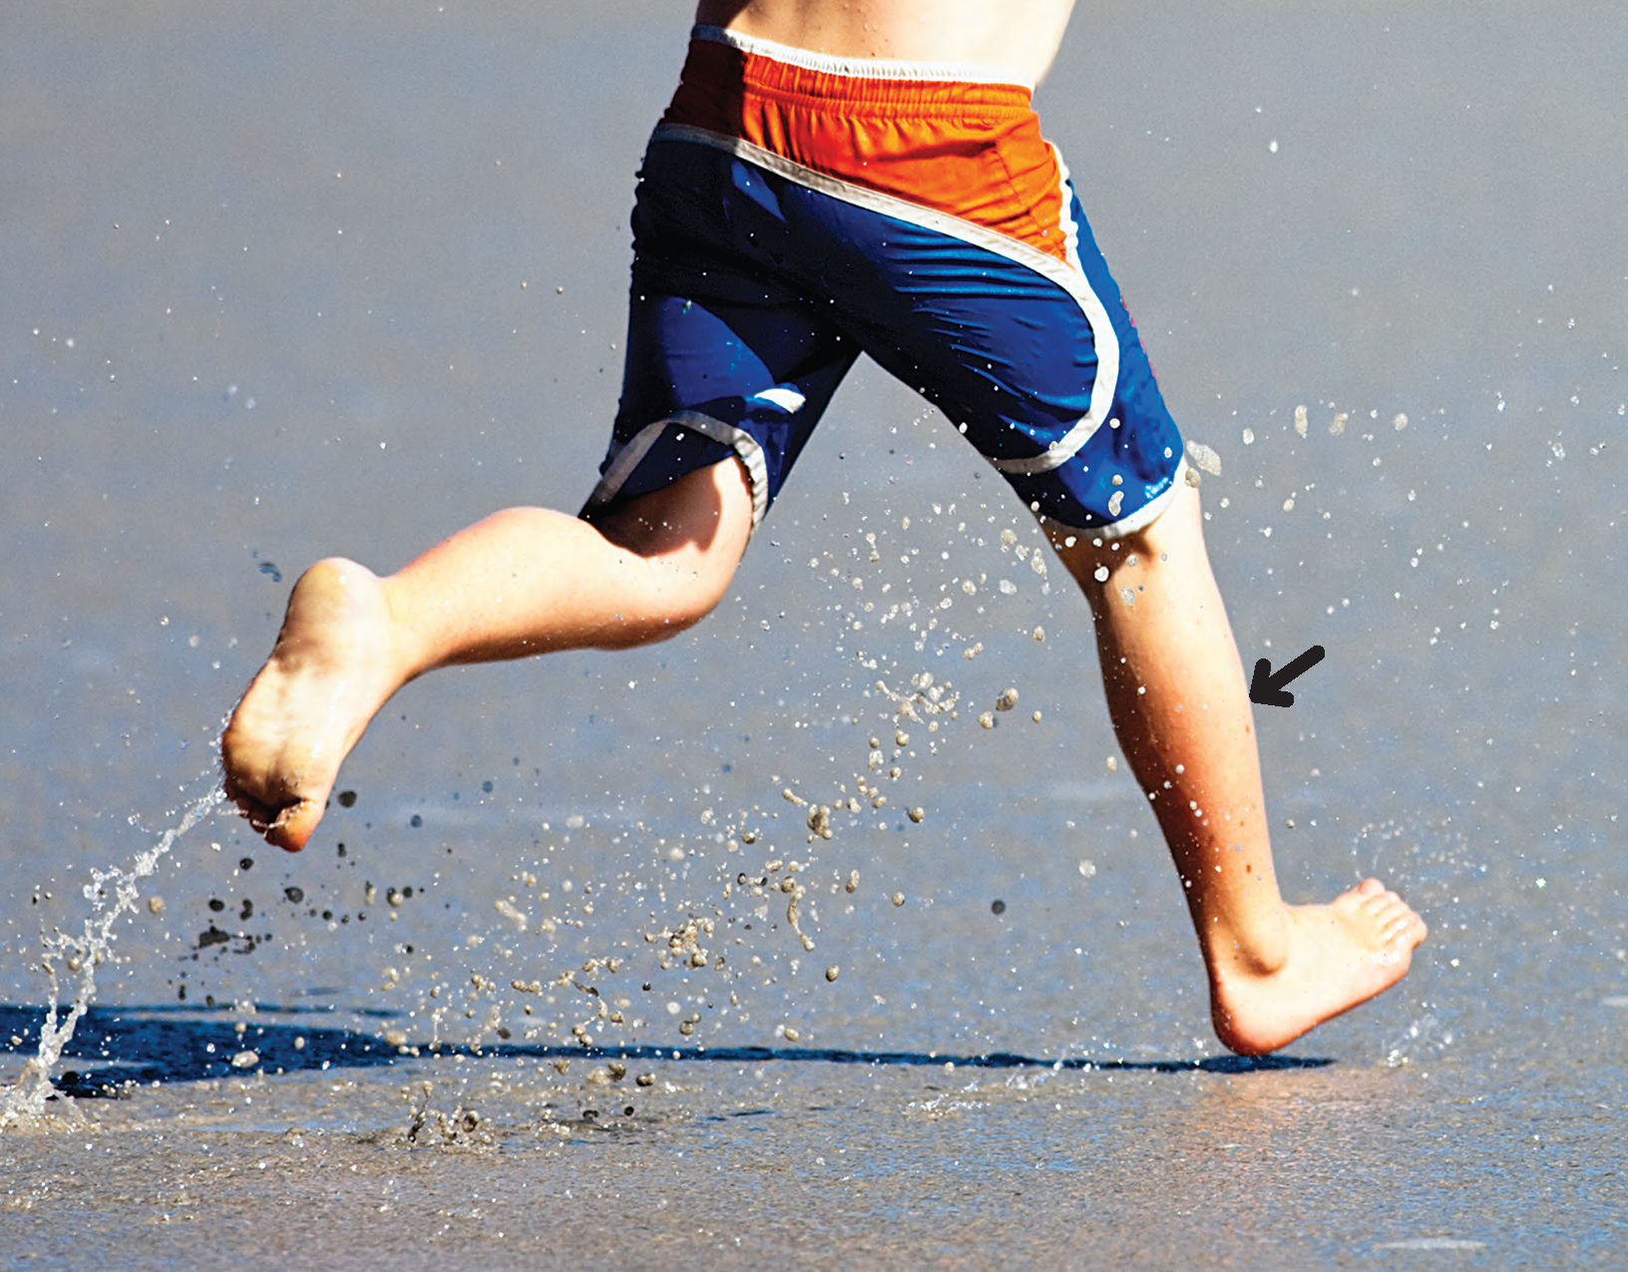
a leg
/ə/ /leɡ/

Slide 9
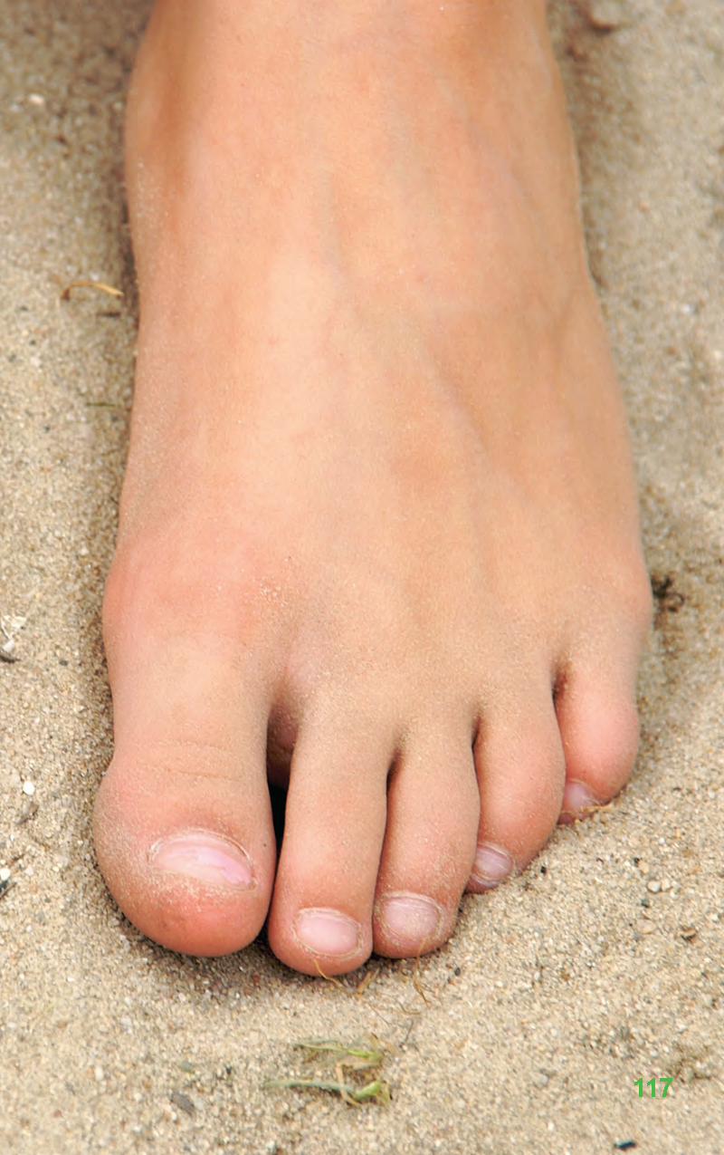
a foot
/ə/ /fʊt/

Slide 10
2
Listen and point. Say.
TR: B70

Slide 11
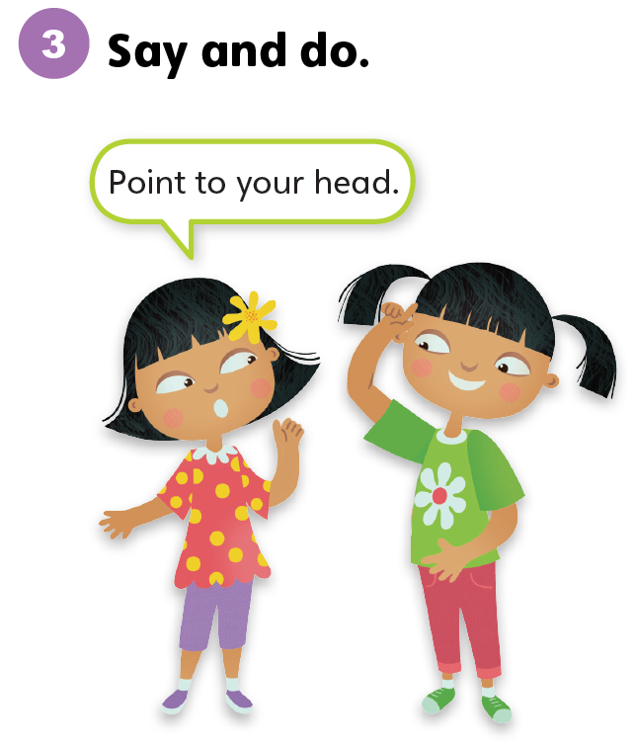

Slide 12
Unit 7:
My Body
Lesson 2

Slide 13
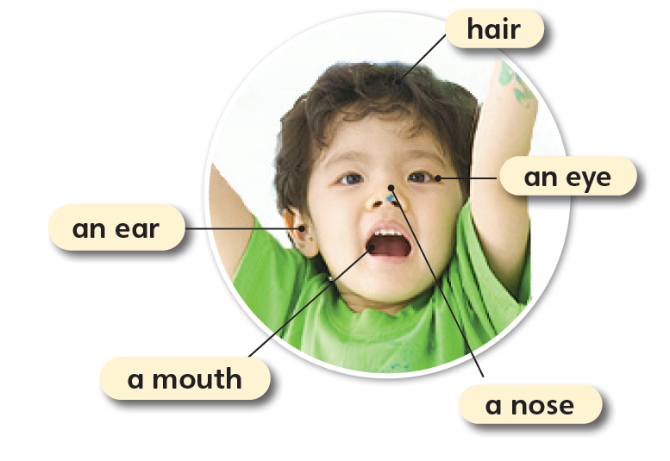
1
Look and listen. Repeat.
TR: B71

Slide 14
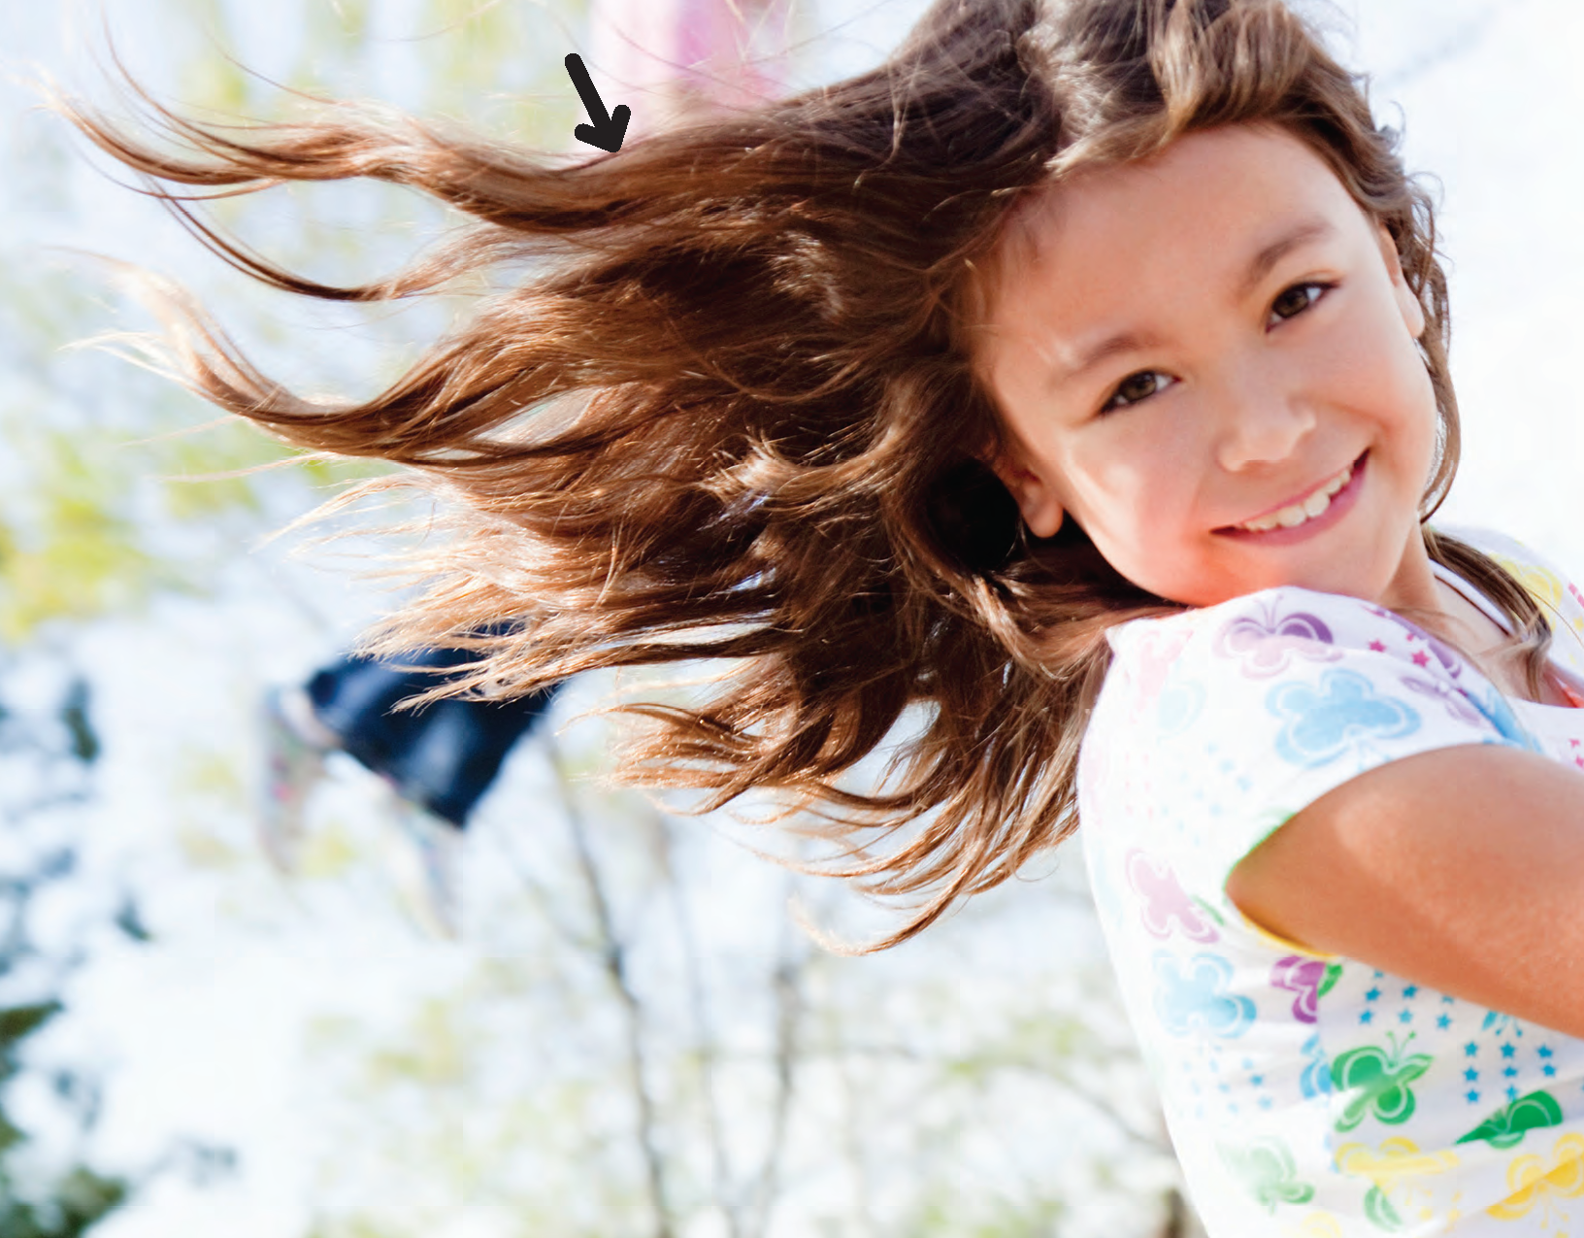
hair
/her/

Slide 15
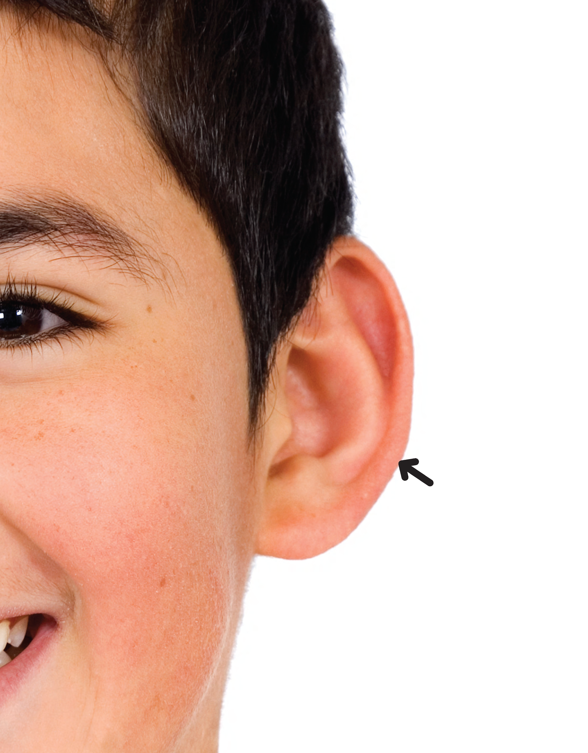
an ear
/ən/ /ɪr/

Slide 16
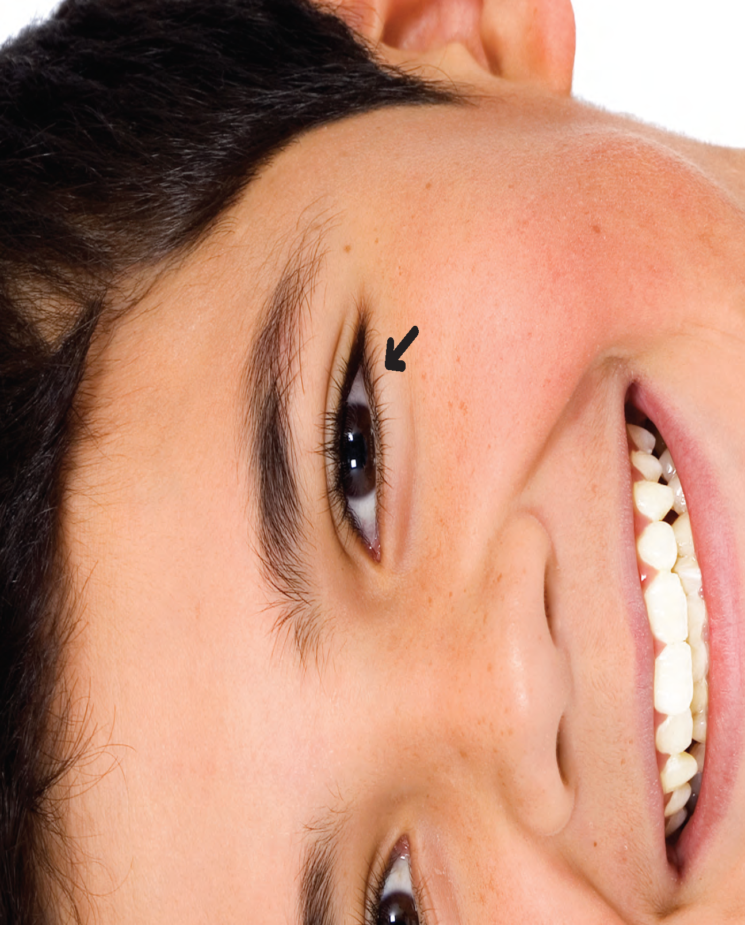
an eye
/ən/ /aɪ/

Slide 17
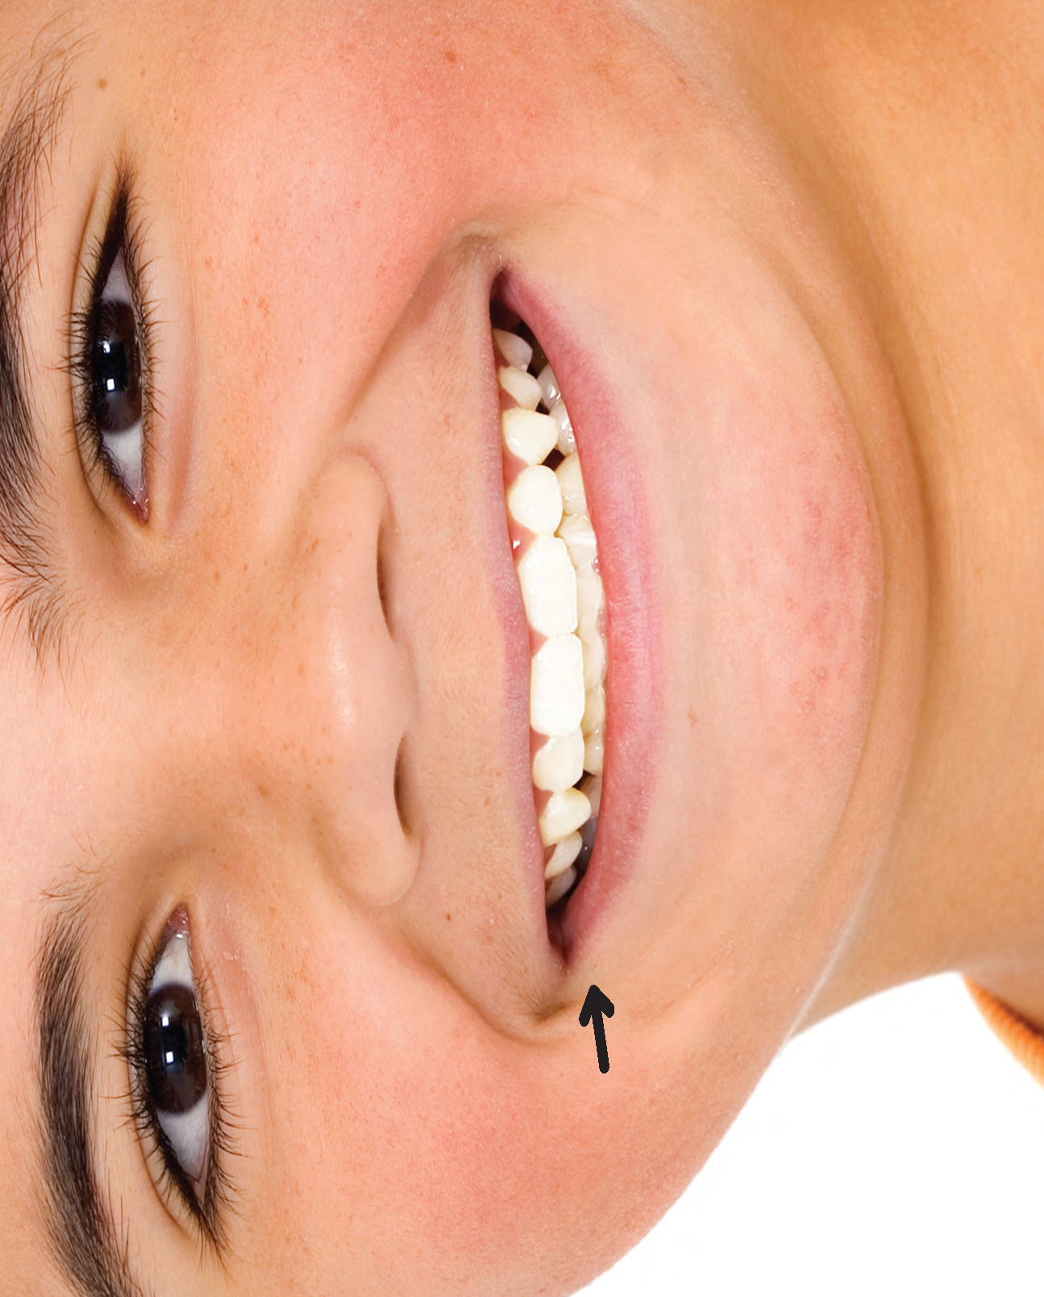
a mouth
/ə/ /maʊθ/

Slide 18
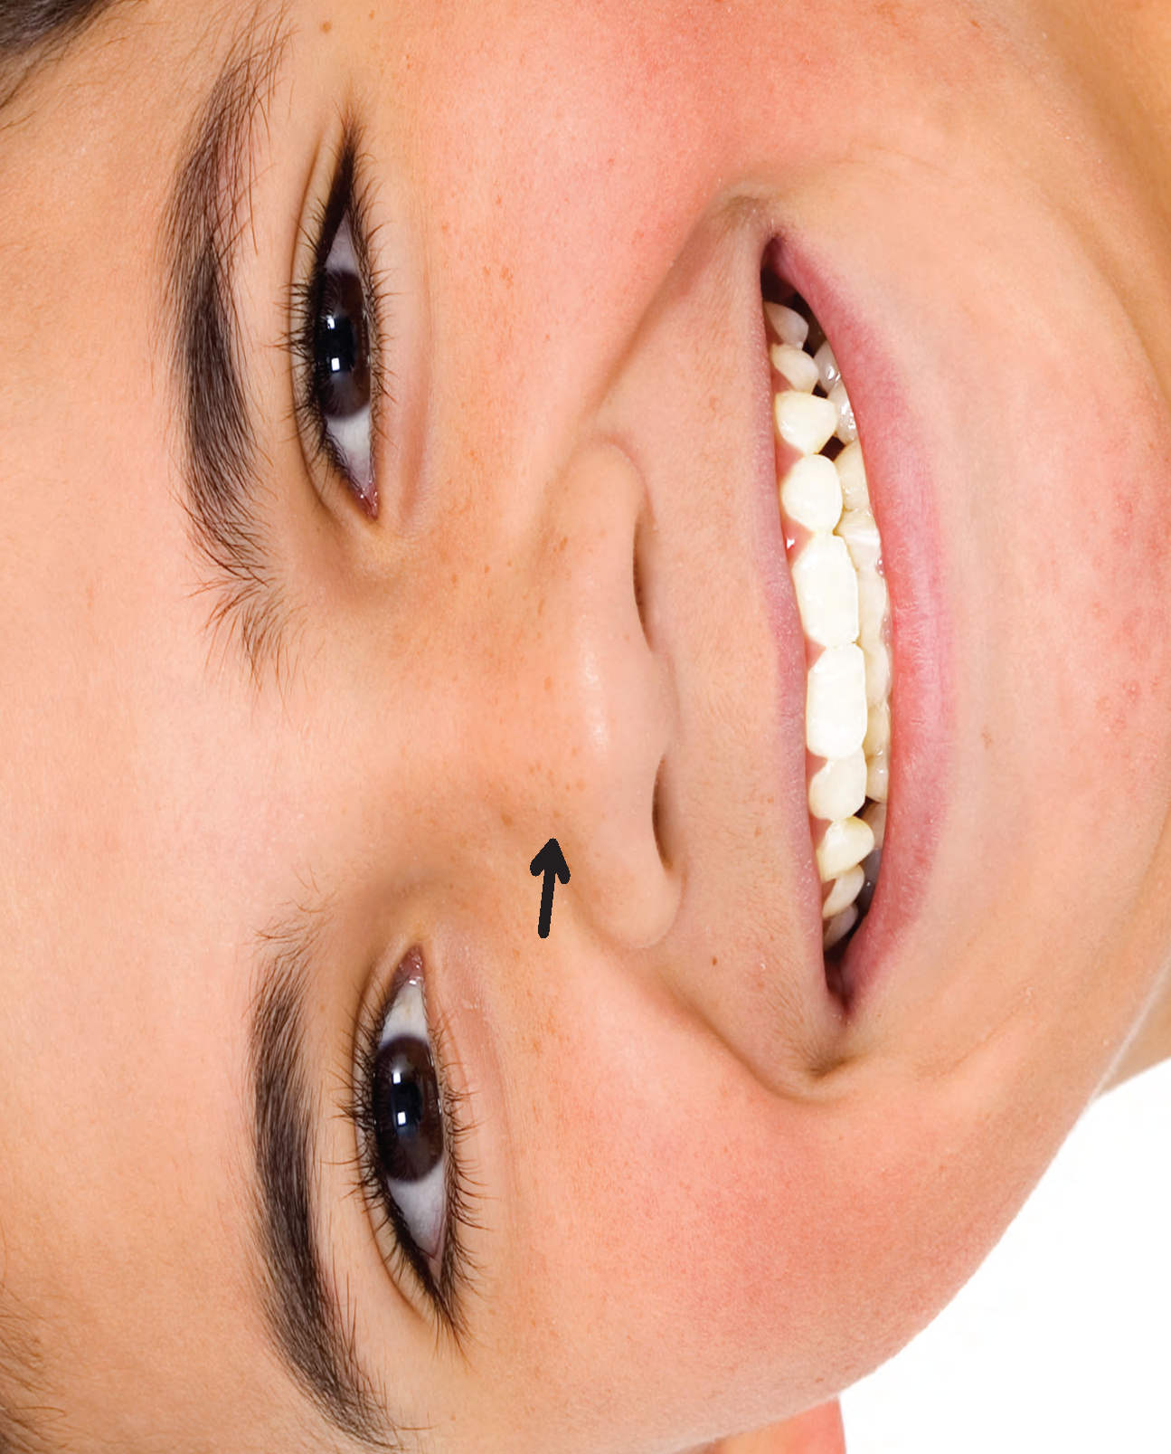
a nose
/ə/ /nəʊz/

Slide 19
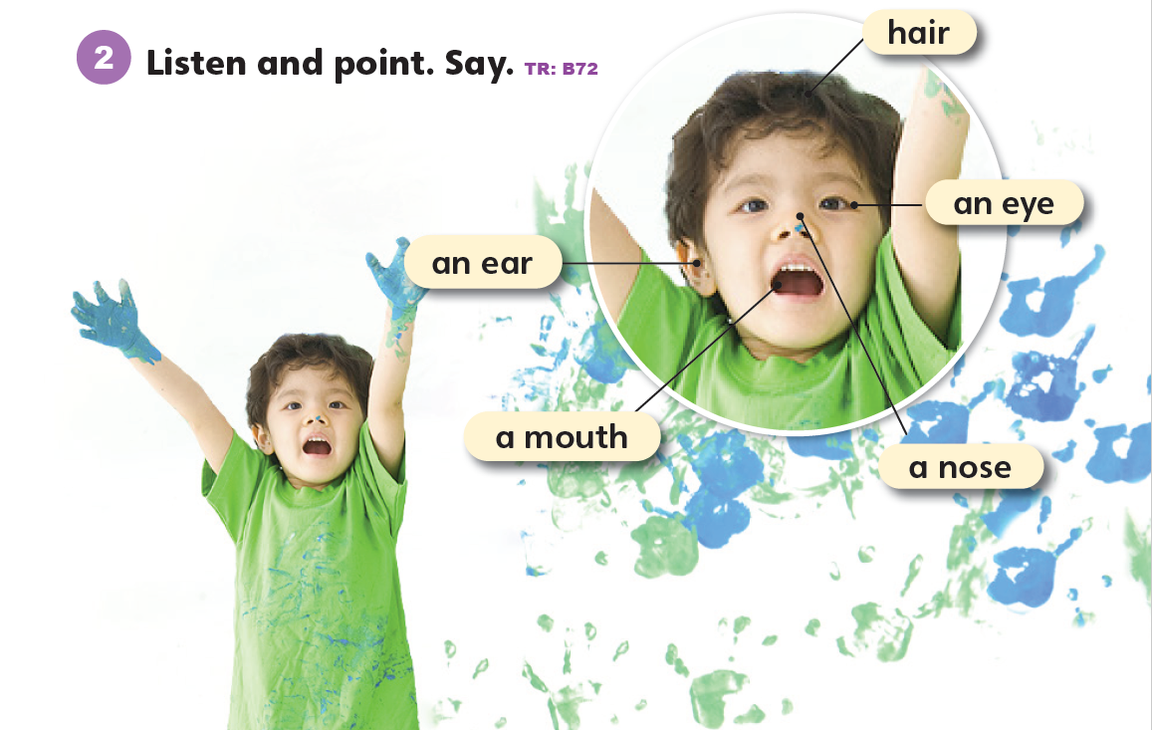

Slide 20
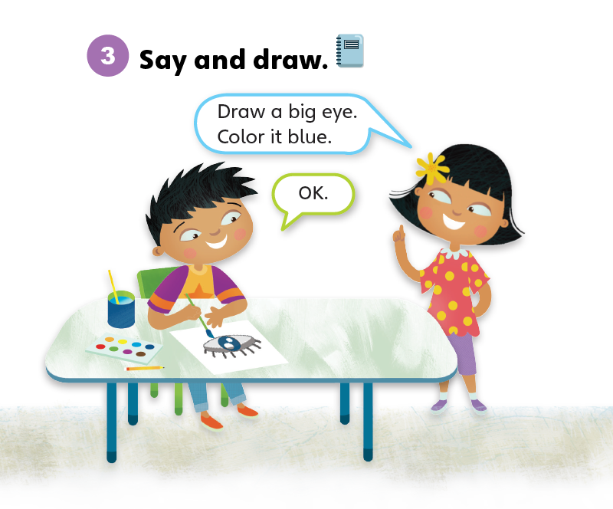

Slide 21
Unit 7:
My Body
Lesson 3

Slide 22
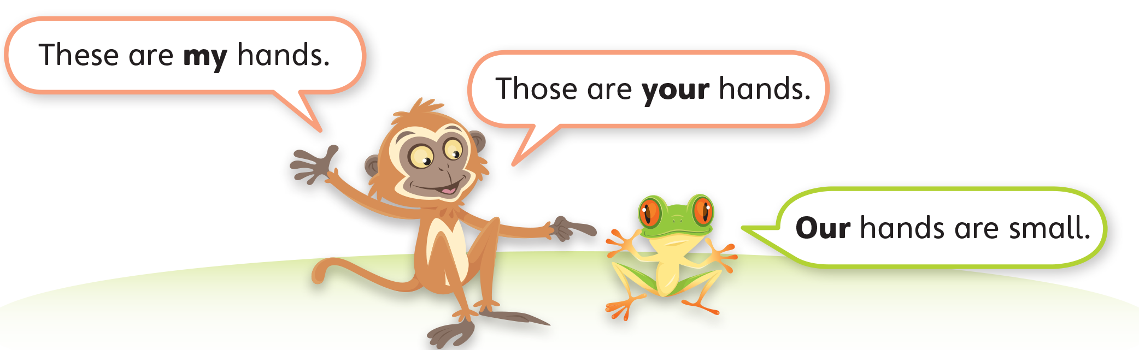
1
Look and listen. Repeat. TR: B73

Slide 23
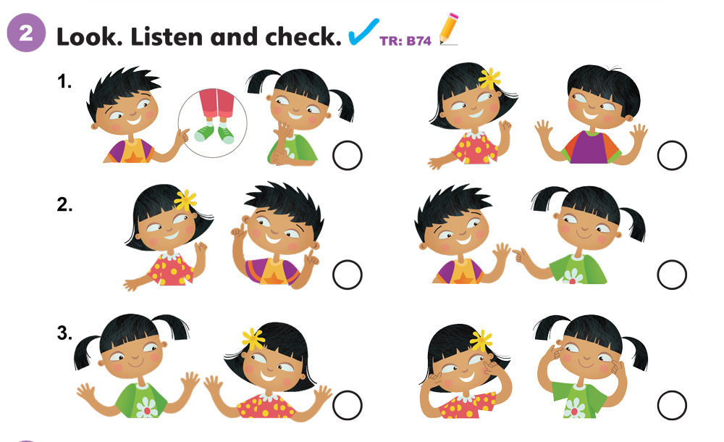

Slide 24
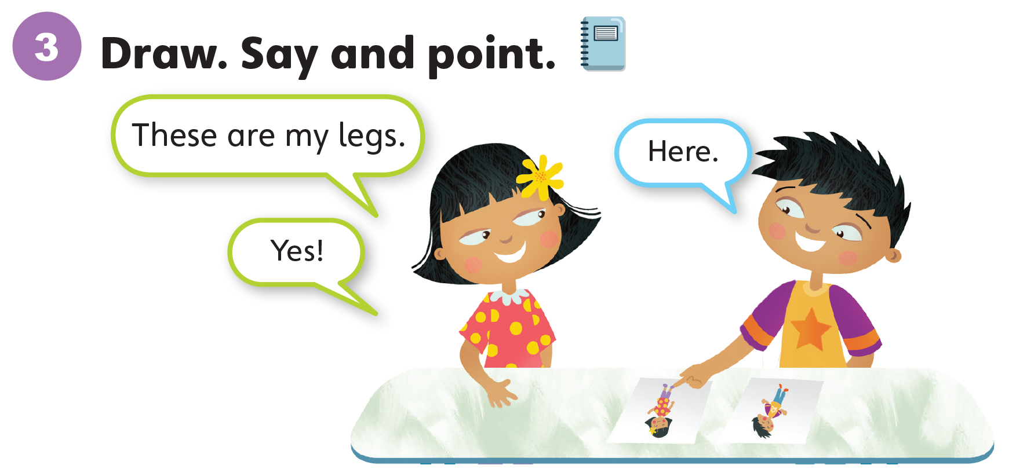

Slide 25
Unit 7:
My Body
Lesson 4

Slide 26
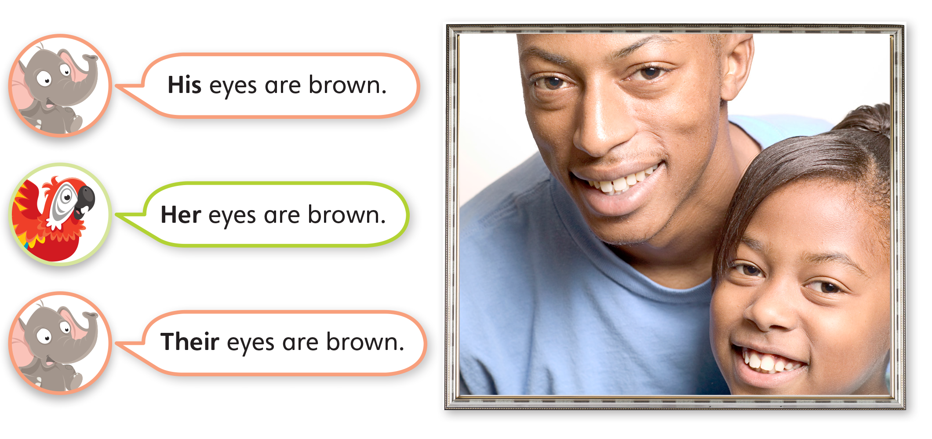
1
Look and listen. Repeat. TR: B75

Slide 27
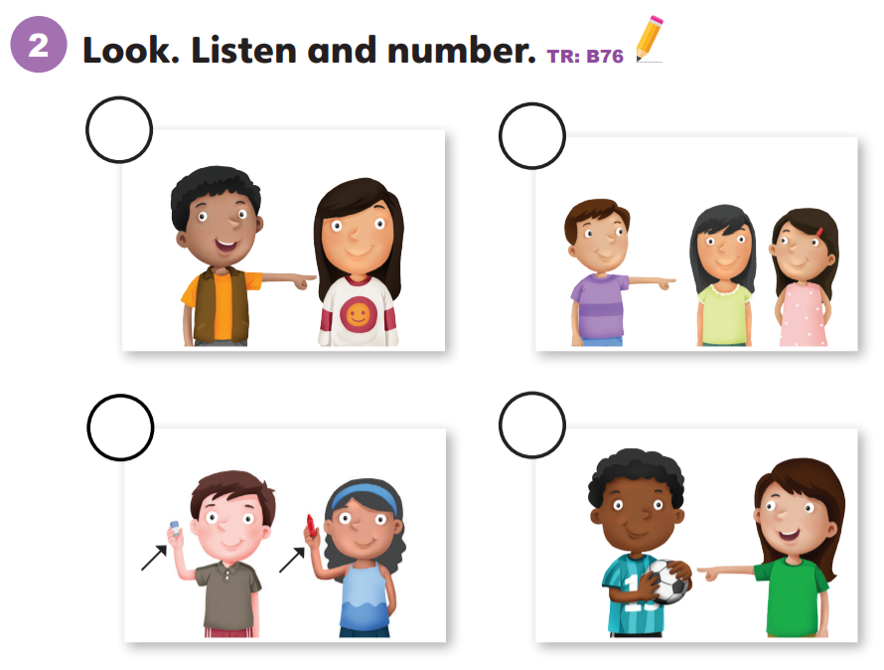
2
4
3
1

Slide 28
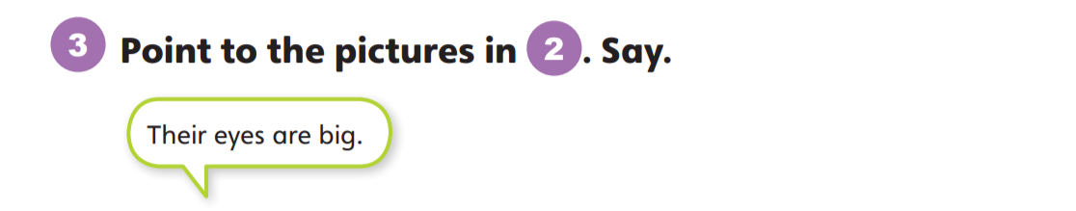
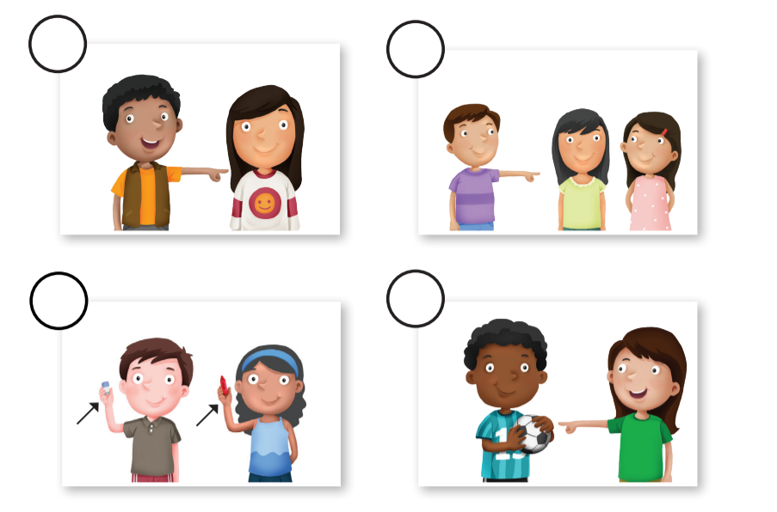

Slide 29
Unit 7:
My Body
Lesson 5

Slide 30
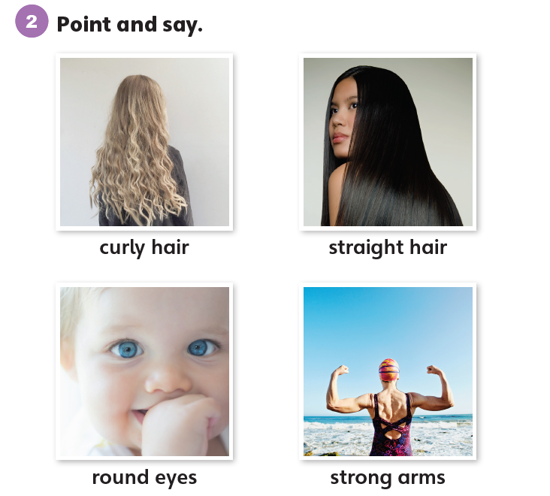
1
Look and listen. Repeat. TR: B77

Slide 31
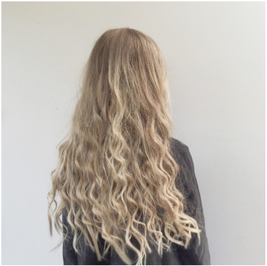
curly hair
/ˈkɜːrli/ /her/

Slide 32
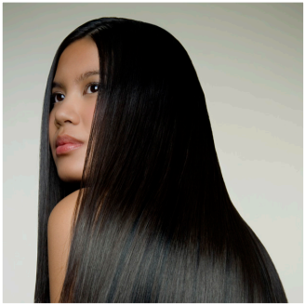
straight hair
/streɪt/ /her/

Slide 33
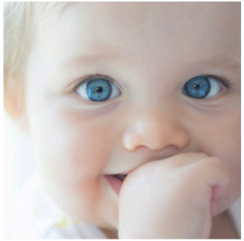
round eyes
/raʊnd/ /aɪz/

Slide 34
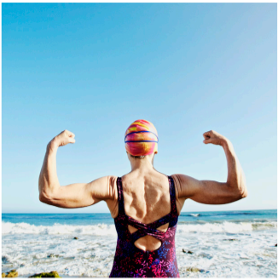
strong arms
/strɔːŋ/ /ɑːrmz/
Notes:
Ưeqwertysfdffaxzv bgftymhgfd

Slide 35
2
Point and say.
curly hair
straight hair
round eyes
strong arms

Slide 36
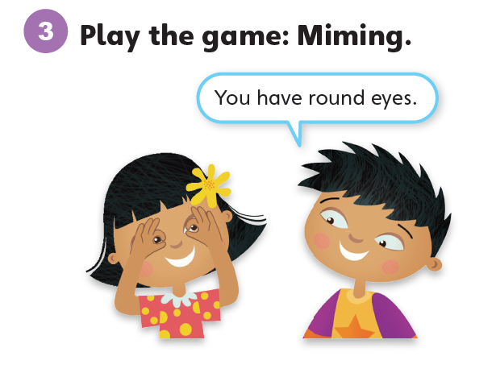

Slide 37
Unit 7:
My Body
Lesson 6

Slide 38
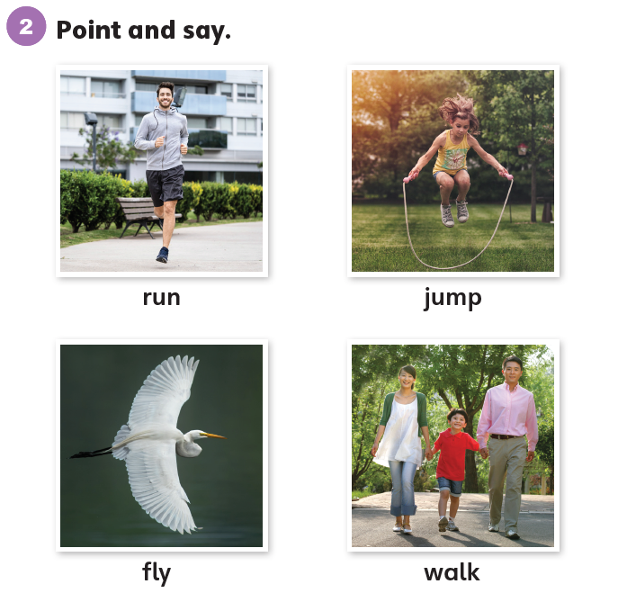
1
Look and listen. Repeat. TR: B78

Slide 39
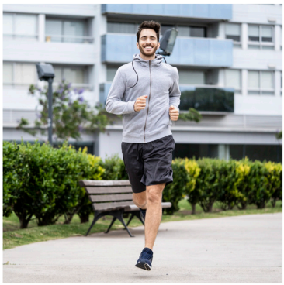
run
/rʌn/

Slide 40
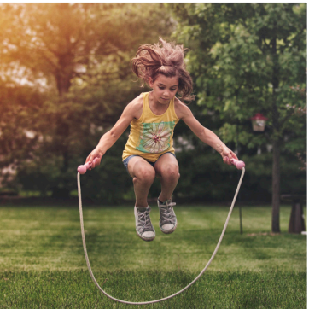
jump
/dʒʌmp/

Slide 41
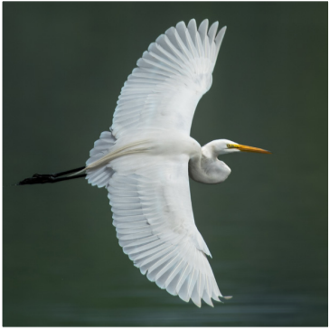
fly
/flaɪ/

Slide 42
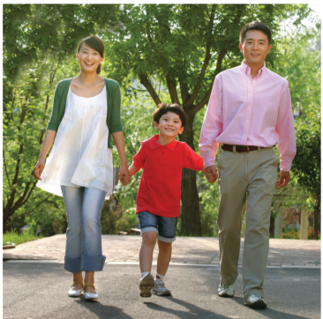
walk
/wɔːk/

Slide 43
2
Point and say.
run
jump
fly
walk

Slide 44
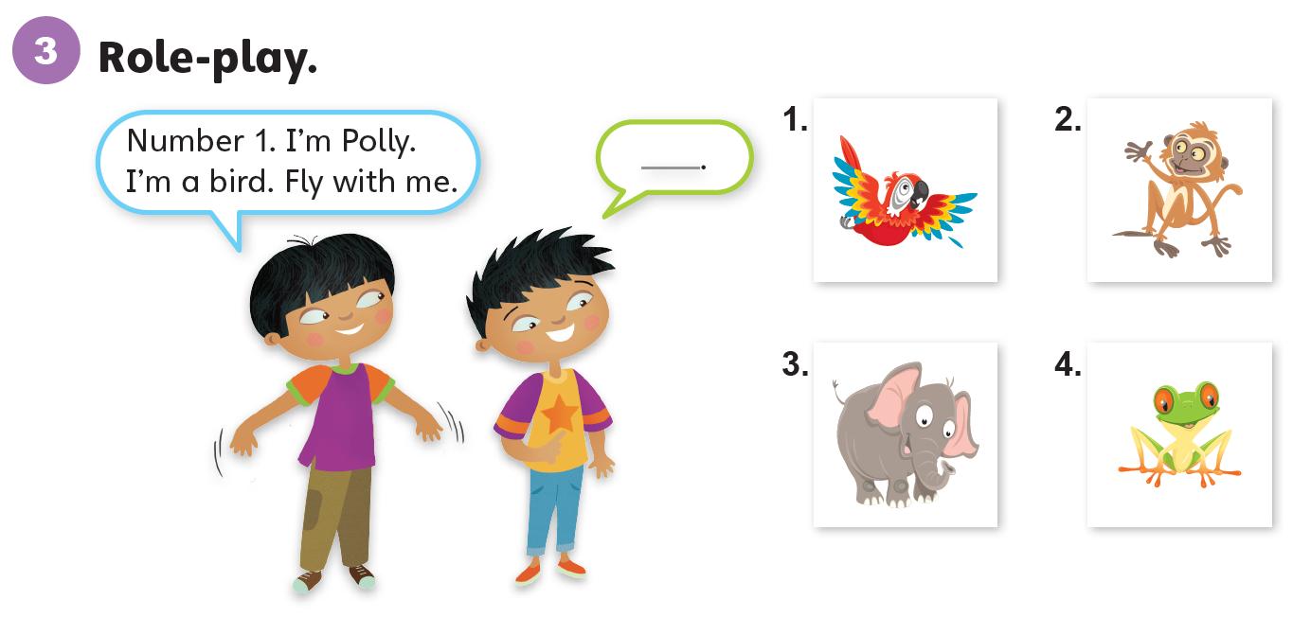

Slide 45
Unit 7:
My Body
Lesson 7

Slide 46
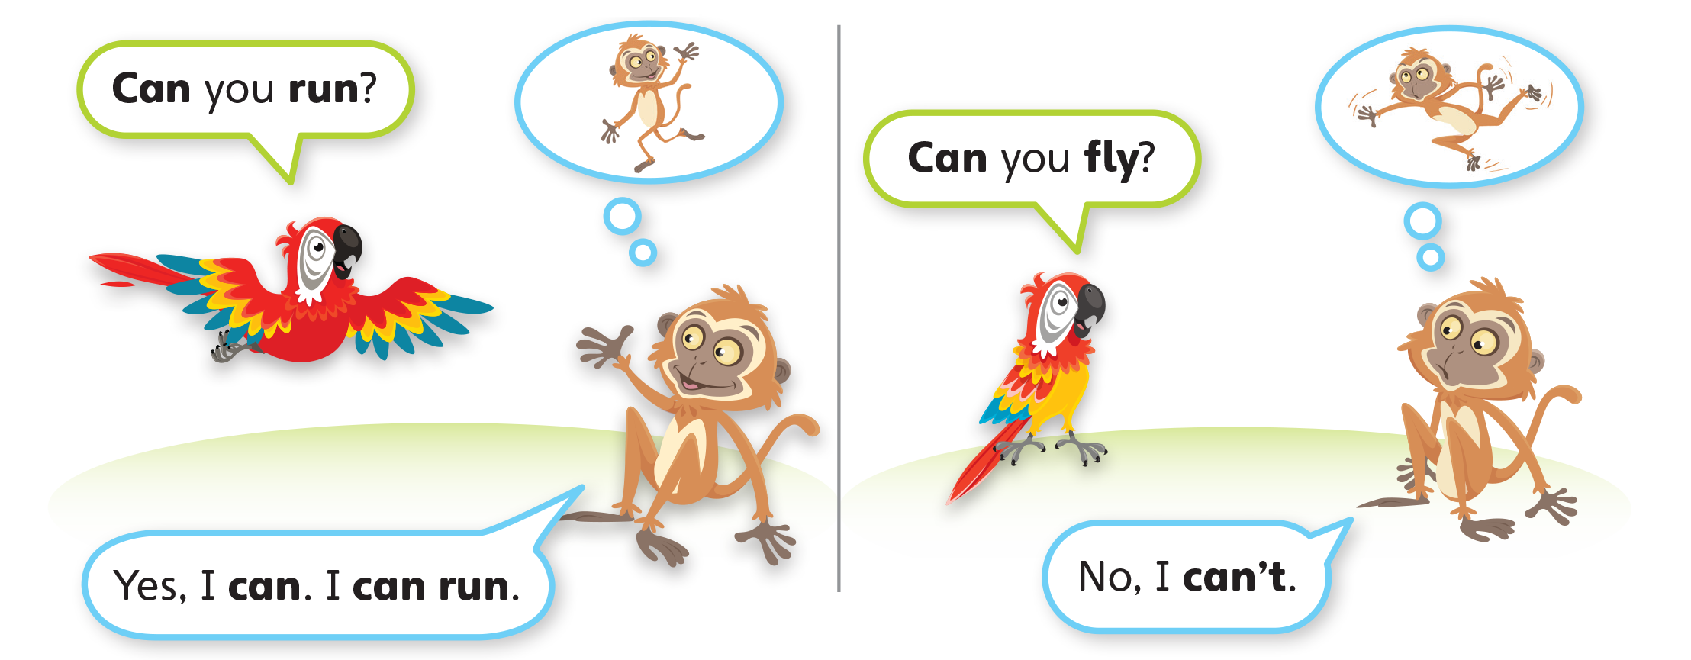
1
Look and listen. Repeat. TR: B79

Slide 47
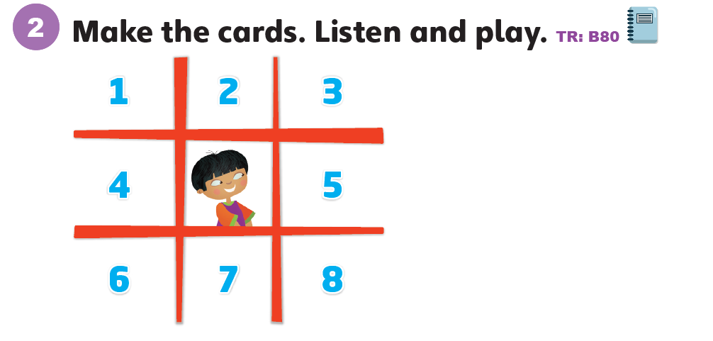
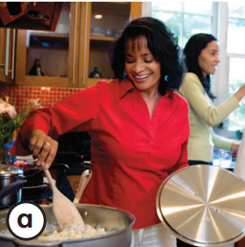

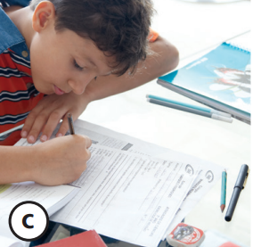
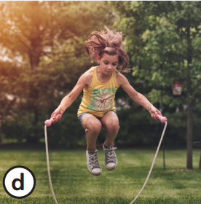
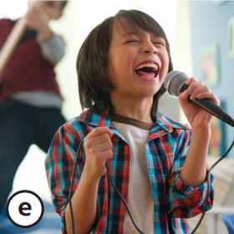
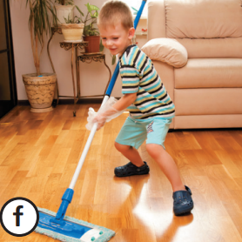
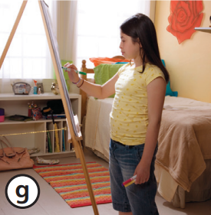
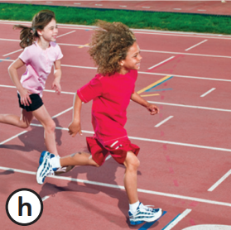

Slide 48
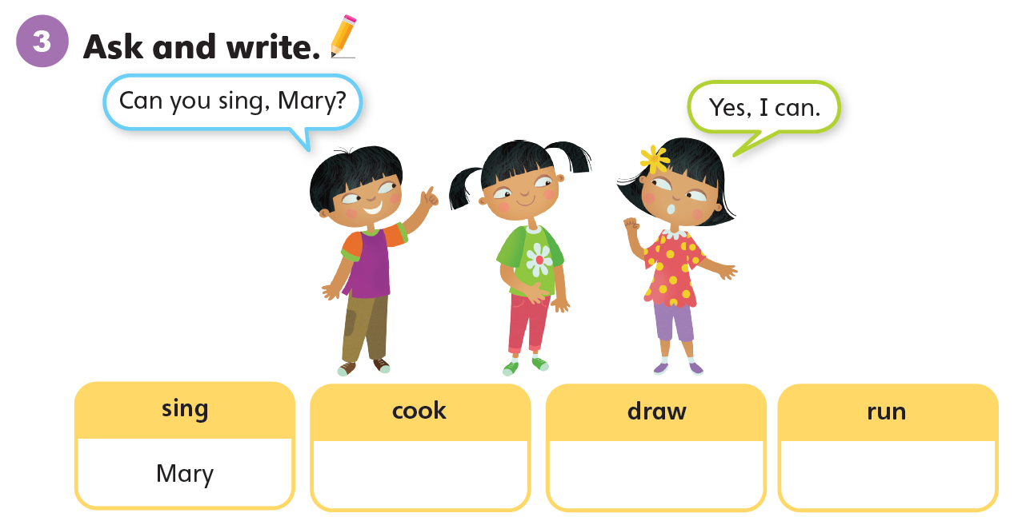

Slide 49
Unit 7:
My Body
Lesson 8

Slide 50
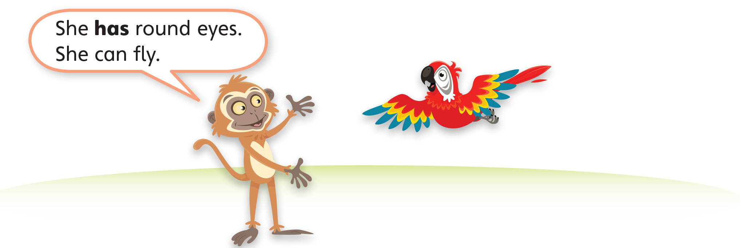
1
Look and listen. Repeat. TR: B81

Slide 51
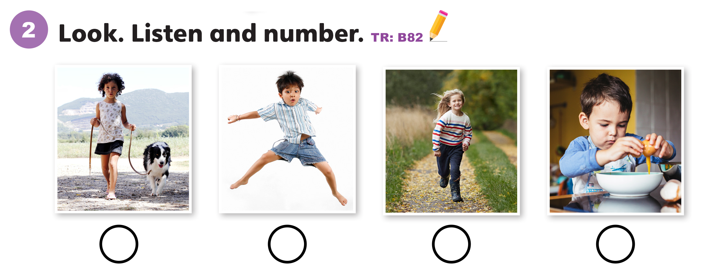
2
3
1
4

Slide 52
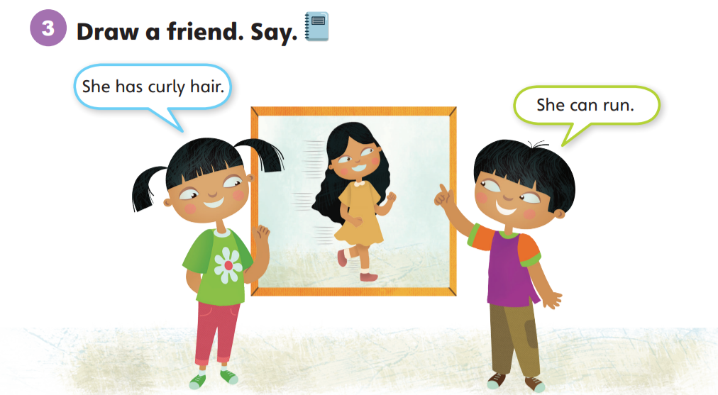

Slide 53
Unit 7:
My Body
Lesson 9

Slide 54
1
Listen and repeat. TR: B83
m
n
  mouth
  map
  nose
  fun

Slide 55
2
Listen and sing. TR: B84
My body, my body!
It’s fun to move my body!
My body, my body!
Can you dance with me?
Mouth, mouth. Move your mouth.
Mouth, mouth. Move your mouth.
Mouth, mouth. Move your mouth.
Can you sing with me?

Slide 56

1.
pen
move
sun
2.
map
move
train

Slide 57
Unit 7:
My Body
Lesson 10

Slide 58
1
Listen and repeat. TR: B85
ea
ai
  ear
  year
  hair
  chair

Slide 59
2
Listen and sing. TR: B86
Ear, ear. Move your ear.
Ear, ear. Move your ear.
Can you move your ear?
No, I can’t.
Hair, hair. Move your hair.
Hair, hair. Move your hair.
Can you move your hair?
Yes, I can.

Slide 60
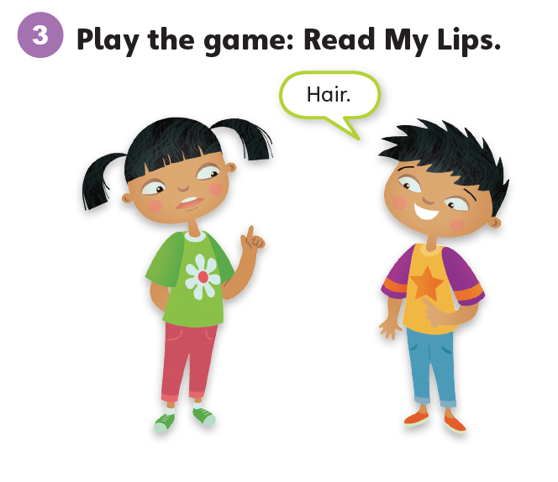

Slide 61
Unit 7:
My Body
Lesson 11

Slide 62
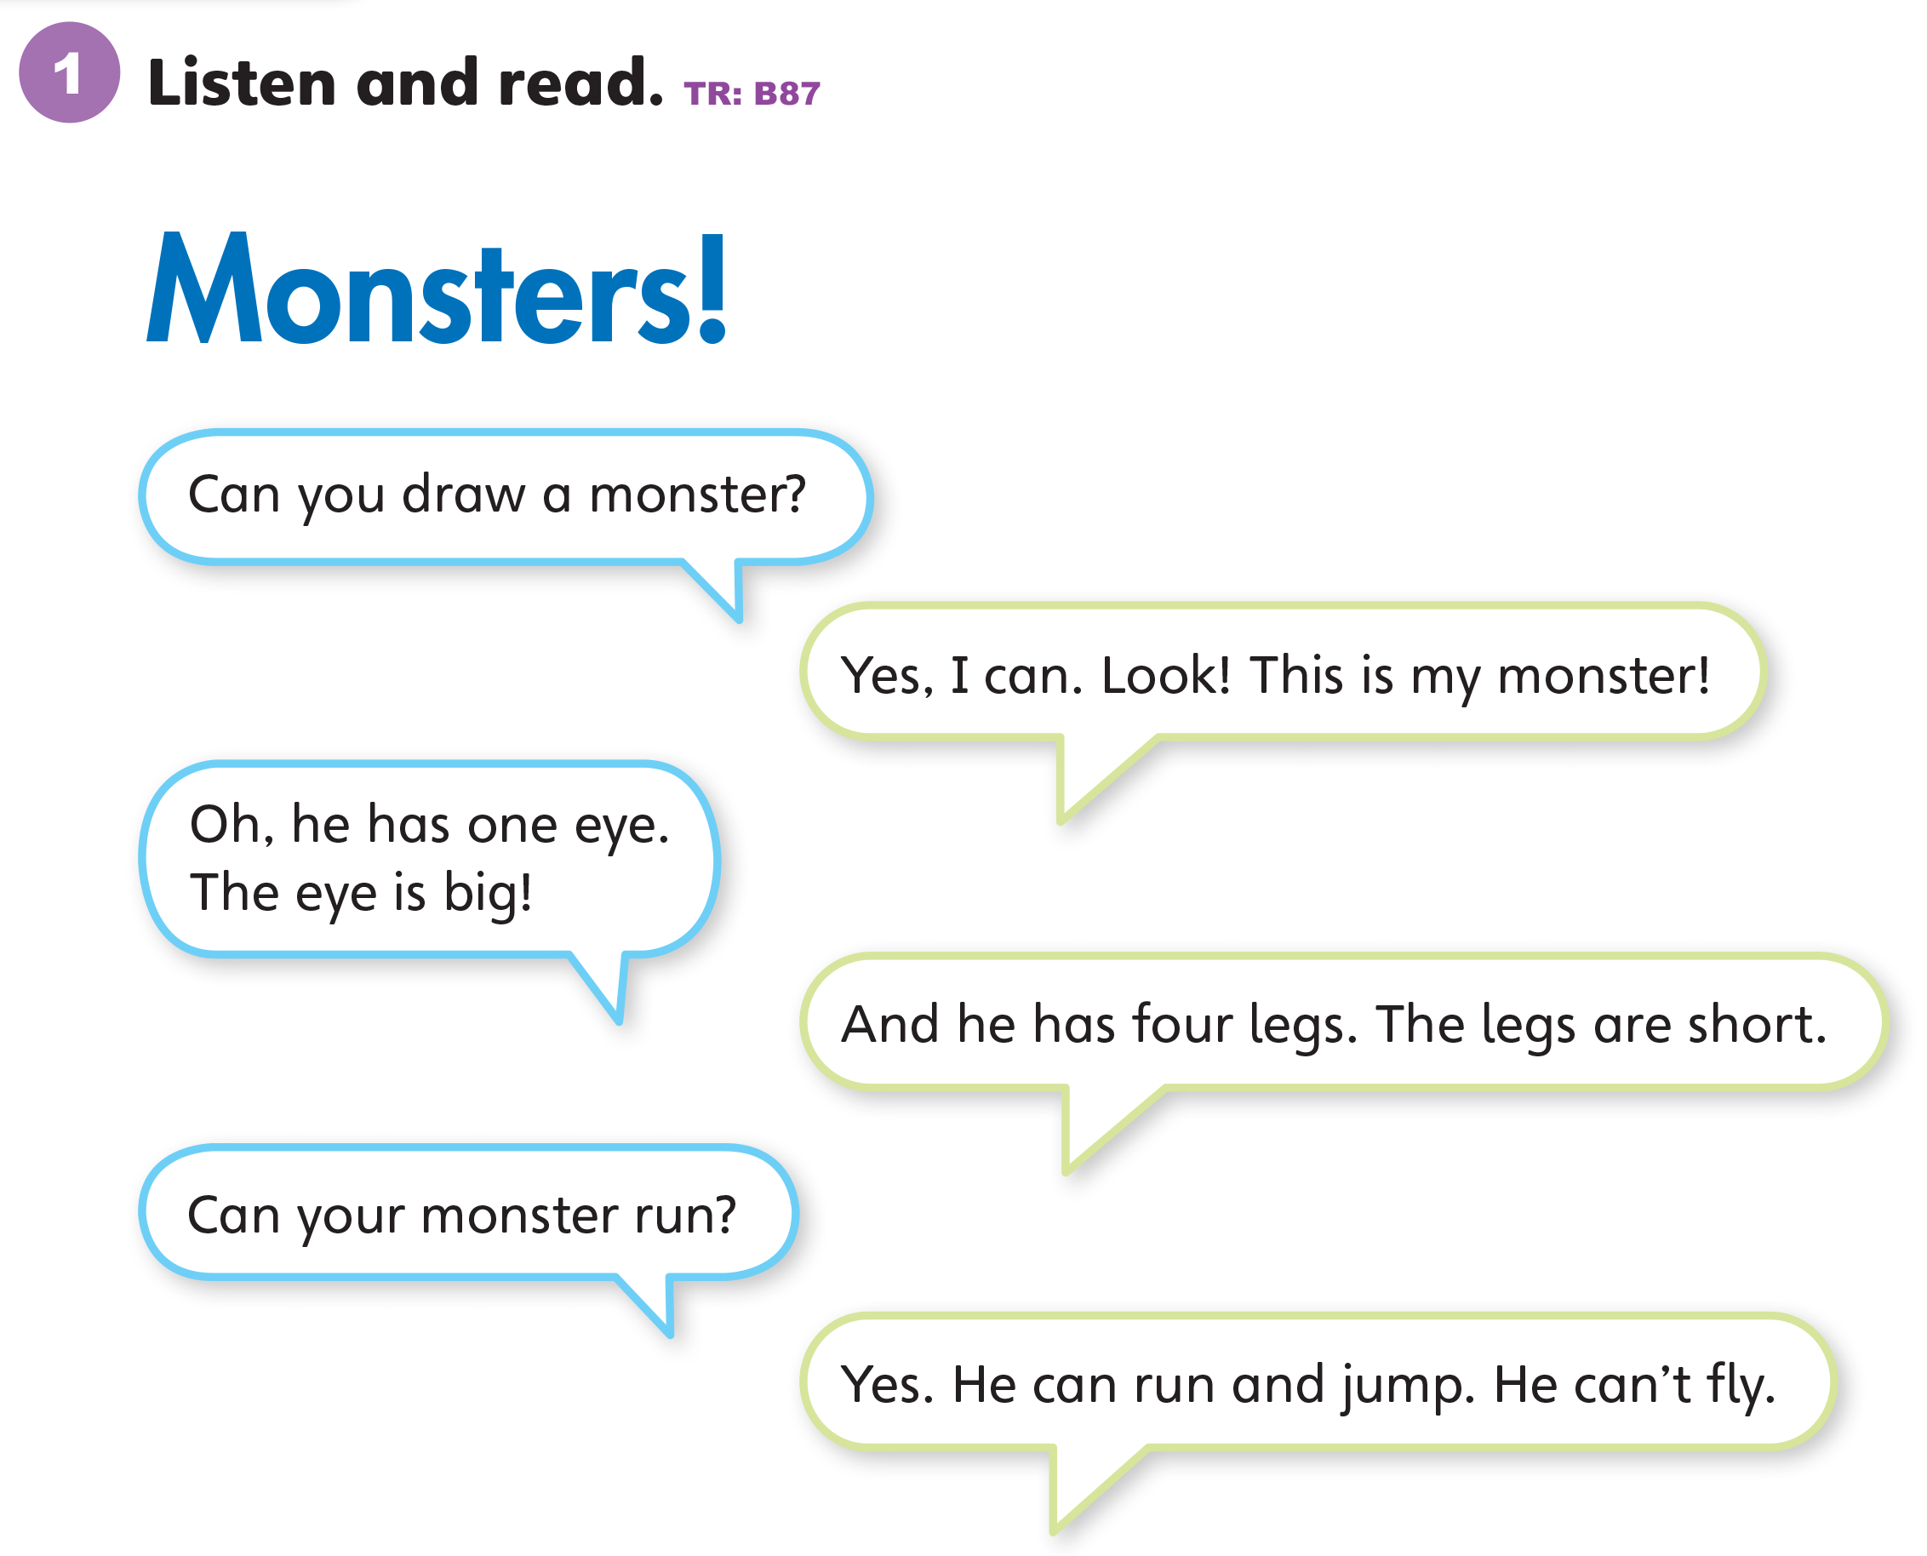

Slide 63

1. The monster has ________.
2. It has ________ legs.
3. The monster can ________.
  a. one eye b. two eyes
  a. big b. short
  a. jump b. fly

Slide 64


Slide 65
Unit 7:
My Body
Lesson 12

Slide 66


Slide 67


Slide 68


Slide 69
Unit 7:
My Body
Value

Slide 70

1
Look and listen. Repeat. TR: B89
Be clean.
I wash my hands. I wash my body. I am clean.

Slide 71
Be clean.
2
Think. What do you do to be clean?

Slide 72
Be clean.
3
Share.
I wash my body. I brush my teeth. I am clean.

Slide 73
Thank you!

