Slide 1
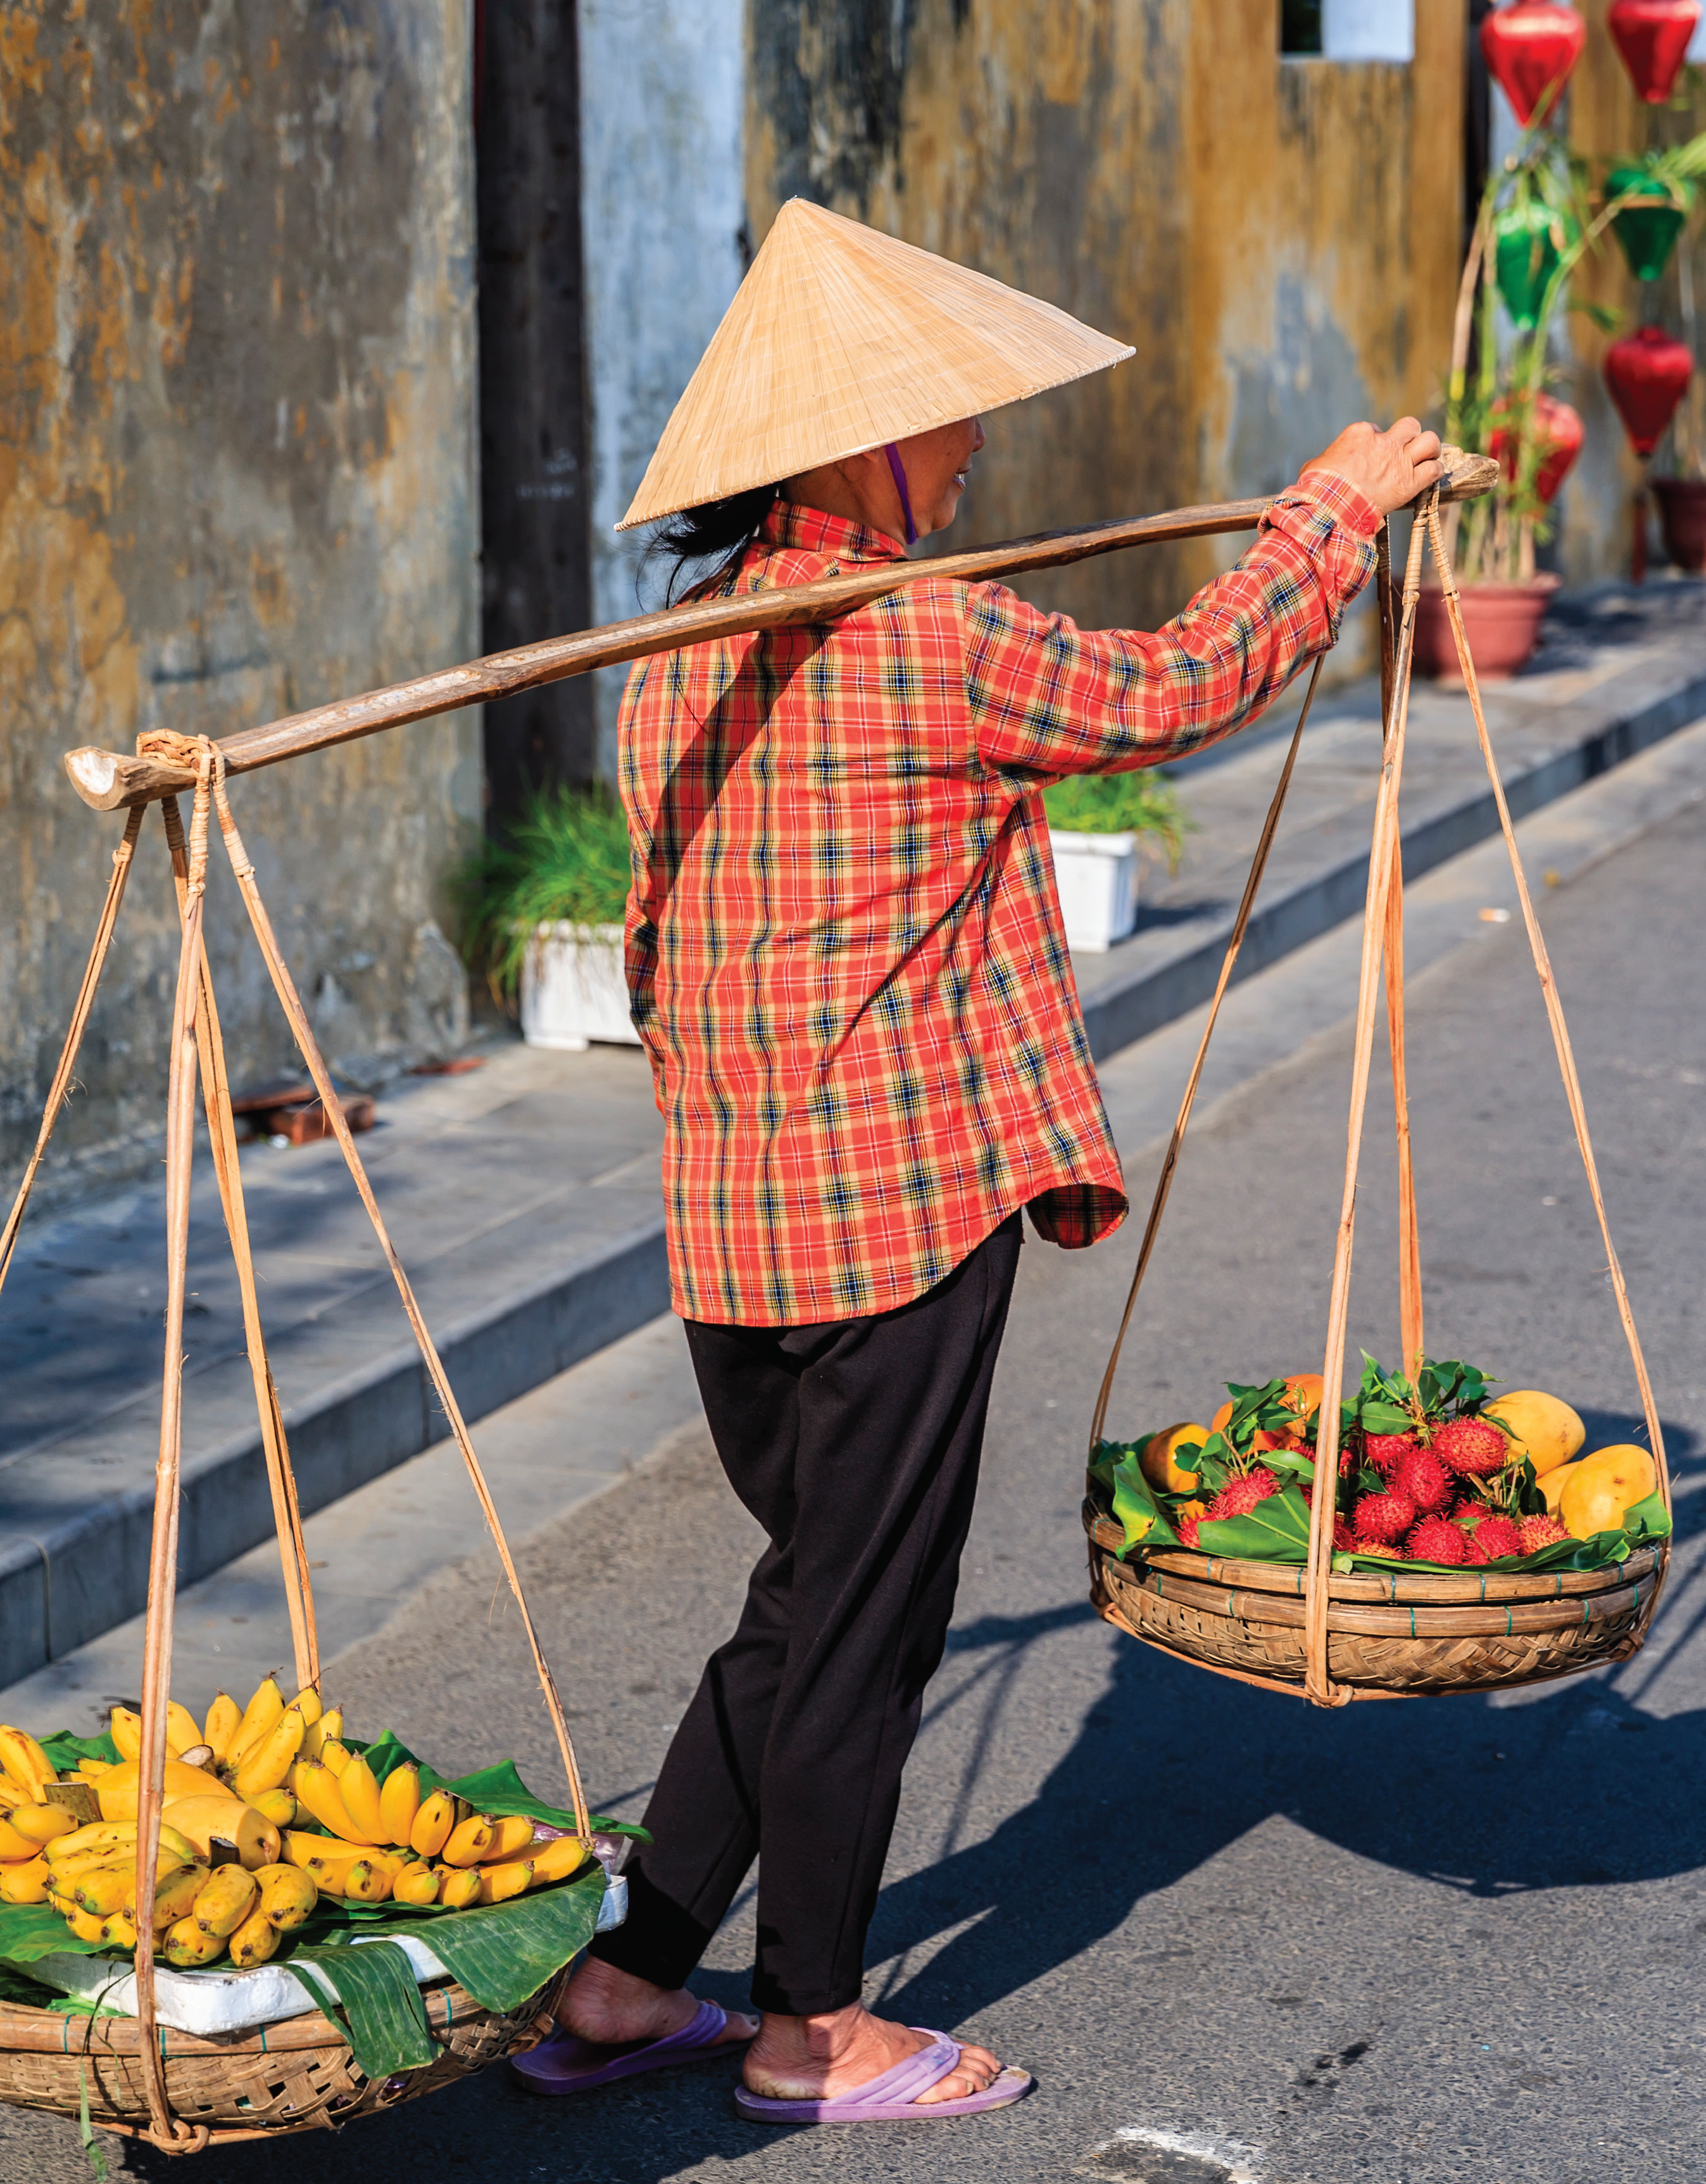
Unit 8
Good Food

Slide 2
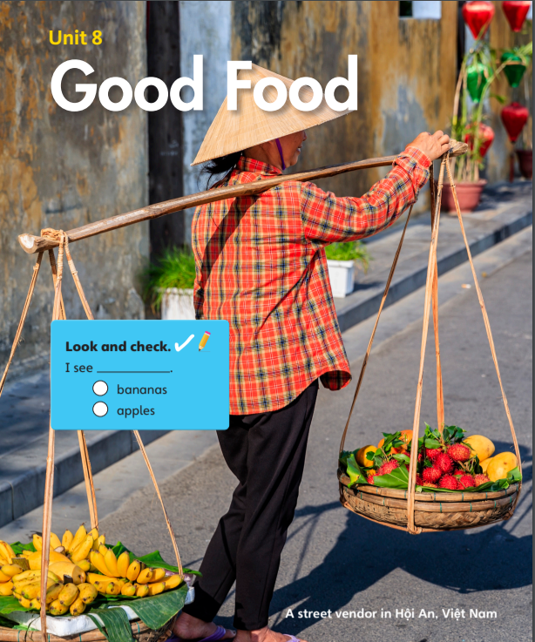

I see ______.
bananas
apples

Slide 3
Unit 8:
Good Food
Lesson 1

Slide 4

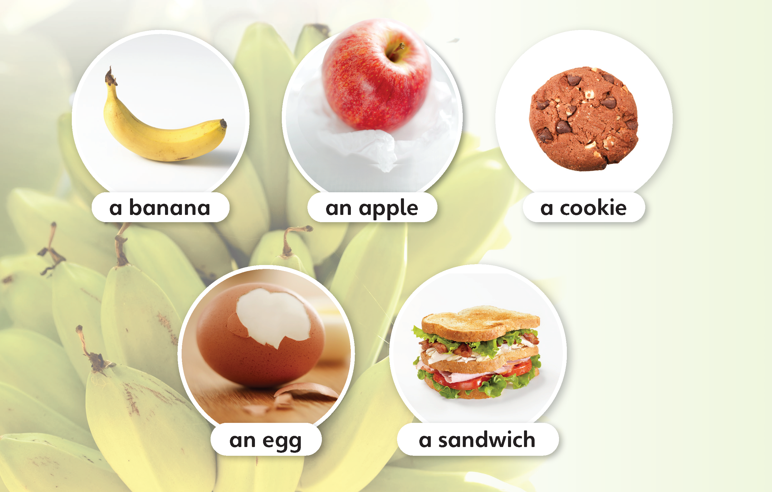
1
Look and listen. Repeat.
TR: B90

Slide 5
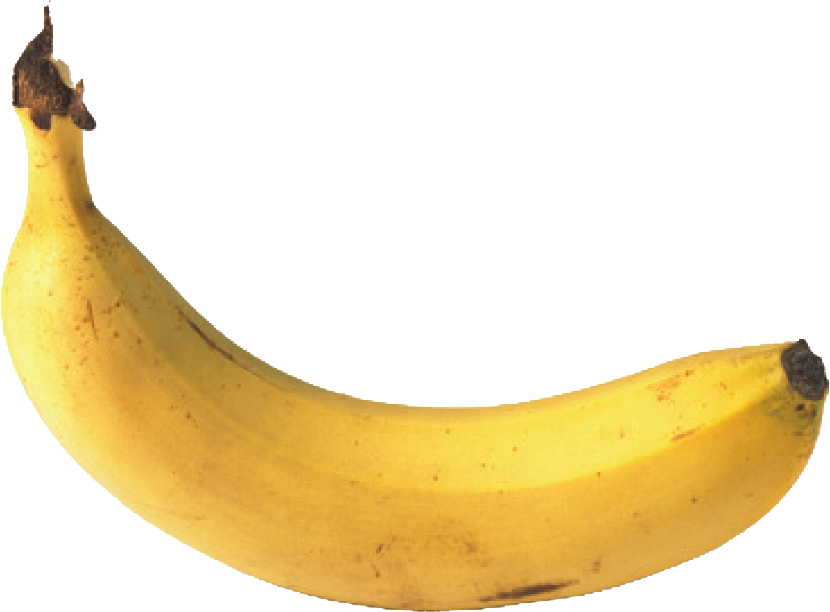
a banana
/ə/ /bəˈnænə/

Slide 6
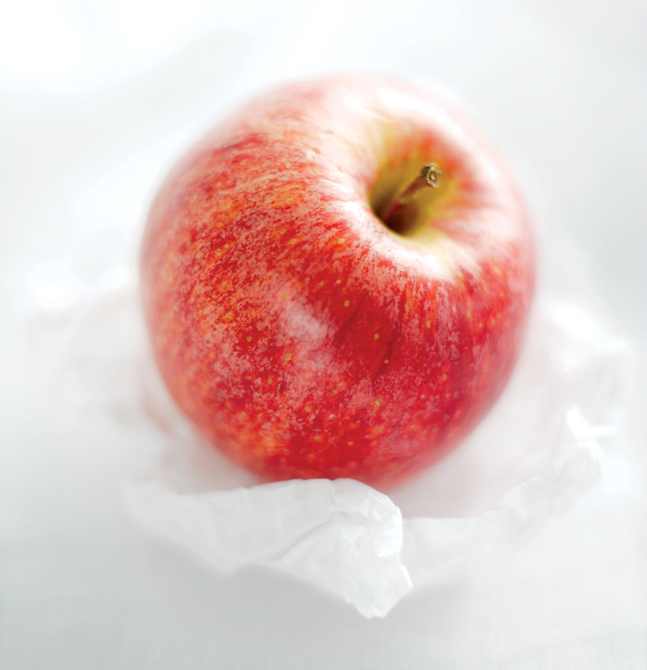
an apple
/ən/ /ˈæpl/

Slide 7
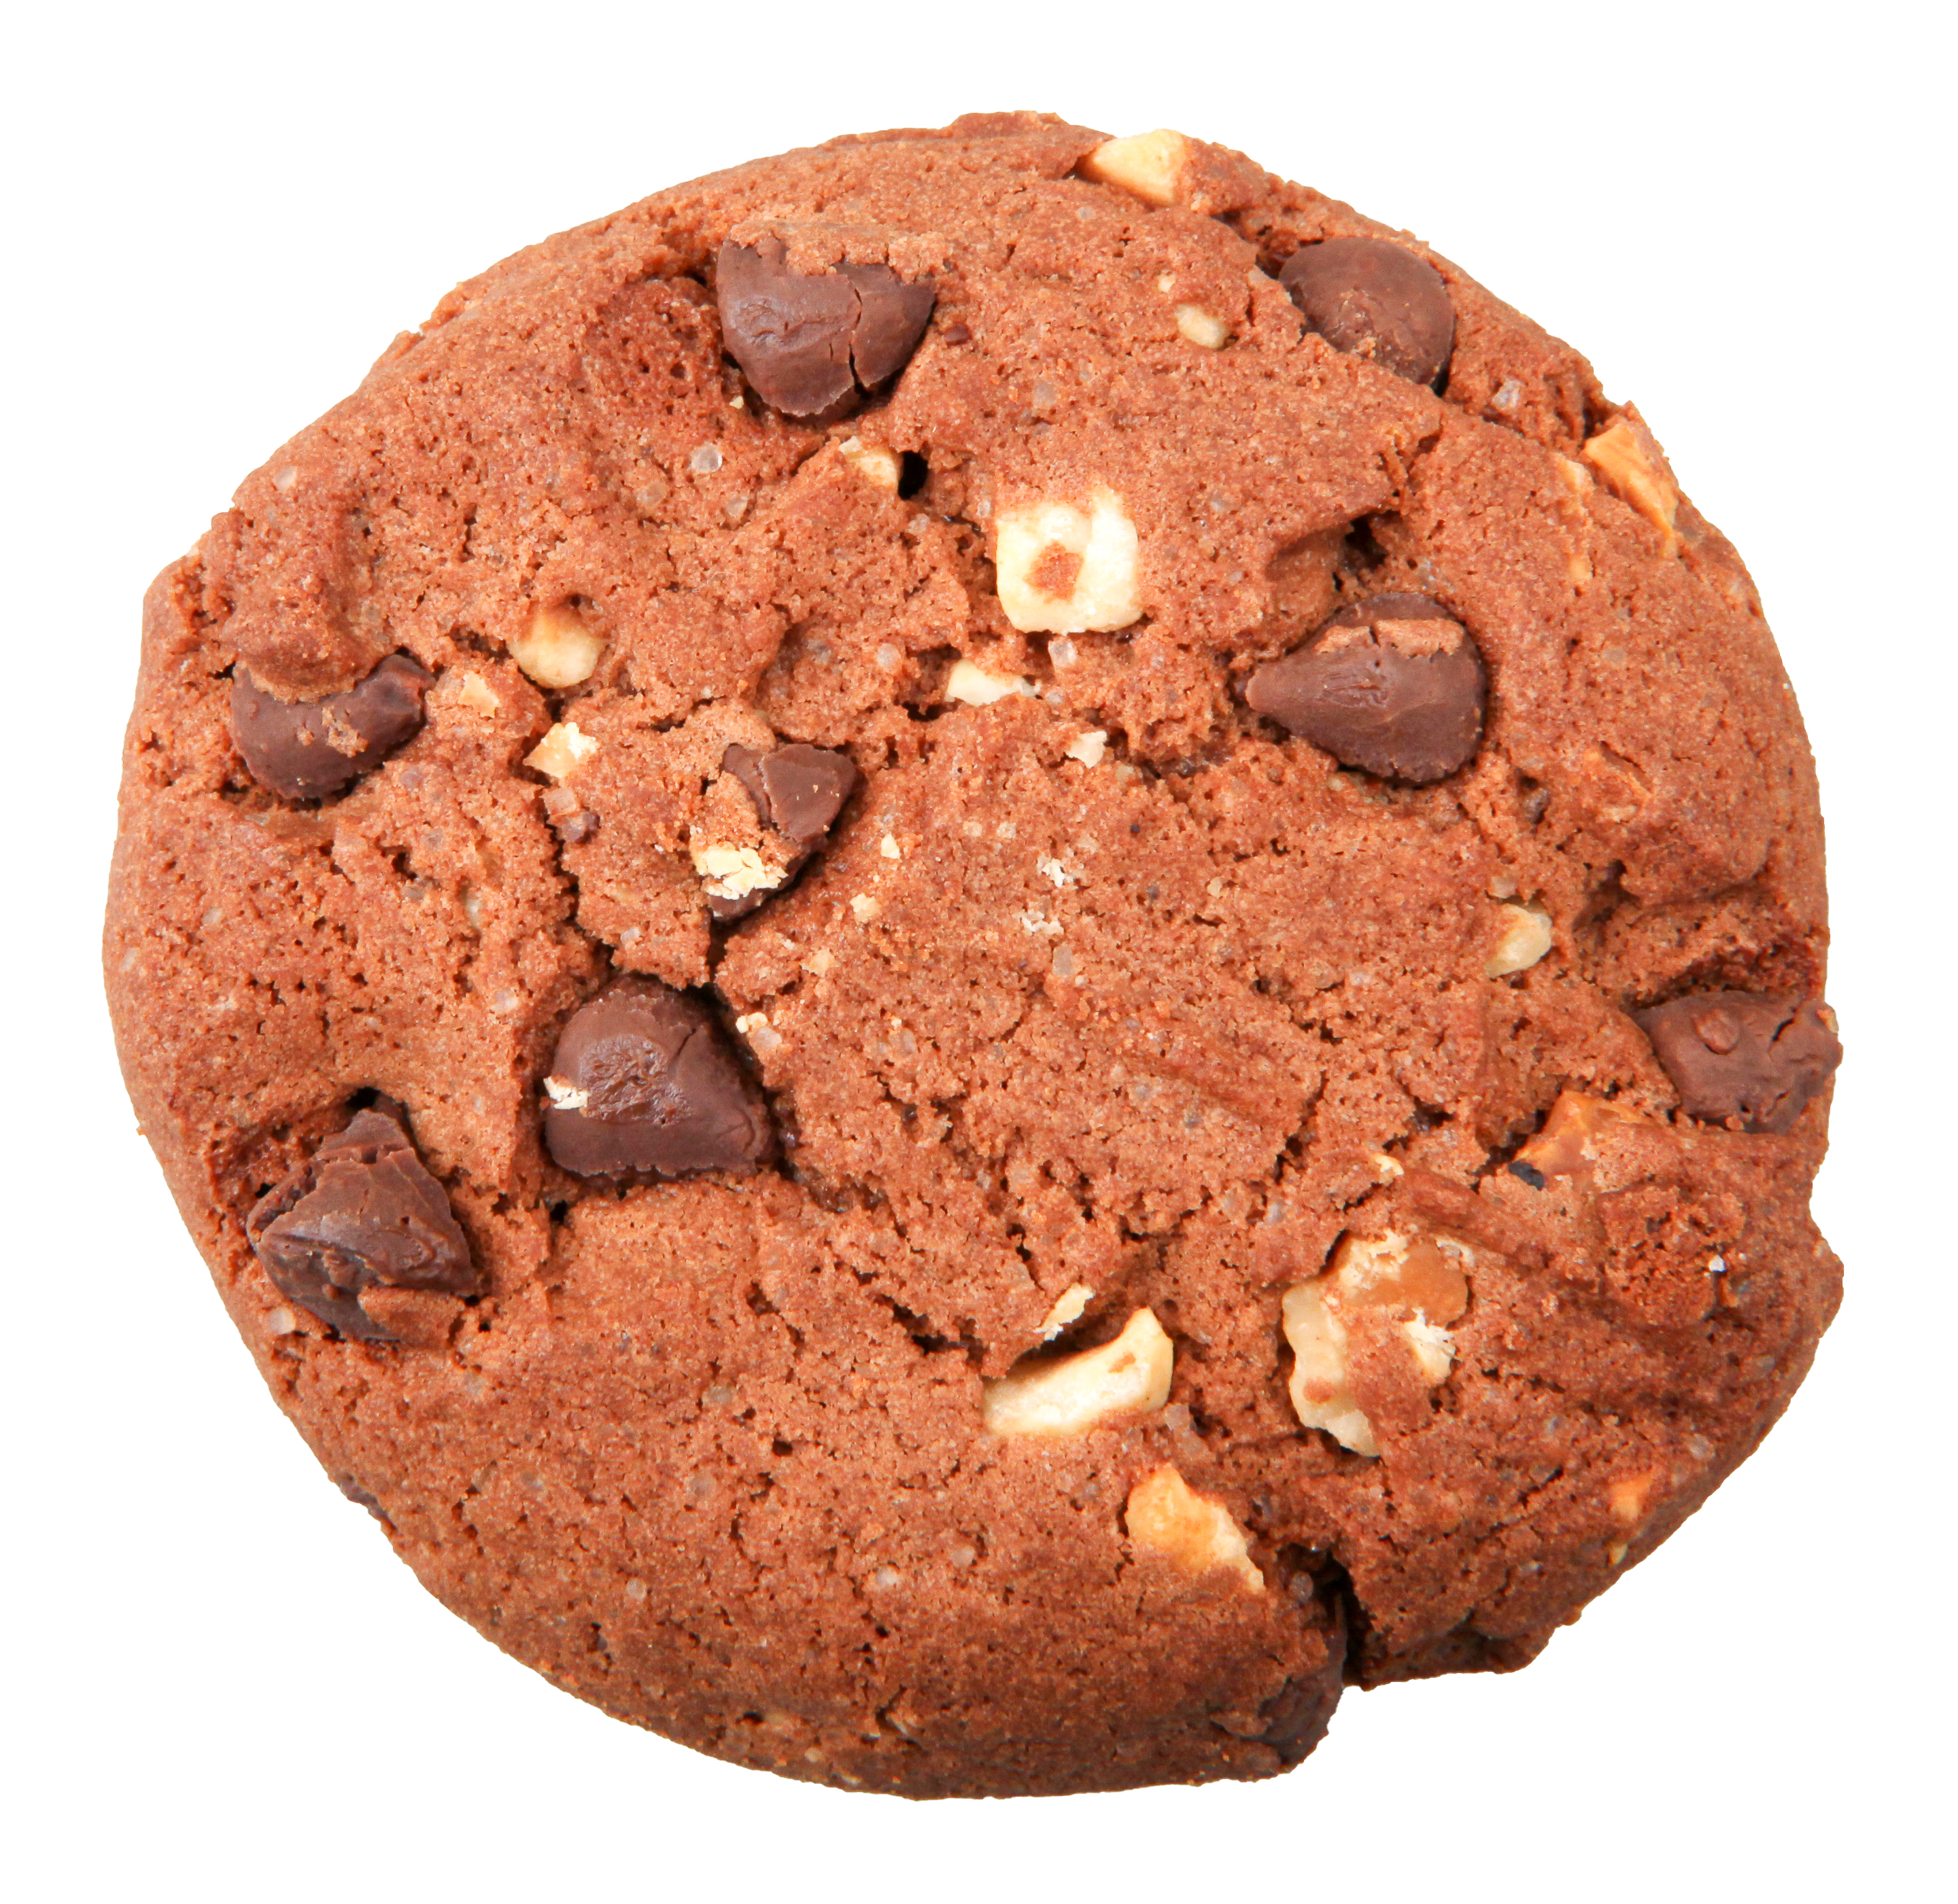
a cookie
/ə/ /ˈkʊki/

Slide 8
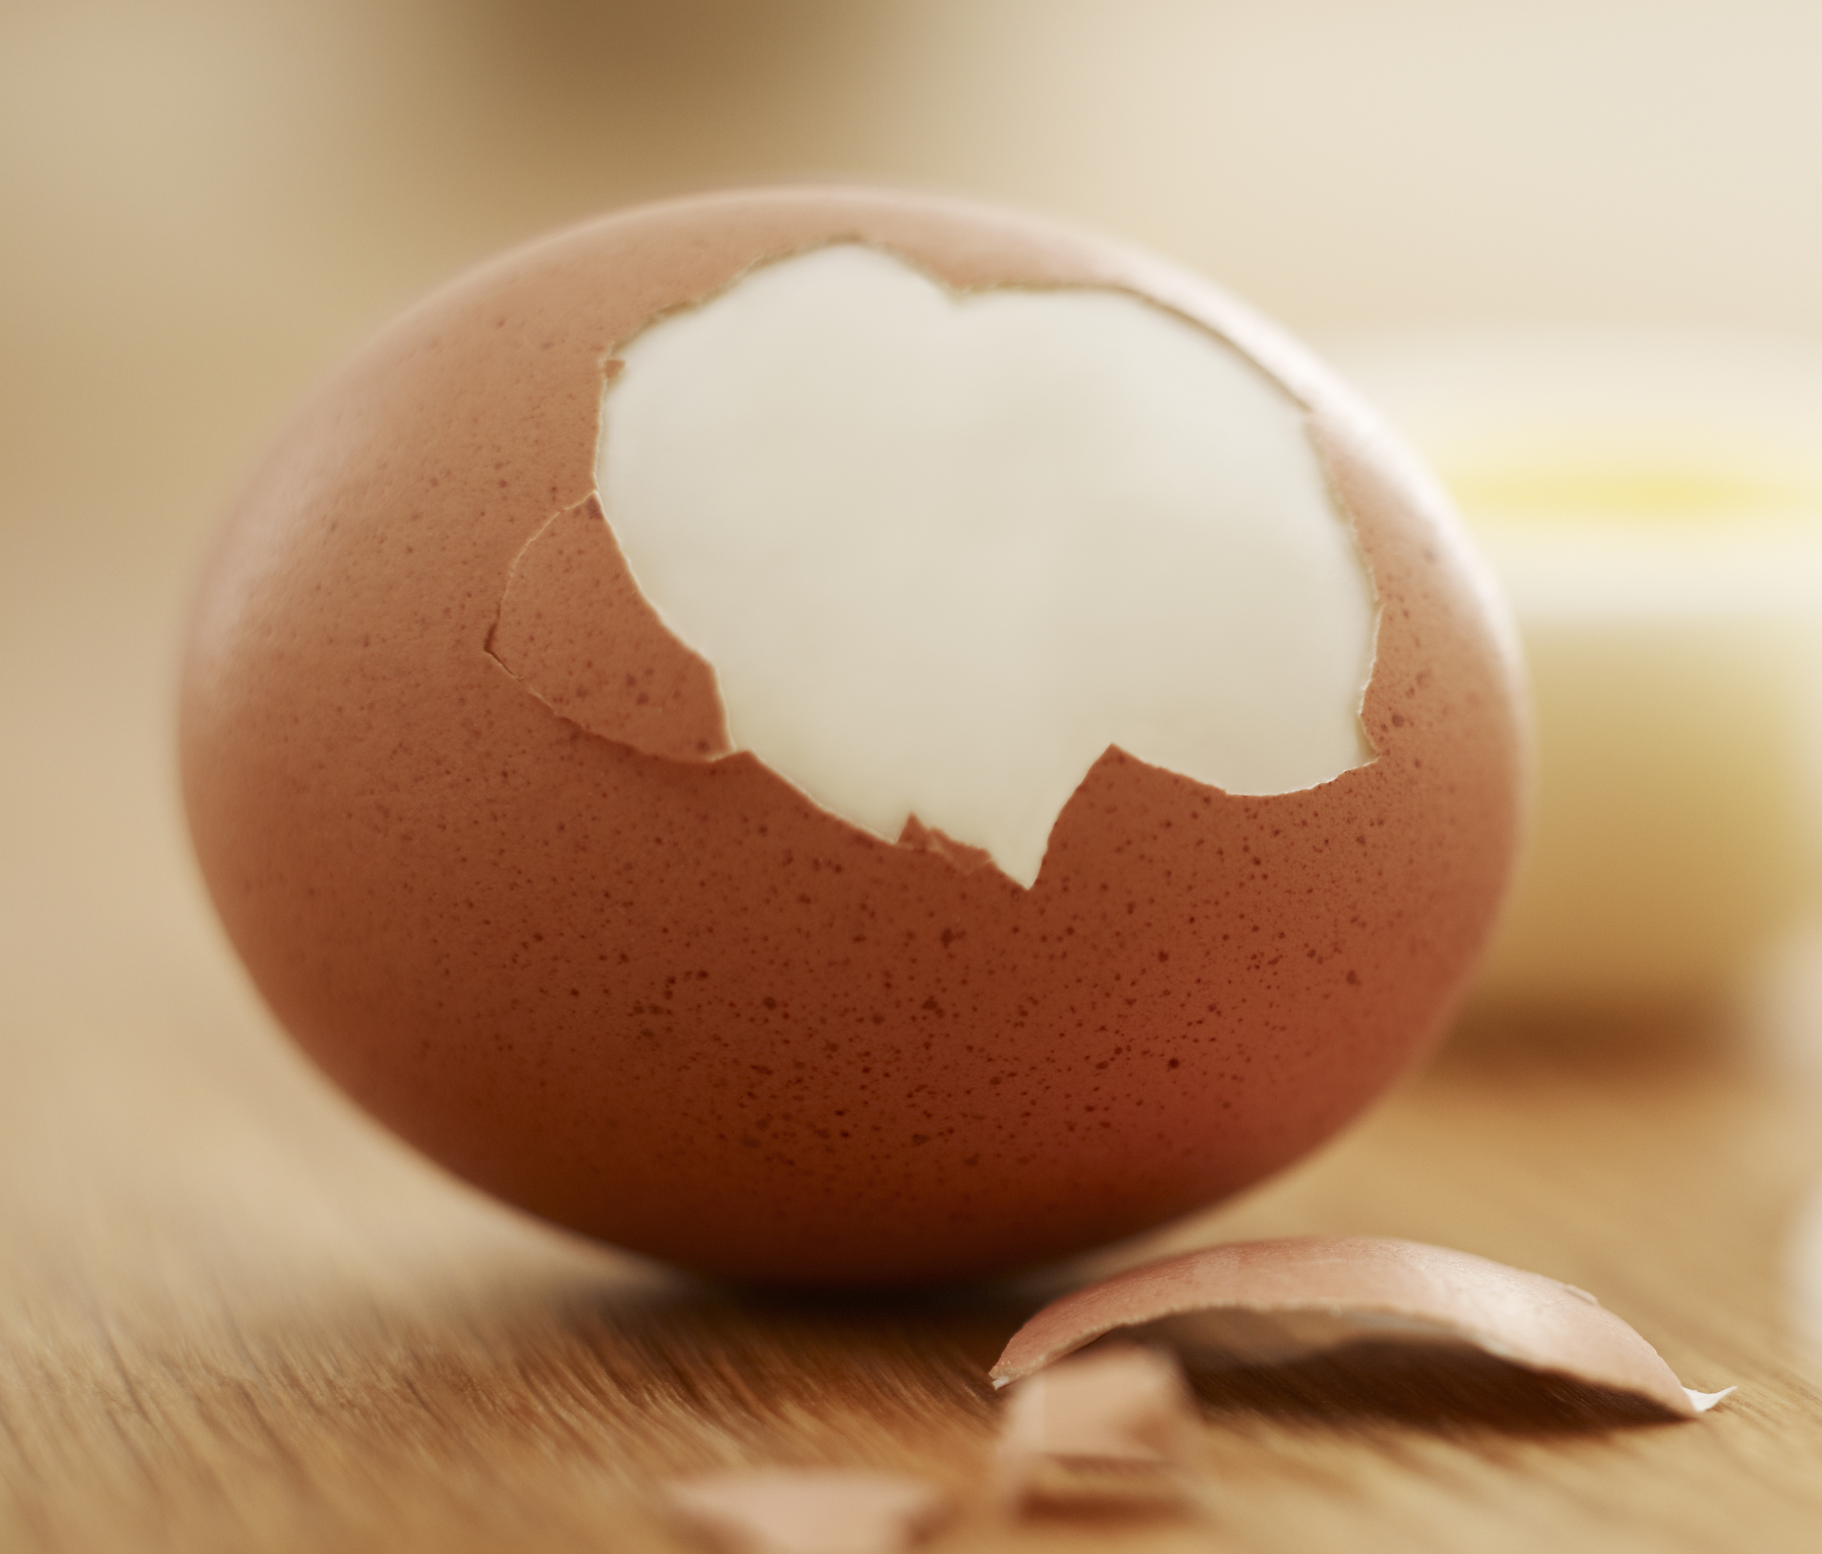
an egg
/ən/ /eɡ/

Slide 9
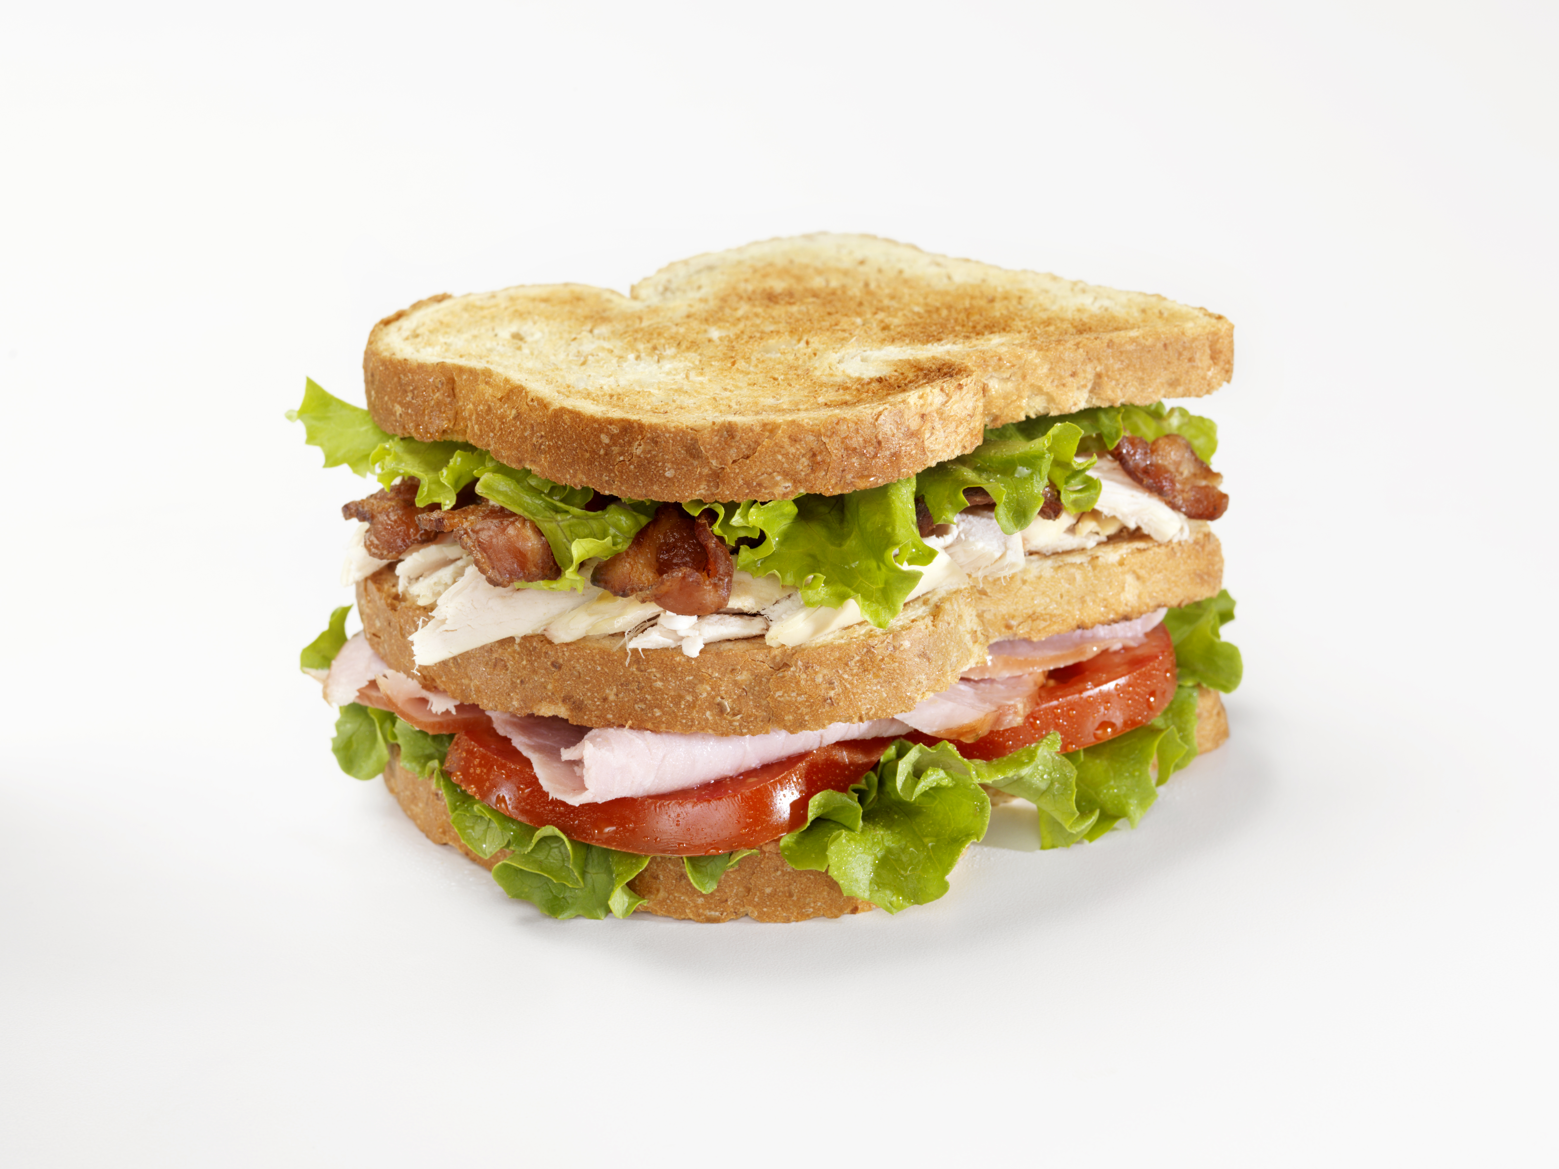
a sandwich
/ə/ /ˈsænwɪtʃ/

Slide 10
2
Listen and point. Say.
TR: B91

Slide 11
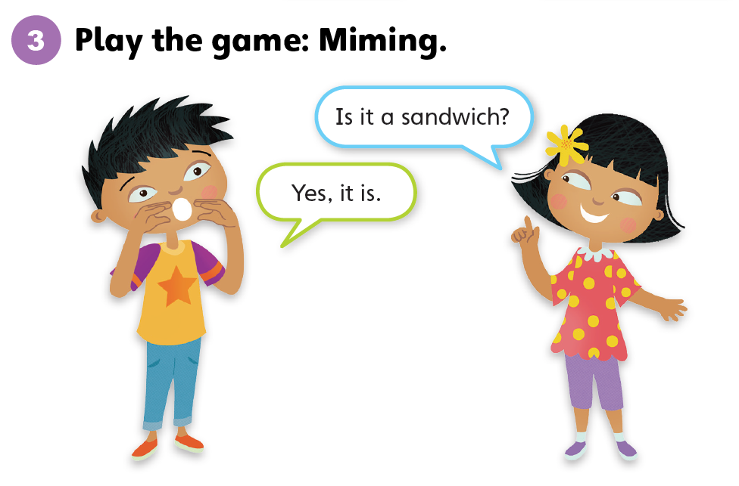

Slide 12
Unit 8:
Good Food
Lesson 2

Slide 13
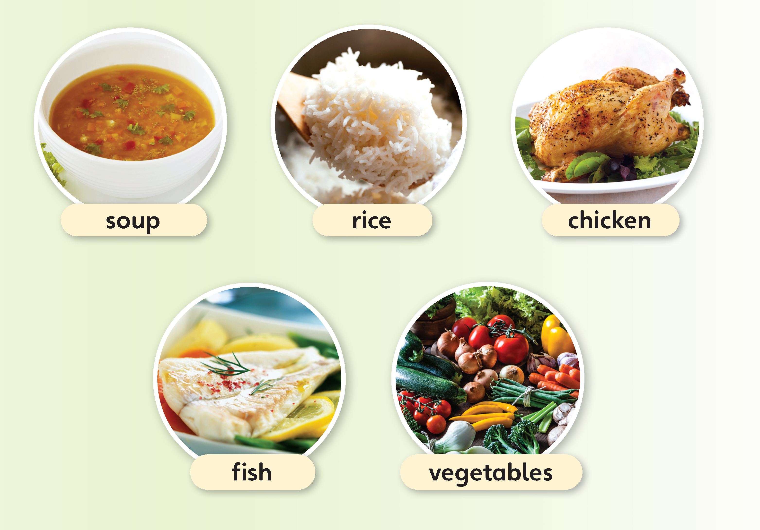
1
Look and listen. Repeat.
TR: B92

Slide 14
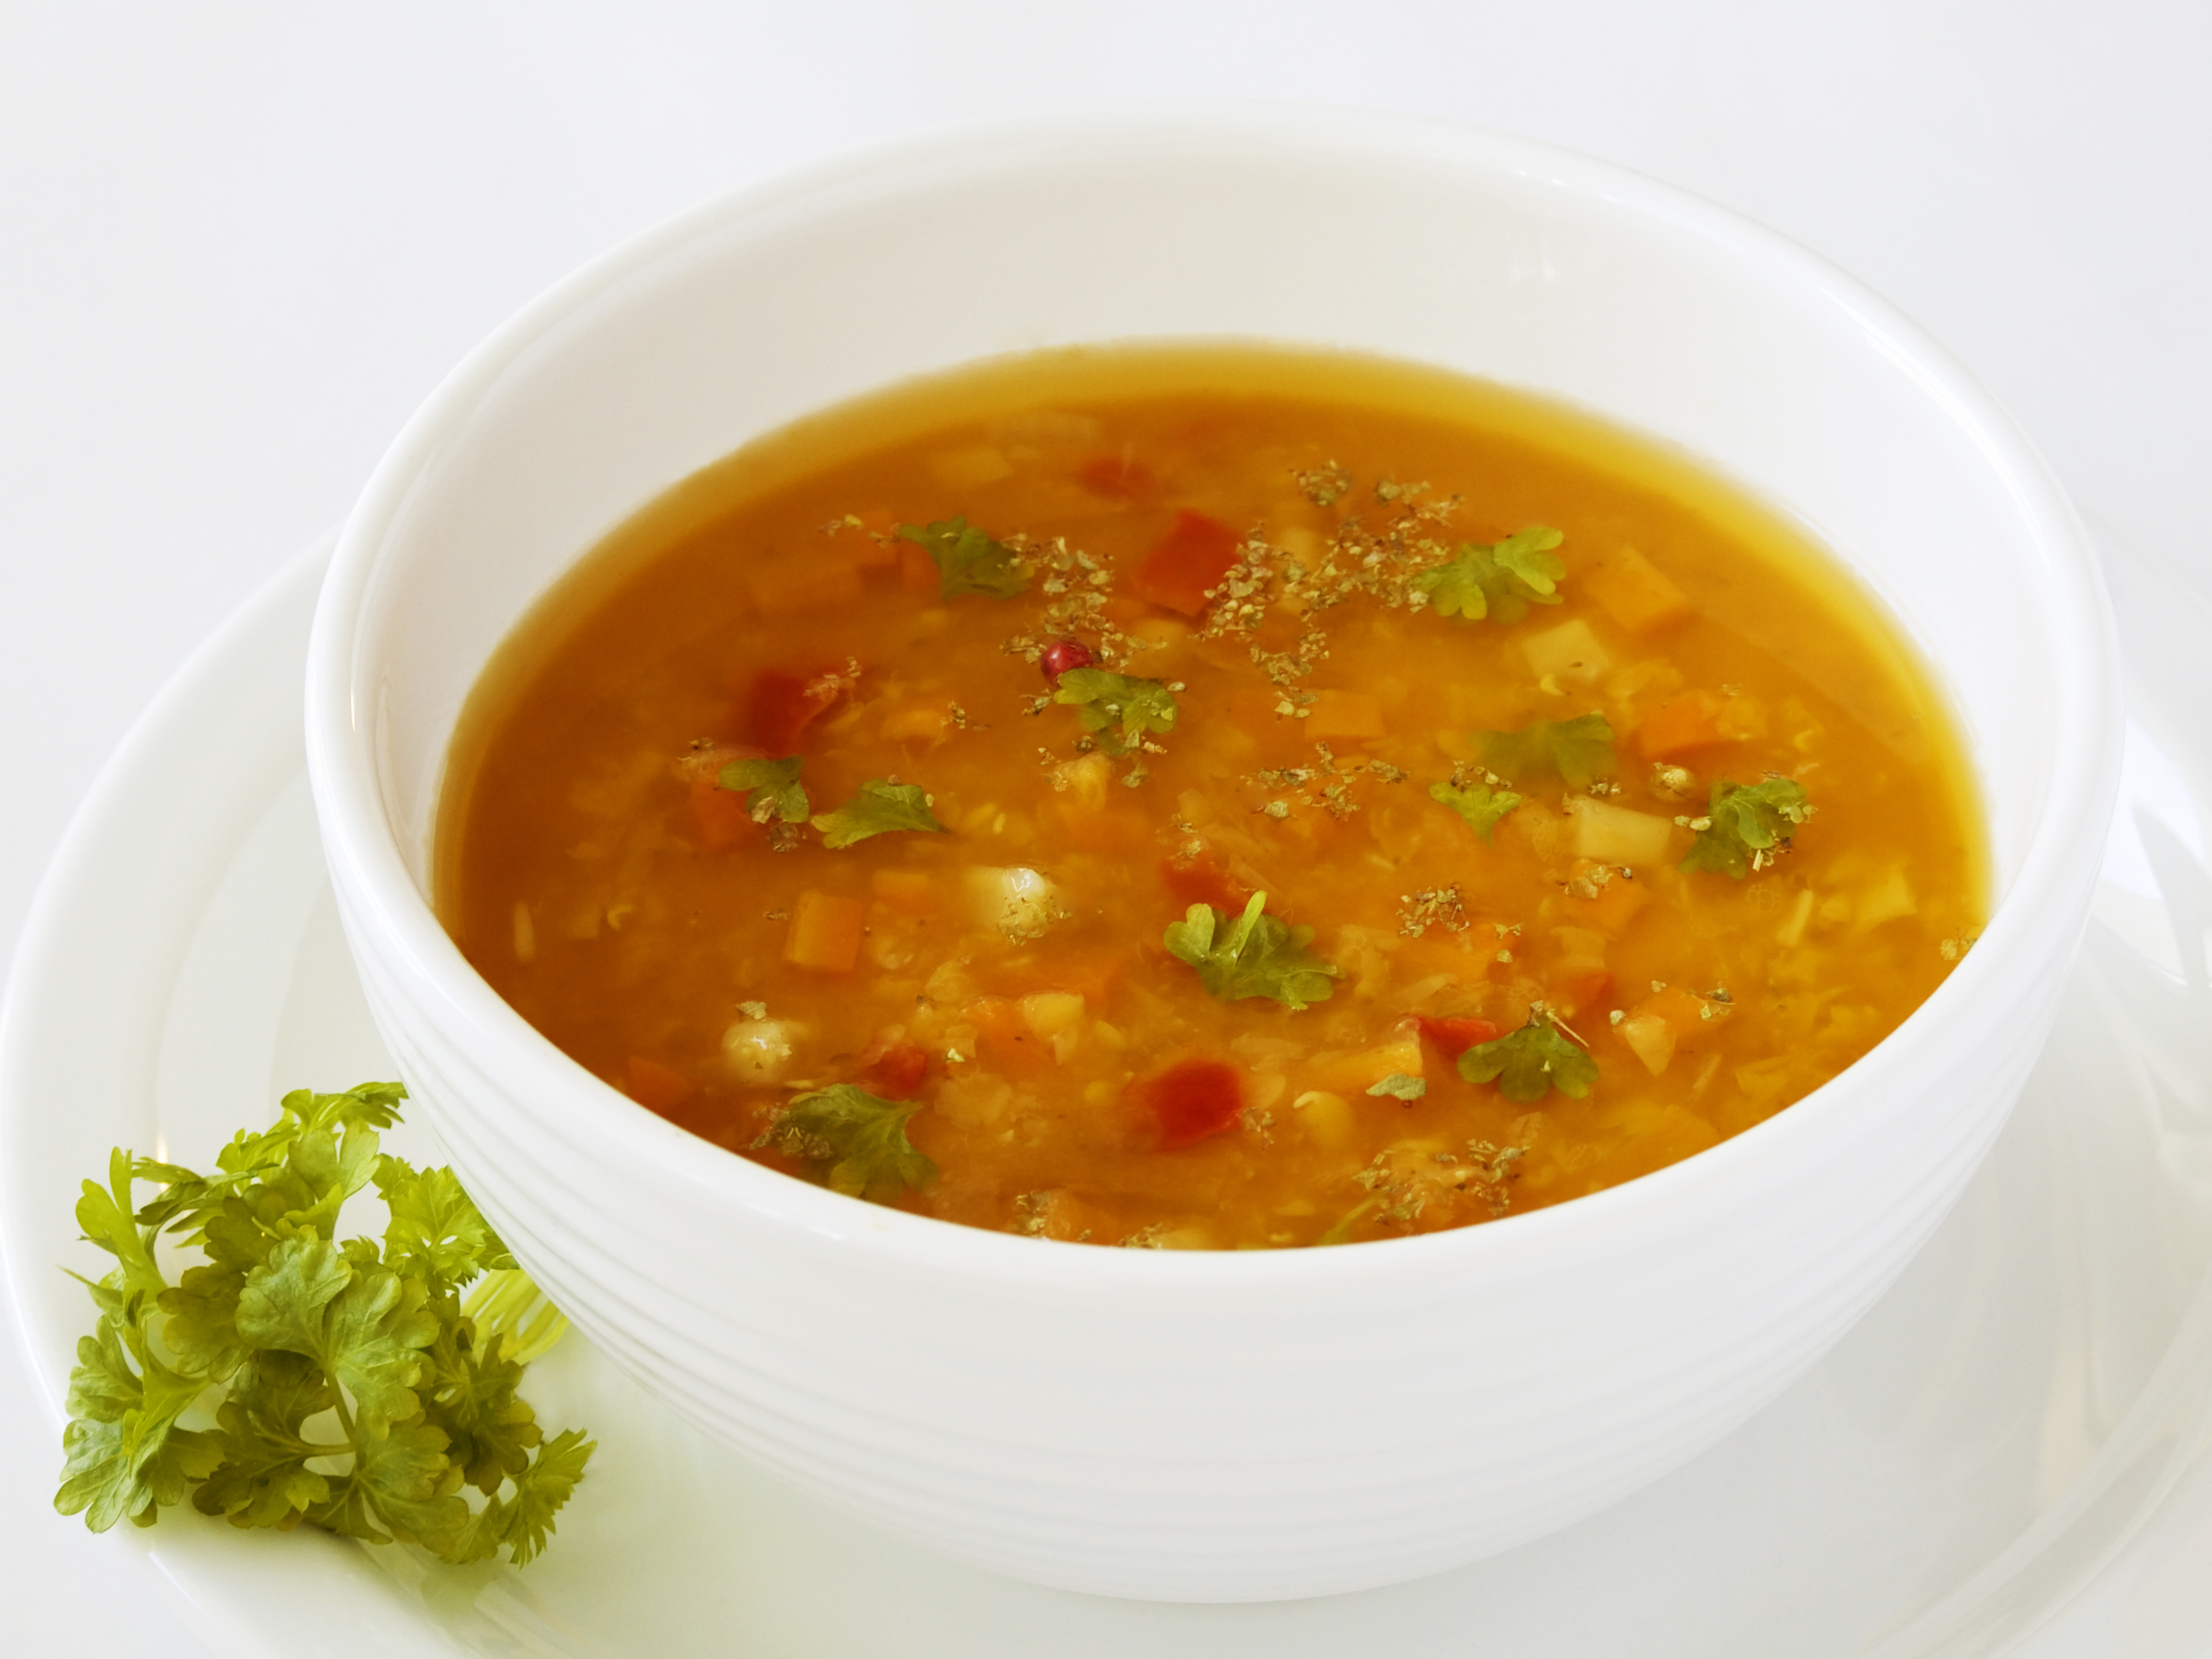
soup
/suːp/

Slide 15
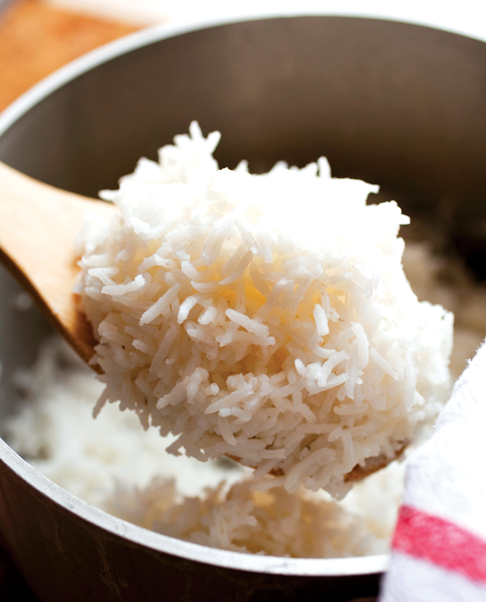
rice
/raɪs/

Slide 16
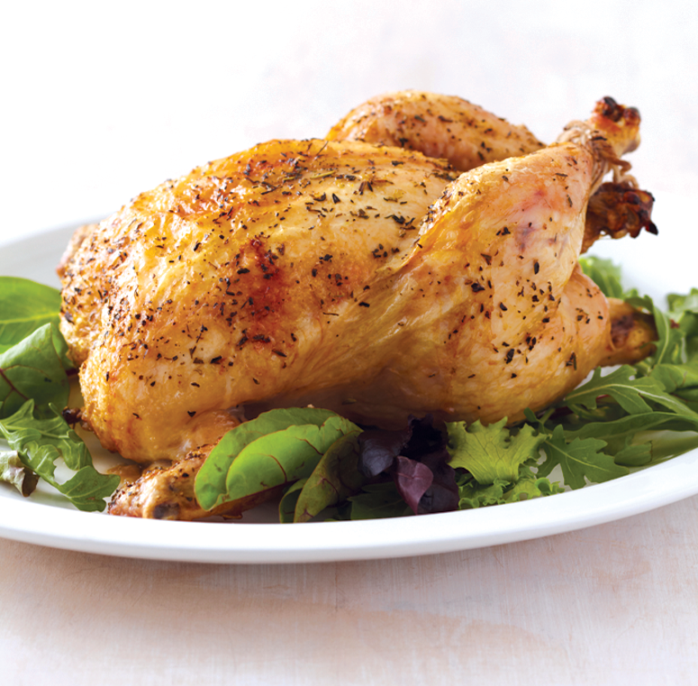
chicken
/ˈtʃɪkɪn/

Slide 17
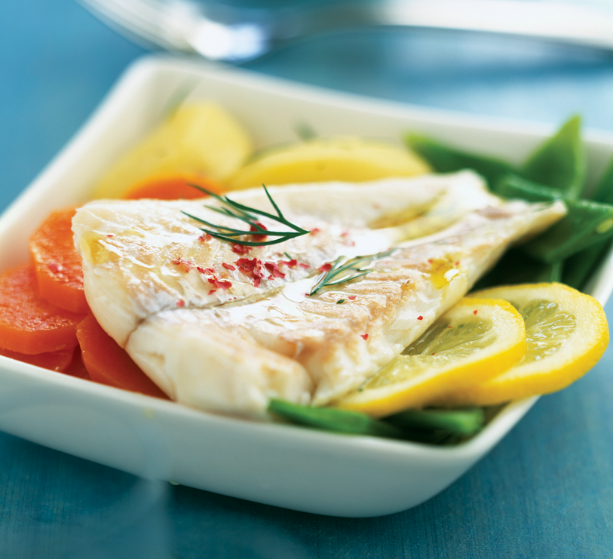
fish
/fɪʃ/

Slide 18
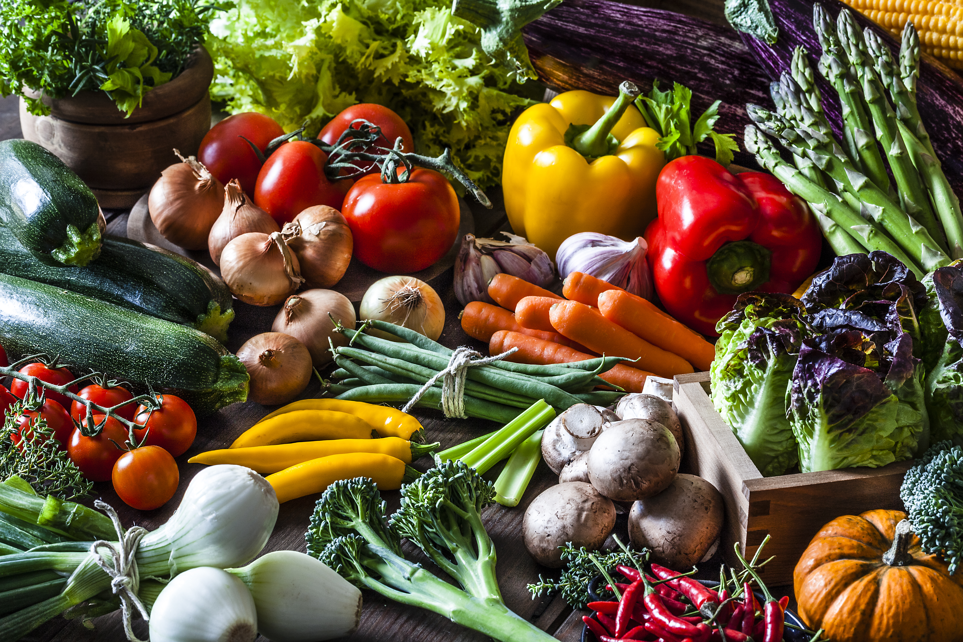
vegetables
/ˈvedʒtəbls/

Slide 19
2
Listen and point. Say.
TR: B93

Slide 20
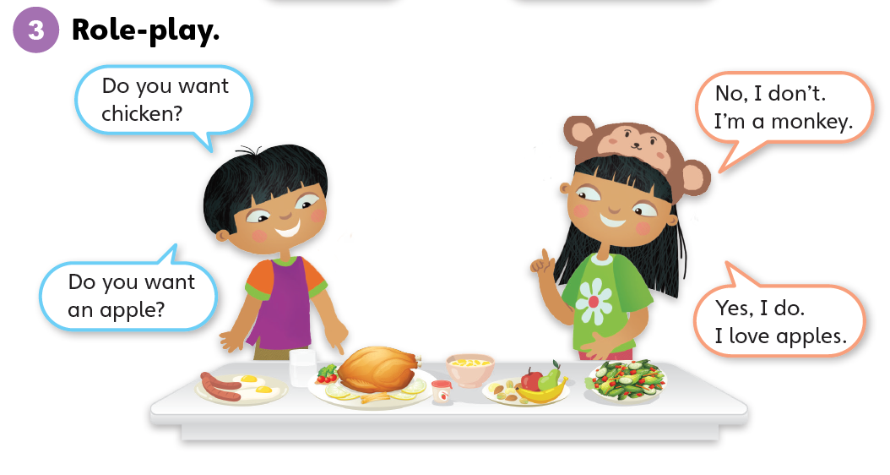

Slide 21
Unit 8:
Good Food
Lesson 3

Slide 22
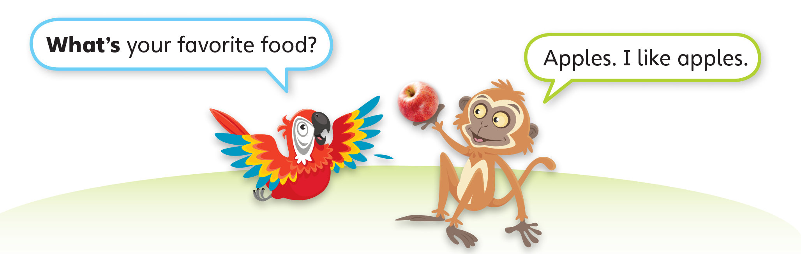
1
Look and listen. Repeat. TR: B94

Slide 23
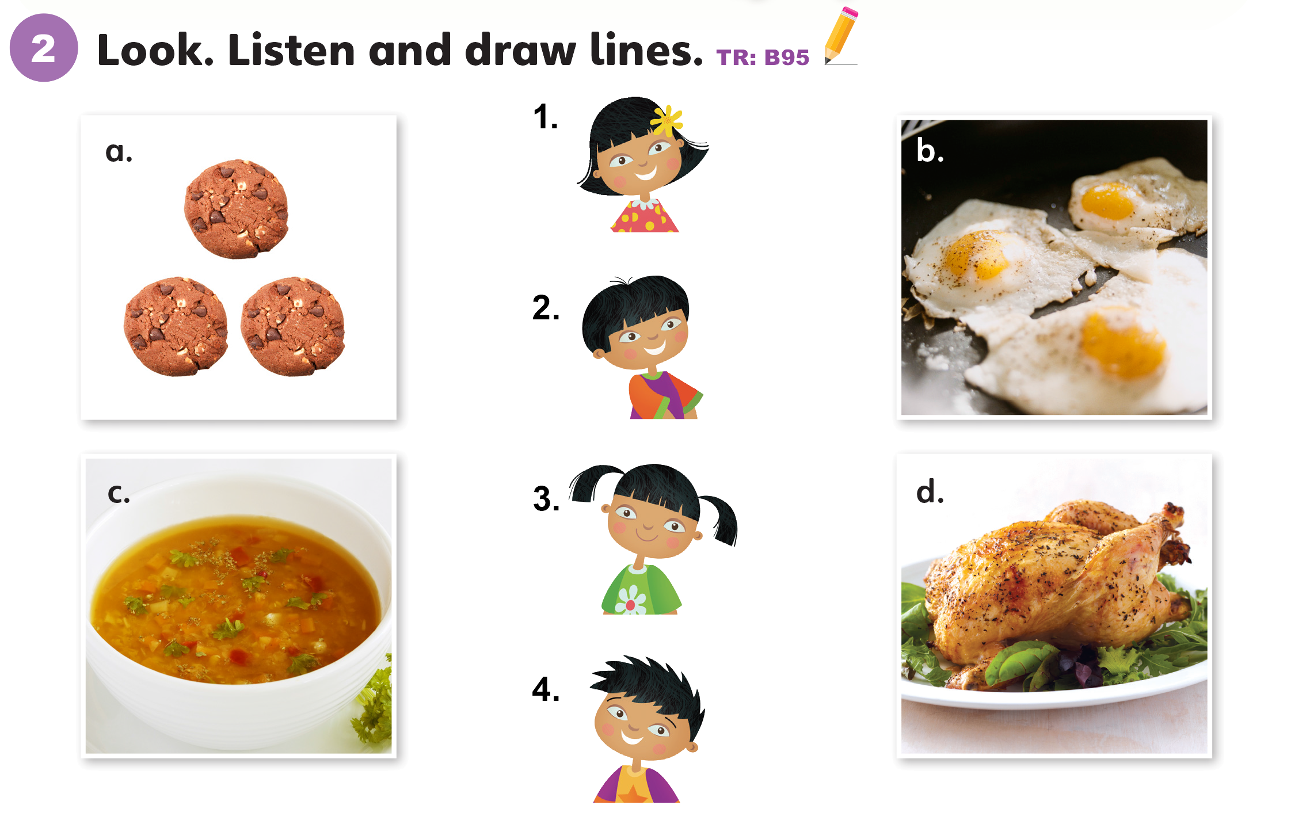

Slide 24
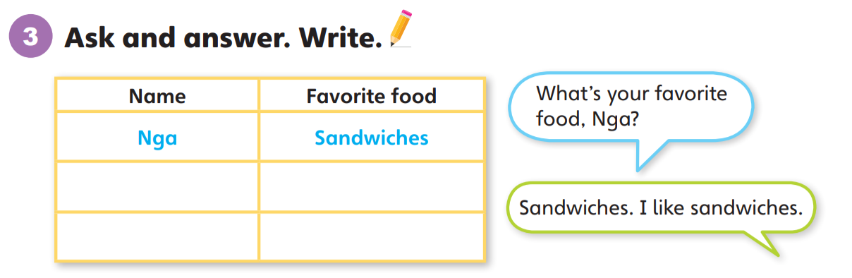

Slide 25
Unit 8:
Good Food
Lesson 4

Slide 26
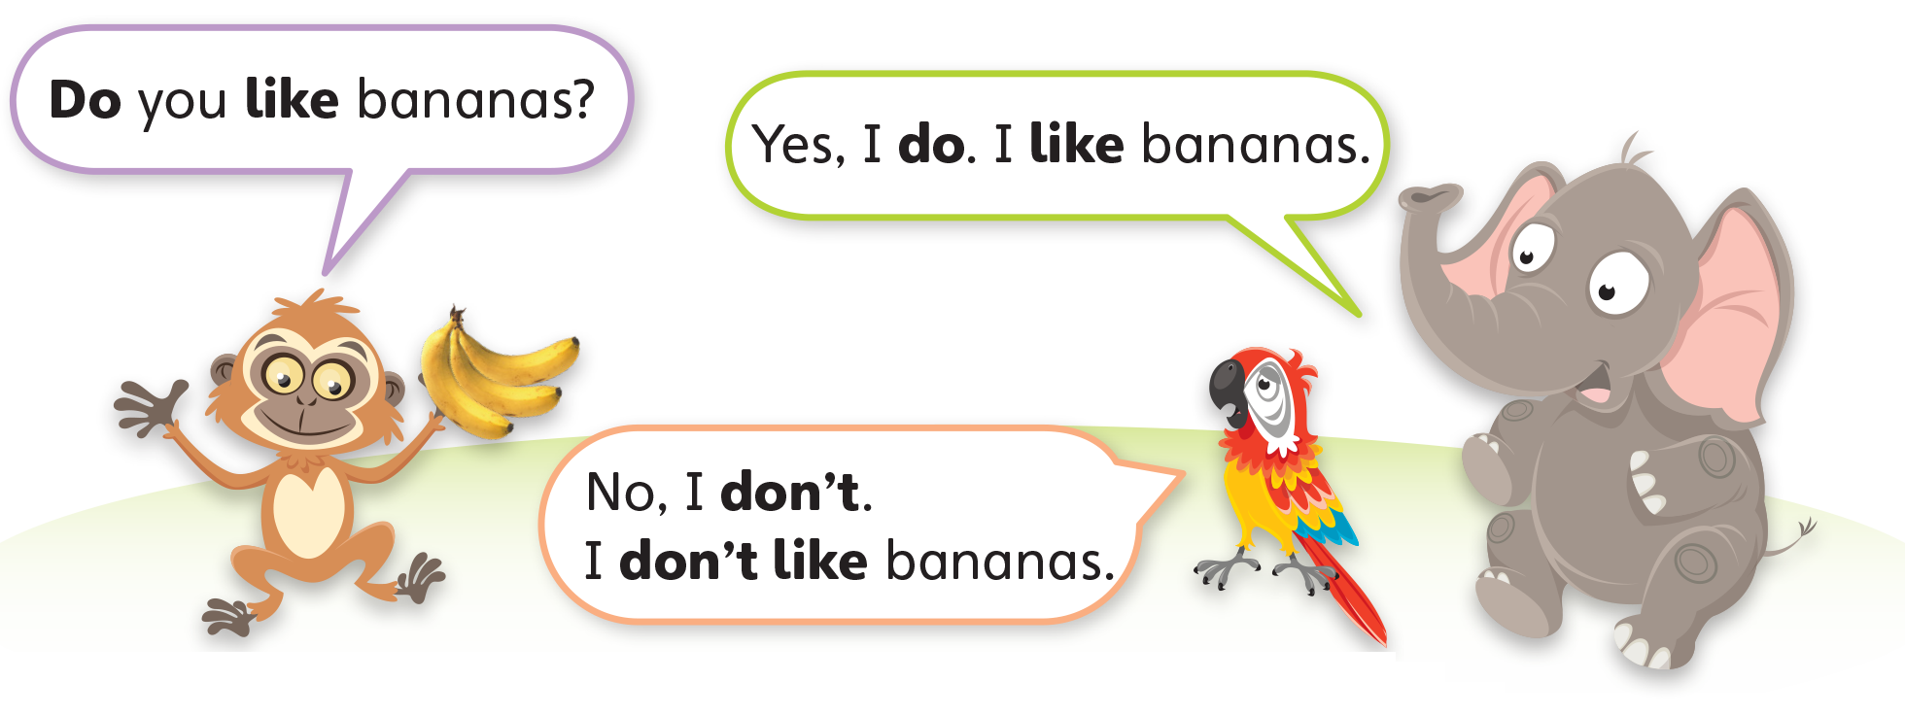
1
Look and listen. Repeat. TR: B96

Slide 27
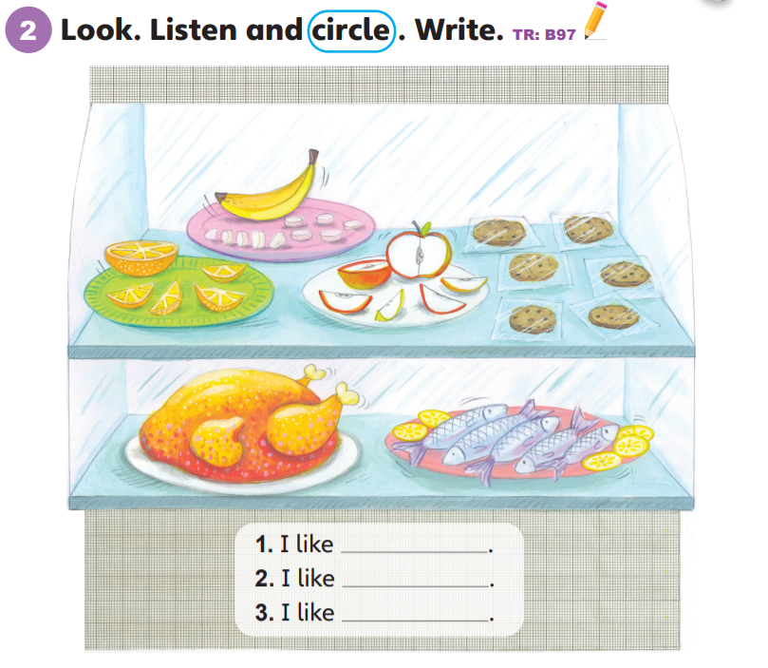
oranges
cookies
fish

Slide 28
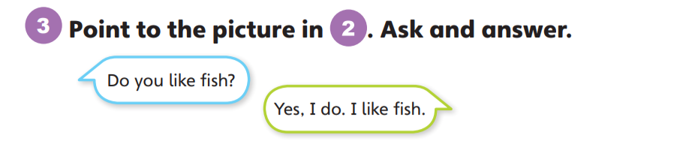
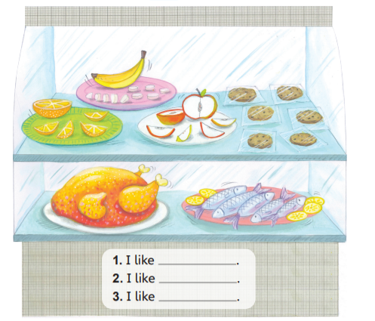

Slide 29
Unit 8:
Good Food
Lesson 5

Slide 30
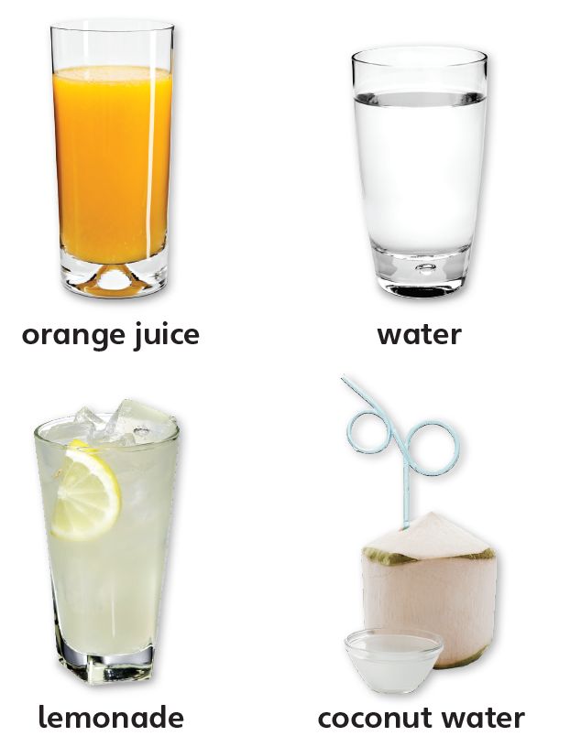
1
Look and listen. Repeat. TR: B98

Slide 31
orange juice
/ˈɔːrɪndʒ/ /dʒuːs/

Slide 32
water
/ˈwɔːtər/

Slide 33
lemonade
/ˌleməˈneɪd/

Slide 34
coconut water
/ˈkəʊkənʌt/ /ˈwɔːtər/
Notes:
Ưeqwertysfdffaxzv bgftymhgfd

Slide 35
2
Point and say.
orange juice
water
lemonade
coconut water

Slide 36
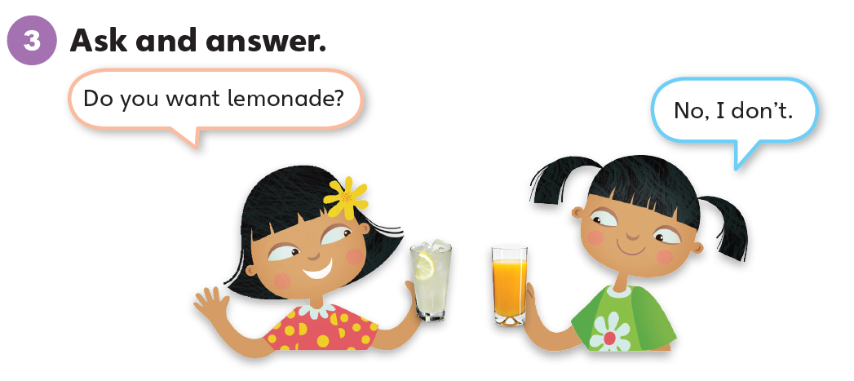

Slide 37
Unit 8:
Good Food
Lesson 6

Slide 38
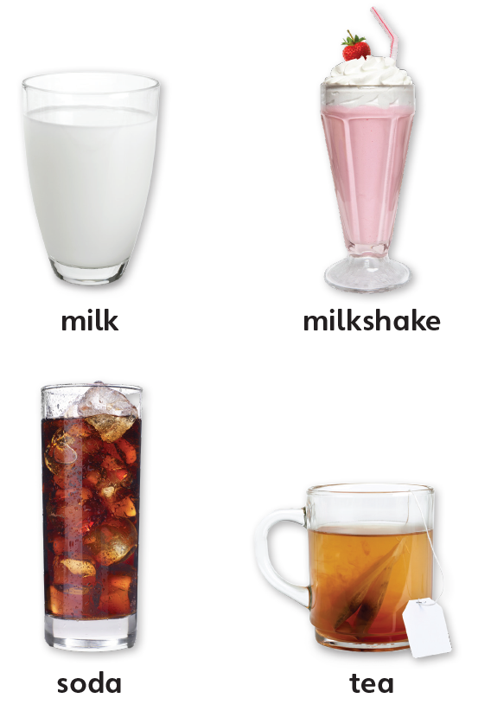
1
Look and listen. Repeat. TR: B99

Slide 39
milk
/mɪlk/

Slide 40
milkshake
/ˈmɪlkʃeɪk/

Slide 41
soda
/ˈsəʊdə/

Slide 42
tea
/tiː/

Slide 43
2
Point and say.
milk
milkshake
soda
tea

Slide 44
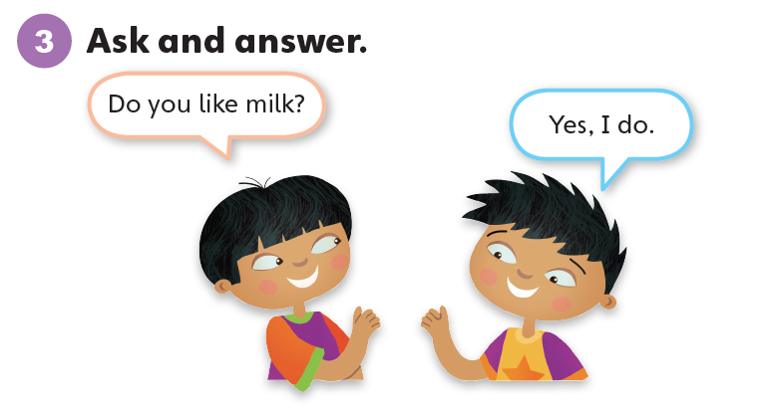

Slide 45
Unit 8:
Good Food
Lesson 7

Slide 46
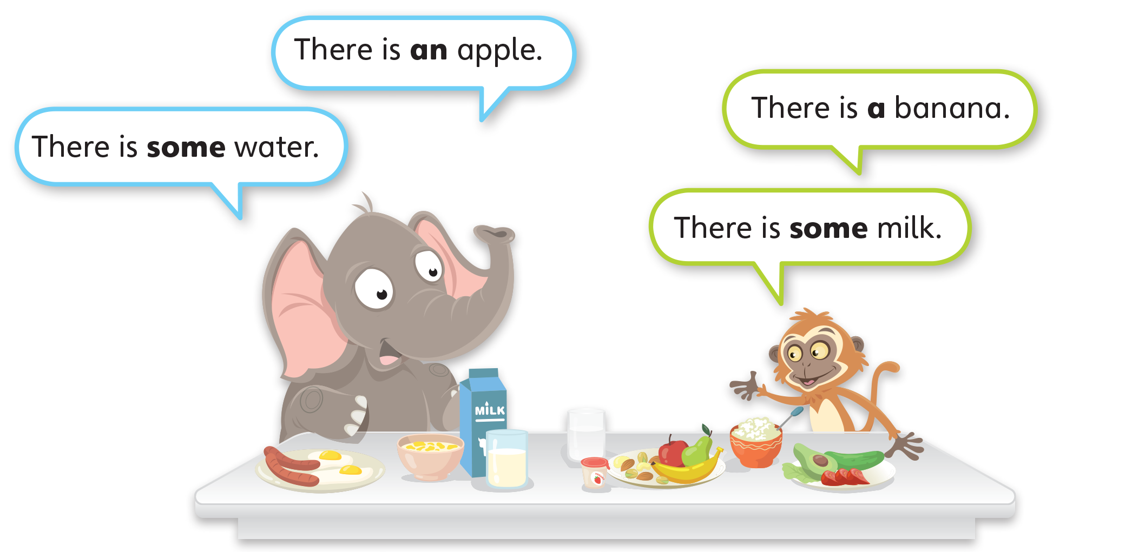
1
Look and listen. Repeat. TR: B100

Slide 47
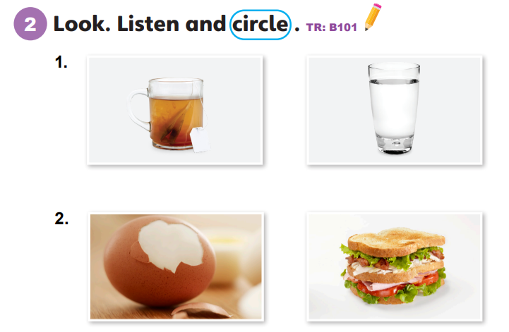

Slide 48
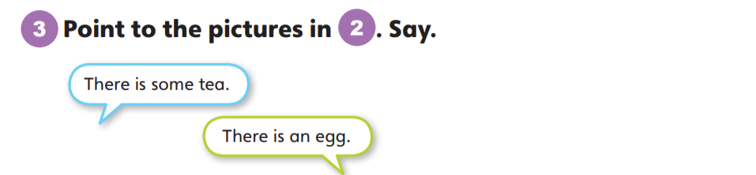
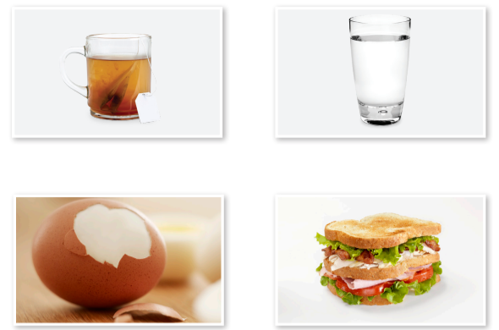

Slide 49
Unit 8:
Good Food
Lesson 8

Slide 50
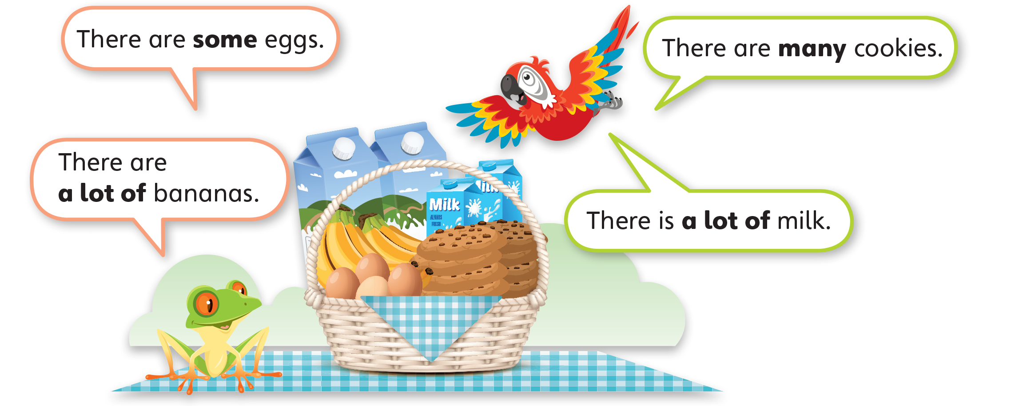
1
Look and listen. Repeat. TR: B102

Slide 51
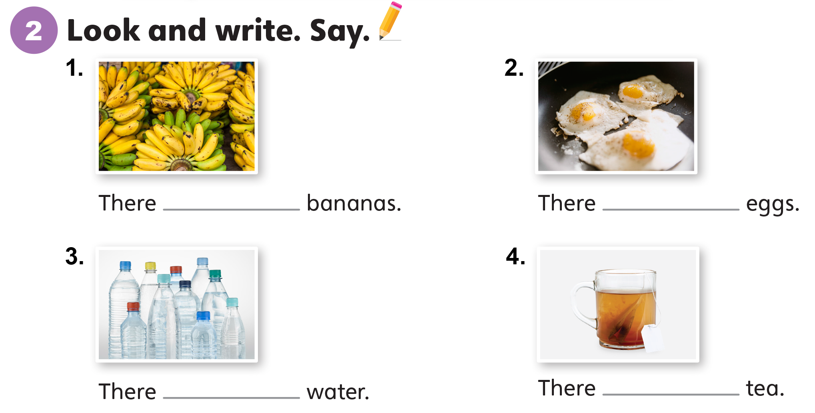
are a lot of / are many
are some
is a lot of
is some

Slide 52
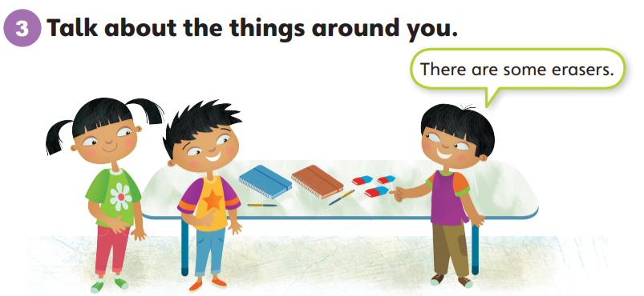

Slide 53
Unit 8:
Good Food
Lesson 9

Slide 54
1
Listen and repeat. TR: B103
a
e
  apple
  sandwich
  egg
  desk

Slide 55
2
Listen and sing. TR: B104
Apples?
I like apples!
Yes, I do! Yes, I do! Yes, I do!
I like apples! Yes, I do. I like them very much.
Eggs?
I like eggs!
Yes, I do! Yes, I do! Yes, I do!
I like eggs! Yes, I do. I like them very much.

Slide 56
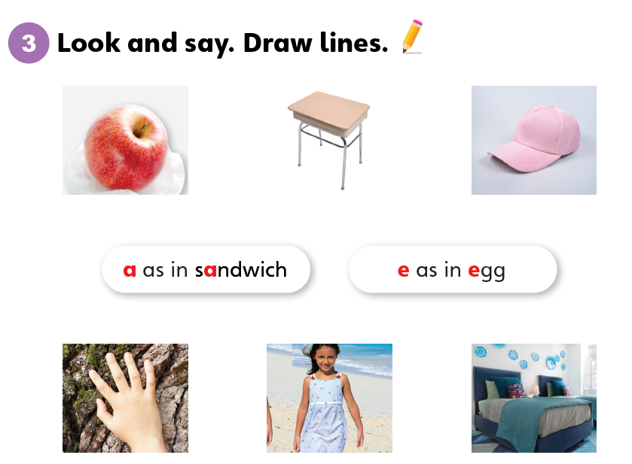

Slide 57
Unit 8:
Good Food
Lesson 10

Slide 58
1
Listen and repeat. TR: B105
ch
j
  chicken
  kitchen
  juice
  jump

Slide 59
2
Listen and chant. TR: B106
Chicken, chicken, chicken.
My favorite food!
I cook chicken.
I cook it in the kitchen.
Juice, juice, juice.
My favorite drink!
I like juice.
I drink a lot of juice.

Slide 60
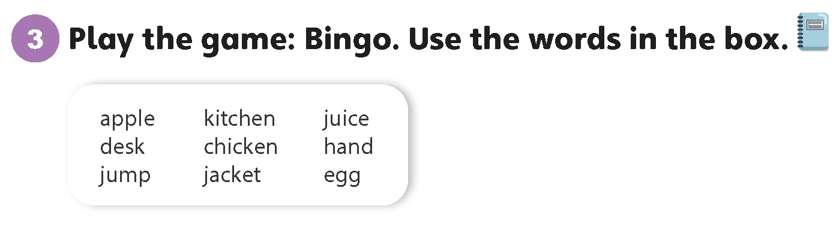

Slide 61
Unit 8:
Good Food
Lesson 11

Slide 62
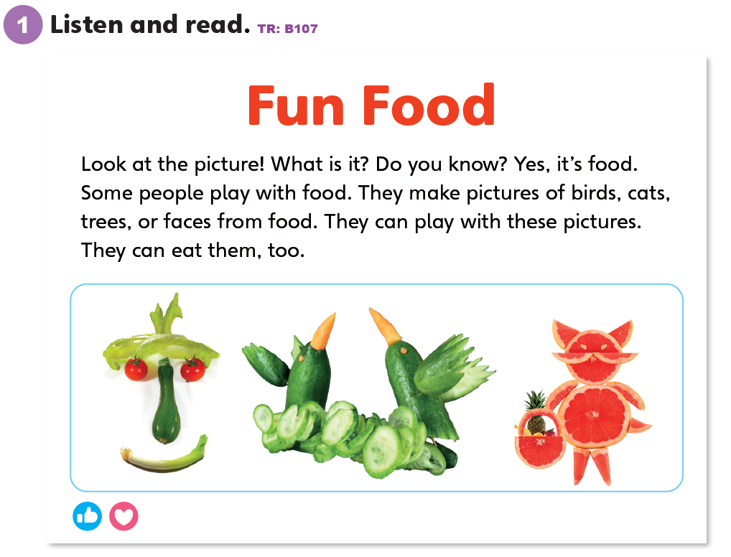

Slide 63
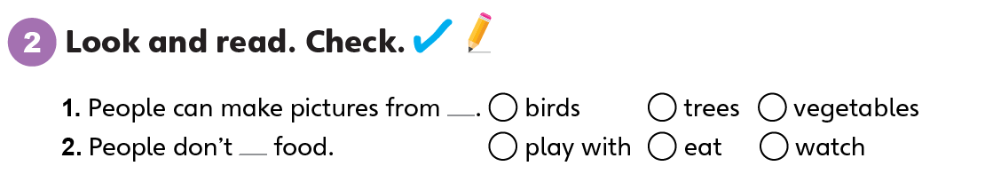

Slide 64
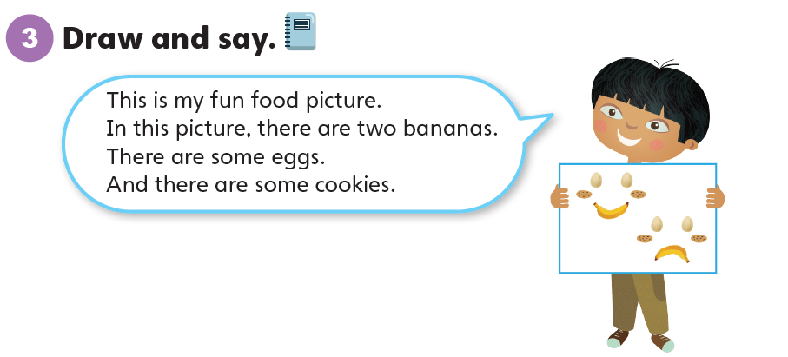

Slide 65
Unit 8:
Good Food
Lesson 12

Slide 66
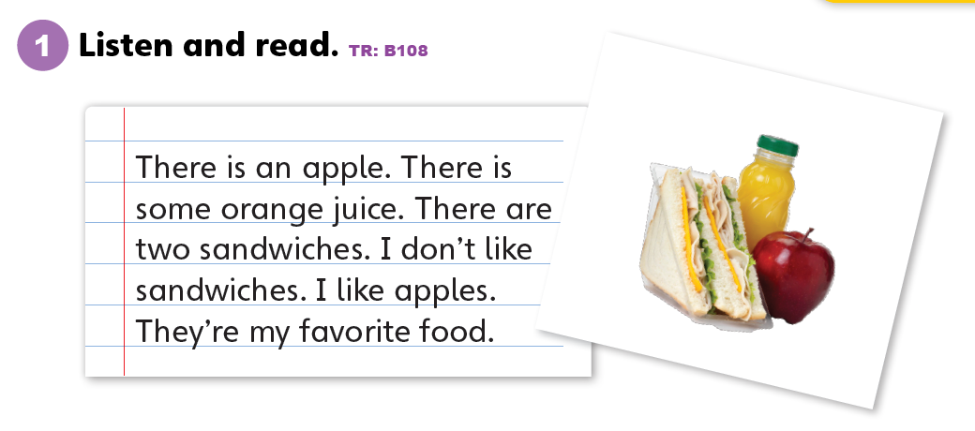

Slide 67
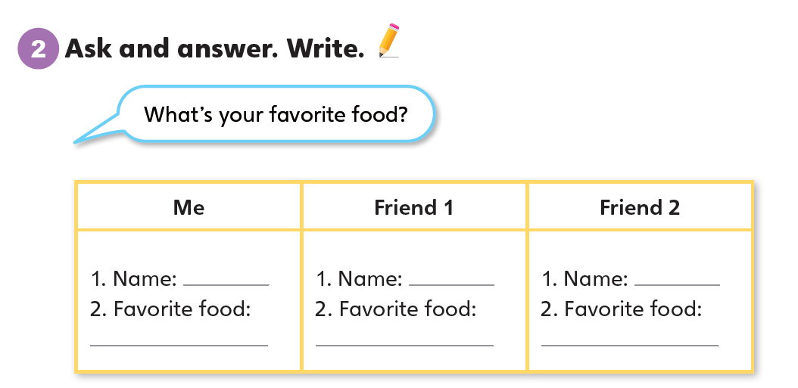

Slide 68
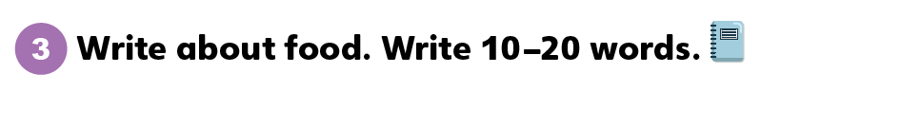
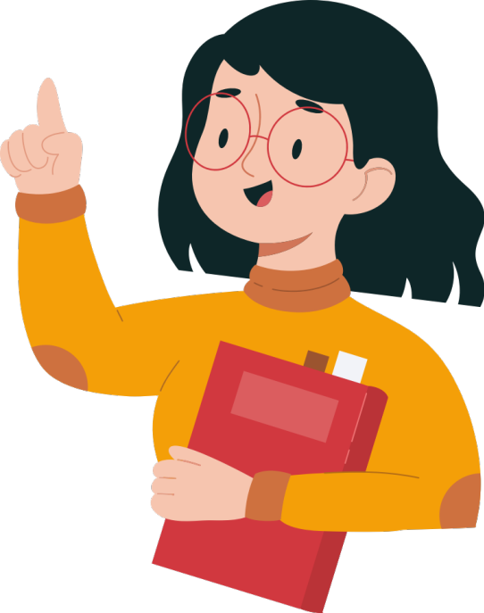

Slide 69
Unit 8:
Good Food
Value

Slide 70
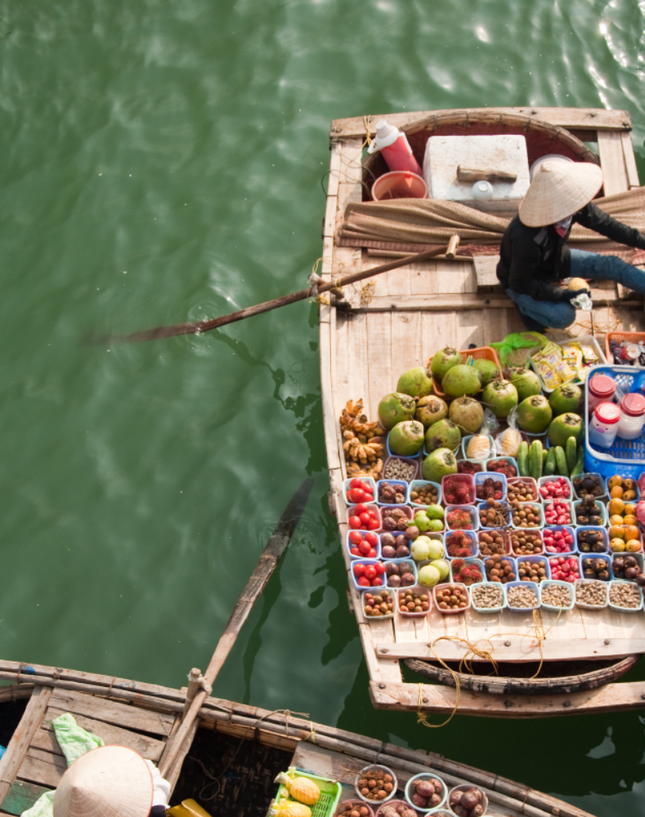
1
Look and listen. Repeat. TR: B109
Eat good food.
I like mangoes, bananas, and coconuts. I love fruits. I eat good food.

Slide 71
Eat good food.
2
Think. What are your
favorite foods?
Do you eat good food?

Slide 72
Eat good food.
3
Share.
I like oranges, eggs, and
fish. I eat good food.

Slide 73
Thank you!

