Slide 1
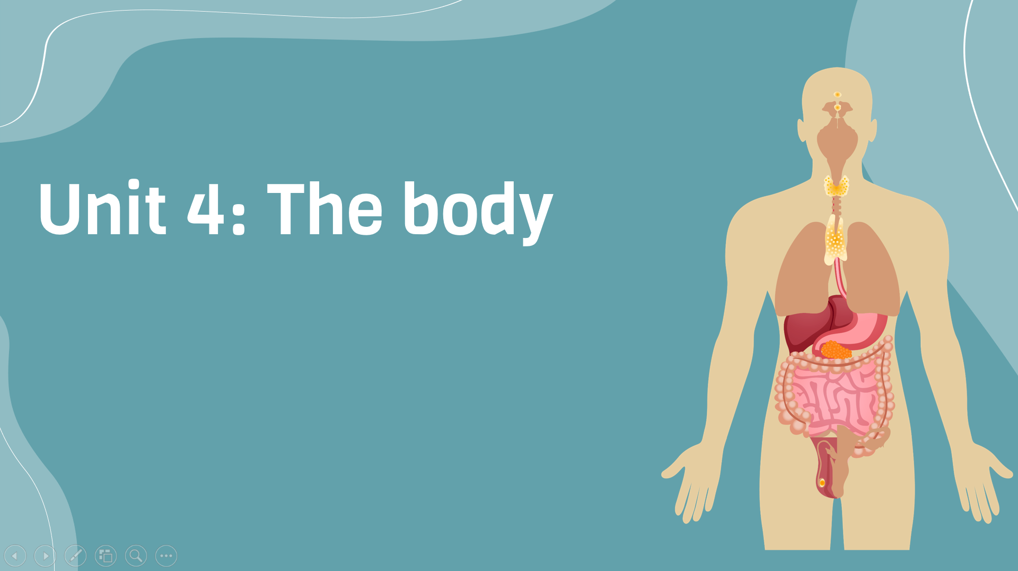
Period 30:
Pronunciation and communication
v
Here is where your presentation begins

Slide 2
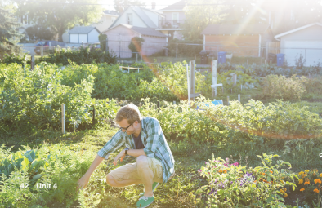
Warm-up
Whispering
Rules Ttwo groups of 8-10 people stand in 2 lines. Teacher lets the last students of each line see the lists of words. They have to remember and whisper to the next ears. The front students of each line go to the board and write down what they hear. The group with more correct answers will be the winner.

Slide 3
Lists of words
1. bought
2. and
3. keep
4. best
5. avoid
6. hate
7. consider
What are the ending sounds of the words?

Slide 4
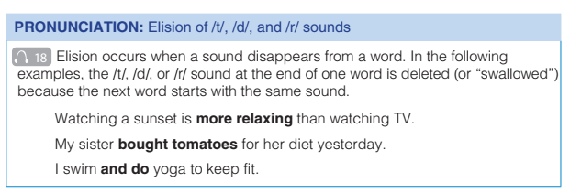
Pronunciation

Slide 5
Pronunciation
Listen carefully to the words in bold and then say the sentence
Watching a sunset is more relaxing than watching TV

Slide 6
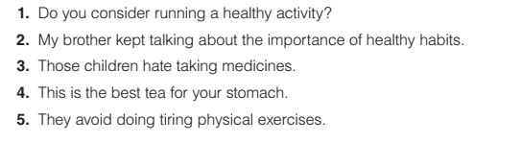
Pronunciation
Exercise E: Listen and repeat
Track 19

Slide 7


Communication
Exercise F: What are the best kinds of food and exercise for a healthy lifestyle? In pairs, rate the foods from the least healthy to the healthiest.
bread ___
fruit ___
meat ___
vegetables ___
Running ___
Swimming ___
Walking ___
Yoga ___

Slide 8
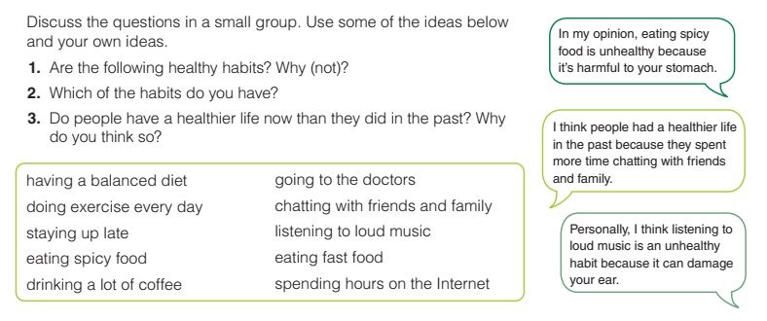
Goal check: talk about healthy habits

Slide 9


