Slide 1
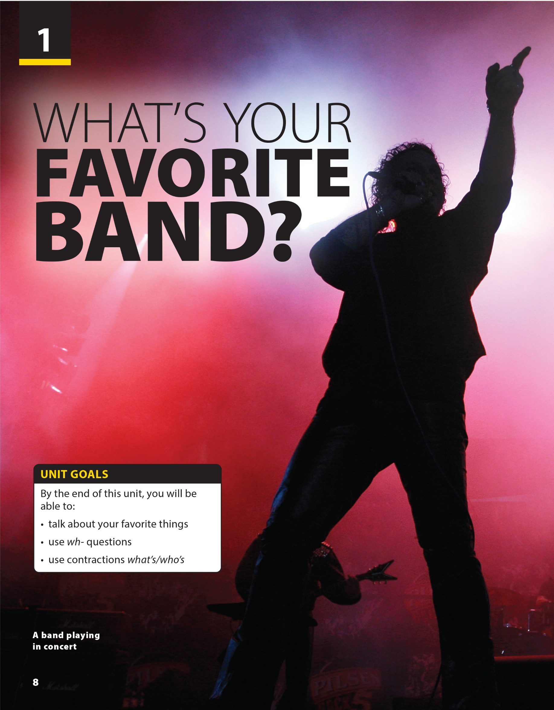
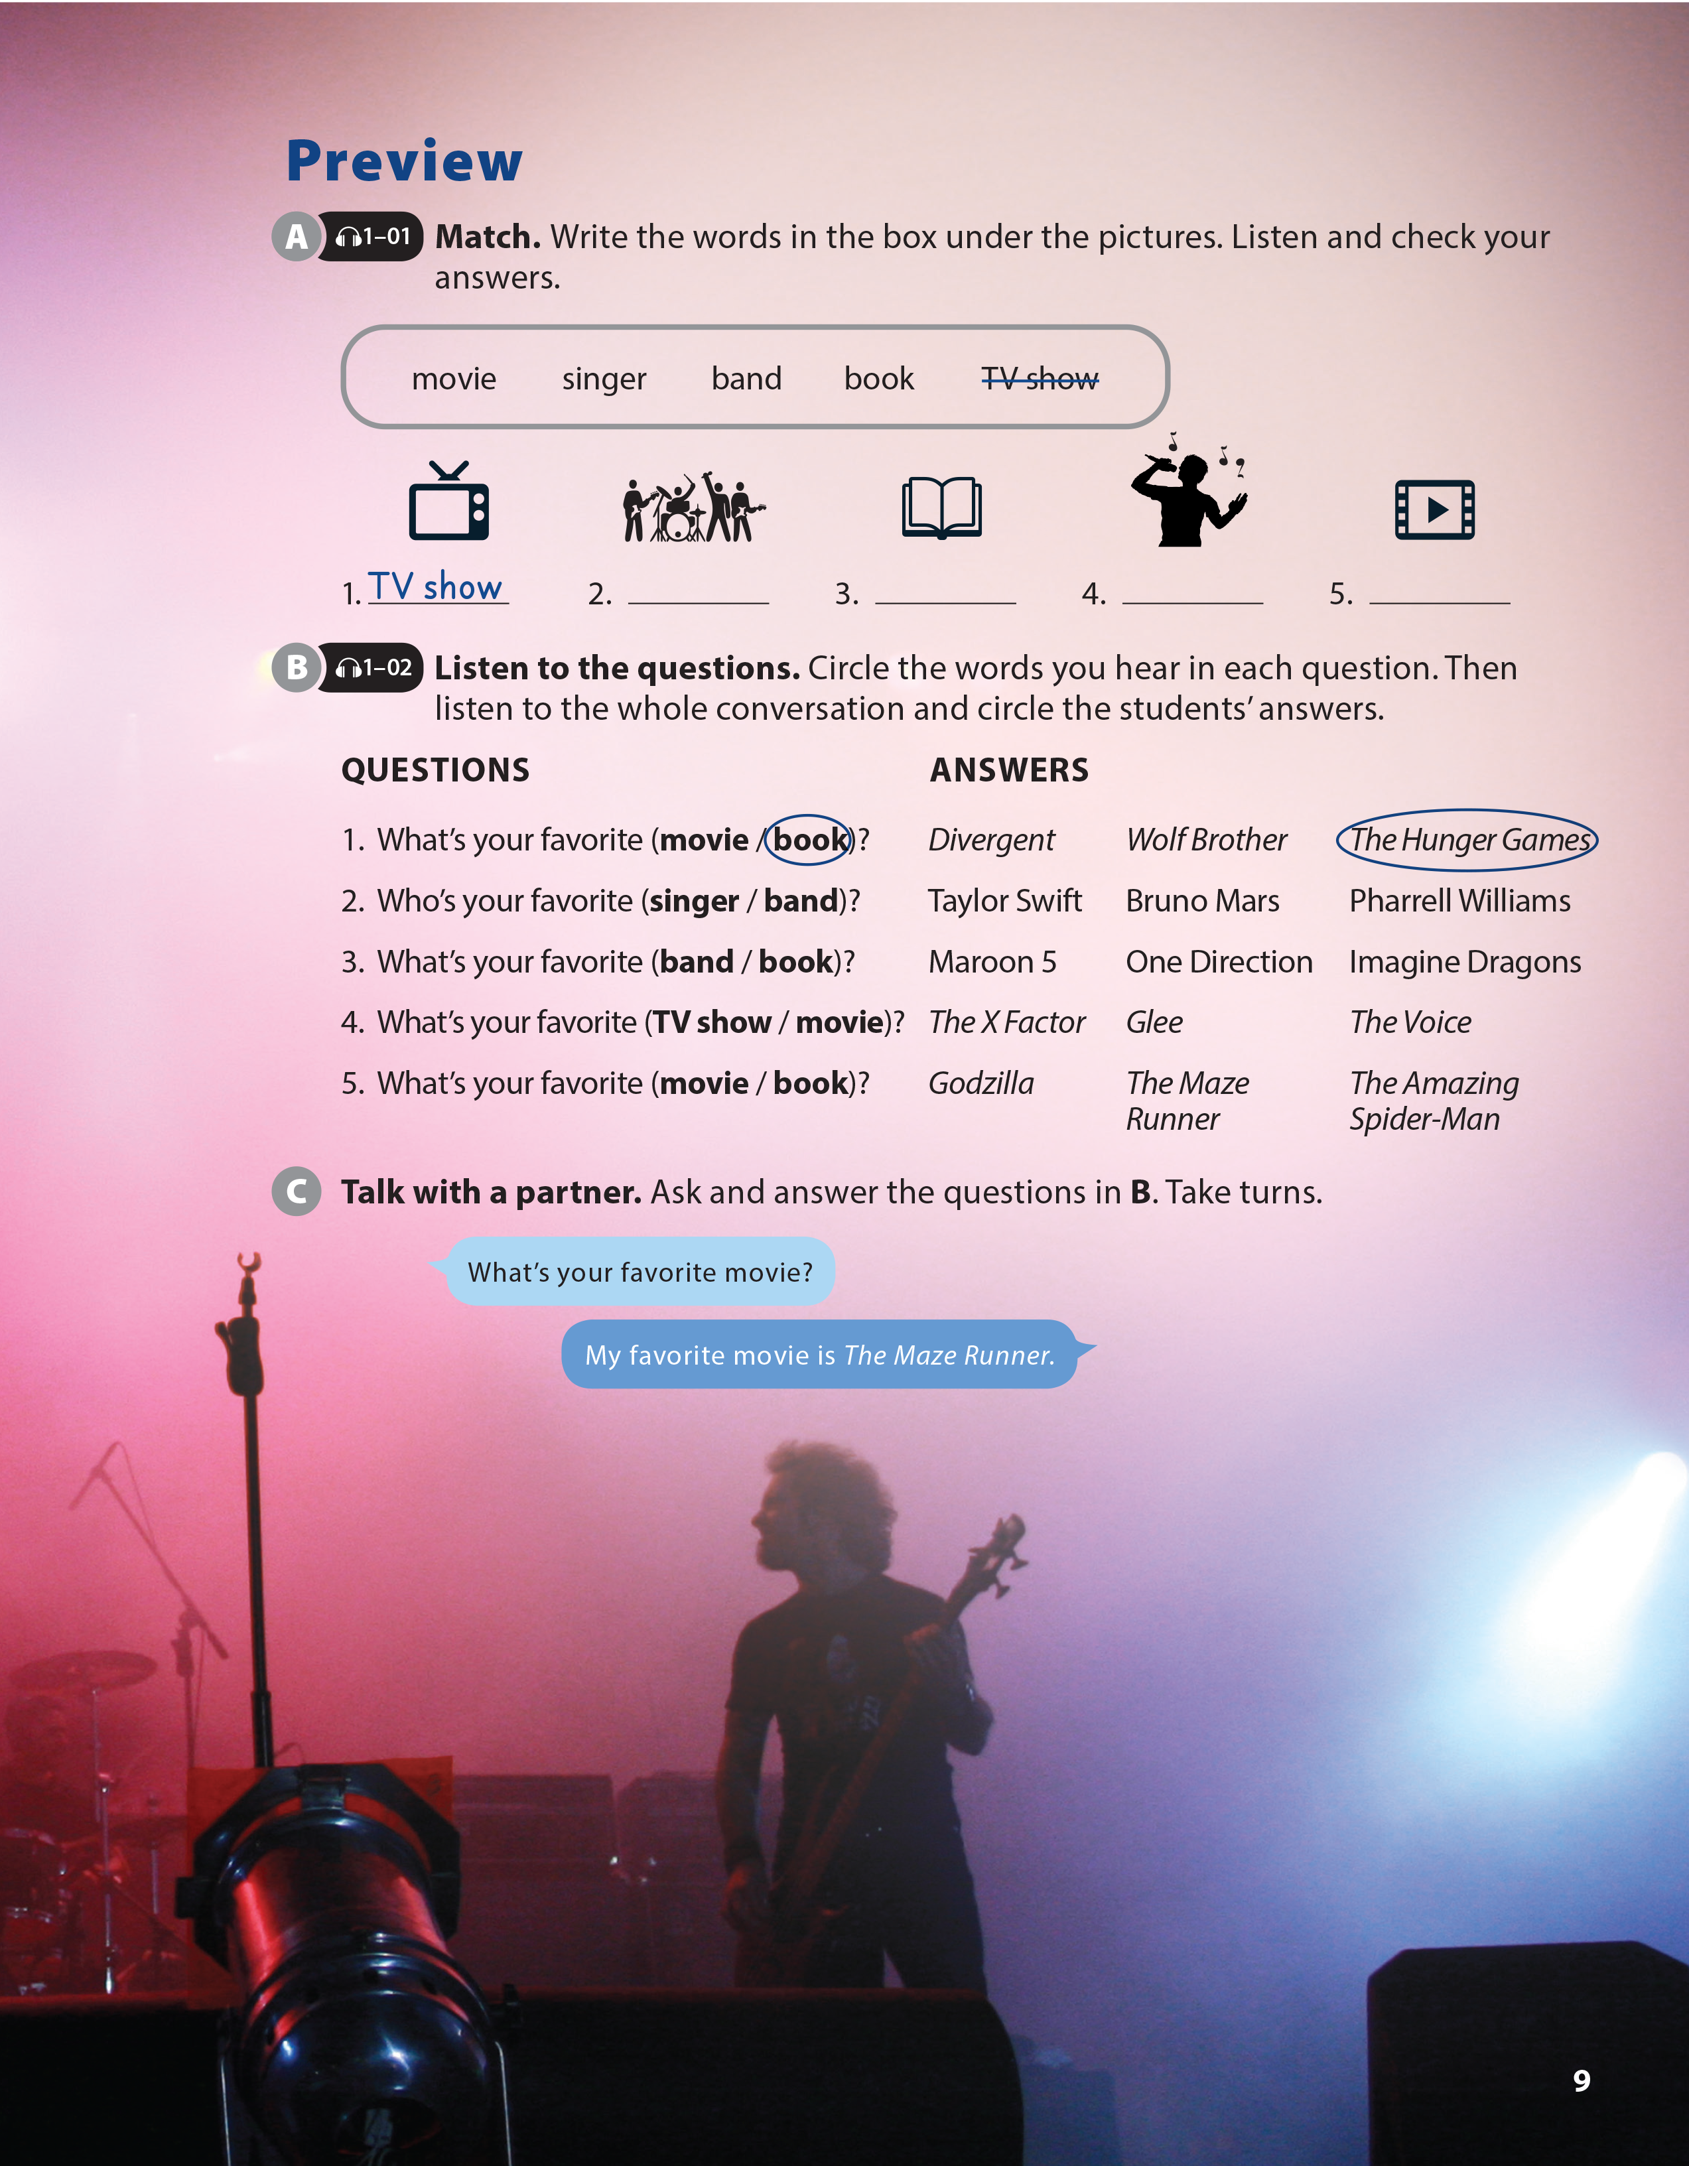

Slide 2

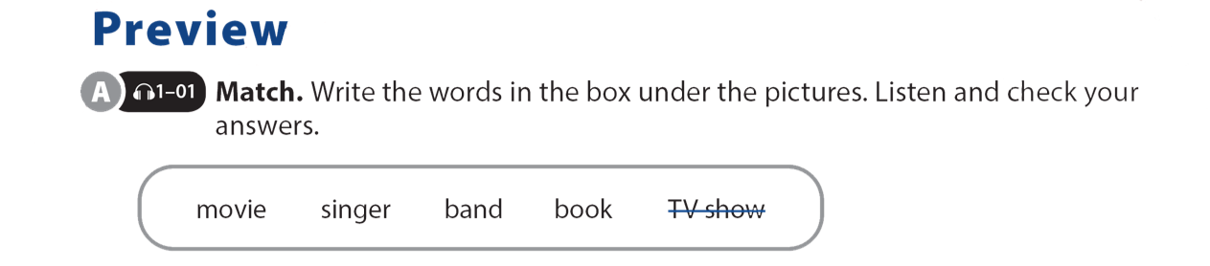

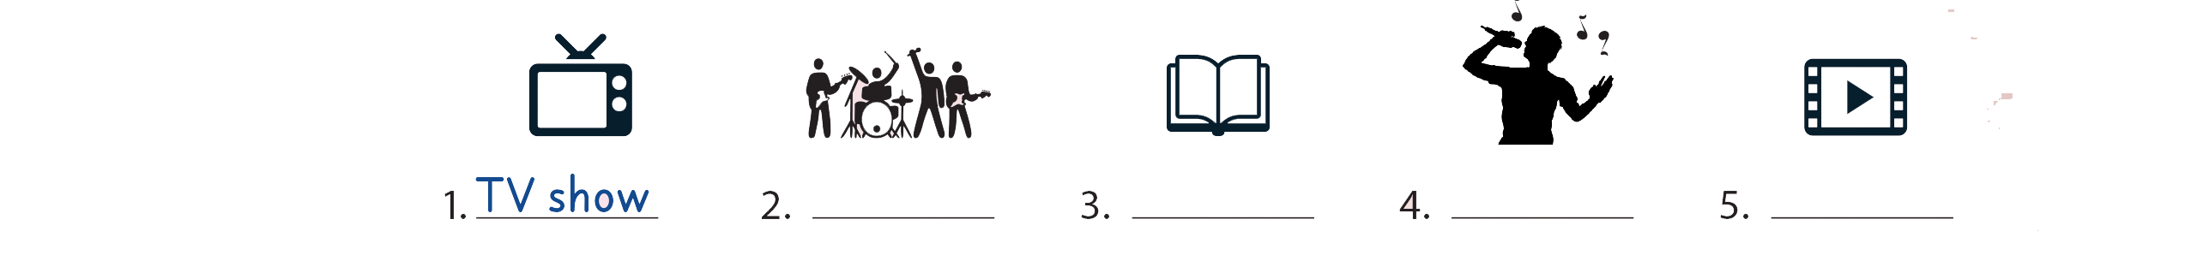
UNIT 1
WHAT'S YOUR FAVORITE BAND?
PREVIEW
band
book
singer
movie

Slide 3
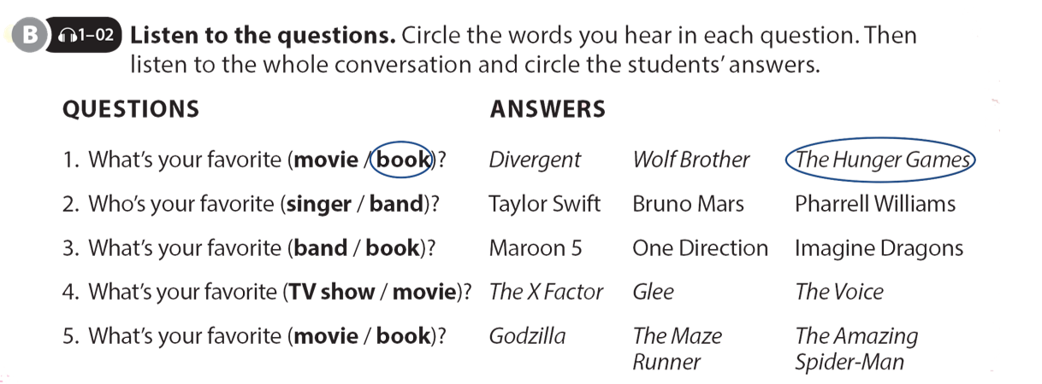
UNIT 1
WHAT'S YOUR FAVORITE BAND?
PREVIEW

Slide 4

UNIT 1
WHAT'S YOUR FAVORITE BAND?
PREVIEW

Slide 5

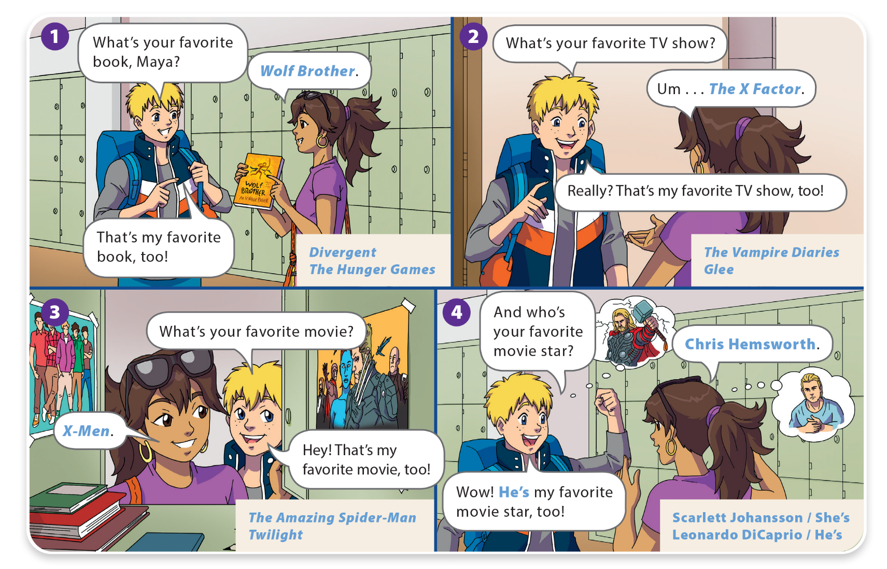
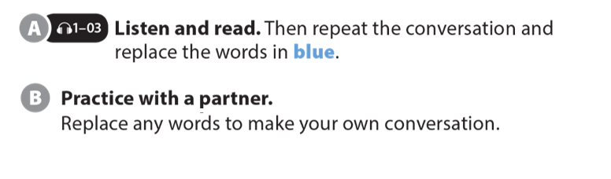
UNIT 1
WHAT'S YOUR FAVORITE BAND?
LANGUAGE FOCUS

Slide 6

UNIT 1
WHAT'S YOUR FAVORITE BAND?
LANGUAGE FOCUS

Slide 7
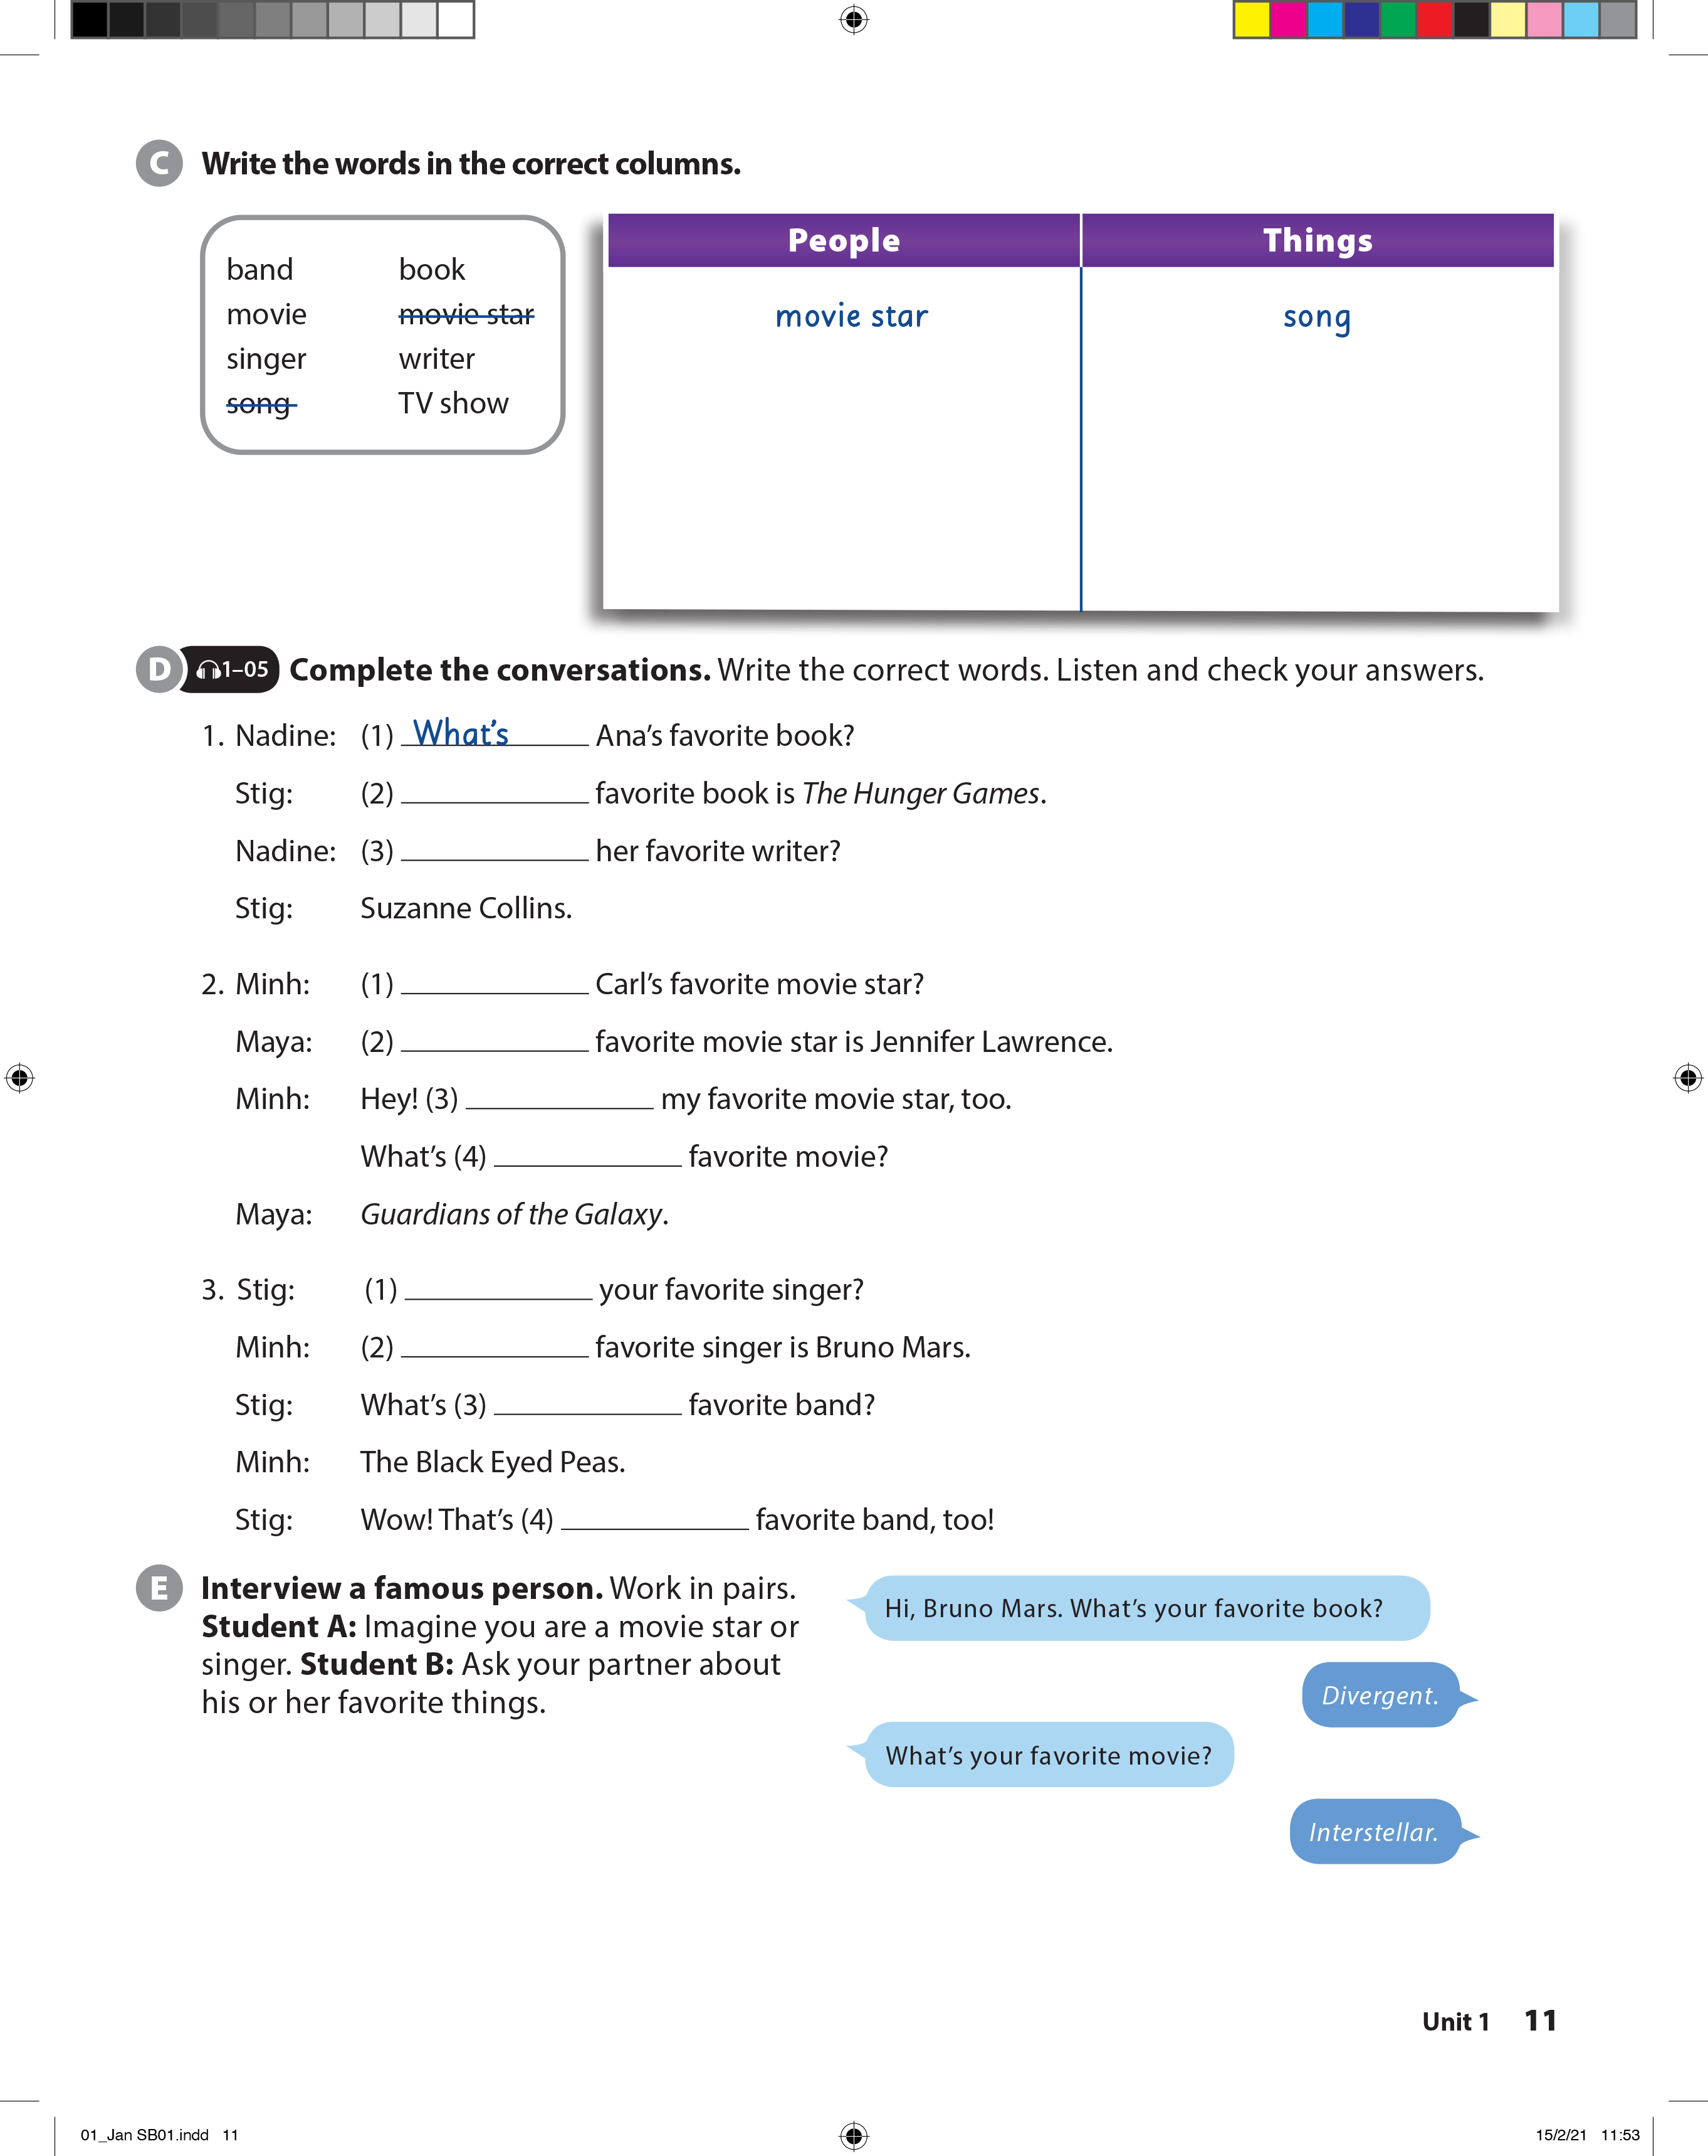
UNIT 1
WHAT'S YOUR FAVORITE BAND?
LANGUAGE FOCUS
writer
book
singer
movie
band
TV show

Slide 8
UNIT 1
WHAT'S YOUR FAVORITE BAND?
LANGUAGE FOCUS
Her
Who’s
Who’s
His
She’s
Carl’s
Who’s
My
your
my

Slide 9
UNIT 1
WHAT'S YOUR FAVORITE BAND?
LANGUAGE FOCUS

Slide 10
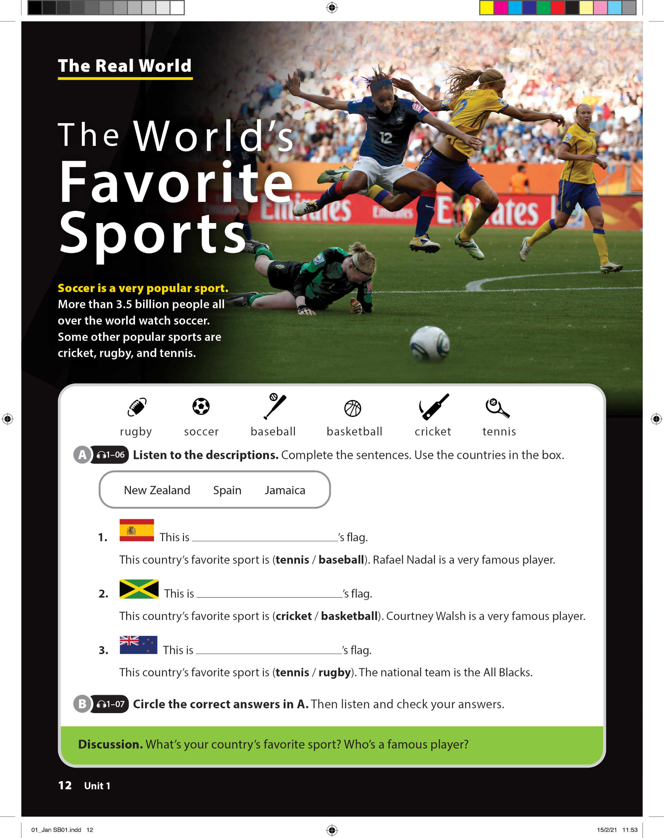
UNIT 1
WHAT'S YOUR FAVORITE BAND?
THE REAL WORLD

Slide 11
UNIT 1
WHAT'S YOUR FAVORITE BAND?
THE REAL WORLD
Spain
Jamaica
New Zealand

Slide 12


UNIT 1
WHAT'S YOUR FAVORITE BAND?
THE REAL WORLD

Slide 13
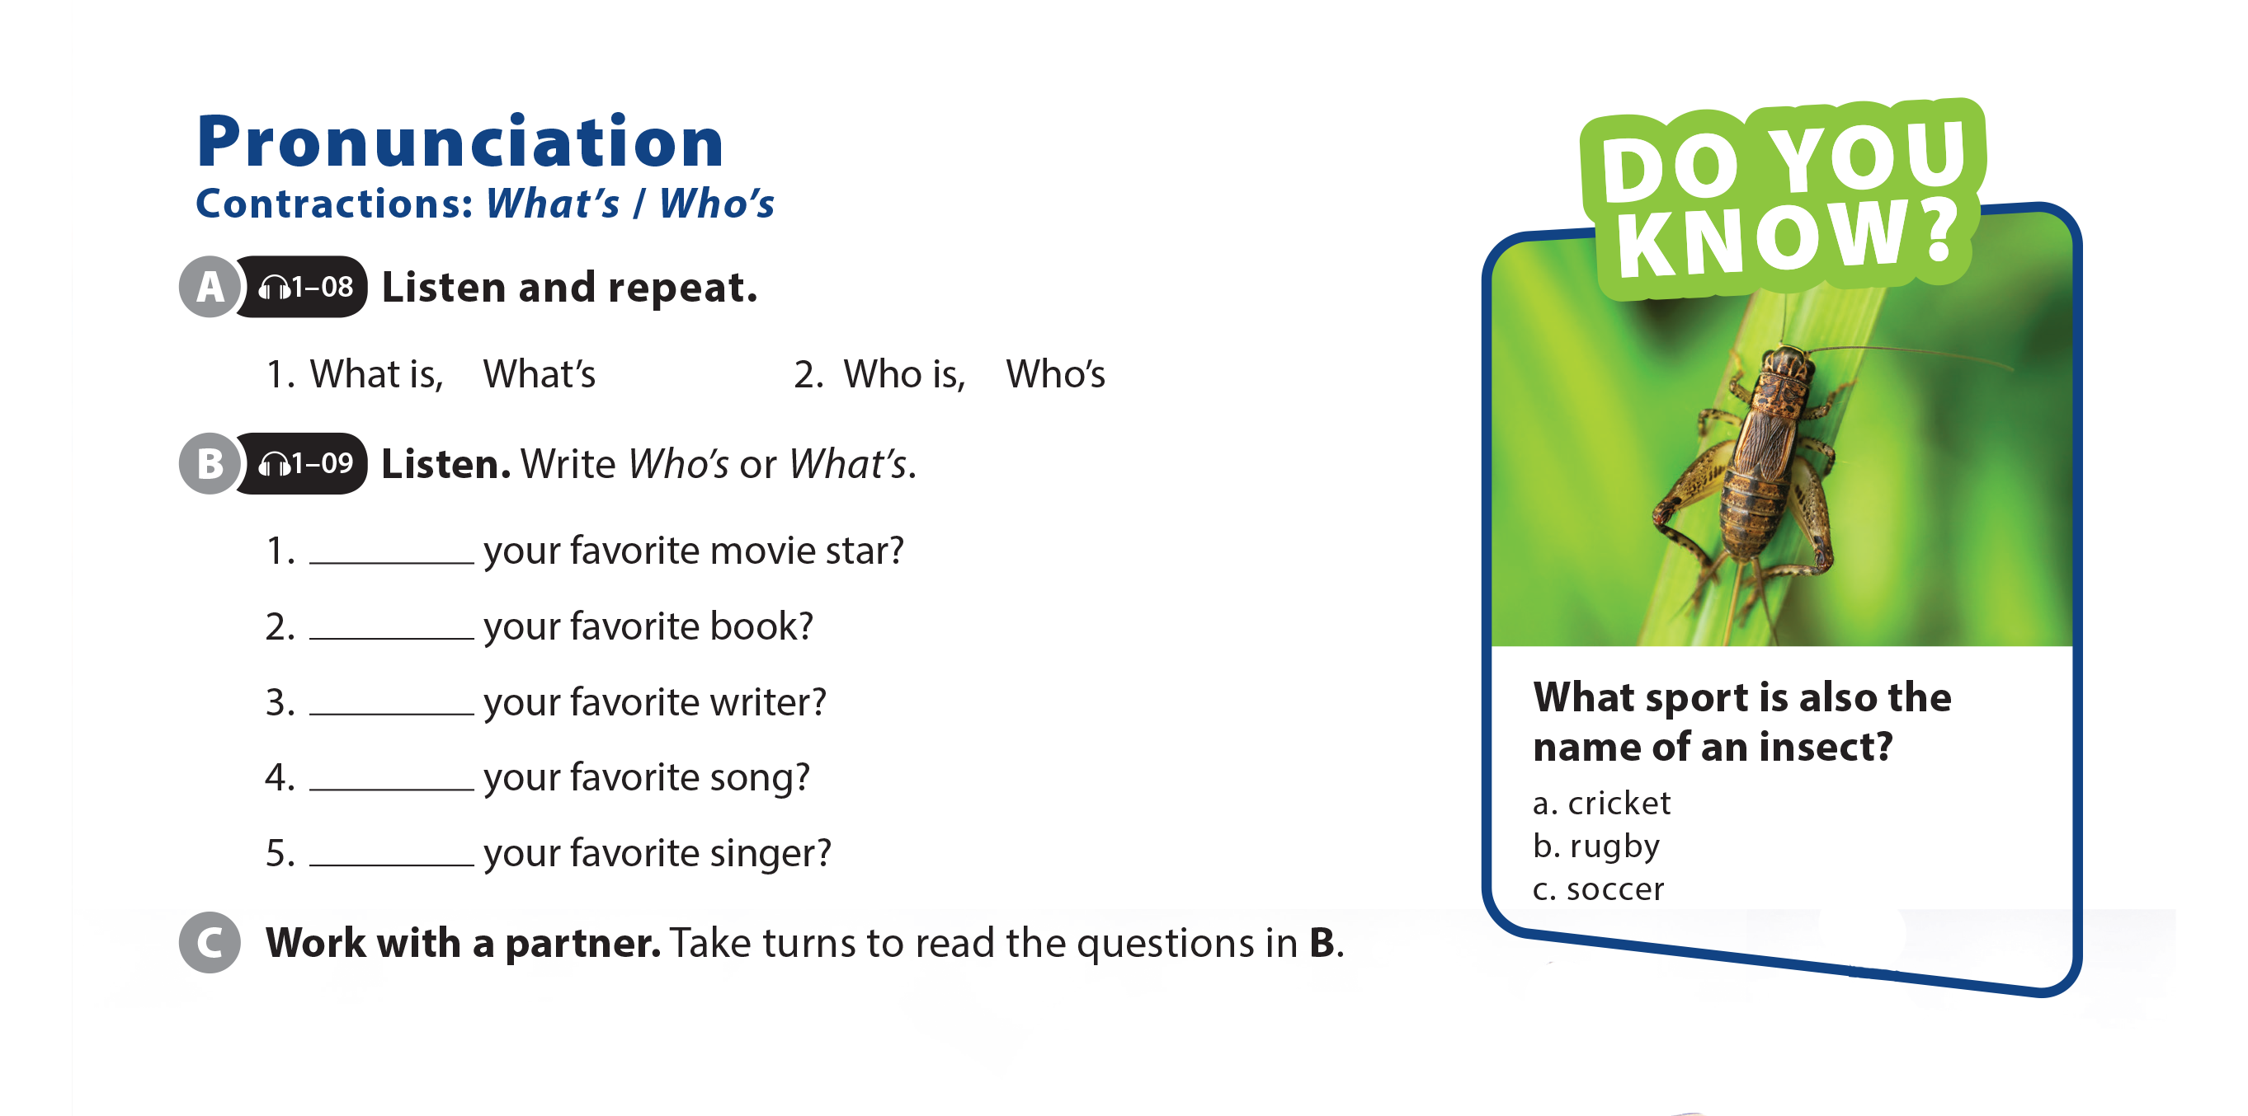
UNIT 1
WHAT'S YOUR FAVORITE BAND?
PRONUNCIATION

Slide 14
UNIT 1
WHAT'S YOUR FAVORITE BAND?
PRONUNCIATION
Who’s
What’s
Who’s
What’s
Who’s

Slide 15
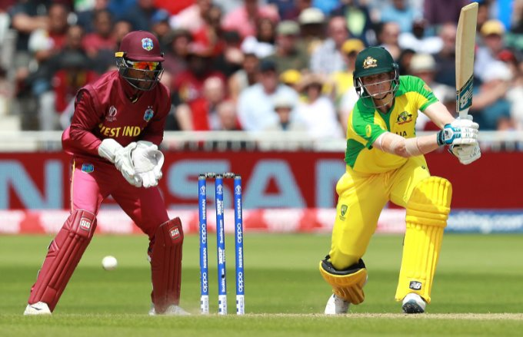
UNIT 1
WHAT'S YOUR FAVORITE BAND?
PRONUNCIATION

Slide 16
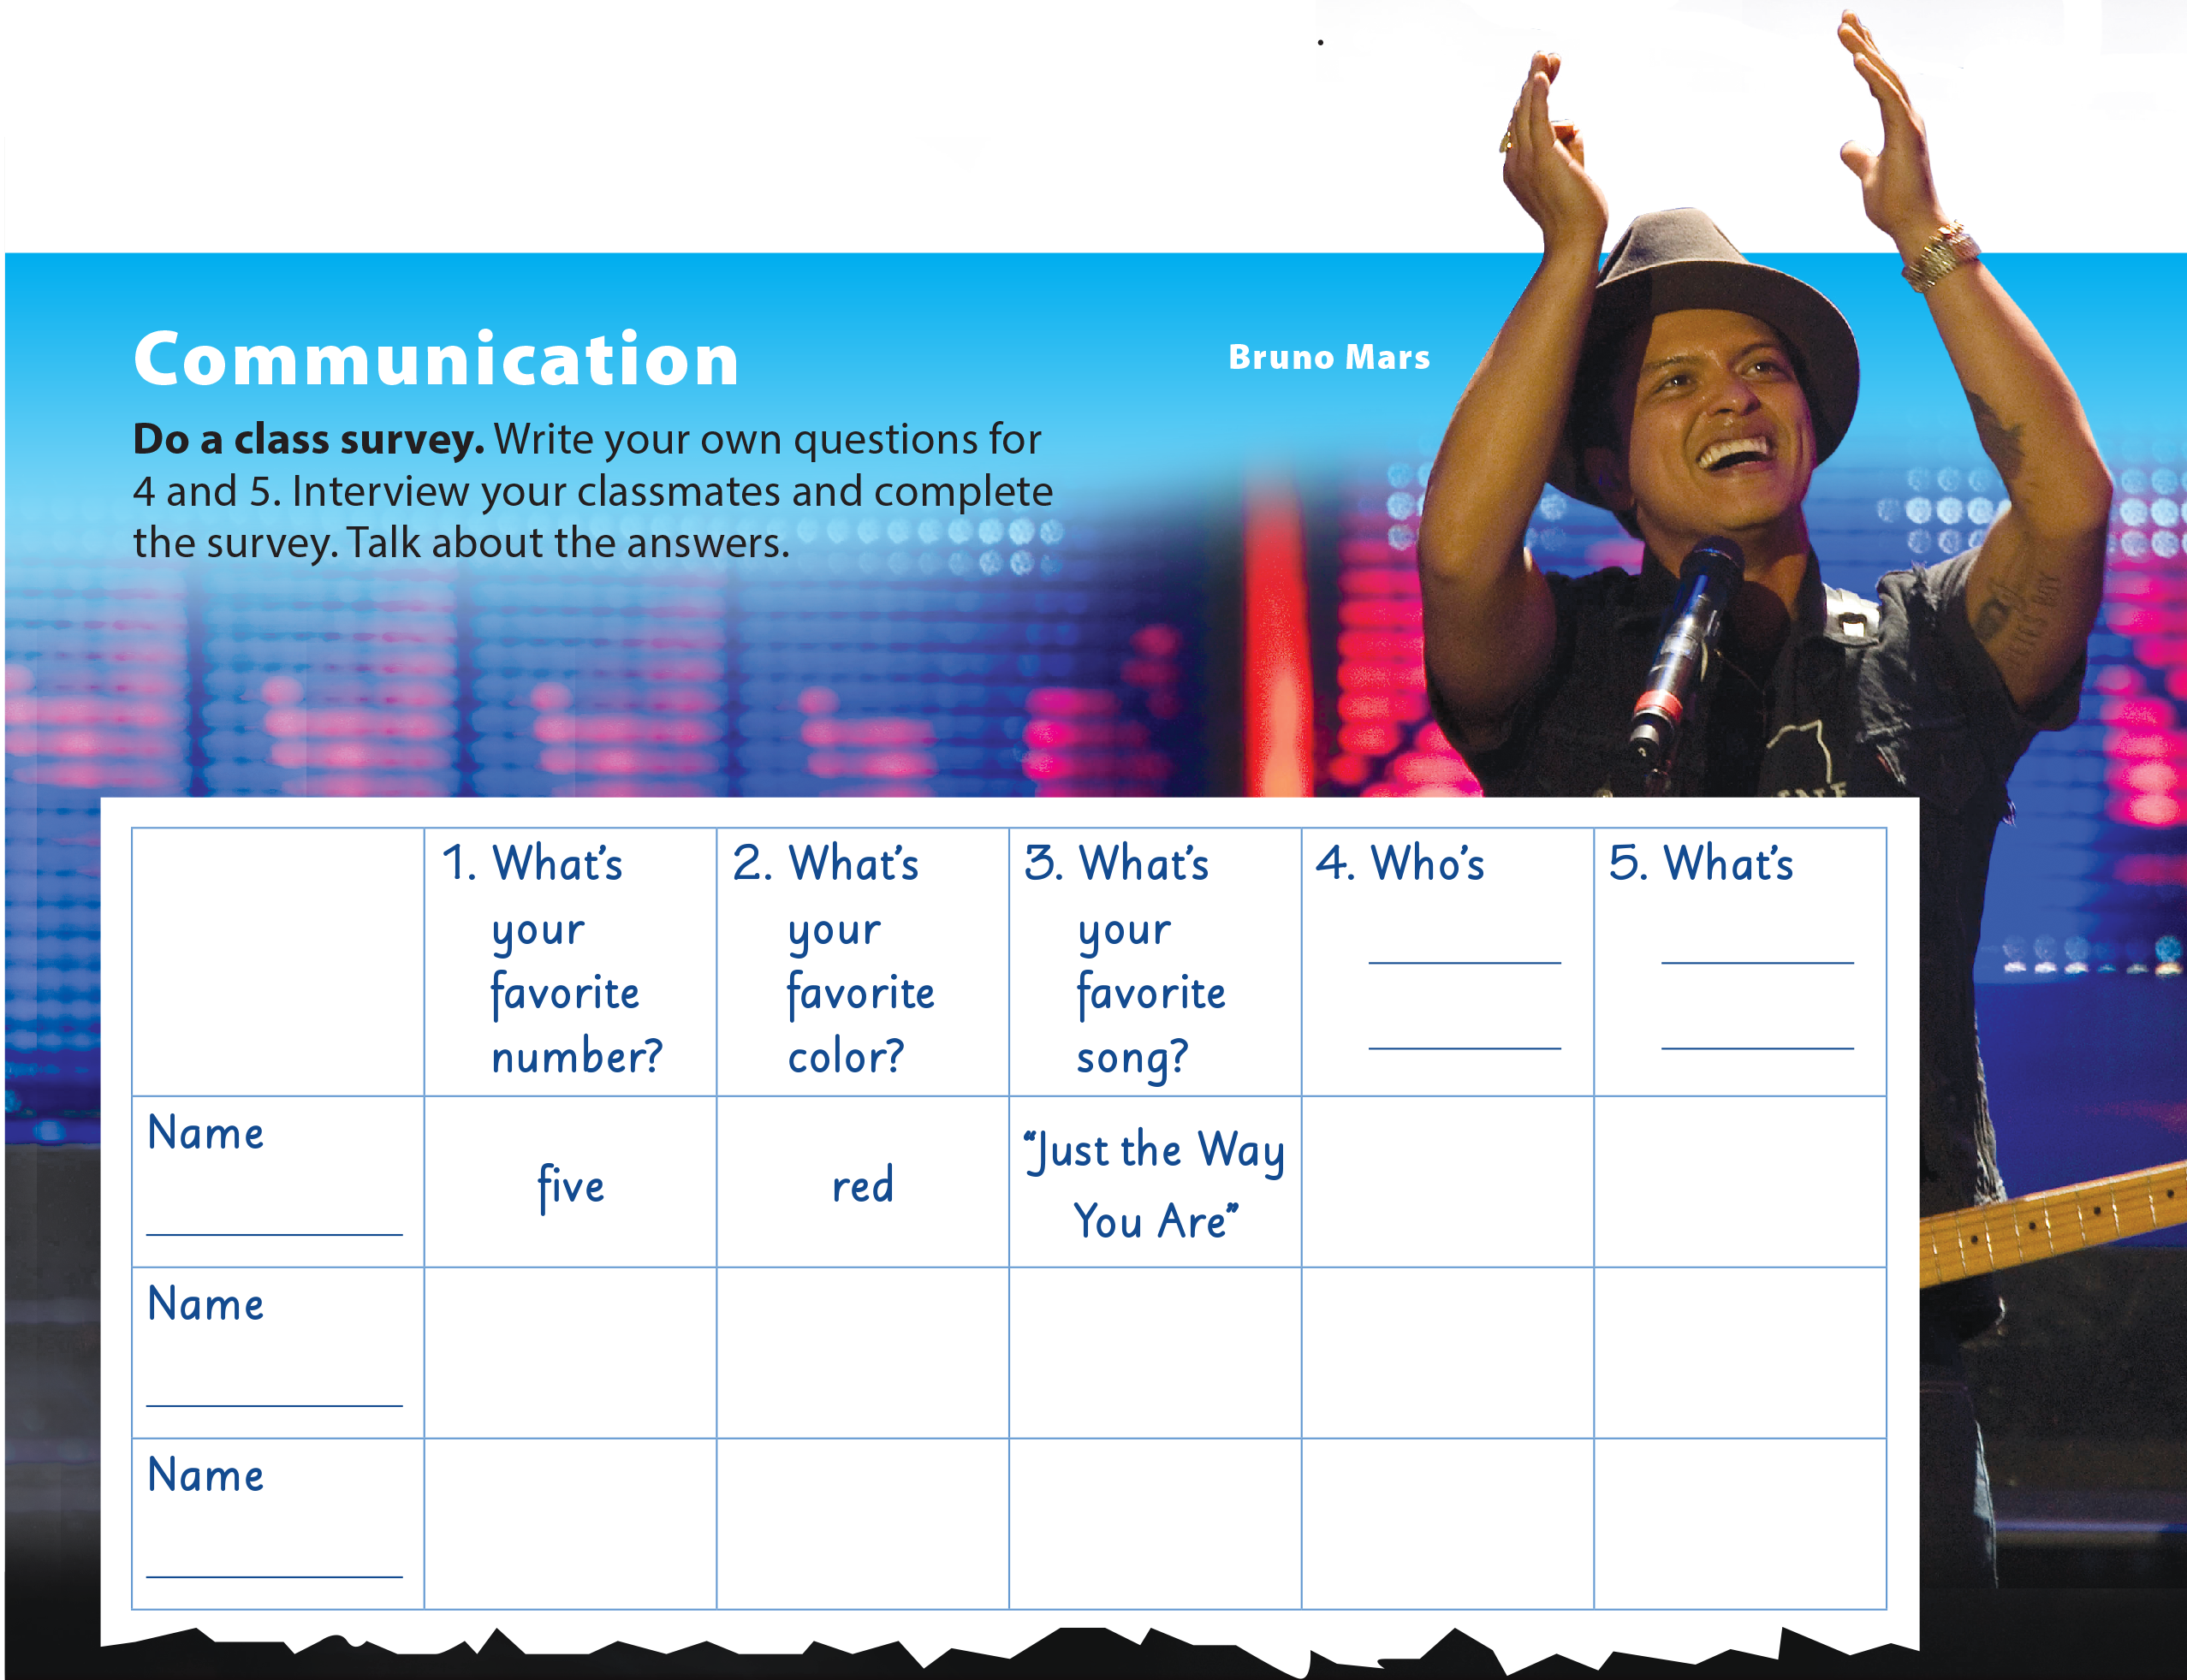
UNIT 1
WHAT'S YOUR FAVORITE BAND?
COMMUNICATION

Slide 17
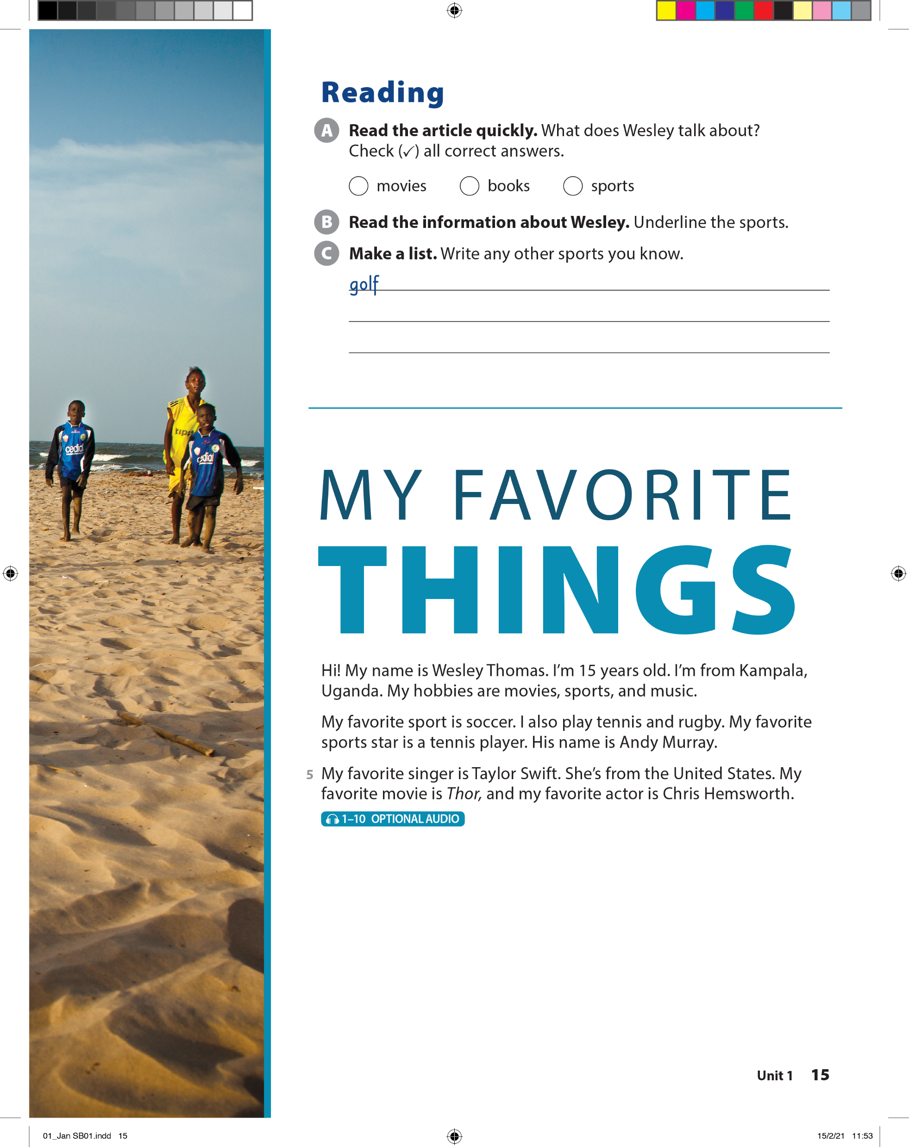



UNIT 1
WHAT'S YOUR FAVORITE BAND?
READING

Slide 18

UNIT 1
WHAT'S YOUR FAVORITE BAND?
READING

Slide 19
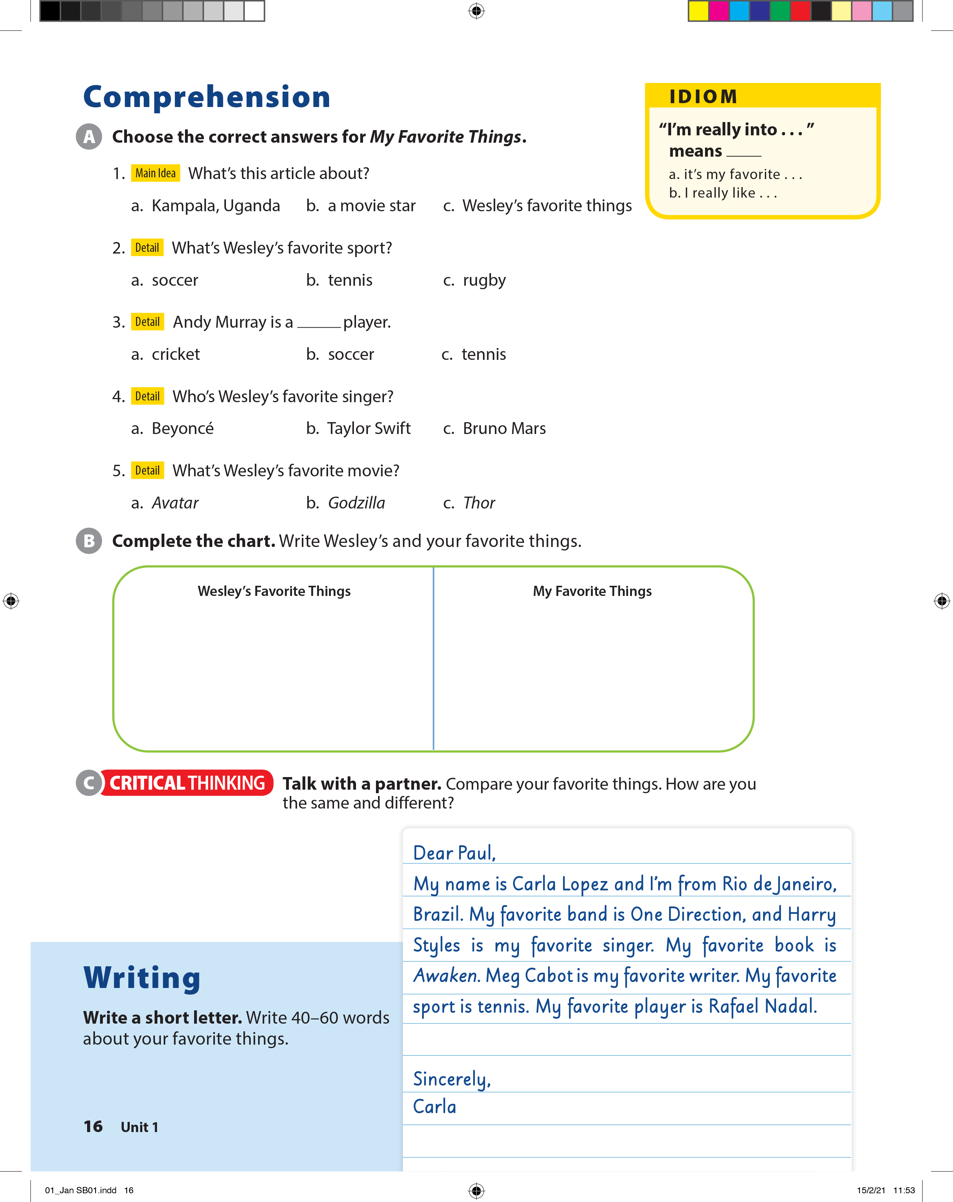
UNIT 1
WHAT'S YOUR FAVORITE BAND?
COMPREHENSION

Slide 20
UNIT 1
WHAT'S YOUR FAVORITE BAND?
IDIOM
“I’m really into …” means ________
it’s my favorite …
I really like ….

Slide 21
UNIT 1
WHAT'S YOUR FAVORITE BAND?
COMPREHENSION
Favorite sport: Soccer
Favorite sports star: Andy Murray
Favorite singer: Taylor Swift
Favorite movie: Thor
Favorite actor: Chris Hemsworth

Slide 22
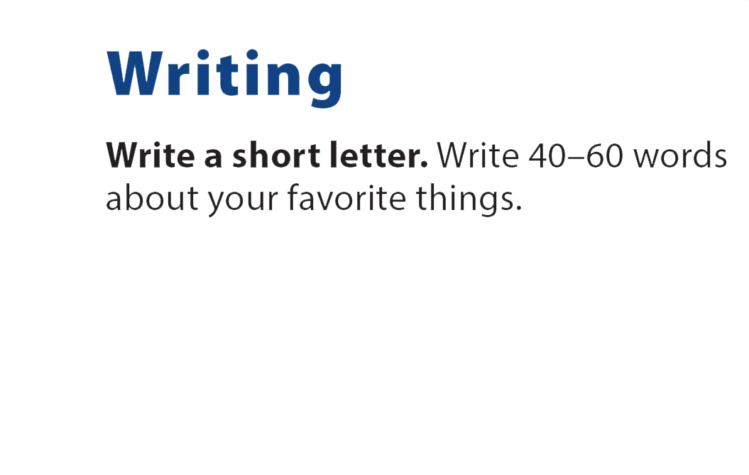
UNIT 1
WHAT'S YOUR FAVORITE BAND?
WRITING

Slide 23
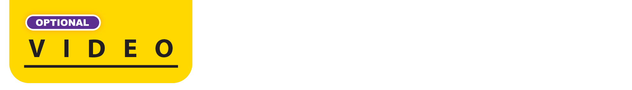
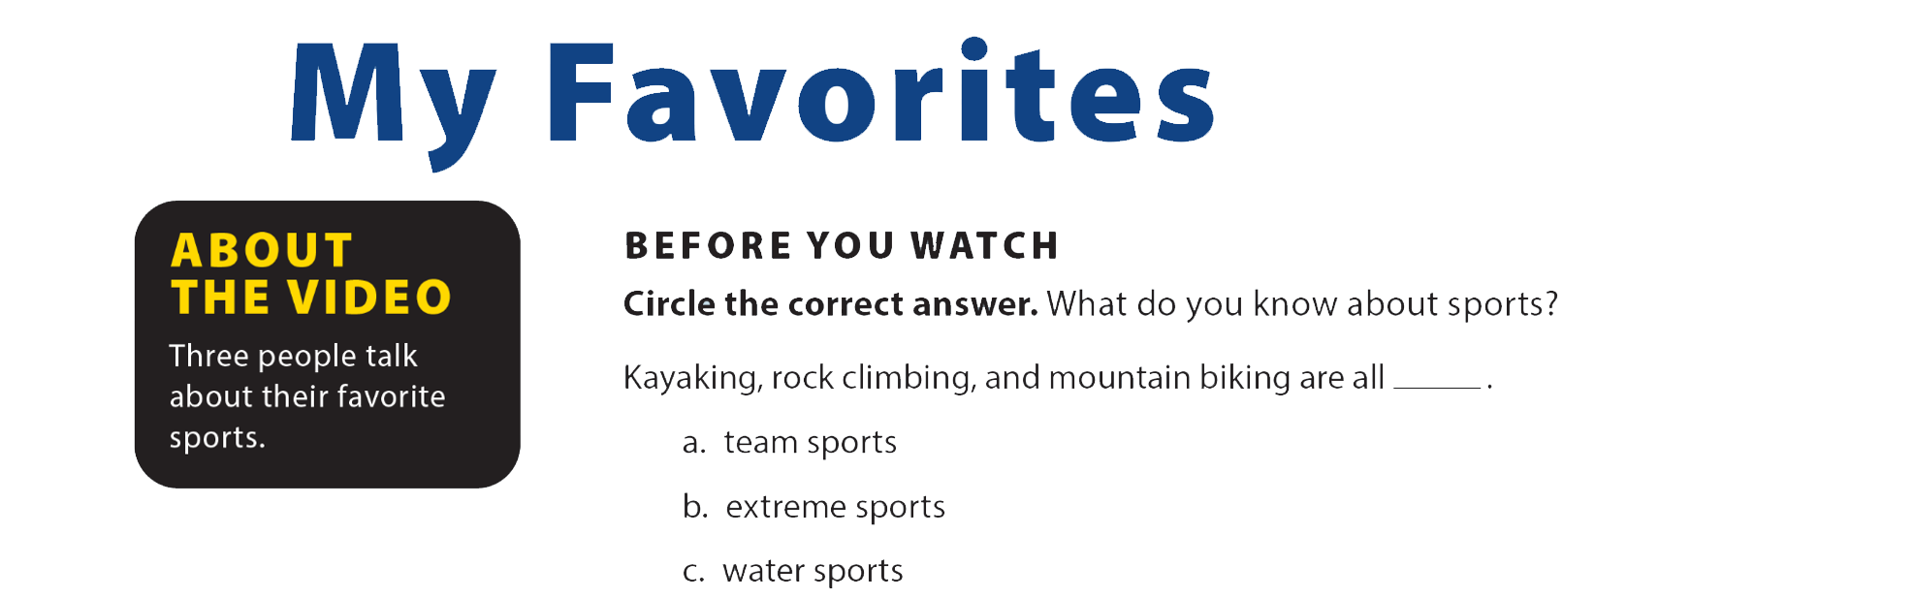


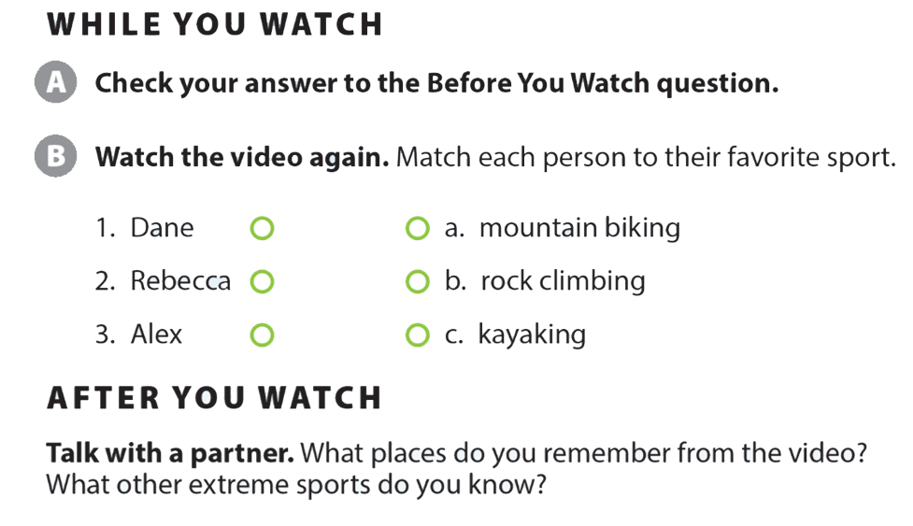
UNIT 1
WHAT'S YOUR FAVORITE BAND?
VIDEO

Slide 24
UNIT 1
WHAT'S YOUR FAVORITE BAND?
VIDEO

Slide 25
UNIT 1
WHAT'S YOUR FAVORITE BAND?
VIDEO

