Slide 1
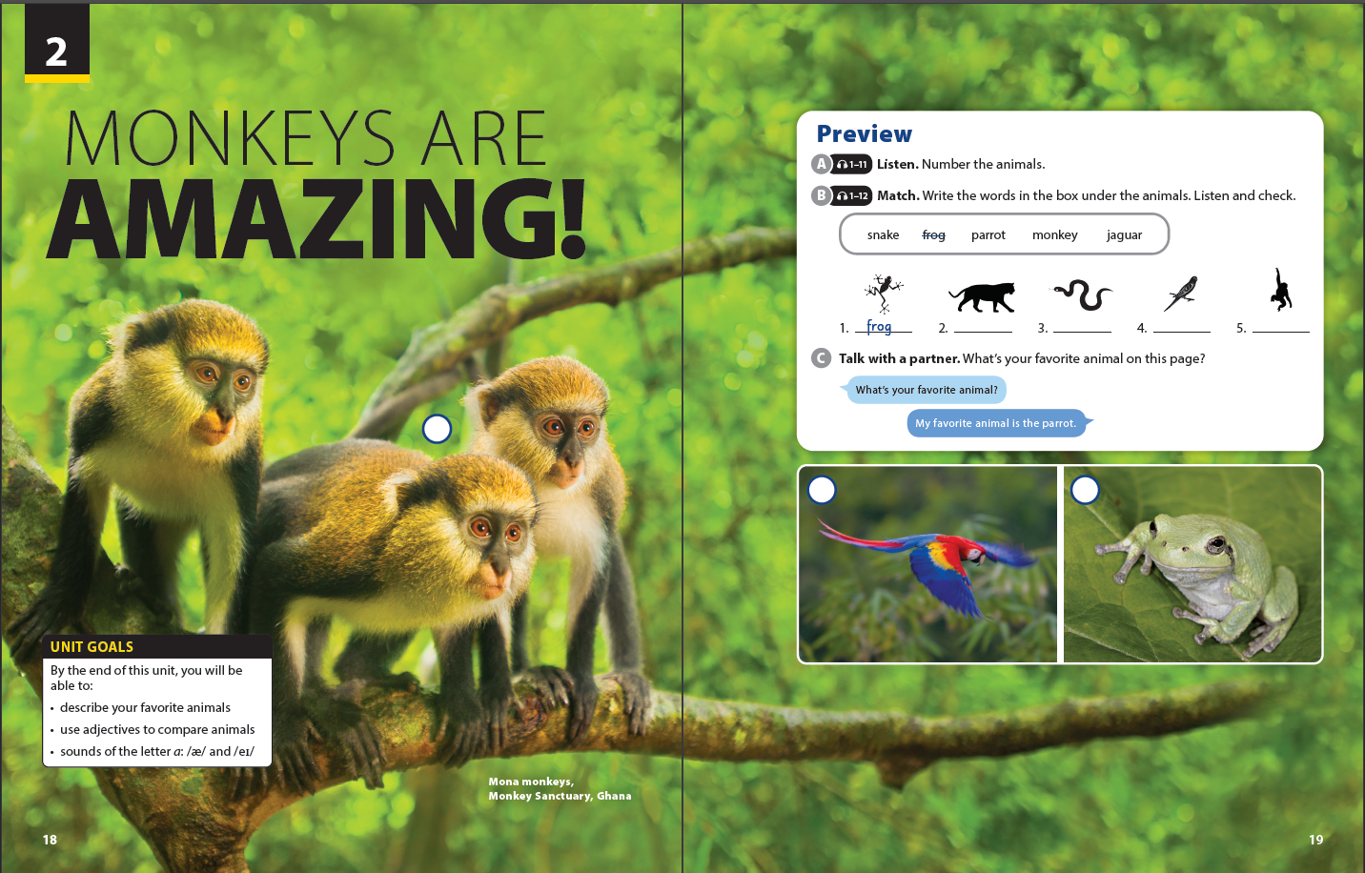

Slide 2

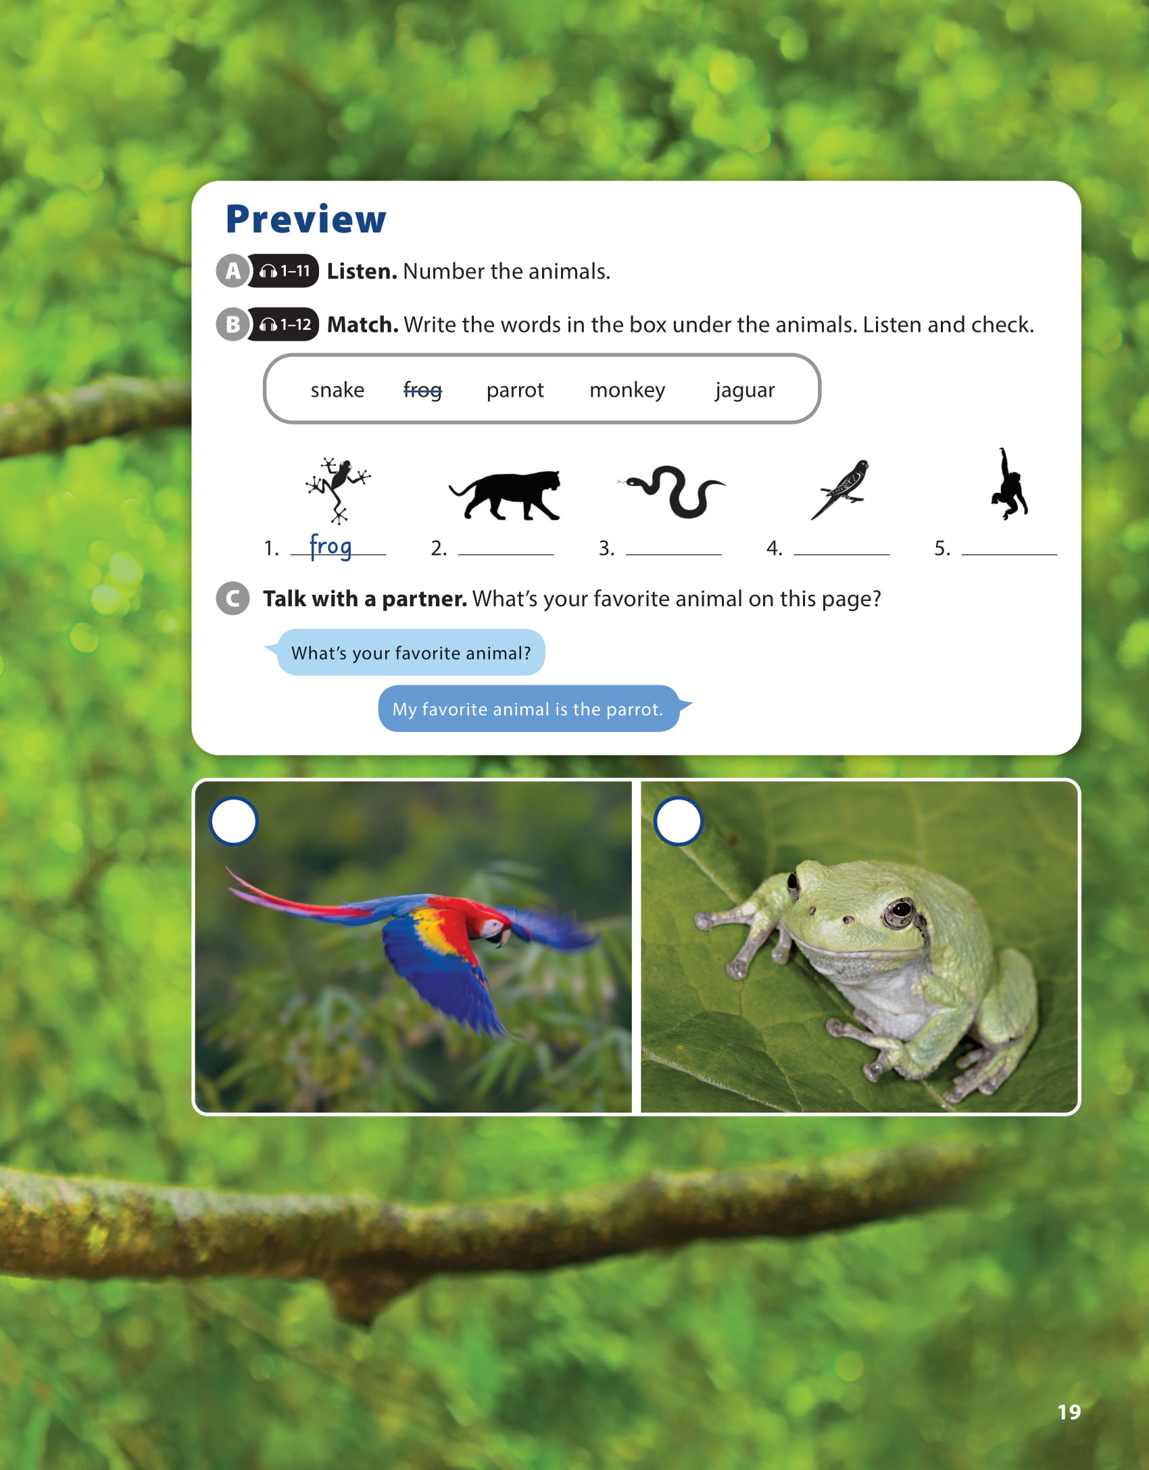

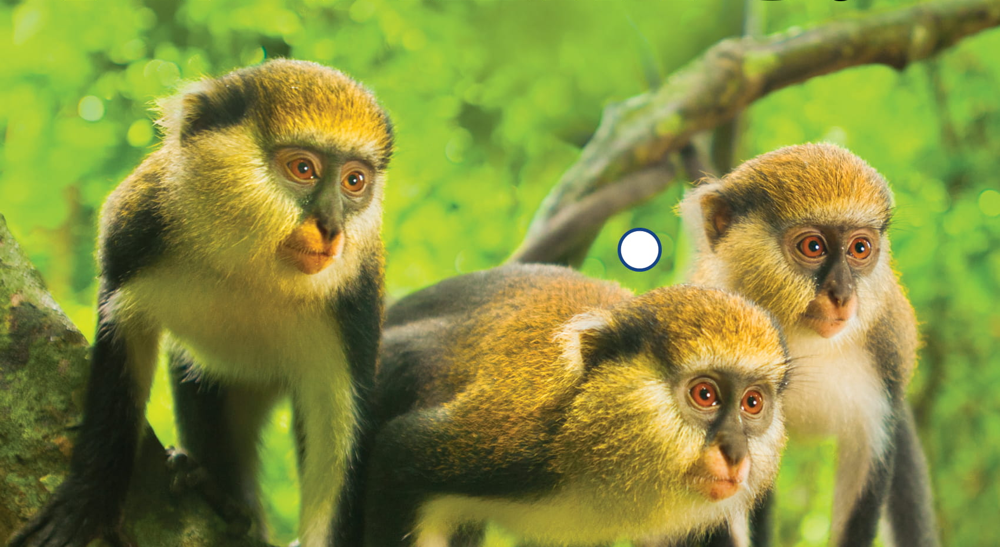
UNIT 2
MONKEYS ARE AMAZING!
PREVIEW
1
2
3

Slide 3
UNIT 2
MONKEYS ARE AMAZING!
LANGUAGE FOCUS
jaguar
snake
parrot
monkey

Slide 4
UNIT 2
MONKEYS ARE AMAZING
LANGUAGE FOCUS

Slide 5
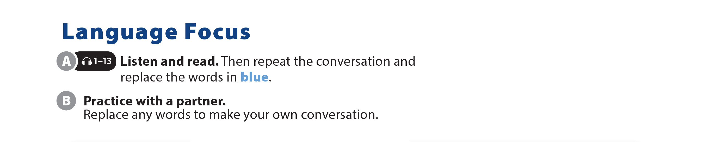

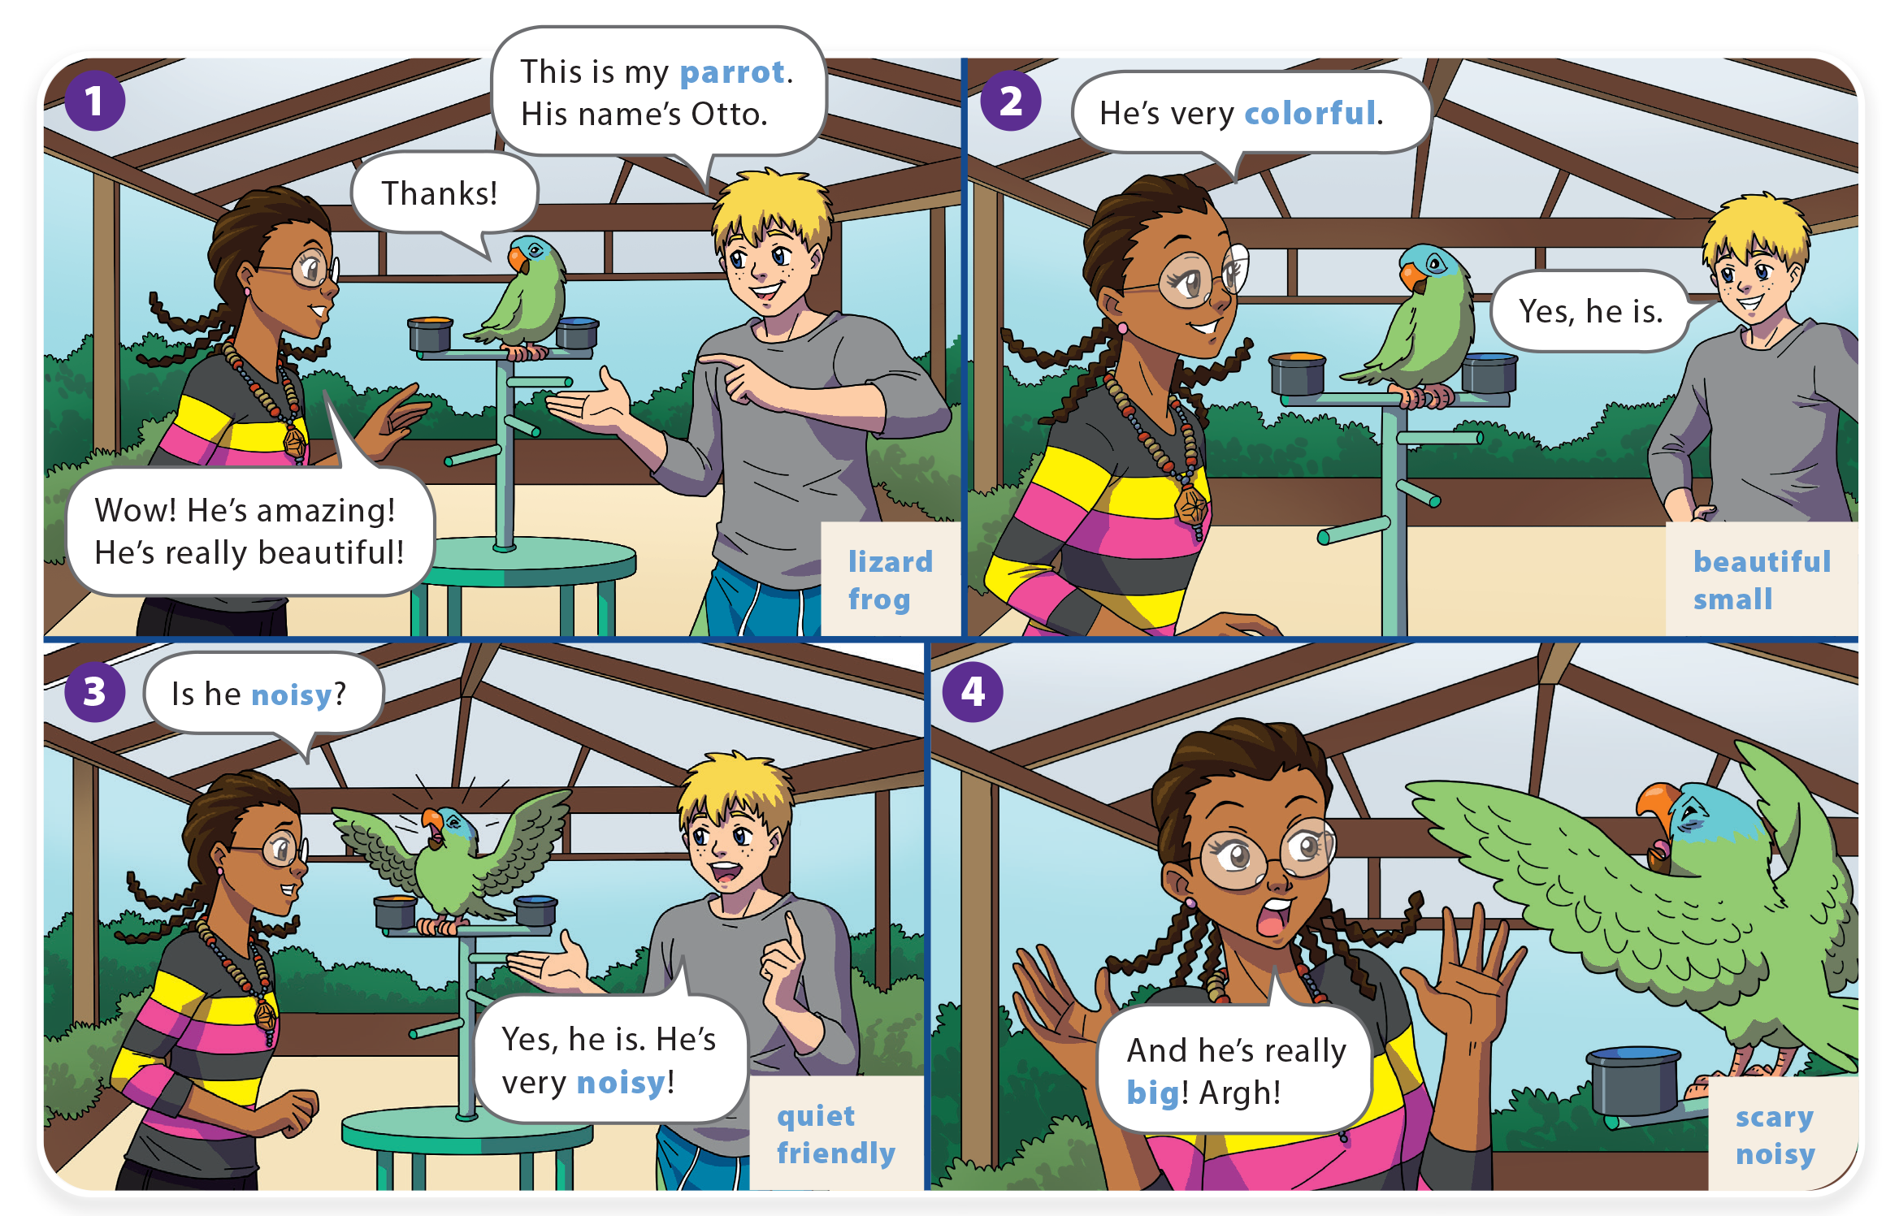
UNIT 2
MONKEYS ARE AMAZING!
LANGUAGE FOCUS

Slide 6
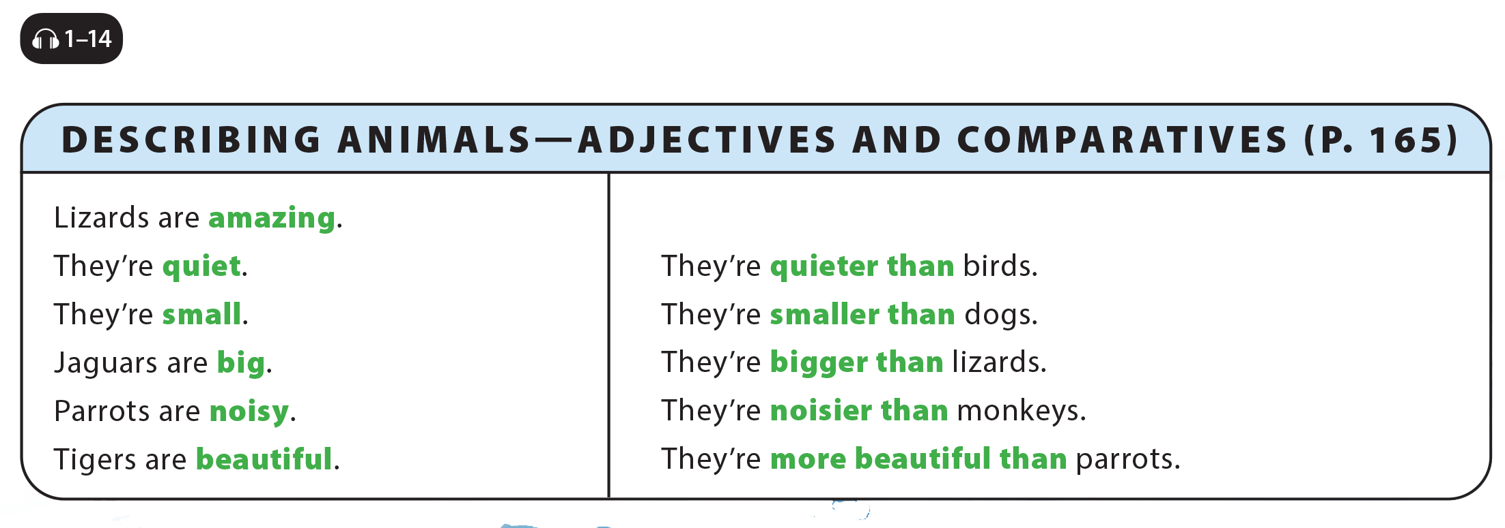
UNIT 2
MONKEYS ARE AMAZING!
LANGUAGE FOCUS

Slide 7
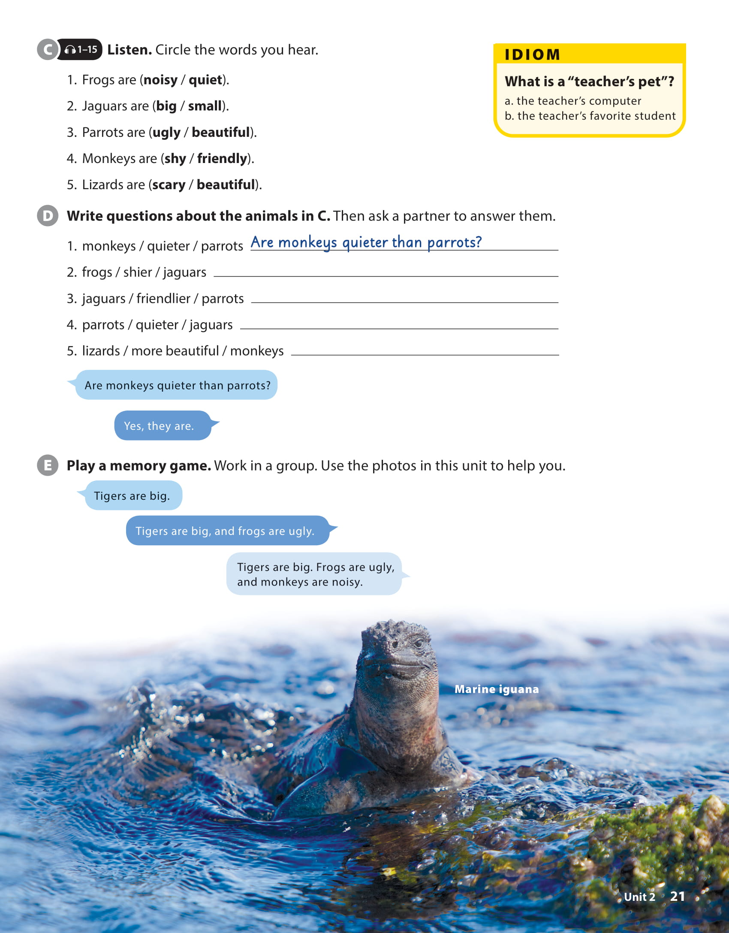
UNIT 2
MONKEYS ARE AMAZING!
LANGUAGE FOCUS

Slide 8
UNIT 2
MONKEYS ARE AMAZING!
LANGUAGE FOCUS
Are frogs shier than jaguars?
Are jaguars friendlier than parrots?
Are parrots quieter than jaguars?
Are lizards more beautiful than monkeys?

Slide 9
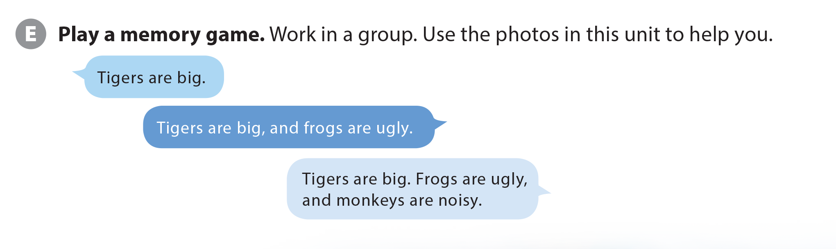
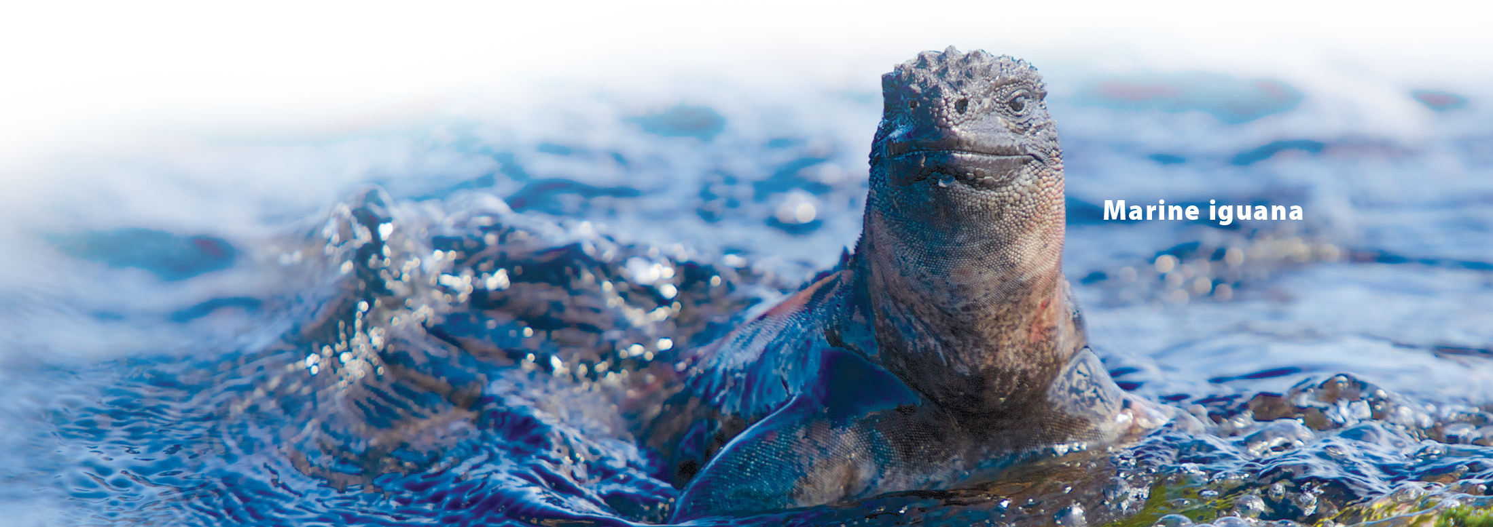
UNIT 2
MONKEYS ARE AMAZING!
LANGUAGE FOCUS

Slide 10
UNIT 2
MONKEYS ARE AMAZING!
IDIOM
What is a “teacher’s pet”?
the teacher’s computer
the teacher’s favorite students

Slide 11
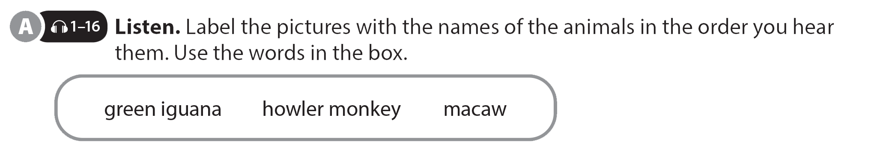
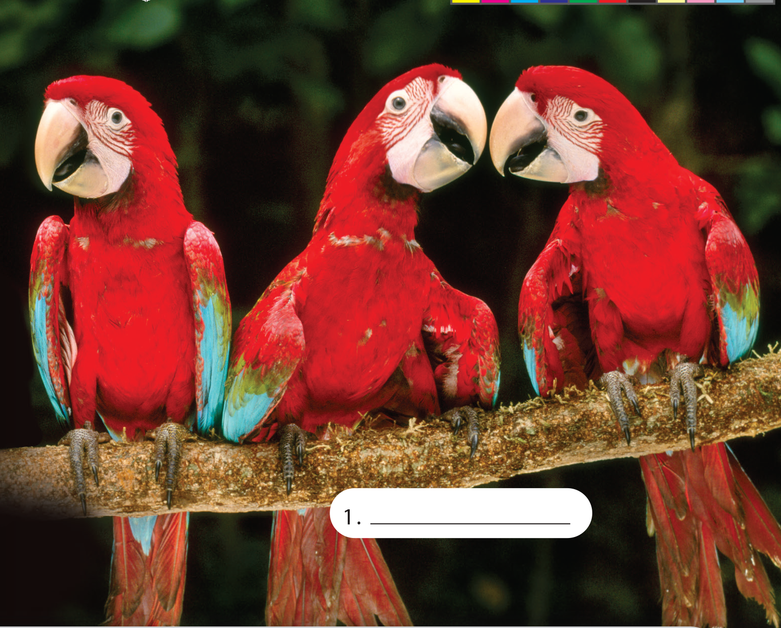
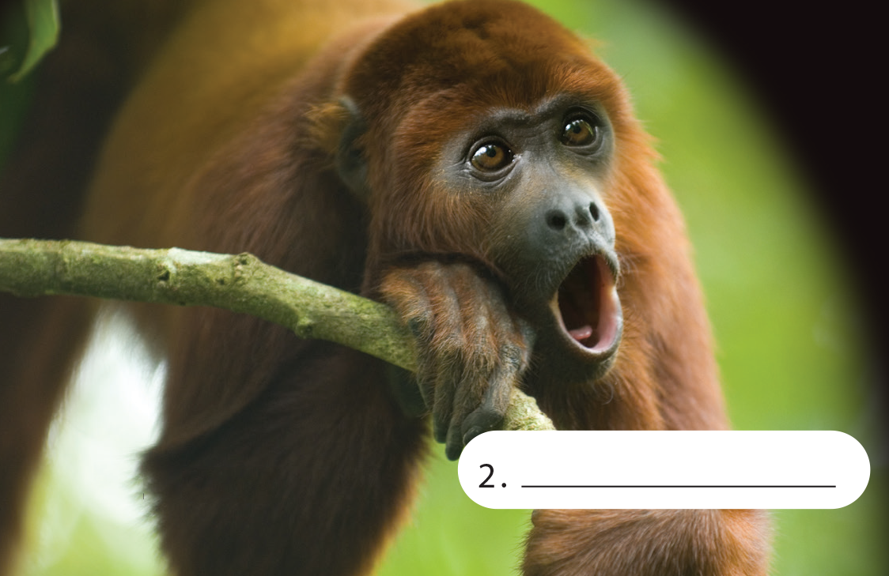
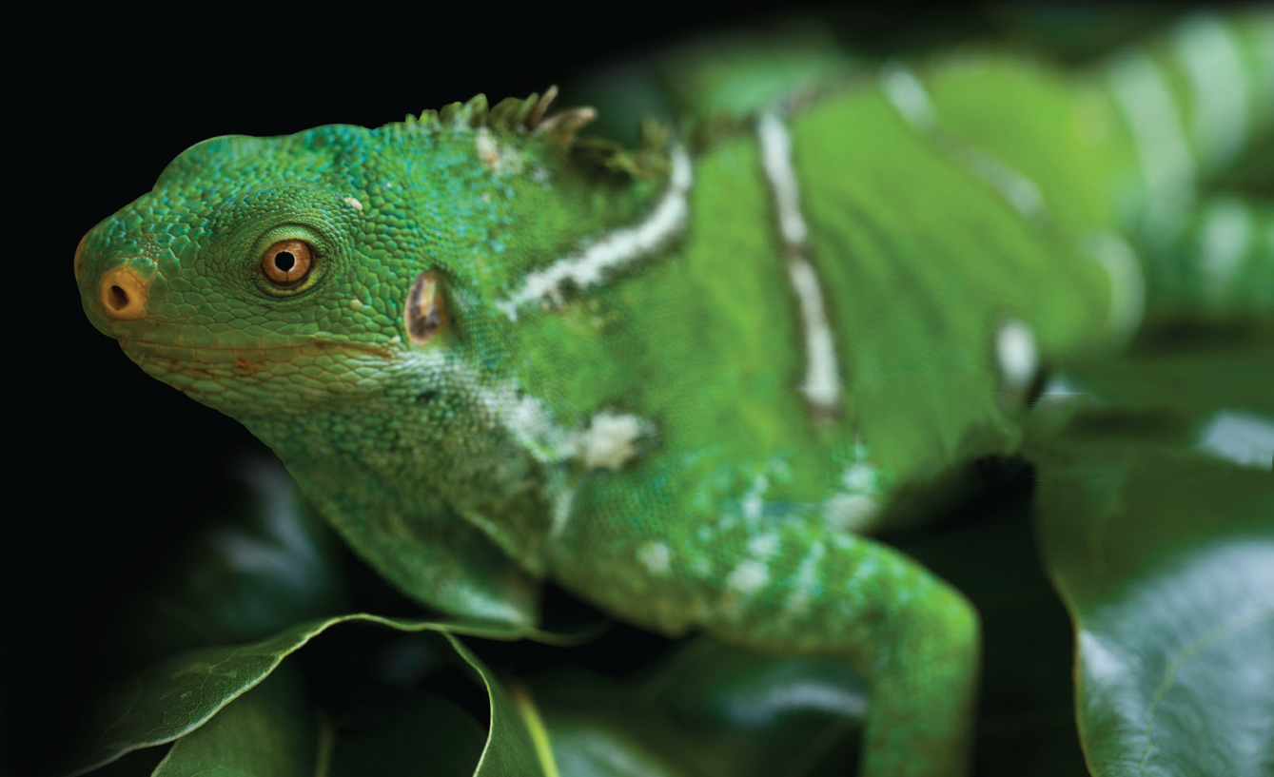
UNIT 2
MONKEYS ARE AMAZING!
THE REAL WORLD
howler monkey
green iguana
macaw
2. ________________________
3. ________________________
1. ________________________

Slide 12
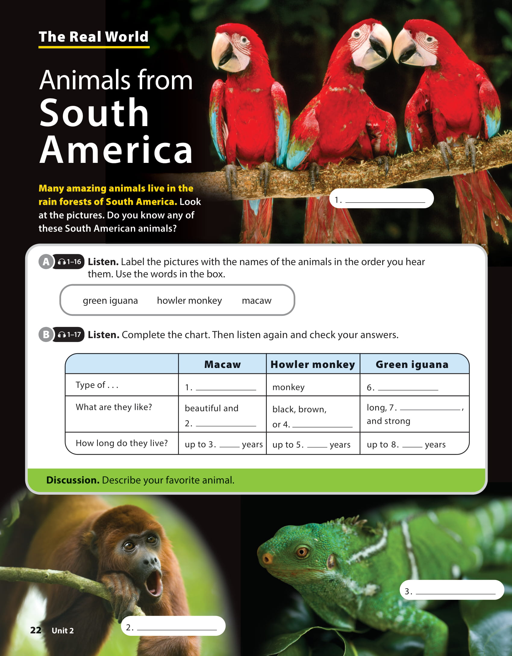
UNIT 2
MONKEYS ARE AMAZING!
THE REAL WORLD
parrot
lizard
bright
colorful
red
60
20
20

Slide 13
UNIT 2
MONKEYS ARE AMAZING!
THE REAL WORLD

Slide 14

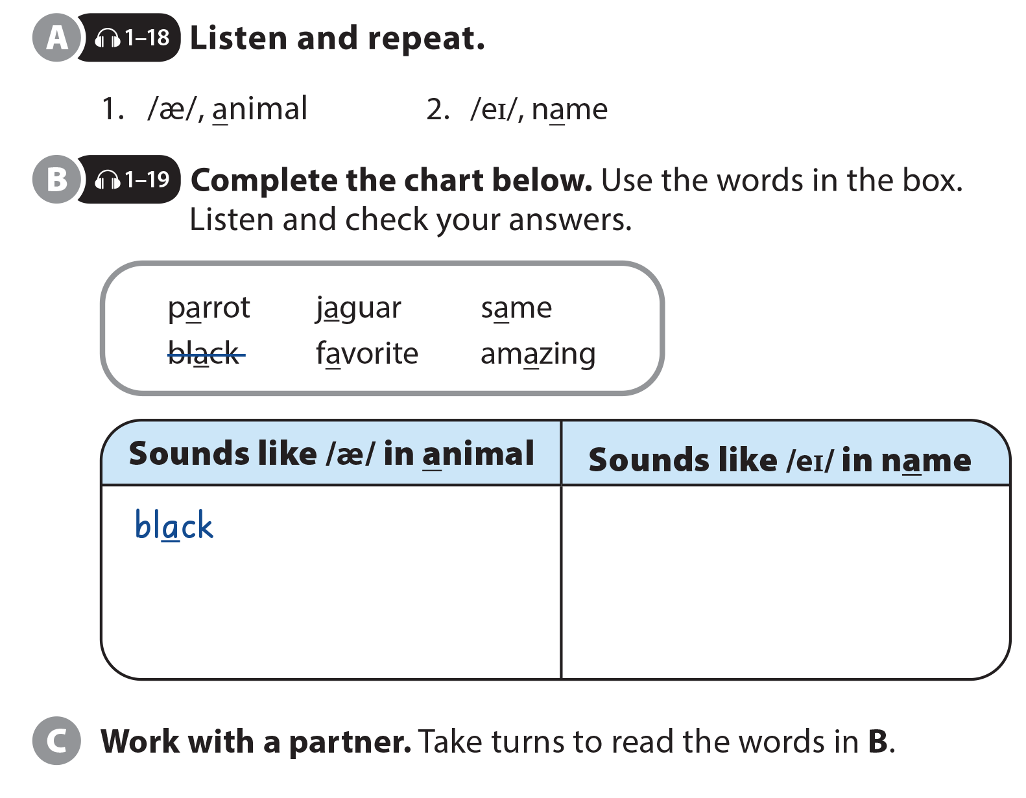
UNIT 2
MONKEYS ARE AMAZING!
PRONUNCIATION

Slide 15
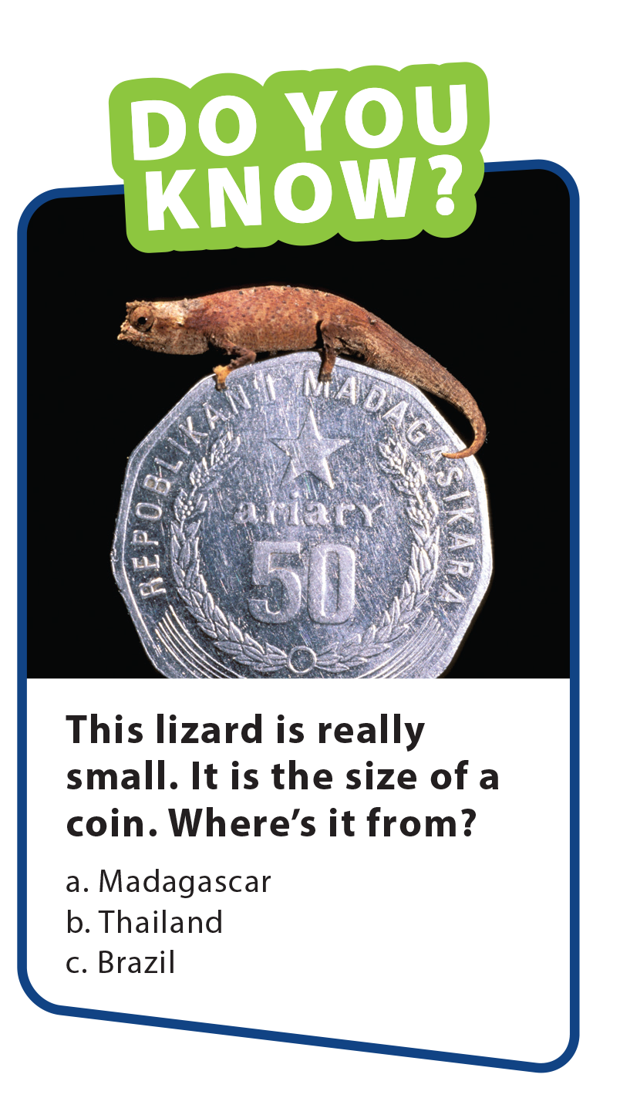
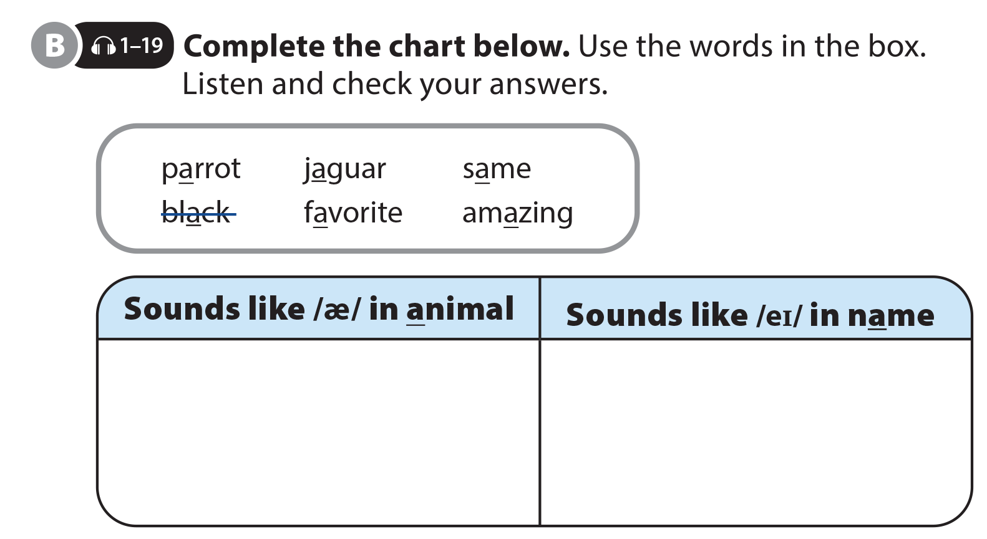
UNIT 2
MONKEYS ARE AMAZING!
PRONUNCIATION
black
parrot
same
favorite
jaguar
amazing

Slide 16
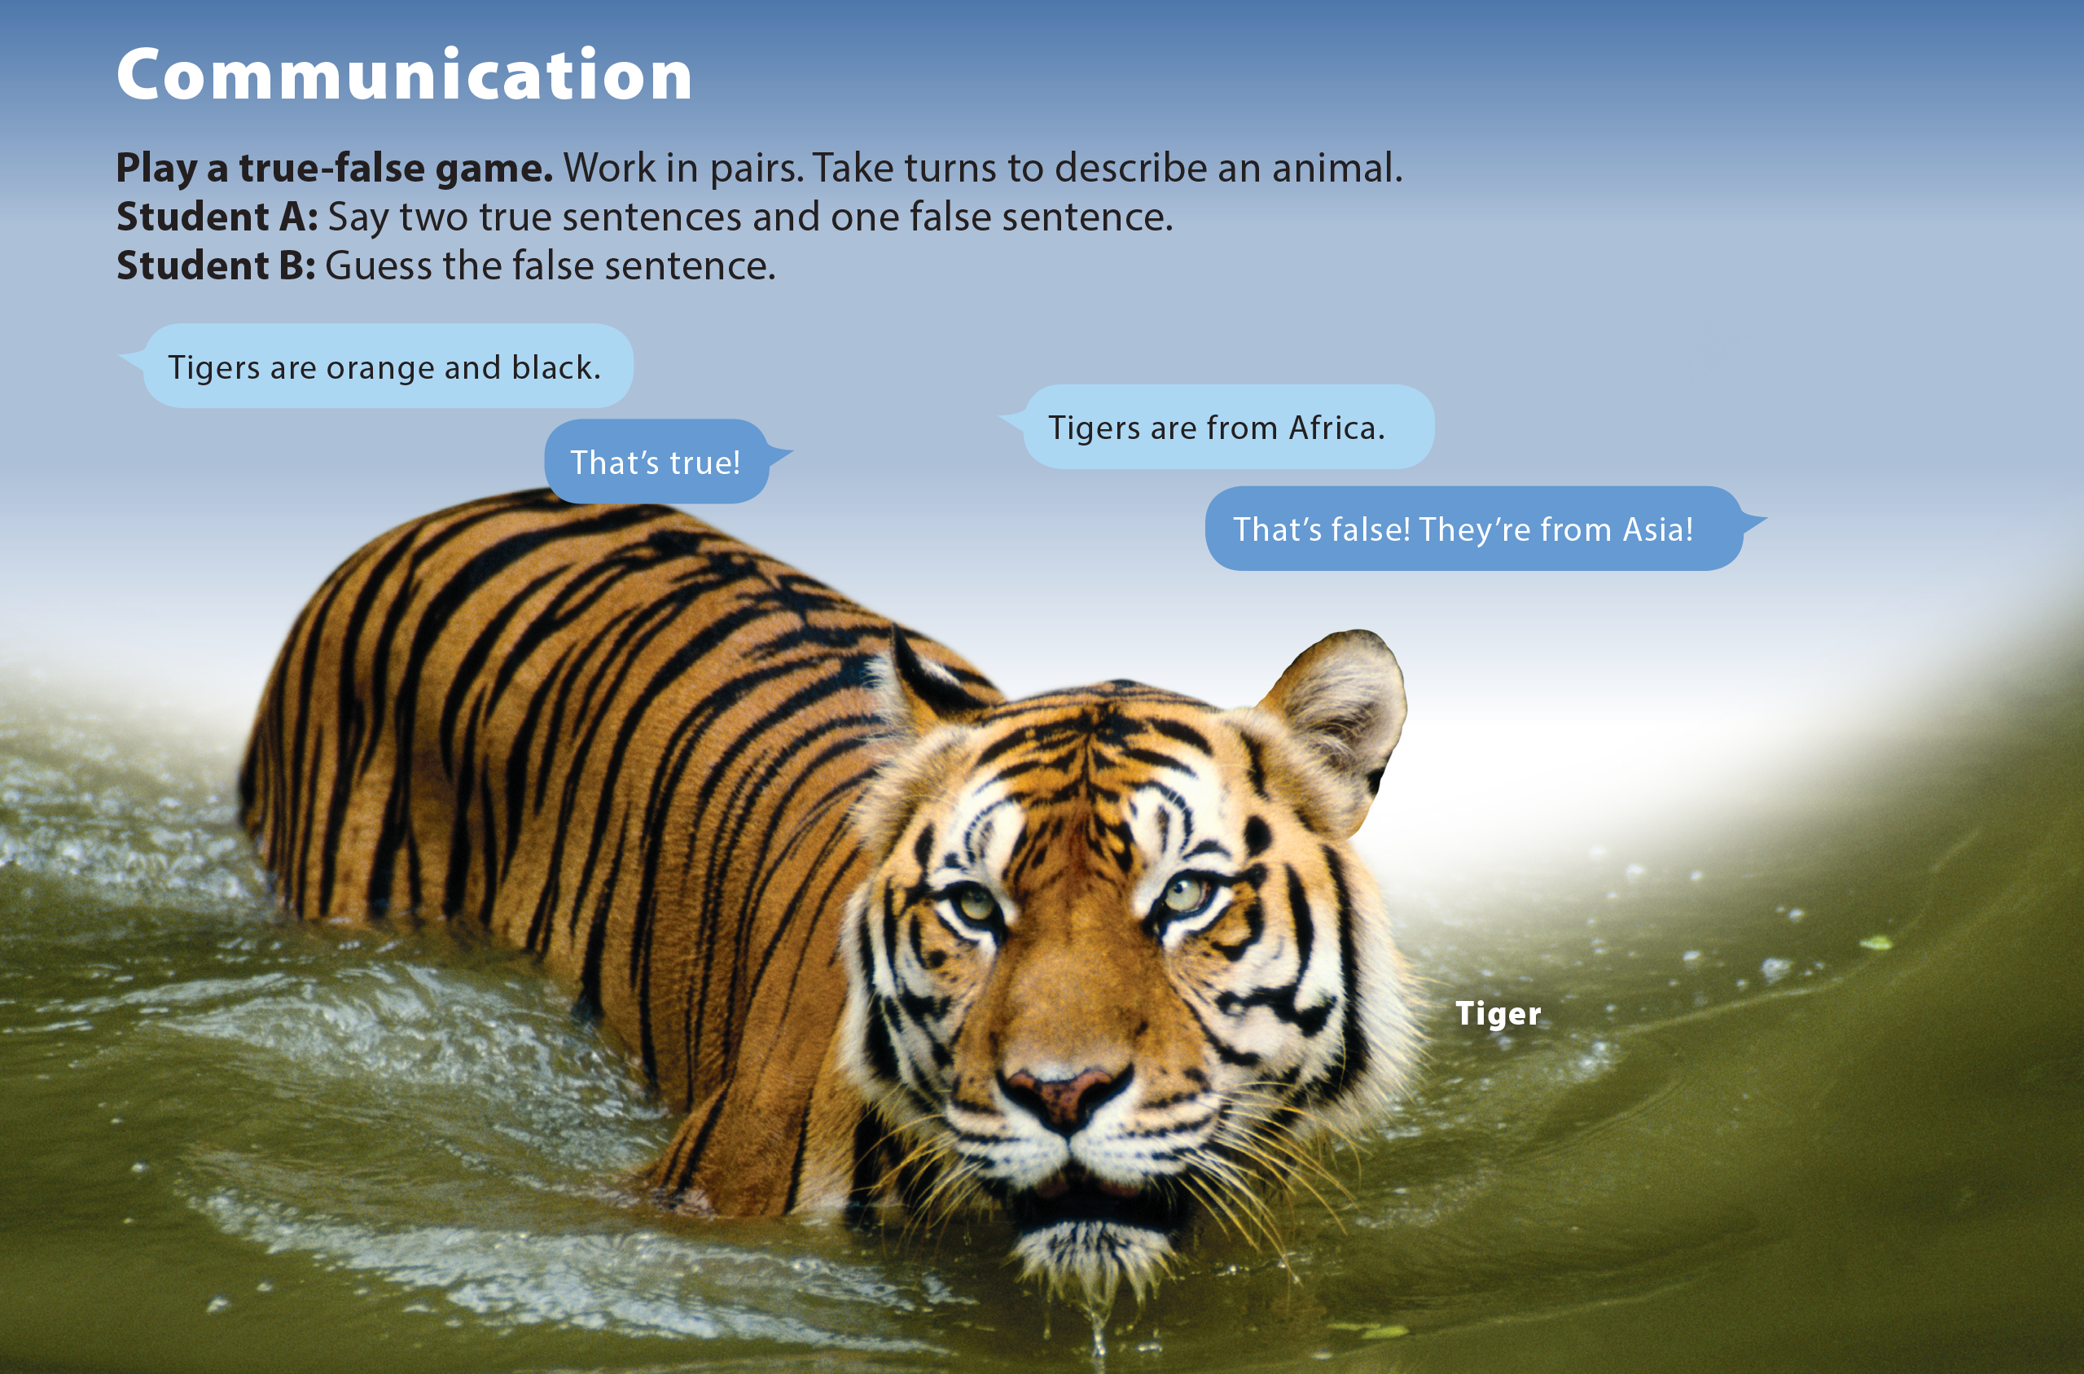

Slide 17
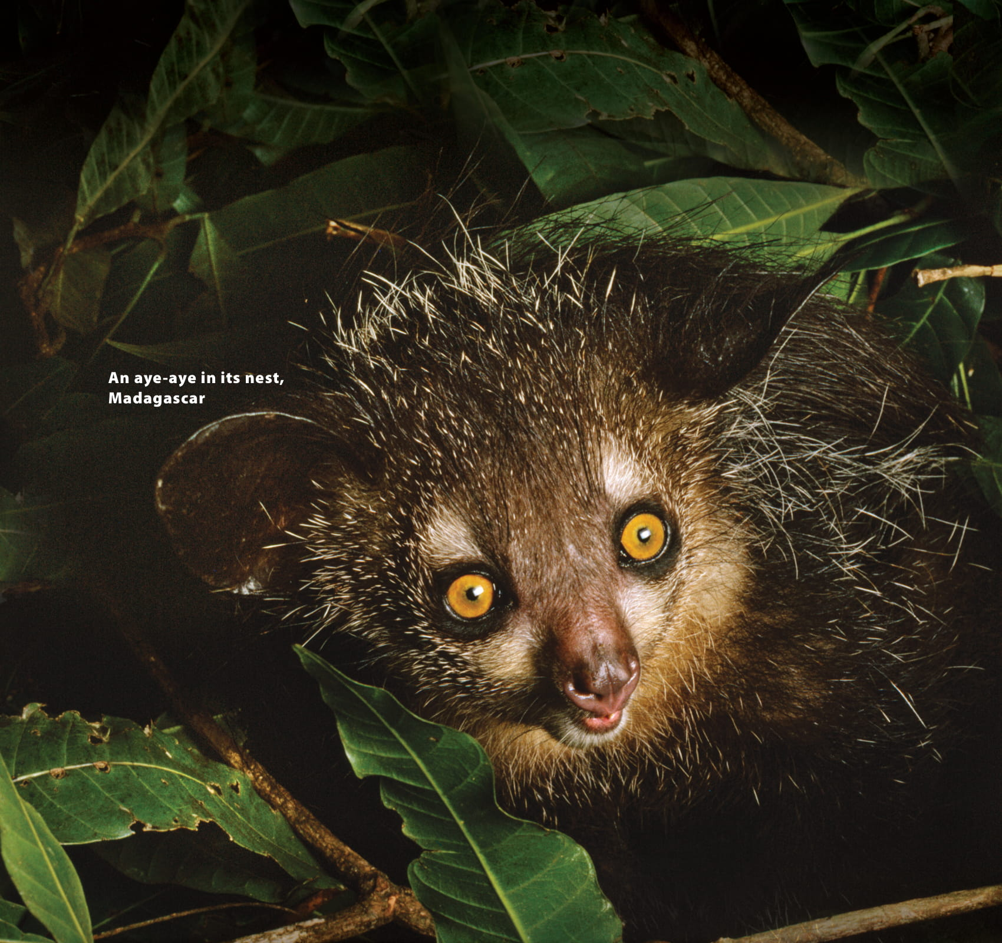
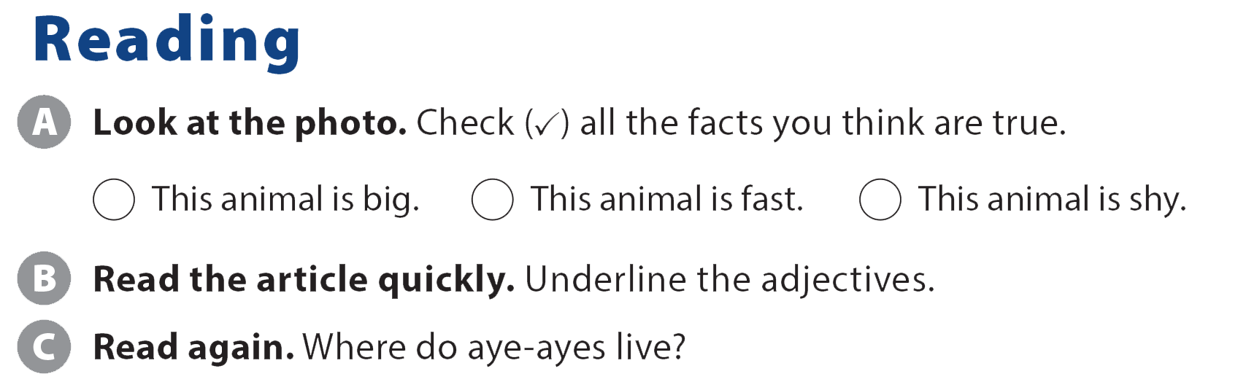
UNIT 2
MONKEYS ARE AMAZING!
READING

Slide 18
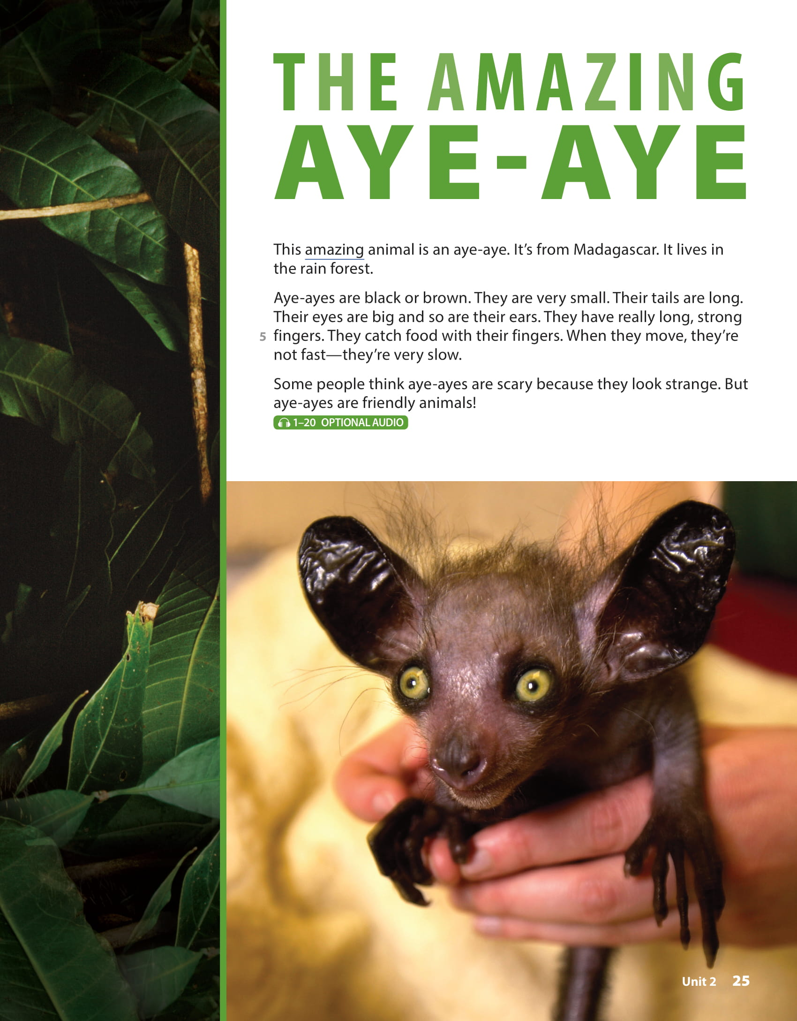
UNIT 2
MONKEYS ARE AMAZING!
READING

Slide 19
UNIT 2
MONKEYS ARE AMAZING!
READING
rain forests / Madagascar

Slide 20
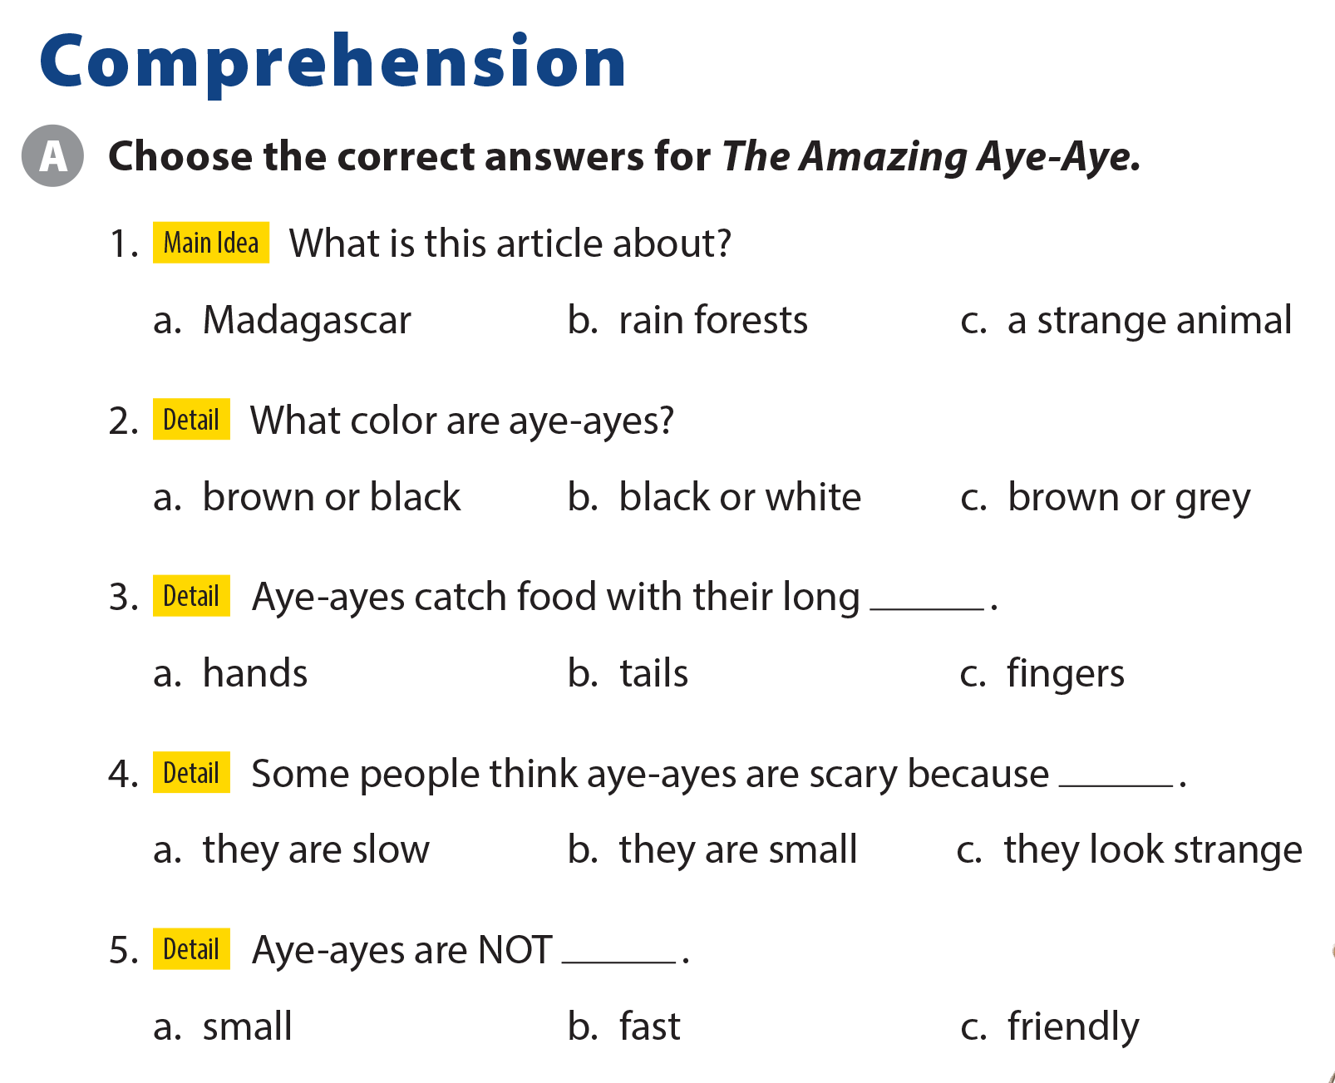
UNIT 2
MONKEYS ARE AMAZING!
COMPREHENSION

Slide 21
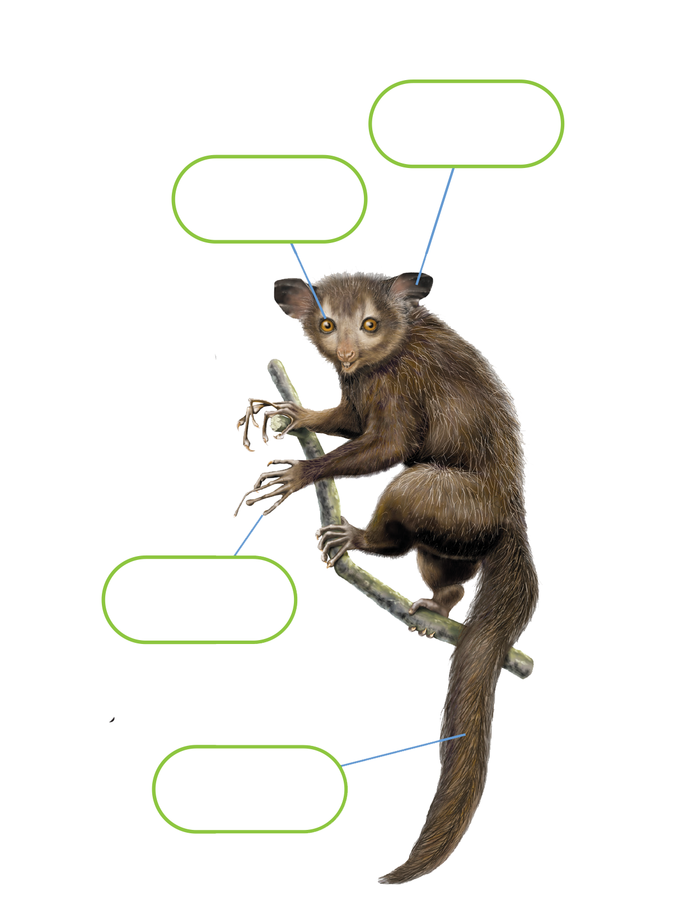
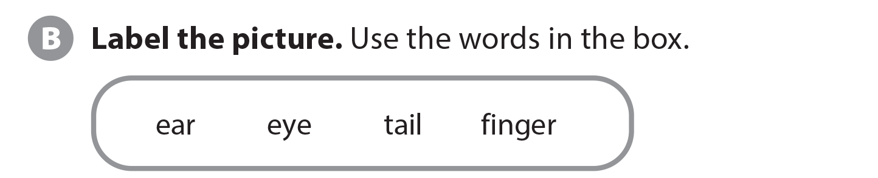
UNIT 2
MONKEYS ARE AMAZING!
COMPREHENSION
ear
eye
finger
tail

Slide 22
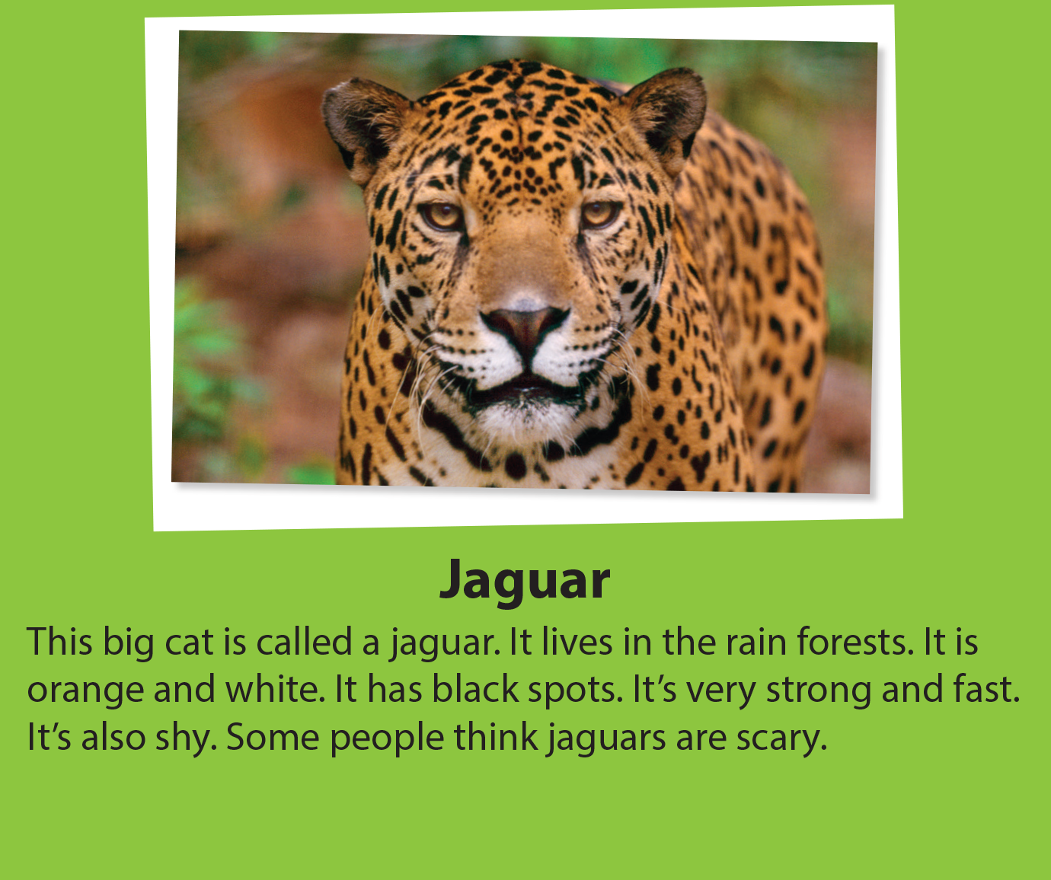
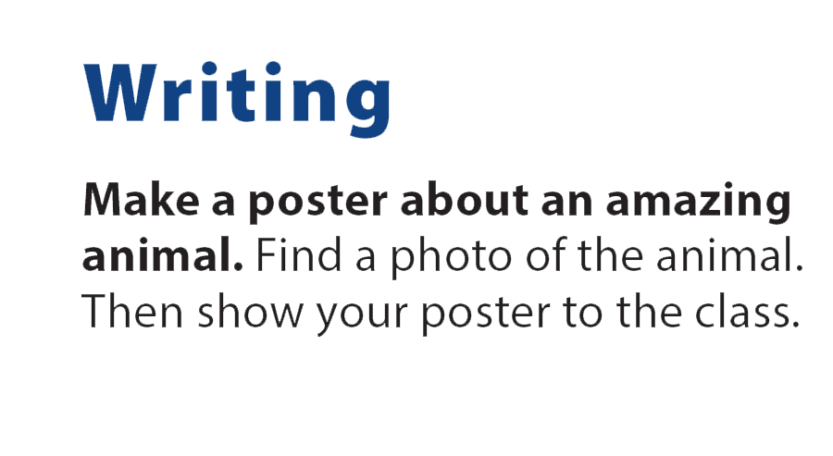
UNIT 2
MONKEYS ARE AMAZING!
WRITING

Slide 23
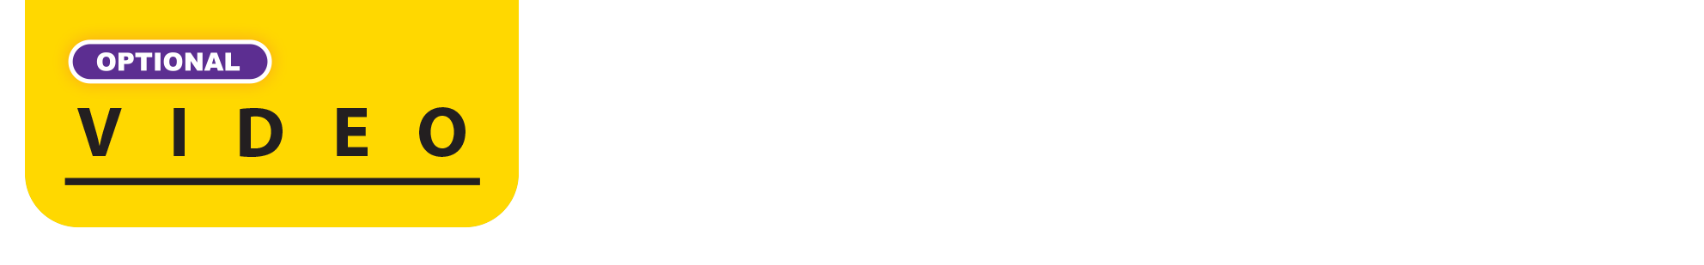
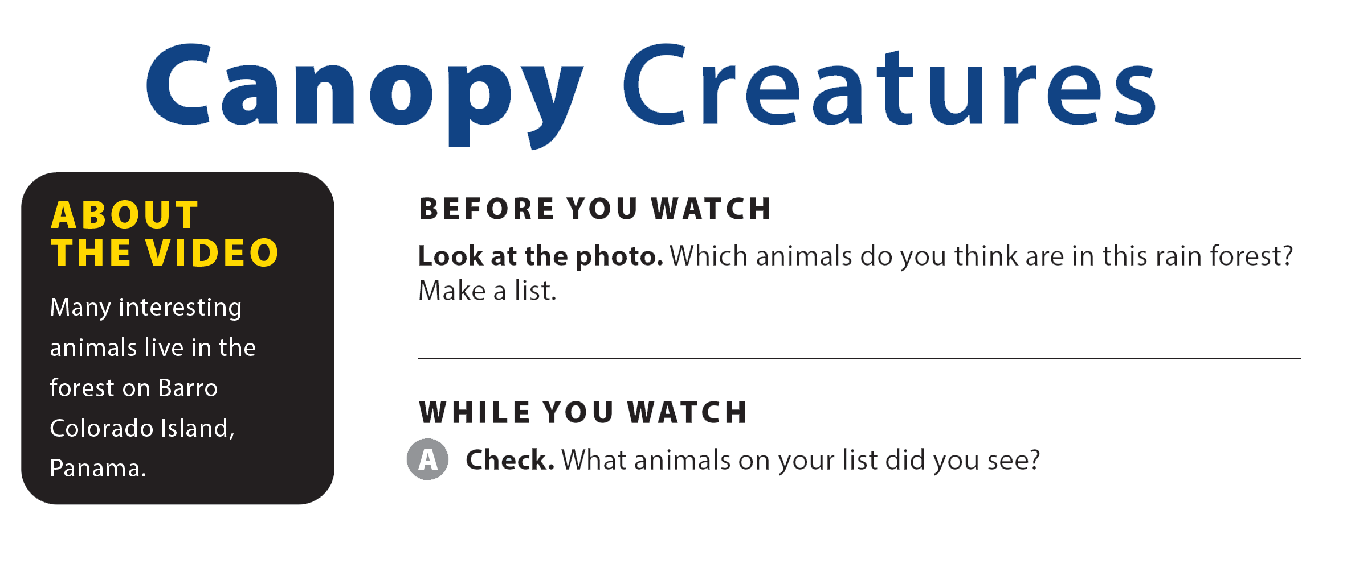
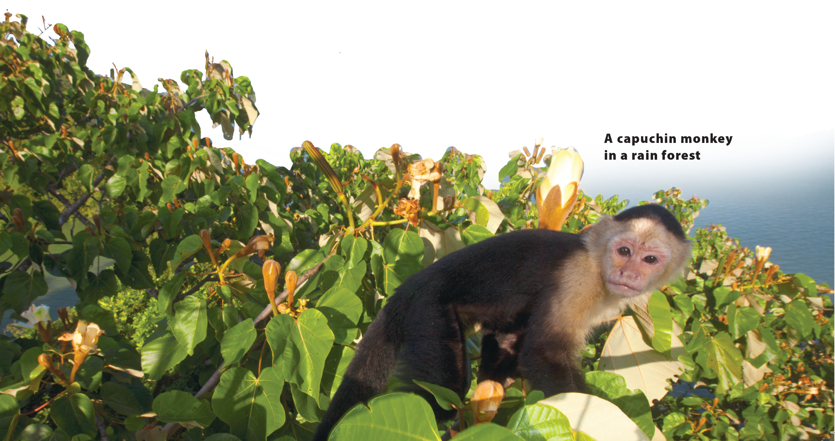

UNIT 2
MONKEYS ARE AMAZING!
VIDEO

Slide 24
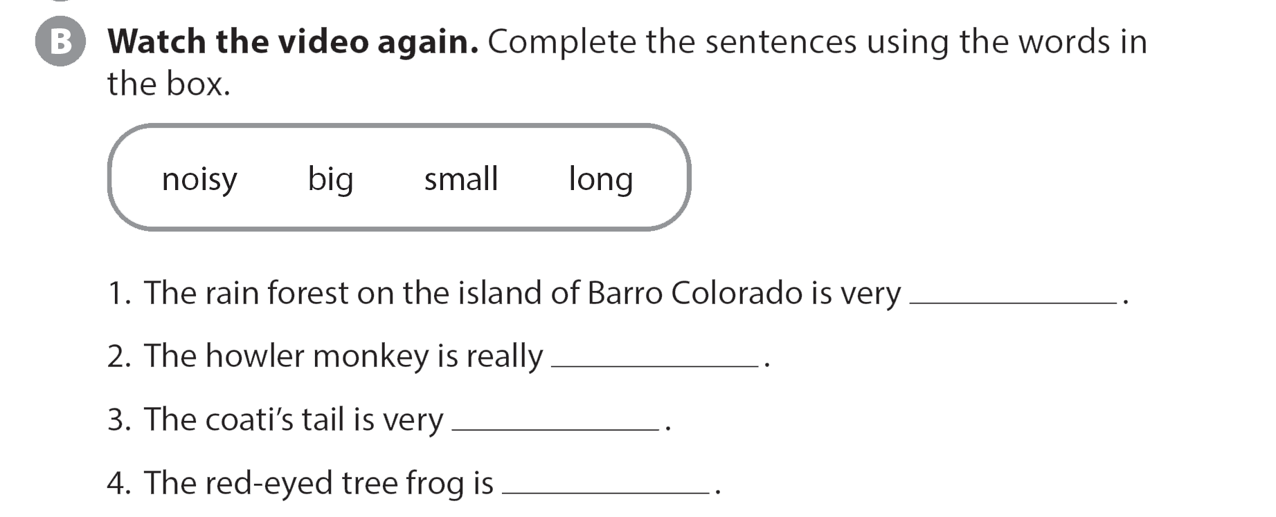
UNIT 2
MONKEYS ARE AMAZING!
VIDEO
big
nosy
long
small

Slide 25

UNIT 2
MONKEYS ARE AMAZING!
VIDEO

