Slide 1
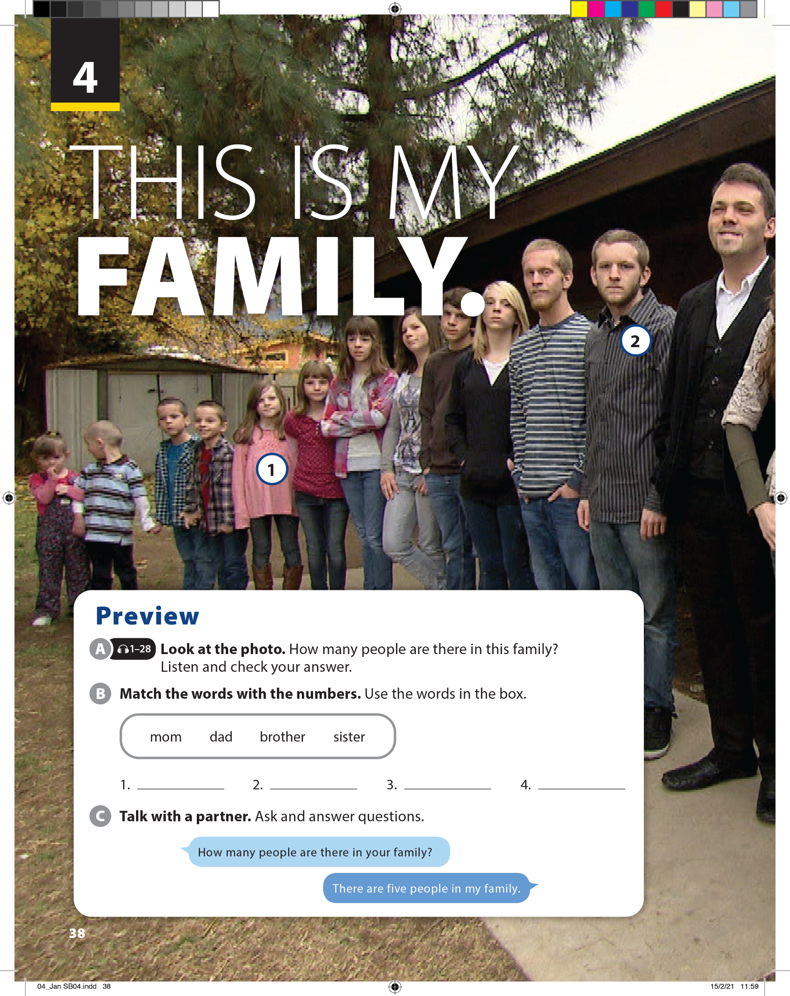
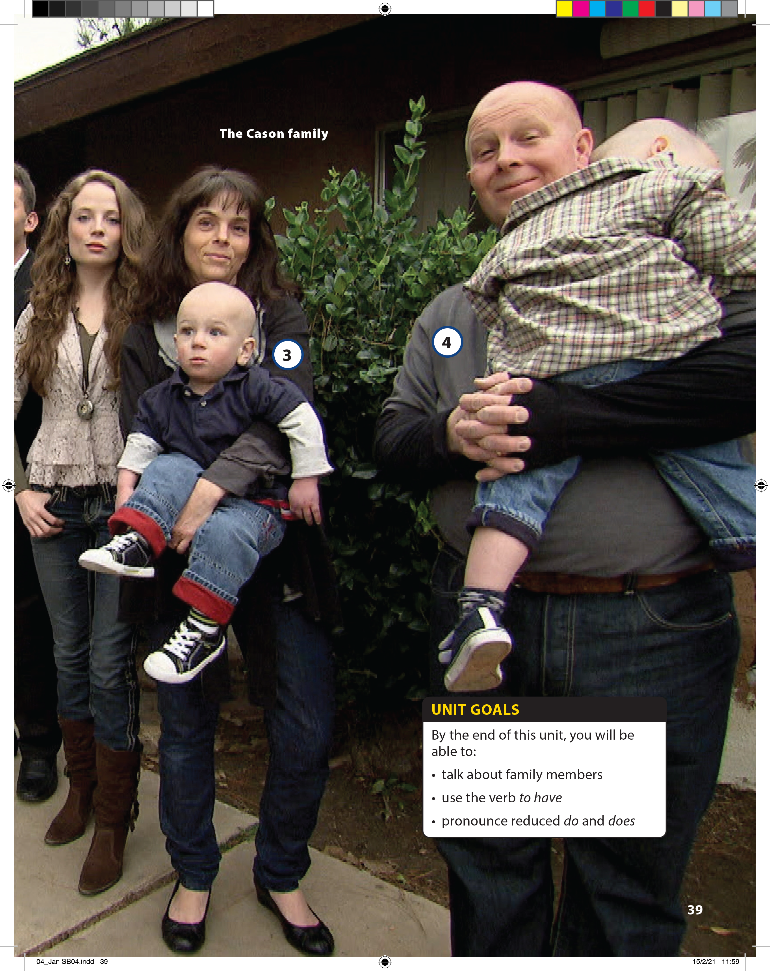

Slide 2

There are 18 people.
sister
brother
mom
dad

Slide 3


UNIT 4
THIS IS MY FAMILY.
PREVIEW

Slide 4
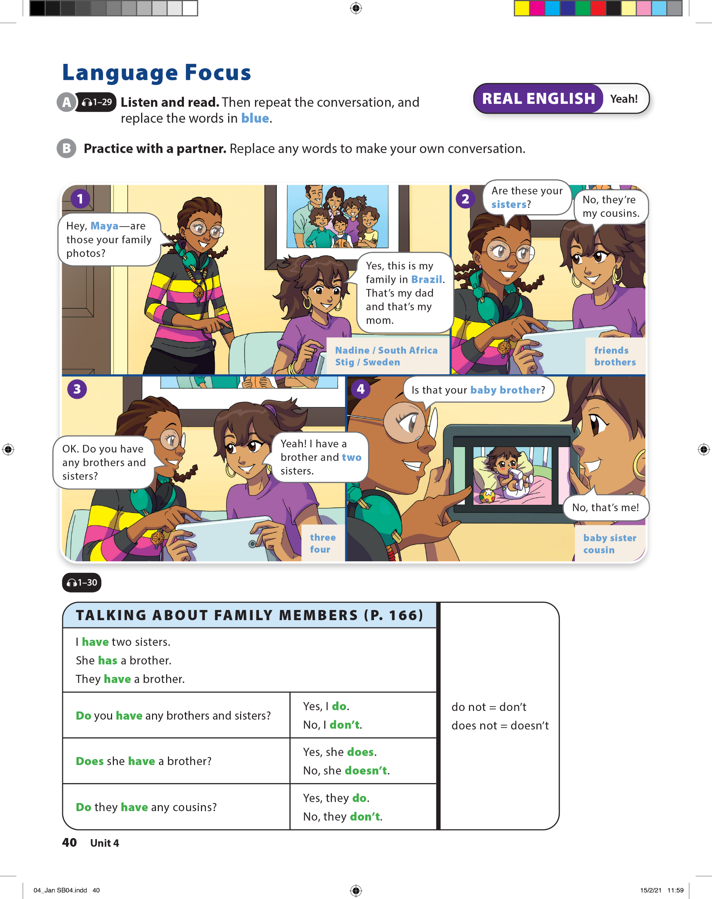
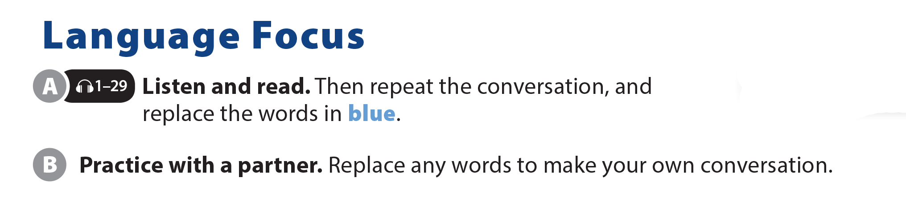
UNIT 4
THIS IS MY FAMILY.
LANGUAGE FOCUS

Slide 5
UNIT 4
THIS IS MY FAMILY.
LANGUAGE FOCUS

Slide 6
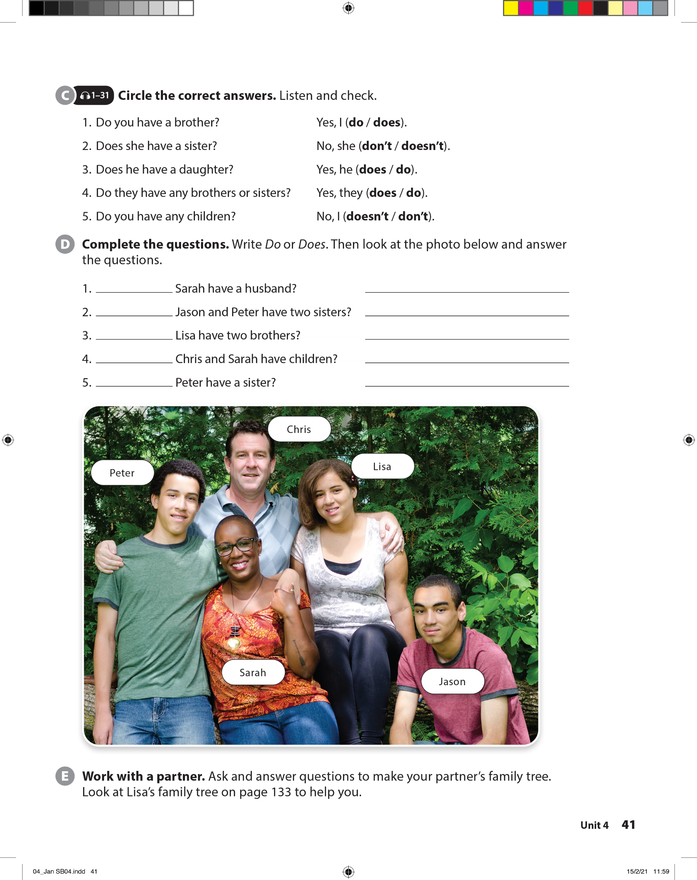
UNIT 4
THIS IS MY FAMILY.
LANGUAGE FOCUS

Slide 7

UNIT 4
THIS IS MY FAMILY.
LANGUAGE FOCUS
Does
Yes, she does.
Do
No, they don’t.
Does
Yes, she does.
Do
Yes, they do.
Does
Yes, he does.

Slide 8
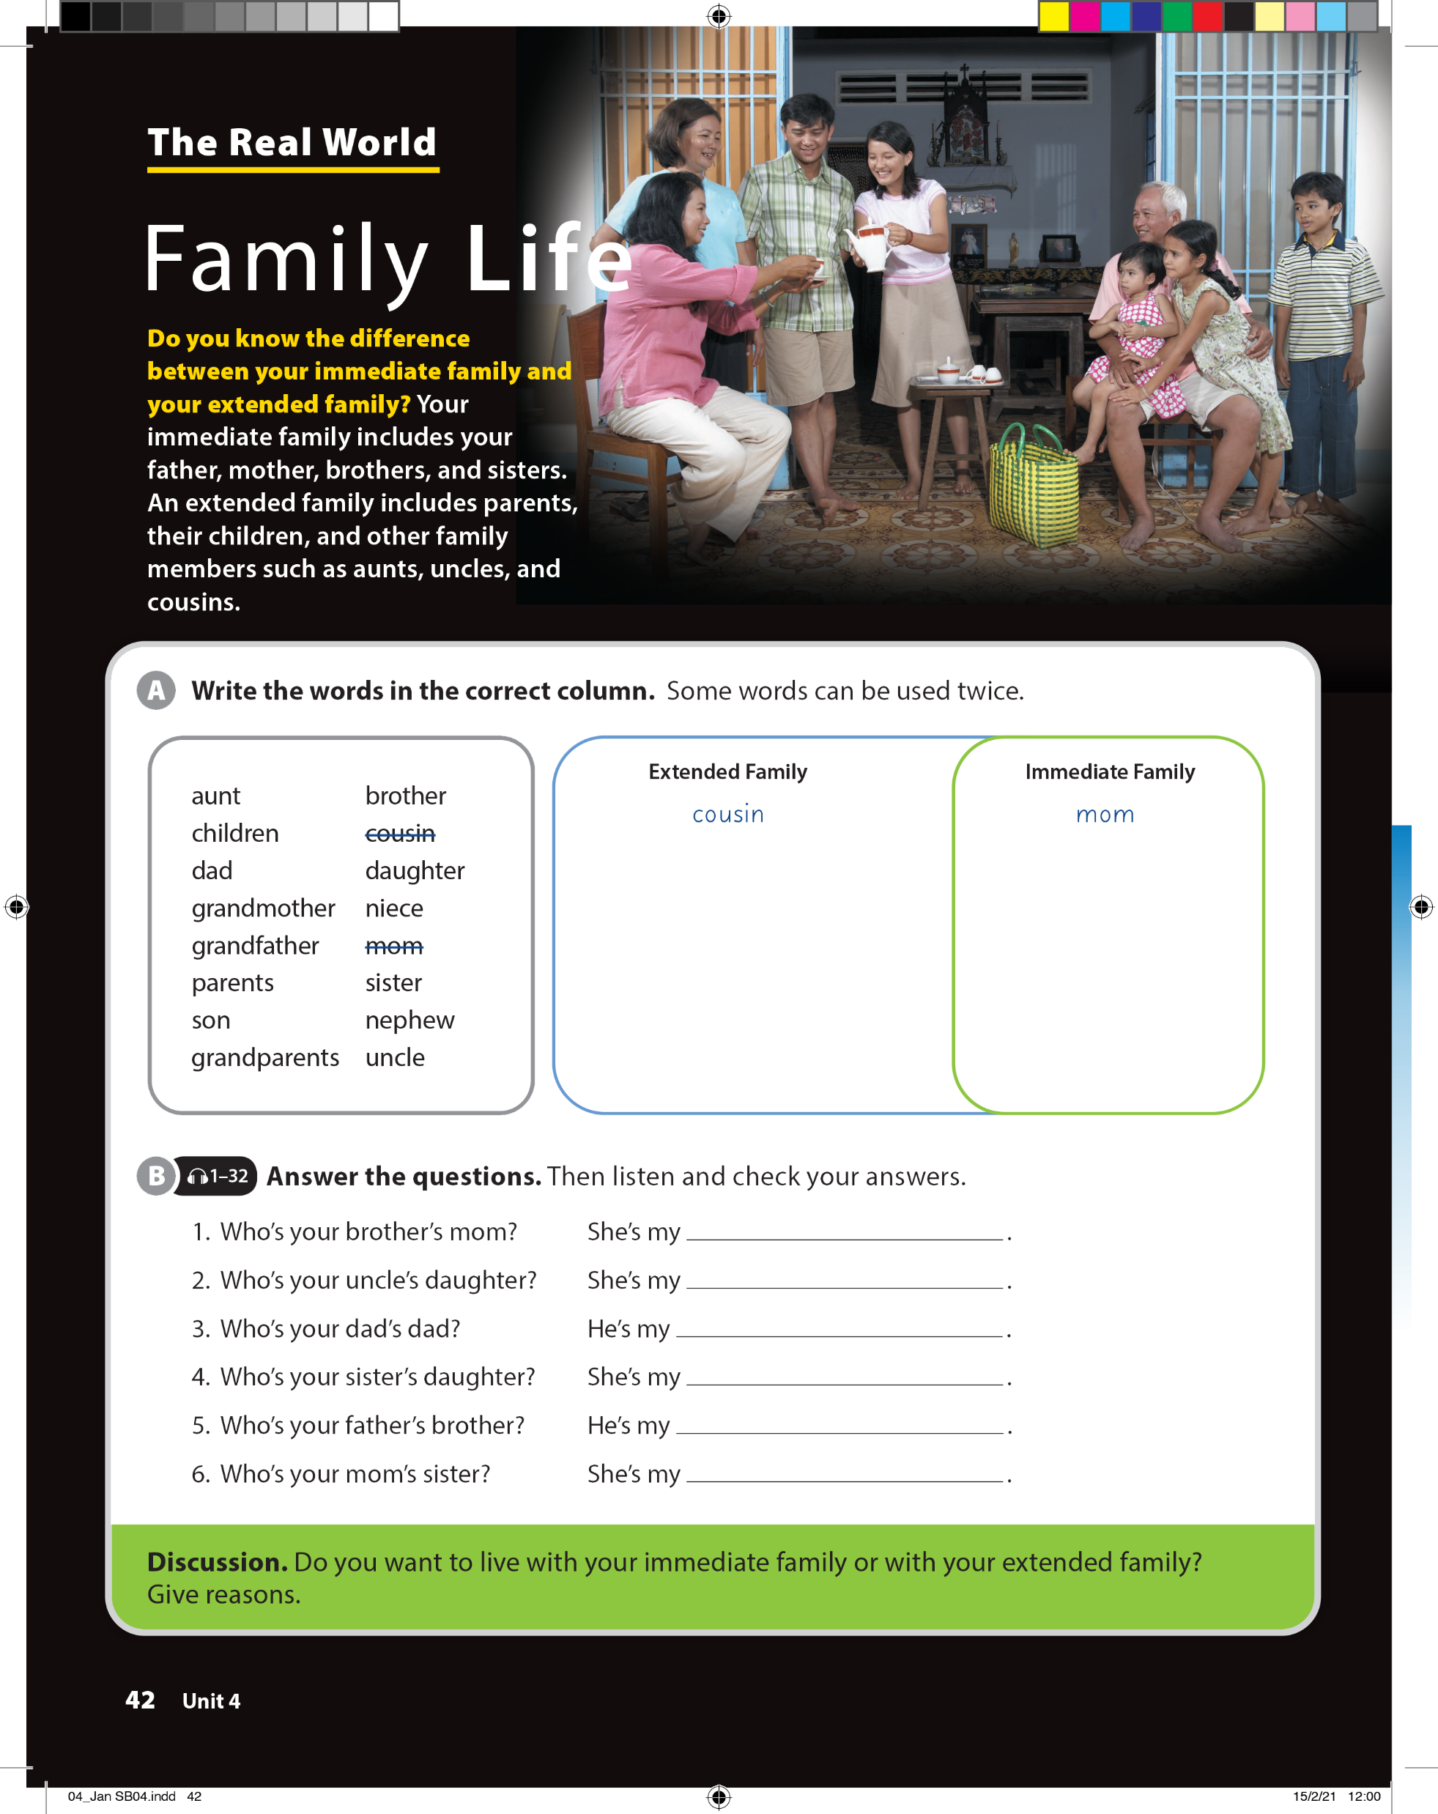
UNIT 4
THIS IS MY FAMILY.
THE REAL WORLD

Slide 9
UNIT 4
THIS IS MY FAMILY.
THE REAL WORLD
mom
children
dad
parents
son
brother
daughter
sister
aunt
grandmother
grandfather
grandparents
niece
nephew
uncle
children
dad
parents
son
brother
daughter
sister

Slide 10
UNIT 4
THIS IS MY FAMILY.
THE REAL WORLD
mom
cousin
grandfather
niece
uncle
aunt

Slide 11
UNIT 4
THIS IS MY FAMILY.
THE REAL WORLD

Slide 12
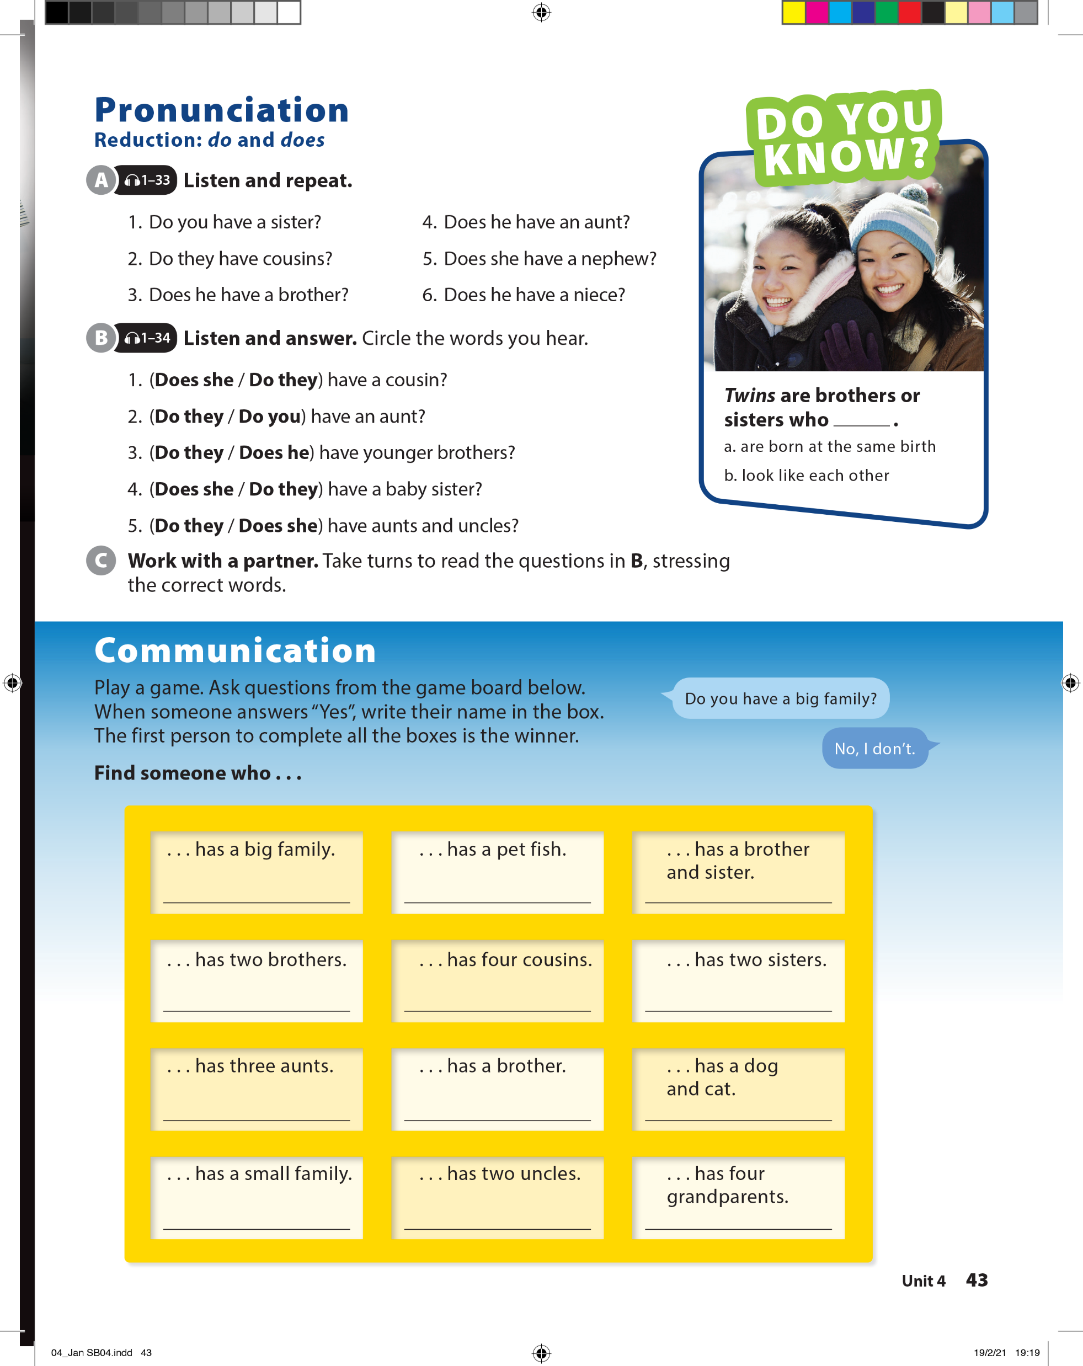
UNIT 4
THIS IS MY FAMILY.
PRONUNCIATION

Slide 13
UNIT 4
THIS IS MY FAMILY.
PRONUNCIATION

Slide 14
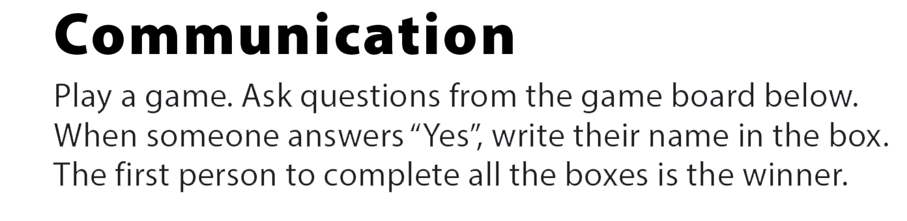
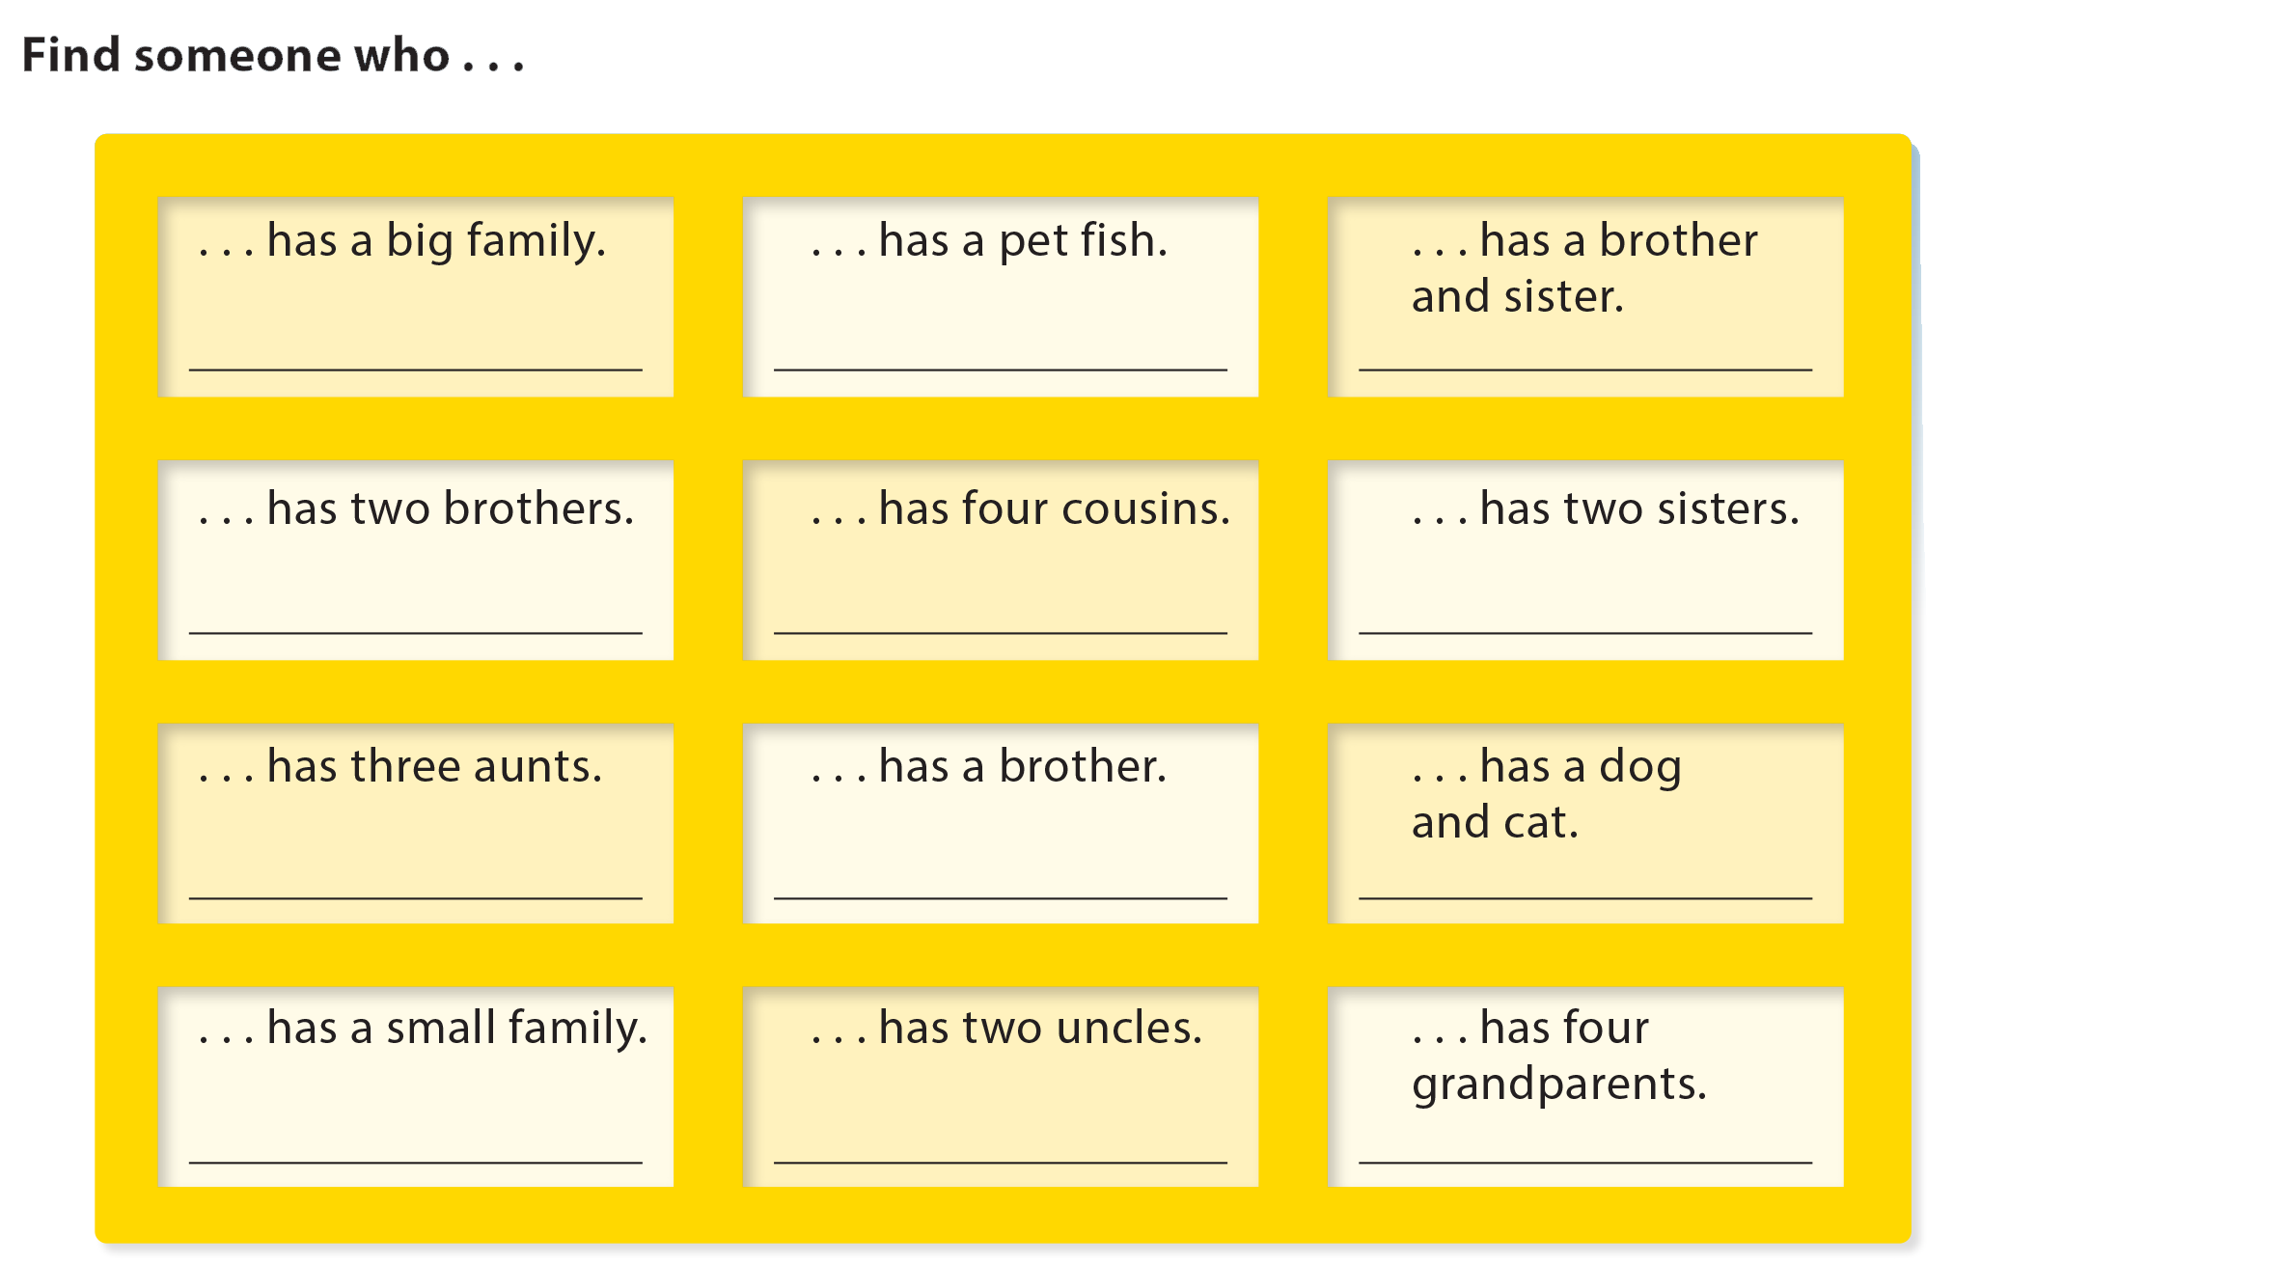
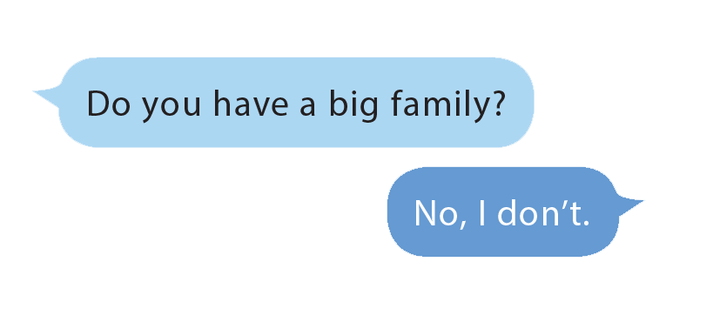
UNIT 4
THIS IS MY FAMILY.
COMMUNICATION

Slide 15
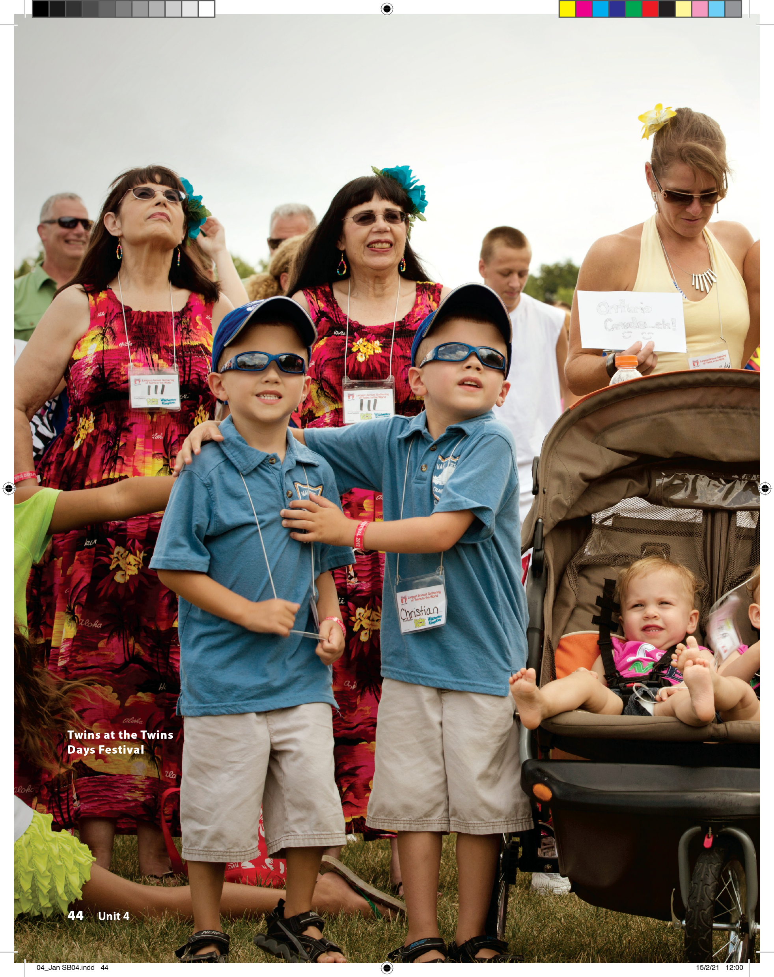
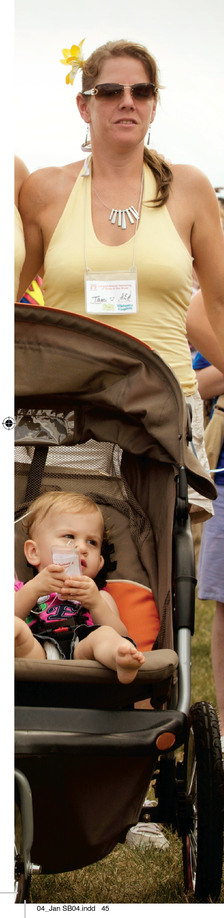


UNIT 4
THIS IS MY FAMILY.
READING

Slide 16



UNIT 4
THIS IS MY FAMILY.
READING

Slide 17
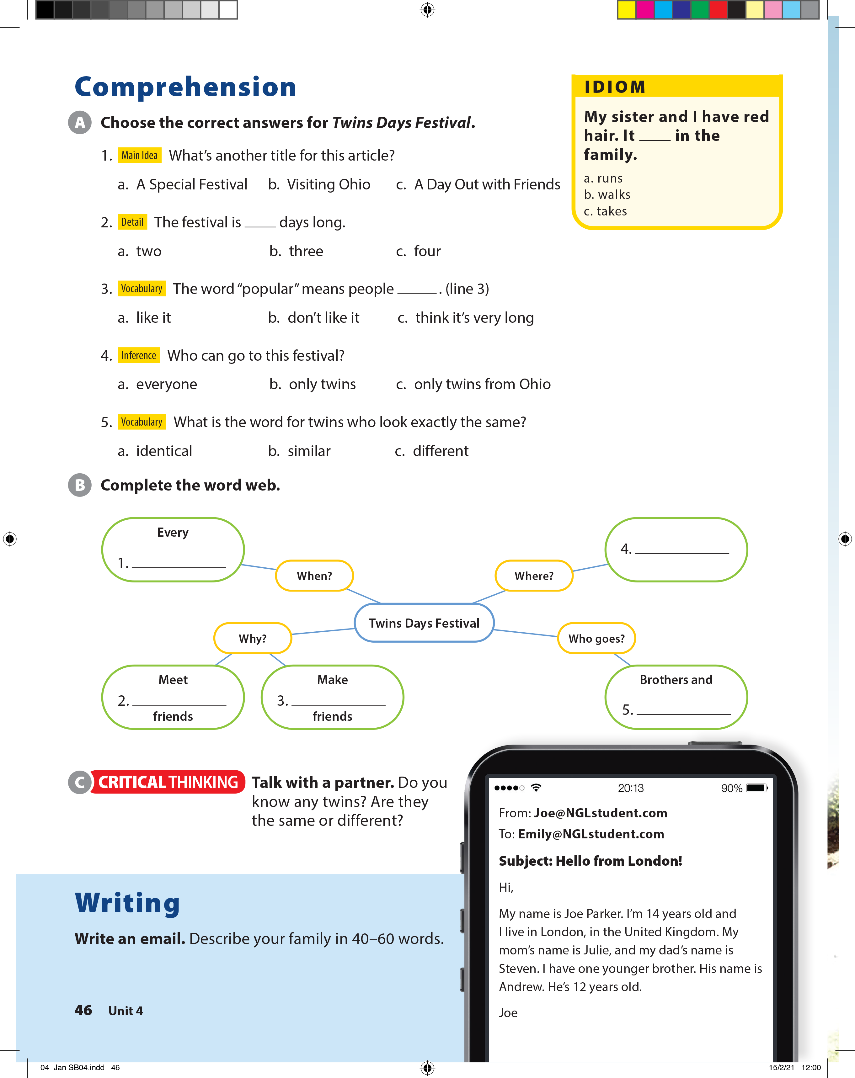
UNIT 4
THIS IS MY FAMILY.
COMPREHENSION

Slide 18
UNIT 2
THIS IS MY FAMILY.
IDIOM
My sister and I have red hair. It ______ in the family.
runs
Walks
takes

Slide 19
UNIT 4
THIS IS MY FAMILY.
COMPREHENSION
Twinsburg (Ohio/ the U.S)
year/August
old
new
sisters

Slide 20
UNIT 4
THIS IS MY FAMILY.
COMPREHENSION

Slide 21
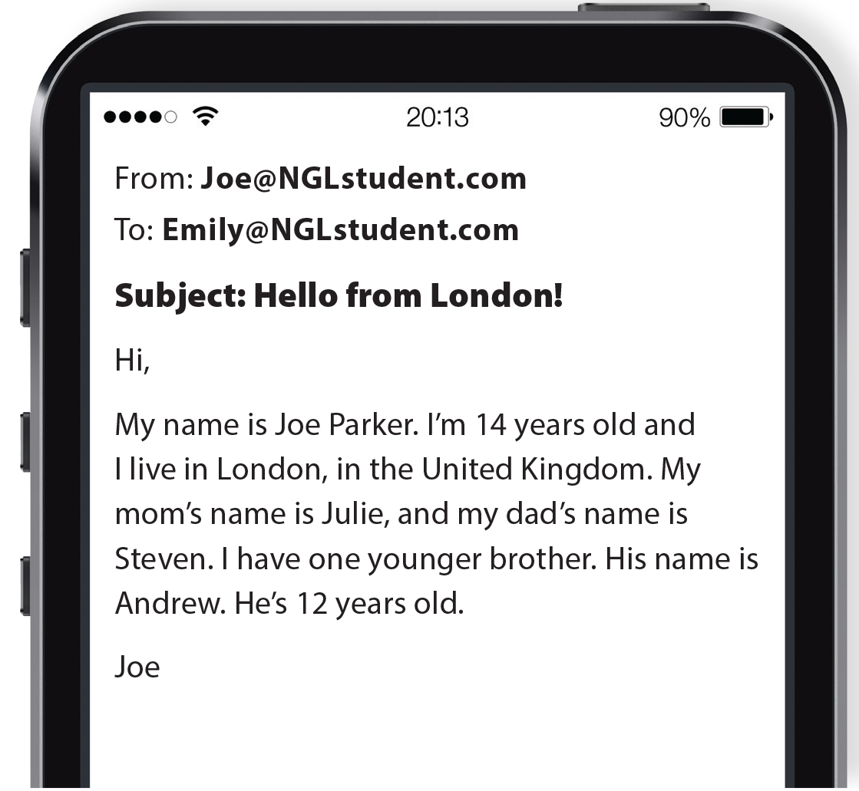
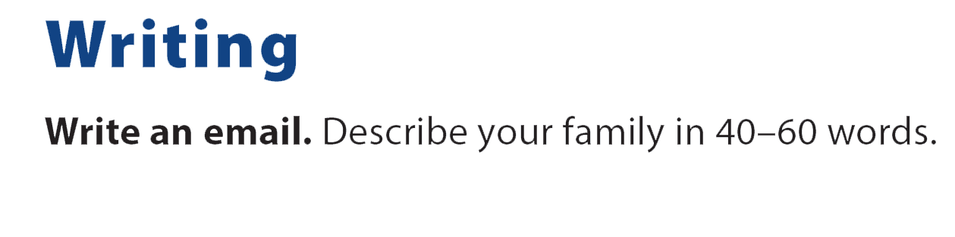
UNIT 4
THIS IS MY FAMILY.
WRITING

Slide 22
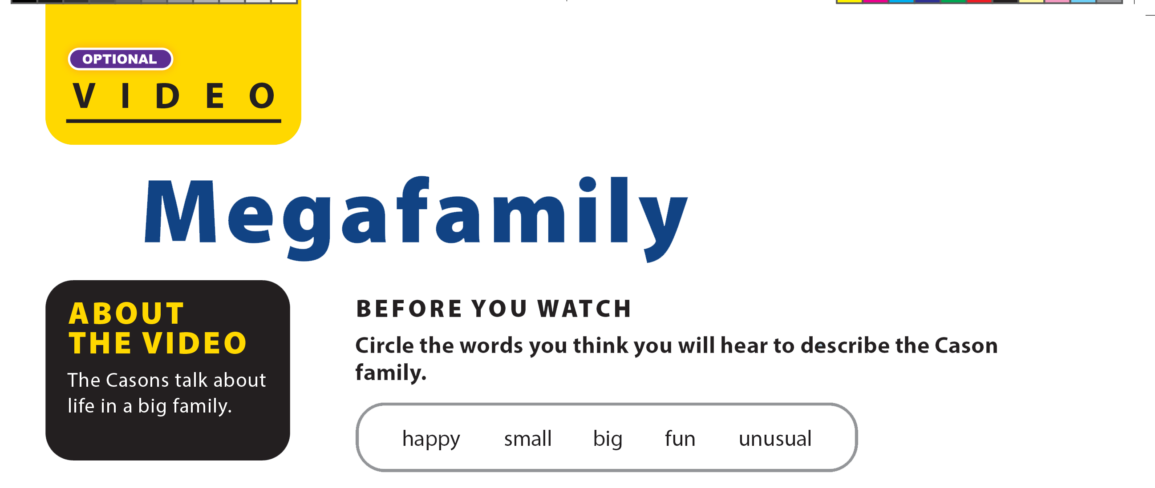

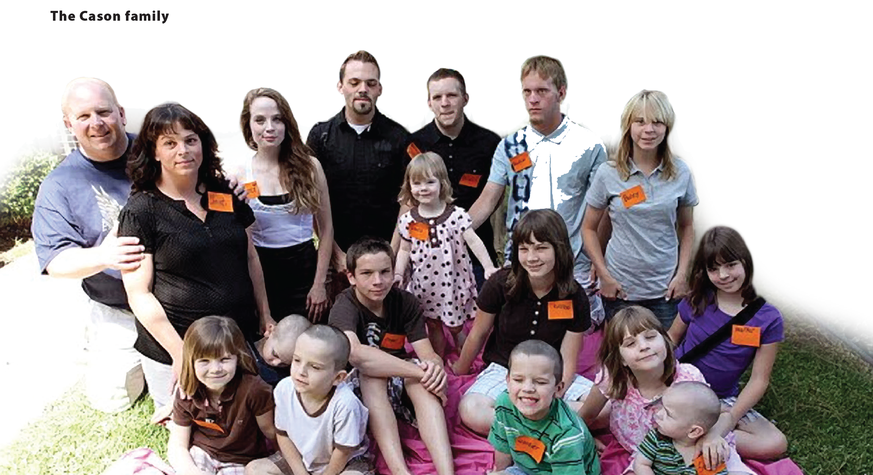
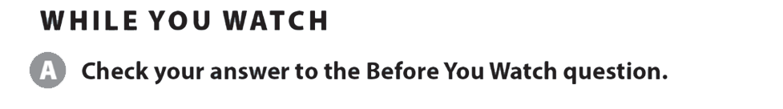
UNIT 4
THIS IS MY FAMILY.
VIDEO

Slide 23
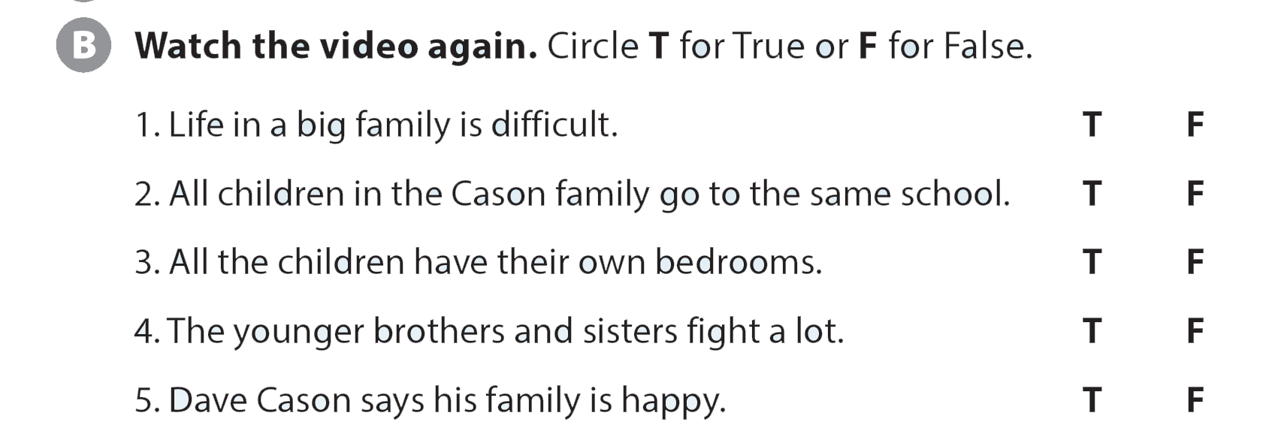
UNIT 4
THIS IS MY FAMILY.
VIDEO

Slide 24
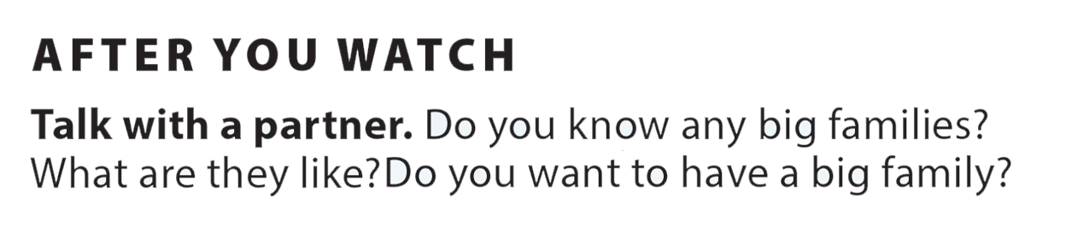
UNIT 4
THIS IS MY FAMILY.
VIDEO

