Slide 1
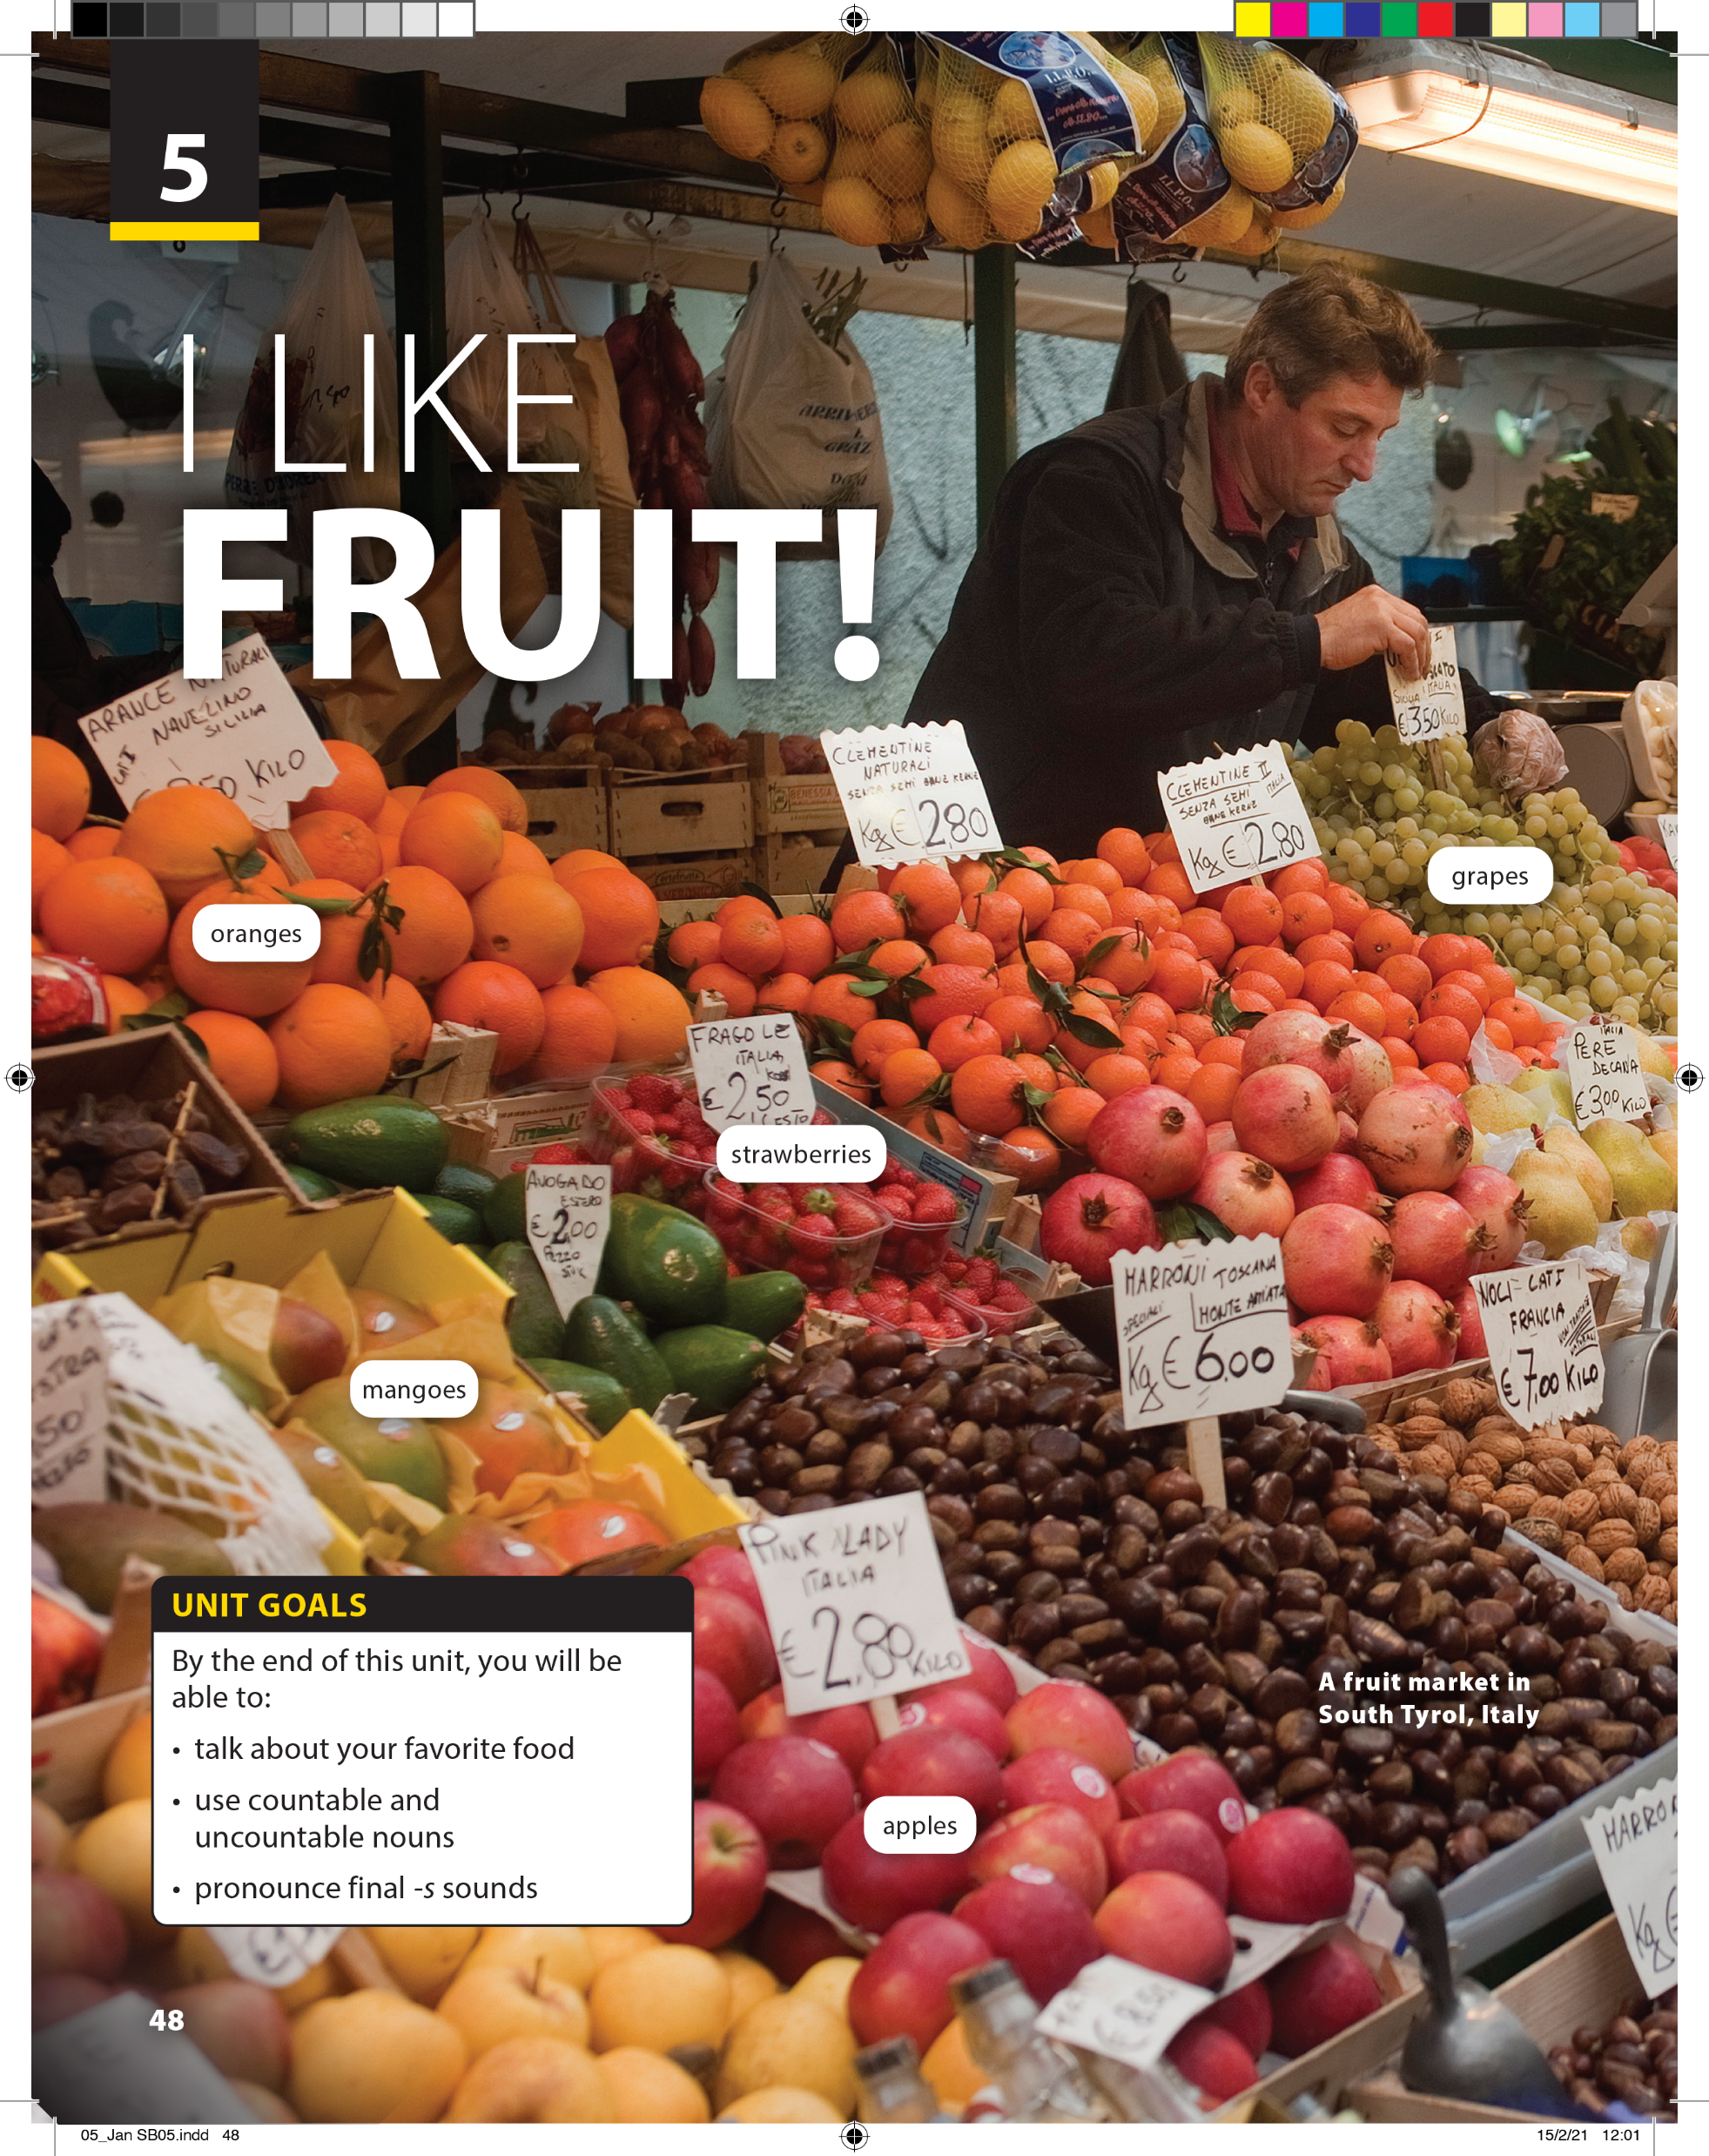
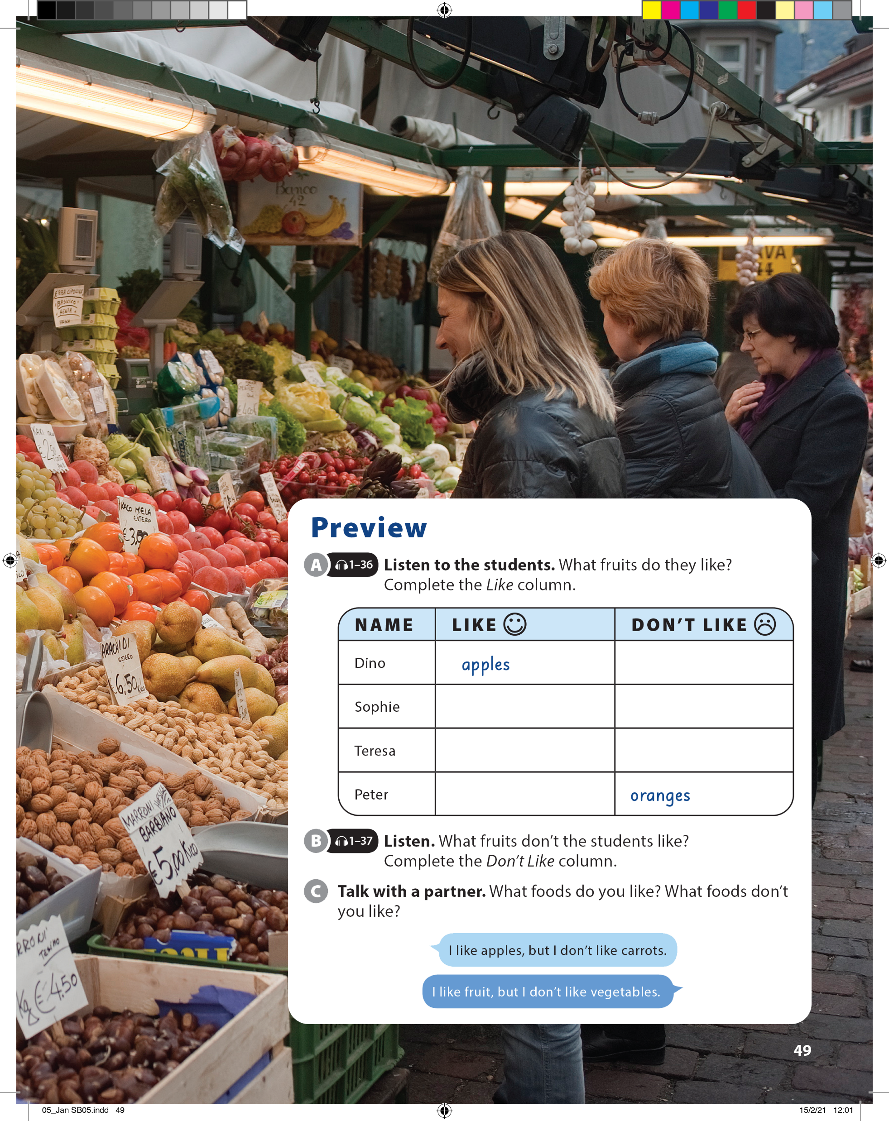

Slide 2


UNIT 5
I LIKE FRUIT!
PREVIEW
mangoes
grapes
apples
strawberries
grapes
strawberries

Slide 3
UNIT 5
I LIKE FRUIT!
PREVIEW

Slide 4
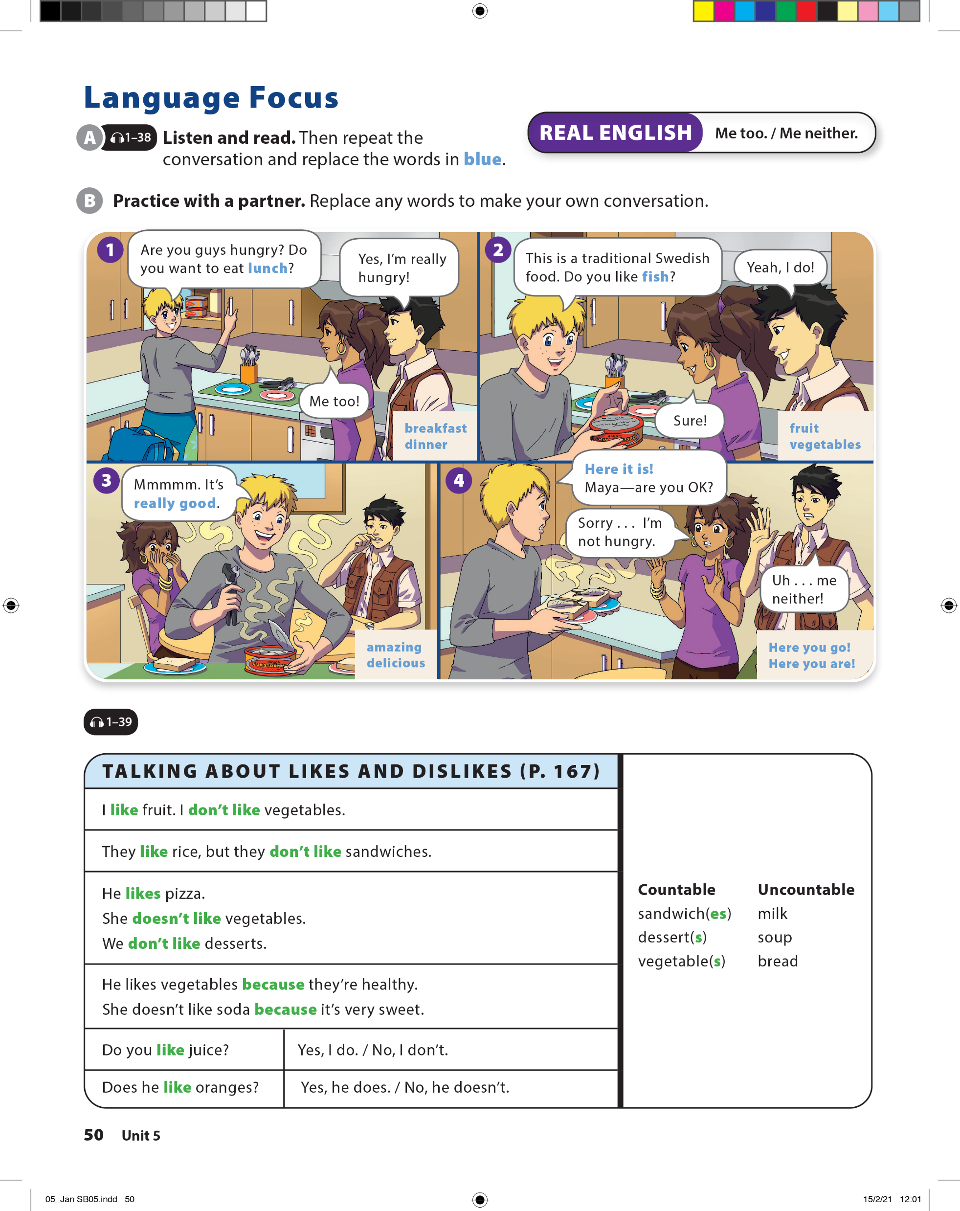

UNIT 5
I LIKE FRUIT!
LANGUAGE FOCUS

Slide 5
UNIT 5
I LIKE FRUIT!
LANGUAGE FOCUS

Slide 6
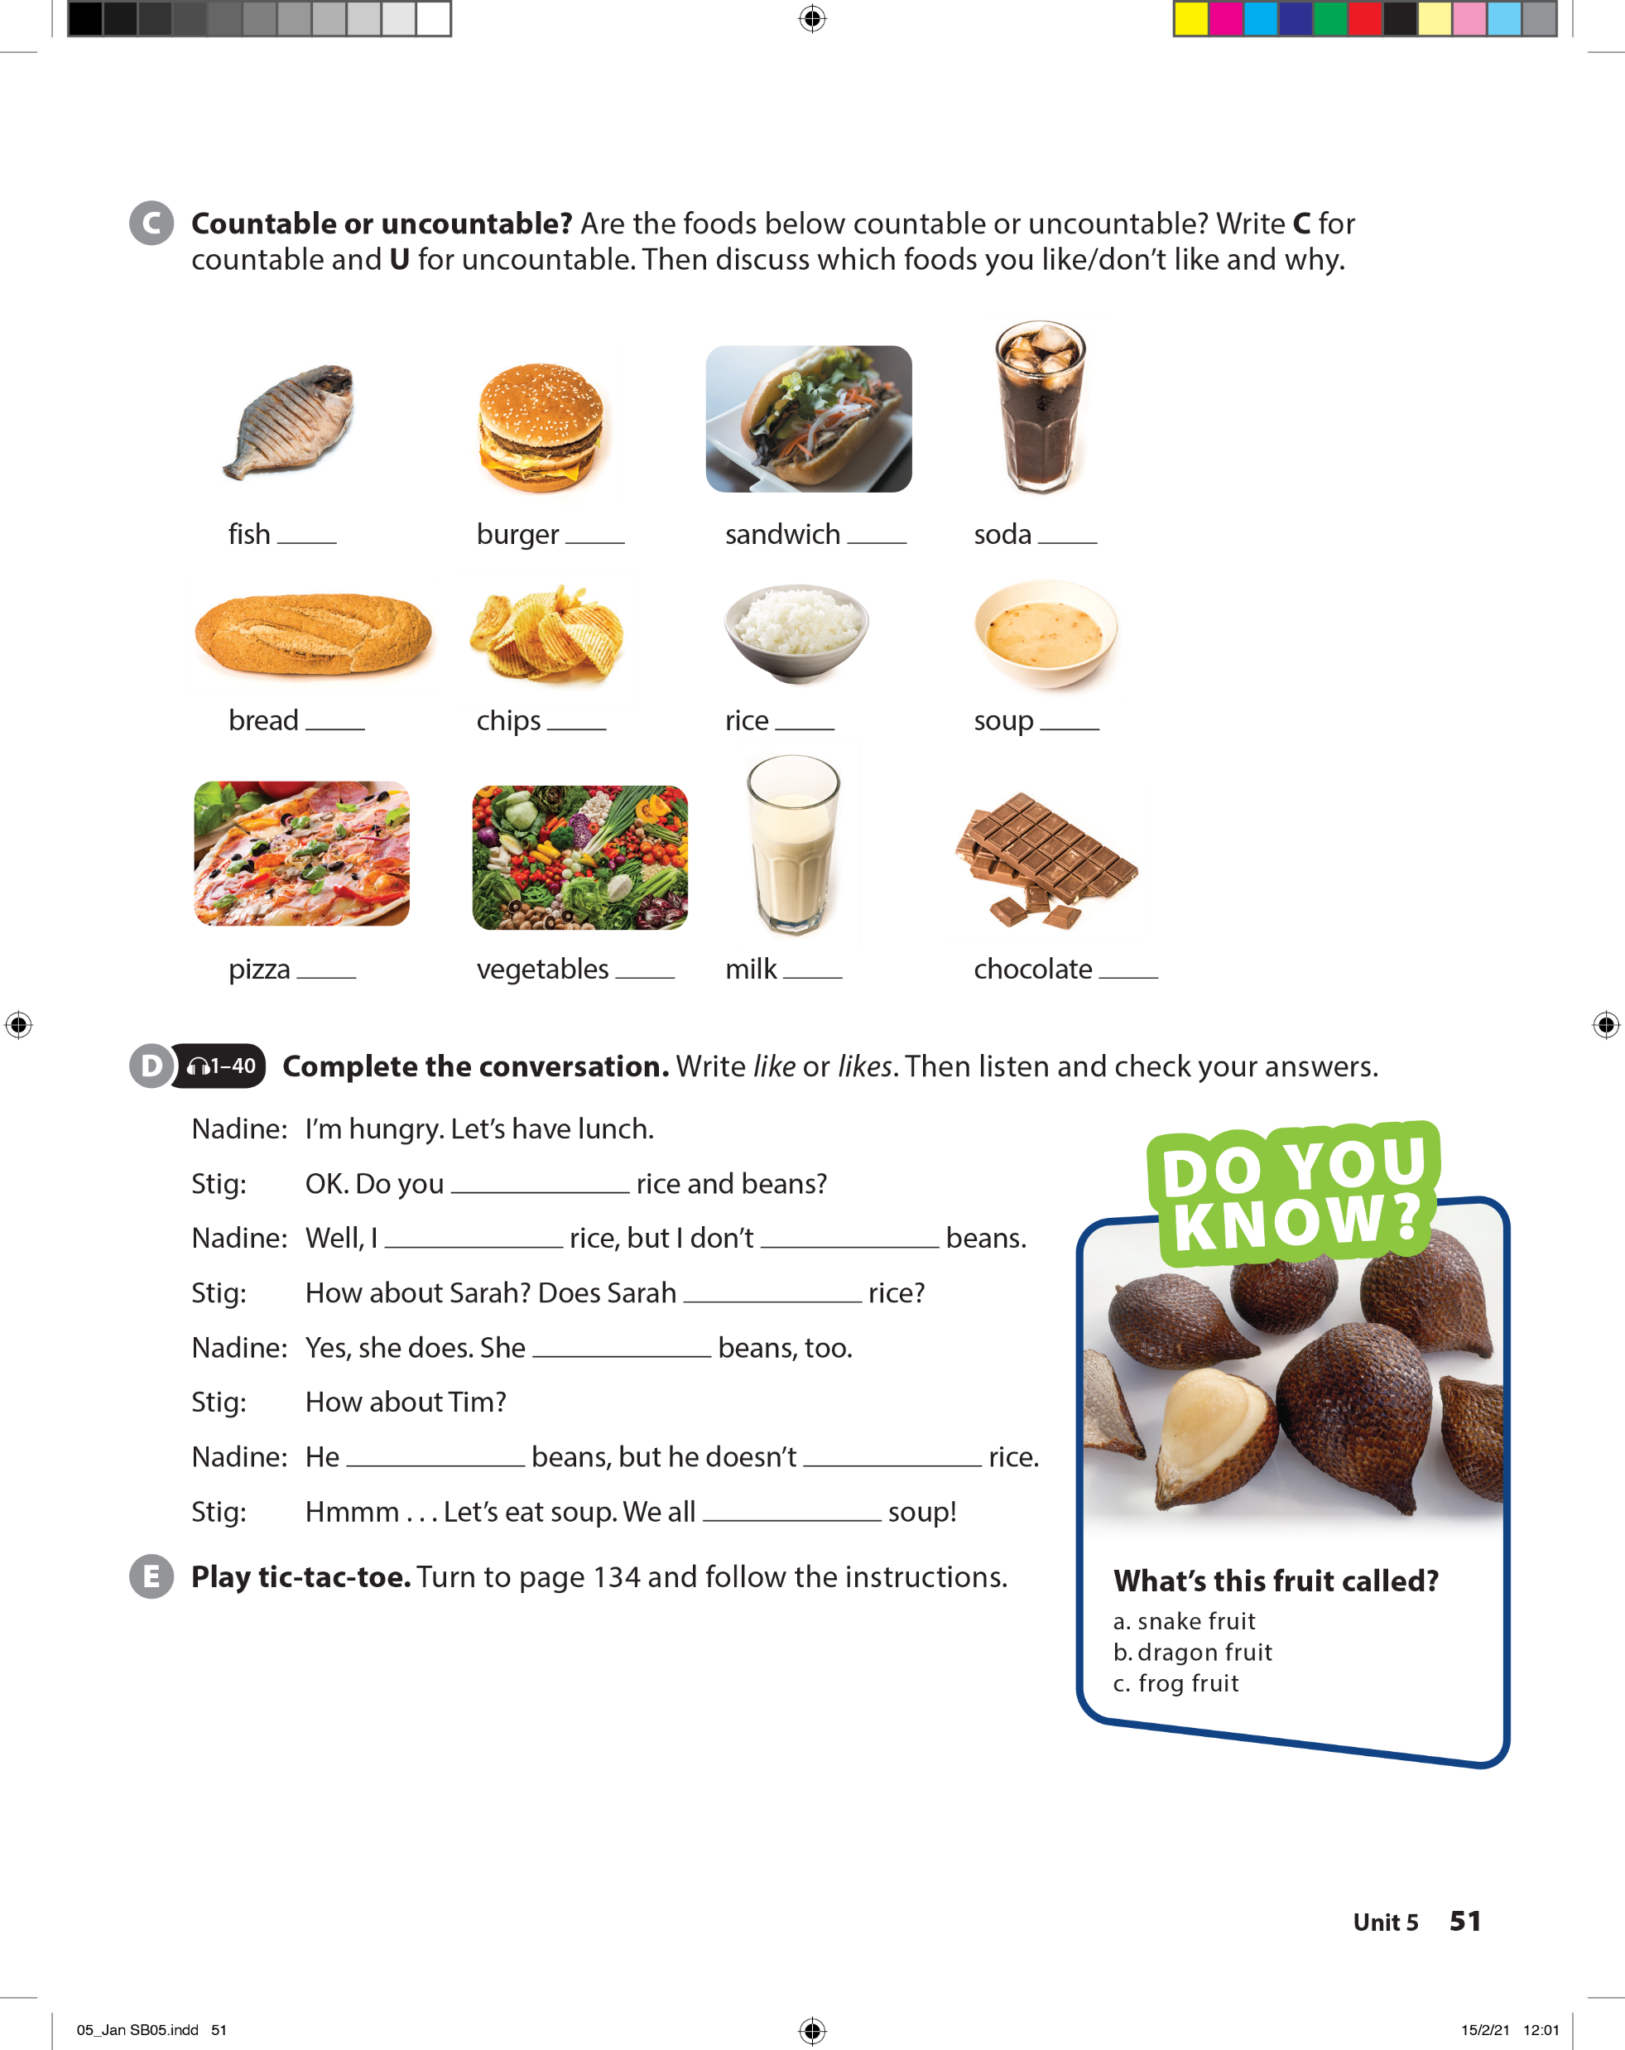
UNIT 5
I LIKE FRUIT!
LANGUAGE FOCUS
C/U
C
C
U
U
C
U
U
C/U
C
U
U

Slide 7

UNIT 5
I LIKE FRUIT!
LANGUAGE FOCUS
like
like
like
like
likes
likes
like
like

Slide 8
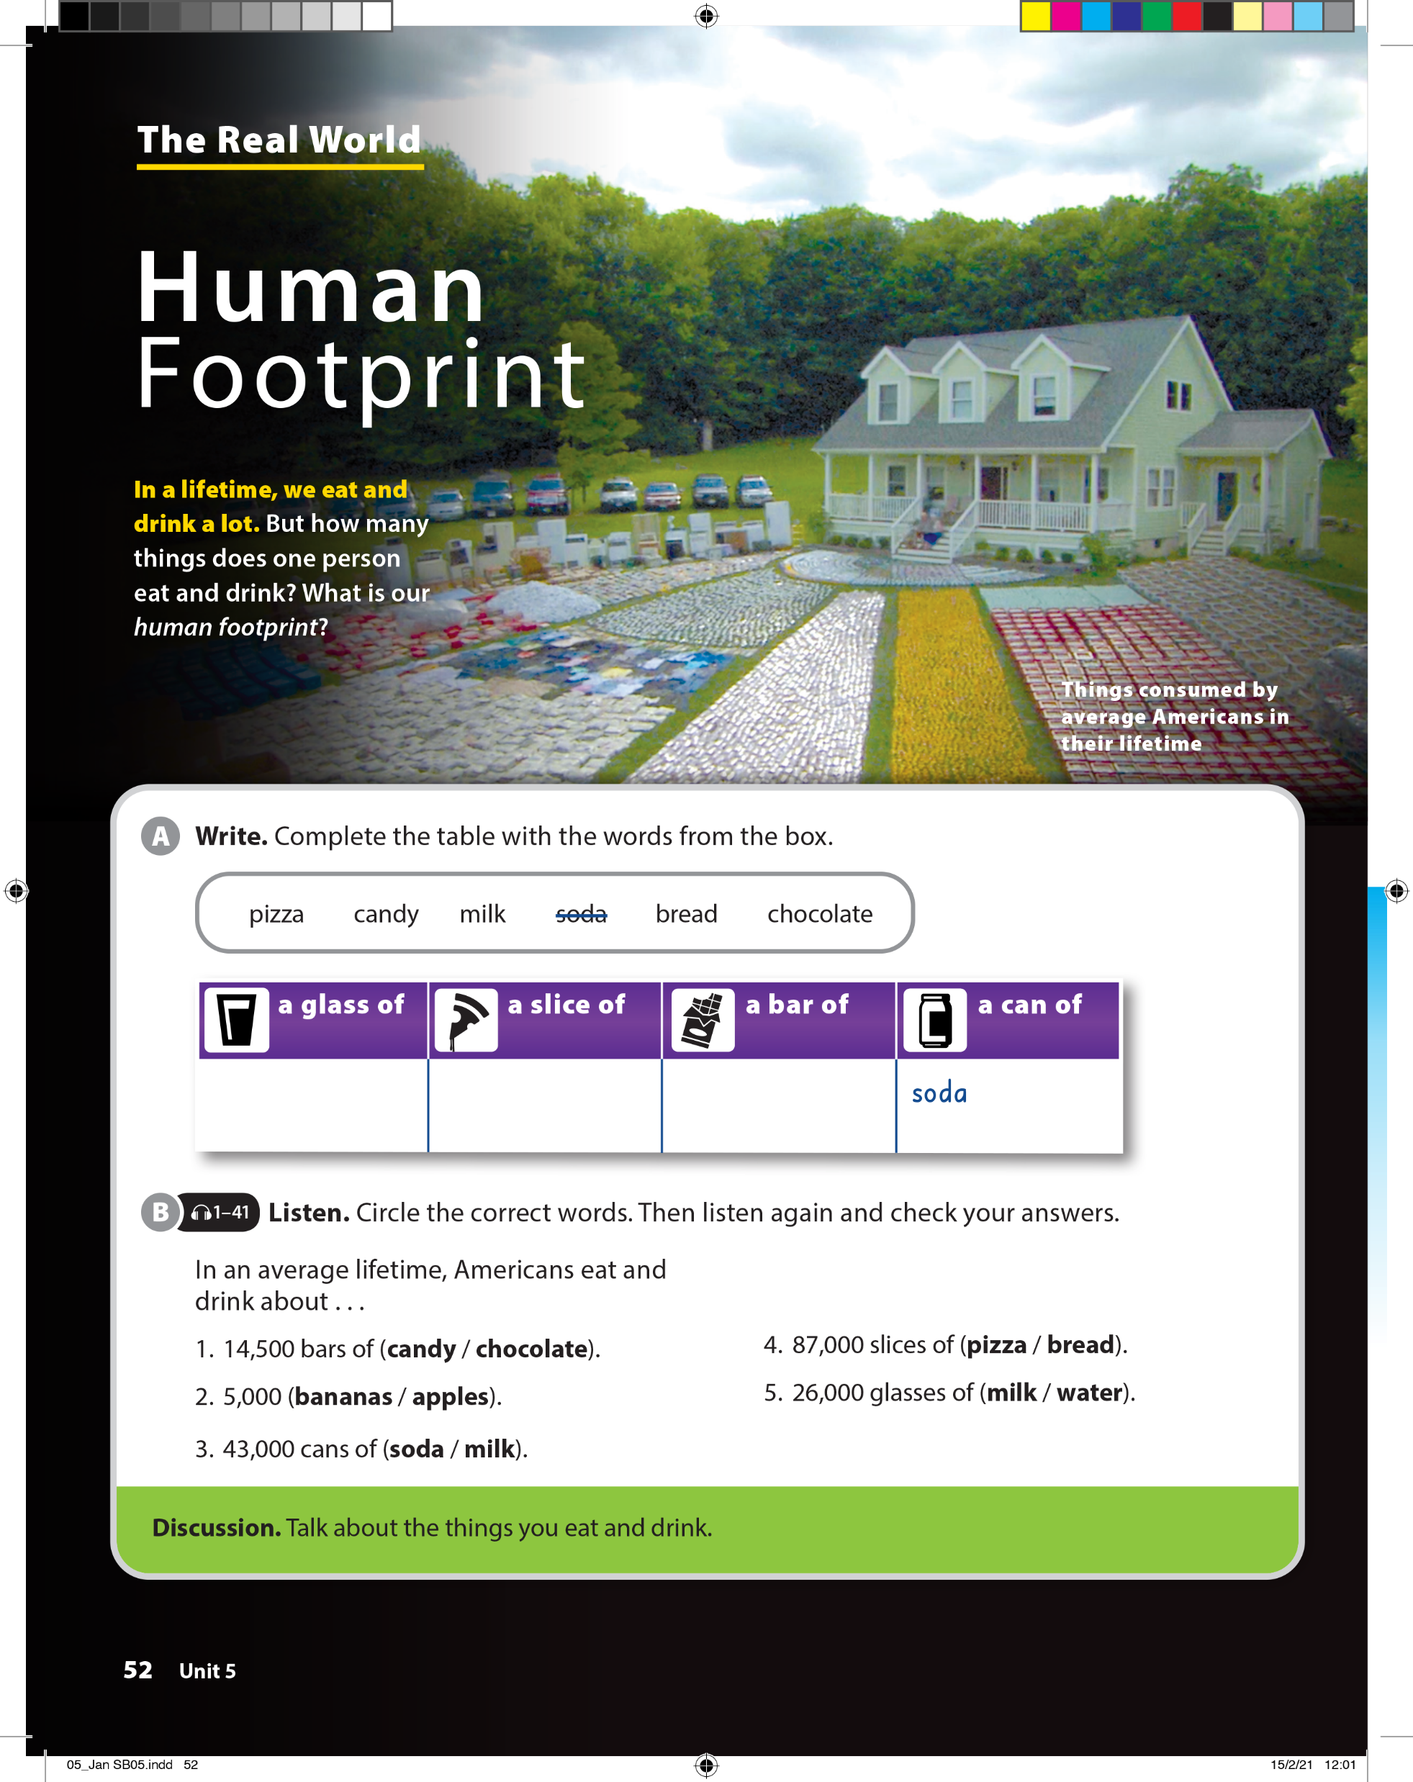
UNIT 5
I LIKE FRUIT!
THE REAL WORLD

Slide 9
UNIT 5
I LIKE FRUIT!
THE REAL WORLD
milk
soda
pizza
bread
candy
chocolate

Slide 10
UNIT 5
I LIKE FRUIT!
THE REAL WORLD

Slide 11
UNIT 5
I LIKE FRUIT!
THE REAL WORLD

Slide 12
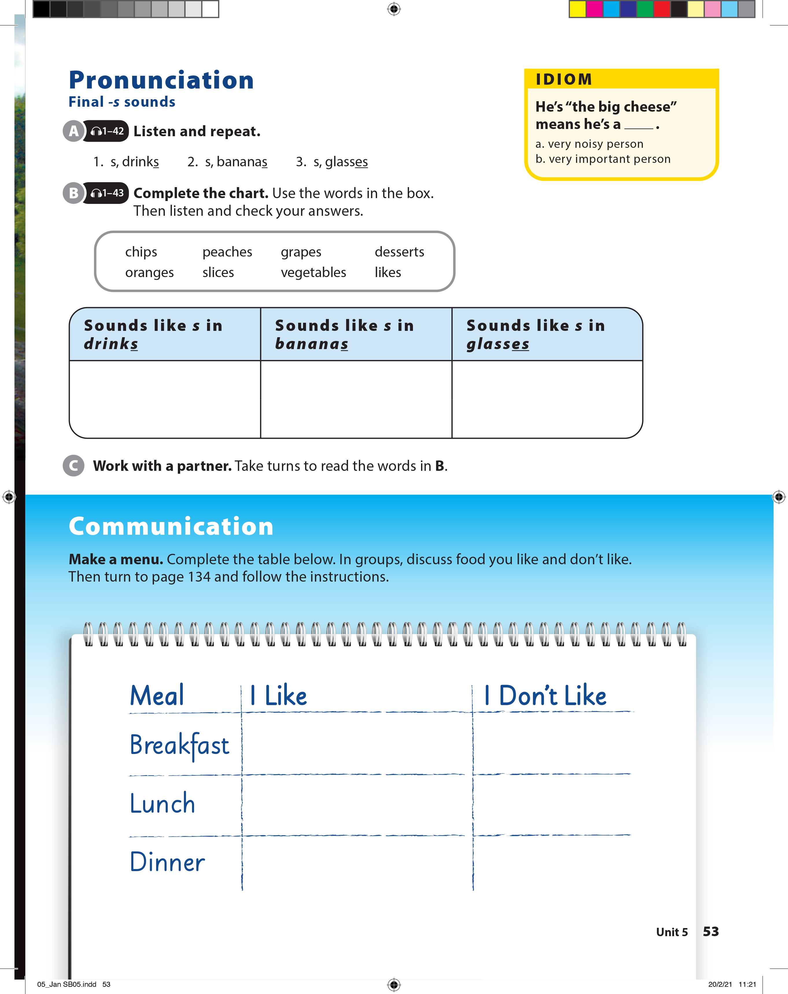
UNIT 5
I LIKE FRUIT!
PRONUNCIATION

Slide 13
UNIT 5
I LIKE FRUIT!
IDIOM
He is “the big cheese” means he’s a _________.
very noisy person
very important person

Slide 14
UNIT 5
I LIKE FRUIT!
PRONUNCIATION
chips
grapes
vegetables
peaches
oranges
desserts
likes
slices

Slide 15
UNIT 5
I LIKE FRUIT!
COMMUNICATION

Slide 16
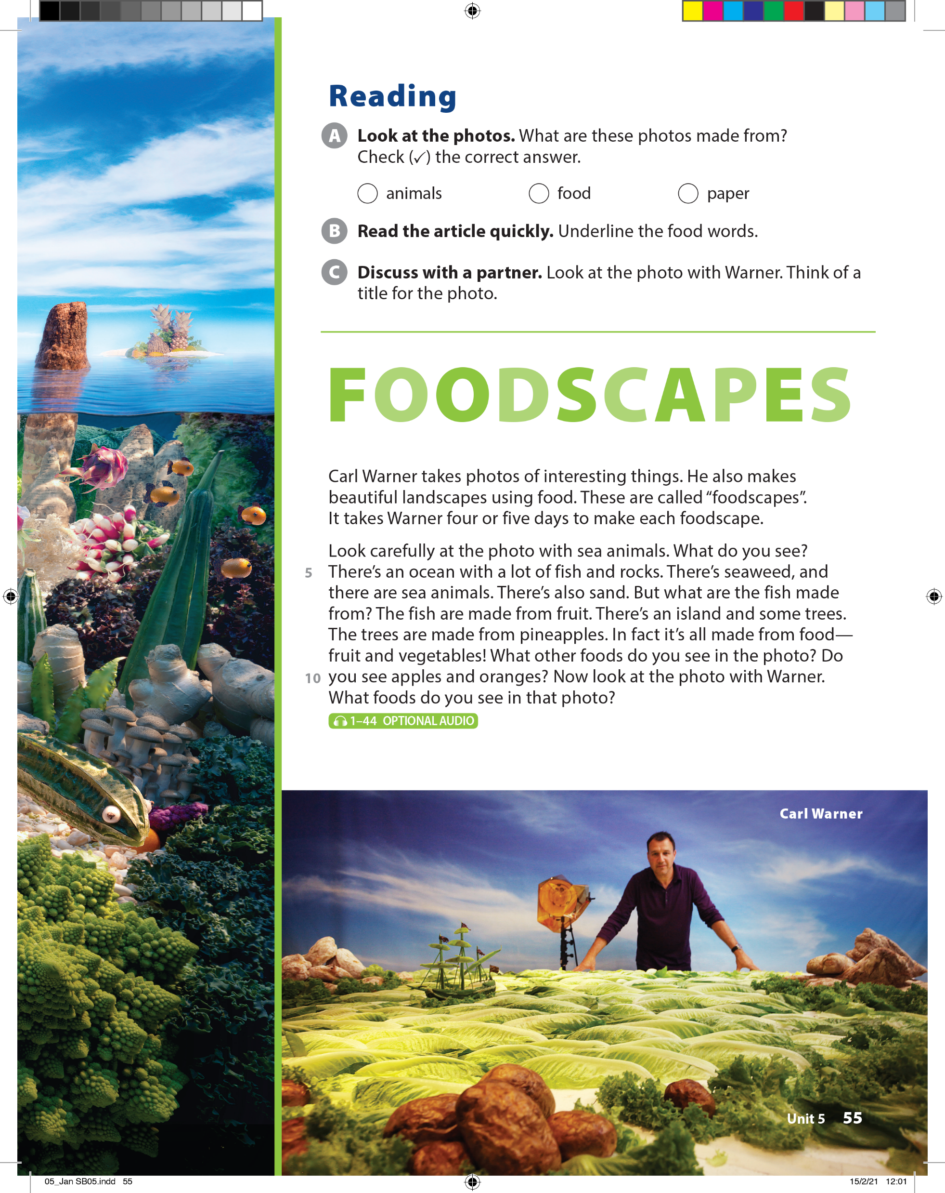
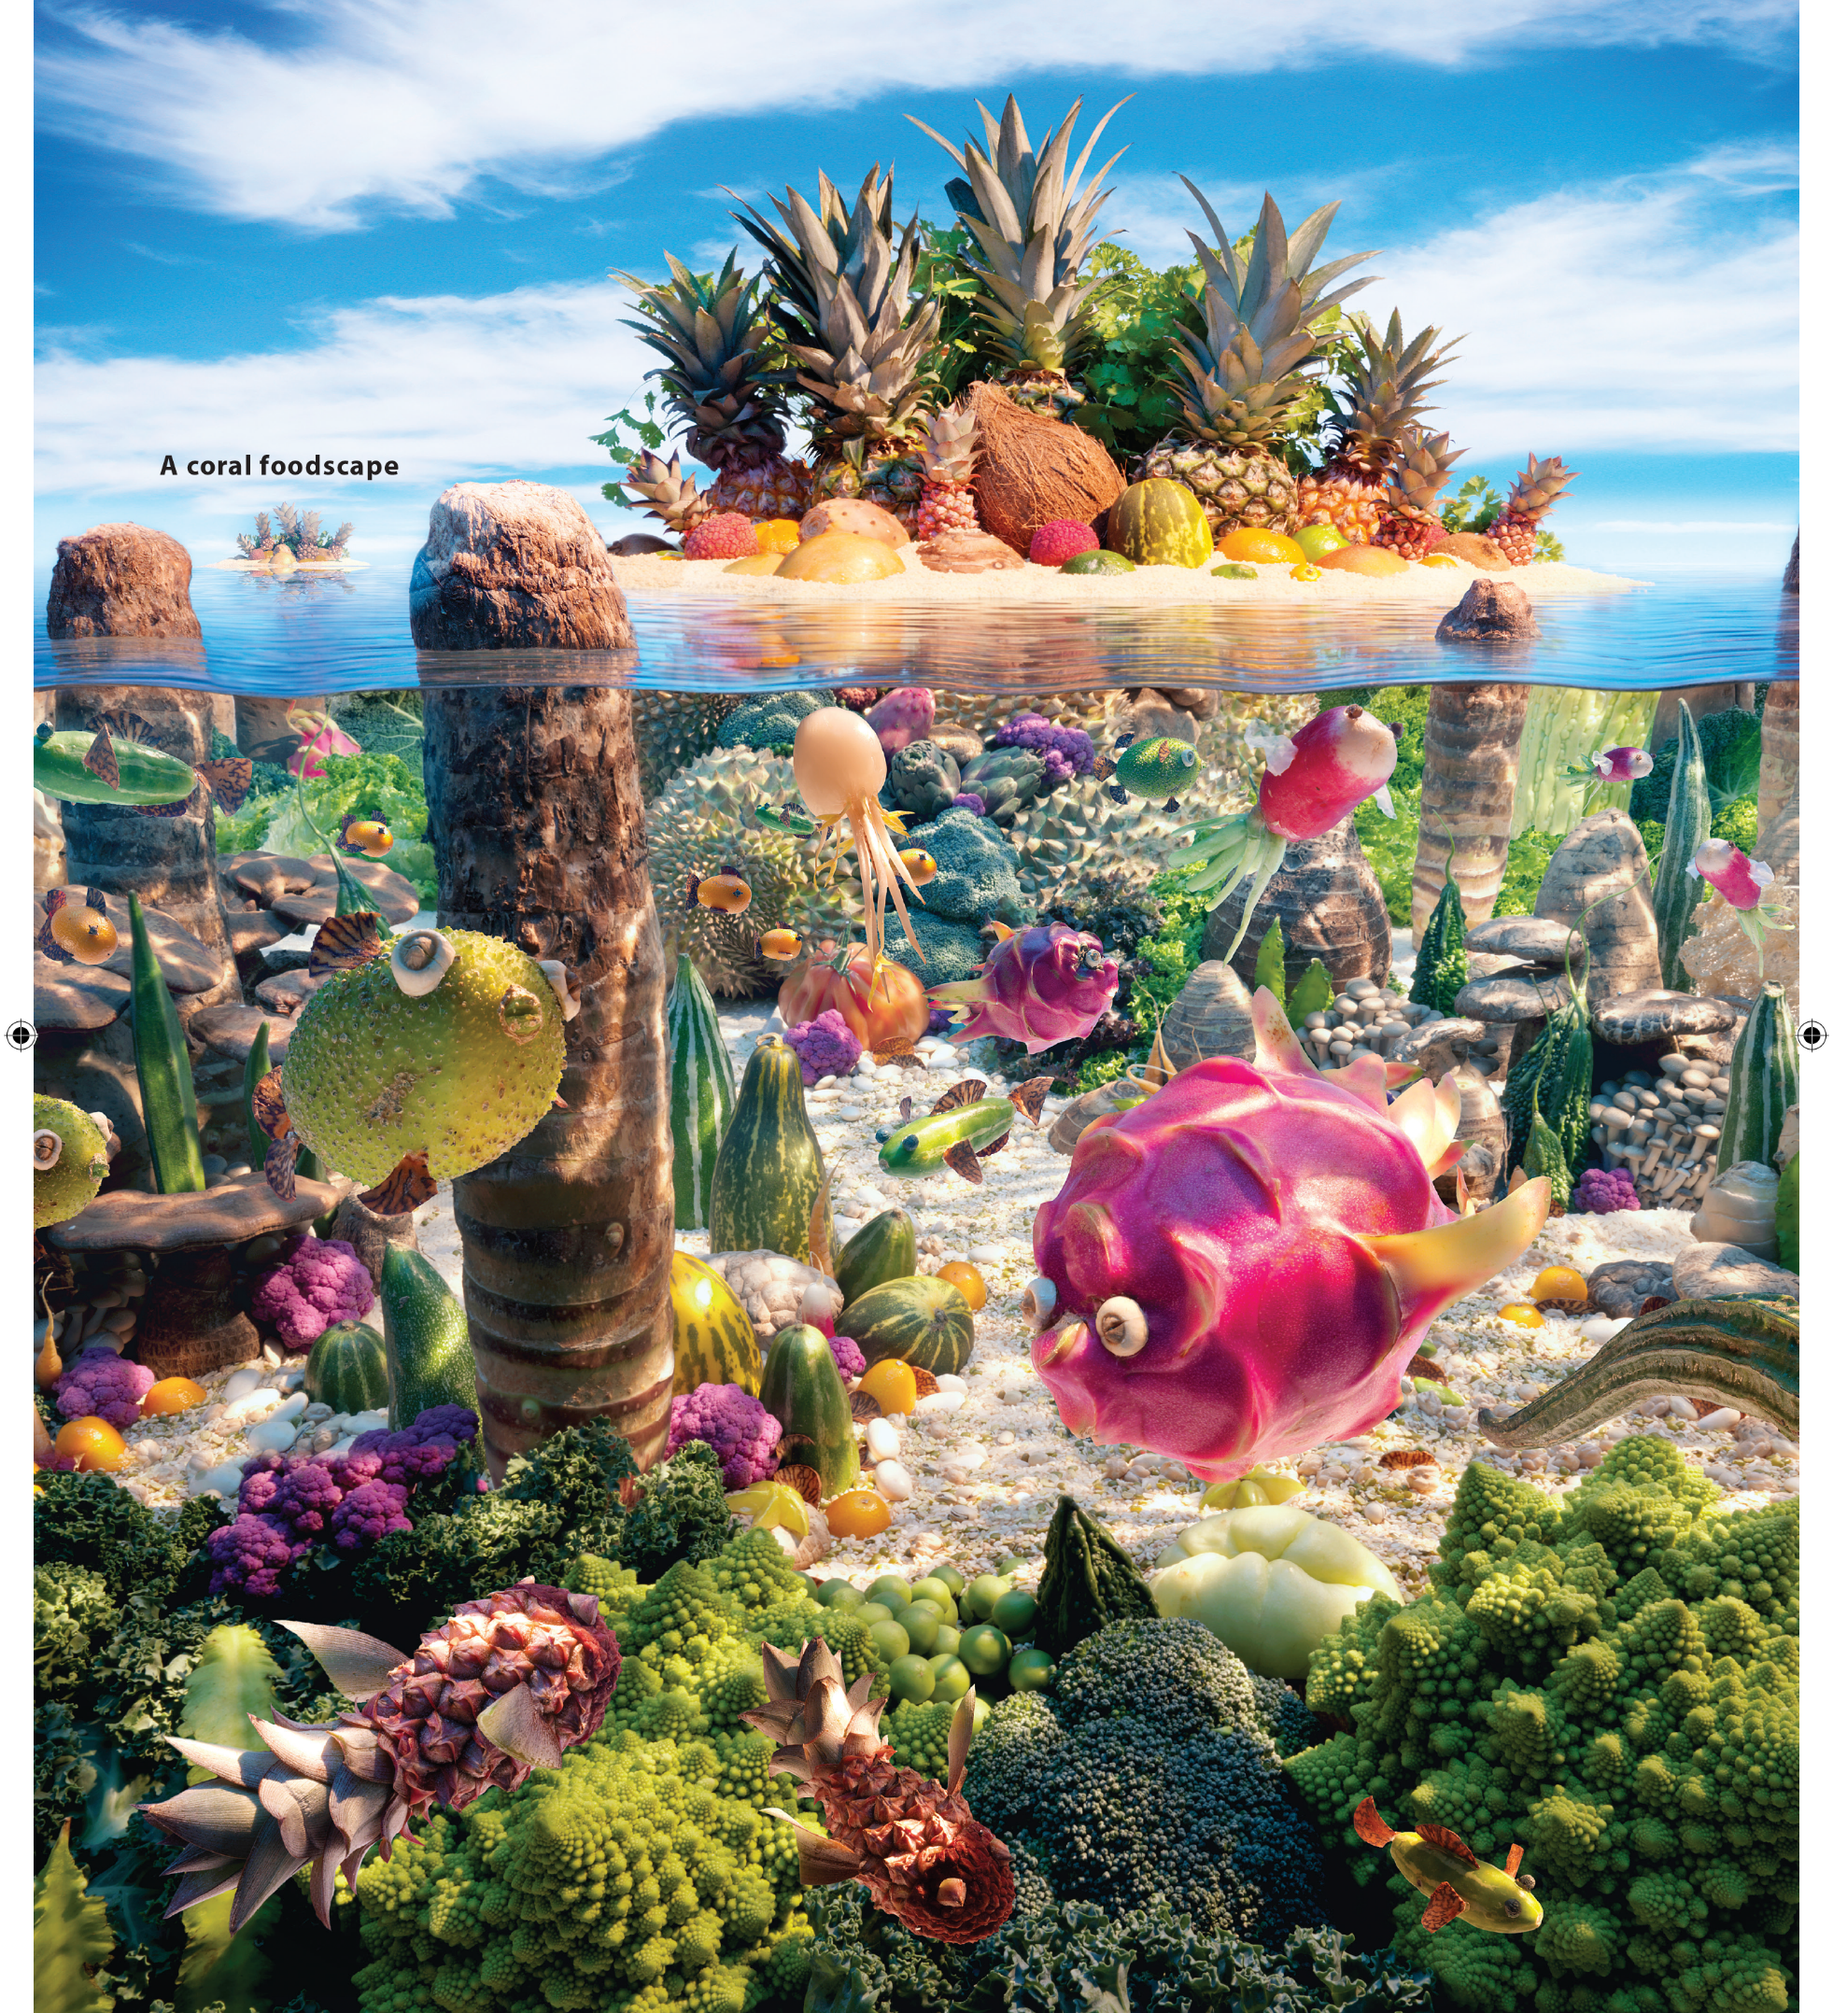

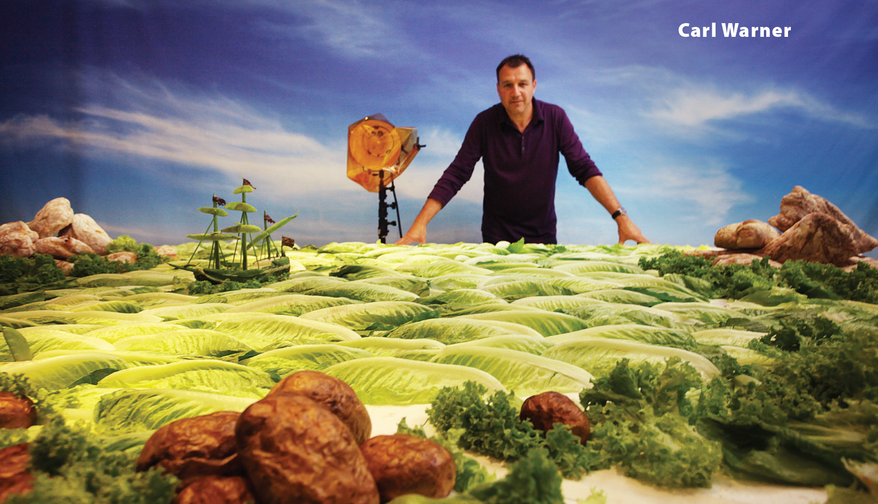
UNIT 5
I LIKE FRUIT!
READING

Slide 17

UNIT 5
I LIKE FRUIT!
READING

Slide 18

UNIT 5
I LIKE FRUIT!
READING

Slide 19
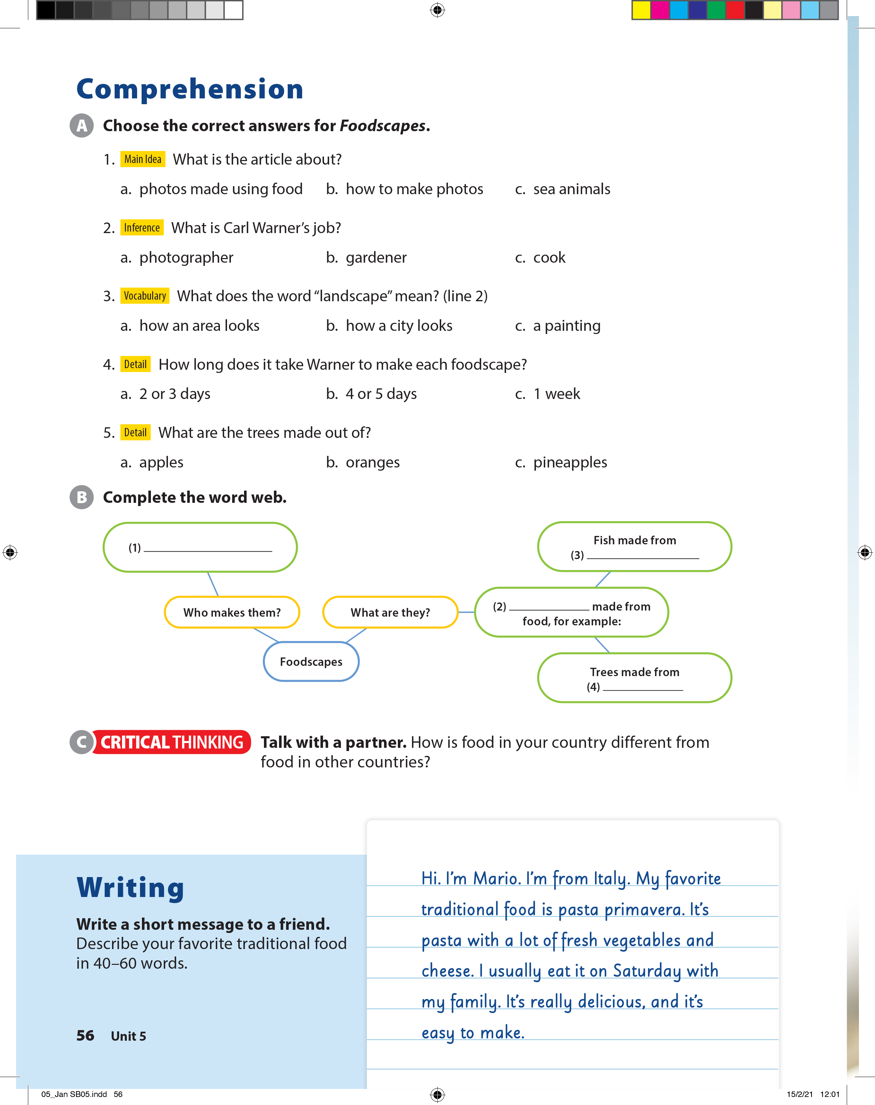
UNIT 5
I LIKE FRUIT!
COMPREHENSION

Slide 20
UNIT 5
I LIKE FRUIT!
COMPREHENSION
Carl Warner
fruit
landscapes
pineapples

Slide 21
UNIT 5
I LIKE FRUIT!
WRITING

Slide 22
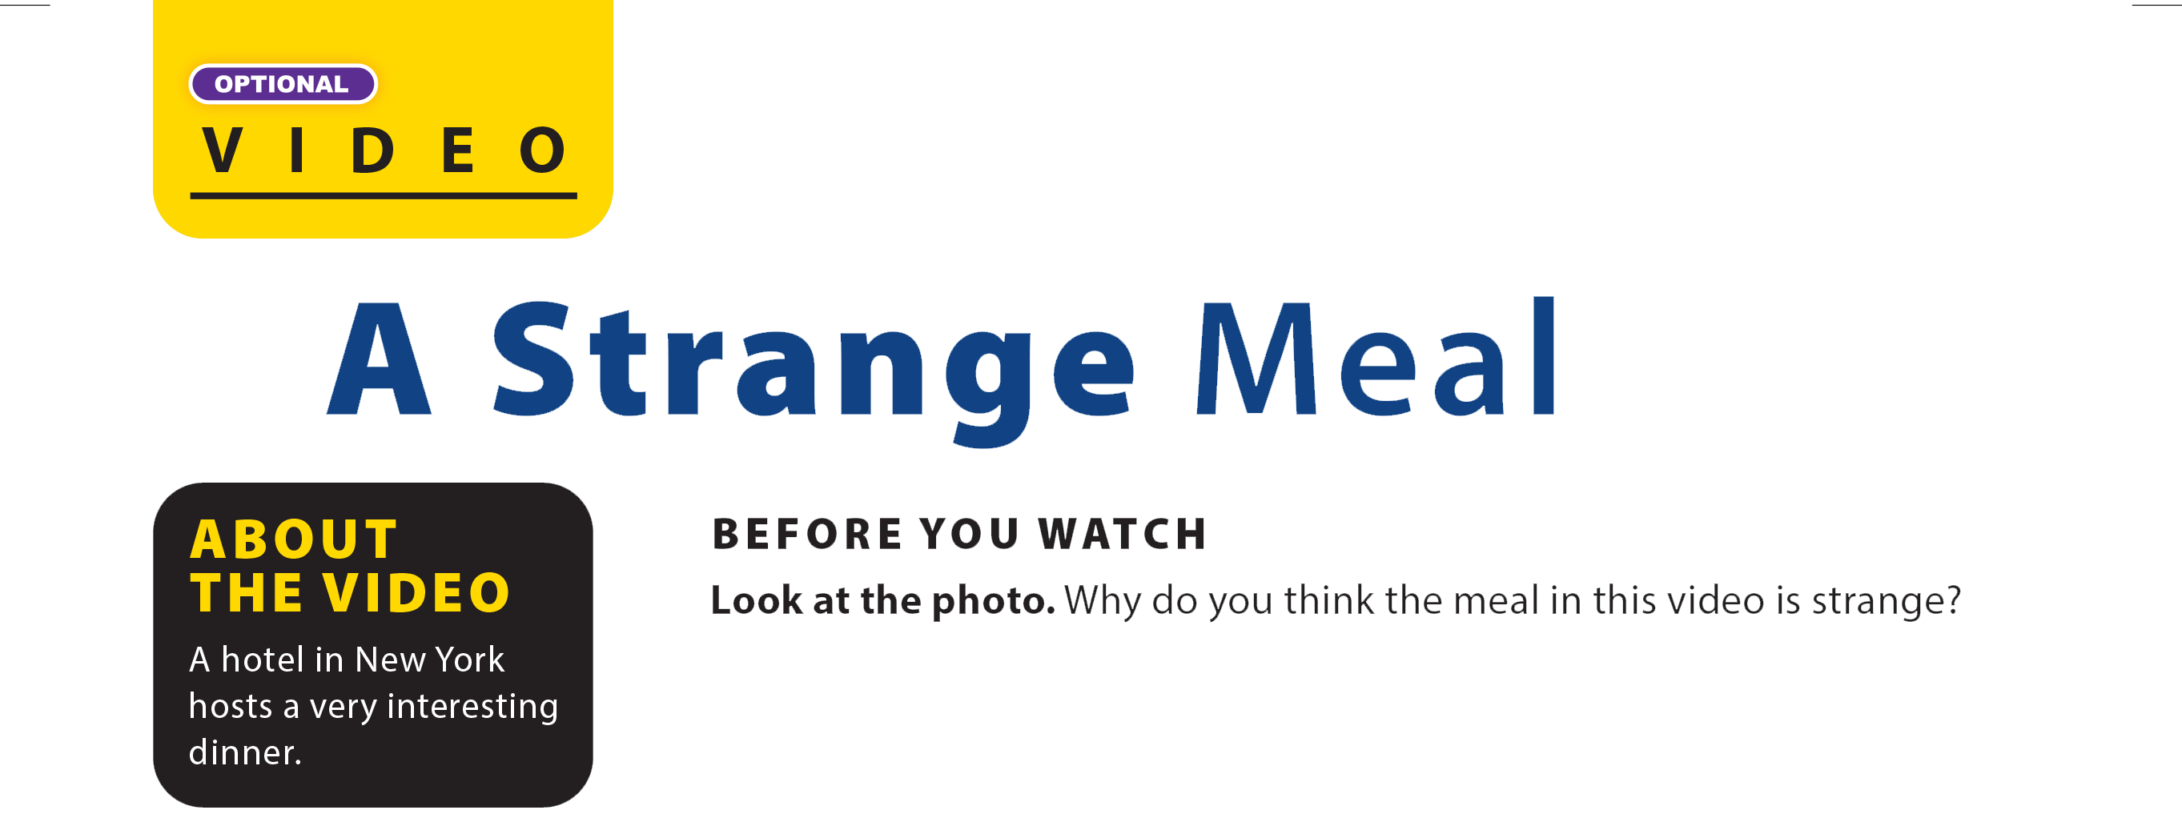
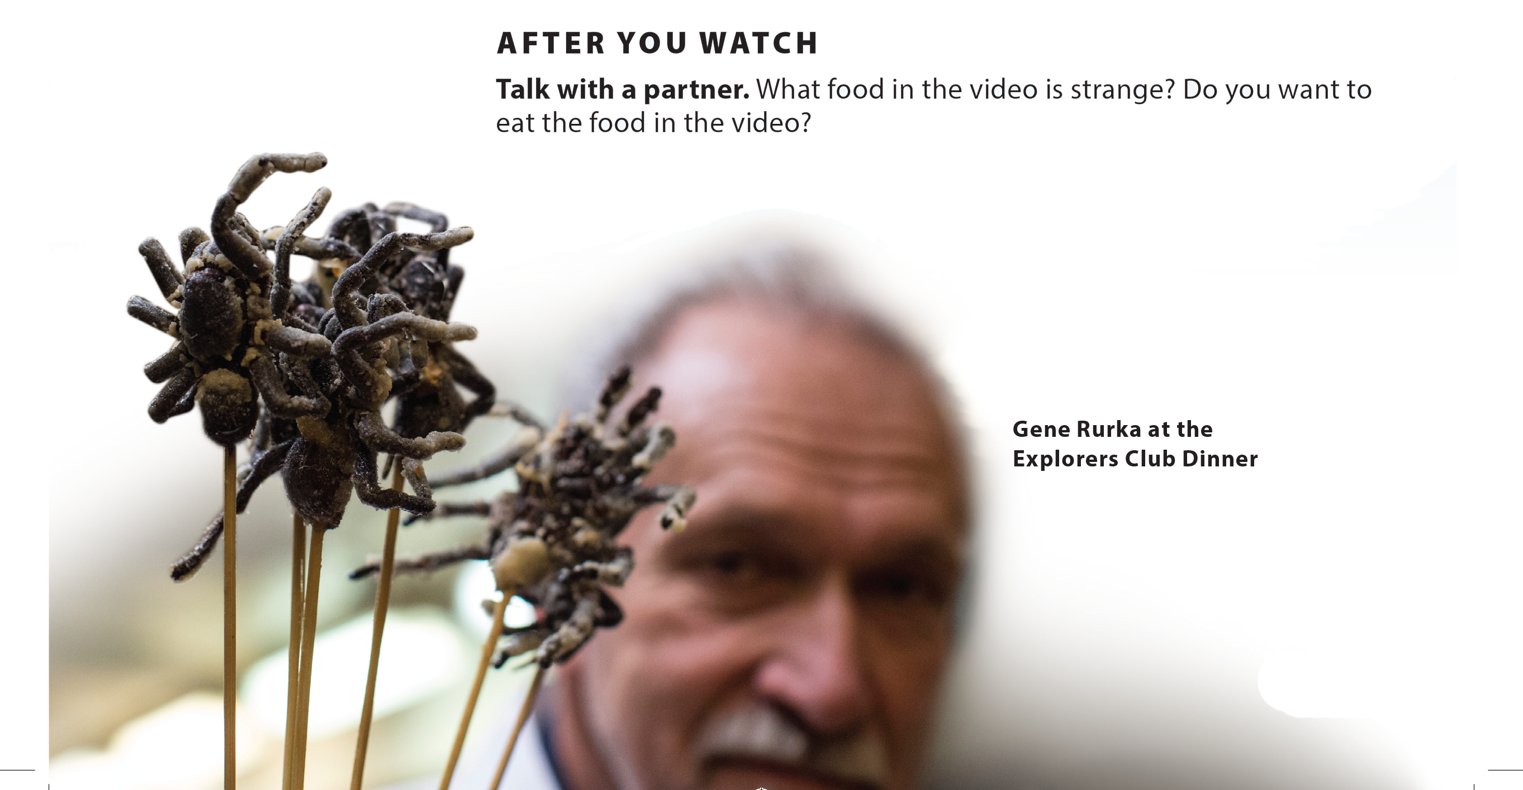
UNIT 5
I LIKE FRUIT!
VIDEO

Slide 23

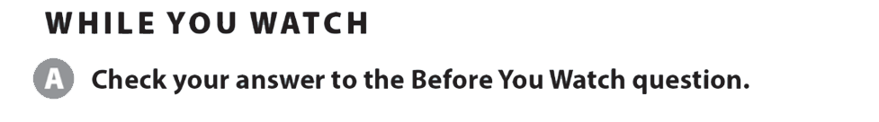
UNIT 5
I LIKE FRUIT!
VIDEO

Slide 24
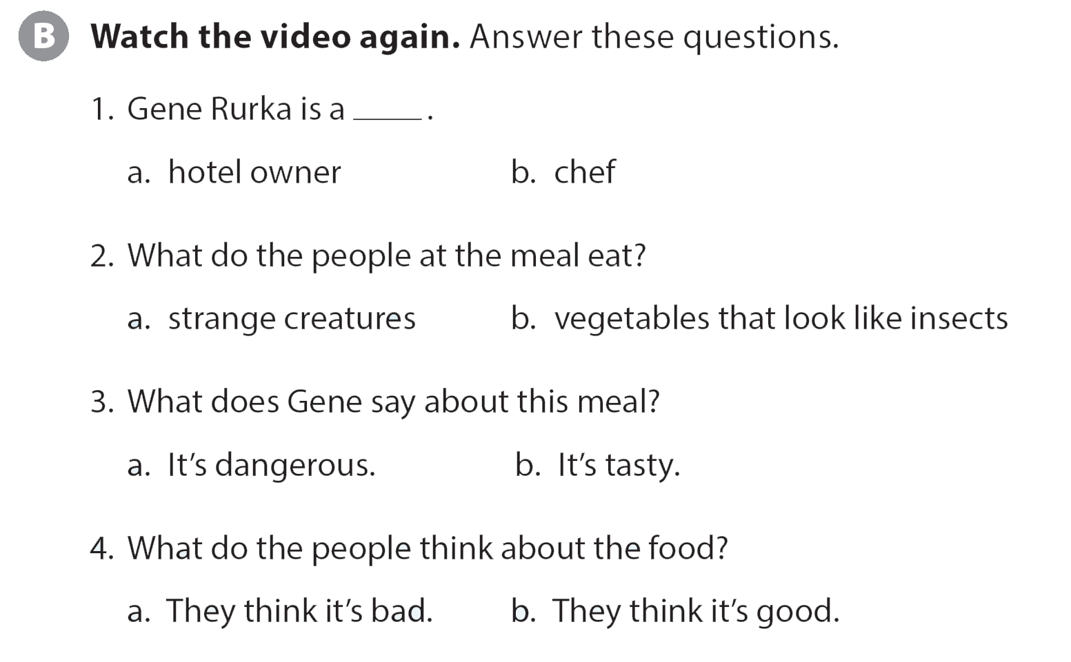
UNIT 5
I LIKE FRUIT!
VIDEO

Slide 25
UNIT 5
I LIKE FRUIT!
VIDEO

