Slide 1
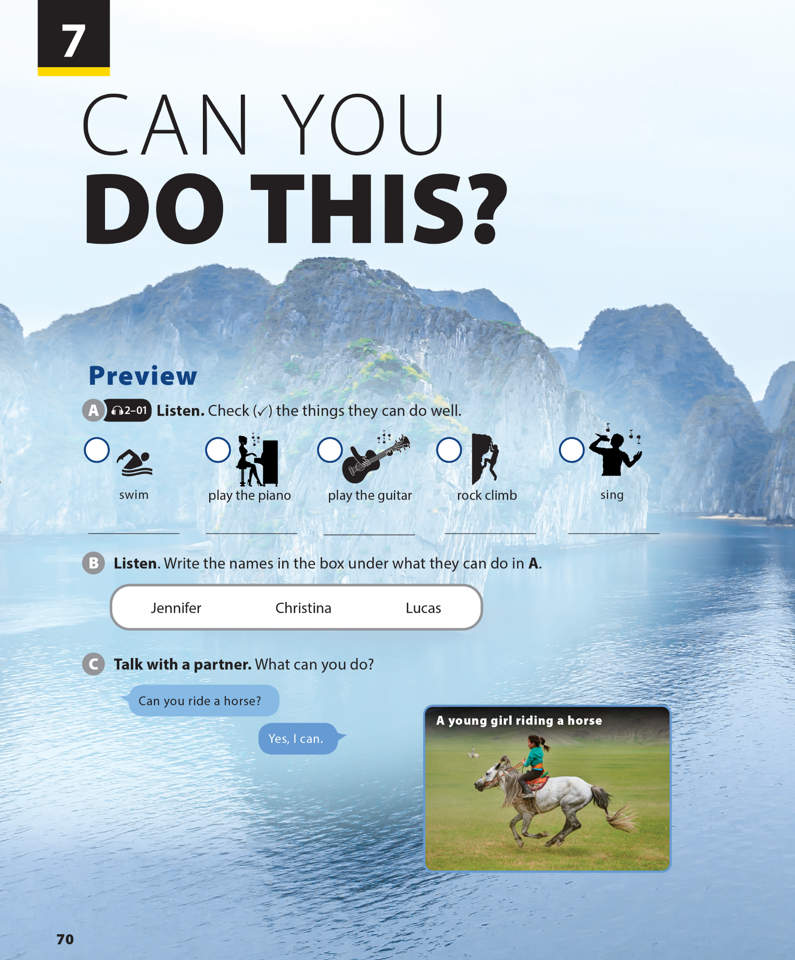
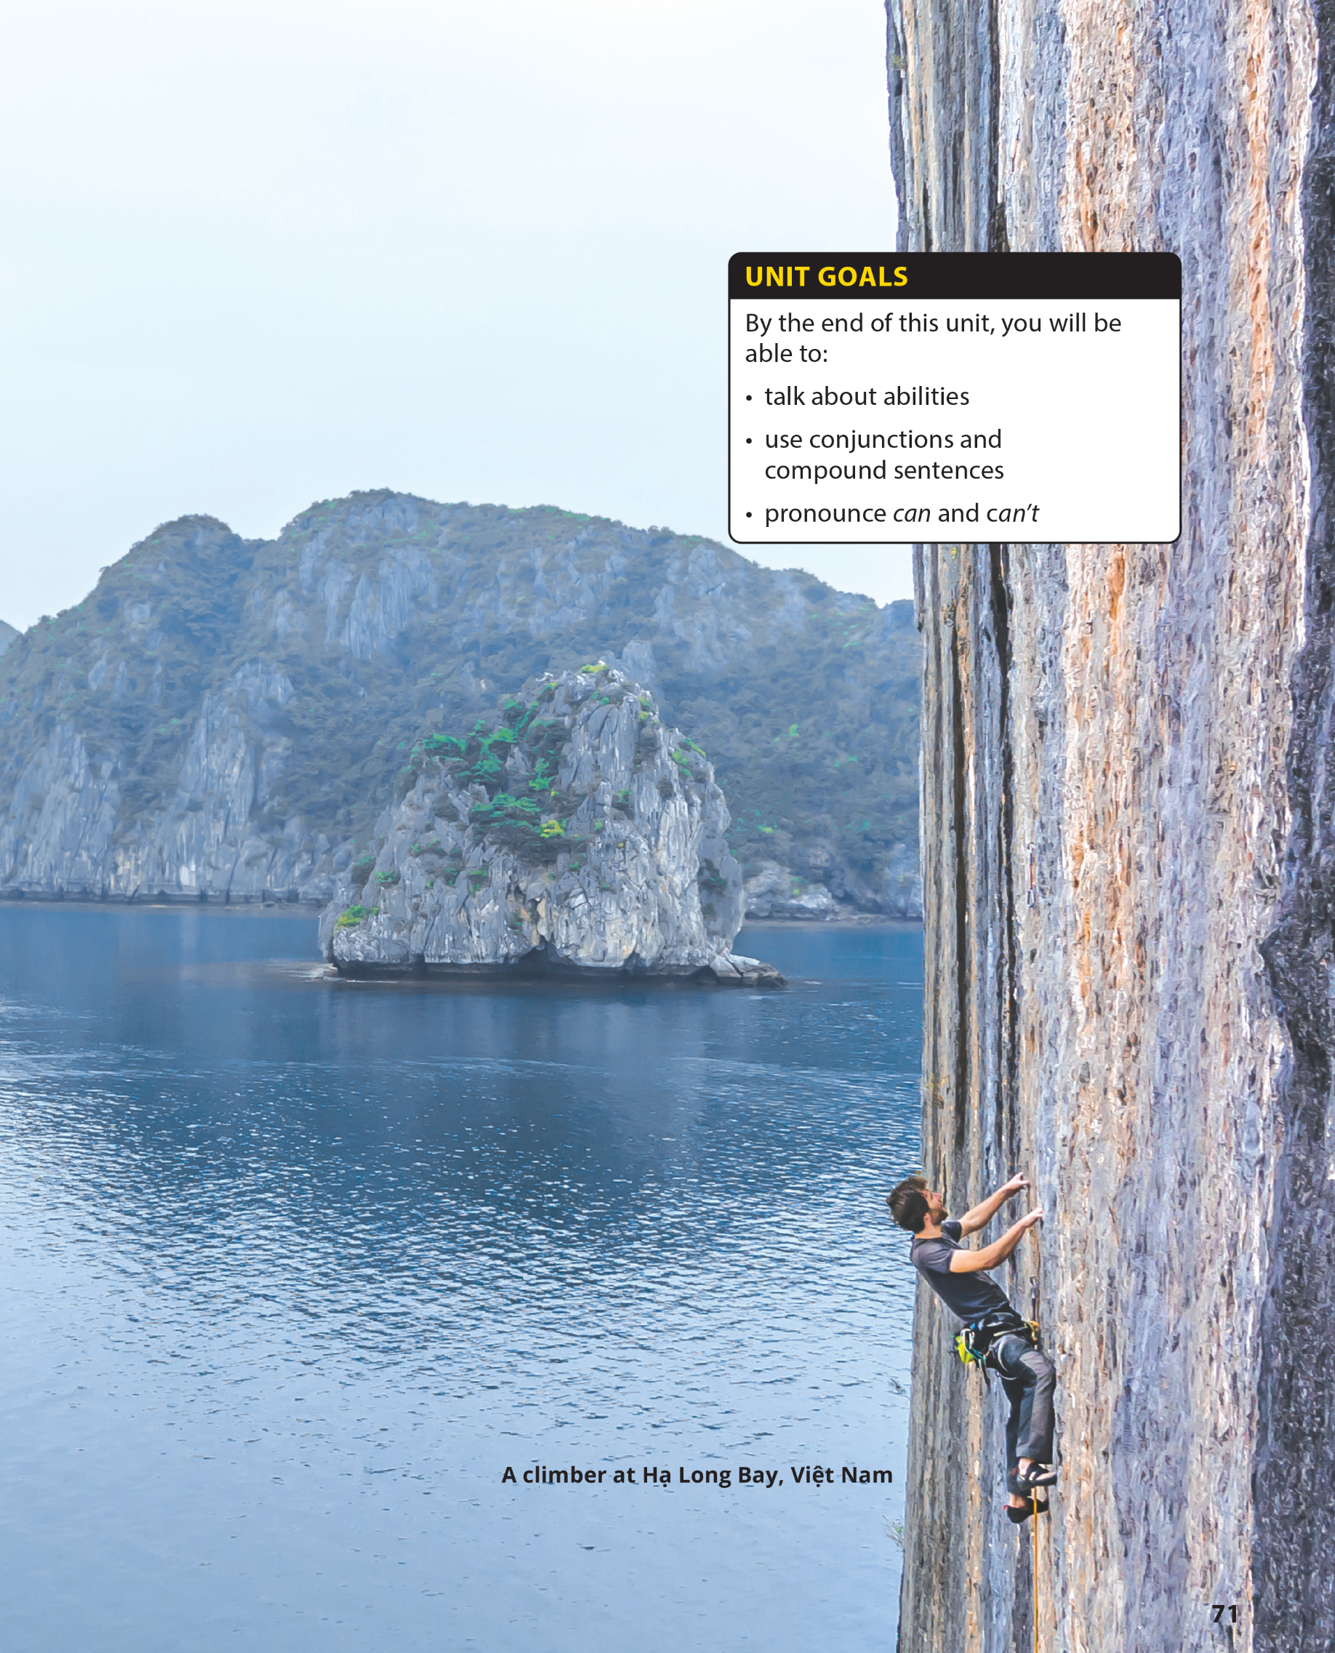

Slide 2

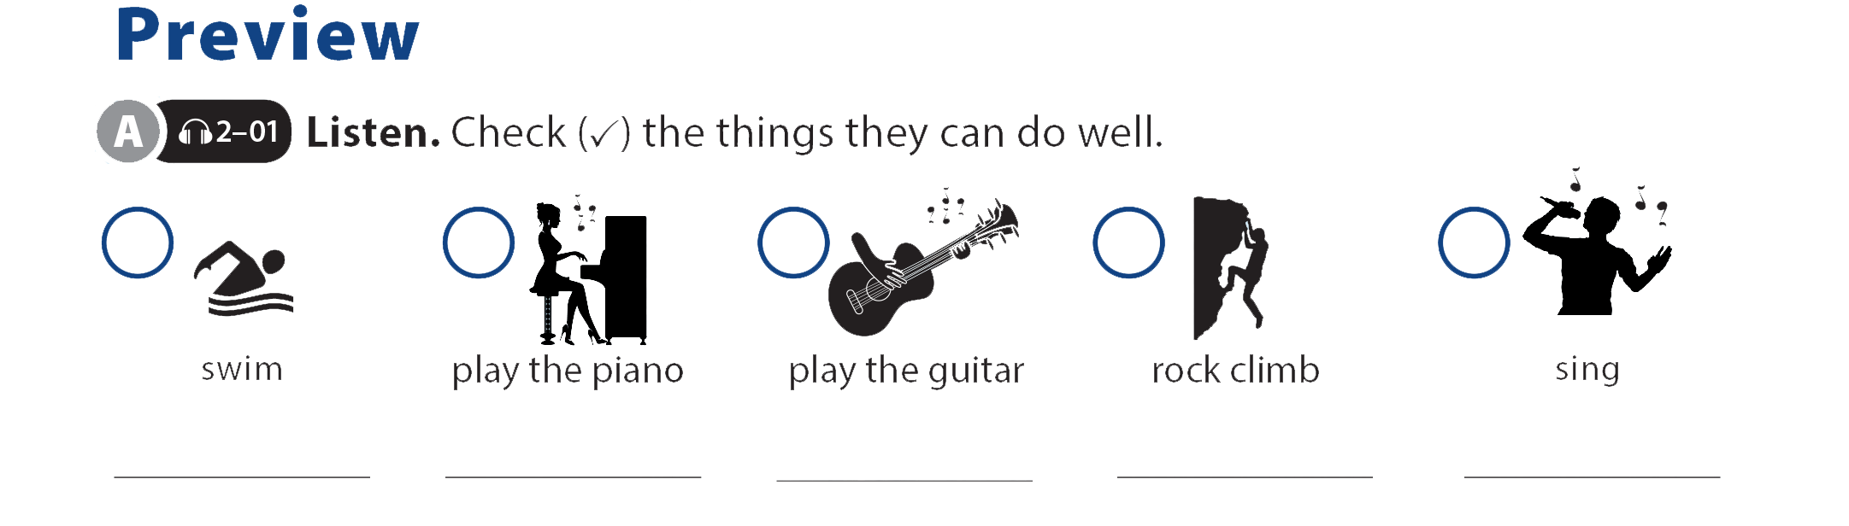



UNIT 7
CAN YOU DO THIS?
PREVIEW
Lucas
Jennifer
Christina

Slide 3
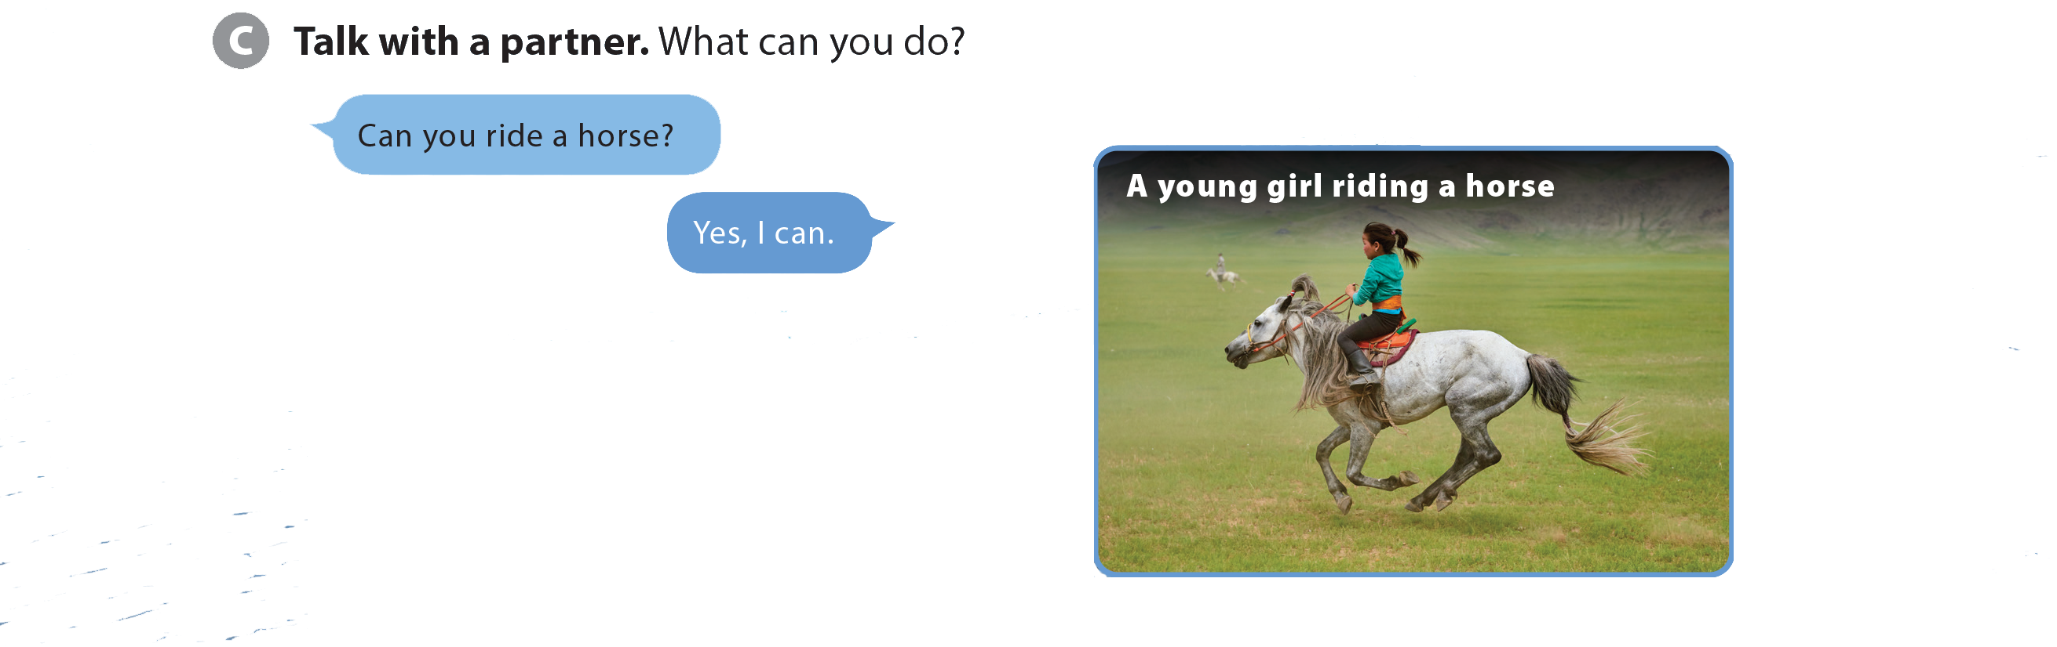
UNIT 7
CAN YOU DO THIS?
PREVIEW

Slide 4
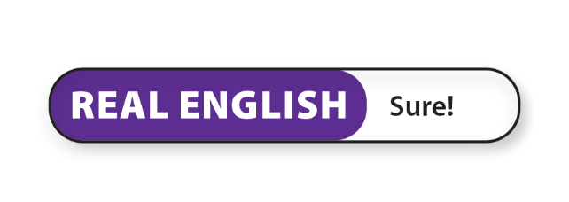


UNIT 7
CAN YOU DO THIS?
LANGUAGE FOCUS

Slide 5
UNIT 7
CAN YOU DO THIS?
LANGUAGE FOCUS

Slide 6
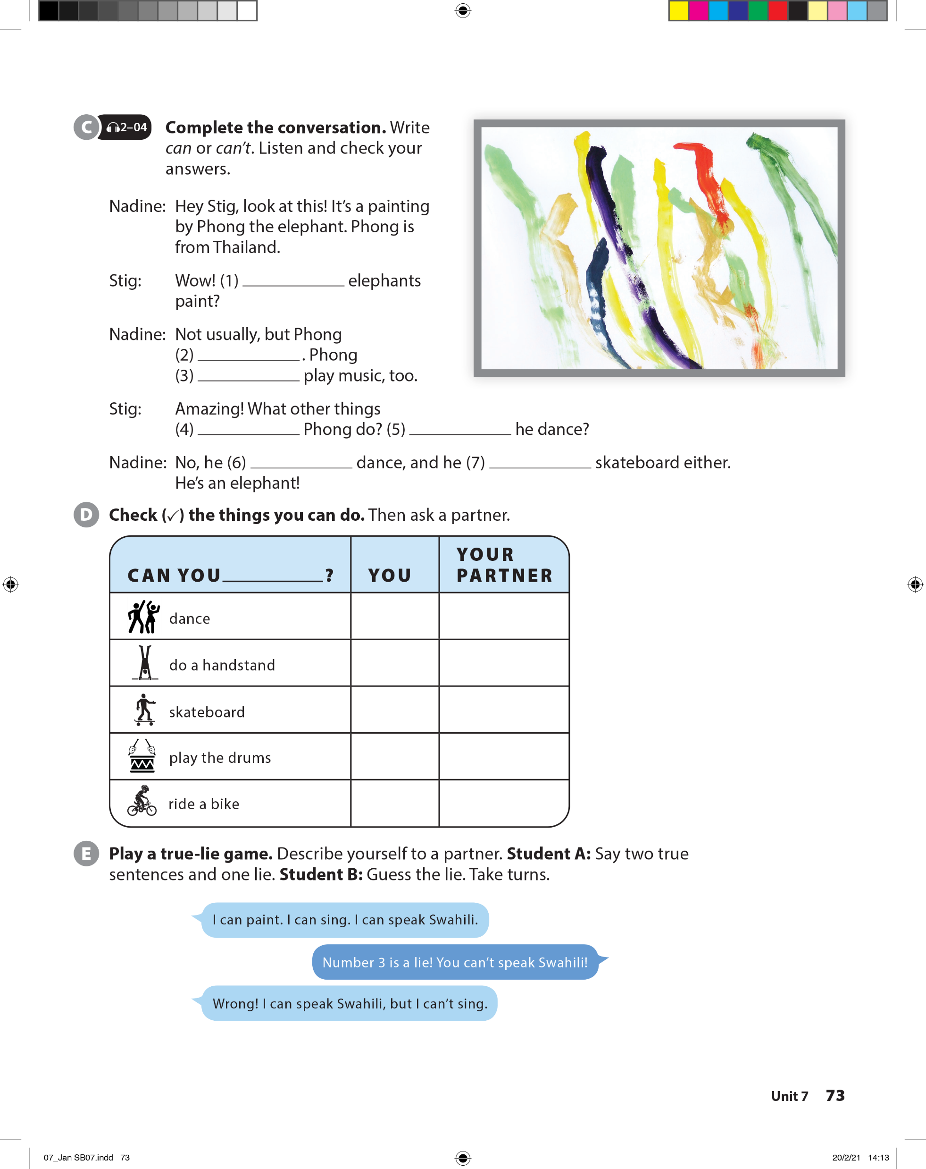
UNIT 7
CAN YOU DO THIS?
LANGUAGE FOCUS
Can
can
can
can
Can
can’t
can’t

Slide 7
UNIT 7
CAN YOU DO THIS?
LANGUAGE FOCUS

Slide 8
UNIT 7
CAN YOU DO THIS?
LANGUAGE FOCUS

Slide 9
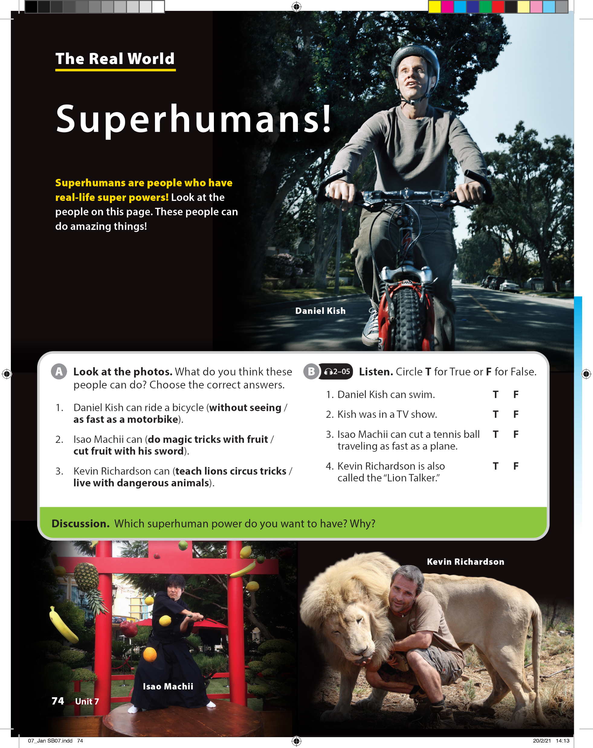
UNIT 7
CAN YOU DO THIS?
THE REAL WORLD

Slide 10

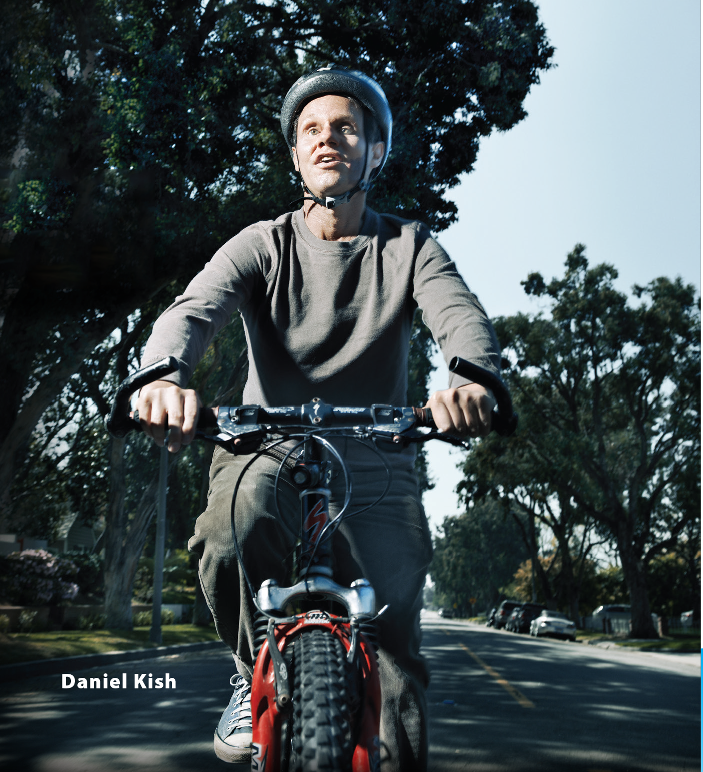
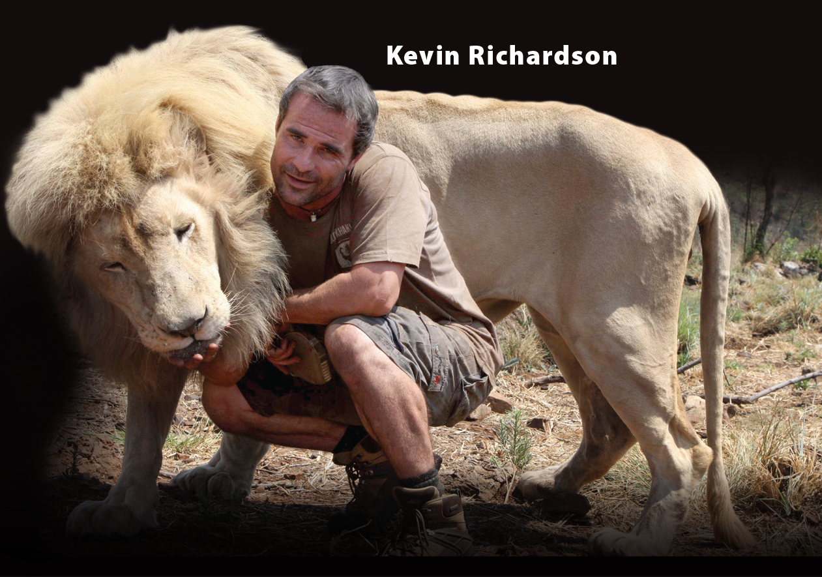
UNIT 7
CAN YOU DO THIS?
THE REAL WORLD

Slide 11

UNIT 7
CAN YOU DO THIS?
THE REAL WORLD

Slide 12
UNIT 7
CAN YOU DO THIS?
THE REAL WORLD

Slide 13
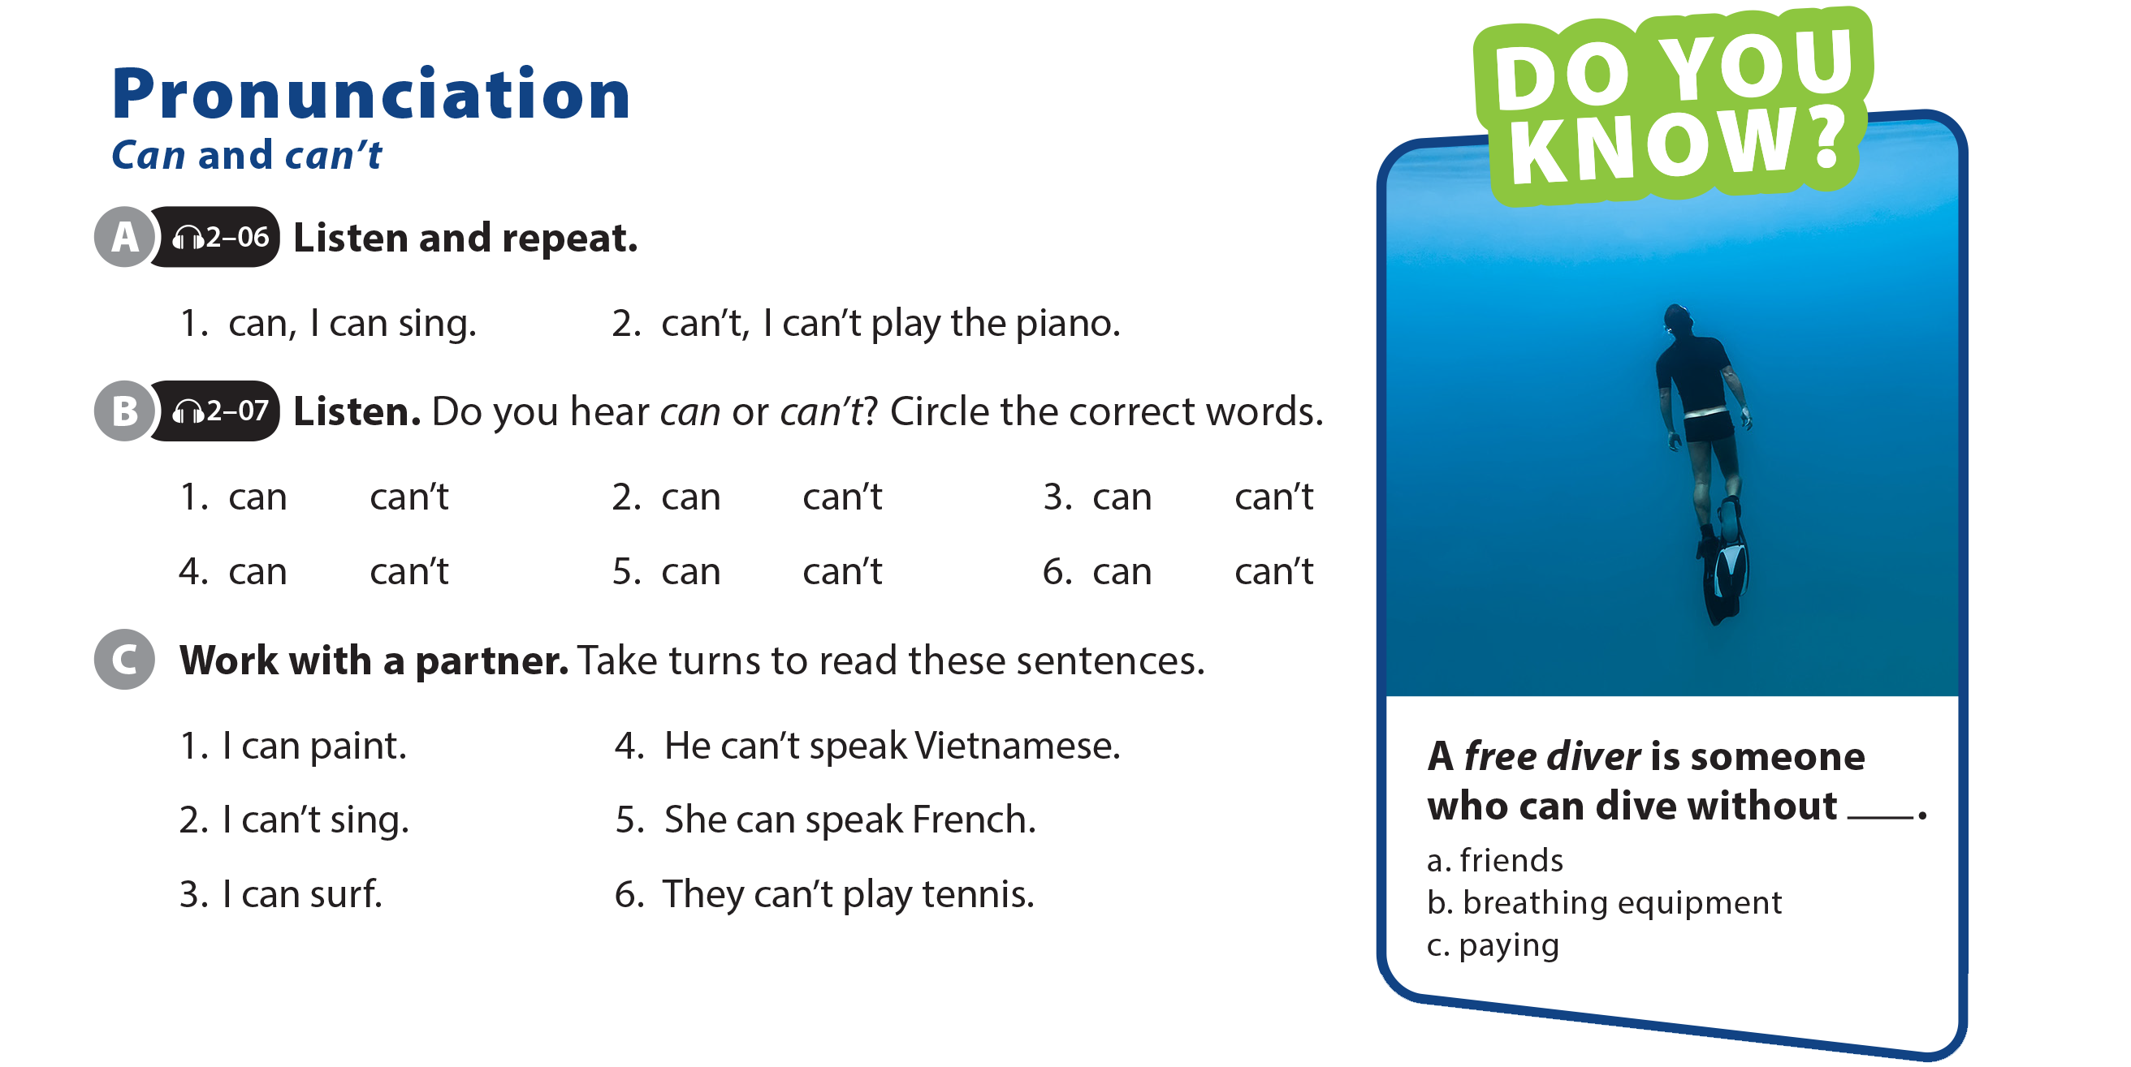
UNIT 7
CAN YOU DO THIS?
PRONUNCIATION

Slide 14
UNIT 7
CAN YOU DO THIS?
PRONUNCIATION

Slide 15
UNIT 7
CAN YOU DO THIS?
PRONUNCIATION

Slide 16
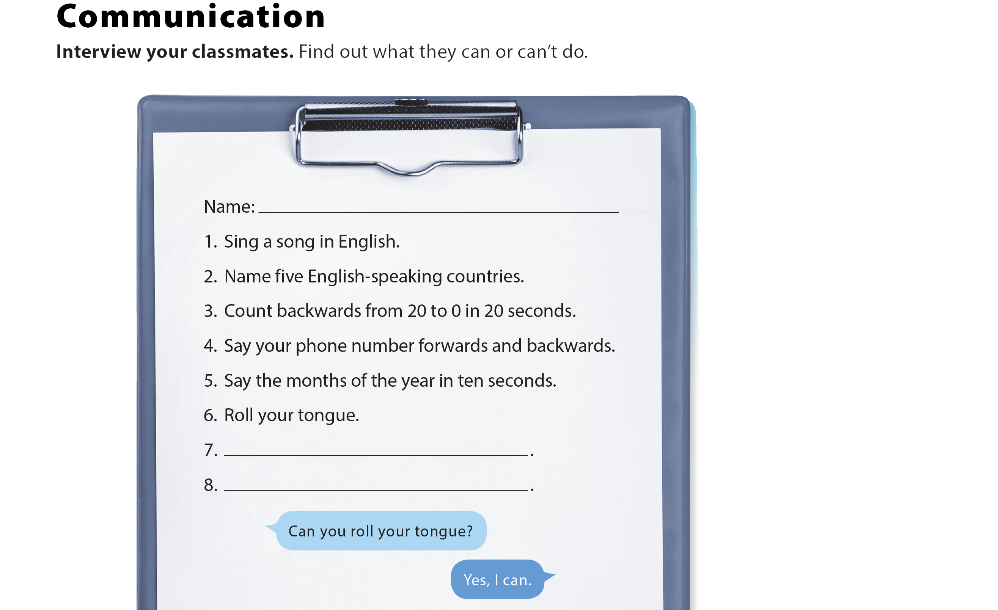
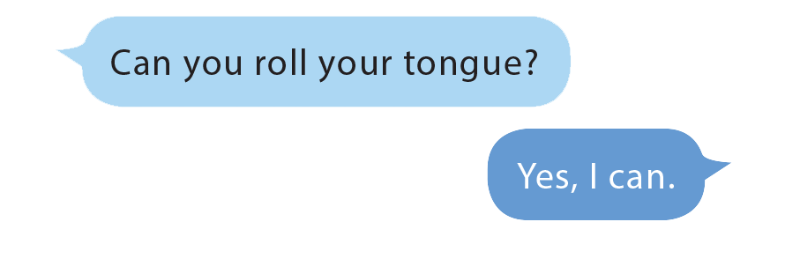
UNIT 7
CAN YOU DO THIS?
COMMUNICATION

Slide 17
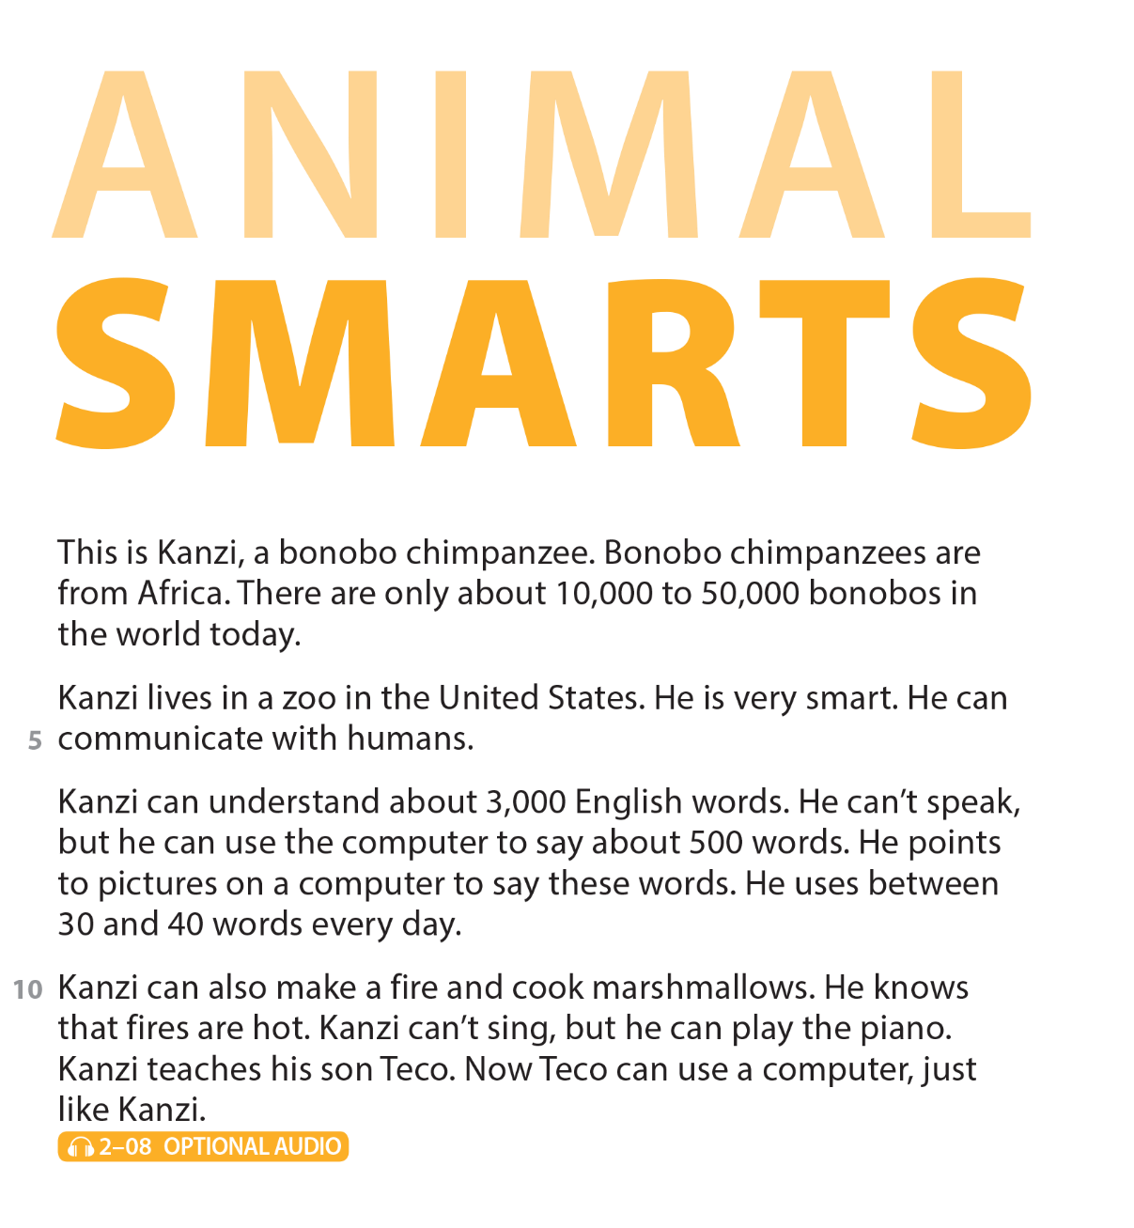

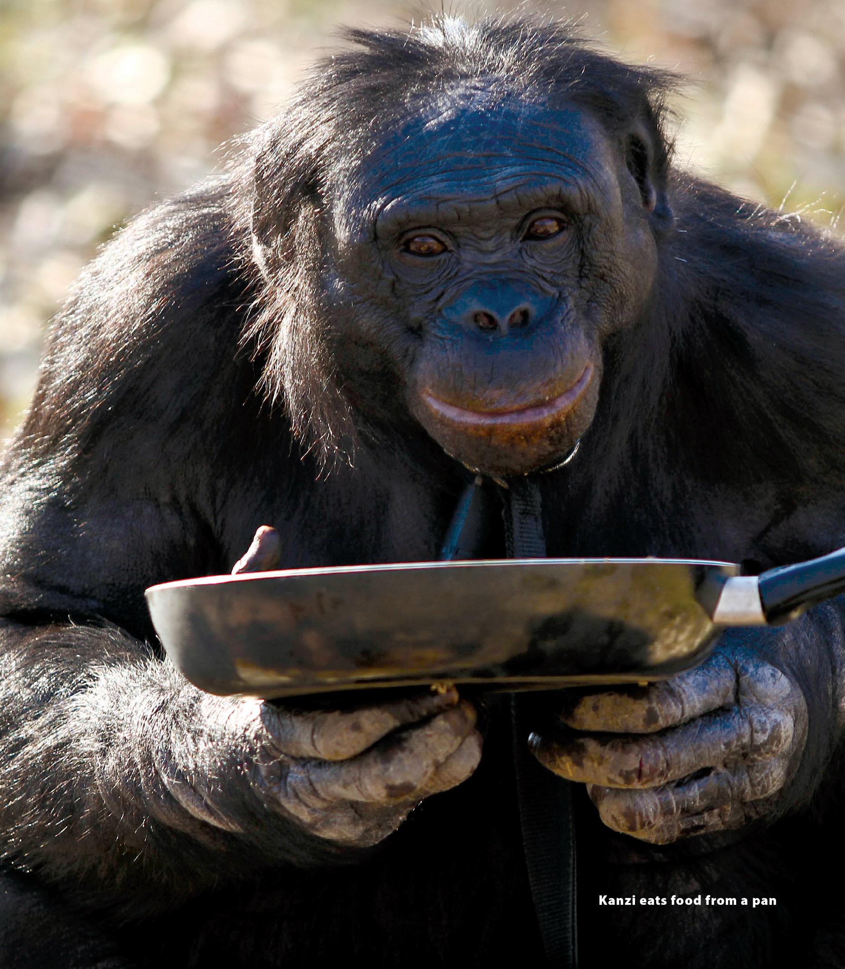
UNIT 7
CAN YOU DO THIS?
READING

Slide 18



UNIT 7
CAN YOU DO THIS?
READING

Slide 19

UNIT 7
CAN YOU DO THIS?
READING
in a zoo in the United States

Slide 20
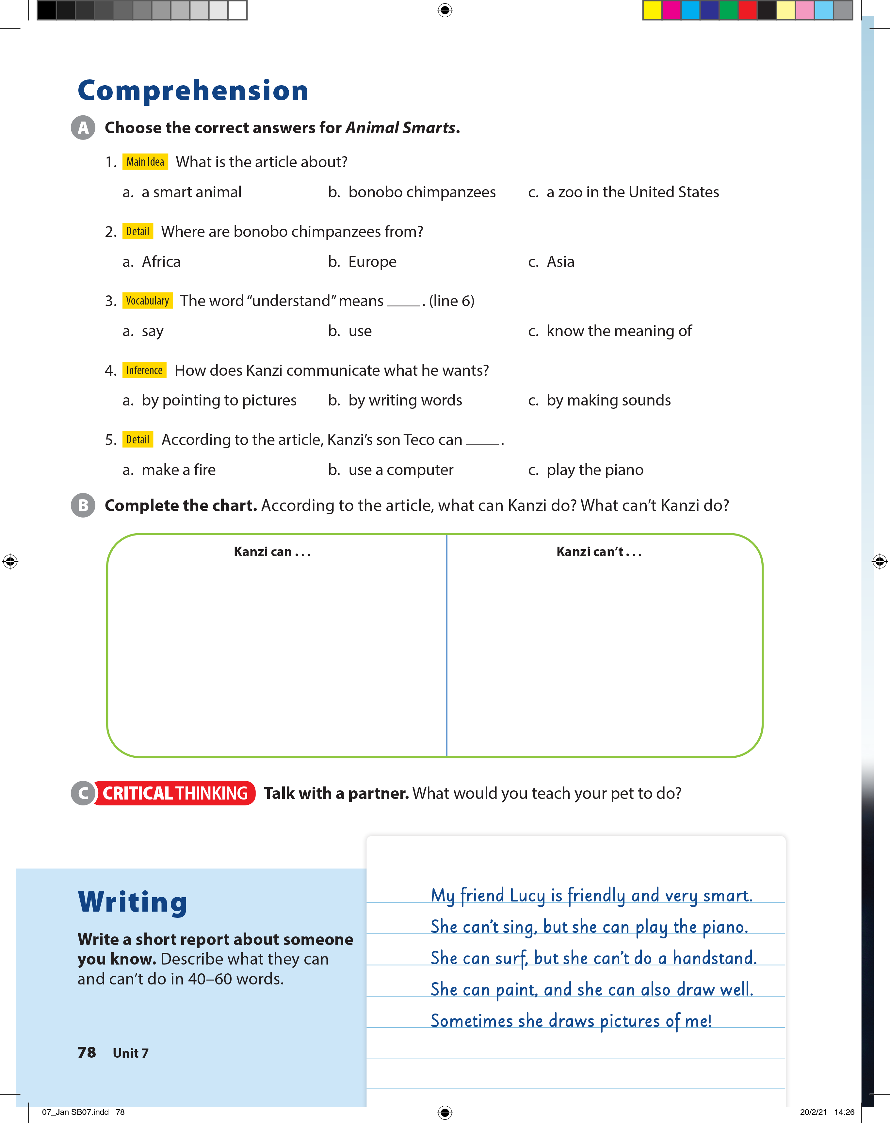
UNIT 7
CAN YOU DO THIS?
COMPREHENSION

Slide 21
UNIT 7
CAN YOU DO THIS?
COMPREHENSION
communicate with humans
understand about 3,000 English words
use the computer
make a fire
cook marshmallows
play the piano
speak
sing

Slide 22
UNIT 7
CAN YOU DO THIS?
WRITING

Slide 23
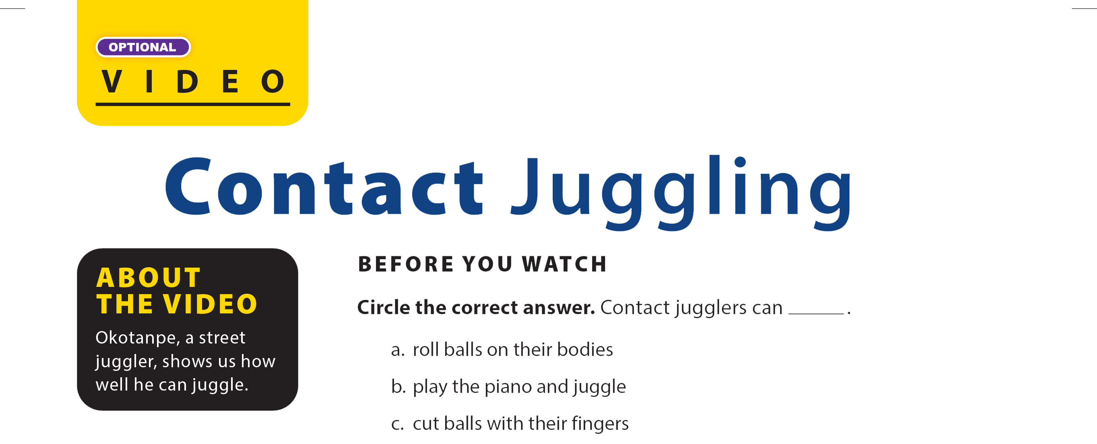

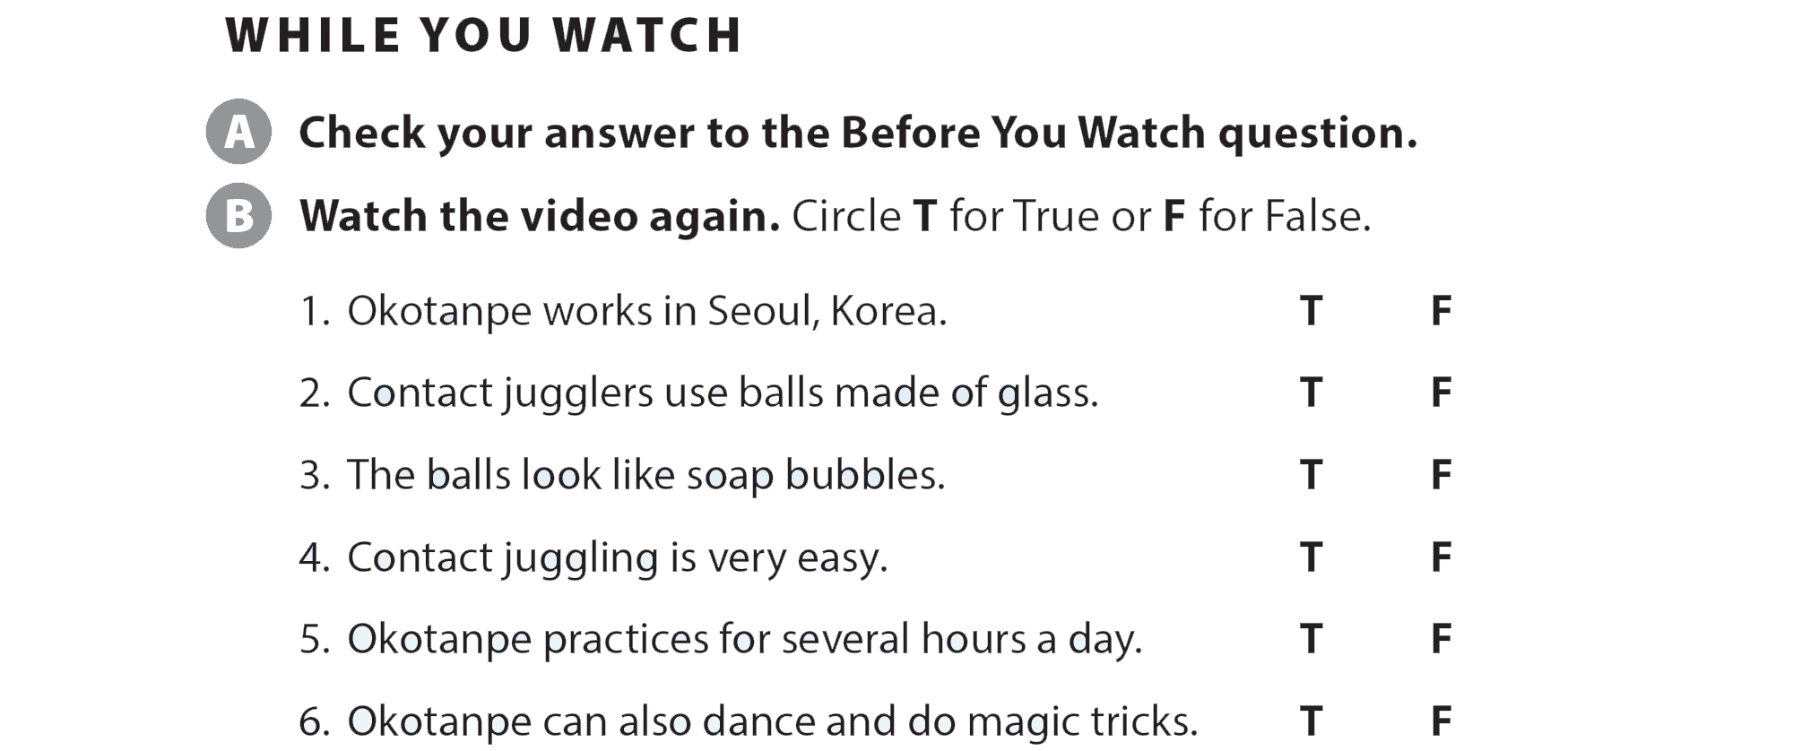
UNIT 7
CAN YOU DO THIS?
VIDEO

Slide 24
UNIT 7
CAN YOU DO THIS?
VIDEO

Slide 25
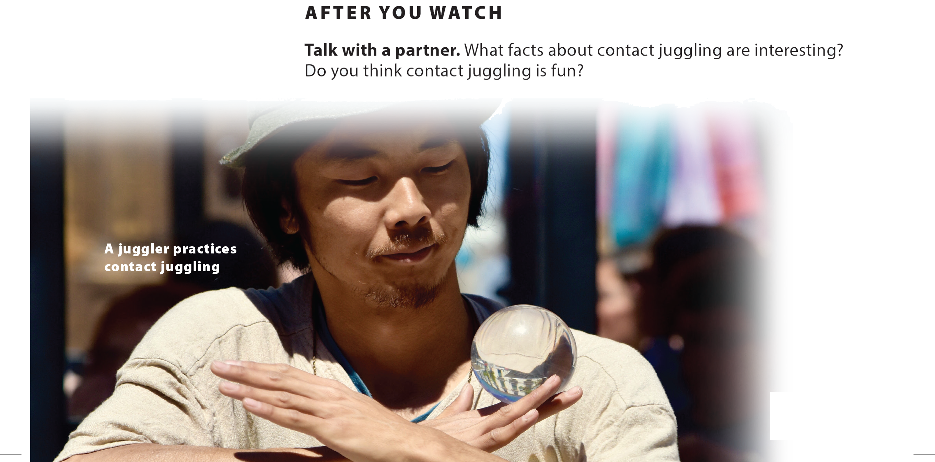
UNIT 7
CAN YOU DO THIS?
VIDEO

