Slide 1
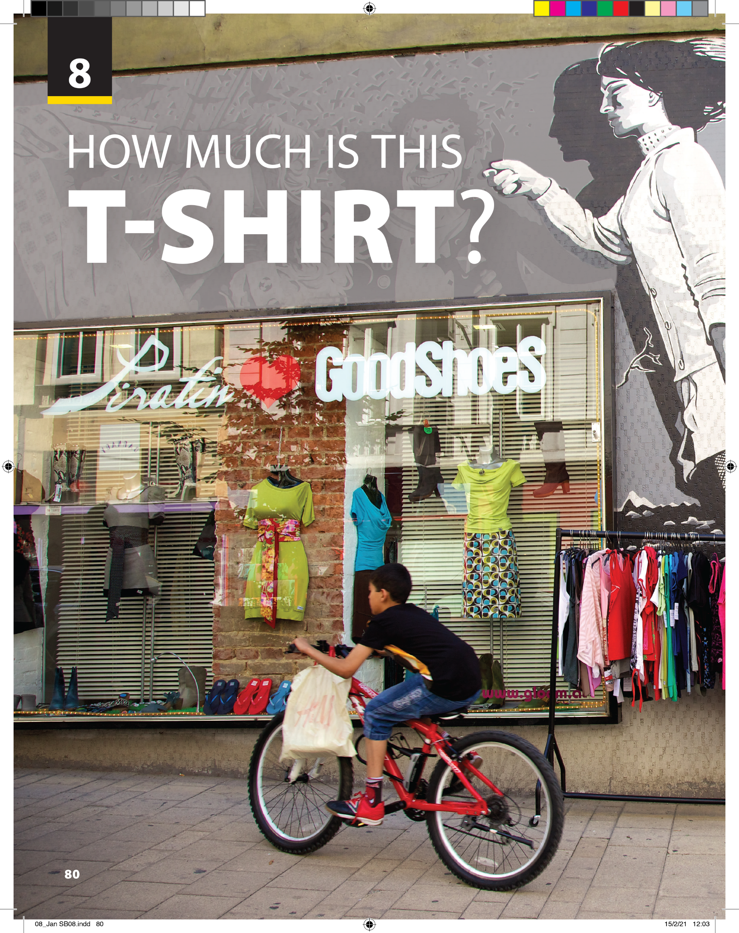
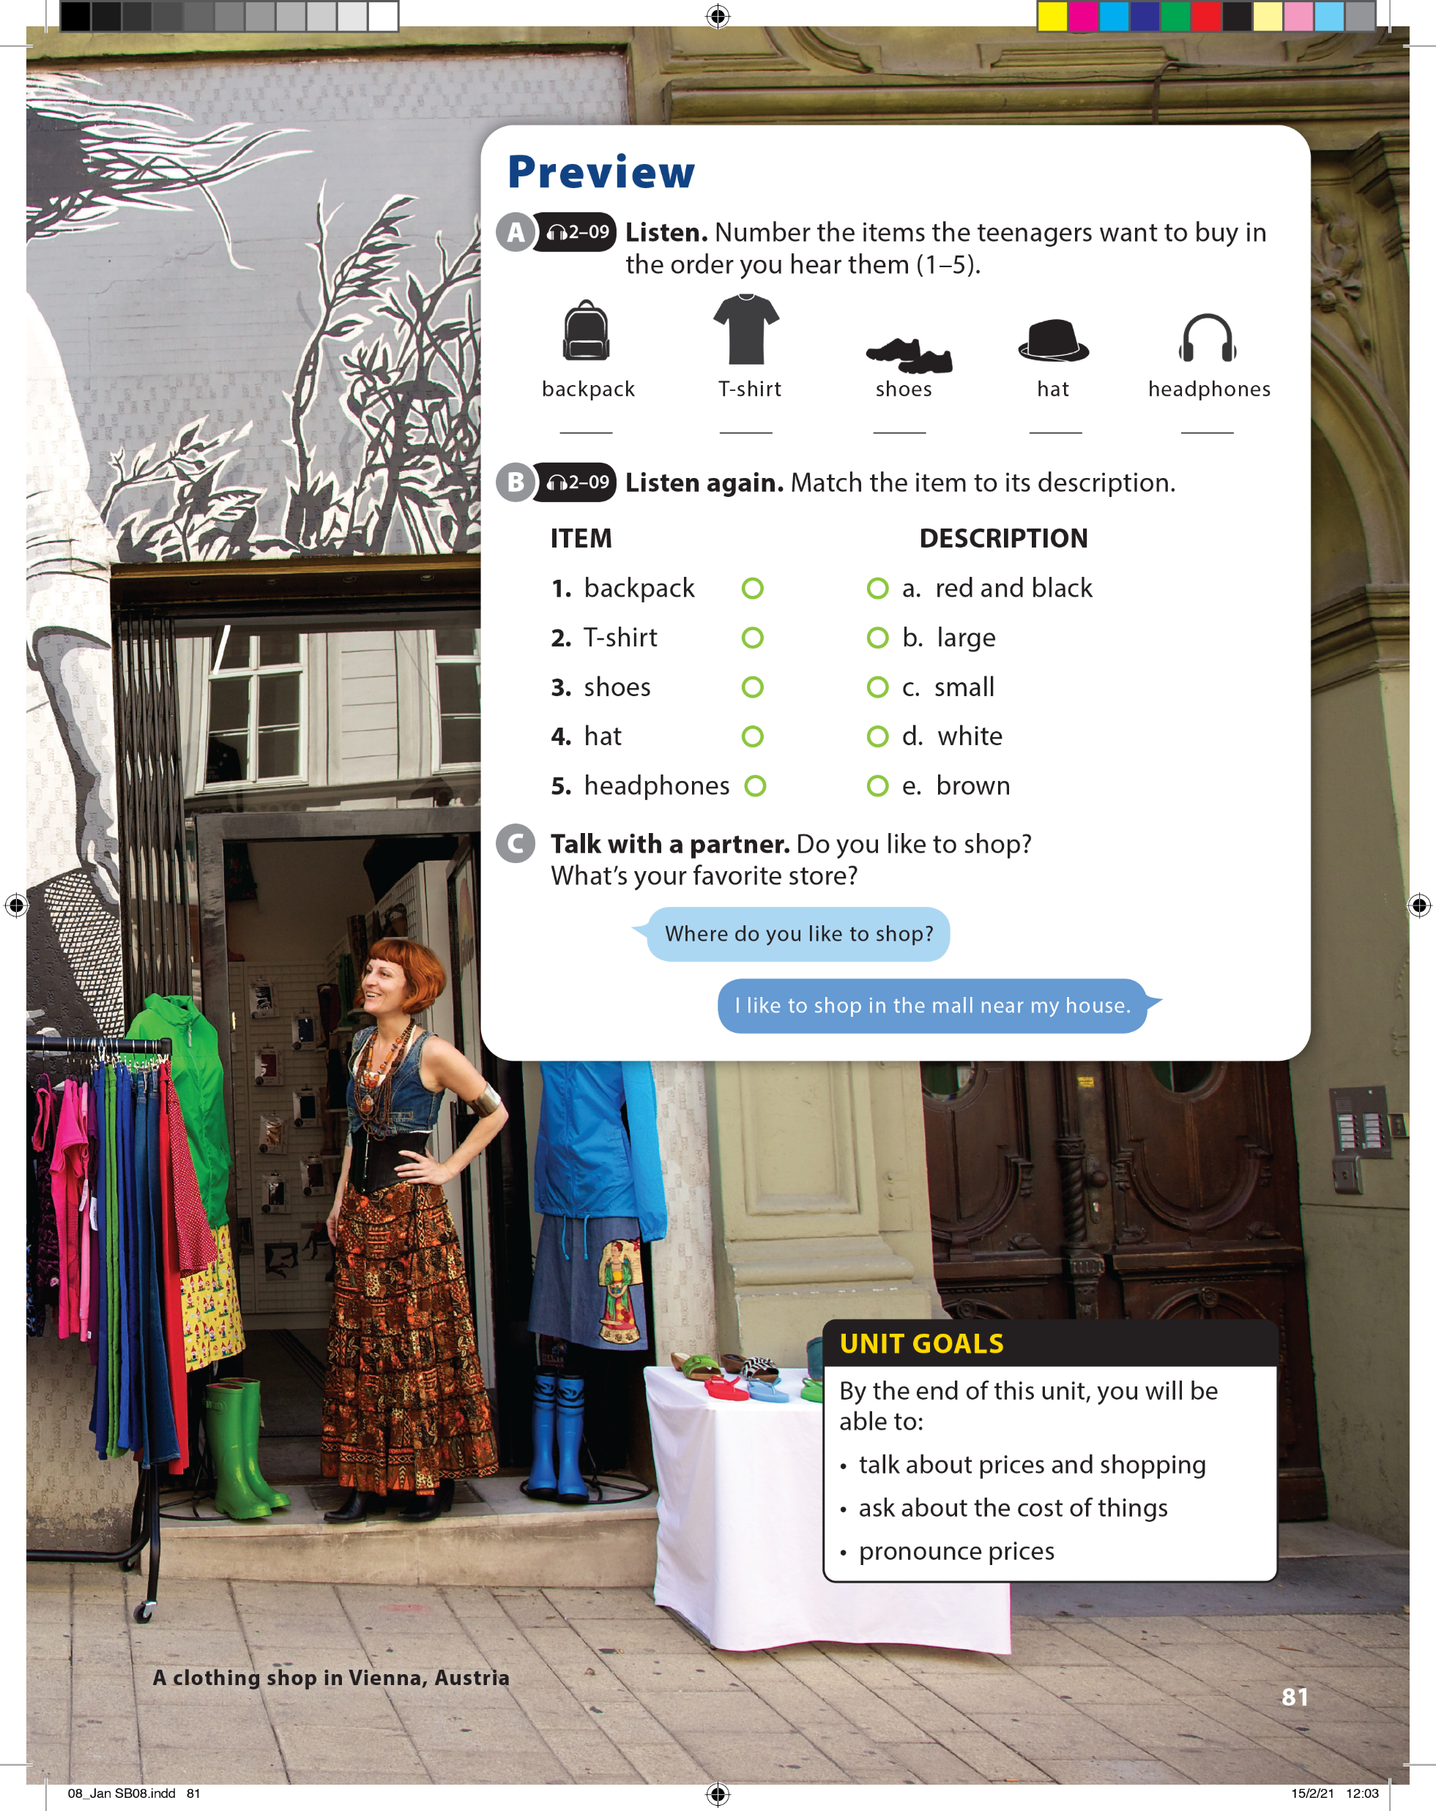

Slide 2

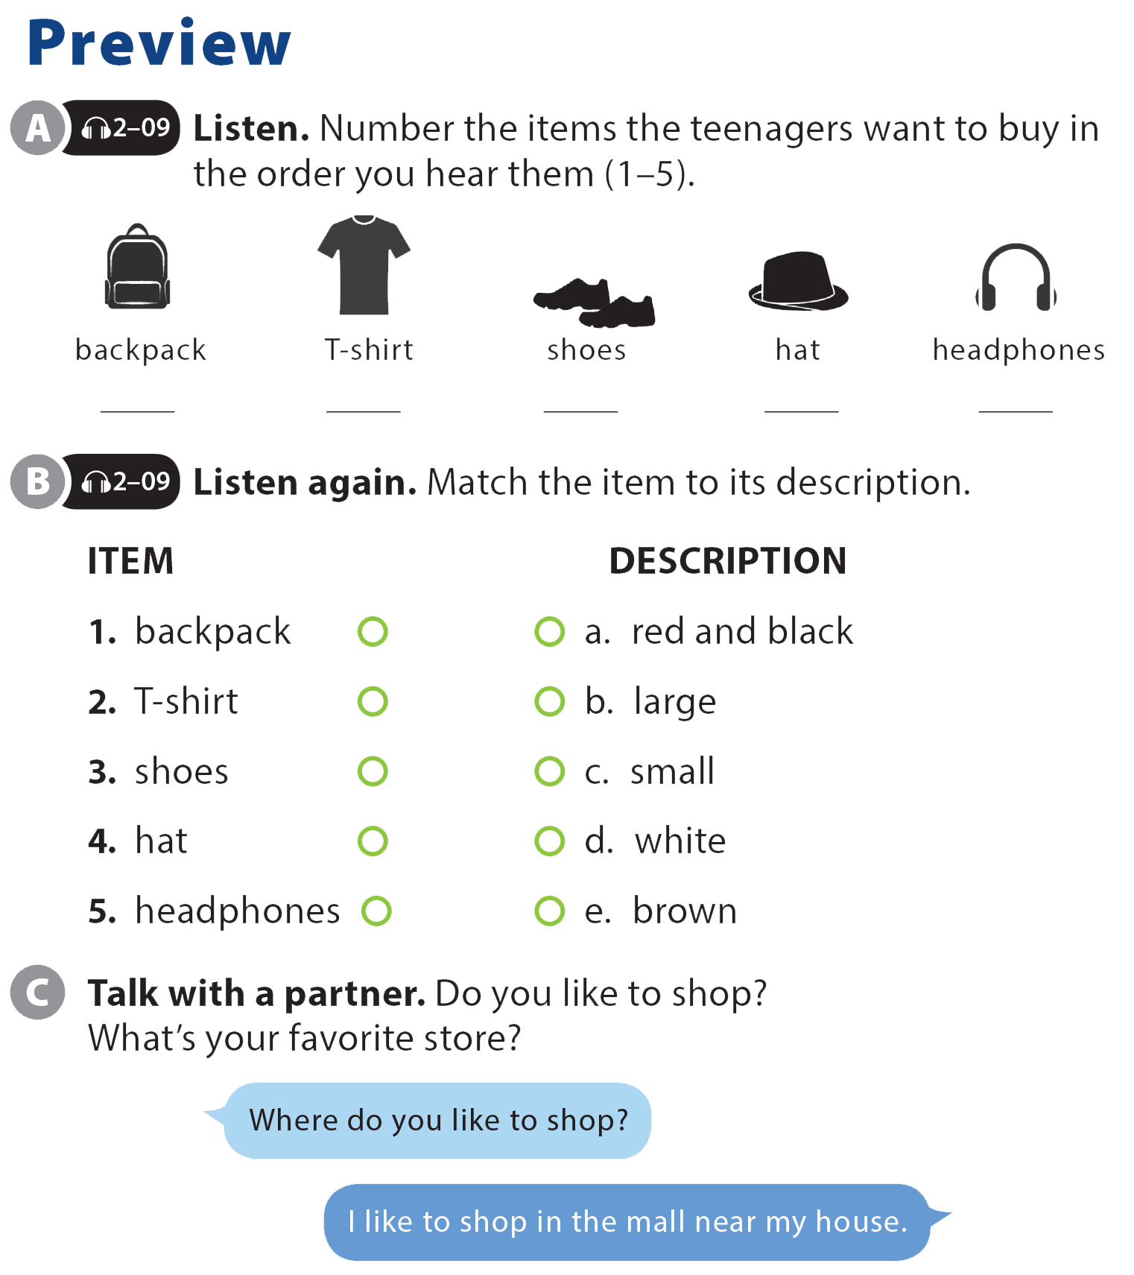

UNIT 8
HOW MUCH IS THIS T-SHIRT?
PREVIEW
3
5
2
4
1

Slide 3
UNIT 8
HOW MUCH IS THIS T-SHIRT?
PREVIEW

Slide 4
UNIT 8
HOW MUCH IS THIS T-SHIRT?
PREVIEW

Slide 5
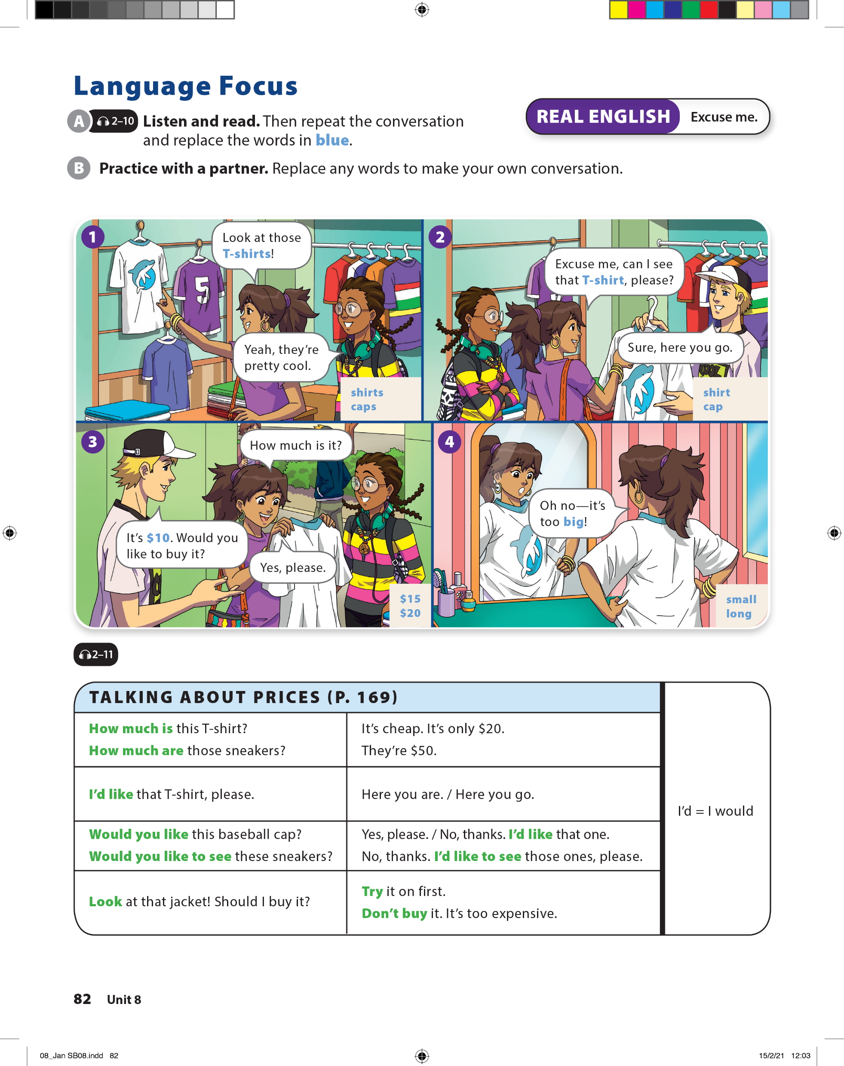
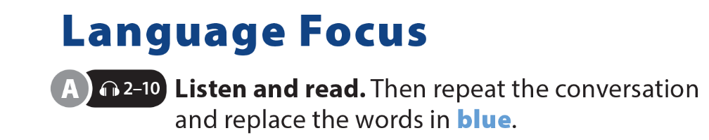
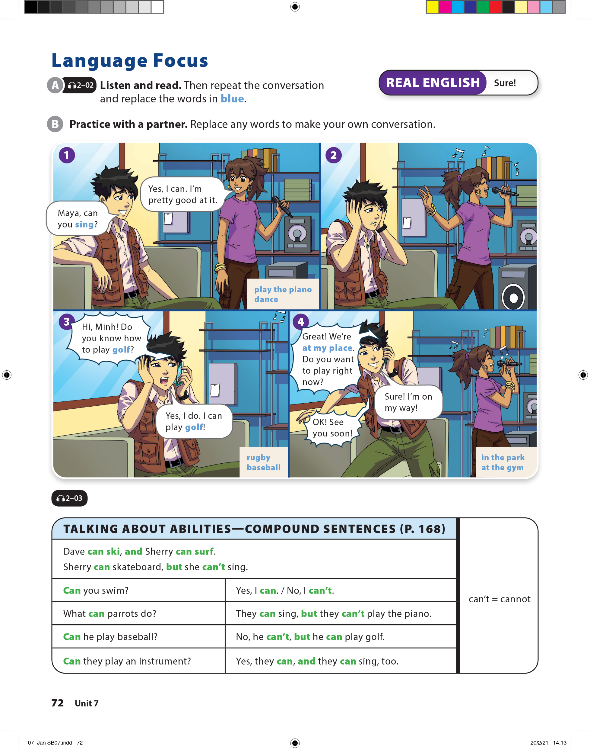
UNIT 8
HOW MUCH IS THIS T-SHIRT?
LANGUAGE FOCUS

Slide 6
UNIT 8
HOW MUCH IS THIS T-SHIRT?
LANGUAGE FOCUS

Slide 7
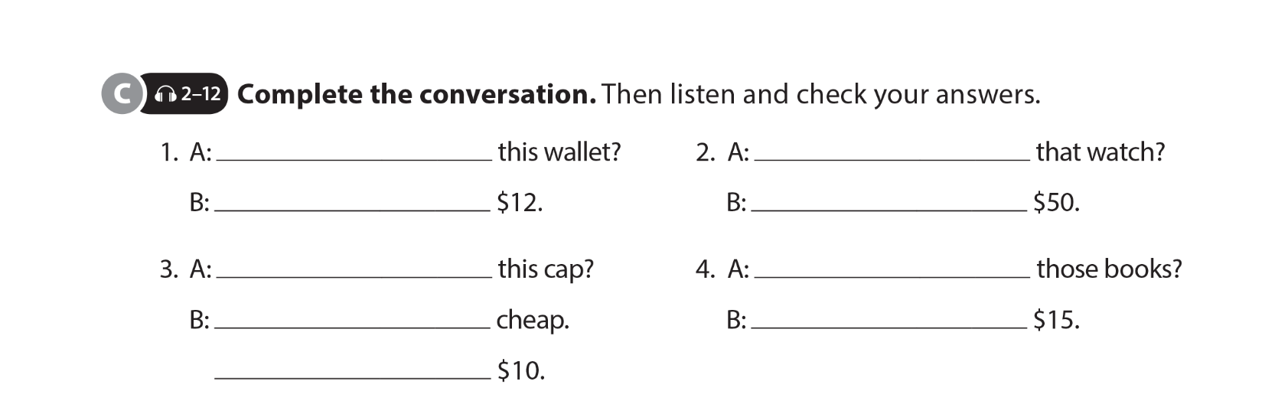
UNIT 8
HOW MUCH IS THIS T-SHIRT?
LANGUAGE FOCUS
How much is
How much is
It’s
It’s
How much is
How much are
It’s
They’re
It’s

Slide 8

UNIT 8
HOW MUCH IS THIS T-SHIRT?
LANGUAGE FOCUS
Would
like
d
like
Try
How much
d
like

Slide 9
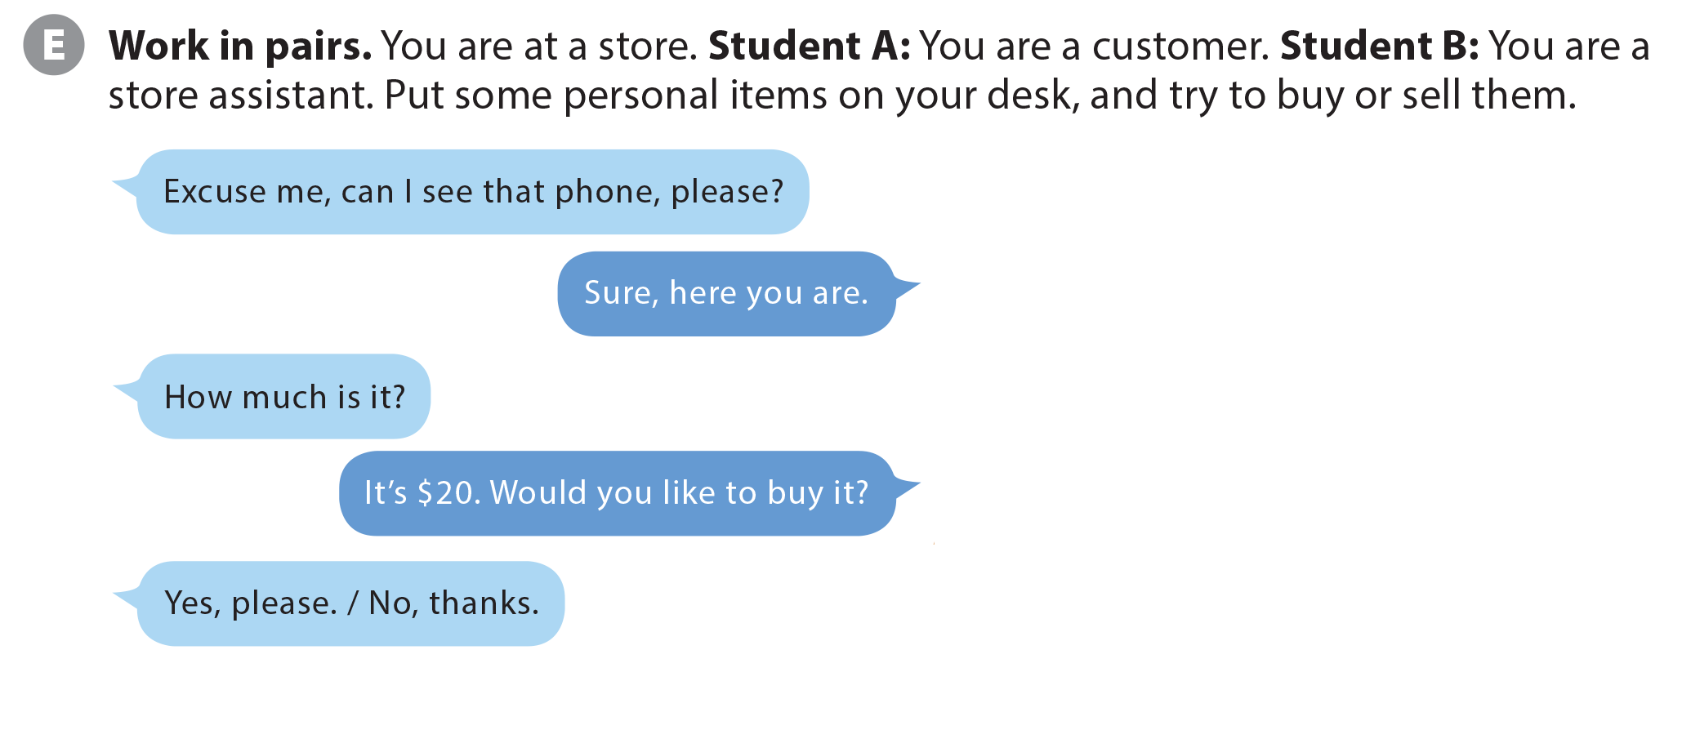

UNIT 8
HOW MUCH IS THIS T-SHIRT?
LANGUAGE FOCUS

Slide 10
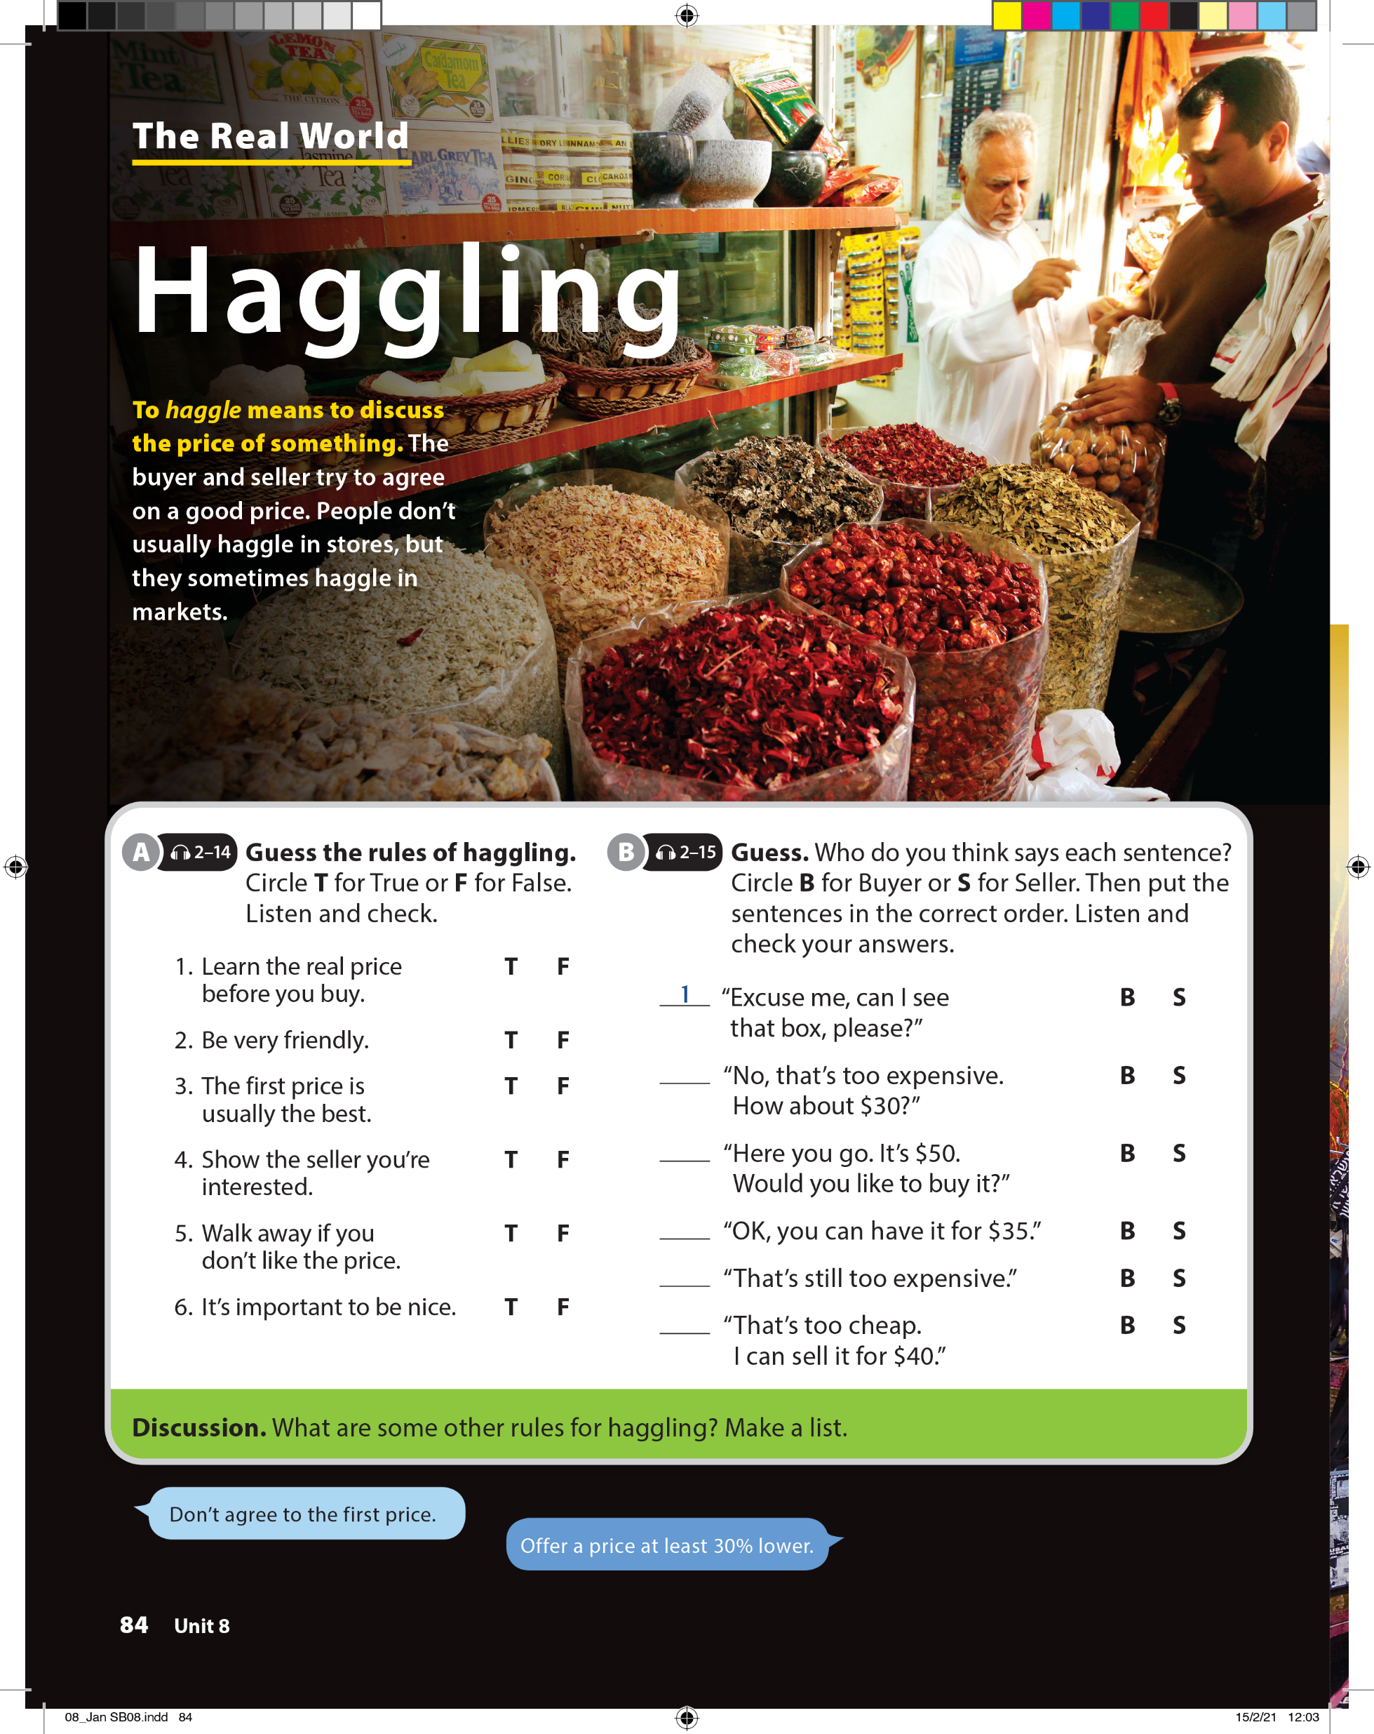
UNIT 8
HOW MUCH IS THIS T-SHIRT?
THE REAL WORLD

Slide 11
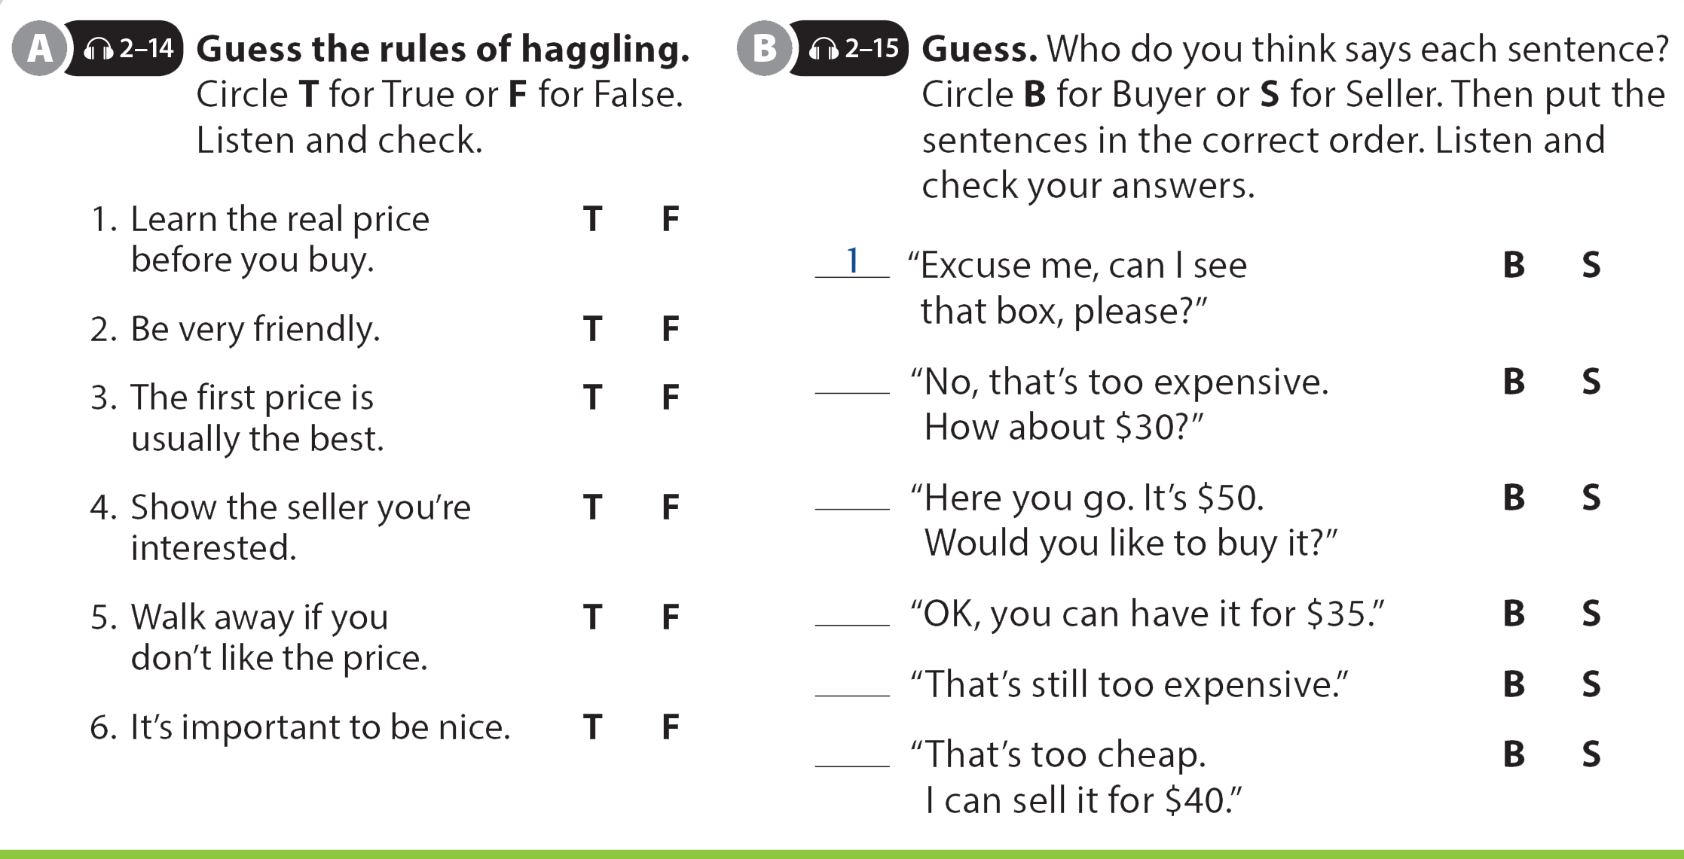
UNIT 8
HOW MUCH IS THIS T-SHIRT?
THE REAL WORLD

Slide 12
UNIT 8
HOW MUCH IS THIS T-SHIRT?
THE REAL WORLD
3
2
6
5
4

Slide 13

UNIT 8
HOW MUCH IS THIS T-SHIRT?
THE REAL WORLD

Slide 14
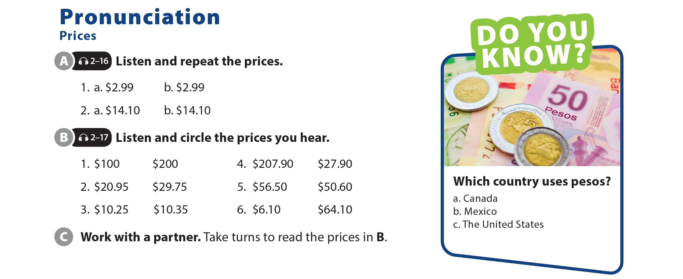
UNIT 8
HOW MUCH IS THIS T-SHIRT?
PRONUNCIATION

Slide 15
UNIT 8
HOW MUCH IS THIS T-SHIRT?
PRONUNCIATION

Slide 16
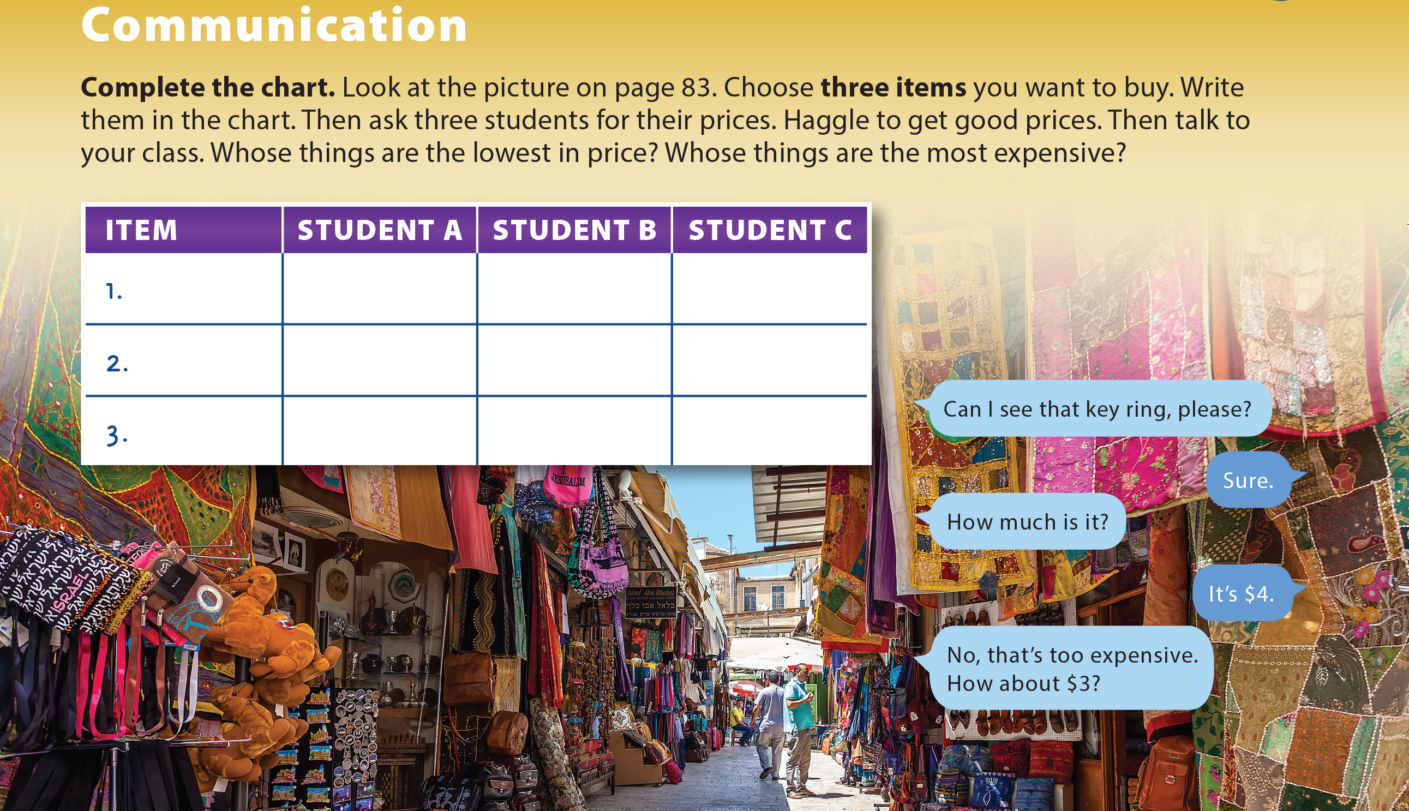
UNIT 8
HOW MUCH IS THIS T-SHIRT?
COMMUNICATION

Slide 17
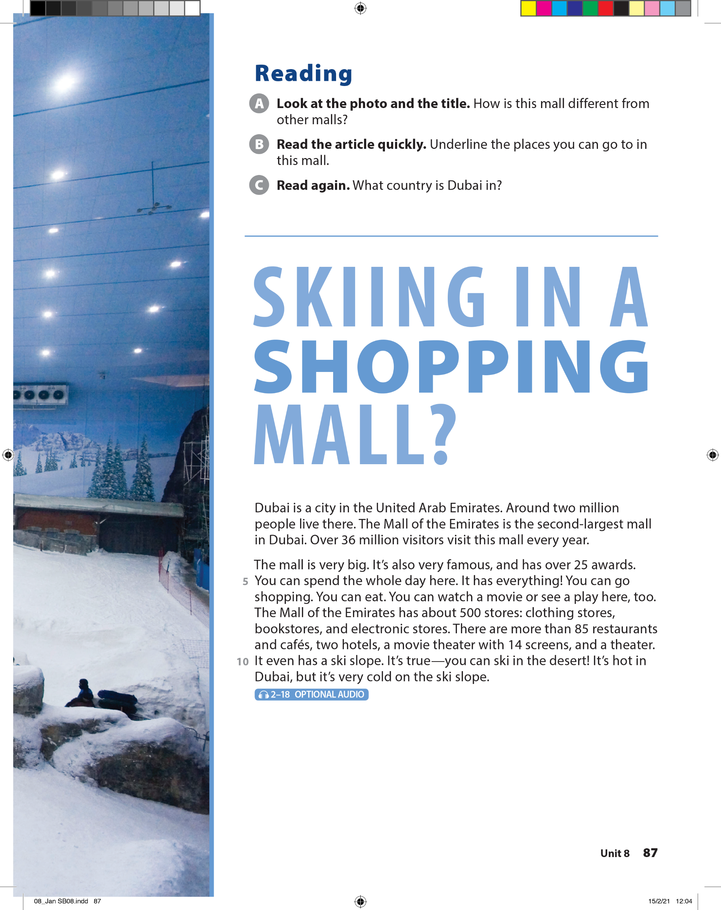
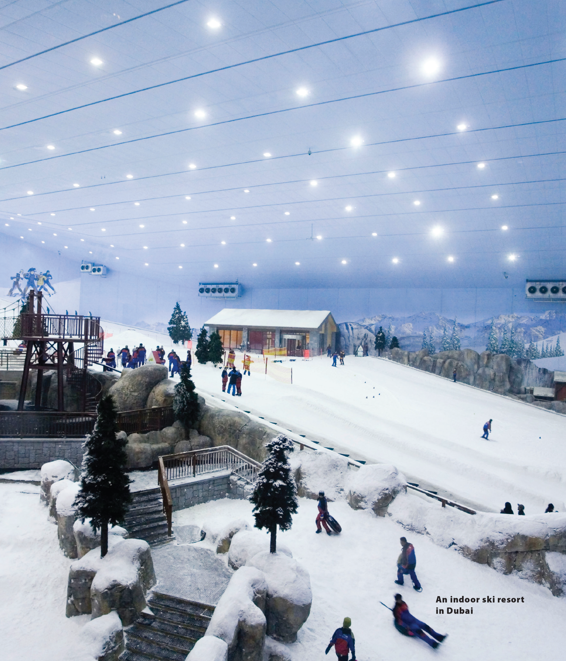
UNIT 8
HOW MUCH IS THIS T-SHIRT?
READING
You can ski here.

Slide 18
UNIT 8
HOW MUCH IS THIS T-SHIRT?
READING

Slide 19
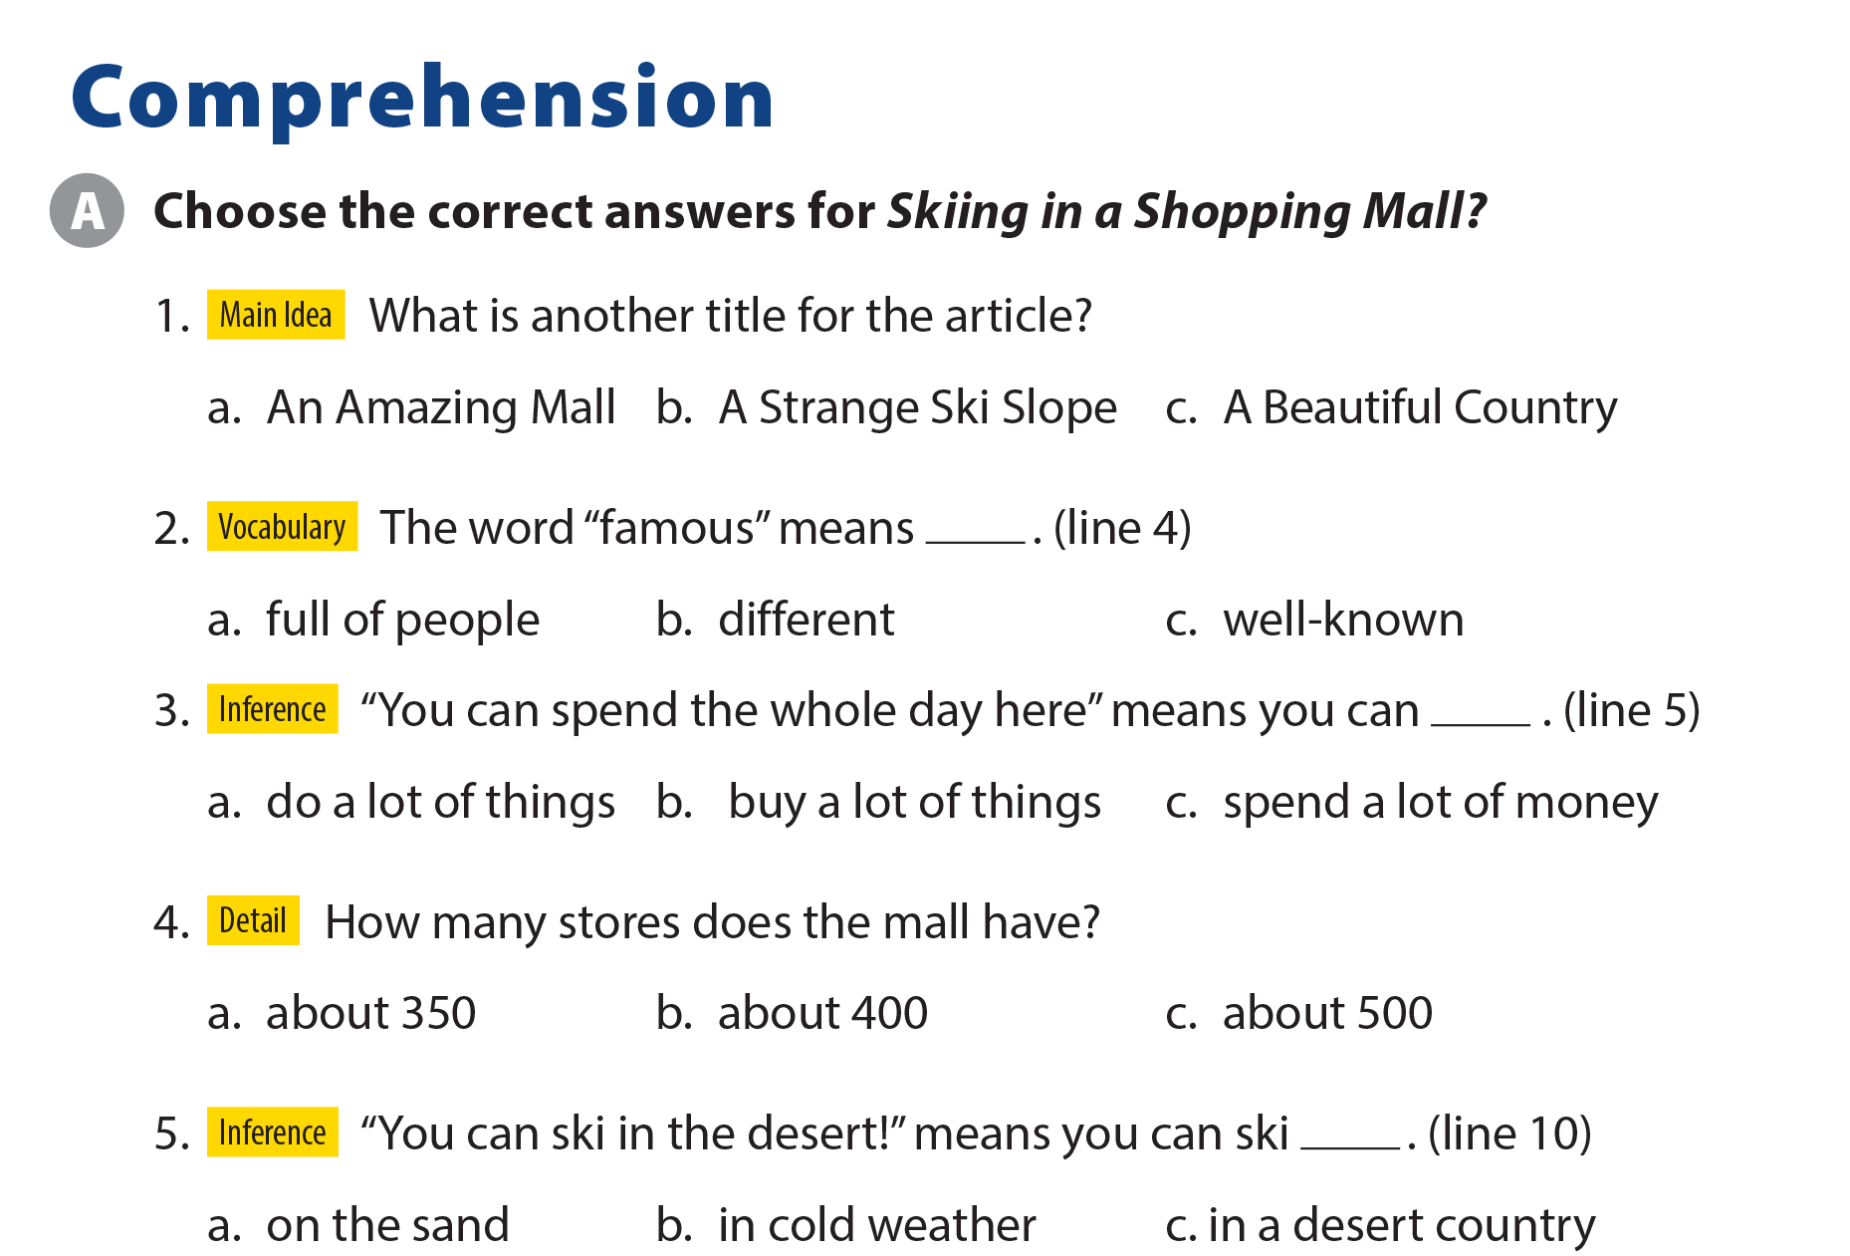
UNIT 8
HOW MUCH IS THIS T-SHIRT?
COMPEHENSION

Slide 20
UNIT 8
HOW MUCH IS THIS T-SHIRT?
IDIOM
“It’s a great deal” means it’s a great ________.
price
store

Slide 21
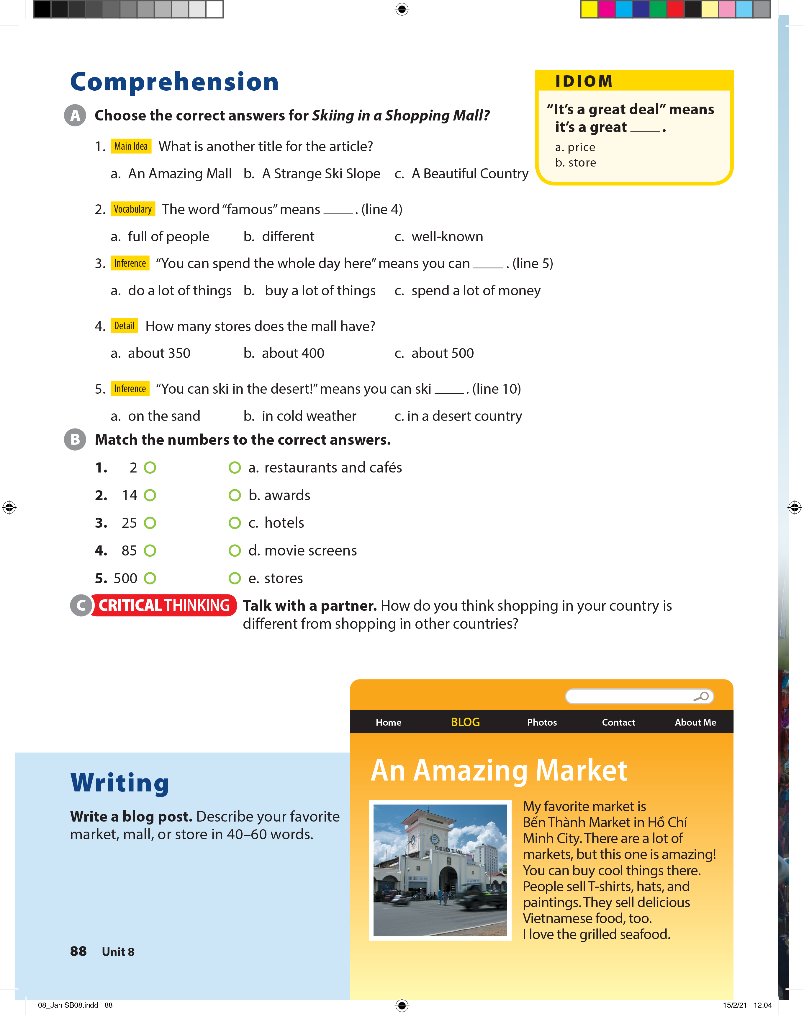
UNIT 8
HOW MUCH IS THIS T-SHIRT?
COMPEHENSION

Slide 22
UNIT 8
HOW MUCH IS THIS T-SHIRT?
WRITING

Slide 23



UNIT 8
HOW MUCH IS THIS T-SHIRT?
VIDEO

Slide 24
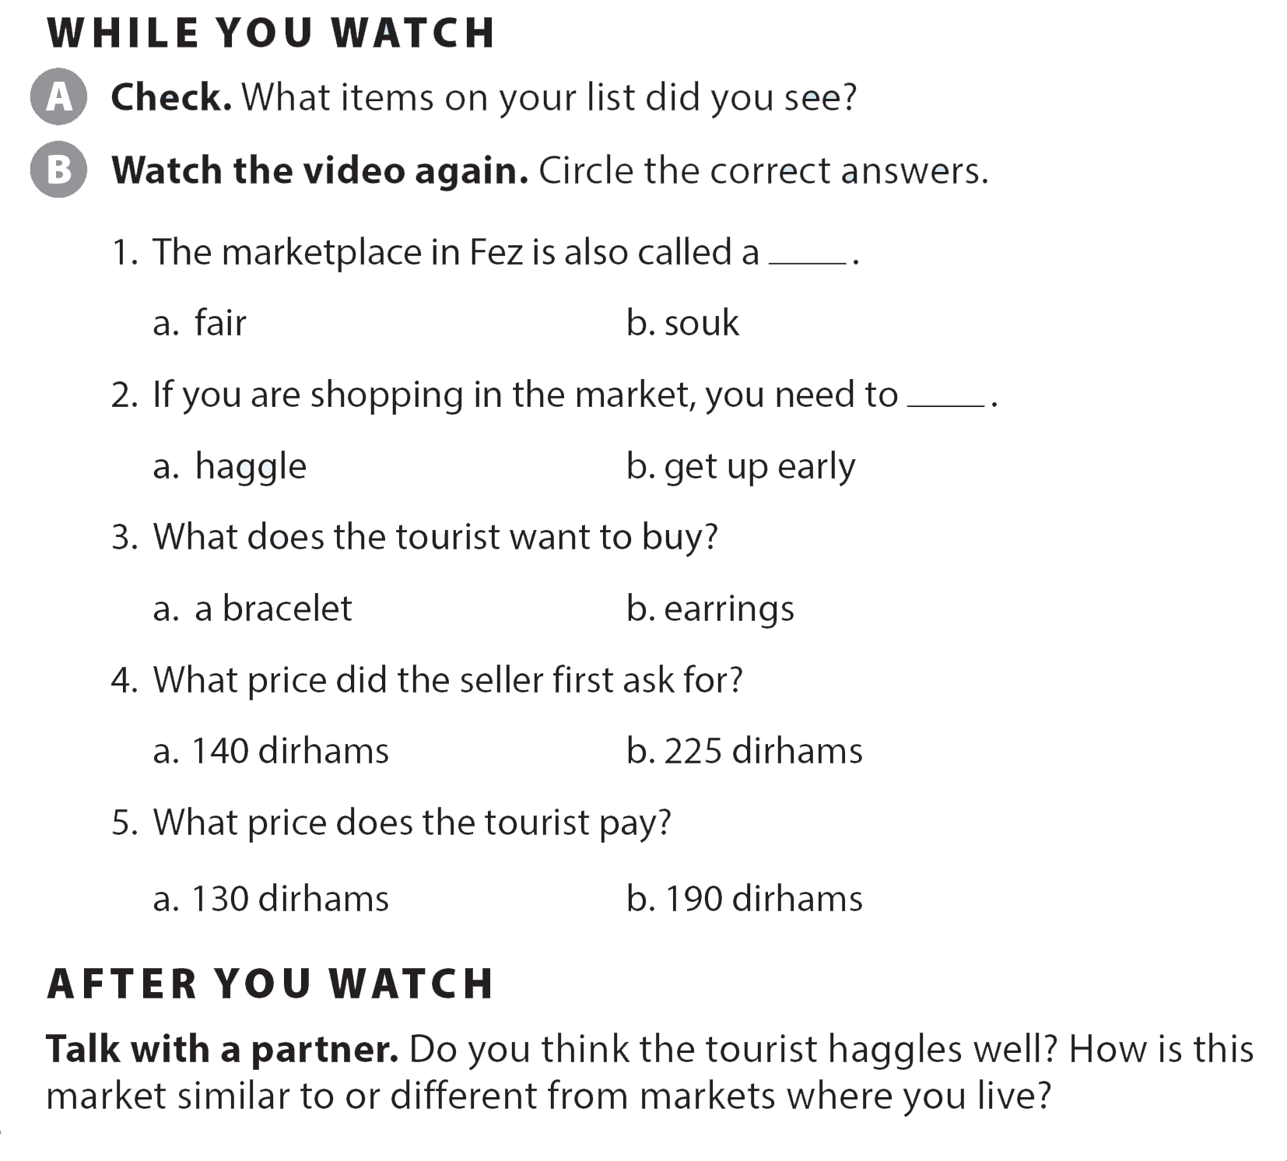
UNIT 8
HOW MUCH IS THIS T-SHIRT?
VIDEO

Slide 25
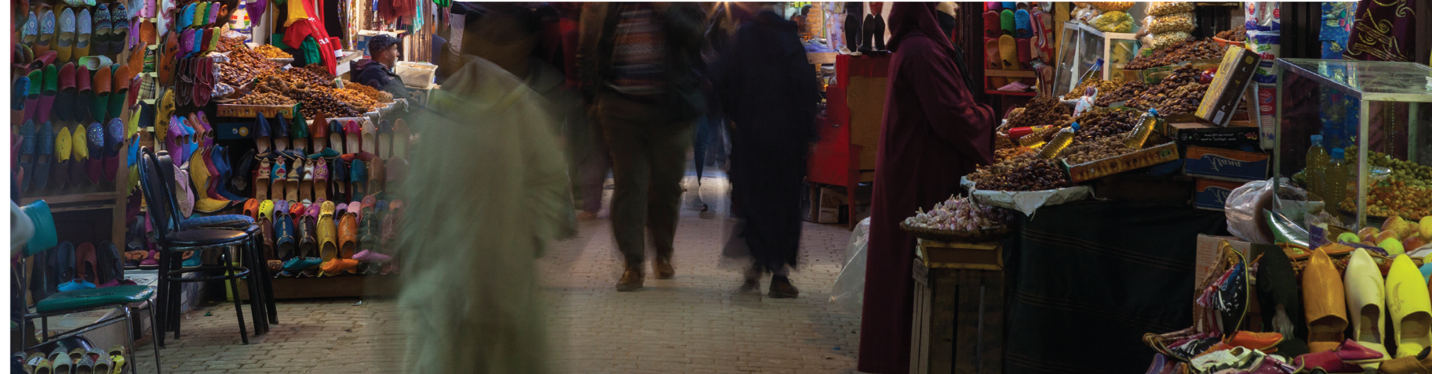
UNIT 8
HOW MUCH IS THIS T-SHIRT?
VIDEO

