Slide 1
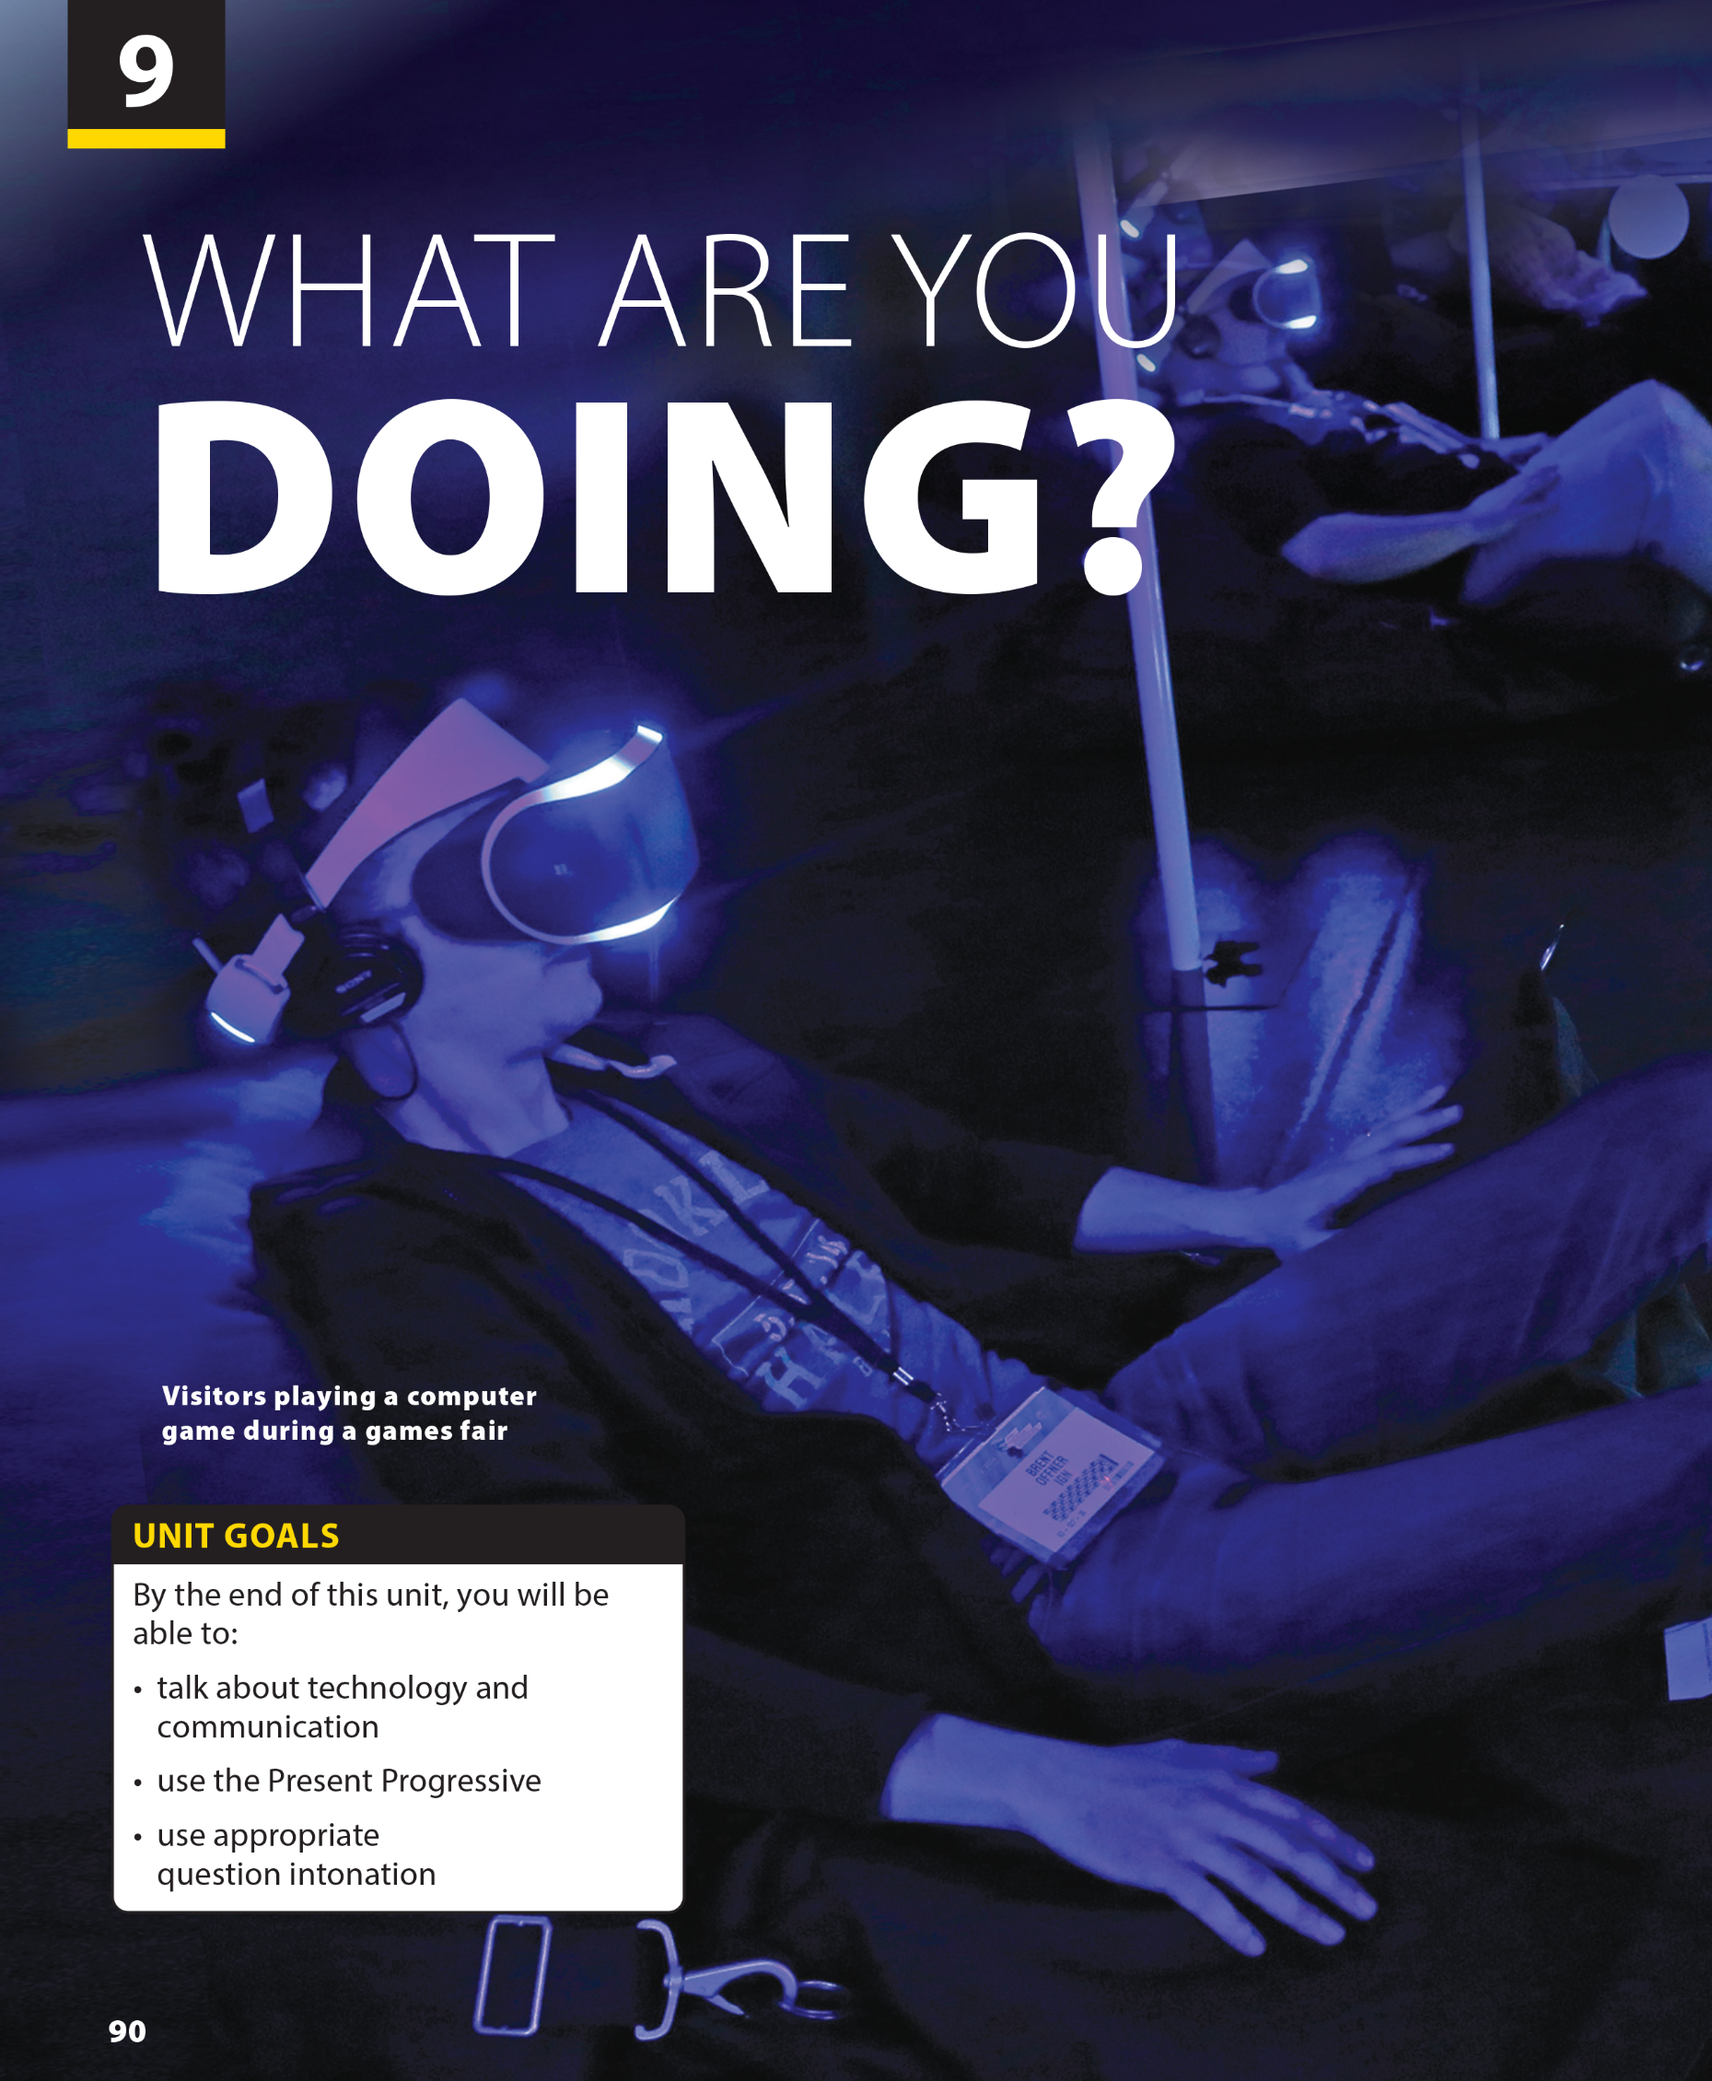
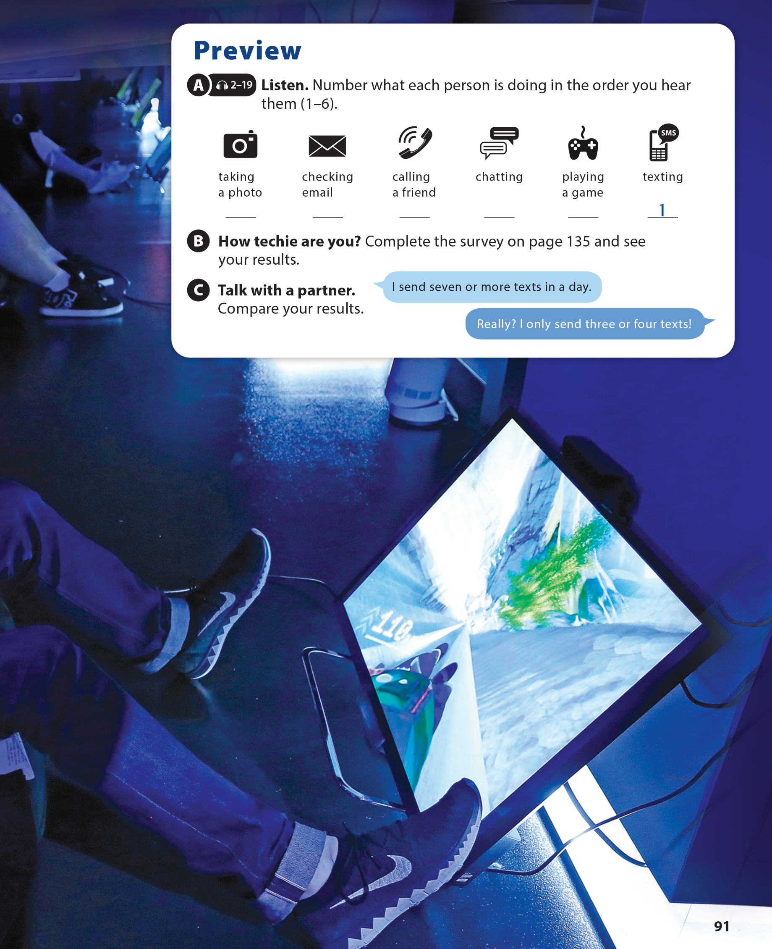

Slide 2

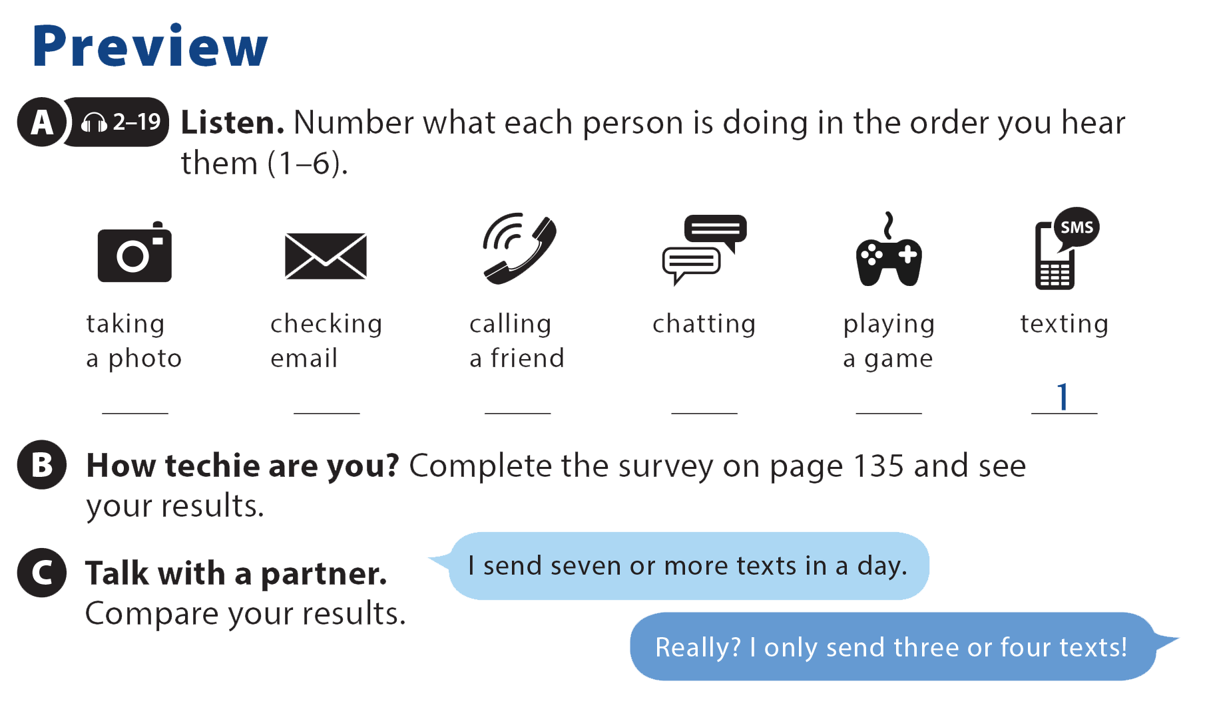

UNIT 9
WHAT ARE YOU DOING?
PREVIEW
4
3
2
5
6

Slide 3
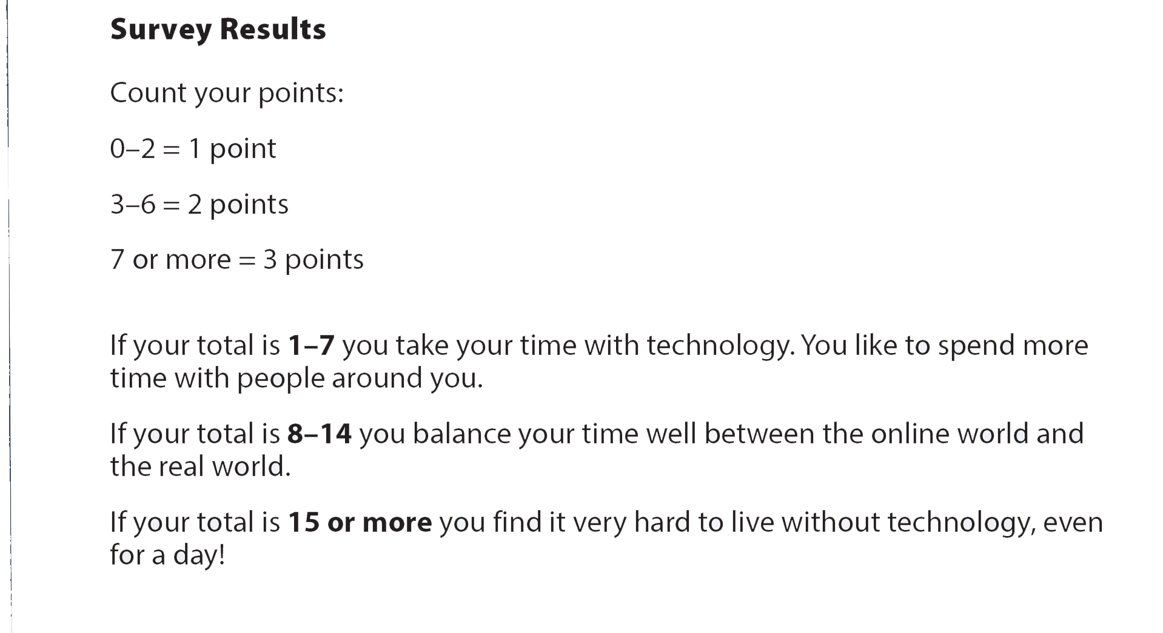
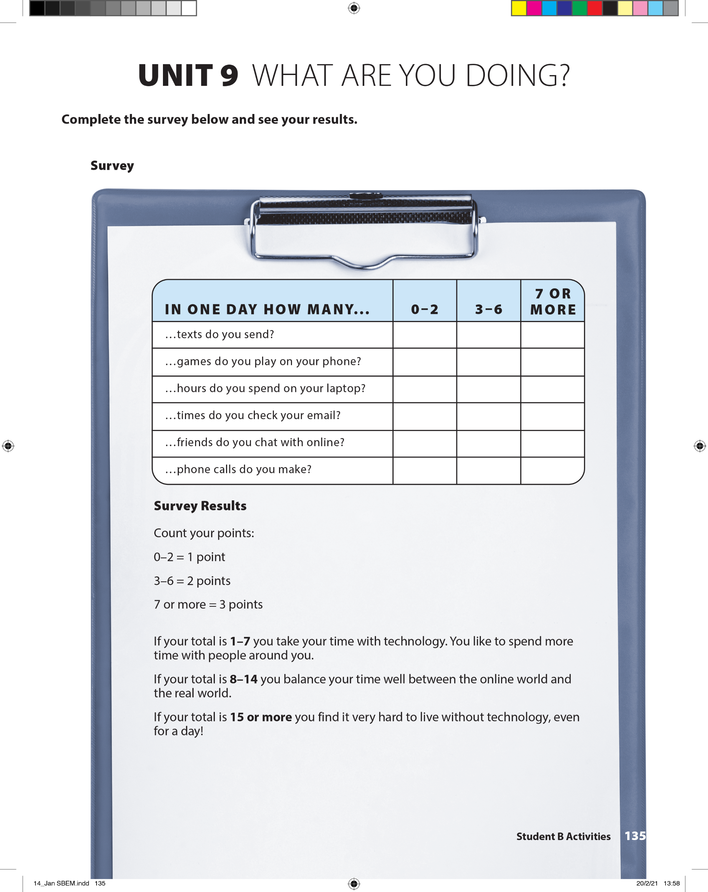
UNIT 9
WHAT ARE YOU DOING?
PREVIEW

Slide 4
UNIT 9
WHAT ARE YOU DOING?
PREVIEW

Slide 5
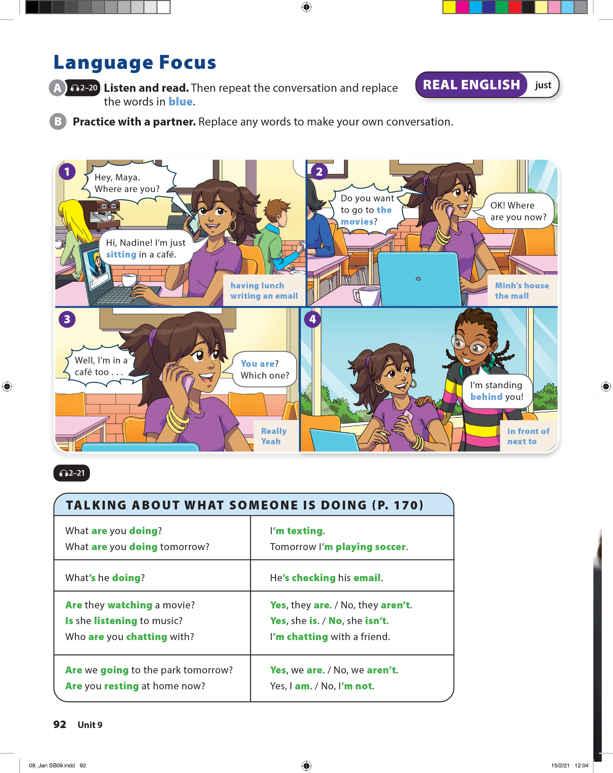

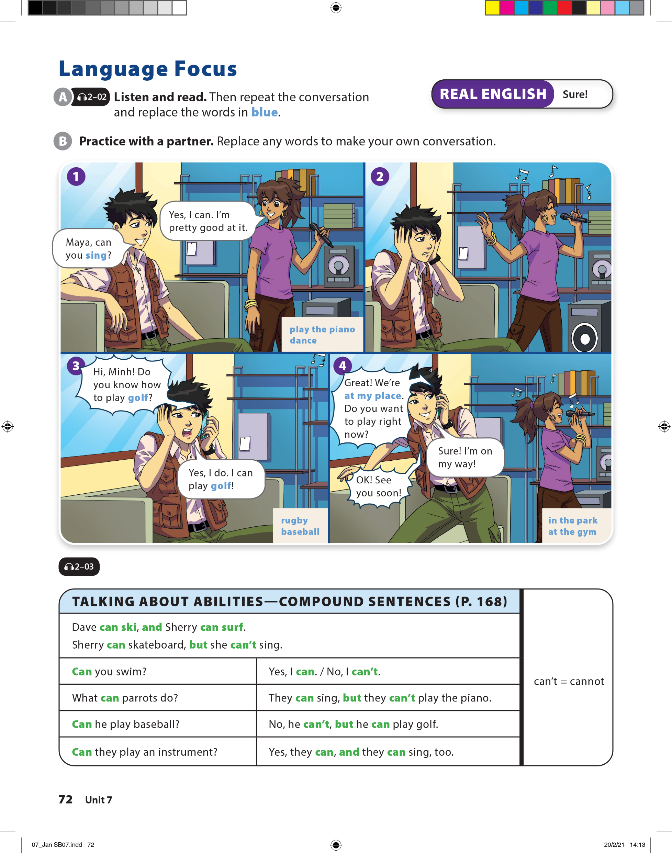
UNIT 9
WHAT ARE YOU DOING?
LANGUAGE FOCUS

Slide 6
UNIT 9
WHAT ARE YOU DOING?
LANGUAGE FOCUS

Slide 7
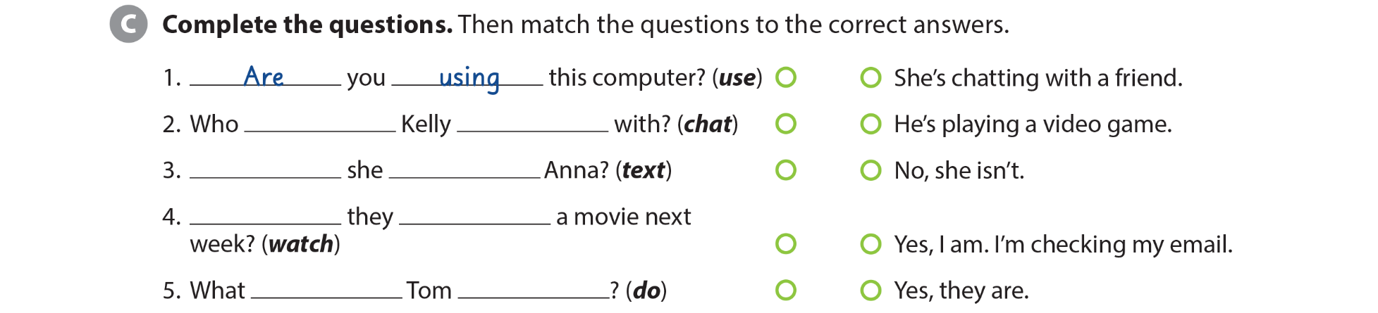
UNIT 9
WHAT ARE YOU DOING?
LANGUAGE FOCUS
’s/is
chatting
Is
texting
Are
watching
is
doing

Slide 8

UNIT 9
WHAT ARE YOU DOING?
LANGUAGE FOCUS
are
doing
Are
studying
m
playing
m
chatting
are
listening

Slide 9
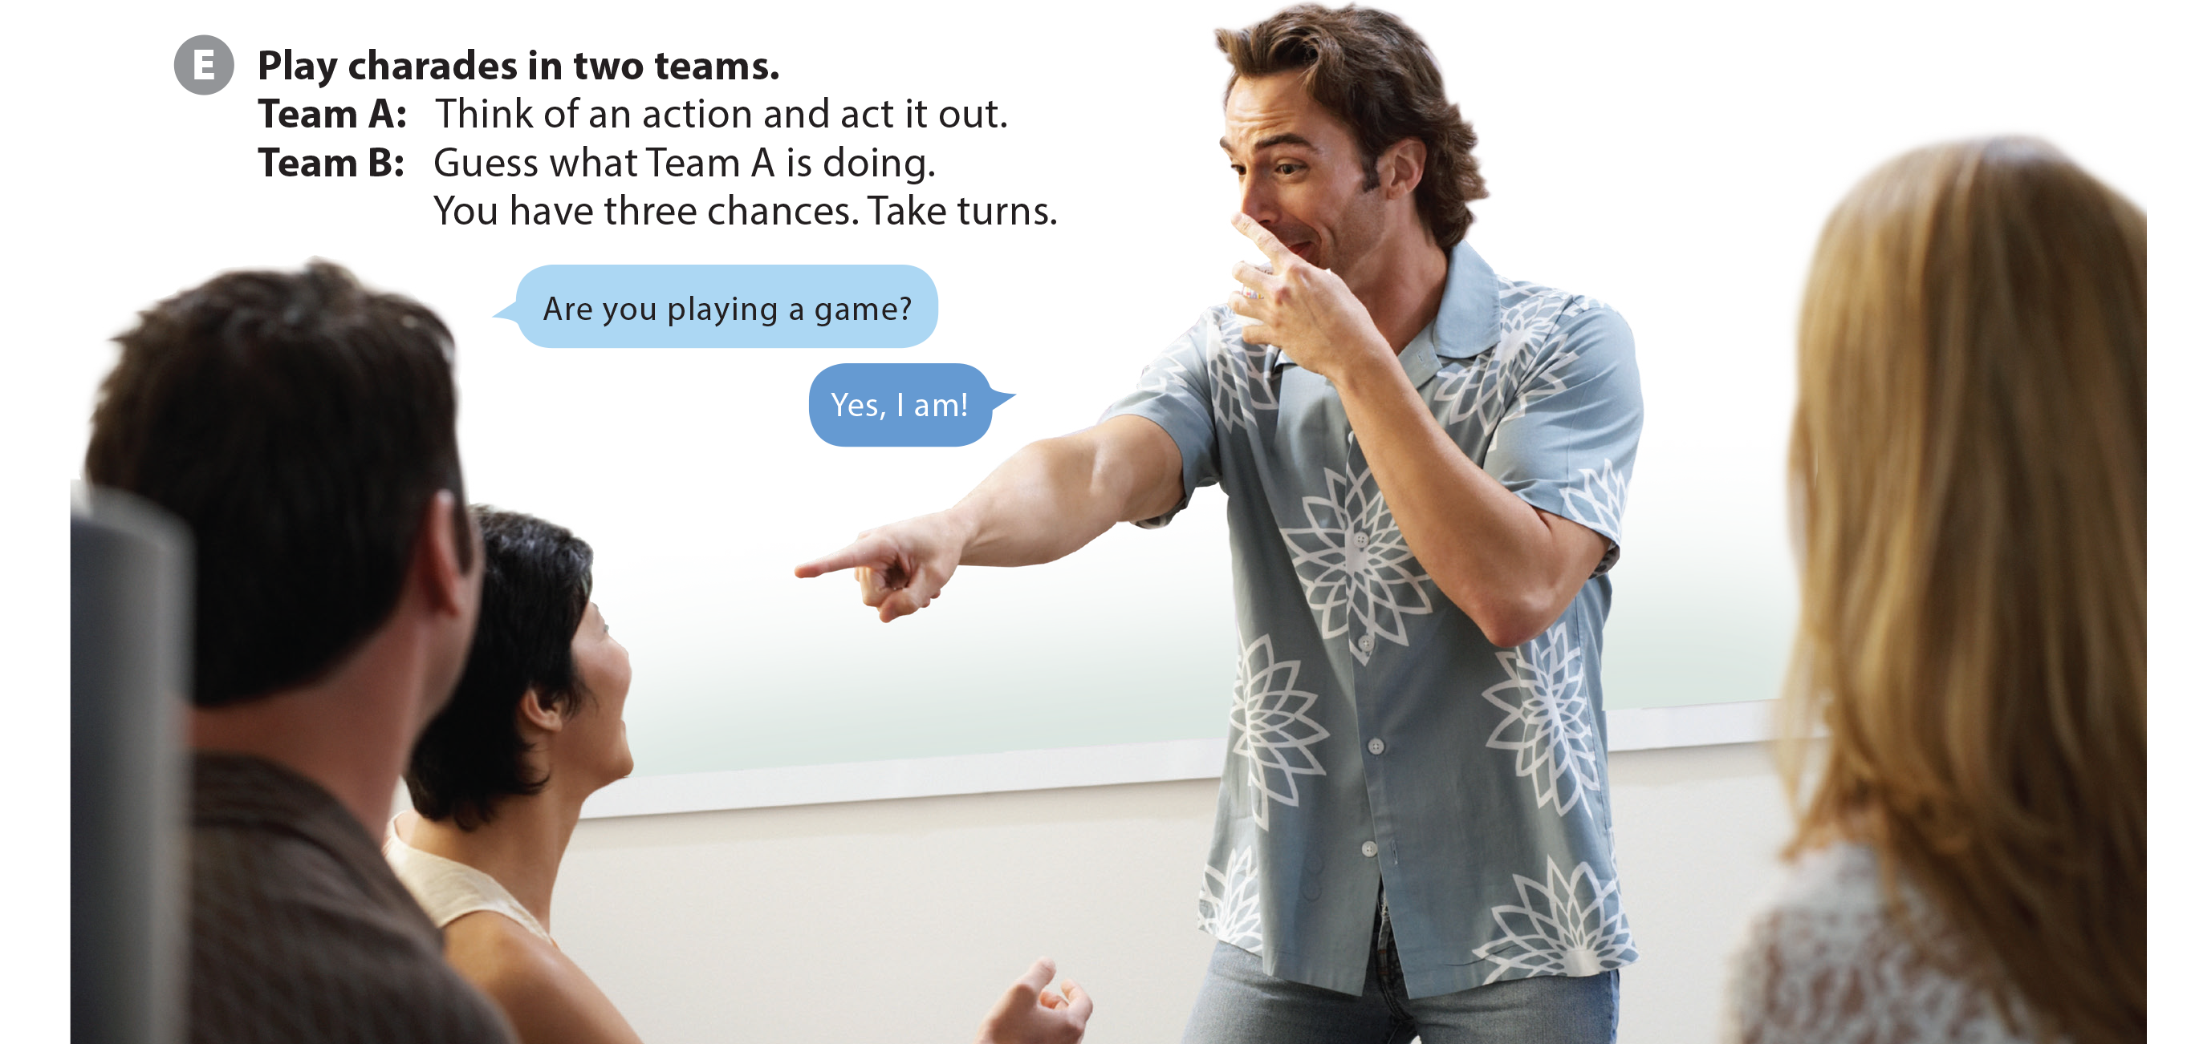
UNIT 9
WHAT ARE YOU DOING?
LANGUAGE FOCUS

Slide 10
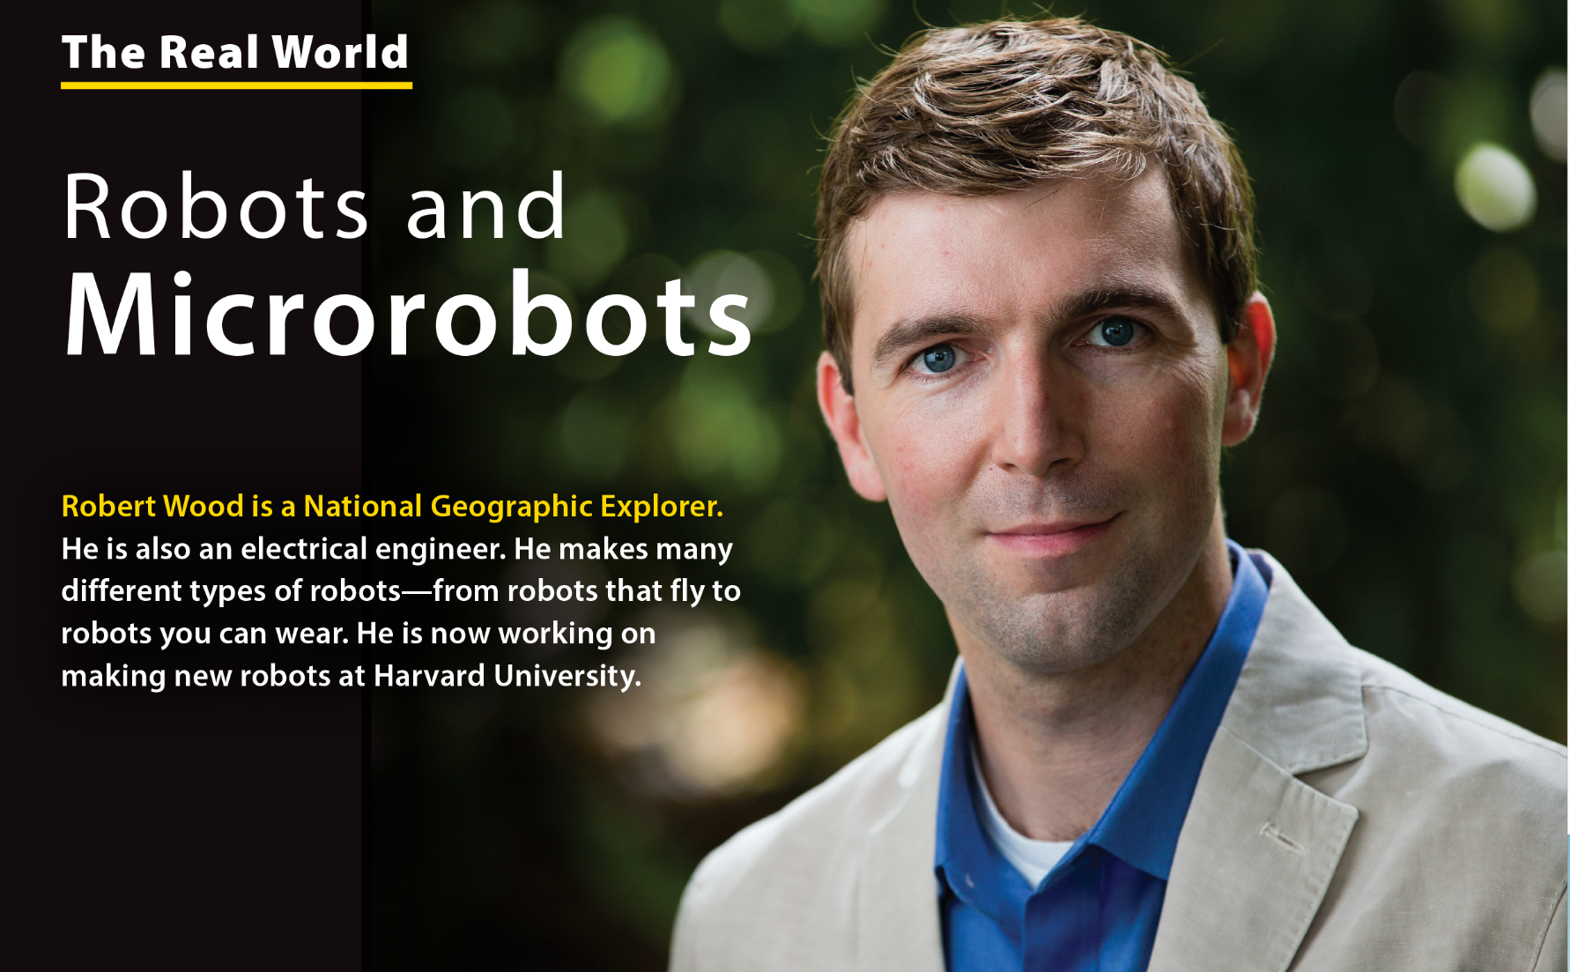
UNIT 9
WHAT ARE YOU DOING?
THE REAL WORLD

Slide 11
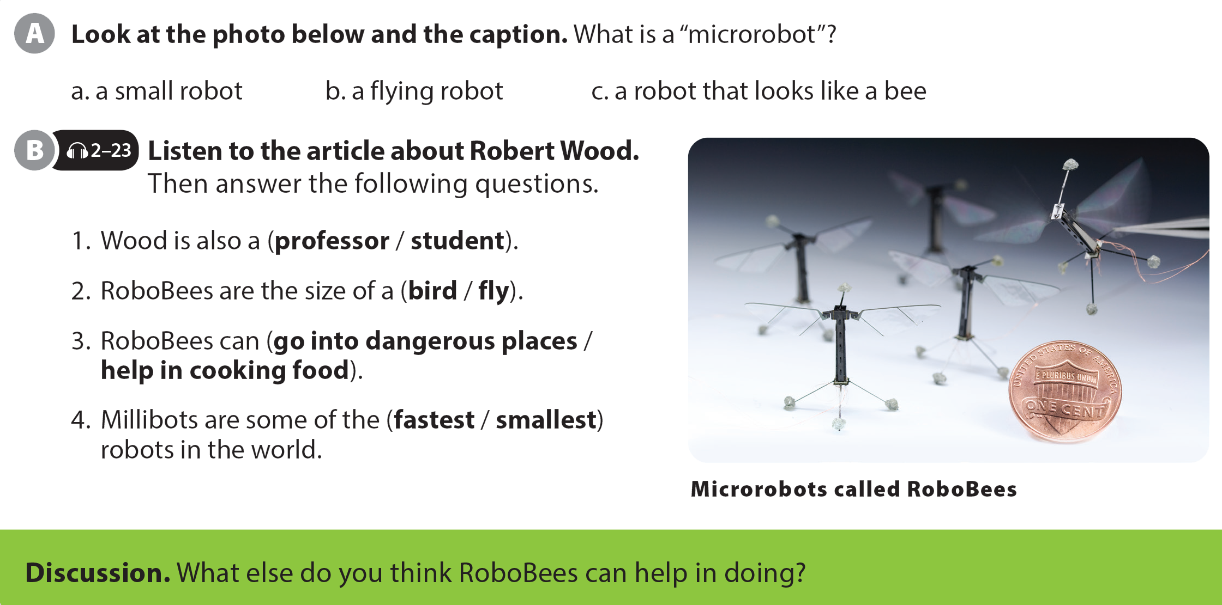
UNIT 9
WHAT ARE YOU DOING?
THE REAL WORLD

Slide 12

UNIT 9
WHAT ARE YOU DOING?
THE REAL WORLD

Slide 13
UNIT 9
WHAT ARE YOU DOING?
THE REAL WORLD

Slide 14
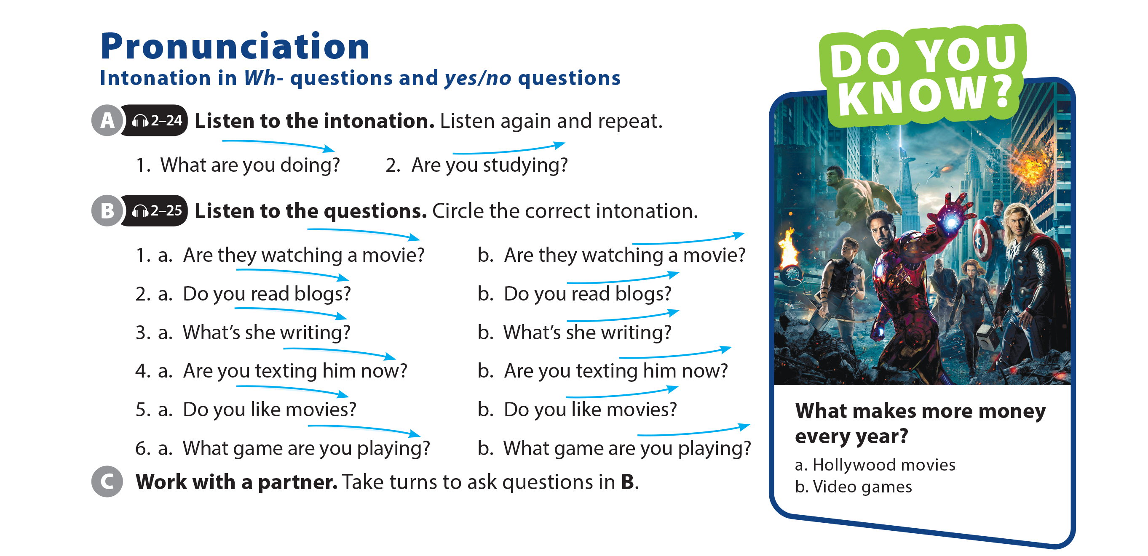
UNIT 9
WHAT ARE YOU DOING?
PRONUNCIATION

Slide 15
UNIT 9
WHAT ARE YOU DOING?
PRONUNCIATION

Slide 16
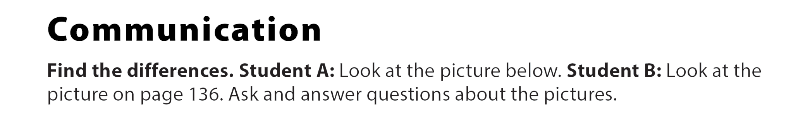

UNIT 9
WHAT ARE YOU DOING?
COMMUNICATION

Slide 17
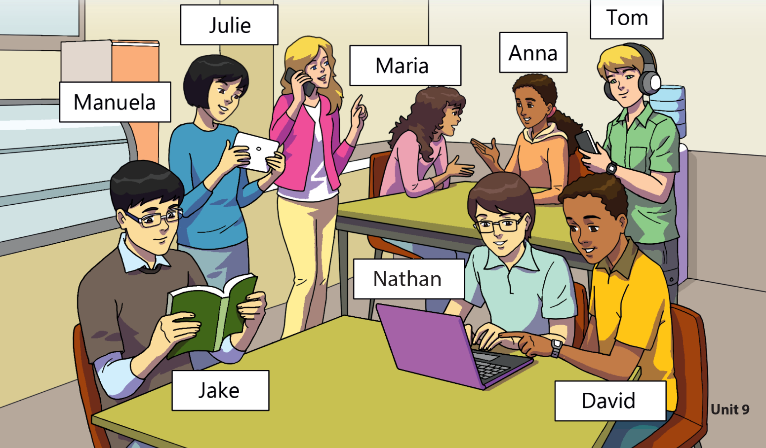
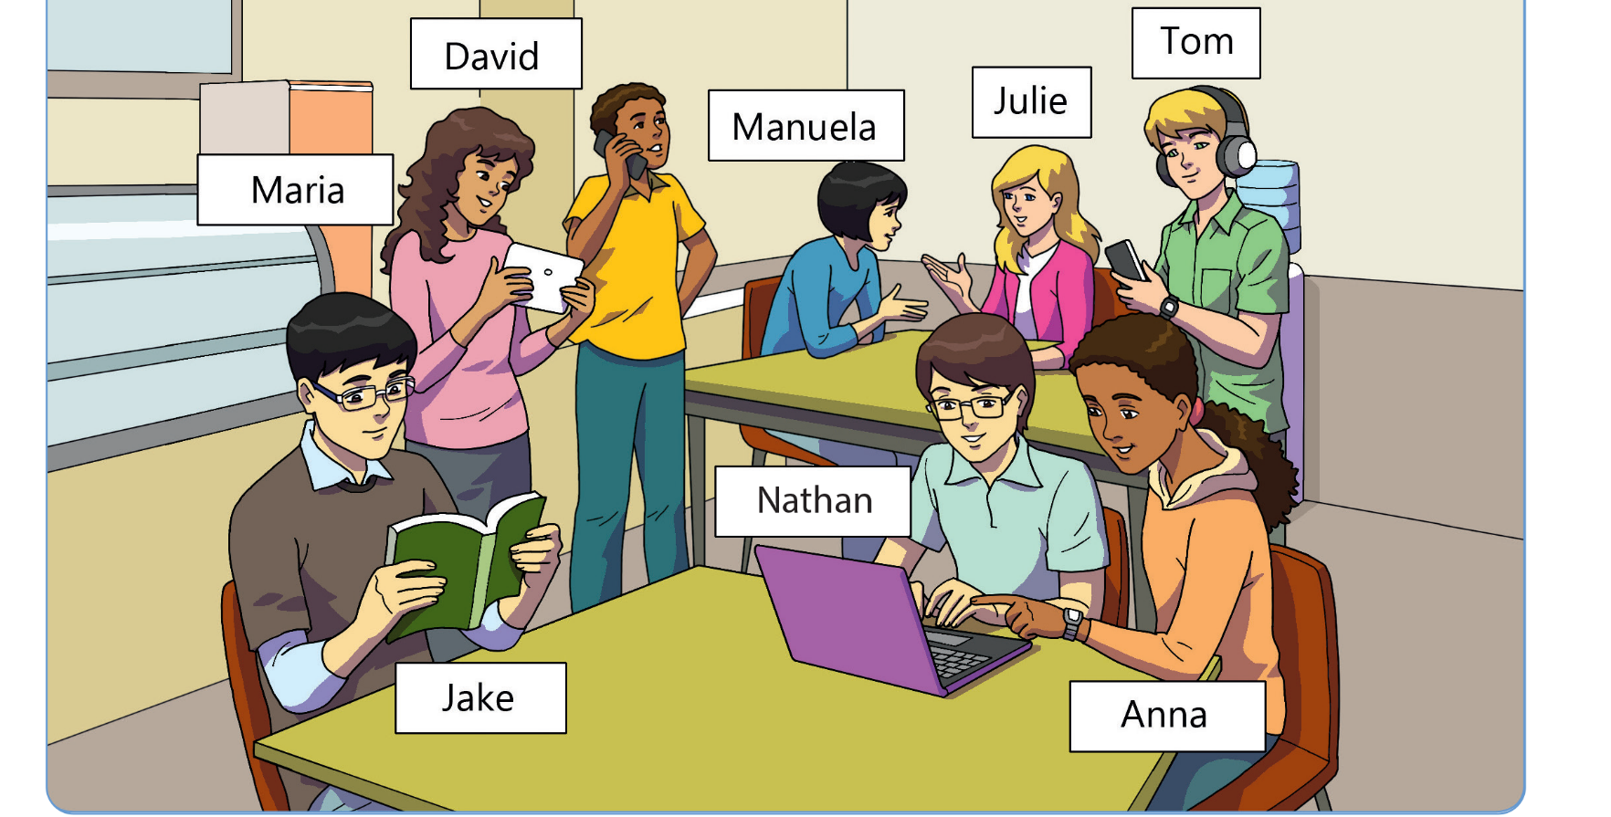
UNIT 9
WHAT ARE YOU DOING?
COMMUNICATION
Answers
p. 95
p. 136

Slide 18
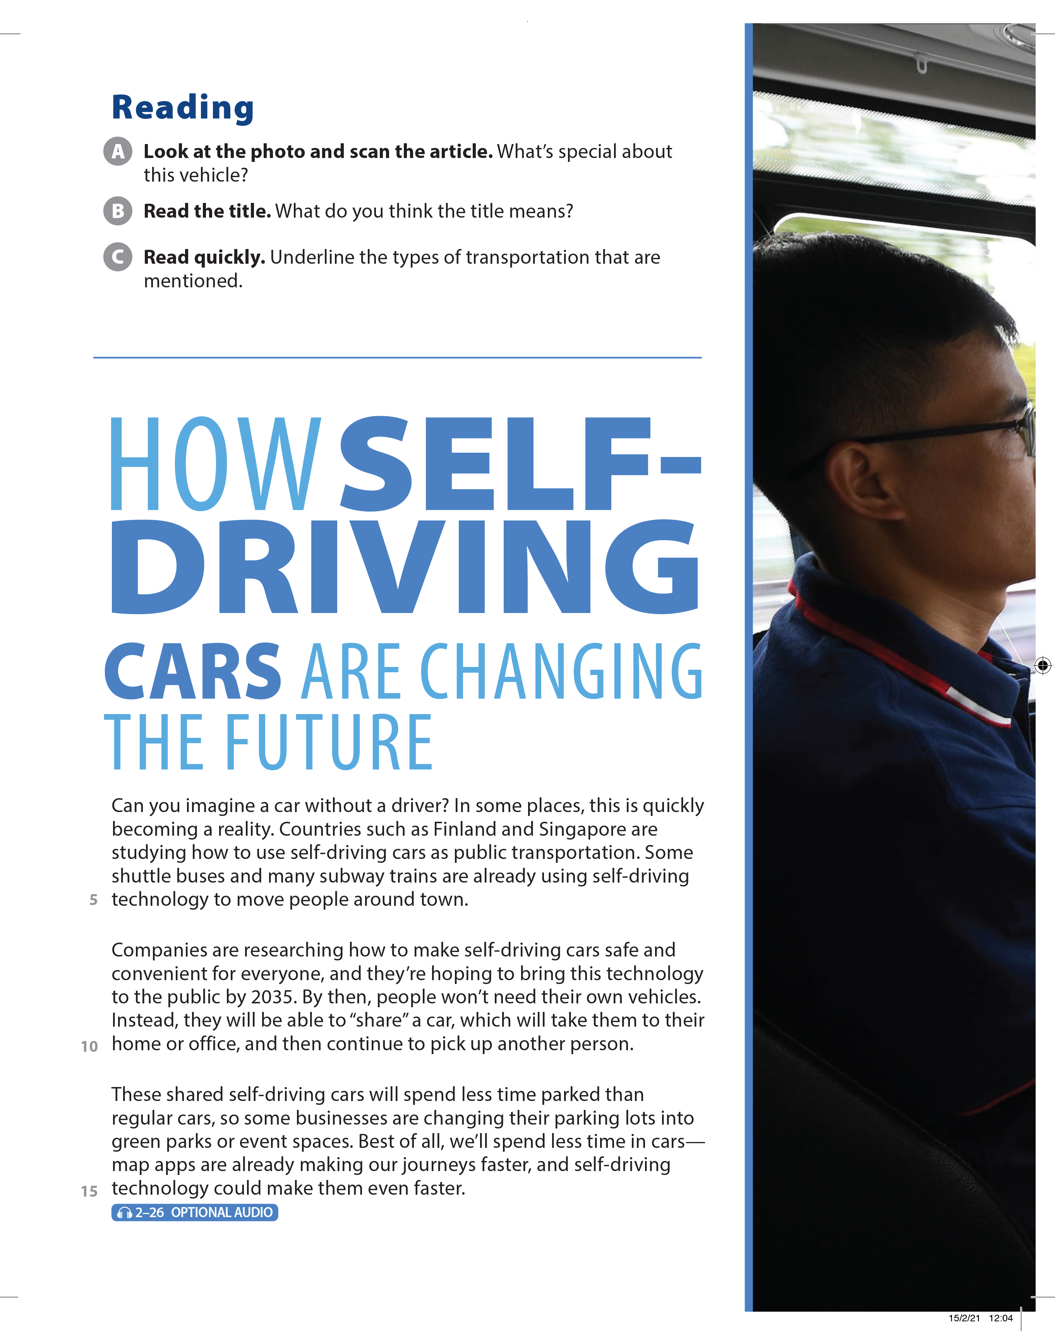
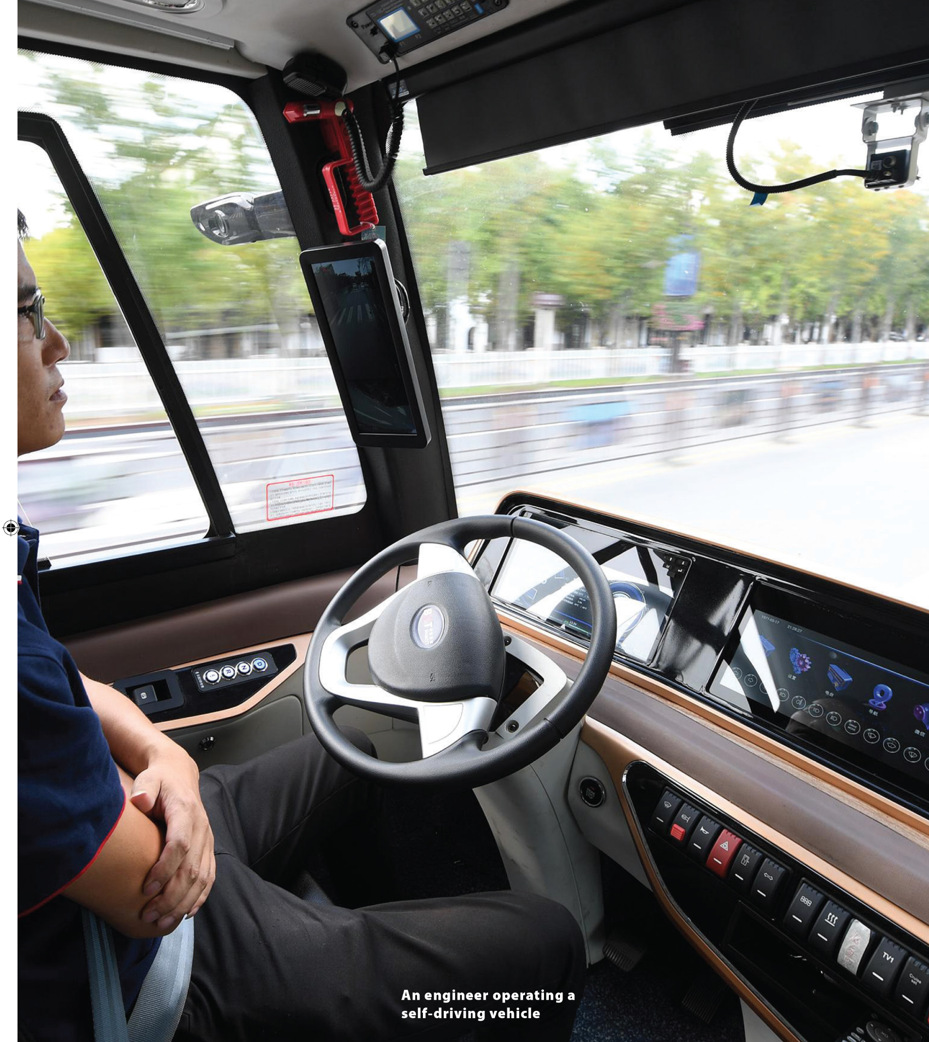
UNIT 9
WHAT ARE YOU DOING?
READING
It doesn’t need a driver.

Slide 19
UNIT 9
WHAT ARE YOU DOING?
READING

Slide 20
UNIT 9
WHAT ARE YOU DOING?
READING

Slide 21
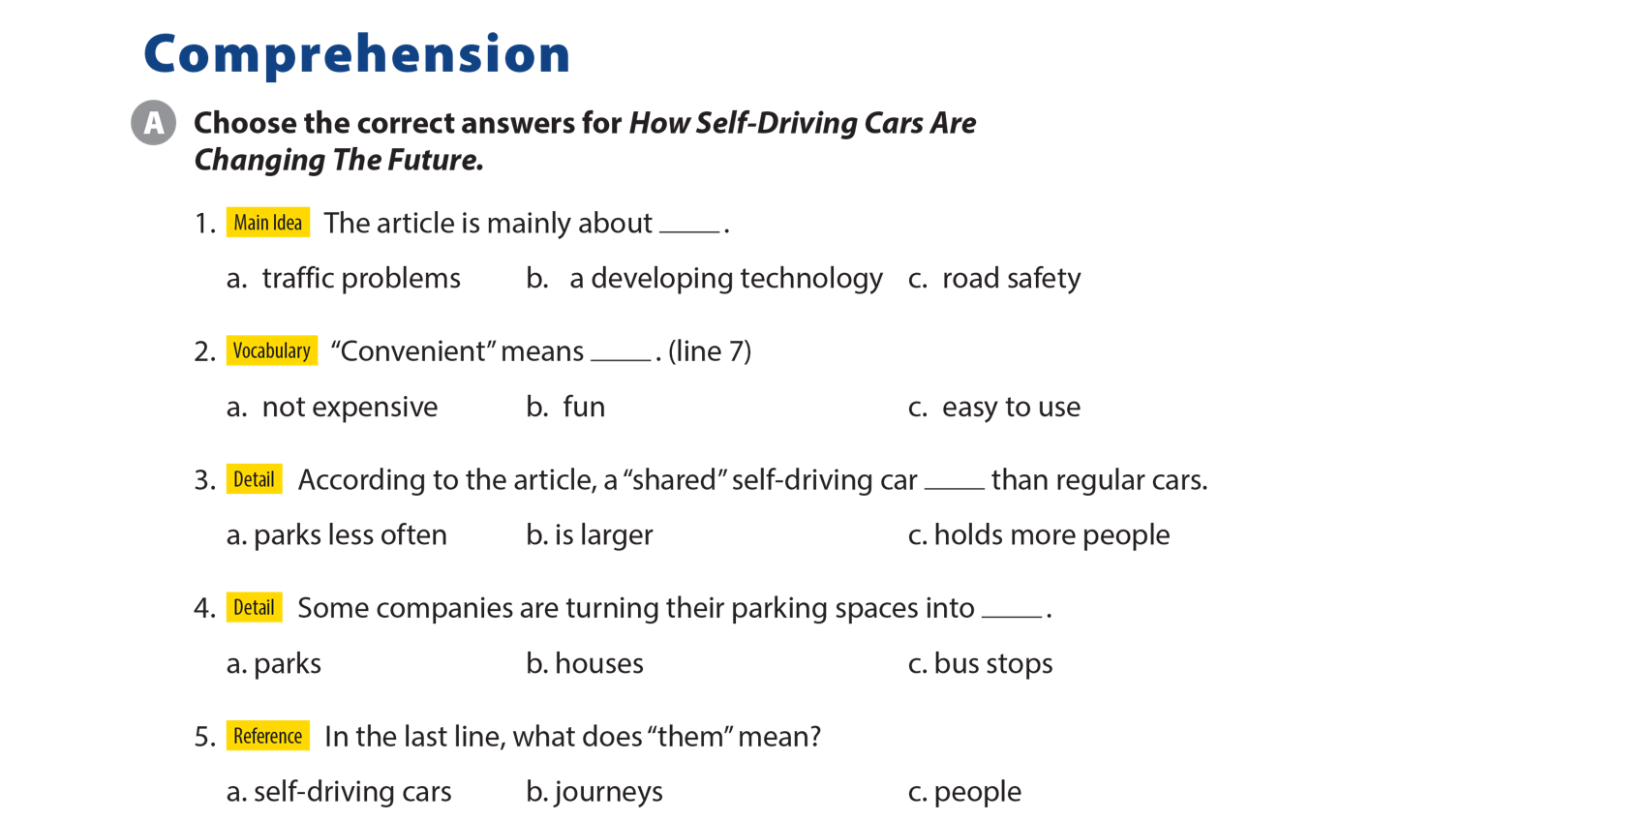
UNIT 9
WHAT ARE YOU DOING?
COMPREHENSION

Slide 22
UNIT 9
WHAT ARE YOU DOING?
IDIOM
“Pushing someone’s buttons” means_________.
making them angry
teaching them something

Slide 23
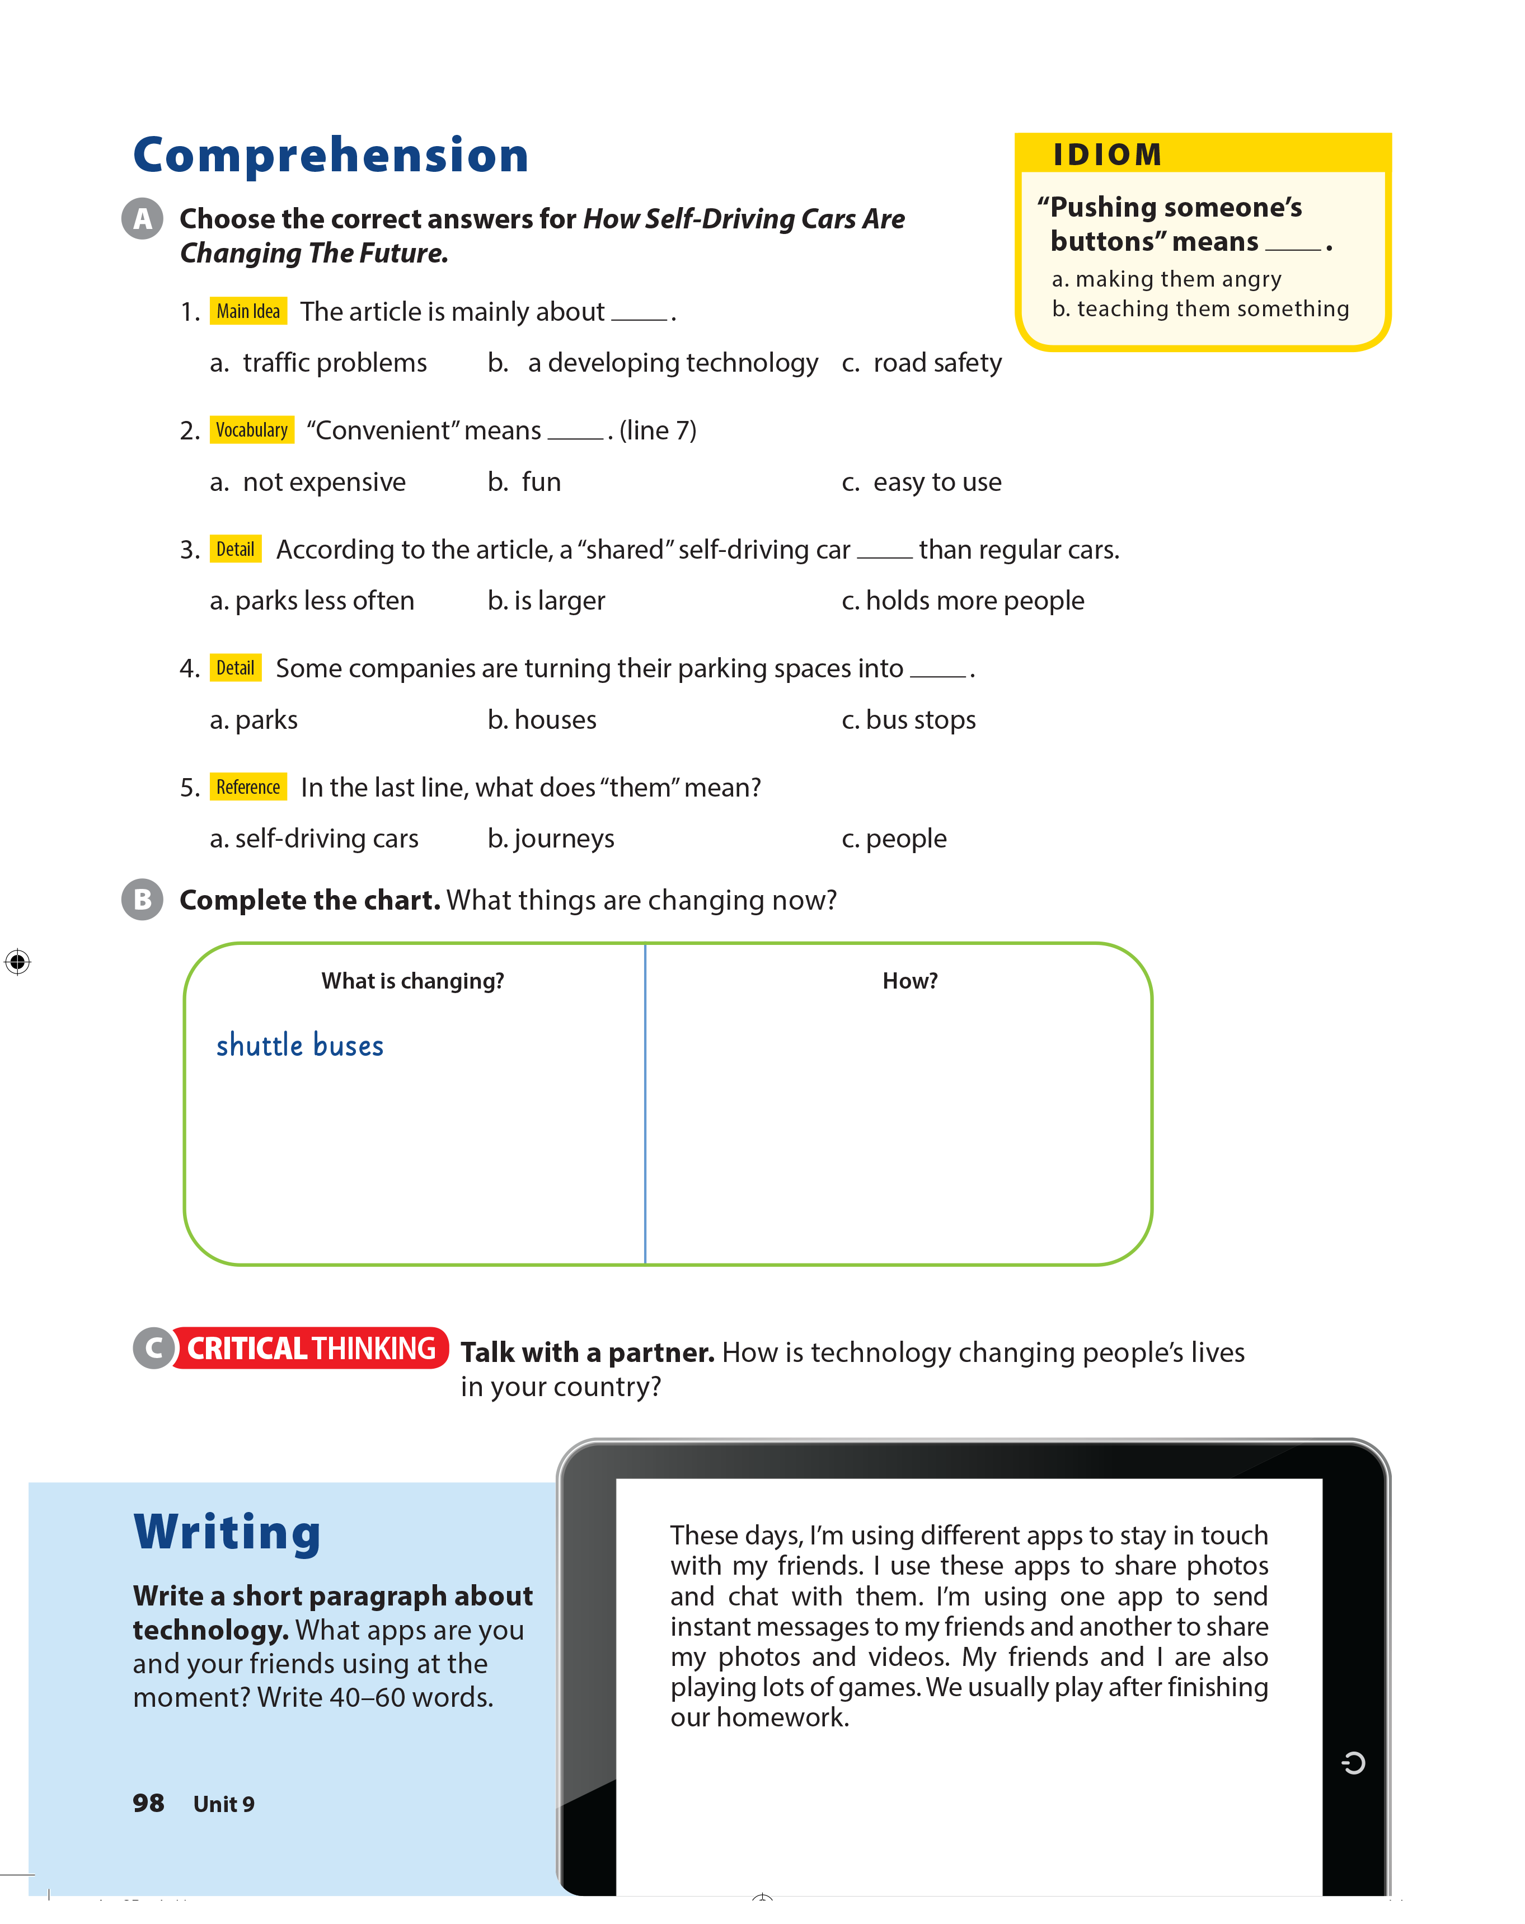
UNIT 9
WHAT ARE YOU DOING?
COMPREHENSION
don’t need drivers
subway trains
parking lots
driving times/our journeys
don’t need drivers
changing into green parks, event spaces
becoming faster

Slide 24
UNIT 9
WHAT ARE YOU DOING?
WRITING

Slide 25


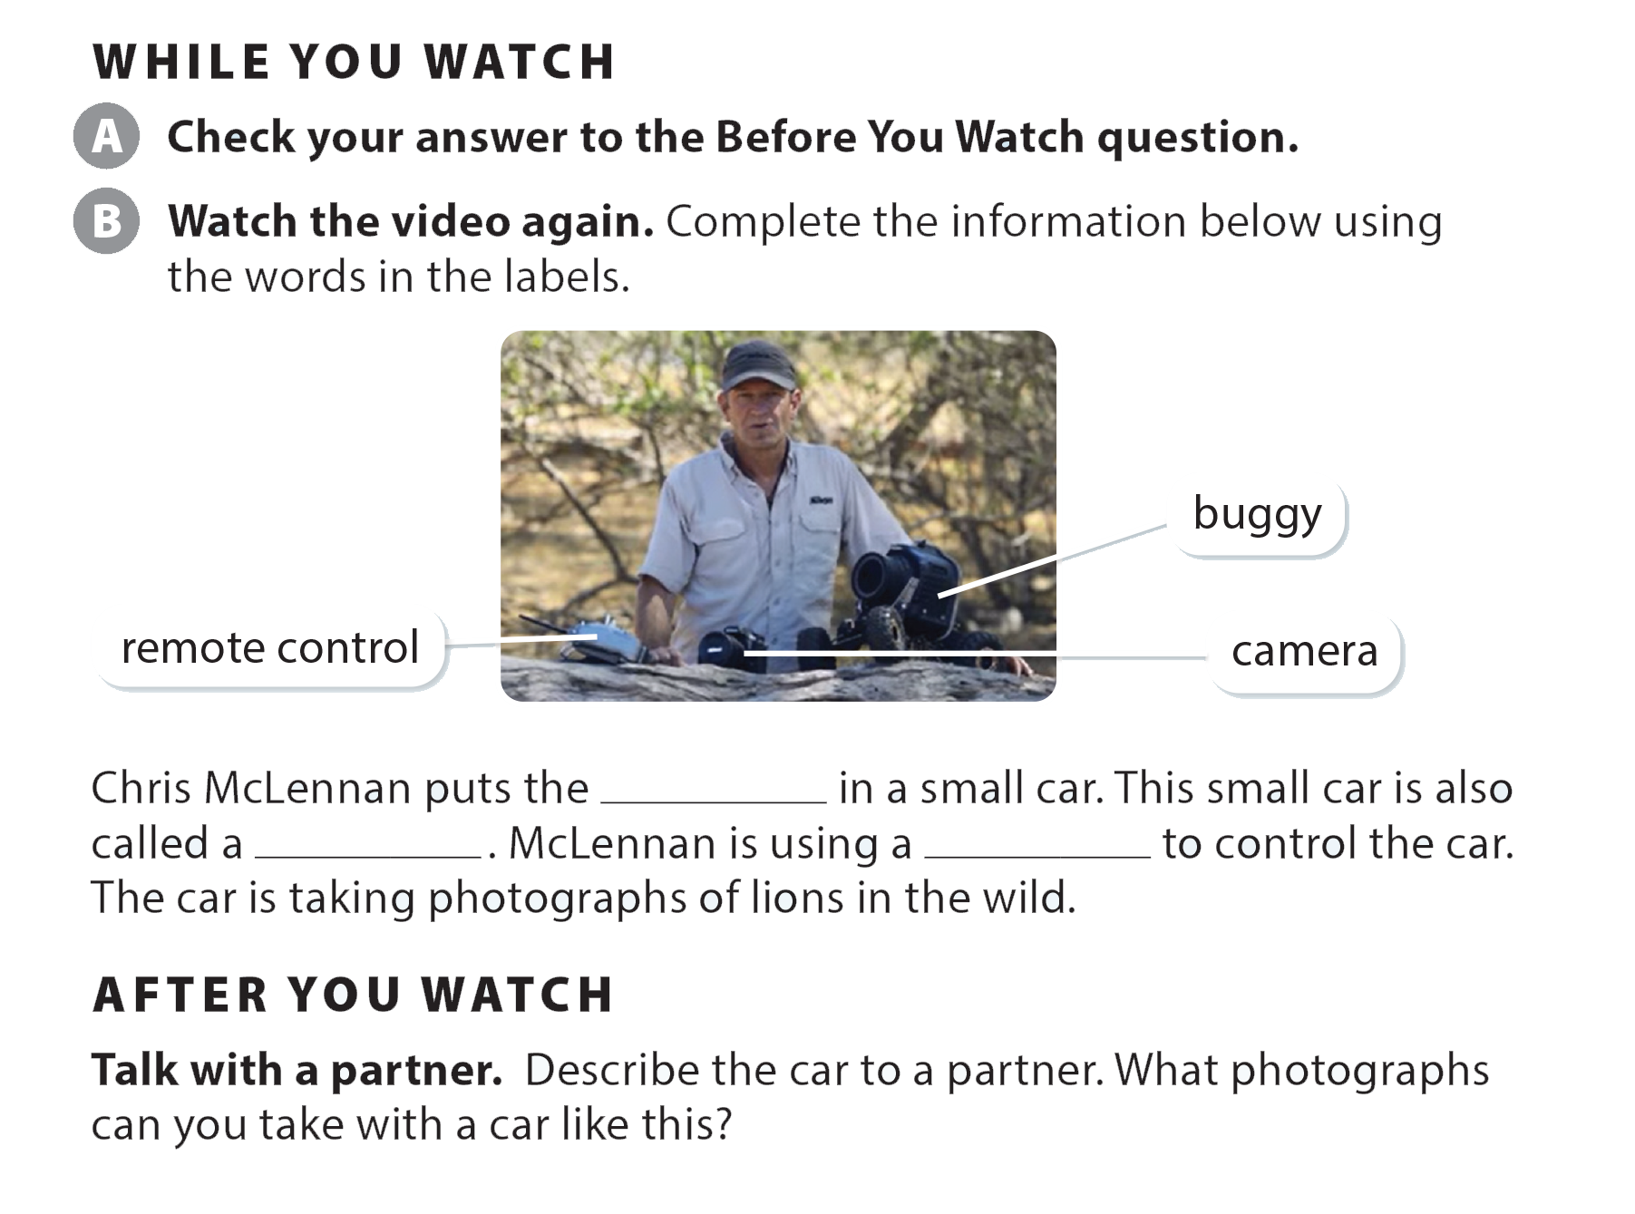
UNIT 9
WHAT ARE YOU DOING?
VIDEO

Slide 26
UNIT 9
WHAT ARE YOU DOING?
VIDEO
camera
buggy
remote control

Slide 27


UNIT 9
WHAT ARE YOU DOING?
VIDEO

