Slide 1
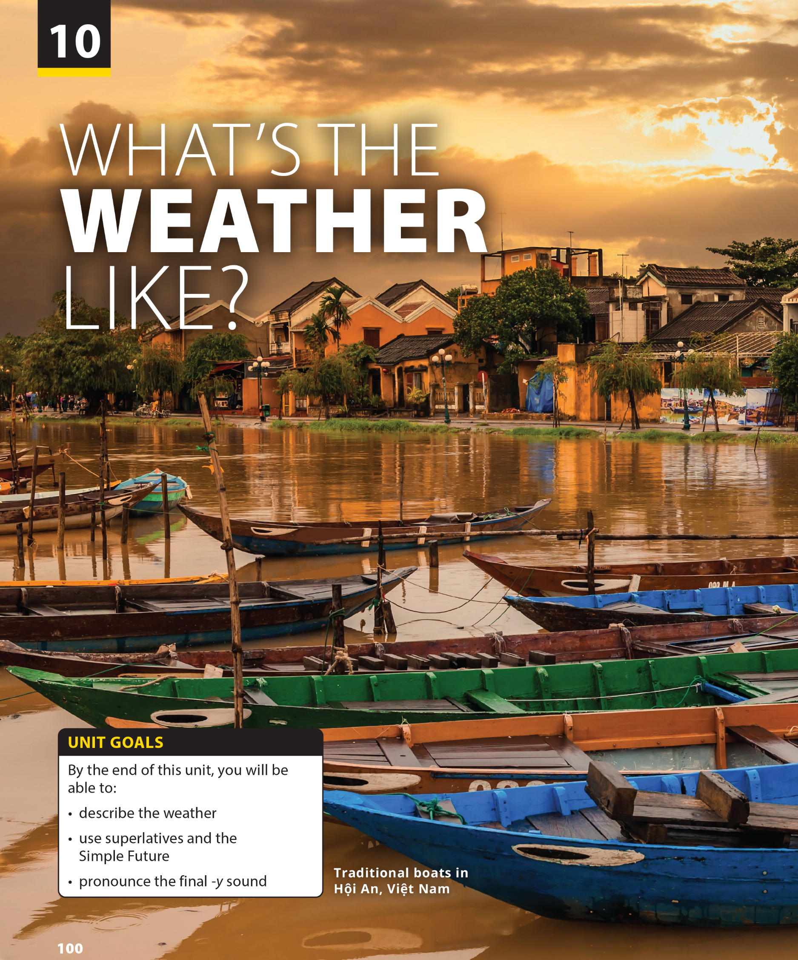
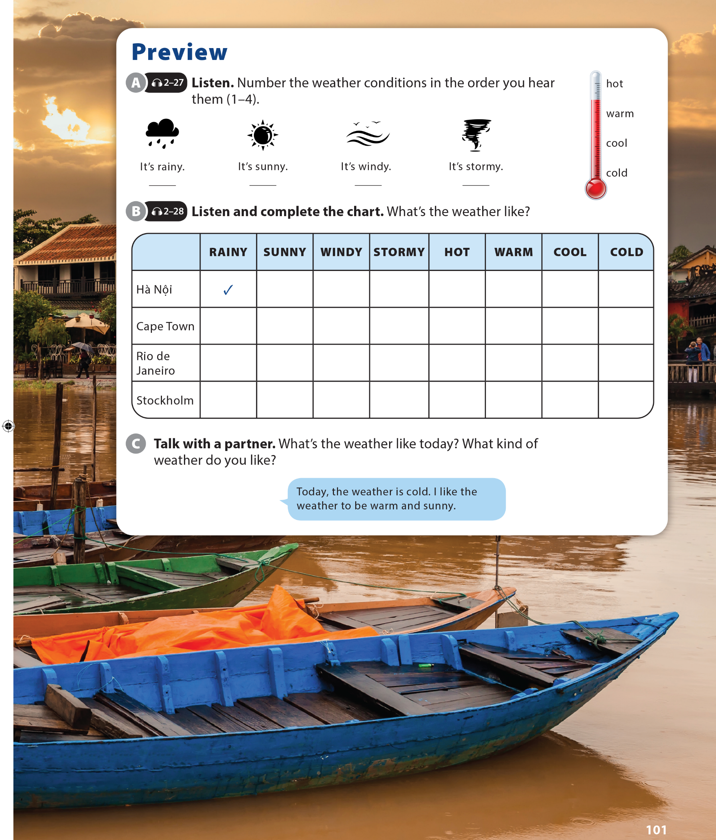

Slide 2

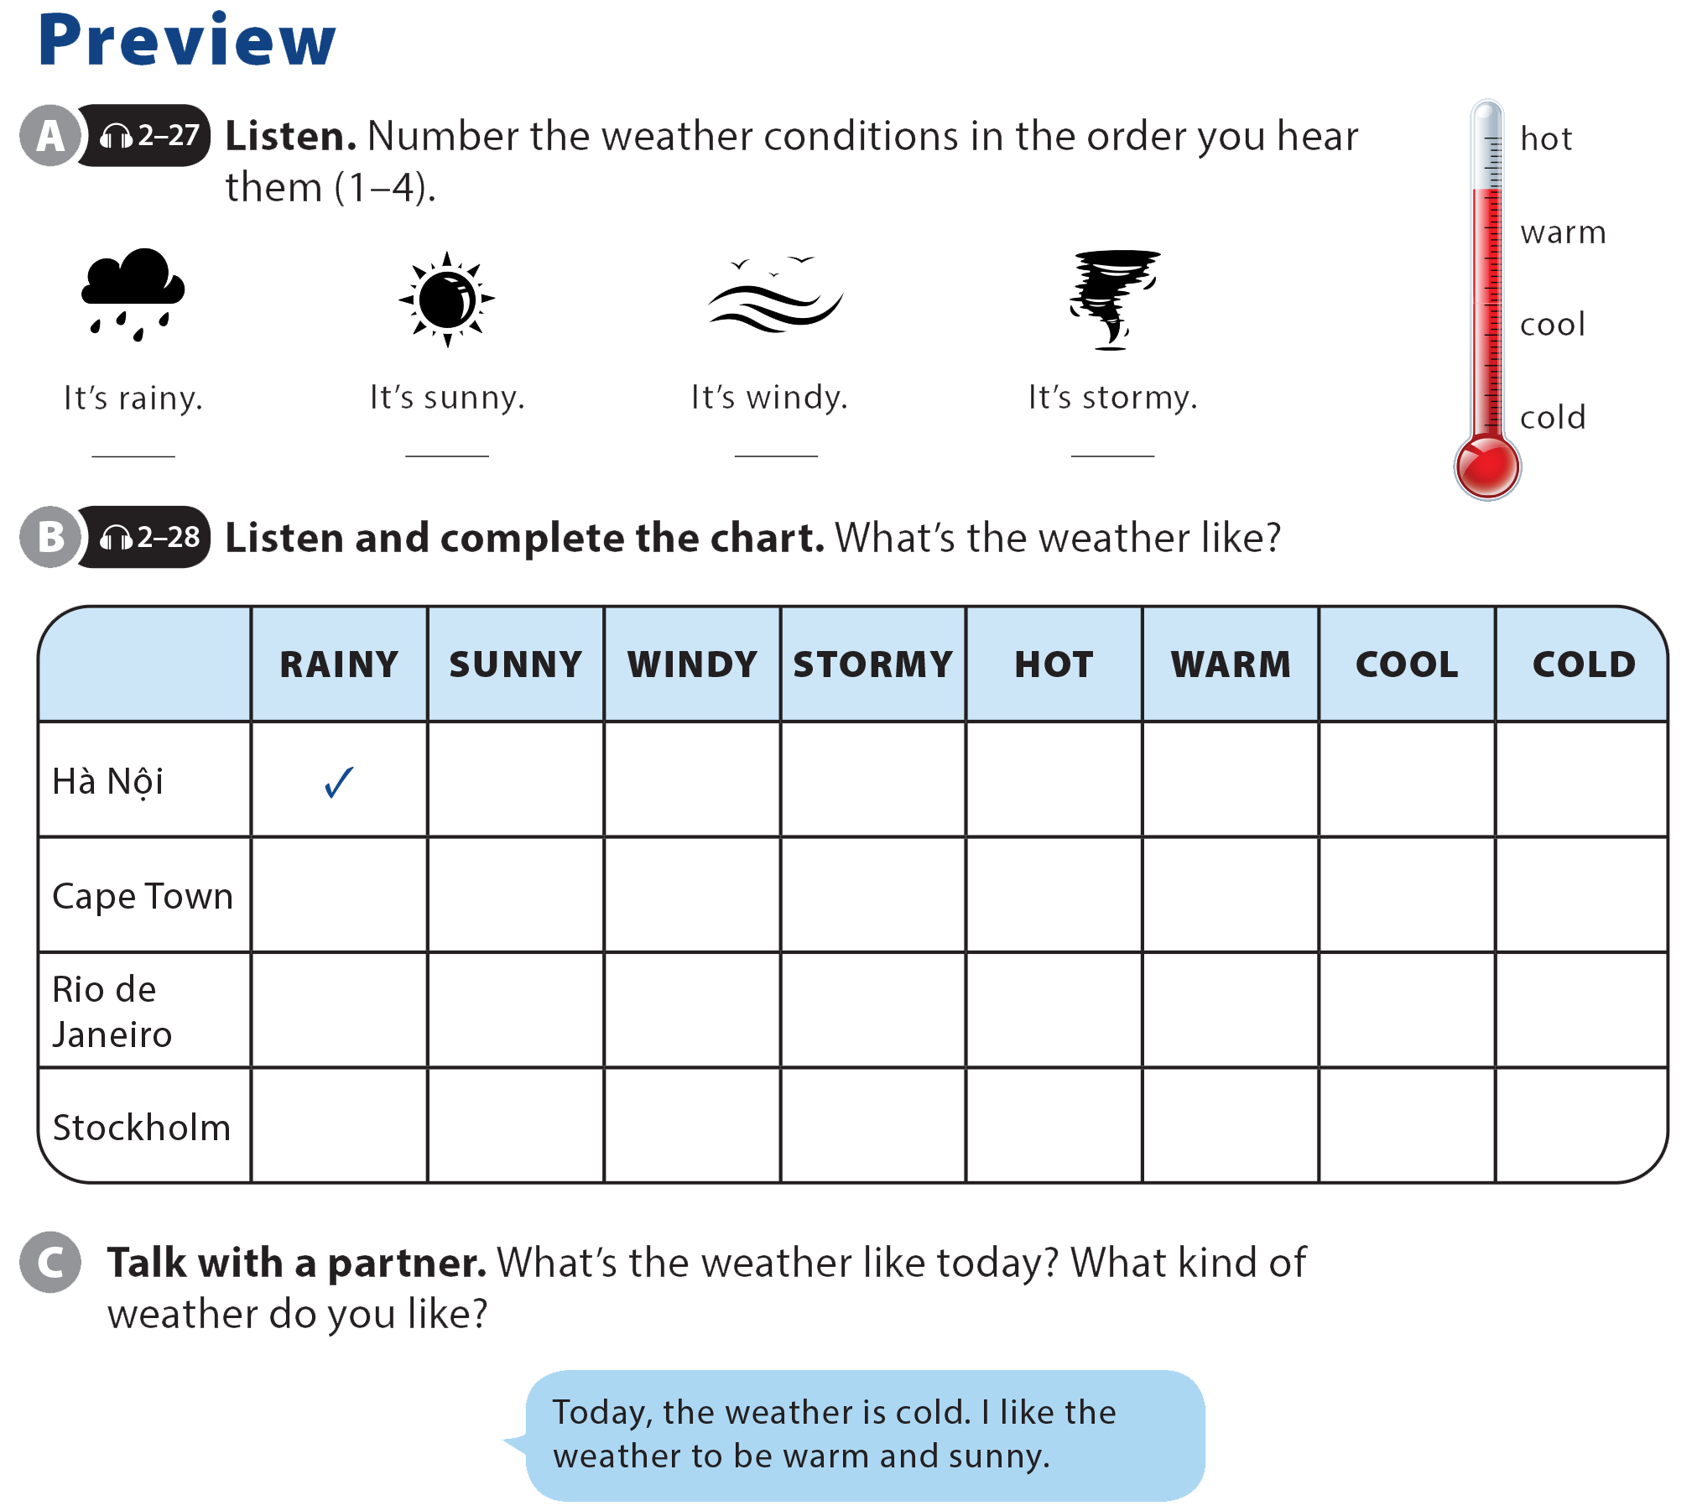

UNIT 10
WHAT'S THE WEATHER LIKE?
PREVIEW
4
2
1
3

Slide 3

UNIT 10
WHAT'S THE WEATHER LIKE?
PREVIEW

Slide 4
UNIT 10
WHAT'S THE WEATHER LIKE?
PREVIEW

Slide 5
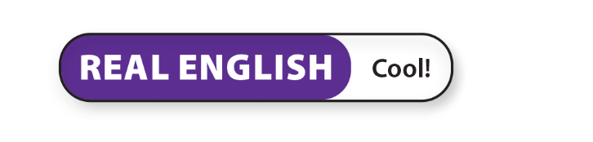

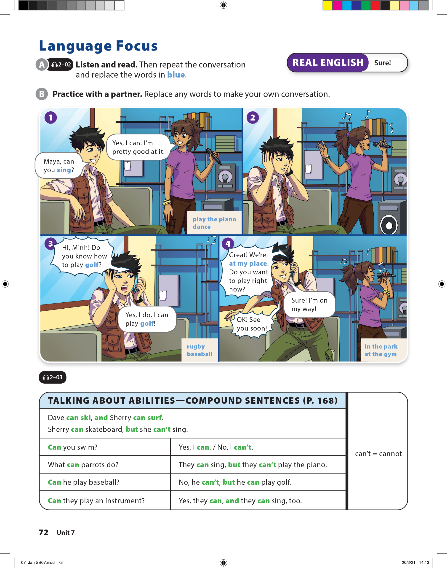
UNIT 10
WHAT'S THE WEATHER LIKE?
LANGUAGE FOCUS

Slide 6

UNIT 10
WHAT'S THE WEATHER LIKE?
LANGUAGE FOCUS

Slide 7
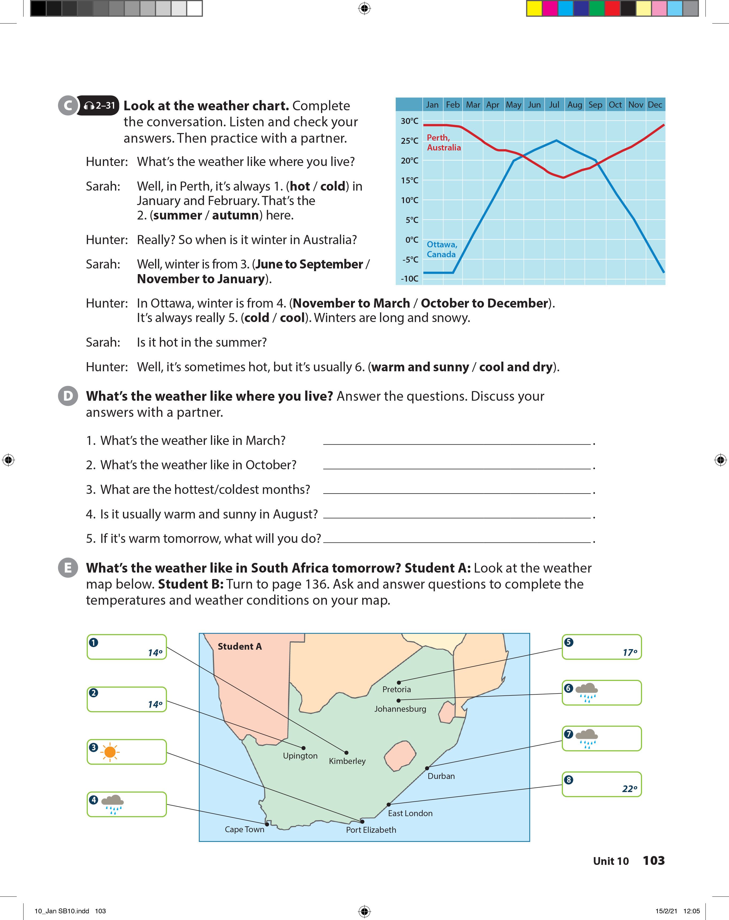
UNIT 10
WHAT'S THE WEATHER LIKE?
LANGUAGE FOCUS

Slide 8
UNIT 10
WHAT'S THE WEATHER LIKE?
LANGUAGE FOCUS

Slide 9
UNIT 10
WHAT'S THE WEATHER LIKE?
LANGUAGE FOCUS
22º
17º
16º
14º

Slide 10
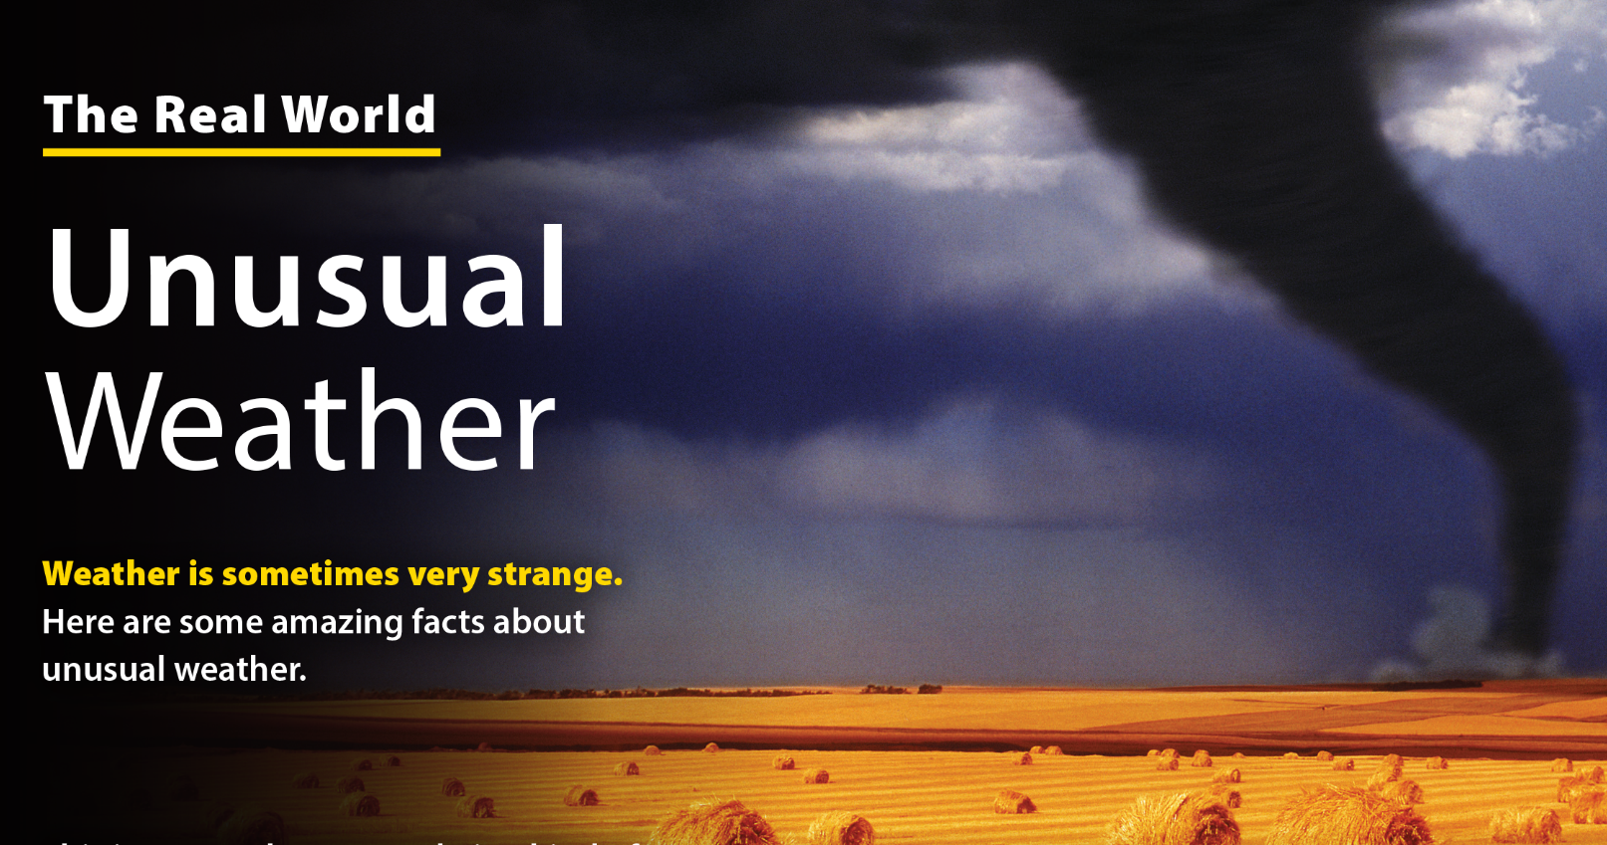
UNIT 10
WHAT'S THE WEATHER LIKE?
THE REAL WORLD

Slide 11
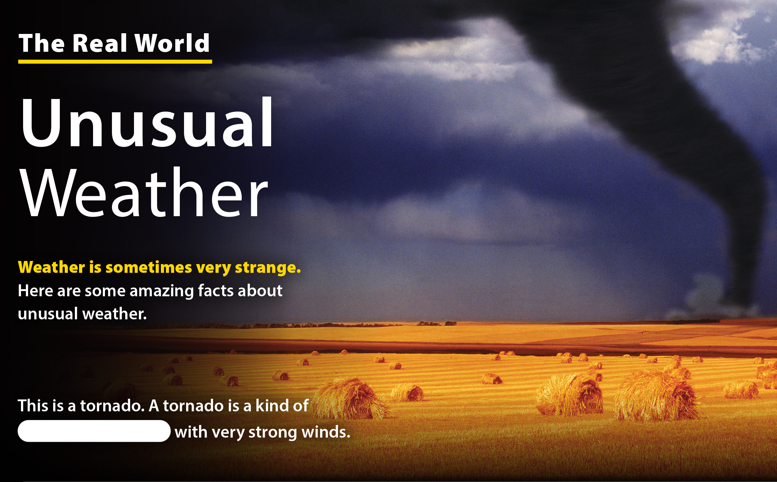
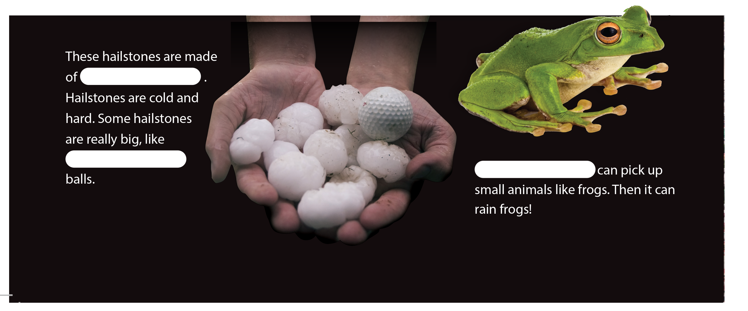
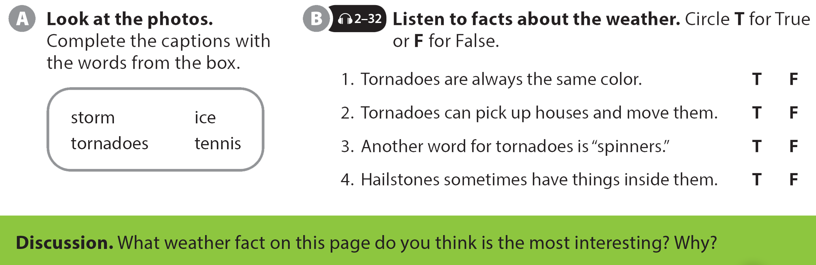
UNIT 10
WHAT'S THE WEATHER LIKE?
THE REAL WORLD
Tornadoes
ice
storm
tennis

Slide 12
UNIT 10
WHAT'S THE WEATHER LIKE?
THE REAL WORLD

Slide 13
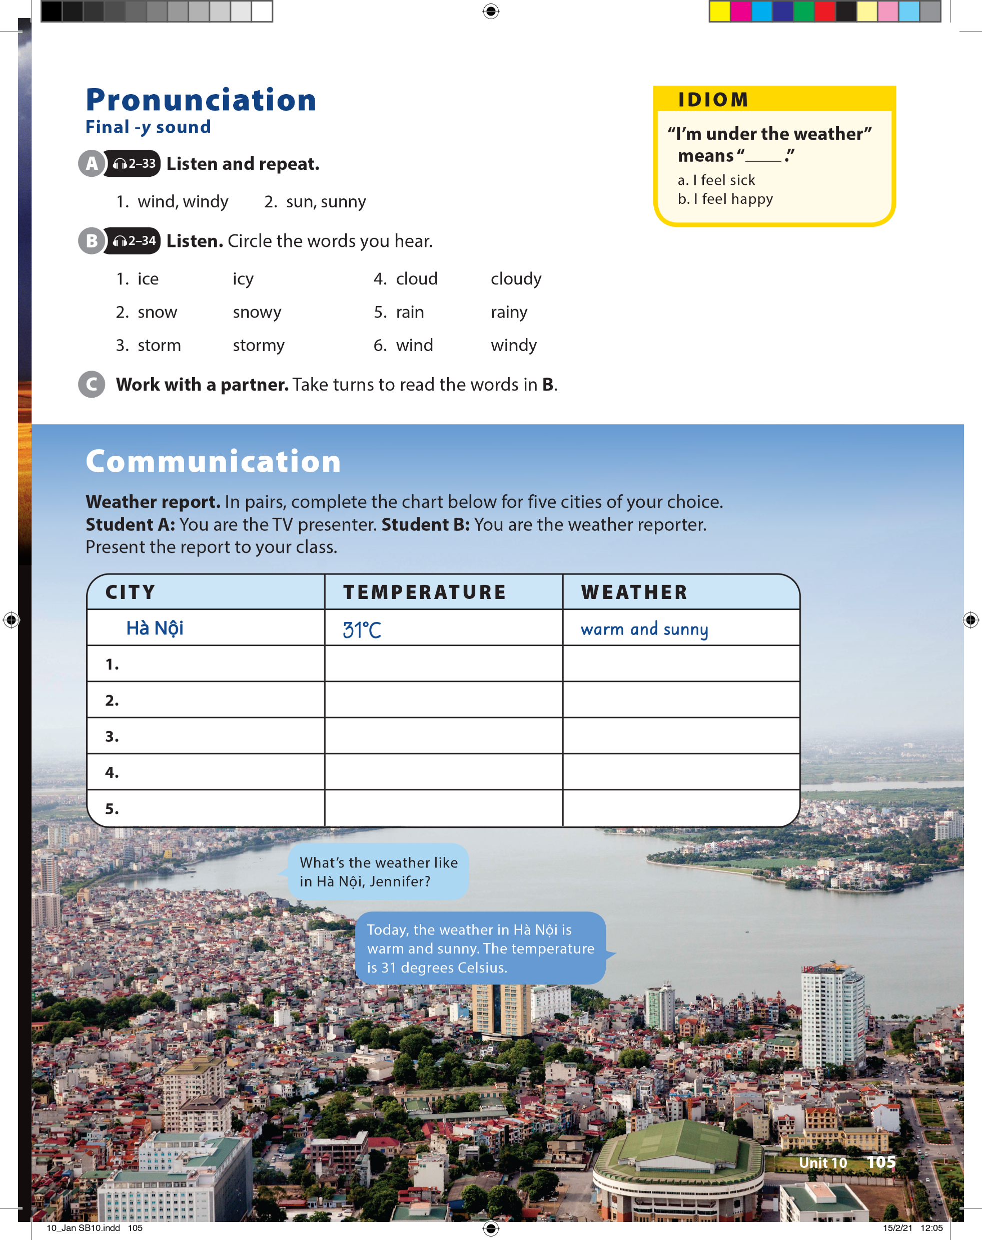
UNIT 10
WHAT'S THE WEATHER LIKE?
PRONUNCIATION

Slide 14
UNIT 10
WHAT'S THE WEATHER LIKE?
IDIOM
“I’m under the weather”
means “__________.”
I feel sick
I feel happy

Slide 15
UNIT 10
WHAT'S THE WEATHER LIKE?
PRONUNCIATION

Slide 16

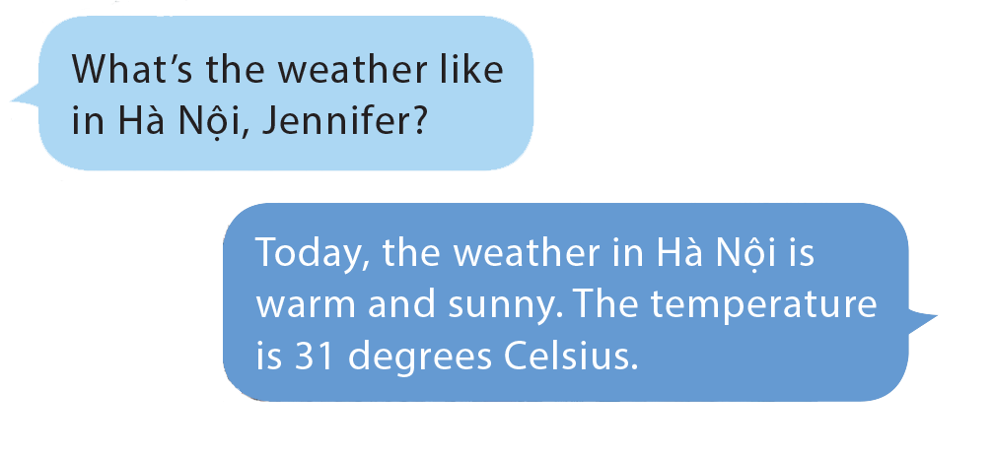
UNIT 10
WHAT'S THE WEATHER LIKE?
COMMUNICATION

Slide 17
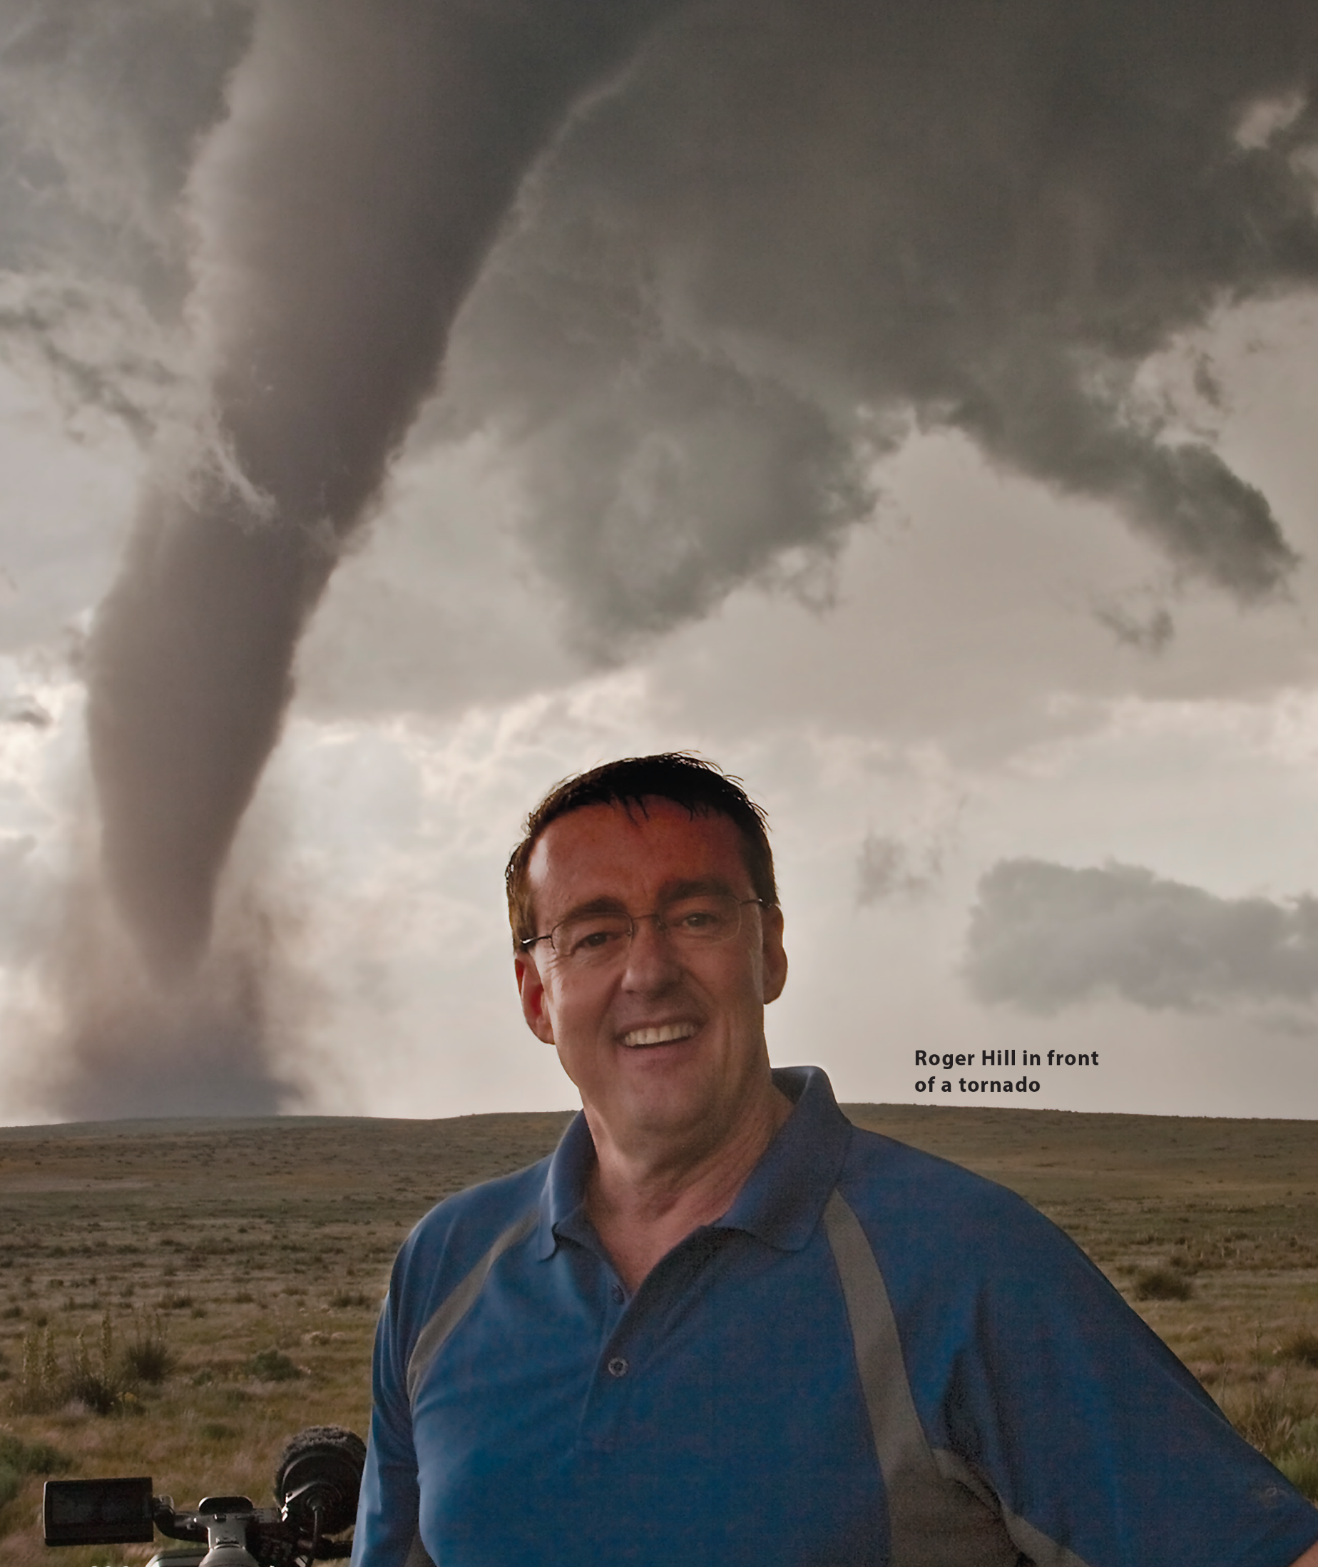
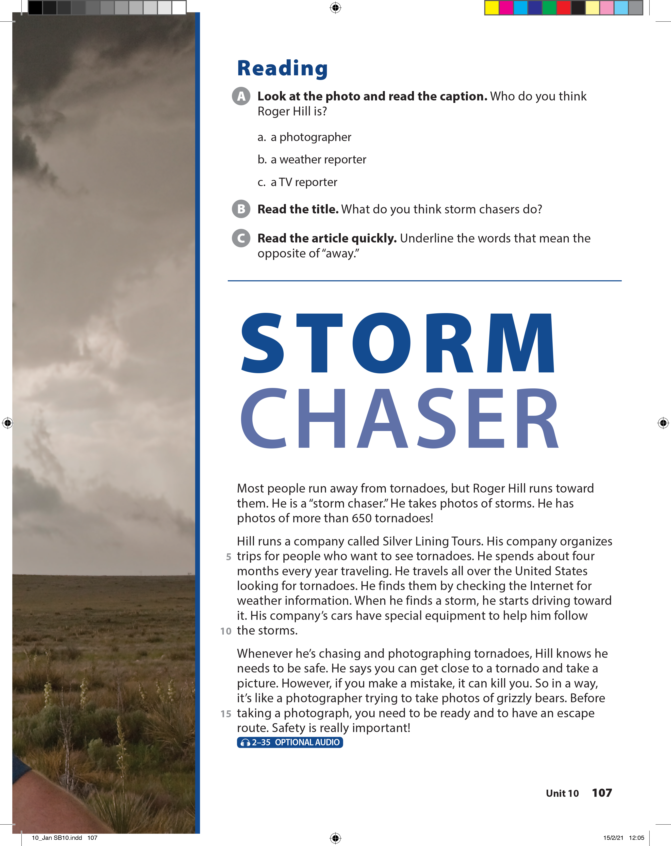
UNIT 10
WHAT'S THE WEATHER LIKE?
READING

Slide 18
UNIT 10
WHAT'S THE WEATHER LIKE?
READING

Slide 19
UNIT 10
WHAT'S THE WEATHER LIKE?
READING

Slide 20
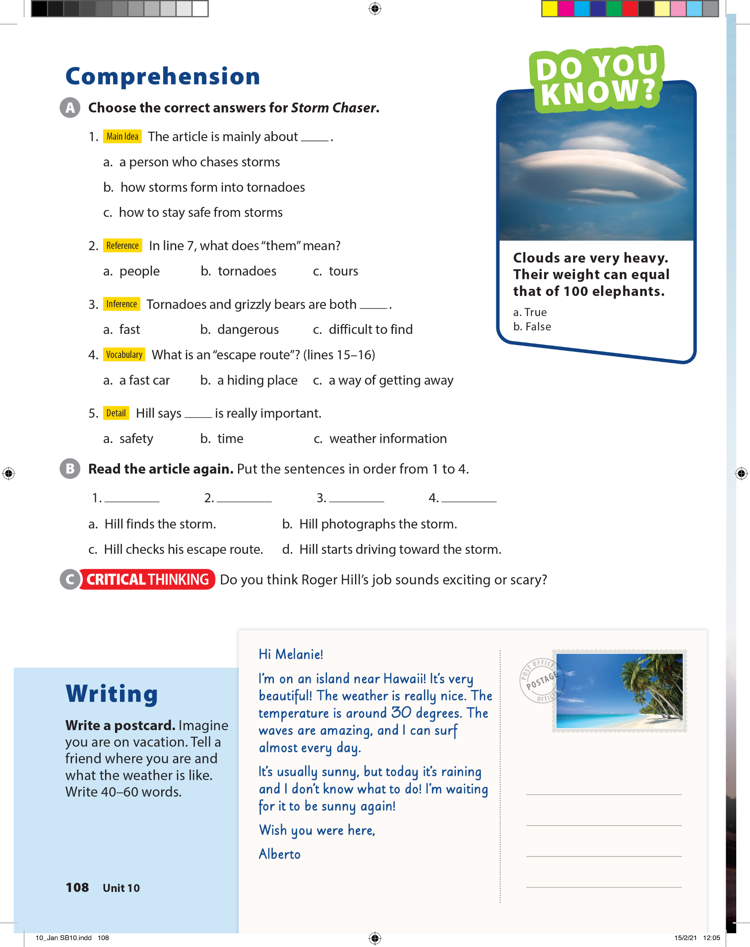
UNIT 10
WHAT'S THE WEATHER LIKE?
COMPREHENSION

Slide 21

UNIT 10
WHAT'S THE WEATHER LIKE?
COMPREHENSION
a
d
c
b

Slide 22

UNIT 10
WHAT'S THE WEATHER LIKE?
WRITING

Slide 23
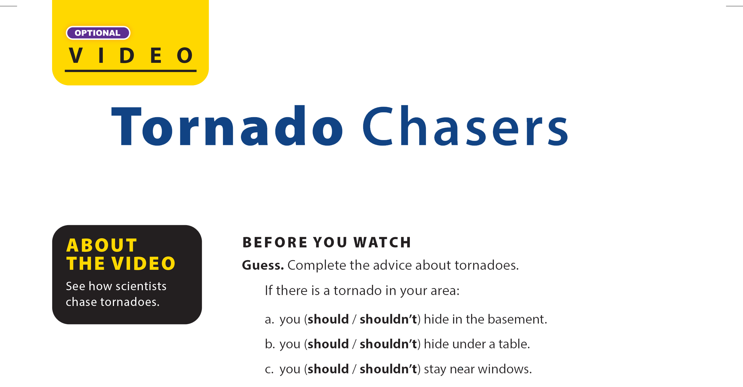

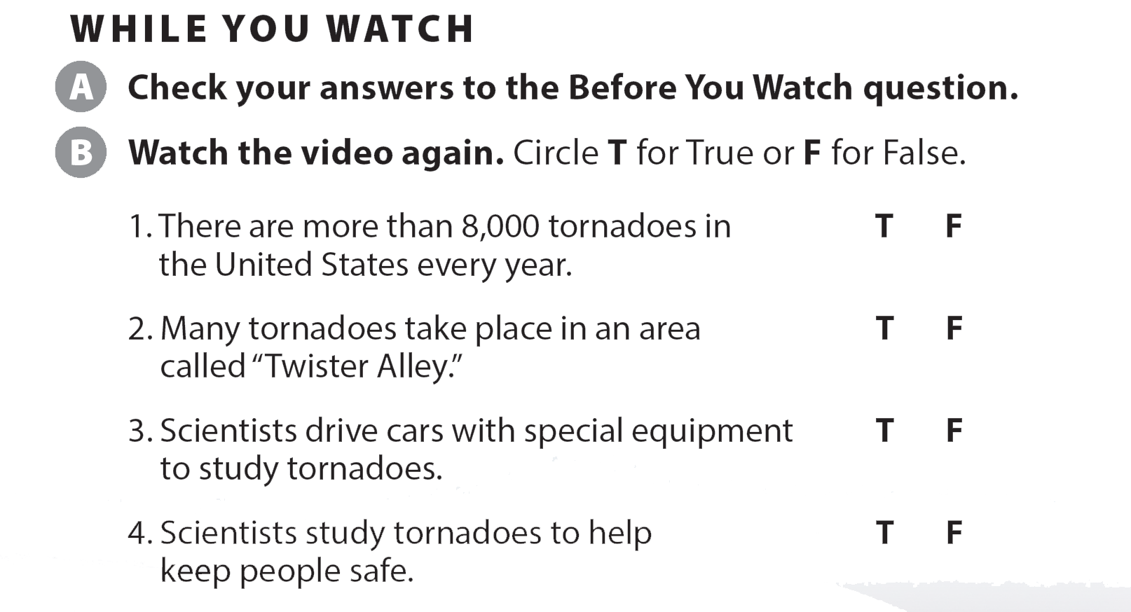
UNIT 10
WHAT'S THE WEATHER LIKE?
VIDEO

Slide 24
UNIT 10
WHAT'S THE WEATHER LIKE?
VIDEO

Slide 25
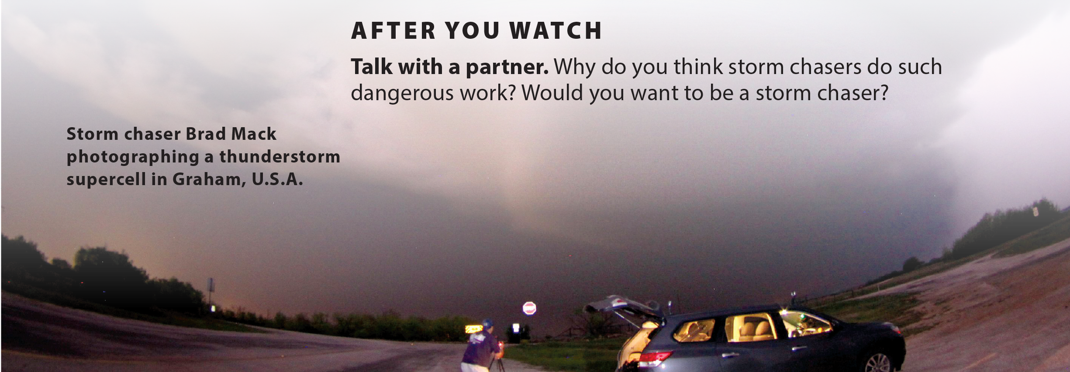
UNIT 10
WHAT'S THE WEATHER LIKE?
VIDEO

