Slide 1
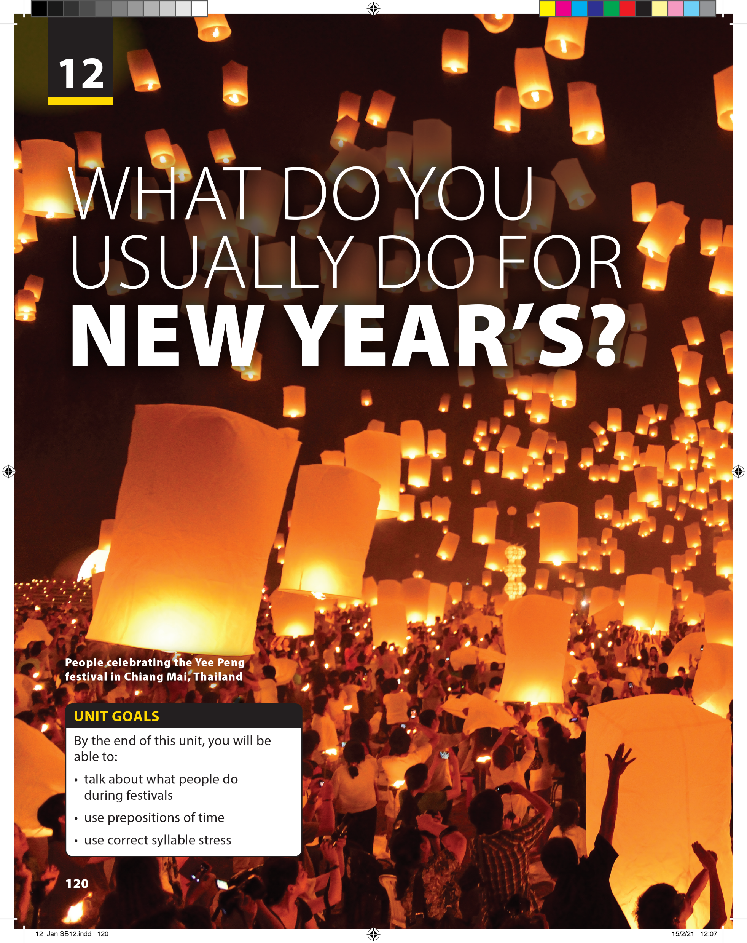
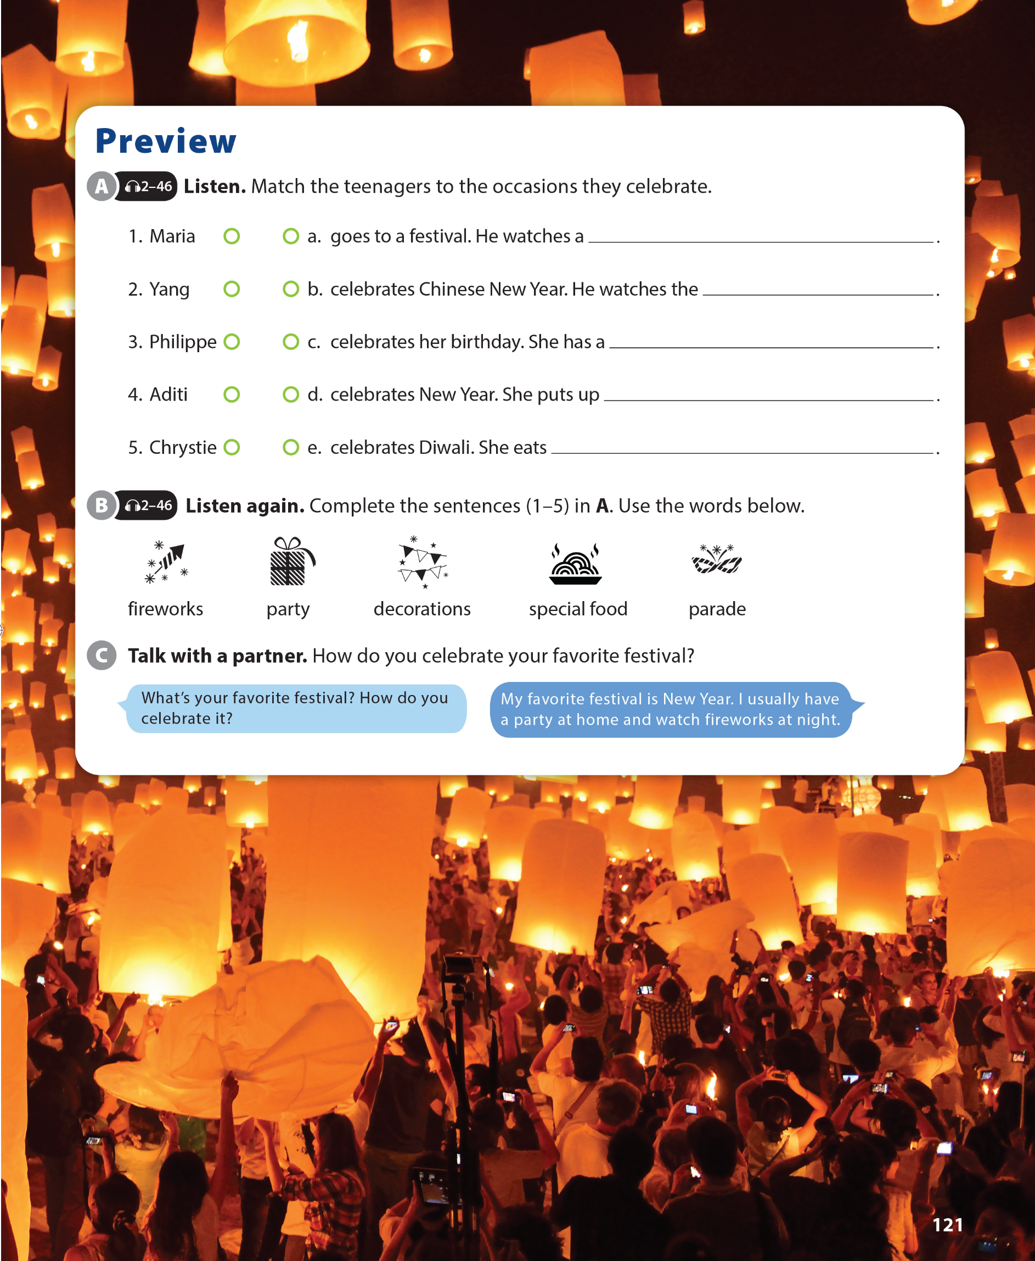

Slide 2

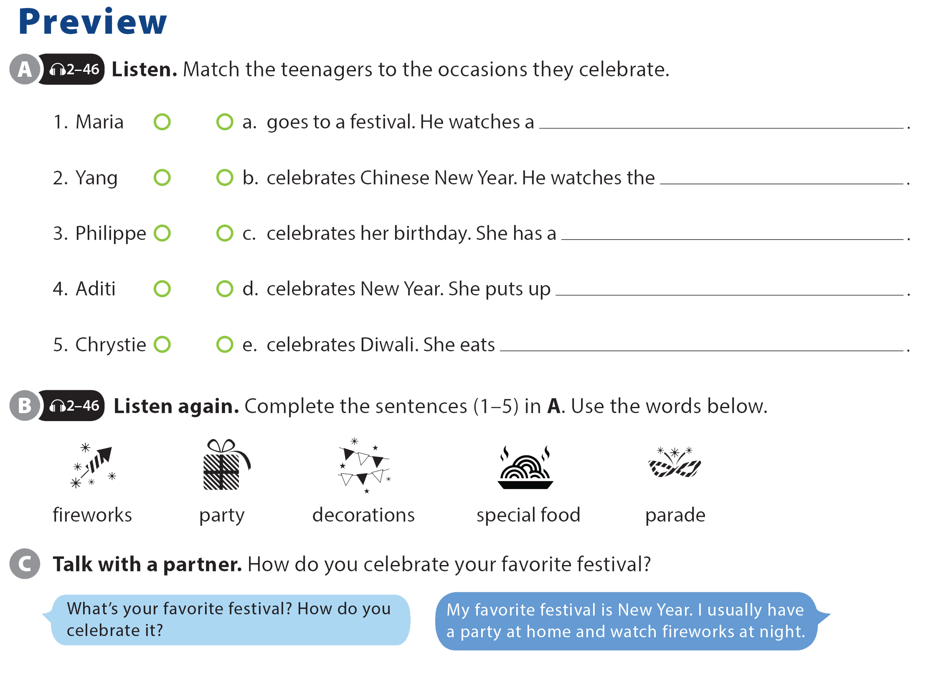

UNIT 12
WHAT DO YOU USUALLY DO FOR NEW YEAR'S?
PREVIEW
parade
fireworks
party
decorations
special food

Slide 3
UNIT 12
WHAT DO YOU USUALLY DO FOR NEW YEAR'S?
PREVIEW

Slide 4
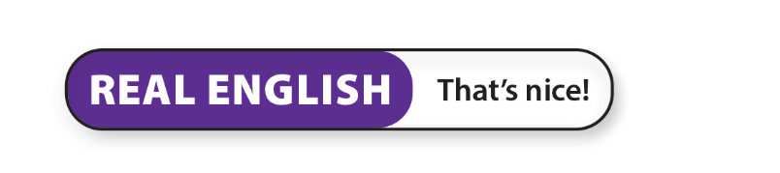

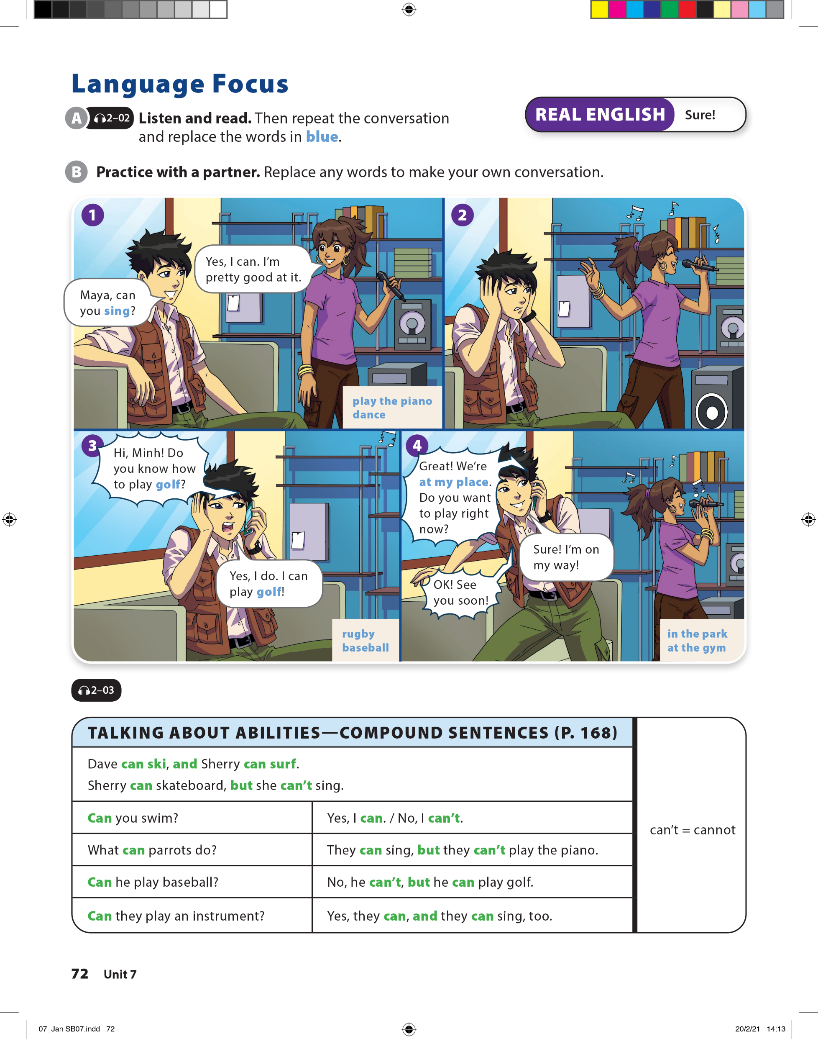
UNIT 12
WHAT DO YOU USUALLY DO FOR NEW YEAR'S?
LANGUAGE FOCUS

Slide 5
UNIT 12
WHAT DO YOU USUALLY DO FOR NEW YEAR'S?
LANGUAGE FOCUS

Slide 6
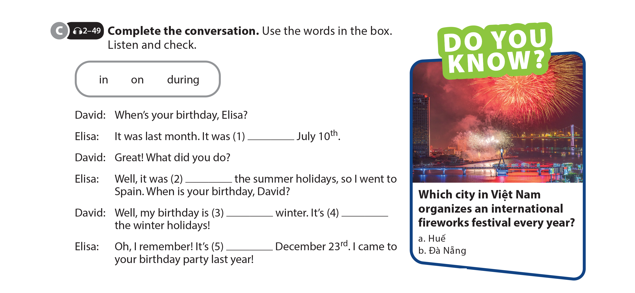
UNIT 12
WHAT DO YOU USUALLY DO FOR NEW YEAR'S?
LANGUAGE FOCUS
on
during
in
during
on

Slide 7
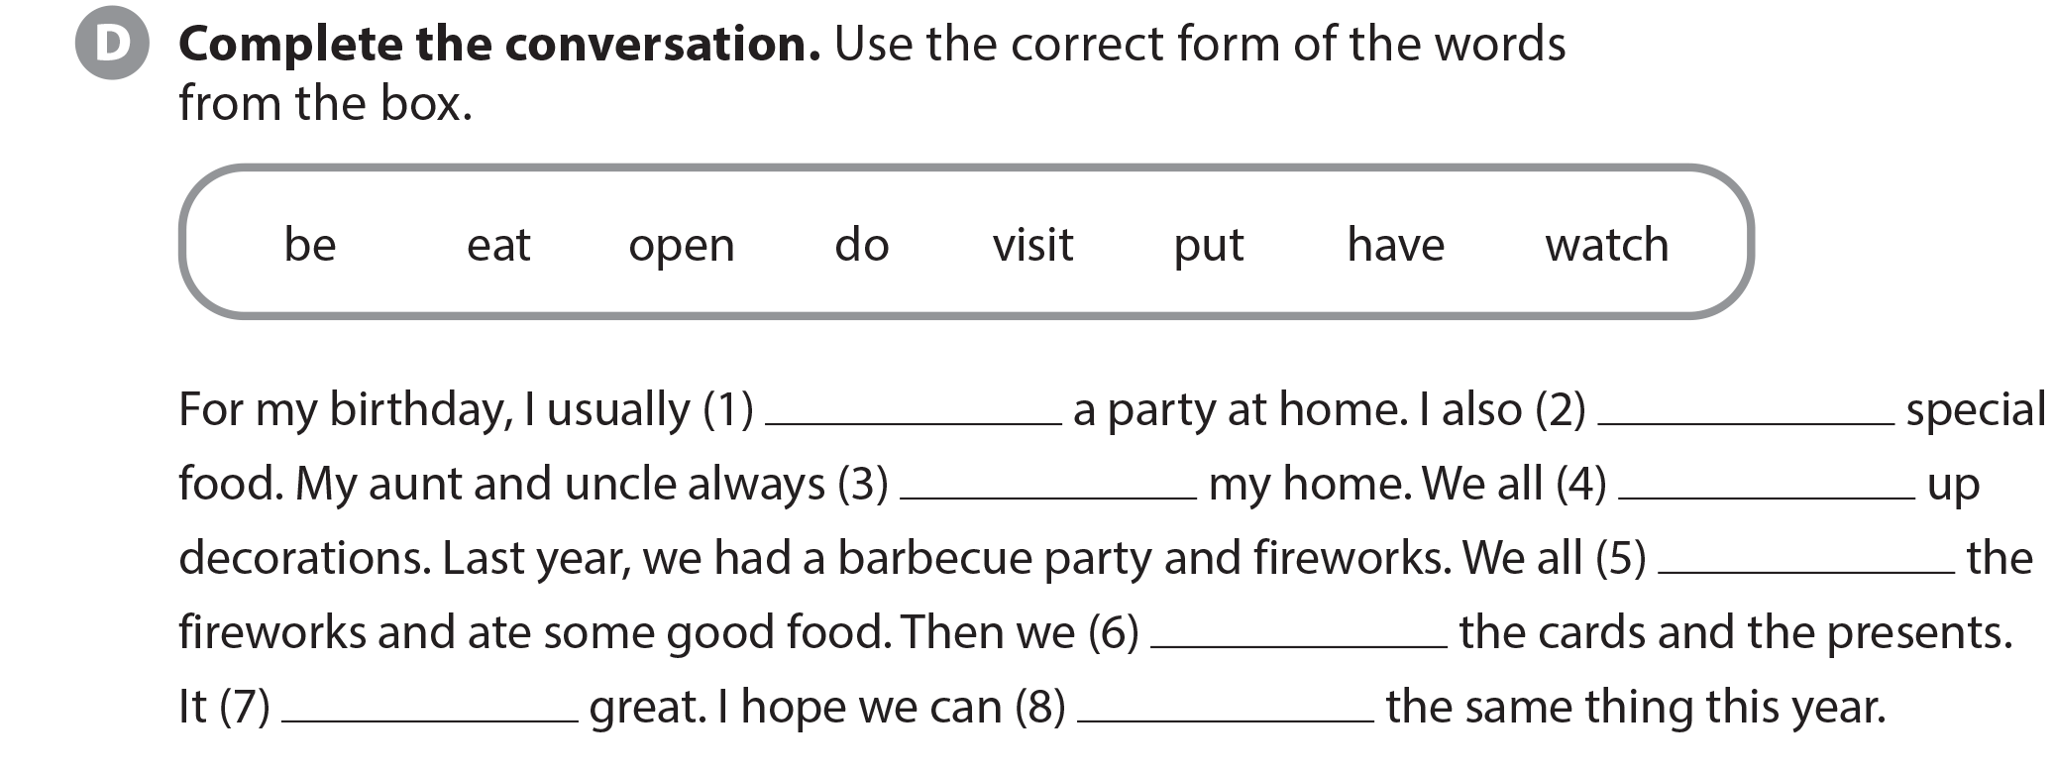
UNIT 12
WHAT DO YOU USUALLY DO FOR NEW YEAR'S?
LANGUAGE FOCUS
have
eat
visit
put
watched
opened
was
do

Slide 8
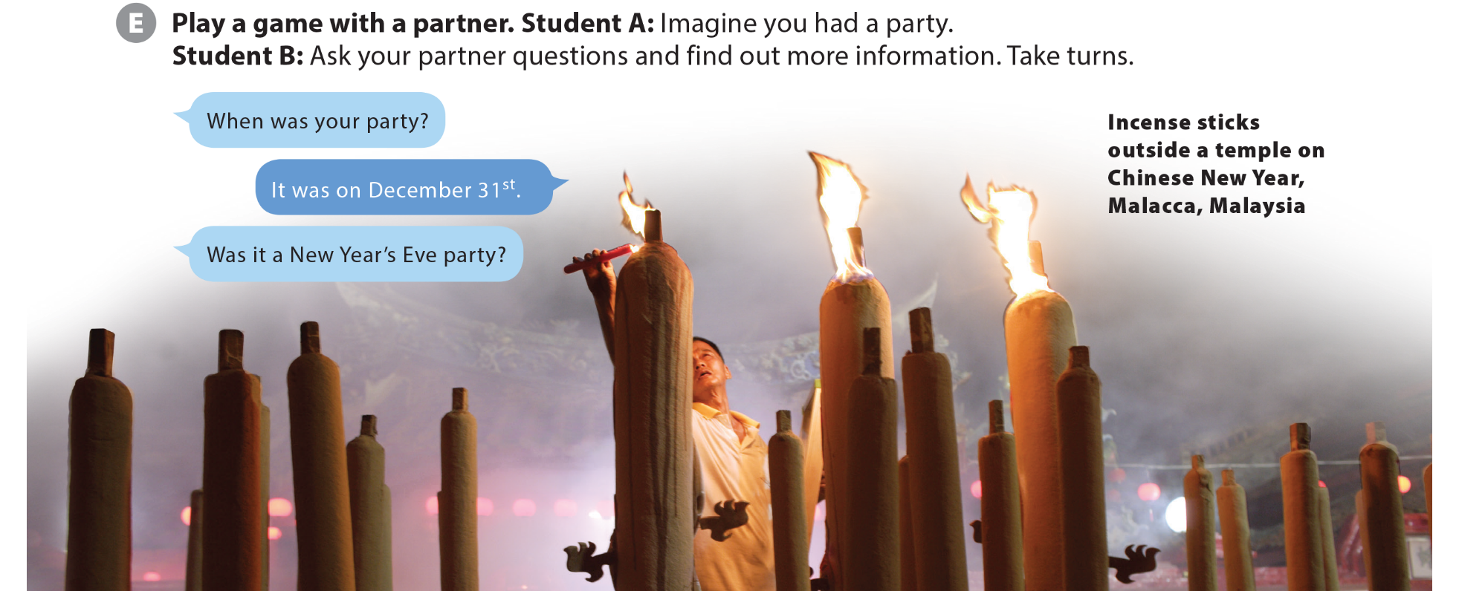
UNIT 12
WHAT DO YOU USUALLY DO FOR NEW YEAR'S?
LANGUAGE FOCUS

Slide 9
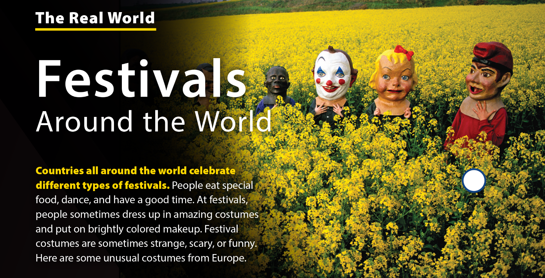
UNIT 12
WHAT DO YOU USUALLY DO FOR NEW YEAR'S?
THE REAL WORLD

Slide 10
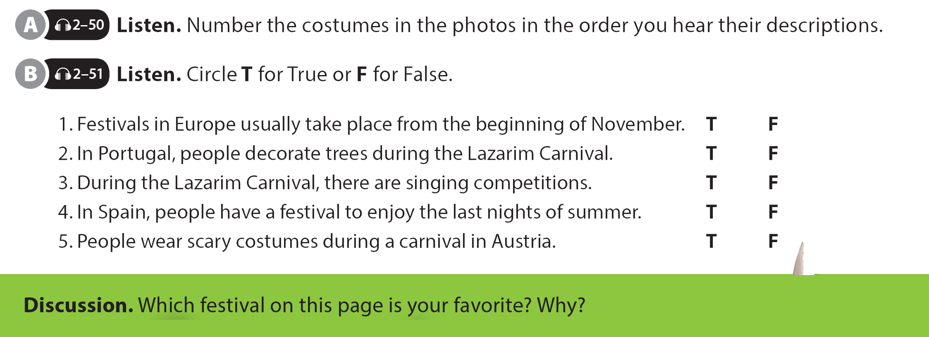
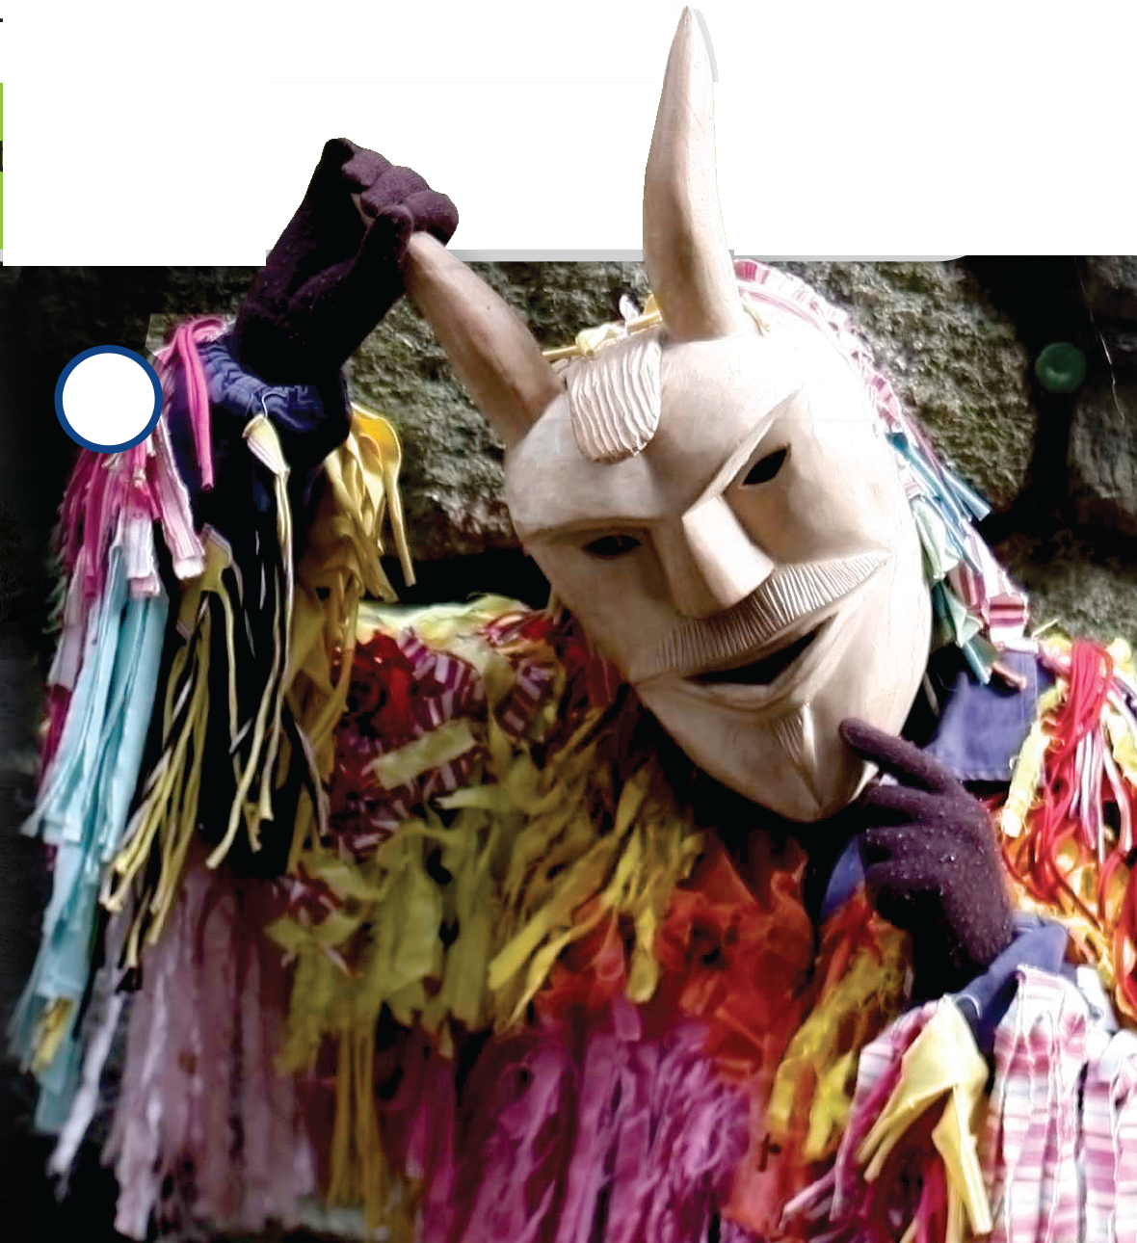
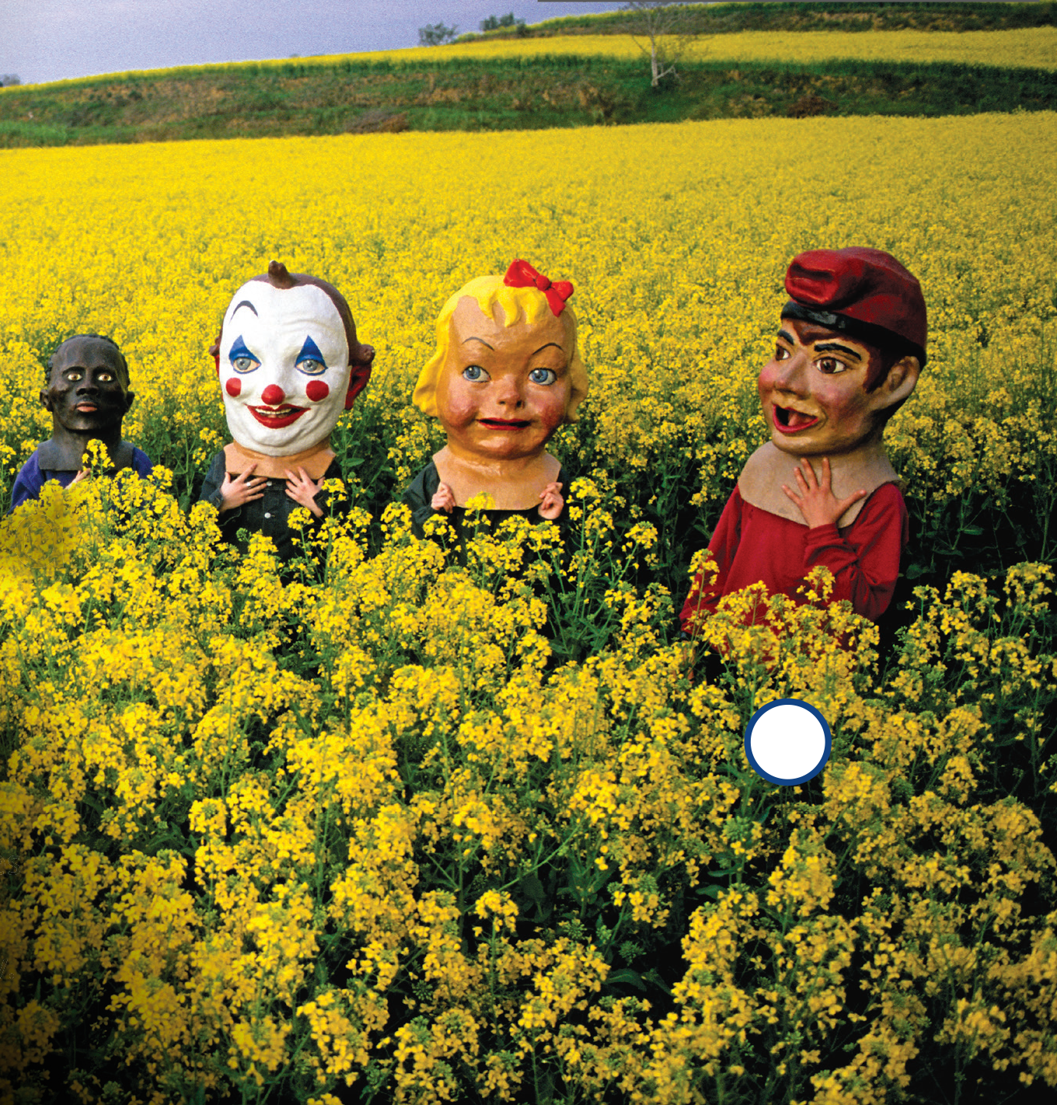
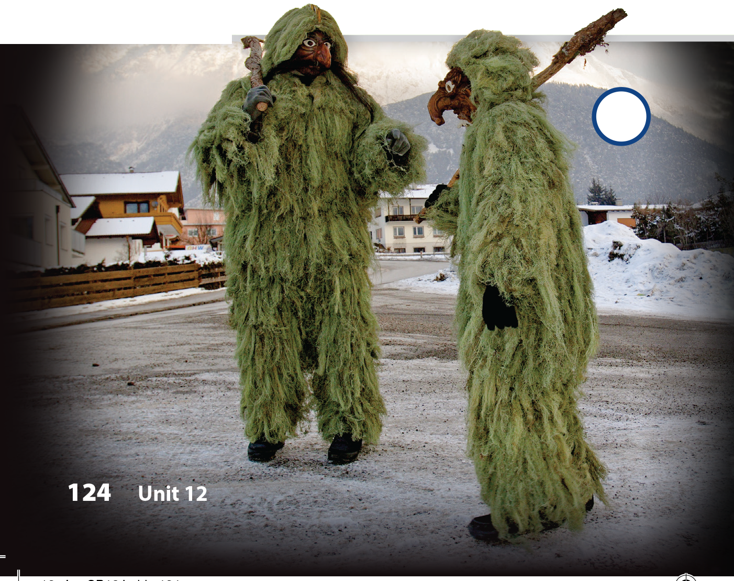
UNIT 12
WHAT DO YOU USUALLY DO FOR NEW YEAR'S?
THE REAL WORLD
3
1
2

Slide 11
UNIT 12
WHAT DO YOU USUALLY DO FOR NEW YEAR'S?
THE REAL WORLD

Slide 12
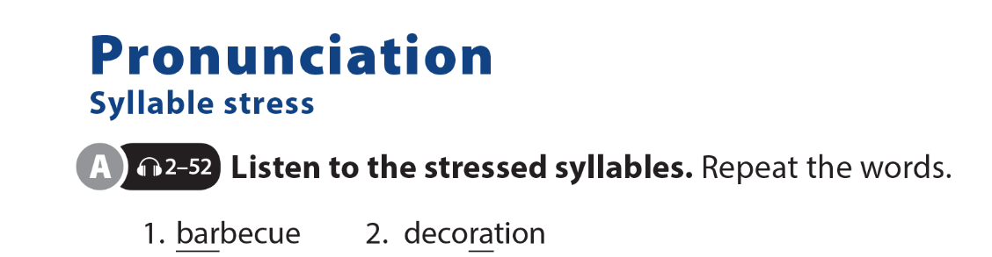
UNIT 12
WHAT DO YOU USUALLY DO FOR NEW YEAR'S?
PRONUNCIATION

Slide 13

UNIT 12
WHAT DO YOU USUALLY DO FOR NEW YEAR'S?
PRONUNCIATION

Slide 14

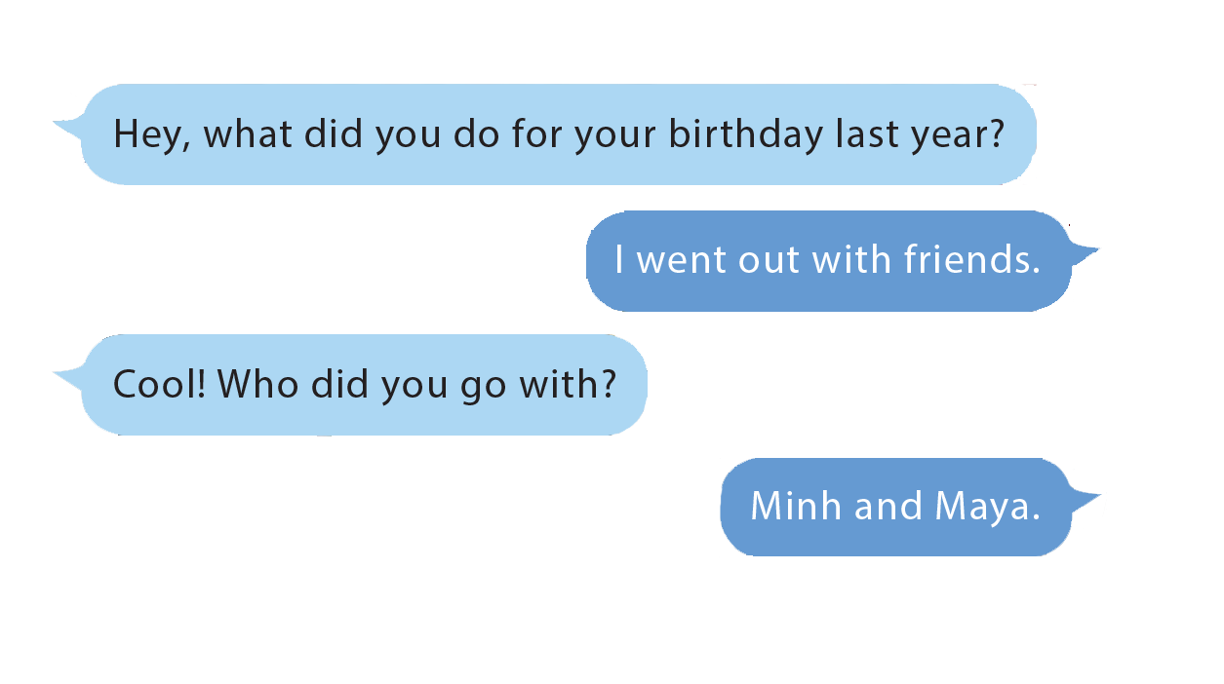
UNIT 12
WHAT DO YOU USUALLY DO FOR NEW YEAR'S?
COMMUNICATION

Slide 15
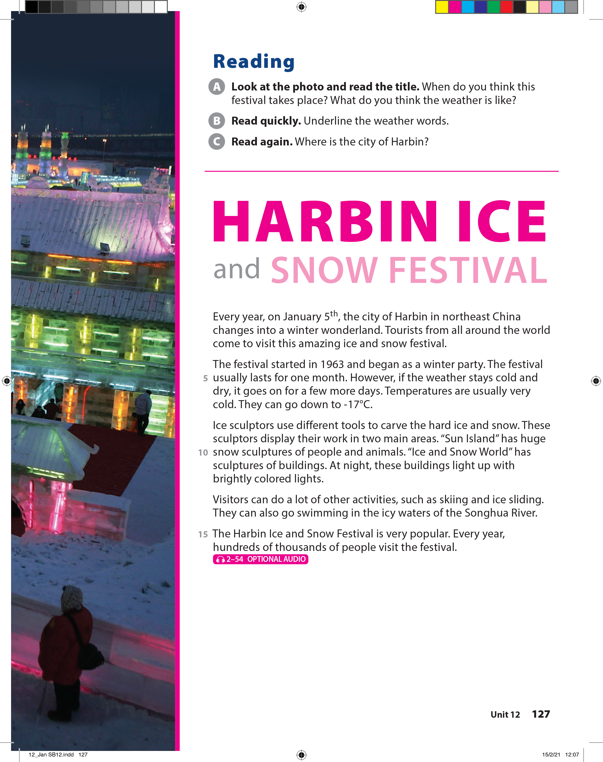
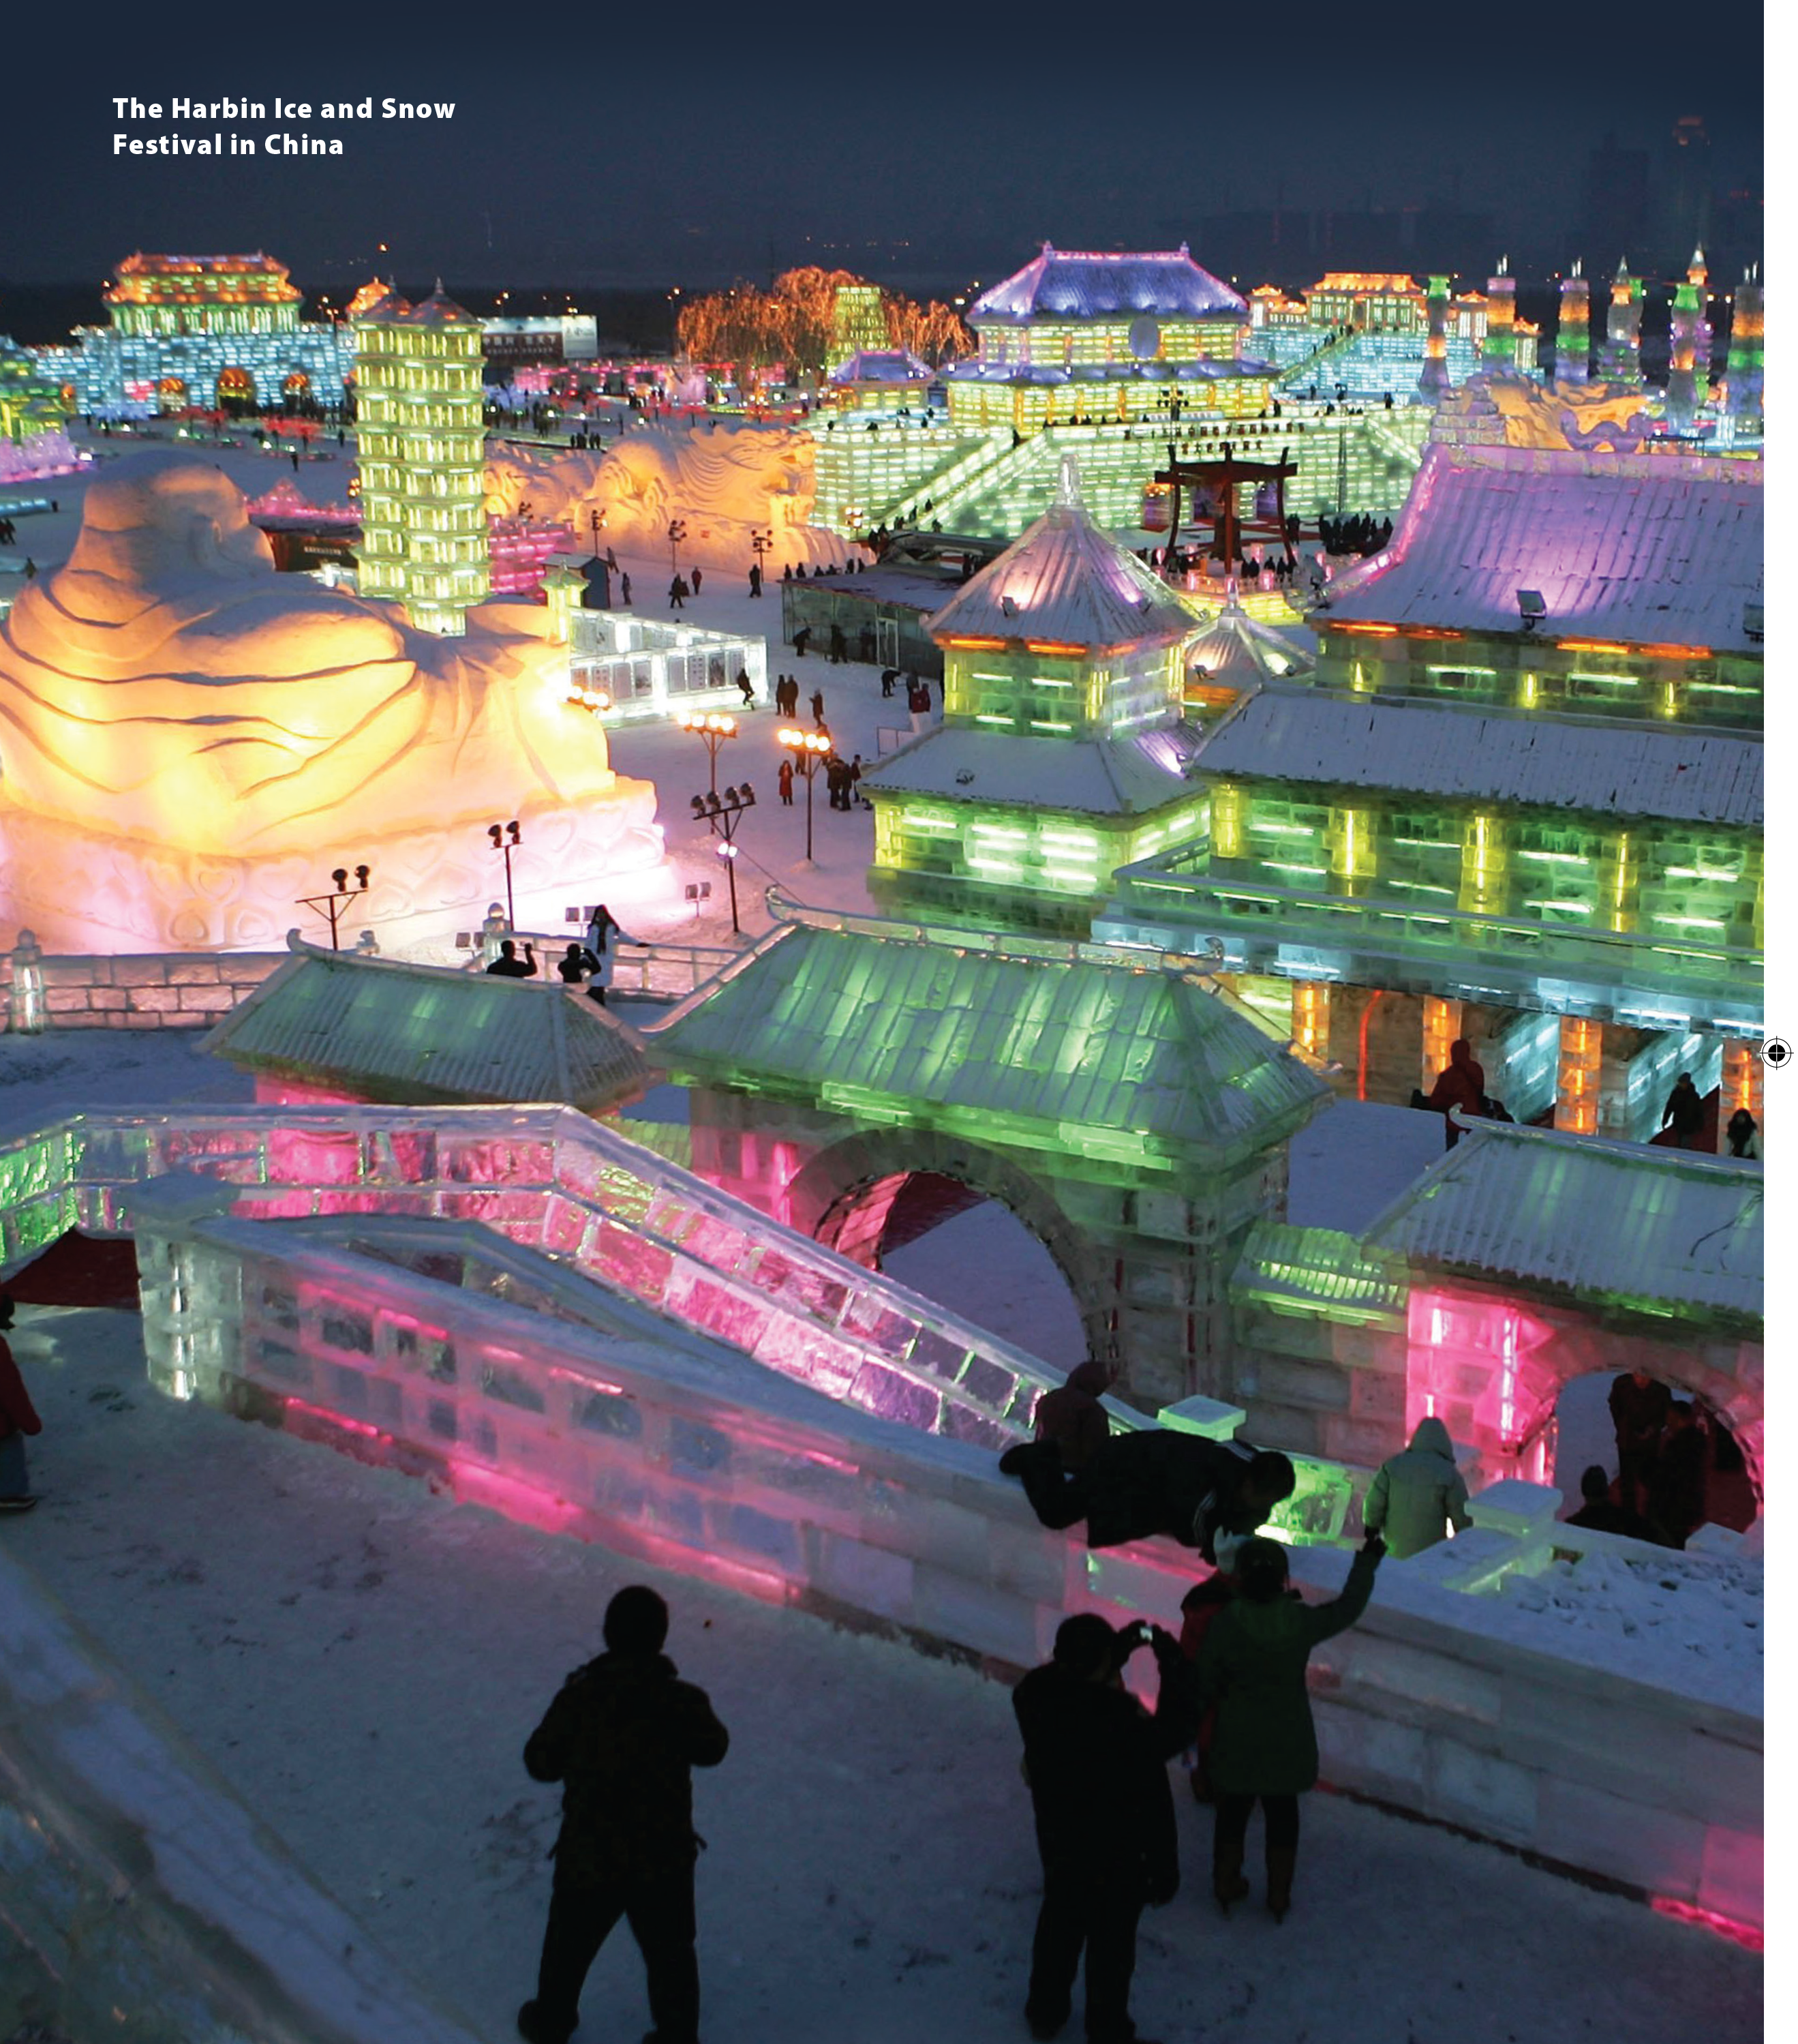
UNIT 12
WHAT DO YOU USUALLY DO FOR NEW YEAR'S?
READING

Slide 16
UNIT 12
WHAT DO YOU USUALLY DO FOR NEW YEAR'S?
READING

Slide 17
UNIT 12
WHAT DO YOU USUALLY DO FOR NEW YEAR'S?
READING
Northeast China

Slide 18
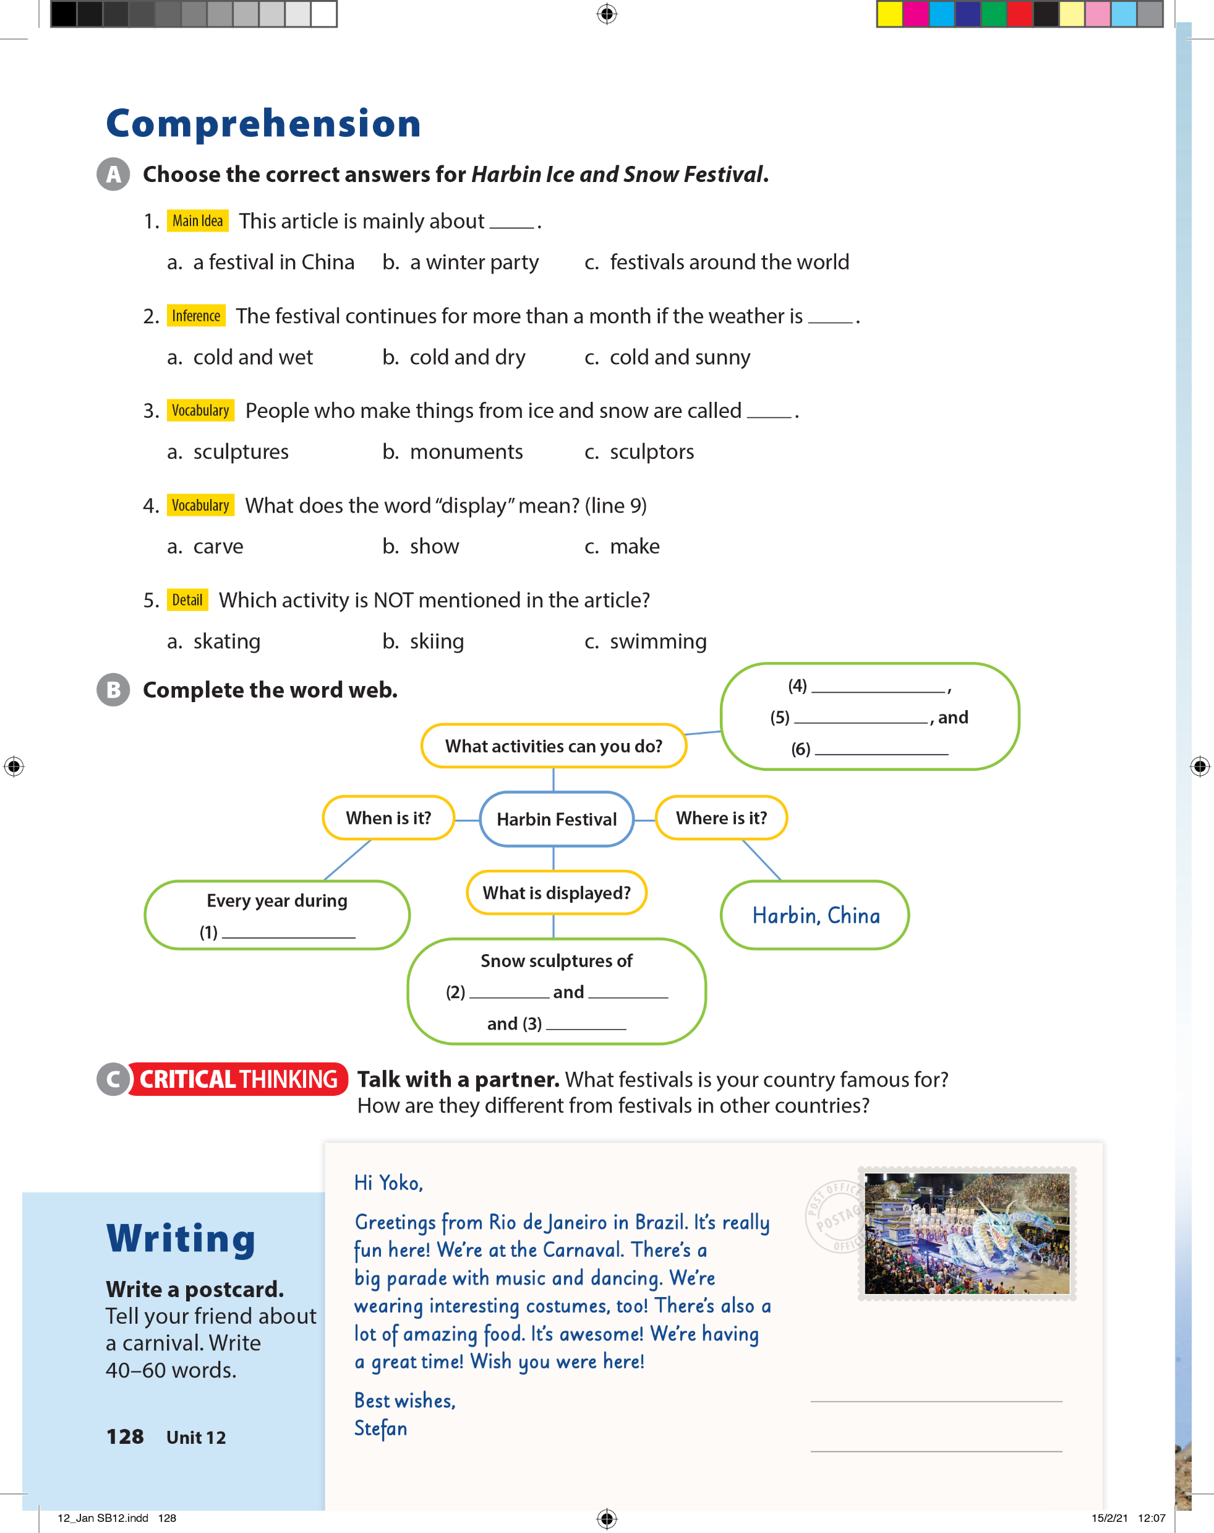
UNIT 12
WHAT DO YOU USUALLY DO FOR NEW YEAR'S?
COMPREHENSION

Slide 19

UNIT 12
WHAT DO YOU USUALLY DO FOR NEW YEAR'S?
COMPREHENSION
skiing
ice sliding
swimming
winter
people
animals
buildings

Slide 20
UNIT 12
WHAT DO YOU USUALLY DO FOR NEW YEAR'S?
WRITING

Slide 21
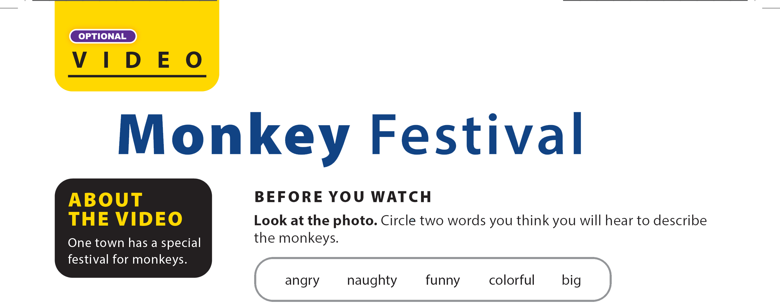

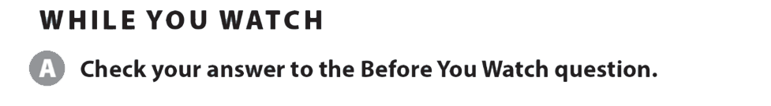
UNIT 12
WHAT DO YOU USUALLY DO FOR NEW YEAR'S?
VIDEO

Slide 22
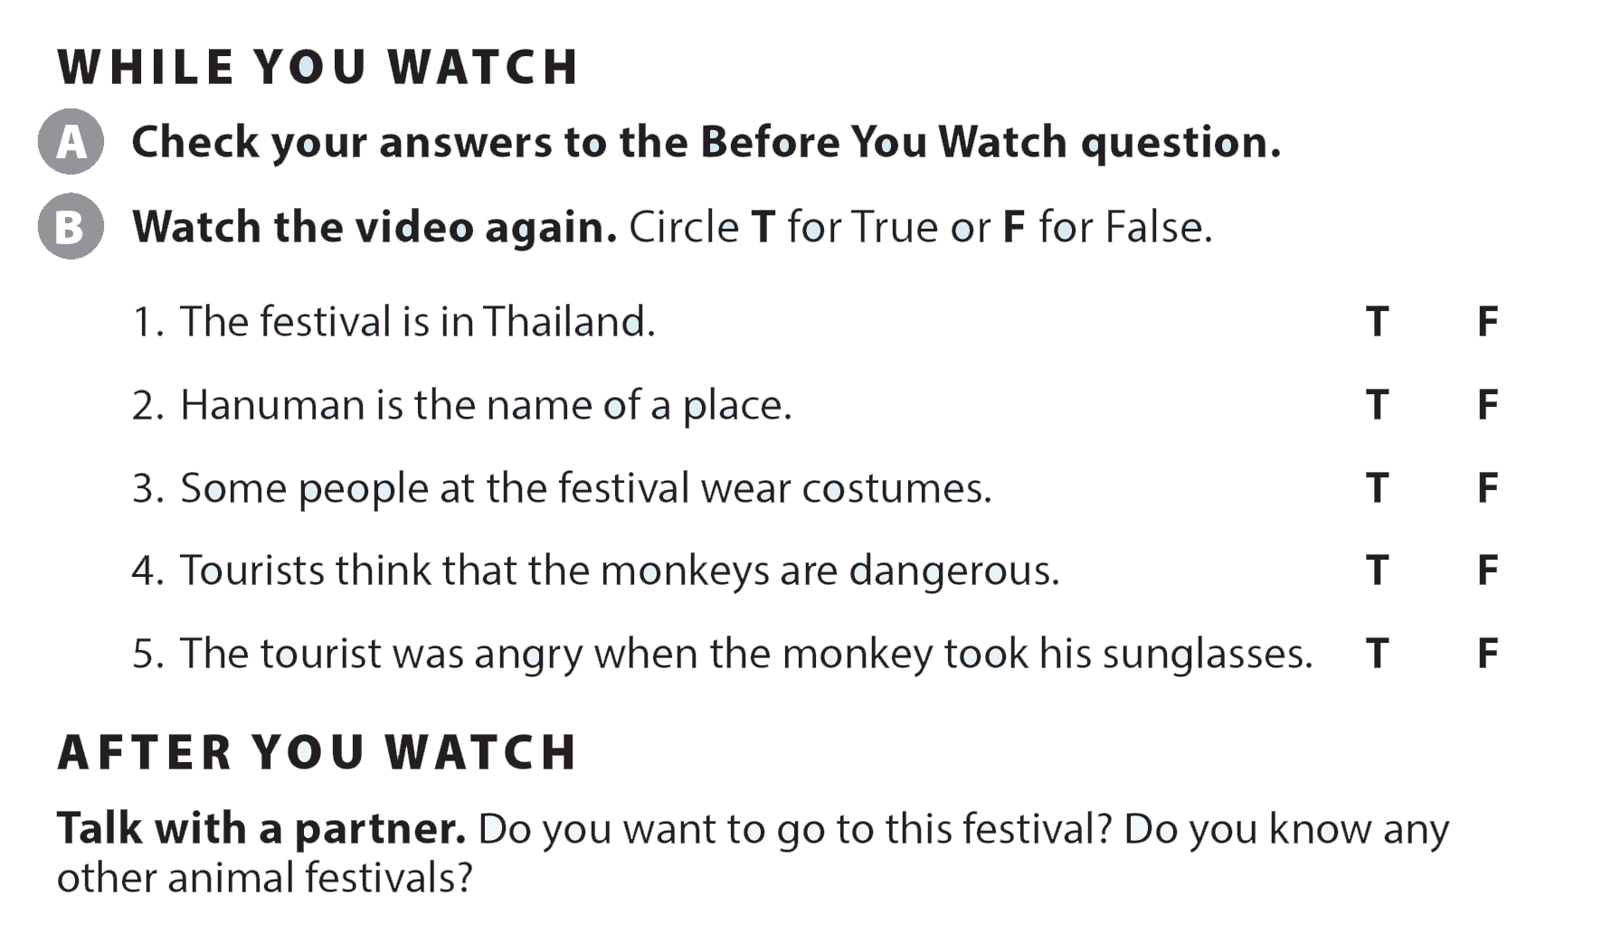
UNIT 12
WHAT DO YOU USUALLY DO FOR NEW YEAR'S?
VIDEO

Slide 23
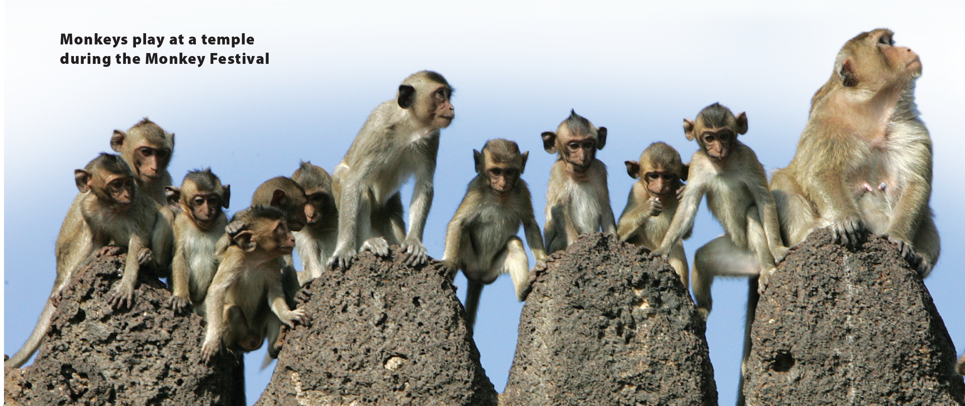

UNIT 12
WHAT DO YOU USUALLY DO FOR NEW YEAR'S?
VIDEO

