Slide 1
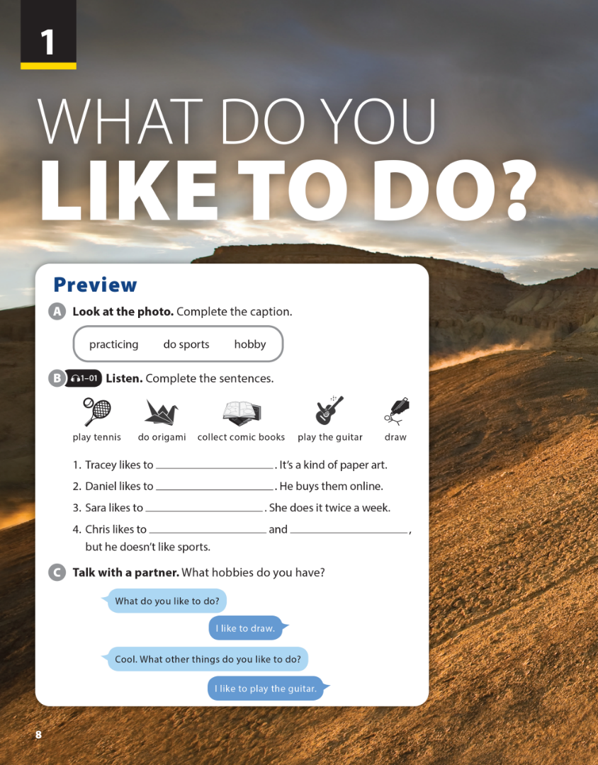
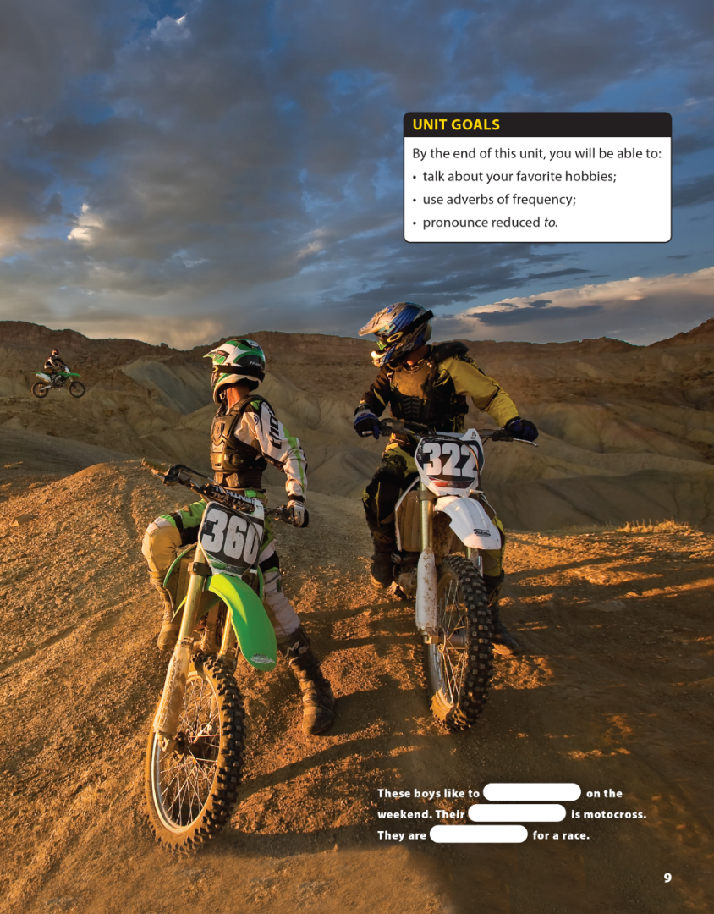


National Geographic Learning, a Cengage Company © 2022 Cengage Learning, Inc. ALL RIGHTS RESERVED. This presentation tool is intended for teaching purposes only and may not be scanned, copied, duplicated, or posted to a publicly accessible platform in whole or in part.

Slide 2

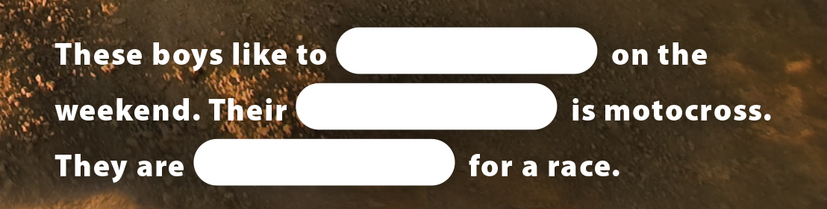
UNIT 1
WHAT DO YOU LIKE TO DO?
PREVIEW
do sports
hobby
practicing

Slide 3

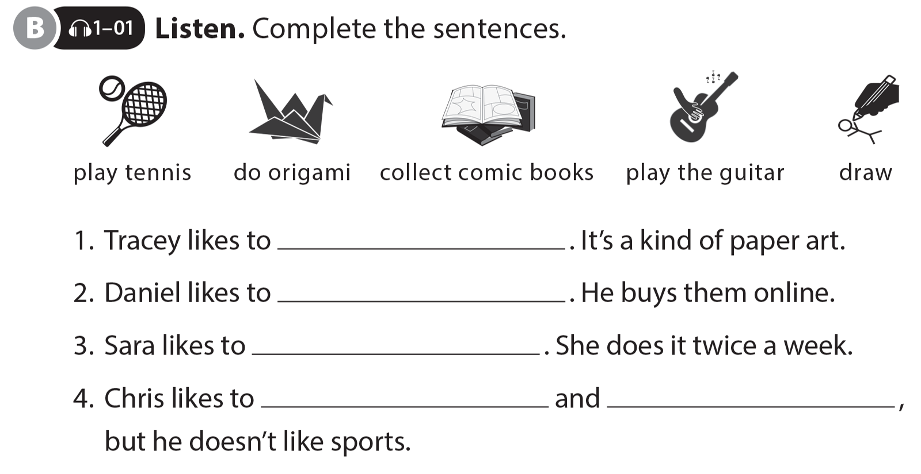
UNIT 1
WHAT DO YOU LIKE TO DO?
PREVIEW
do origami
collect comic books
play tennis
draw
play the guitar

Slide 4
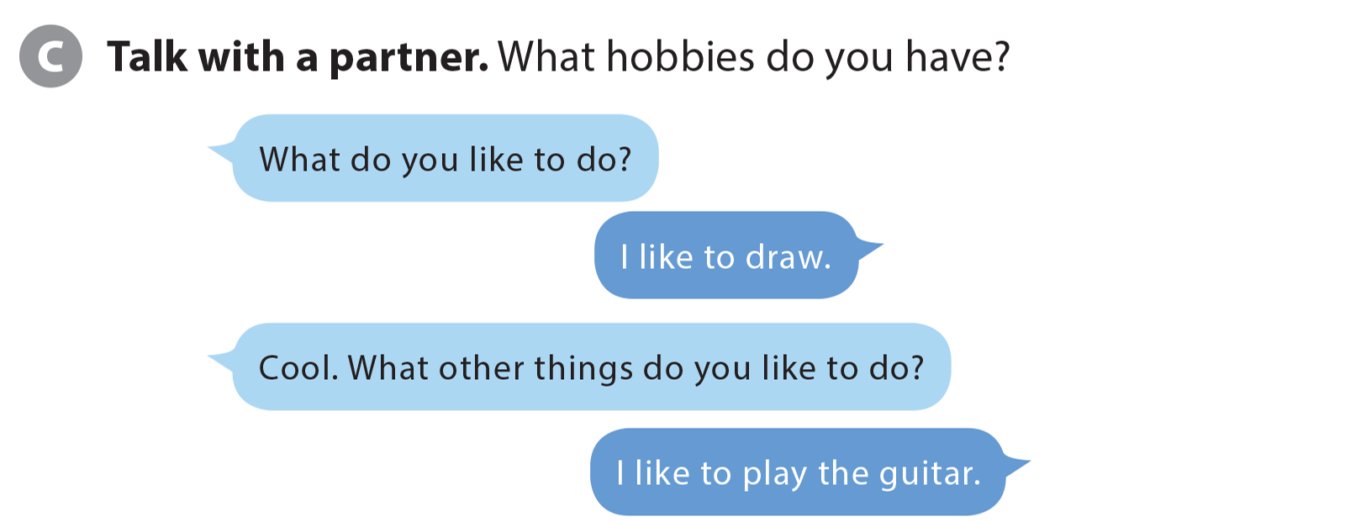
UNIT 1
WHAT DO YOU LIKE TO DO?
PREVIEW

Slide 5


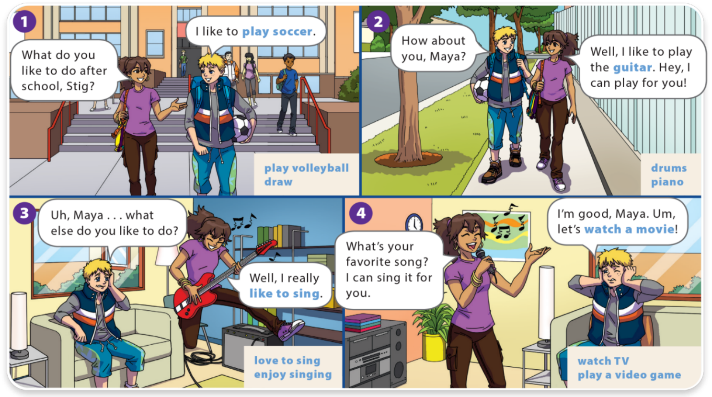
UNIT 1
WHAT DO YOU LIKE TO DO?
LANGUAGE FOCUS

Slide 6
UNIT 1
WHAT DO YOU LIKE TO DO?
LANGUAGE FOCUS

Slide 7
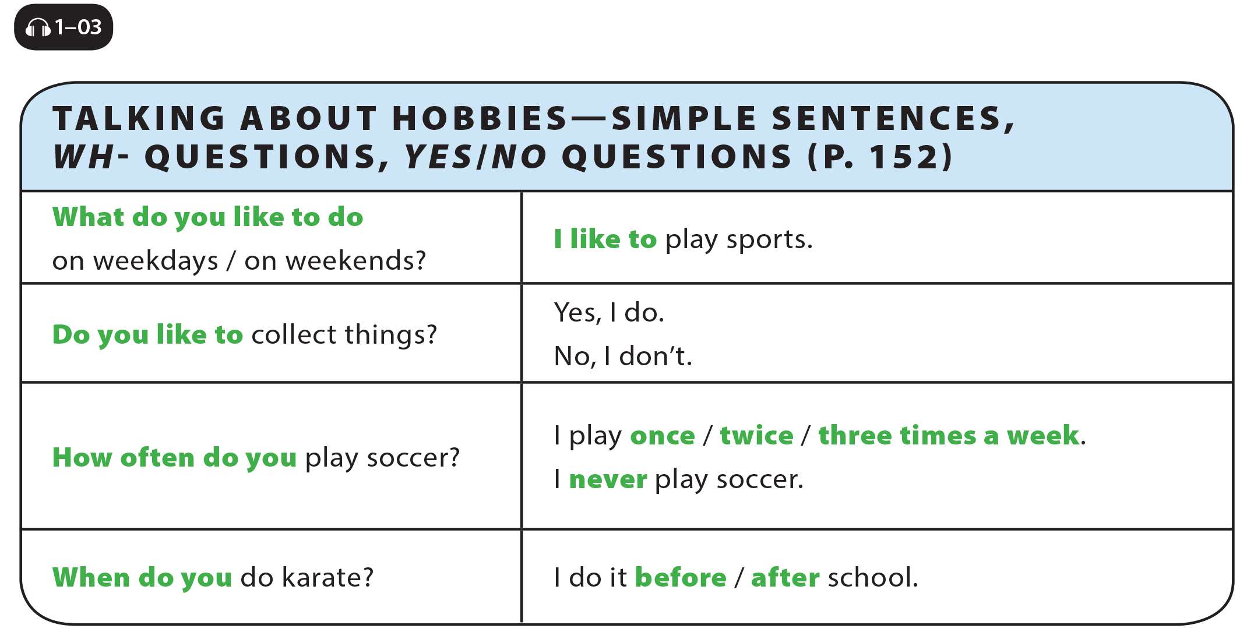
UNIT 1
WHAT DO YOU LIKE TO DO?
LANGUAGE FOCUS

Slide 8
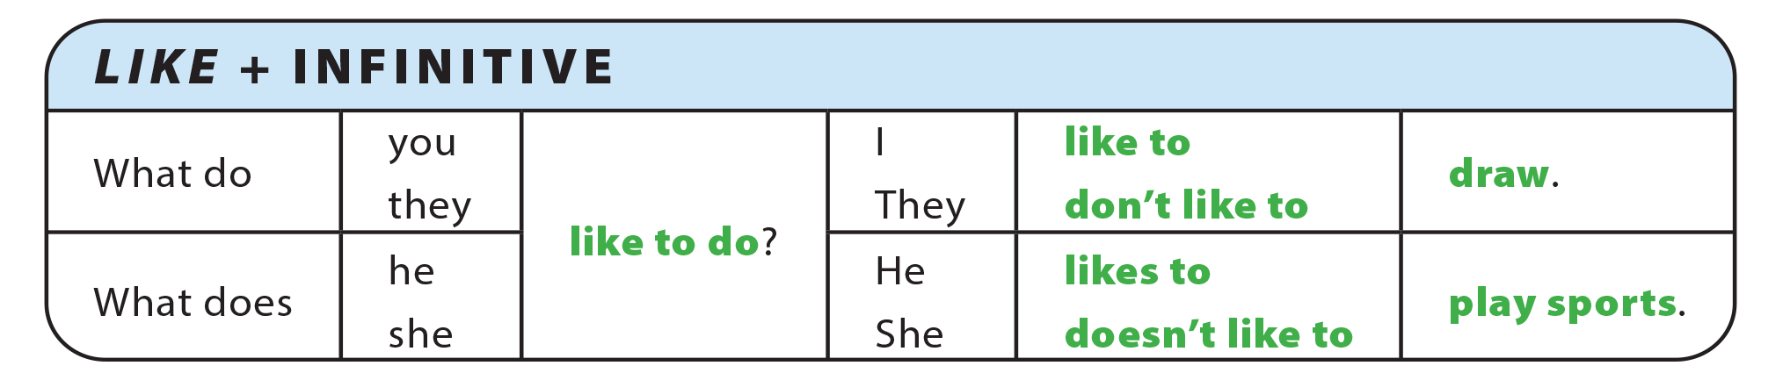
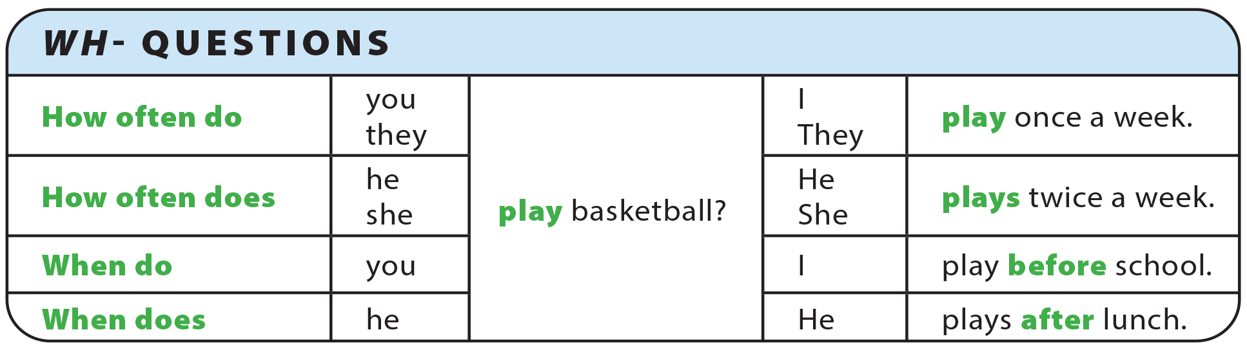
UNIT 1
WHAT DO YOU LIKE TO DO?
GRAMMAR REFERENCE

Slide 9
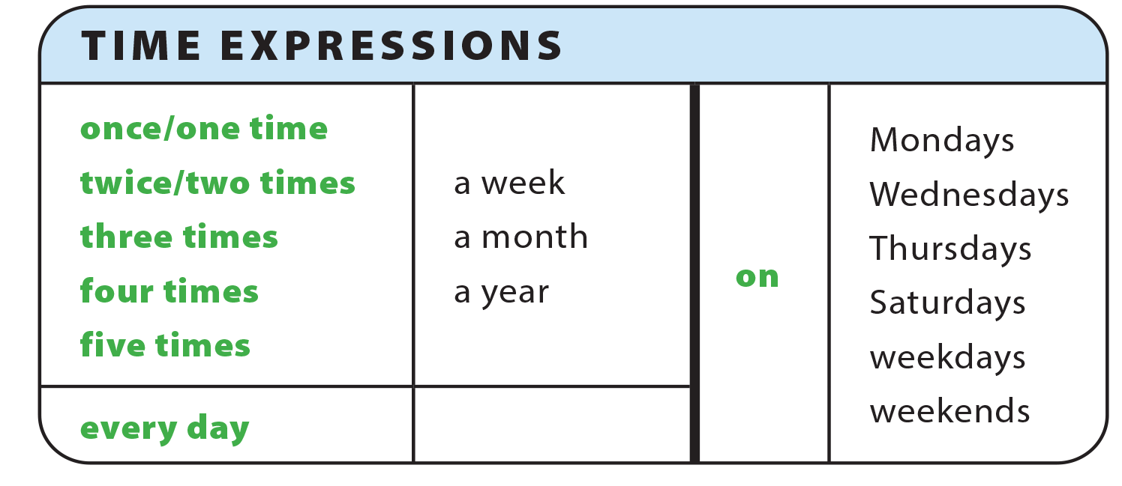
UNIT 1
WHAT DO YOU LIKE TO DO?
GRAMMAR REFERENCE

Slide 10
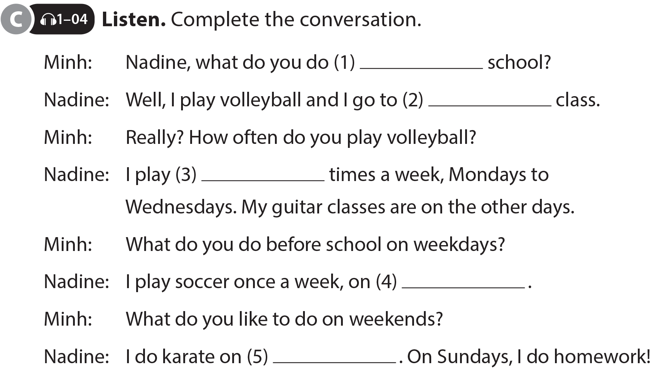
UNIT 1
WHAT DO YOU LIKE TO DO?
LANGUAGE FOCUS
after
guitar
three
Thursdays
Saturdays

Slide 11
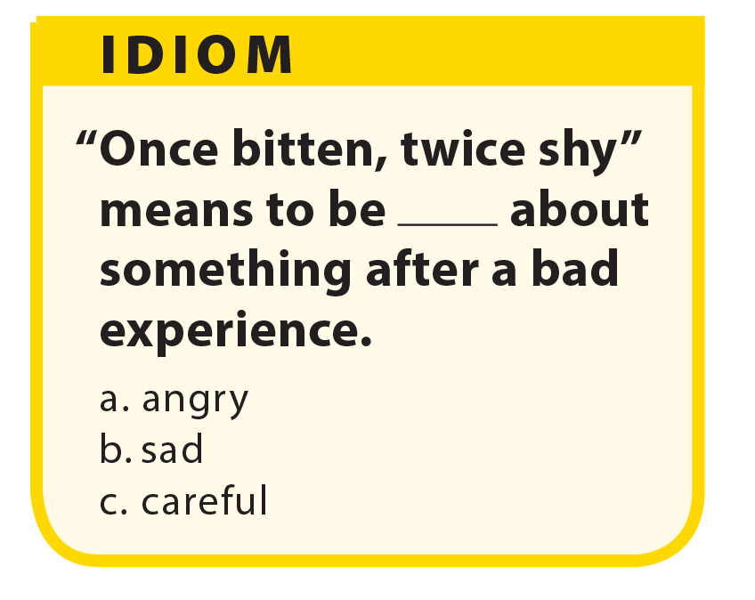
UNIT 1
WHAT DO YOU LIKE TO DO?
LANGUAGE FOCUS

Slide 12
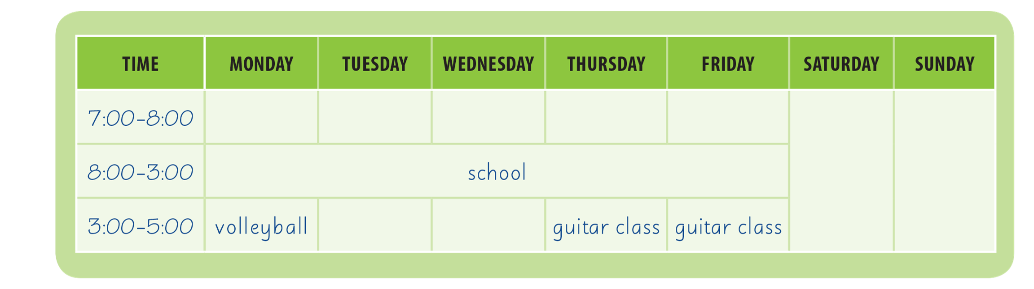
UNIT 1
WHAT DO YOU LIKE TO DO?
LANGUAGE FOCUS
soccer
karate
homework
volleyball
volleyball

Slide 13
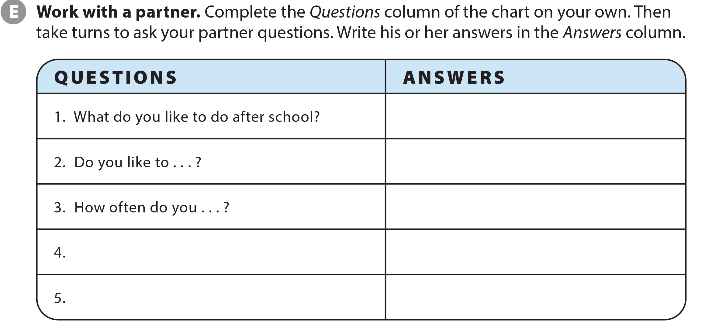
UNIT 1
WHAT DO YOU LIKE TO DO?
LANGUAGE FOCUS

Slide 14



UNIT 1
WHAT DO YOU LIKE TO DO?
THE REAL WORLD
National Geographic Learning, a Cengage Company © 2022 Cengage Learning, Inc. ALL RIGHTS RESERVED. This presentation tool is intended for teaching purposes only and may not be scanned, copied, duplicated, or posted to a publicly accessible platform in whole or in part.

Slide 15
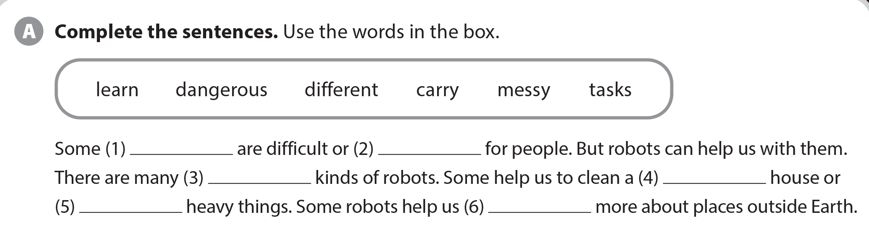
UNIT 1
WHAT DO YOU LIKE TO DO?
THE REAL WORLD
tasks
dangerous
different
messy
carry
learn

Slide 16


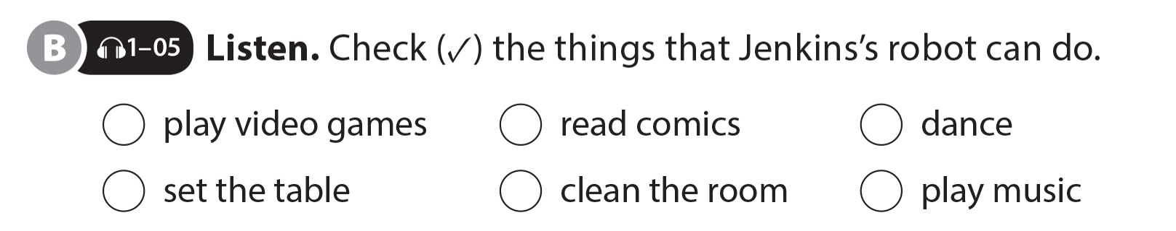

UNIT 1
WHAT DO YOU LIKE TO DO?
THE REAL WORLD
National Geographic Learning, a Cengage Company © 2022 Cengage Learning, Inc. ALL RIGHTS RESERVED. This presentation tool is intended for teaching purposes only and may not be scanned, copied, duplicated, or posted to a publicly accessible platform in whole or in part.

Slide 17
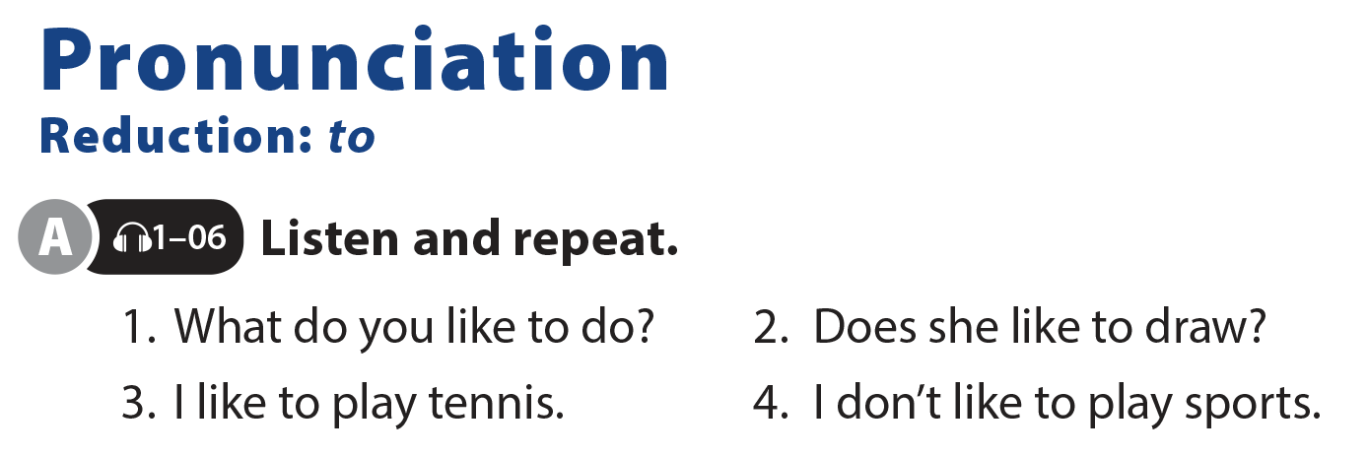
UNIT 1
WHAT DO YOU LIKE TO DO?
PRONUNCIATION

Slide 18
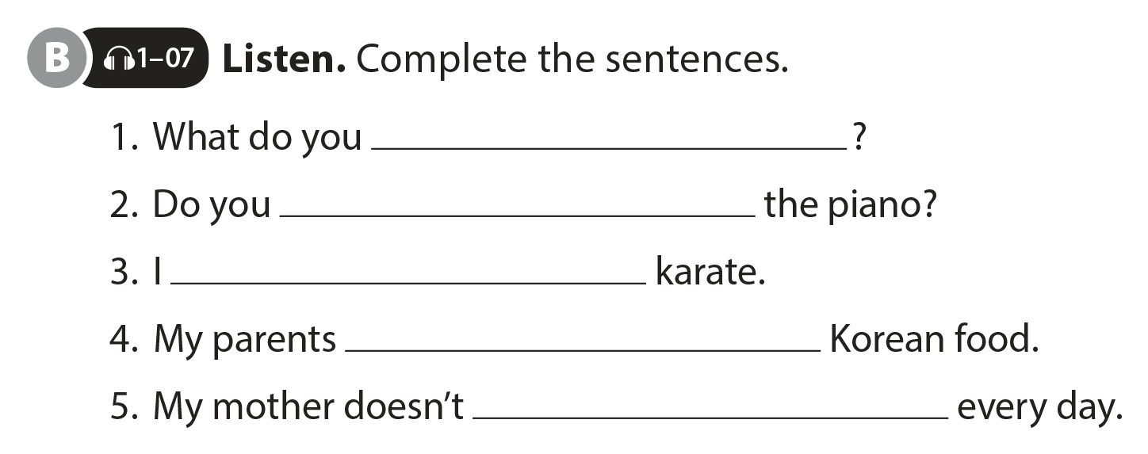
UNIT 1
WHAT DO YOU LIKE TO DO?
PRONUNCIATION
like to do
like to play
like to do
like to eat
like to cook

Slide 19
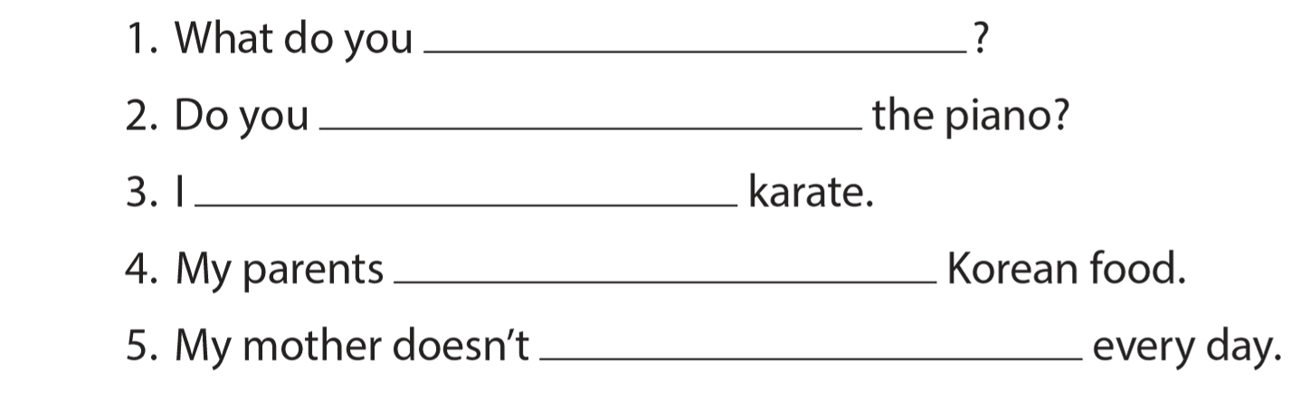
UNIT 1
WHAT DO YOU LIKE TO DO?
PRONUNCIATION
like to do
like to play
like to do
like to eat
like to cook

Slide 20
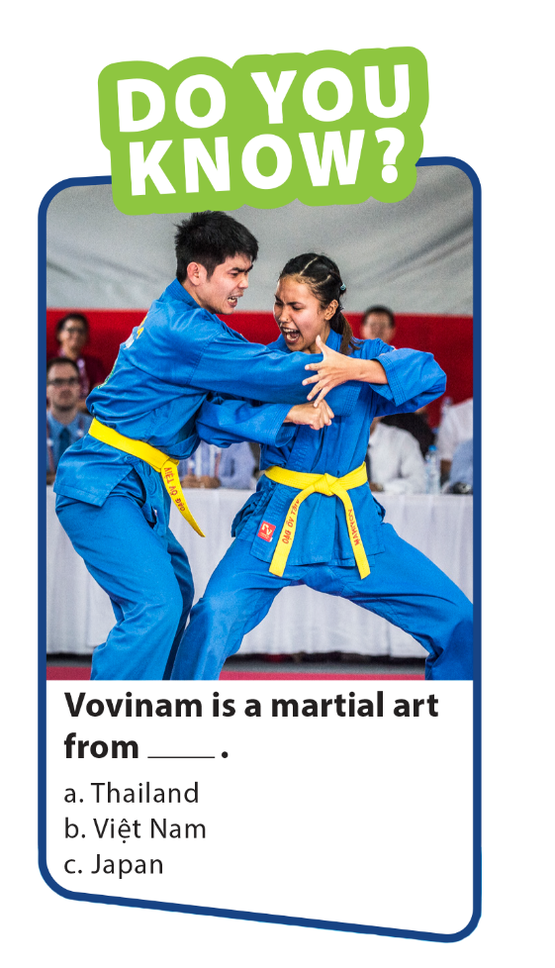
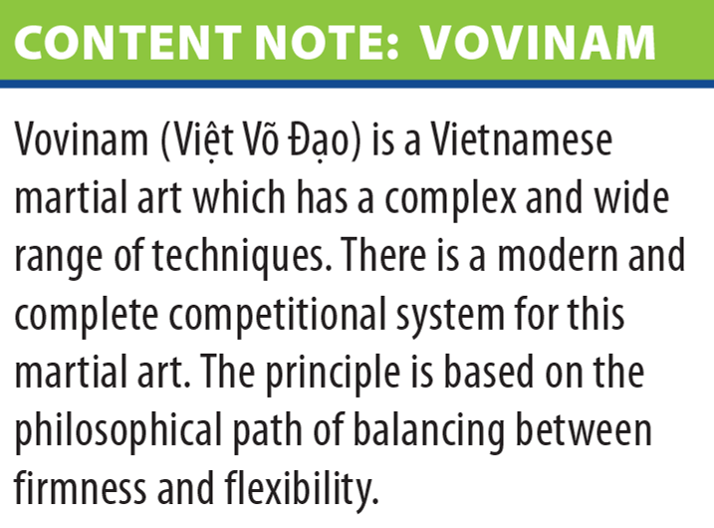
UNIT 1
WHAT DO YOU LIKE TO DO?
PRONUNCIATION

Slide 21

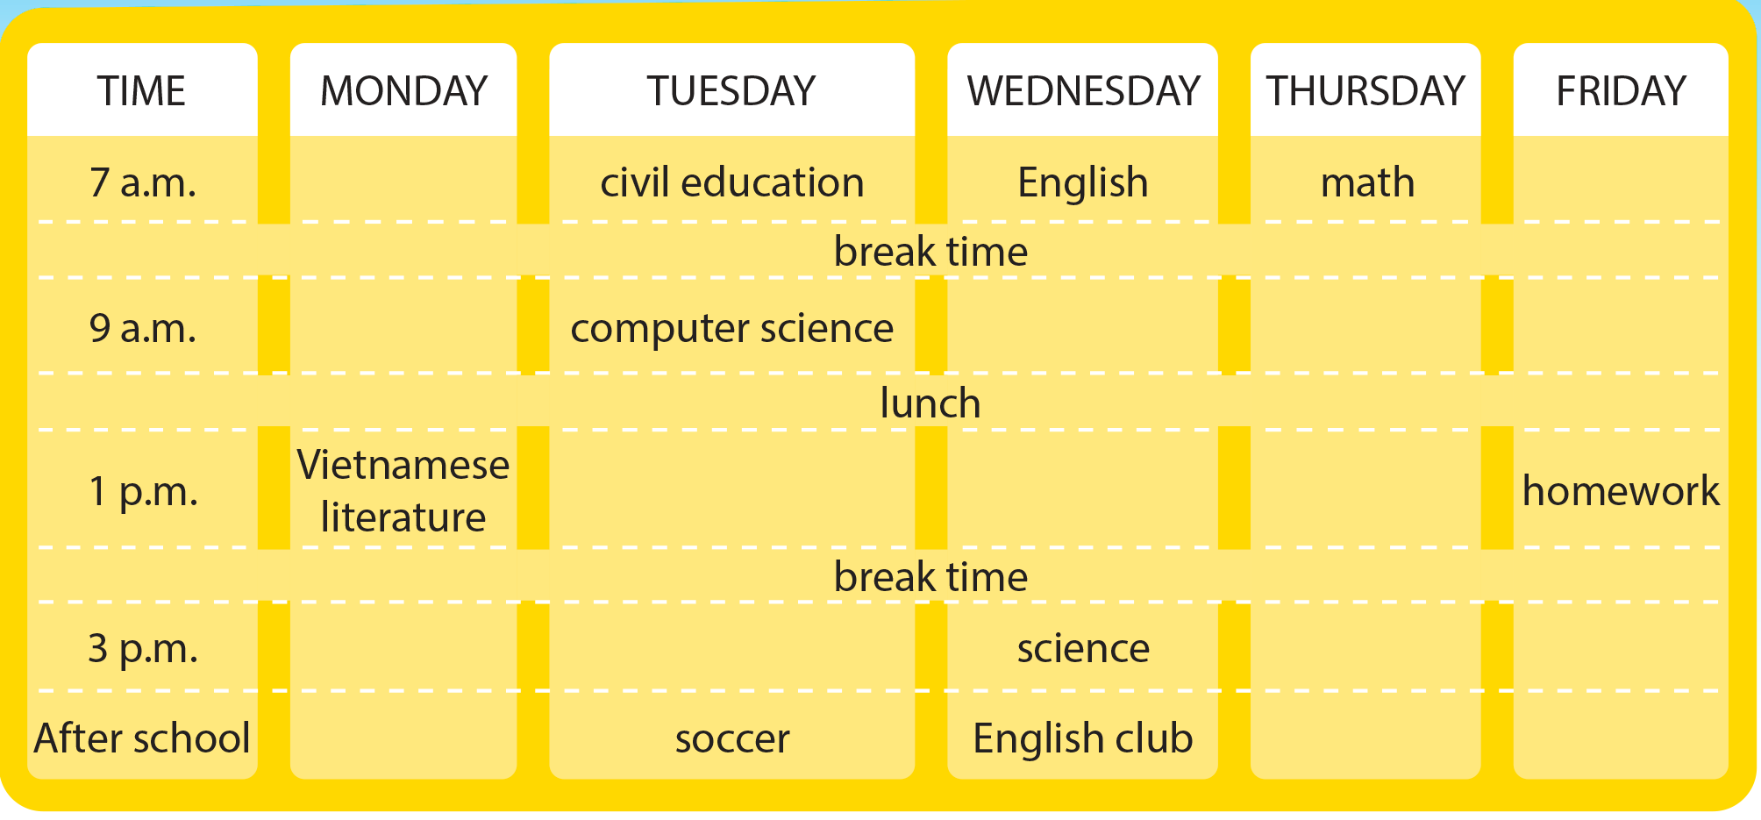
UNIT 1
WHAT DO YOU LIKE TO DO?
COMMUNICATION
National Geographic Learning, a Cengage Company © 2022 Cengage Learning, Inc. ALL RIGHTS RESERVED. This presentation tool is intended for teaching purposes only and may not be scanned, copied, duplicated, or posted to a publicly accessible platform in whole or in part.

Slide 22
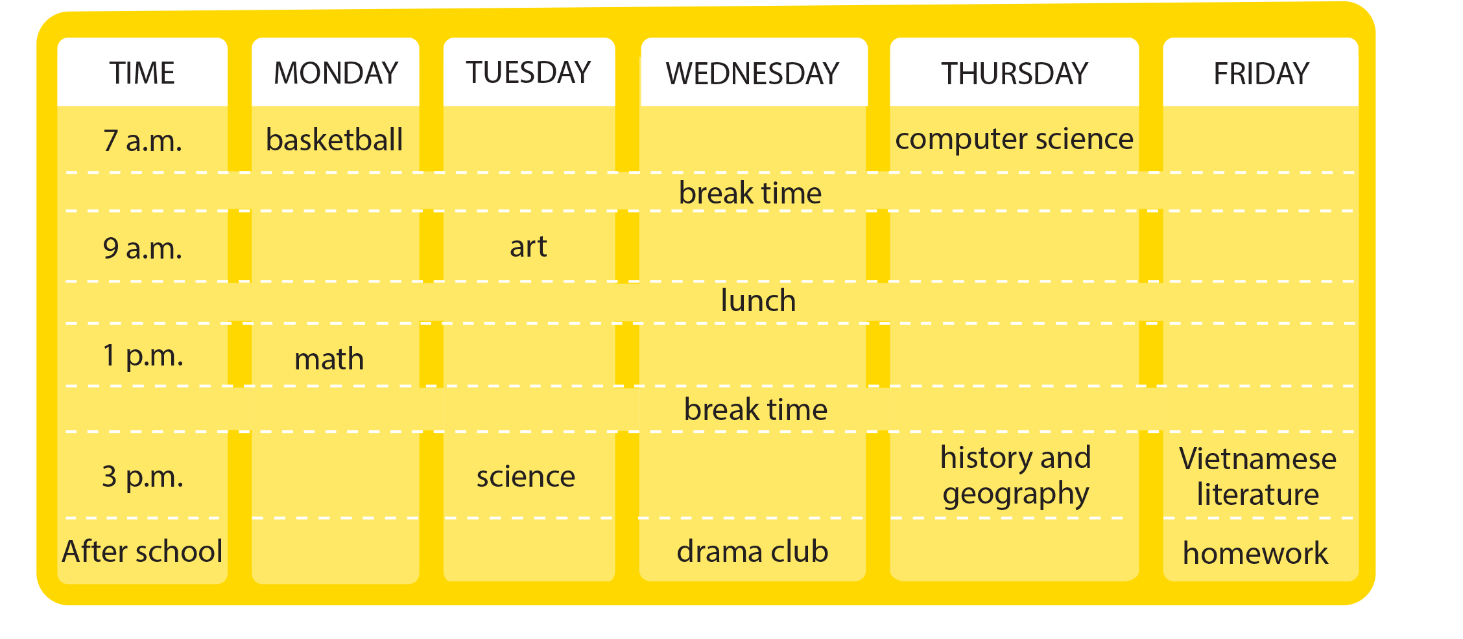
UNIT 1
WHAT DO YOU LIKE TO DO?
COMMUNICATION
National Geographic Learning, a Cengage Company © 2022 Cengage Learning, Inc. ALL RIGHTS RESERVED. This presentation tool is intended for teaching purposes only and may not be scanned, copied, duplicated, or posted to a publicly accessible platform in whole or in part.

Slide 23
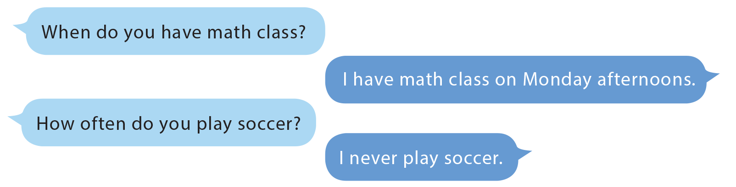
UNIT 1
WHAT DO YOU LIKE TO DO?
COMMUNICATION

Slide 24

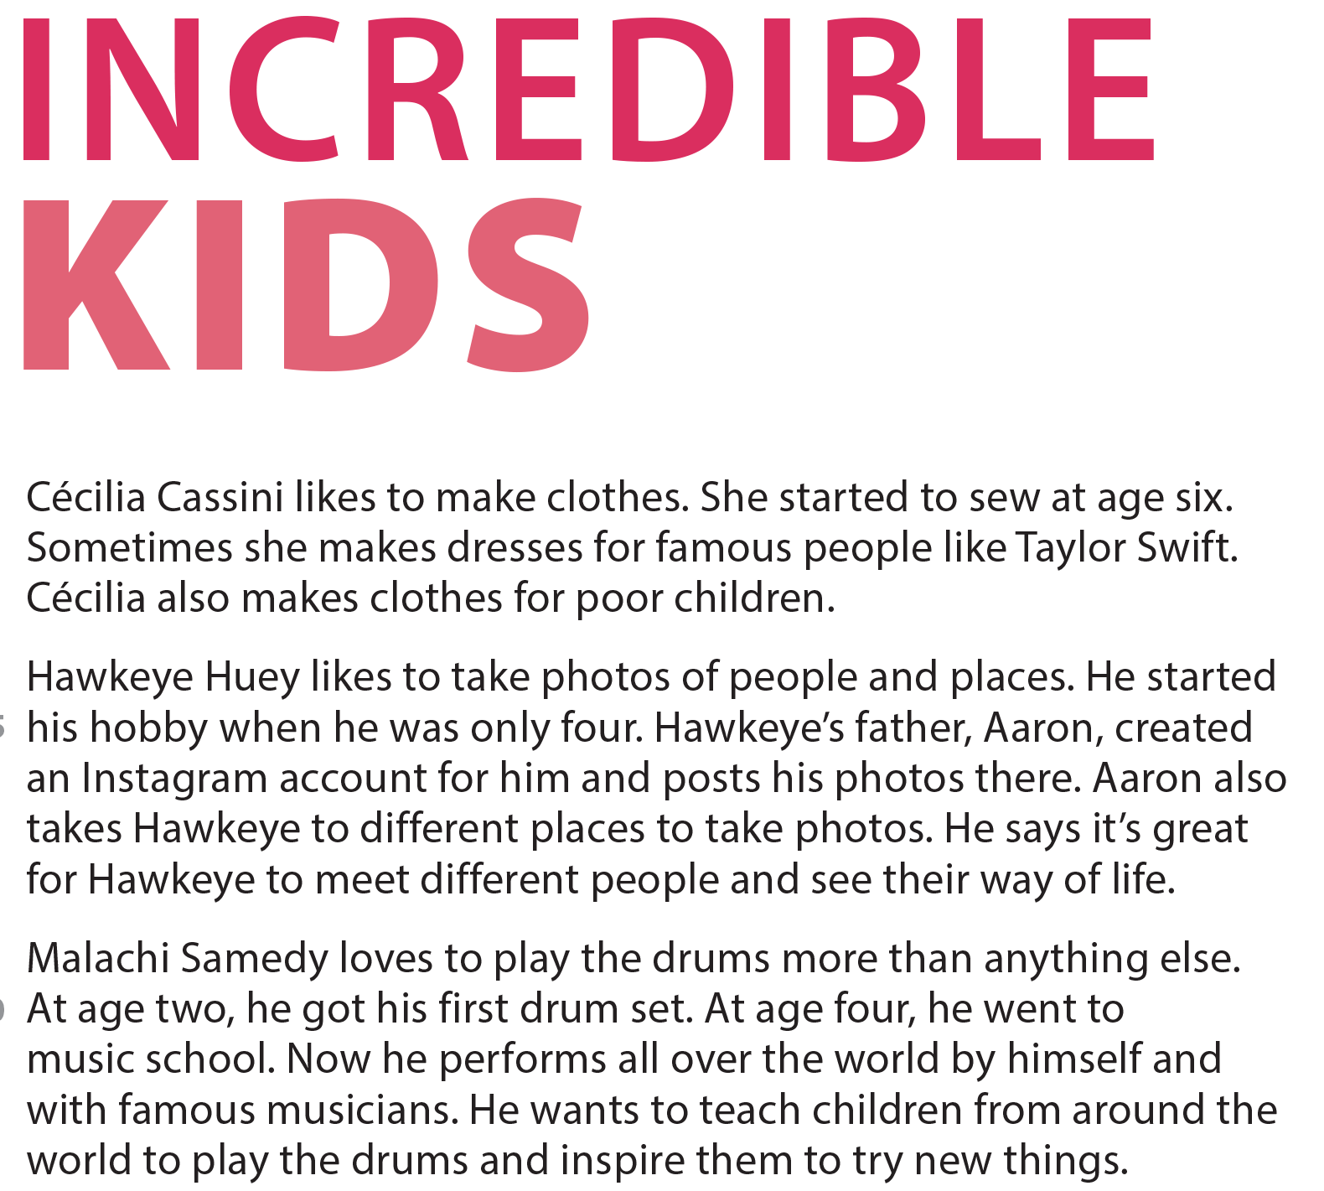


UNIT 1
WHAT DO YOU LIKE TO DO?
READING
National Geographic Learning, a Cengage Company © 2022 Cengage Learning, Inc. ALL RIGHTS RESERVED. This presentation tool is intended for teaching purposes only and may not be scanned, copied, duplicated, or posted to a publicly accessible platform in whole or in part.

Slide 25
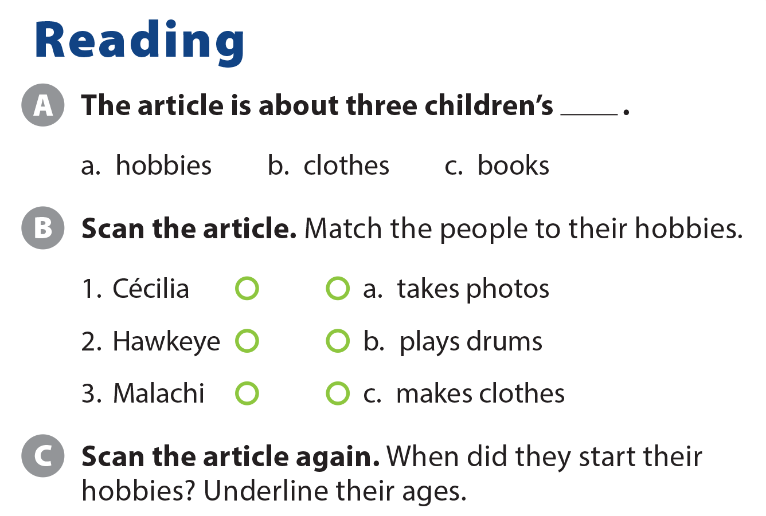
UNIT 1
WHAT DO YOU LIKE TO DO?
READING

Slide 26
UNIT 1
WHAT DO YOU LIKE TO DO?
READING
National Geographic Learning, a Cengage Company © 2022 Cengage Learning, Inc. ALL RIGHTS RESERVED. This presentation tool is intended for teaching purposes only and may not be scanned, copied, duplicated, or posted to a publicly accessible platform in whole or in part.

Slide 27
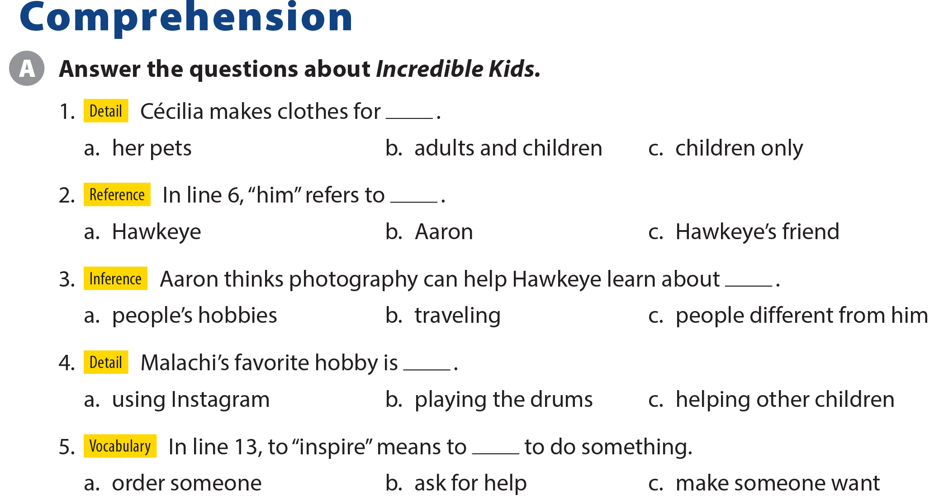
UNIT 1
WHAT DO YOU LIKE TO DO?
COMPREHENSION

Slide 28
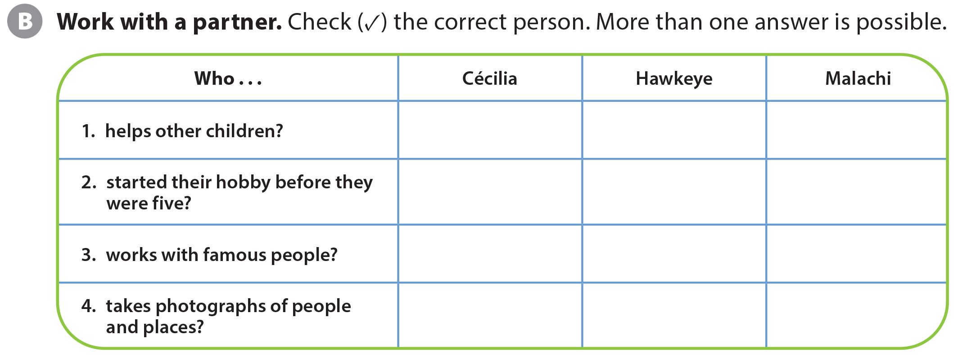
UNIT 1
WHAT DO YOU LIKE TO DO?
COMPREHENSION

Slide 29
UNIT 1
WHAT DO YOU LIKE TO DO?
PROJECT

Slide 30
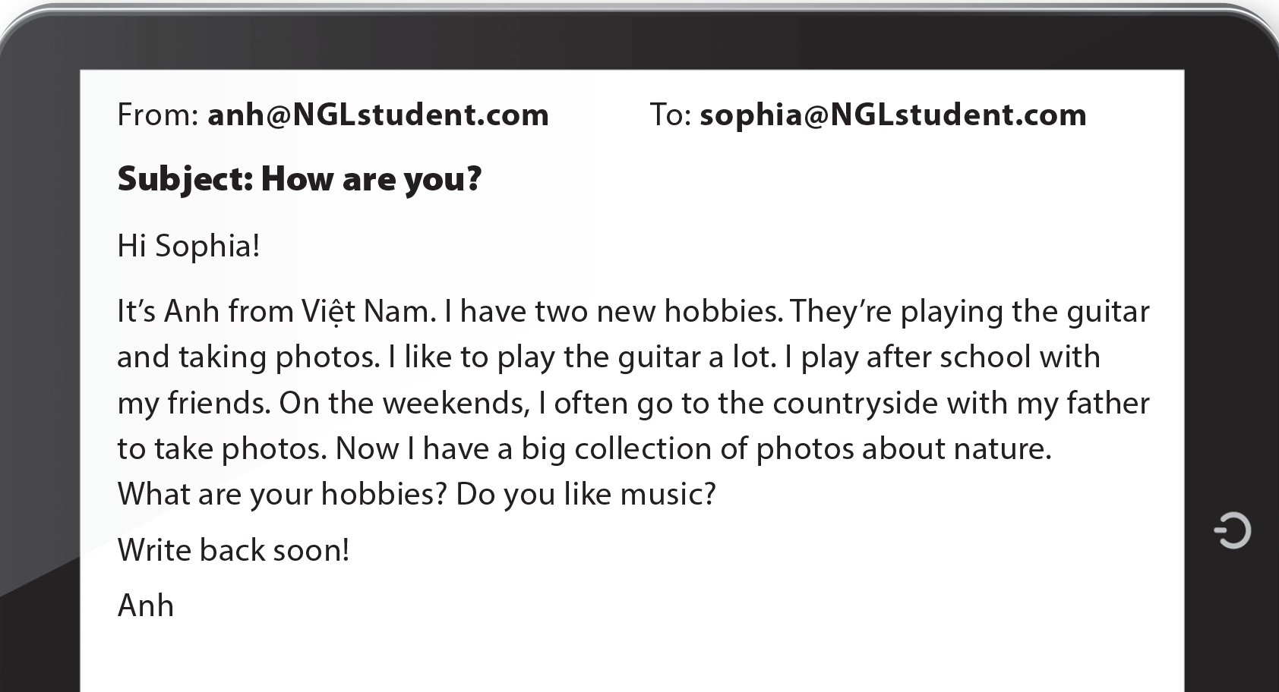
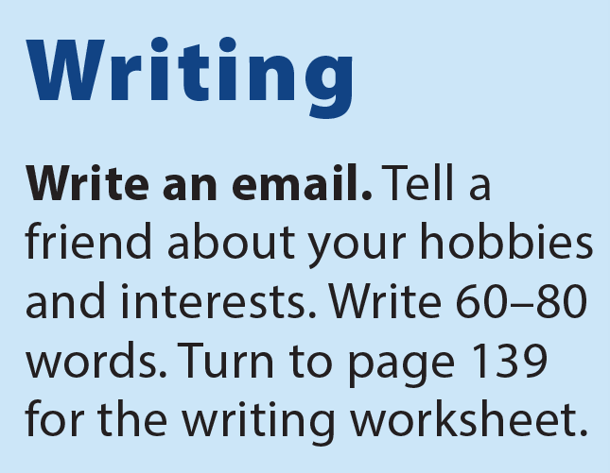
UNIT 1
WHAT DO YOU LIKE TO DO?
WRITING

Slide 31
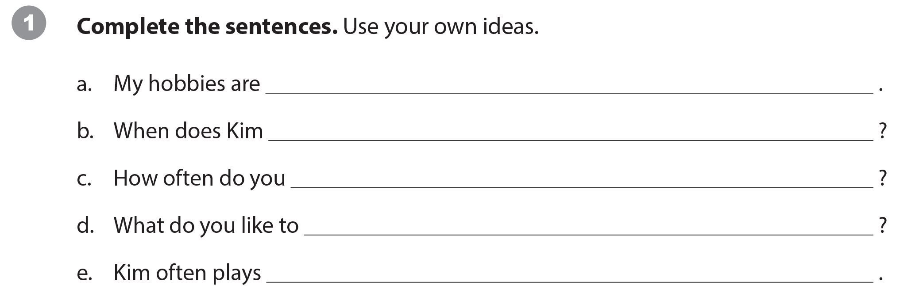
UNIT 1
WHAT DO YOU LIKE TO DO?
WRITING WORKSHEET

Slide 32
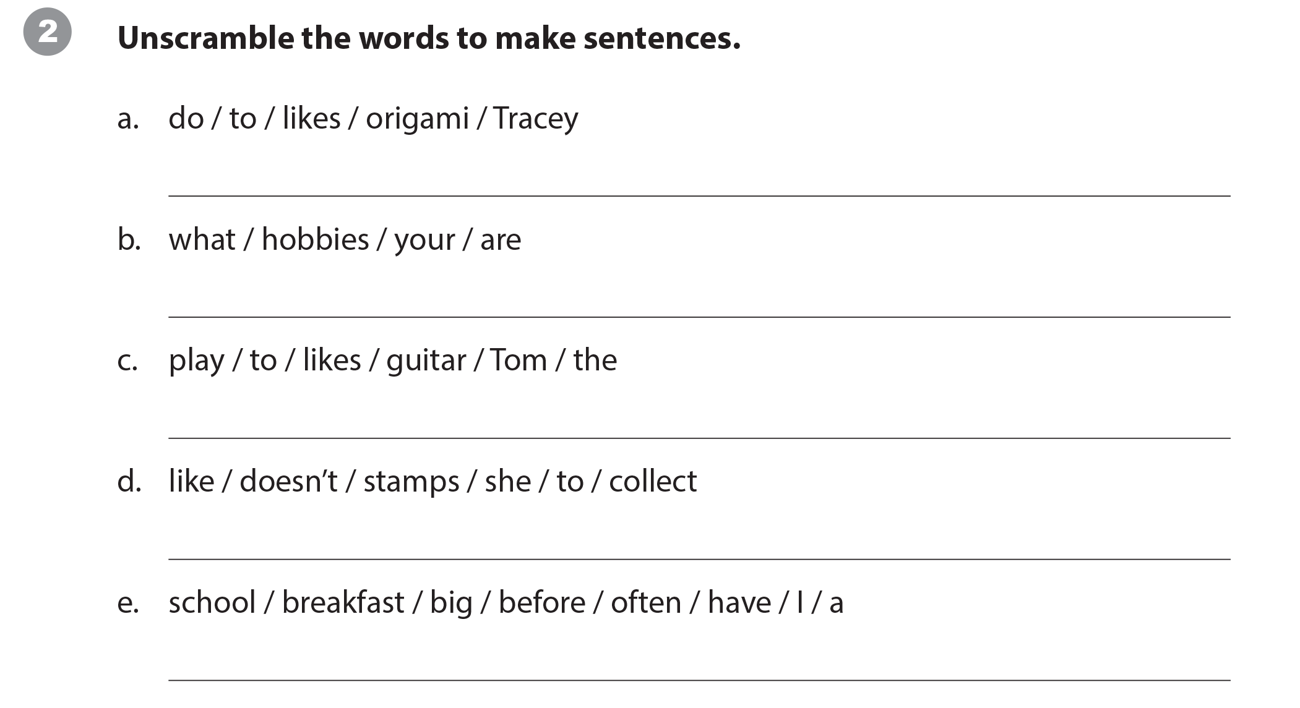
UNIT 1
WHAT DO YOU LIKE TO DO?
WRITING WORKSHEET
Tracey likes to do origami.
What are your hobbies?
Tom likes to play the guitar.
She doesn’t like to collect stamps.
I often have a big breakfast before school.

Slide 33
UNIT 1
WHAT DO YOU LIKE TO DO?
WRITING WORKSHEET

Slide 34

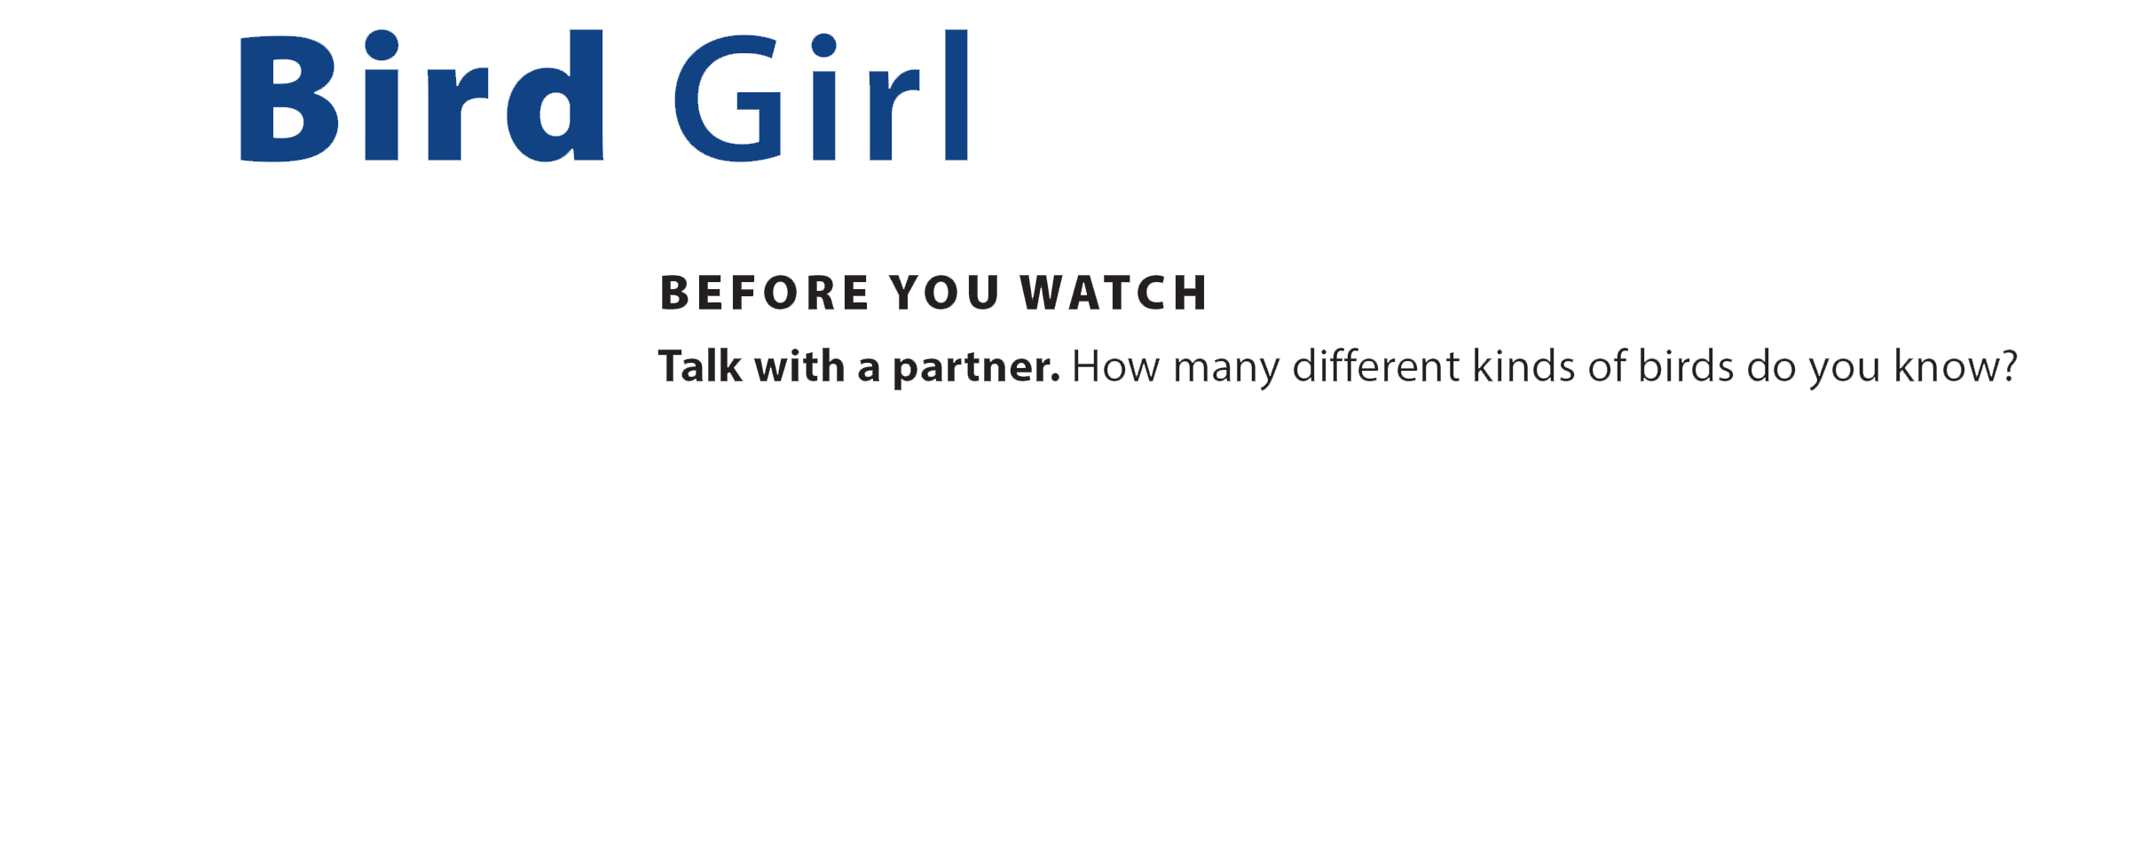
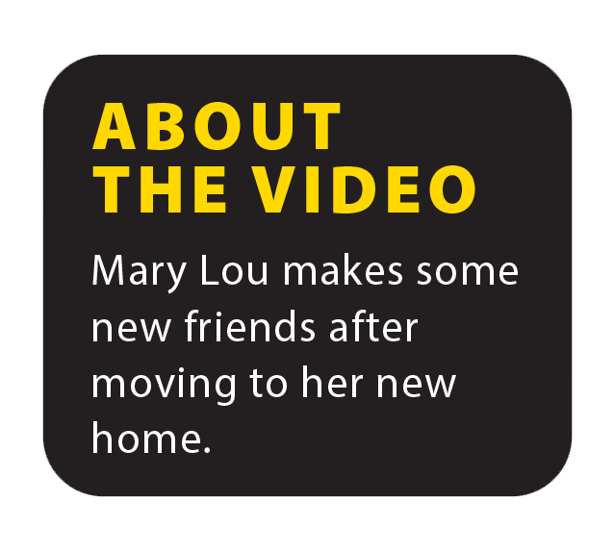
UNIT 1
WHAT DO YOU LIKE TO DO?
VIDEO

Slide 35


UNIT 1
WHAT DO YOU LIKE TO DO?
VIDEO

Slide 36
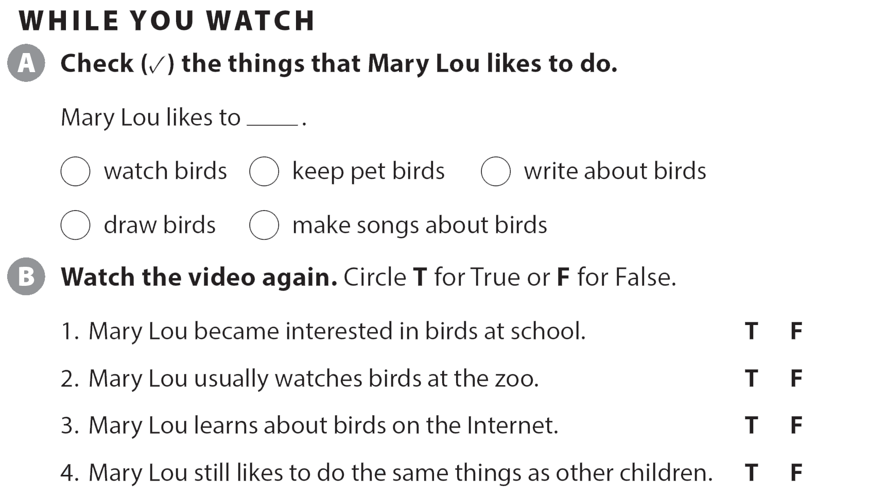
UNIT 1
WHAT DO YOU LIKE TO DO?
VIDEO

Slide 37
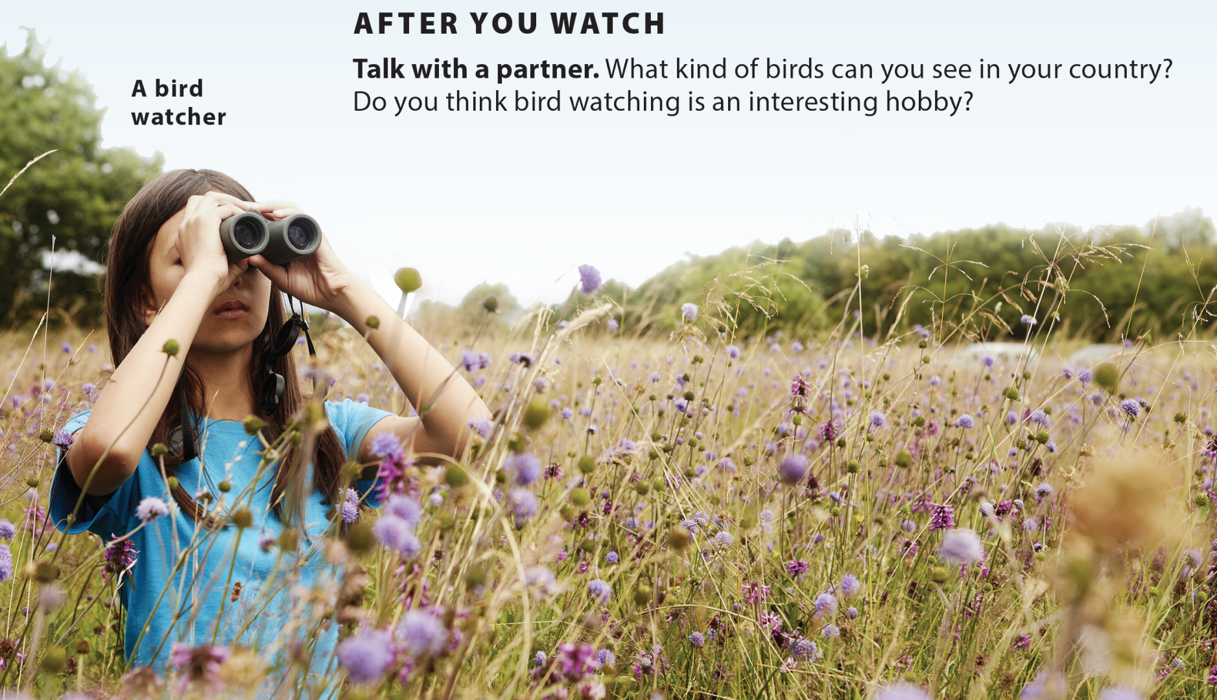
UNIT 1
WHAT DO YOU LIKE TO DO?
VIDEO
National Geographic Learning, a Cengage Company © 2022 Cengage Learning, Inc. ALL RIGHTS RESERVED. This presentation tool is intended for teaching purposes only and may not be scanned, copied, duplicated, or posted to a publicly accessible platform in whole or in part.

Slide 38
UNIT 1
WHAT DO YOU LIKE TO DO?
Thank you!

