Slide 1

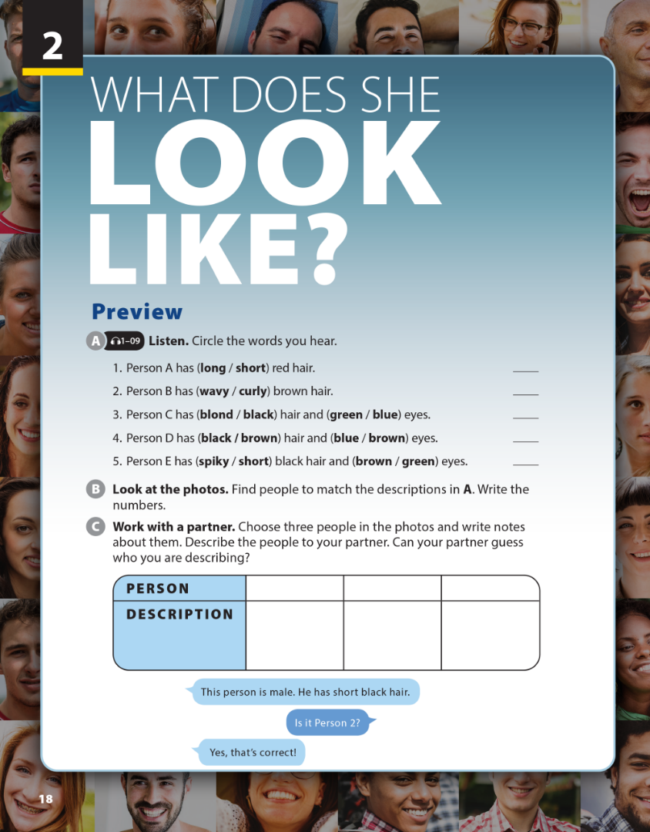
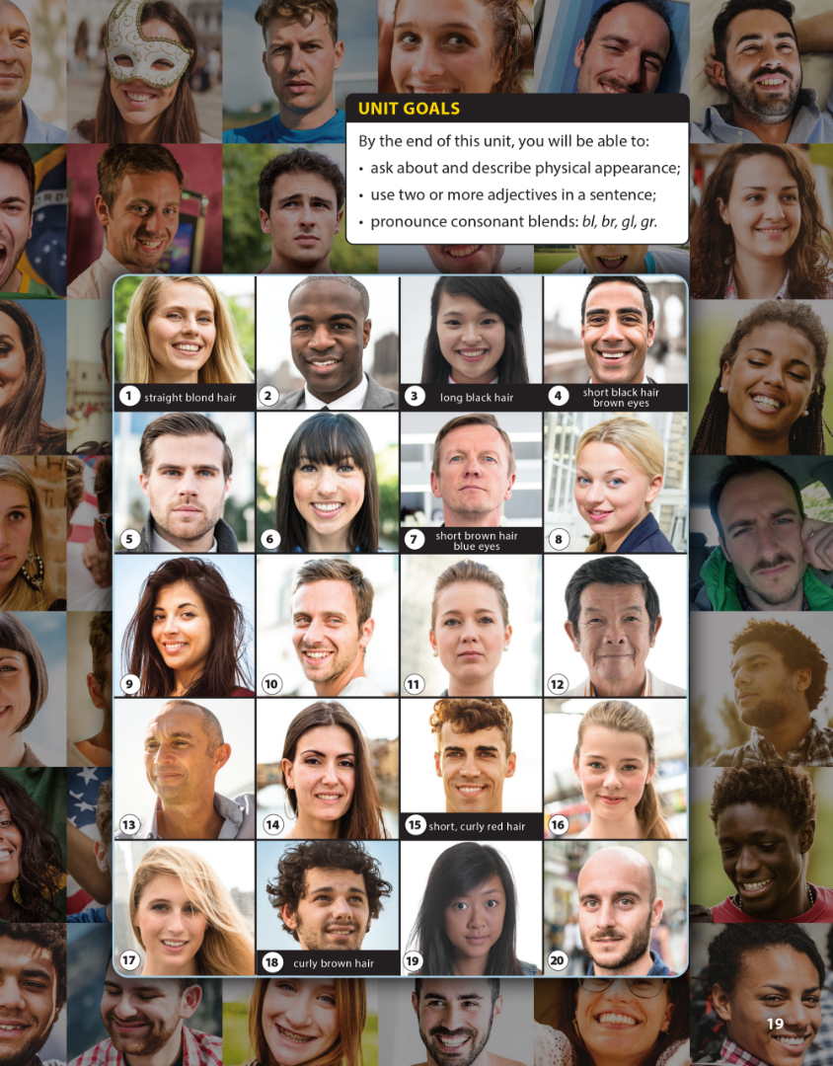

National Geographic Learning, a Cengage Company © 2022 Cengage Learning, Inc. ALL RIGHTS RESERVED. This presentation tool is intended for teaching purposes only and may not be scanned, copied, duplicated, or posted to a publicly accessible platform in whole or in part.

Slide 2
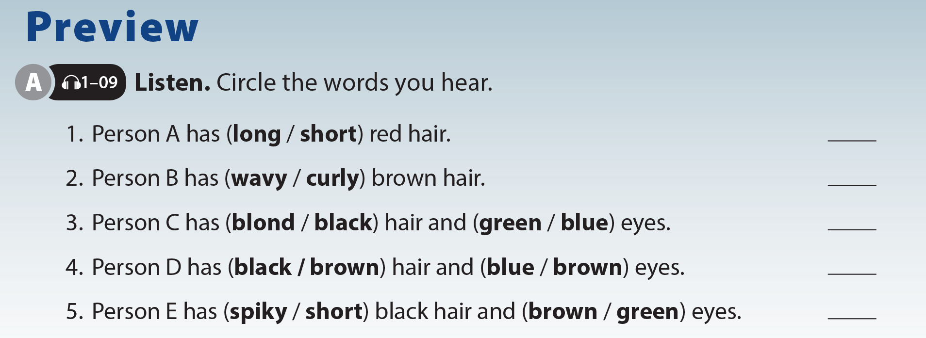

UNIT 2
WHAT DOES SHE LOOK LIKE?
PREVIEW

Slide 3
UNIT 2
WHAT DOES SHE LOOK LIKE?
PREVIEW
15
18
1, 8, 10, 11, 16, or 17
5 or 7
2 or 4

Slide 4
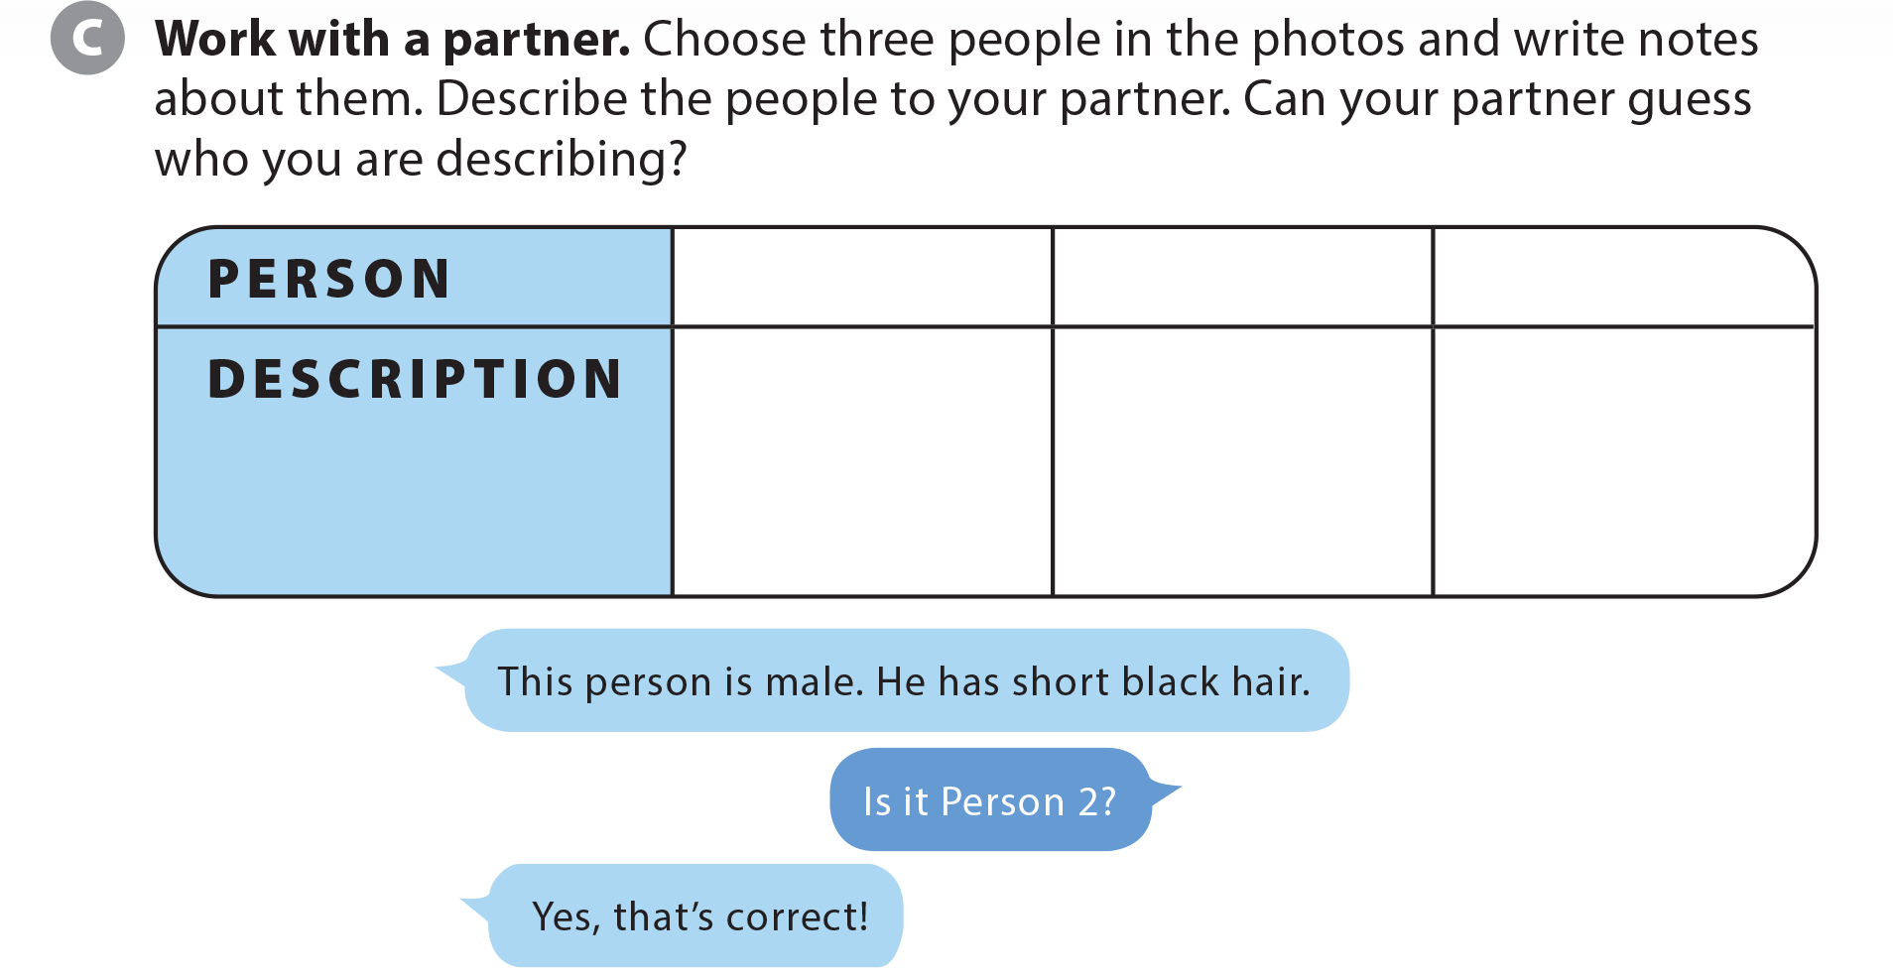
UNIT 2
WHAT DOES SHE LOOK LIKE?
PREVIEW

Slide 5



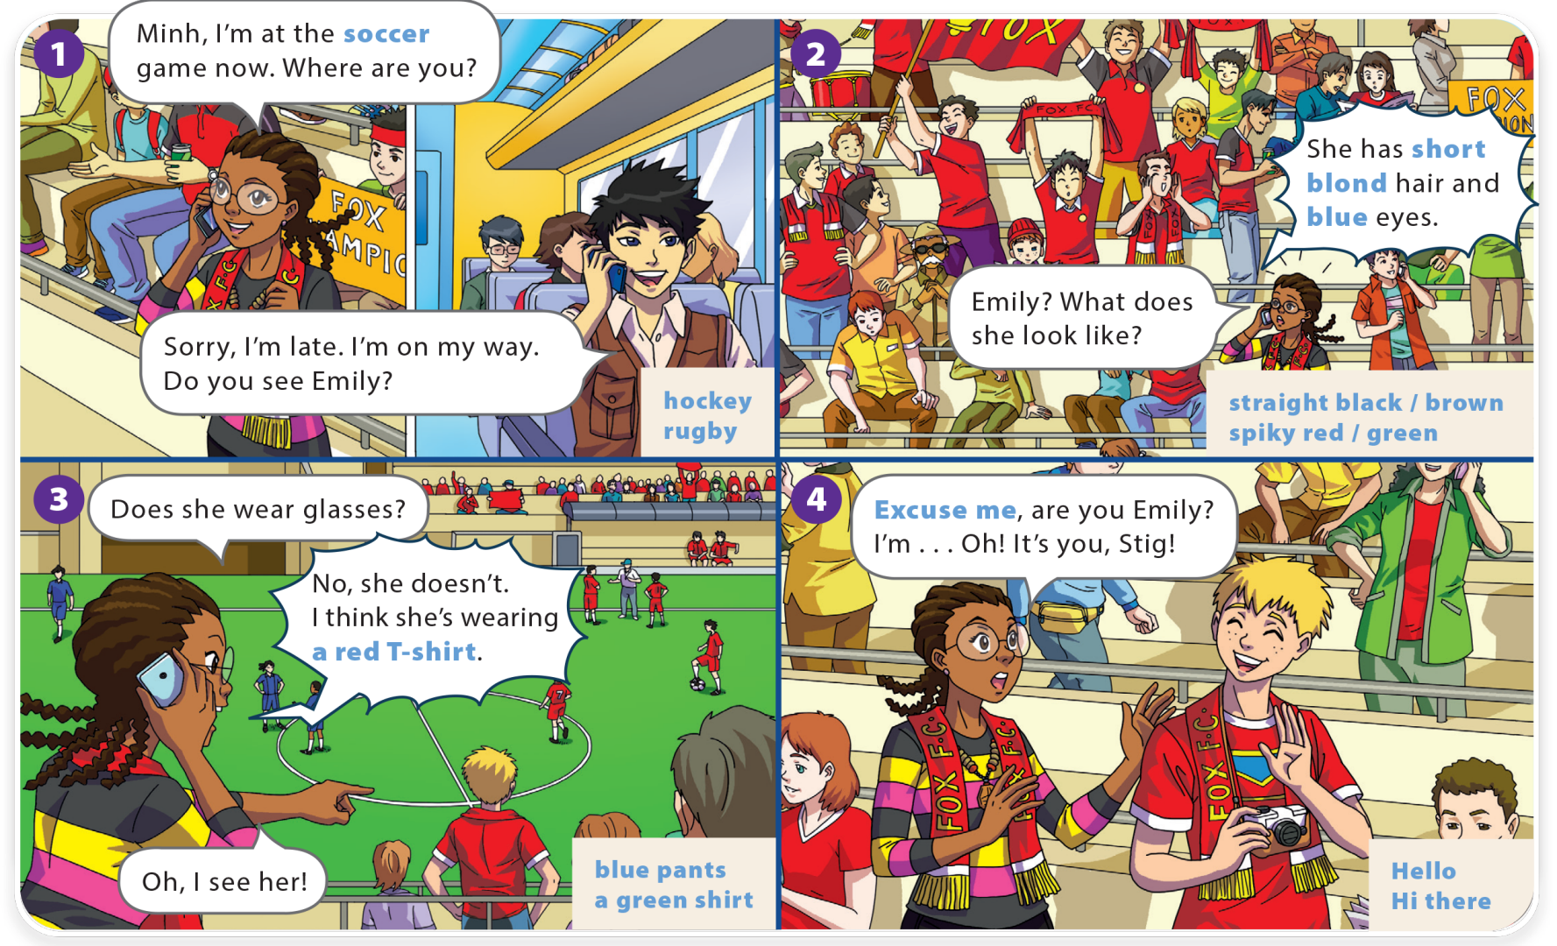
UNIT 2
WHAT DOES SHE LOOK LIKE?
LANGUAGE FOCUS

Slide 6
UNIT 2
WHAT DOES SHE LOOK LIKE?
LANGUAGE FOCUS

Slide 7
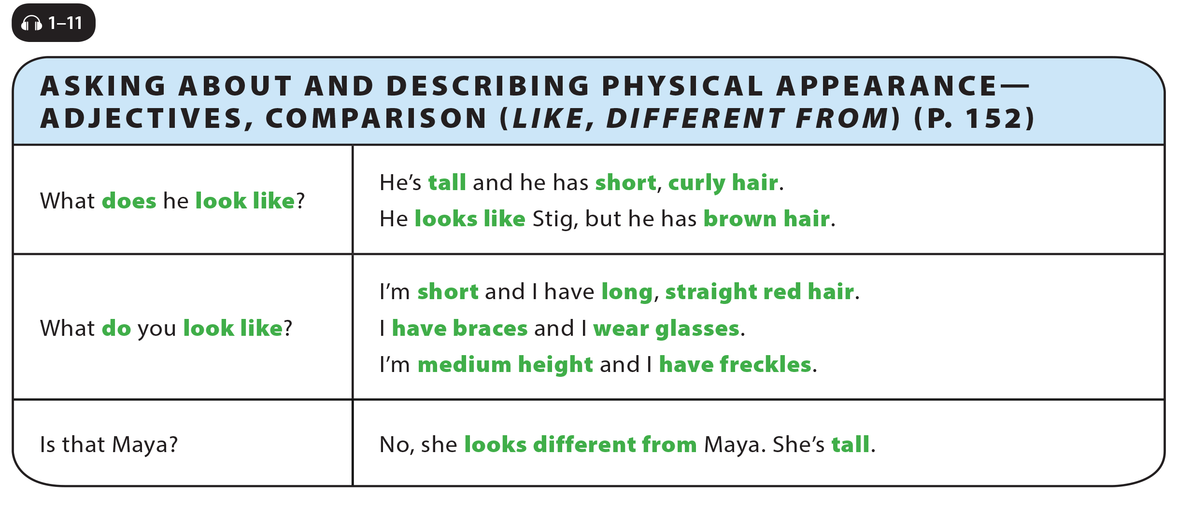
UNIT 2
WHAT DOES SHE LOOK LIKE?
LANGUAGE FOCUS

Slide 8
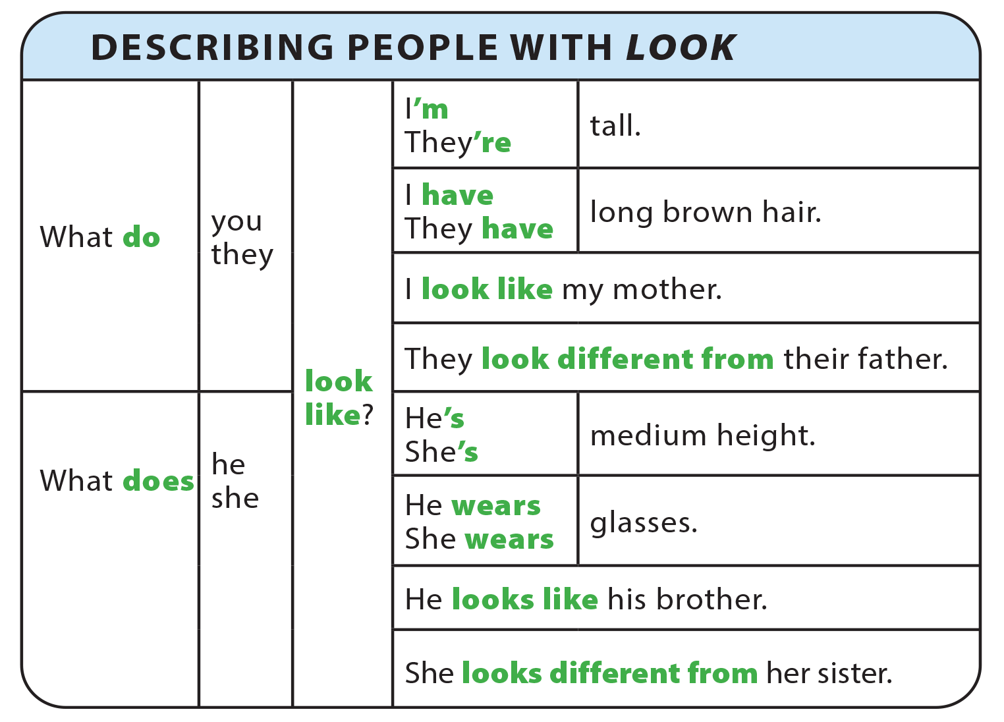
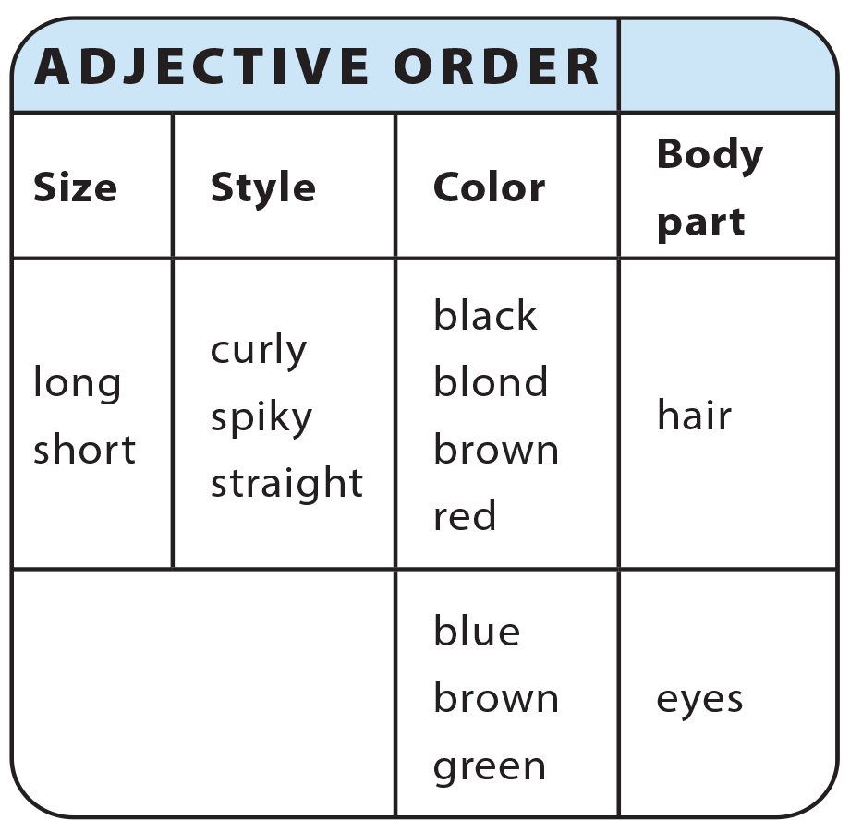
UNIT 2
WHAT DOES SHE LOOK LIKE?
GRAMMAR REFERENCE

Slide 9
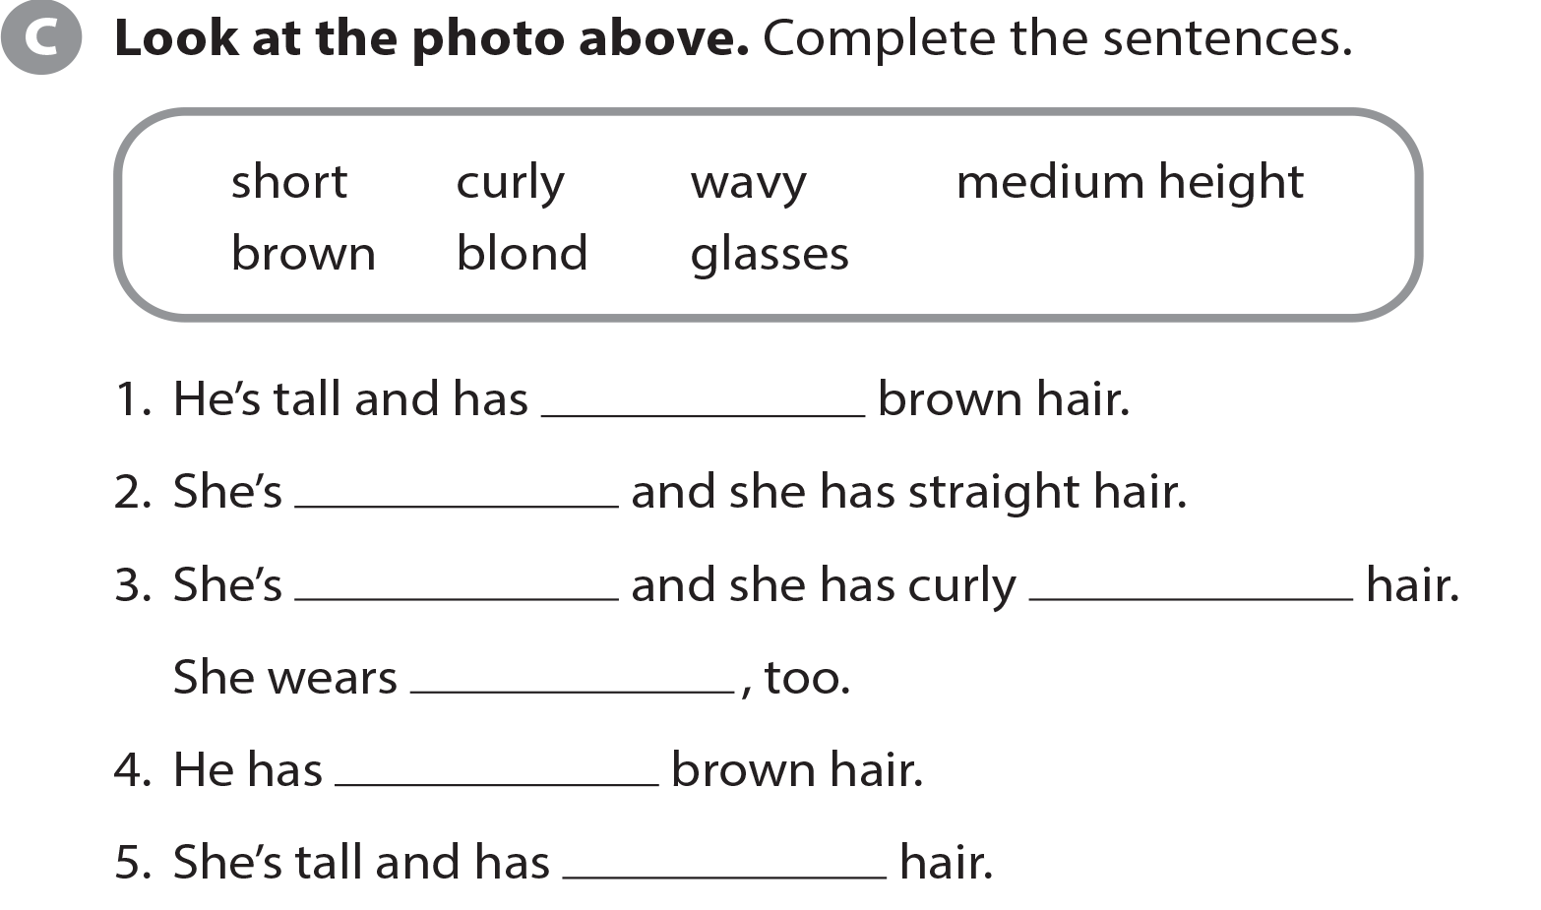
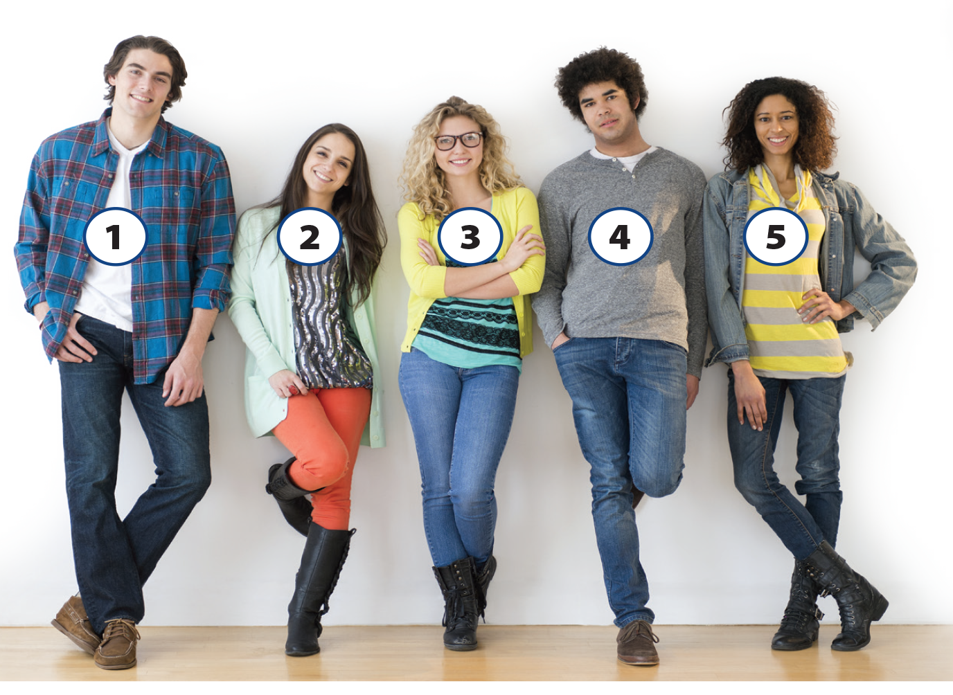
UNIT 2
WHAT DOES SHE LOOK LIKE?
LANGUAGE FOCUS
wavy
short
medium height
blond
glasses
curly
brown

Slide 10
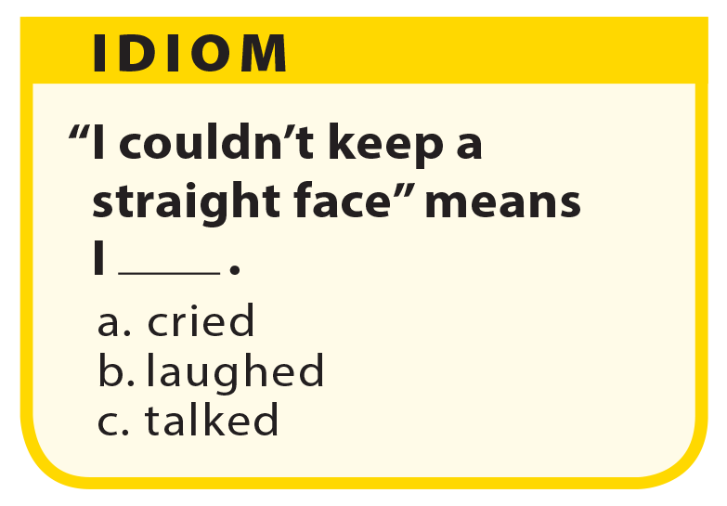
UNIT 2
WHAT DOES SHE LOOK LIKE?
LANGUAGE FOCUS

Slide 11
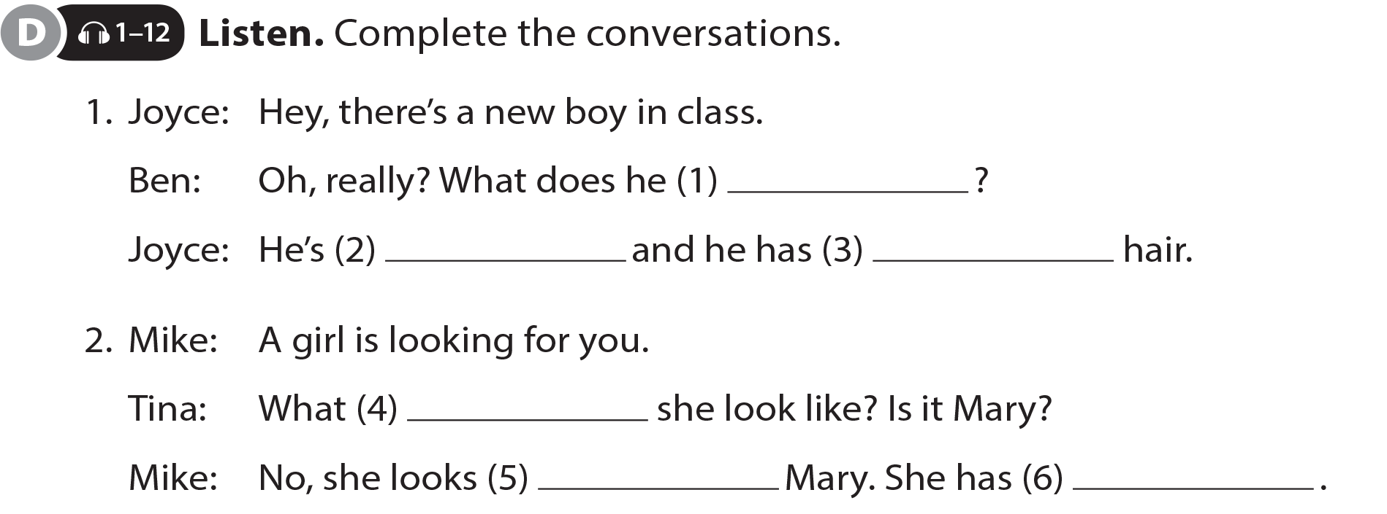
UNIT 2
WHAT DOES SHE LOOK LIKE?
LANGUAGE FOCUS
look like
tall
blond
does
different from
short black hair

Slide 12
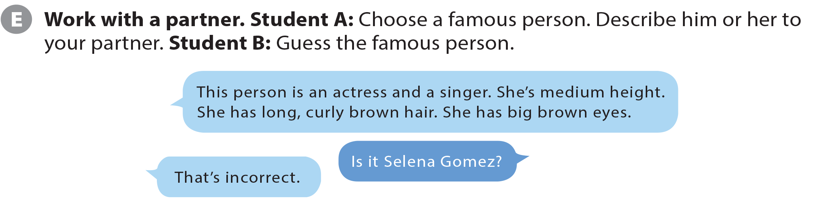
UNIT 2
WHAT DOES SHE LOOK LIKE?
LANGUAGE FOCUS

Slide 13
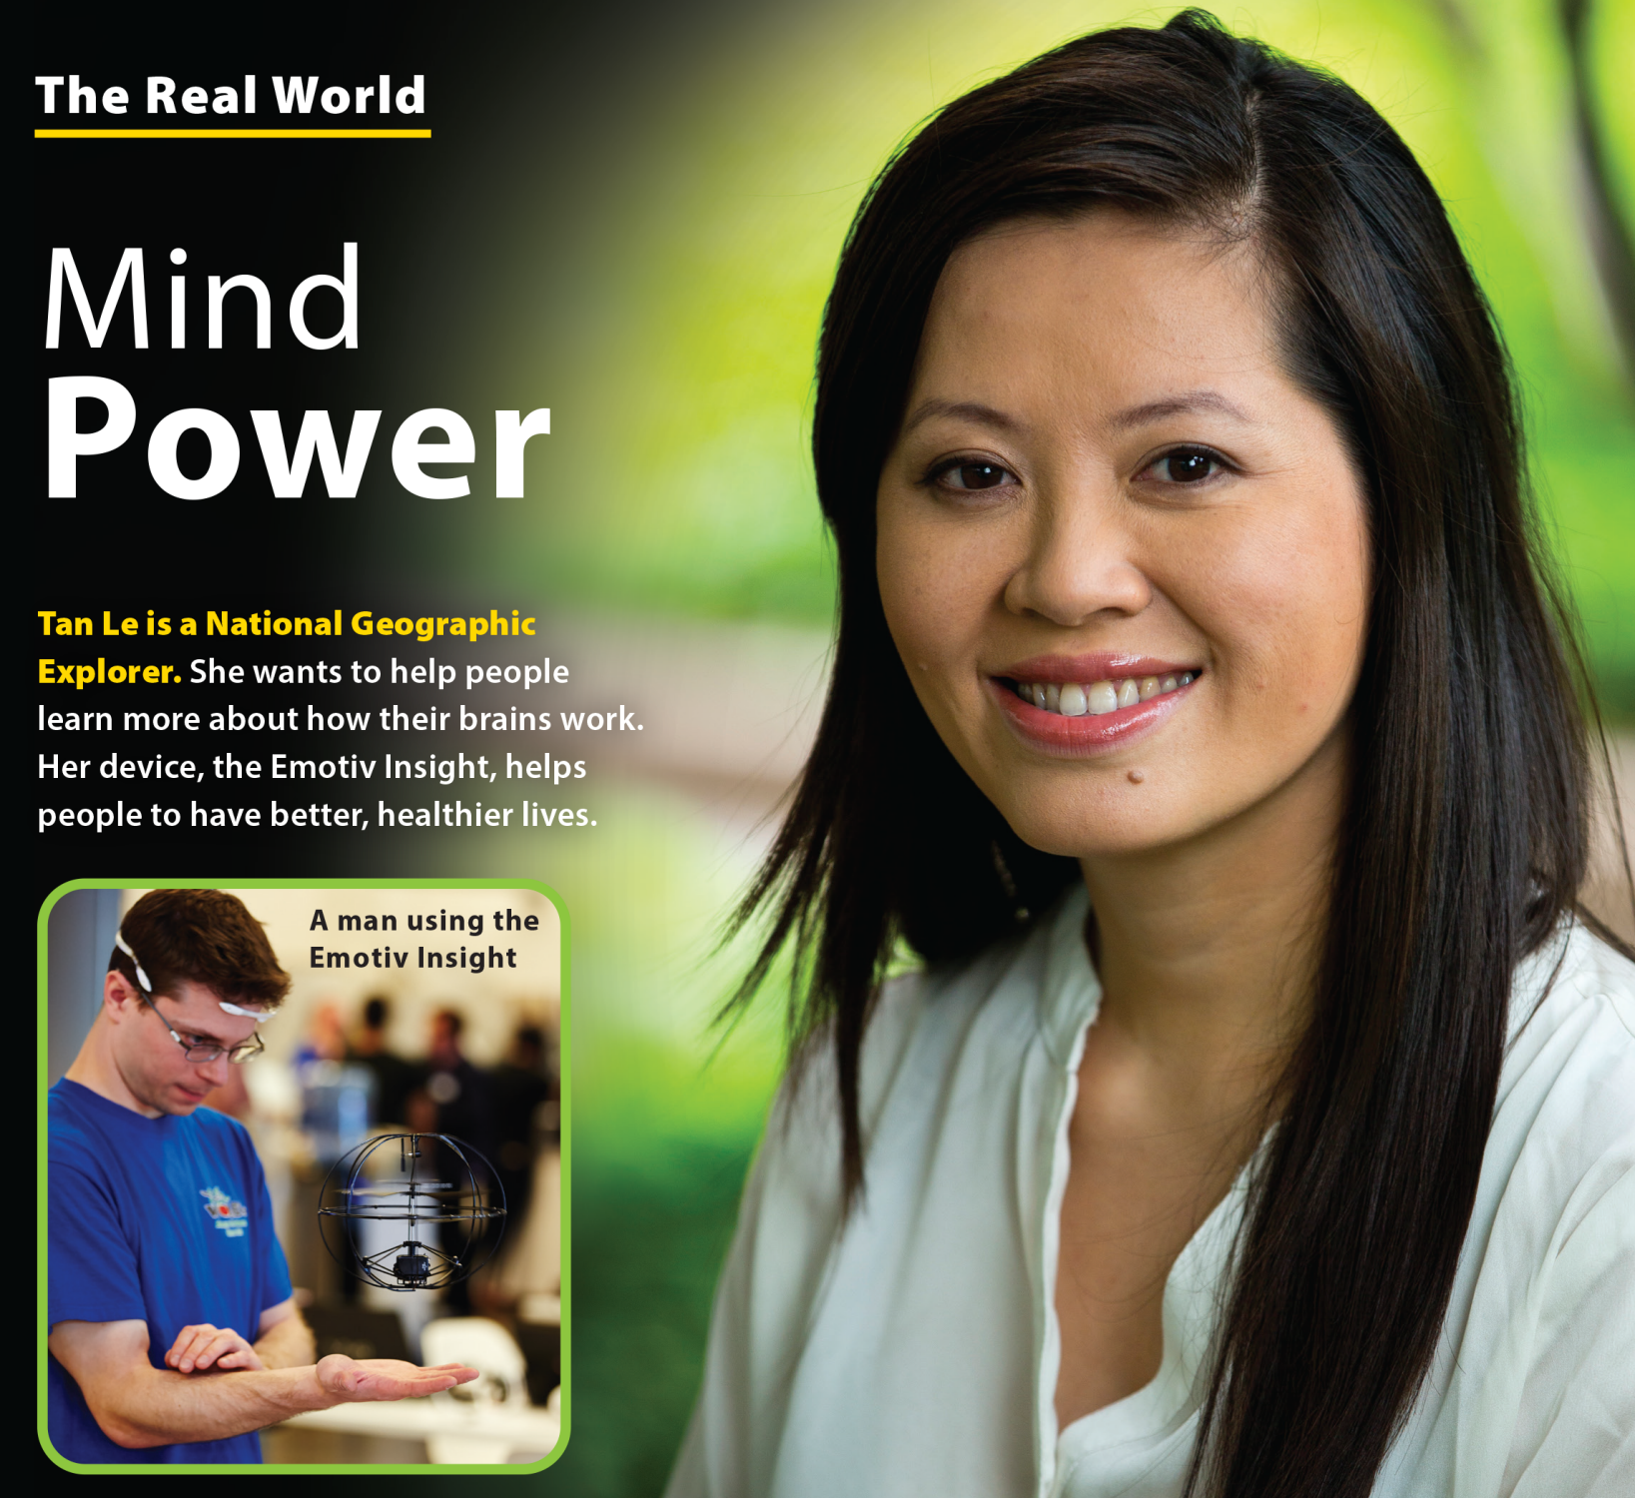
UNIT 2
WHAT DOES SHE LOOK LIKE?
THE REAL WORLD

Slide 14
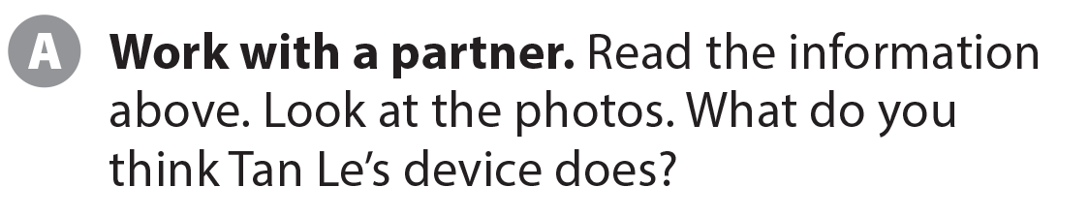
UNIT 2
WHAT DOES SHE LOOK LIKE?
THE REAL WORLD

Slide 15


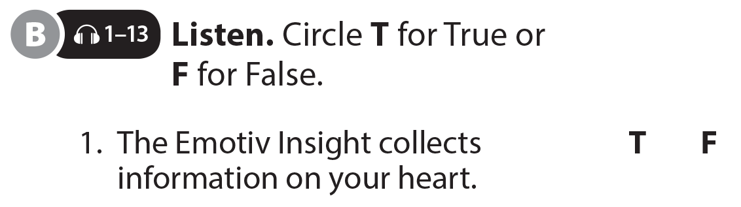
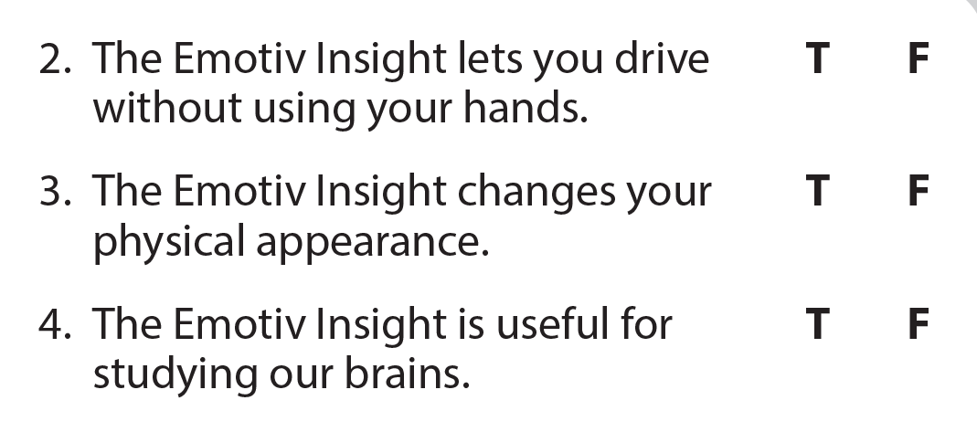
UNIT 2
WHAT DOES SHE LOOK LIKE?
THE REAL WORLD

Slide 16
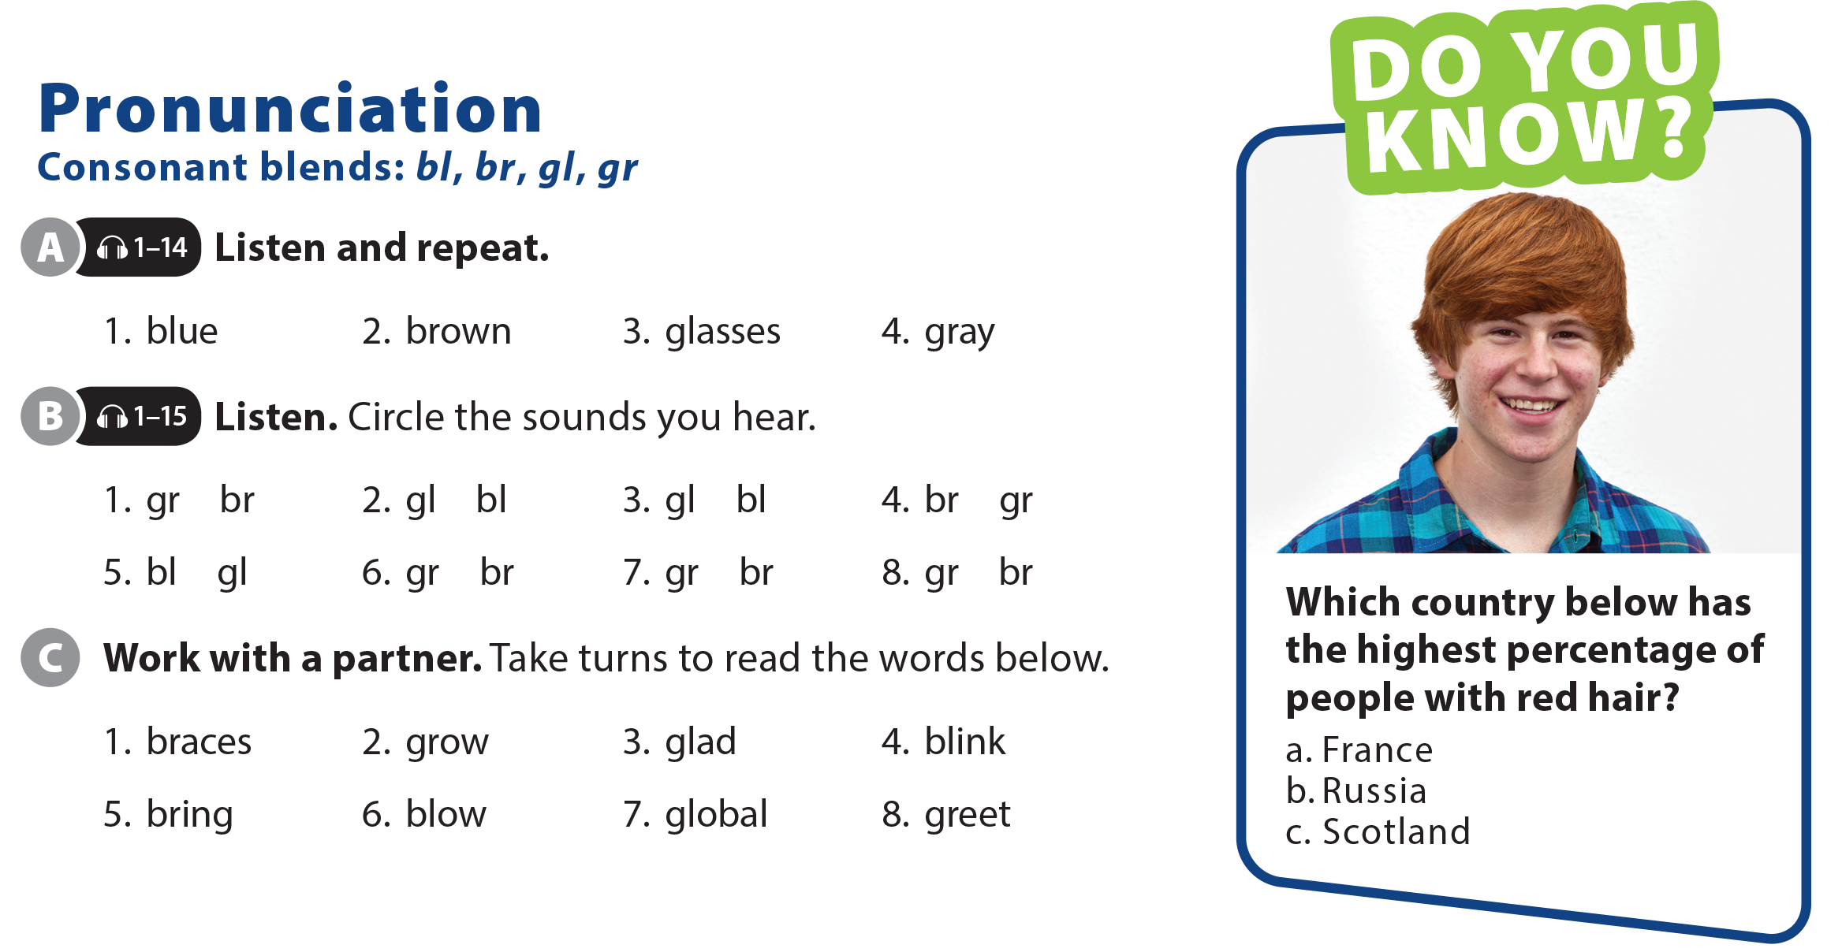
UNIT 2
WHAT DOES SHE LOOK LIKE?
PRONUNCIATION

Slide 17
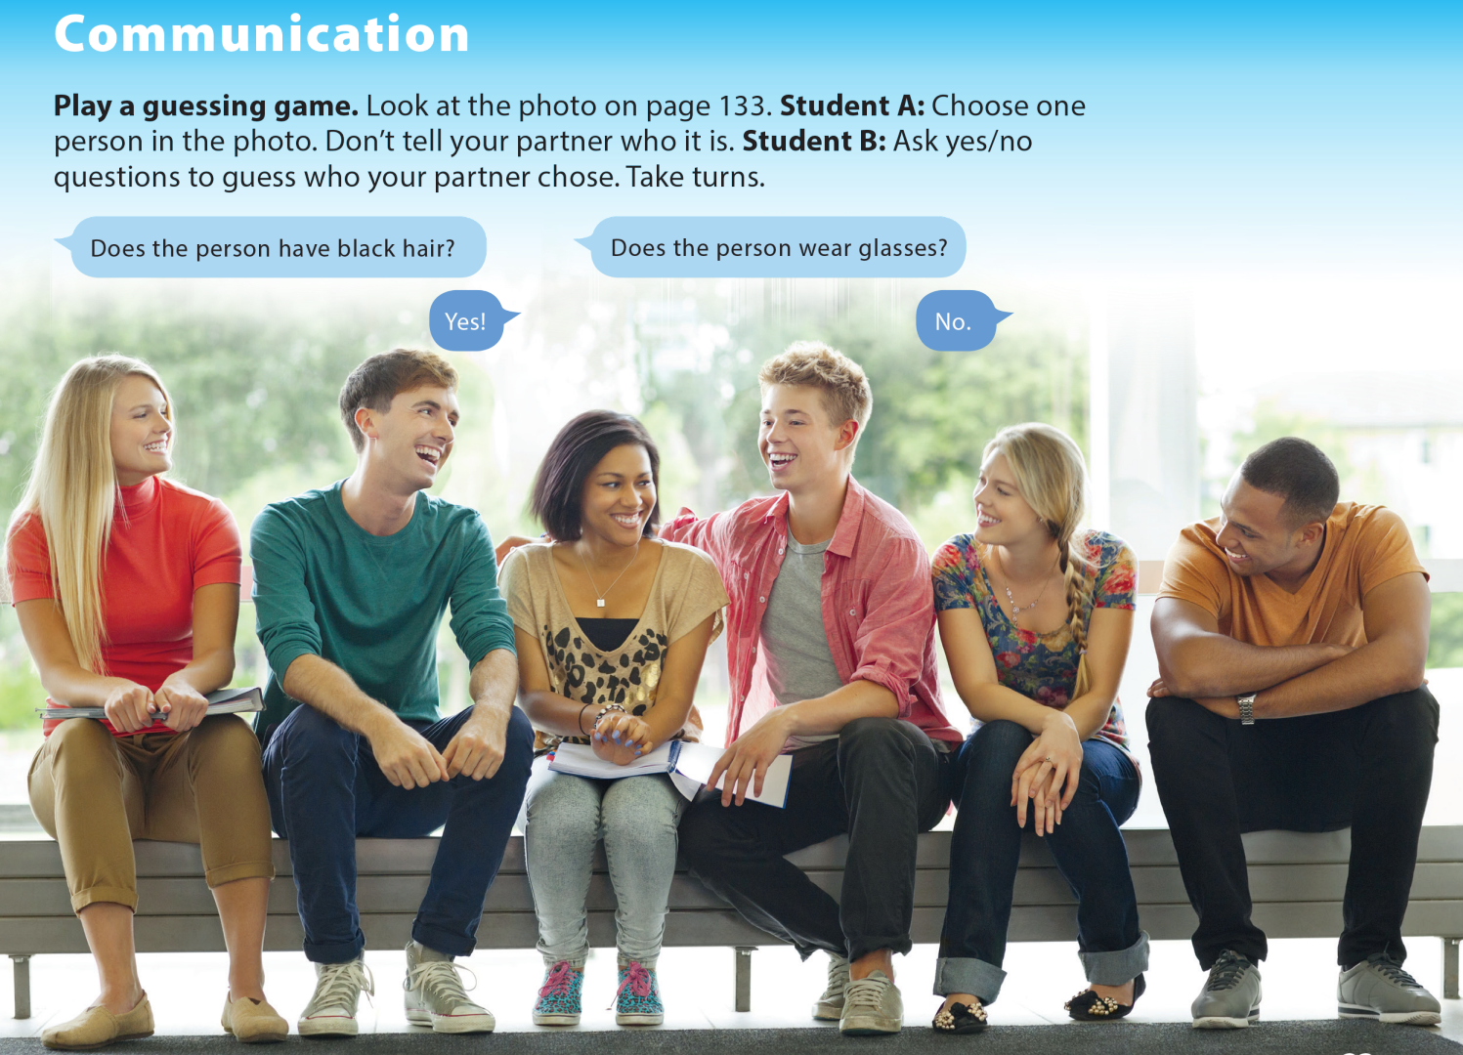
UNIT 2
WHAT DOES SHE LOOK LIKE?
COMMUNICATION

Slide 18
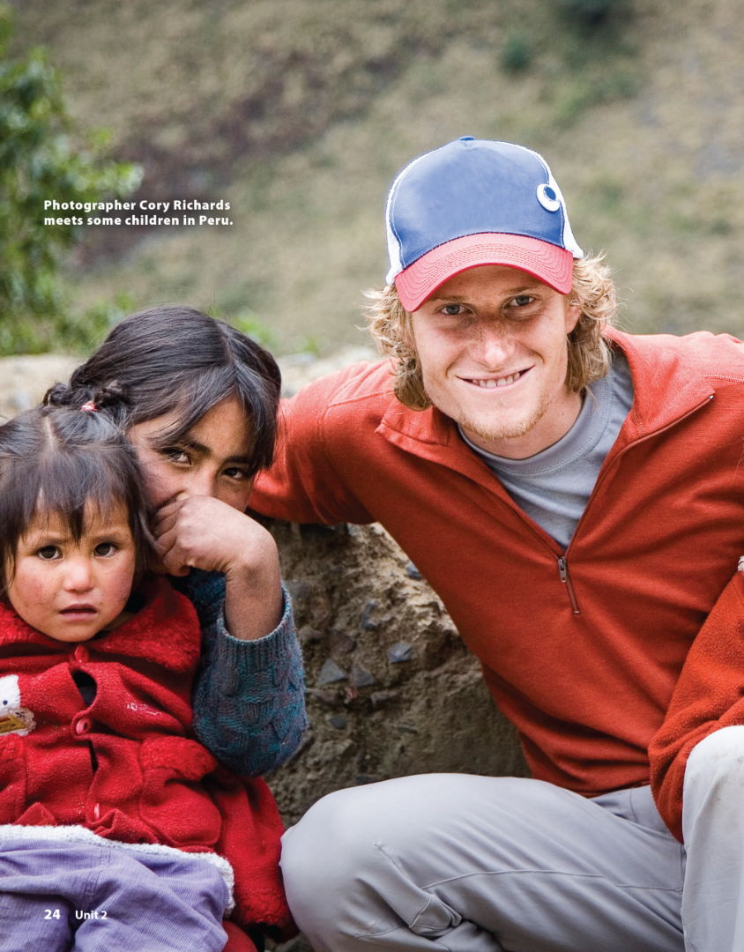

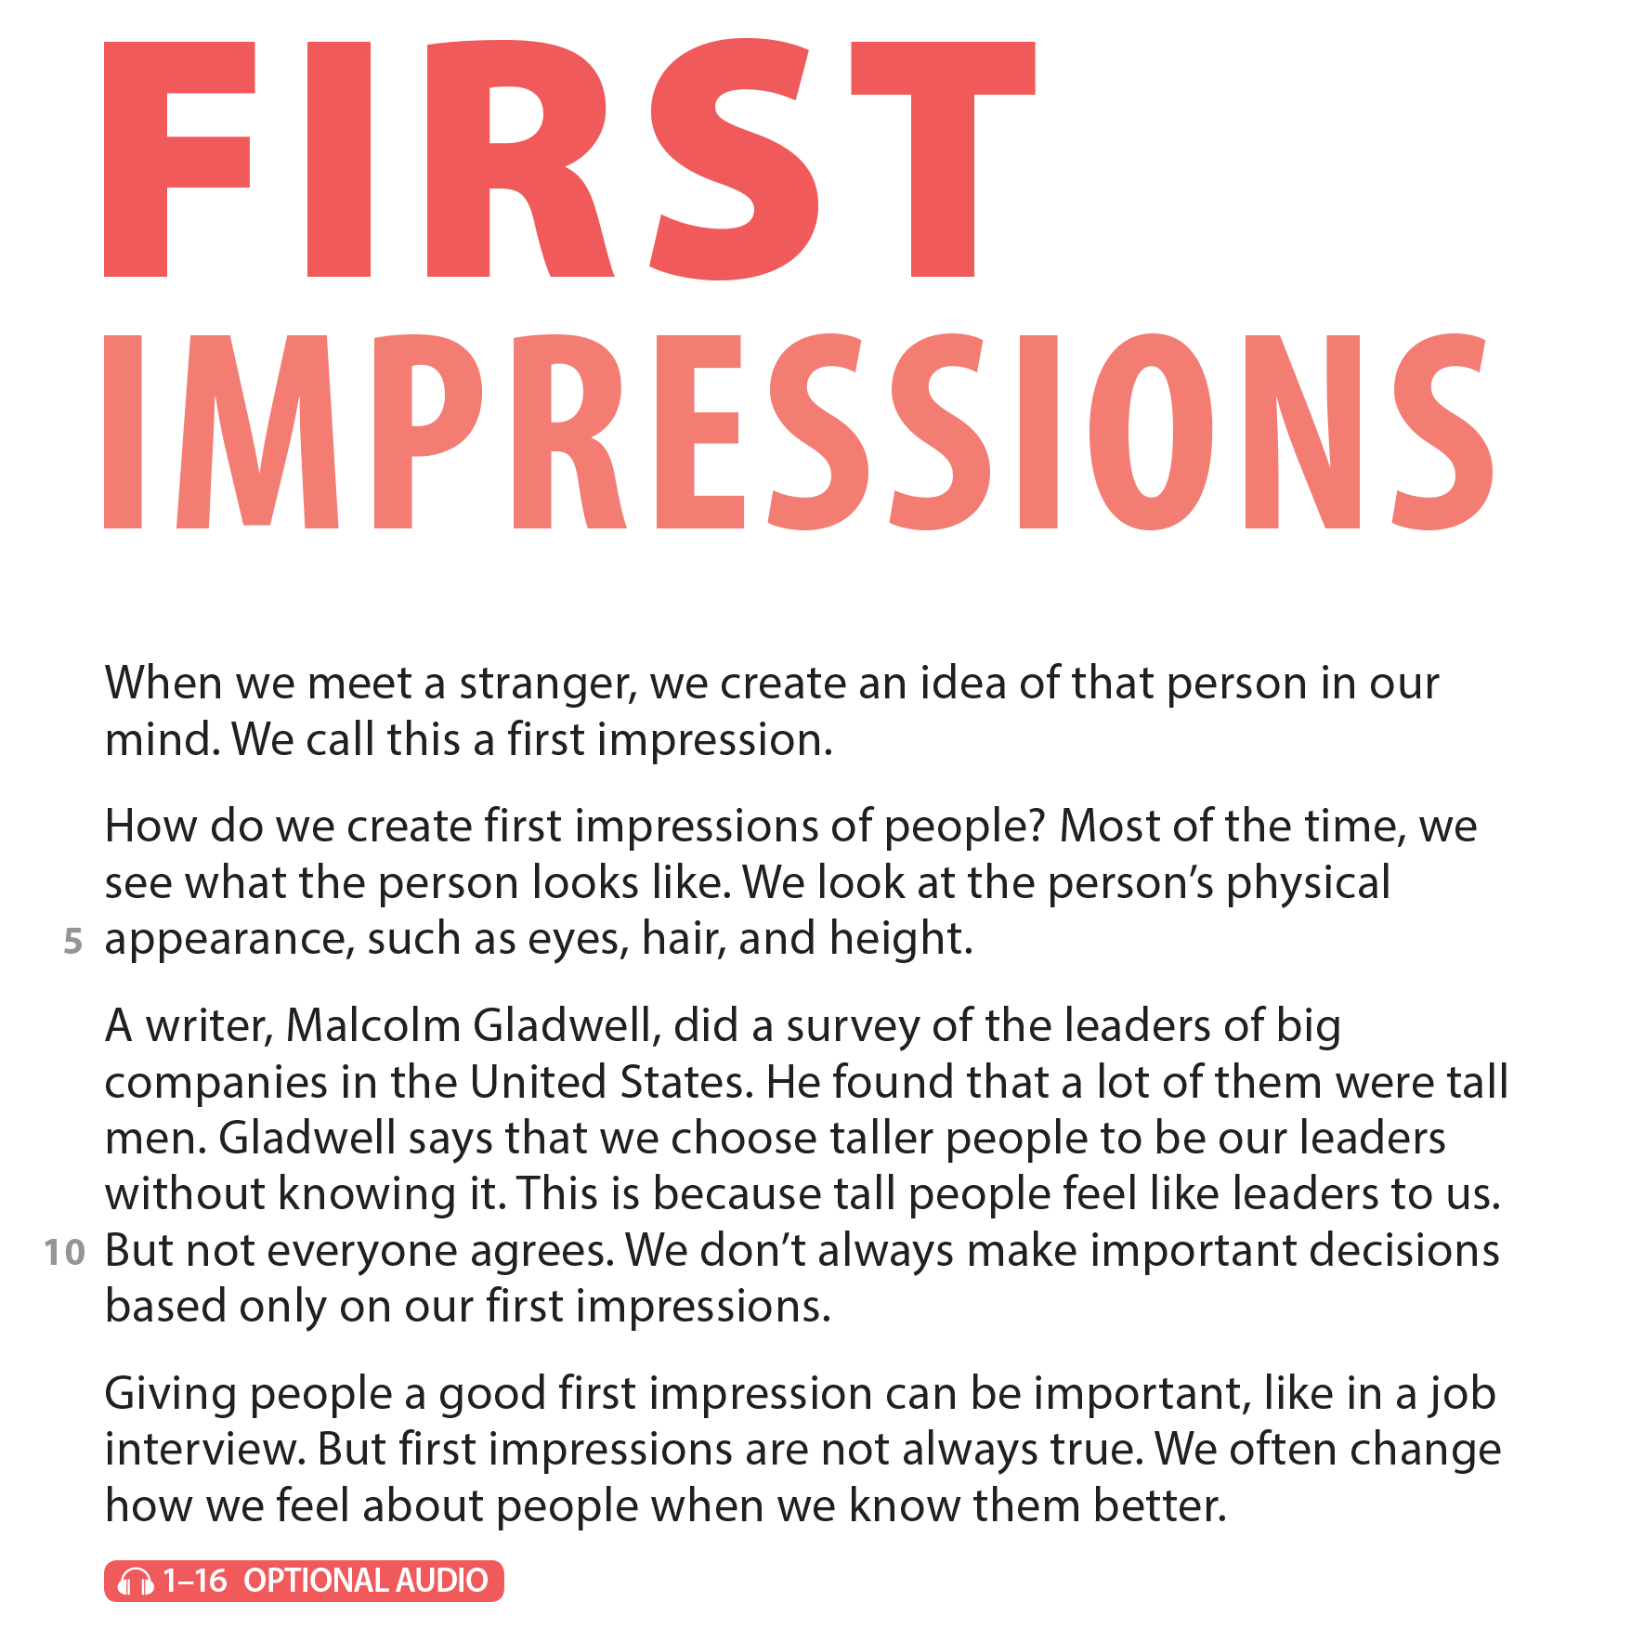
UNIT 2
WHAT DOES SHE LOOK LIKE?
READING

Slide 19
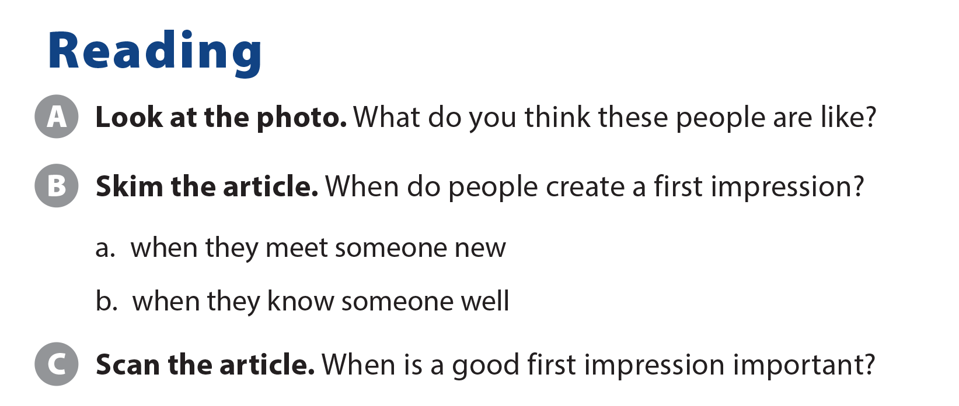
UNIT 2
WHAT DOES SHE LOOK LIKE?
READING
in a job interview

Slide 20
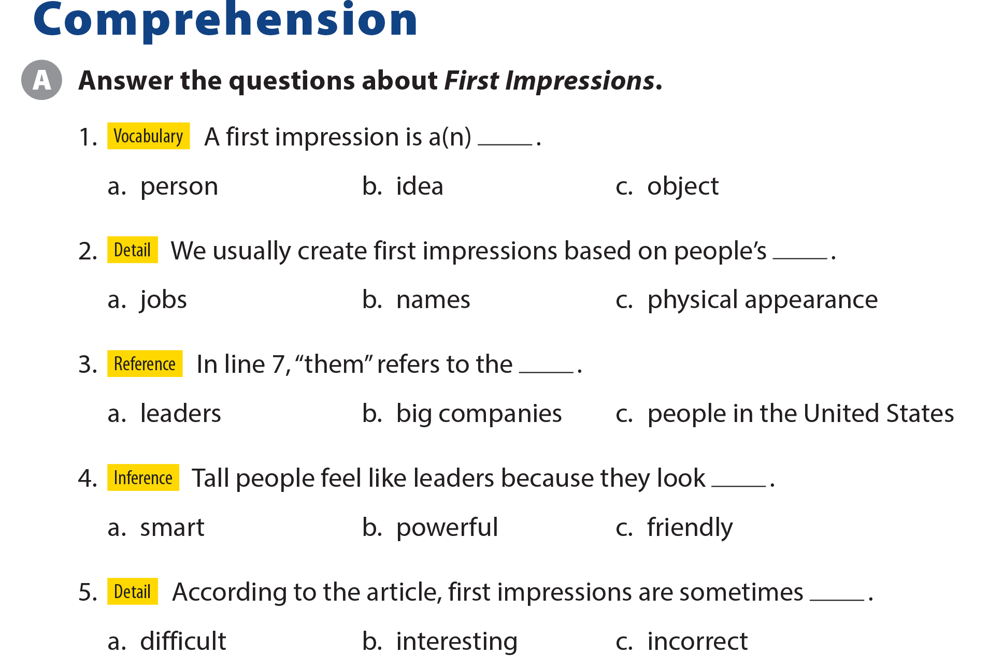
UNIT 2
WHAT DOES SHE LOOK LIKE?
COMPREHENSION

Slide 21
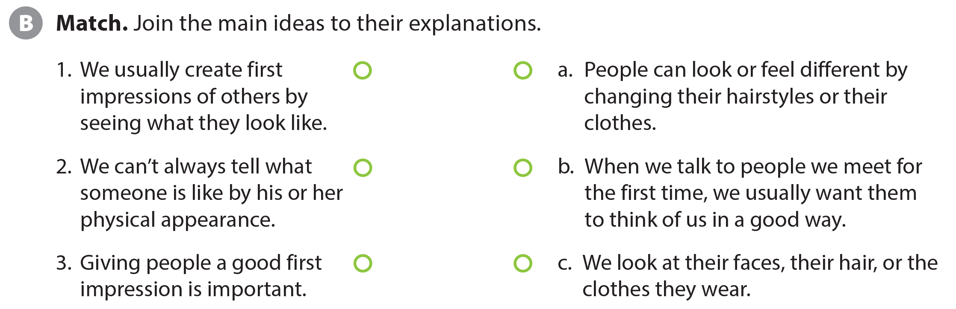
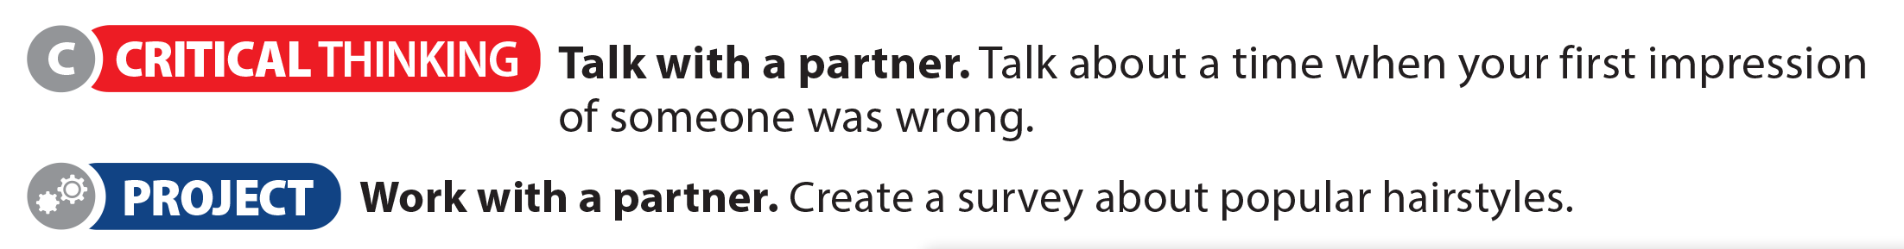
UNIT 2
WHAT DOES SHE LOOK LIKE?
COMPREHENSION

Slide 22
UNIT 2
WHAT DOES SHE LOOK LIKE?
PROJECT

Slide 23
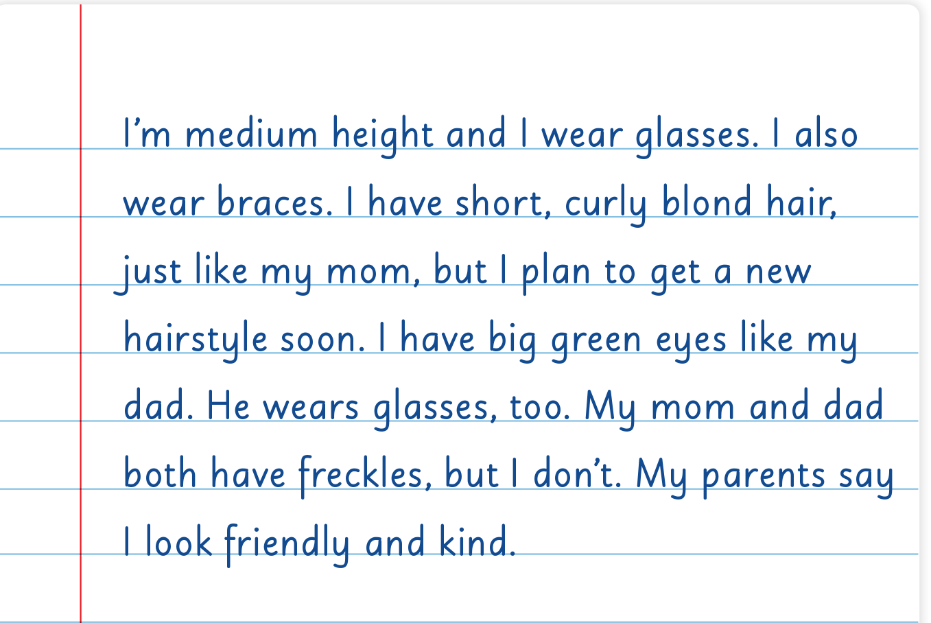
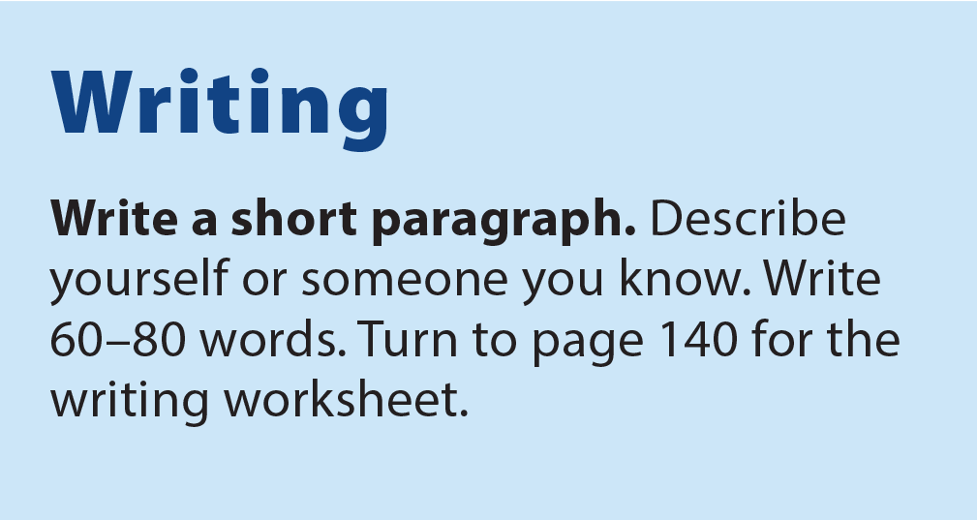
UNIT 2
WHAT DOES SHE LOOK LIKE?
WRITING

Slide 24
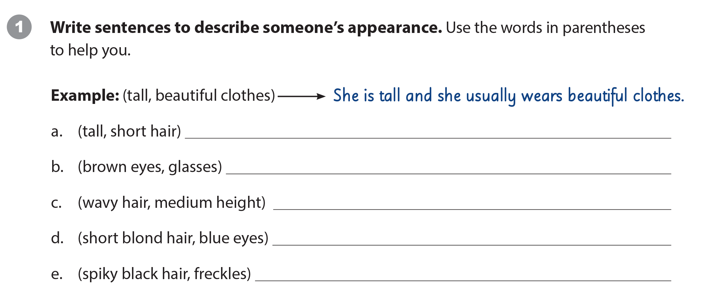
UNIT 2
WHAT DOES SHE LOOK LIKE?
WRITING WORKSHEET
Suggested answers
She’s tall and she has short hair.
Mike has brown eyes and he wears glasses.
My mother has wavy hair and she is medium height.
Ann’s sister has short blond hair and blue eyes.
He has spiky black hair and freckles.

Slide 25
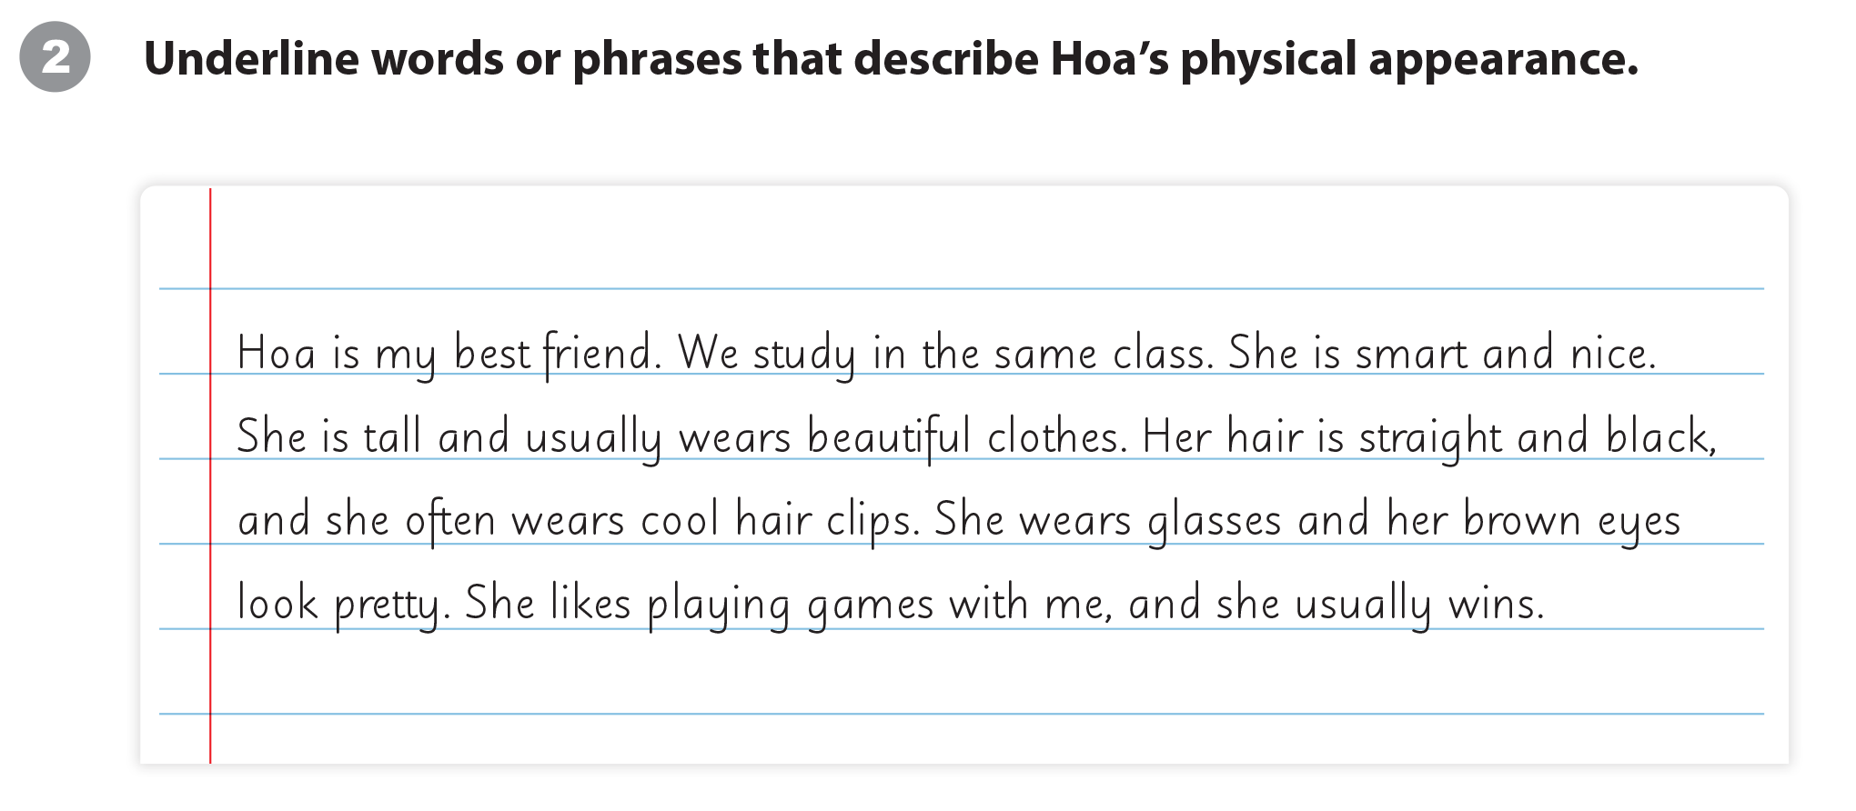
UNIT 2
WHAT DOES SHE LOOK LIKE?
WRITING WORKSHEET

Slide 26
UNIT 2
WHAT DOES SHE LOOK LIKE?
WRITING WORKSHEET

Slide 27

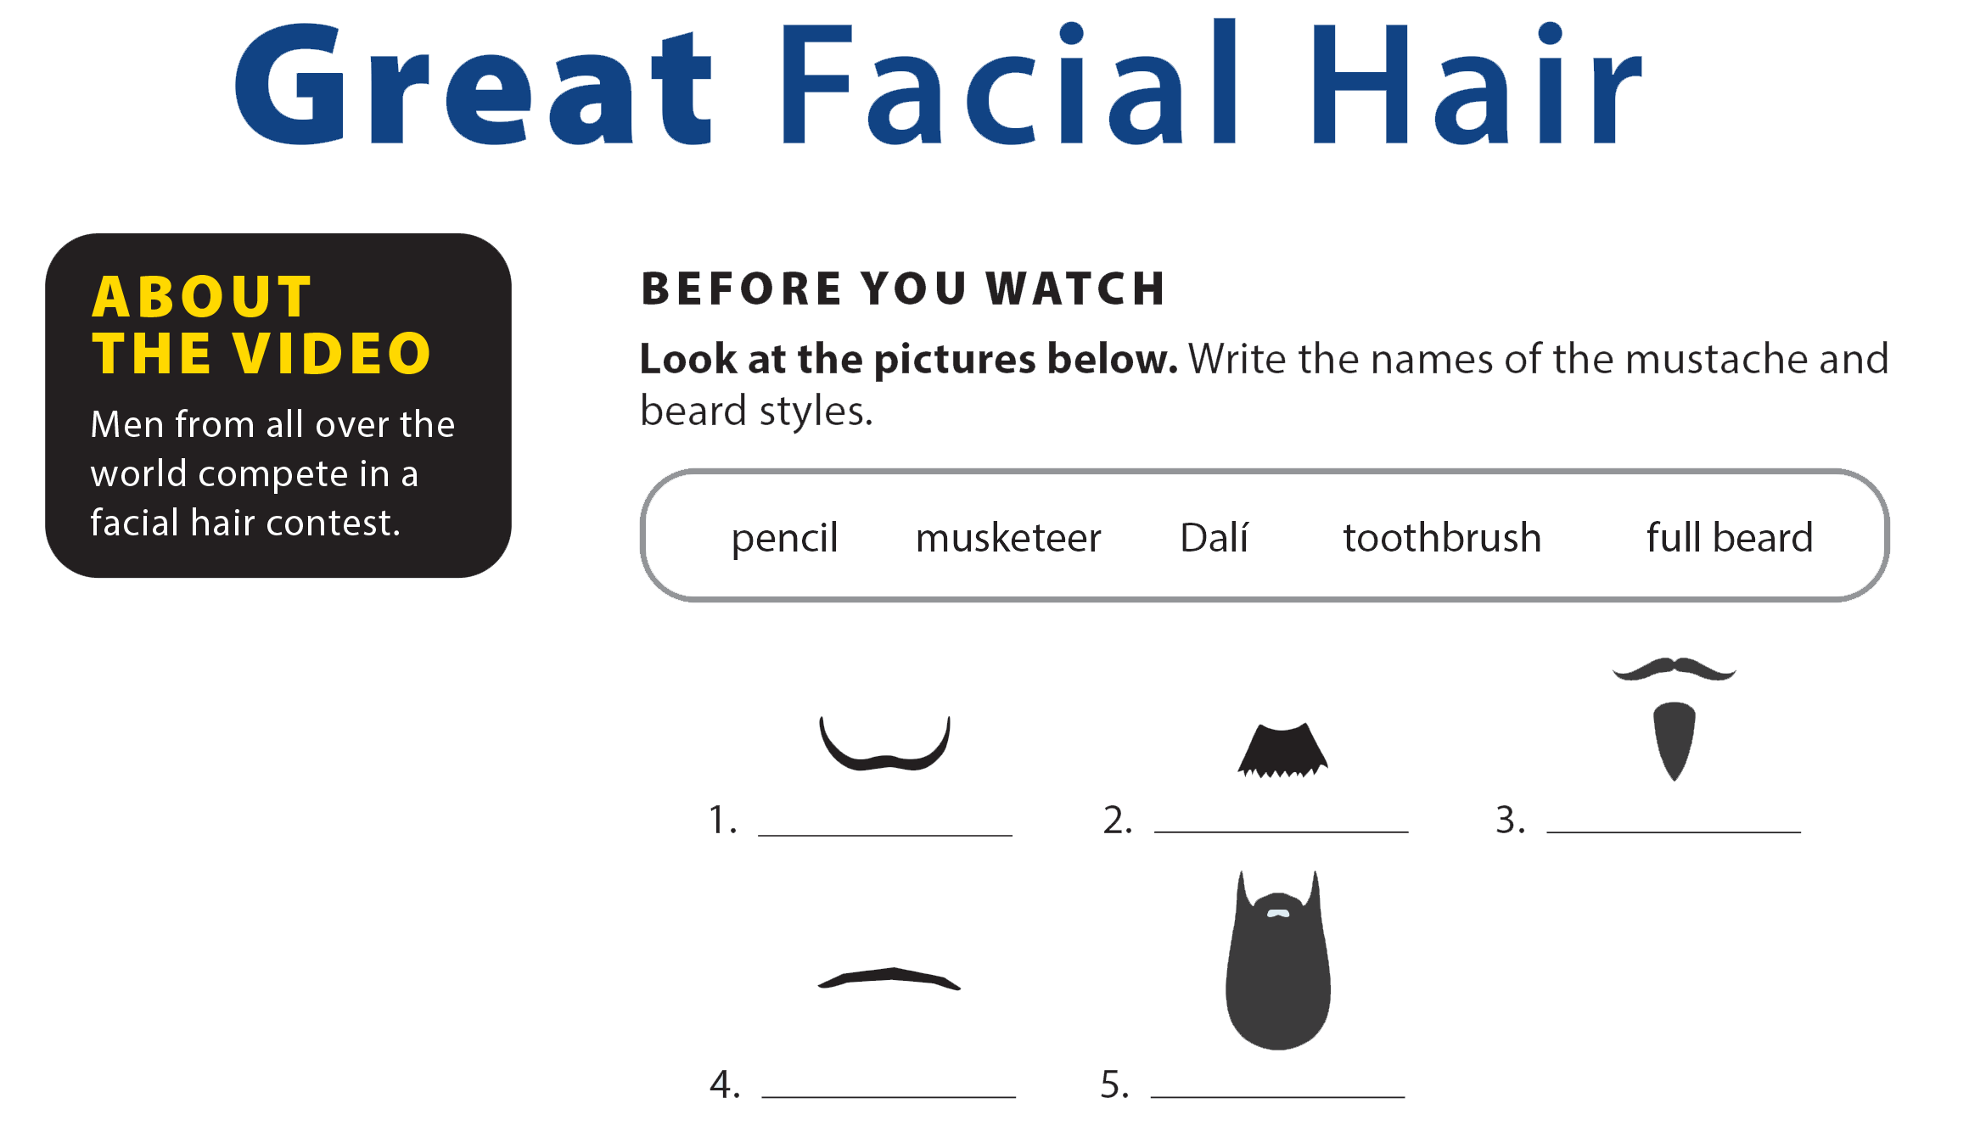
UNIT 2
WHAT DOES SHE LOOK LIKE?
VIDEO
Dalí
toothbrush
musketeer
pencil
full beard

Slide 28


UNIT 2
WHAT DOES SHE LOOK LIKE?
VIDEO

Slide 29
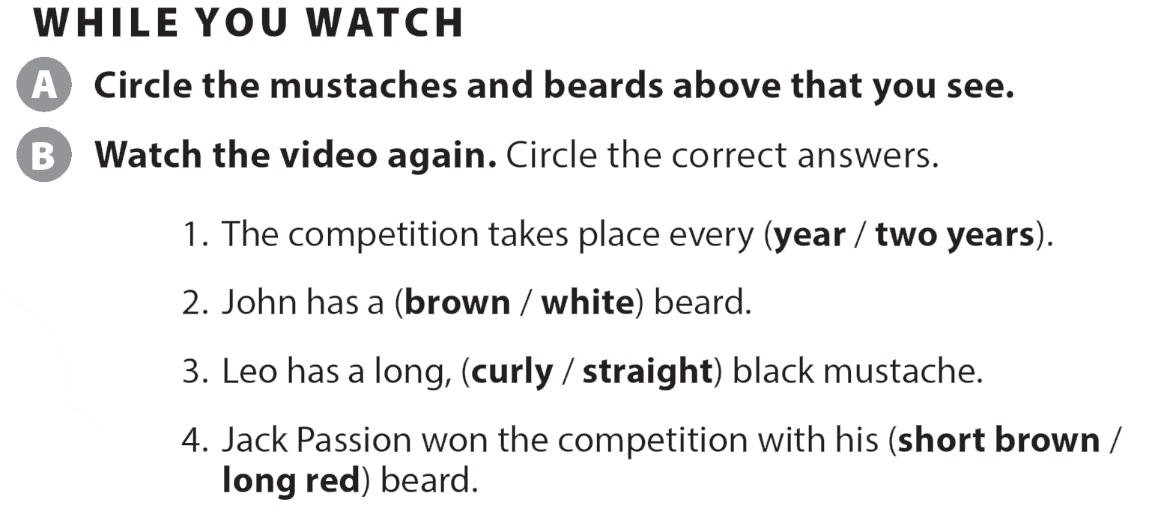
UNIT 2
WHAT DOES SHE LOOK LIKE?
VIDEO
Dalí

Slide 30
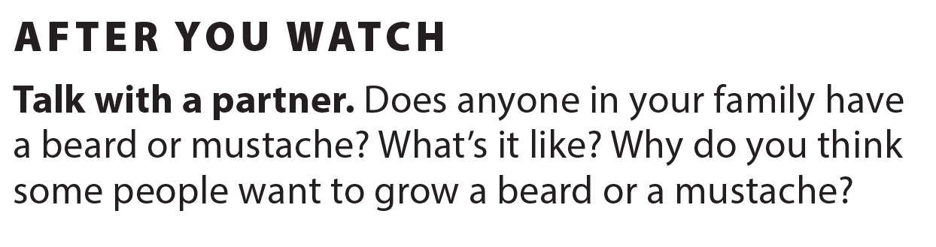
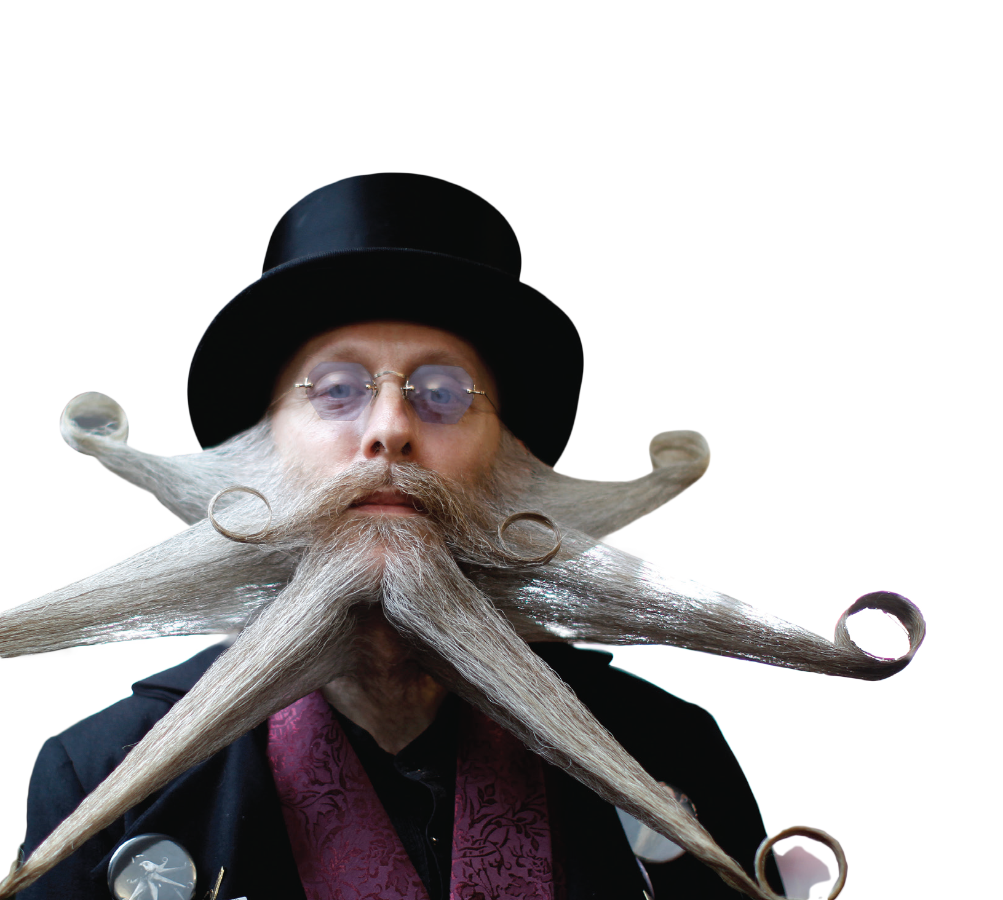
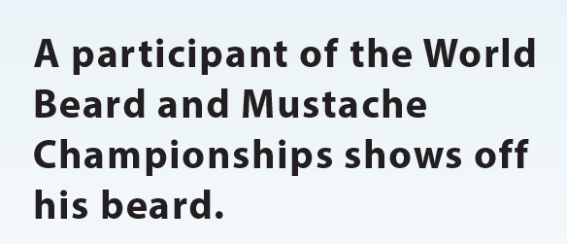
UNIT 2
WHAT DOES SHE LOOK LIKE?
VIDEO

Slide 31
UNIT 2
WHAT DOES SHE LOOK LIKE?
Thank you!

