Slide 1

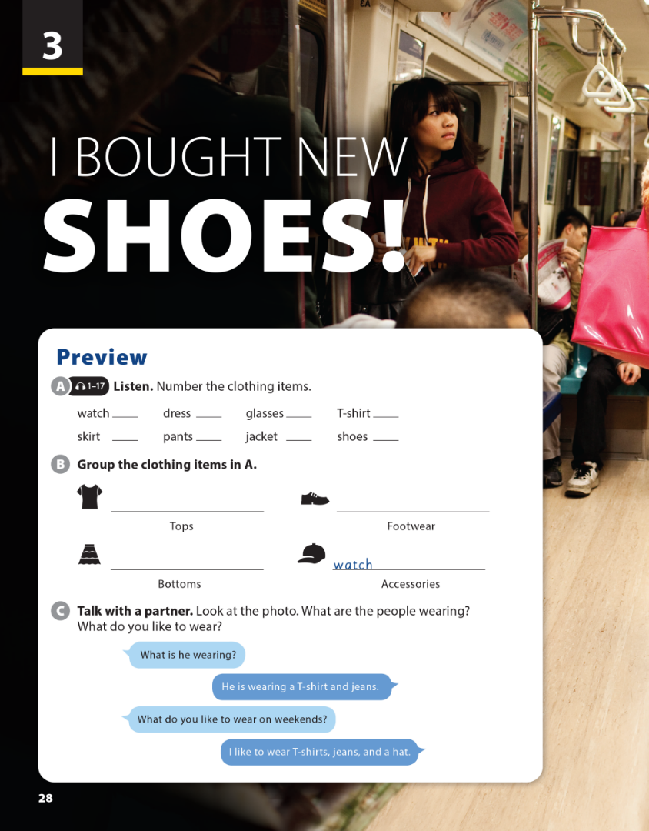


3
National Geographic Learning, a Cengage Company © 2022 Cengage Learning, Inc. ALL RIGHTS RESERVED. This presentation tool is intended for teaching purposes only and may not be scanned, copied, duplicated, or posted to a publicly accessible platform in whole or in part.

Slide 2
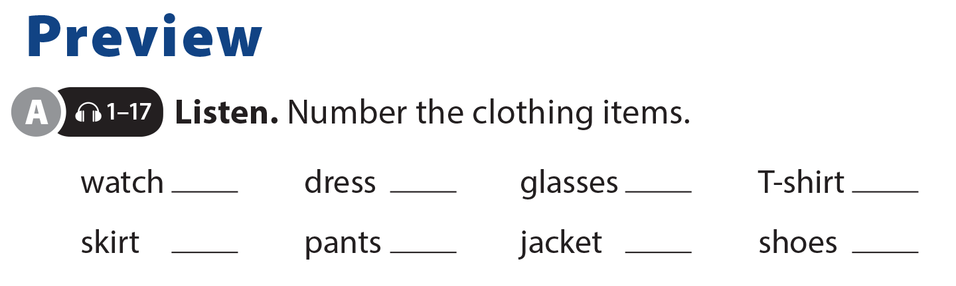

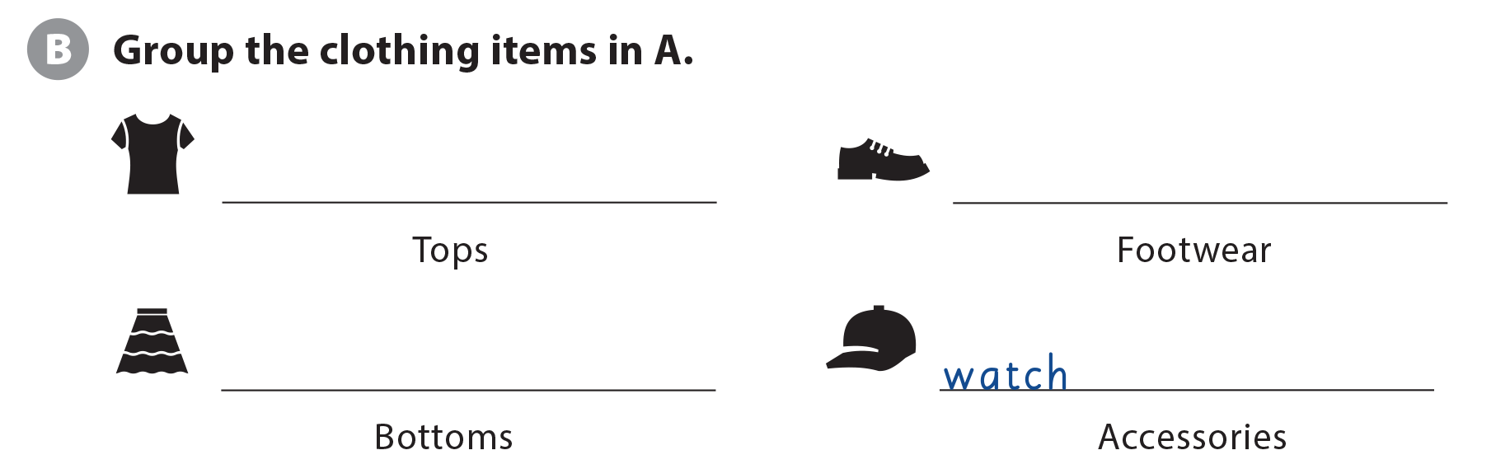
UNIT 3
I BOUGHT NEW SHOES!
PREVIEW
2
5
6
7
3
8
1
4
T-shirt, jacket, dress
shoes
skirt, pants, dress
, glasses

Slide 3
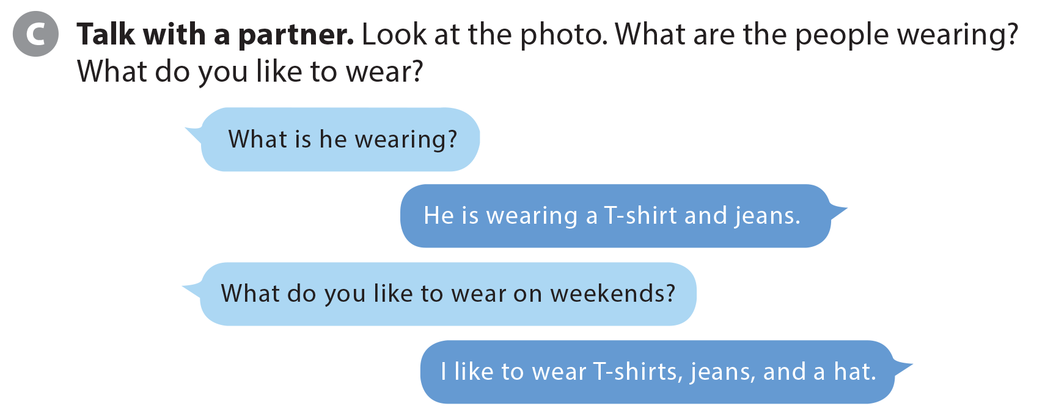
UNIT 3
I BOUGHT NEW SHOES!
PREVIEW

Slide 4


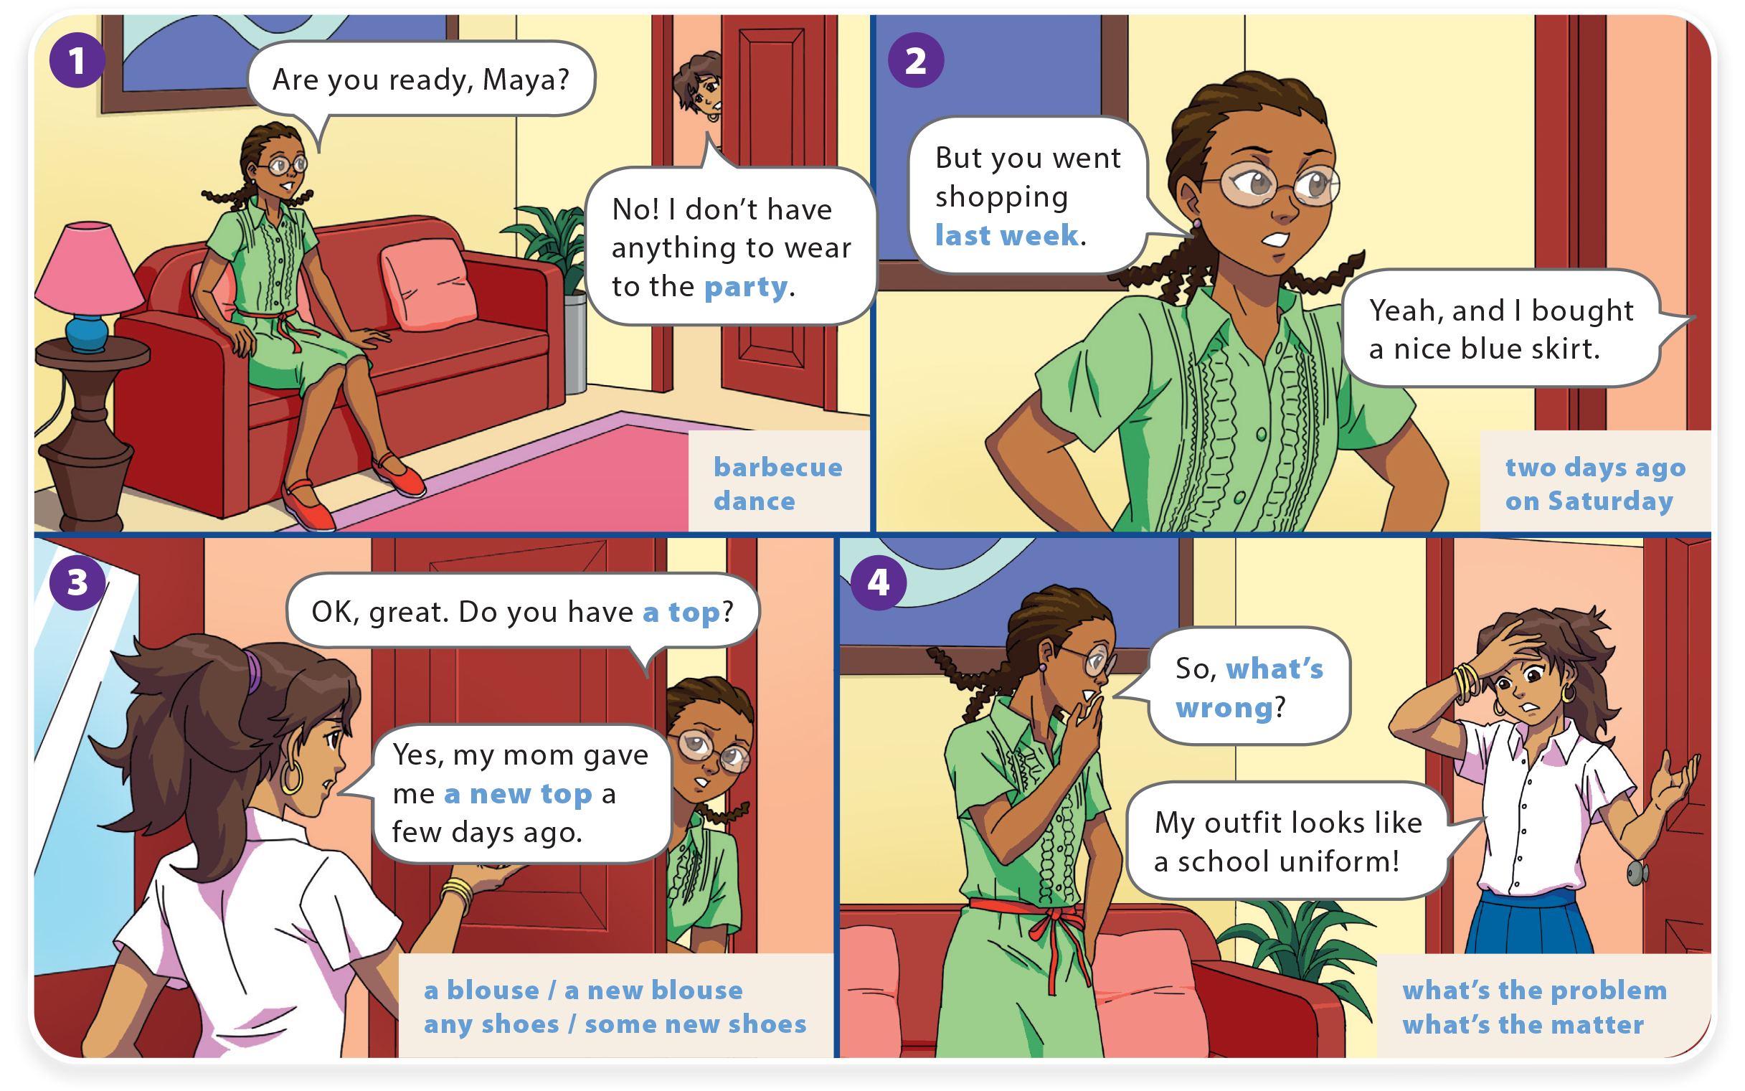
WHAT DO YOU LIKE TO DO?
UNIT 3
I BOUGHT NEW SHOES!
LANGUAGE FOCUS

Slide 5
WHAT DO YOU LIKE TO DO?
UNIT 3
I BOUGHT NEW SHOES!
LANGUAGE FOCUS

Slide 6
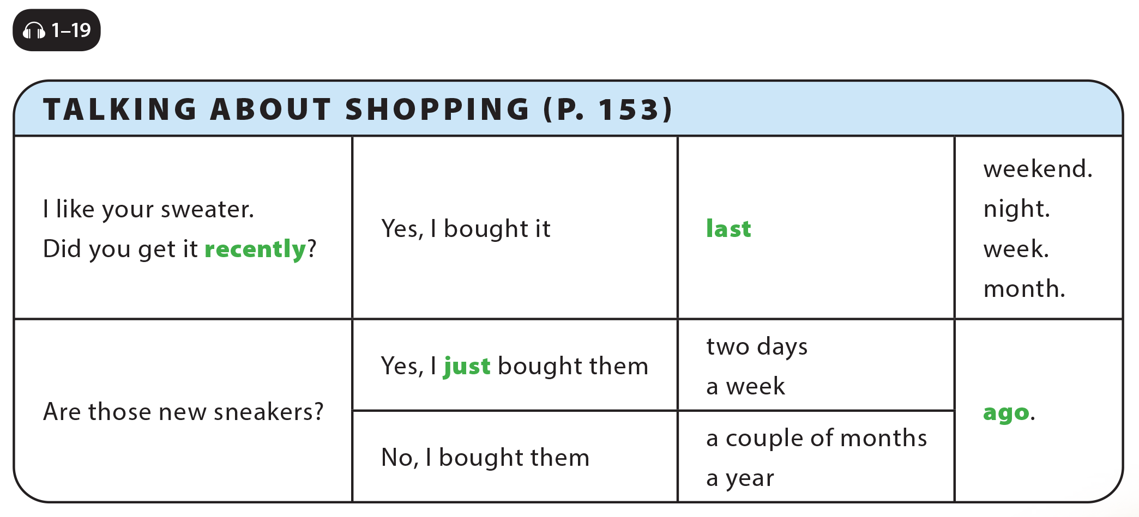
UNIT 3
I BOUGHT NEW SHOES!
LANGUAGE FOCUS

Slide 7
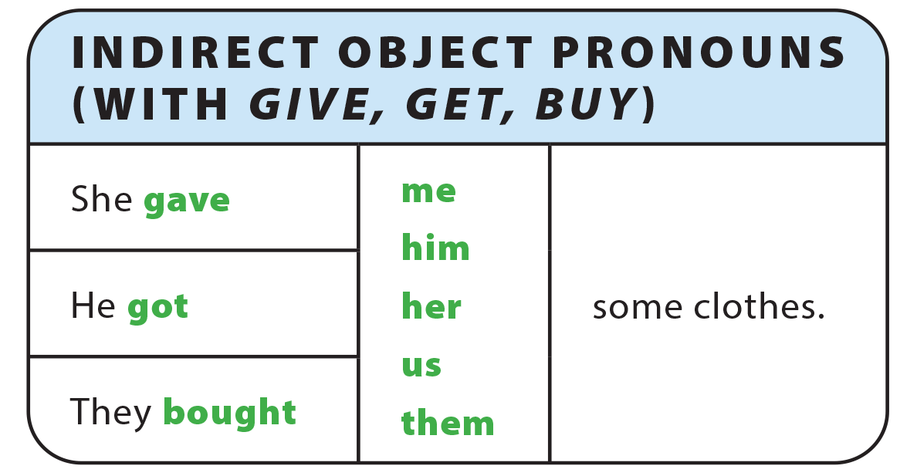
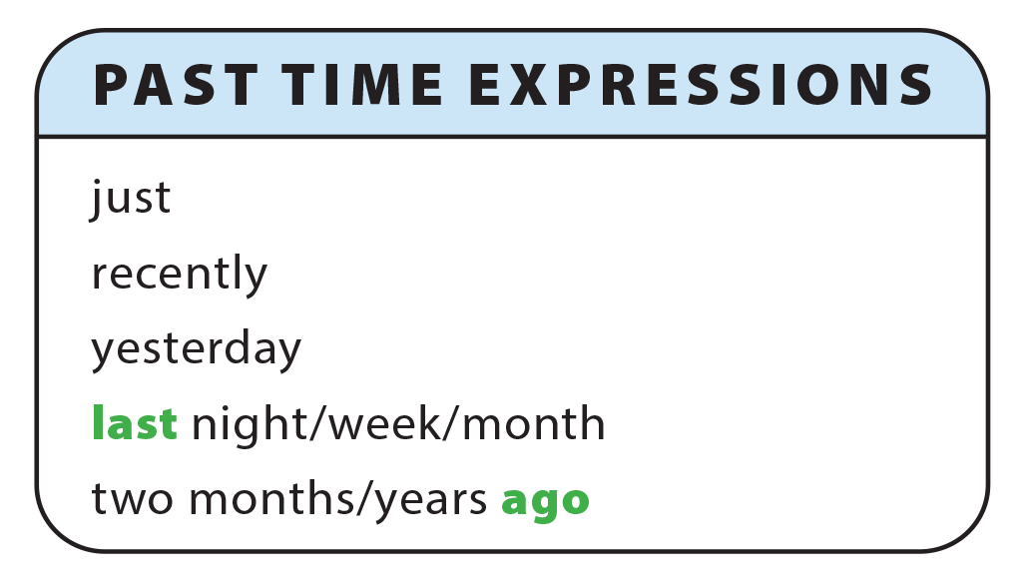
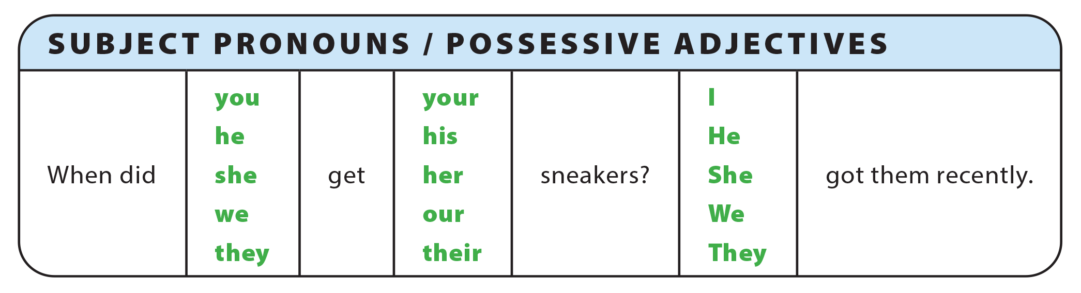
UNIT 3
I BOUGHT NEW SHOES!
GRAMMAR REFERENCE

Slide 8
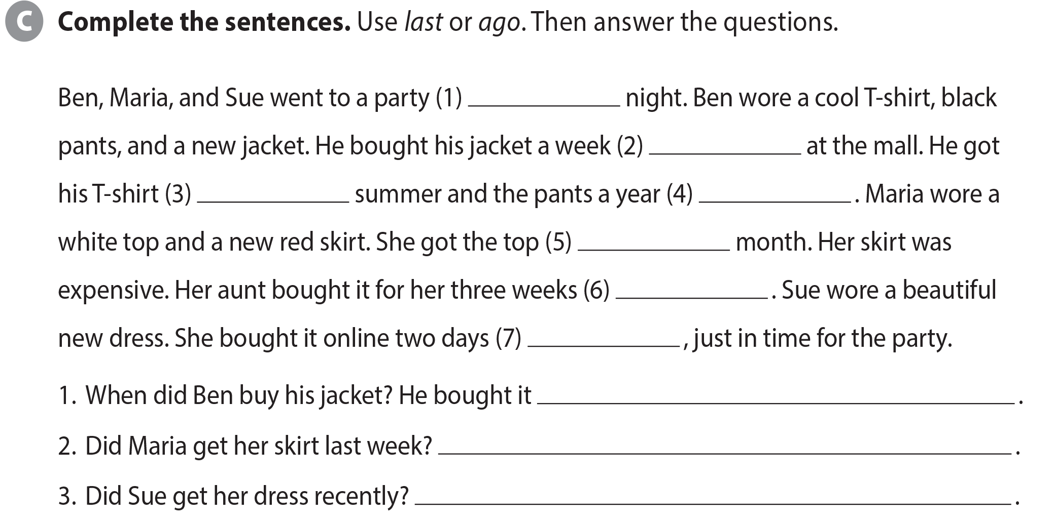
UNIT 3
I BOUGHT NEW SHOES!
LANGUAGE FOCUS
last
ago
last
ago
last
ago
ago
a week ago
No, she got it three weeks ago
Yes, she just bought it two days ago

Slide 9
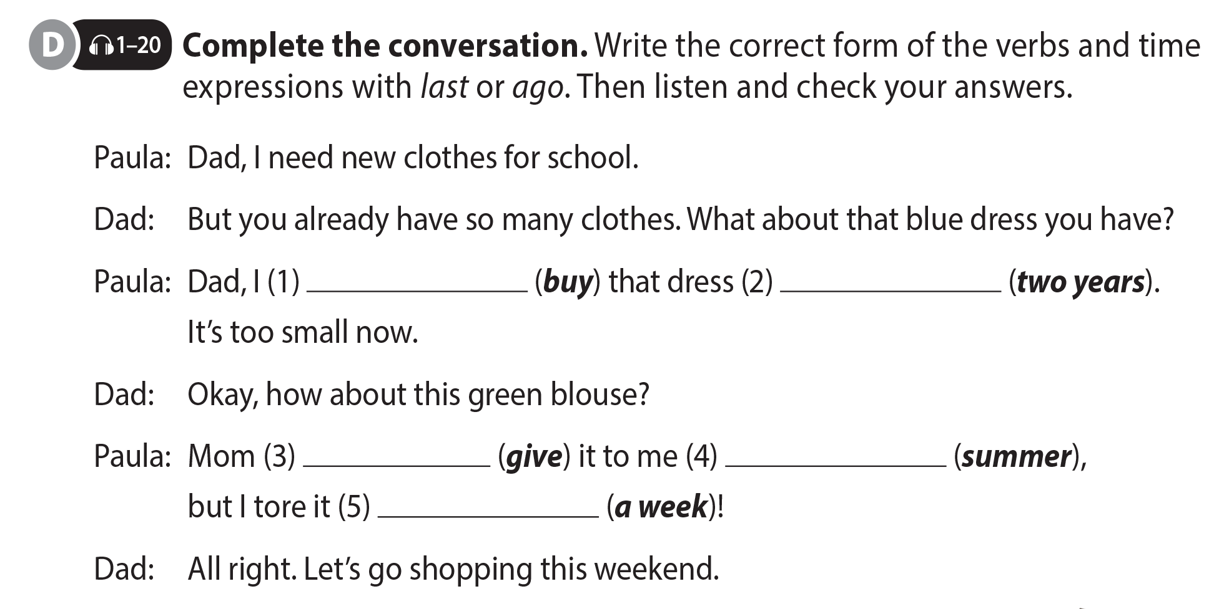
UNIT 3
I BOUGHT NEW SHOES!
LANGUAGE FOCUS
bought
two years ago
gave
last summer
a week ago

Slide 10
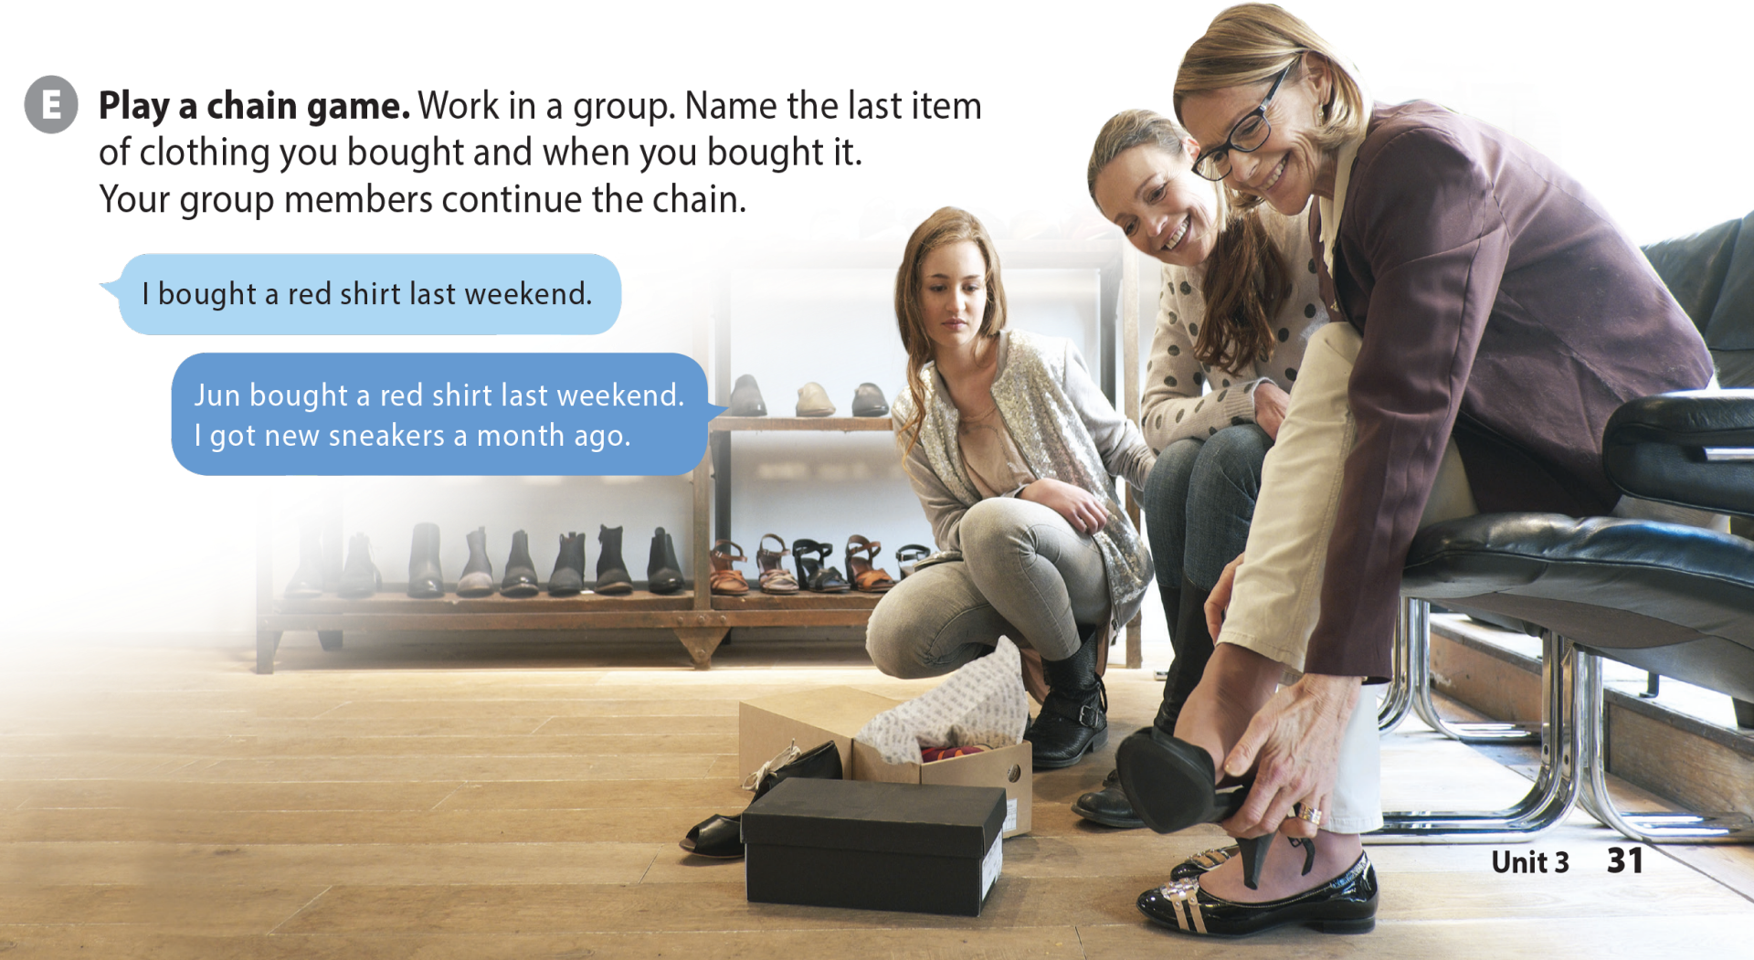


UNIT 3
I BOUGHT NEW SHOES!
LANGUAGE FOCUS
National Geographic Learning, a Cengage Company © 2022 Cengage Learning, Inc. ALL RIGHTS RESERVED. This presentation tool is intended for teaching purposes only and may not be scanned, copied, duplicated, or posted to a publicly accessible platform in whole or in part.

Slide 11

UNIT 3
I BOUGHT NEW SHOES!
THE REAL WORLD

Slide 12
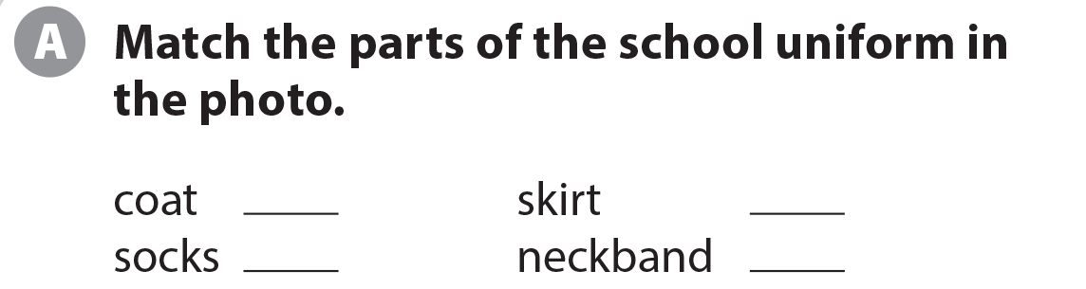
UNIT 3
I BOUGHT NEW SHOES!
THE REAL WORLD
1
4
3
2

Slide 13

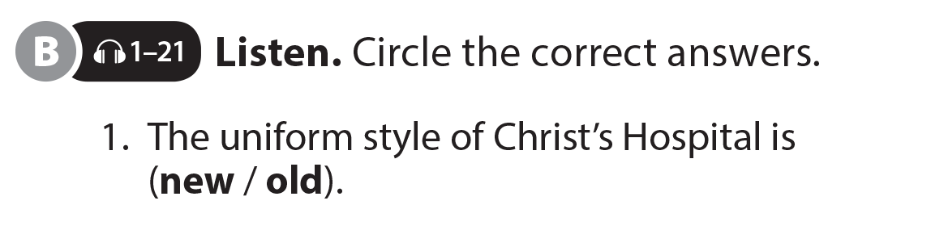
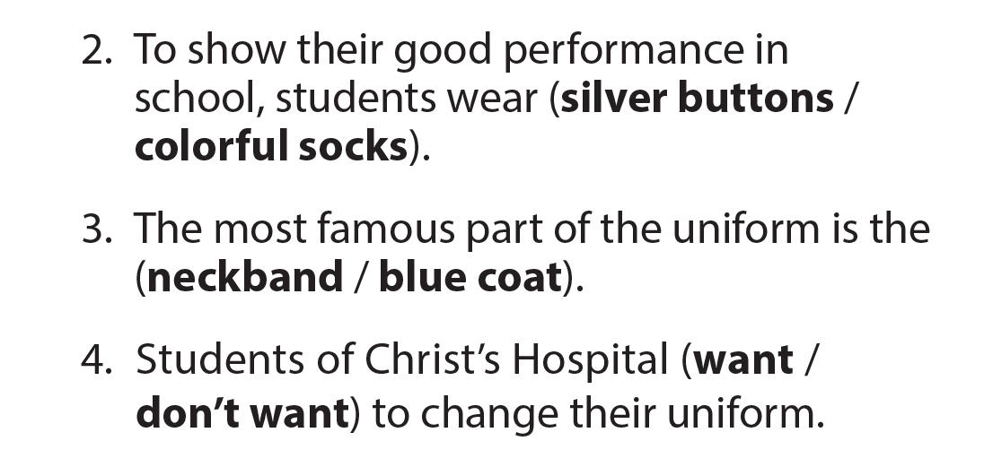
UNIT 3
I BOUGHT NEW SHOES!
THE REAL WORLD
National Geographic Learning, a Cengage Company © 2022 Cengage Learning, Inc. ALL RIGHTS RESERVED. This presentation tool is intended for teaching purposes only and may not be scanned, copied, duplicated, or posted to a publicly accessible platform in whole or in part.

Slide 14
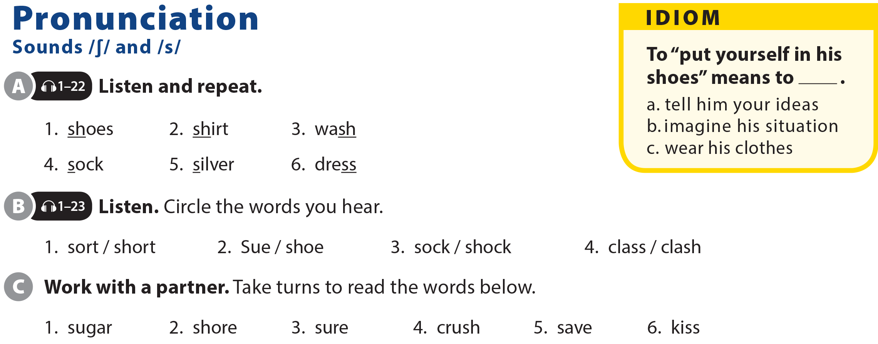
UNIT 3
I BOUGHT NEW SHOES!
PRONUNCIATION

Slide 15

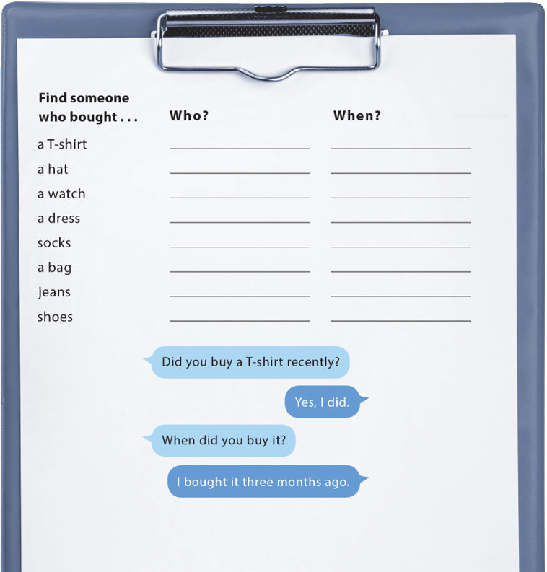
UNIT 3
I BOUGHT NEW SHOES!
COMMUNICATION

Slide 16




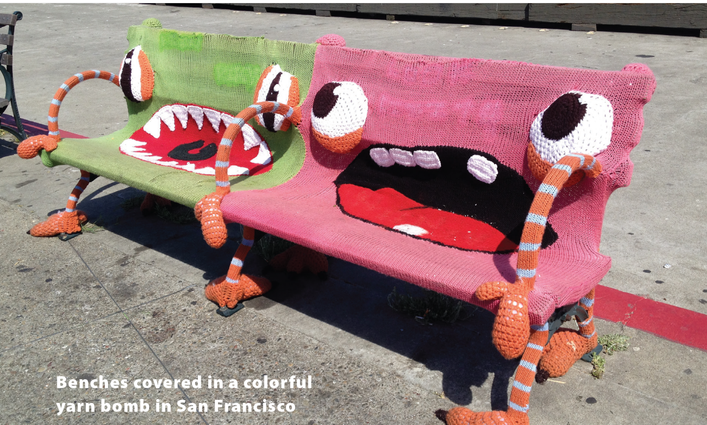
UNIT 3
I BOUGHT NEW SHOES!
READING
National Geographic Learning, a Cengage Company © 2022 Cengage Learning, Inc. ALL RIGHTS RESERVED. This presentation tool is intended for teaching purposes only and may not be scanned, copied, duplicated, or posted to a publicly accessible platform in whole or in part.

Slide 17
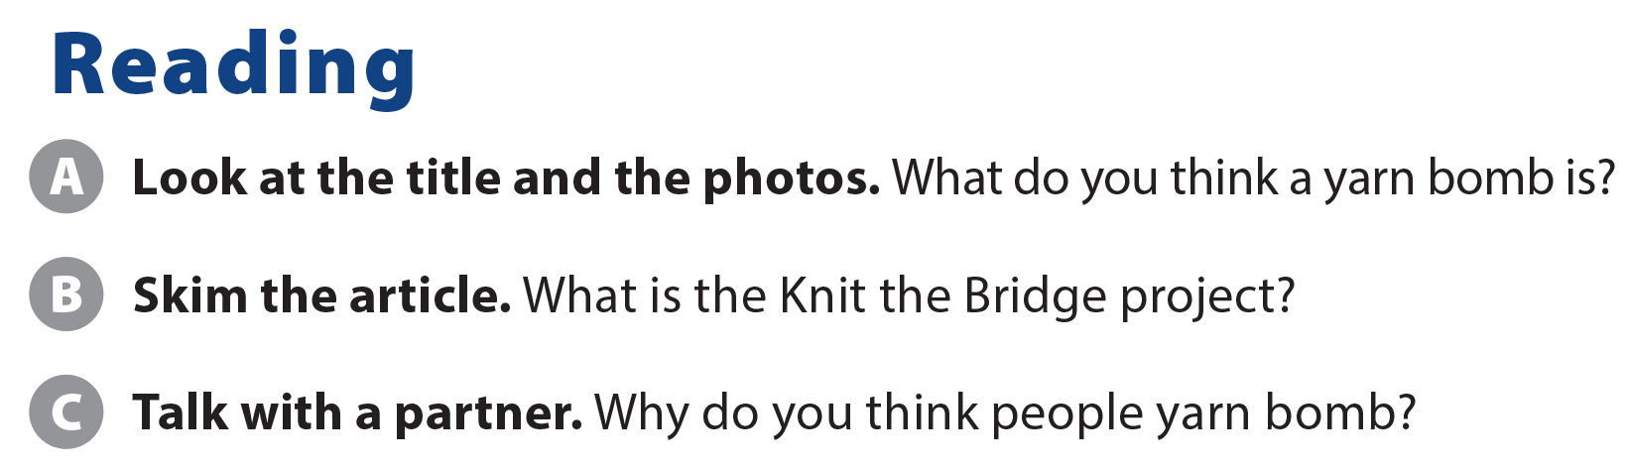
UNIT 3
I BOUGHT NEW SHOES!
READING
It’s the largest yarn bomb project ever in the United States.

Slide 18
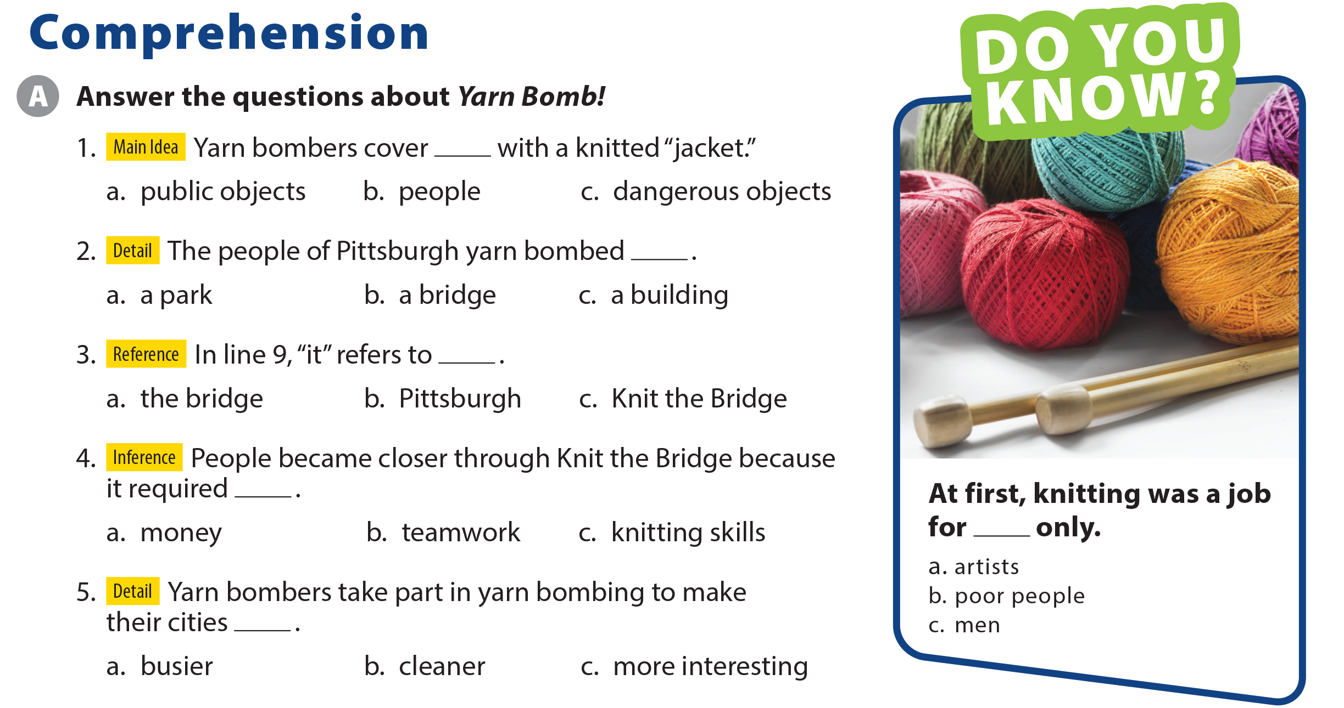
UNIT 3
I BOUGHT NEW SHOES!
COMPREHENSION

Slide 19
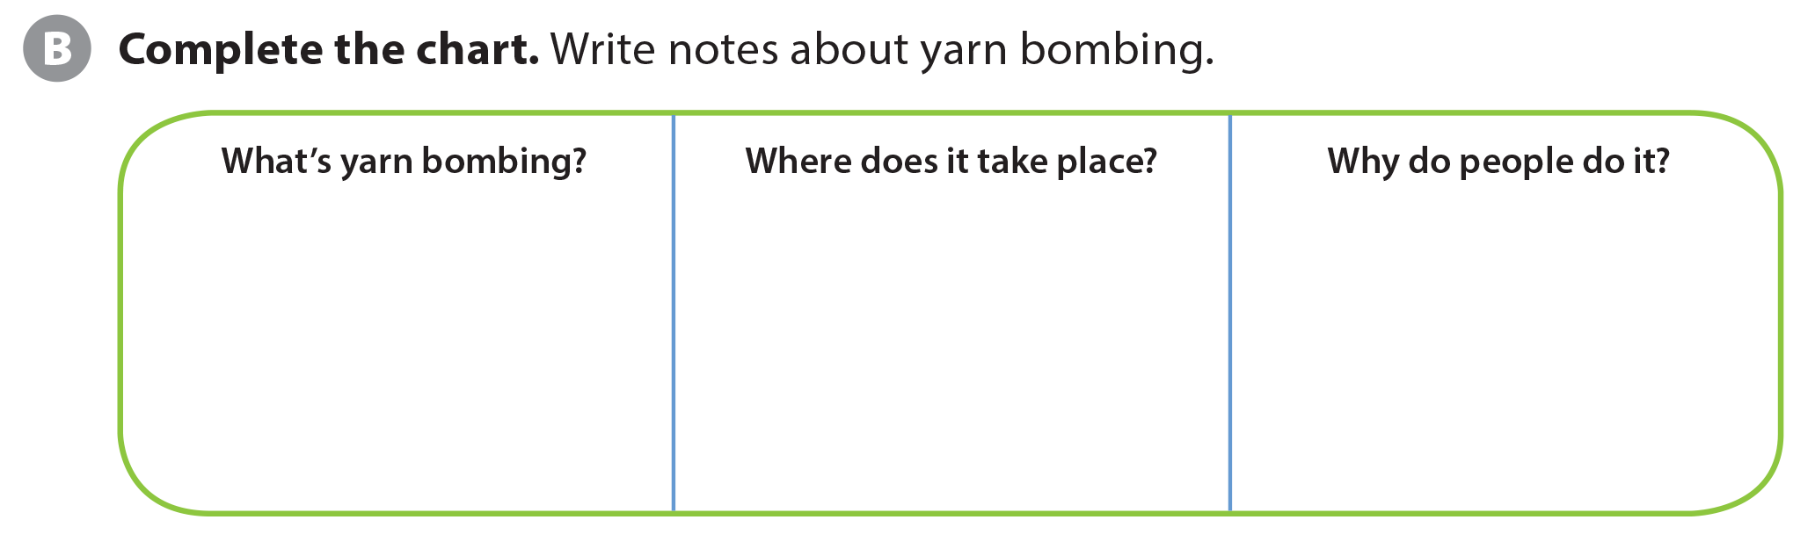
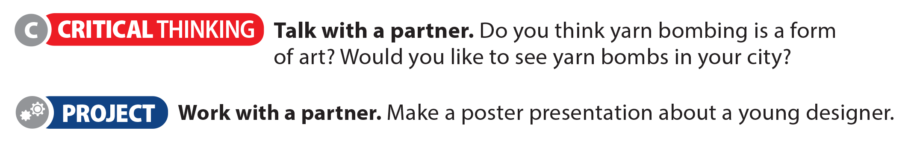
UNIT 3
I BOUGHT NEW SHOES!
COMPREHENSION
Around the world, in places such as London, Copenhagen, Paris, Mexico City, and Bali
• to tell stories through their knit art
• to make their cities more colorful and interesting
• to make people see their cities in a different way
A kind of street art

Slide 20
UNIT 3
I BOUGHT NEW SHOES!
PROJECT

Slide 21
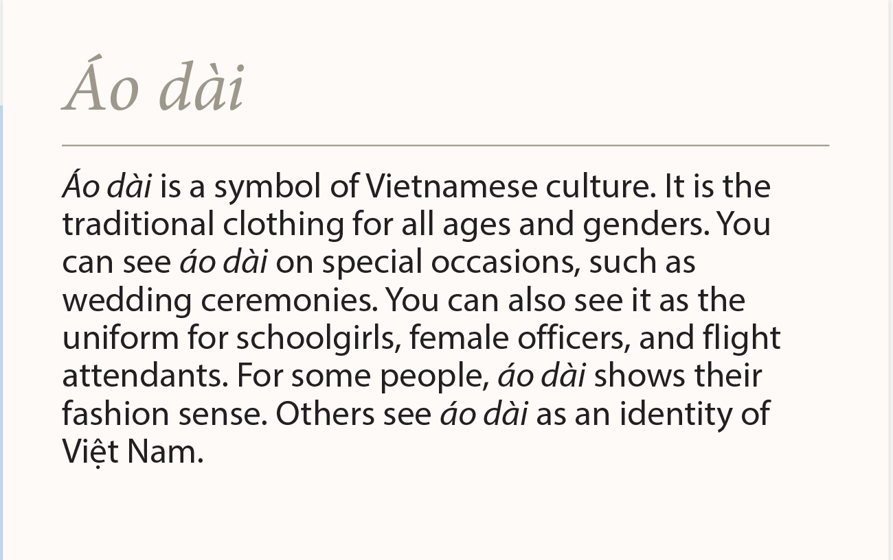
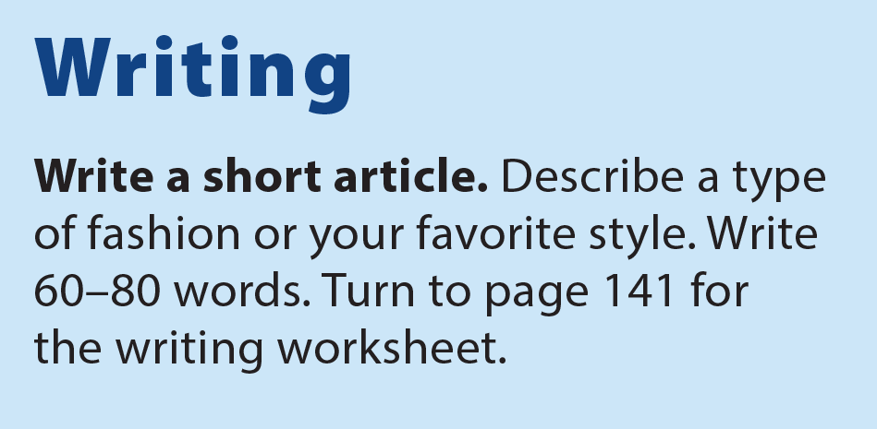
UNIT 3
I BOUGHT NEW SHOES!
WRITING

Slide 22
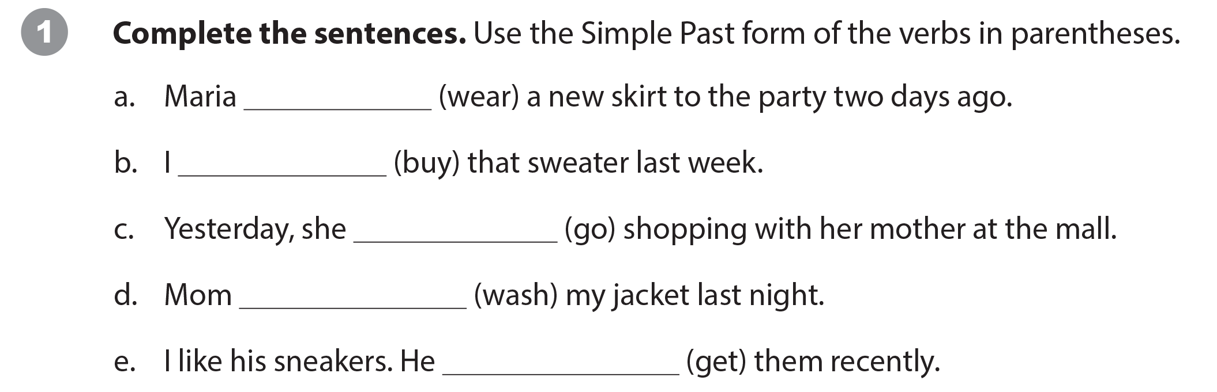
UNIT 3
I BOUGHT NEW SHOES!
WRITING WORKSHEET
wore
bought
went
washed
got

Slide 23
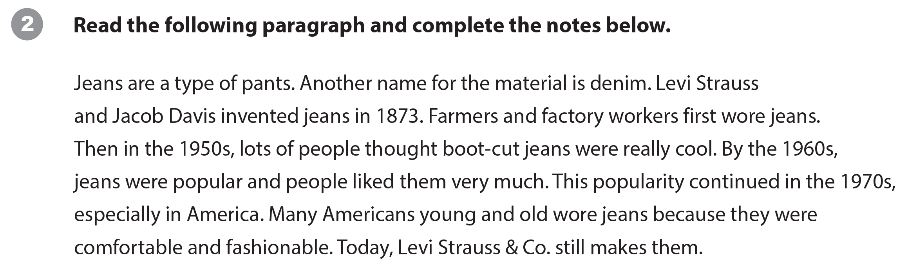
UNIT 3
I BOUGHT NEW SHOES!
WRITING WORKSHEET

Slide 24
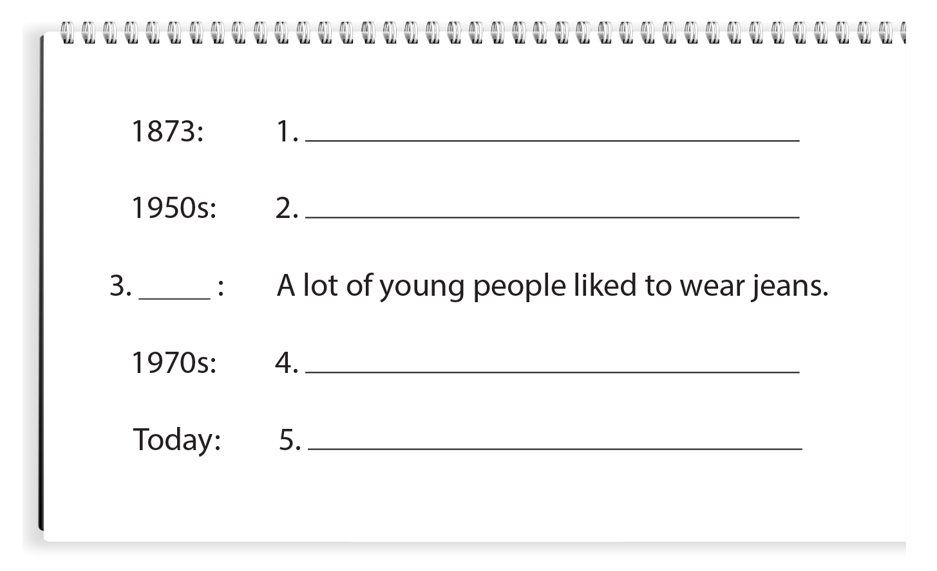
UNIT 3
I BOUGHT NEW SHOES!
WRITING WORKSHEET
Levi Strauss and Jacob Davis invented jeans.
People thought boot-cut jeans were really cool.
1960s
Many Americans young and old wore jeans.
Levi Strauss & Co. still makes jeans.
Suggested answers

Slide 25
UNIT 3
I BOUGHT NEW SHOES!
WRITING WORKSHEET

Slide 26

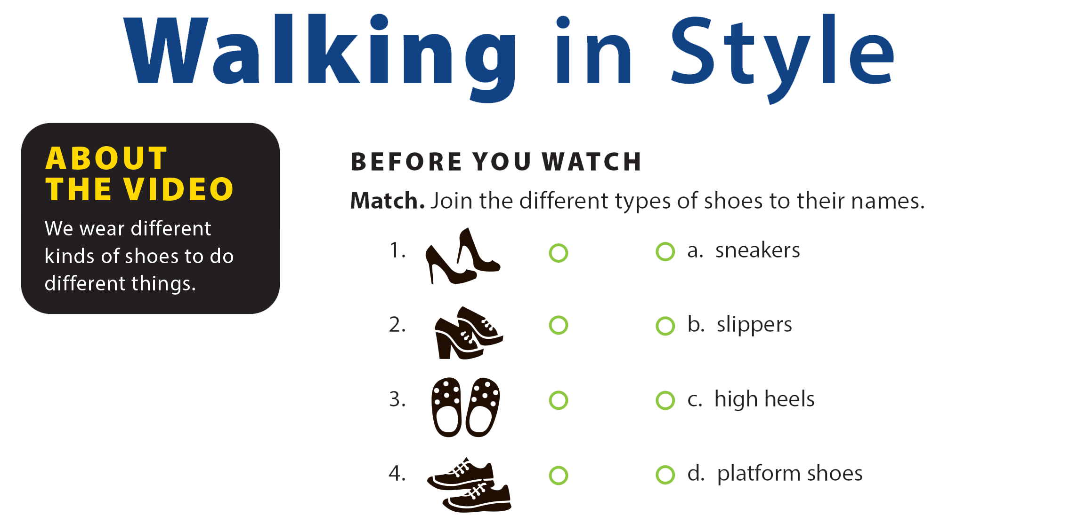
UNIT 3
I BOUGHT NEW SHOES!
VIDEO

Slide 27


UNIT 3
I BOUGHT NEW SHOES!
VIDEO

Slide 28
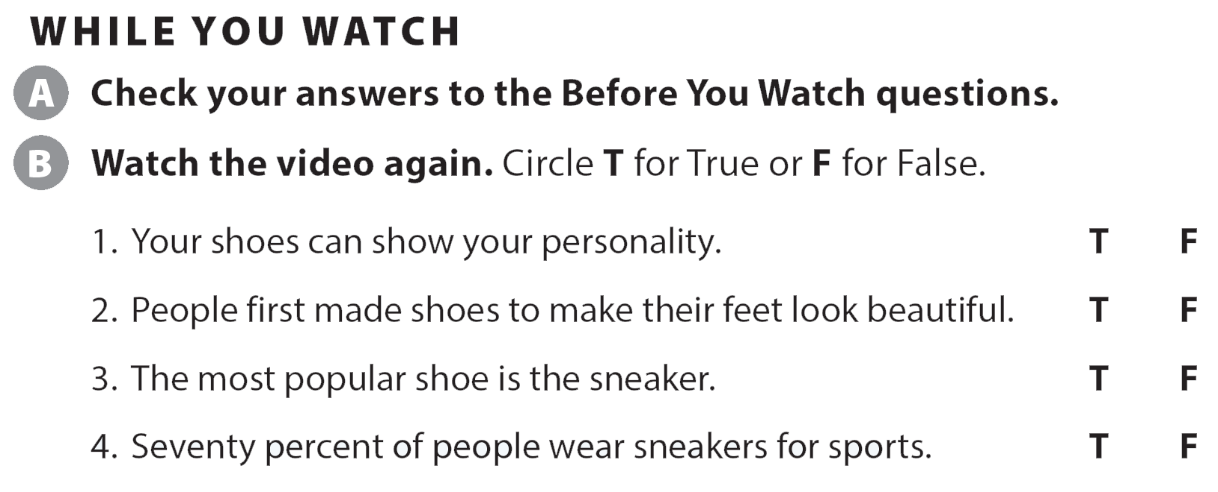
UNIT 3
I BOUGHT NEW SHOES!
VIDEO

Slide 29

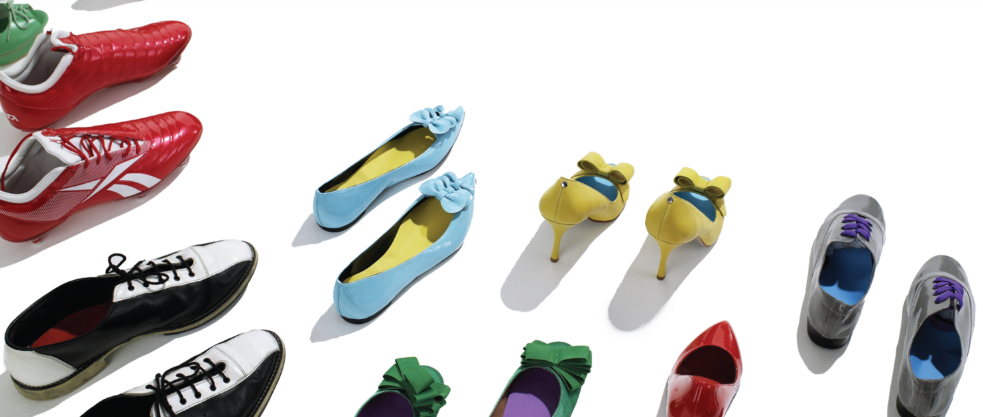
UNIT 3
I BOUGHT NEW SHOES!
VIDEO

Slide 30
UNIT 3
I BOUGHT NEW SHOES!
Thank you!

