Slide 1

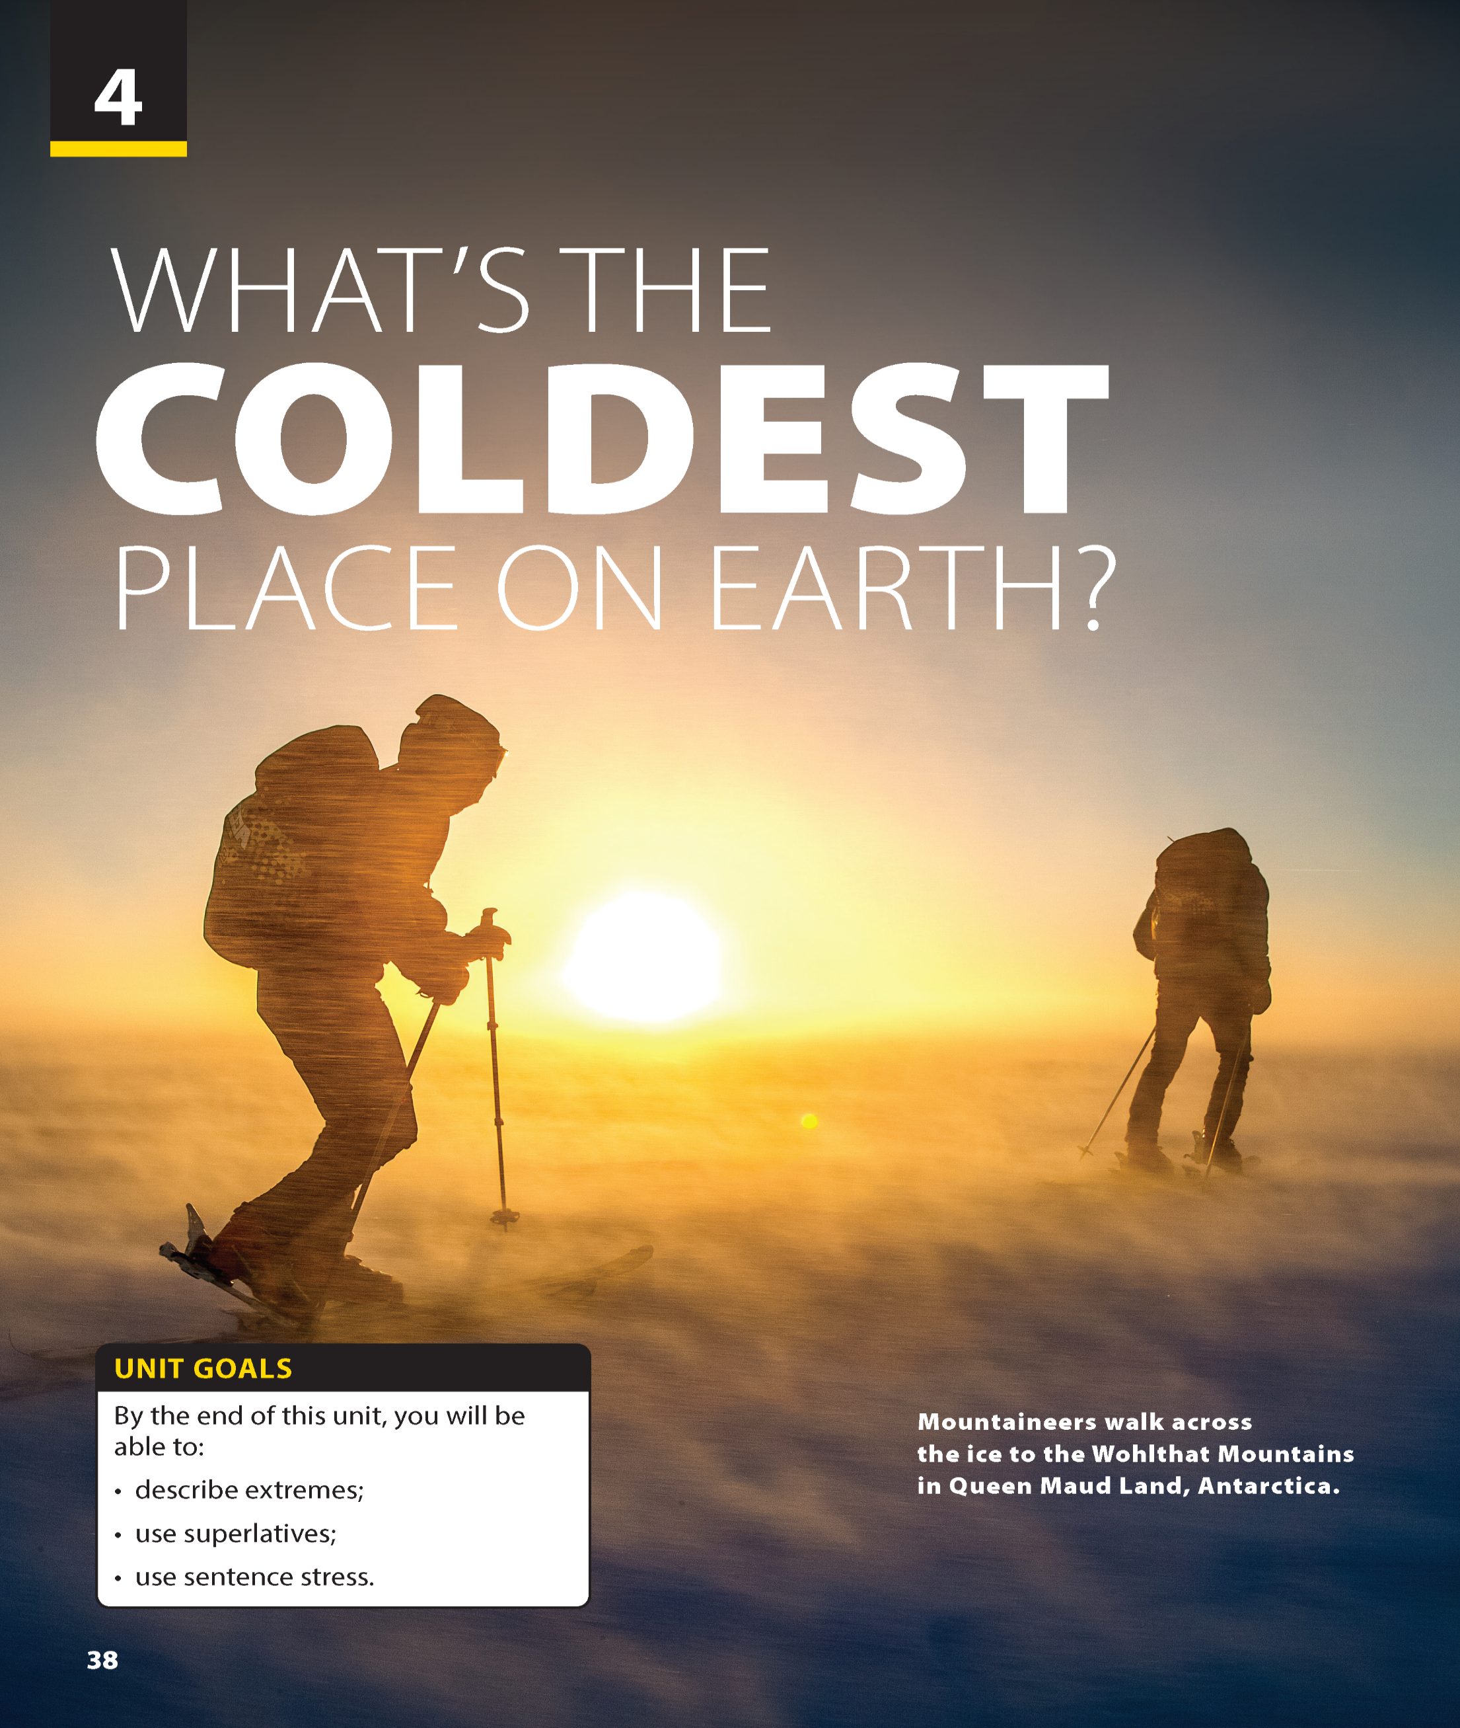
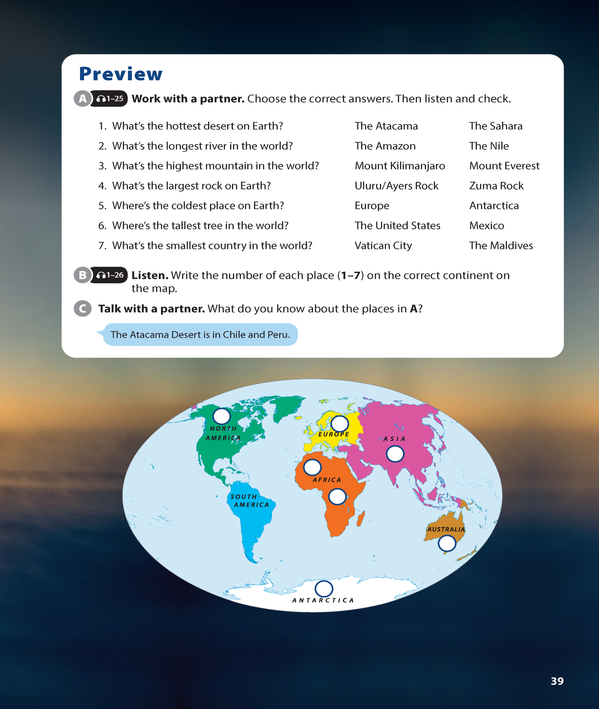

National Geographic Learning, a Cengage Company © 2022 Cengage Learning, Inc. ALL RIGHTS RESERVED. This presentation tool is intended for teaching purposes only and may not be scanned, copied, duplicated, or posted to a publicly accessible platform in whole or in part.

Slide 2
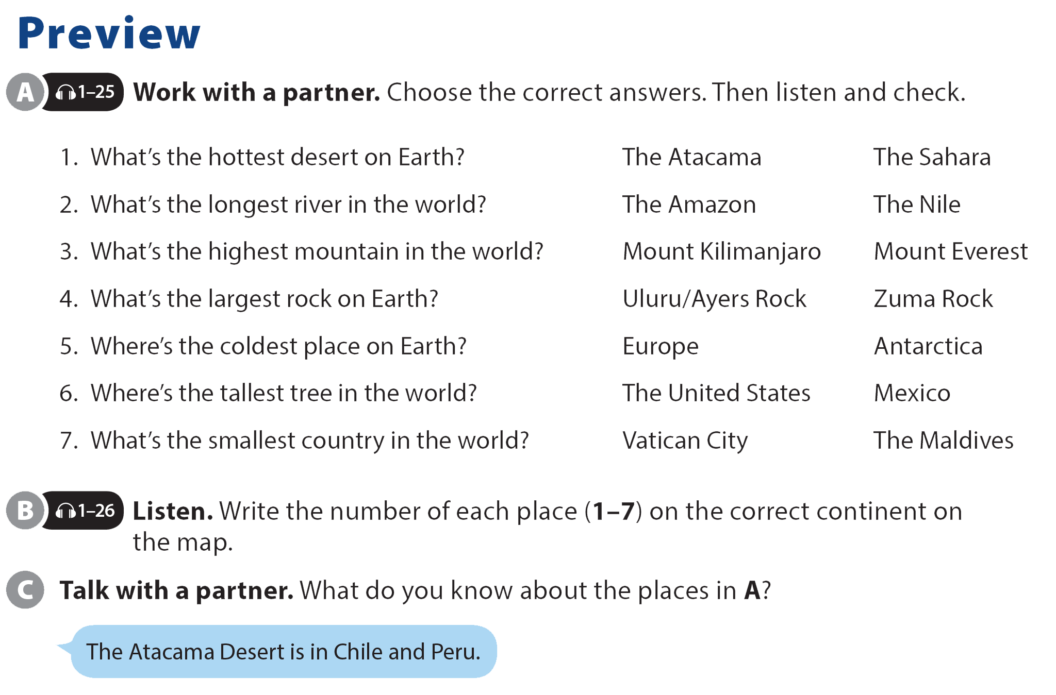

UNIT 4
WHAT’S THE COLDEST PLACE ON EARTH?
PREVIEW

Slide 3
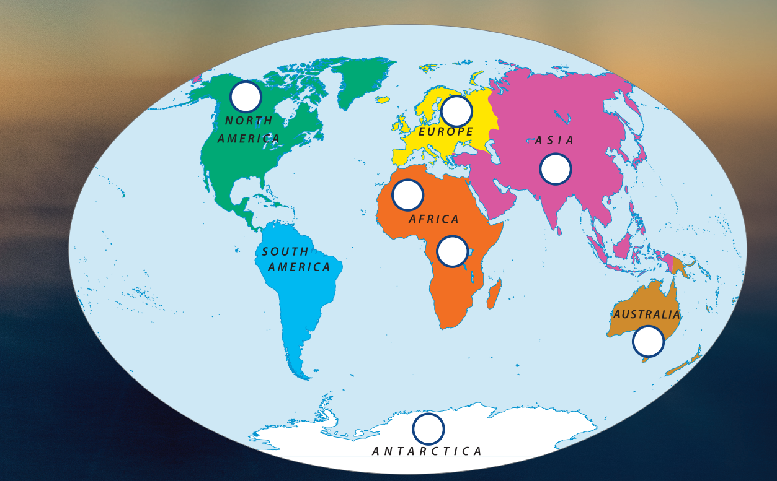
UNIT 4
WHAT’S THE COLDEST PLACE ON EARTH?
PREVIEW
6
7
3
1
2
4
5

Slide 4
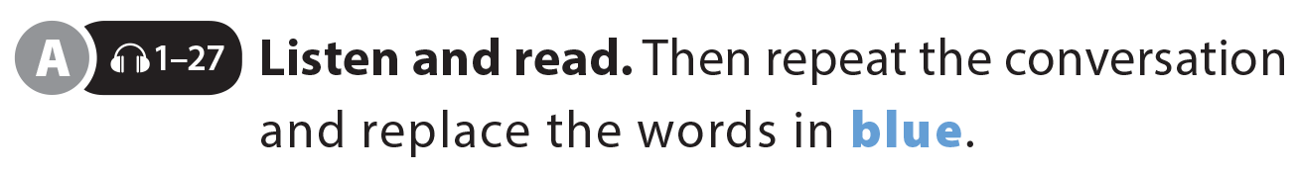

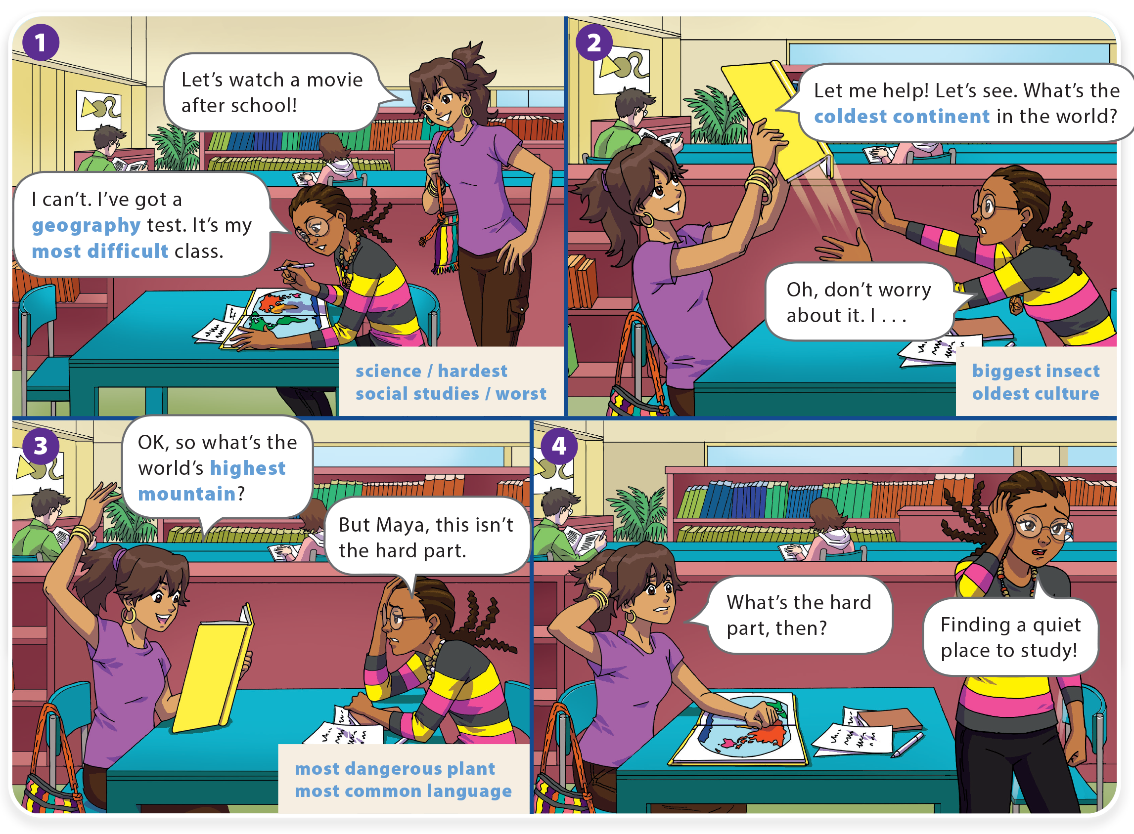
UNIT 4
WHAT’S THE COLDEST PLACE ON EARTH?
LANGUAGE FOCUS

Slide 5
UNIT 4
WHAT’S THE COLDEST PLACE ON EARTH?
LANGUAGE FOCUS

Slide 6
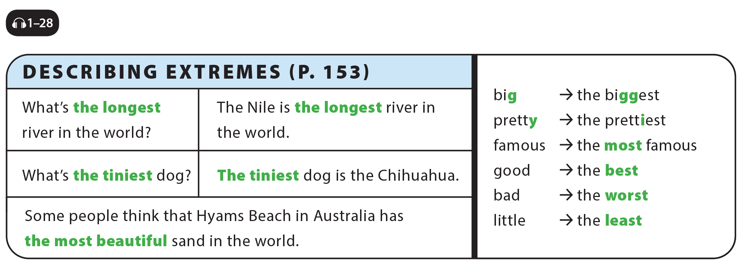
UNIT 4
WHAT’S THE COLDEST PLACE ON EARTH?
LANGUAGE FOCUS

Slide 7
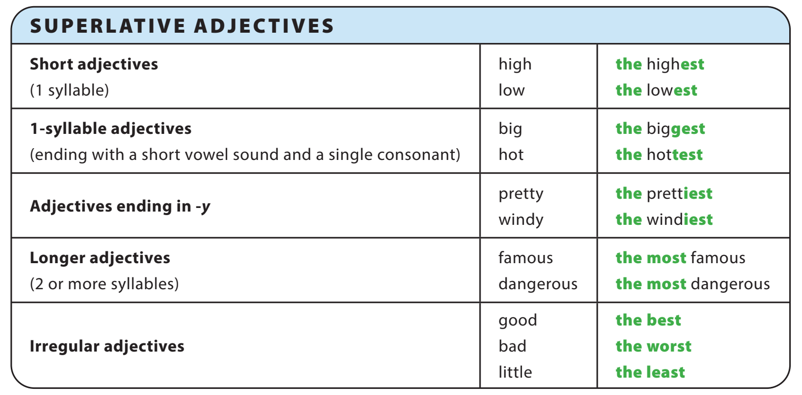
UNIT 4
WHAT’S THE COLDEST PLACE ON EARTH?
GRAMMAR REFERENCE

Slide 8
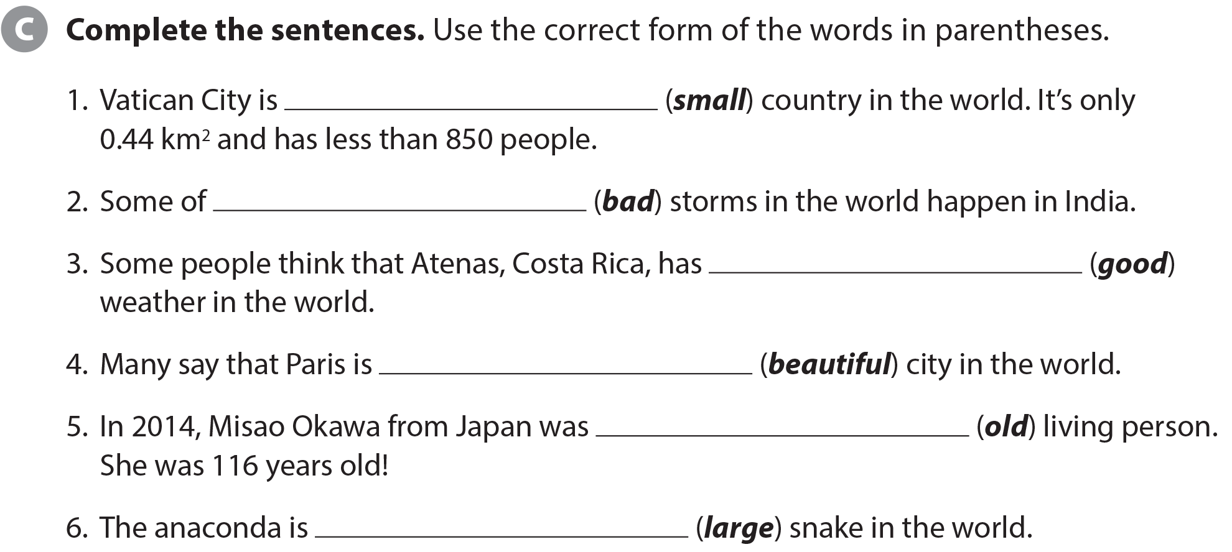
UNIT 4
WHAT’S THE COLDEST PLACE ON EARTH?
LANGUAGE FOCUS
the smallest
the worst
the best
the most beautiful
the oldest
the largest

Slide 9
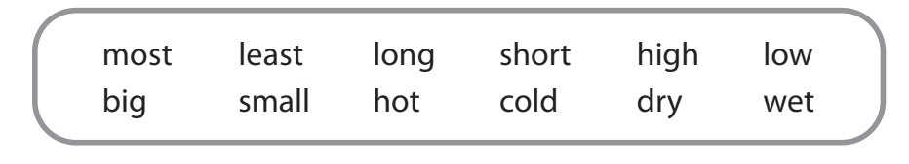
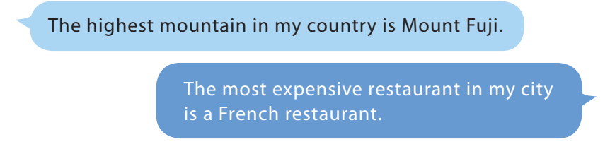
UNIT 4
WHAT’S THE COLDEST PLACE ON EARTH?
LANGUAGE FOCUS

Slide 10
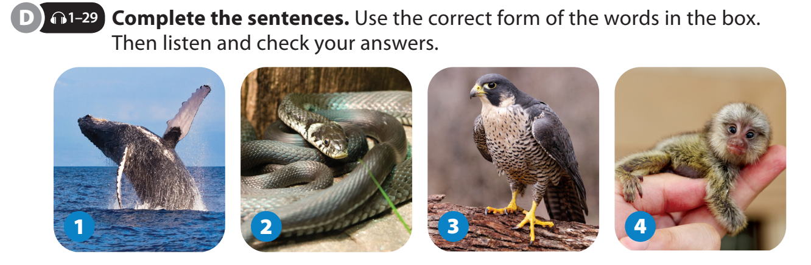
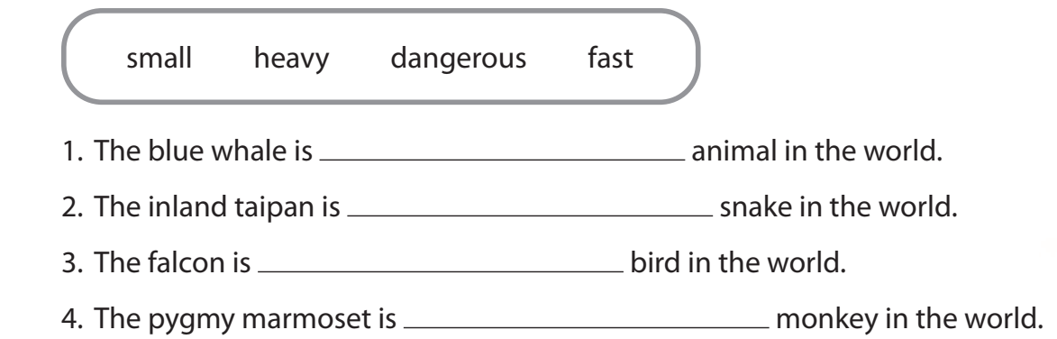
UNIT 4
WHAT’S THE COLDEST PLACE ON EARTH?
LANGUAGE FOCUS
the heaviest
the most dangerous
the fastest
the smallest

Slide 11
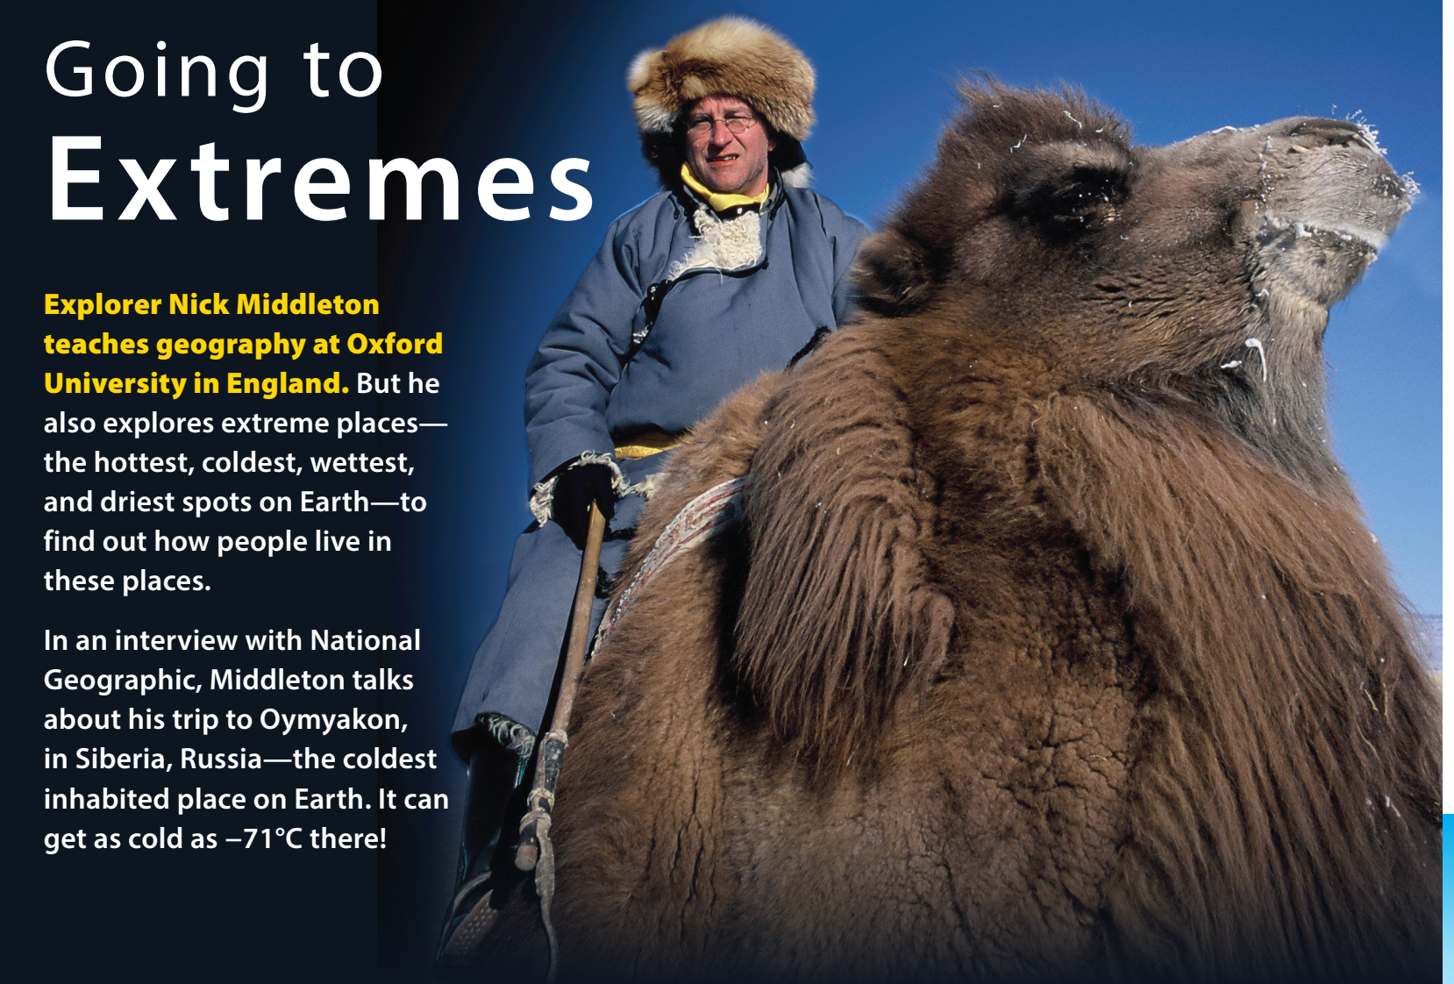
UNIT 4
WHAT’S THE COLDEST PLACE ON EARTH?
THE REAL WORLD

Slide 12
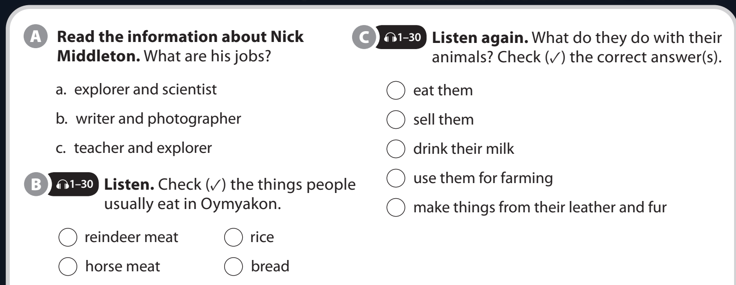

UNIT 4
WHAT’S THE COLDEST PLACE ON EARTH?
THE REAL WORLD

Slide 13
UNIT 4
WHAT’S THE COLDEST PLACE ON EARTH?
THE REAL WORLD
YES | NO

Slide 14
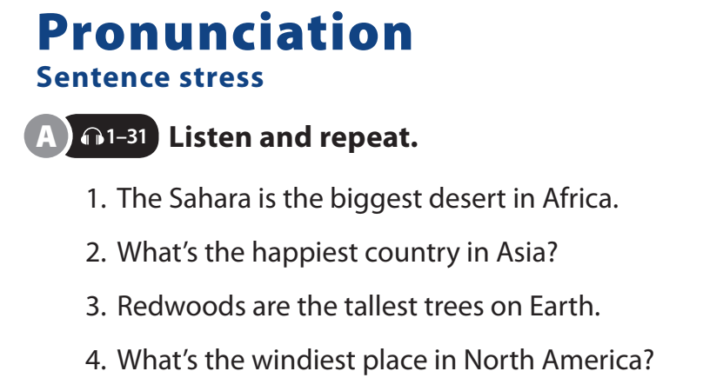
UNIT 4
WHAT’S THE COLDEST PLACE ON EARTH?
PRONUNCIATION

Slide 15
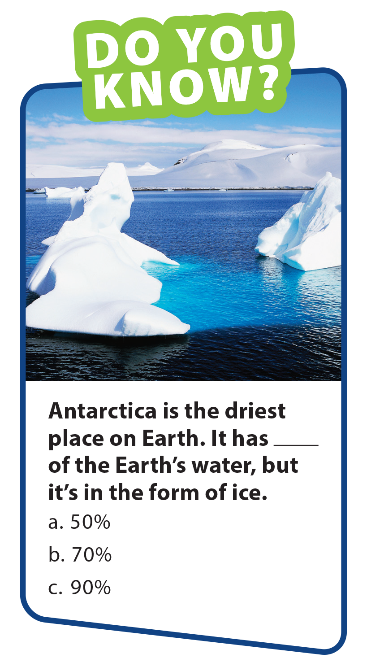
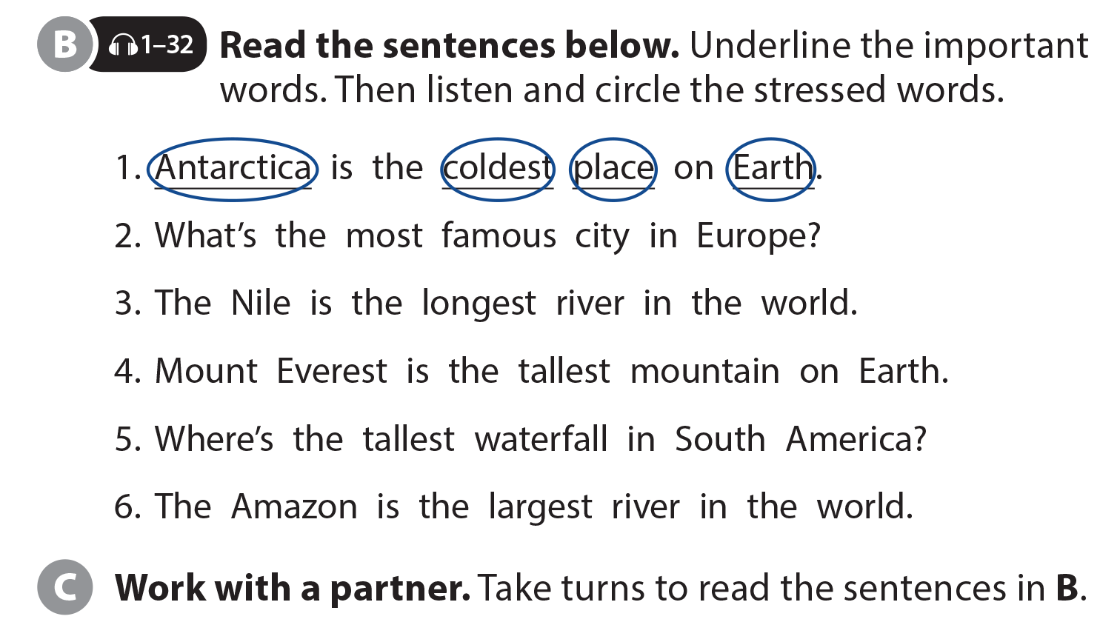
UNIT 4
WHAT’S THE COLDEST PLACE ON EARTH?
PRONUNCIATION

Slide 16
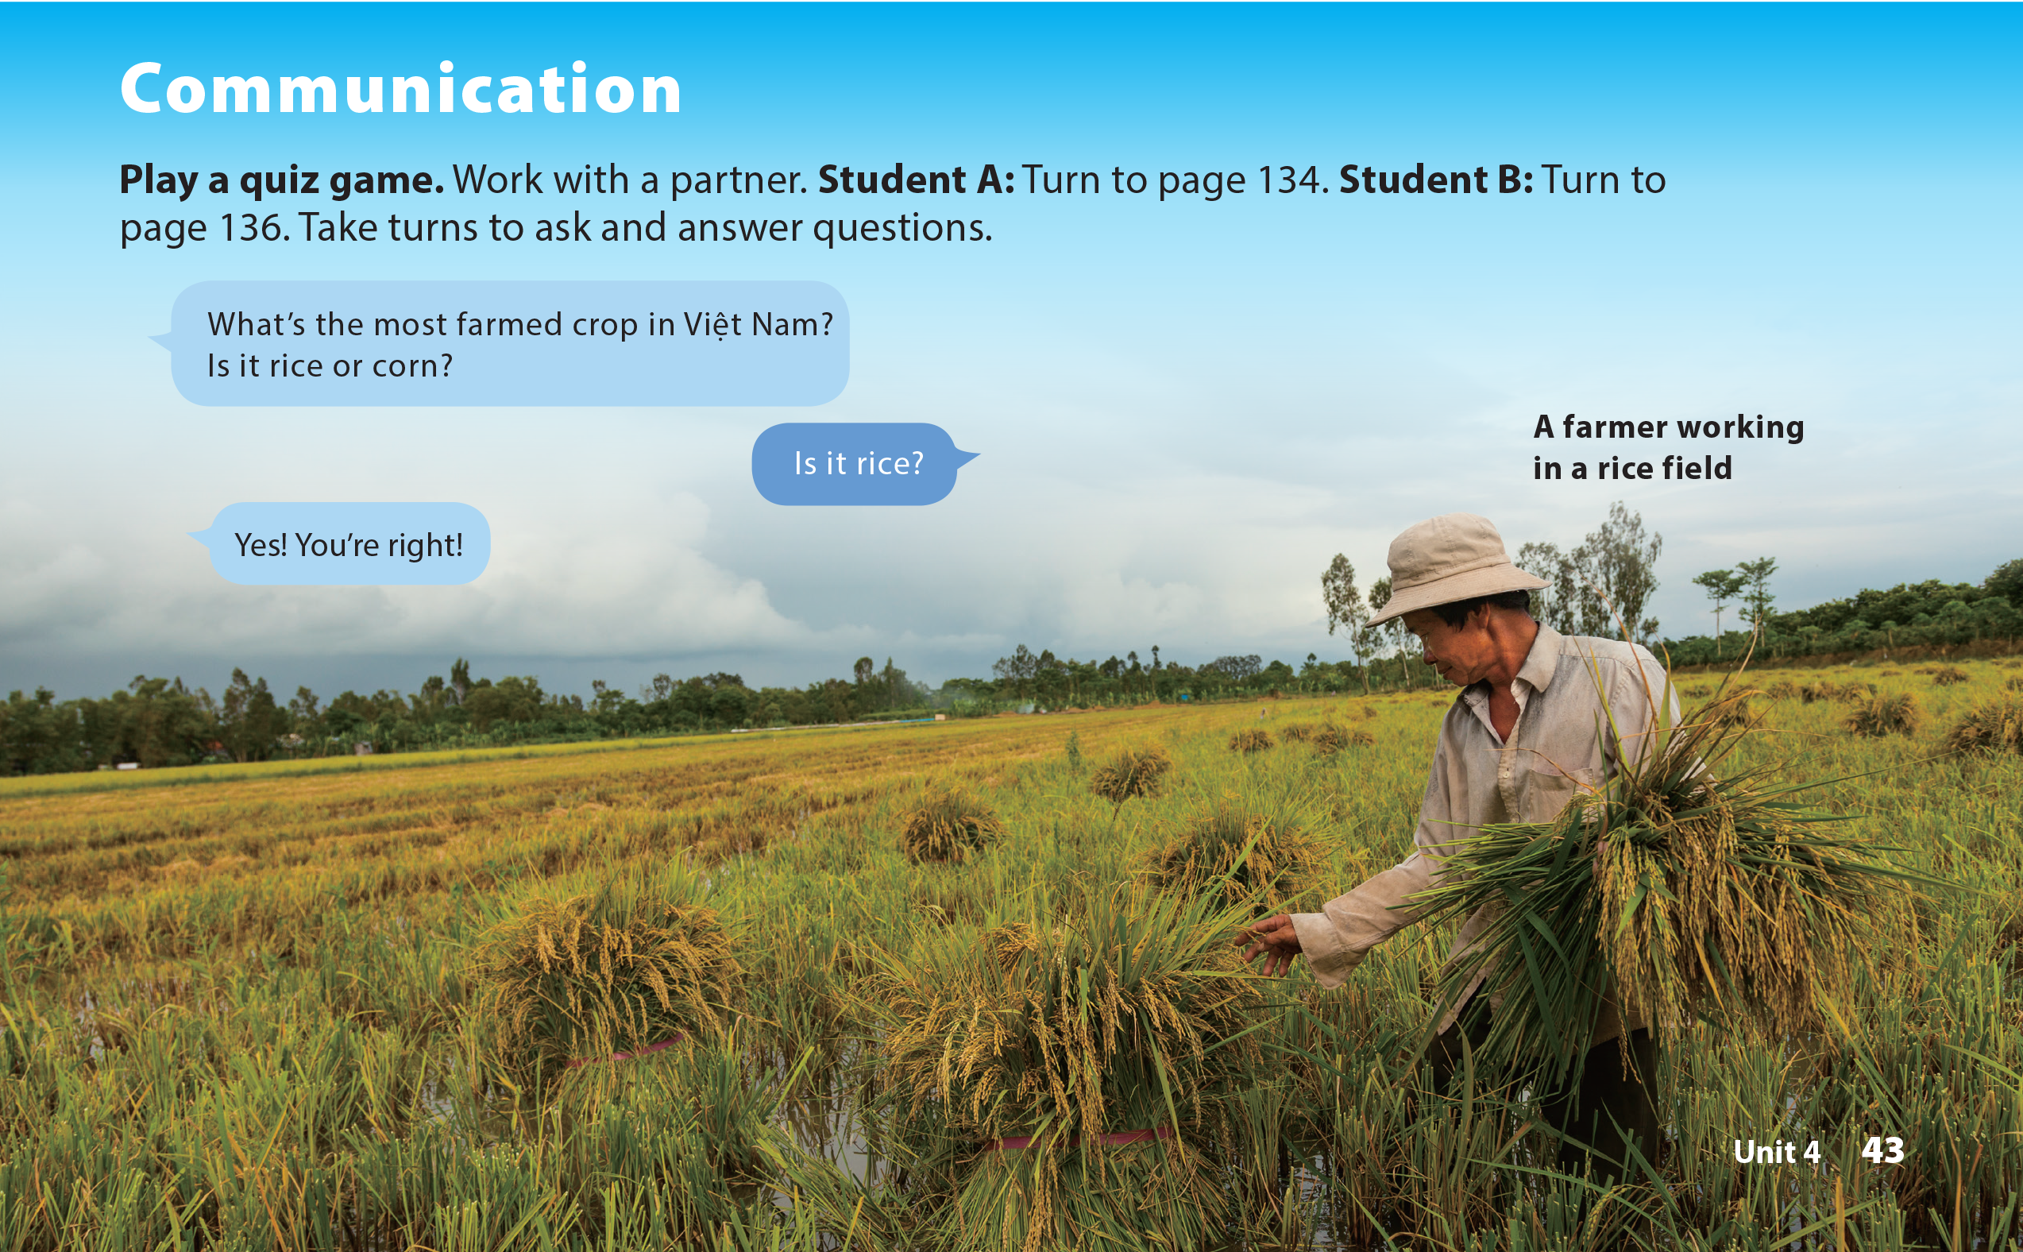
UNIT 4
WHAT’S THE COLDEST PLACE ON EARTH?
COMMUNICATION

Slide 17
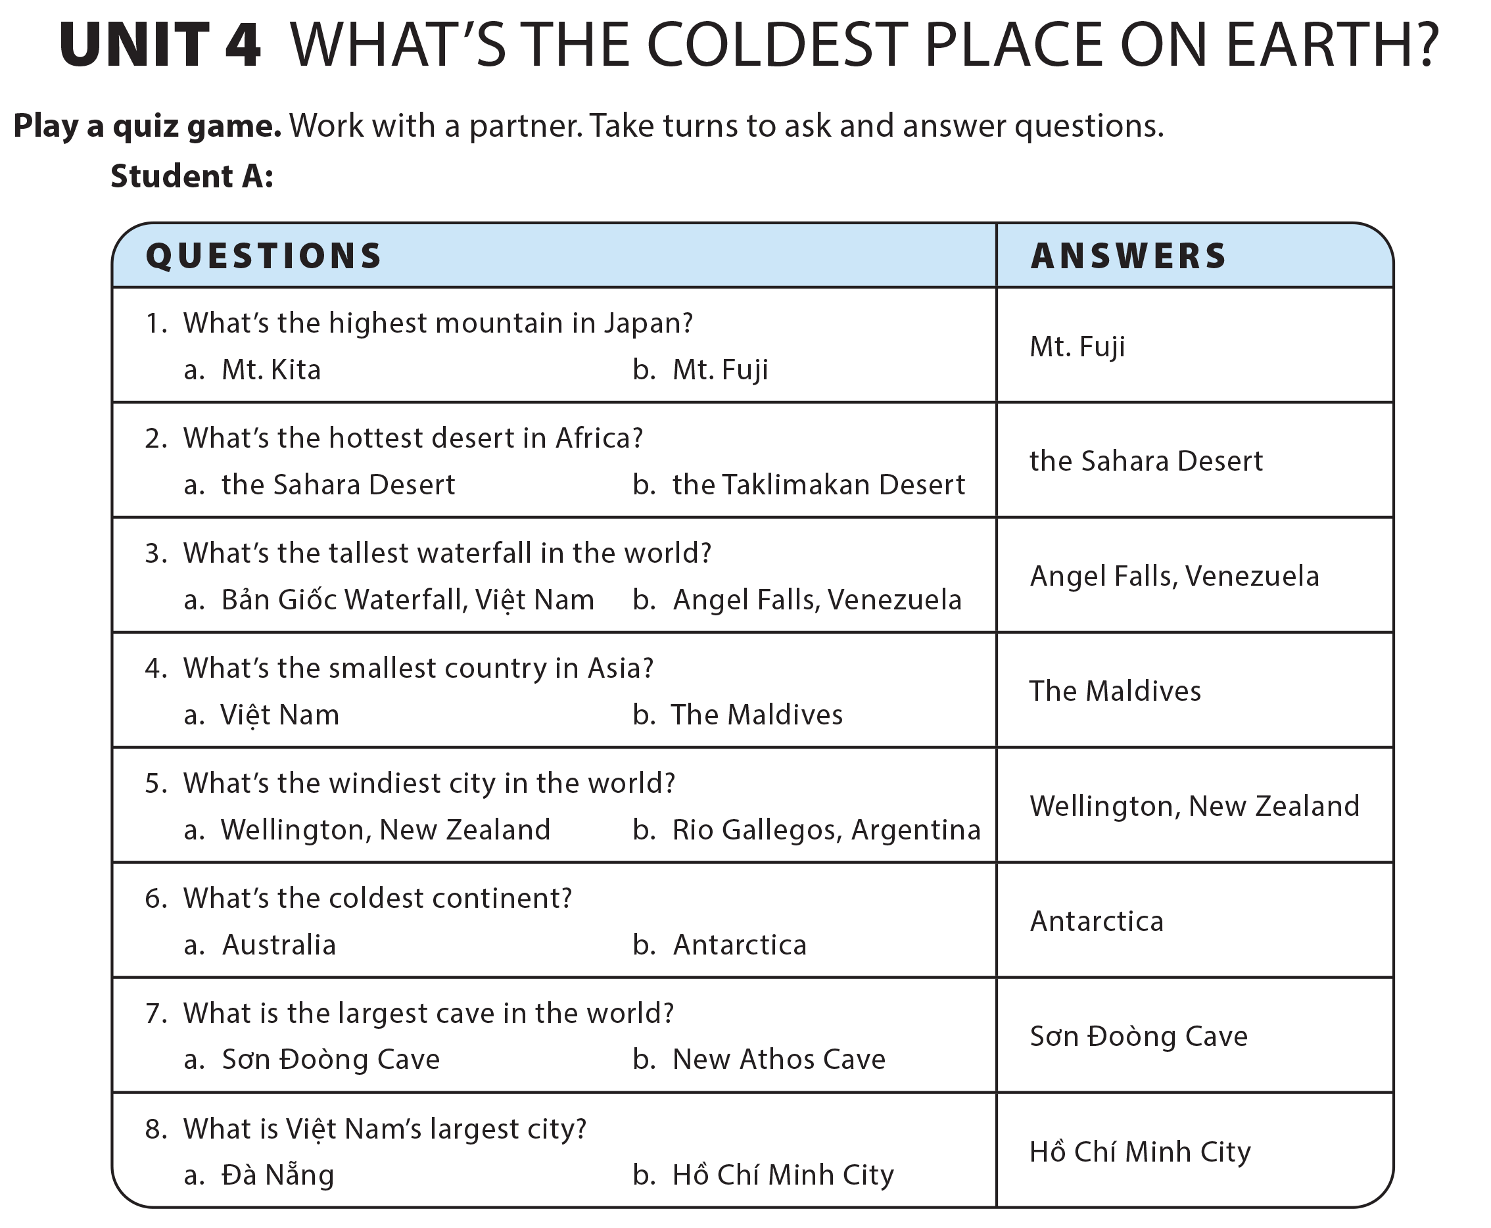
UNIT 4
WHAT’S THE COLDEST PLACE ON EARTH?
COMMUNICATION

Slide 18
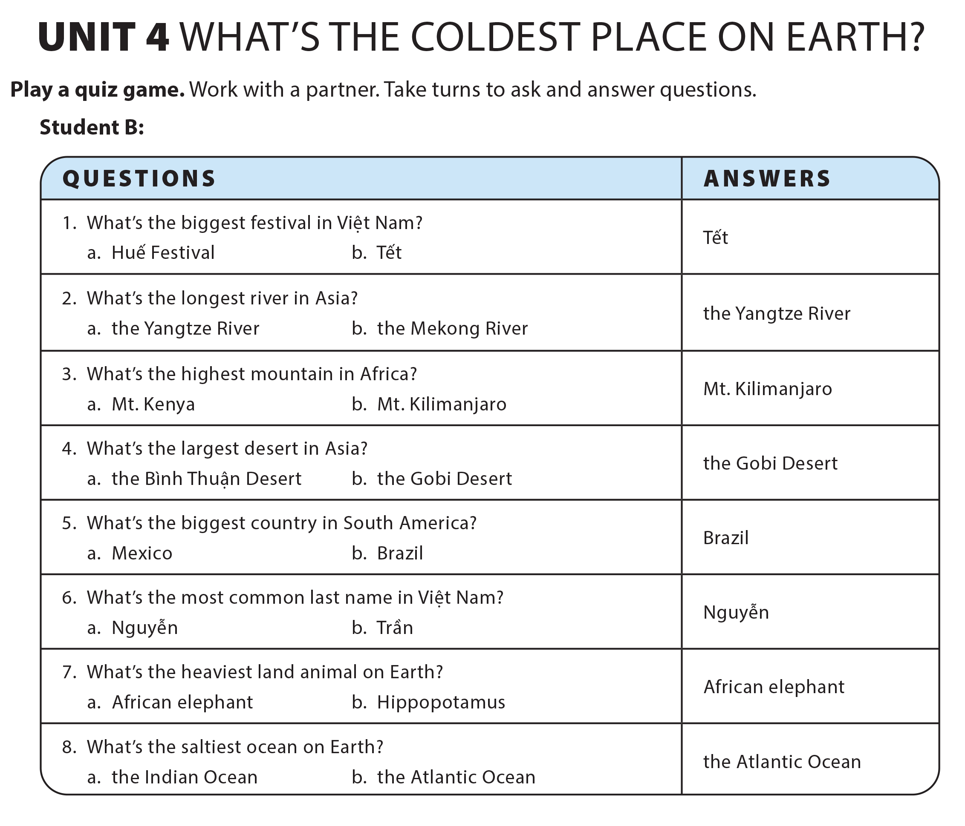
UNIT 4
WHAT’S THE COLDEST PLACE ON EARTH?
COMMUNICATION

Slide 19
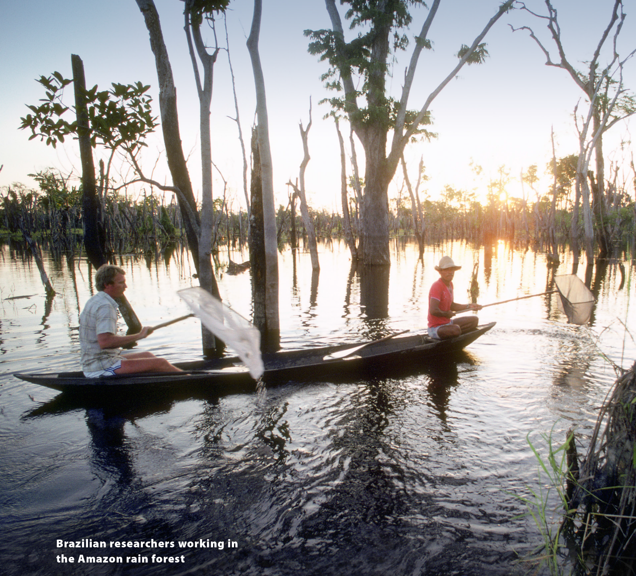
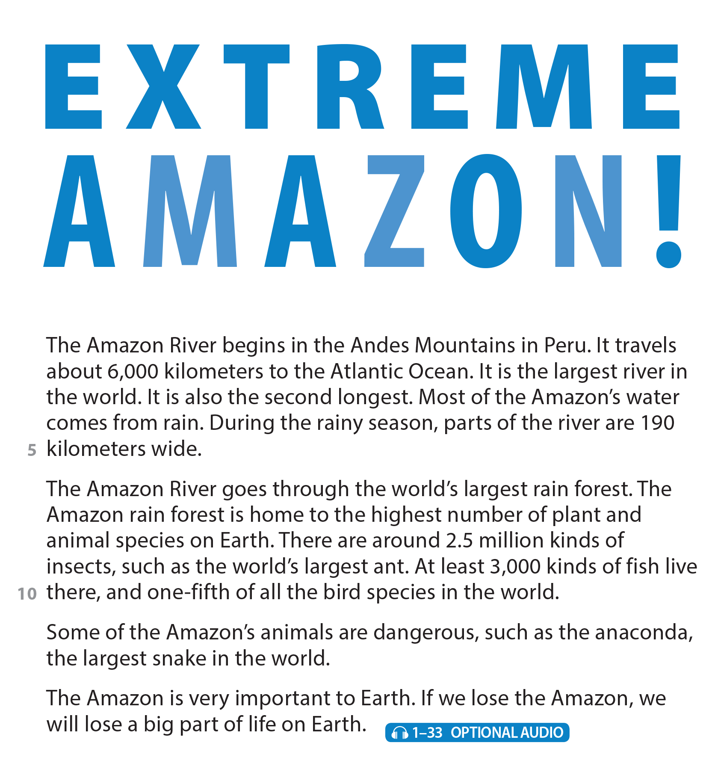


THIS IS MY FAMILY.
READING
UNIT 4
WHAT’S THE COLDEST PLACE ON EARTH?
READING
UNIT 4
WHAT IS THE COLDEST PLACE ON EARTH?
National Geographic Learning, a Cengage Company © 2022 Cengage Learning, Inc. ALL RIGHTS RESERVED. This presentation tool is intended for teaching purposes only and may not be scanned, copied, duplicated, or posted to a publicly accessible platform in whole or in part.

Slide 20
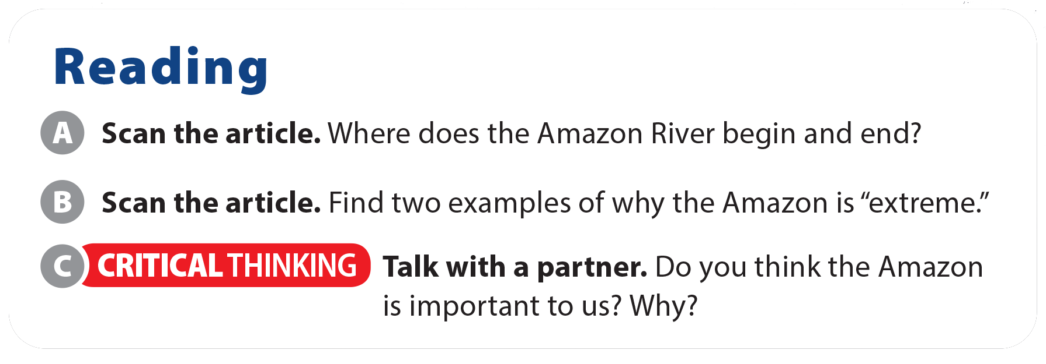
THIS IS MY FAMILY.
READING
UNIT 4
WHAT’S THE COLDEST PLACE ON EARTH?
READING
UNIT 4
WHAT IS THE COLDEST PLACE ON EARTH?
Suggested answers:
It begins in the Andes Mountains in Peru and ends at the Atlantic Ocean.
largest river, second longest river, largest rain forest, highest number of plant and animal species

Slide 21
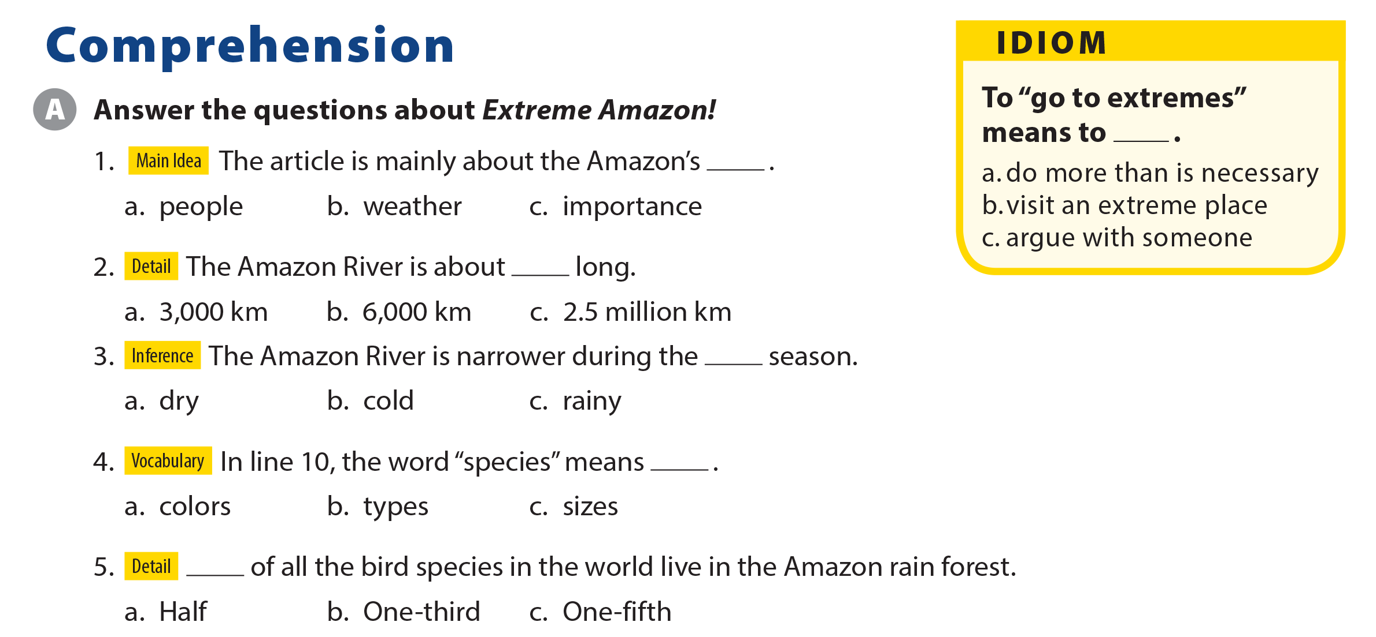
THIS IS MY FAMILY.
READING
UNIT 4
WHAT’S THE COLDEST PLACE ON EARTH?
COMPREHENSION
UNIT 4
WHAT IS THE COLDEST PLACE ON EARTH?

Slide 22
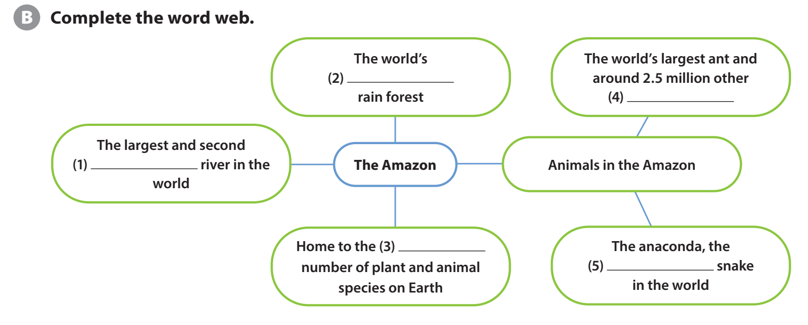
THIS IS MY FAMILY.
READING
UNIT 4
WHAT’S THE COLDEST PLACE ON EARTH?
COMPREHENSION
UNIT 4
WHAT IS THE COLDEST PLACE ON EARTH?
largest
kinds of insects
longest
highest
largest

Slide 23
THIS IS MY FAMILY.
READING
UNIT 4
WHAT’S THE COLDEST PLACE ON EARTH?
COMPREHENSION
UNIT 4
WHAT IS THE COLDEST PLACE ON EARTH?

Slide 24
THIS IS MY FAMILY.
READING
UNIT 4
WHAT’S THE COLDEST PLACE ON EARTH?
PROJECT
UNIT 4
WHAT IS THE COLDEST PLACE ON EARTH?

Slide 25
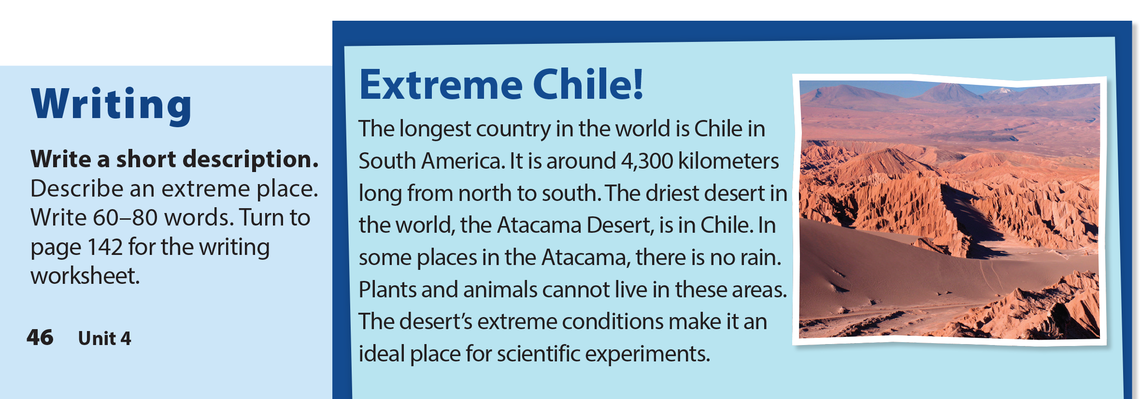
THIS IS MY FAMILY.
READING
UNIT 4
WHAT’S THE COLDEST PLACE ON EARTH?
WRITING
UNIT 4
WHAT IS THE COLDEST PLACE ON EARTH?

Slide 26
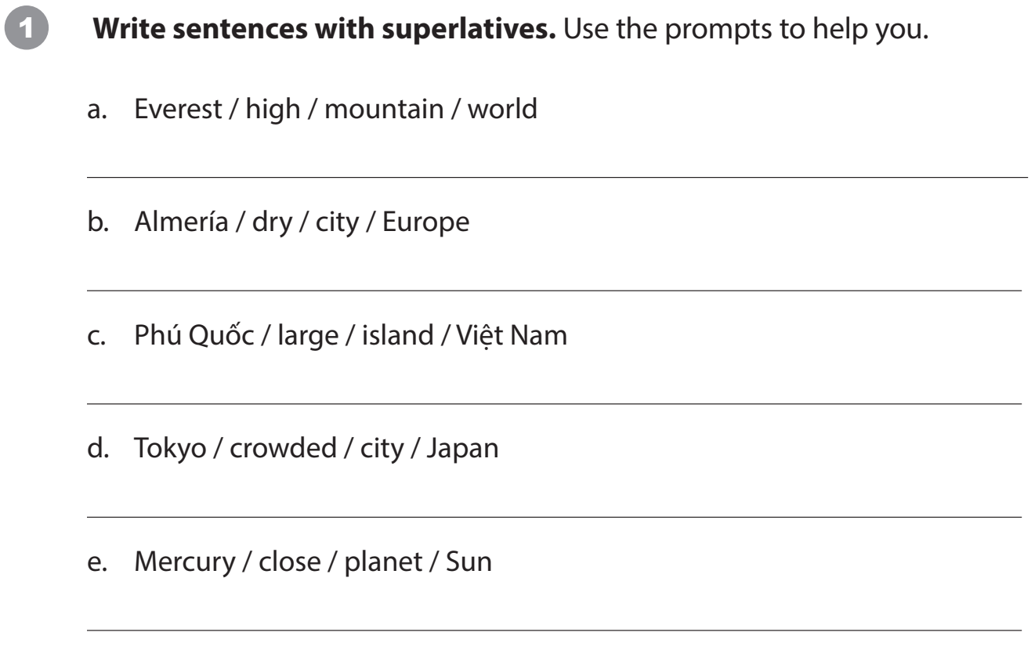
THIS IS MY FAMILY.
READING
UNIT 4
WHAT’S THE COLDEST PLACE ON EARTH?
WRITING WORKSHEET
UNIT 4
WHAT IS THE COLDEST PLACE ON EARTH?
Everest is the highest mountain in the world.
Almería is the driest city in Europe.
Phú Quốc is the largest island in Việt Nam.
Tokyo is the most crowded city in Japan.
Mercury is the closest planet to the Sun.

Slide 27
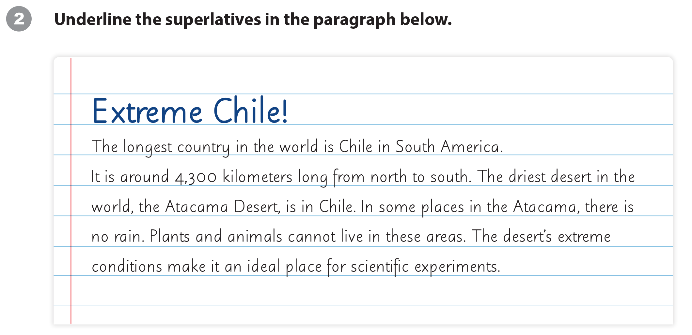
THIS IS MY FAMILY.
READING
UNIT 4
WHAT’S THE COLDEST PLACE ON EARTH?
WRITING WORKSHEET
UNIT 4
WHAT IS THE COLDEST PLACE ON EARTH?

Slide 28
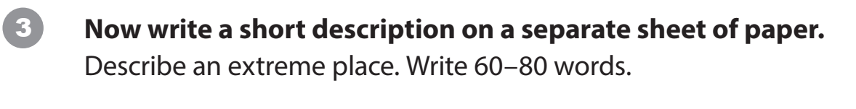
THIS IS MY FAMILY.
READING
UNIT 4
WHAT’S THE COLDEST PLACE ON EARTH?
WRITING WORKSHEET
UNIT 4
WHAT IS THE COLDEST PLACE ON EARTH?

Slide 29
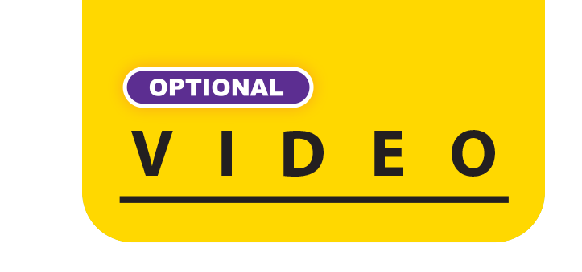
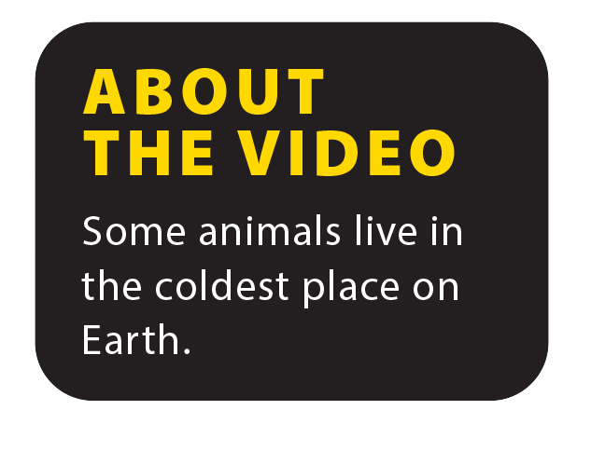

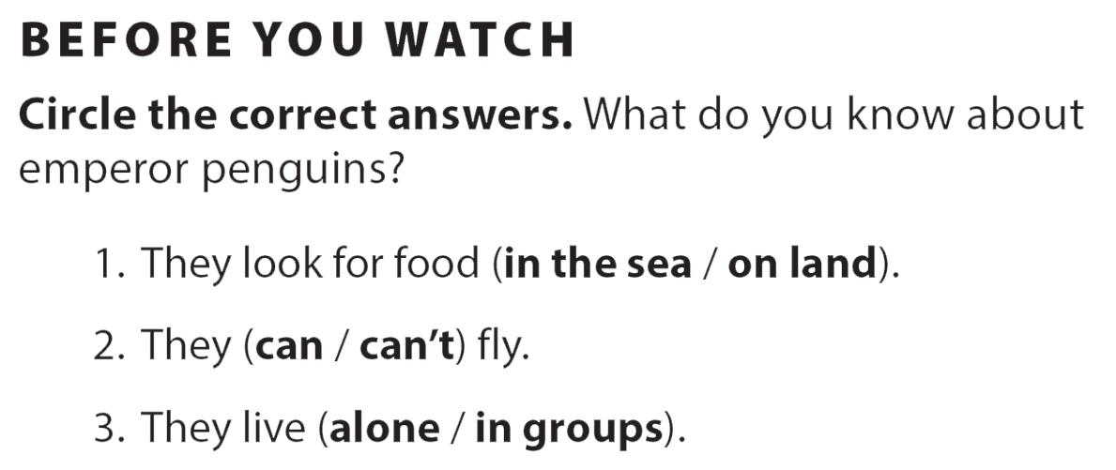
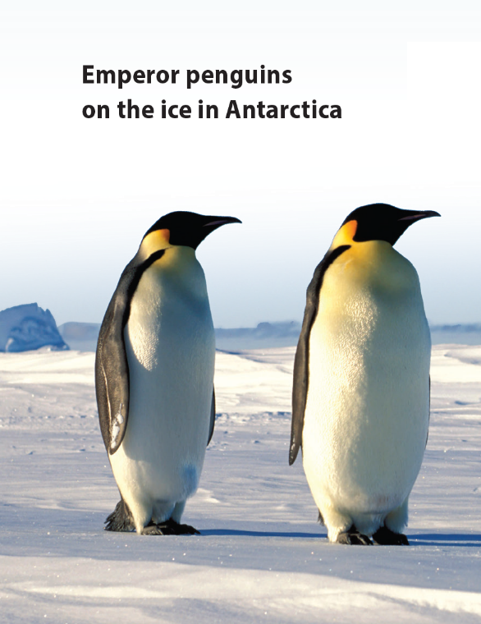
UNIT 4
WHAT’S THE COLDEST PLACE ON EARTH?
VIDEO

Slide 30


UNIT 4
WHAT’S THE COLDEST PLACE ON EARTH?
VIDEO

Slide 31
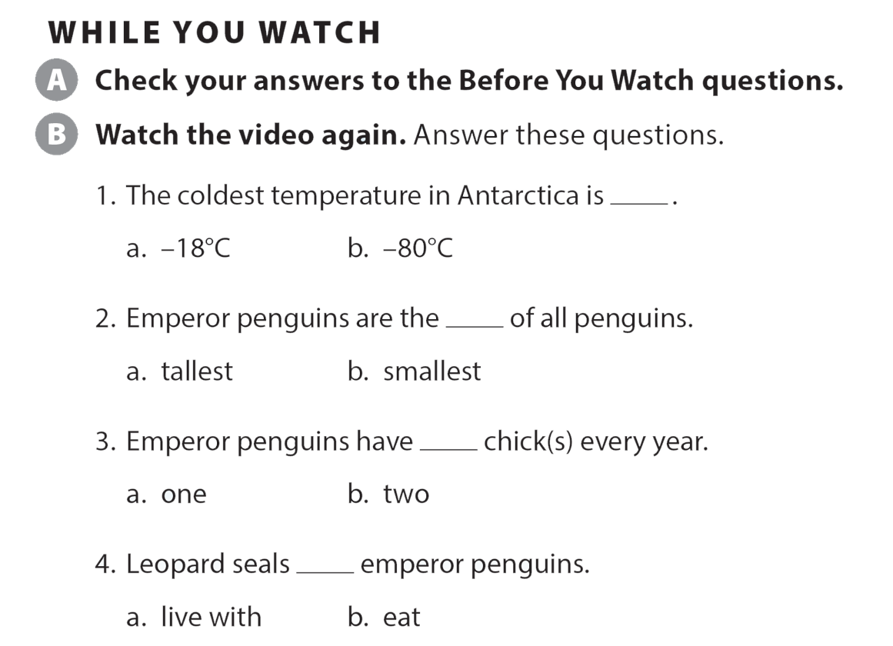
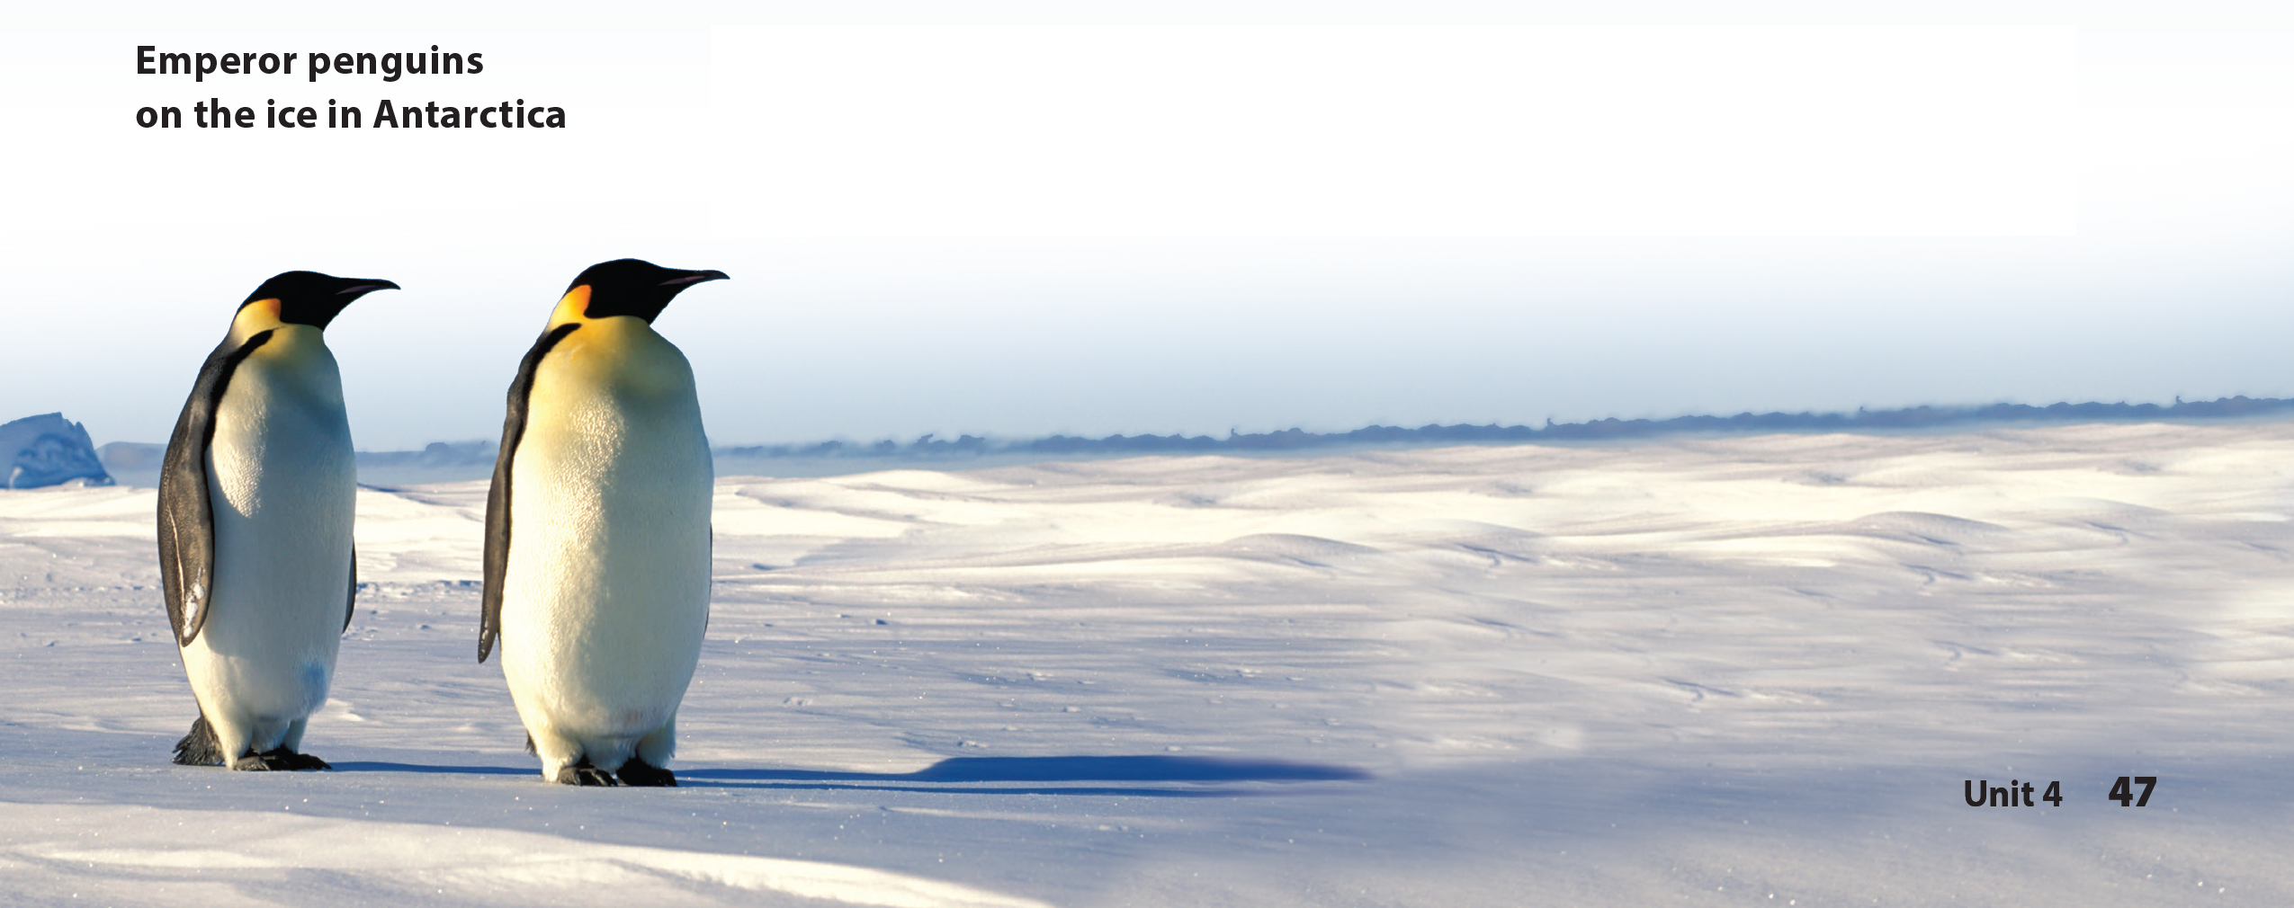
UNIT 4
WHAT’S THE COLDEST PLACE ON EARTH?
VIDEO

Slide 32
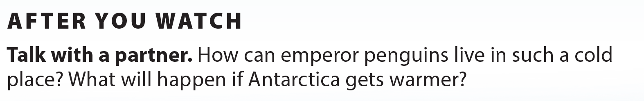
UNIT 4
WHAT’S THE COLDEST PLACE ON EARTH?
VIDEO
They have feathers and a lot of fat to keep them warm.
Answers will vary.

Slide 33
UNIT 4
WHAT’S THE COLDEST PLACE ON EARTH?
Thank you!

