Slide 1

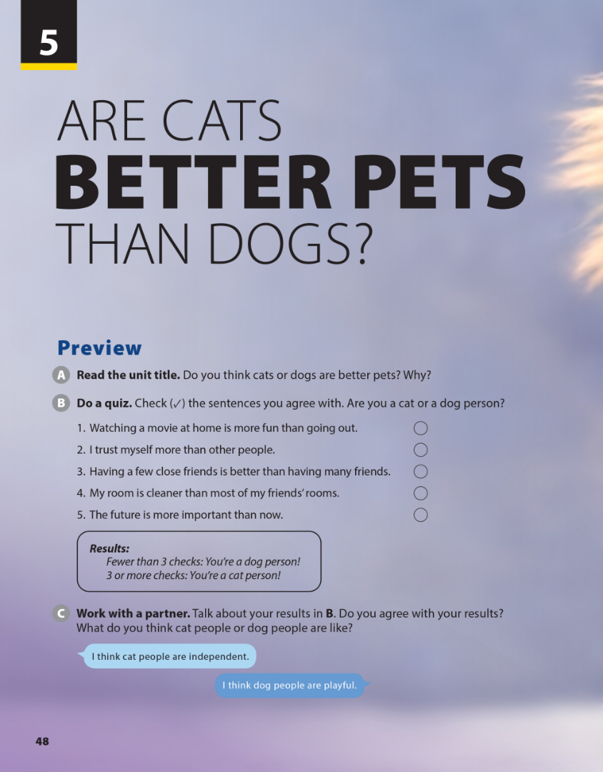
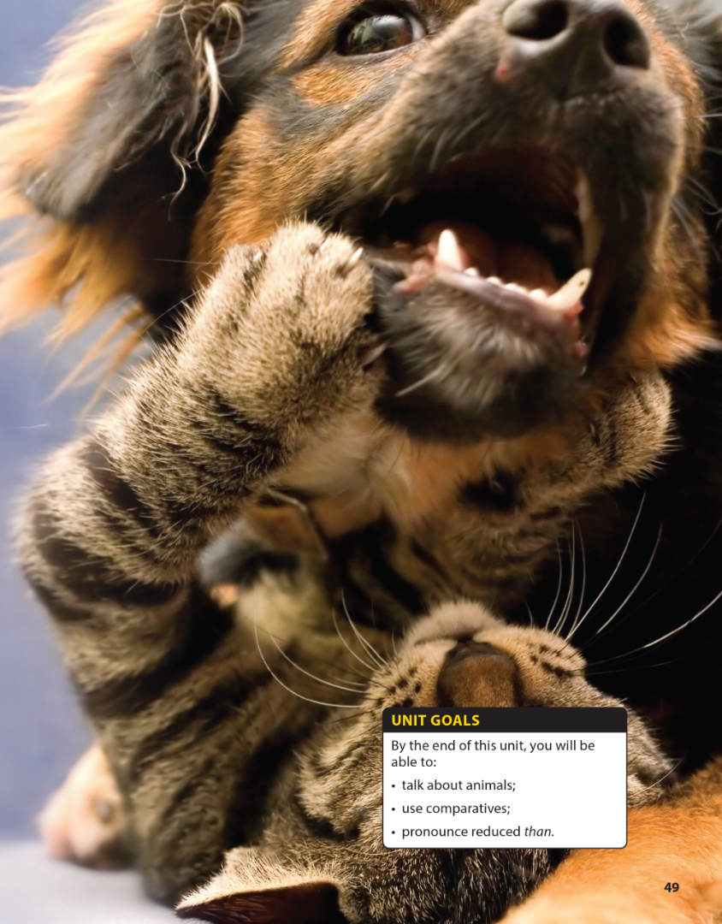

National Geographic Learning, a Cengage Company © 2022 Cengage Learning, Inc. ALL RIGHTS RESERVED. This presentation tool is intended for teaching purposes only and may not be scanned, copied, duplicated, or posted to a publicly accessible platform in whole or in part.

Slide 2
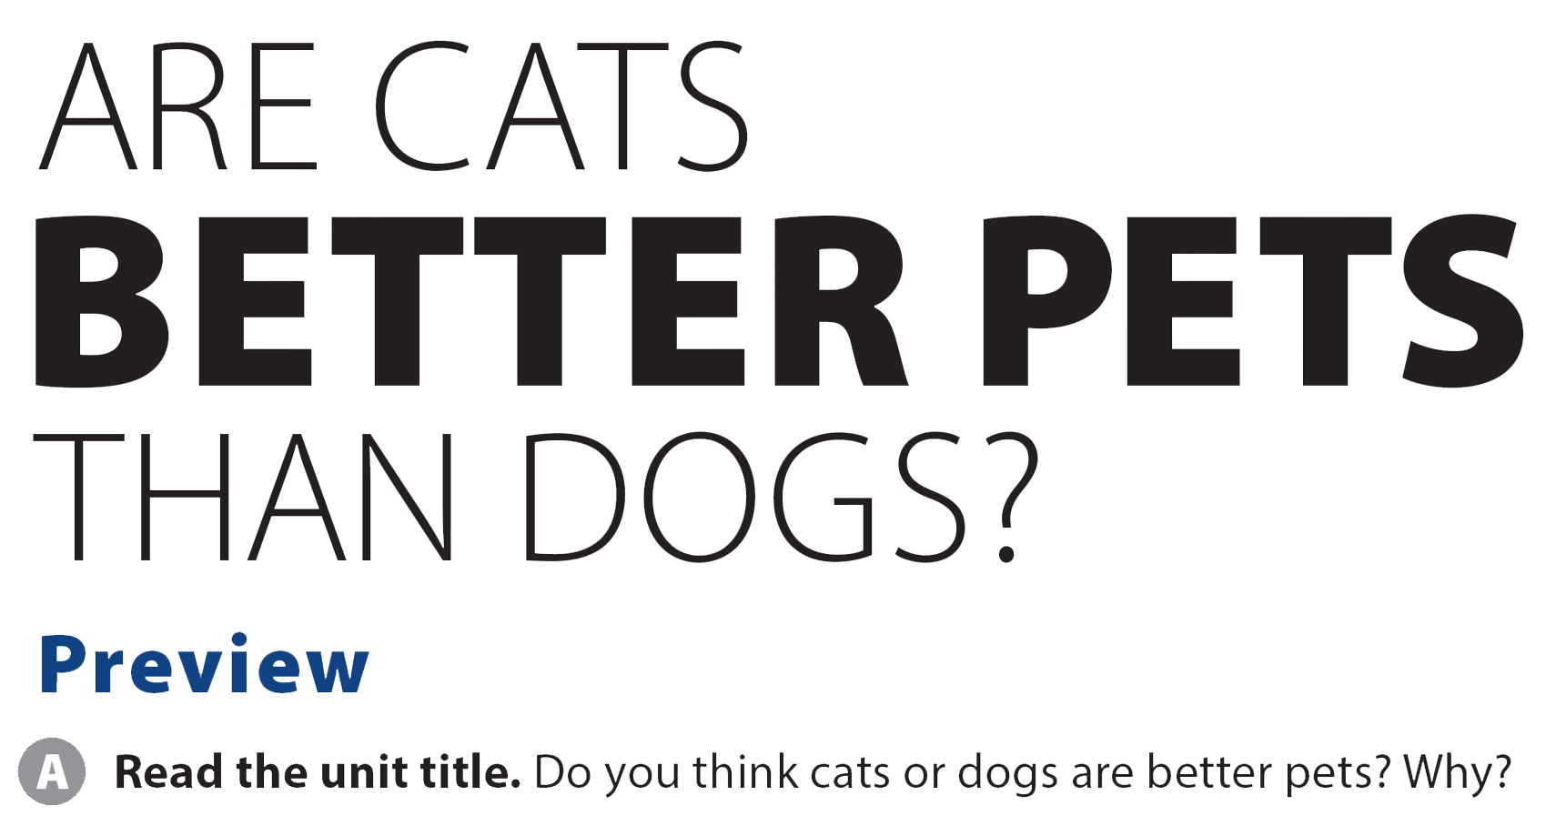
UNIT 5
ARE CATS BETTER PETS THAN DOGS?
PREVIEW

Slide 3
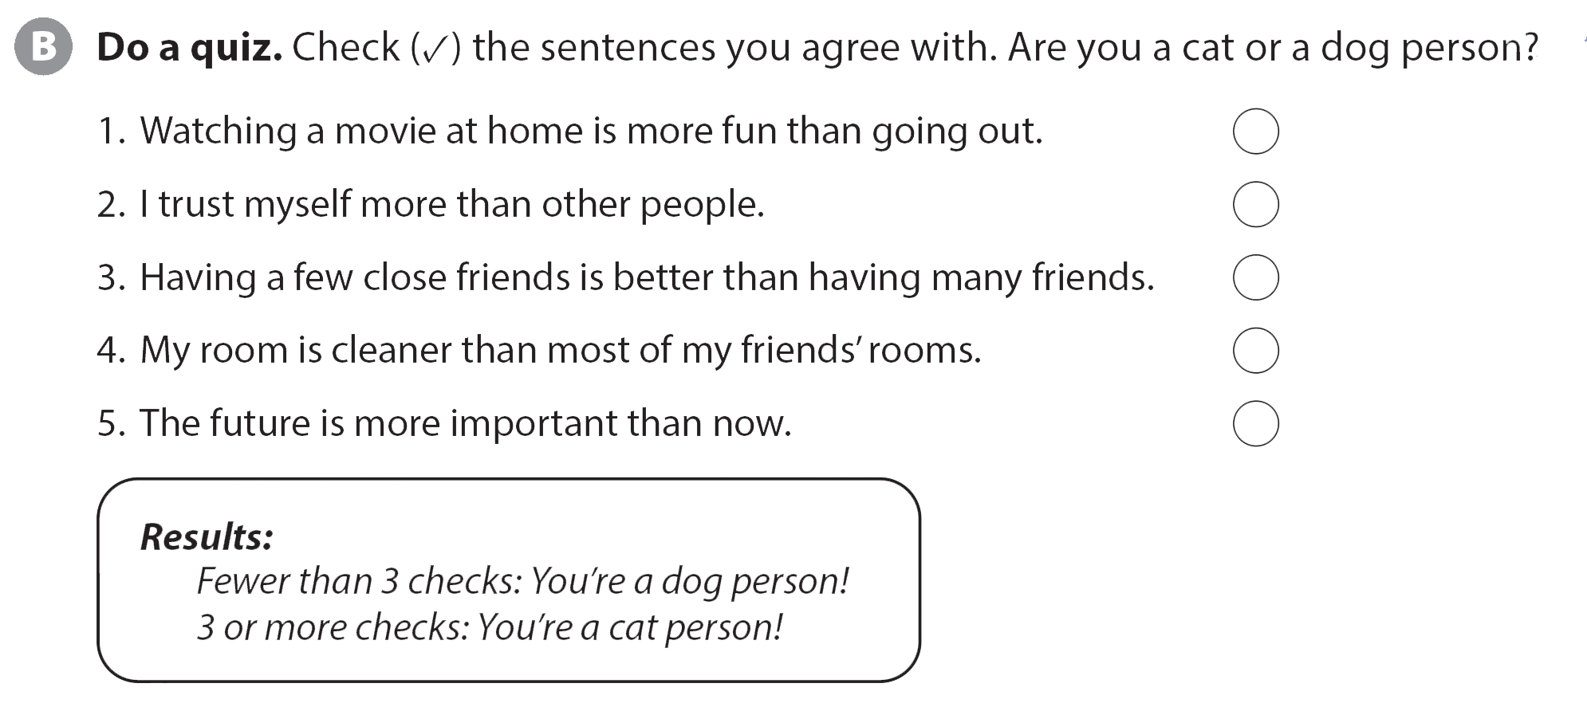
UNIT 5
ARE CATS BETTER PETS THAN DOGS?
PREVIEW

Slide 4

UNIT 5
ARE CATS BETTER PETS THAN DOGS?
PREVIEW

Slide 5



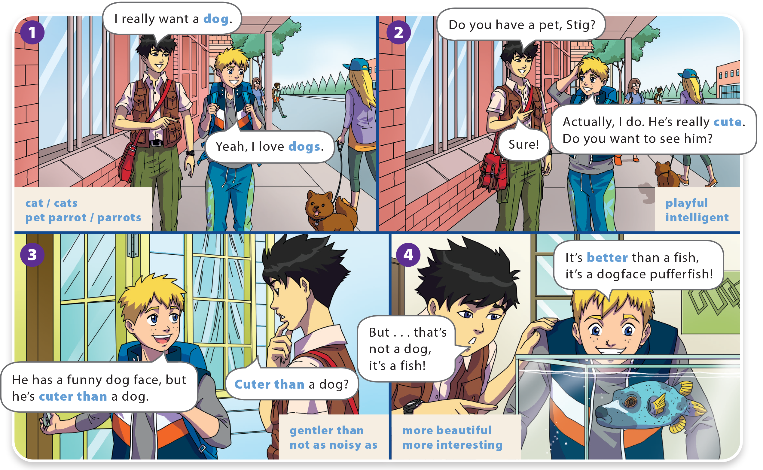
UNIT 5
ARE CATS BETTER PETS THAN DOGS?
LANGUAGE FOCUS

Slide 6
UNIT 5
ARE CATS BETTER PETS THAN DOGS?
LANGUAGE FOCUS

Slide 7
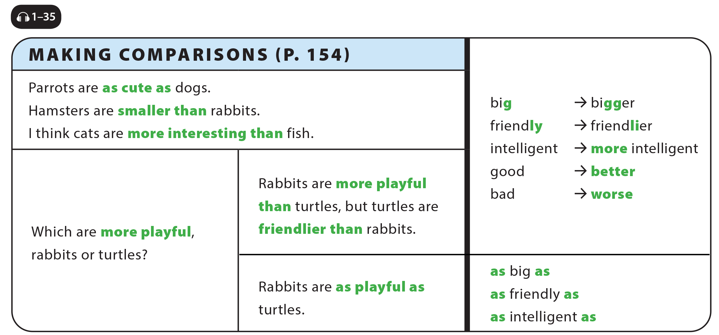
UNIT 5
ARE CATS BETTER PETS THAN DOGS?
LANGUAGE FOCUS

Slide 8
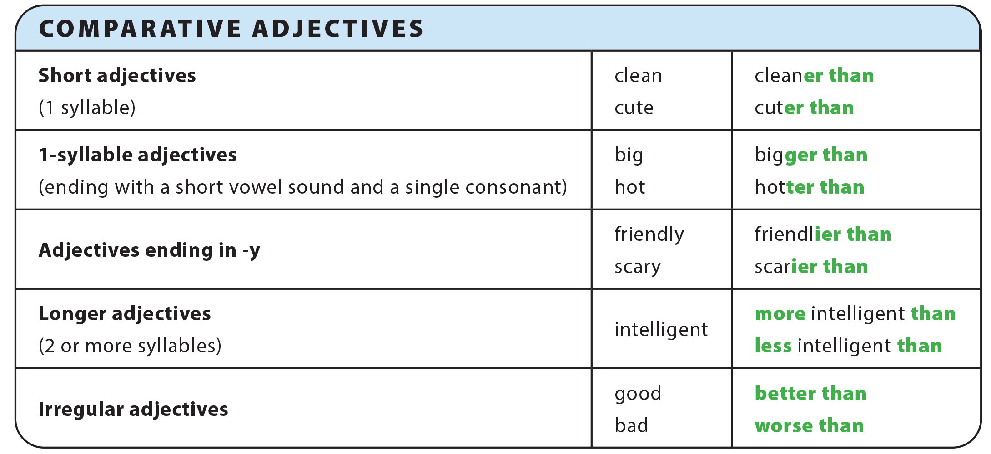
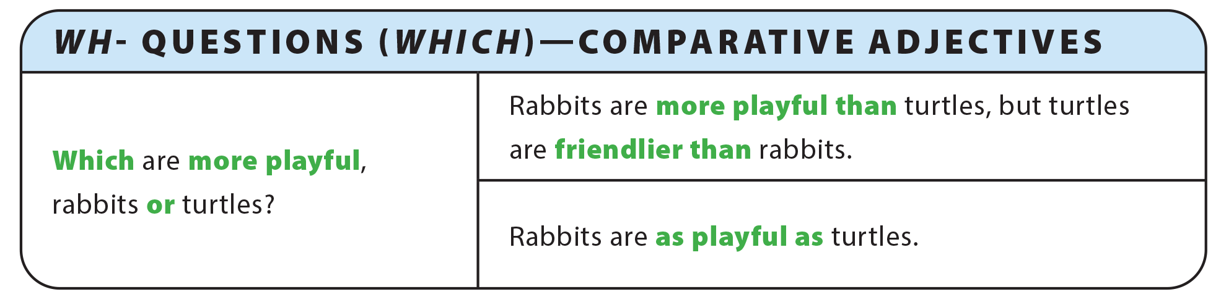
UNIT 5
ARE CATS BETTER PETS THAN DOGS?
GRAMMAR REFERENCE

Slide 9

Answers will vary.
Rabbits are cuter than mice. / Mice are cuter than rabbits.

Slide 10
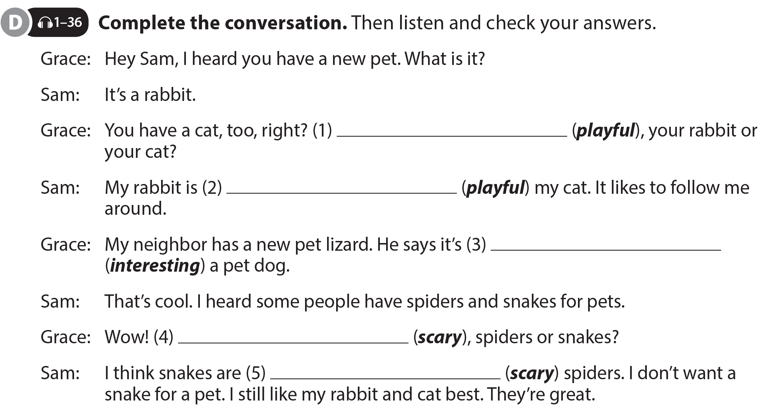
UNIT 5
ARE CATS BETTER PETS THAN DOGS?
LANGUAGE FOCUS
Which is more playful
more playful than
more interesting than
Which are scarier
scarier than

Slide 11

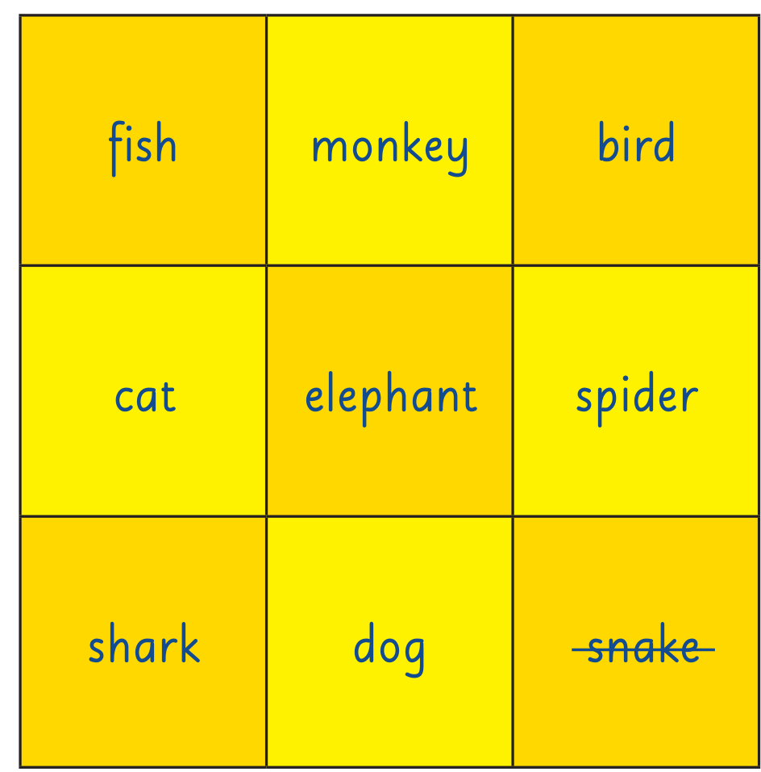
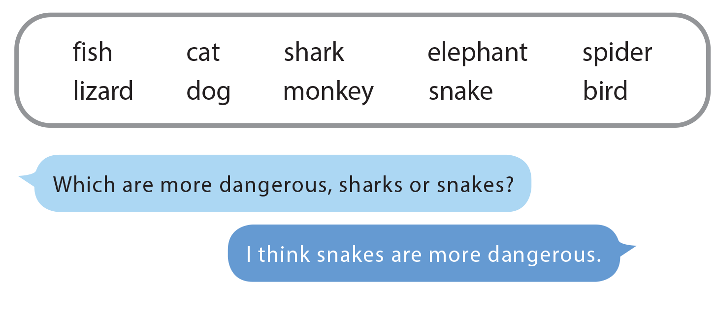
UNIT 5
ARE CATS BETTER PETS THAN DOGS?
LANGUAGE FOCUS

Slide 12

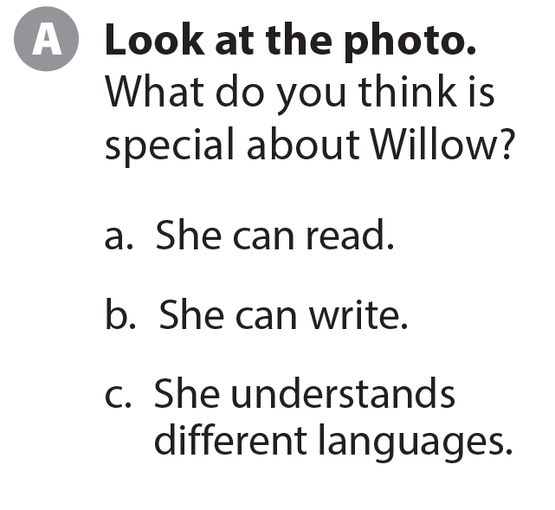
UNIT 5
ARE CATS BETTER PETS THAN DOGS?
THE REAL WORLD

Slide 13


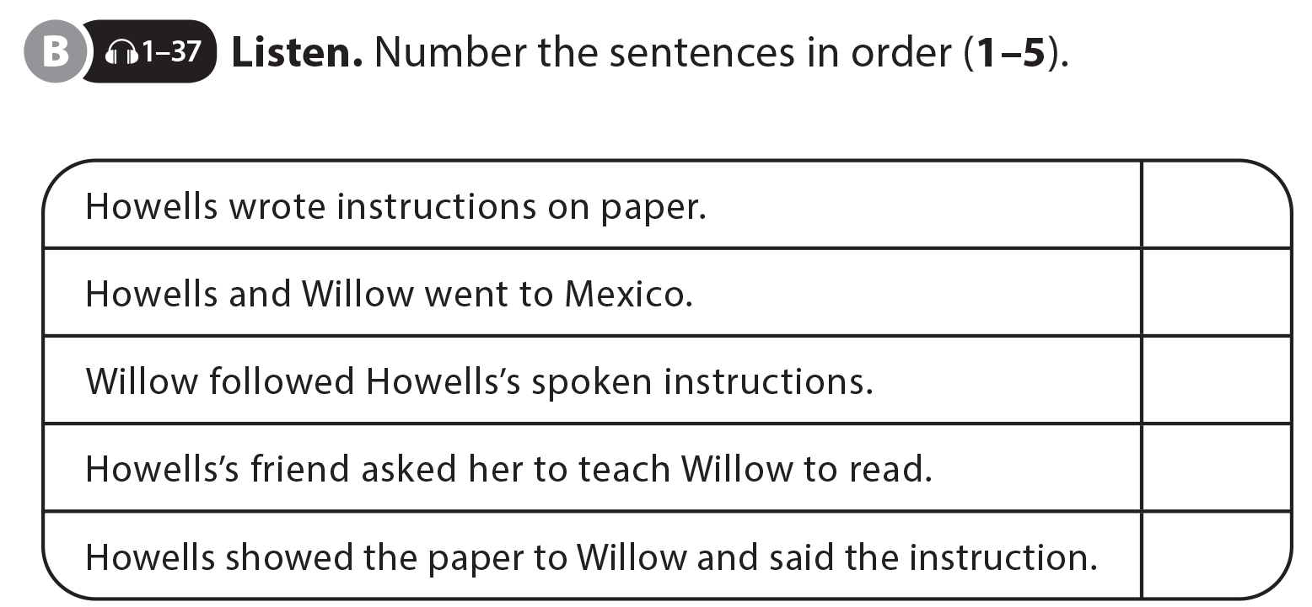
UNIT 5
ARE CATS BETTER PETS THAN DOGS?
THE REAL WORLD
3
5
2
1
4

Slide 14
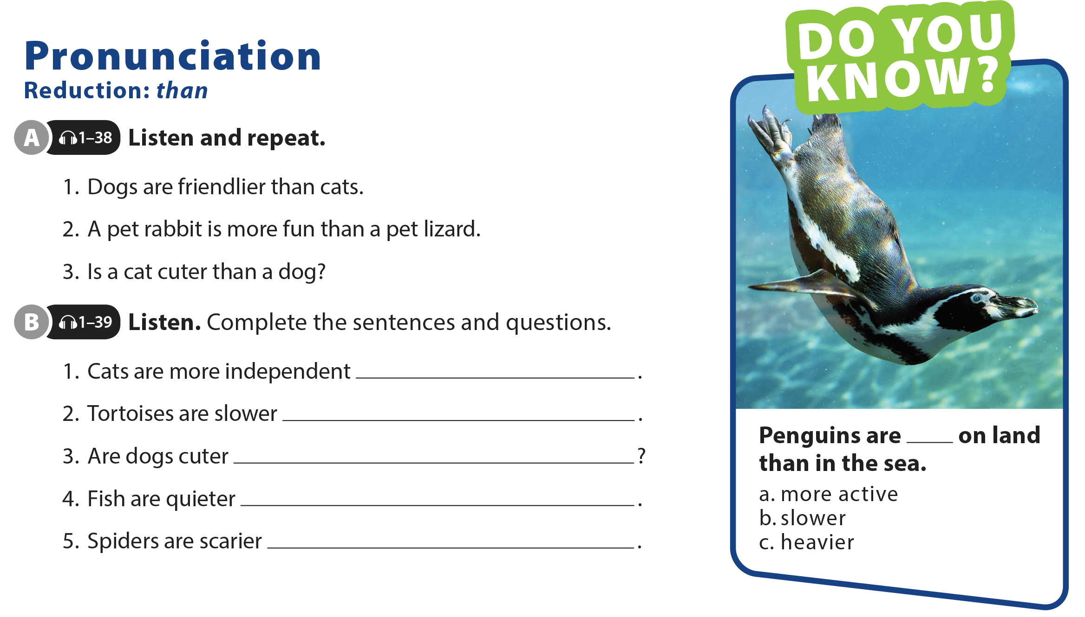
UNIT 5
ARE CATS BETTER PETS THAN DOGS?
PRONUNCIATION

Slide 15
UNIT 5
ARE CATS BETTER PETS THAN DOGS?
PRONUNCIATION
than dogs
than rabbits
than cats
than birds
than lizards

Slide 16
UNIT 5
ARE CATS BETTER PETS THAN DOGS?
PRONUNCIATION
than dogs
than rabbits
than cats
than birds
than lizards

Slide 17
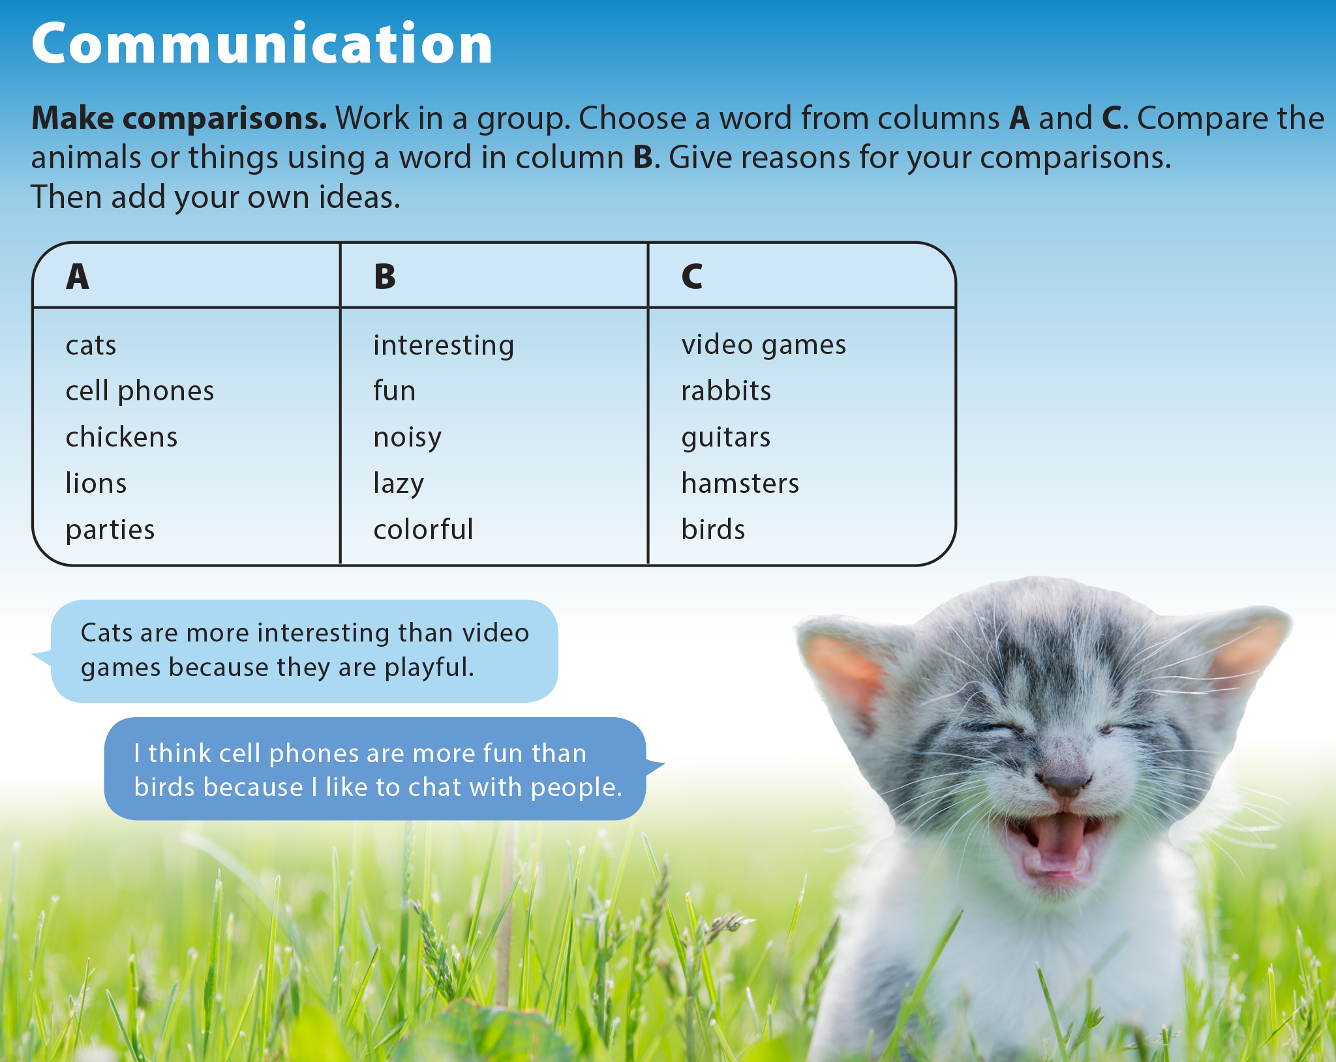
UNIT 5
ARE CATS BETTER PETS THAN DOGS?
COMMUNICATION

Slide 18

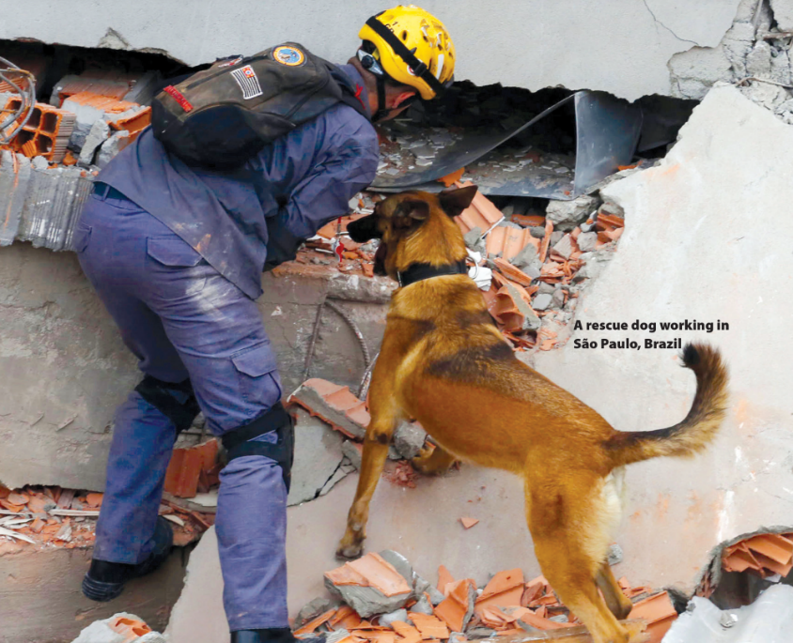

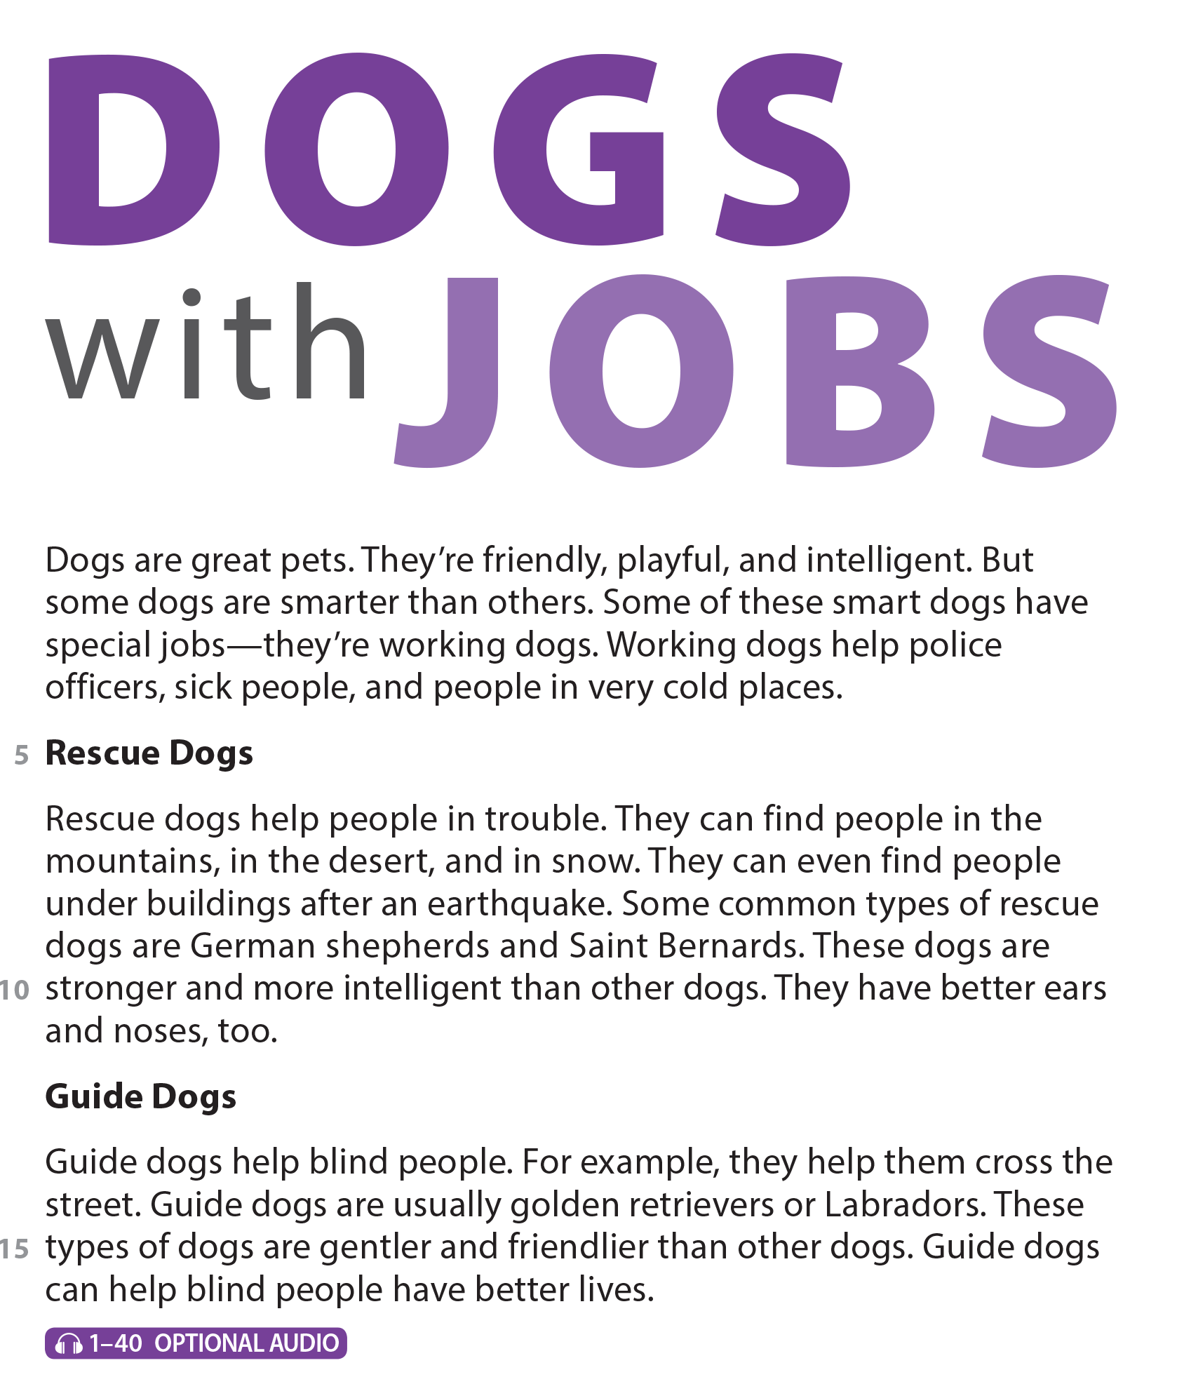
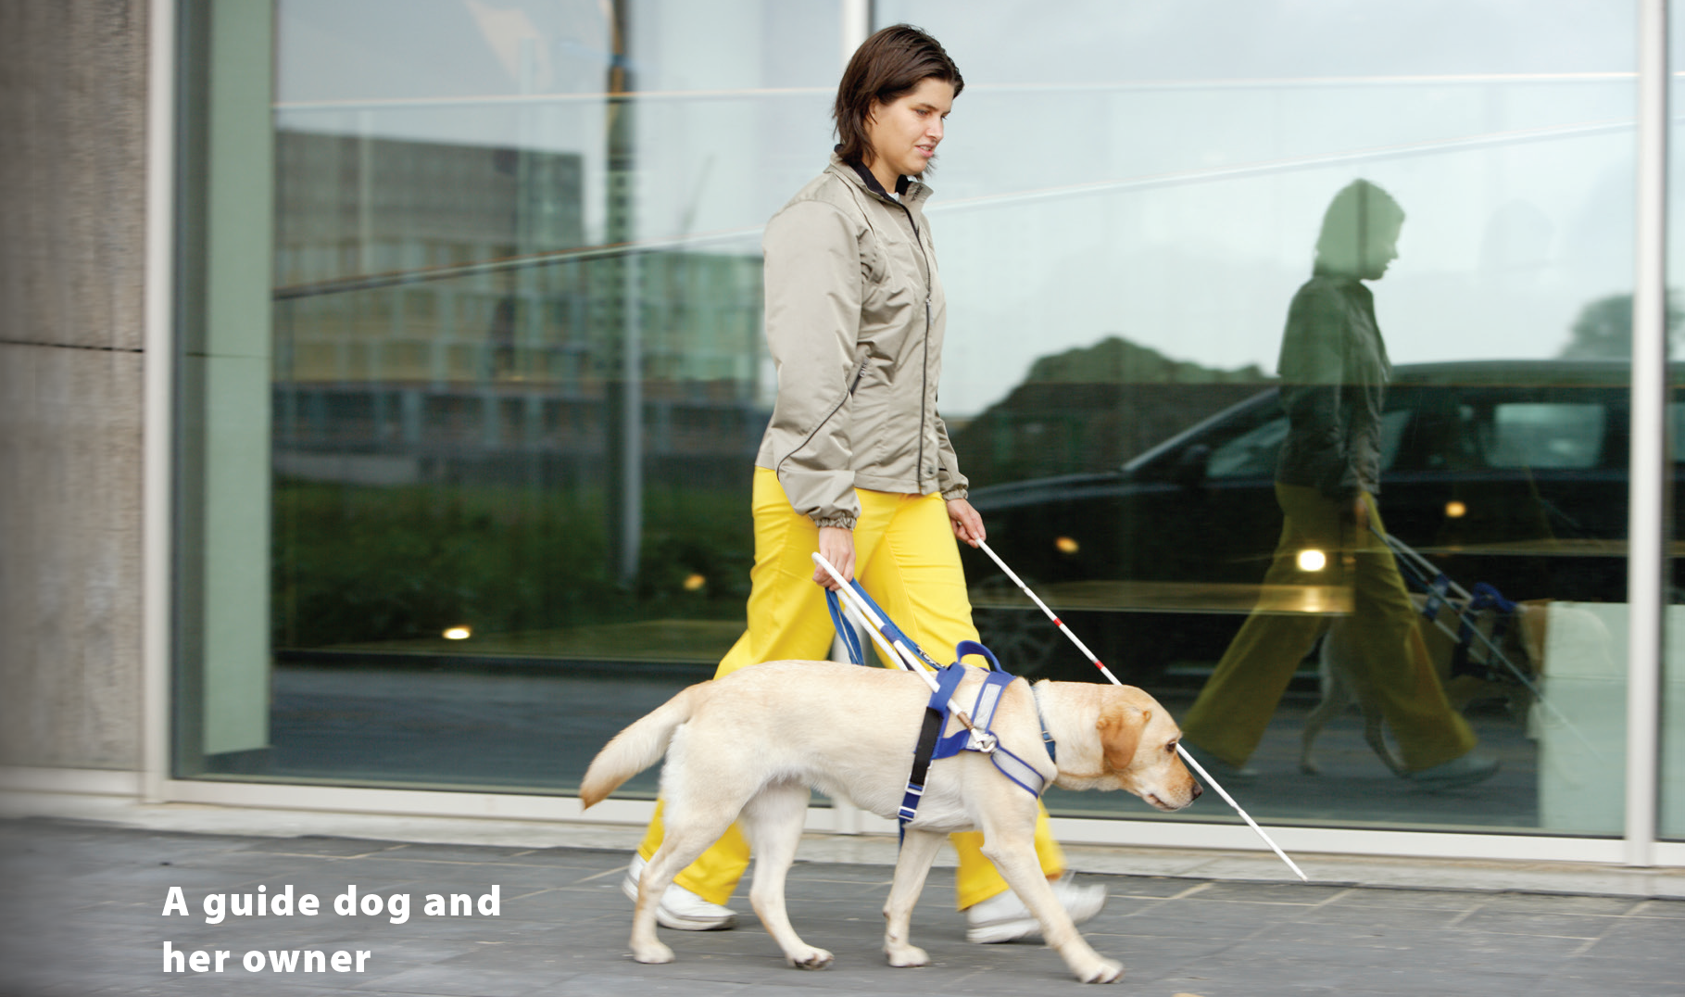
UNIT 5
ARE CATS BETTER PETS THAN DOGS?
READING

Slide 19
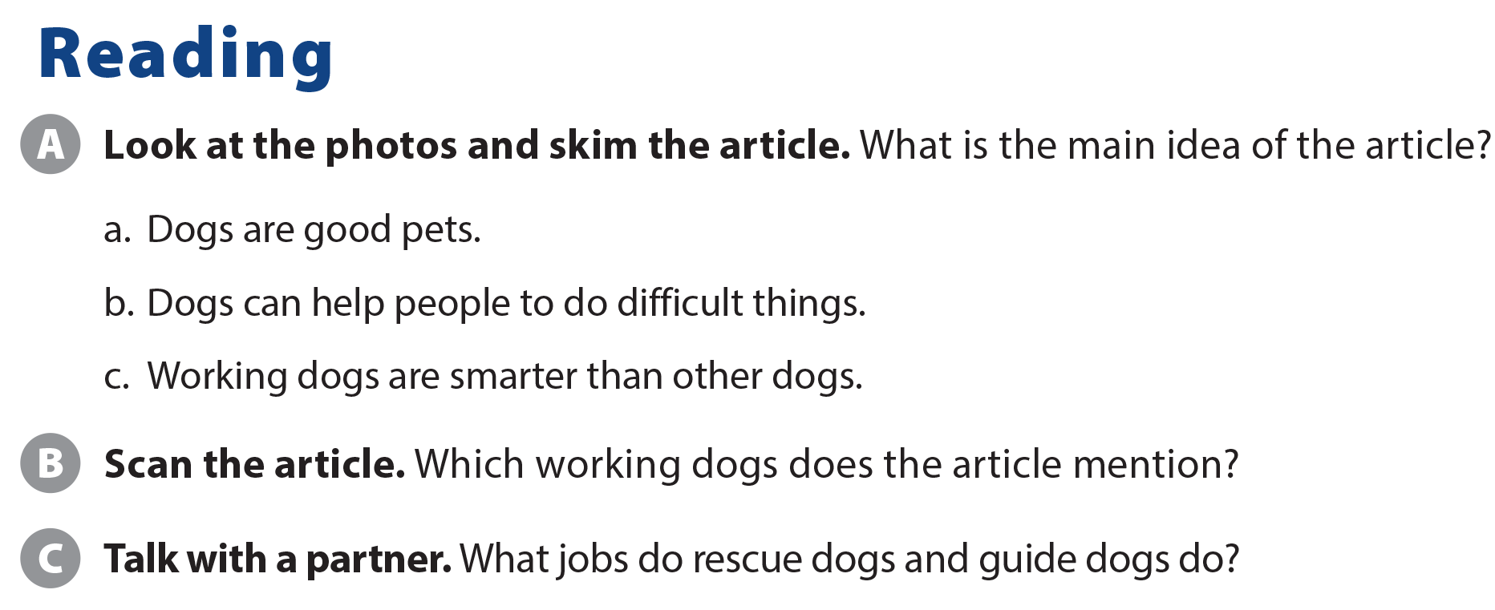
UNIT 5
ARE CATS BETTER PETS THAN DOGS?
READING
Rescue dogs and guide dogs
Rescue dogs help people in trouble. Guide dogs help blind people.

Slide 20
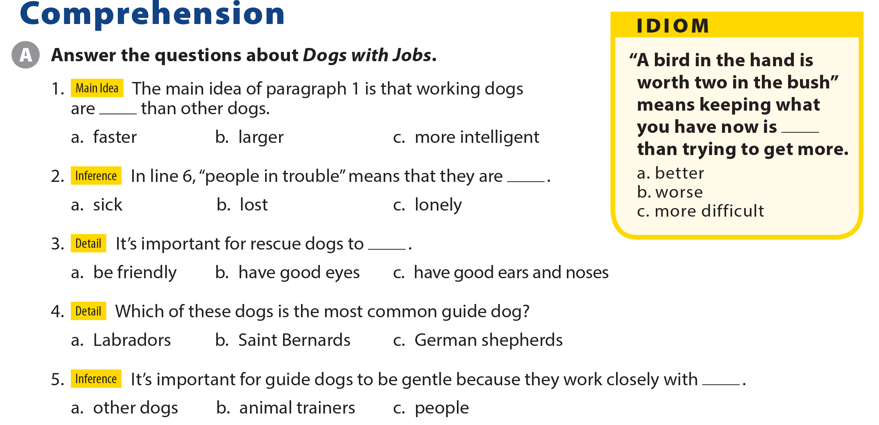
UNIT 5
ARE CATS BETTER PETS THAN DOGS?
COMPREHENSION

Slide 21
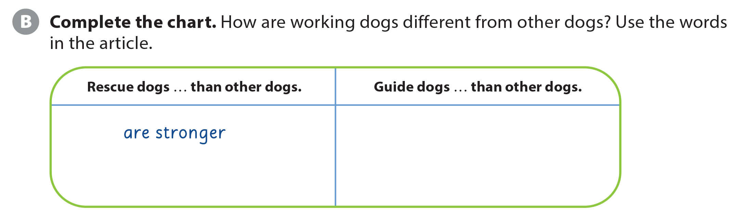

UNIT 5
ARE CATS BETTER PETS THAN DOGS?
COMPREHENSION
are gentler
are more intelligent
are friendlier
have better ears and noses

Slide 22
UNIT 5
ARE CATS BETTER PETS THAN DOGS?
PROJECT

Slide 23
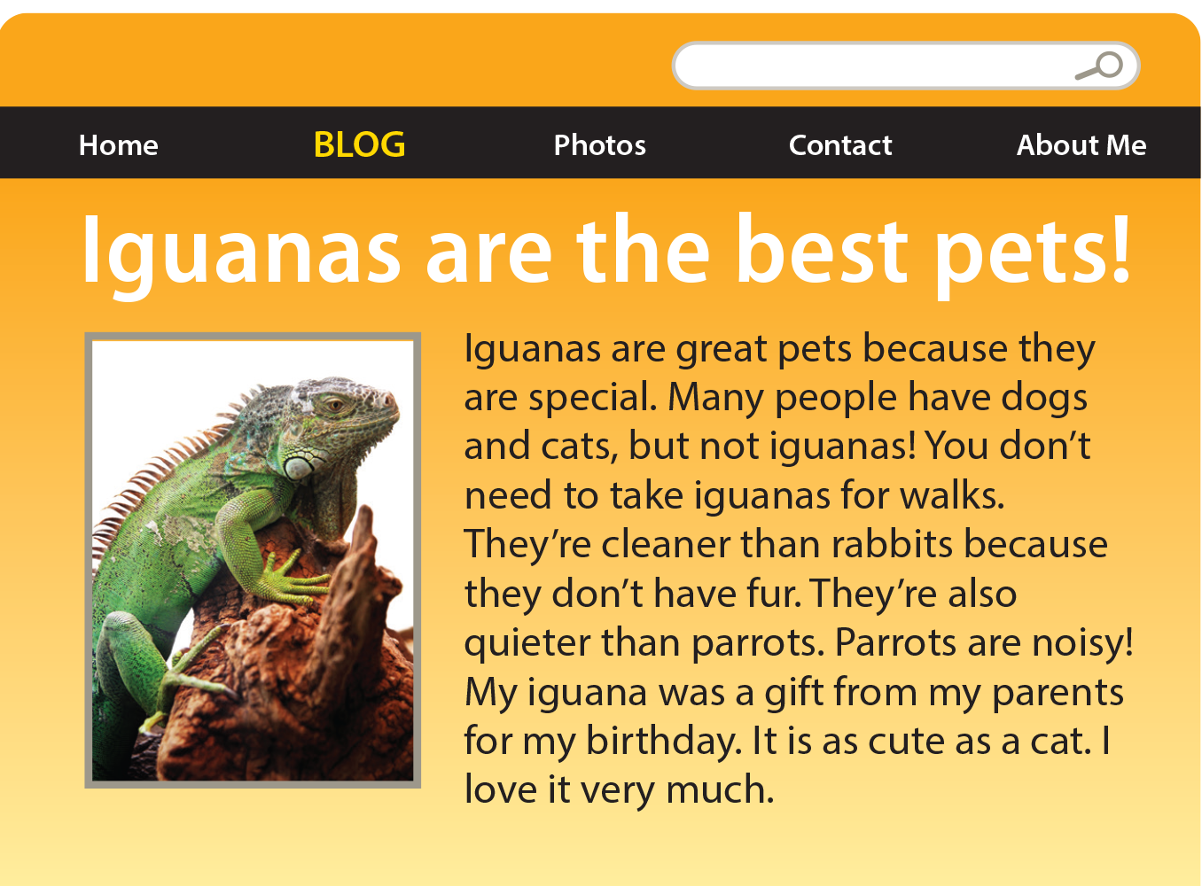
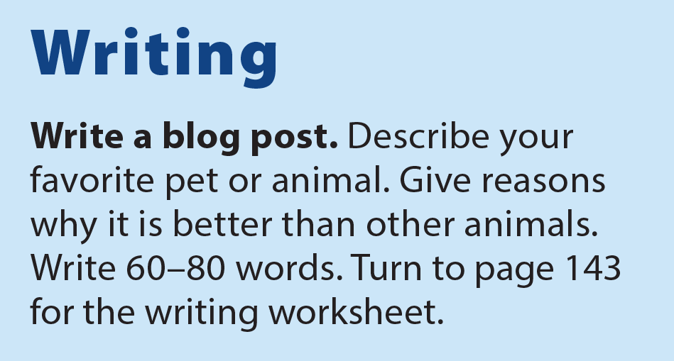
UNIT 5
ARE CATS BETTER PETS THAN DOGS?
WRITING

Slide 24
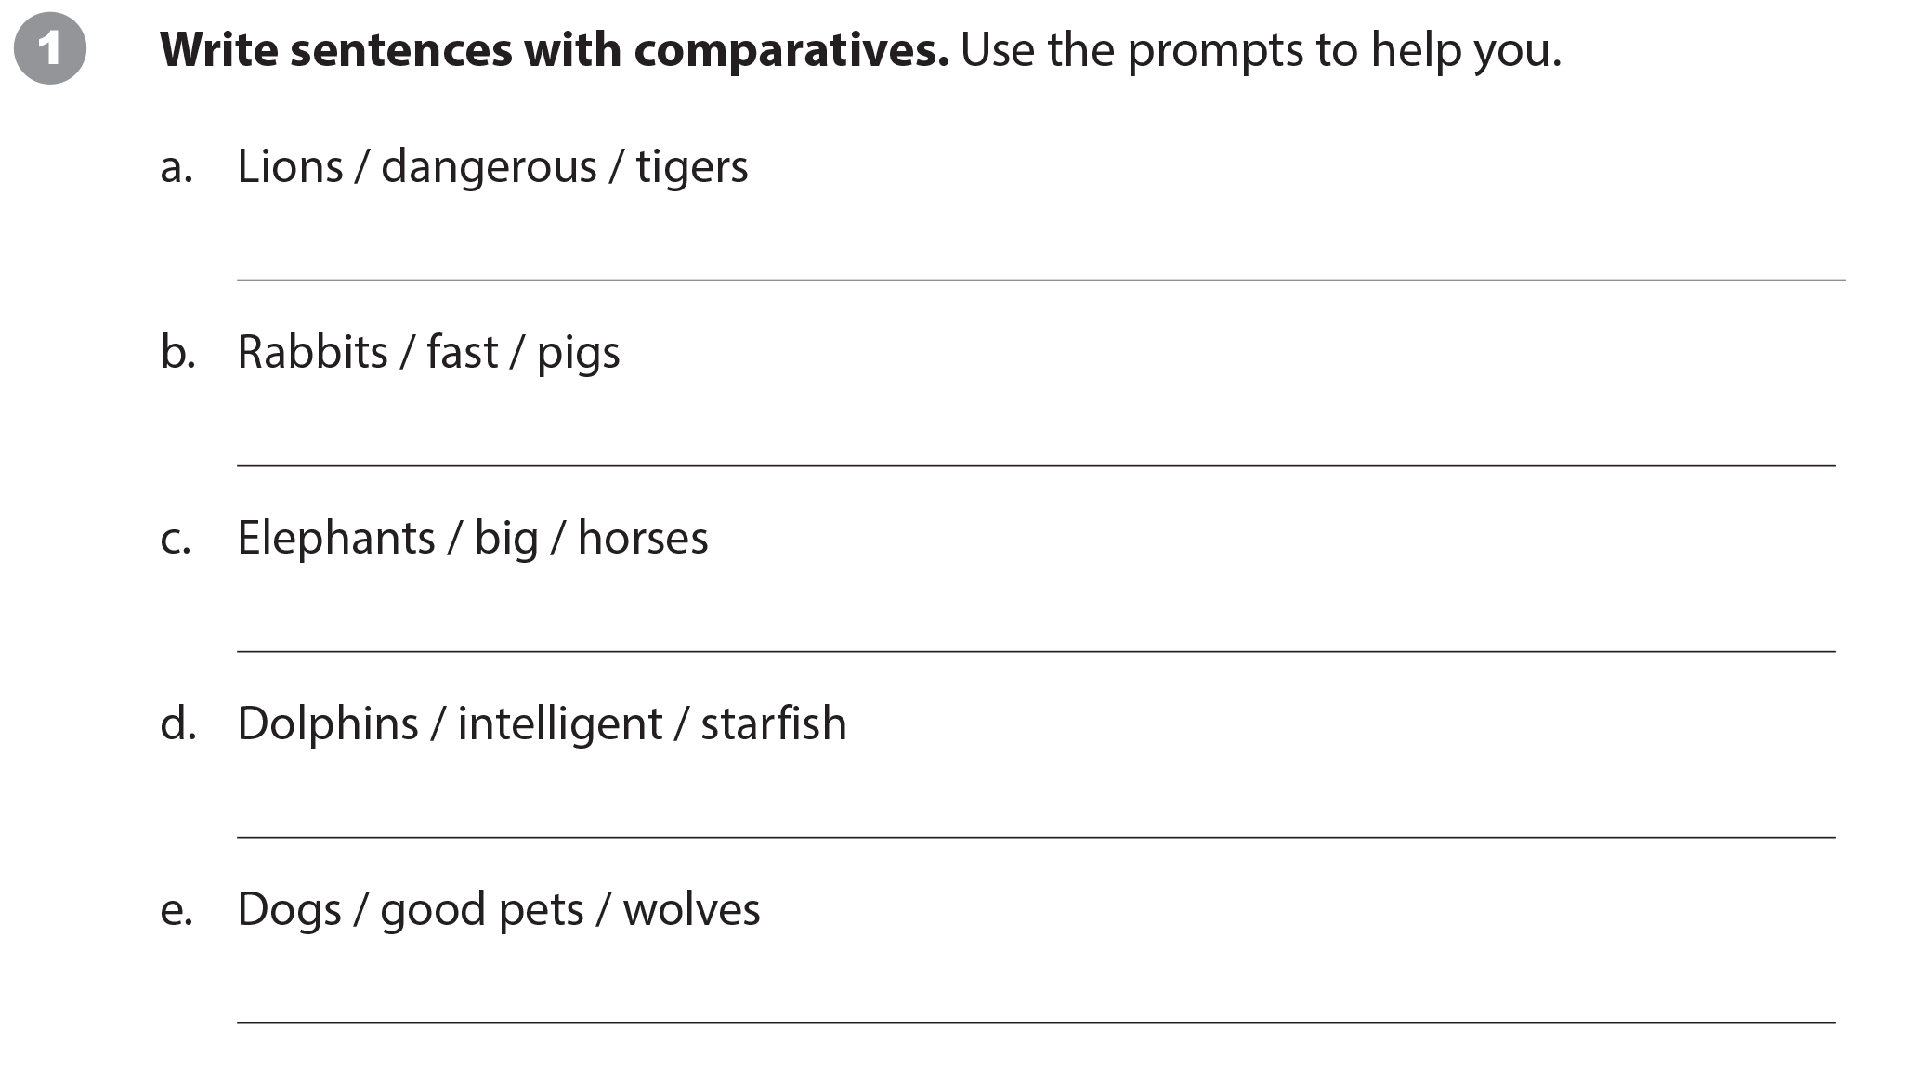
UNIT 5
ARE CATS BETTER PETS THAN DOGS?
WRITING WORKSHEET
Suggested answers:
Lions are as dangerous as tigers.
Rabbits are faster than pigs.
Elephants are bigger than horses.
Dolphins are more intelligent than starfish.
Dogs are better pets than wolves.

Slide 25
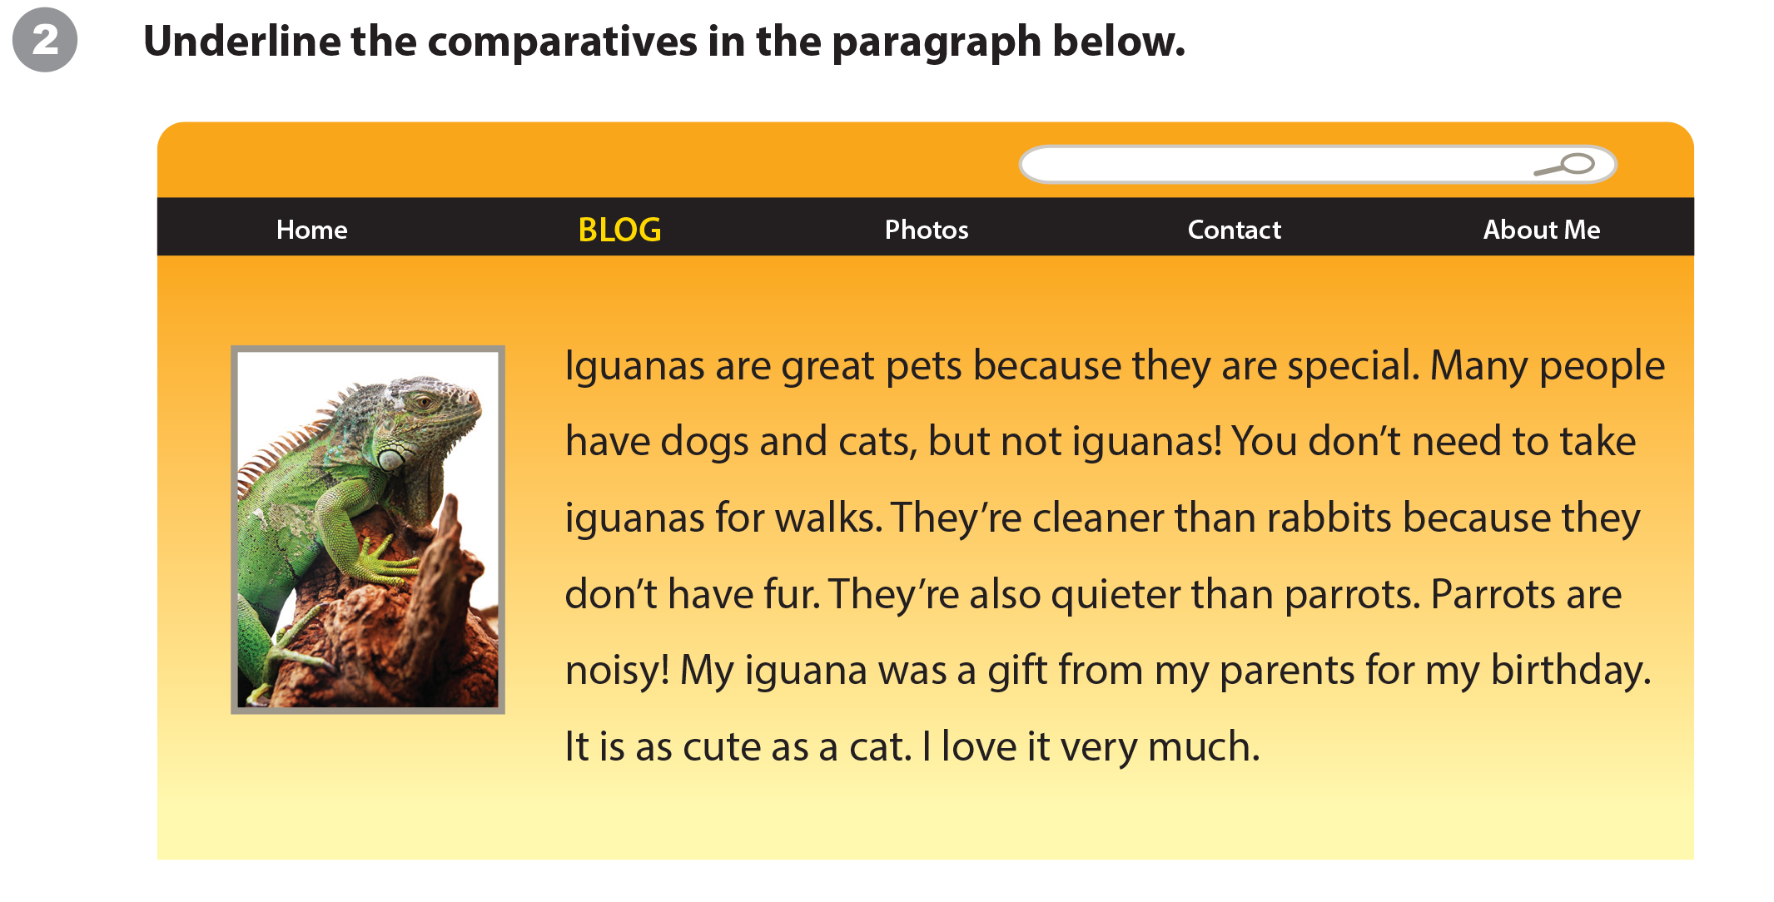
UNIT 5
ARE CATS BETTER PETS THAN DOGS?
WRITING WORKSHEET

Slide 26
UNIT 5
ARE CATS BETTER PETS THAN DOGS?
WRITING WORKSHEET

Slide 27

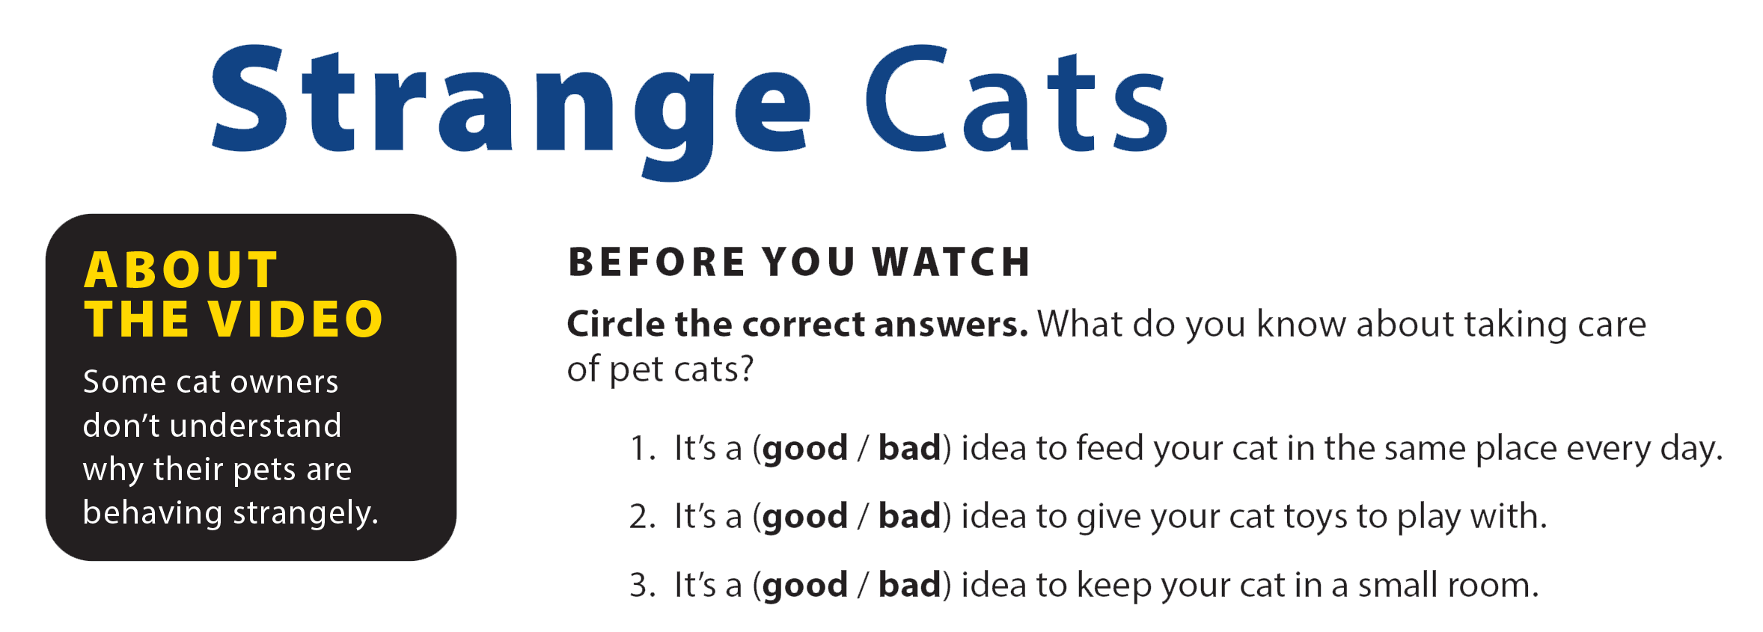
UNIT 5
ARE CATS BETTER PETS THAN DOGS?
VIDEO

Slide 28


UNIT 5
ARE CATS BETTER PETS THAN DOGS?
VIDEO

Slide 29

UNIT 5
ARE CATS BETTER PETS THAN DOGS?
VIDEO

Slide 30


UNIT 5
ARE CATS BETTER PETS THAN DOGS?
VIDEO
National Geographic Learning, a Cengage Company © 2022 Cengage Learning, Inc. ALL RIGHTS RESERVED. This presentation tool is intended for teaching purposes only and may not be scanned, copied, duplicated, or posted to a publicly accessible platform in whole or in part.

Slide 31
UNIT 5
ARE CATS BETTER PETS THAN DOGS?
Thank you!

