Slide 1

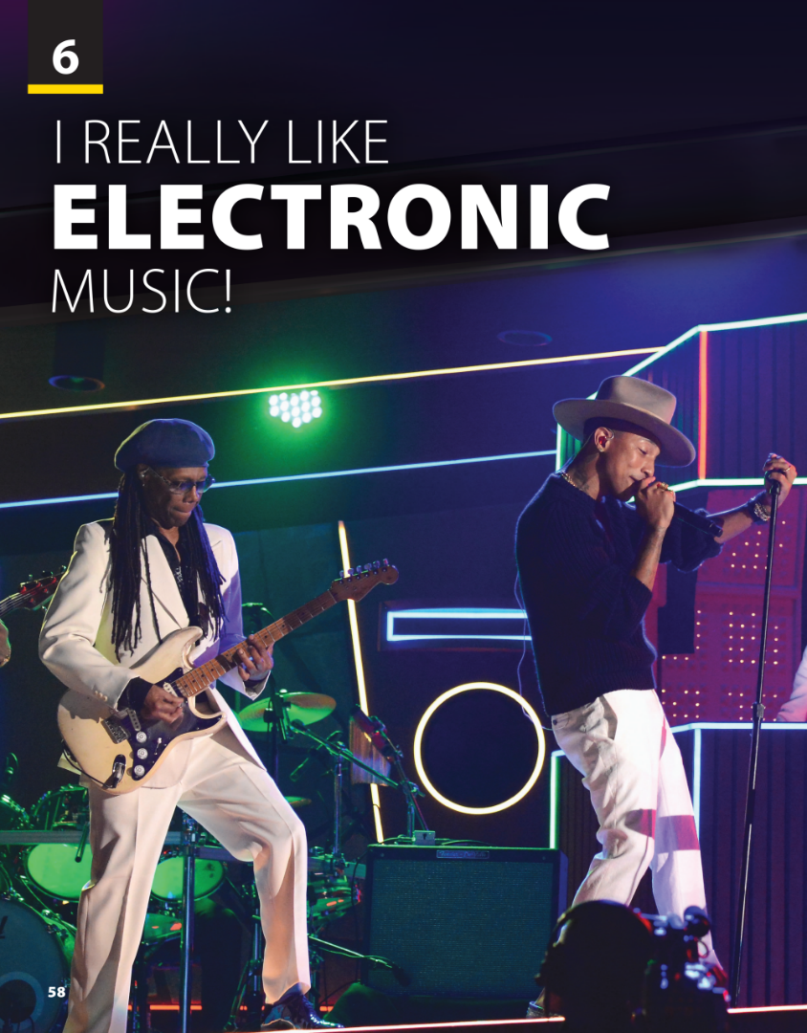
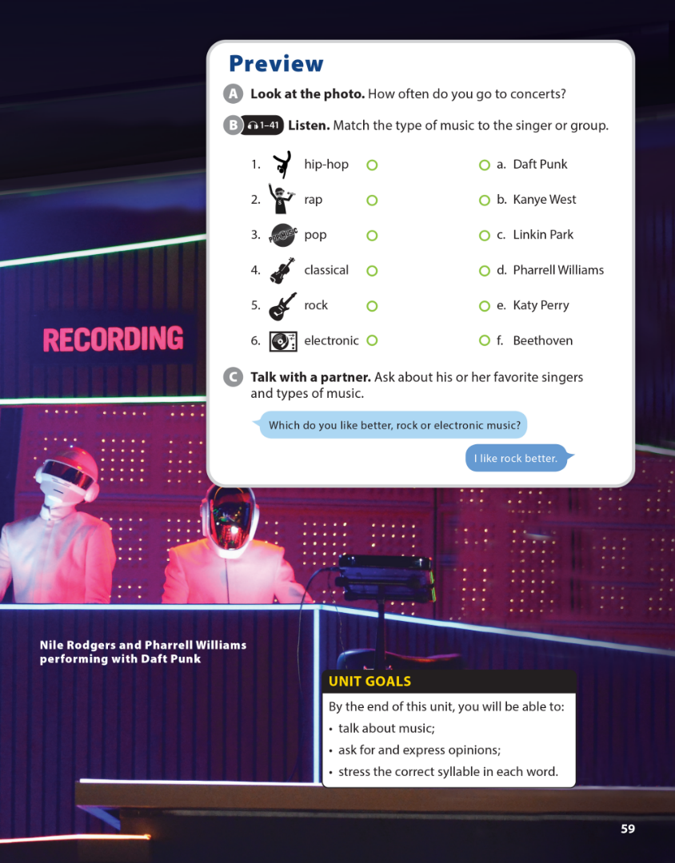

National Geographic Learning, a Cengage Company © 2022 Cengage Learning, Inc. ALL RIGHTS RESERVED. This presentation tool is intended for teaching purposes only and may not be scanned, copied, duplicated, or posted to a publicly accessible platform in whole or in part.

Slide 2
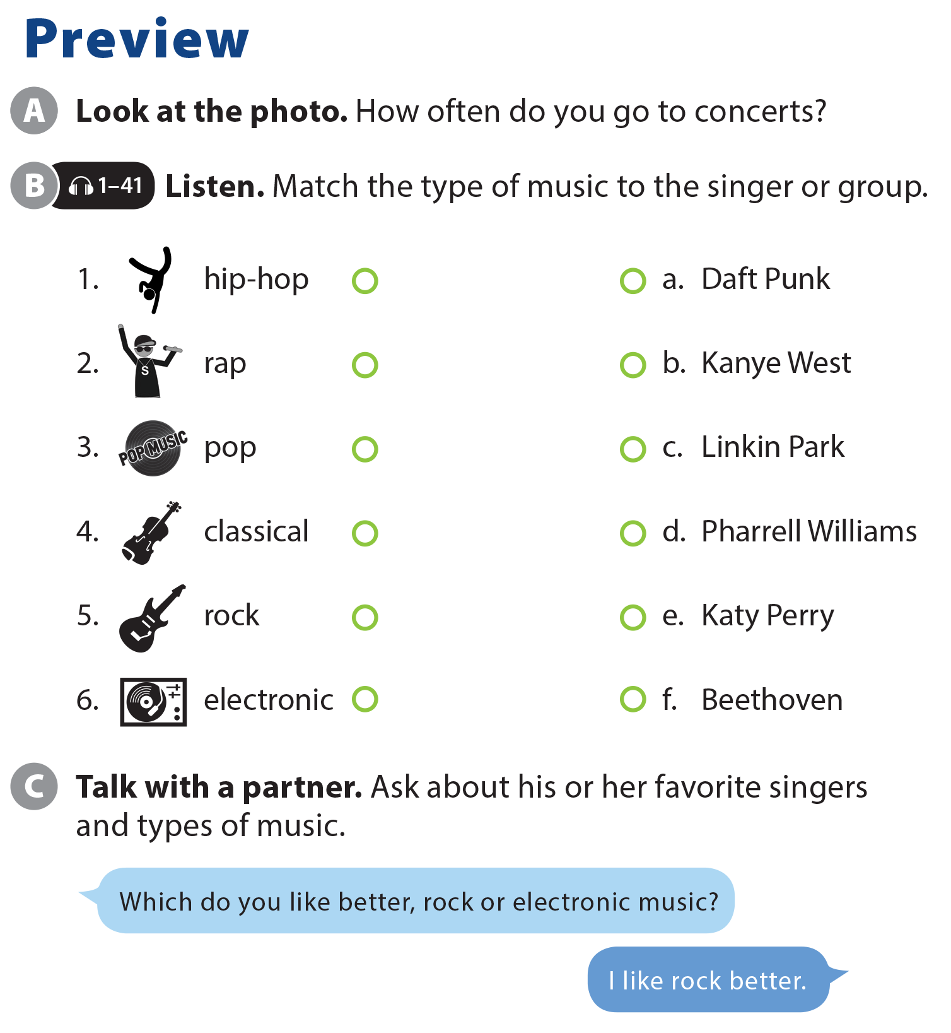

UNIT 6
I REALLY LIKE ELECTRONIC MUSIC!
PREVIEW

Slide 3
UNIT 6
I REALLY LIKE ELECTRONIC MUSIC!
PREVIEW

Slide 4


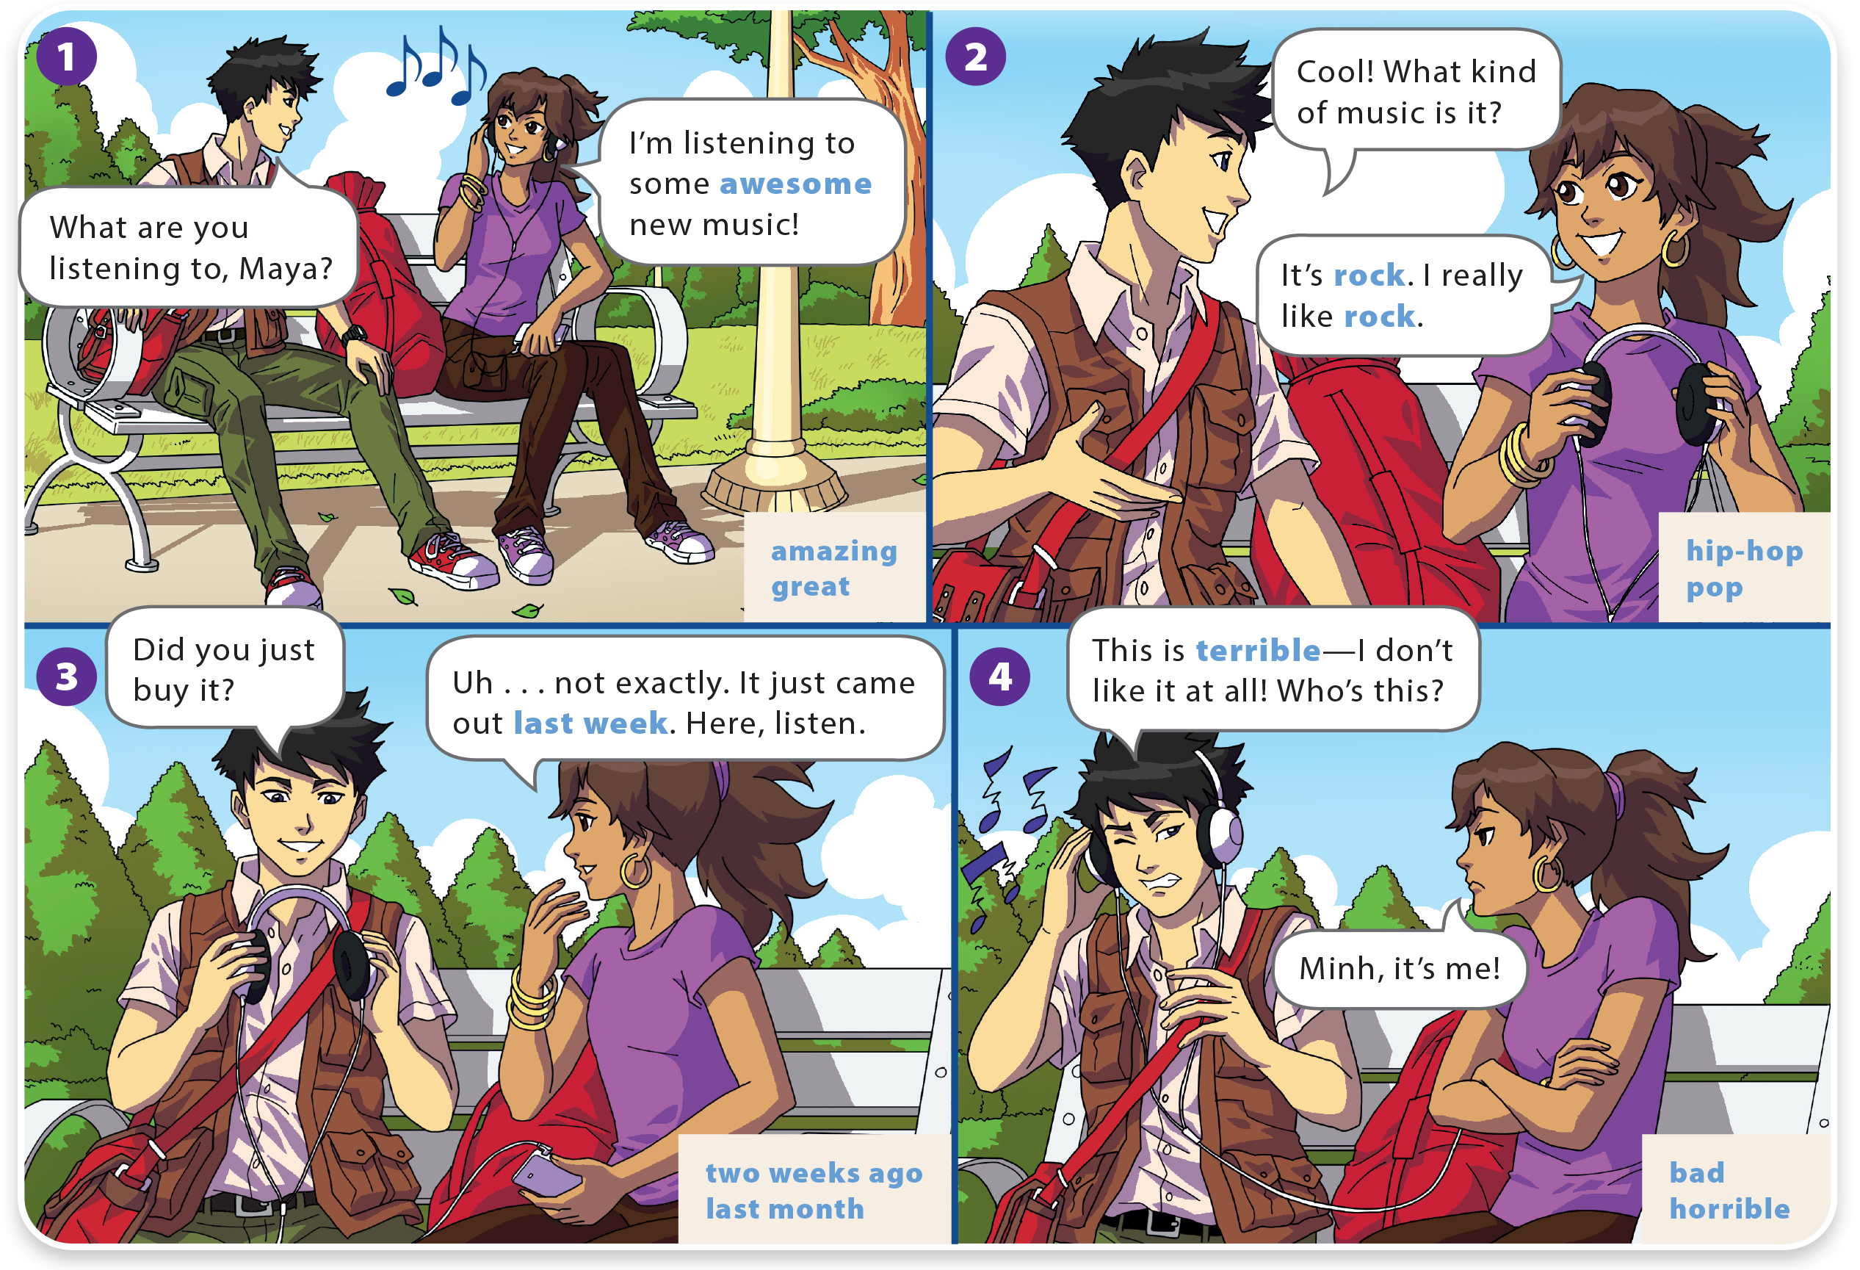
WHAT DO YOU LIKE TO DO?
UNIT 6
I REALLY LIKE ELECTRONIC MUSIC!
LANGUAGE FOCUS

Slide 5
WHAT DO YOU LIKE TO DO?
UNIT 6
I REALLY LIKE ELECTRONIC MUSIC!
LANGUAGE FOCUS

Slide 6
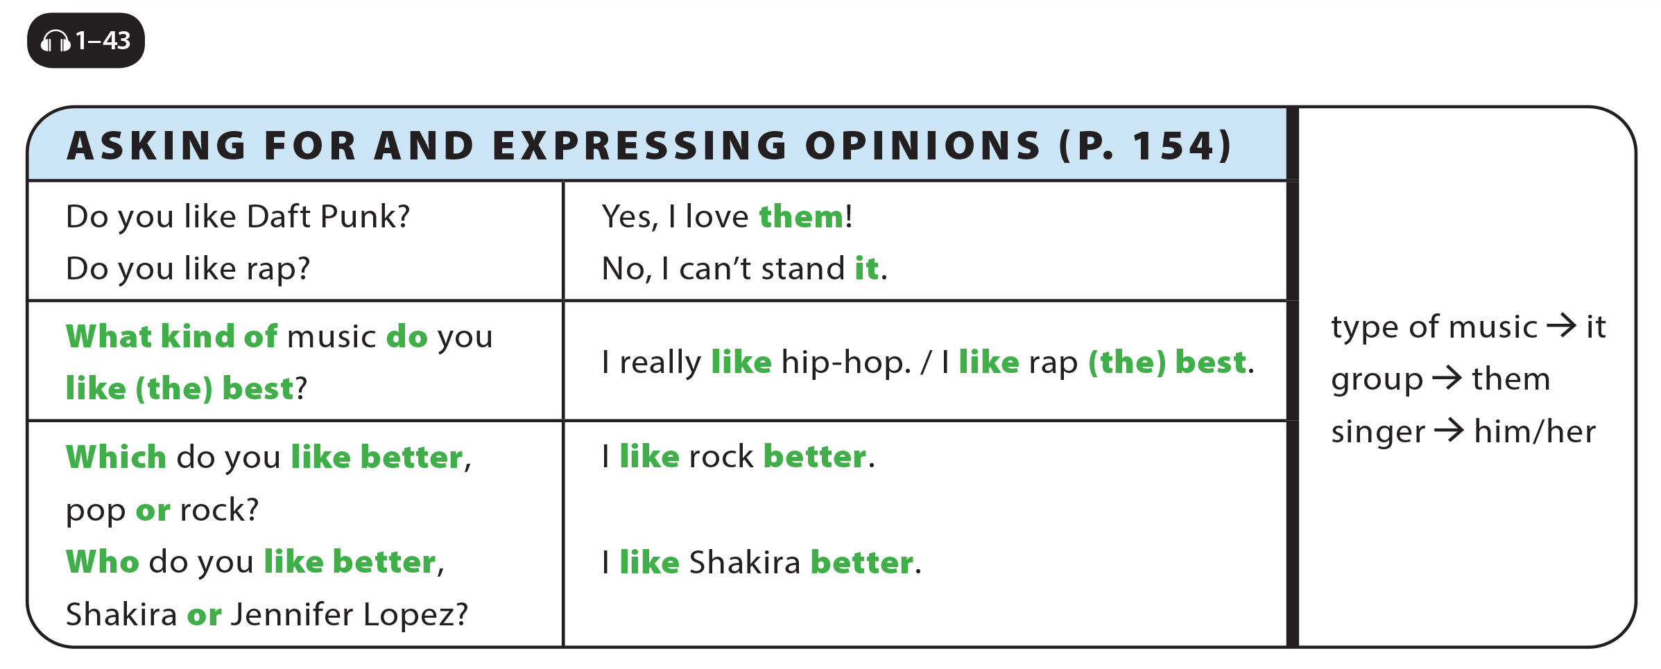
UNIT 6
I REALLY LIKE ELECTRONIC MUSIC!
LANGUAGE FOCUS

Slide 7
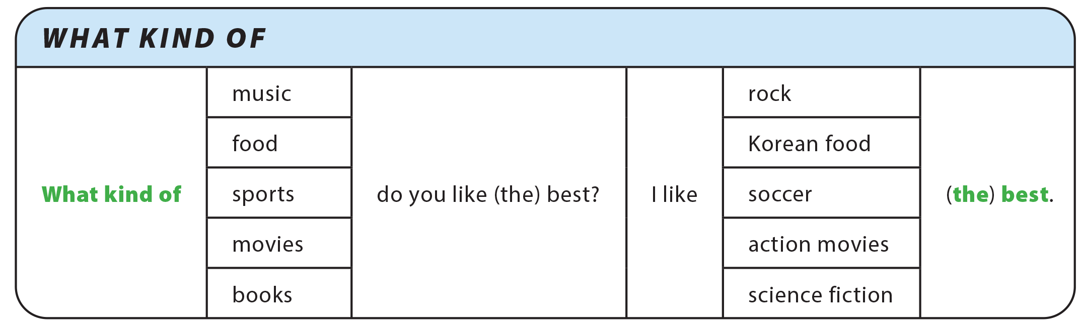
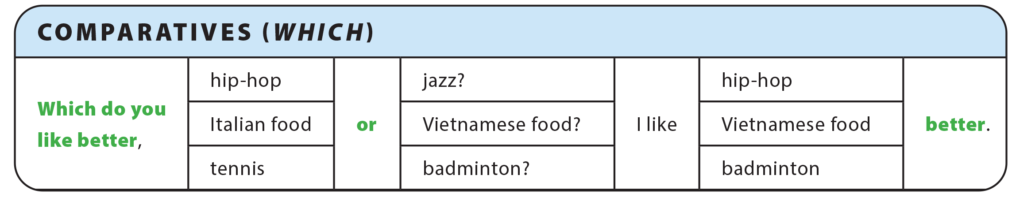
UNIT 6
I REALLY LIKE ELECTRONIC MUSIC!
GRAMMAR REFERENCE

Slide 8
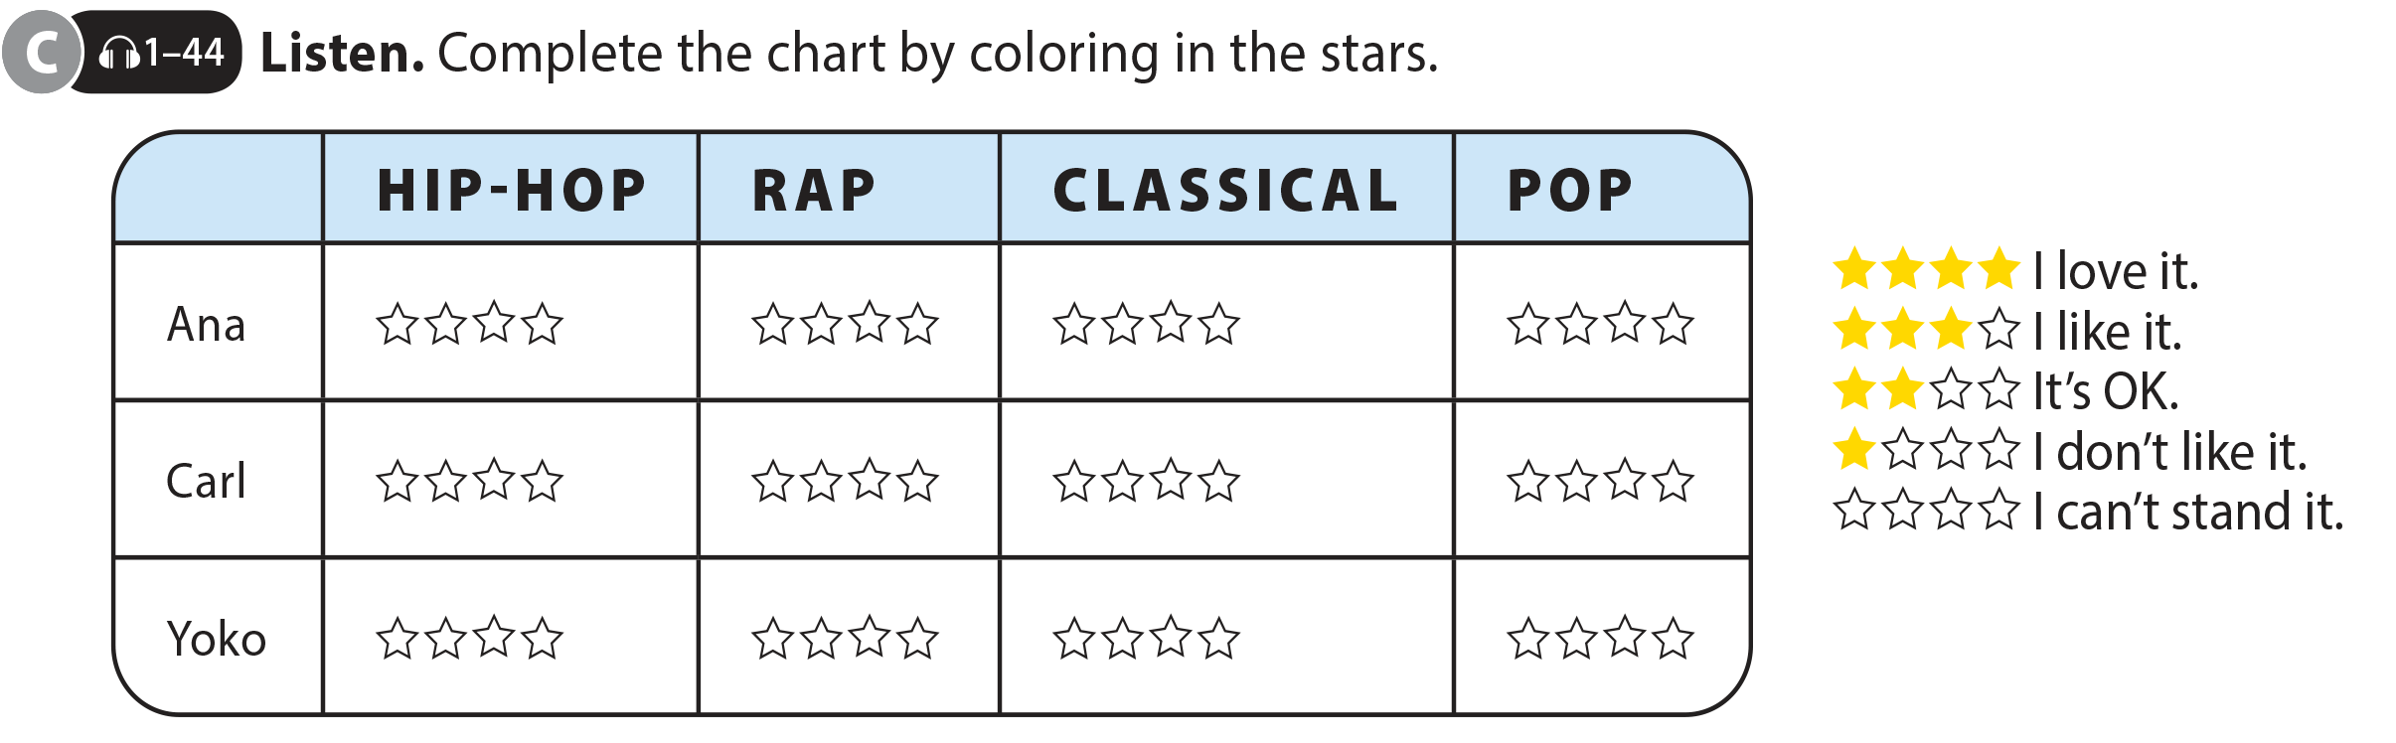
UNIT 6
I REALLY LIKE ELECTRONIC MUSIC!
LANGUAGE FOCUS

Slide 9
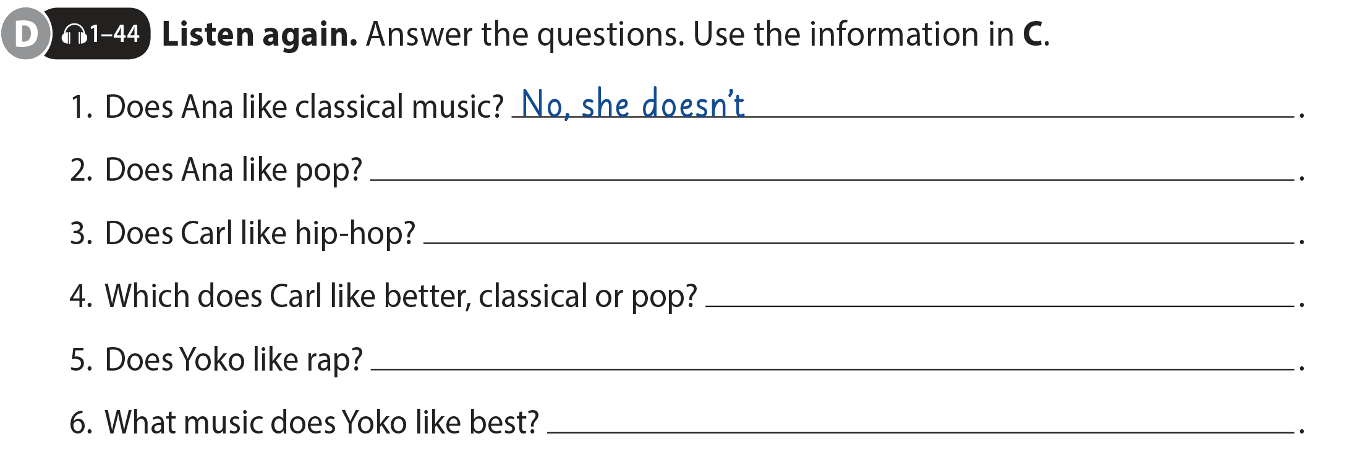
UNIT 6
I REALLY LIKE ELECTRONIC MUSIC!
LANGUAGE FOCUS
Yes, she does
Yes, he does
He likes classical music better
No, she doesn’t
She likes pop (the) best

Slide 10
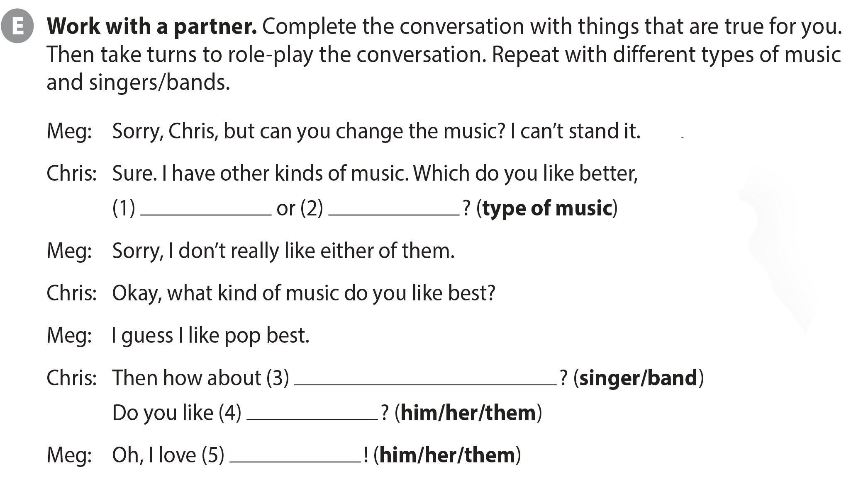
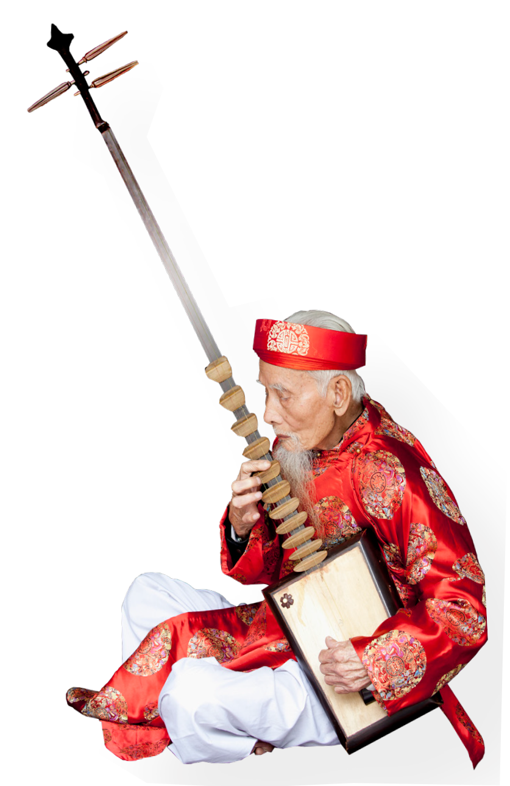
UNIT 6
I REALLY LIKE ELECTRONIC MUSIC!
LANGUAGE FOCUS

Slide 11
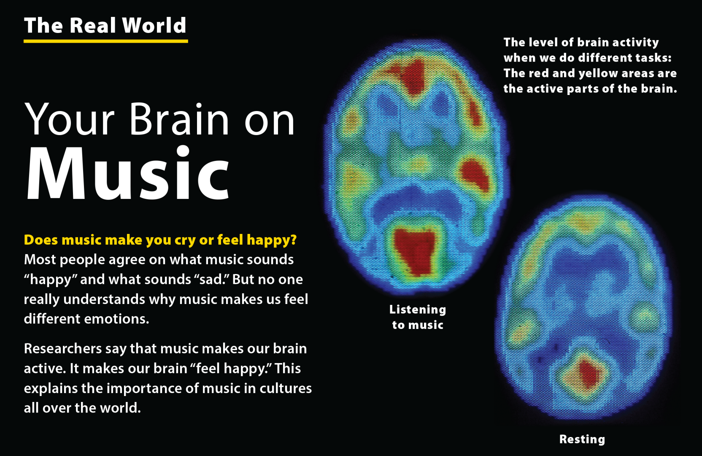
UNIT 6
I REALLY LIKE ELECTRONIC MUSIC!
THE REAL WORLD

Slide 12
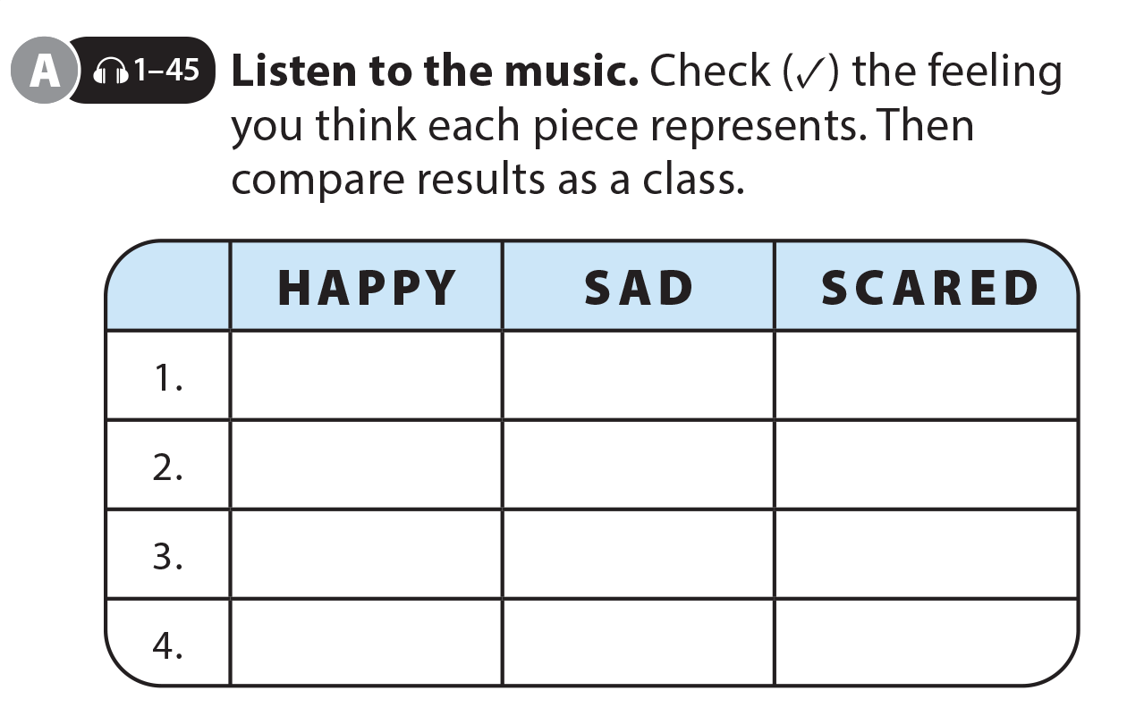
UNIT 6
I REALLY LIKE ELECTRONIC MUSIC!
THE REAL WORLD

Slide 13
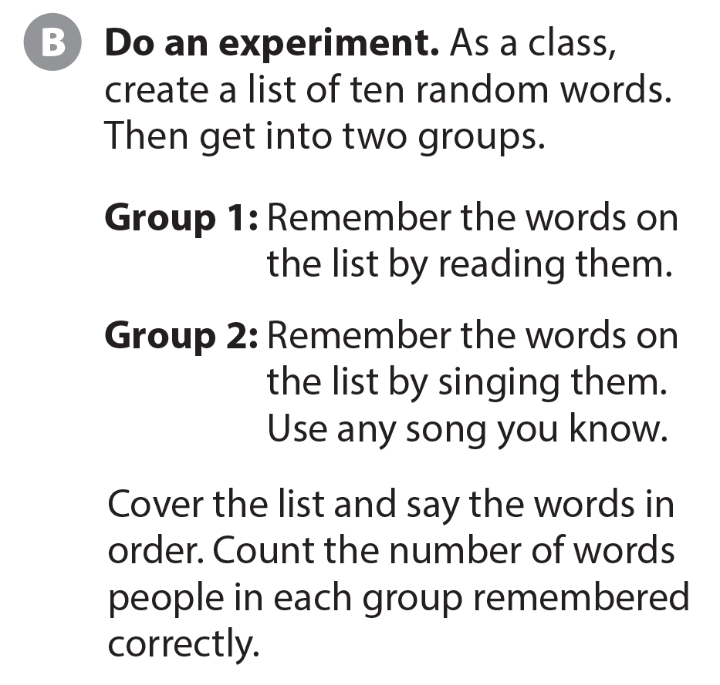
UNIT 6
I REALLY LIKE ELECTRONIC MUSIC!
THE REAL WORLD
National Geographic Learning, a Cengage Company © 2022 Cengage Learning, Inc. ALL RIGHTS RESERVED. This presentation tool is intended for teaching purposes only and may not be scanned, copied, duplicated, or posted to a publicly accessible platform in whole or in part.

Slide 14
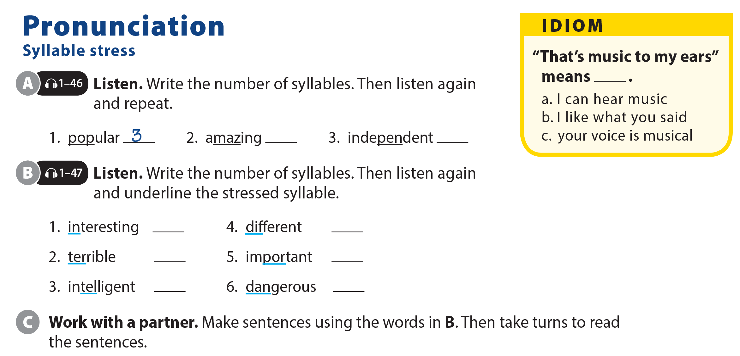
UNIT 6
I REALLY LIKE ELECTRONIC MUSIC!
PRONUNCIATION
3
4
3
2
3
3
4
3

Slide 15
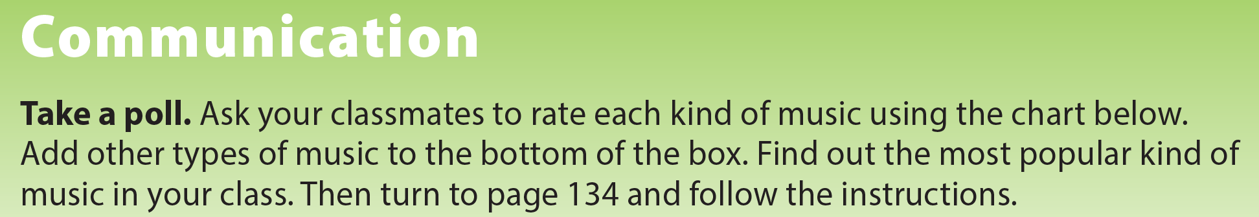
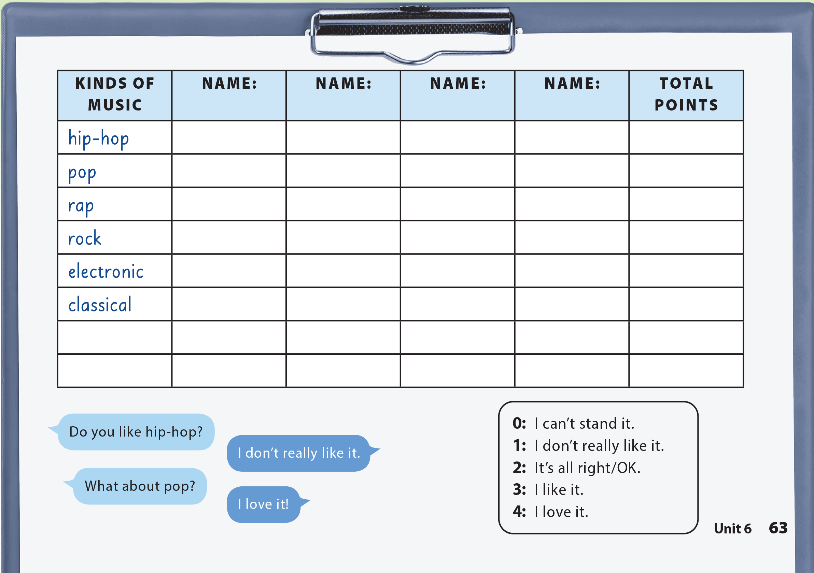
UNIT 6
I REALLY LIKE ELECTRONIC MUSIC!
COMMUNICATION

Slide 16

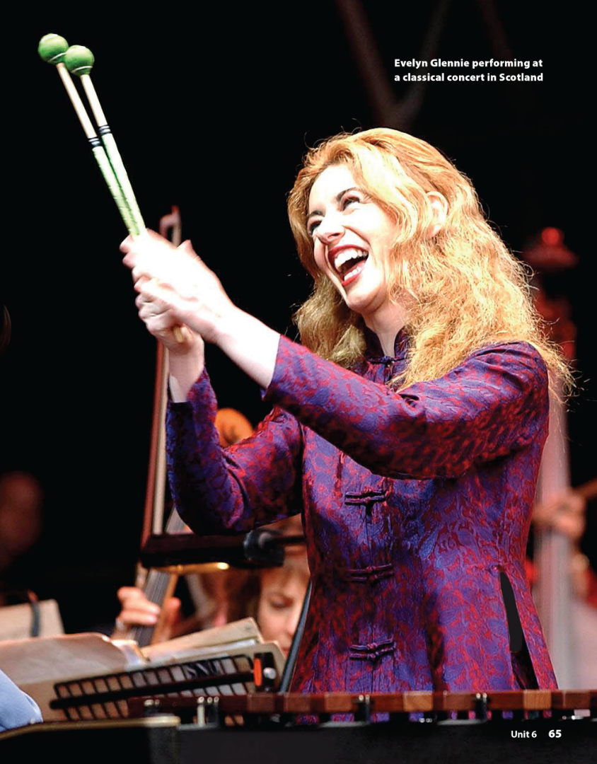
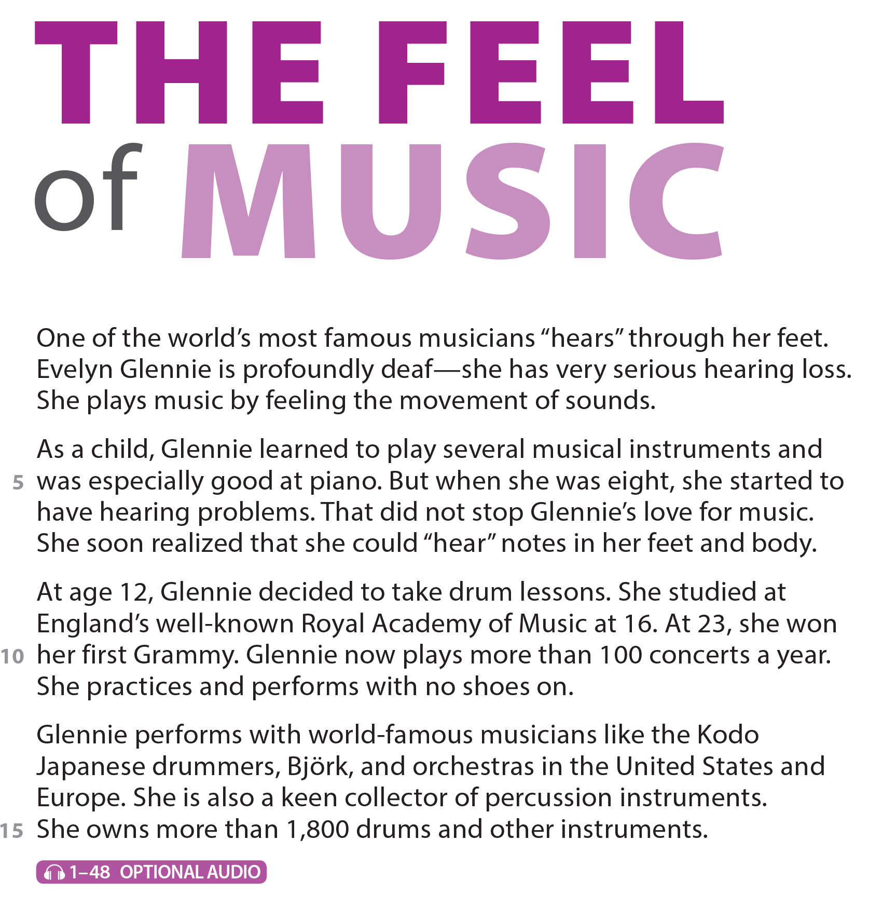

UNIT 6
I REALLY LIKE ELECTRONIC MUSIC!
READING
National Geographic Learning, a Cengage Company © 2022 Cengage Learning, Inc. ALL RIGHTS RESERVED. This presentation tool is intended for teaching purposes only and may not be scanned, copied, duplicated, or posted to a publicly accessible platform in whole or in part.

Slide 17
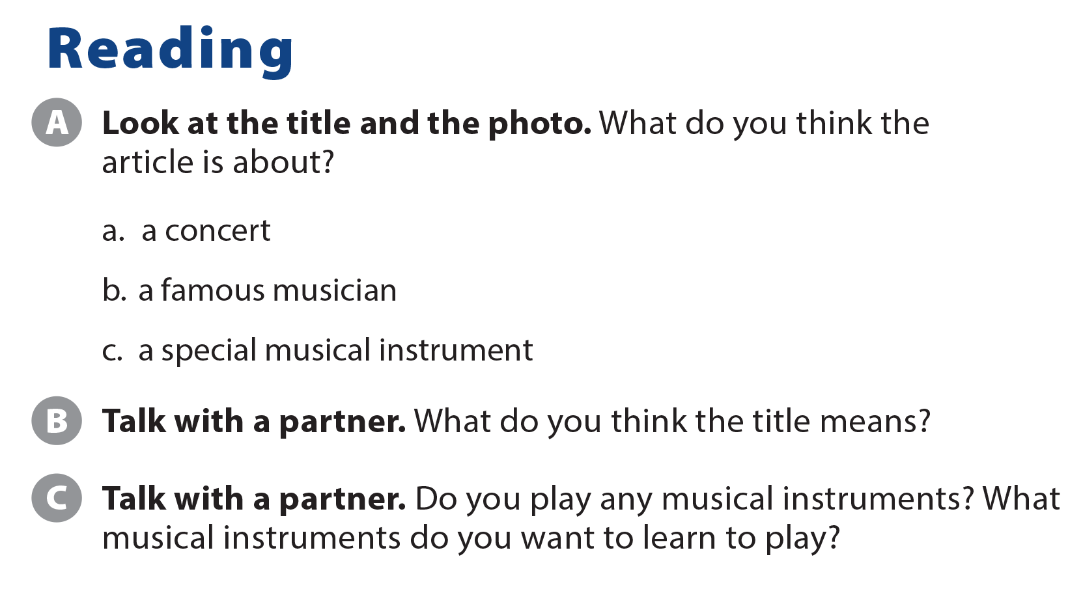
UNIT 6
I REALLY LIKE ELECTRONIC MUSIC!
READING

Slide 18
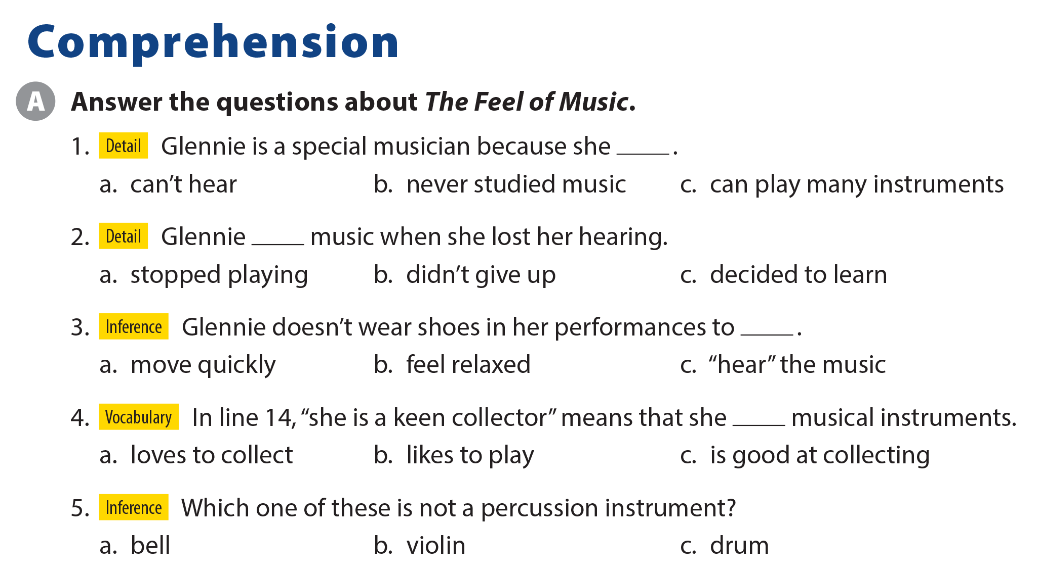
UNIT 6
I REALLY LIKE ELECTRONIC MUSIC!
COMPREHENSION

Slide 19
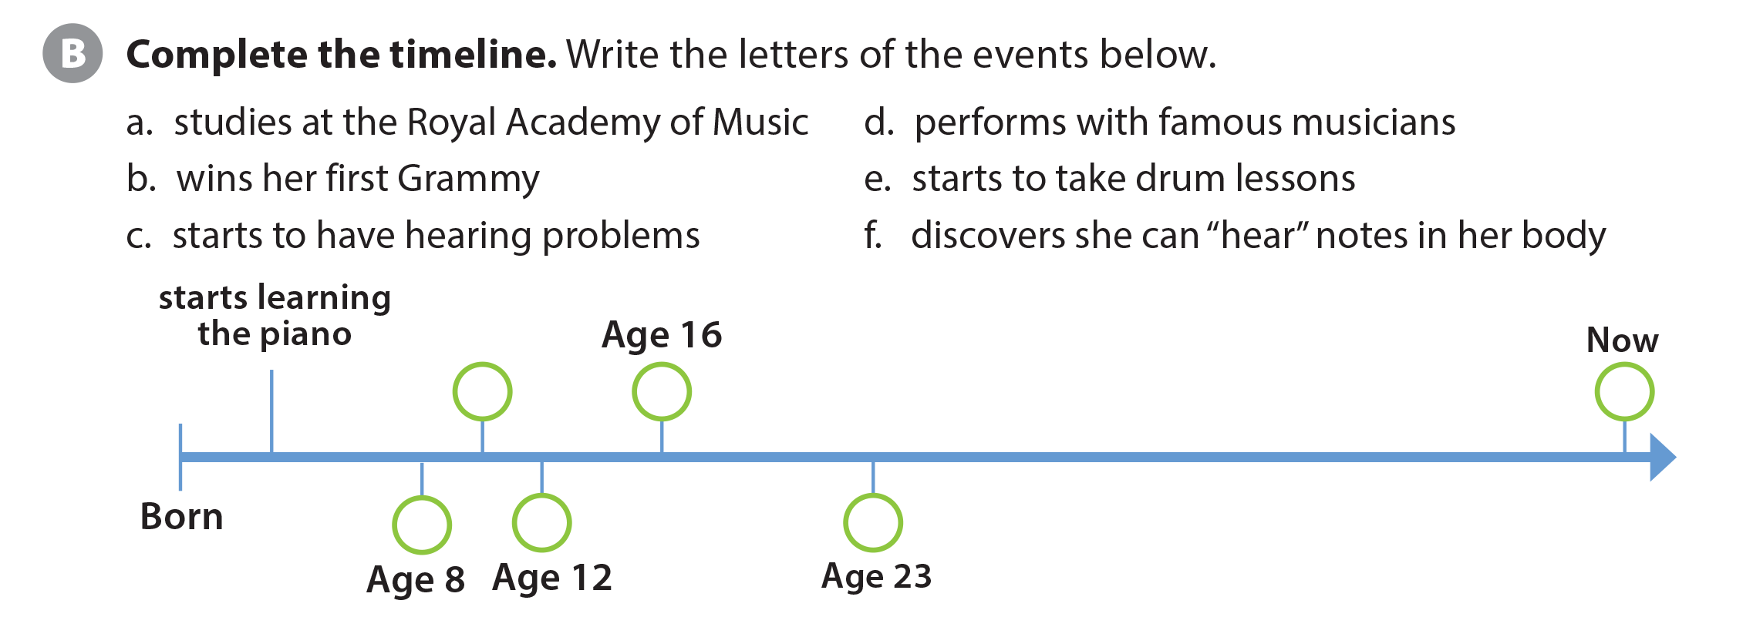

UNIT 6
I REALLY LIKE ELECTRONIC MUSIC!
COMPREHENSION
f
a
d
c
e
b

Slide 20
UNIT 6
I REALLY LIKE ELECTRONIC MUSIC!
PROJECT

Slide 21
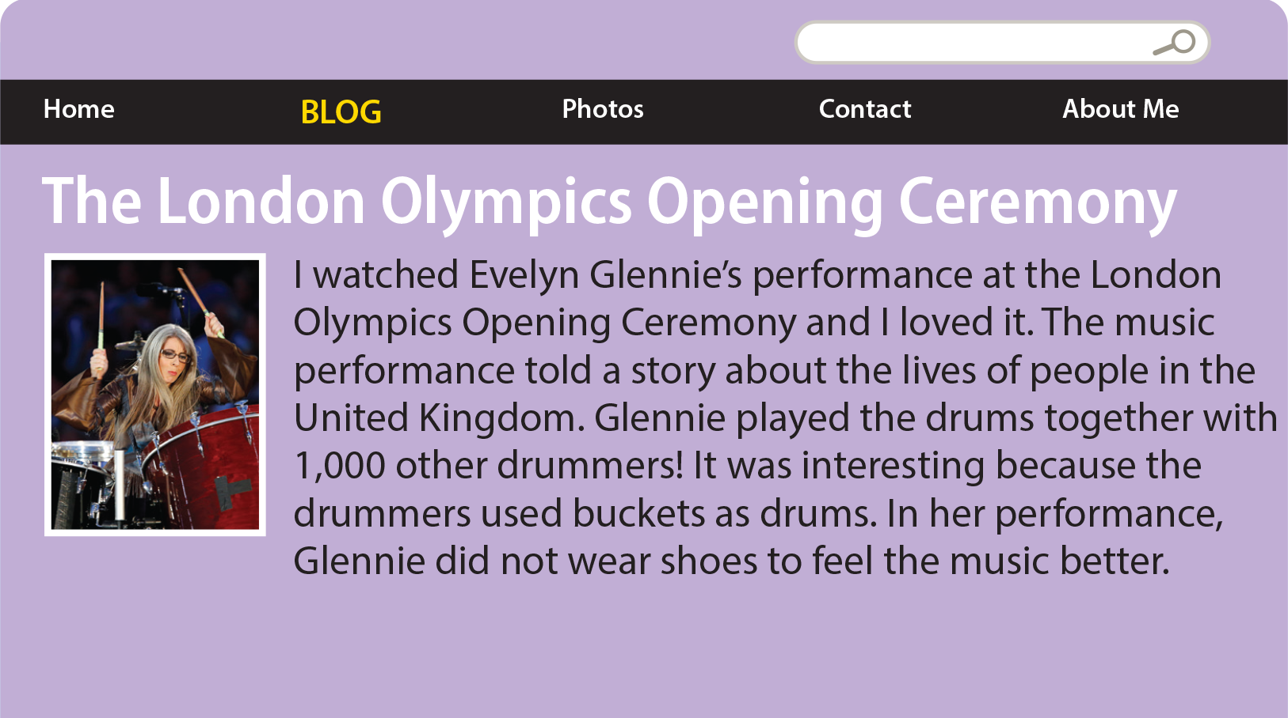
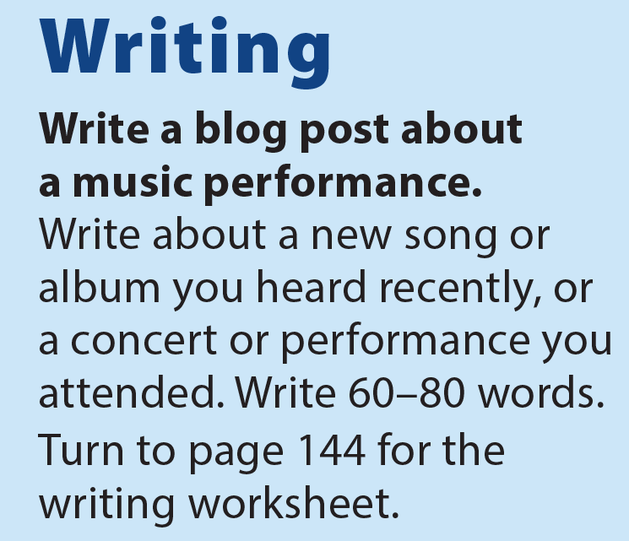
UNIT 6
I REALLY LIKE ELECTRONIC MUSIC!
WRITING

Slide 22
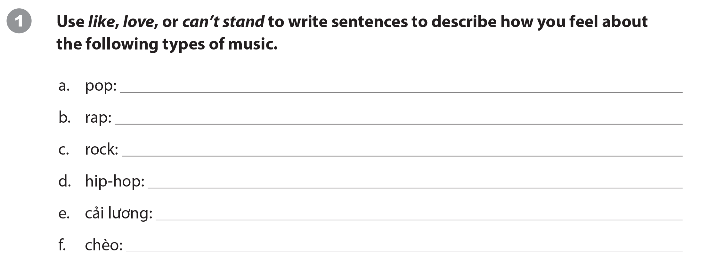
UNIT 6
I REALLY LIKE ELECTRONIC MUSIC!
WRITING WORKSHEET

Slide 23
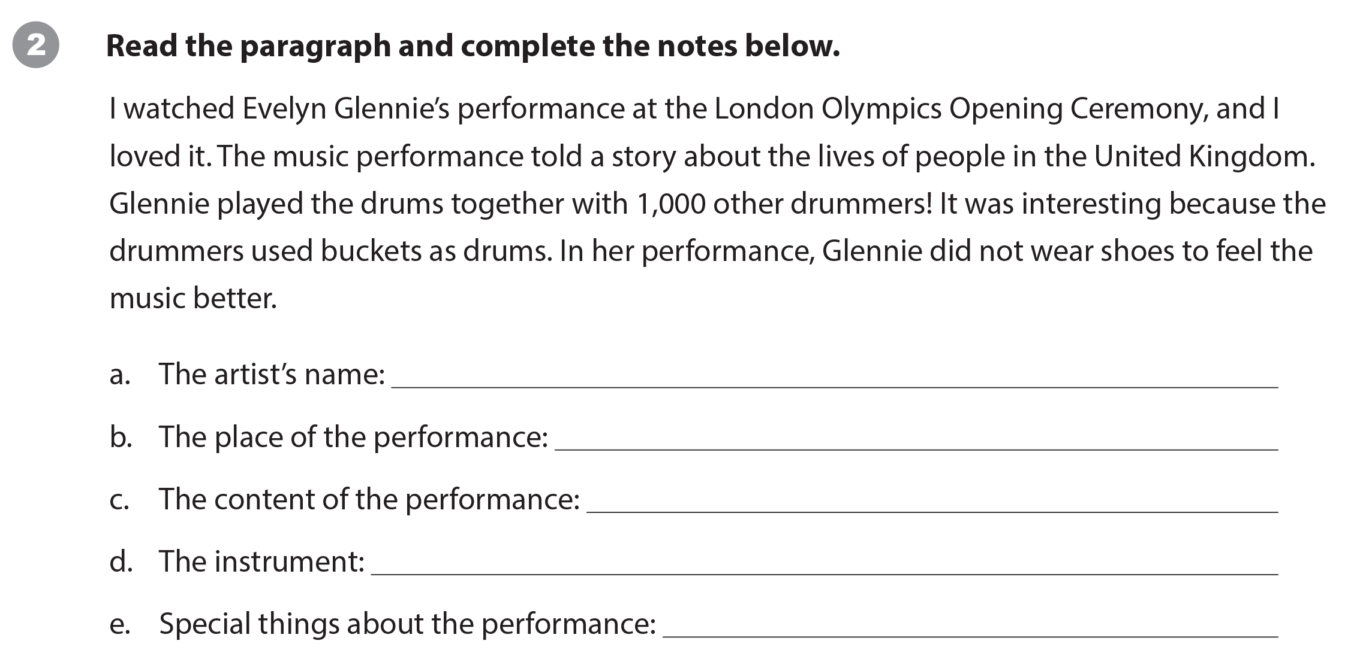
UNIT 6
I REALLY LIKE ELECTRONIC MUSIC!
WRITING WORKSHEET
Evelyn Glennie
London/London Olympics Opening Ceremony
a story about the lives of people in the United Kingdom
drums
drummers used buckets as drums / Glennie did not wear shoes

Slide 24
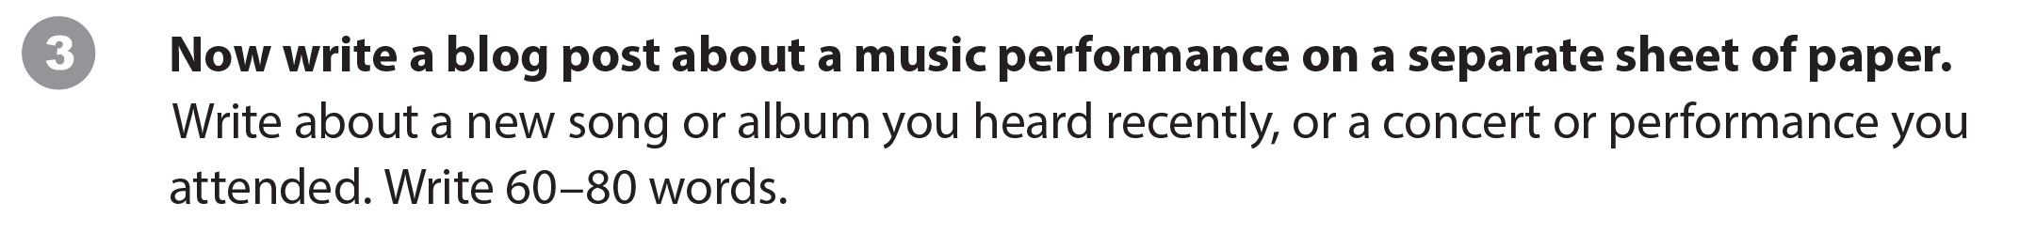
UNIT 6
I REALLY LIKE ELECTRONIC MUSIC!
WRITING WORKSHEET

Slide 25

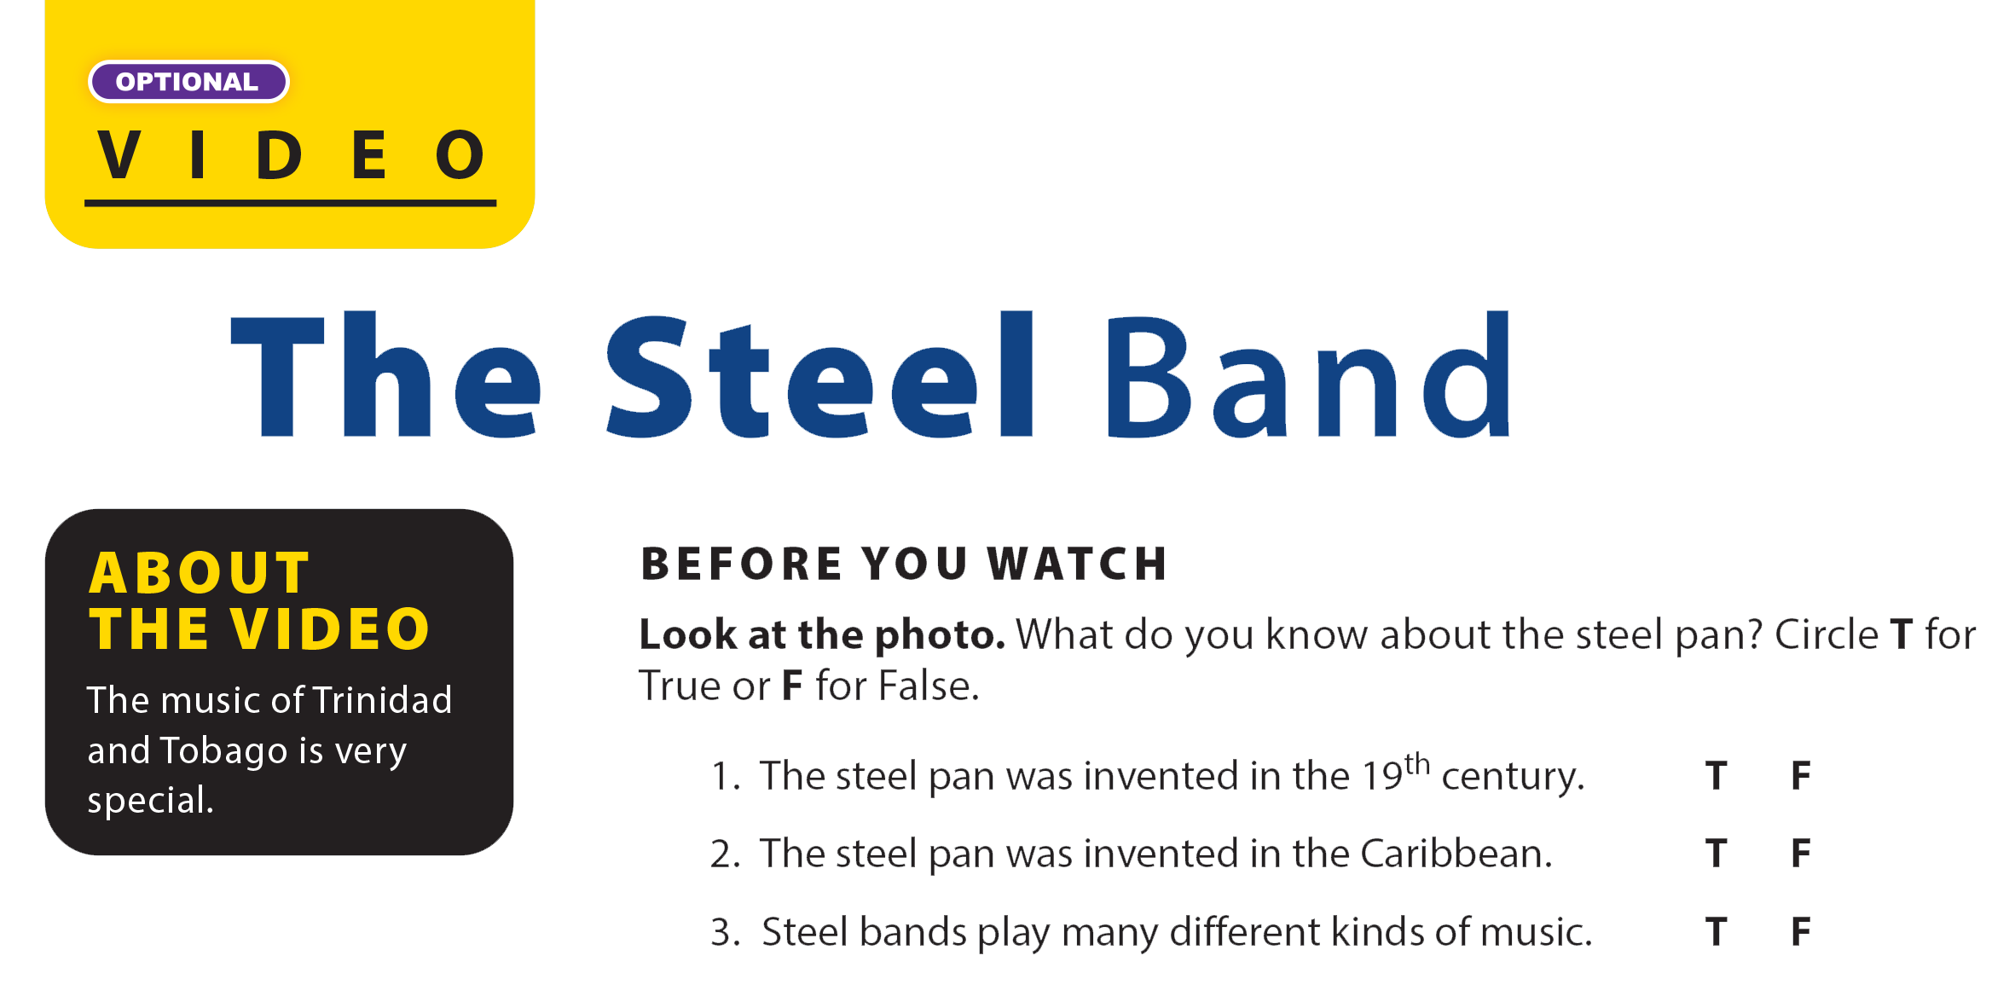
UNIT 6
I REALLY LIKE ELECTRONIC MUSIC!
VIDEO

Slide 26


UNIT 6
I REALLY LIKE ELECTRONIC MUSIC!
VIDEO

Slide 27
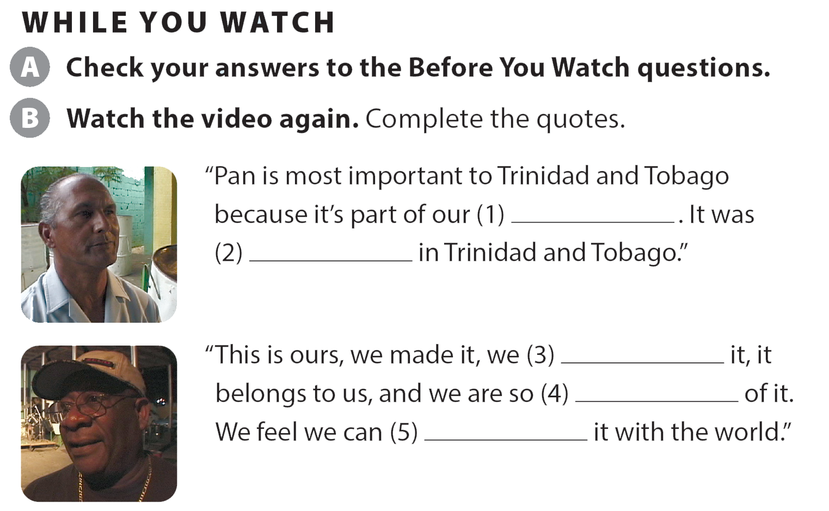
UNIT 6
I REALLY LIKE ELECTRONIC MUSIC!
VIDEO
culture
invented
created
proud
share

Slide 28
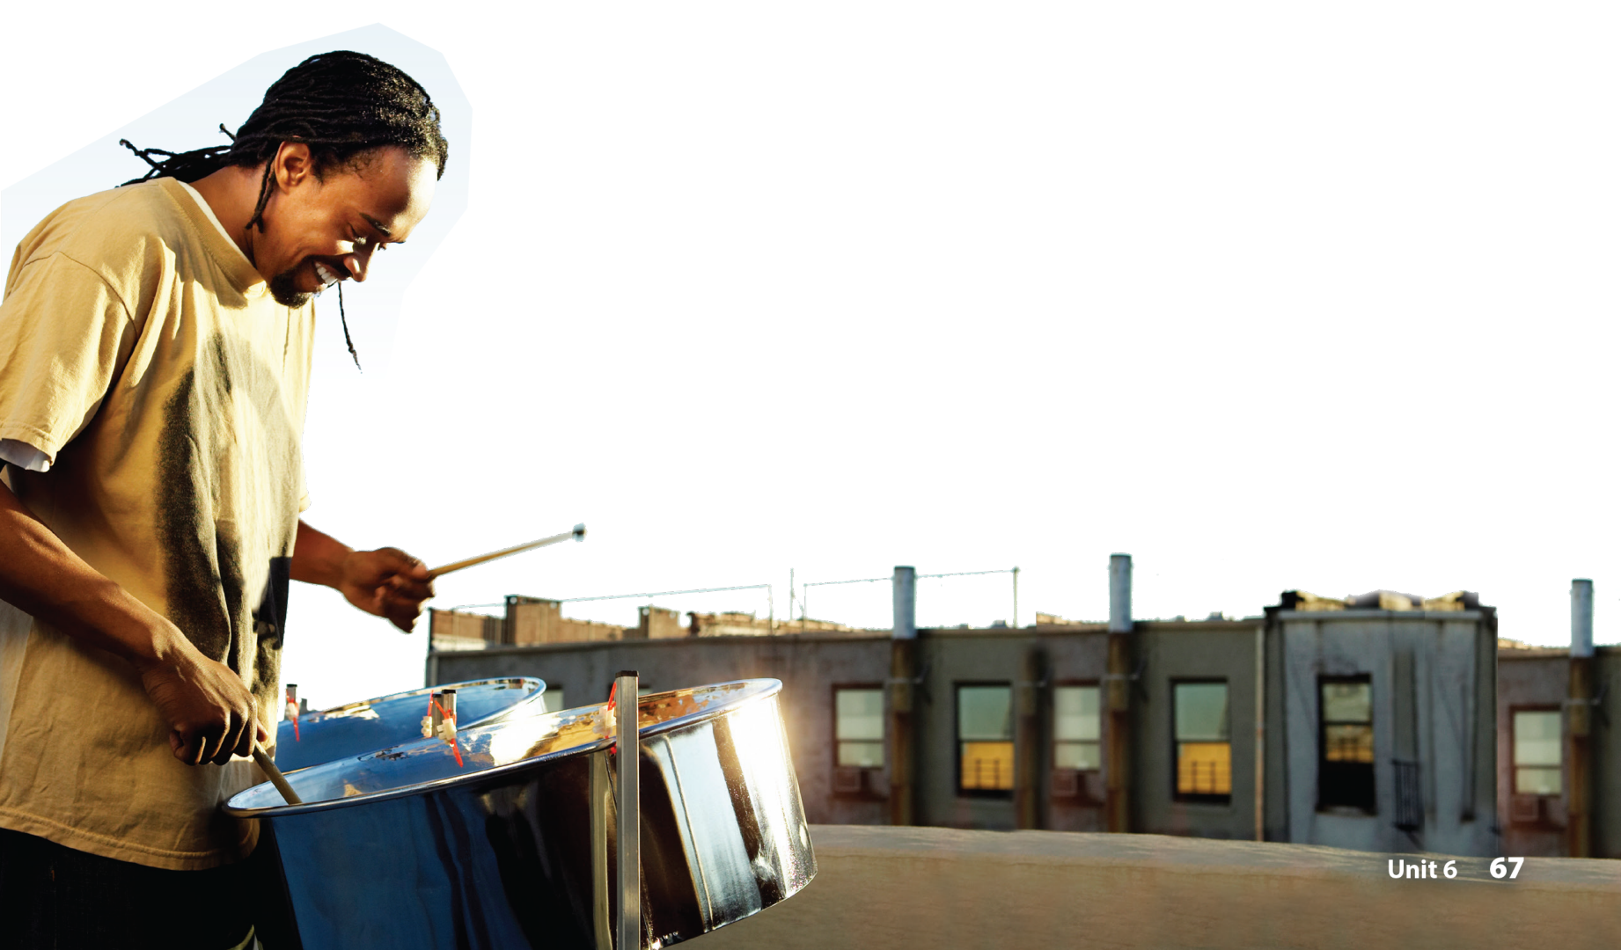
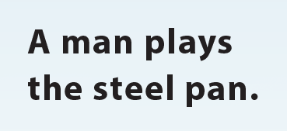
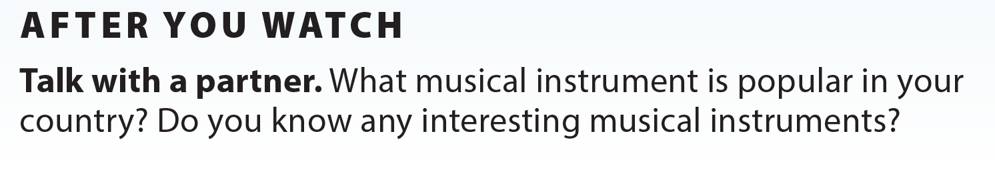
UNIT 6
I REALLY LIKE ELECTRONIC MUSIC!
VIDEO
National Geographic Learning, a Cengage Company © 2022 Cengage Learning, Inc. ALL RIGHTS RESERVED. This presentation tool is intended for teaching purposes only and may not be scanned, copied, duplicated, or posted to a publicly accessible platform in whole or in part.

Slide 29
UNIT 6
I REALLY LIKE ELECTRONIC MUSIC!
Thank you!

