Slide 1

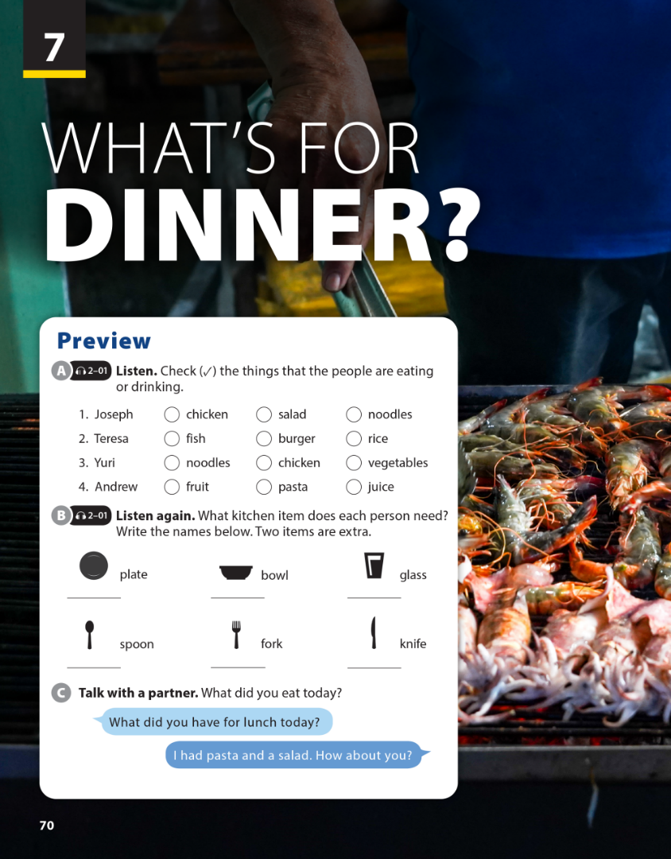
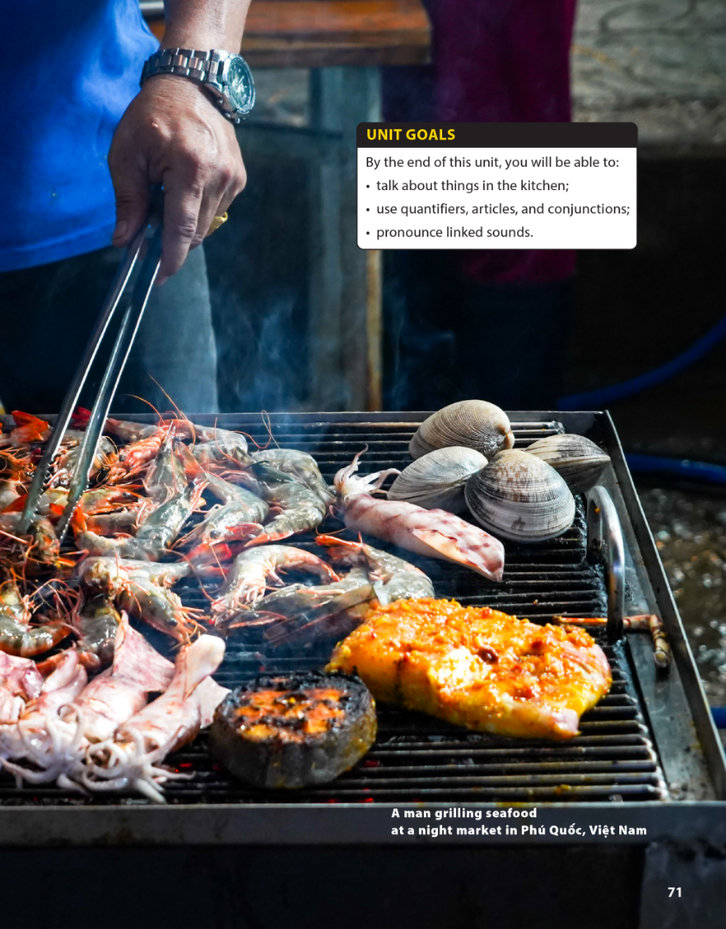

7
National Geographic Learning, a Cengage Company © 2022 Cengage Learning, Inc. ALL RIGHTS RESERVED. This presentation tool is intended for teaching purposes only and may not be scanned, copied, duplicated, or posted to a publicly accessible platform in whole or in part.

Slide 2
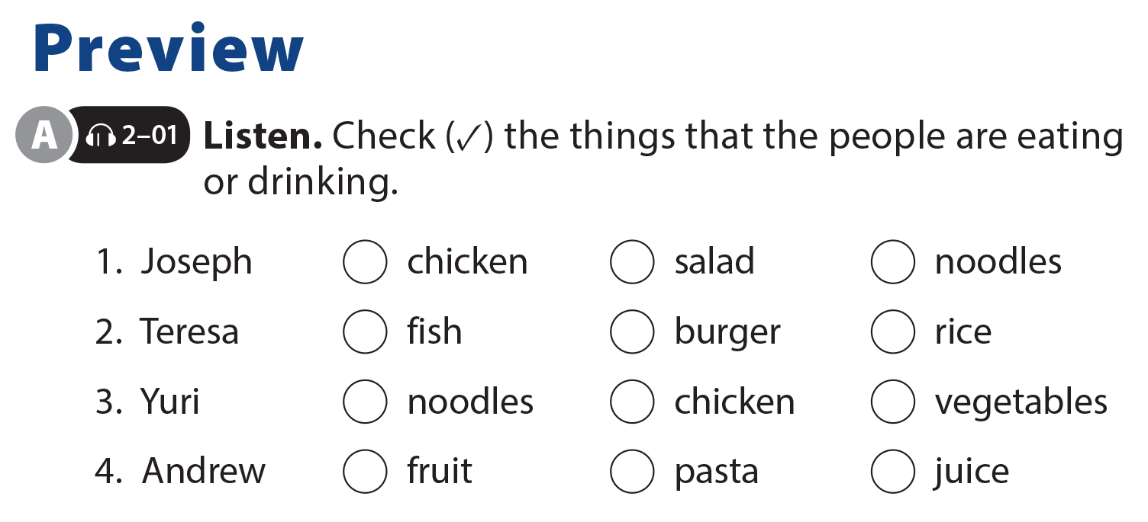

UNIT 7
WHAT’S FOR DINNER?
PREVIEW
✓
✓
✓
✓
✓
✓

Slide 3
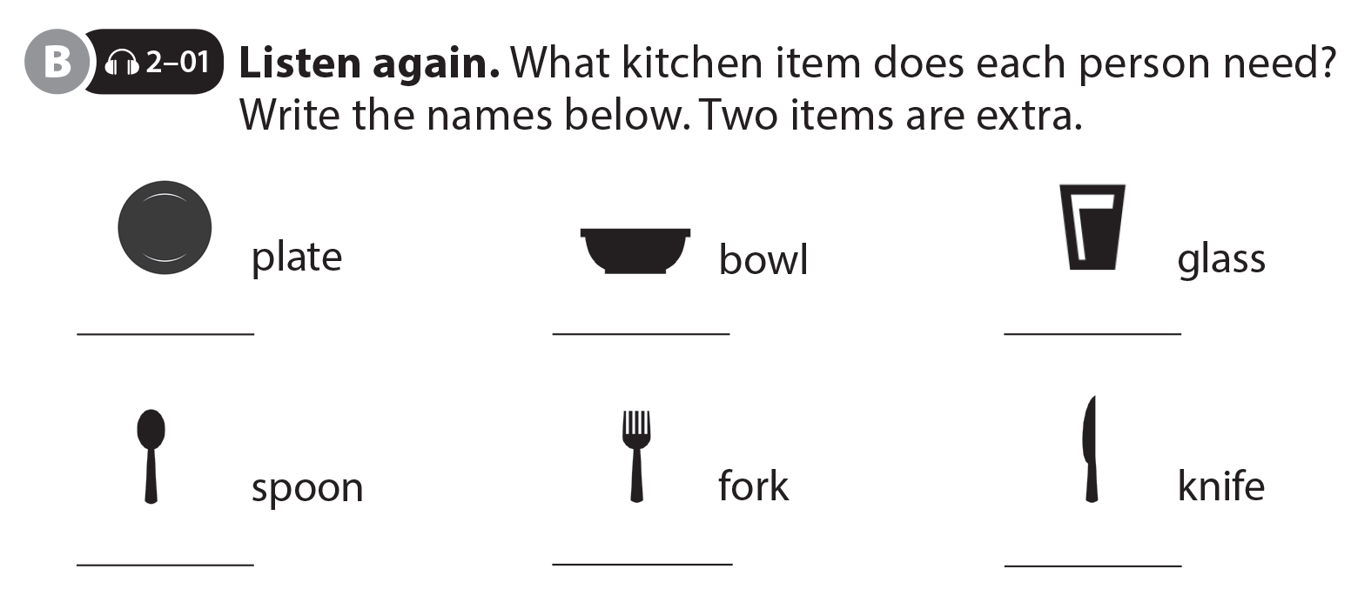
UNIT 7
WHAT’S FOR DINNER?
PREVIEW
Teresa
Yuri
Andrew
Joseph

Slide 4
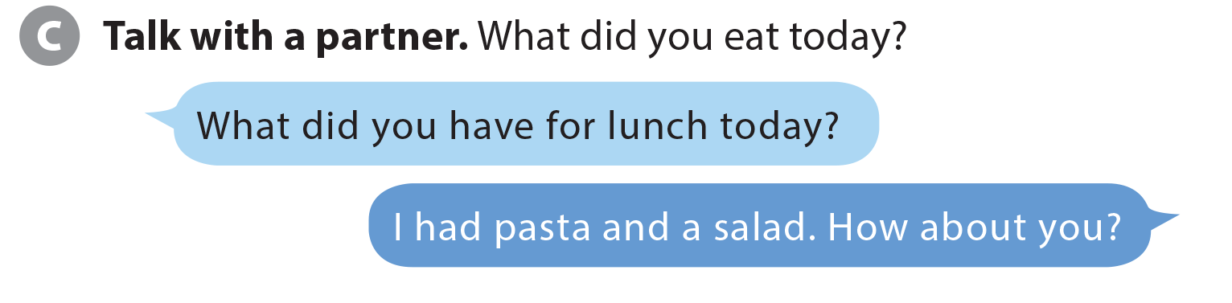
UNIT 7
WHAT’S FOR DINNER?
PREVIEW

Slide 5

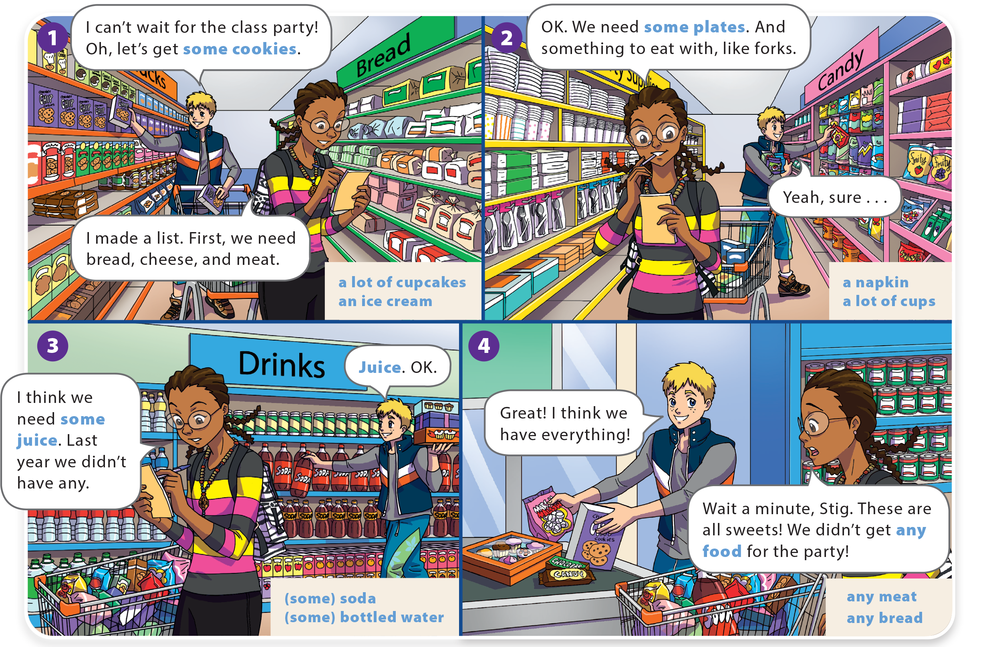
UNIT 7
WHAT’S FOR DINNER?
LANGUAGE FOCUS

Slide 6
UNIT 7
WHAT’S FOR DINNER?
LANGUAGE FOCUS

Slide 7

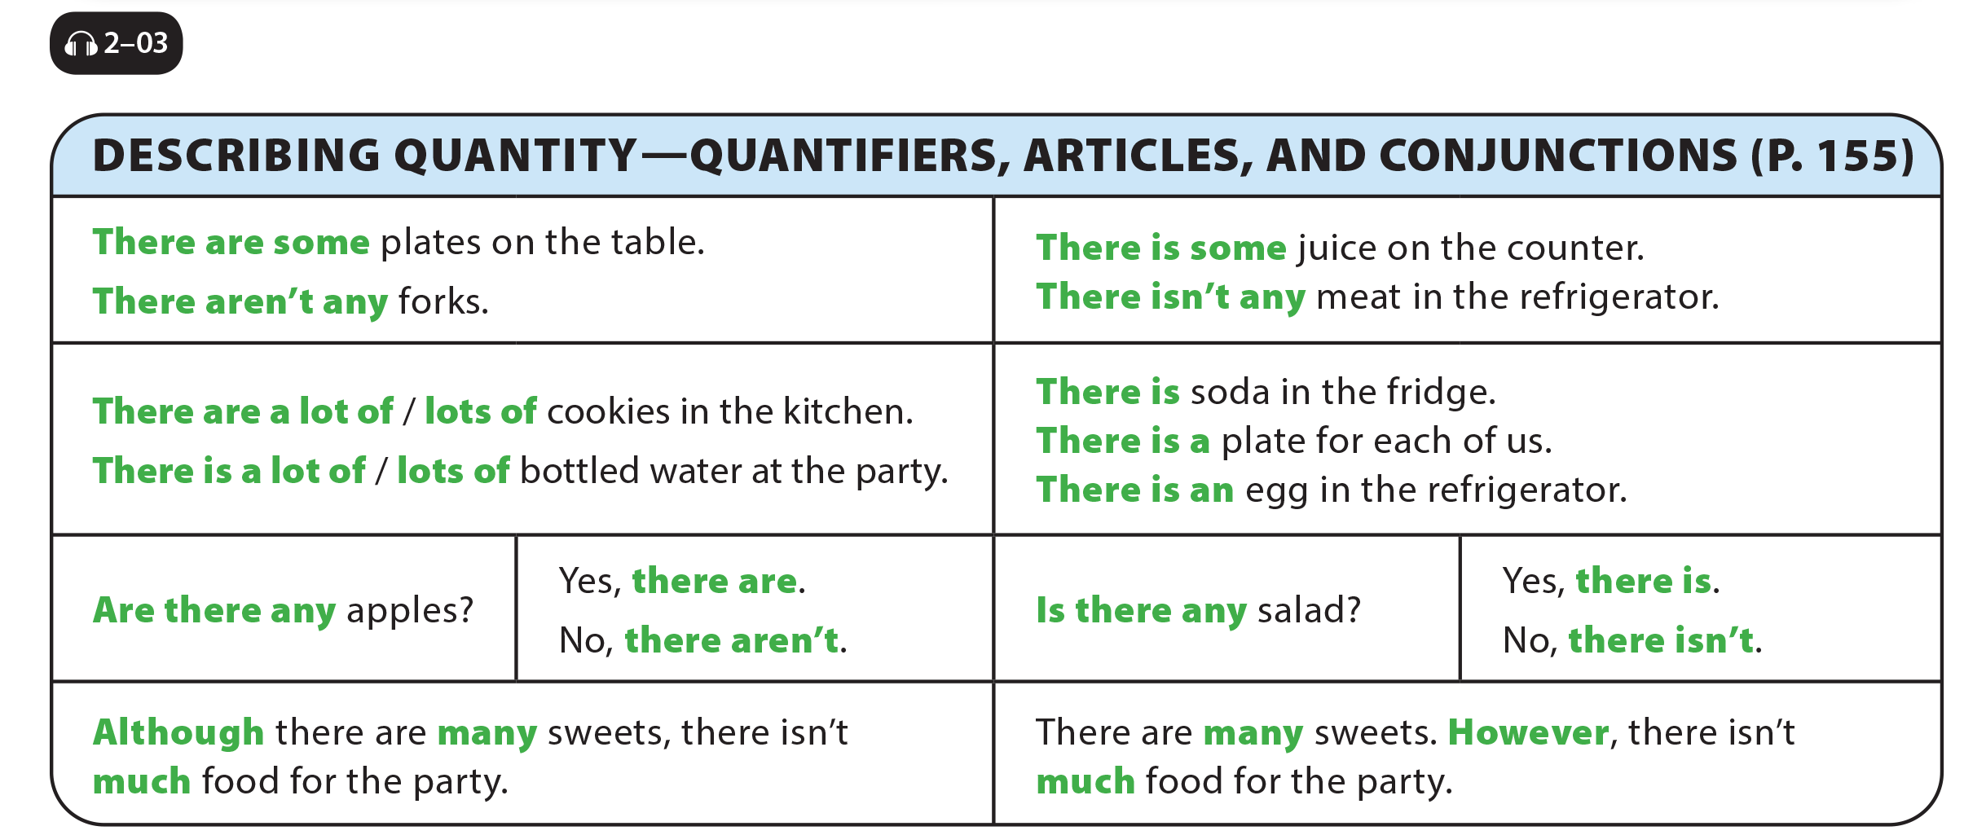
UNIT 7
WHAT’S FOR DINNER?
LANGUAGE FOCUS

Slide 8
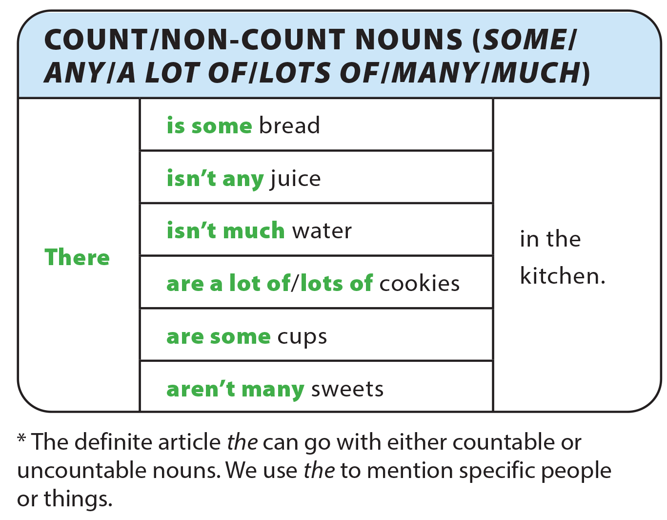
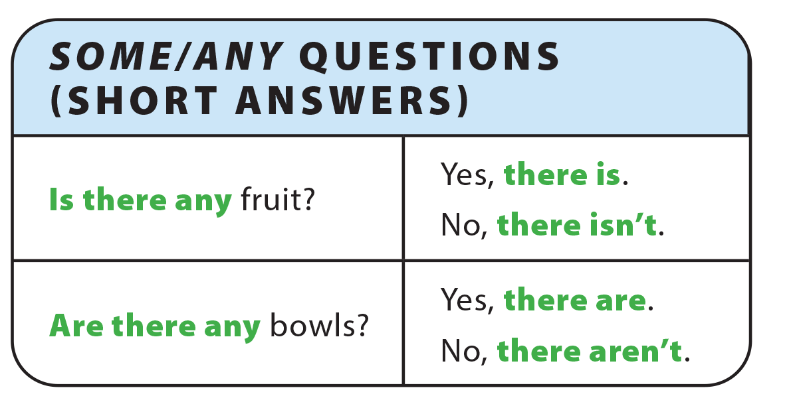
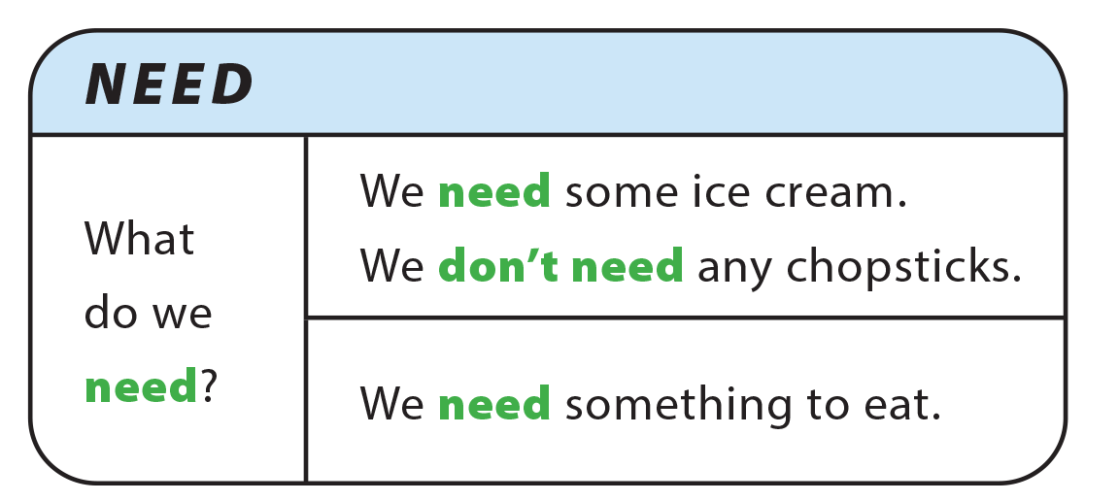
UNIT 7
WHAT’S FOR DINNER?
GRAMMAR REFERENCE

Slide 9
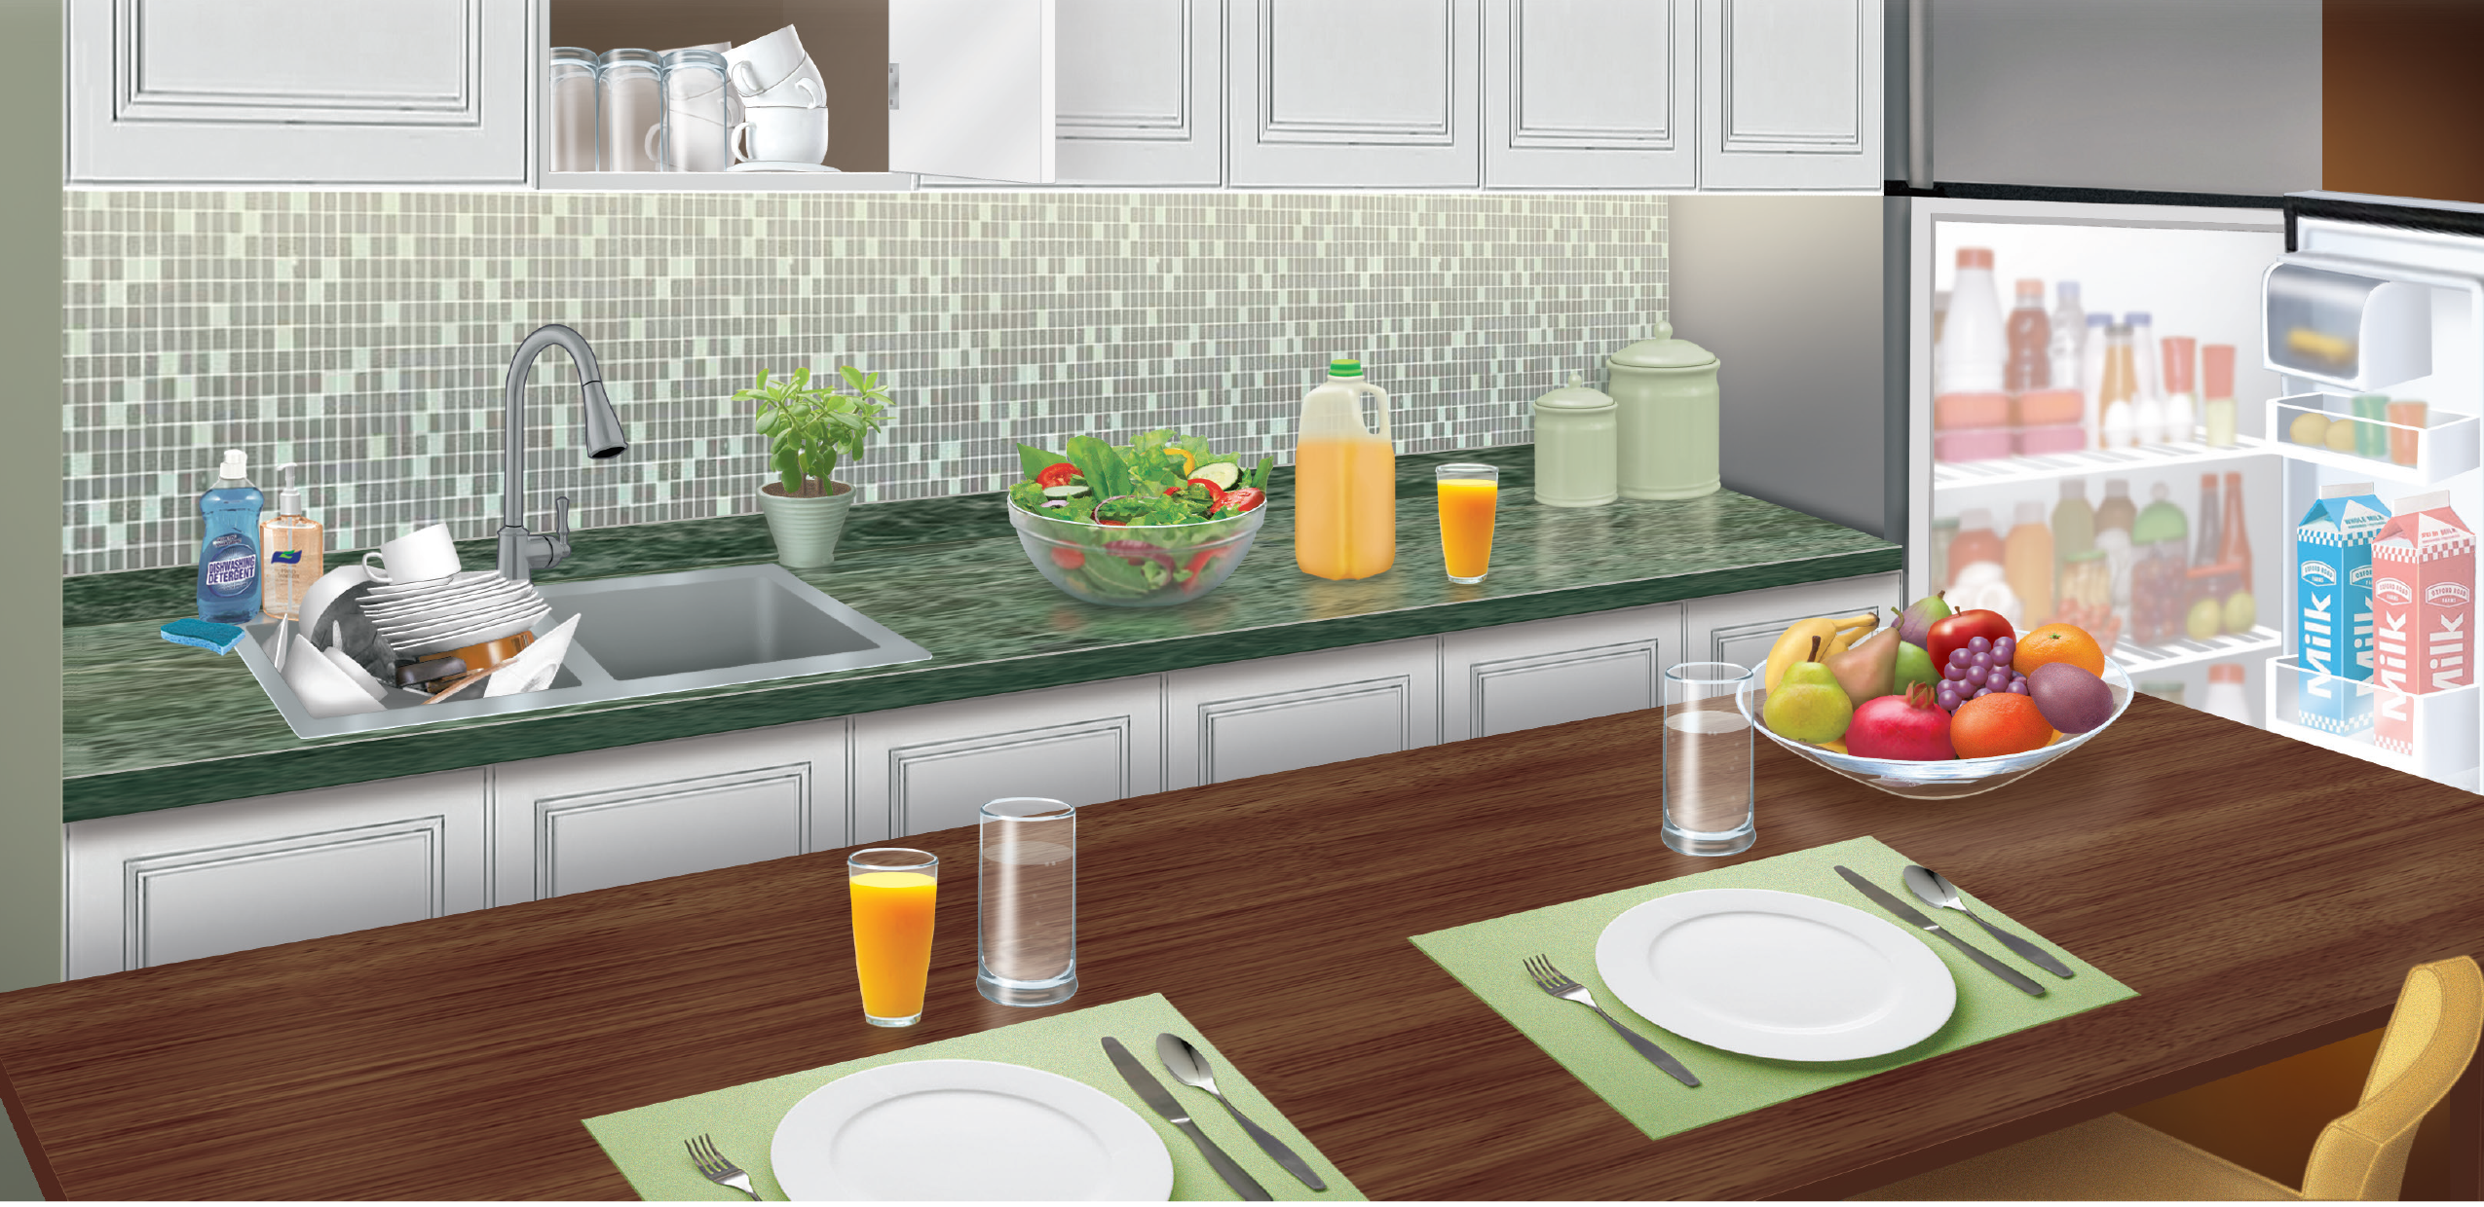
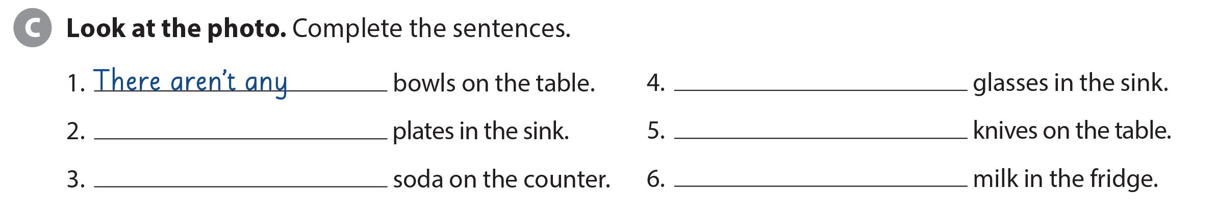
UNIT 7
WHAT’S FOR DINNER?
LANGUAGE FOCUS
There aren’t any
There are a lot of /
lots of / many
There are some
There isn’t any
There is some

Slide 10
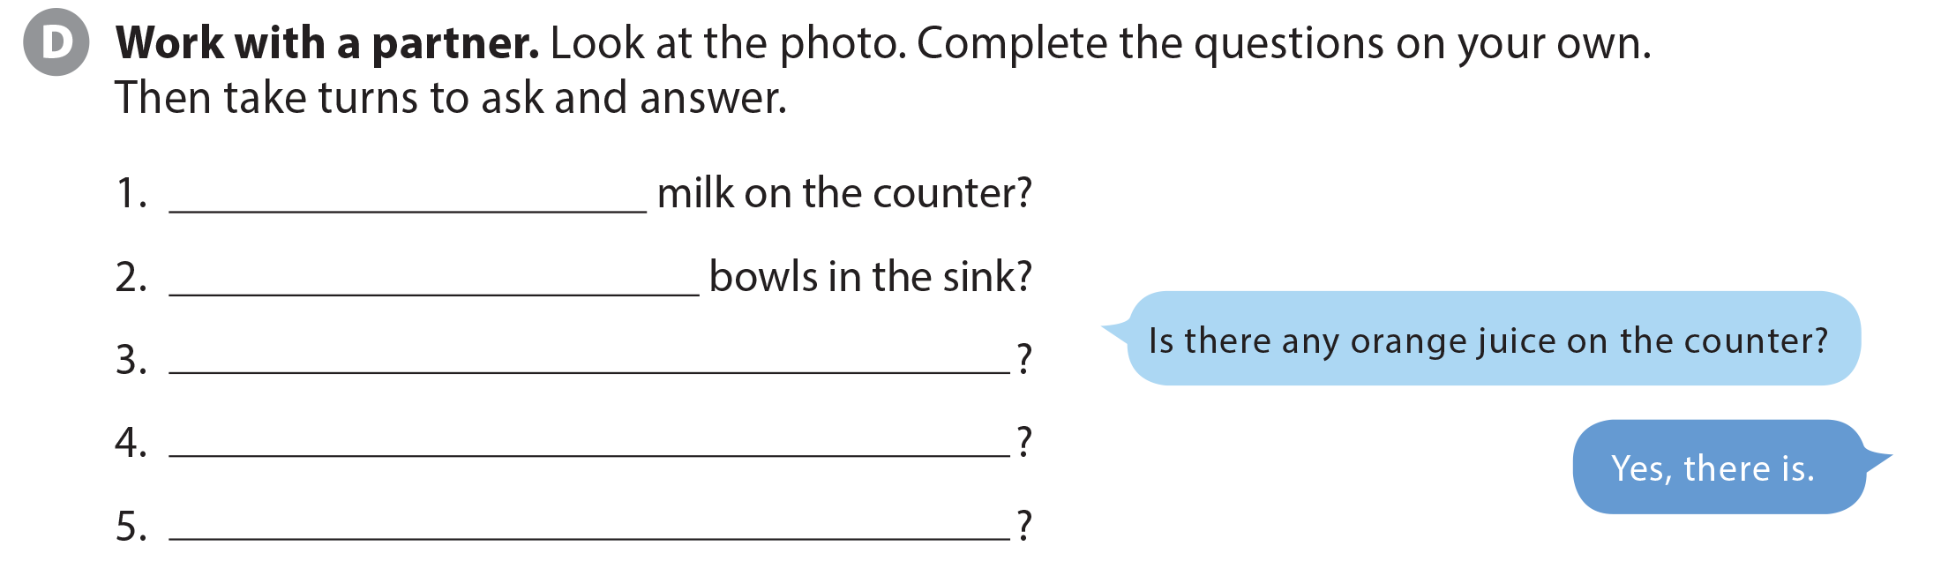
UNIT 7
WHAT’S FOR DINNER?
LANGUAGE FOCUS
Is there any
Are there any

Slide 11
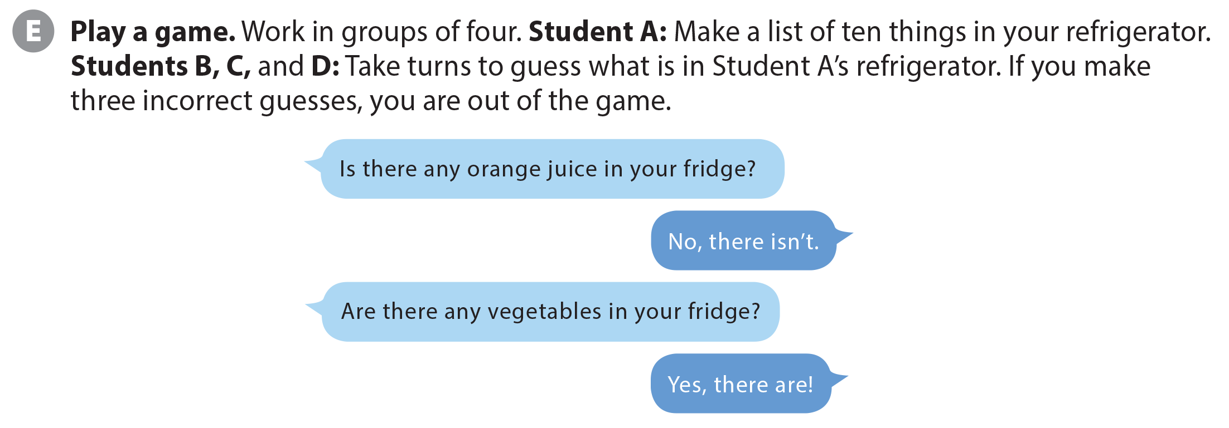
UNIT 7
WHAT’S FOR DINNER?
LANGUAGE FOCUS

Slide 12
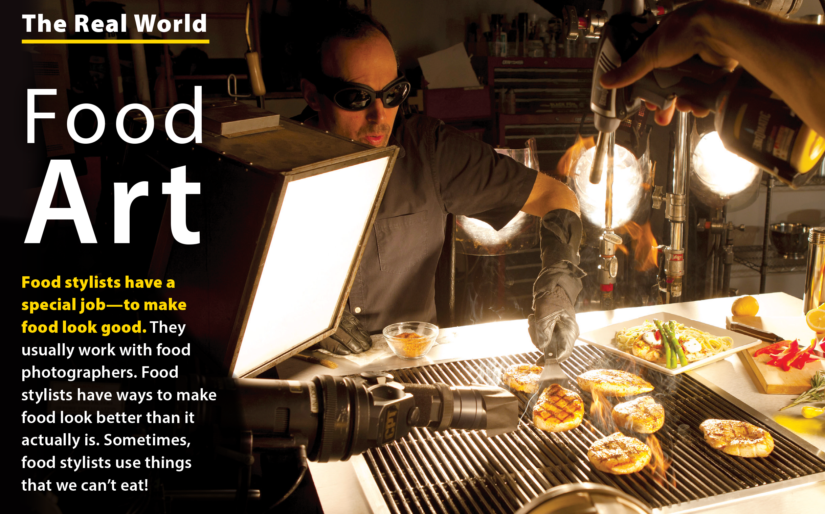
UNIT 7
WHAT’S FOR DINNER?
THE REAL WORLD

Slide 13
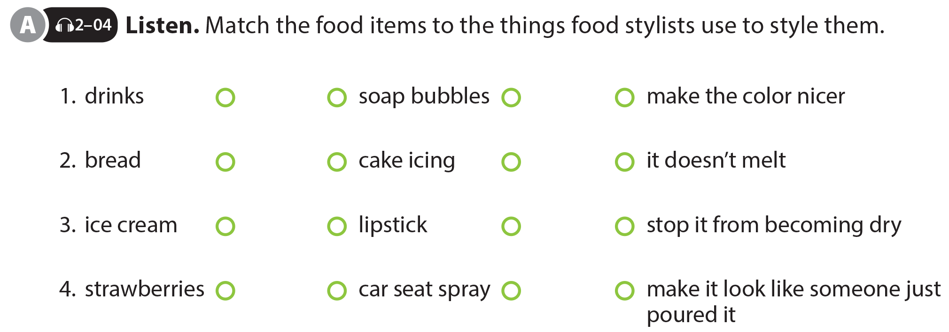
UNIT 7
WHAT’S FOR DINNER?
THE REAL WORLD

Slide 14


UNIT 7
WHAT’S FOR DINNER?
THE REAL WORLD
National Geographic Learning, a Cengage Company © 2022 Cengage Learning, Inc. ALL RIGHTS RESERVED. This presentation tool is intended for teaching purposes only and may not be scanned, copied, duplicated, or posted to a publicly accessible platform in whole or in part.

Slide 15
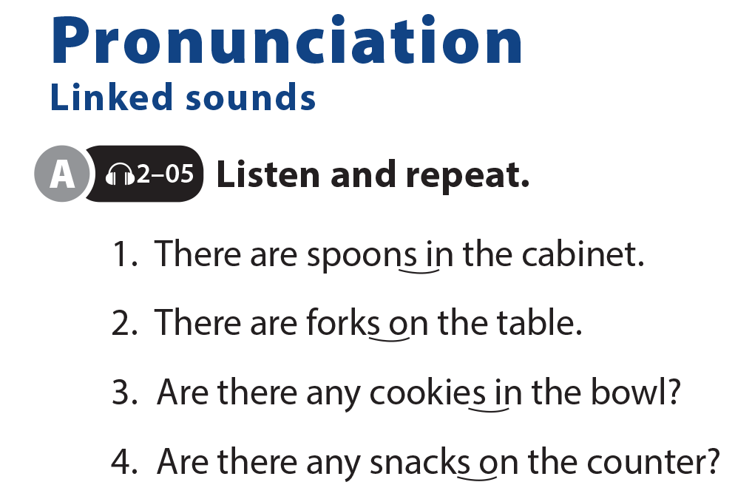
UNIT 7
WHAT’S FOR DINNER?
PRONUNCIATION

Slide 16
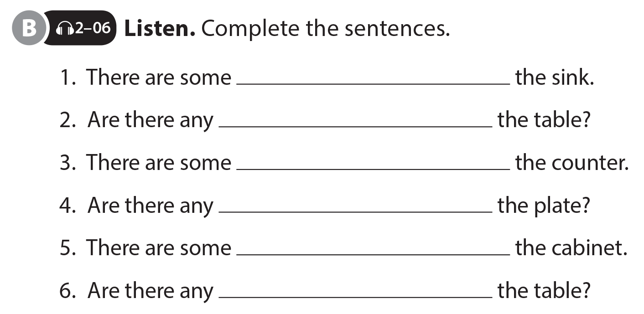
UNIT 7
WHAT’S FOR DINNER?
PRONUNCIATION
knives in
bowls on
cups on
hamburgers on
plates in
spoons on

Slide 17
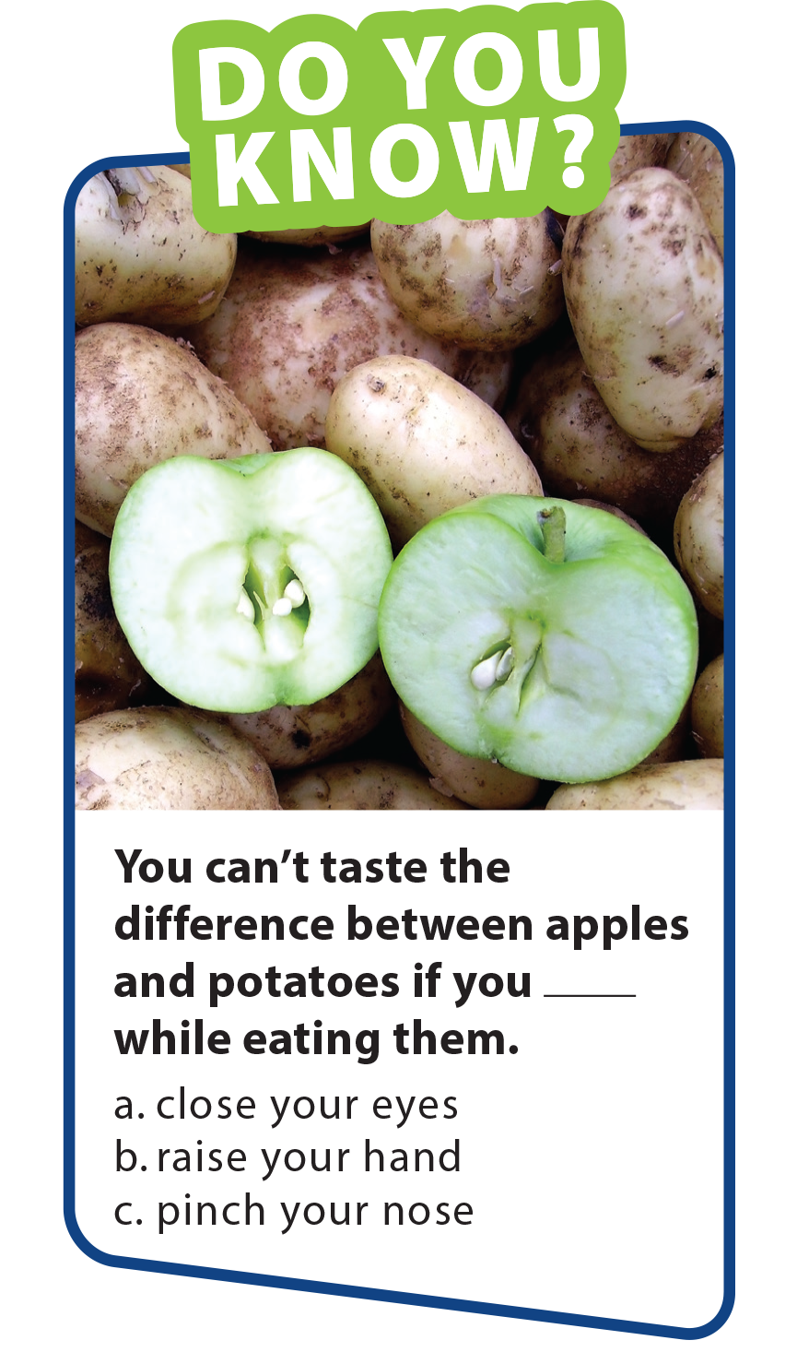
UNIT 7
WHAT’S FOR DINNER?
PRONUNCIATION
knives in
bowls on
cups on
hamburgers on
plates in
spoons on

Slide 18
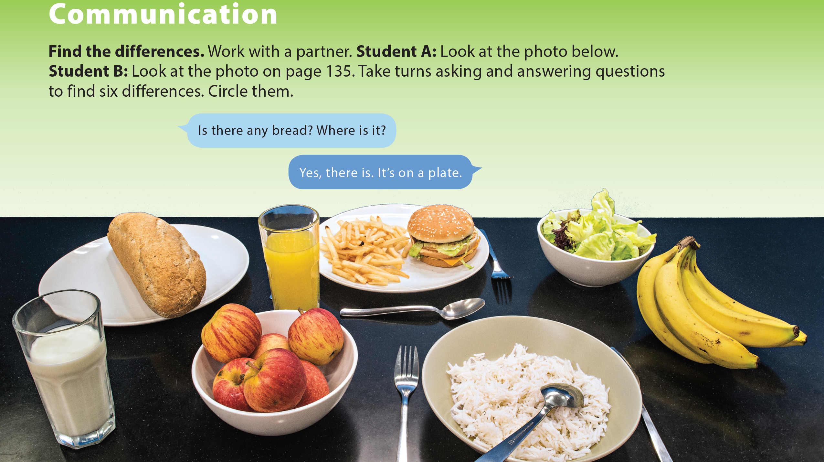
UNIT 7
WHAT’S FOR DINNER?
COMMUNICATION
National Geographic Learning, a Cengage Company © 2022 Cengage Learning, Inc. ALL RIGHTS RESERVED. This presentation tool is intended for teaching purposes only and may not be scanned, copied, duplicated, or posted to a publicly accessible platform in whole or in part.

Slide 19
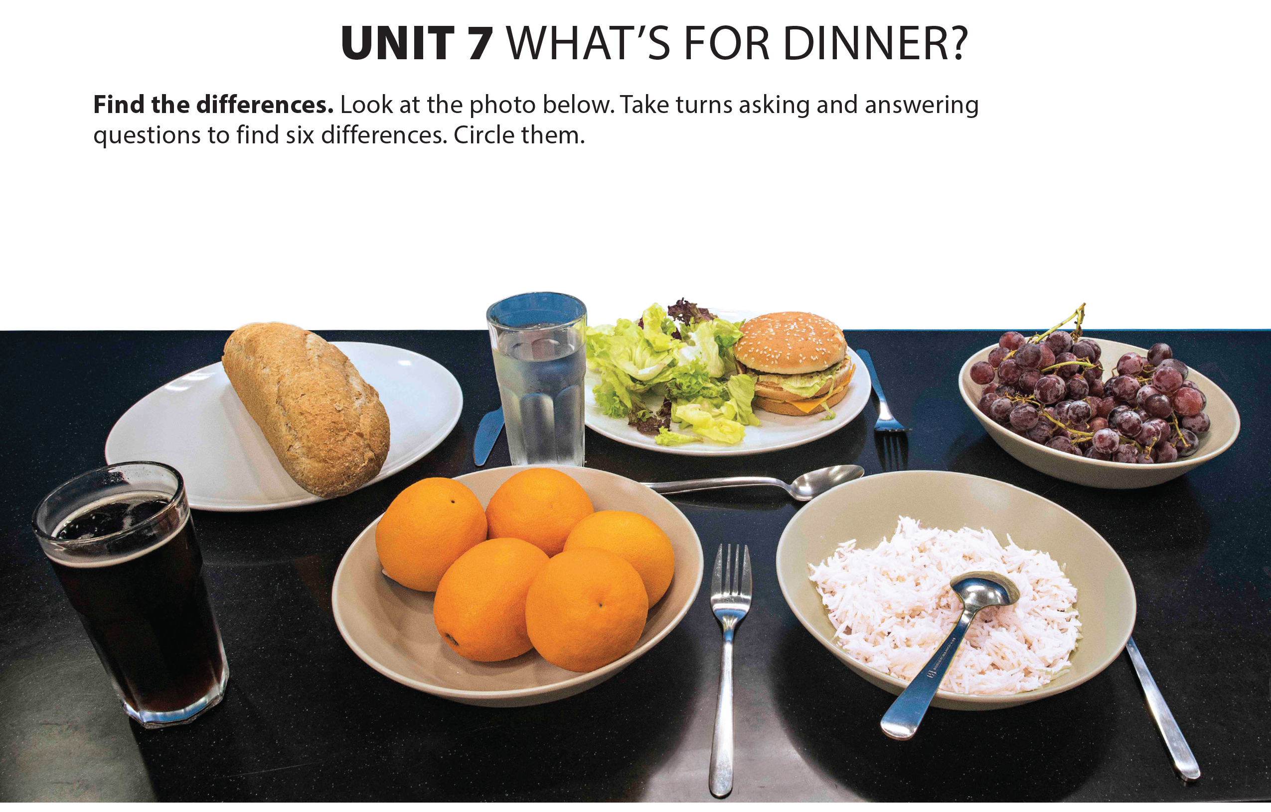
UNIT 7
WHAT’S FOR DINNER?
COMMUNICATION
National Geographic Learning, a Cengage Company © 2022 Cengage Learning, Inc. ALL RIGHTS RESERVED. This presentation tool is intended for teaching purposes only and may not be scanned, copied, duplicated, or posted to a publicly accessible platform in whole or in part.

Slide 20
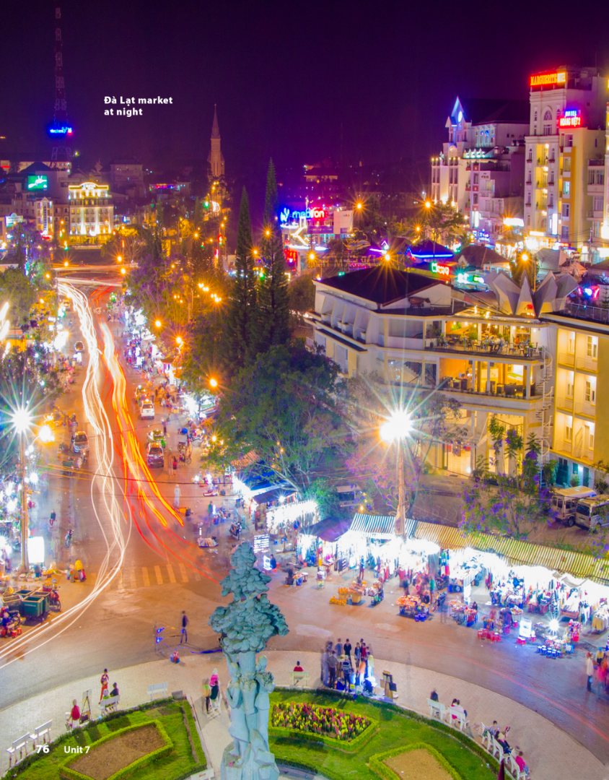
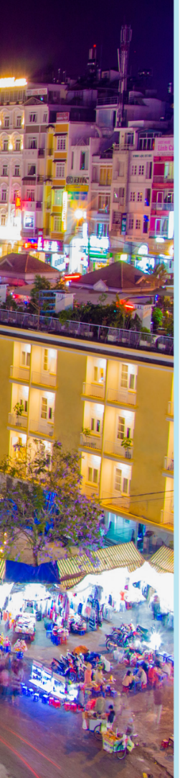

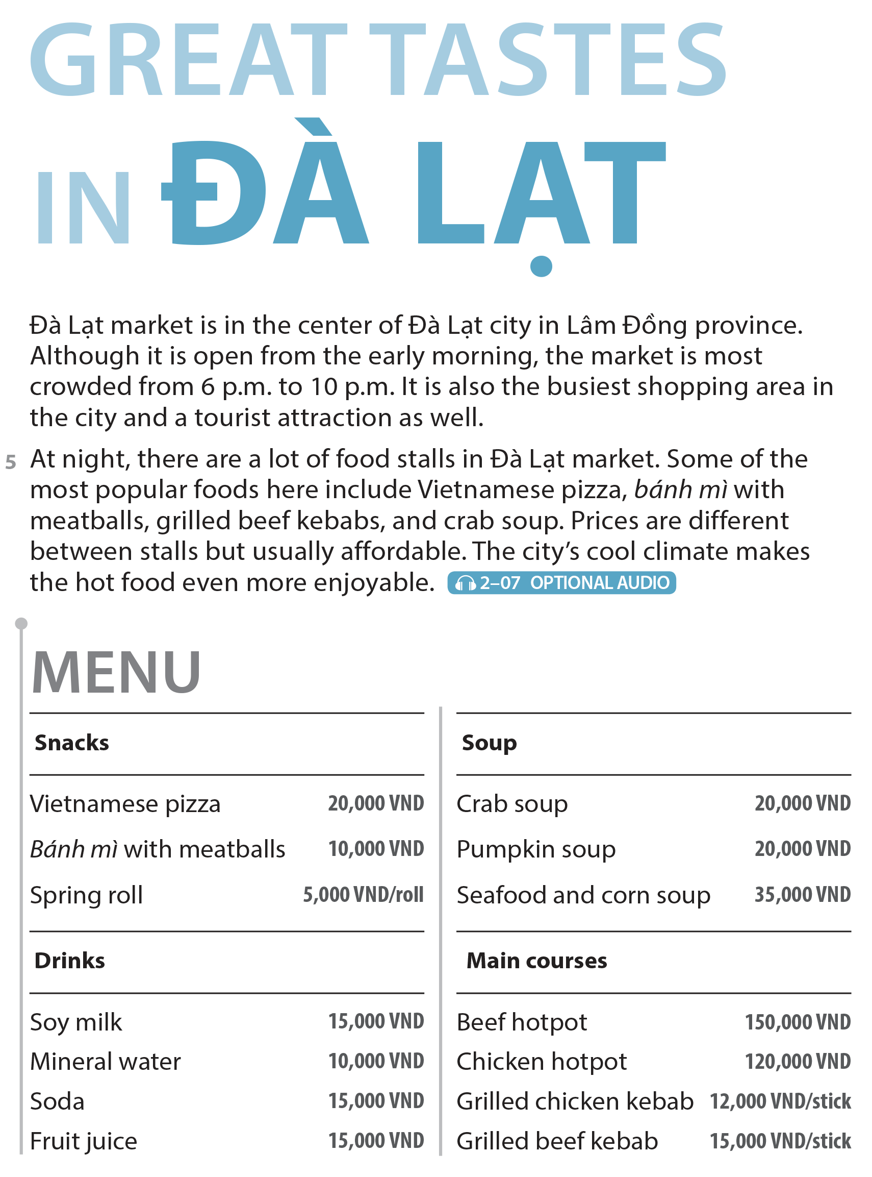

UNIT 7
WHAT’S FOR DINNER?
READING
National Geographic Learning, a Cengage Company © 2022 Cengage Learning, Inc. ALL RIGHTS RESERVED. This presentation tool is intended for teaching purposes only and may not be scanned, copied, duplicated, or posted to a publicly accessible platform in whole or in part.

Slide 21
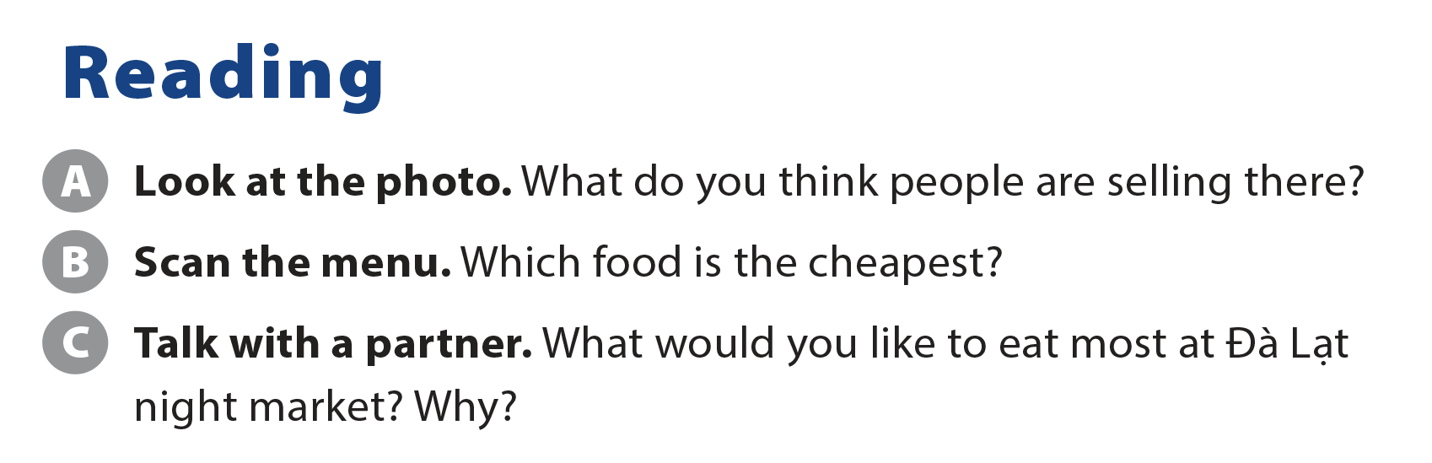
UNIT 7
WHAT’S FOR DINNER?
READING
Spring roll

Slide 22
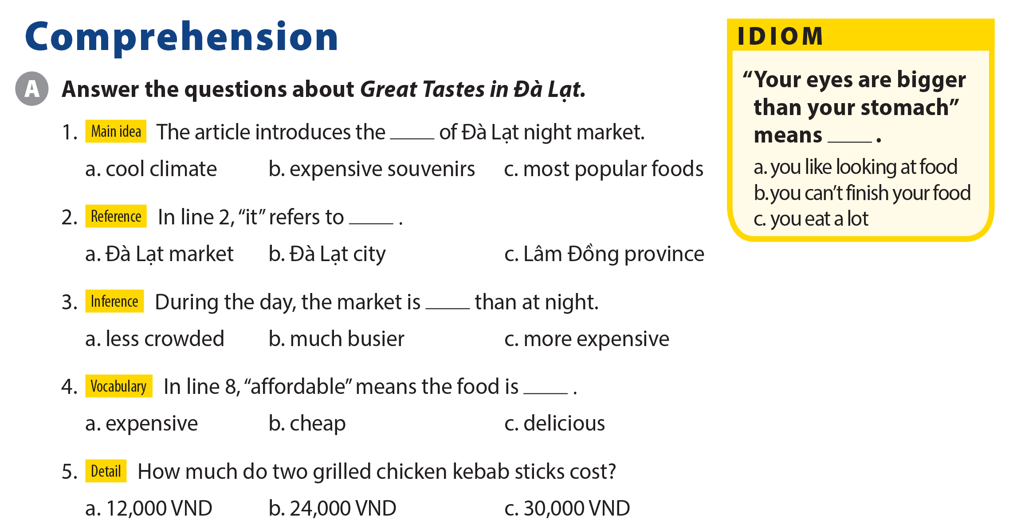
UNIT 7
WHAT’S FOR DINNER?
COMPREHENSION

Slide 23
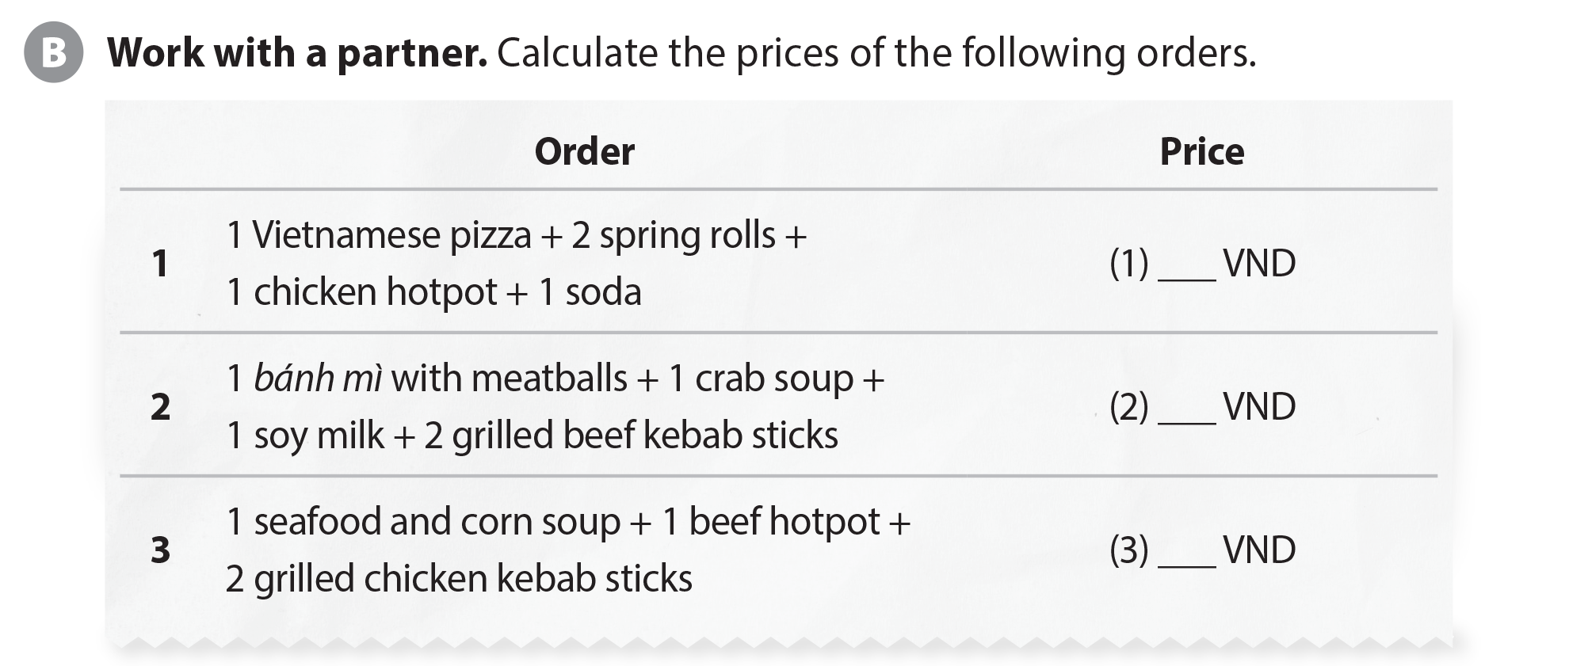
UNIT 7
WHAT’S FOR DINNER?
COMPREHENSION
165,000
75,000
209,000

Slide 24
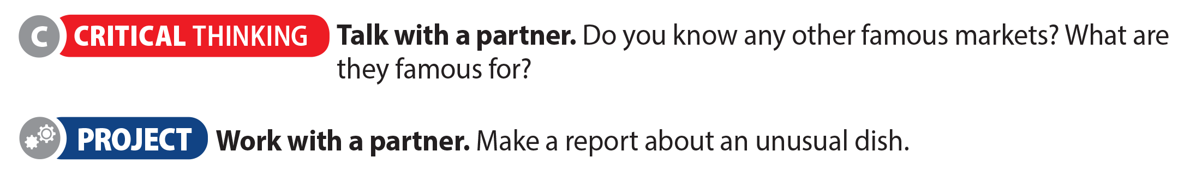
UNIT 7
WHAT’S FOR DINNER?
COMPREHENSION
The market’s name | Reasons why it is famous

Slide 25
UNIT 7
WHAT’S FOR DINNER?
PROJECT

Slide 26
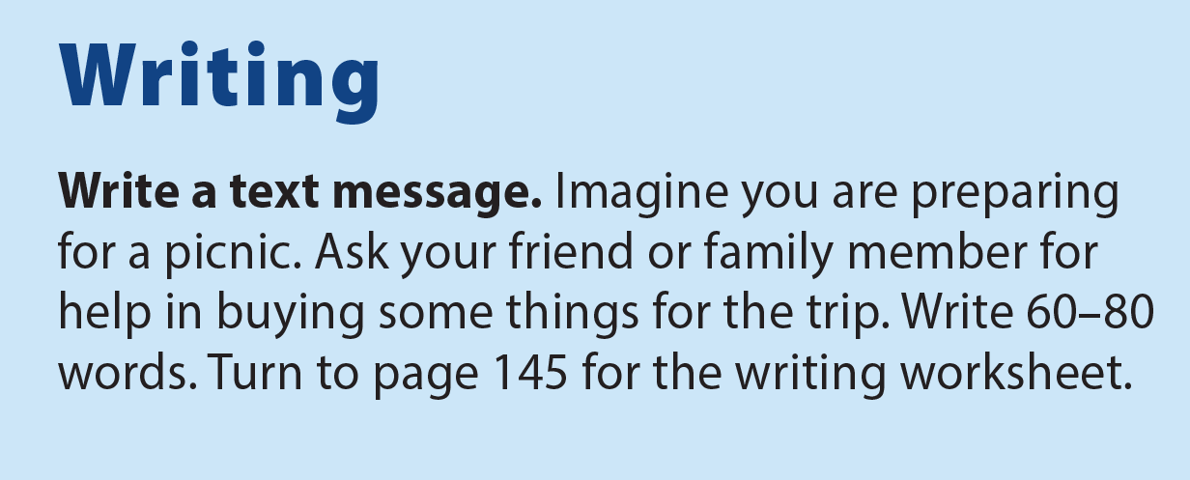
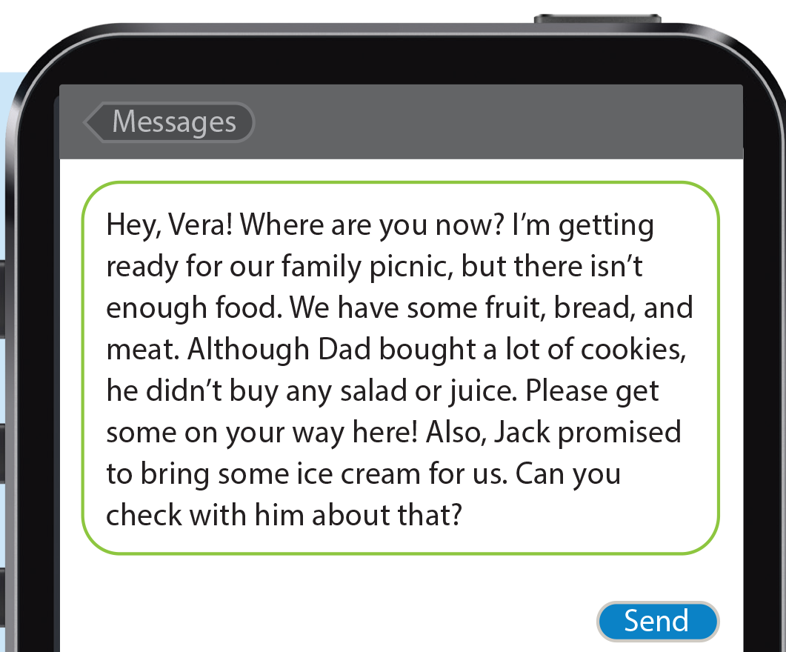
UNIT 7
WHAT’S FOR DINNER?
WRITING

Slide 27
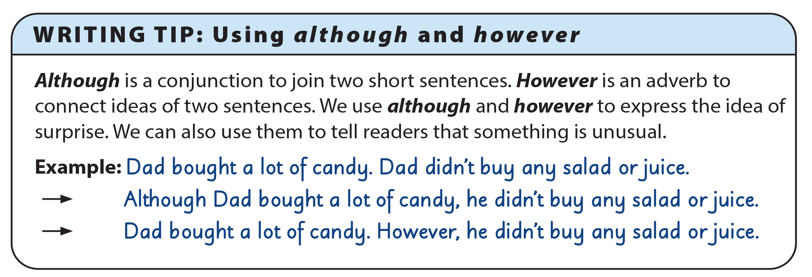
UNIT 7
WHAT’S FOR DINNER?
WRITING

Slide 28
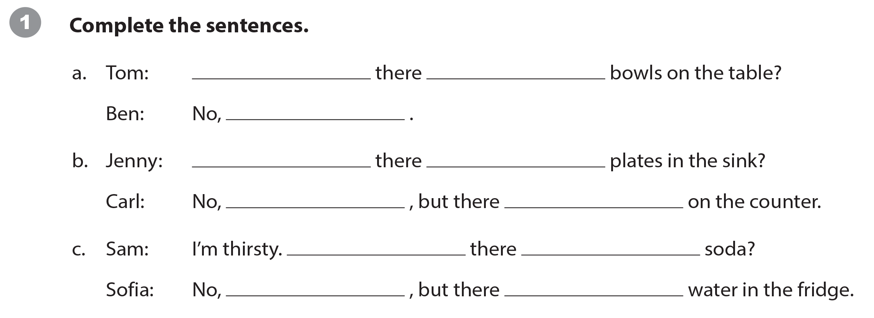
UNIT 7
WHAT’S FOR DINNER?
WRITING WORKSHEET
Are
any
there aren’t
Are
any
there aren’t
are some (plates)
Is
any
there isn’t
is

Slide 29
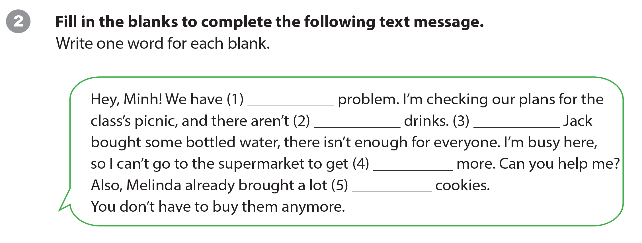
UNIT 7
WHAT’S FOR DINNER?
WRITING WORKSHEET
a
any
Although
some
of

Slide 30
UNIT 7
WHAT’S FOR DINNER?
WRITING WORKSHEET

Slide 31
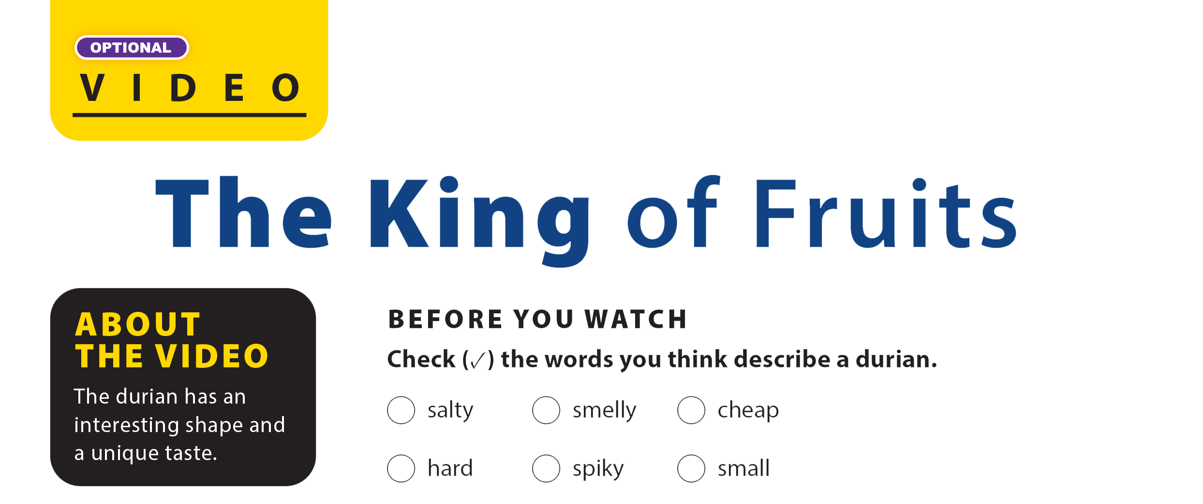
UNIT 7
WHAT’S FOR DINNER?
VIDEO
✓
✓
✓

Slide 32


UNIT 7
WHAT’S FOR DINNER?
VIDEO

Slide 33
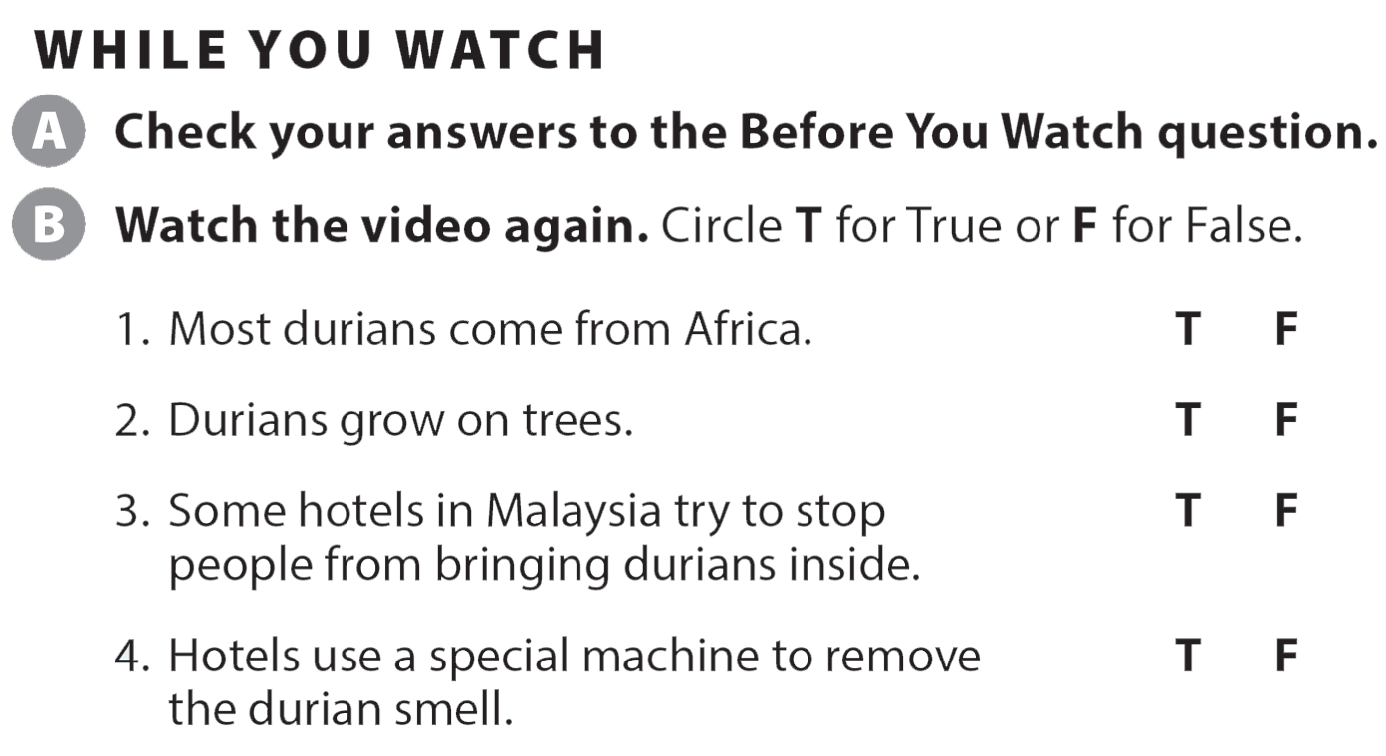
UNIT 7
WHAT’S FOR DINNER?
VIDEO

Slide 34
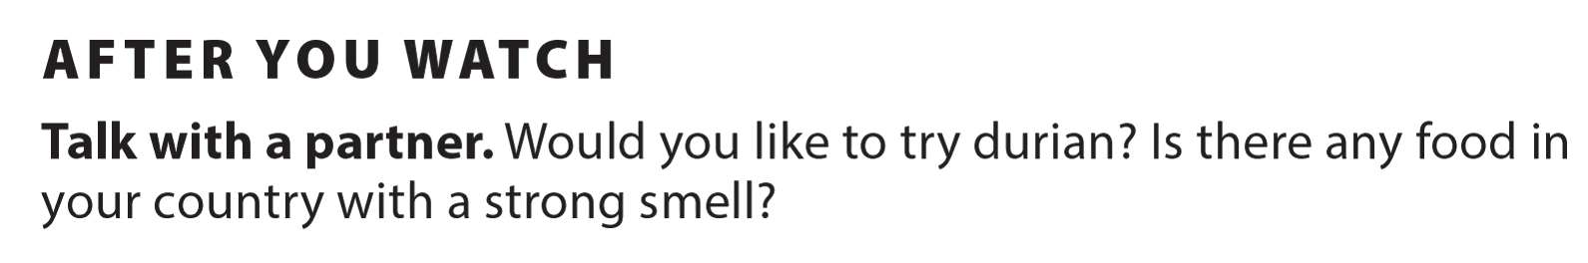


UNIT 7
WHAT’S FOR DINNER?
VIDEO

Slide 35
UNIT 7
WHAT’S FOR DINNER?
VIDEO
Thank you!

