Slide 1


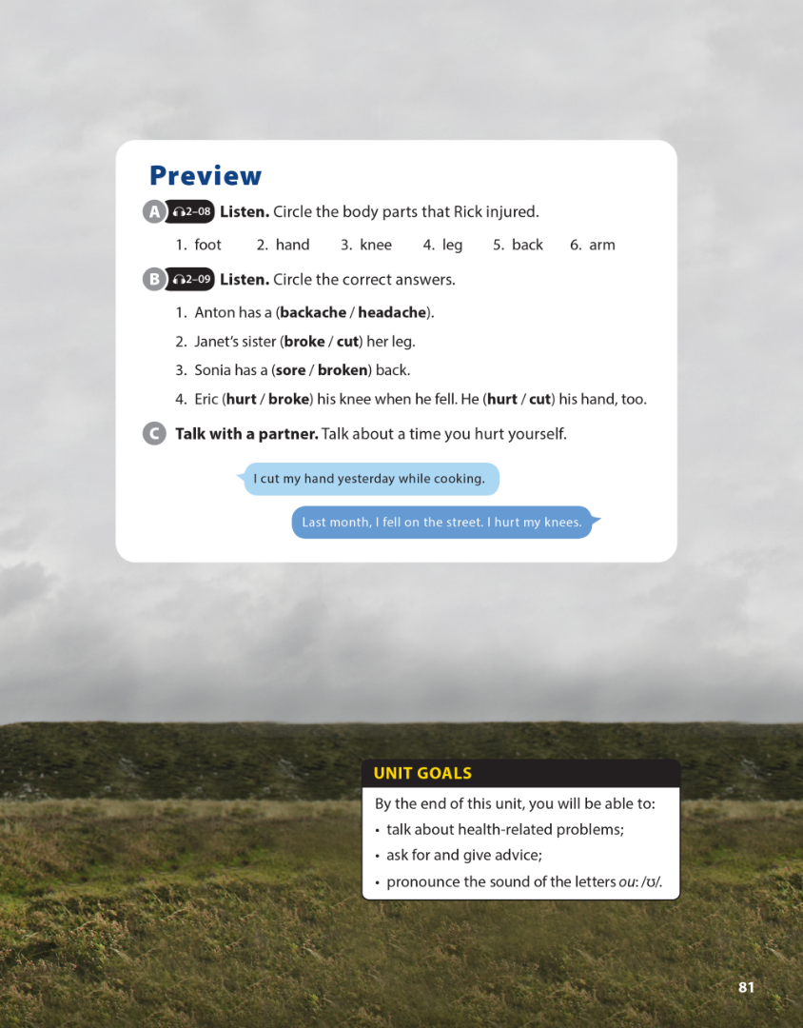

National Geographic Learning, a Cengage Company © 2022 Cengage Learning, Inc. ALL RIGHTS RESERVED. This presentation tool is intended for teaching purposes only and may not be scanned, copied, duplicated, or posted to a publicly accessible platform in whole or in part.

Slide 2
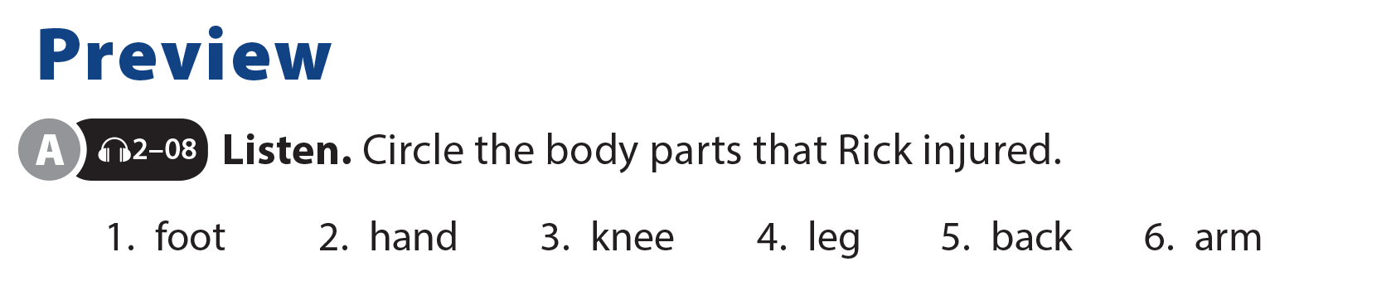

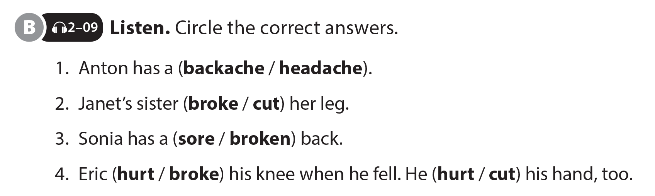
UNIT 8
YOU SHOULD SEE A DOCTOR!
PREVIEW

Slide 3
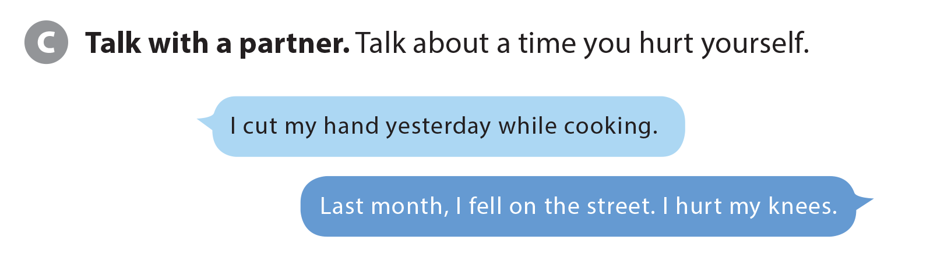
UNIT 8
YOU SHOULD SEE A DOCTOR!
PREVIEW

Slide 4


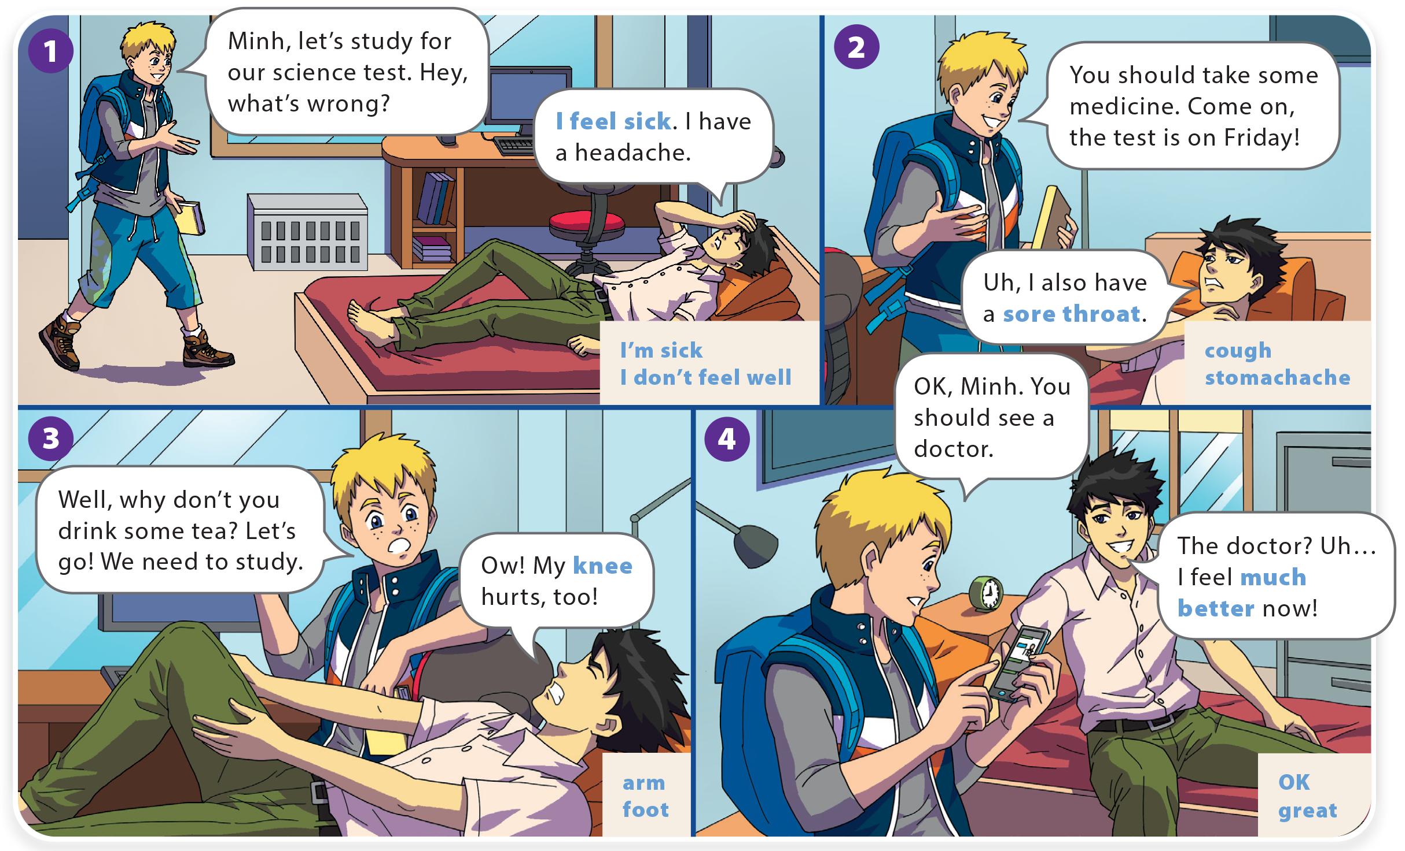
YOU SHOULD SEE A DOCTOR!
UNIT 8
WHAT DO YOU LIKE TO DO?
LANGUAGE FOCUS

Slide 5
YOU SHOULD SEE A DOCTOR!
UNIT 8
WHAT DO YOU LIKE TO DO?
LANGUAGE FOCUS

Slide 6
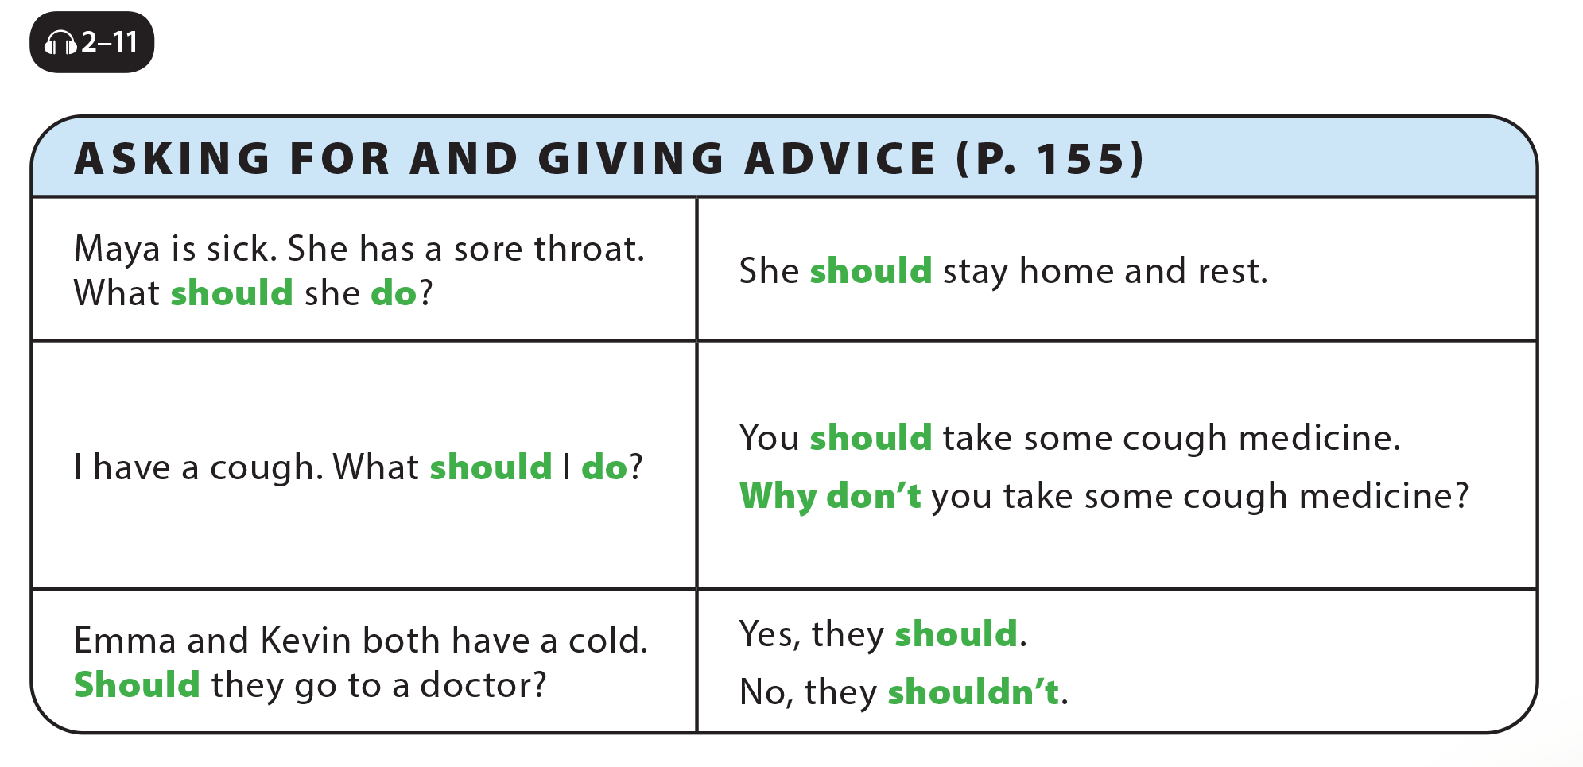
UNIT 8
YOU SHOULD SEE A DOCTOR!
LANGUAGE FOCUS

Slide 7
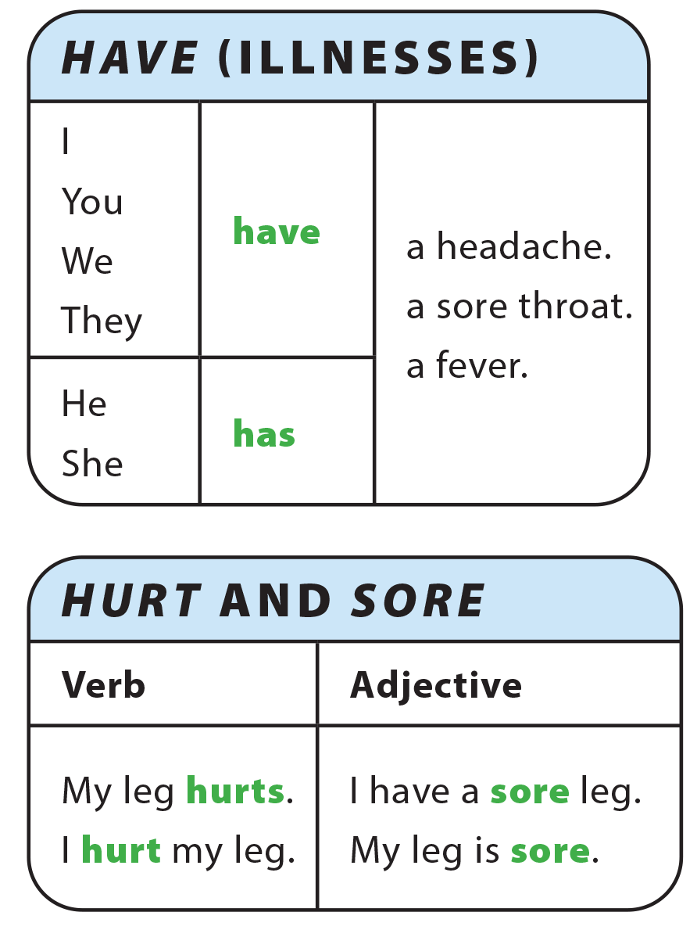
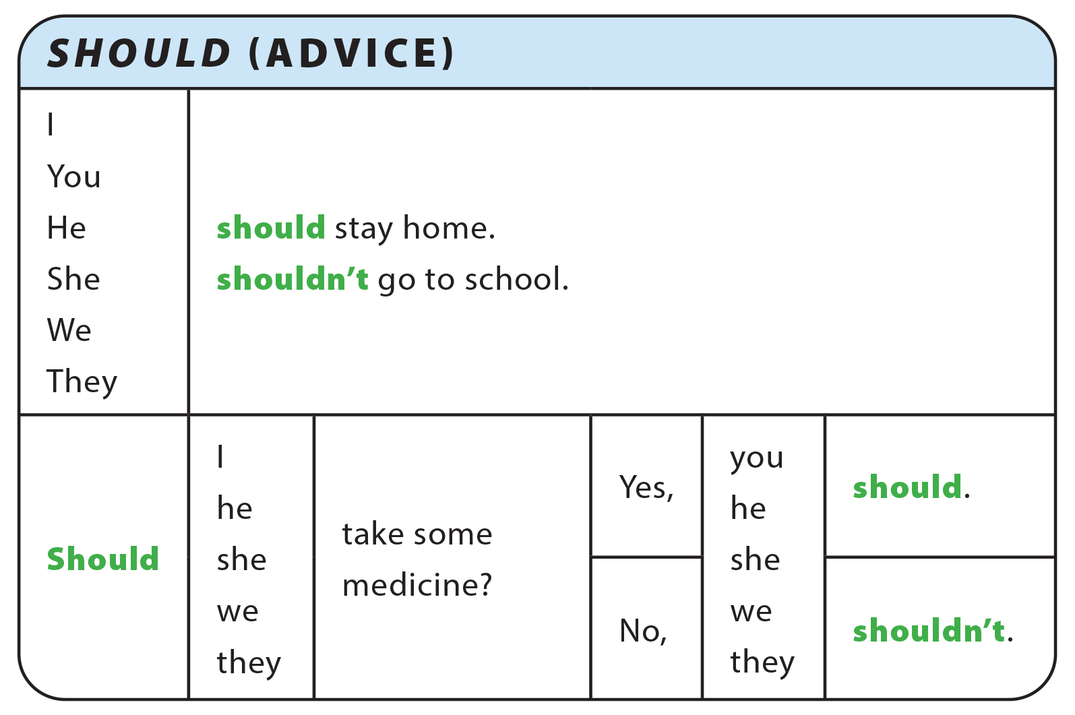
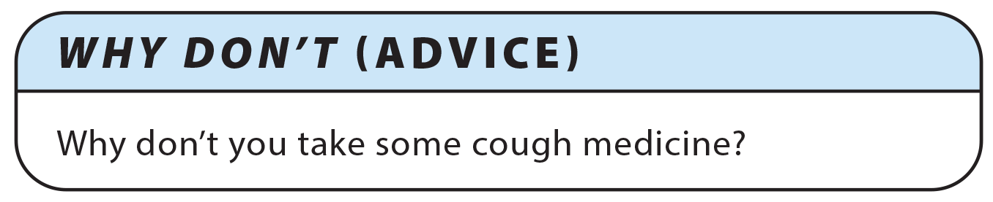
UNIT 8
YOU SHOULD SEE A DOCTOR!
GRAMMAR REFERENCE

Slide 8
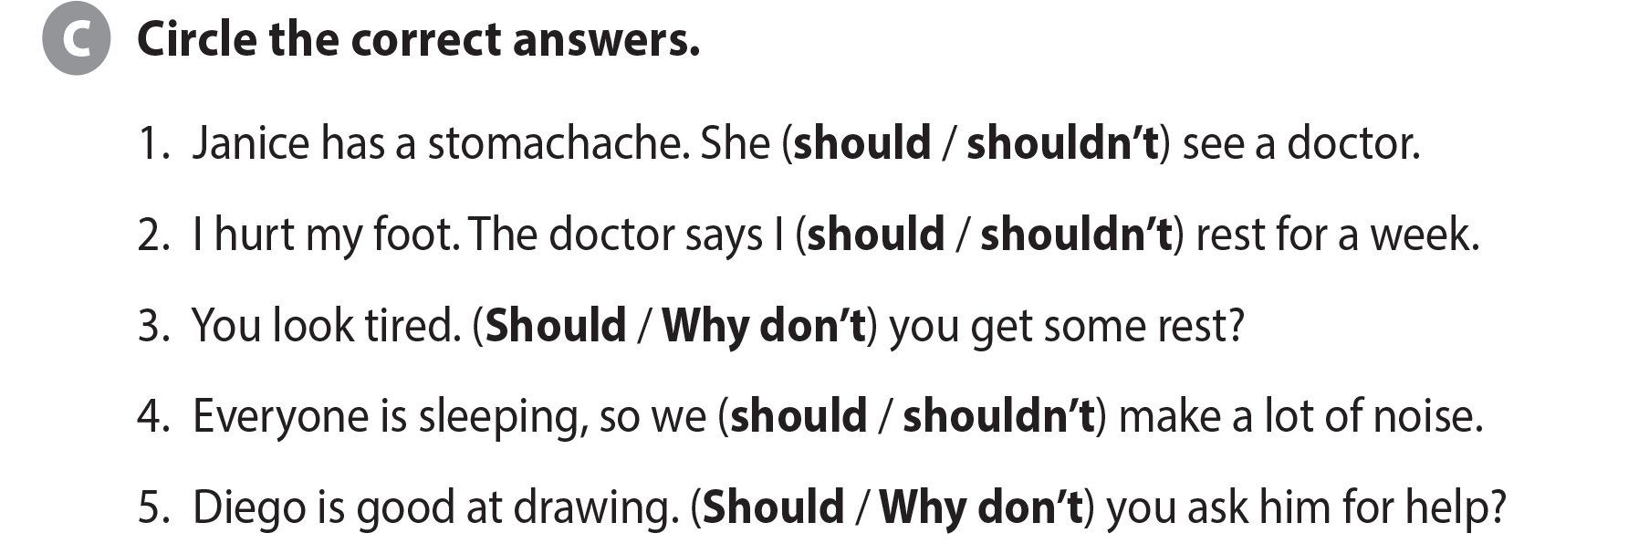
UNIT 8
YOU SHOULD SEE A DOCTOR!
LANGUAGE FOCUS

Slide 9
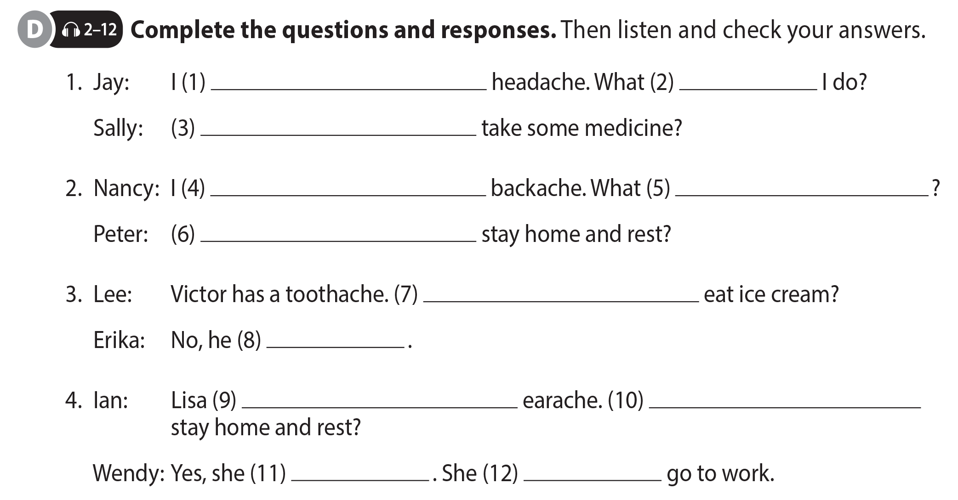
UNIT 8
YOU SHOULD SEE A DOCTOR!
LANGUAGE FOCUS
have a
should
Why don’t you
have a
should I do
Why don’t you
Should he
shouldn’t
has a
Should she
should
shouldn’t

Slide 10
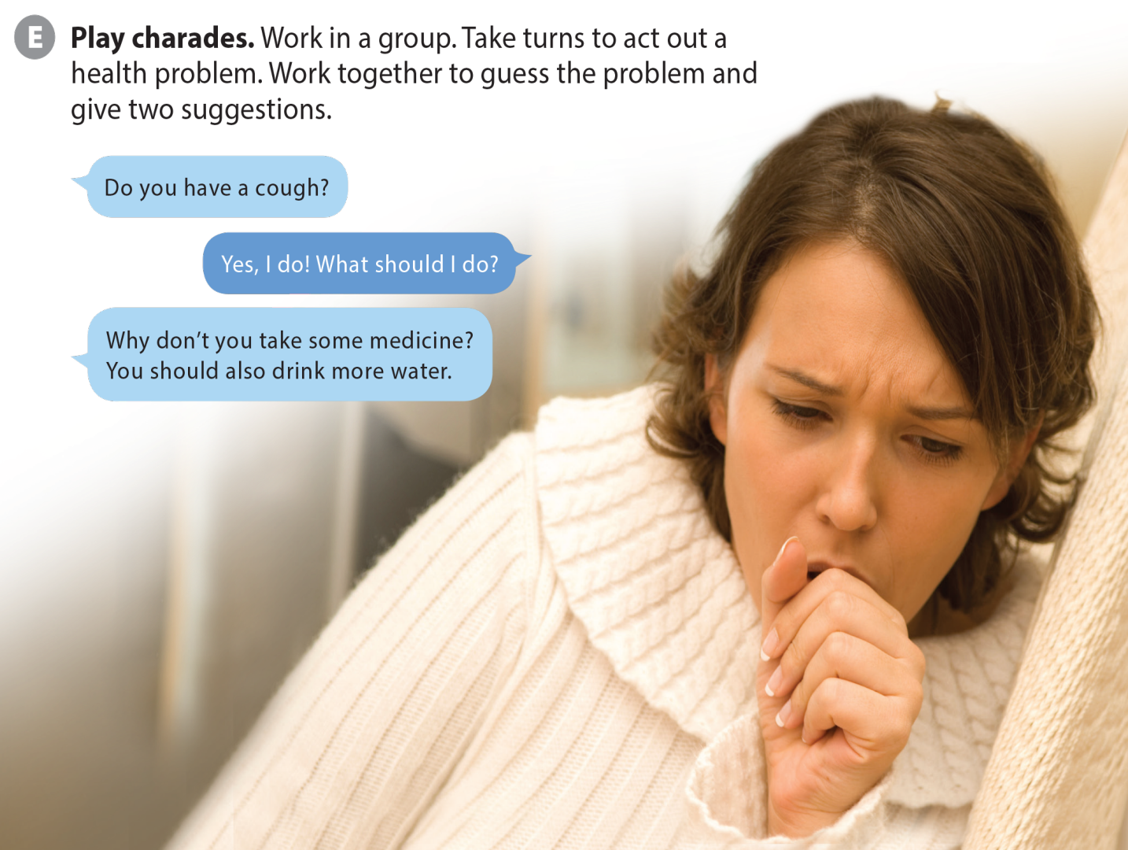
UNIT 8
YOU SHOULD SEE A DOCTOR!
LANGUAGE FOCUS

Slide 11
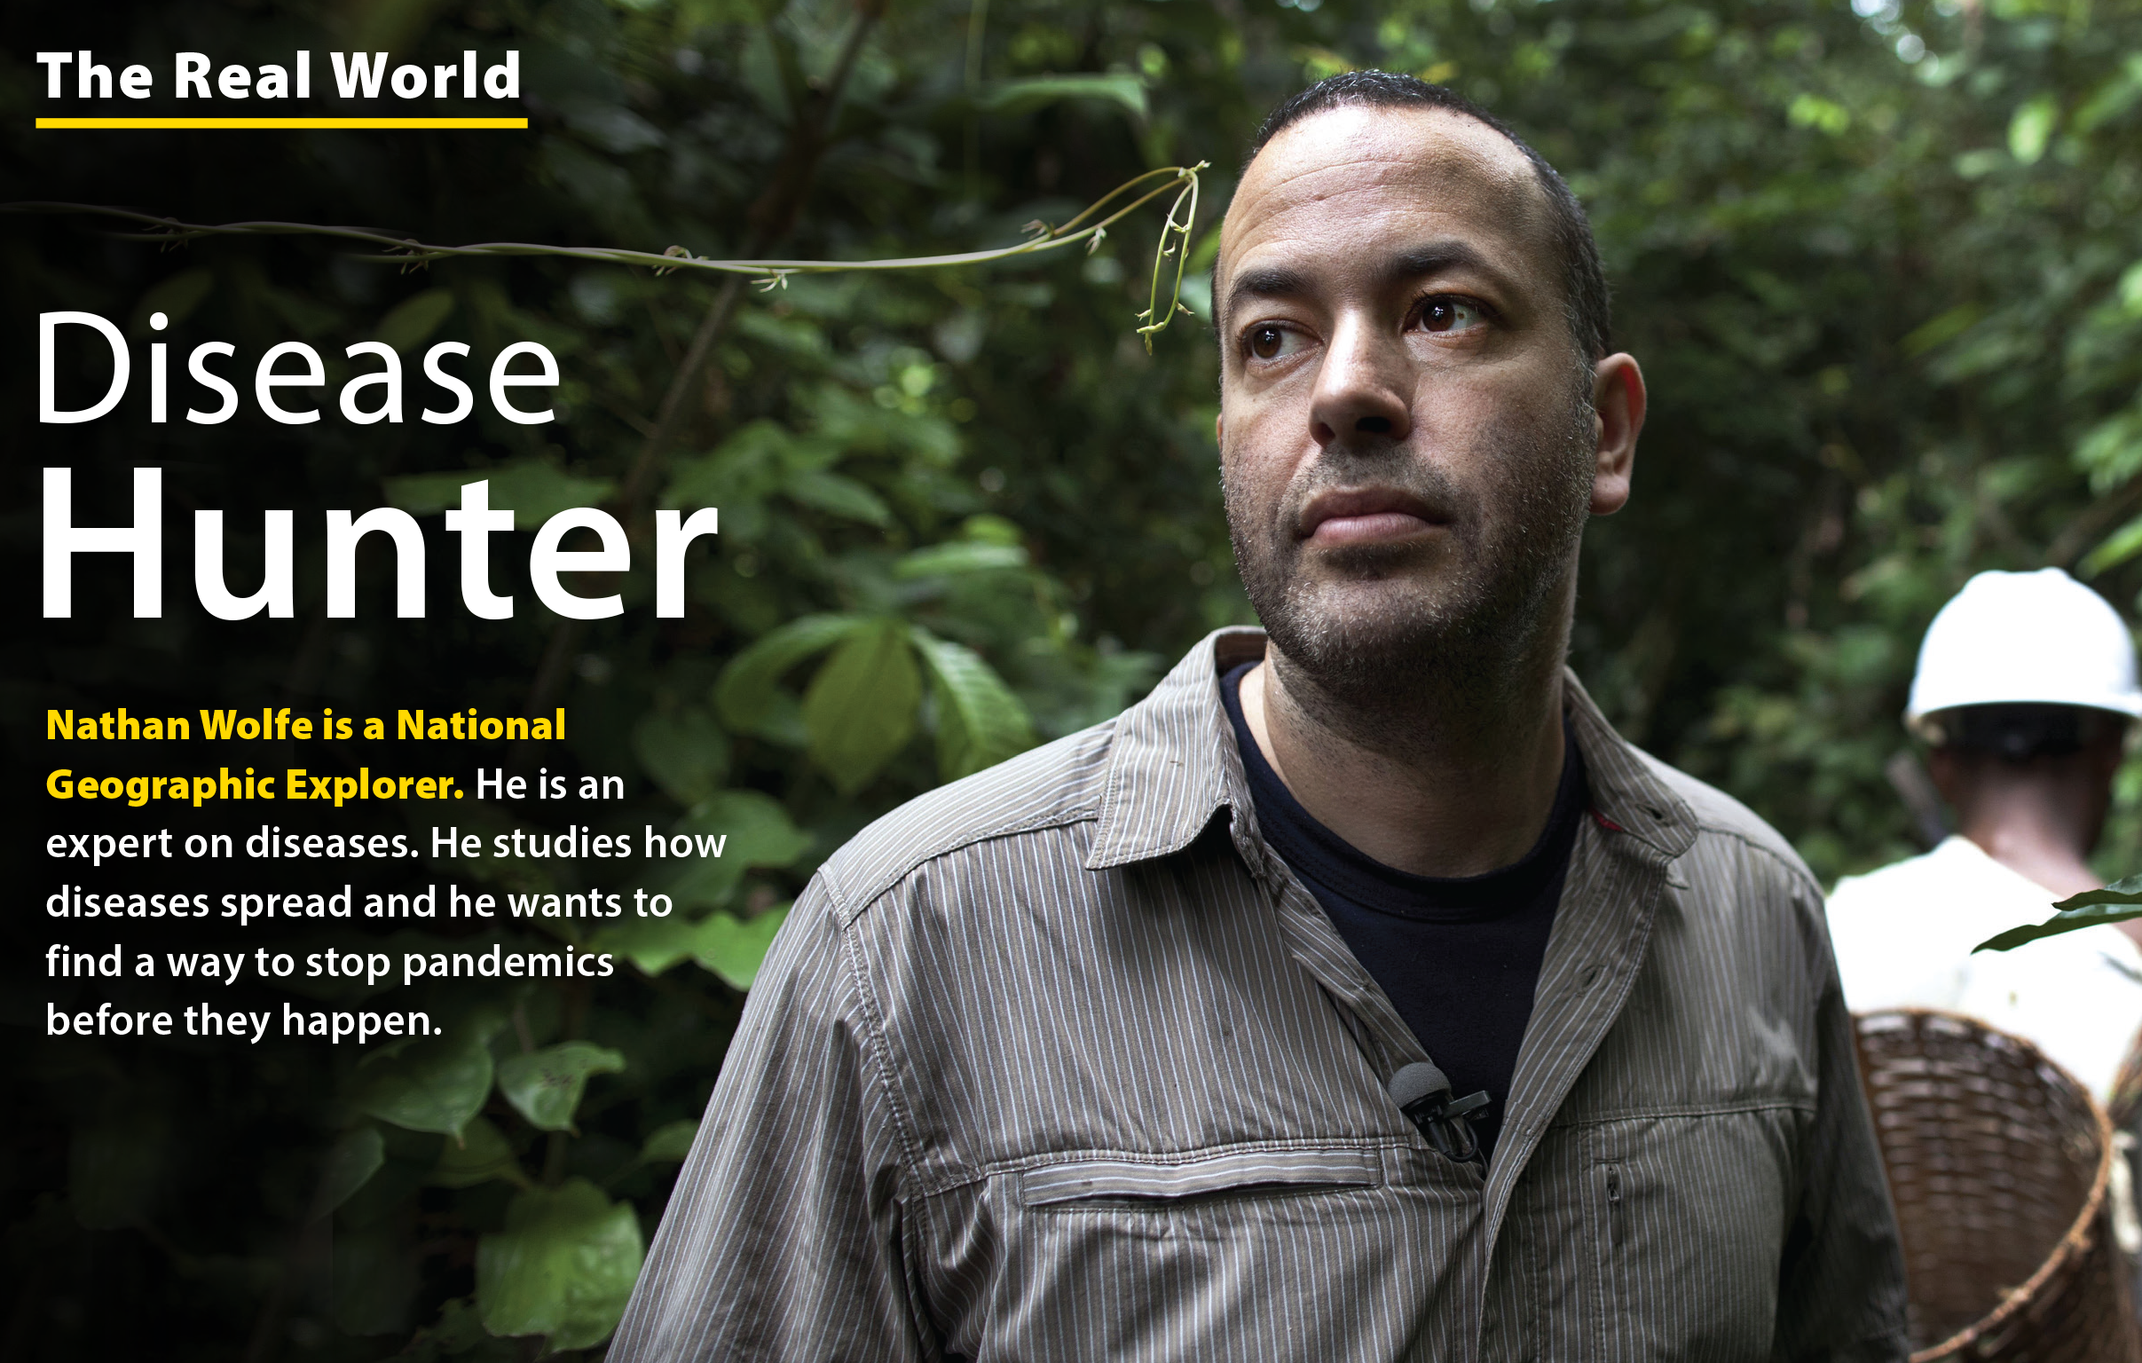
UNIT 8
YOU SHOULD SEE A DOCTOR!
THE REAL WORLD

Slide 12
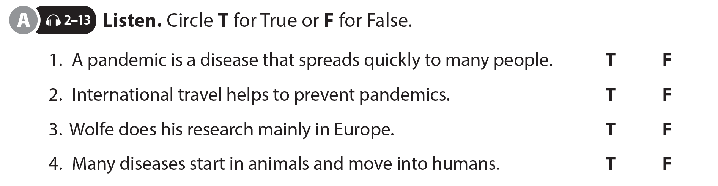
UNIT 8
YOU SHOULD SEE A DOCTOR!
THE REAL WORLD

Slide 13

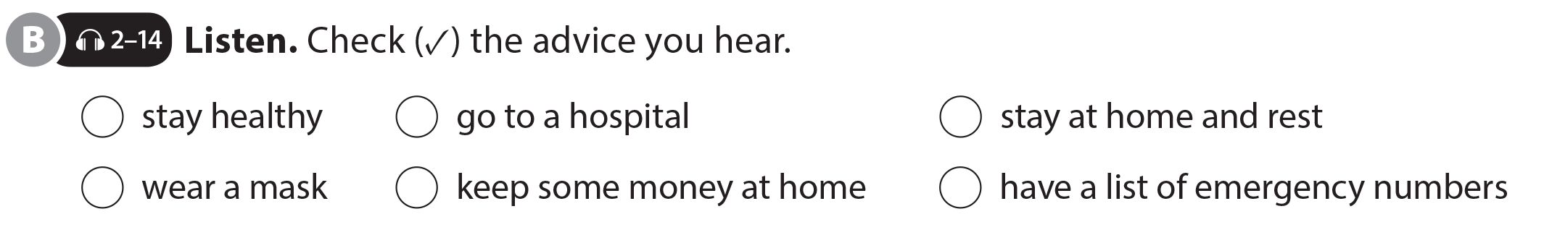
UNIT 8
YOU SHOULD SEE A DOCTOR!
THE REAL WORLD
✓
✓
✓
✓
National Geographic Learning, a Cengage Company © 2022 Cengage Learning, Inc. ALL RIGHTS RESERVED. This presentation tool is intended for teaching purposes only and may not be scanned, copied, duplicated, or posted to a publicly accessible platform in whole or in part.

Slide 14
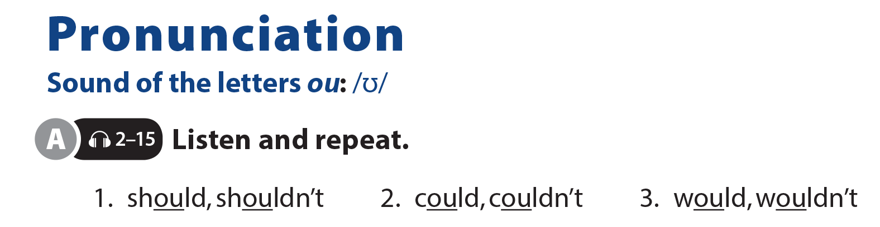
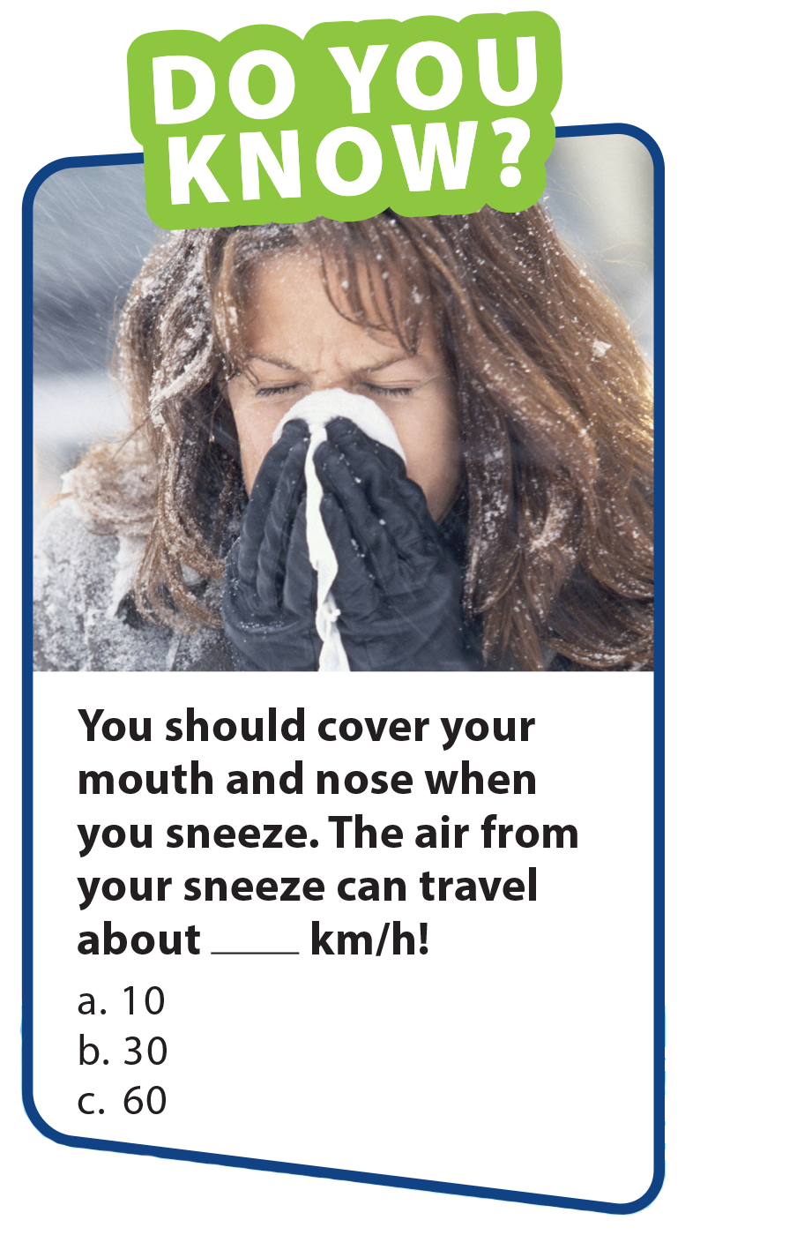
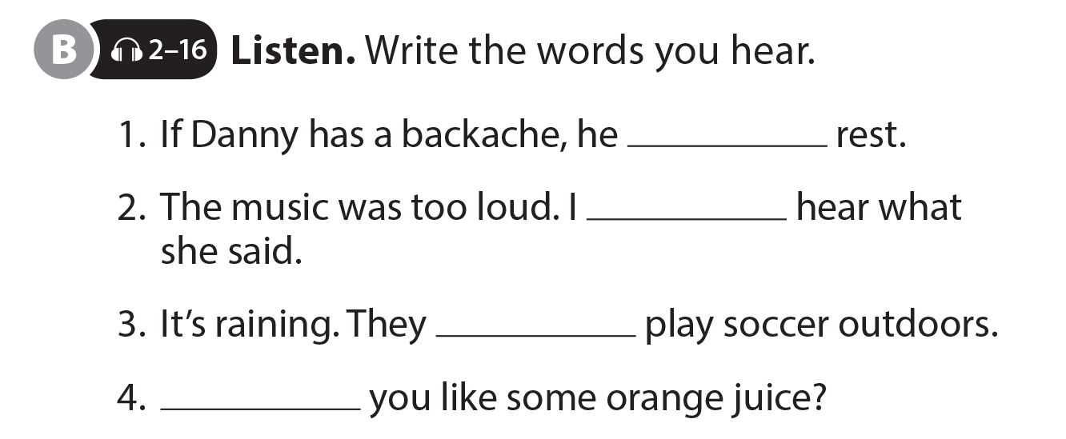
UNIT 8
YOU SHOULD SEE A DOCTOR!
PRONUNCIATION
should
couldn’t
shouldn’t
Would

Slide 15
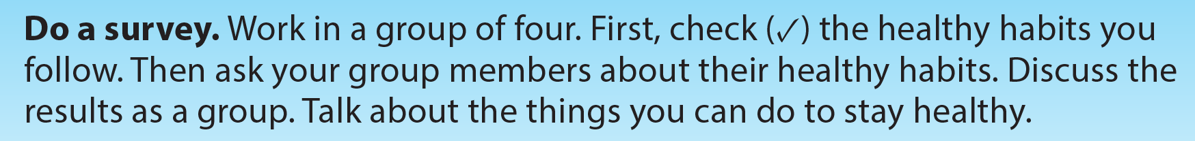
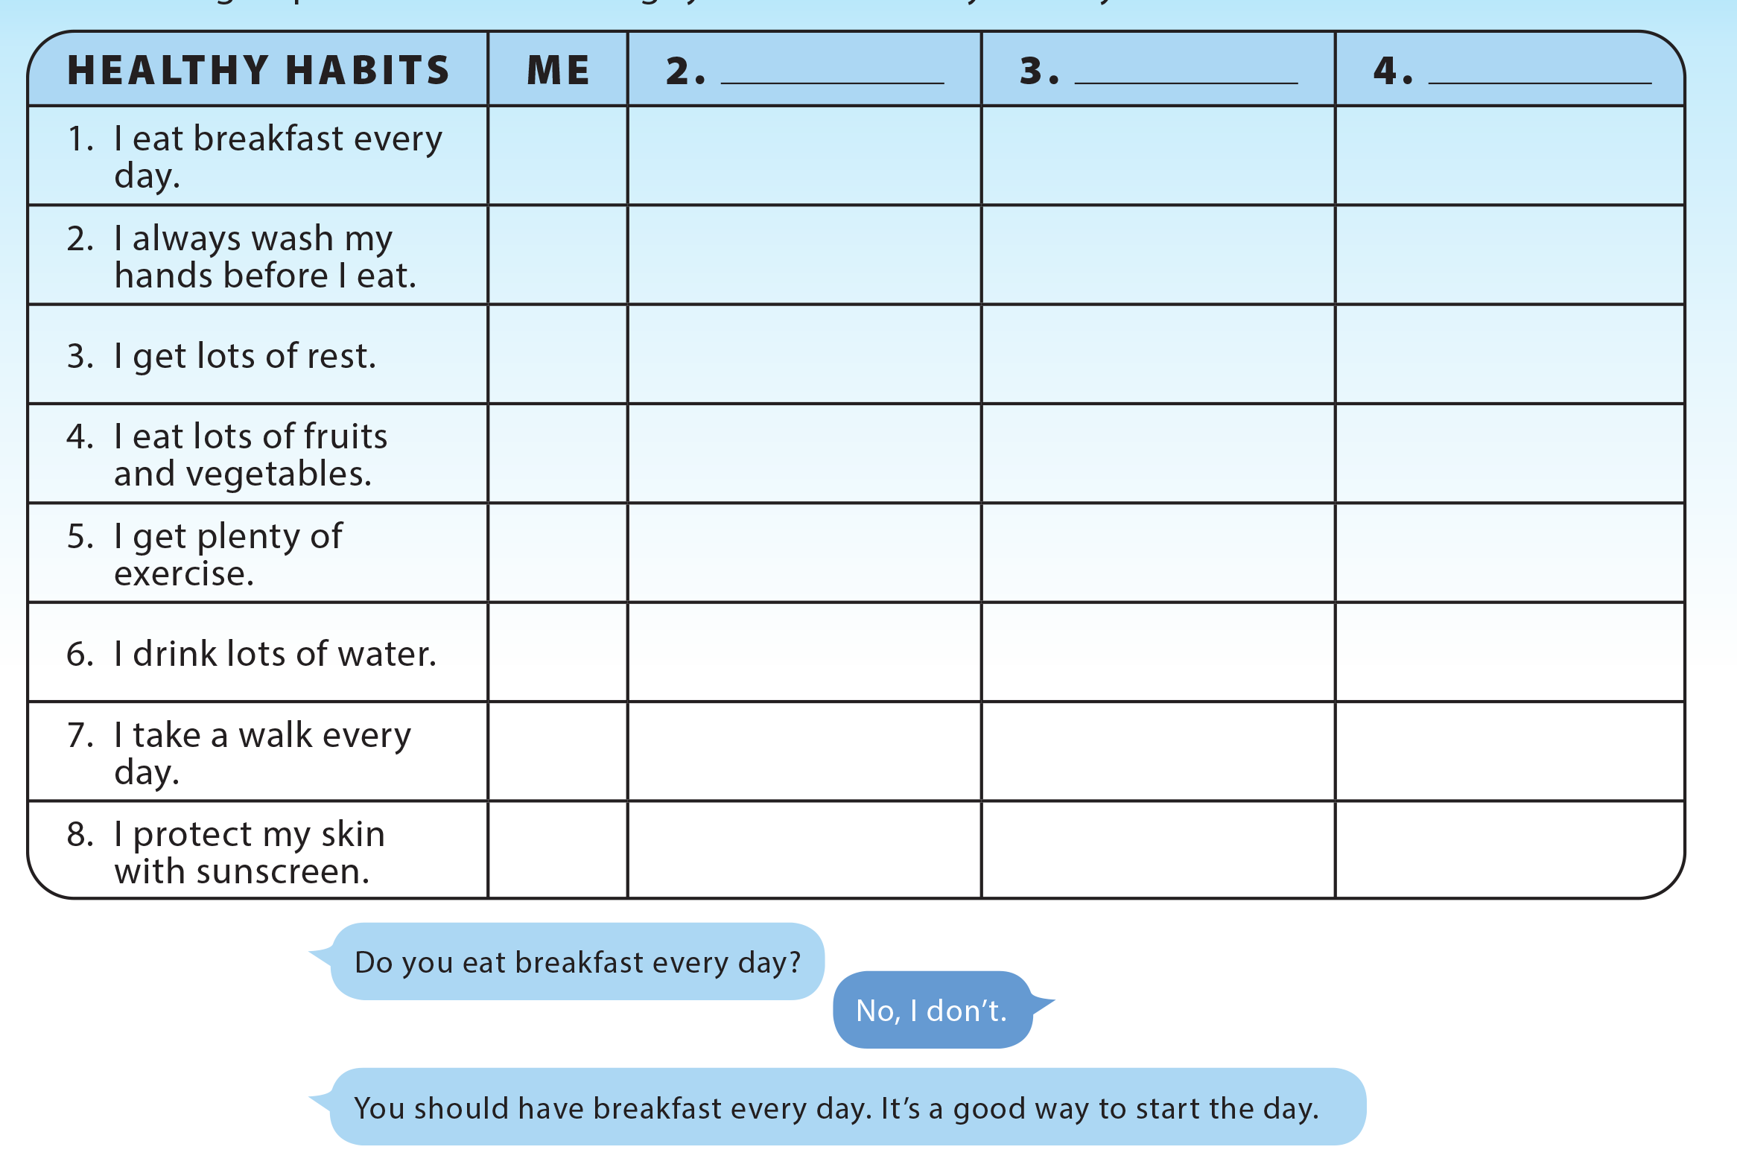
UNIT 8
YOU SHOULD SEE A DOCTOR!
COMMUNICATION

Slide 16
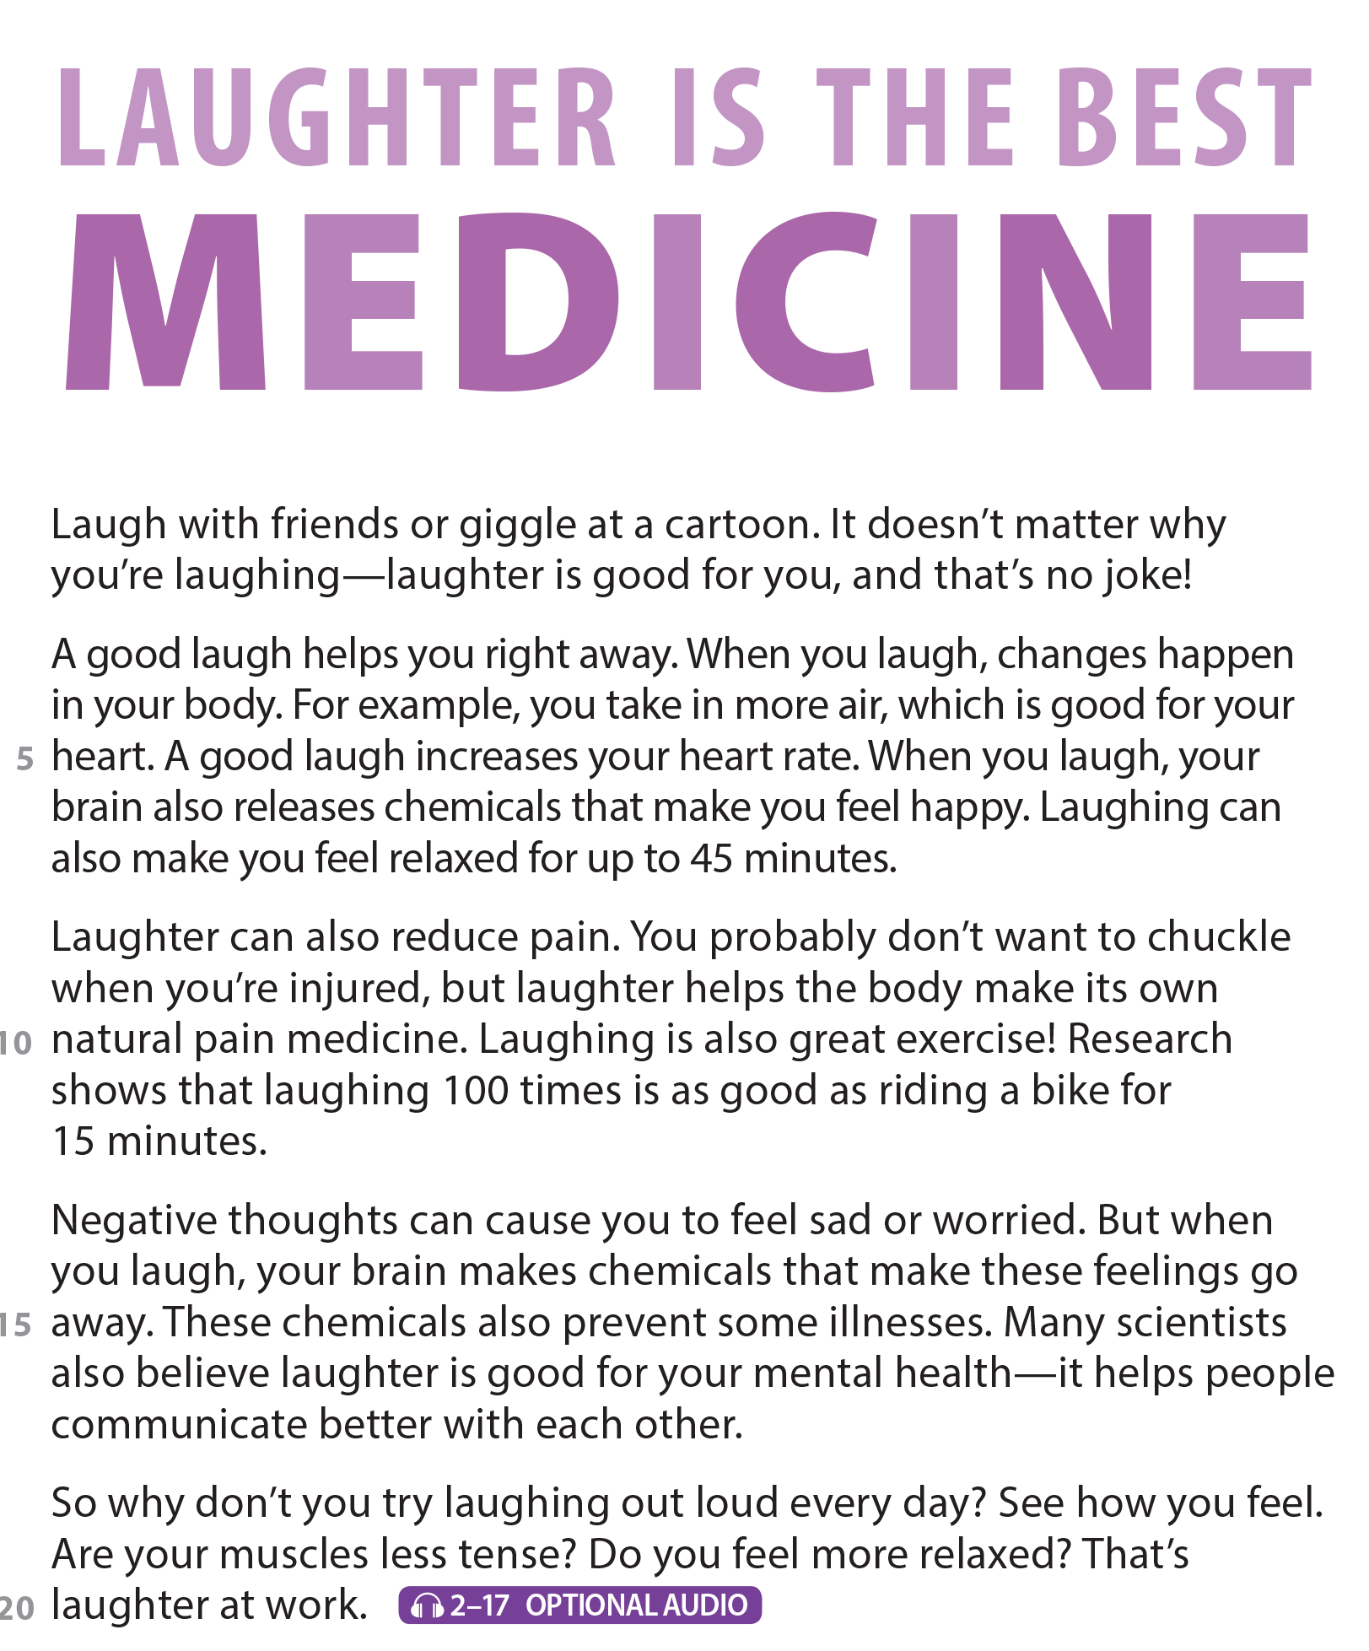
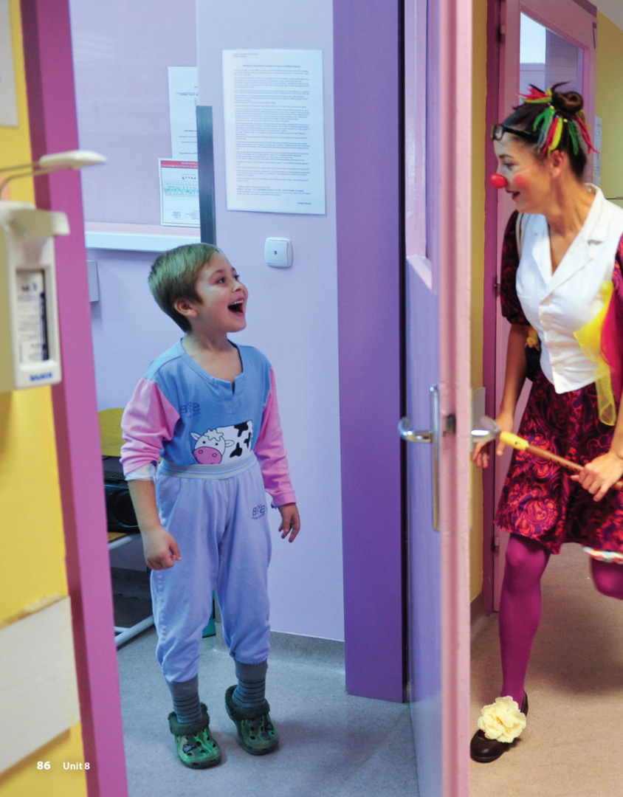
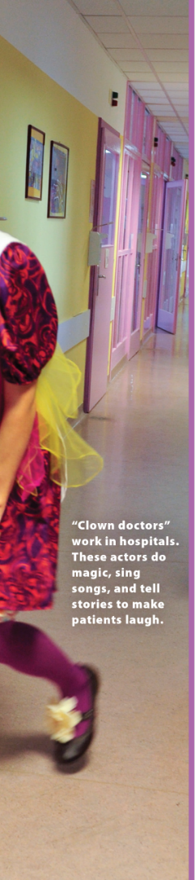


UNIT 8
YOU SHOULD SEE A DOCTOR!
READING
National Geographic Learning, a Cengage Company © 2022 Cengage Learning, Inc. ALL RIGHTS RESERVED. This presentation tool is intended for teaching purposes only and may not be scanned, copied, duplicated, or posted to a publicly accessible platform in whole or in part.

Slide 17
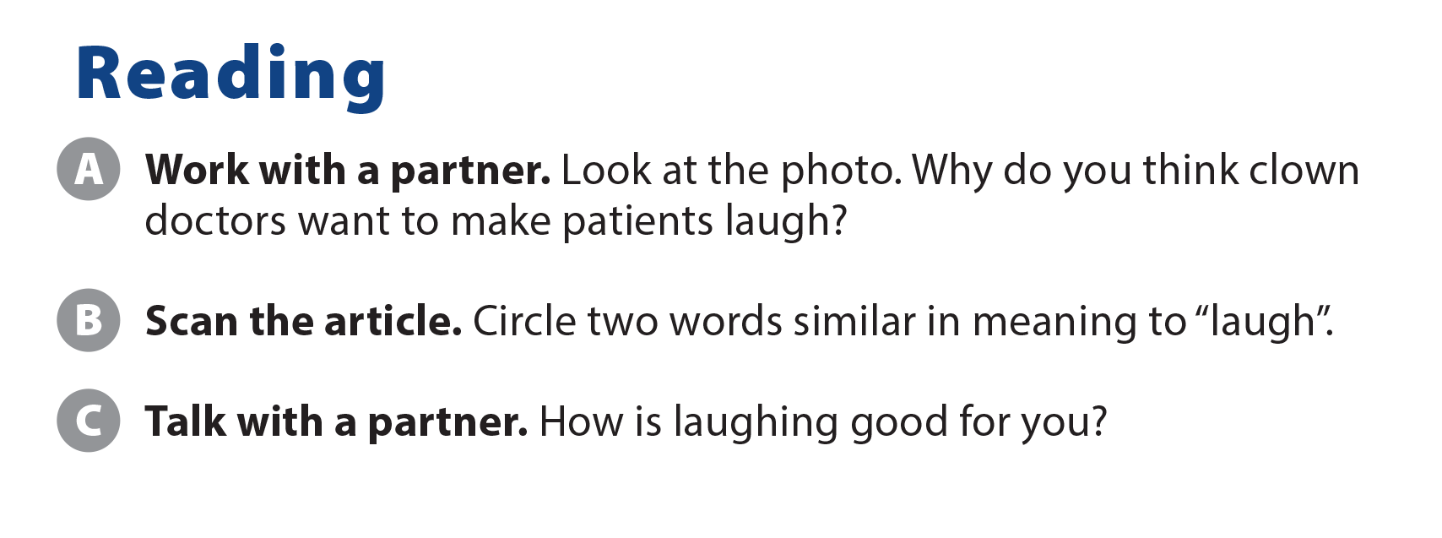
UNIT 8
YOU SHOULD SEE A DOCTOR!
READING
giggle
chuckle

Slide 18
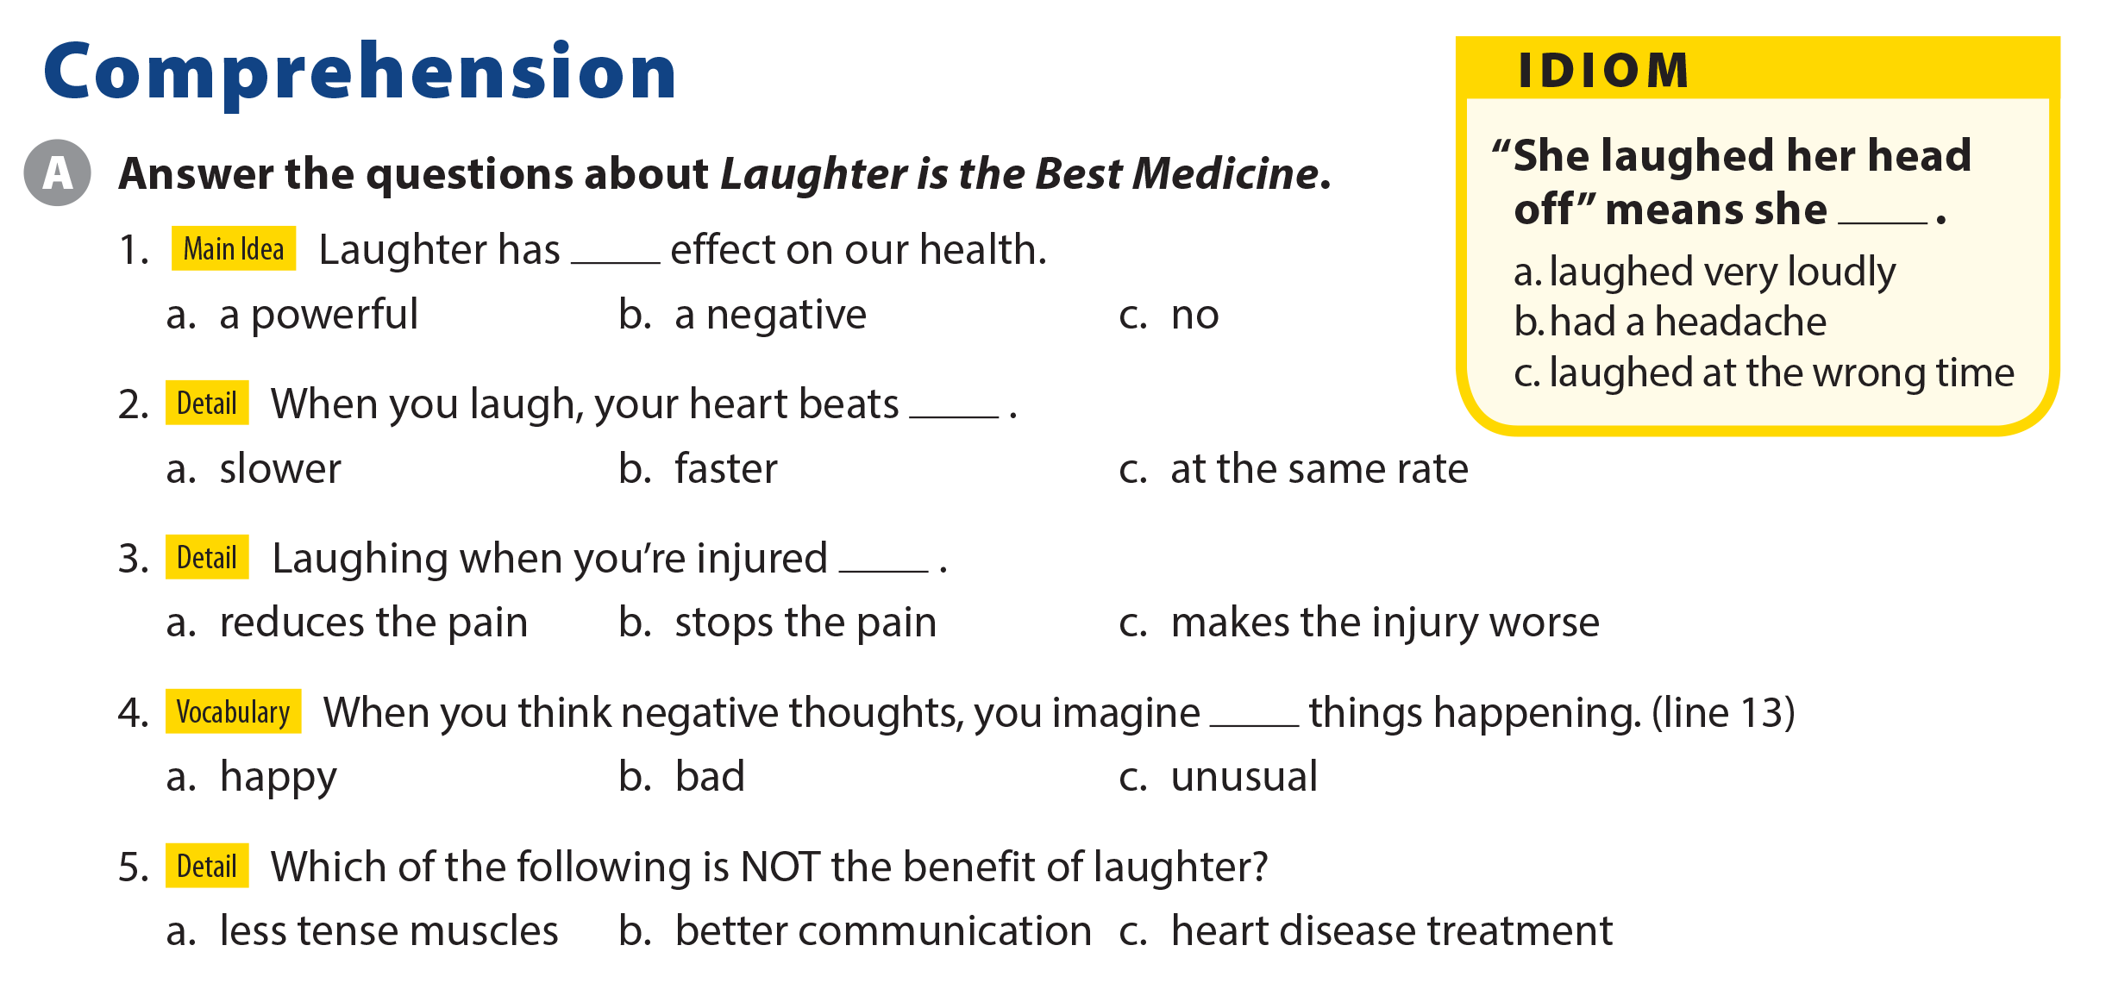
UNIT 8
YOU SHOULD SEE A DOCTOR!
COMPREHENSION

Slide 19
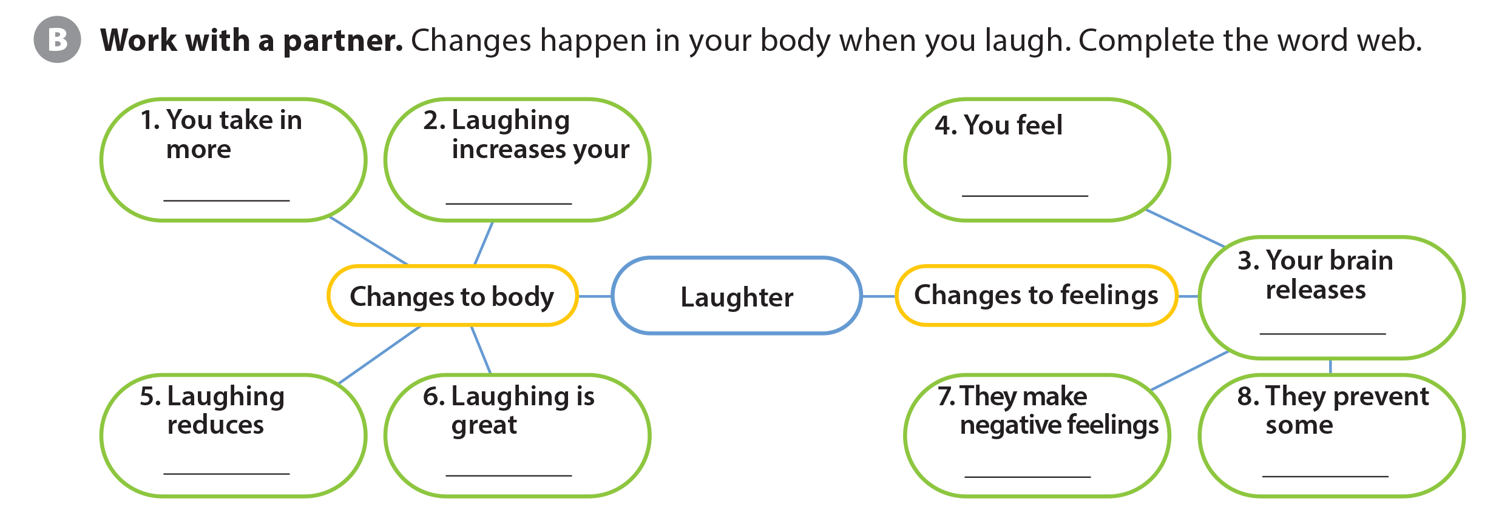
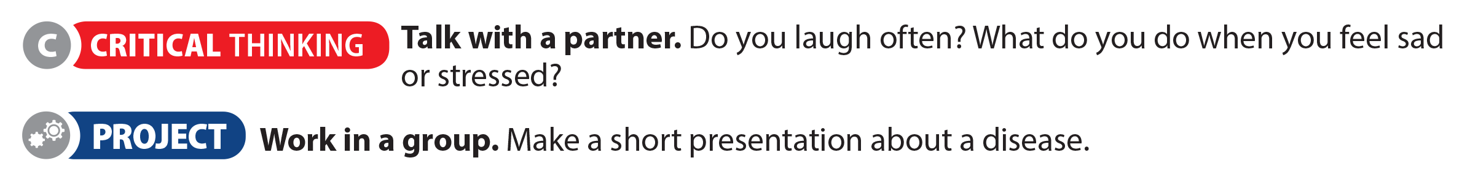
UNIT 8
YOU SHOULD SEE A DOCTOR!
COMPREHENSION
air
heart race
happy
chemicals
pain
exercise
go away
illnesses

Slide 20
UNIT 8
YOU SHOULD SEE A DOCTOR!
PROJECT

Slide 21
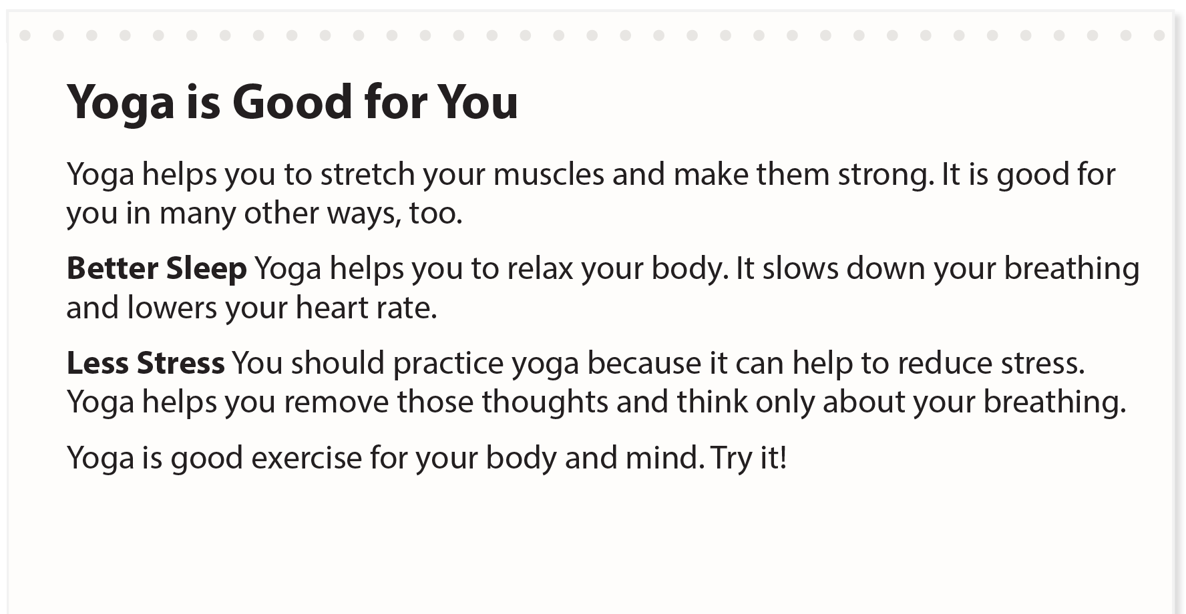
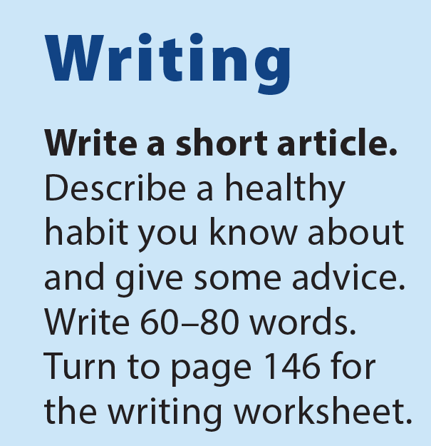
UNIT 8
YOU SHOULD SEE A DOCTOR!
WRITING

Slide 22
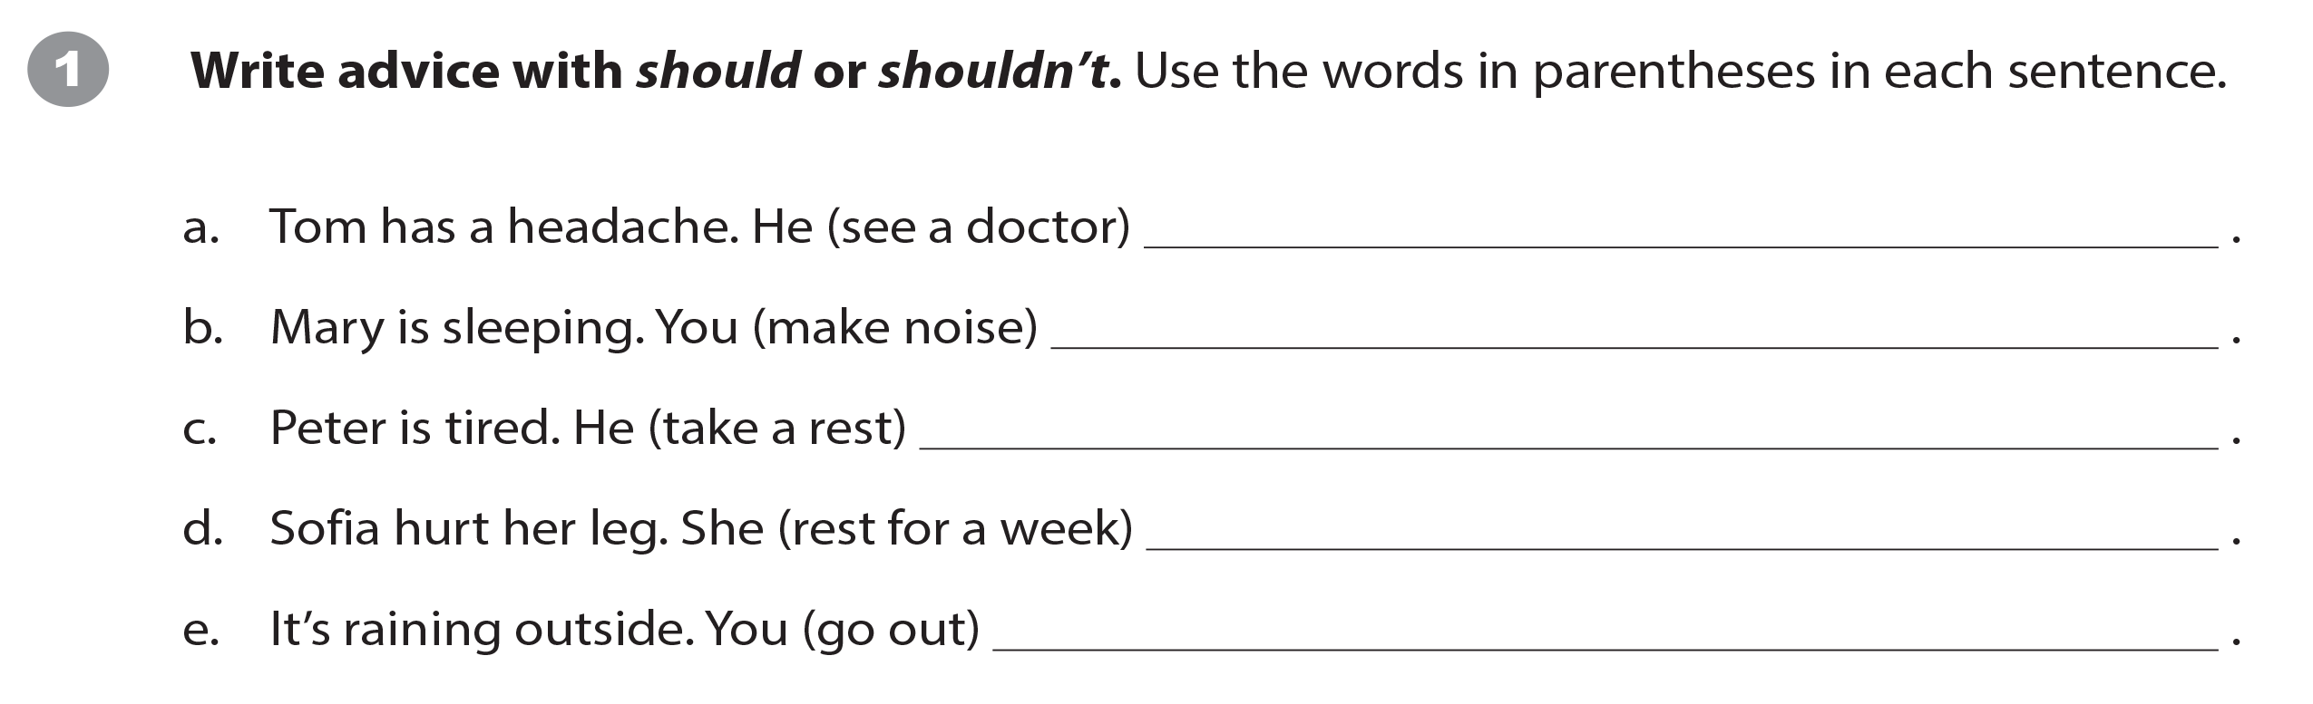
UNIT 8
YOU SHOULD SEE A DOCTOR!
WRITING WORKSHEET
should see a doctor
shouldn’t make noise
should take a rest
should rest for a week
shouldn’t go out

Slide 23
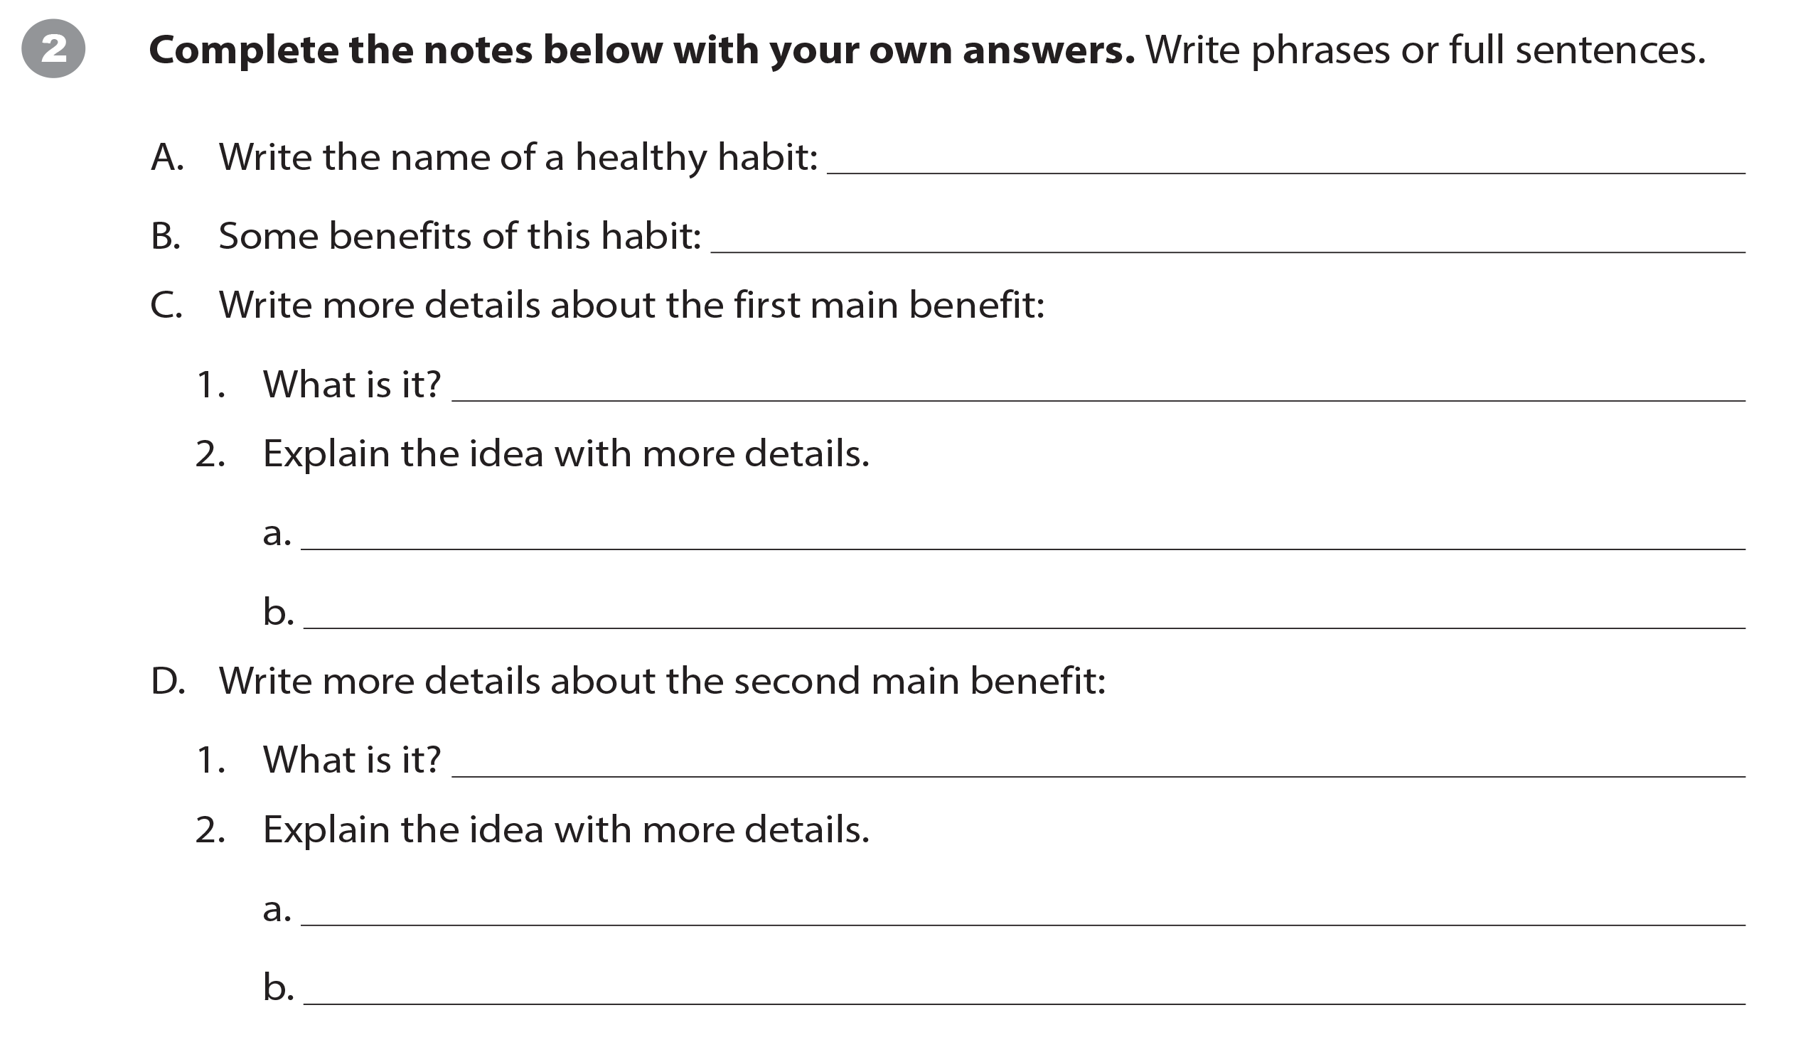
UNIT 8
YOU SHOULD SEE A DOCTOR!
WRITING WORKSHEET

Slide 24
UNIT 8
YOU SHOULD SEE A DOCTOR!
WRITING WORKSHEET

Slide 25
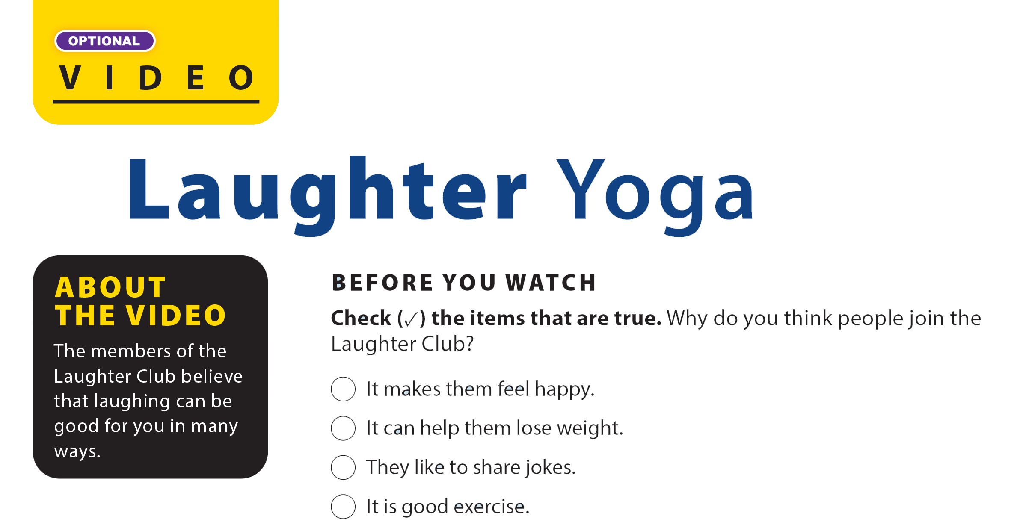

UNIT 8
YOU SHOULD SEE A DOCTOR!
VIDEO
✓
✓
✓

Slide 26

UNIT 8
YOU SHOULD SEE A DOCTOR!
VIDEO

Slide 27
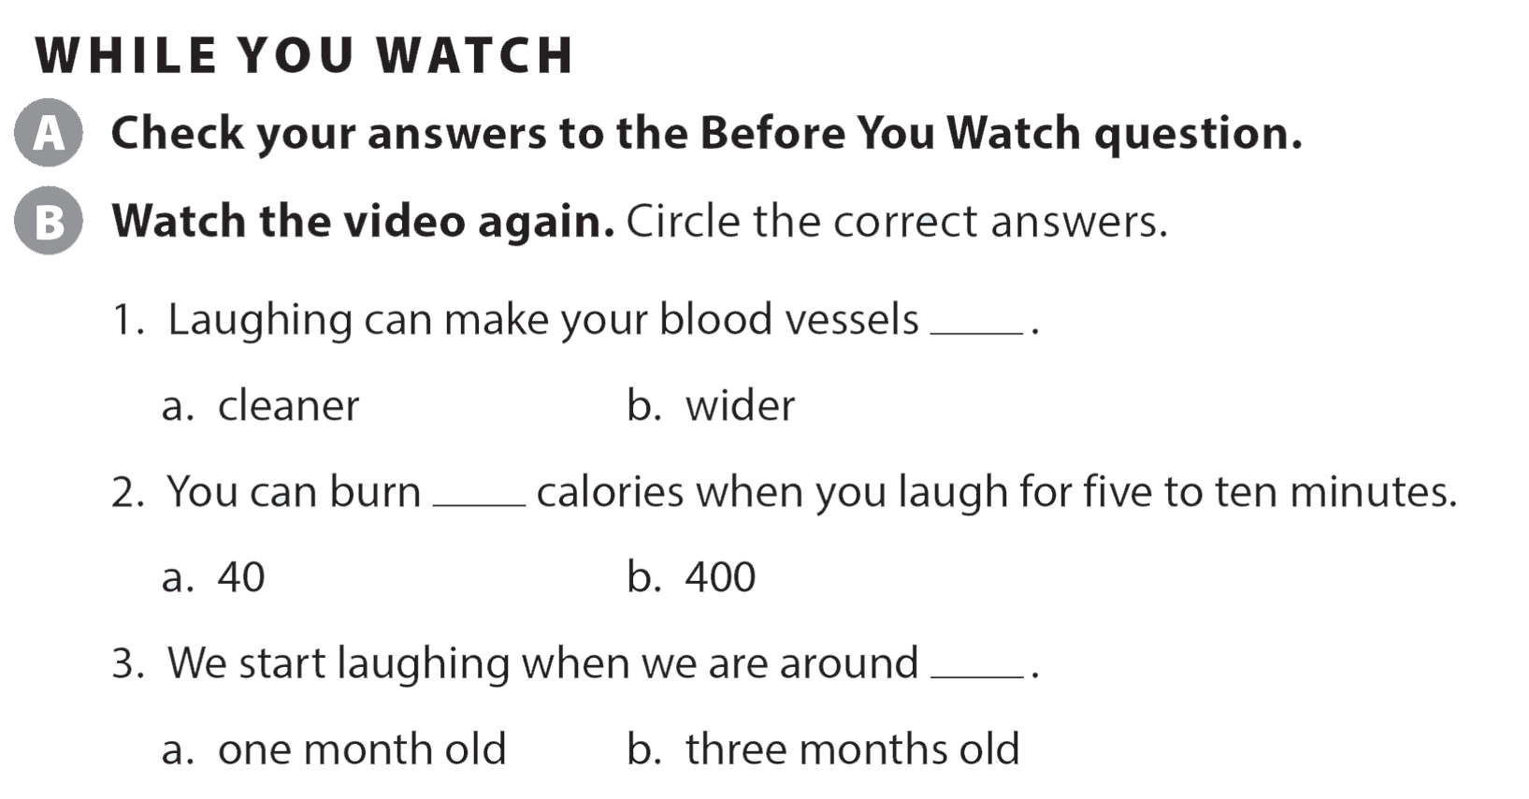
UNIT 8
YOU SHOULD SEE A DOCTOR!
VIDEO

Slide 28
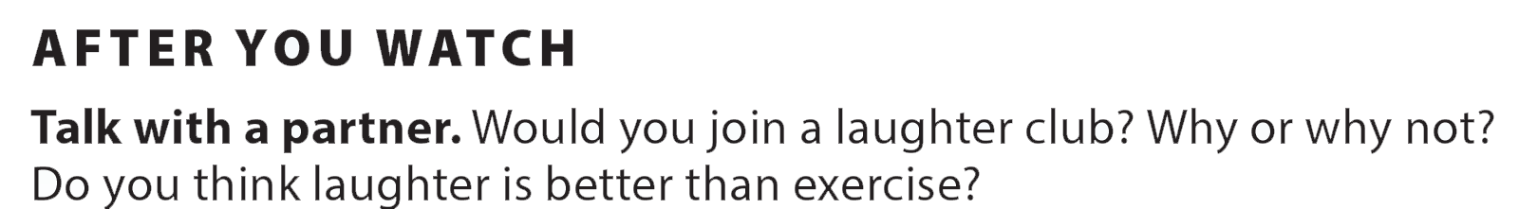
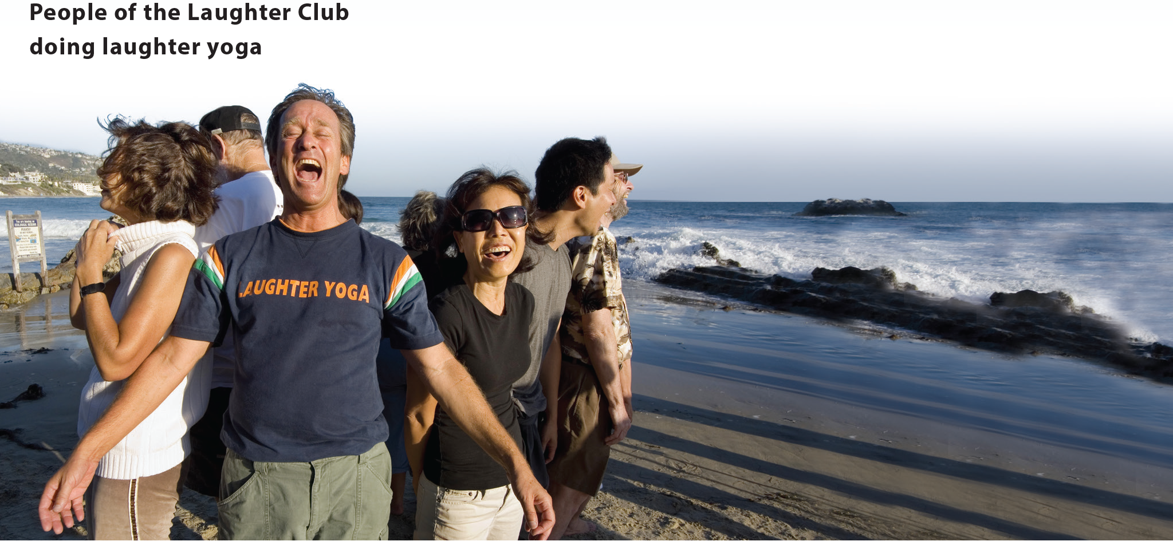

UNIT 8
YOU SHOULD SEE A DOCTOR!
VIDEO
National Geographic Learning, a Cengage Company © 2022 Cengage Learning, Inc. ALL RIGHTS RESERVED. This presentation tool is intended for teaching purposes only and may not be scanned, copied, duplicated, or posted to a publicly accessible platform in whole or in part.

Slide 29
UNIT 8
YOU SHOULD SEE A DOCTOR!
Thank you!

