Slide 1

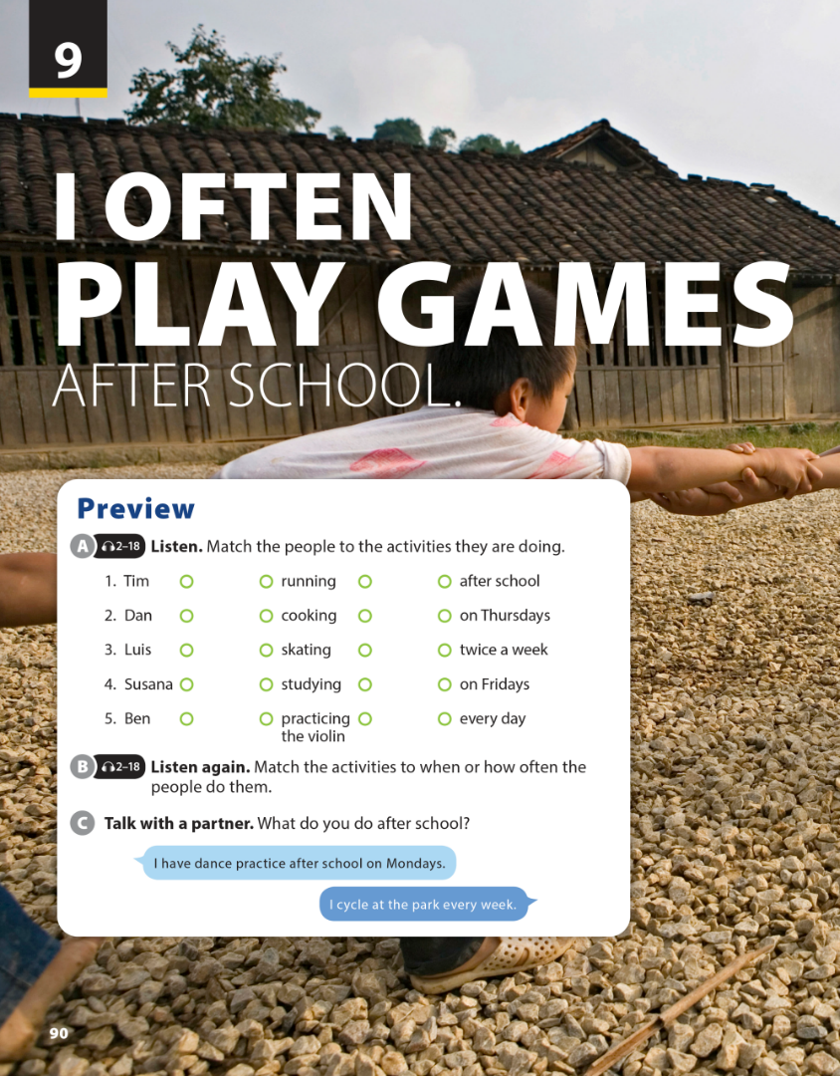
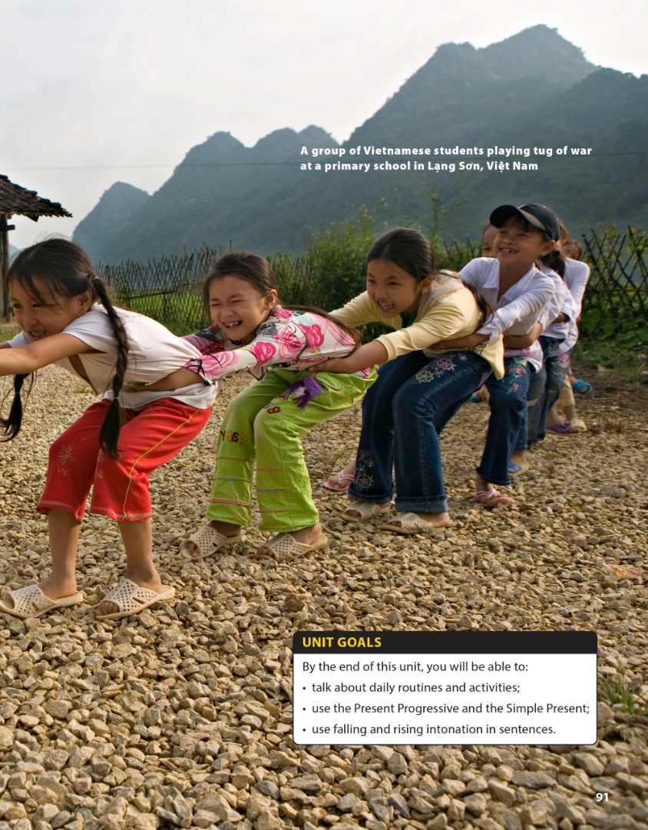

National Geographic Learning, a Cengage Company © 2022 Cengage Learning, Inc. ALL RIGHTS RESERVED. This presentation tool is intended for teaching purposes only and may not be scanned, copied, duplicated, or posted to a publicly accessible platform in whole or in part.

Slide 2
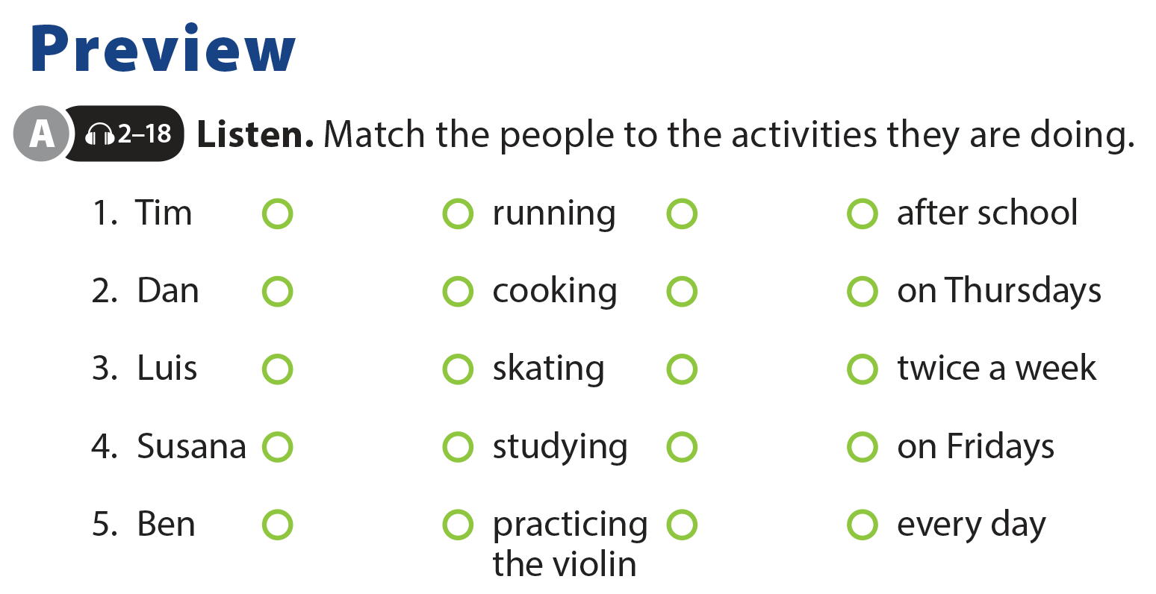

UNIT 9
I OFTEN PLAY GAMES AFTER SCHOOL.
PREVIEW

Slide 3


UNIT 9
I OFTEN PLAY GAMES AFTER SCHOOL.
PREVIEW

Slide 4
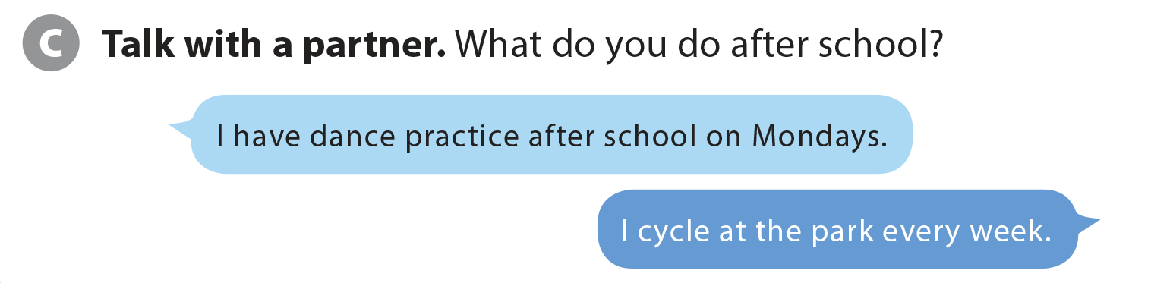
UNIT 9
I OFTEN PLAY GAMES AFTER SCHOOL.
PREVIEW

Slide 5


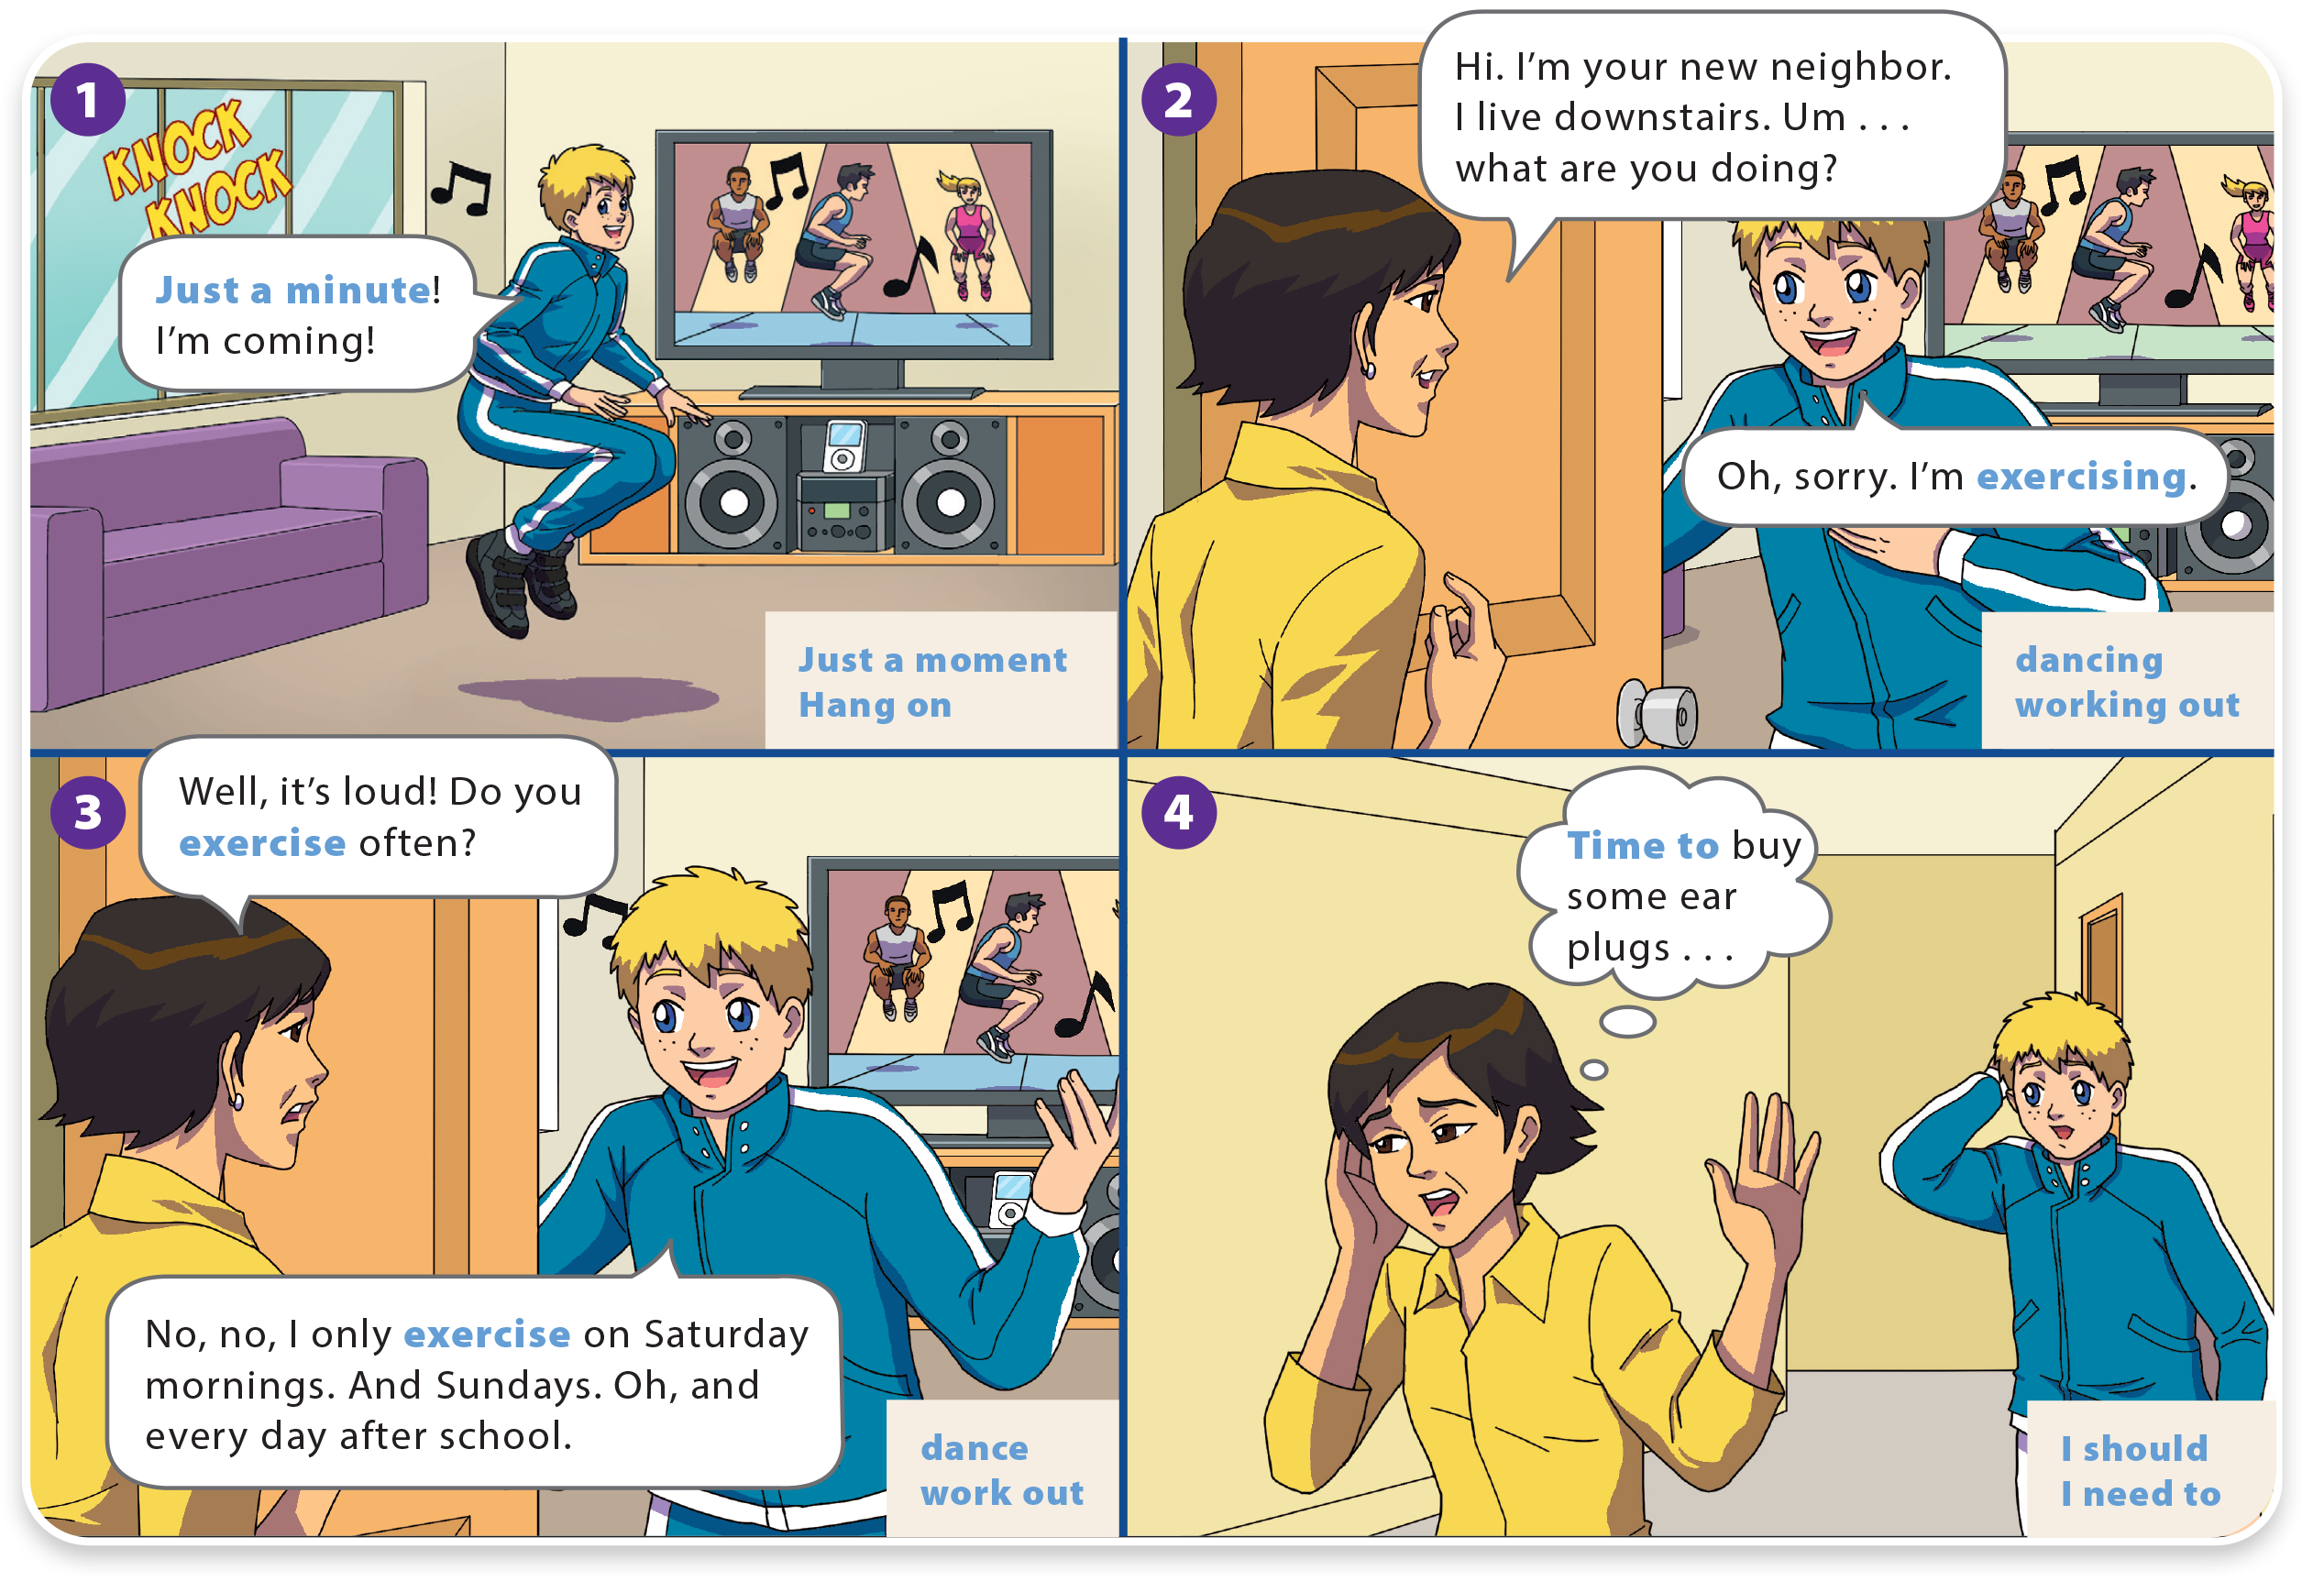
I OFTEN PLAY GAMES AFTER SCHOOL.
UNIT 9
WHAT DO YOU LIKE TO DO?
LANGUAGE FOCUS

Slide 6
WHAT DO YOU LIKE TO DO?
UNIT 9
I OFTEN PLAY GAMES AFTER SCHOOL.
LANGUAGE FOCUS

Slide 7
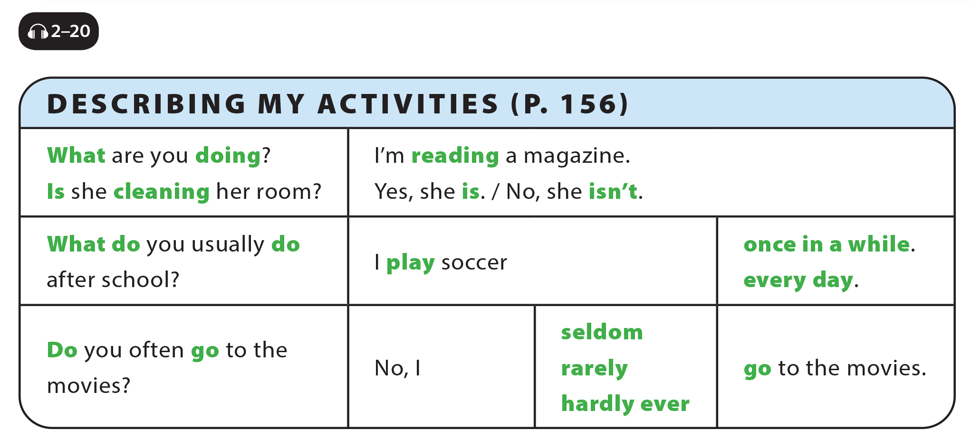
UNIT 9
I OFTEN PLAY GAMES AFTER SCHOOL.
LANGUAGE FOCUS

Slide 8
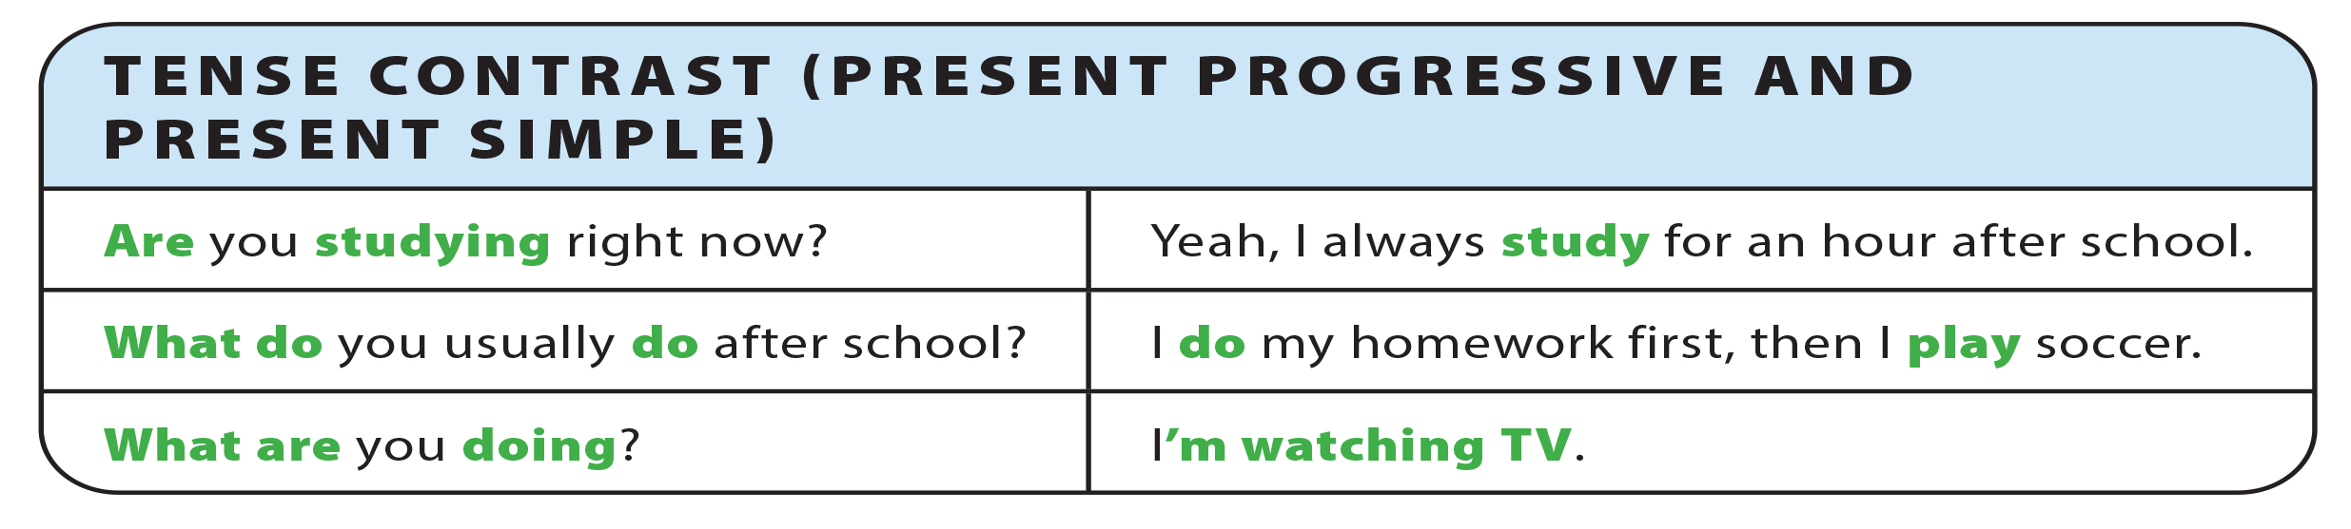
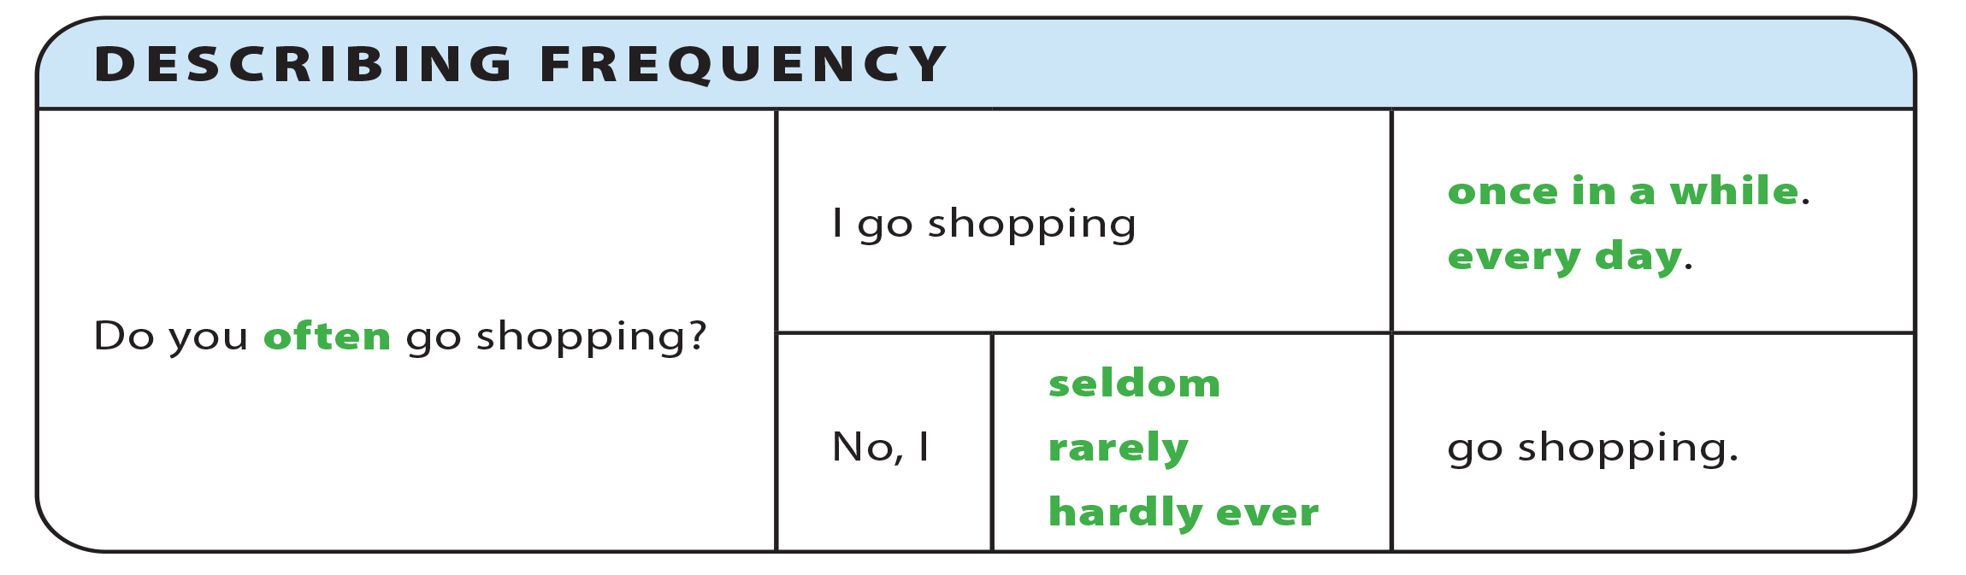
UNIT 9
I OFTEN PLAY GAMES AFTER SCHOOL.
GRAMMAR REFERENCE

Slide 9
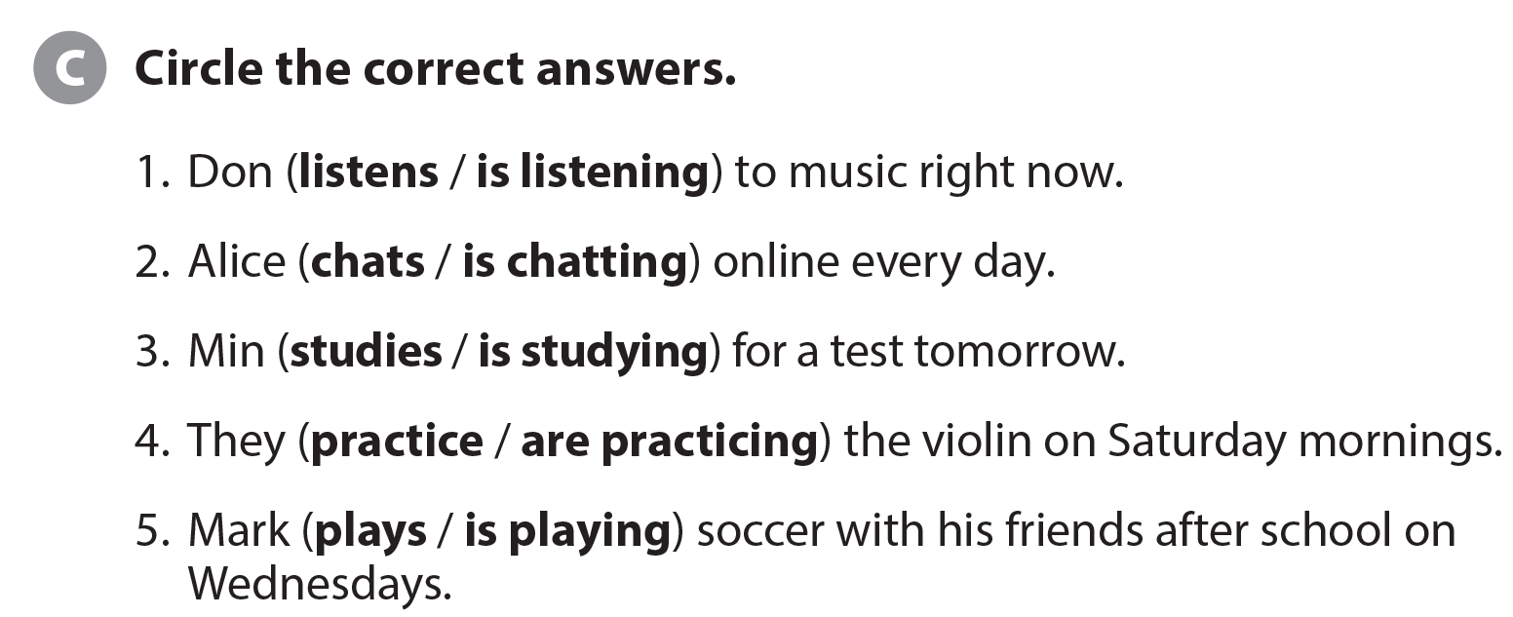
UNIT 9
I OFTEN PLAY GAMES AFTER SCHOOL.
LANGUAGE FOCUS

Slide 10
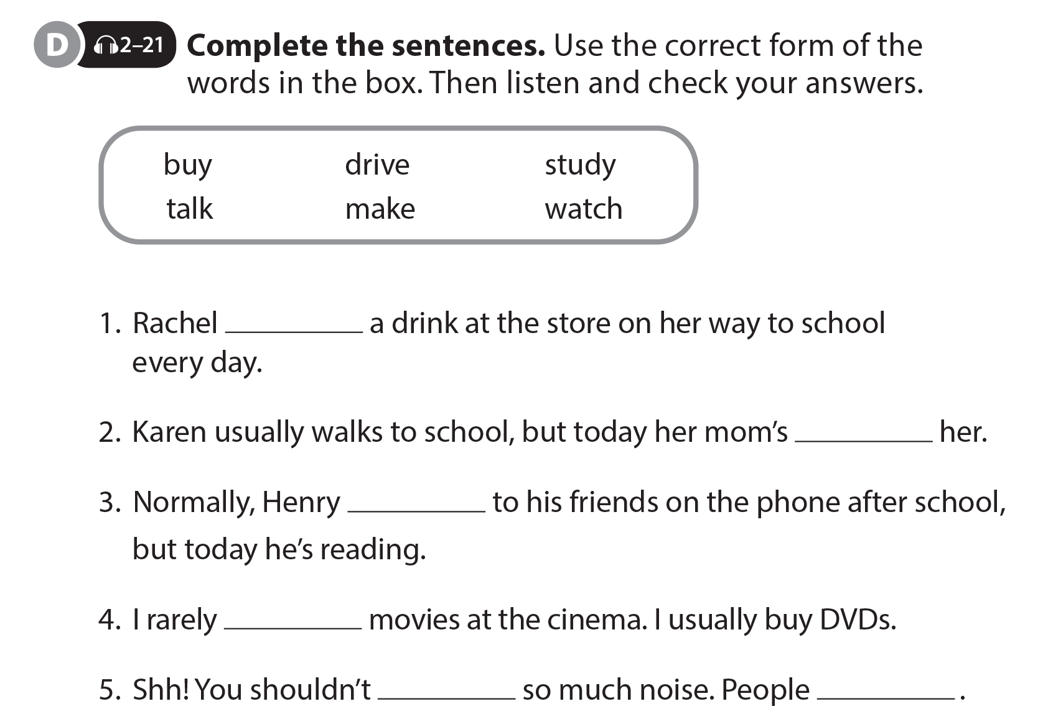
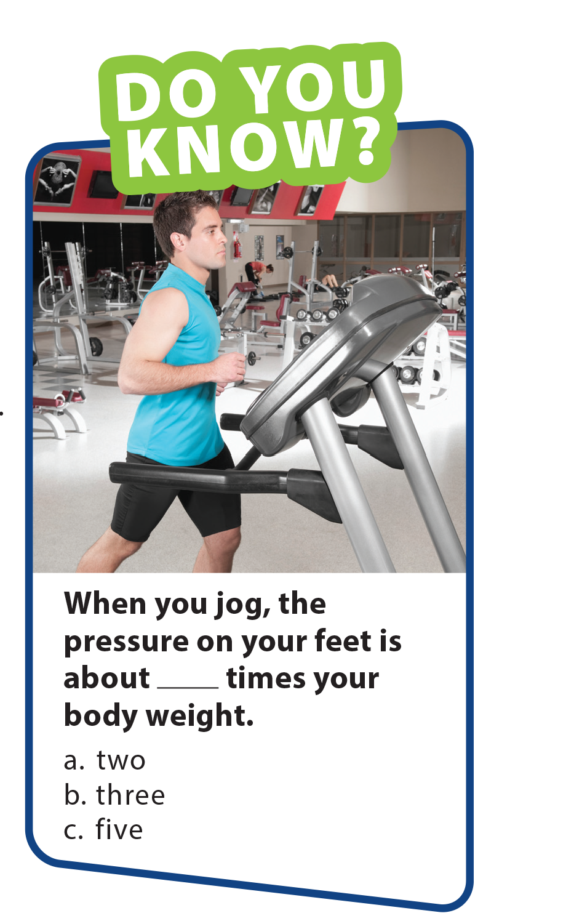
UNIT 9
I OFTEN PLAY GAMES AFTER SCHOOL.
LANGUAGE FOCUS
buys
driving
talks
watch
make
are studying

Slide 11
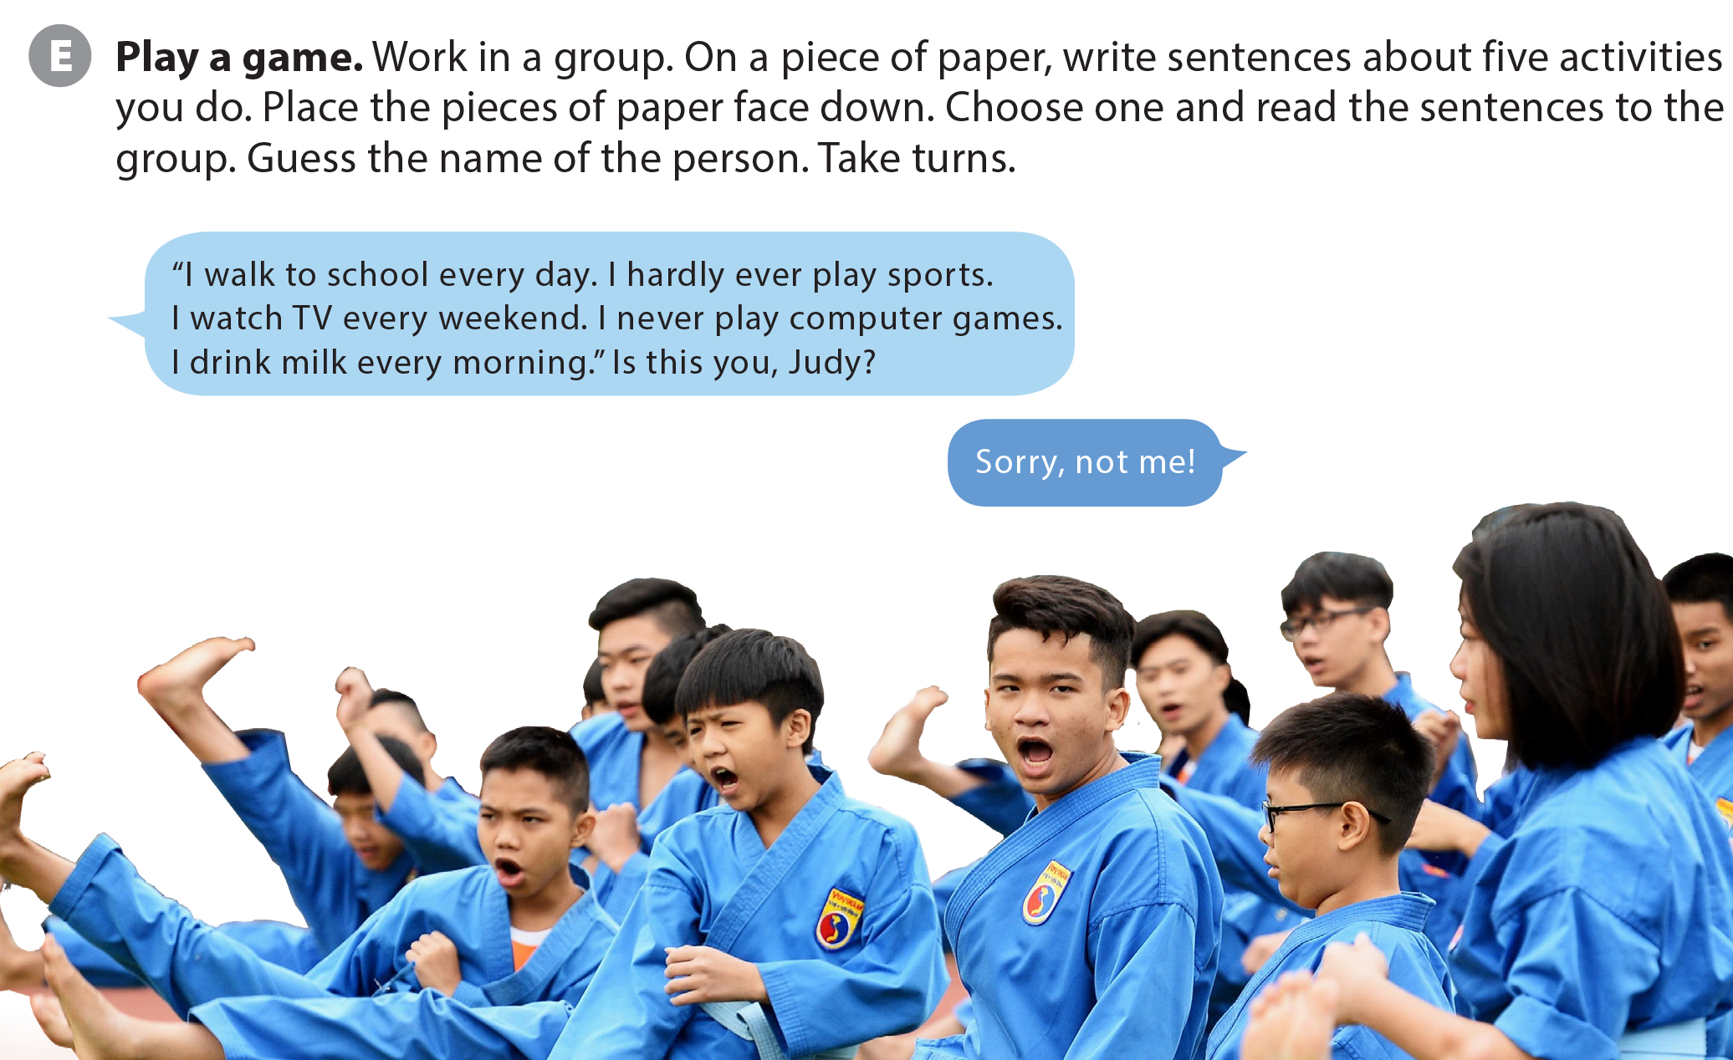
UNIT 9
I OFTEN PLAY GAMES AFTER SCHOOL.
LANGUAGE FOCUS

Slide 12

UNIT 9
I OFTEN PLAY GAMES AFTER SCHOOL.
THE REAL WORLD
National Geographic Learning, a Cengage Company © 2022 Cengage Learning, Inc. ALL RIGHTS RESERVED. This presentation tool is intended for teaching purposes only and may not be scanned, copied, duplicated, or posted to a publicly accessible platform in whole or in part.

Slide 13
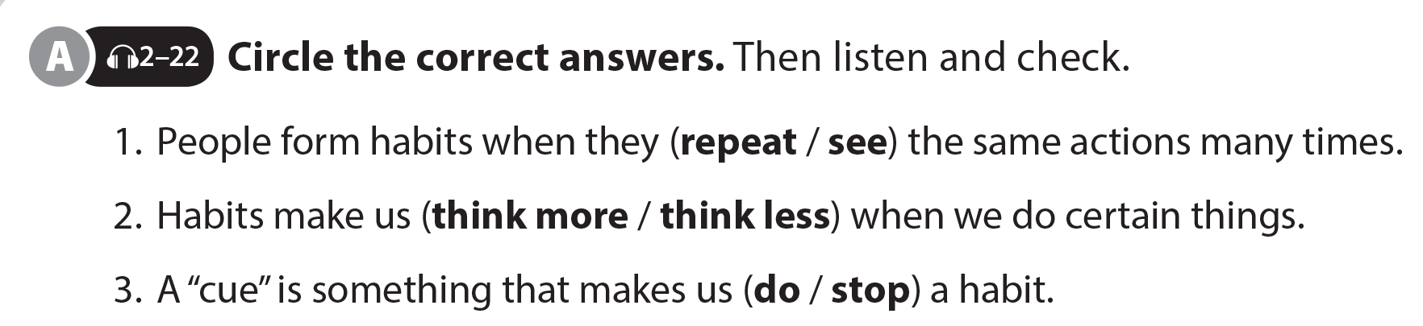
UNIT 9
I OFTEN PLAY GAMES AFTER SCHOOL.
THE REAL WORLD

Slide 14

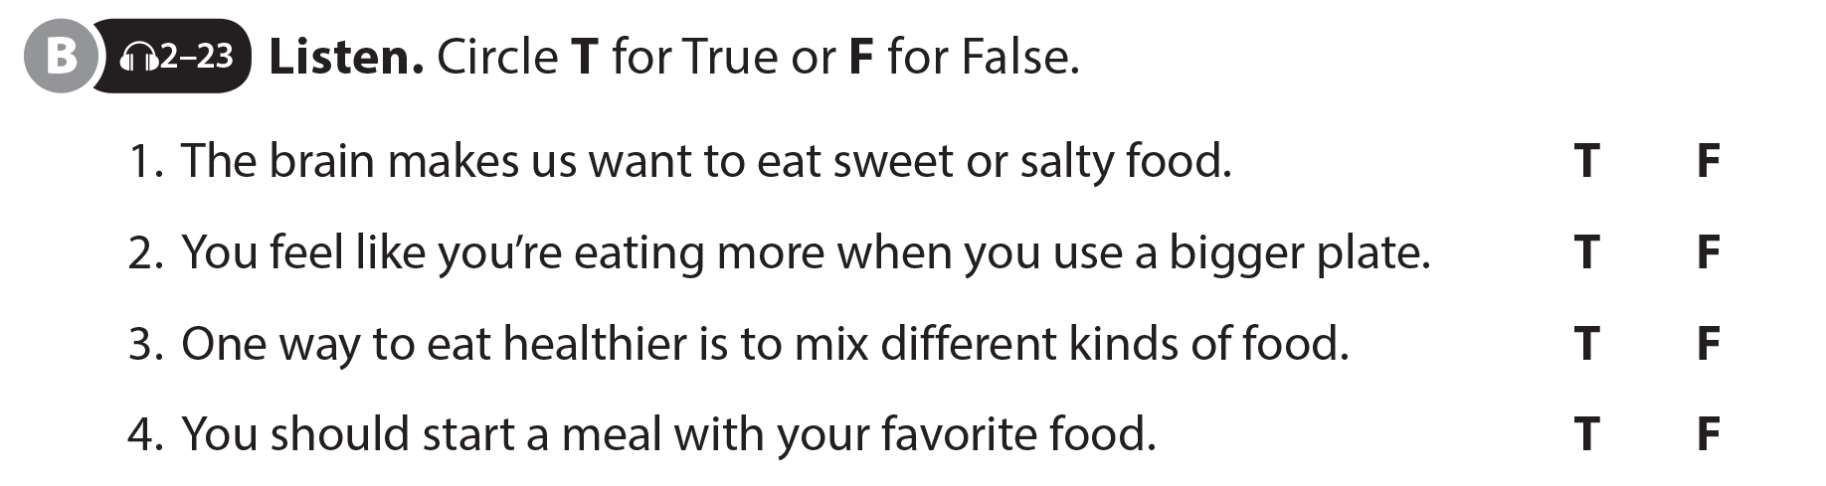
UNIT 9
I OFTEN PLAY GAMES AFTER SCHOOL.
THE REAL WORLD
National Geographic Learning, a Cengage Company © 2022 Cengage Learning, Inc. ALL RIGHTS RESERVED. This presentation tool is intended for teaching purposes only and may not be scanned, copied, duplicated, or posted to a publicly accessible platform in whole or in part.

Slide 15
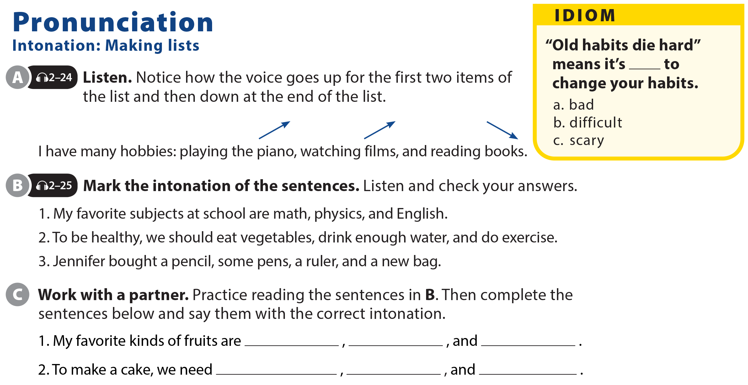
UNIT 9
I OFTEN PLAY GAMES AFTER SCHOOL.
PRONUNCIATION

Slide 16
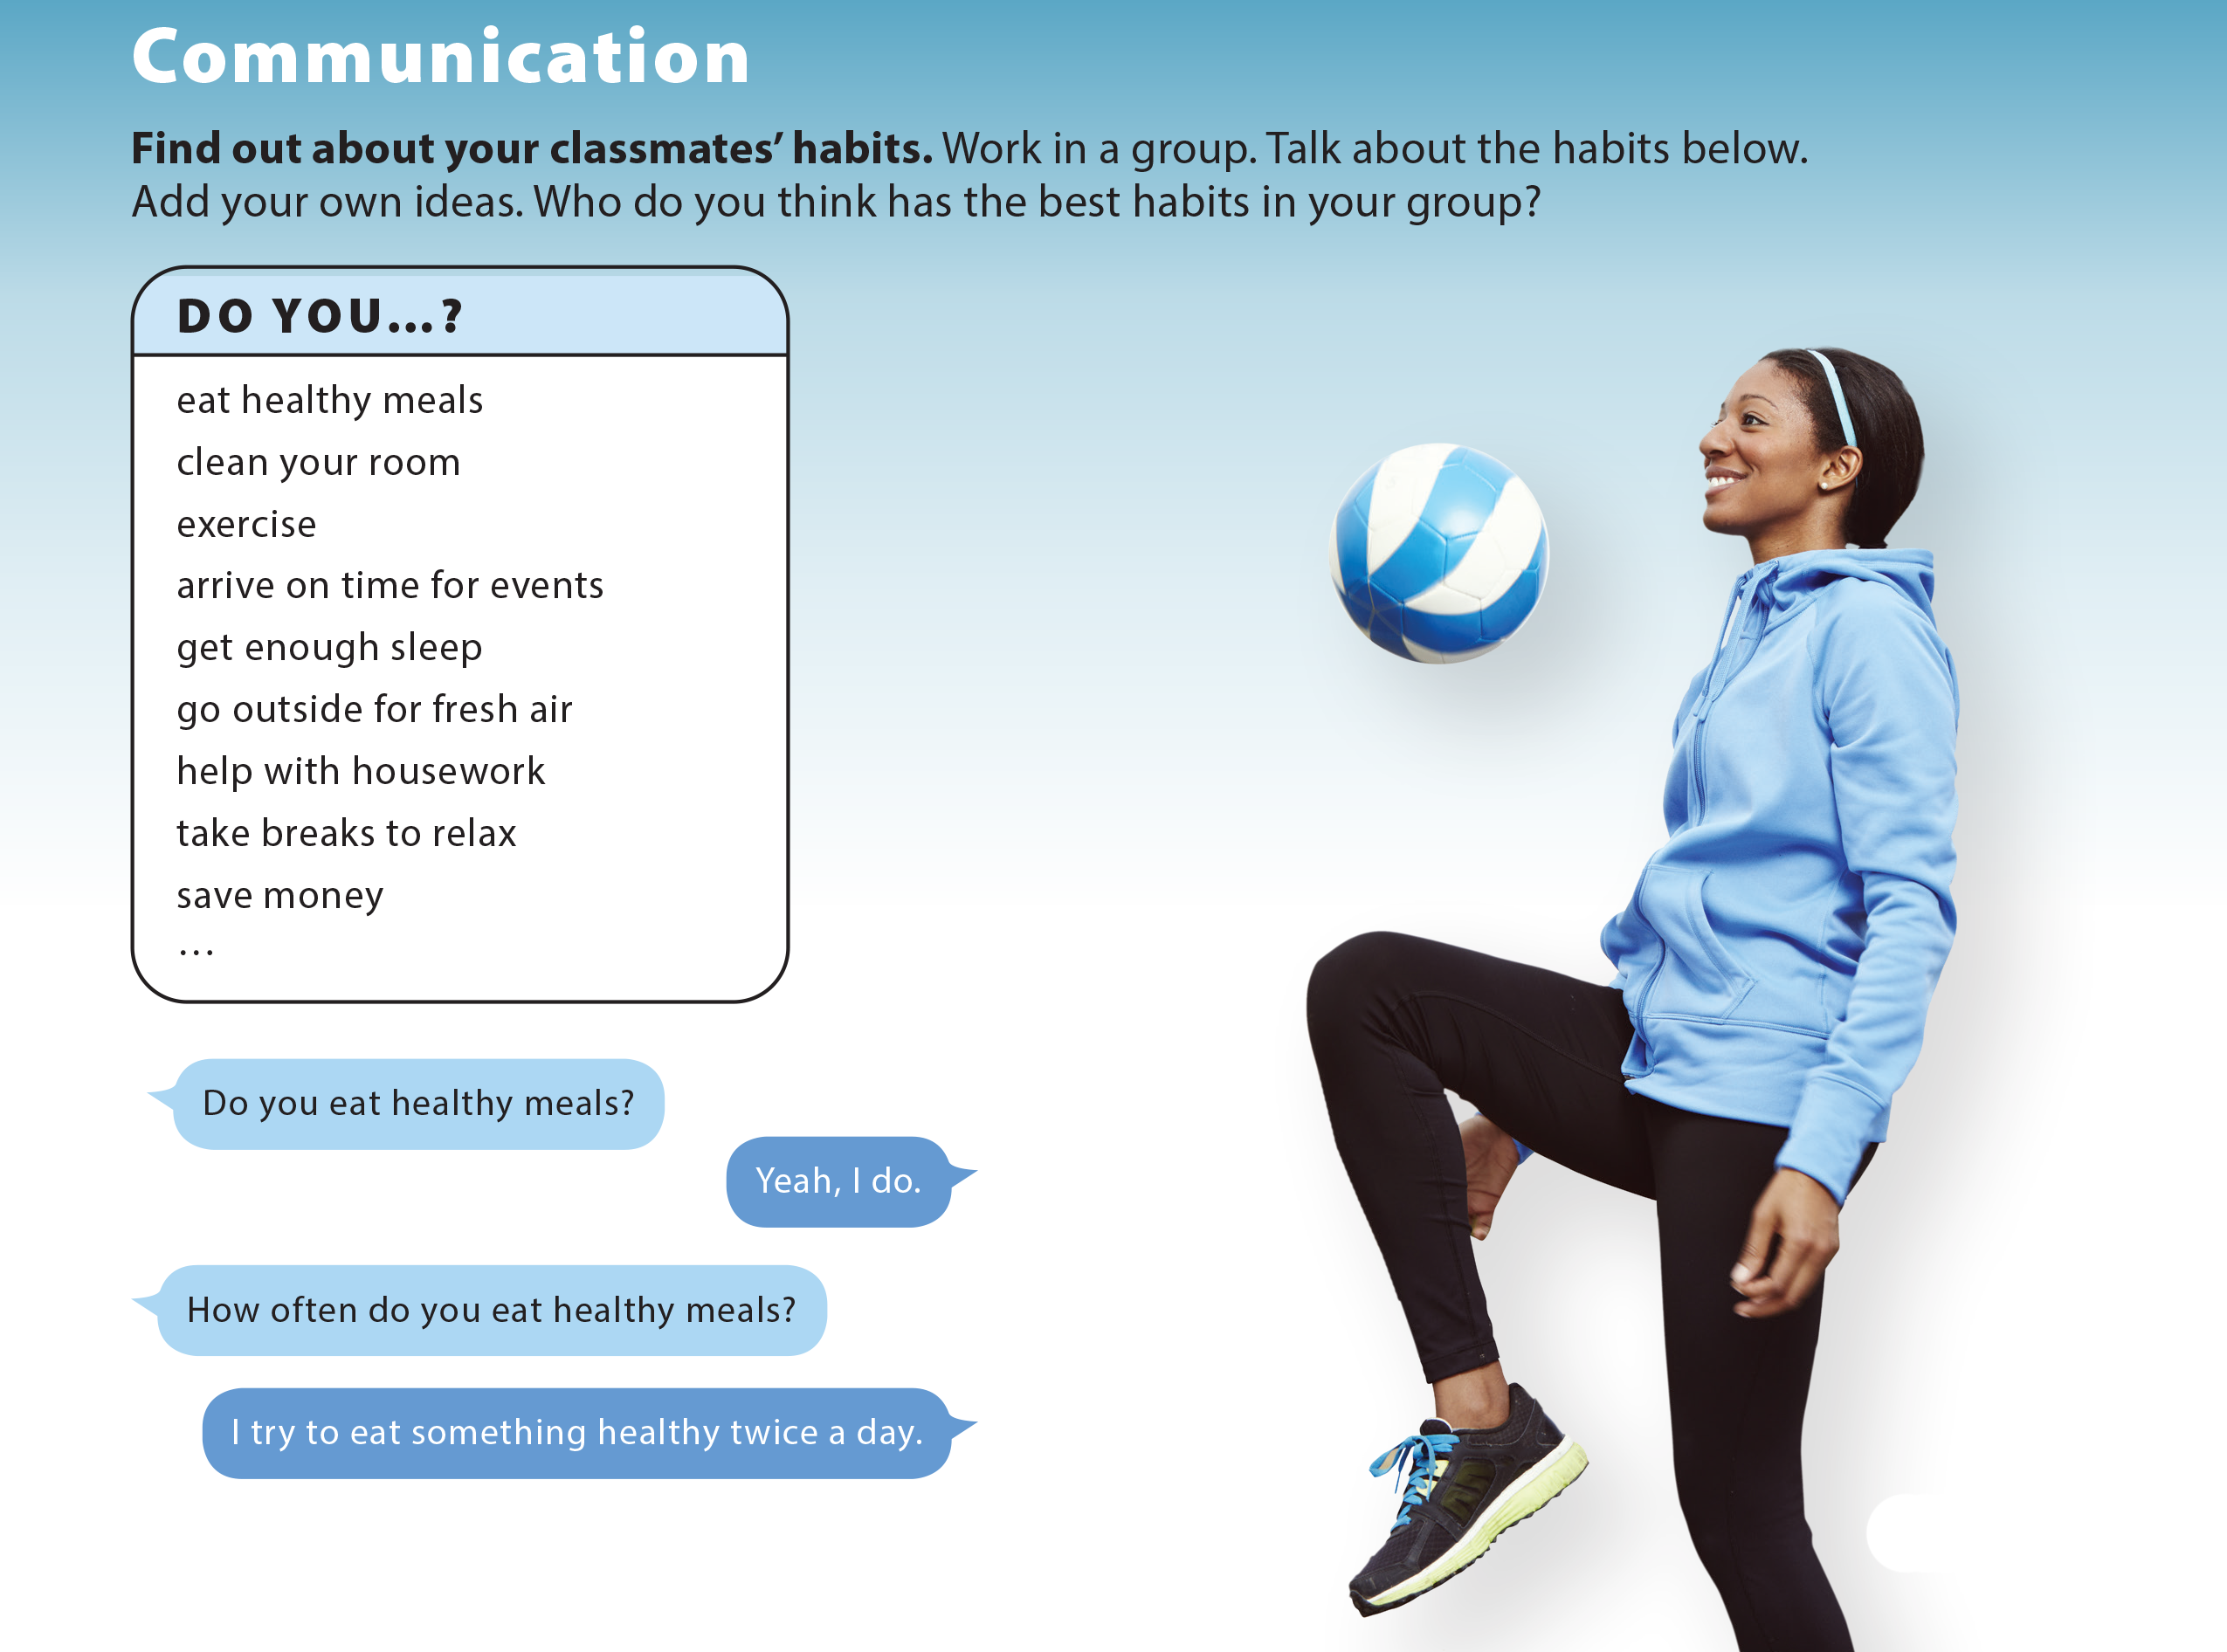
UNIT 9
I OFTEN PLAY GAMES AFTER SCHOOL.
COMMUNICATION

Slide 17
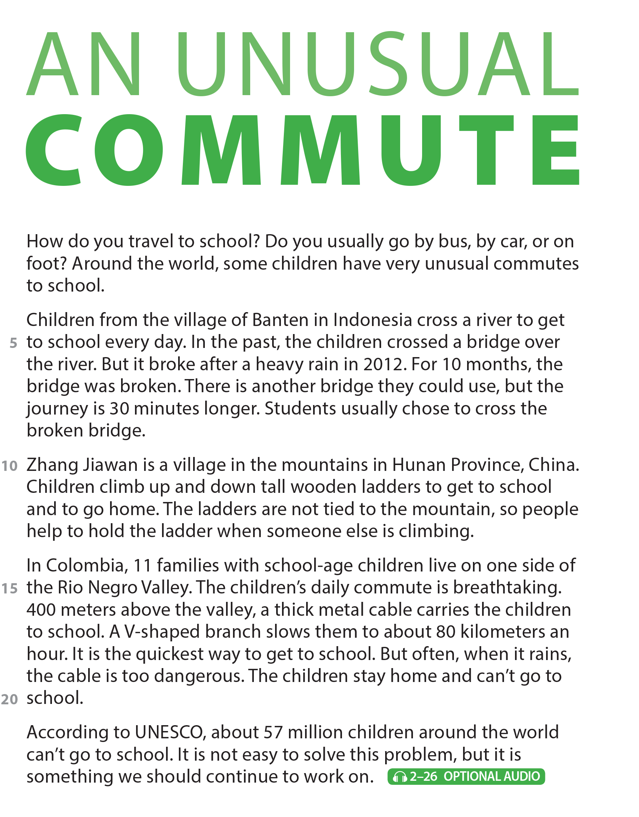
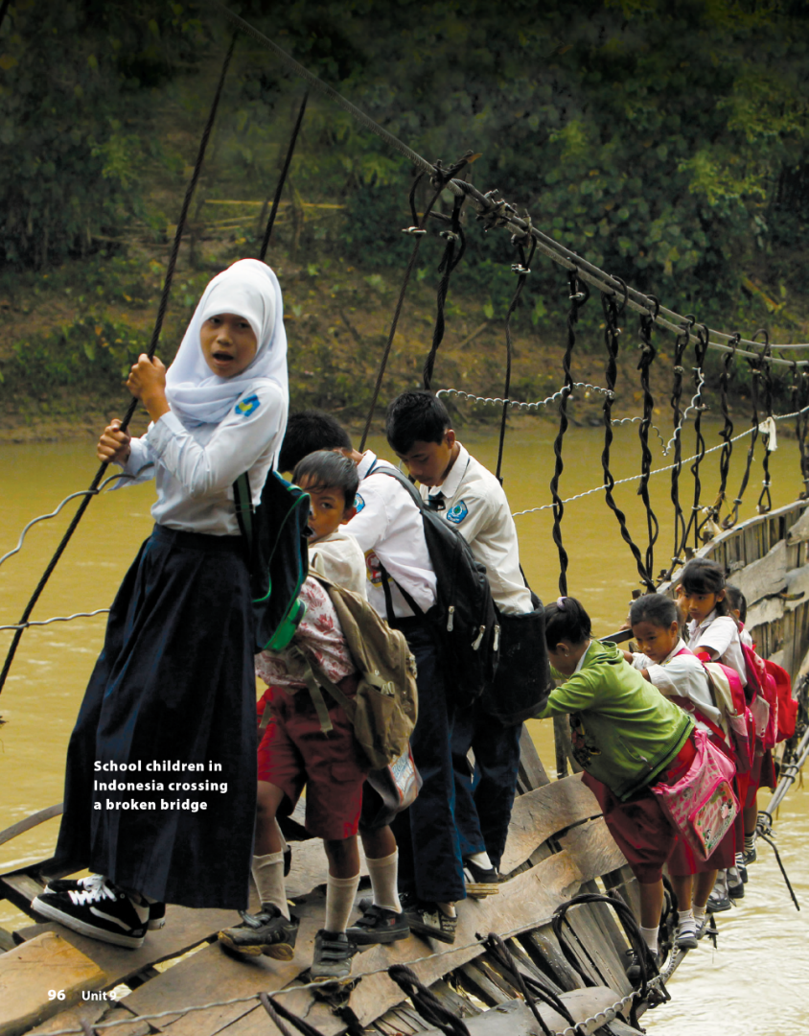



UNIT 9
I OFTEN PLAY GAMES AFTER SCHOOL.
READING
National Geographic Learning, a Cengage Company © 2022 Cengage Learning, Inc. ALL RIGHTS RESERVED. This presentation tool is intended for teaching purposes only and may not be scanned, copied, duplicated, or posted to a publicly accessible platform in whole or in part.

Slide 18
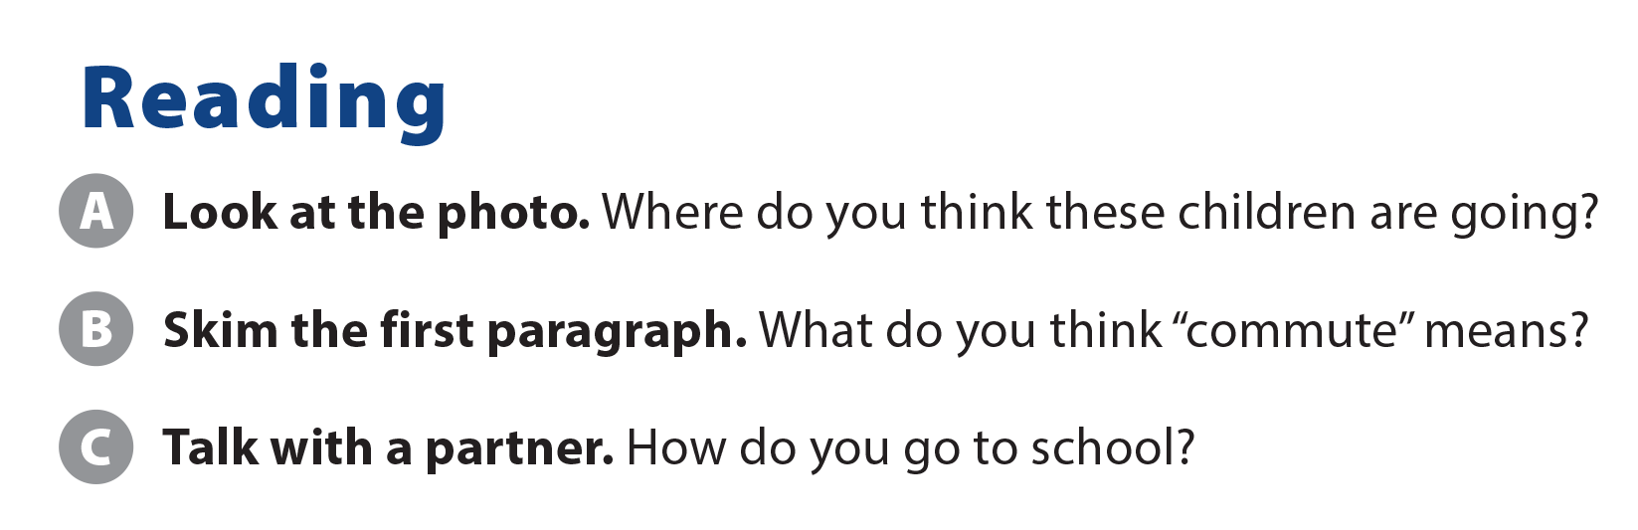
UNIT 9
I OFTEN PLAY GAMES AFTER SCHOOL.
READING
Suggested answer: The journey you make when you travel to and from a place you go to regularly.

Slide 19
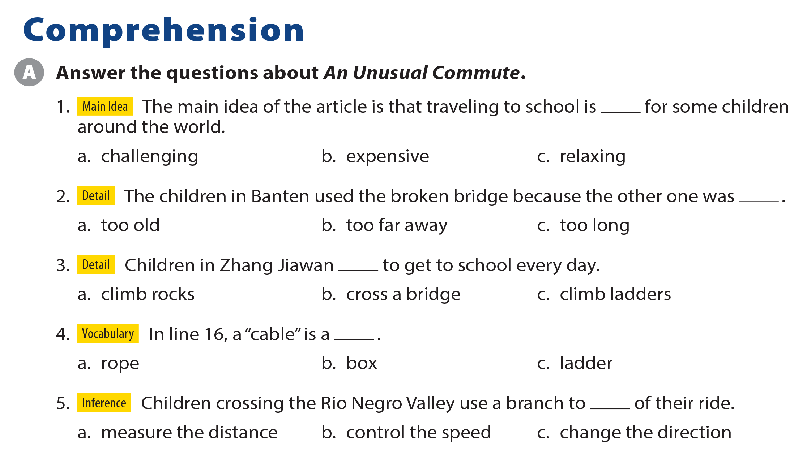
UNIT 9
I OFTEN PLAY GAMES AFTER SCHOOL.
COMPREHENSION

Slide 20
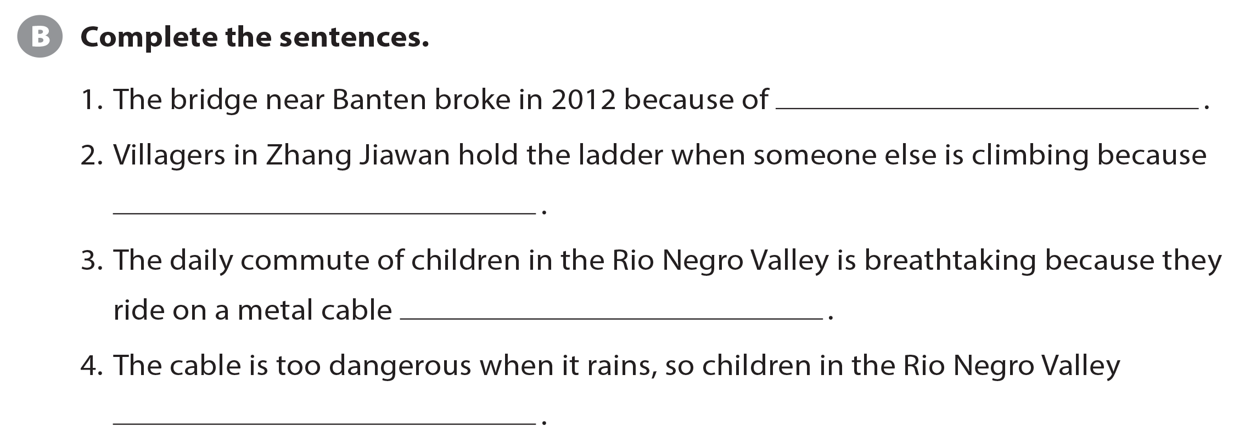

UNIT 9
I OFTEN PLAY GAMES AFTER SCHOOL.
COMPREHENSION
a heavy rain
the ladders are not tied to the mountain
400 meters above the valley
stay home and can’t go to school

Slide 21
UNIT 9
I OFTEN PLAY GAMES AFTER SCHOOL.
PROJECT

Slide 22
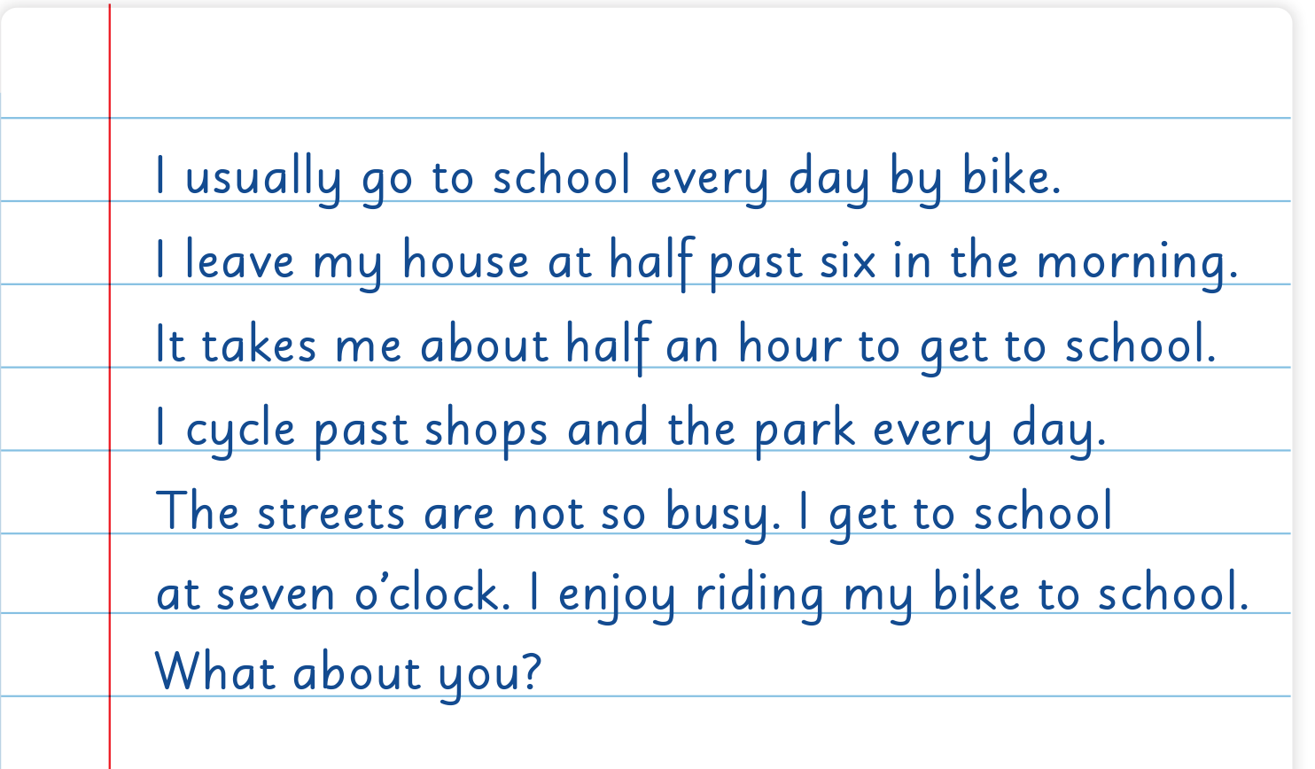
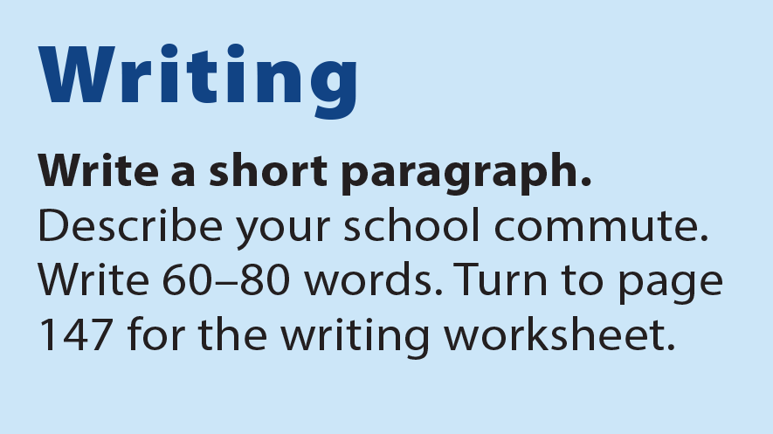
UNIT 9
I OFTEN PLAY GAMES AFTER SCHOOL.
WRITING

Slide 23
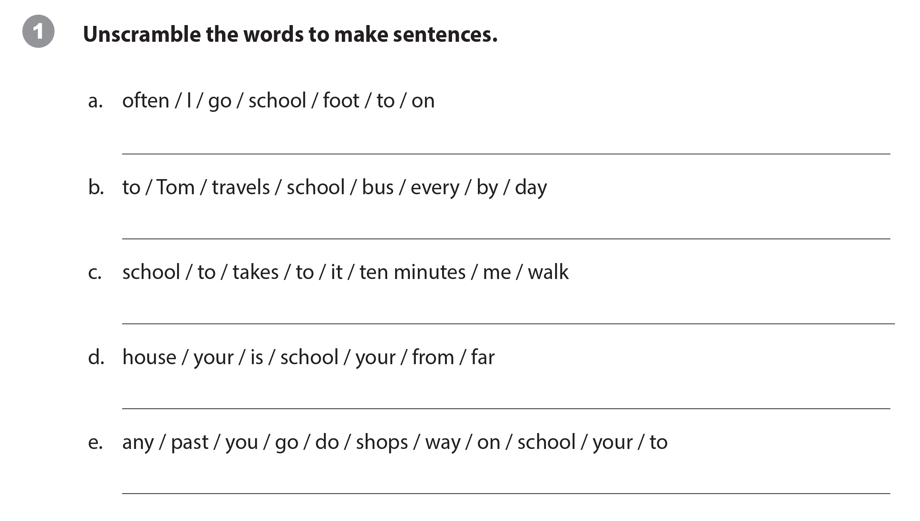
UNIT 9
I OFTEN PLAY GAMES AFTER SCHOOL.
WRITING WORKSHEET
I often go to school on foot. / Often, I go to school on foot.
Tom travels to school by bus every day. / Every day, Tom travels to school by bus. / Tom travels to school every day by bus.
It takes me ten minutes to walk to school.
Is your school far from your house? / Is your house far from your school?
/ Your school is far from your house. / Your house is far from your school.
Do you go past any shops on your way to school?

Slide 24
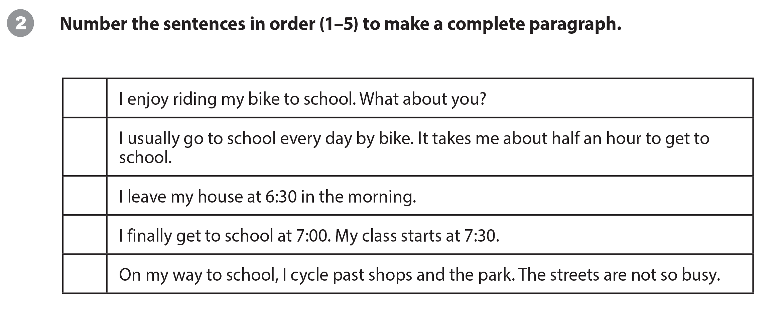
UNIT 9
I OFTEN PLAY GAMES AFTER SCHOOL.
WRITING WORKSHEET
5
1
2
4
3

Slide 25

UNIT 9
I OFTEN PLAY GAMES AFTER SCHOOL.
WRITING WORKSHEET

Slide 26



UNIT 9
I OFTEN PLAY GAMES AFTER SCHOOL.
VIDEO
It’s a skateboarding school in Afghanistan.

Slide 27

UNIT 9
I OFTEN PLAY GAMES AFTER SCHOOL.
VIDEO

Slide 28
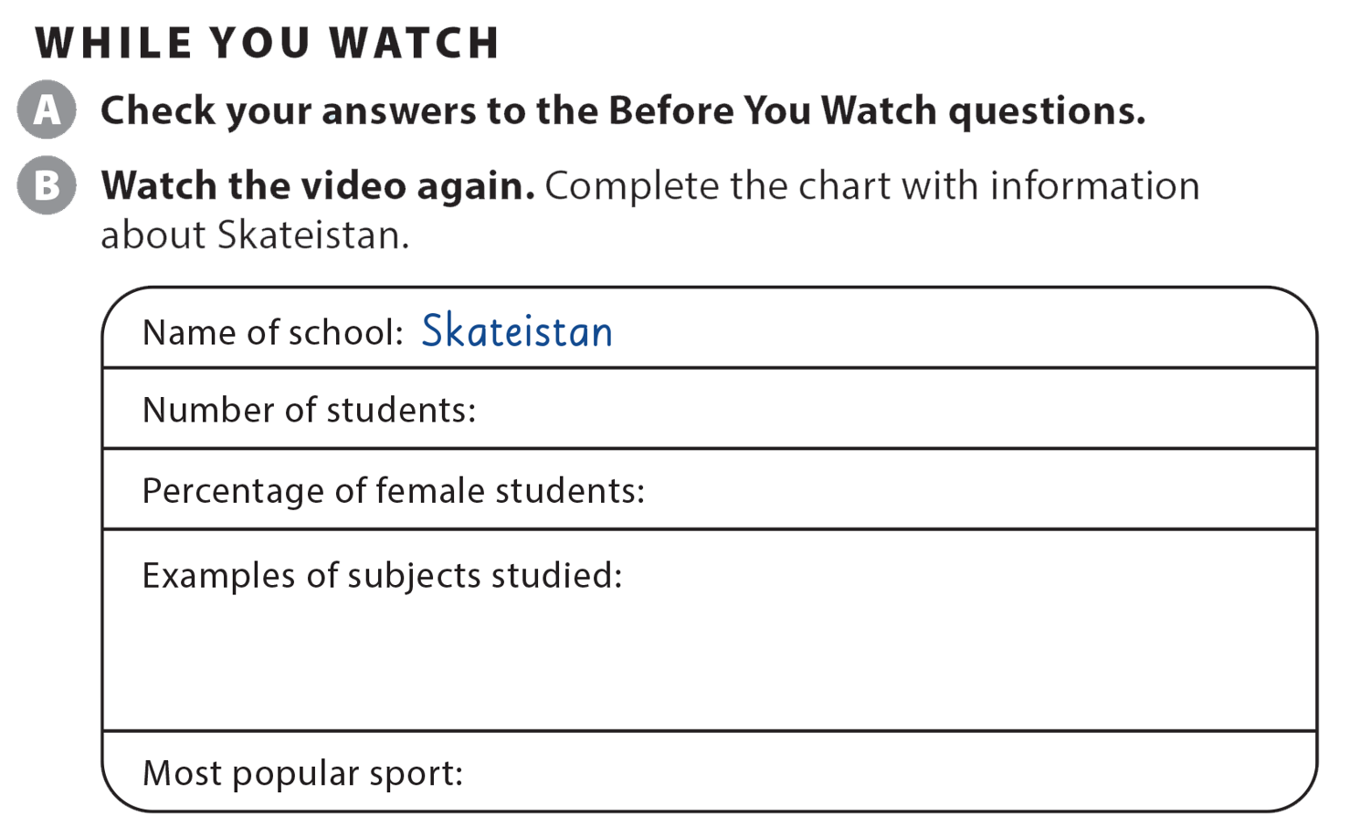
UNIT 9
I OFTEN PLAY GAMES AFTER SCHOOL.
VIDEO
more than 400
40%
science, history, art, math
skateboarding

Slide 29
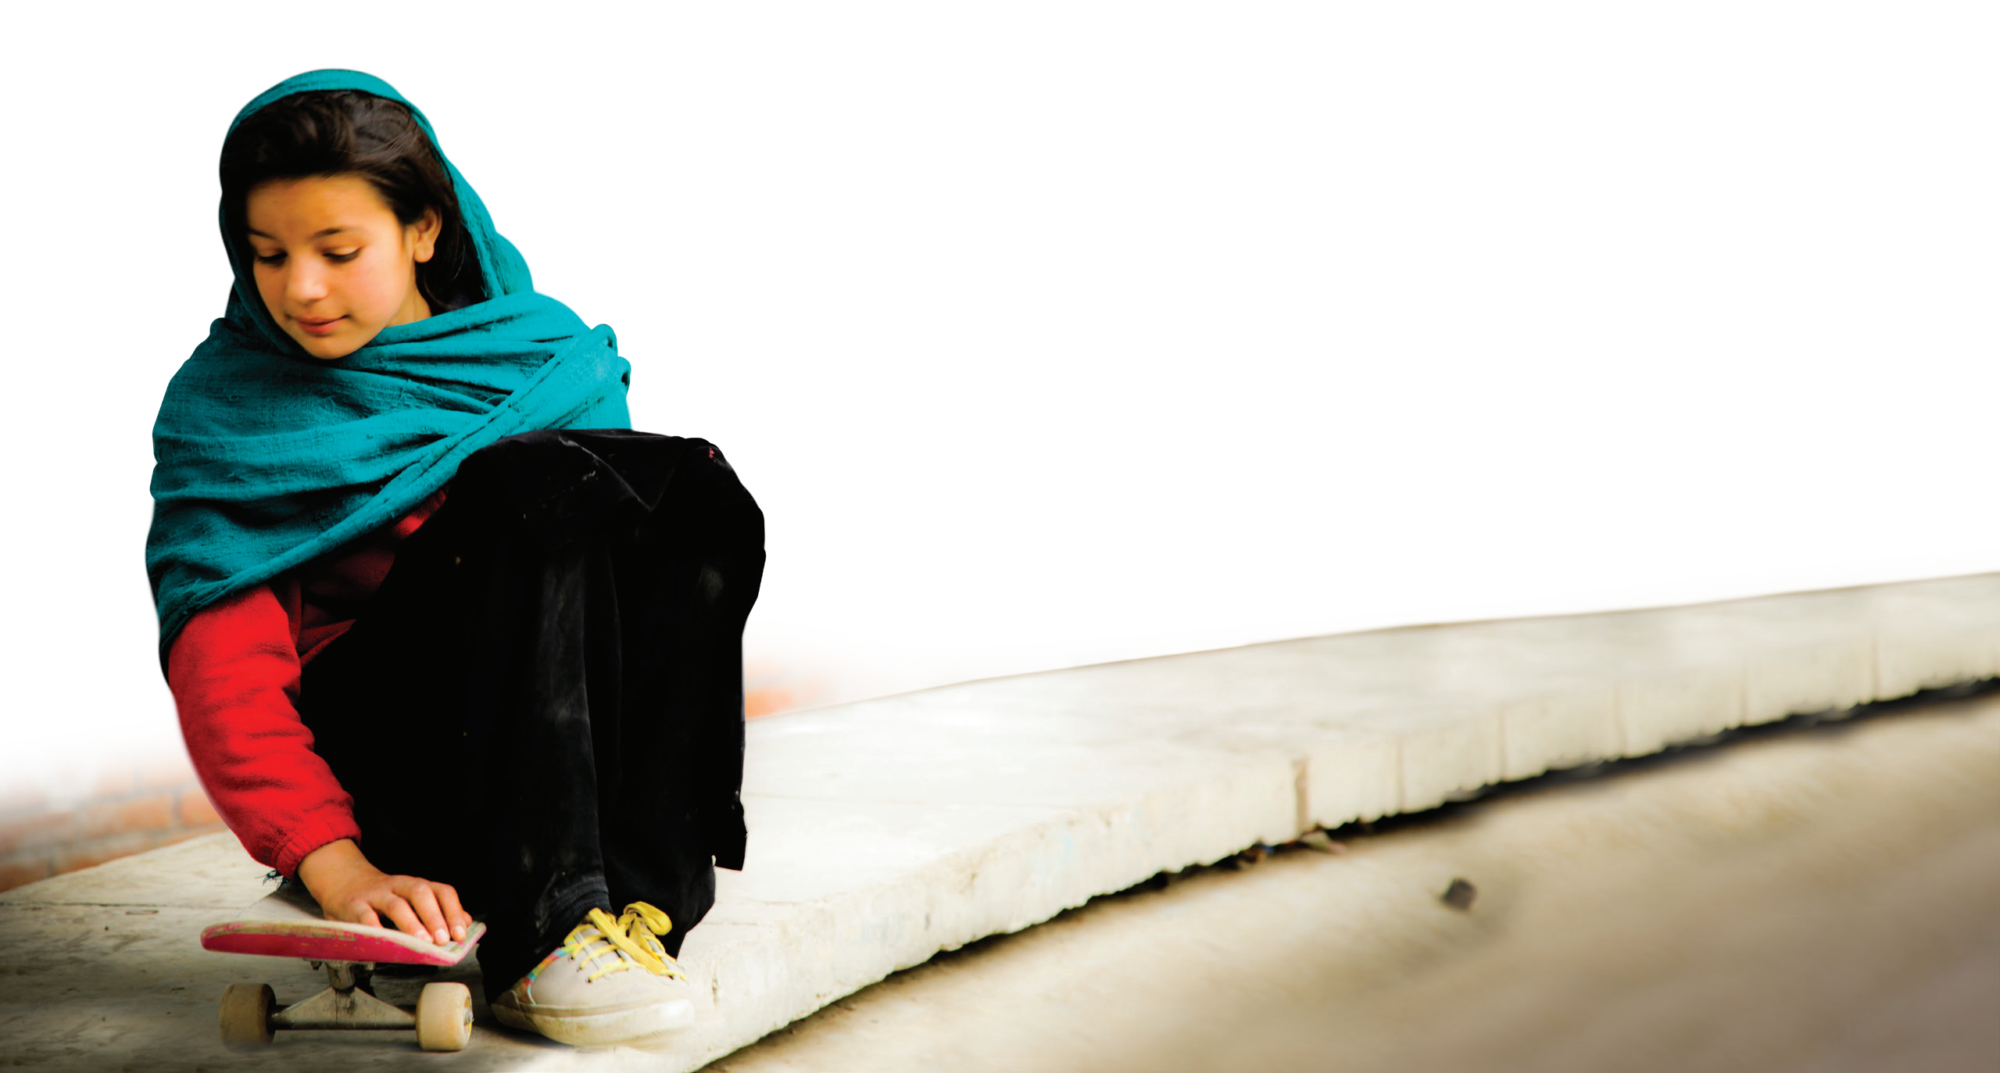



UNIT 9
I OFTEN PLAY GAMES AFTER SCHOOL.
VIDEO

Slide 30
UNIT 9
I OFTEN PLAY GAMES AFTER SCHOOL.
Thank you!

