Slide 1

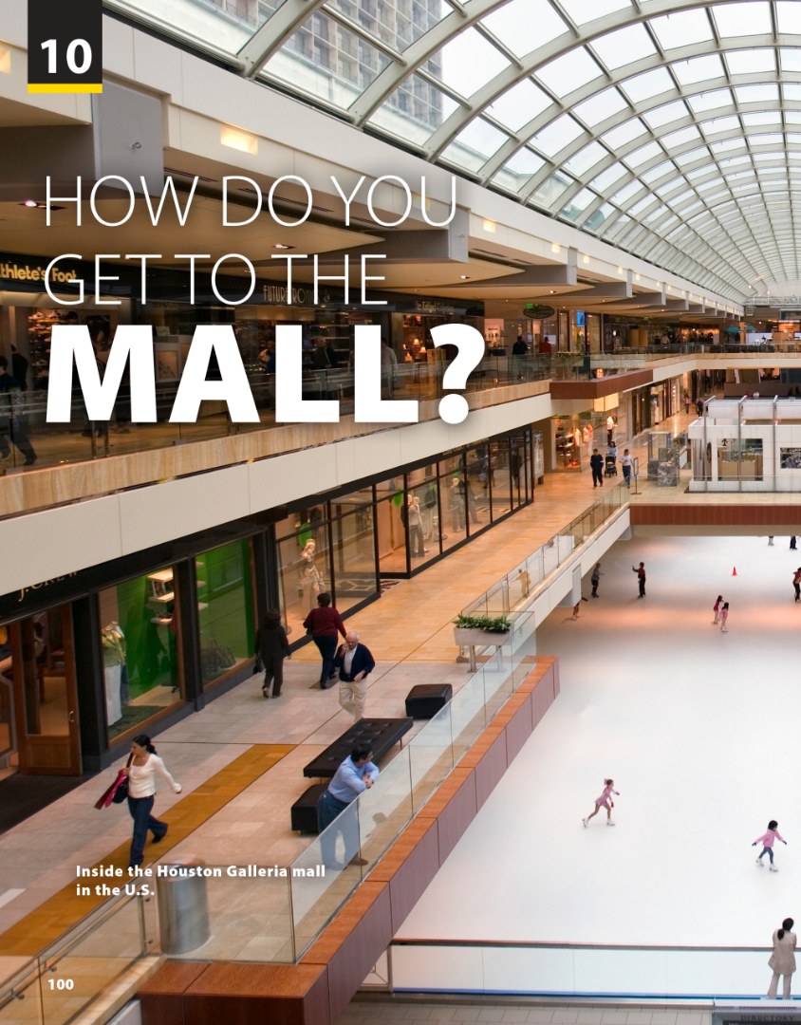
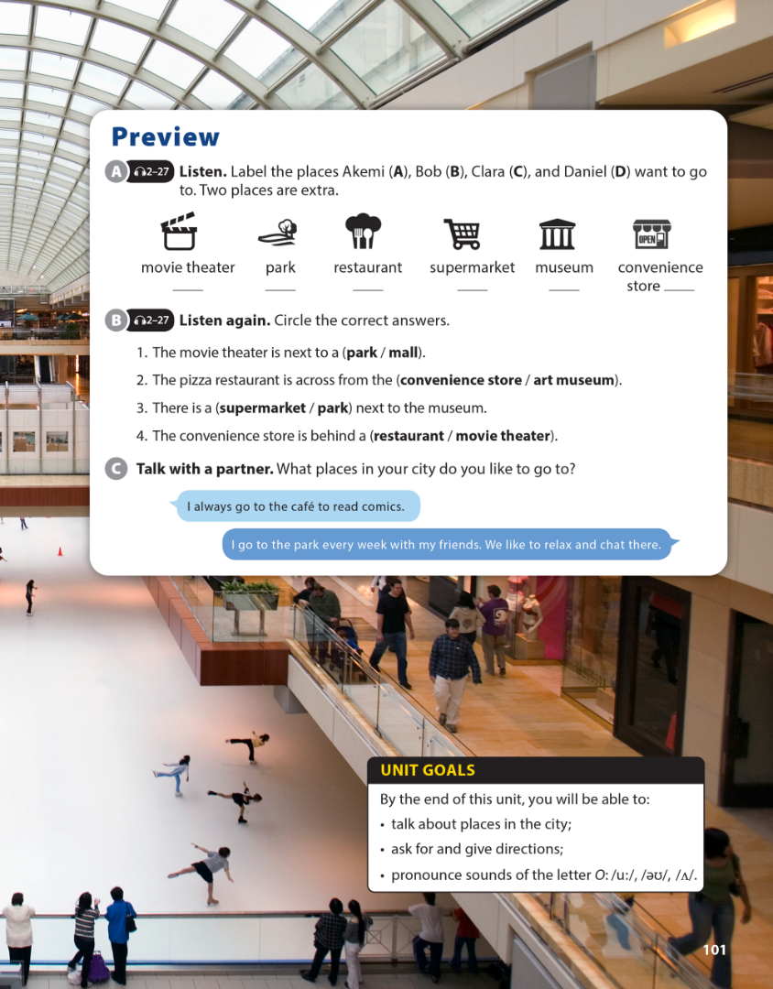

National Geographic Learning, a Cengage Company © 2022 Cengage Learning, Inc. ALL RIGHTS RESERVED. This presentation tool is intended for teaching purposes only and may not be scanned, copied, duplicated, or posted to a publicly accessible platform in whole or in part.

Slide 2
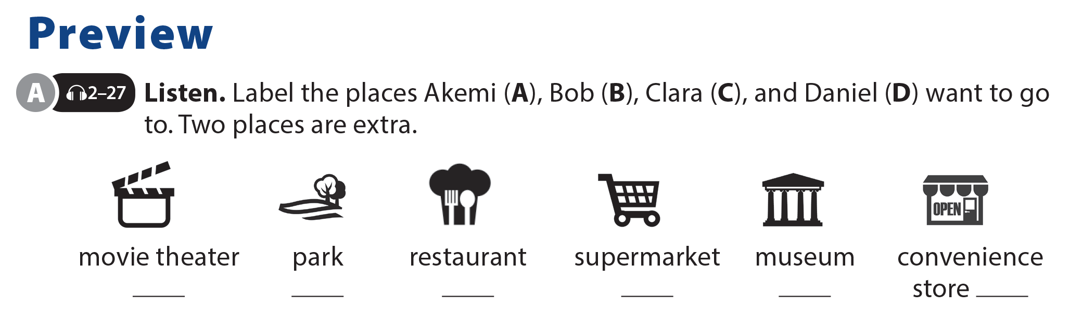

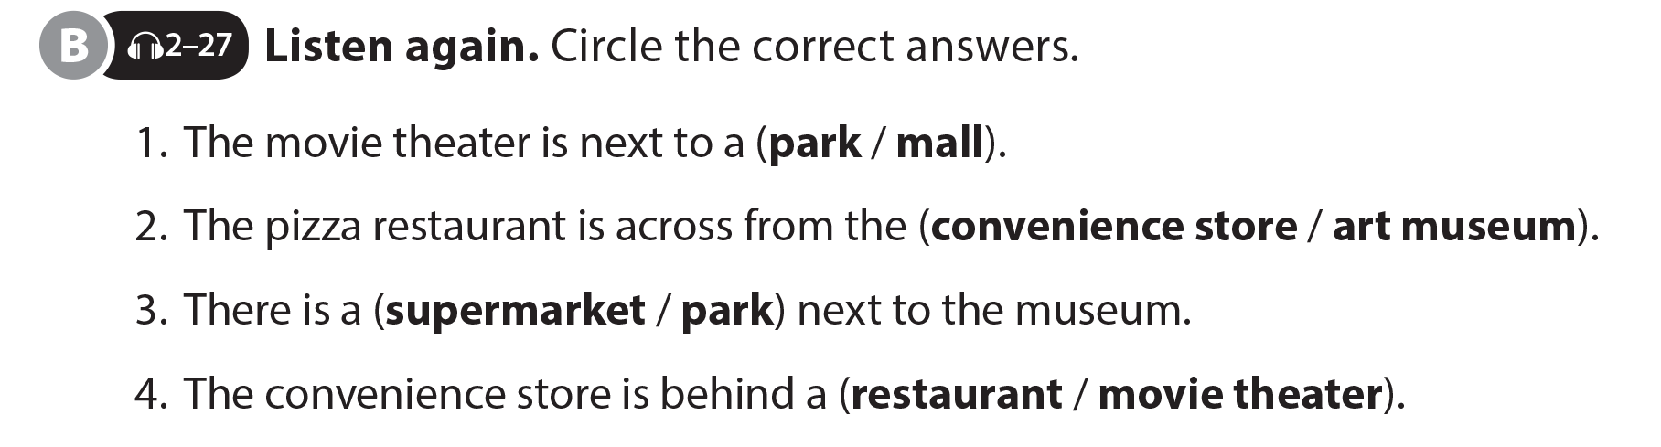
UNIT 10
HOW DO YOU GET TO THE MALL?
PREVIEW
A
B
C
D

Slide 3
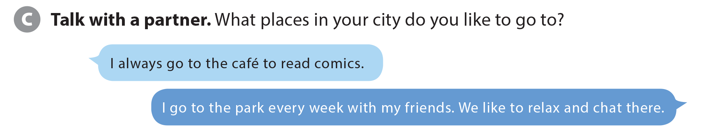
UNIT 10
HOW DO YOU GET TO THE MALL?
PREVIEW

Slide 4

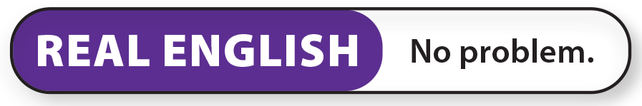
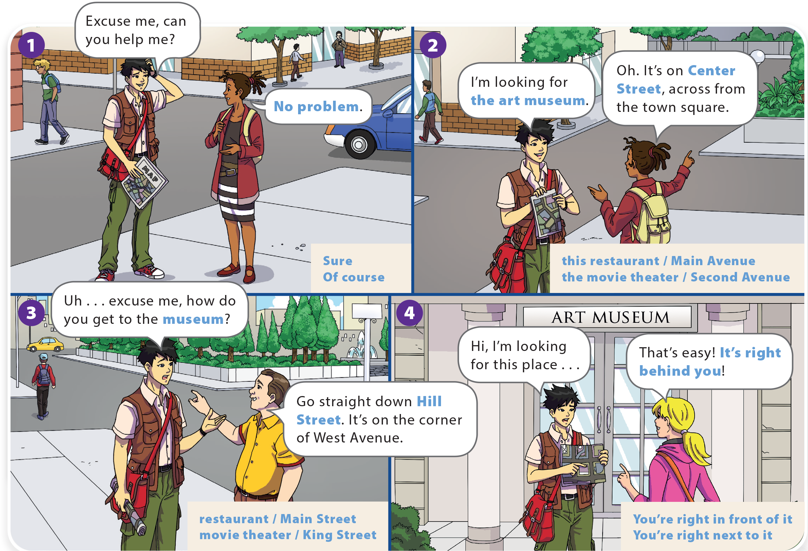
YOU SHOULD SEE A DOCTOR!
HOW DO YOU GET TO THE MALL?
UNIT 10
WHAT DO YOU LIKE TO DO?
UNIT 8
LANGUAGE FOCUS
LANGUAGE FOCUS

Slide 5
HOW DO YOU GET TO THE MALL?
UNIT 10
WHAT DO YOU LIKE TO DO?
LANGUAGE FOCUS

Slide 6
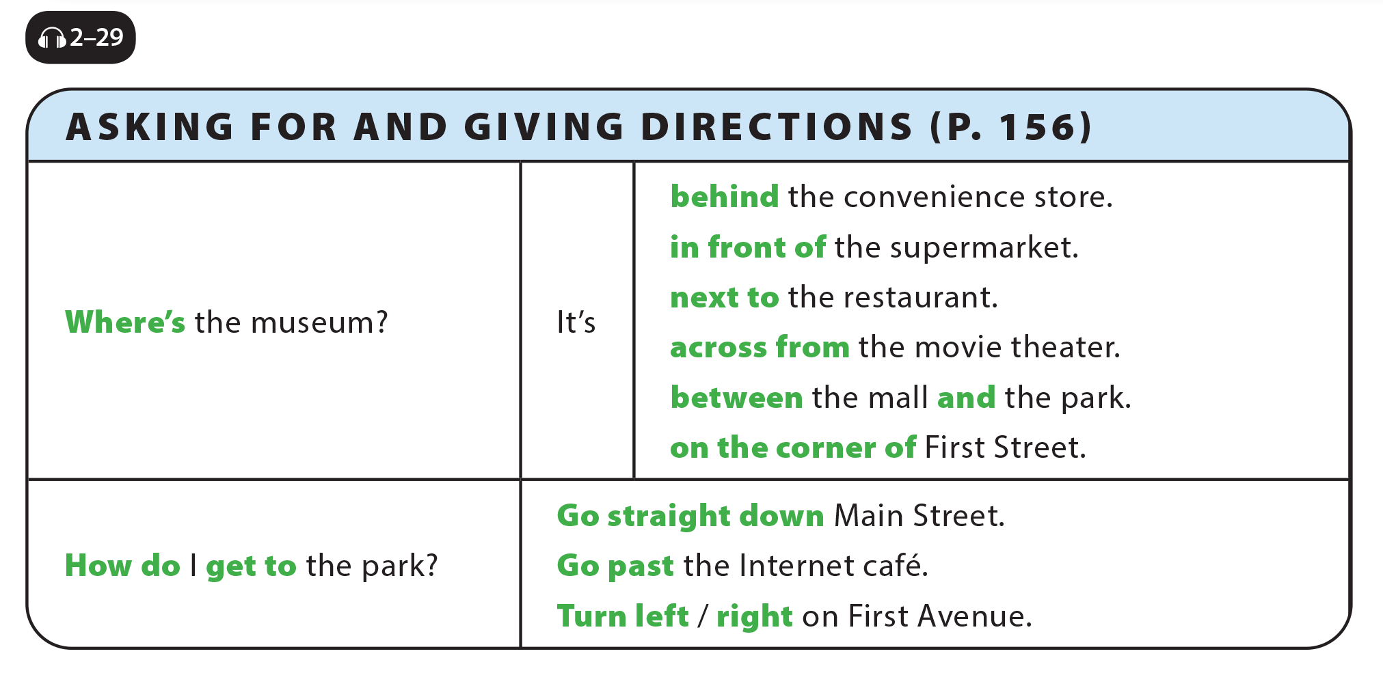
UNIT 10
HOW DO YOU GET TO THE MALL?
LANGUAGE FOCUS

Slide 7
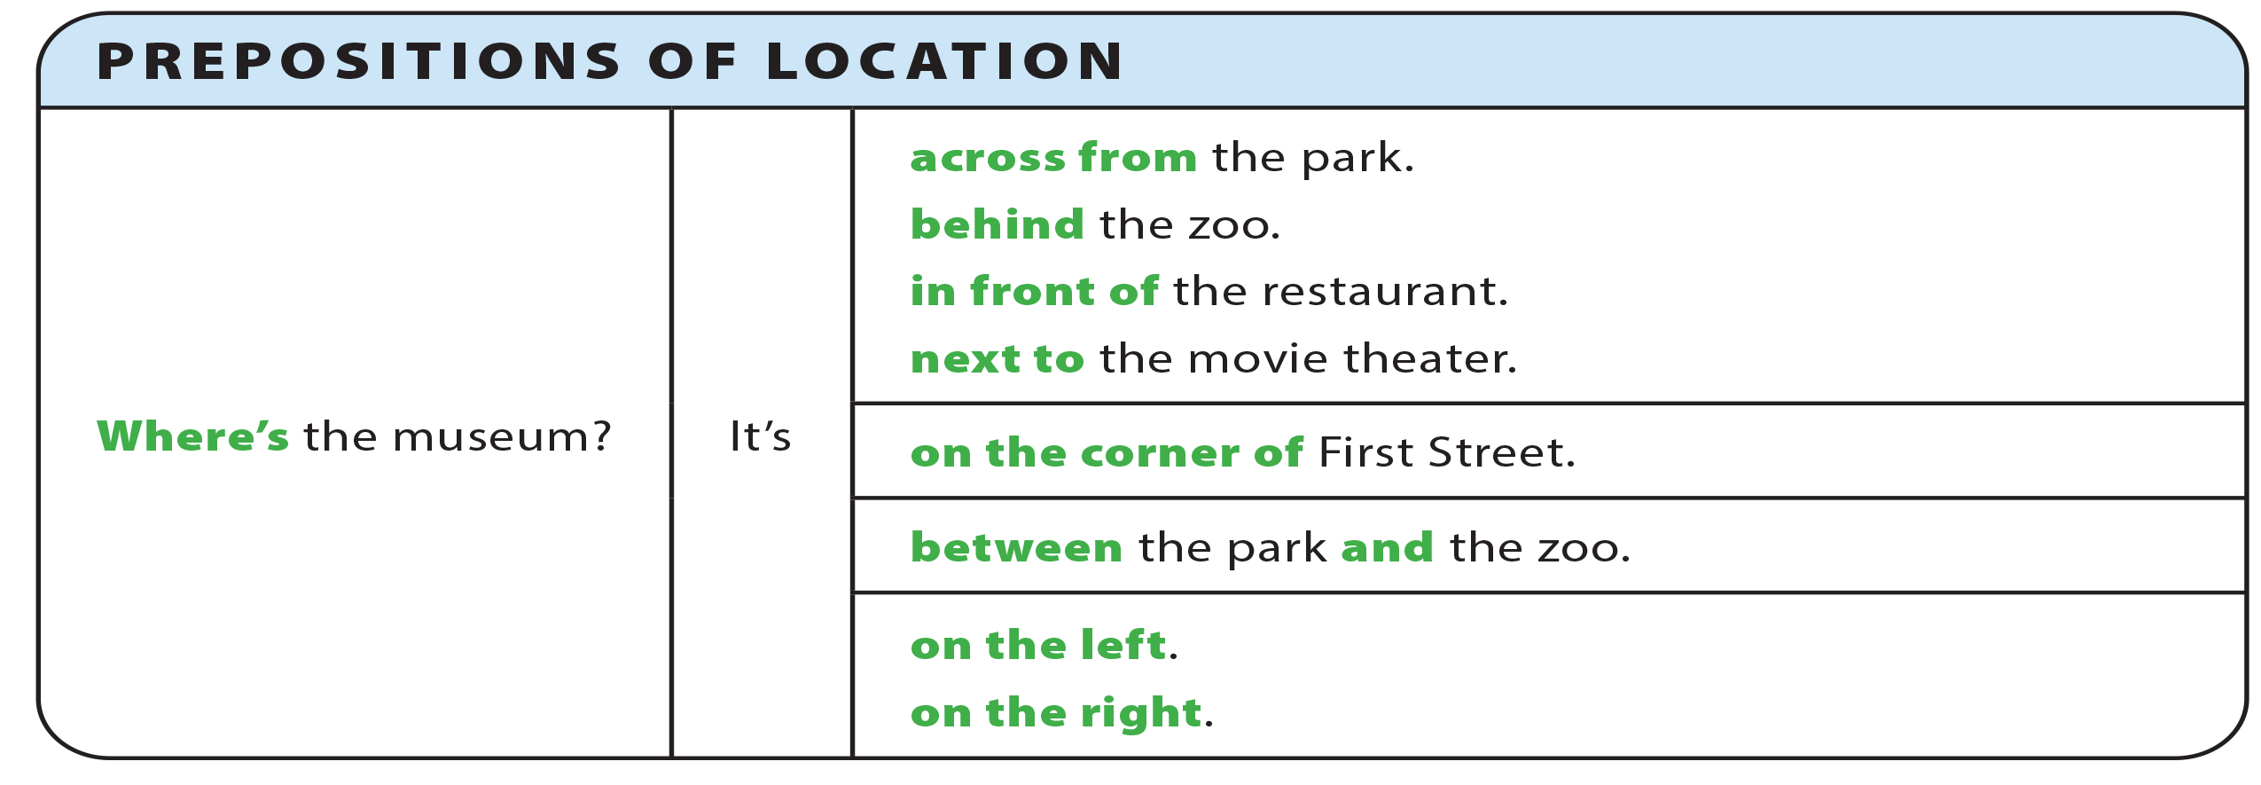
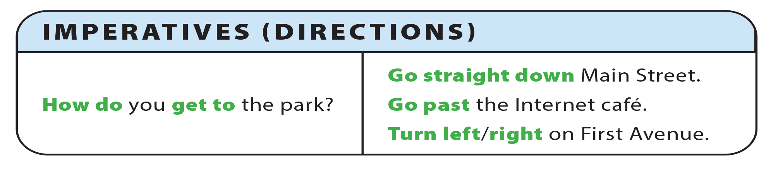
UNIT 10
HOW DO YOU GET TO THE MALL?
GRAMMAR REFERENCE

Slide 8
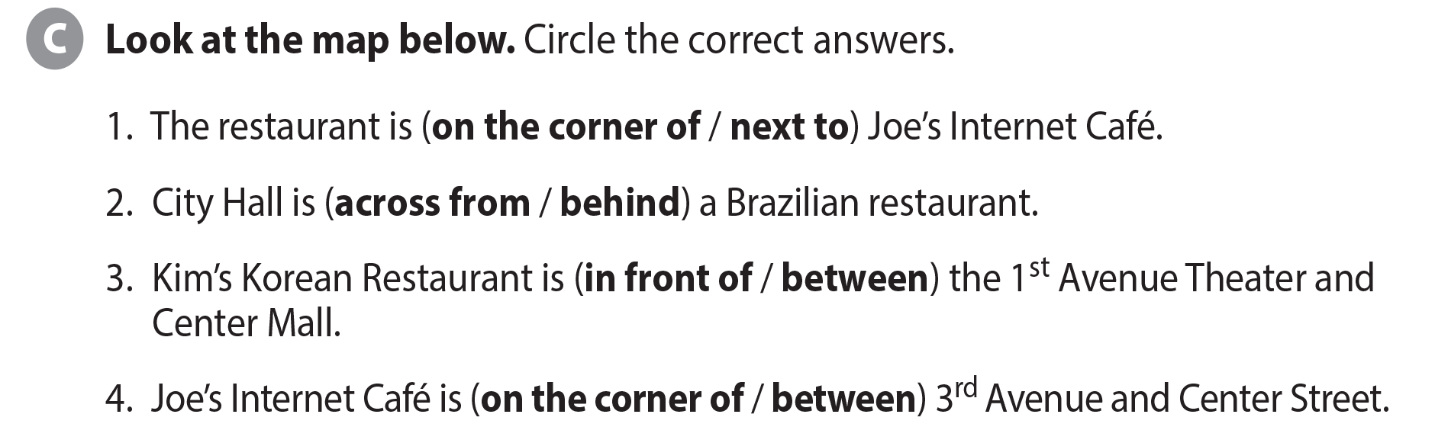
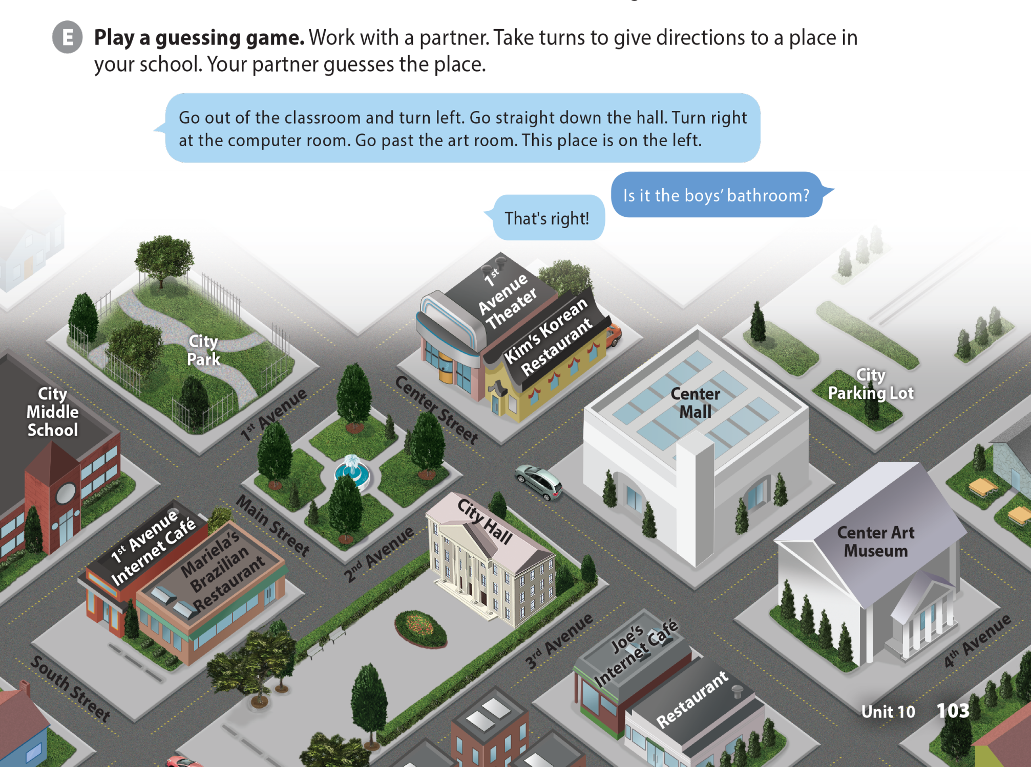

UNIT 10
HOW DO YOU GET TO THE MALL?
LANGUAGE FOCUS

Slide 9
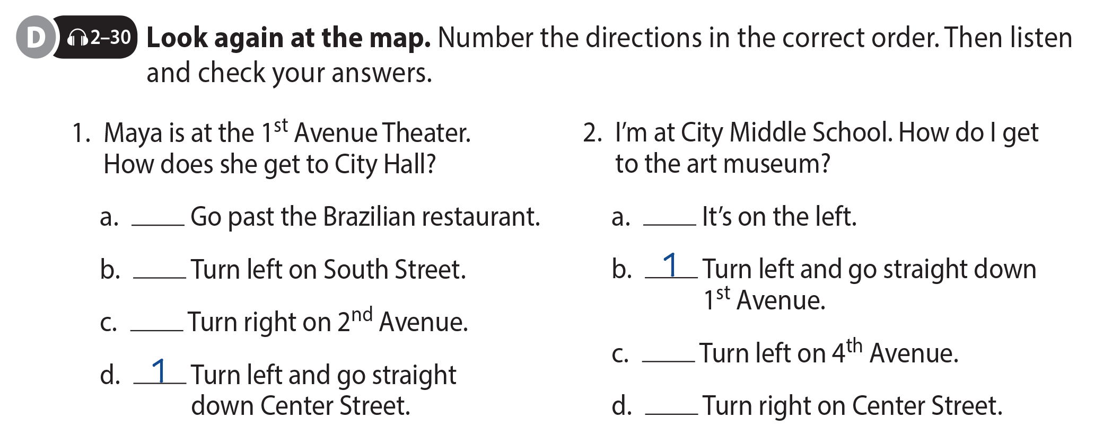
UNIT 10
HOW DO YOU GET TO THE MALL?
LANGUAGE FOCUS
3
4
4
2
3
2

Slide 10
UNIT 10
HOW DO YOU GET TO THE MALL?
LANGUAGE FOCUS

Slide 11
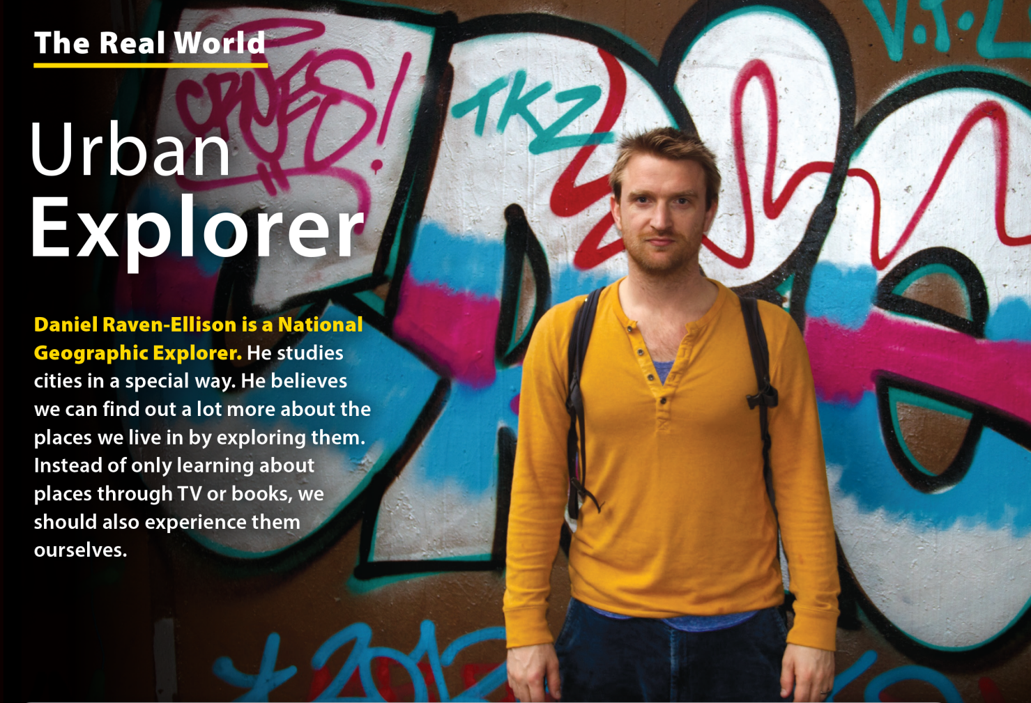
UNIT 10
HOW DO YOU GET TO THE MALL?
THE REAL WORLD

Slide 12
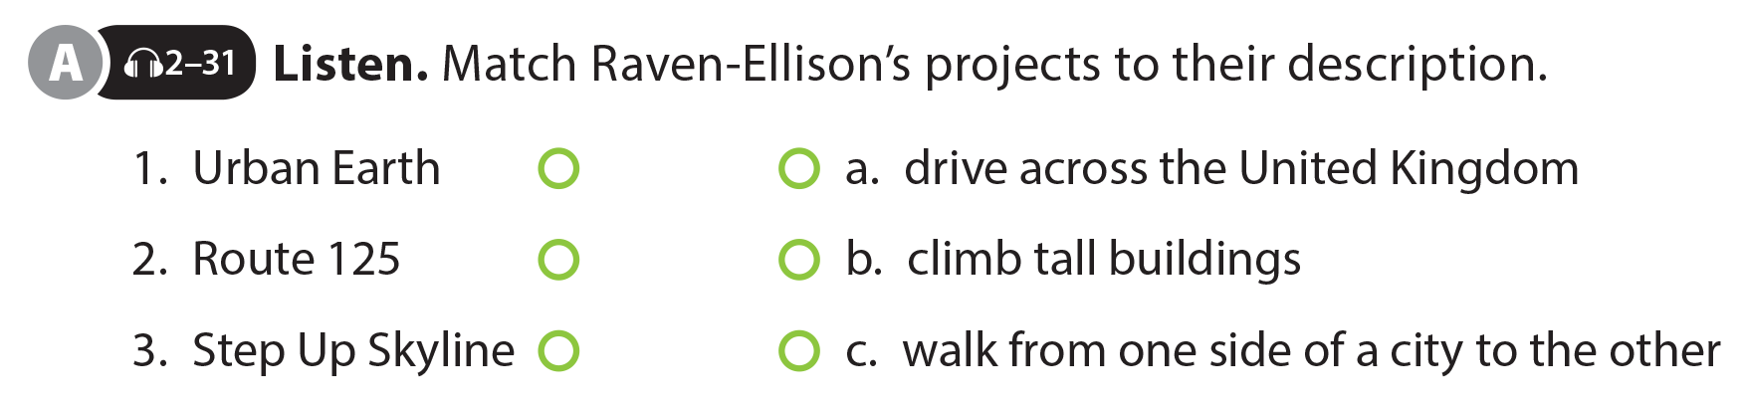
UNIT 10
HOW DO YOU GET TO THE MALL?
THE REAL WORLD

Slide 13


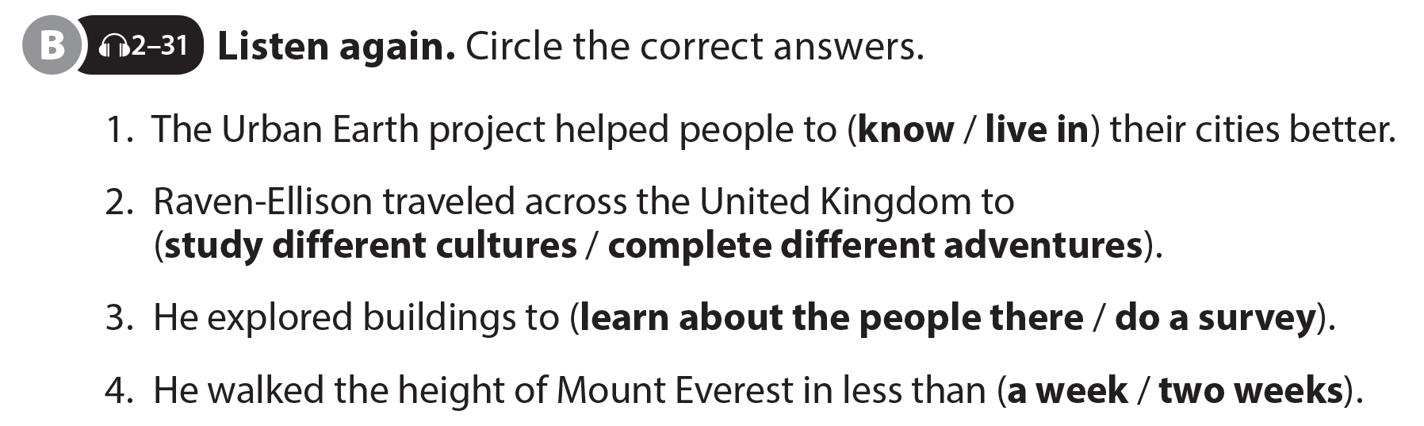
UNIT 10
HOW DO YOU GET TO THE MALL?
THE REAL WORLD
National Geographic Learning, a Cengage Company © 2022 Cengage Learning, Inc. ALL RIGHTS RESERVED. This presentation tool is intended for teaching purposes only and may not be scanned, copied, duplicated, or posted to a publicly accessible platform in whole or in part.

Slide 14
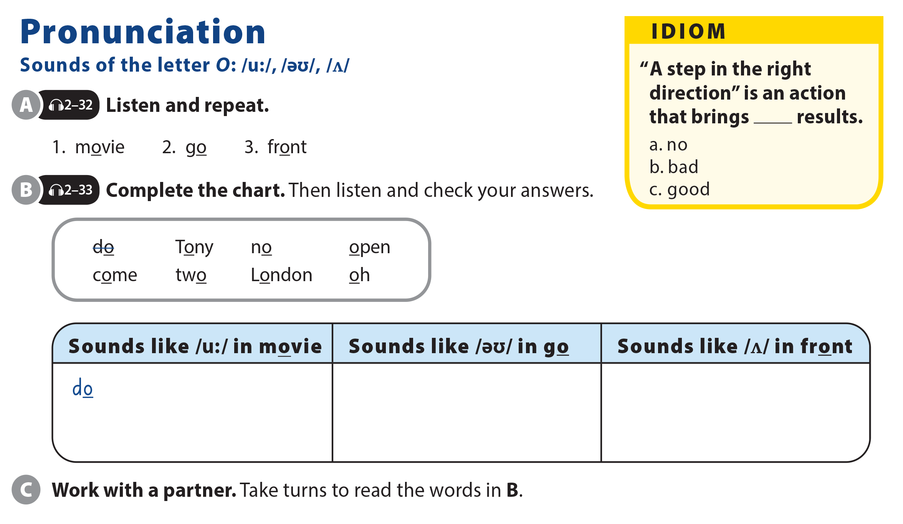
UNIT 10
HOW DO YOU GET TO THE MALL?
PRONUNCIATION
Tony
no
open
oh
come
London
two

Slide 15
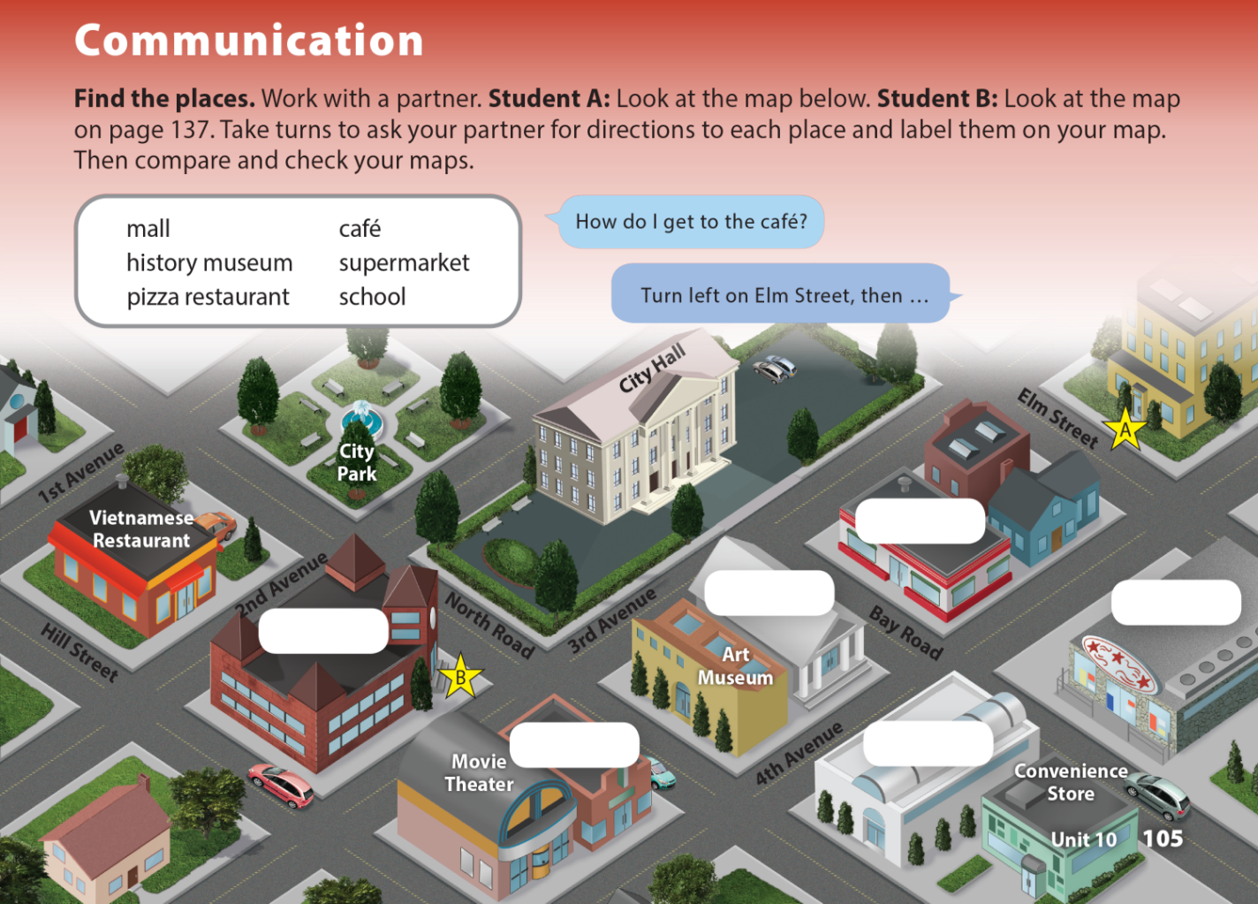
UNIT 10
HOW DO YOU GET TO THE MALL?
COMMUNICATION
Pizza Restaurant
History Museum
Supermarket
School
Café
Mall

Slide 16
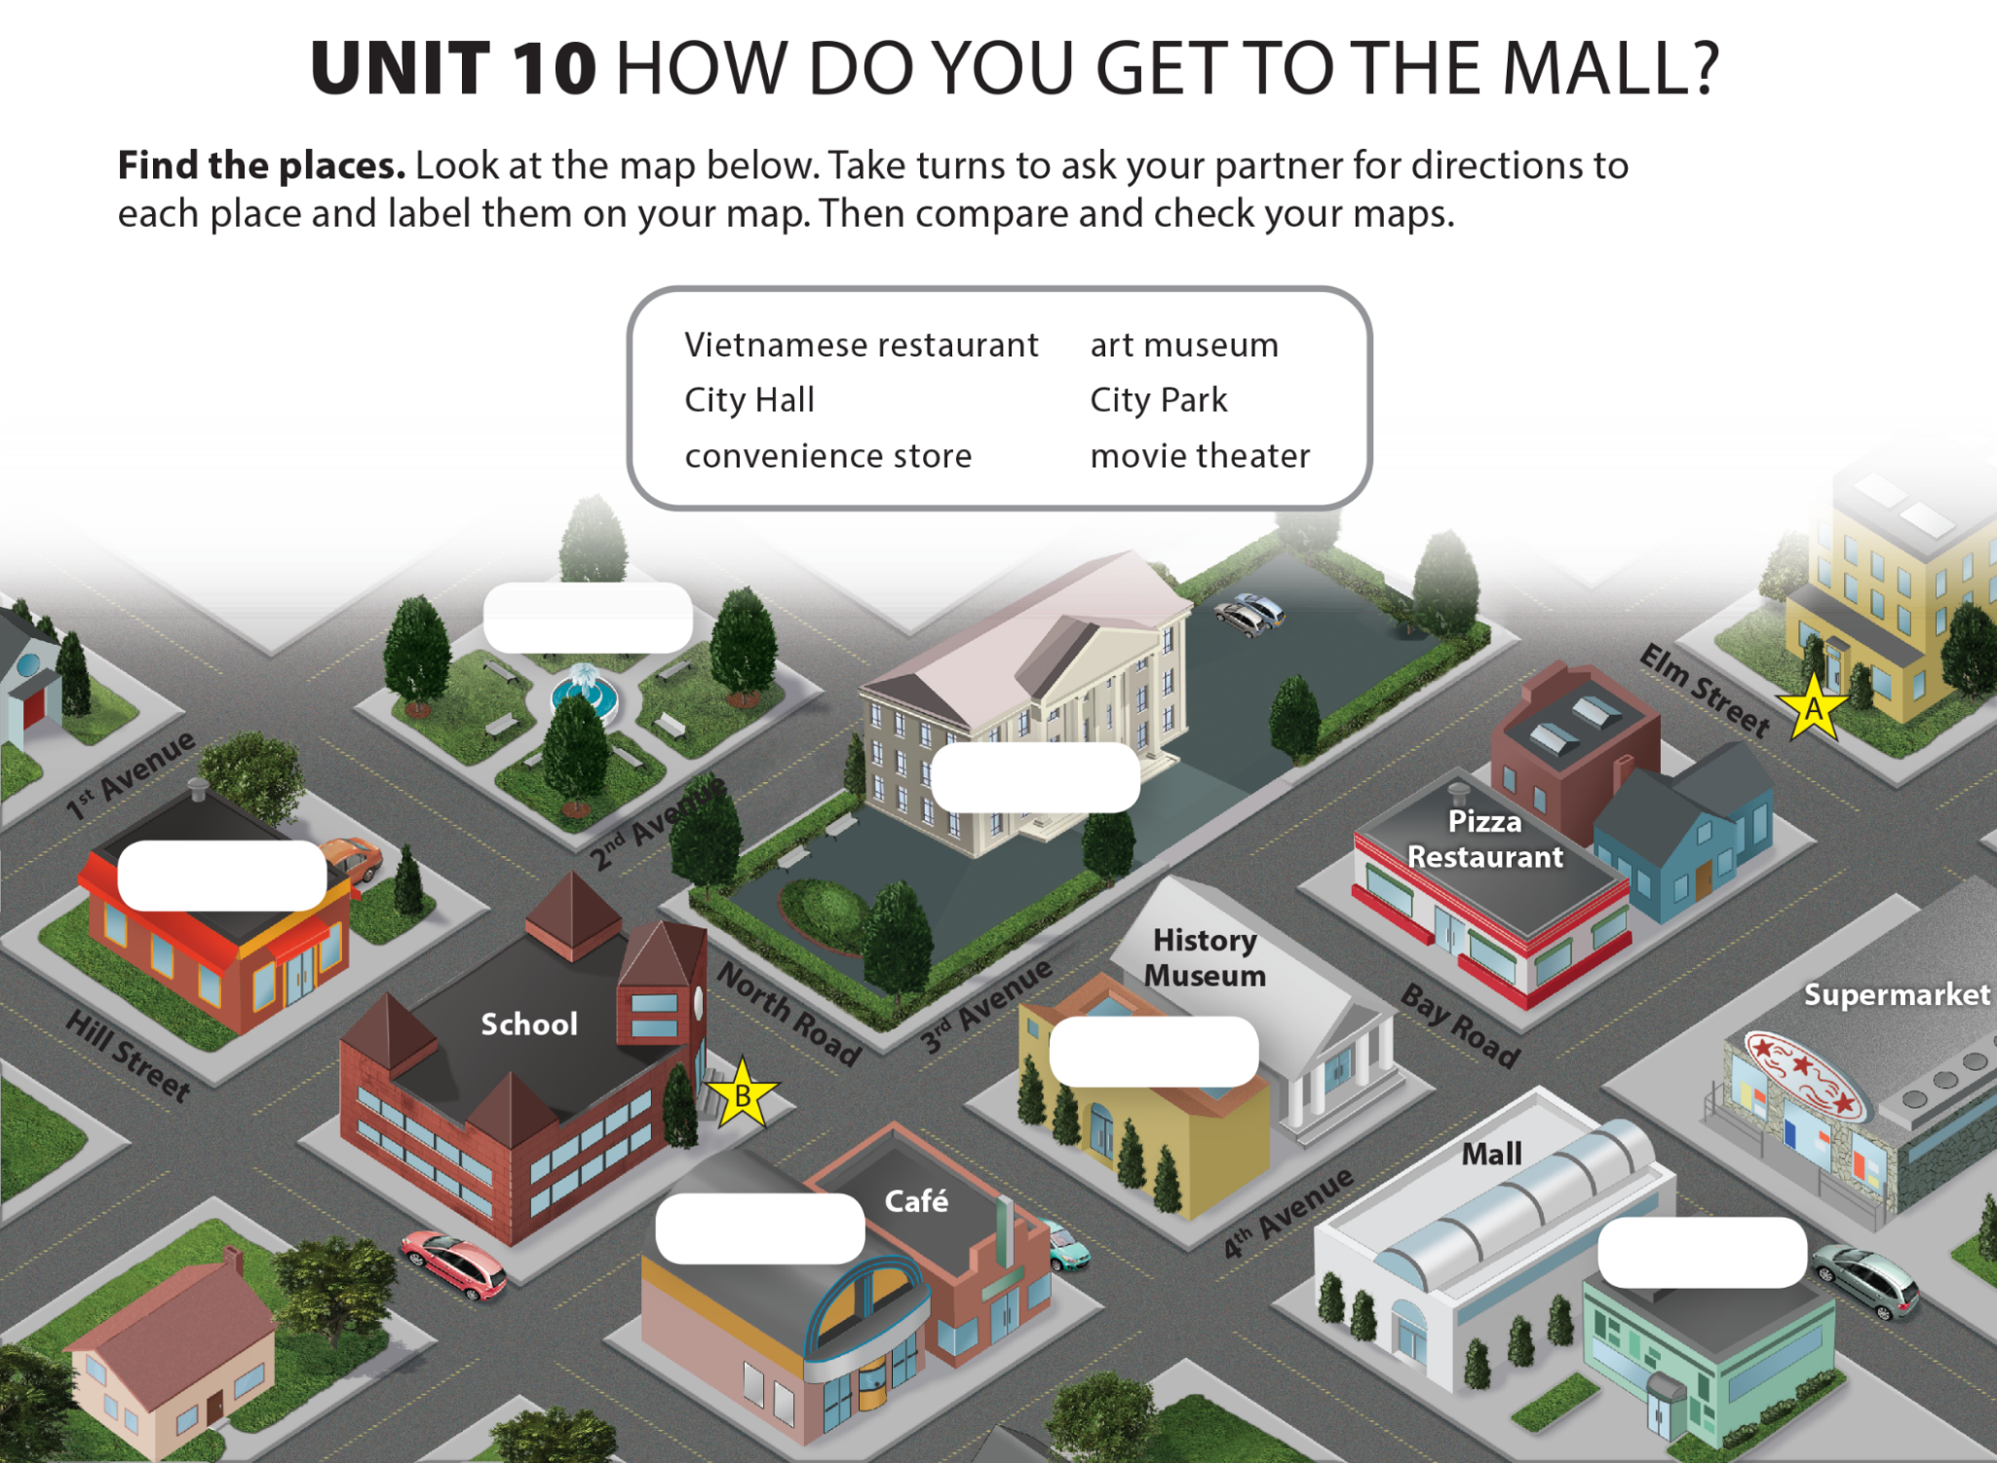
UNIT 10
HOW DO YOU GET TO THE MALL?
COMMUNICATION
City Park
City Hall
Vietnamese
Restaurant
Art Museum
Movie Theater
Convenience
Store

Slide 17
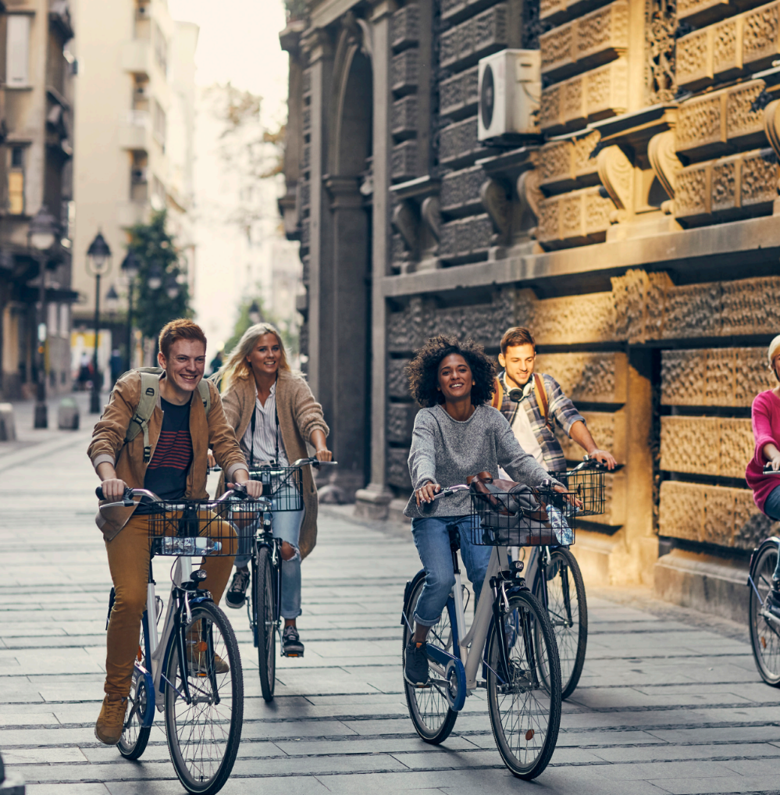
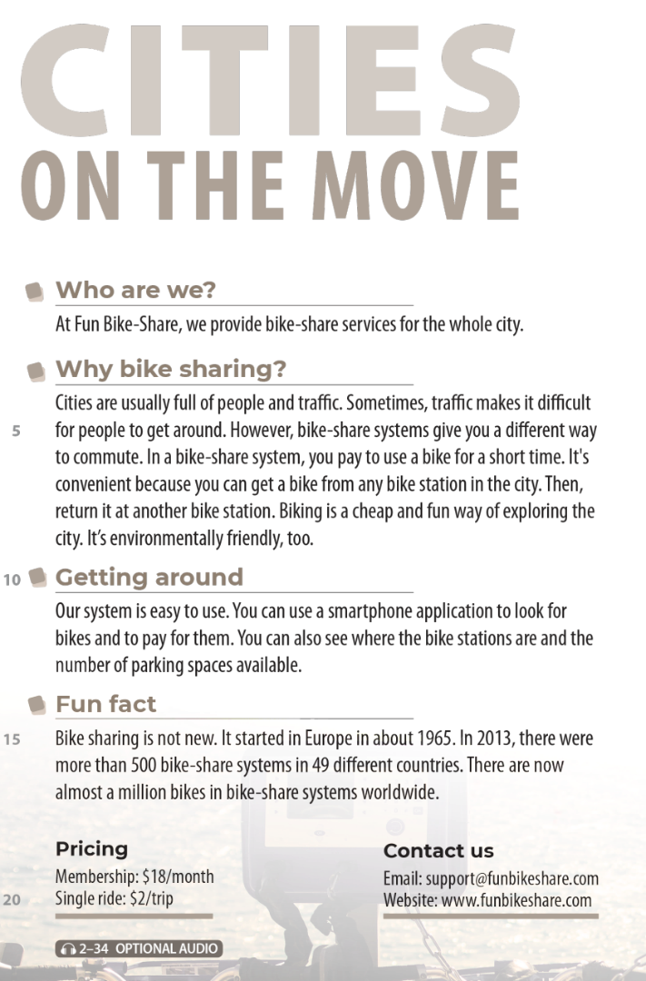



UNIT 10
HOW DO YOU GET TO THE MALL?
READING
National Geographic Learning, a Cengage Company © 2022 Cengage Learning, Inc. ALL RIGHTS RESERVED. This presentation tool is intended for teaching purposes only and may not be scanned, copied, duplicated, or posted to a publicly accessible platform in whole or in part.

Slide 18
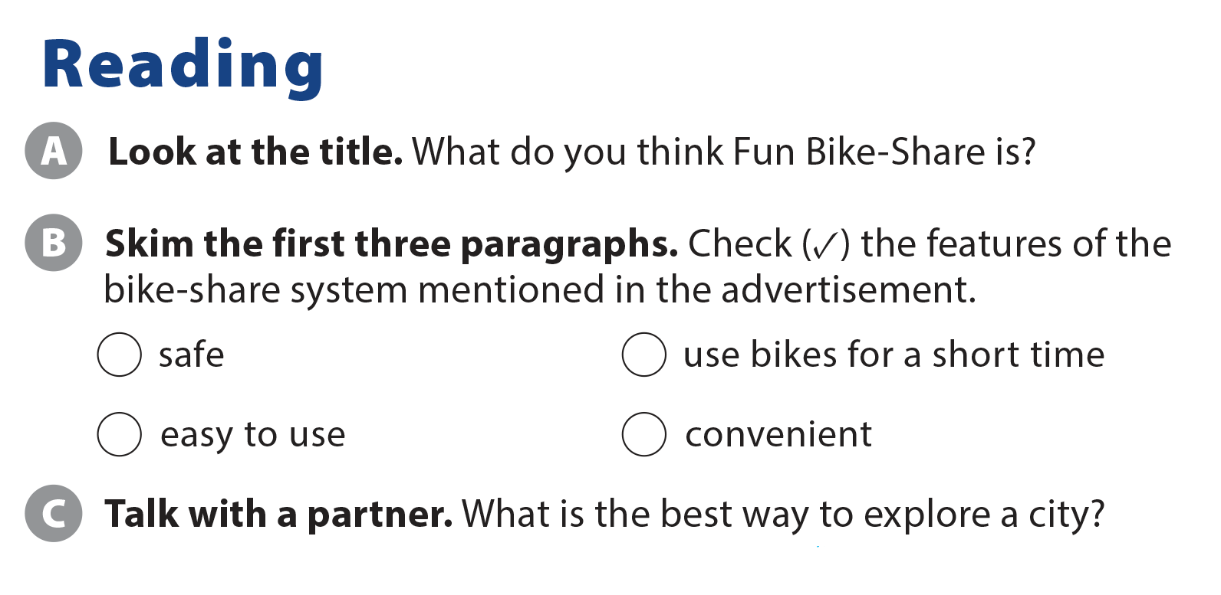
UNIT 10
HOW DO YOU GET TO THE MALL?
READING
✓
✓
✓

Slide 19
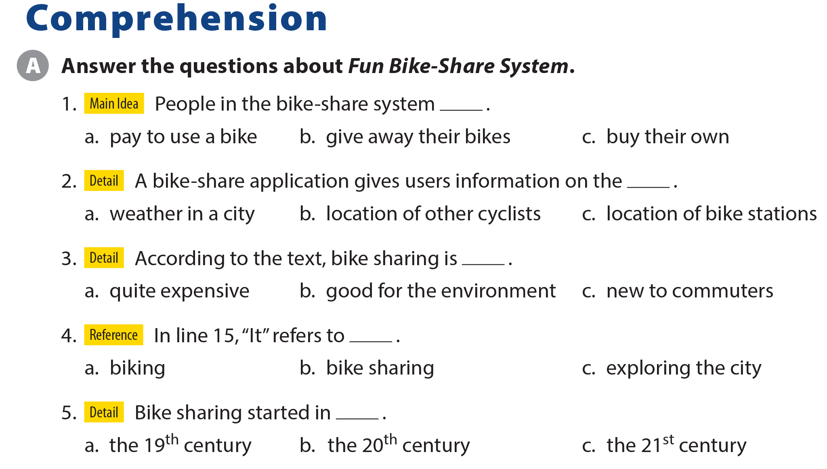
UNIT 10
HOW DO YOU GET TO THE MALL?
COMPREHENSION

Slide 20
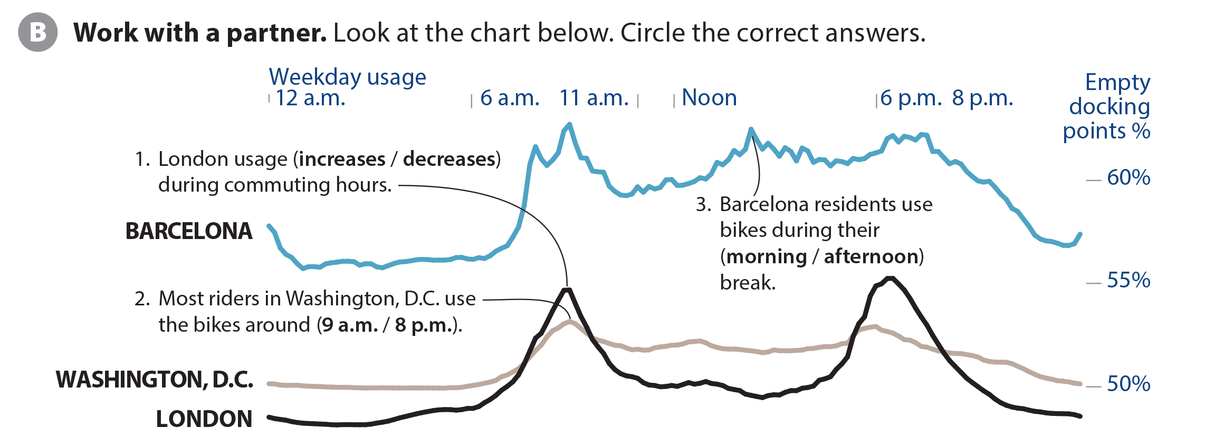

UNIT 10
HOW DO YOU GET TO THE MALL?
COMPREHENSION

Slide 21
UNIT 10
HOW DO YOU GET TO THE MALL?
PROJECT

Slide 22
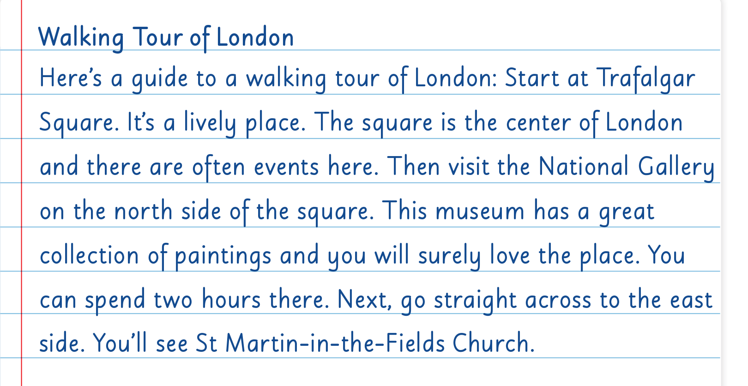
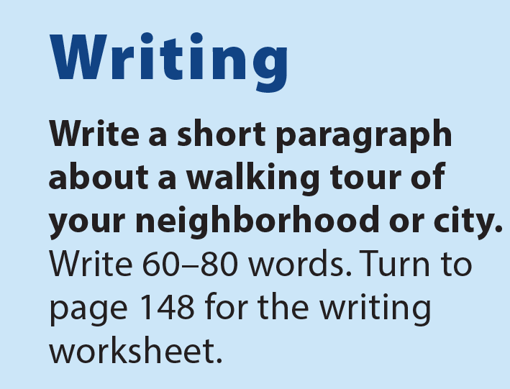
UNIT 10
HOW DO YOU GET TO THE MALL?
WRITING

Slide 23
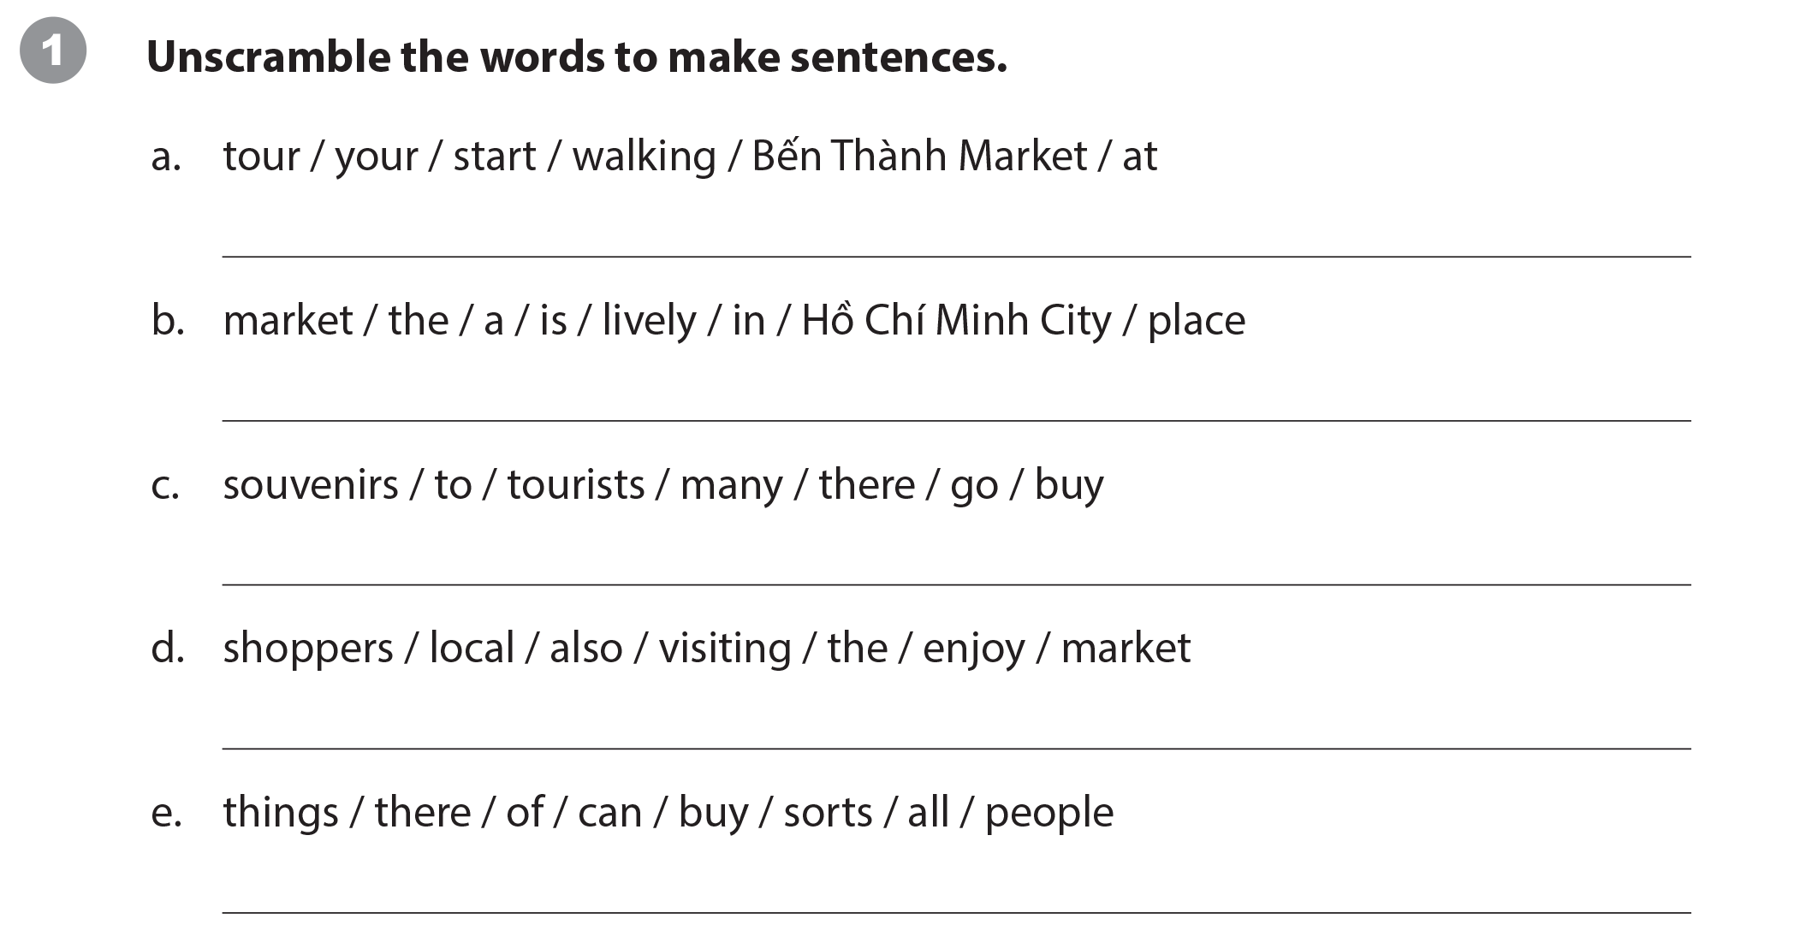
UNIT 10
HOW DO YOU GET TO THE MALL?
WRITING WORKSHEET
Start your walking tour at Bến Thành market.
The market is a lively place in Hồ Chí Minh City. / In Hồ Chí Minh City, the market is a lively place.
Many tourists go there to buy souvenirs.
Local shoppers also enjoy visiting the market.
People can buy all sorts of things there.

Slide 24
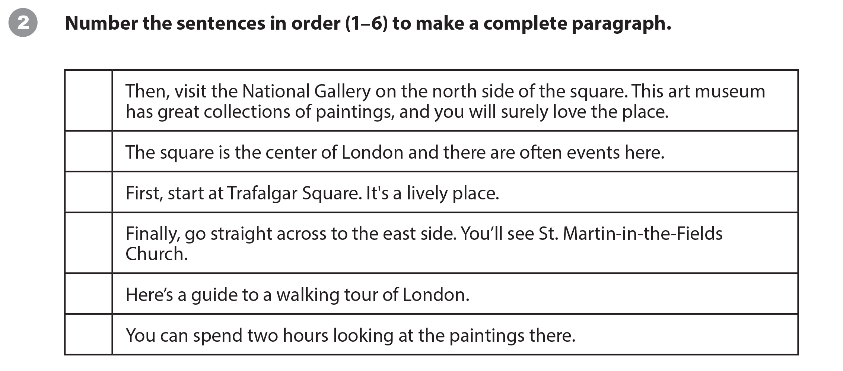
UNIT 10
HOW DO YOU GET TO THE MALL?
WRITING WORKSHEET
4
3
2
6
1
5

Slide 25
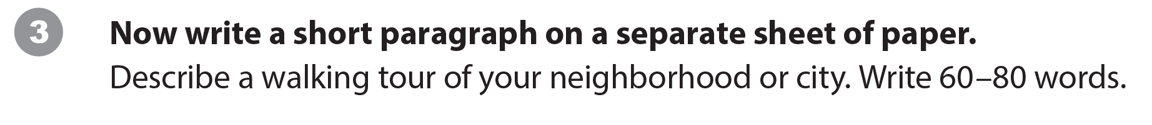
UNIT 10
HOW DO YOU GET TO THE MALL?
WRITING WORKSHEET

Slide 26
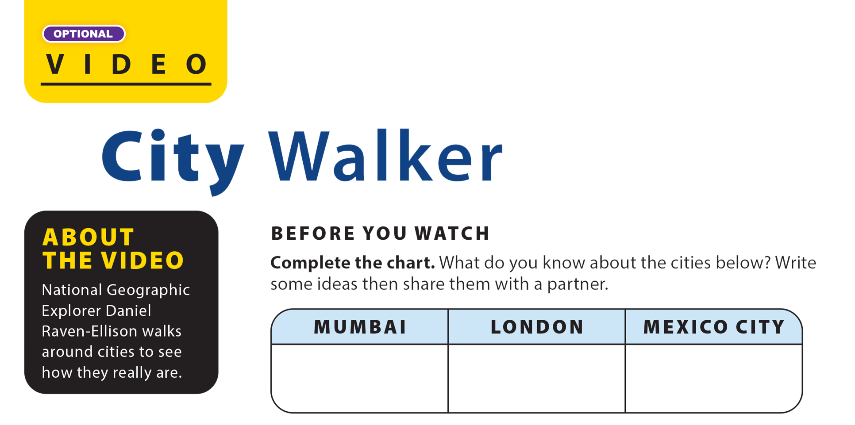
UNIT 10
HOW DO YOU GET TO THE MALL?
VIDEO

Slide 27
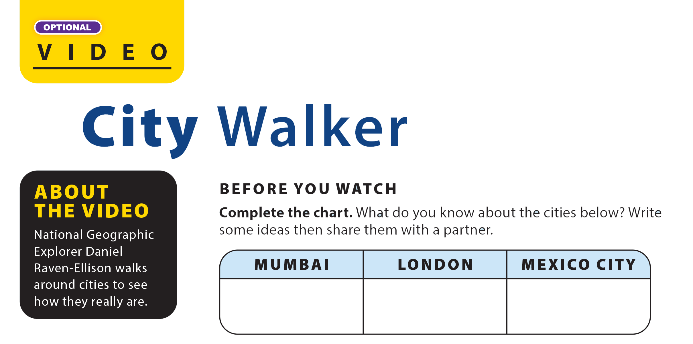

UNIT 10
HOW DO YOU GET TO THE MALL?
VIDEO

Slide 28
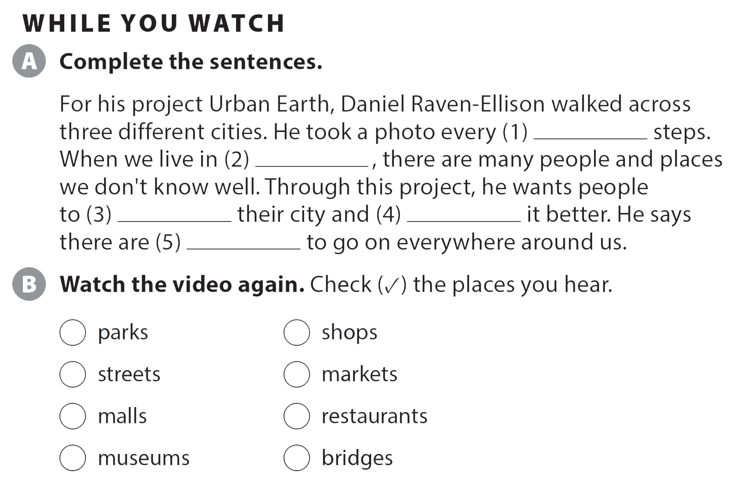
UNIT 10
HOW DO YOU GET TO THE MALL?
VIDEO
eight
a big city
explore
understand
adventures
✓
✓
✓
✓

Slide 29
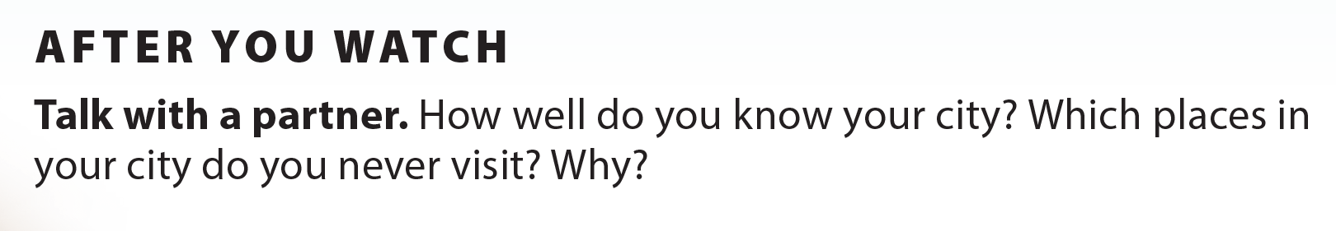
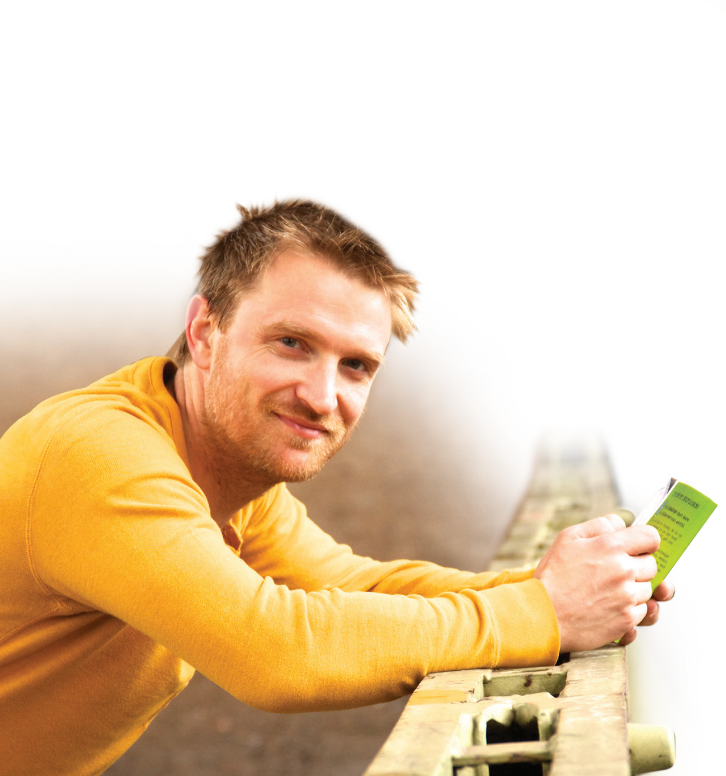
UNIT 10
HOW DO YOU GET TO THE MALL?
VIDEO
Daniel Raven-Ellison

Slide 30
UNIT 10
HOW DO YOU GET TO THE MALL?
Thank you!

