Slide 1


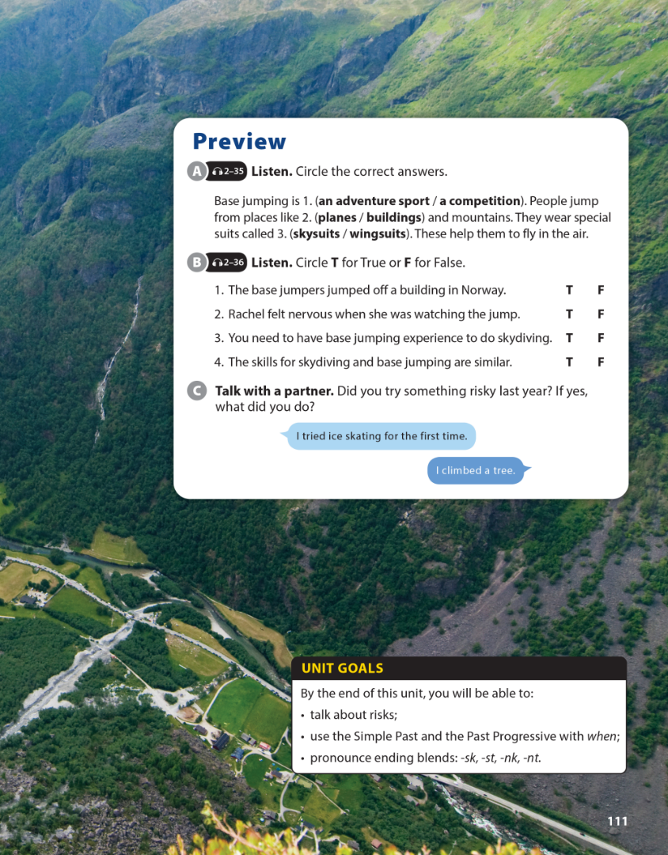

National Geographic Learning, a Cengage Company © 2022 Cengage Learning, Inc. ALL RIGHTS RESERVED. This presentation tool is intended for teaching purposes only and may not be scanned, copied, duplicated, or posted to a publicly accessible platform in whole or in part.

Slide 2
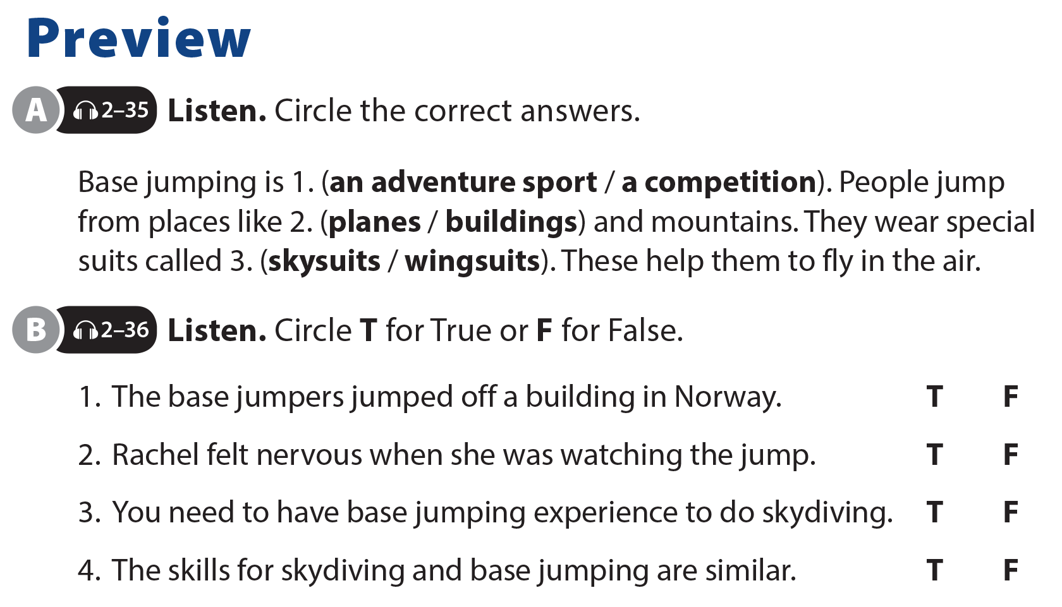

UNIT 11
WHAT WERE YOU DOING?
PREVIEW

Slide 3
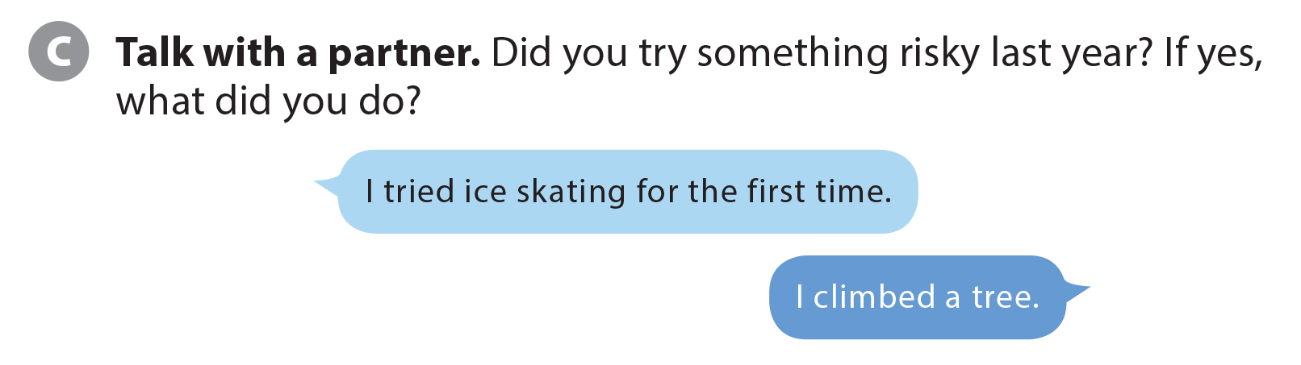
UNIT 11
WHAT WERE YOU DOING?
PREVIEW

Slide 4



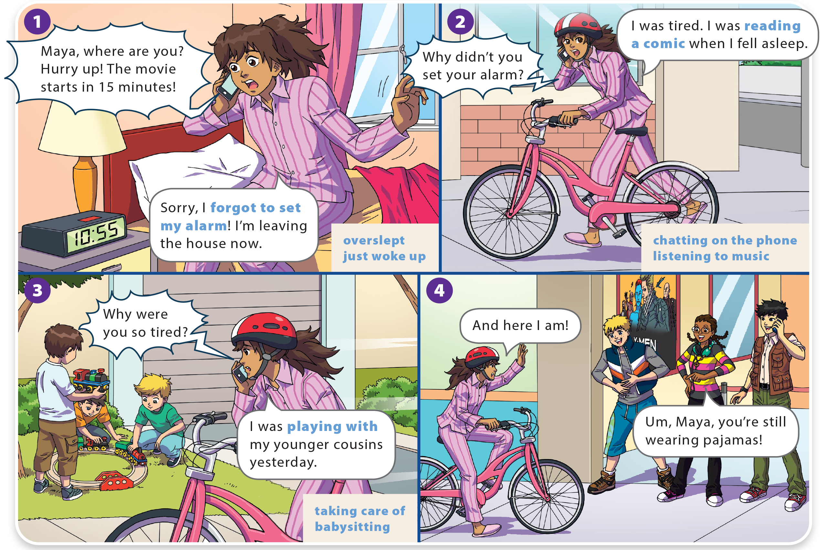
WHAT WERE YOU DOING?
UNIT 11
WHAT DO YOU LIKE TO DO?
LANGUAGE FOCUS

Slide 5
WHAT DO YOU LIKE TO DO?
UNIT 11
WHAT WERE YOU DOING?
LANGUAGE FOCUS

Slide 6
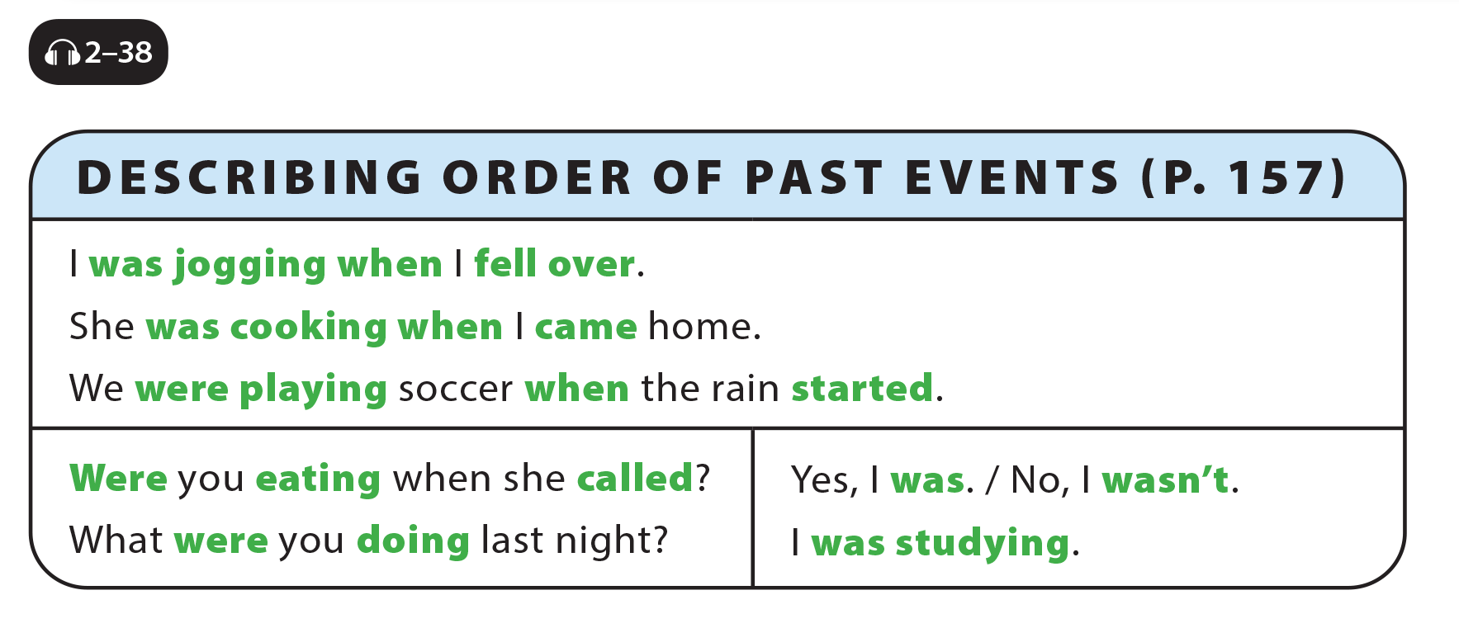
UNIT 11
WHAT WERE YOU DOING?
LANGUAGE FOCUS

Slide 7
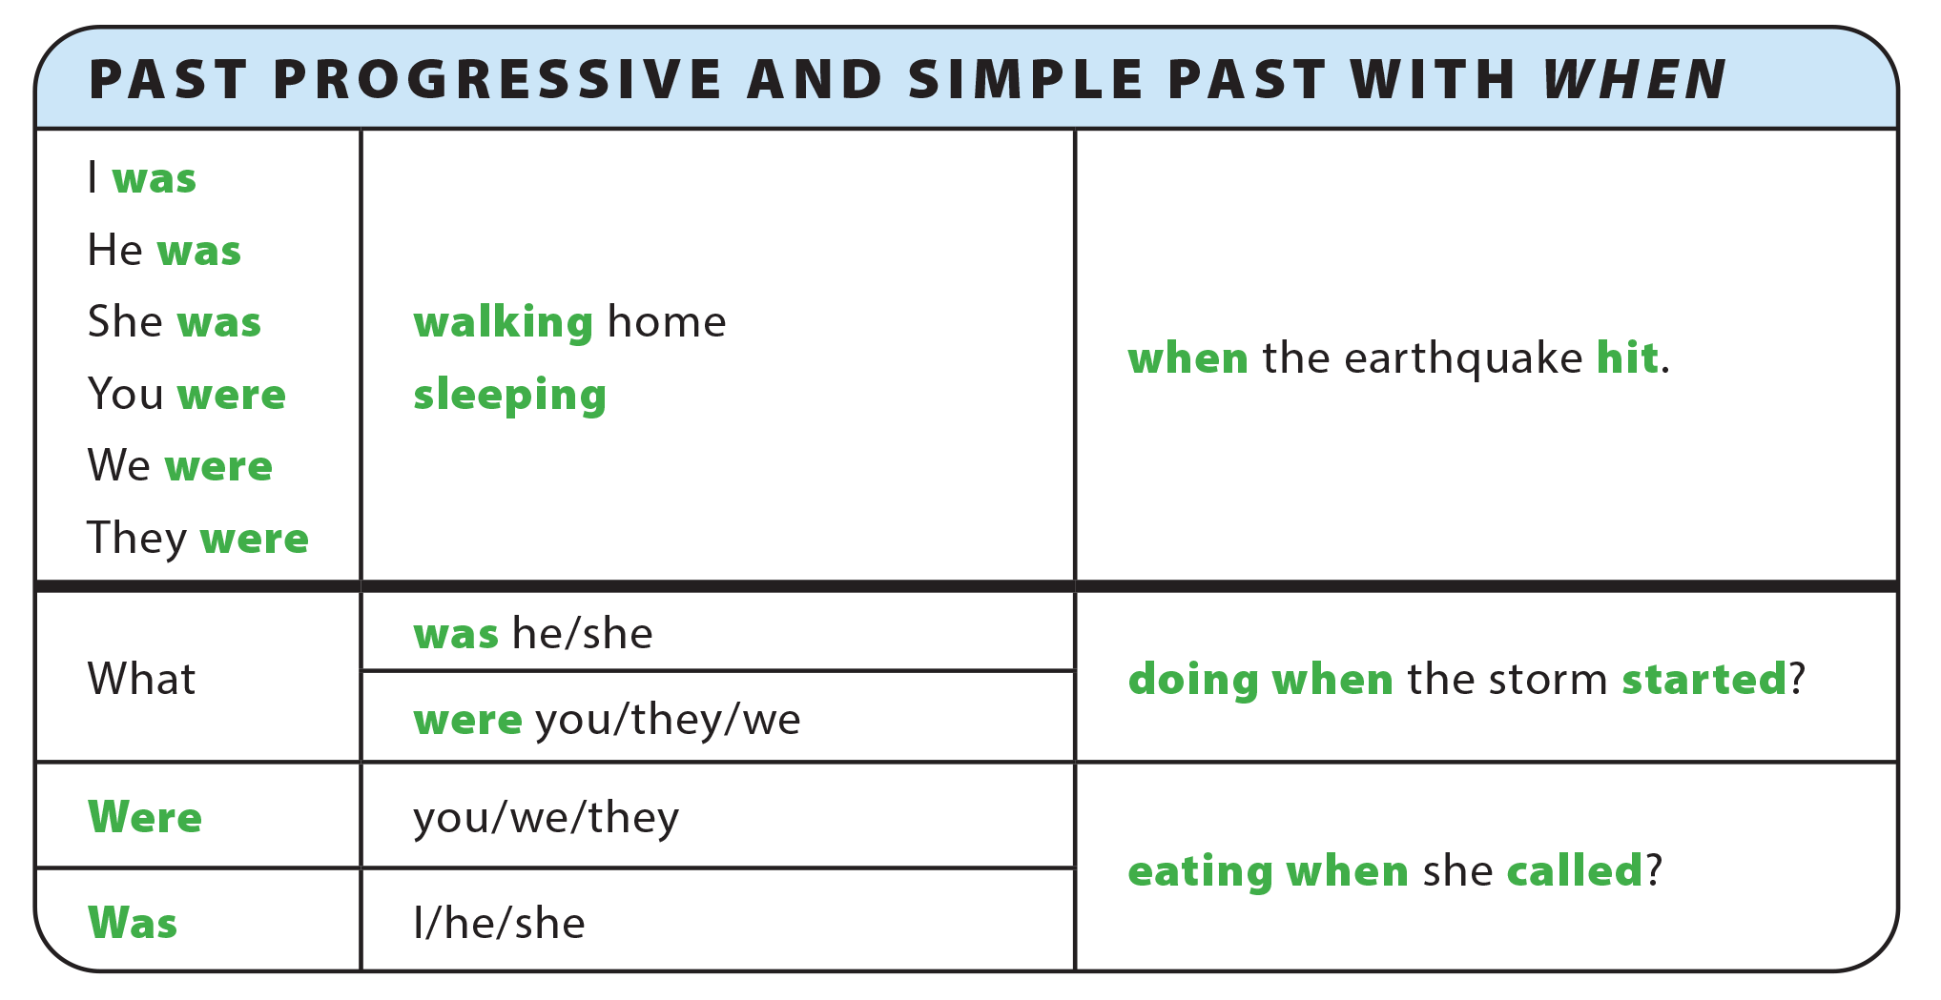
UNIT 11
WHAT WERE YOU DOING?
GRAMMAR REFERENCE

Slide 8
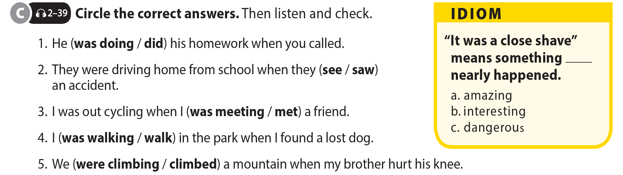
UNIT 11
WHAT WERE YOU DOING?
LANGUAGE FOCUS

Slide 9
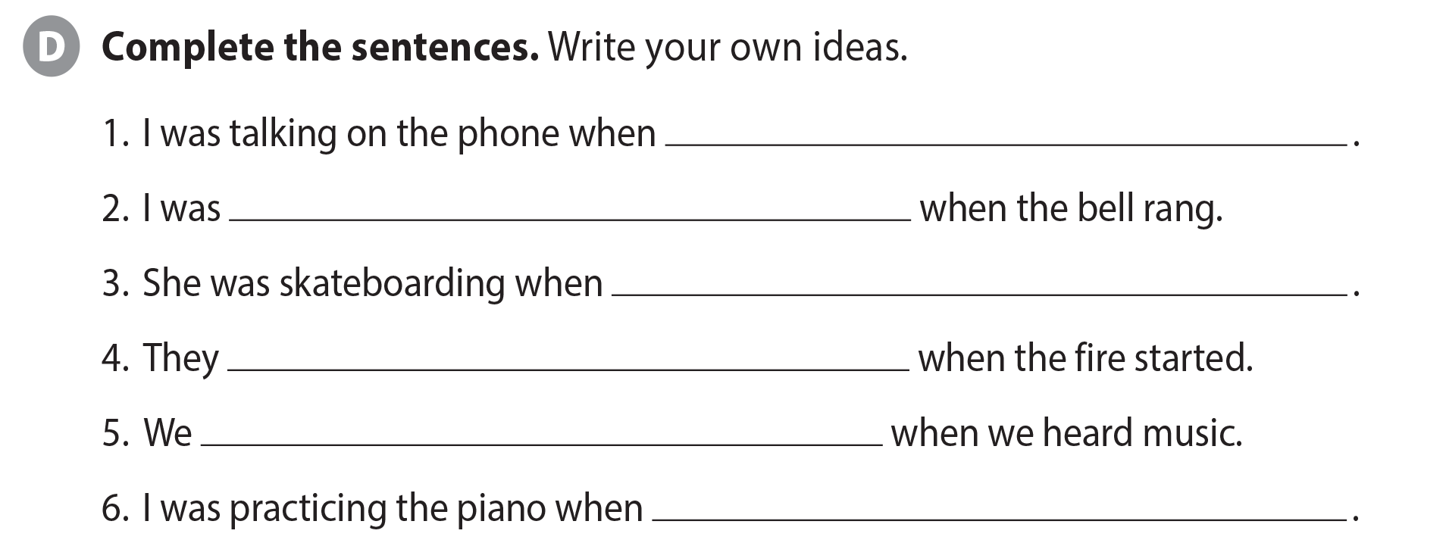
UNIT 11
WHAT WERE YOU DOING?
LANGUAGE FOCUS

Slide 10
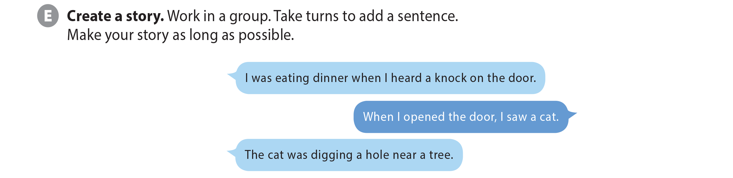

UNIT 11
WHAT WERE YOU DOING?
LANGUAGE FOCUS

Slide 11

UNIT 11
WHAT WERE YOU DOING?
THE REAL WORLD

Slide 12
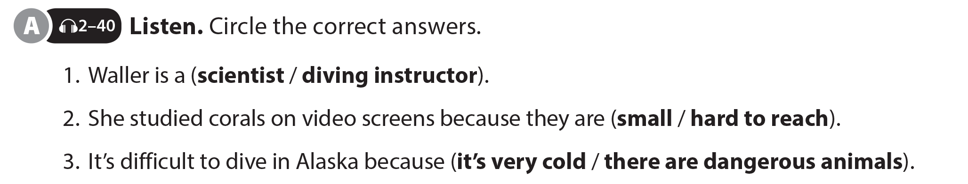
UNIT 11
WHAT WERE YOU DOING?
THE REAL WORLD

Slide 13

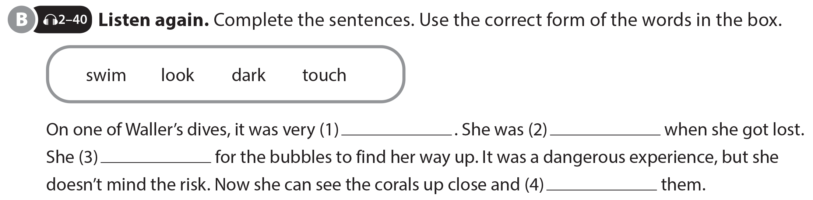
UNIT 11
WHAT WERE YOU DOING?
THE REAL WORLD
dark
swimming
had to look
touch
National Geographic Learning, a Cengage Company © 2022 Cengage Learning, Inc. ALL RIGHTS RESERVED. This presentation tool is intended for teaching purposes only and may not be scanned, copied, duplicated, or posted to a publicly accessible platform in whole or in part.

Slide 14
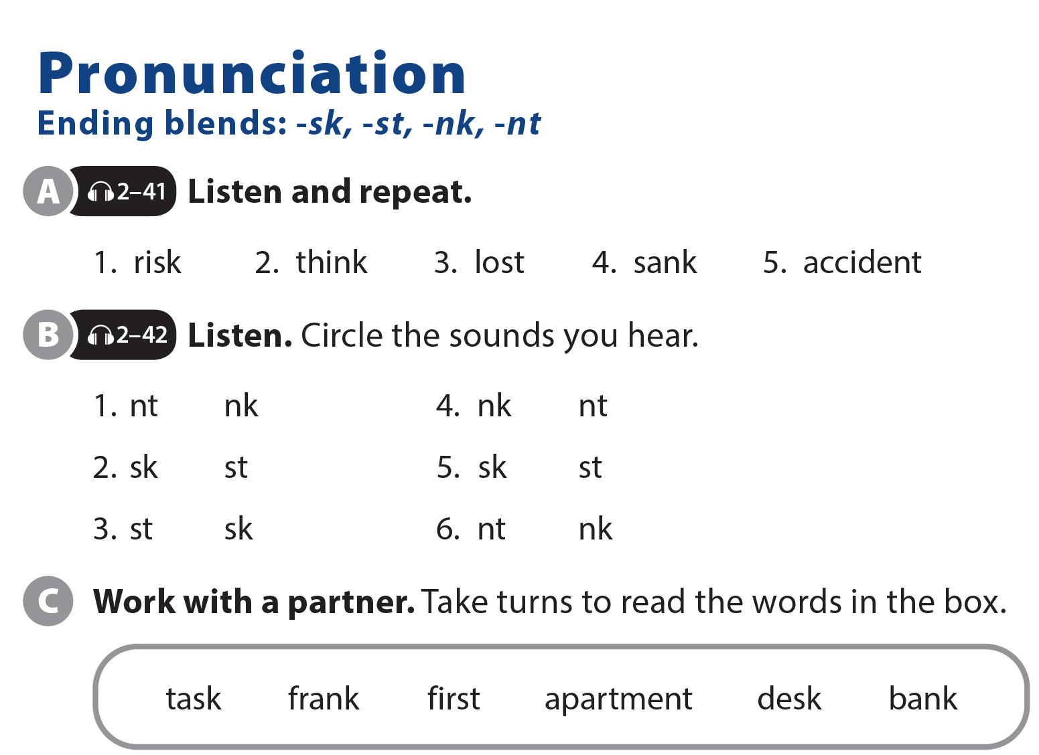
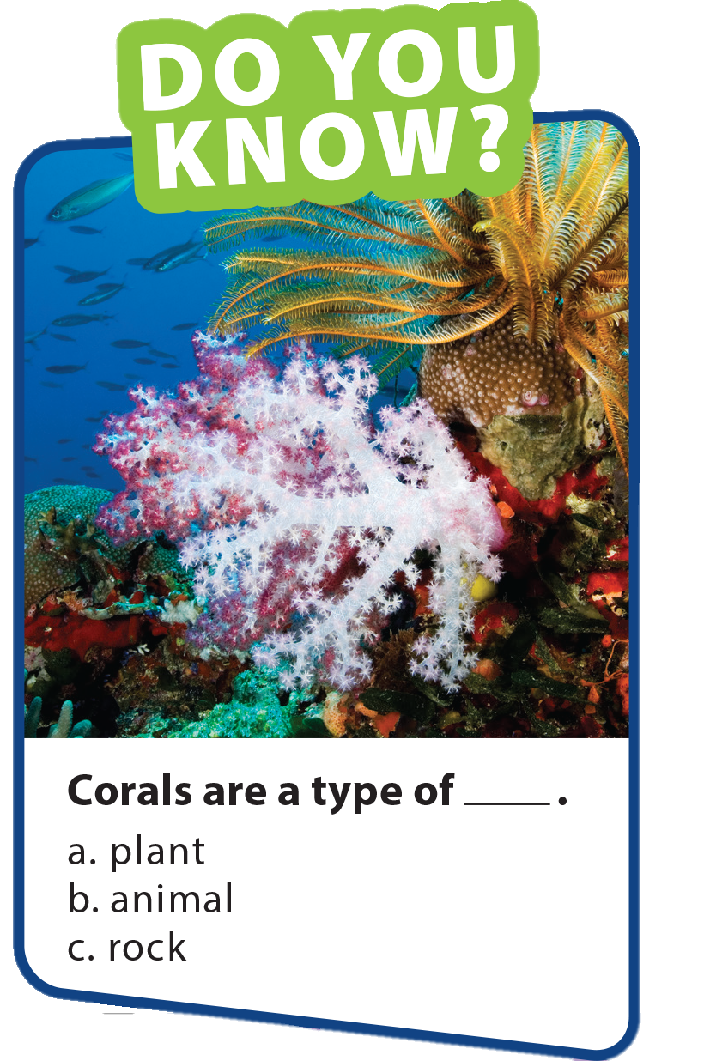
UNIT 11
WHAT WERE YOU DOING?
PRONUNCIATION

Slide 15
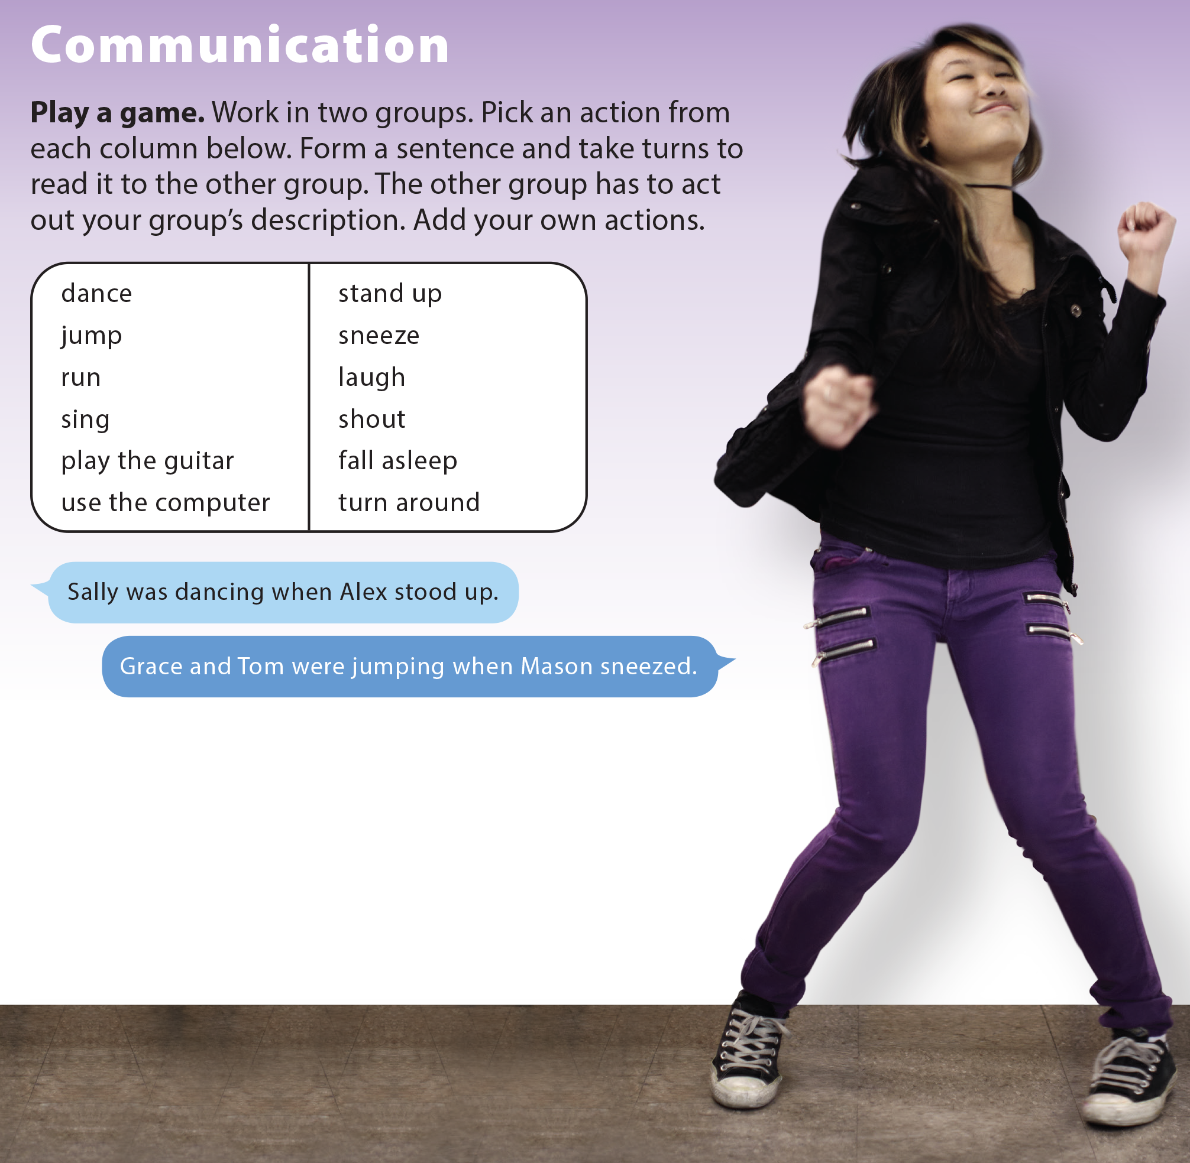
UNIT 11
WHAT WERE YOU DOING?
COMMUNICATION

Slide 16
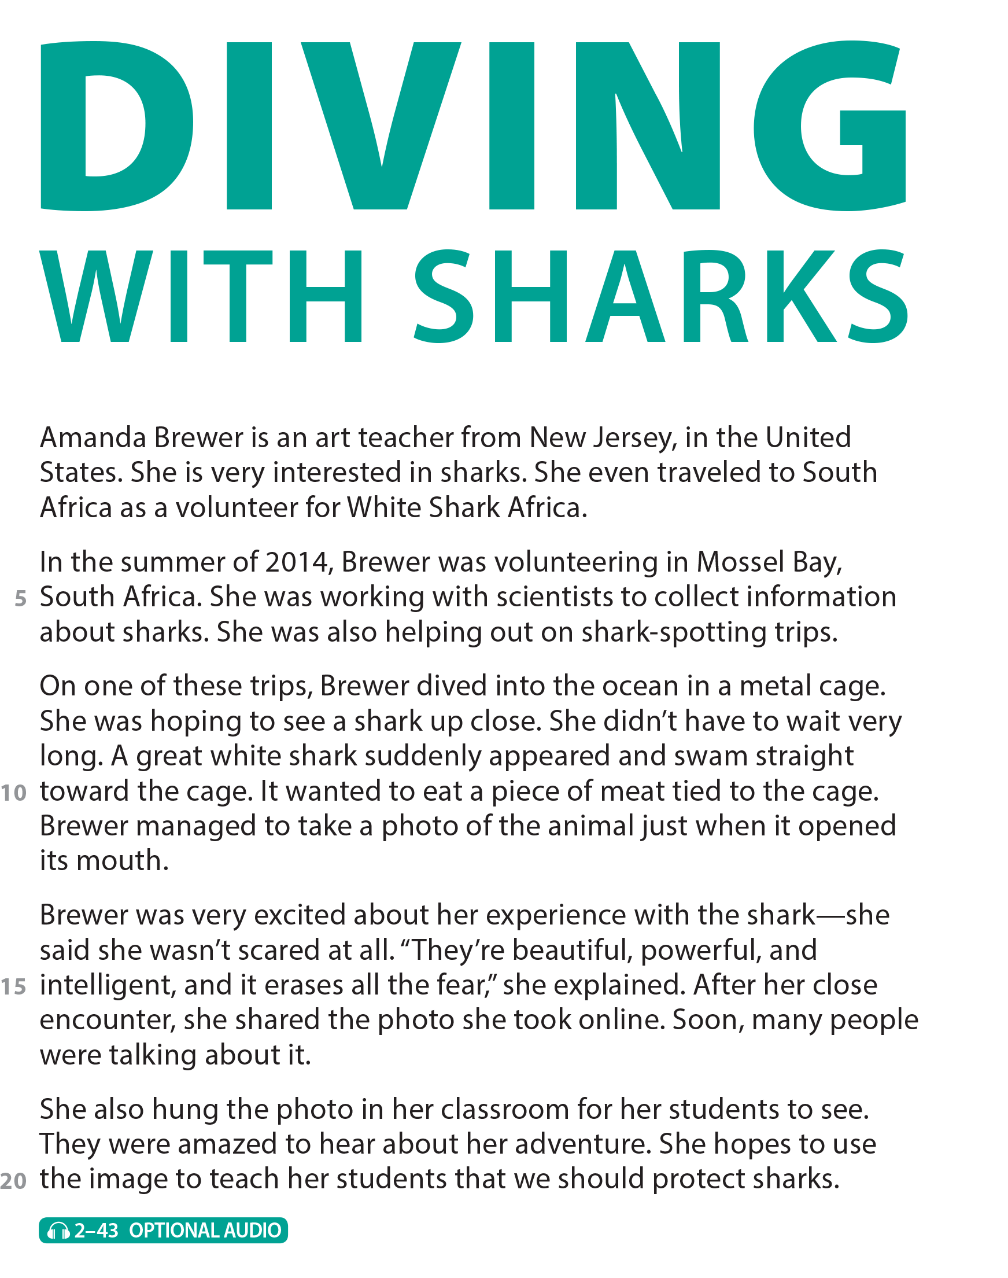
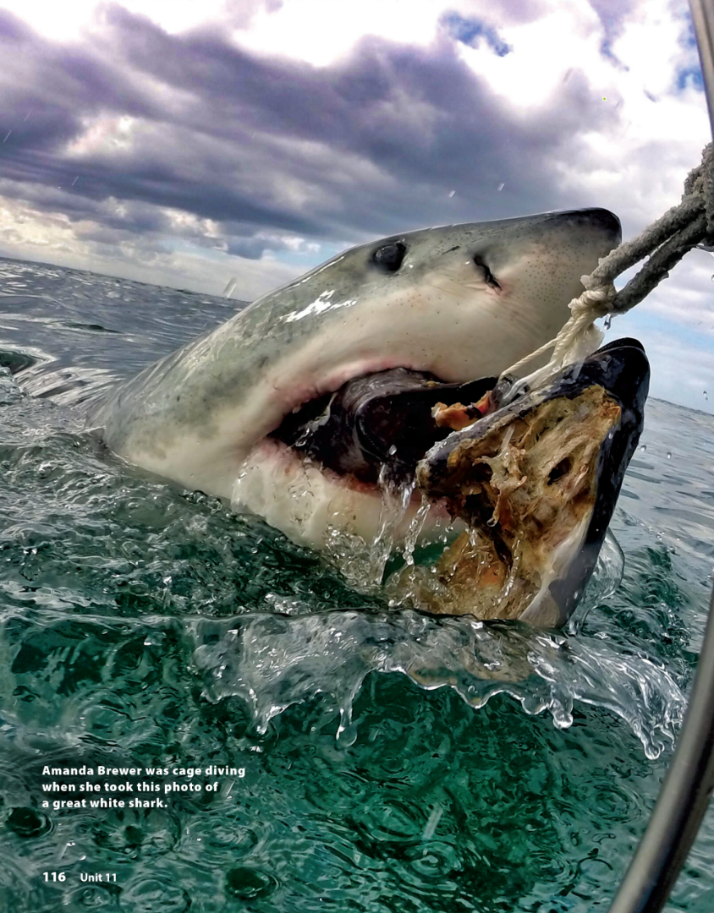
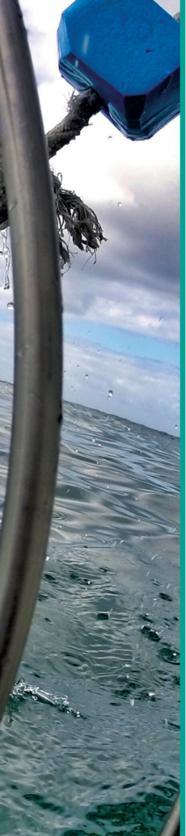
UNIT 11
WHAT WERE YOU DOING?
READING
National Geographic Learning, a Cengage Company © 2022 Cengage Learning, Inc. ALL RIGHTS RESERVED. This presentation tool is intended for teaching purposes only and may not be scanned, copied, duplicated, or posted to a publicly accessible platform in whole or in part.

Slide 17
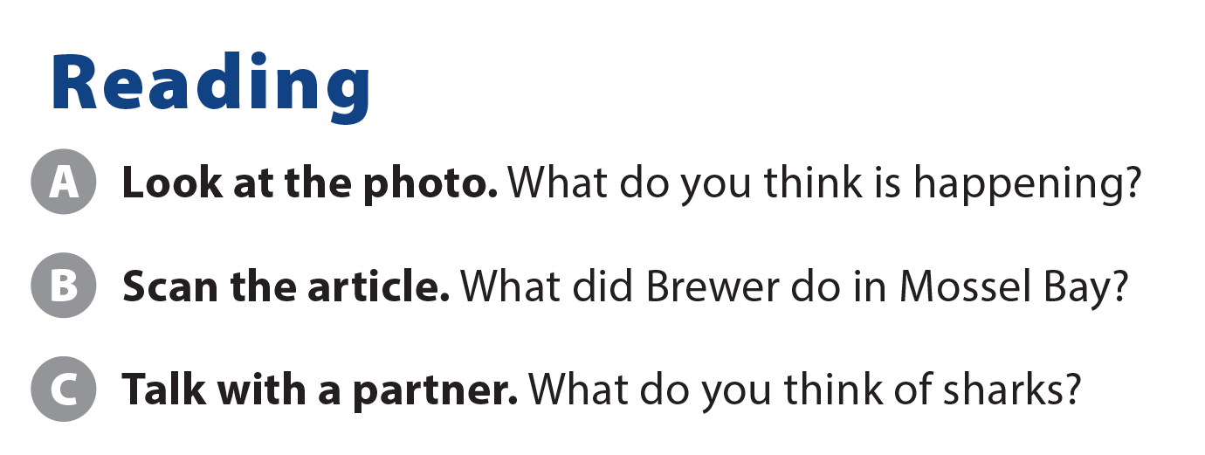
UNIT 11
WHAT WERE YOU DOING?
READING
She did volunteer work.

Slide 18
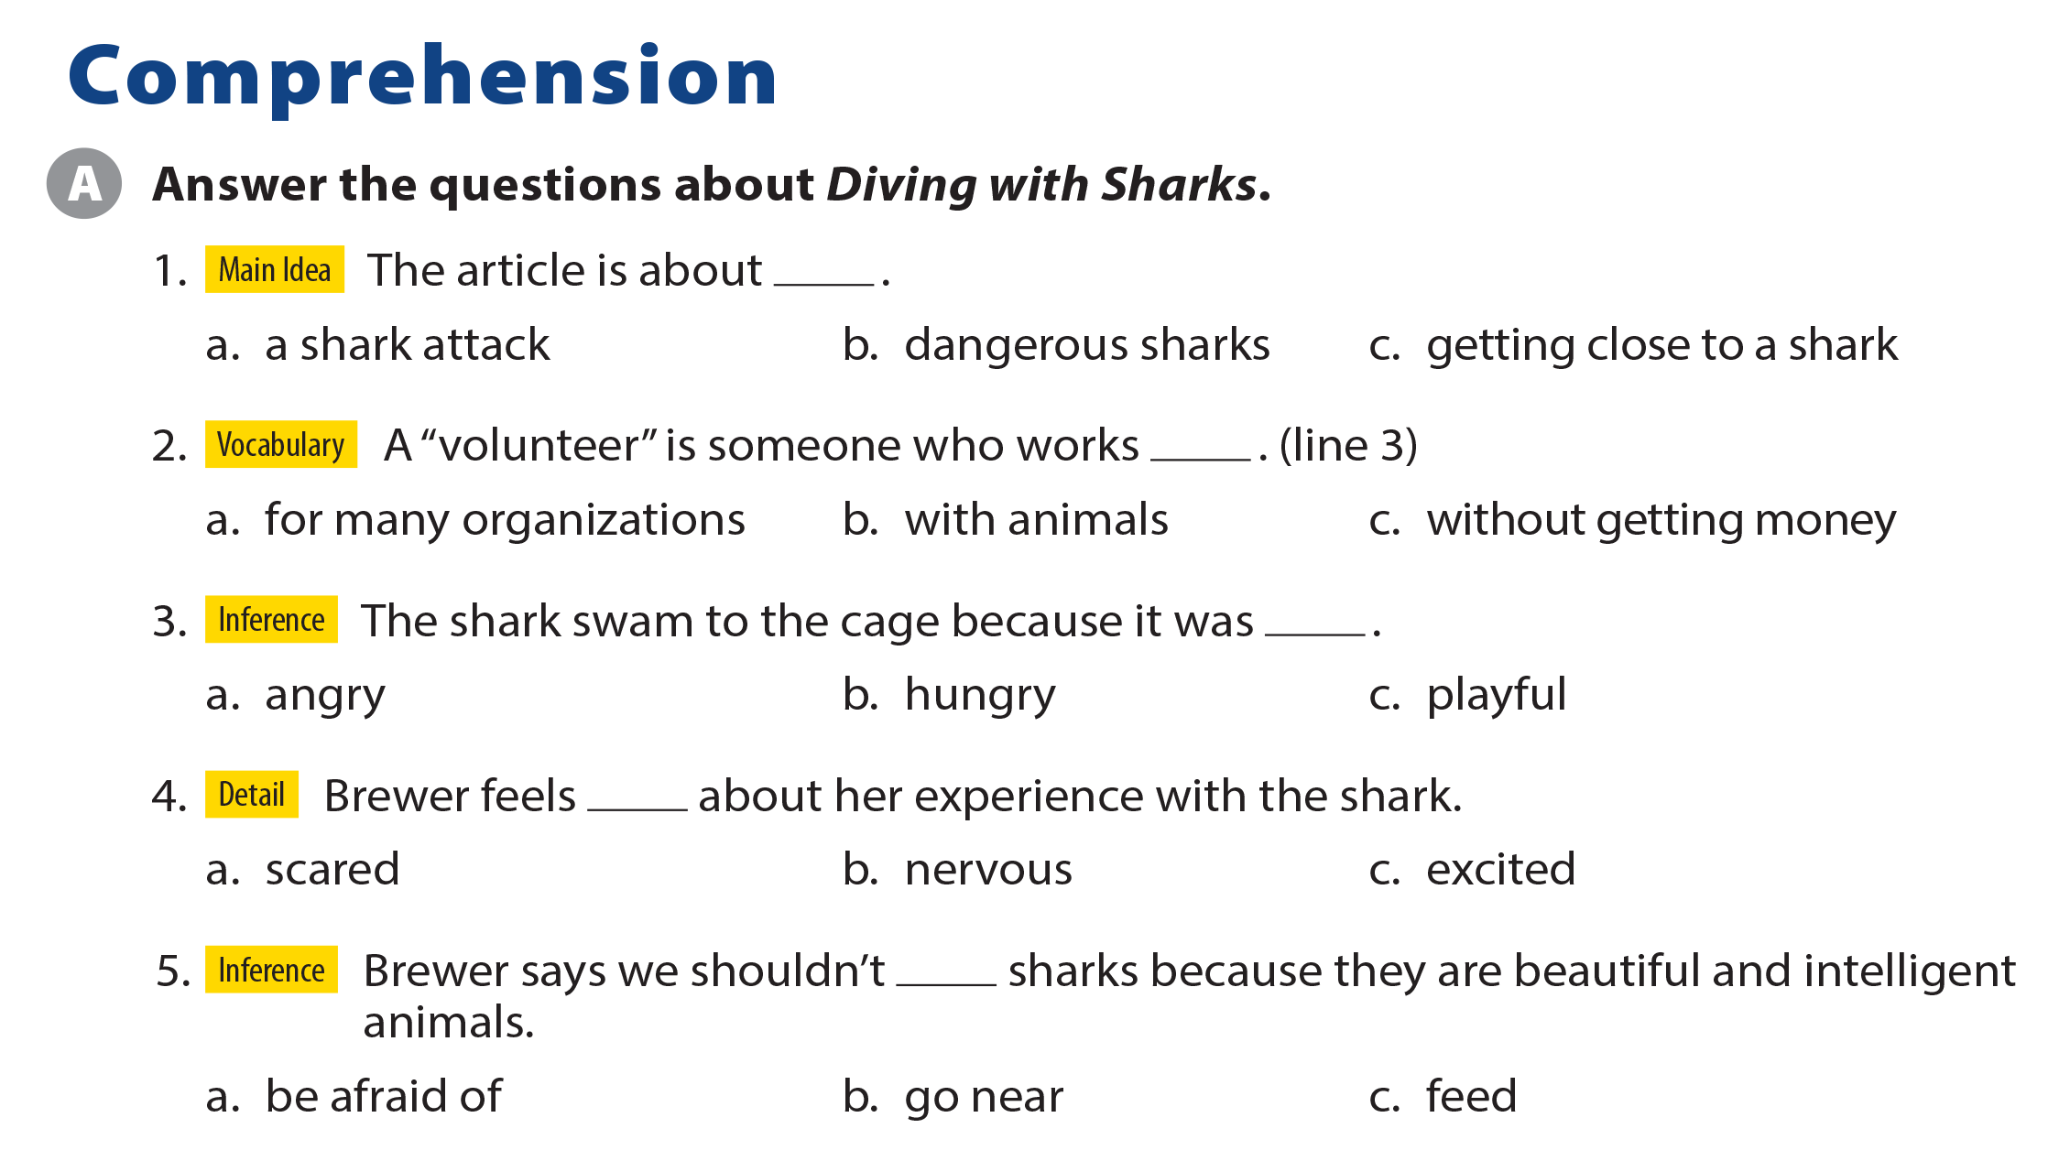
UNIT 11
WHAT WERE YOU DOING?
COMPREHENSION

Slide 19
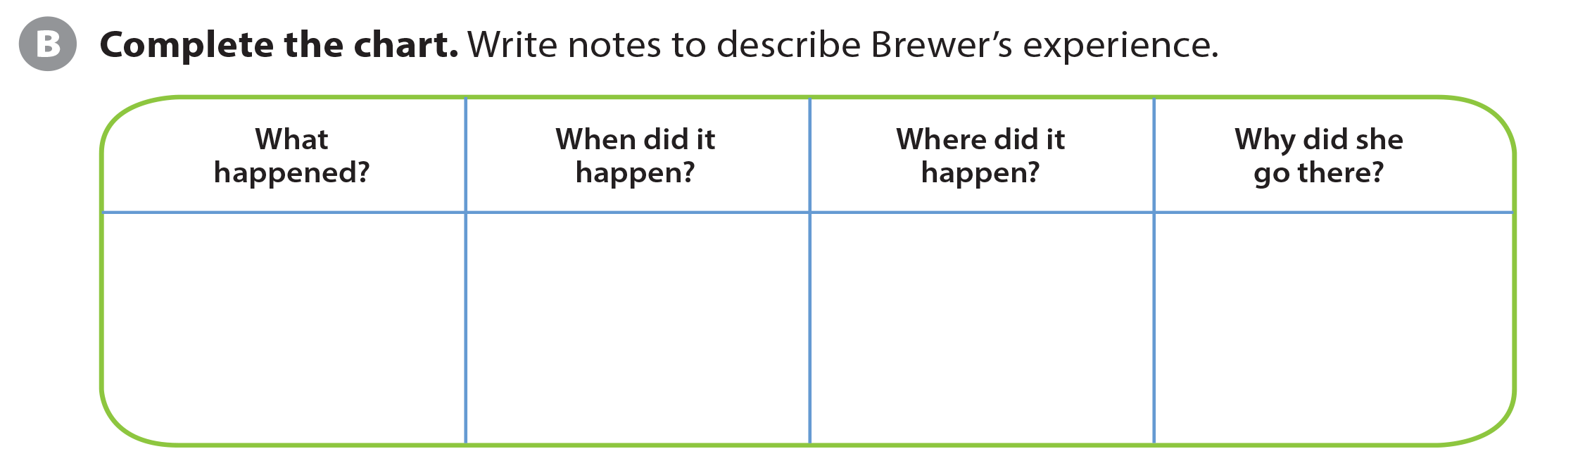
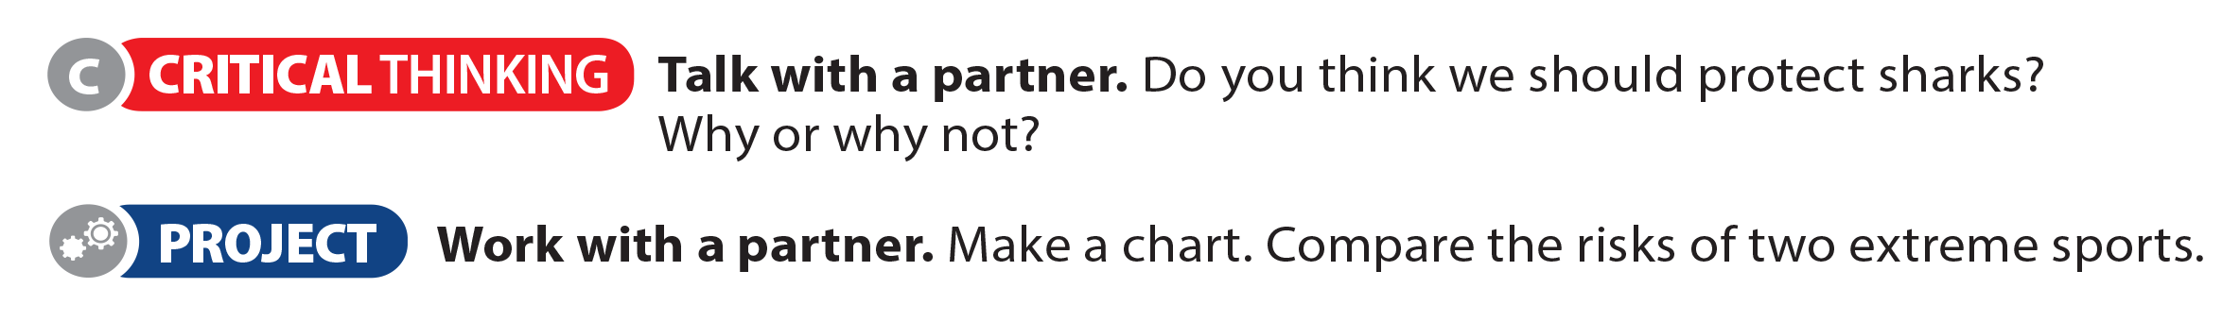
UNIT 11
WHAT WERE YOU DOING?
COMPREHENSION
She saw a great white shark when she was diving.
In the summer of 2014
In Mossel Bay, South Africa
She was volunteering for White Shark Africa.

Slide 20
UNIT 11
WHAT WERE YOU DOING?
PROJECT

Slide 21
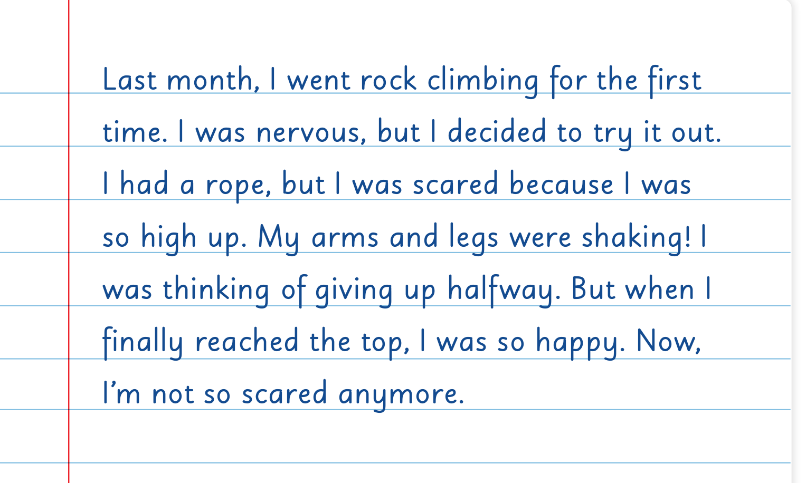
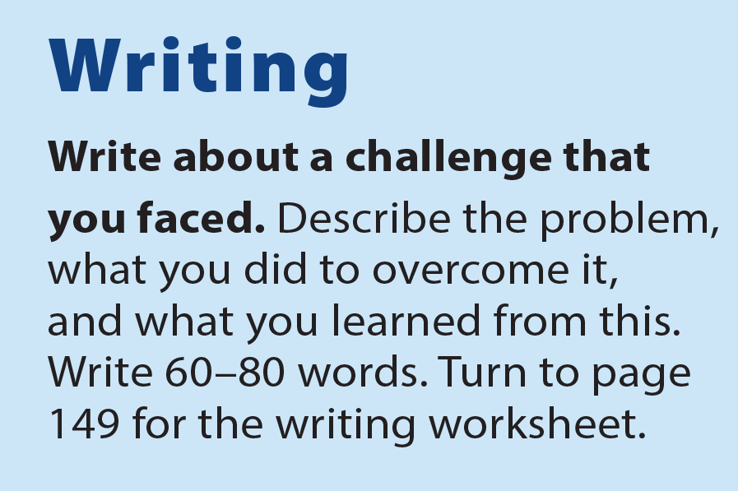
UNIT 11
WHAT WERE YOU DOING?
WRITING

Slide 22
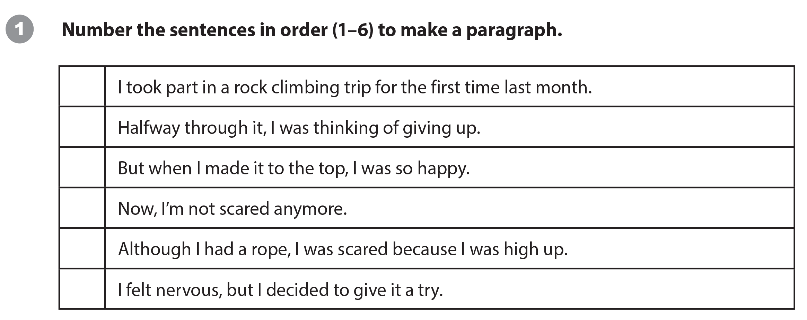
UNIT 11
WHAT WERE YOU DOING?
WRITING WORKSHEET
1
4
5
6
3
2

Slide 23
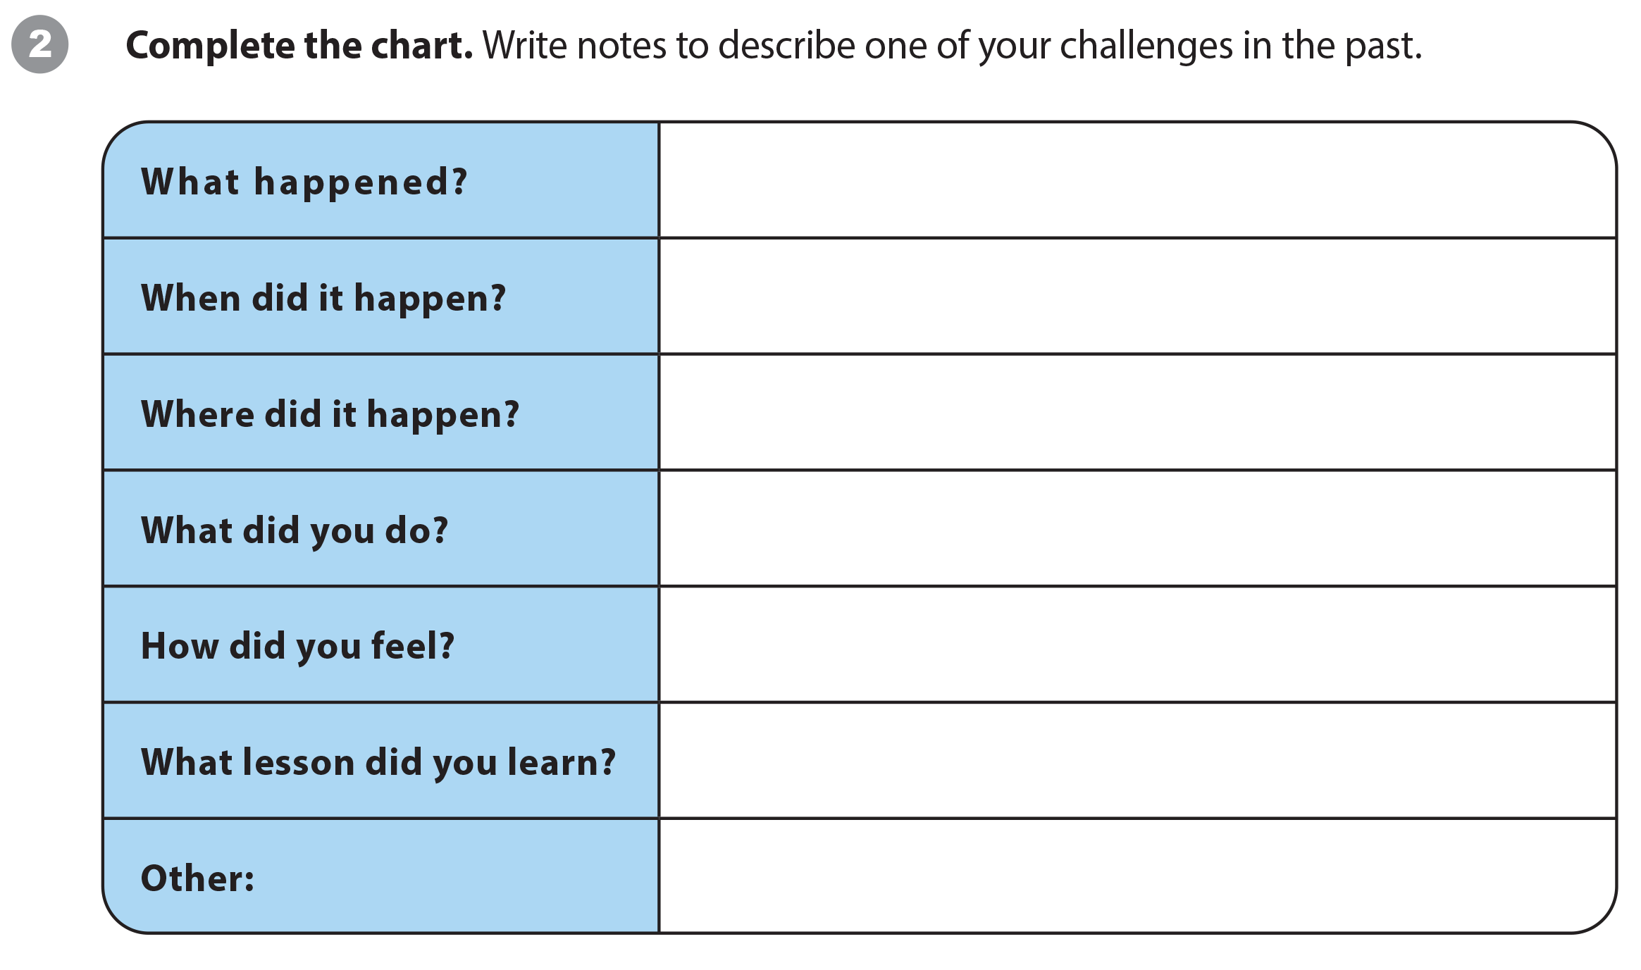
UNIT 11
WHAT WERE YOU DOING?
WRITING WORKSHEET

Slide 24
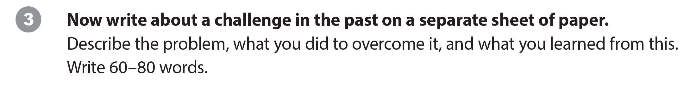
UNIT 11
WHAT WERE YOU DOING?
WRITING WORKSHEET

Slide 25
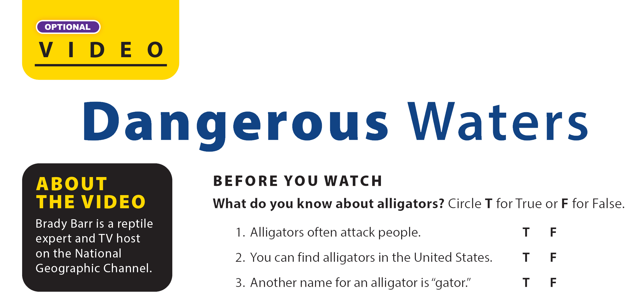
UNIT 11
WHAT WERE YOU DOING?
VIDEO

Slide 26


UNIT 11
WHAT WERE YOU DOING?
VIDEO

Slide 27
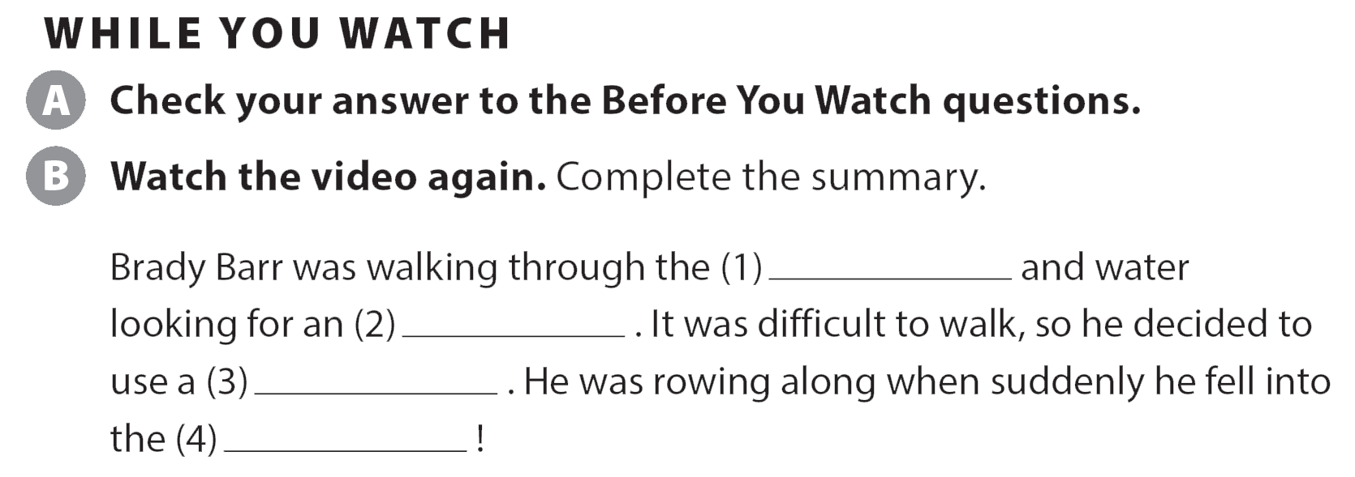
UNIT 11
WHAT WERE YOU DOING?
VIDEO
grass
aligator
boat
water

Slide 28

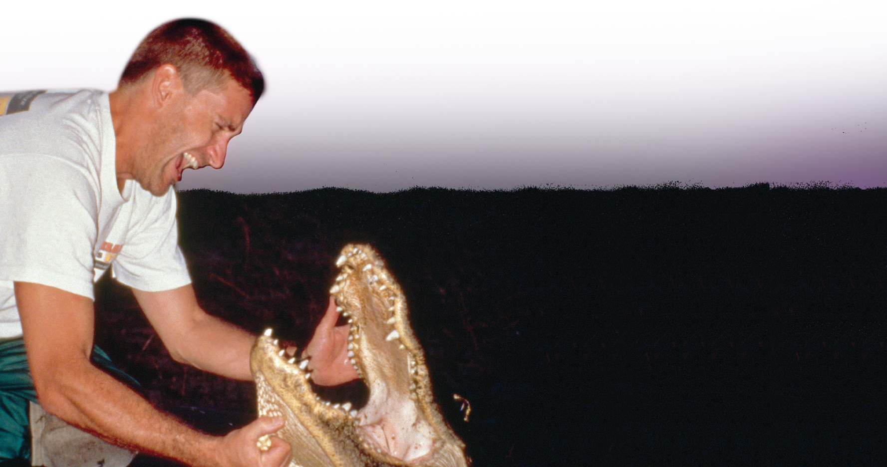
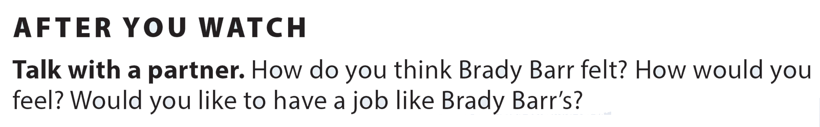
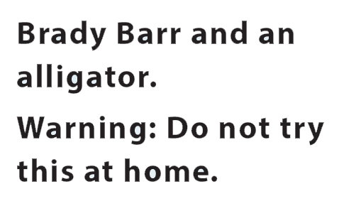
UNIT 11
WHAT WERE YOU DOING?
VIDEO
National Geographic Learning, a Cengage Company © 2022 Cengage Learning, Inc. ALL RIGHTS RESERVED. This presentation tool is intended for teaching purposes only and may not be scanned, copied, duplicated, or posted to a publicly accessible platform in whole or in part.

Slide 29
UNIT 11
WHAT WERE YOU DOING?
Thank you!

