Slide 1

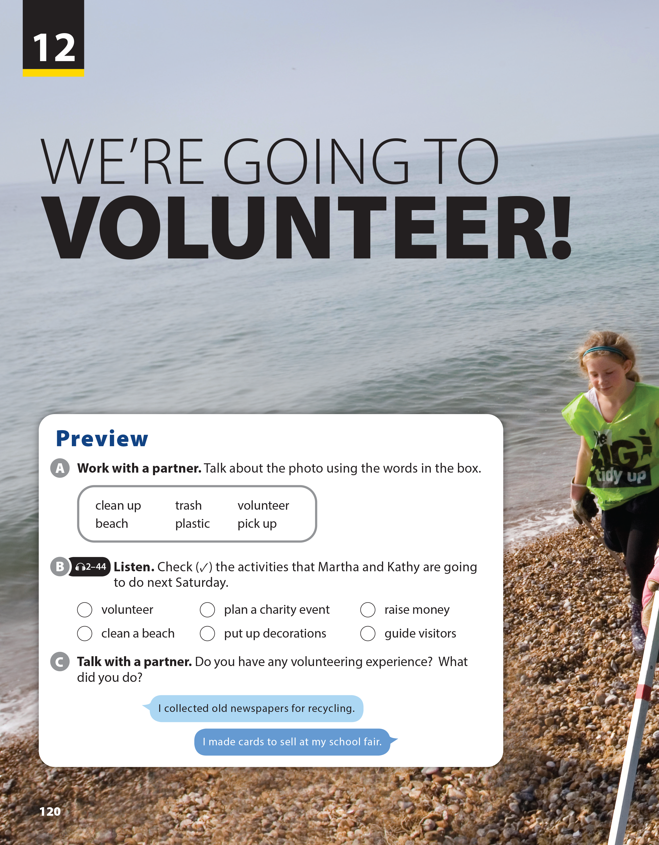
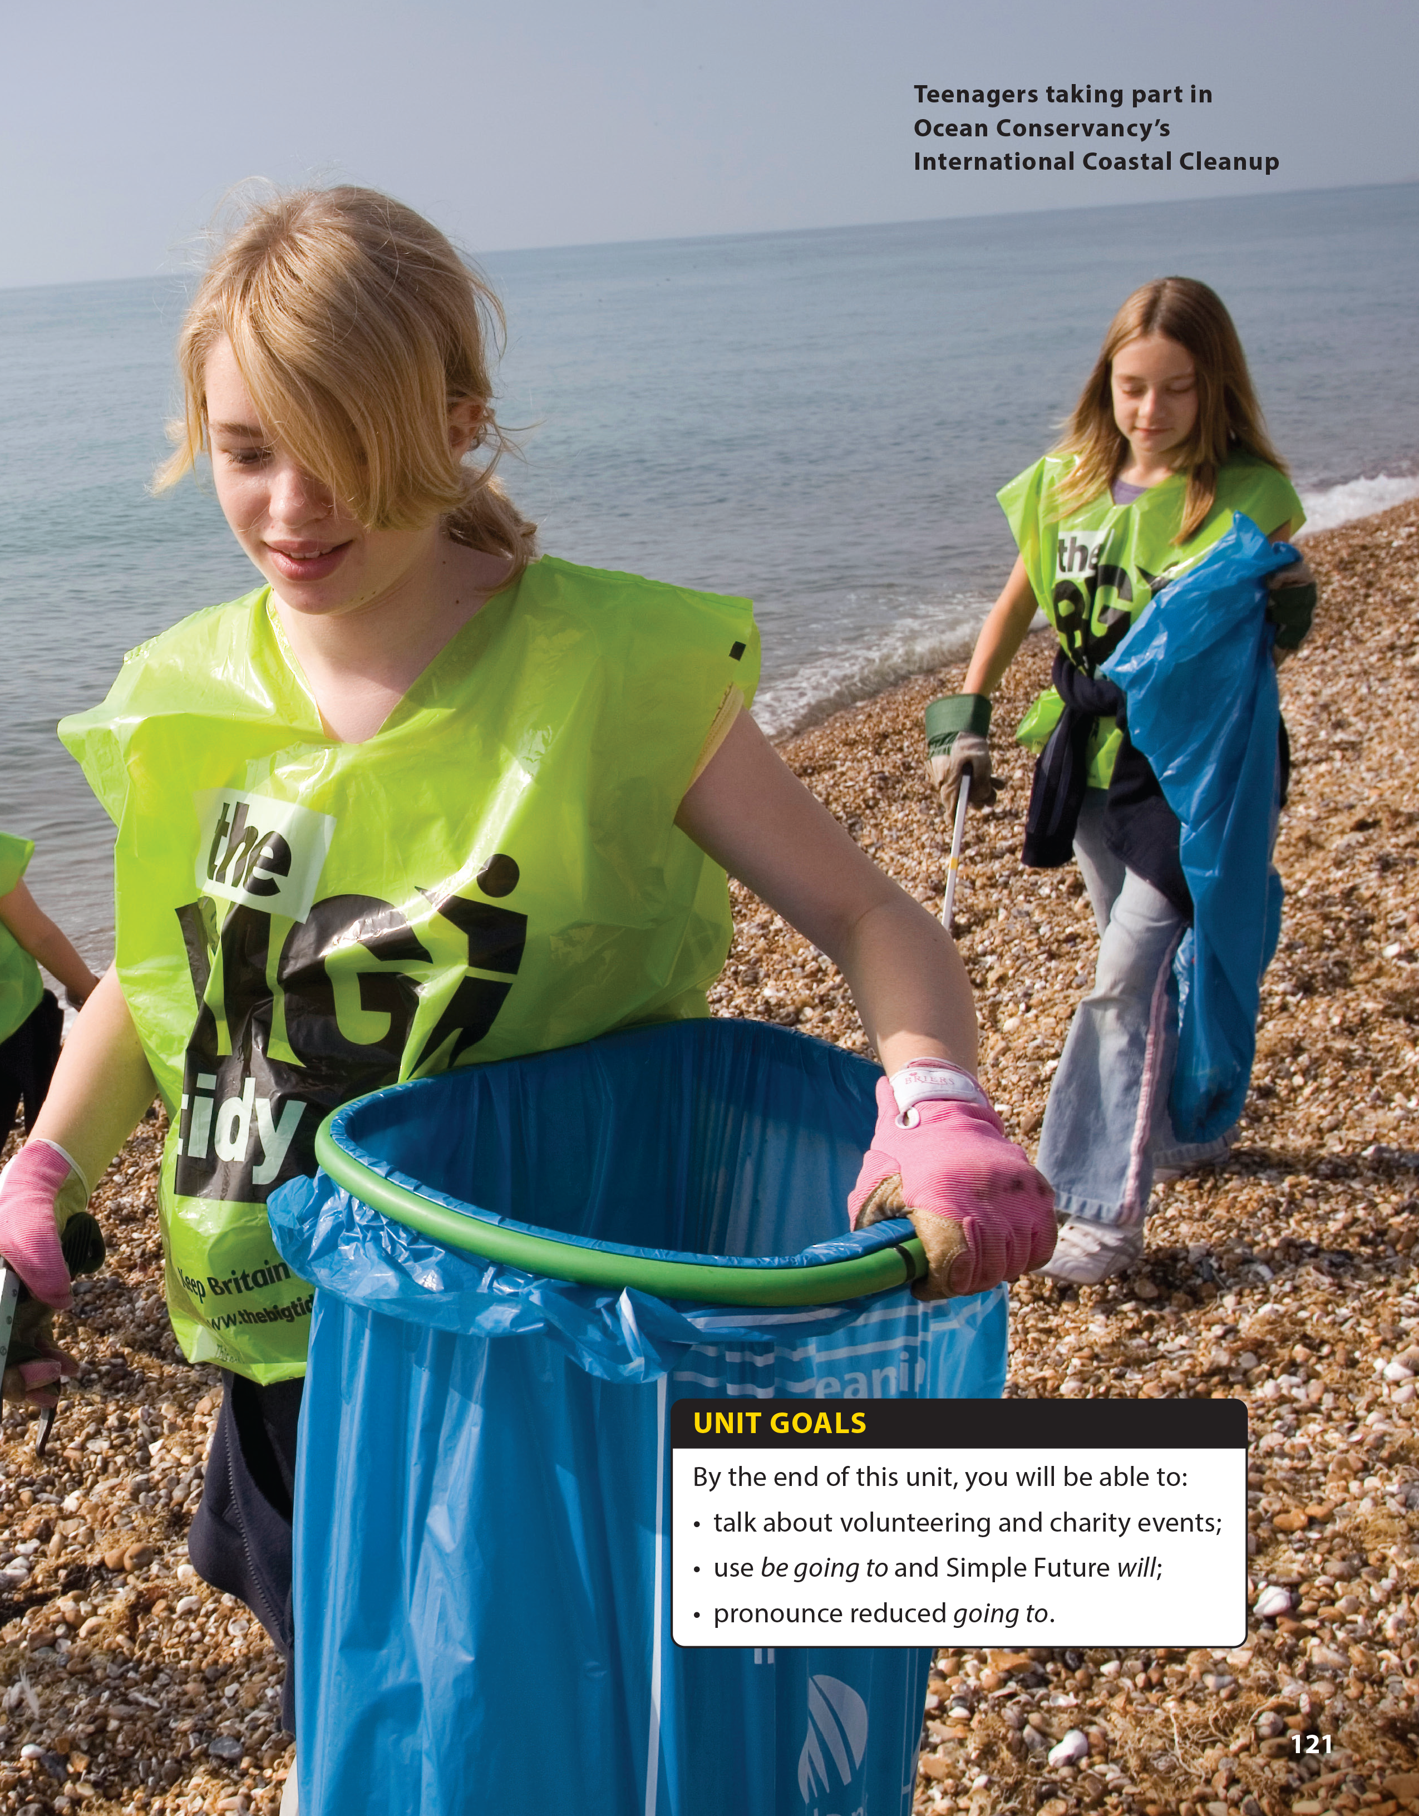

National Geographic Learning, a Cengage Company © 2022 Cengage Learning, Inc. ALL RIGHTS RESERVED. This presentation tool is intended for teaching purposes only and may not be scanned, copied, duplicated, or posted to a publicly accessible platform in whole or in part.

Slide 2
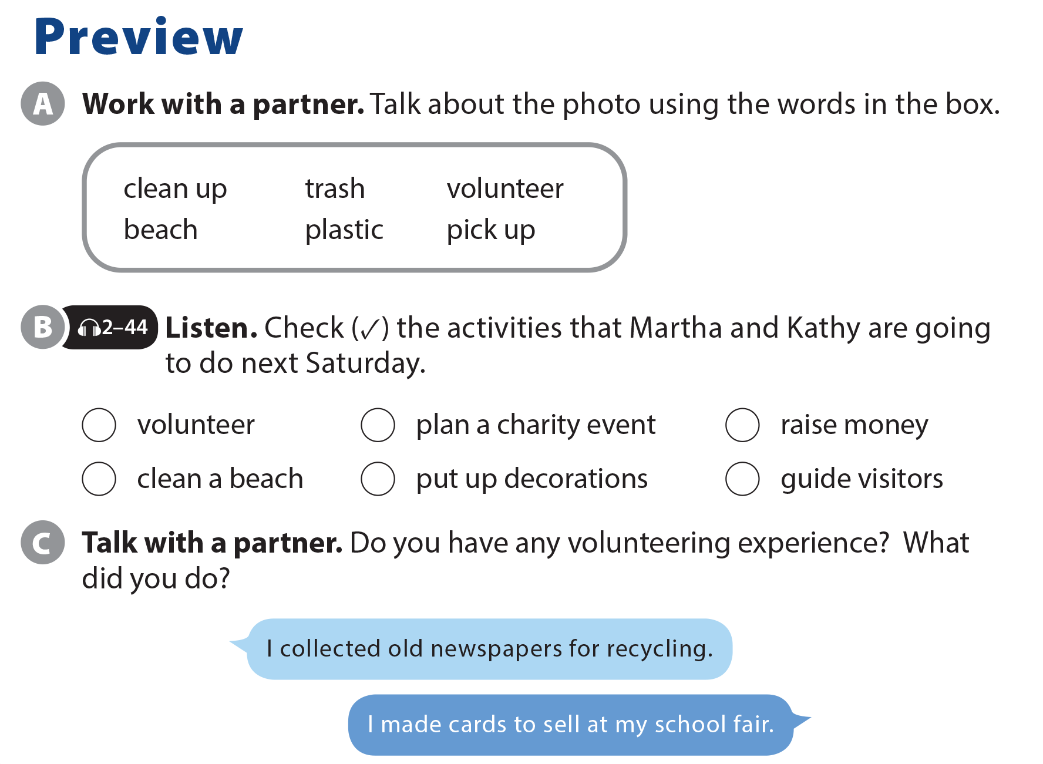
UNIT 12
WE’RE GOING TO VOLUNTEER!
PREVIEW

Slide 3

UNIT 12
WE’RE GOING TO VOLUNTEER!
PREVIEW
✓
✓
✓
✓

Slide 4
UNIT 12
WE’RE GOING TO VOLUNTEER!
PREVIEW

Slide 5


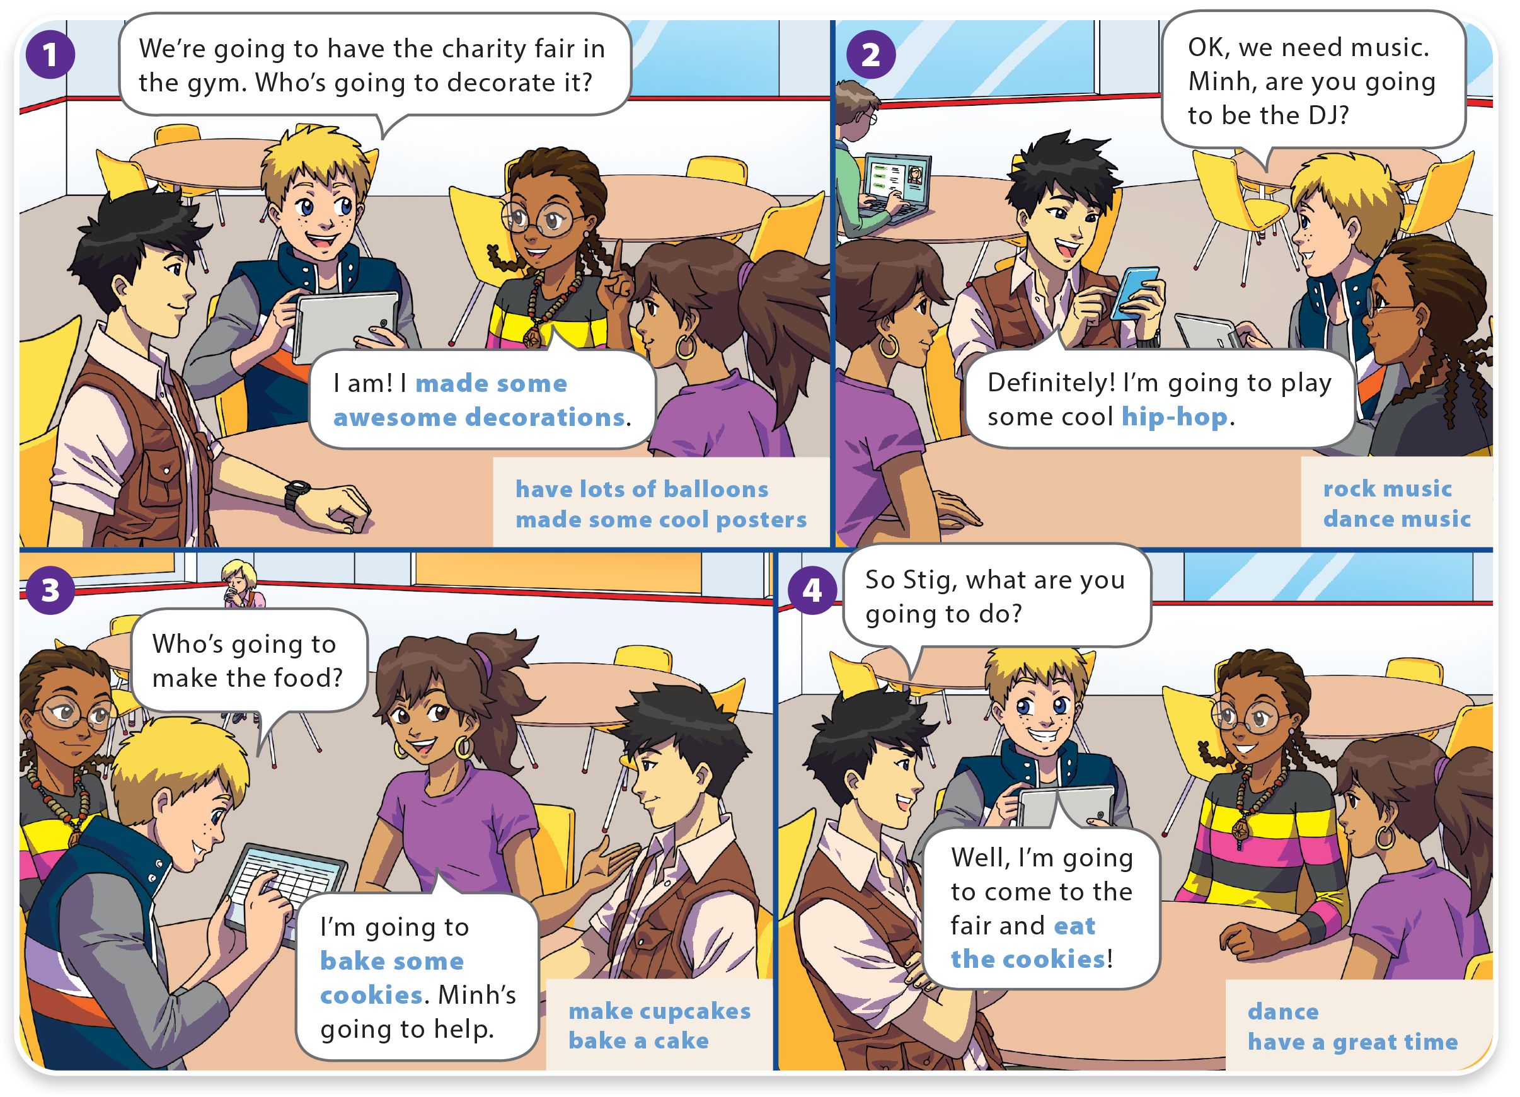
UNIT 12
WE’RE GOING TO VOLUNTEER!
LANGUAGE FOCUS

Slide 6
UNIT 12
WE’RE GOING TO VOLUNTEER!
LANGUAGE FOCUS

Slide 7
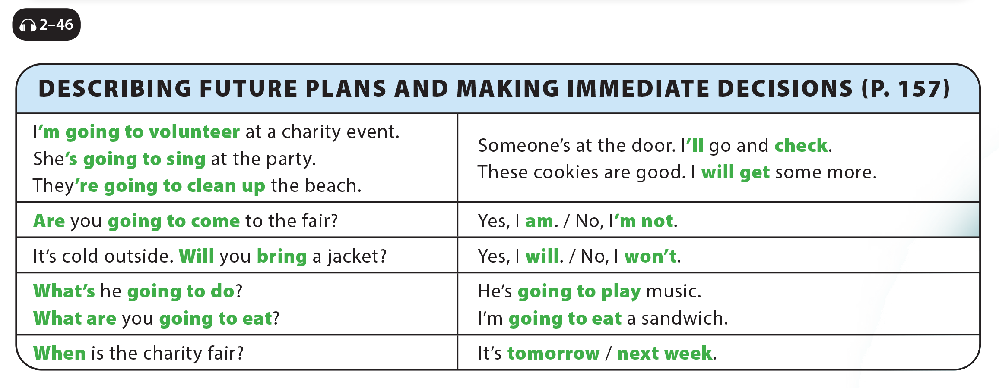
UNIT 12
WE’RE GOING TO VOLUNTEER!
LANGUAGE FOCUS

Slide 8
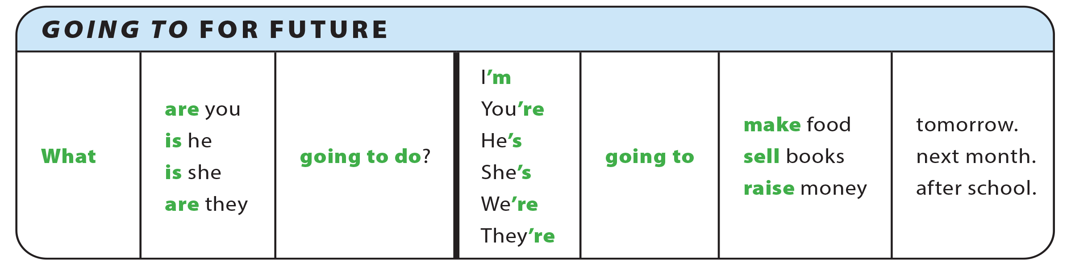
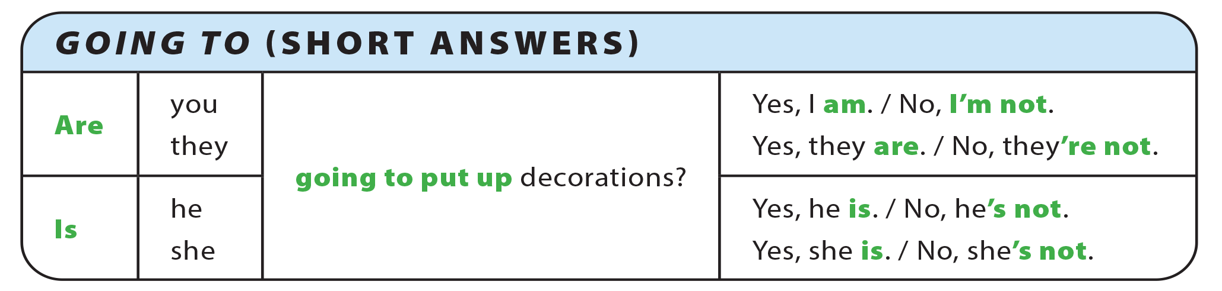
UNIT 12
WE’RE GOING TO VOLUNTEER!
GRAMMAR REFERENCE

Slide 9
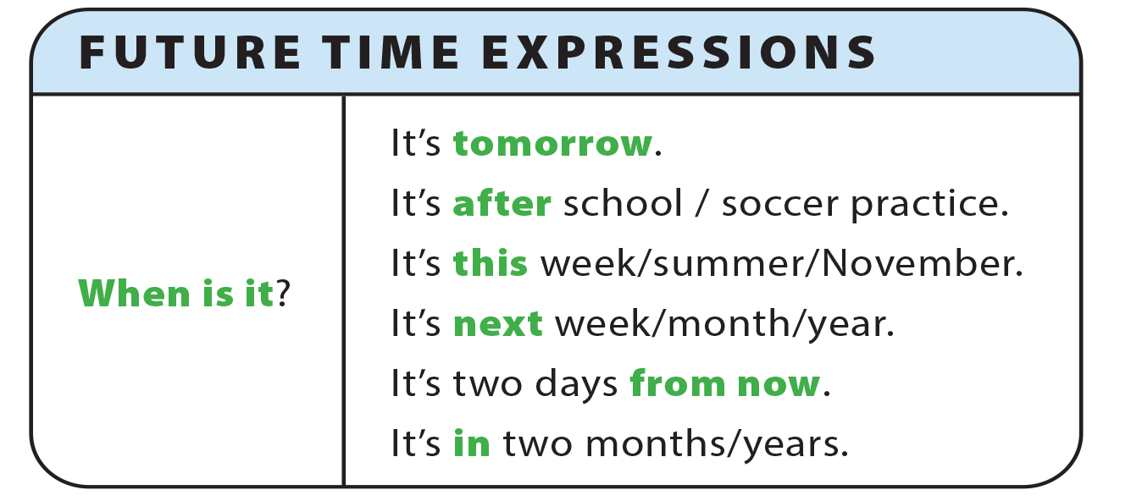
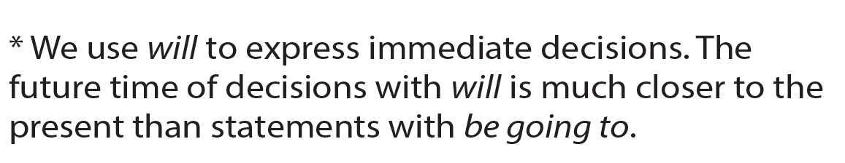
UNIT 12
WE’RE GOING TO VOLUNTEER!
GRAMMAR REFERENCE

Slide 10
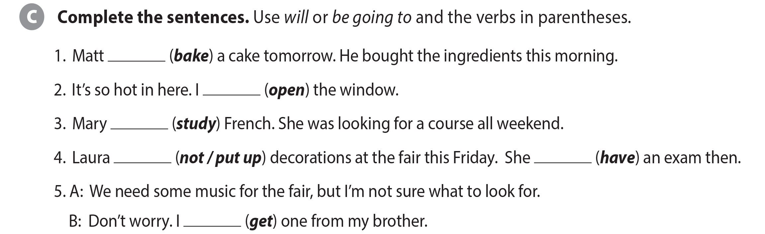
UNIT 12
WE’RE GOING TO VOLUNTEER!
LANGUAGE FOCUS
is/’s going to bake
will/’ll open
is‘/’s going to study
is not/isn’t going to put up
is/’s going to have
will/’ll get

Slide 11
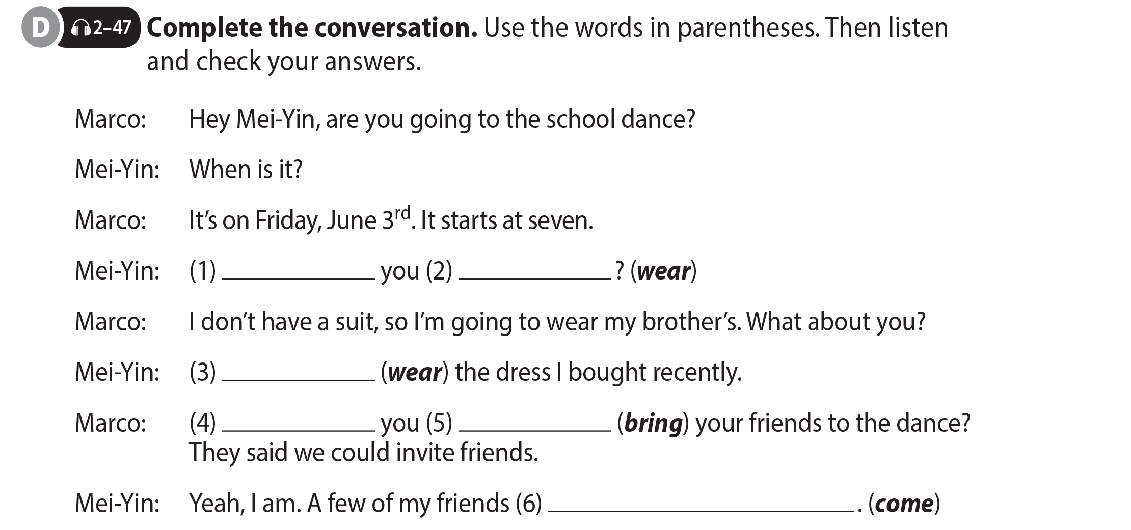
UNIT 12
WE’RE GOING TO VOLUNTEER!
LANGUAGE FOCUS
What are
going to wear
I’m going to wear
Are
going to bring
are going to come

Slide 12



UNIT 12
WE’RE GOING TO VOLUNTEER!
LANGUAGE FOCUS

Slide 13
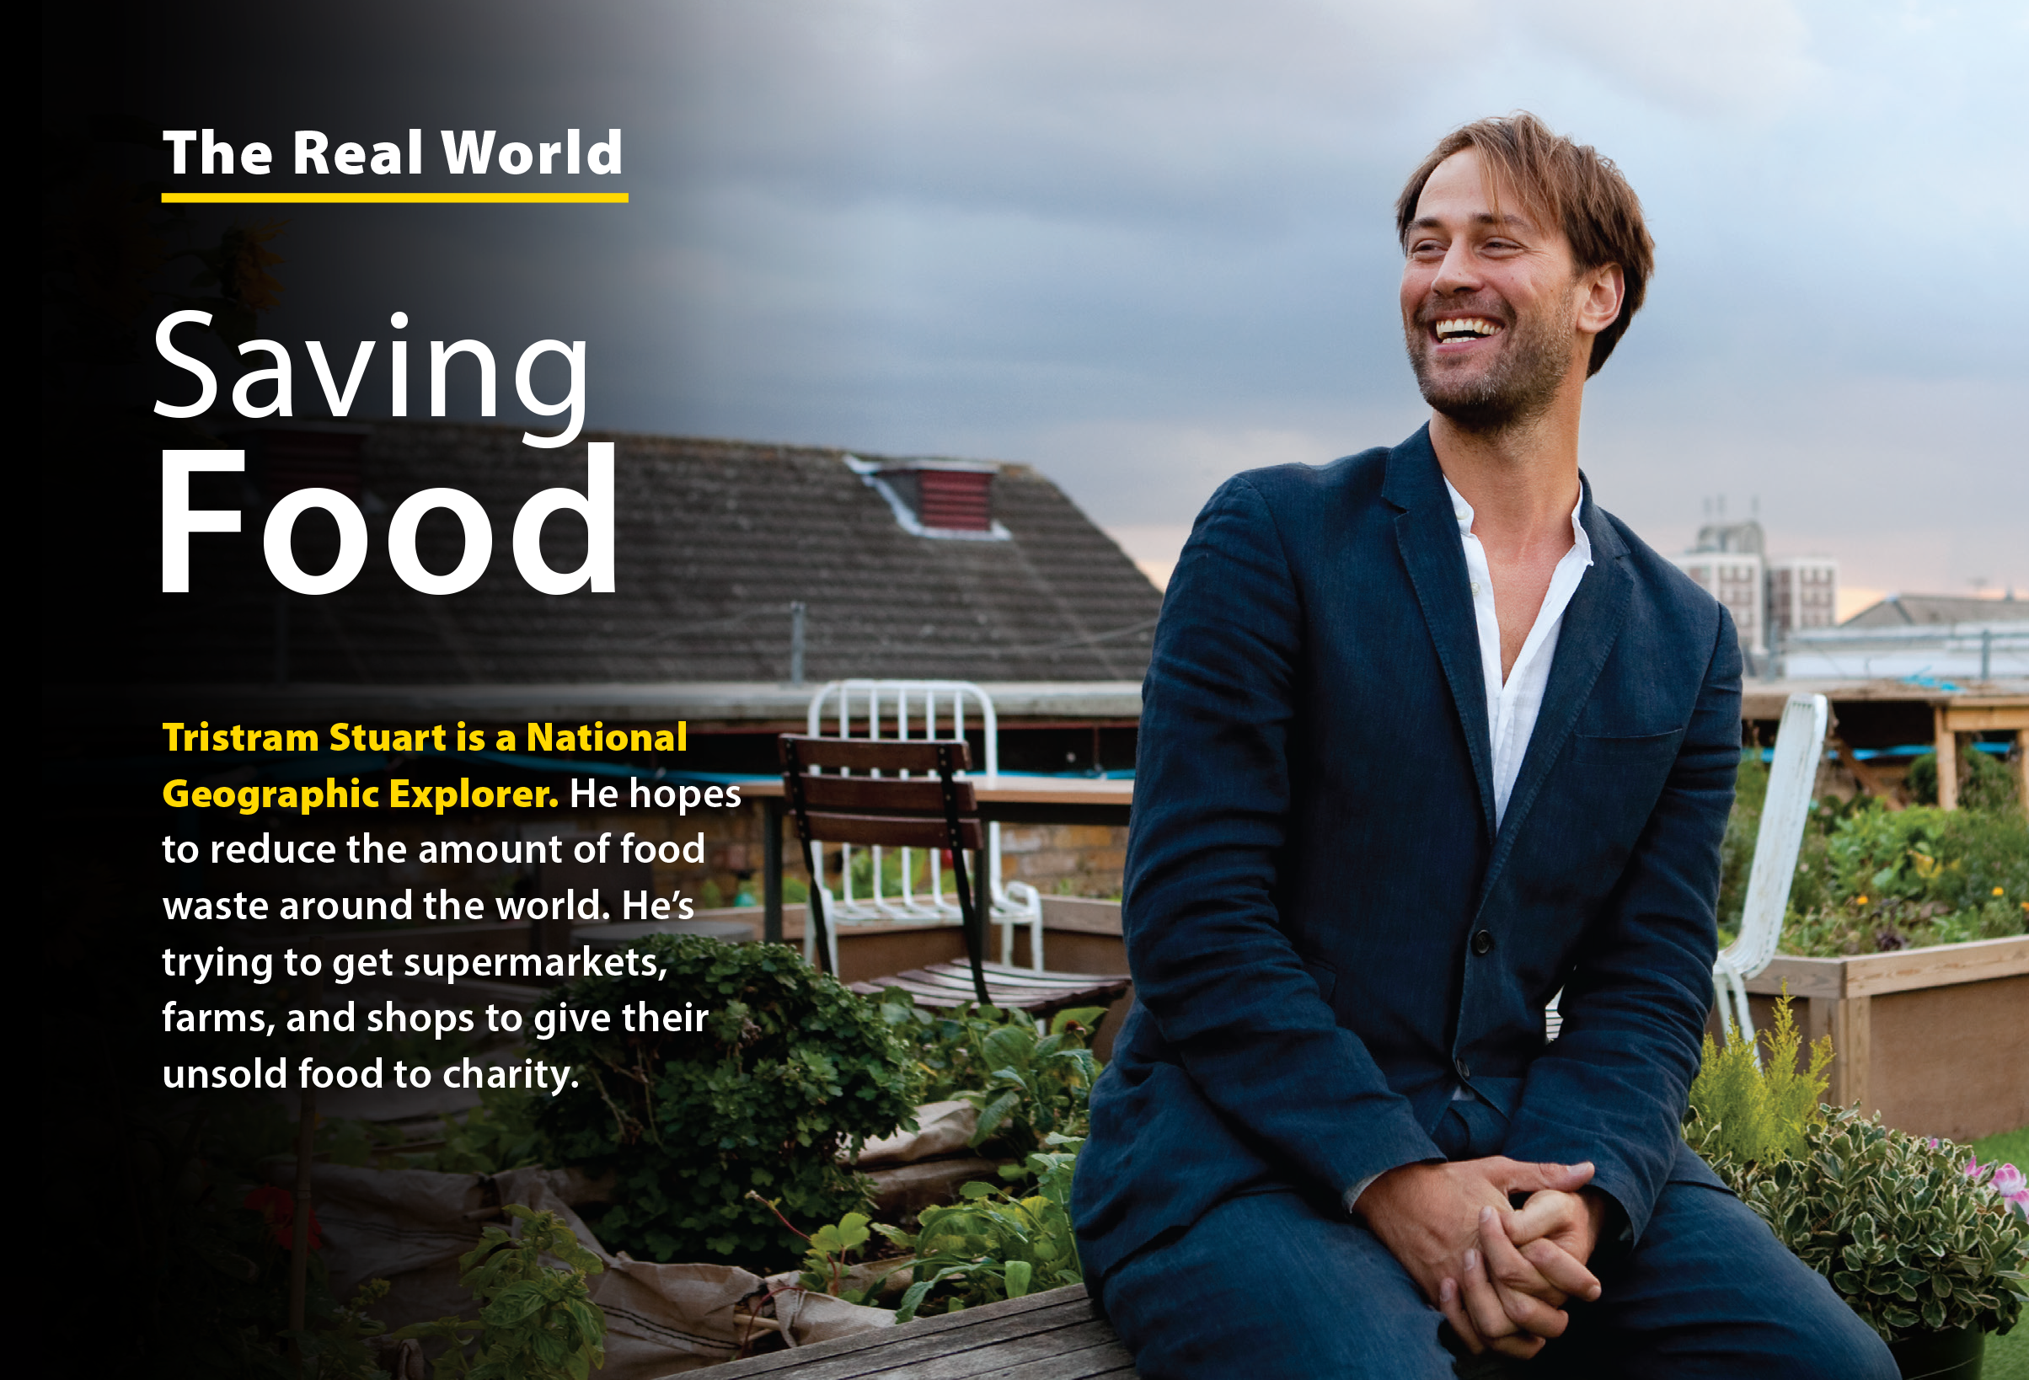
UNIT 12
WE’RE GOING TO VOLUNTEER!
THE REAL WORLD

Slide 14

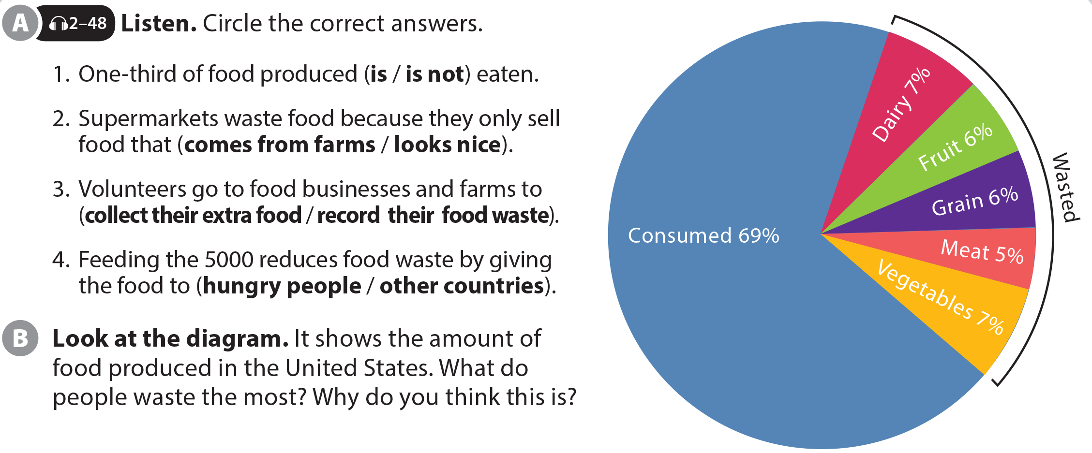
UNIT 12
WE’RE GOING TO VOLUNTEER!
THE REAL WORLD
Dairy and Vegetables (Answers will vary)
National Geographic Learning, a Cengage Company © 2022 Cengage Learning, Inc. ALL RIGHTS RESERVED. This presentation tool is intended for teaching purposes only and may not be scanned, copied, duplicated, or posted to a publicly accessible platform in whole or in part.

Slide 15
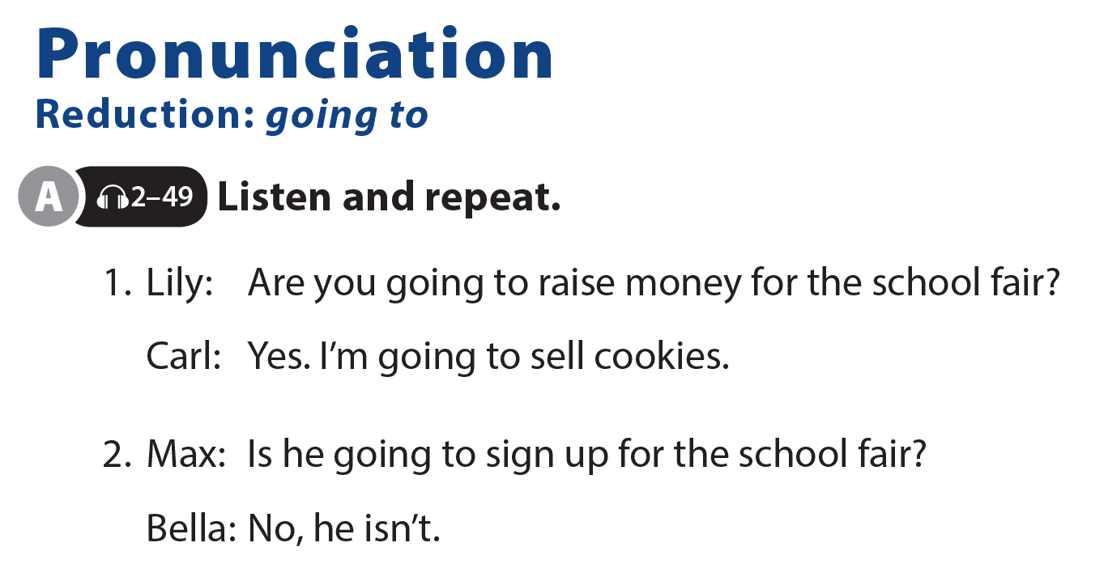
UNIT 12
WE’RE GOING TO VOLUNTEER!
PRONUNCIATION

Slide 16
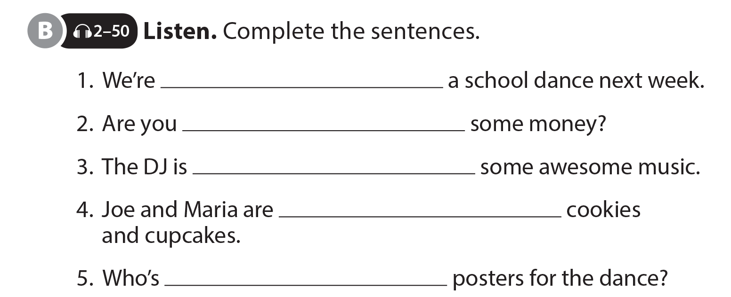
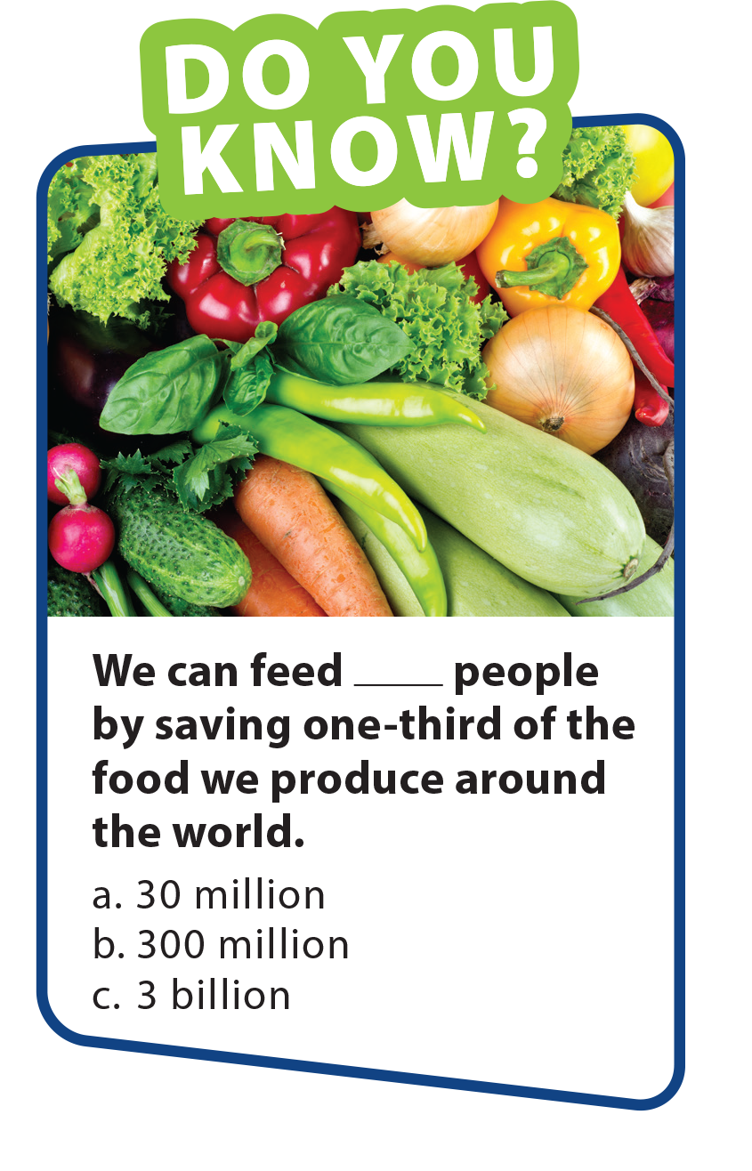
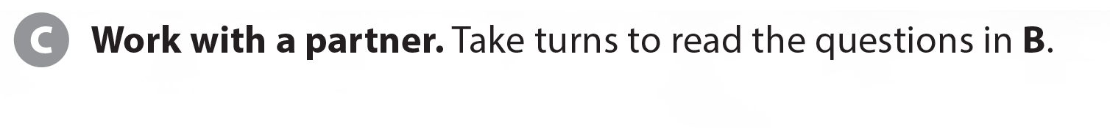
UNIT 12
WE’RE GOING TO VOLUNTEER!
PRONUNCIATION
going to have
going to donate
going to play
going to bake
going to make

Slide 17
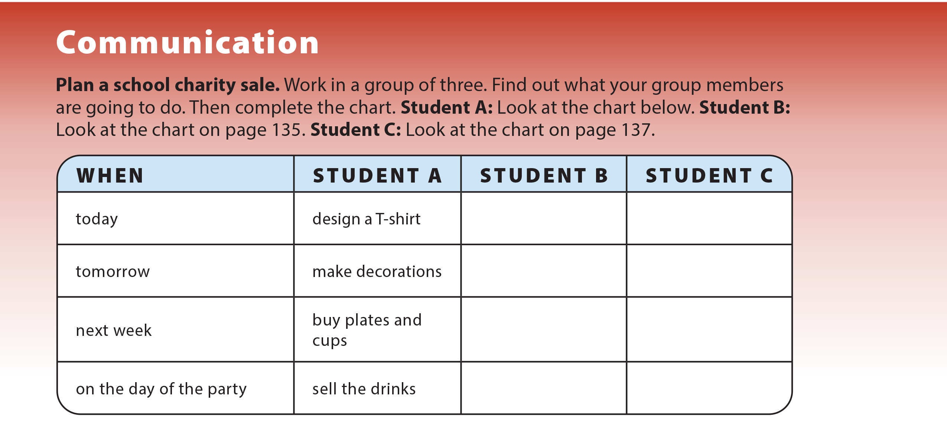
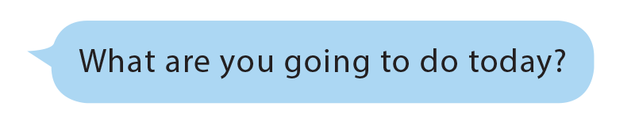

UNIT 12
WE’RE GOING TO VOLUNTEER!
COMMUNICATION
plan the entertainment
plan the poster design
buy balloons
make posters
put up
decorations
choose
the music
make
sandwiches
sell
sandwiches

Slide 18
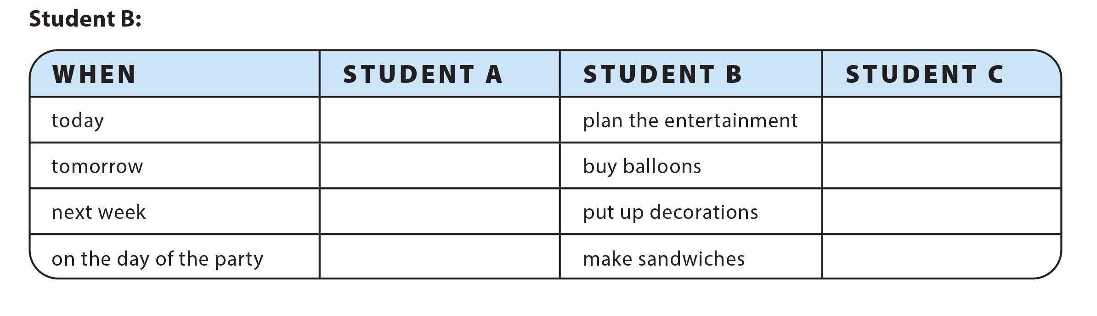
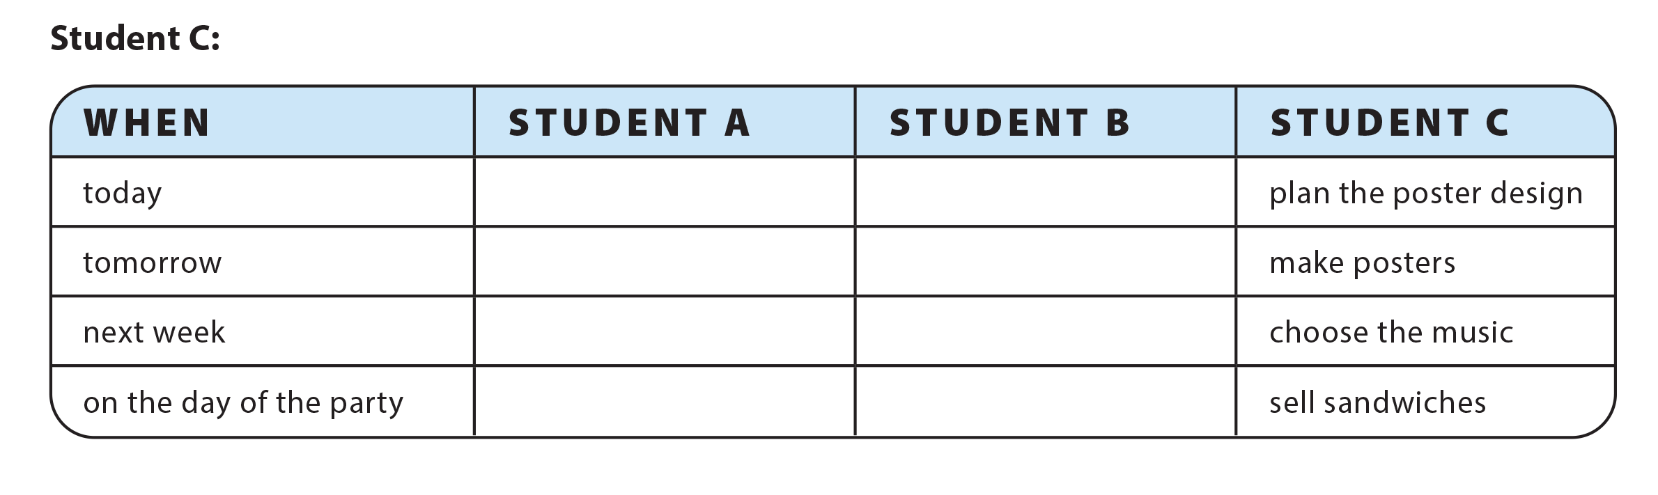
UNIT 12
WE’RE GOING TO VOLUNTEER!
COMMUNICATION
design a T-shirt
plan the poster design
make decorations
make posters
buy plates and cups
choose the music
sell the drinks
sell sandwiches
design a T-shirt
plan the entertainment
make decorations
buy balloons
buy plates and cups
put up decorations
sell the drinks
make sandwiches

Slide 19
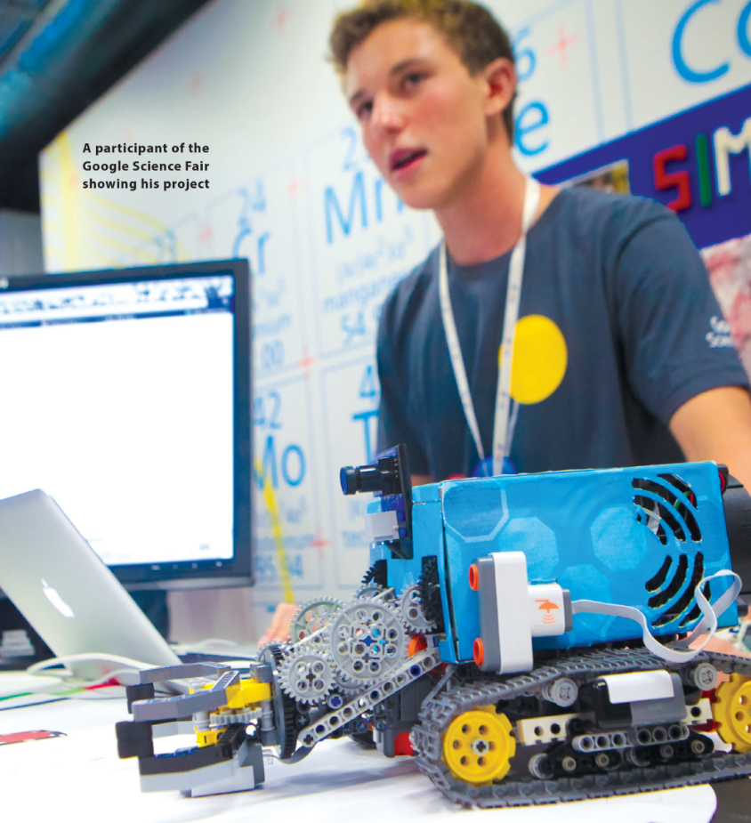
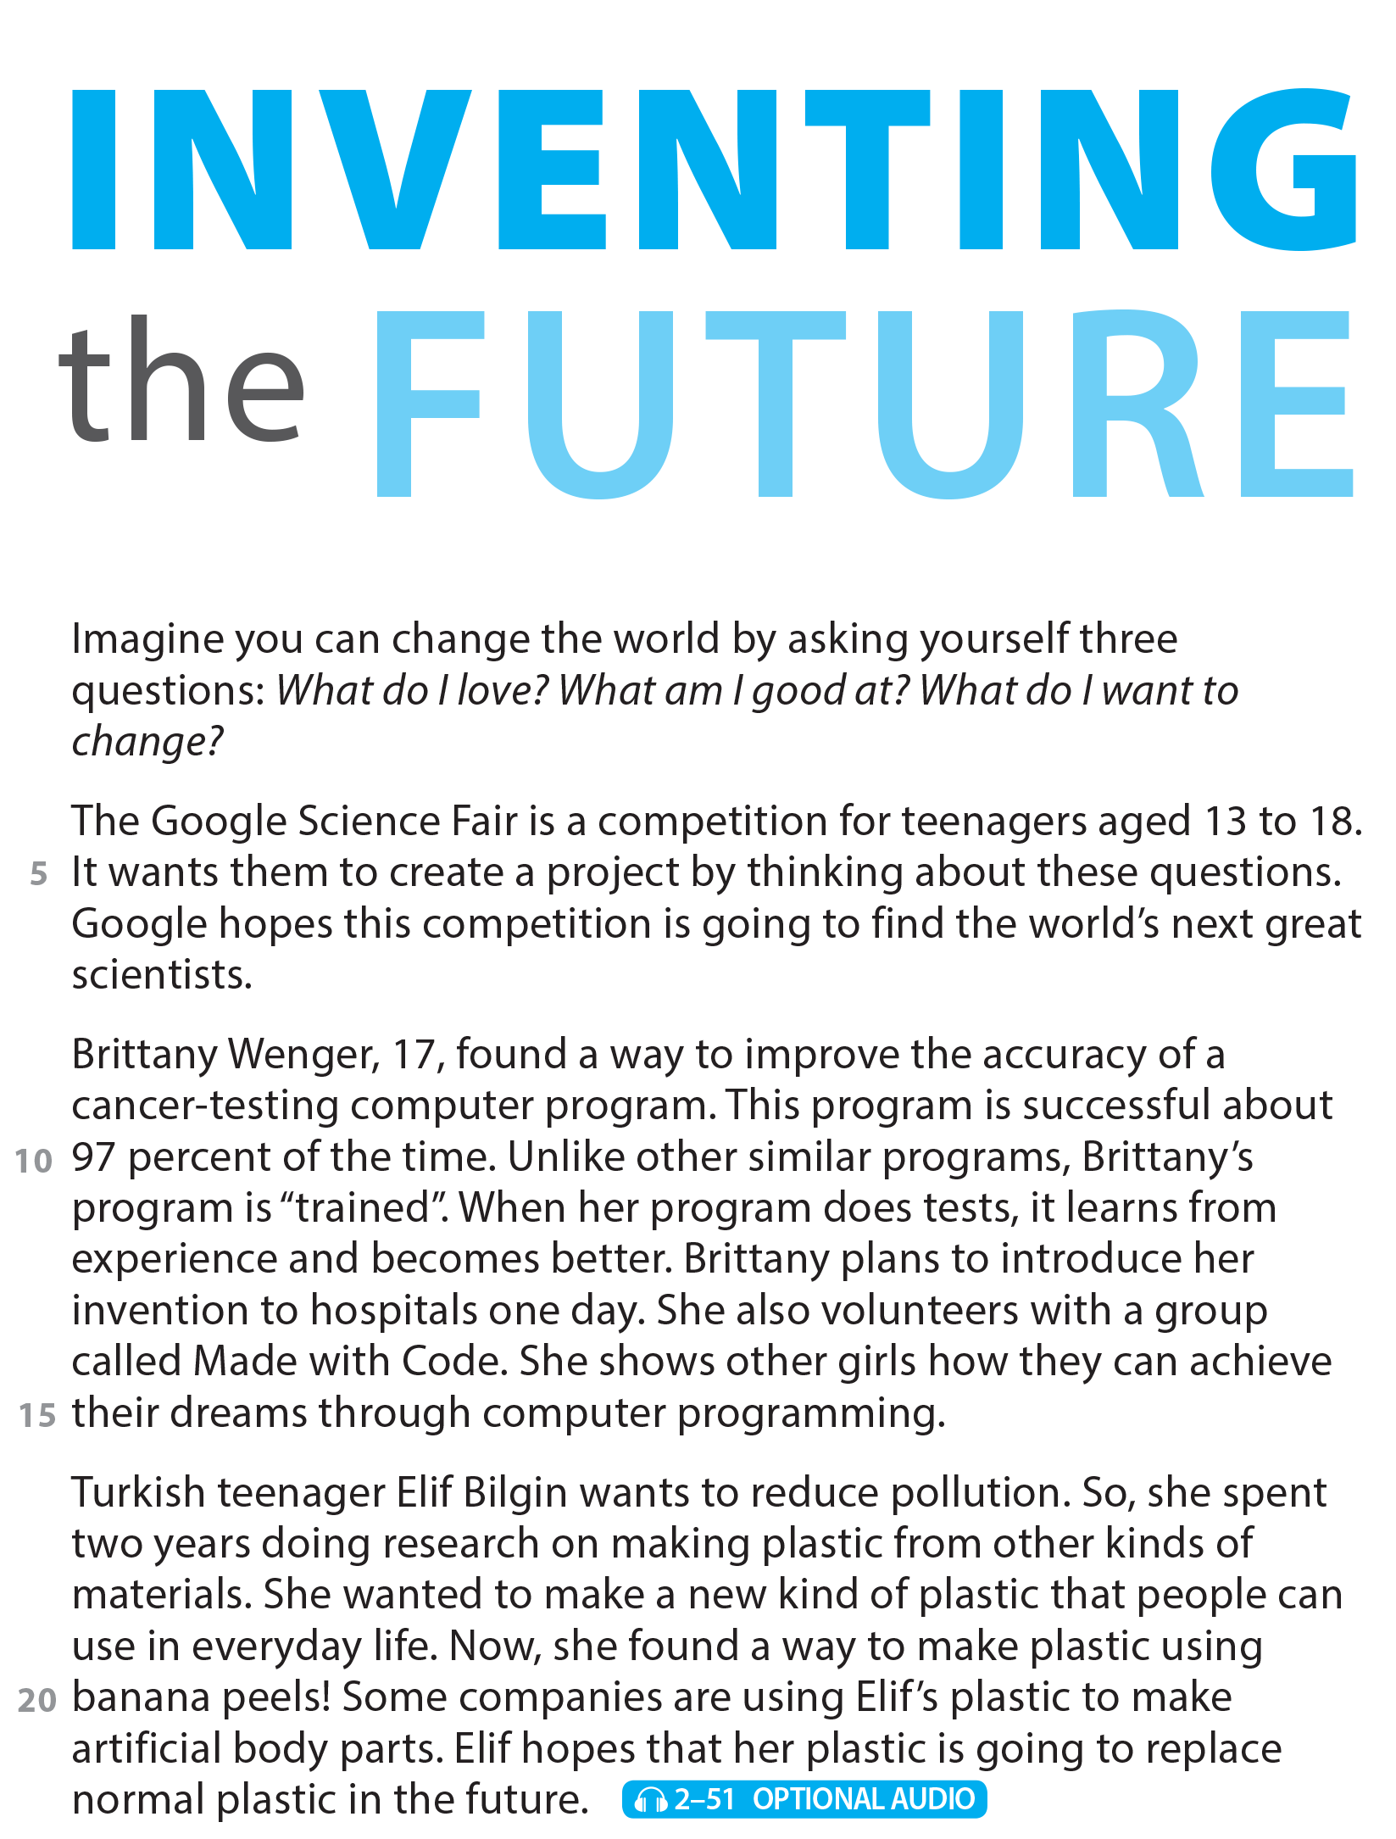
WE’RE GOING TO VOLUNTEER!
READING
UNIT 12
READING
UNIT 12
WE’RE GOING TO VOLUNTEER!
National Geographic Learning, a Cengage Company © 2022 Cengage Learning, Inc. ALL RIGHTS RESERVED. This presentation tool is intended for teaching purposes only and may not be scanned, copied, duplicated, or posted to a publicly accessible platform in whole or in part.

Slide 20

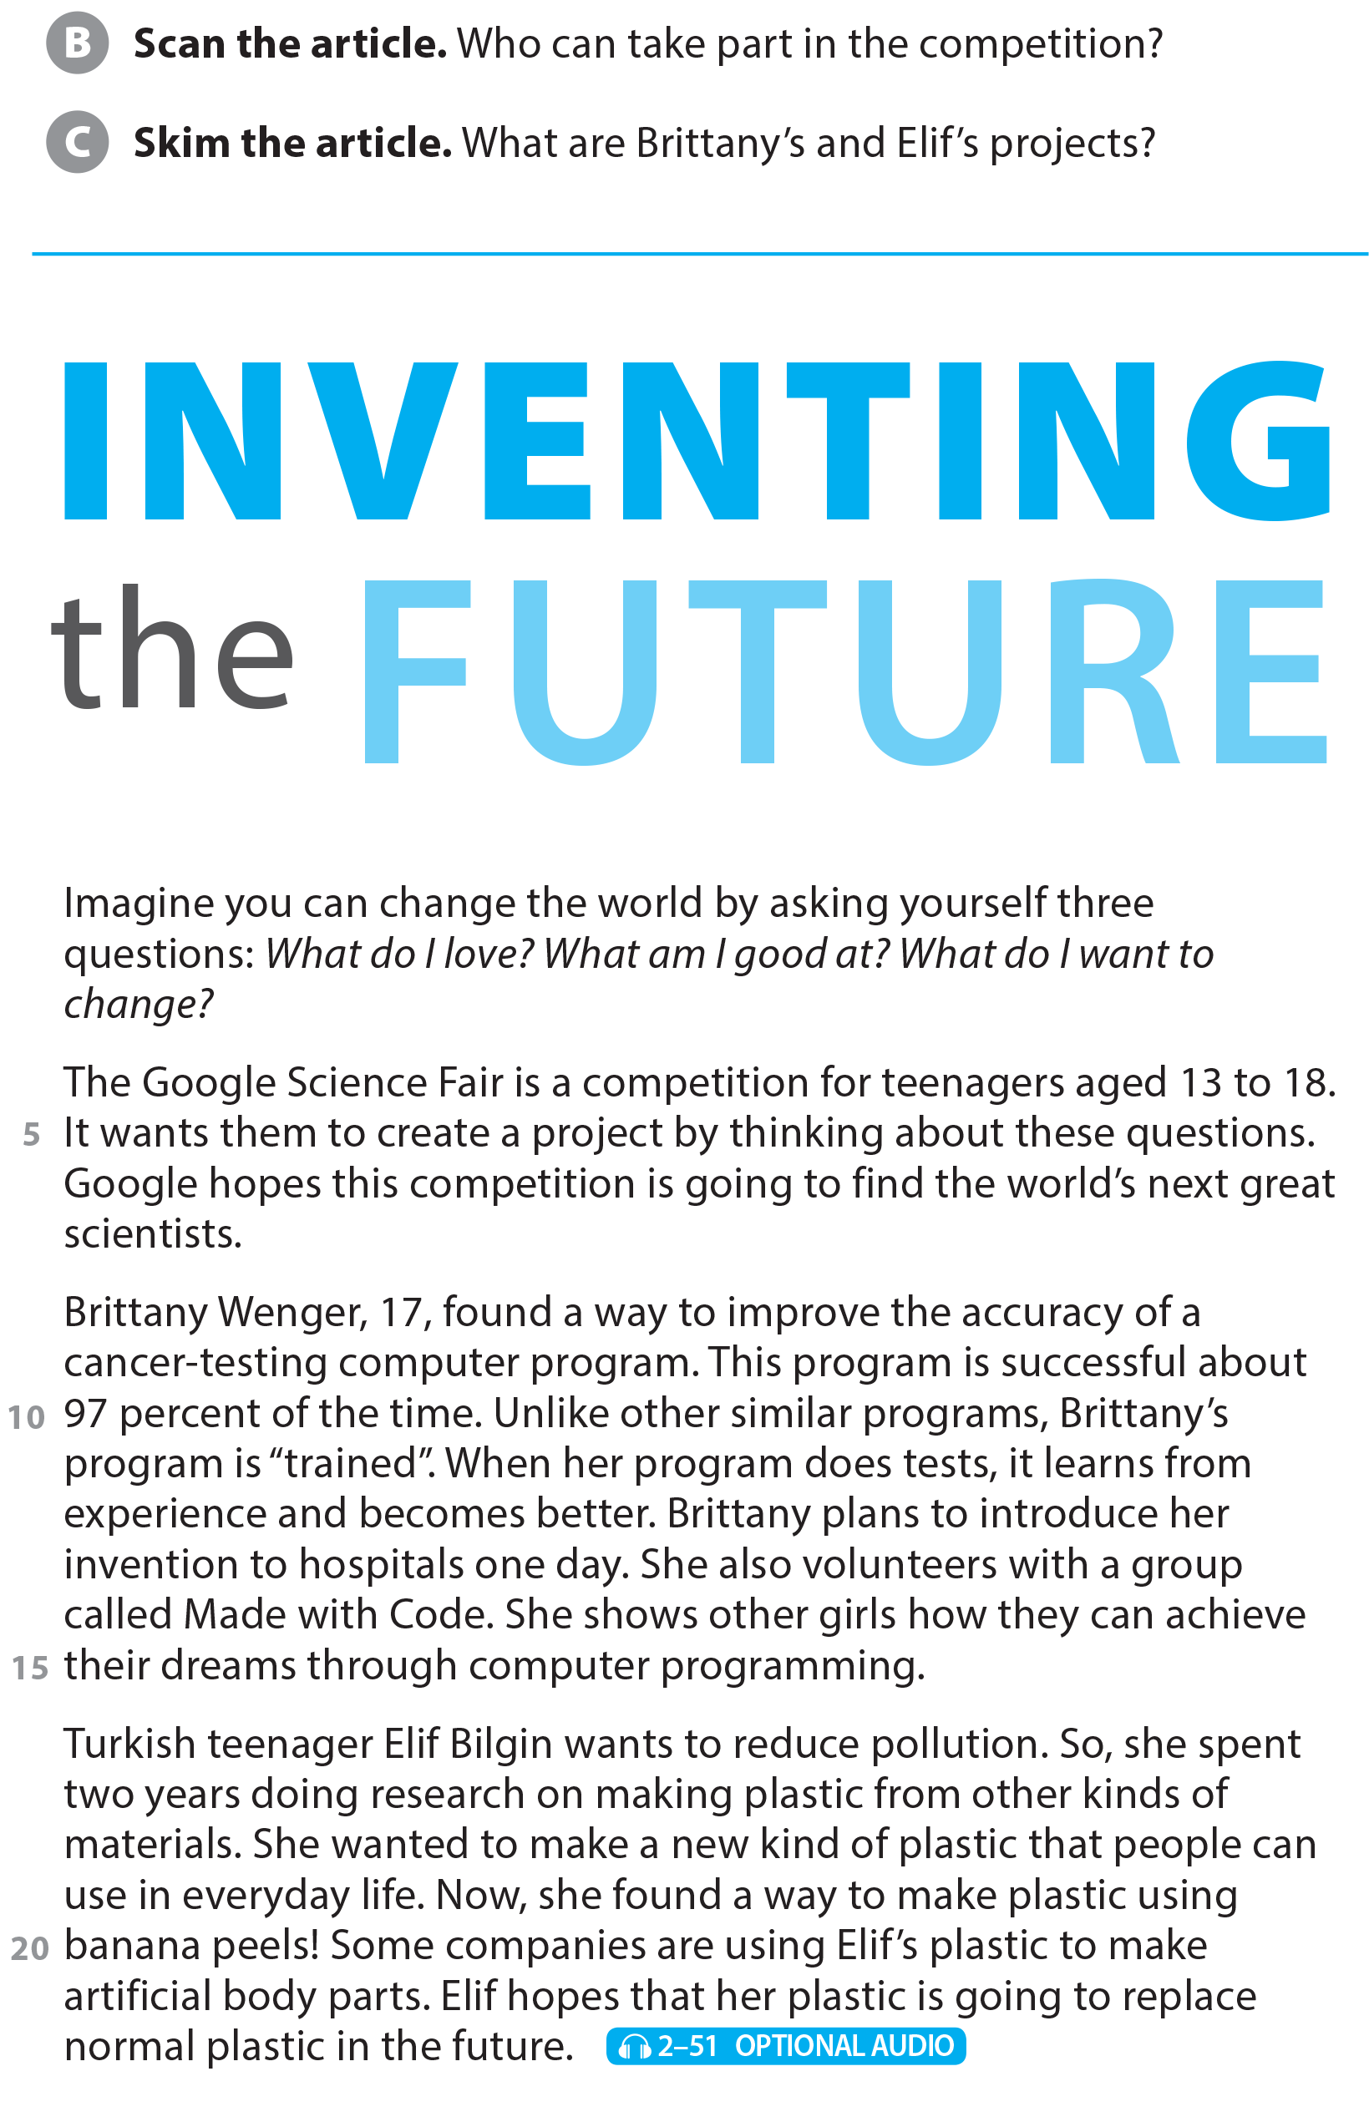
UNIT 12
WE’RE GOING TO VOLUNTEER!
READING
teenagers aged 13 to 18
Brittany: a cancer-testing program
Elif: a new kind of plastic made from banana peels

Slide 21
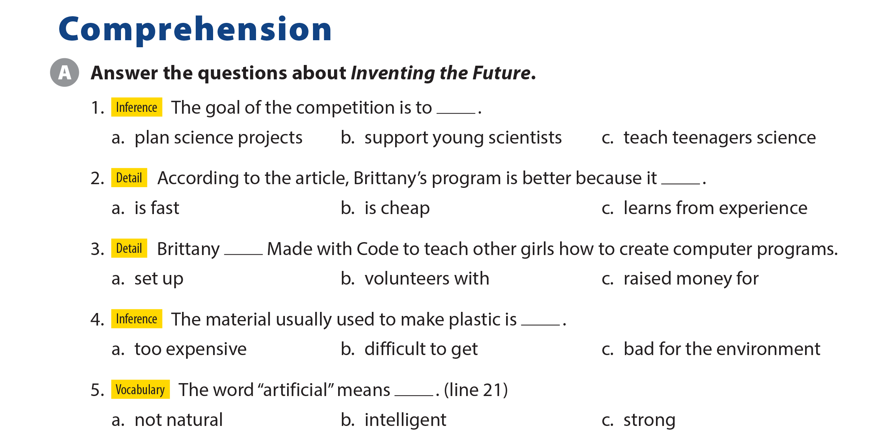
UNIT 12
WE’RE GOING TO VOLUNTEER!
COMPREHENSION

Slide 22
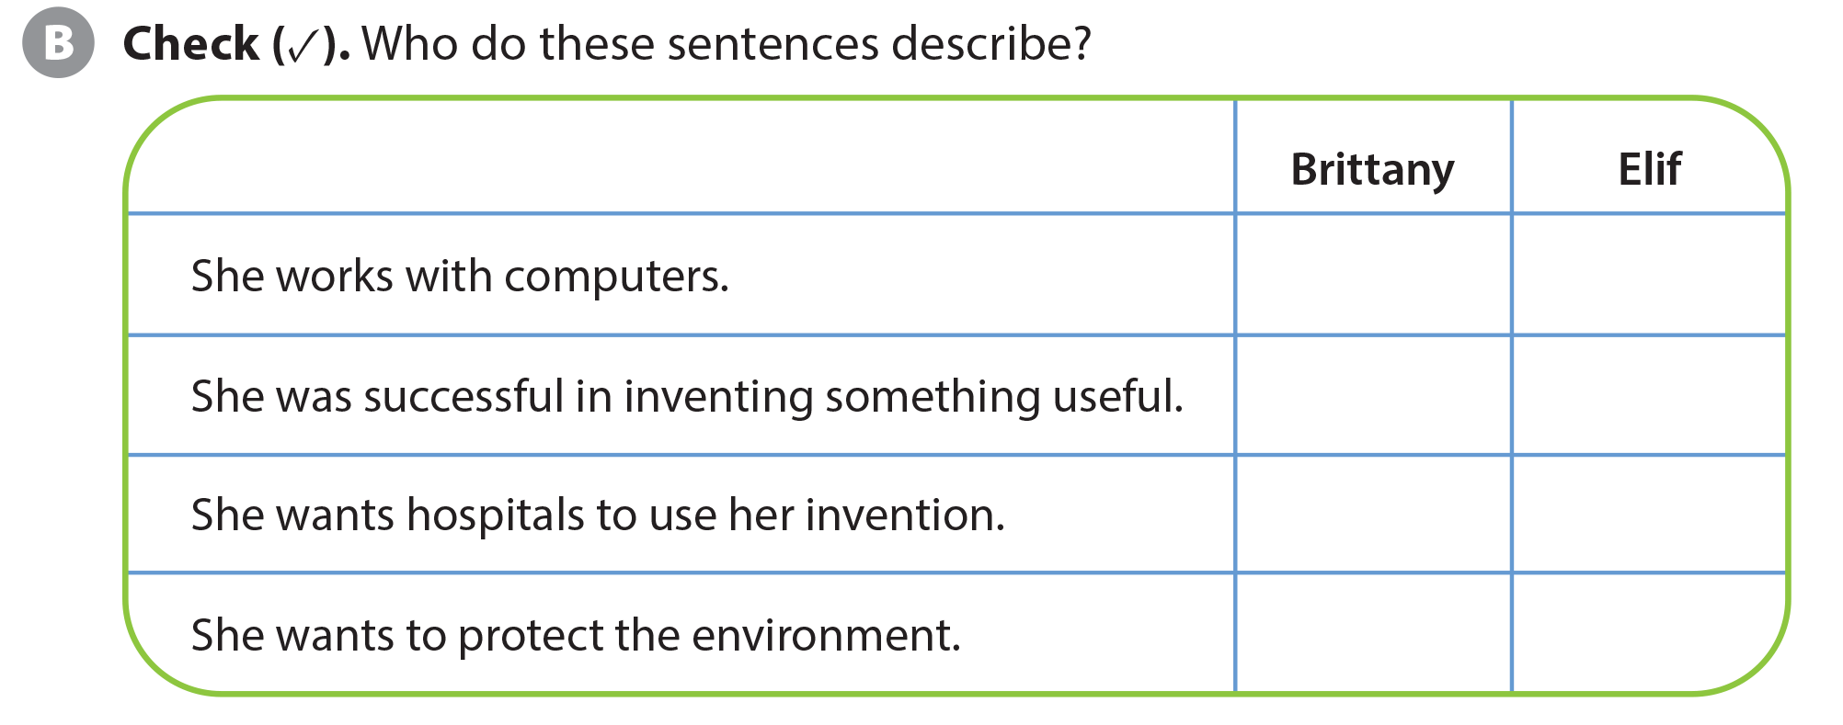
UNIT 12
WE’RE GOING TO VOLUNTEER!
COMPREHENSION
✓
✓
✓
✓
✓
✓

Slide 23
UNIT 12
WE’RE GOING TO VOLUNTEER!
PROJECT

Slide 24
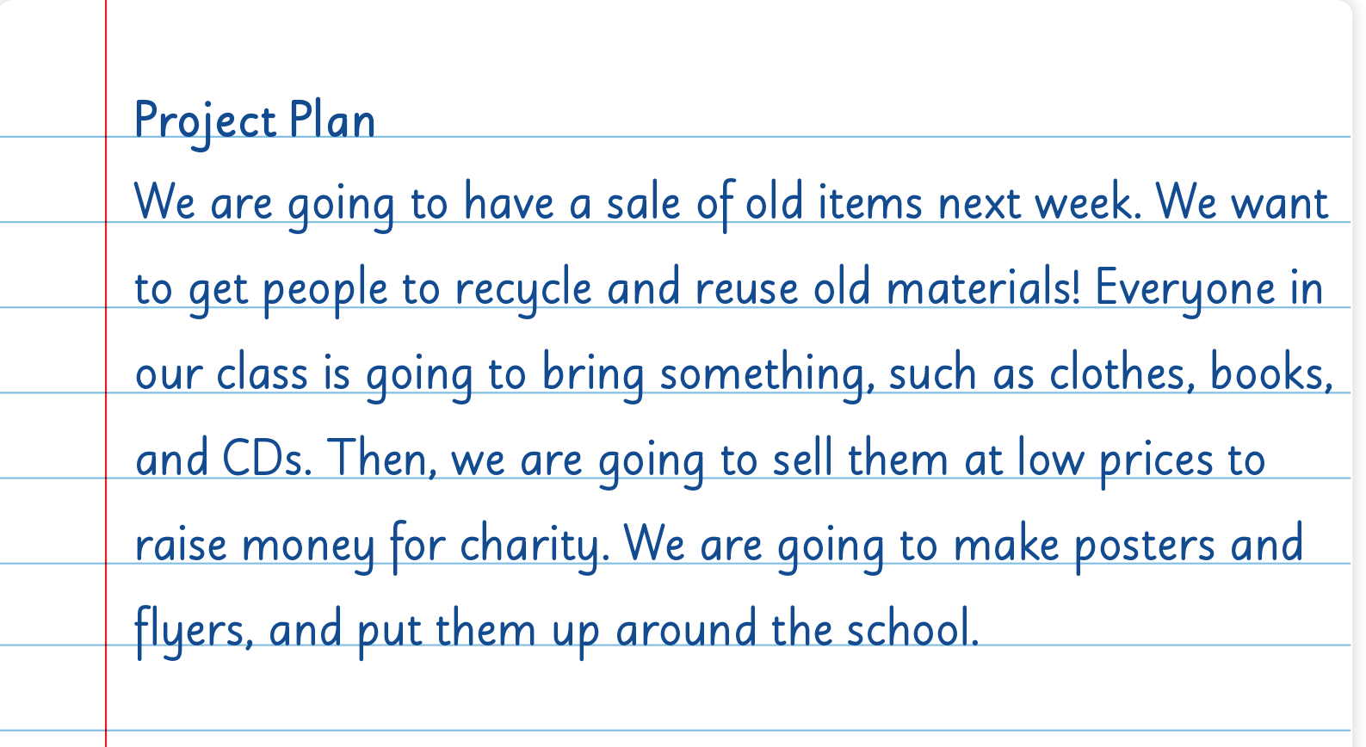
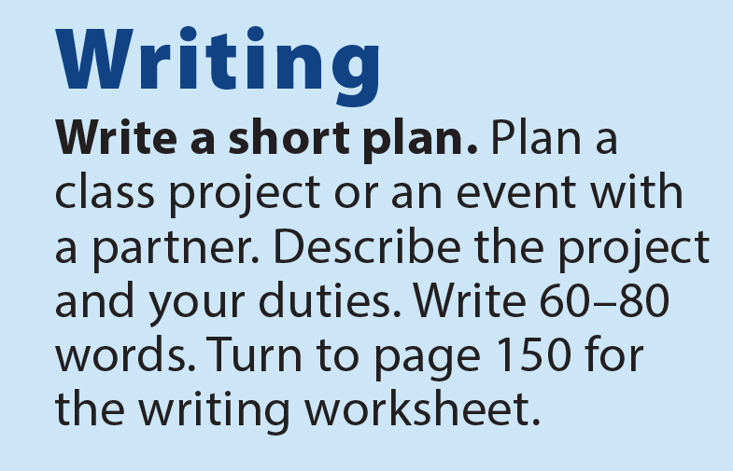
UNIT 12
WE’RE GOING TO VOLUNTEER!
WRITING

Slide 25
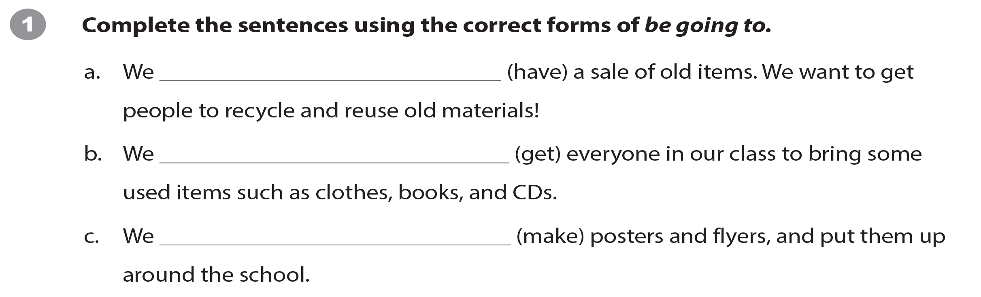
UNIT 12
WE’RE GOING TO VOLUNTEER!
WRITING WORKSHEET
are going to have
are going to get
are going to make

Slide 26
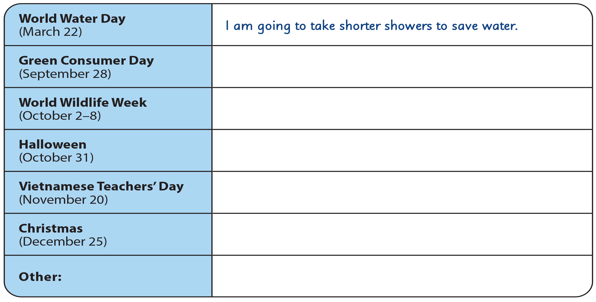
UNIT 12
WE’RE GOING TO VOLUNTEER!
WRITING WORKSHEET

Slide 27
UNIT 12
WE’RE GOING TO VOLUNTEER!
WRITING WORKSHEET
Happy Teachers’ Day
Halloween
Women’s Day
Christmas
Lunar New Year

Slide 28

UNIT 12
WE’RE GOING TO VOLUNTEER!
VIDEO

Slide 29


UNIT 12
WE’RE GOING TO VOLUNTEER!
VIDEO

Slide 30
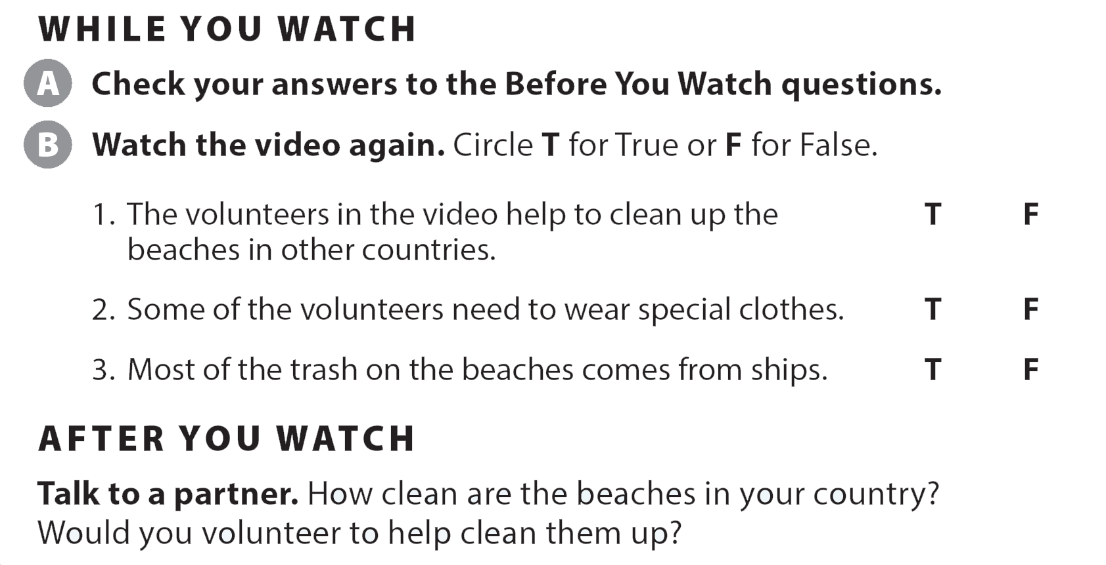
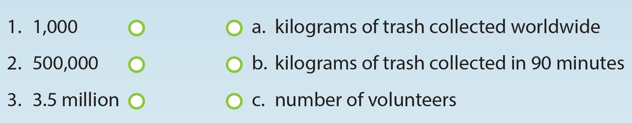
UNIT 12
WE’RE GOING TO VOLUNTEER!
VIDEO

Slide 31
UNIT 12
WE’RE GOING TO VOLUNTEER!
VIDEO

Slide 32



UNIT 12
WE’RE GOING TO VOLUNTEER!
VIDEO
National Geographic Learning, a Cengage Company © 2022 Cengage Learning, Inc. ALL RIGHTS RESERVED. This presentation tool is intended for teaching purposes only and may not be scanned, copied, duplicated, or posted to a publicly accessible platform in whole or in part.

Slide 33
UNIT 12
WE’RE GOING TO VOLUNTEER!
Thank you!

