Slide 1


Let’s talk
Notes:
T divides class into 2 groups and lets them look at pictures page 8 and discuss/ describe what they are looking at. Ss have 2 minutes to describe in group.
Each group has 1 minutes to describe.
T gives comments and give the lesson’s topic.

Slide 2
C
d
a
b
Notes:
Have students get into pairs and talk about what the students in the photo are wearing (e.g., a T-shirt)
Tell students that they will hear a conversation between Matt and Emma about Matt’s friends (read the names), and they should label the students in the photo.
Play the CD. Play again, if necessary.
Check answers.

Slide 3
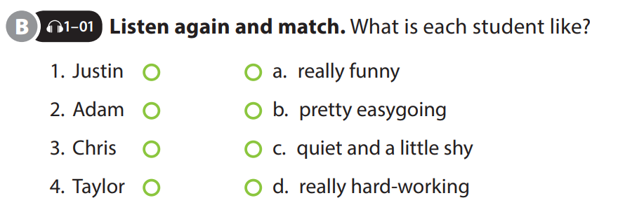
UNIT 1
WHICH ONE IS JUSTIN ?
PREVIEW
Notes:
Have ss read the adjectives and explain if necessary
Let ss hear the conversation again and they should match the students to their personalities.
Play the CD twice.
Check answers

Slide 4




GAME
M
U
S
I
C
A
L
C
H
A
I
N
Notes:
During 2 minutes, T plays a song, Ss pass 1 thing (like a ball) to a friend. When music stops, those who has the ball have to name one adjectives that can use to describe people.

Slide 5
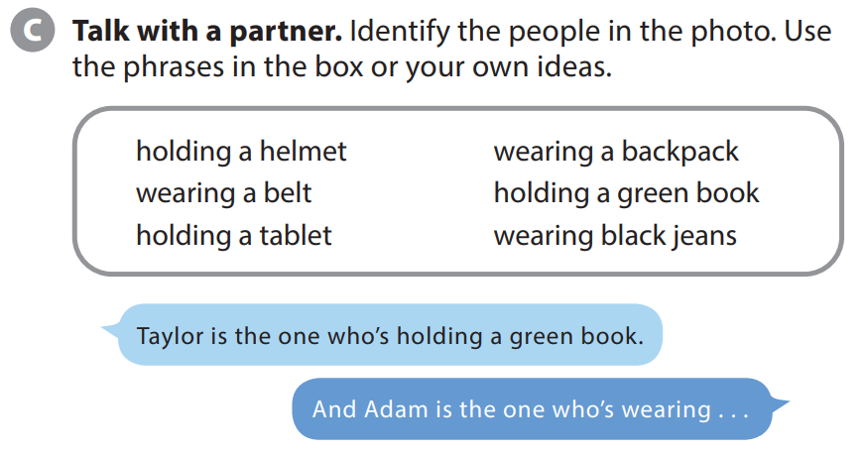
UNIT 1
WHICH ONE IS JUSTIN ?
PREVIEW
Notes:
Preview - Activity C
Game: Musical chain. During 2 minutes, T plays a song, Ss pass 1 thing (like a ball) to a friend. When music stops, those who has the ball have to name one adjectives that can use to describe people.
Tell students they are going to get into pairs and take turns describing the people in the photo. As students follow along, read the phrases in the box.
Model the conversation with a student. After modeling the conversation, point out that students should also use their
own ideas. All the answers are acceptable.
Have students get into pairs and do the task.

Slide 6
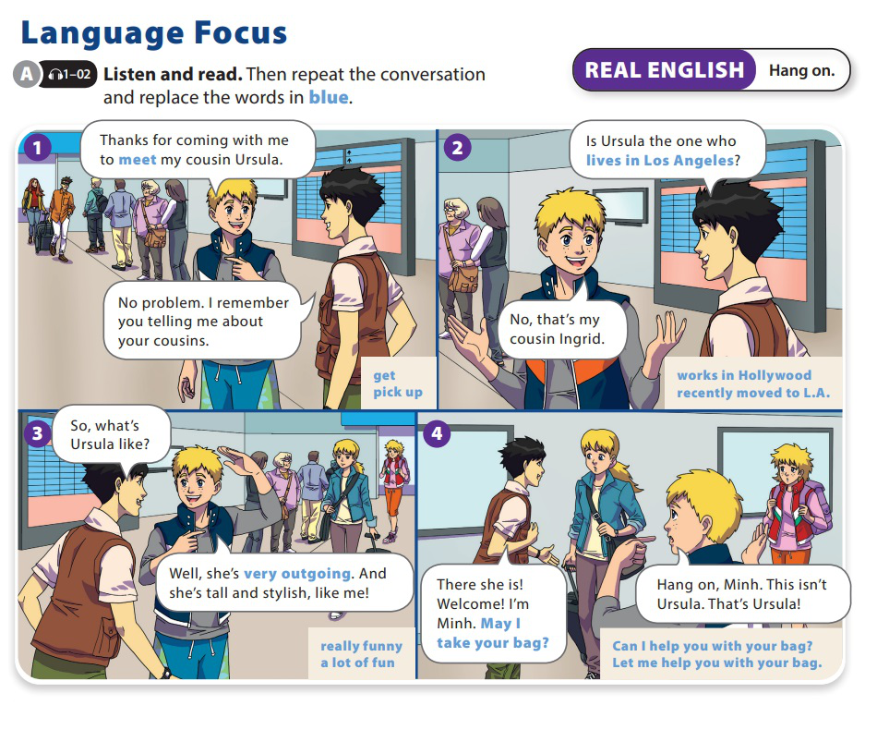
UNIT 1
WHICH ONE IS JUSTIN ?
LANGUAGE FOCUS

Slide 7
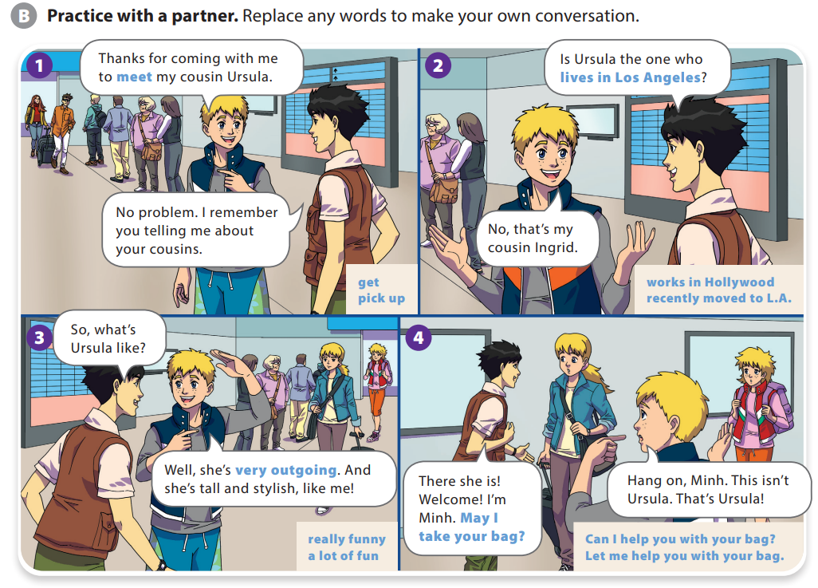
UNIT 1
WHICH ONE IS JUSTIN ?
LANGUAGE FOCUS

Slide 8

UNIT 1
WHICH ONE IS JUSTIN ?
REAL ENGLISH
A: It takes 30 minutes to go to there. Let’s leave at 6:30 so we get there at 7:00.
B: Hang on. We’re meeting everyone at 6:30. We should leave at 6:00.
Notes:
Hang on is used in informal English to interrupt someone, particularly when the other person has made a mistake or the speaker didn’t understand what was said. Point out that in the exchange, Stig interrupts Minh before he takes the woman’s bags.

Slide 9


THANK YOU!

