Slide 1
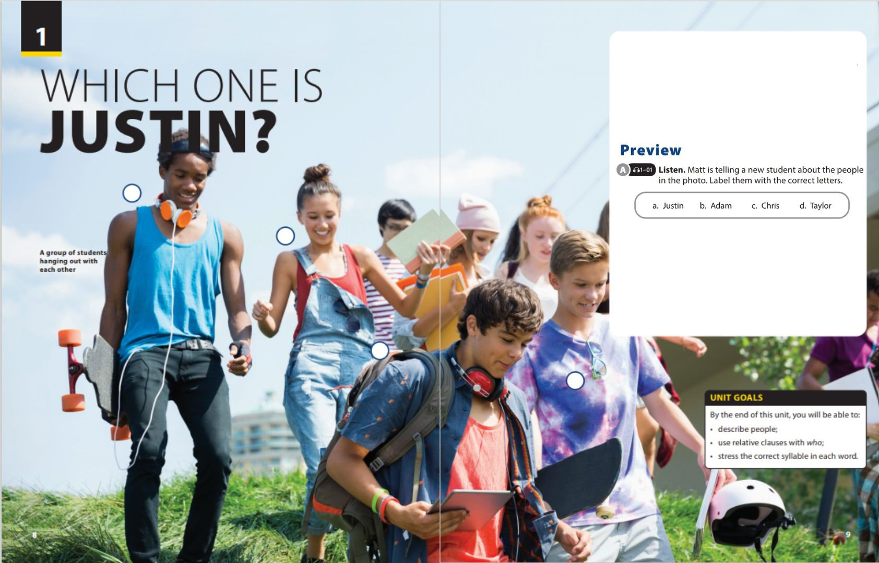

Language Focus (Finish) and
The Real World

Slide 2





Let's play
Who is
she/he
Start Now
Notes:
Divide class into 2 teams. One student from each team comes to the board and gives 3 clues so that other team can guess who the student is.
For example:
Clue 1: She is the one who often really loves Black Pink.
Clue 2: She is a tall girl with long black hair.
Clue 3: She is quite but hard-working.
(Other team guess: She is ….)

Slide 3
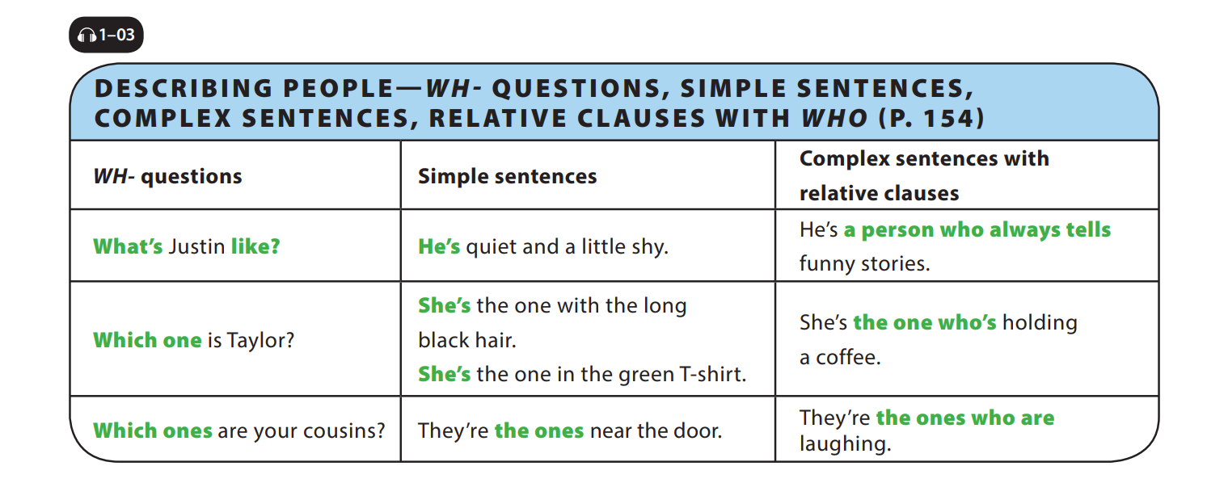
UNIT 1
WHICH ONE IS JUSTIN ?
LANGUAGE FOCUS
Notes:
Simple sentence includes one independent clause, while a complex sentence includes one independent clause and one dependent clause.
Relative clauses are dependent clauses that modify a word, phrase, or idea in the independent clause. Ask students to name some relative pronouns they may know. Explain when to use the relative pronoun who as the subject of the verb in the dependent clause).

Slide 4
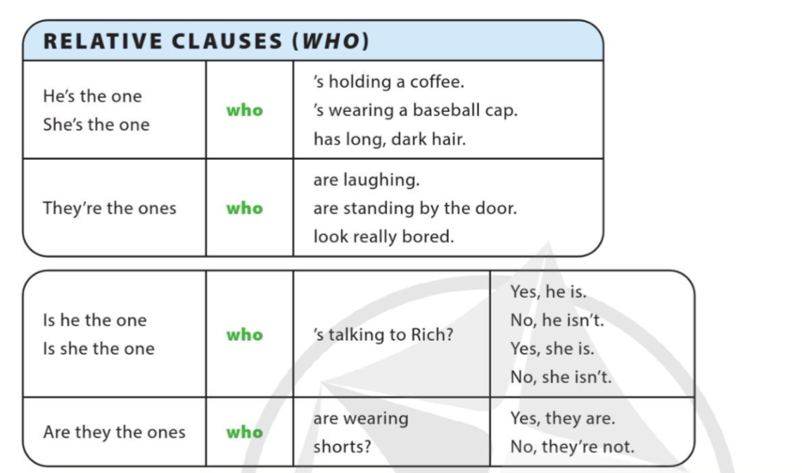
UNIT 1
WHICH ONE IS JUSTIN ?
LANGUAGE NOTE

Slide 5
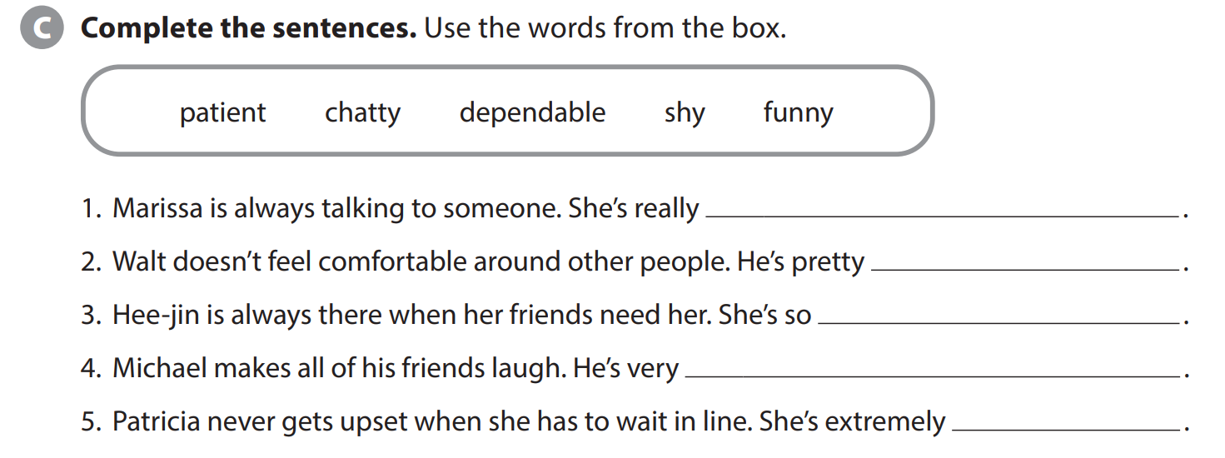
UNIT 1
WHICH ONE IS JUSTIN ?
LANGUAGE FOCUS
chatty
shy
dependable
funny
patient

Slide 6
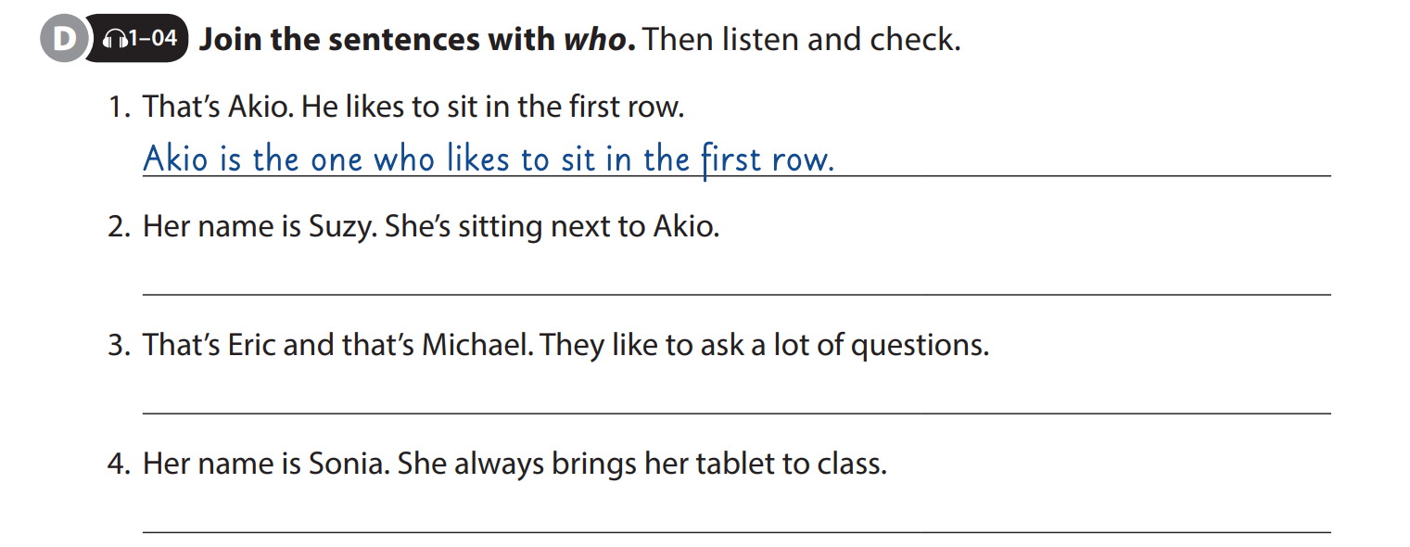
UNIT 1
WHICH ONE IS JUSTIN ?
LANGUAGE FOCUS
Suzy is the one who’s sitting next to Akio.
Eric and Michael are the ones who like to ask a lot of questions.
Sonia is the one who always brings her tablet to class.

Slide 7

UNIT 1
WHICH ONE IS JUSTIN ?
LANGUAGE FOCUS
Notes:
Lowe uses his cameras to take many kinds of photos and videos—adventure and extreme sports, travel, and lifestyle. He believes that photography allows him to see things that he might not have seen if he weren’t looking through a camera. He does not, however, think that the photos that he takes around the world are the end product of his life’s work. Instead, Lowe believes, the most valuable aspect is the people that he meets.

Slide 8
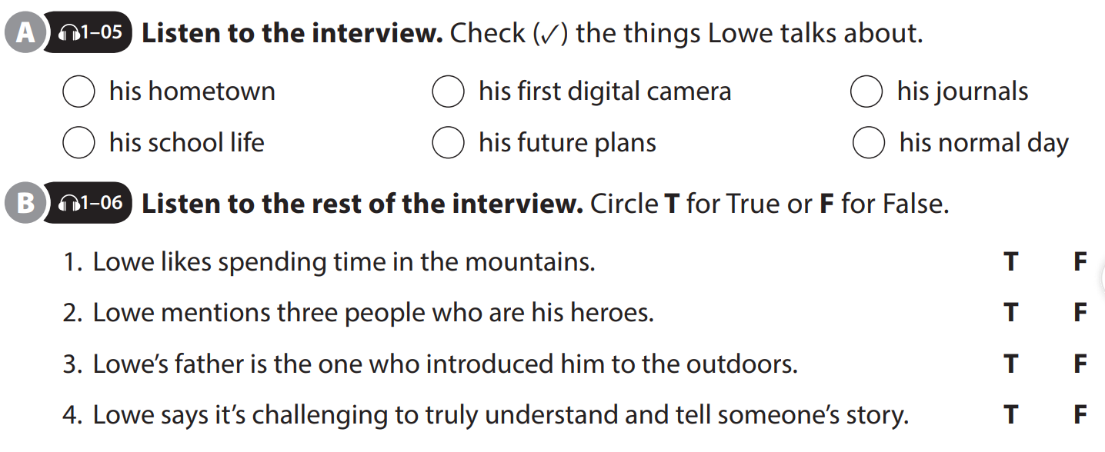
UNIT 1
WHICH ONE IS JUSTIN ?
THE REAL WORLD
✓
✓
✓
✓

Slide 9


THANK YOU!

