Slide 1
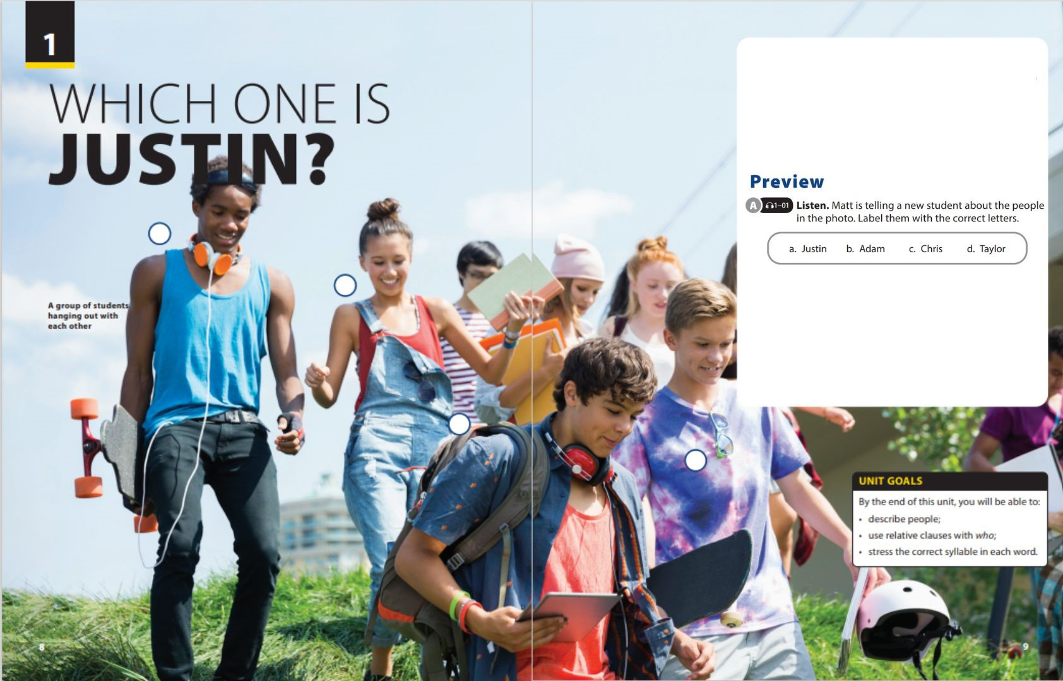

Pronunciation and Communication

Slide 2


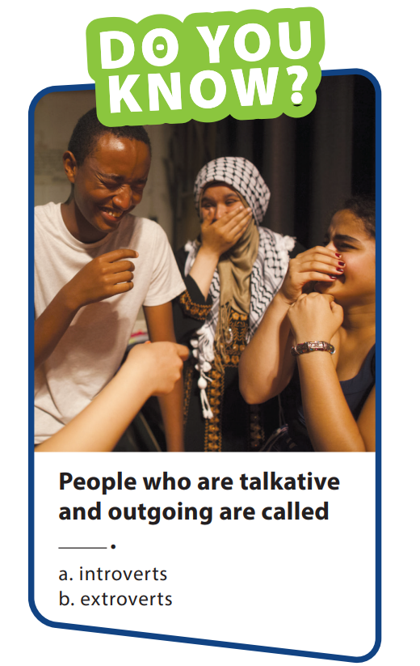





UNIT 1
WHICH ONE IS JUSTIN ?
PRONUNCIATION
I scream
You scream
We all scream
For ice - cream
Notes:
Do the tongue twister 3 times continuously at the fastest speed
- Do you know? Extroverts are people who are energized by being around other people. They enjoy talking and sometimes think out loud. In contrast, introverts enjoy being alone. They tend to be more reserved
and less outspoken in large groups.

Slide 3
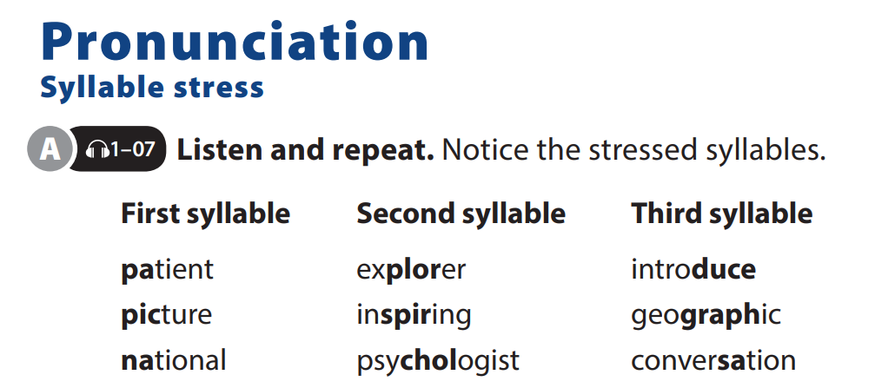
UNIT 1
WHICH ONE IS JUSTIN ?
PRONUNCIATION
Notes:
when we speak, we stress (say more strongly) different syllables (parts of the words that are complete sounds). Tell them this is important because some words have the same pronunciation, but the stress changes the meaning and form.

Slide 4
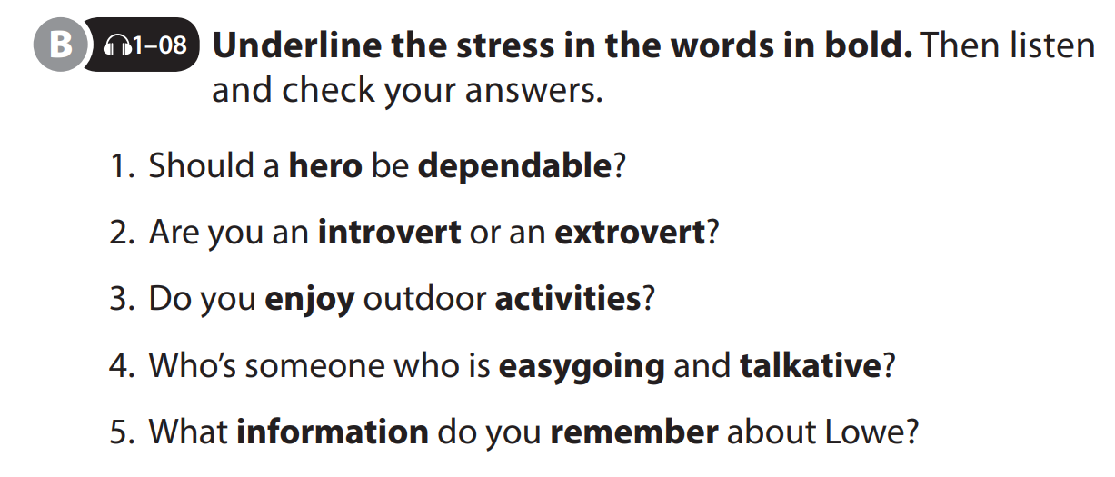
UNIT 1
WHICH ONE IS JUSTIN ?
PRONUNCIATION

Slide 5
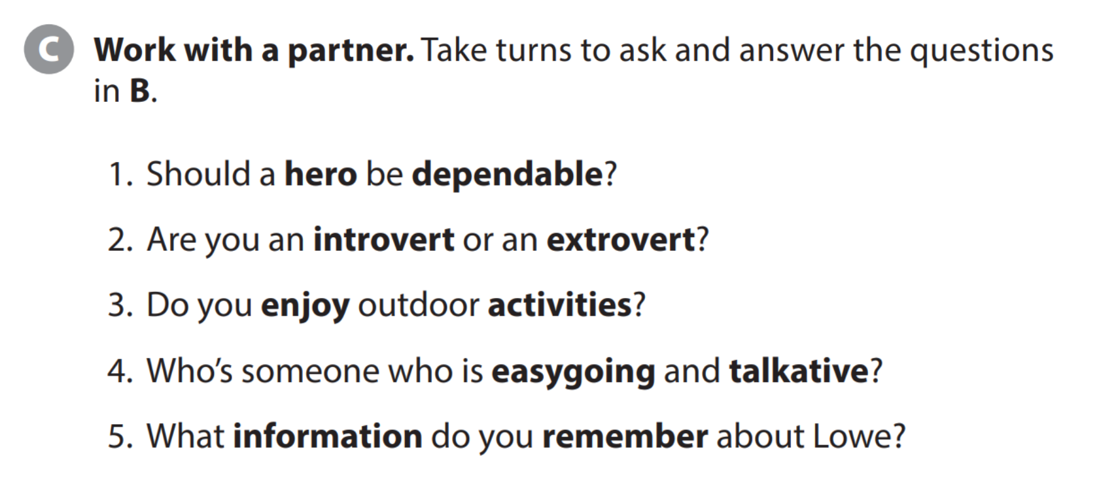
UNIT 1
WHICH ONE IS JUSTIN ?
PRONUNCIATION

Slide 6
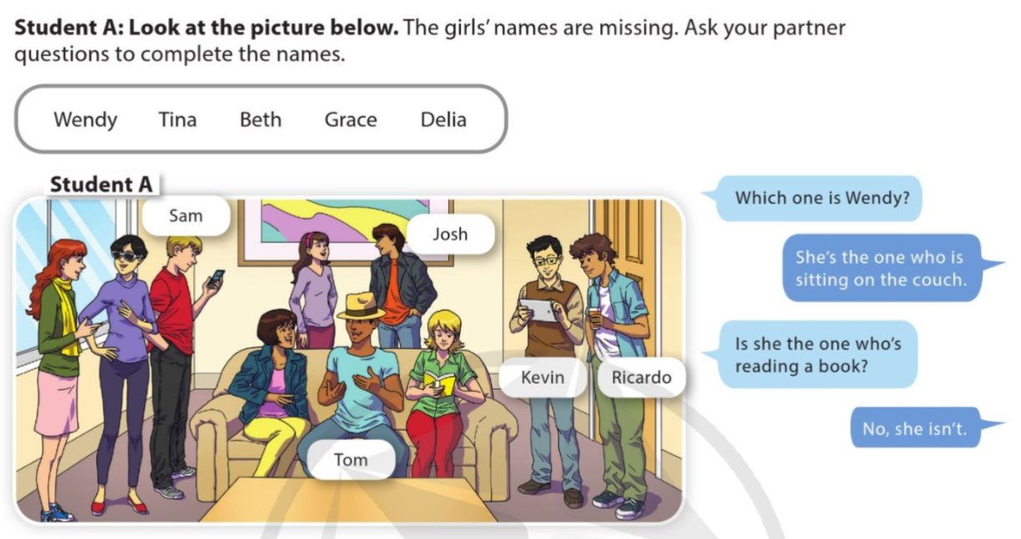
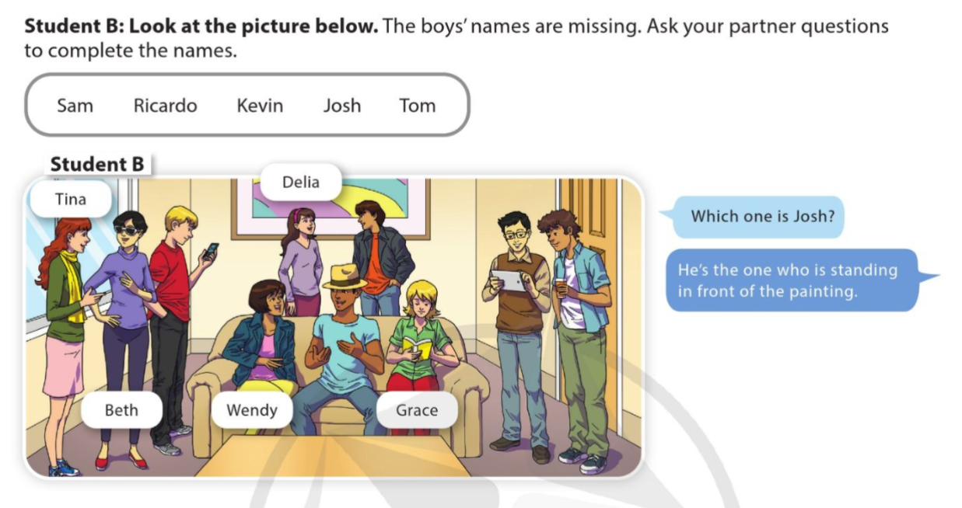
UNIT 1
WHICH ONE IS JUSTIN ?
PRONUNCIATION

Slide 7
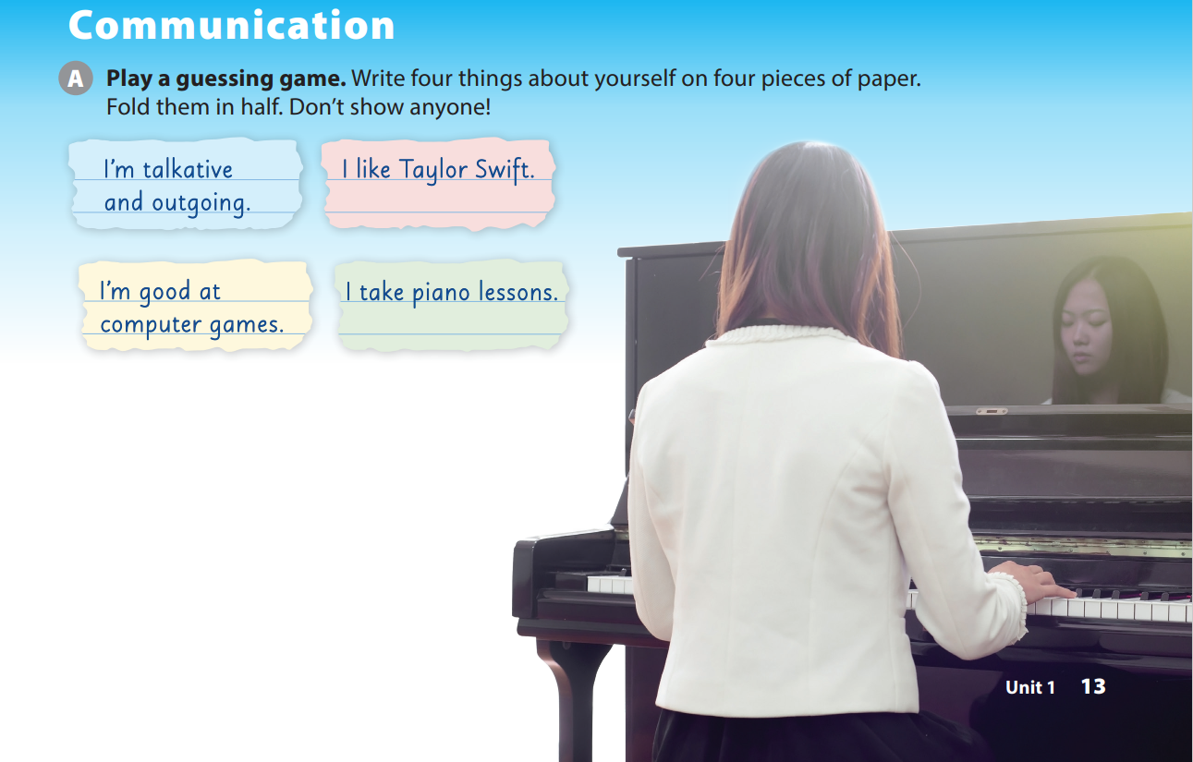
UNIT 1
WHICH ONE IS JUSTIN ?
COMMUNICATION
Notes:
Tell students that they should write four different things about themselves, each on a separate piece of paper, and then fold the papers in half without showing anyone.

Slide 8
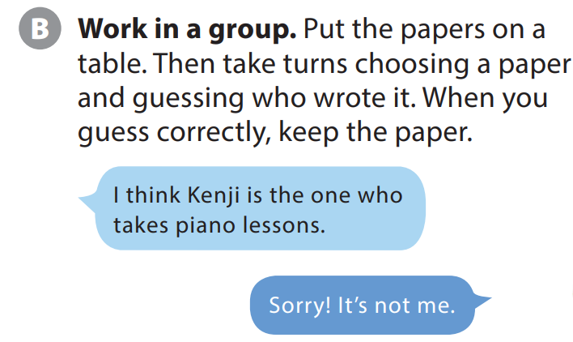


UNIT 1
WHICH ONE IS JUSTIN ?
COMMUNICATION
3
4
Notes:
Have students get into groups and put their pieces of paper in the center of the table. Explain to students that they should take turns selecting a paper and guessing who wrote it. Tell them that if they guess correctly, they can keep the paper, but when they guess incorrectly, they must return the paper to the center of the table. Tell students the game is over when there are no papers left in the middle of the table or when you call time.
As students follow along, model the
conversation with a student.

Slide 9


THANK YOU!

