Slide 1
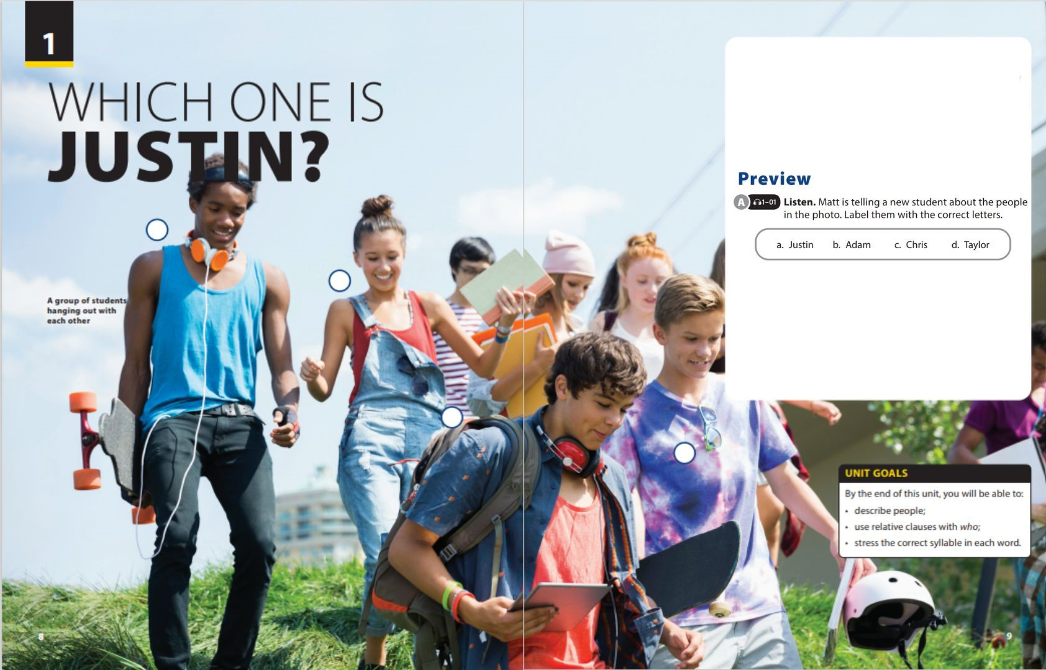

Reading
and Comprehension

Slide 2
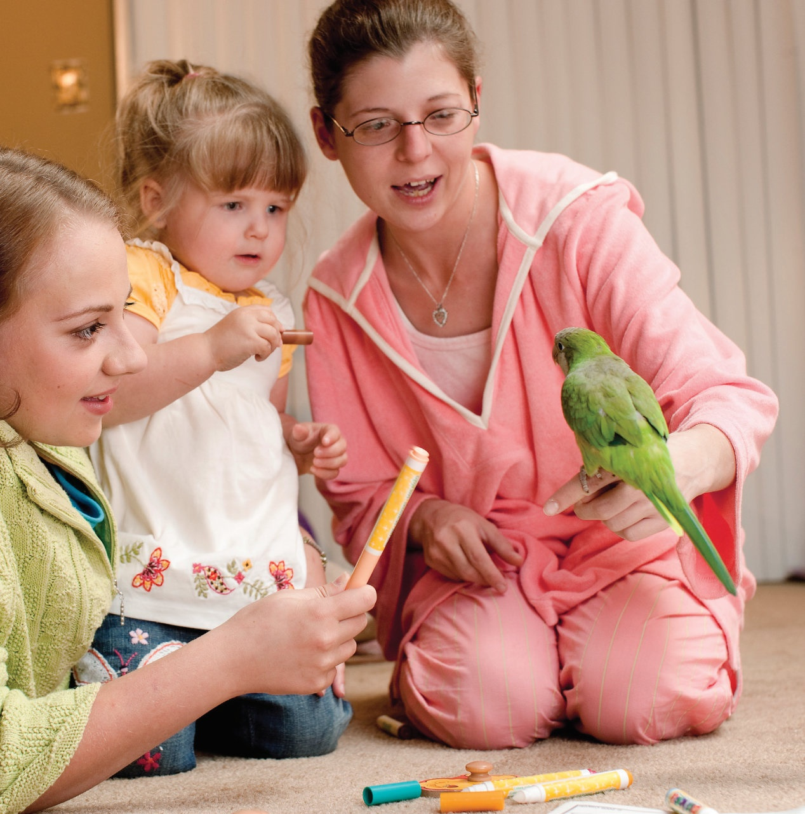
UNIT 1
WHICH ONE IS JUSTIN ?
READING
Describe the picture
Notes:
Tell students to describe specifically the big picture in the textbook.
Eg: There may be a mom and 2 children.
A baby sister may be scared of a parrot., etc.
Ask students some questions:
Have you ever thought that an animal can save people?
Have you ever been saved by an animal? Tell your friends.

Slide 3

Skimming is a reading technique in which you read more quickly than in regular reading. You do not read every word. You look for key words to get the main idea(s) in the text. You can also use skimming to decide if you want to read the text more closely. To skim:
1. Read the title.
2. Look at the pictures.
3. Read the headings and notice how
the text is arranged.
4. In longer texts, read the first and
last sentence of each paragraph.
5. Try to notice key words.
Exercise 1: Use skimming skill to find the main idea of this text.
Much of Canada's forestry production goes towards making pulp and paper. According to the Canadian Pulp and Paper Association, Canada supplies 34% of the world's wood pulp and 49% of its newsprint paper. If these paper products could be produced in some other way, Canadian forests could be preserved. Recently, a possible alternative way of producing paper has been suggested by agriculturalists and environmentalists: a plant called hemp.
Canadian forests are especially under threat.
Hemp is a kind of plant.
Canada is a major supplier of paper and pulp.
Canada produces a lot of hemp

Slide 4
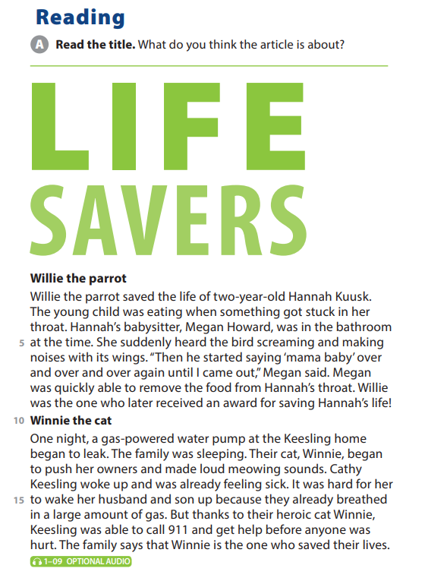
UNIT 1
WHICH ONE IS JUSTIN ?
READING

Slide 5
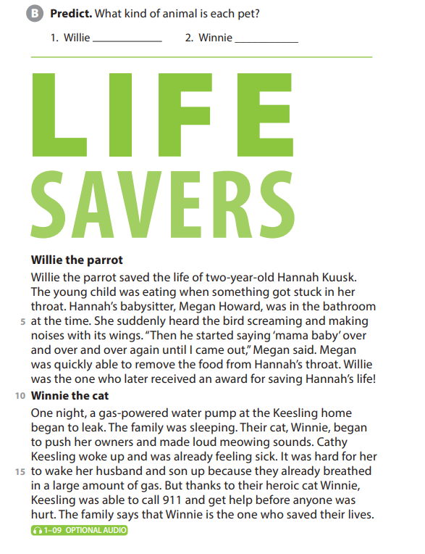
UNIT 1
WHICH ONE IS JUSTIN ?
READING
parrot
cat

Slide 6
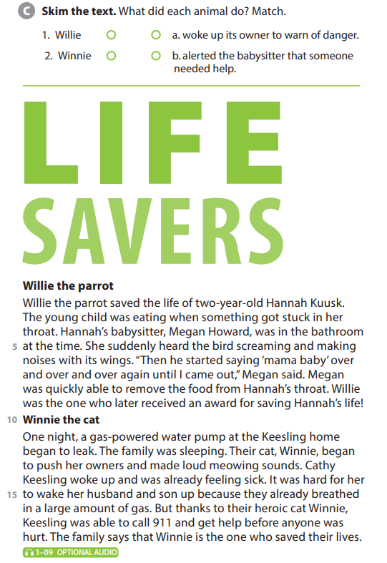
UNIT 1
WHICH ONE IS JUSTIN ?
READING

Slide 7
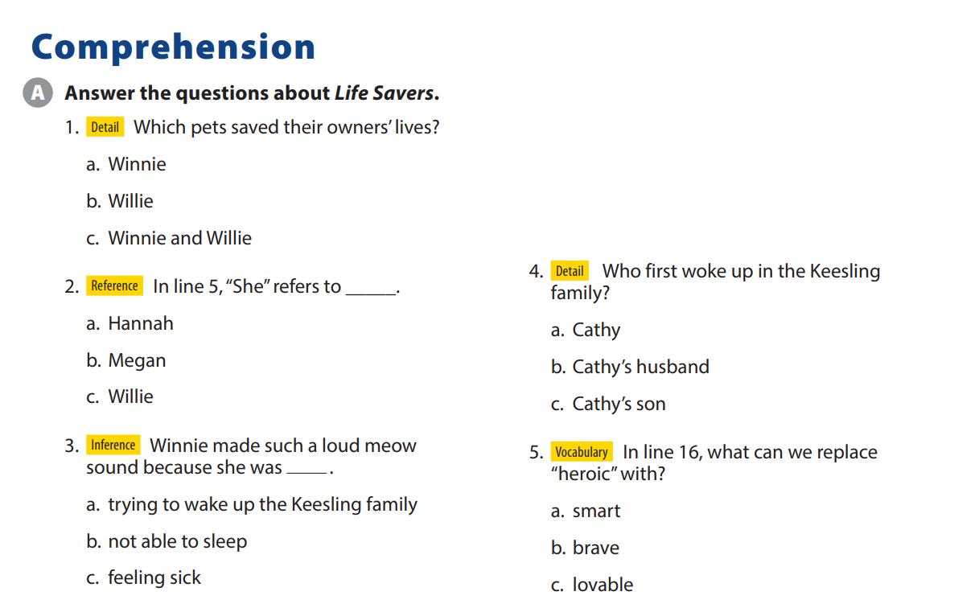
UNIT 1
WHICH ONE IS JUSTIN ?
COMPREHENSION

Slide 8
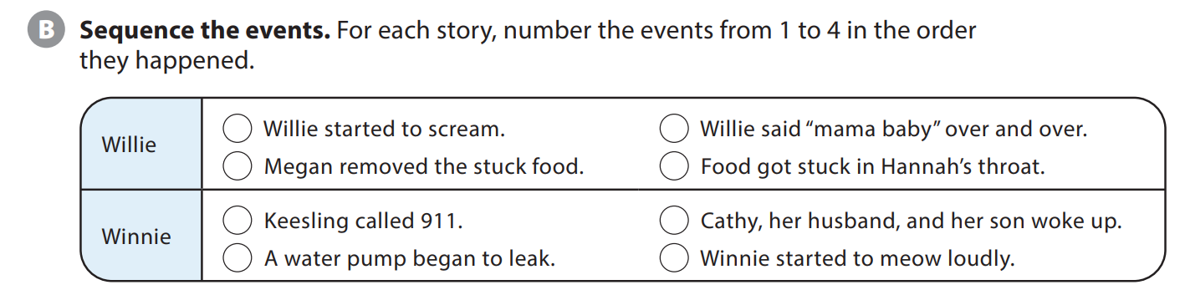
UNIT 1
WHICH ONE IS JUSTIN ?
COMPREHENSION
2
3
4
1
4
3
1
2

Slide 9


THANK YOU!

