Slide 1
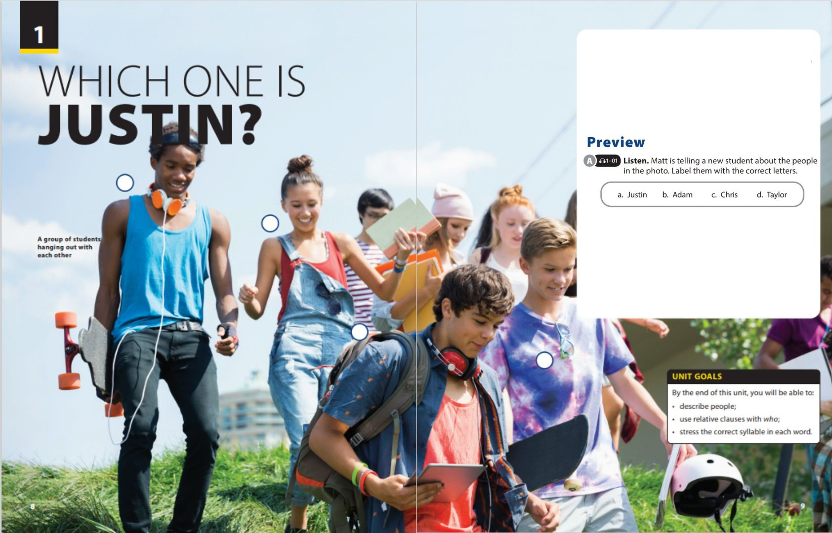

Writing
and
Writing Worksheet

Slide 2







Introduction
ALL ABOUT
Appearance
Characteristics
MOM
Passion
Favorite Food
Hobbies
…………….
Notes:
Free talk.
Let students talk about their mom ( her appearance, her characteristics, her passion…)

Slide 3






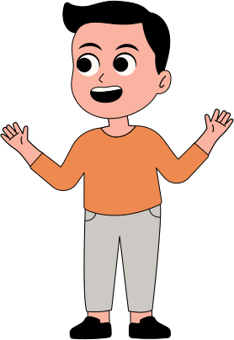




What paragraph is ?
Willie the parrot saved the life of two-year-old Hannah Kuusk. The young child was eating when something got stuck in her throat. Hannah’s babysitter, Megan Howard, was in the bathroom at the time. She suddenly heard the bird screaming and making noises with its wings. “Then he started saying ‘mama baby’ over and over and over again until I came out,” Megan said. Megan was quickly able to remove the food from Hannah’s throat. Willie was the
one who later received an award for saving Hannah’s life.
A paragraph is a unit of writing in a larger body of work. A paragraph express a particular topic of theme.
A paragraph consists of
1 topic sentence + supporting sentences +
1 concluding sentence

Slide 4
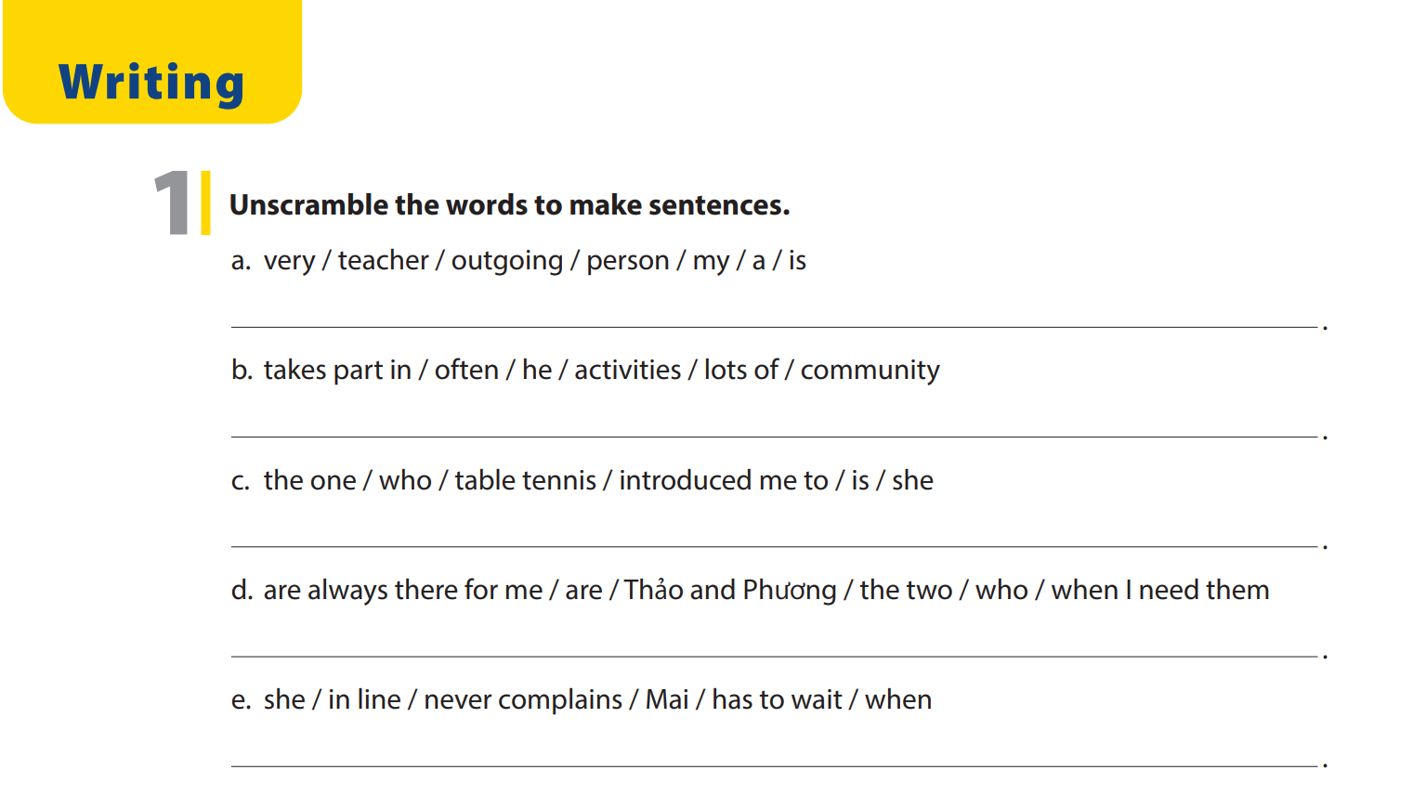
UNIT 1
WHICH ONE IS JUSTIN ?
WRITING
My teacher is a very outgoing person
He often takes part in lots of community activities
She is the one who introduced me to table tennis
Those two are Thảo and Phương who are always there for me when I need them
Mai never complains when she has to wait in line / When Mai has to wait in line,
she never complains / When she has to wait in line, Mai never complains

Slide 5
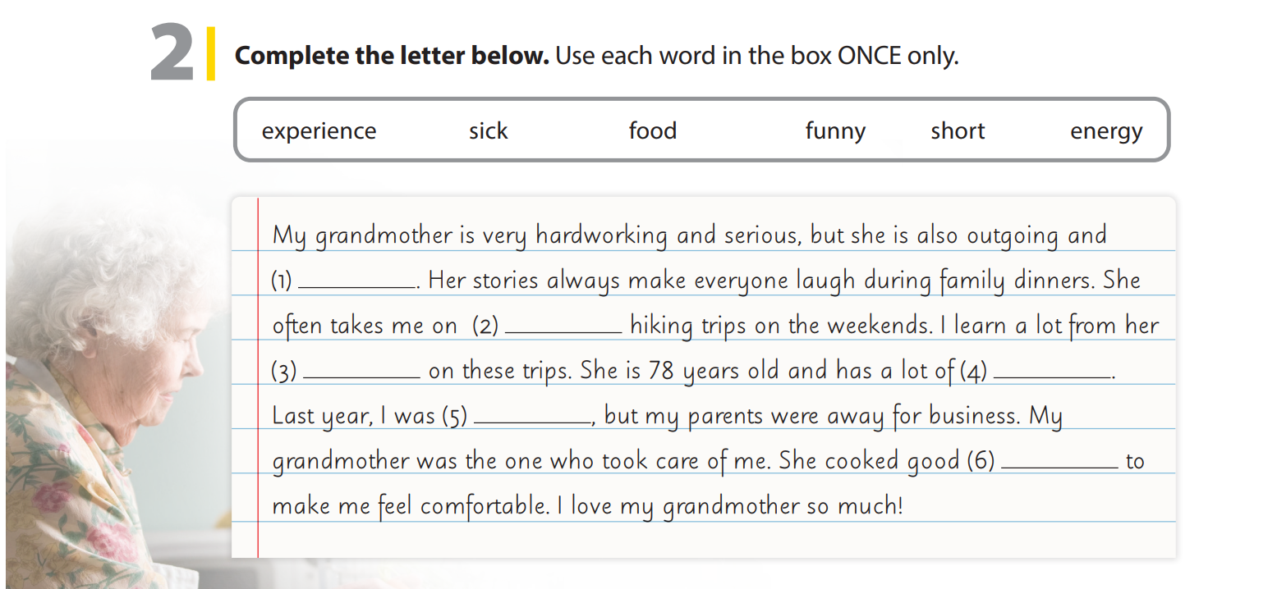
UNIT 1
WHICH ONE IS JUSTIN ?
WRITING
funny
short
experience
energy
sick
food

Slide 6




UNIT 1
WHICH ONE IS JUSTIN ?
WRITING
EXERCISE
Writing a blog about someone who inspires you
Notes:
Tell students they are going to write a
blog about someone who inspires them.
Give students about 10 minutes to finish
the blog, and set a minimum number of
words they must write (e.g. 80–100
words).
After students have finished writing their blogs, have them get into pairs and take turns reading them and check if they can.

Slide 7


THANK YOU!

