Slide 1


Video
and
Video
Worksheet
Notes:
Have students describe the picture on p.140, then connect all the information together to guess what the video is going to be about.
Call on some students to share their thoughts and let the class vote on the best prediction.

Slide 2

UNIT 1
WHICH ONE IS JUSTIN ?
VIDEO

Slide 3
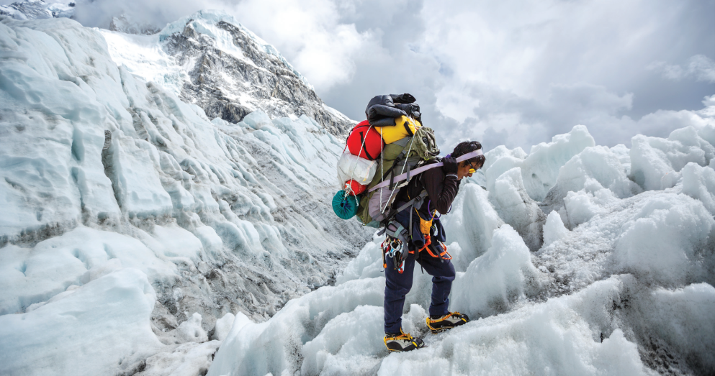
UNIT 1
WHICH ONE IS JUSTIN ?
VIDEO
Being a Sherpa is a risky, as many lose their lives or get hurt in accidents and avalanches. Although it may seem puzzling why they continue as mountain guides, some have no other job options due to a lack of education, and they want their children to have better opportunities in life. Others continue for financial reasons, as one expedition up the mountain can support a family for a year. In other cases, it’s personal. For instance, one Sherpa aims to achieve her father’s unfulfilled dream of reaching the summit.

Slide 4
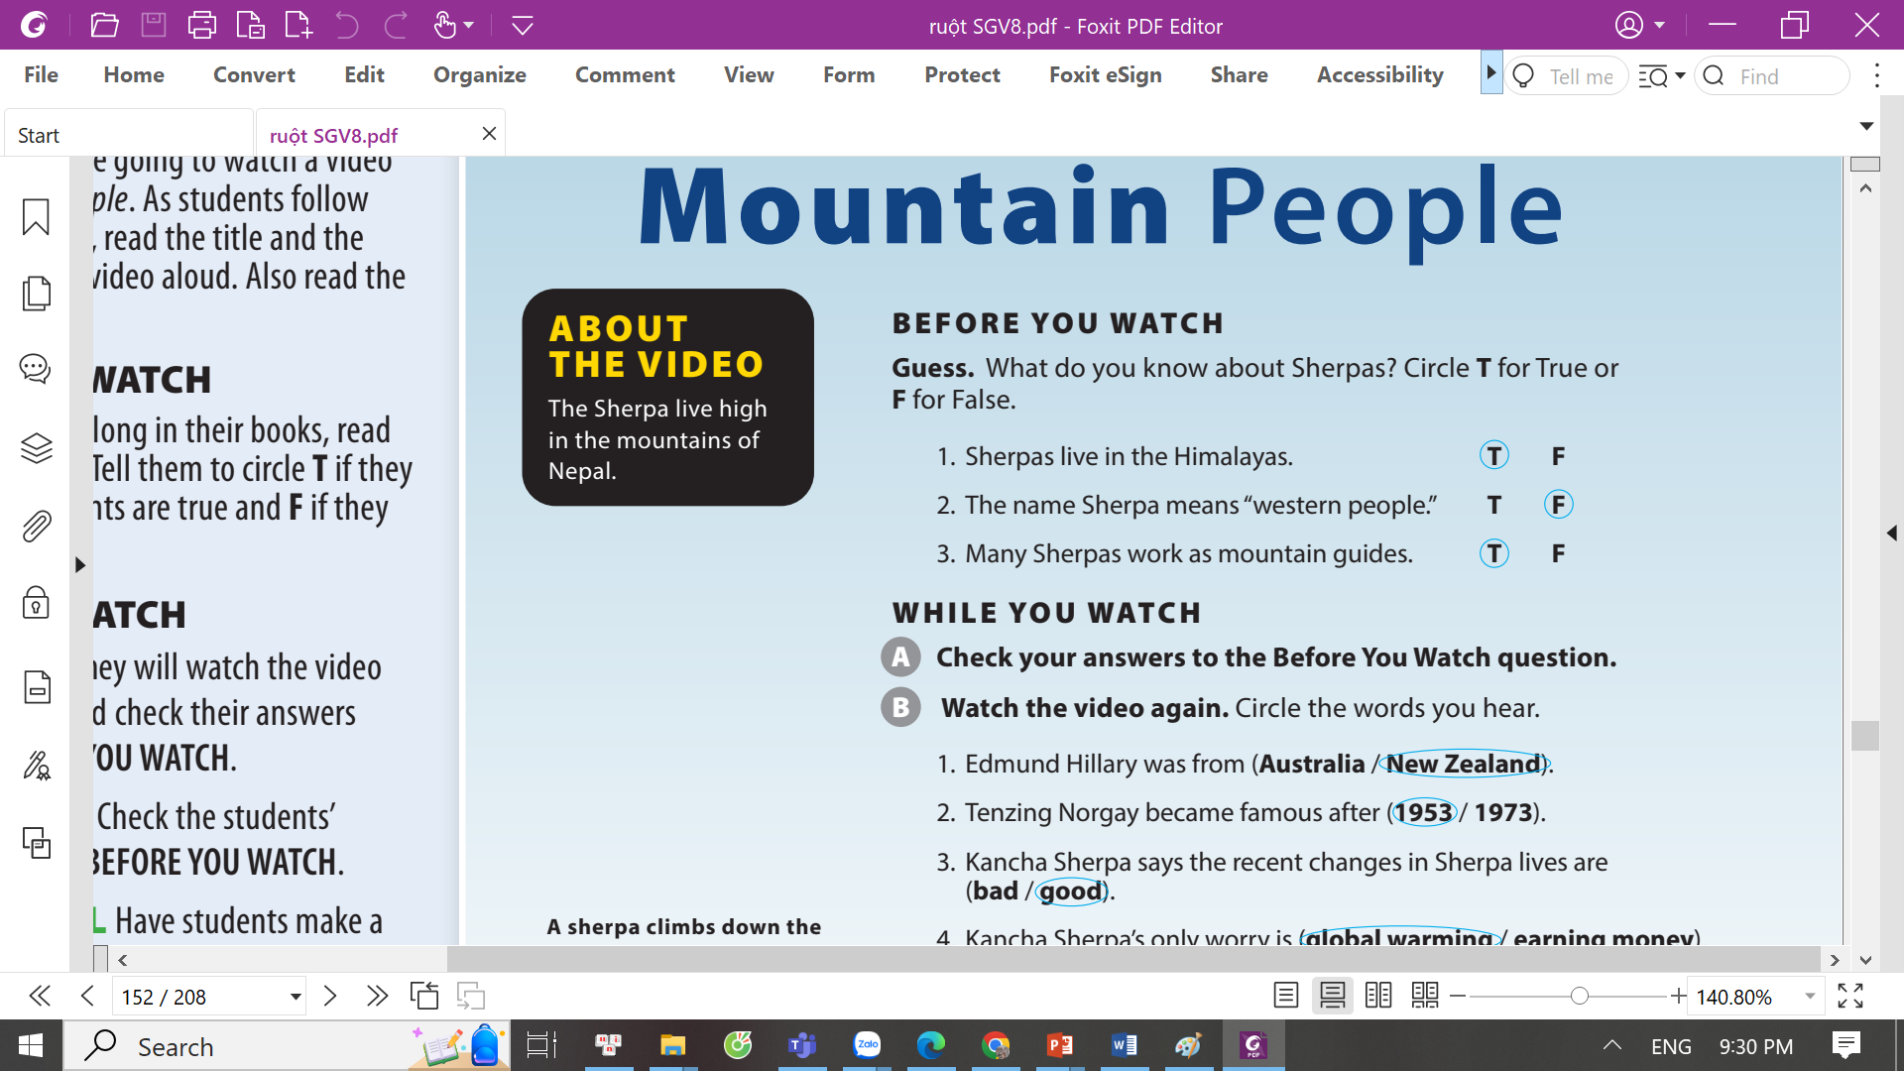

UNIT 1
WHICH ONE IS JUSTIN ?
VIDEO

Slide 5
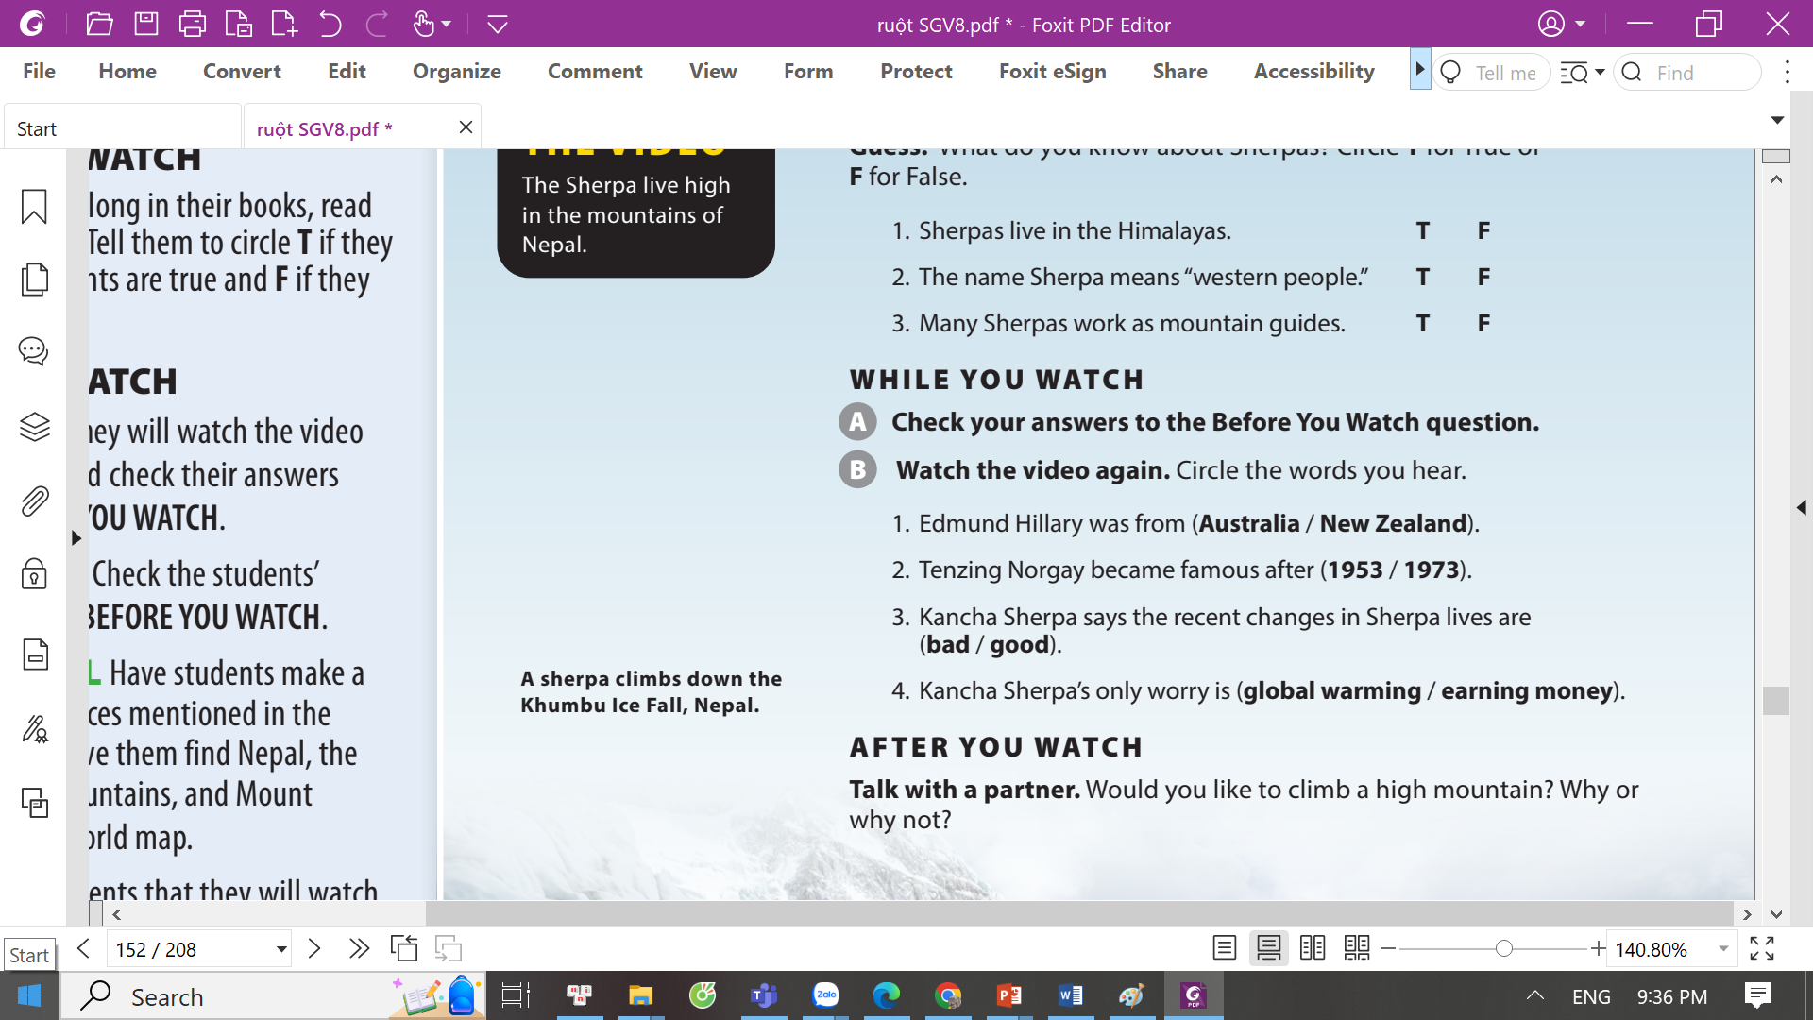
UNIT 1
WHICH ONE IS JUSTIN ?
VIDEO

Slide 6

UNIT 1
WHICH ONE IS JUSTIN ?
VIDEO
Notes:
Tell students they will get into pairs and talk about the video.
As students follow along in their books, read the two questions aloud.

Slide 7


THANK YOU!

