Slide 1
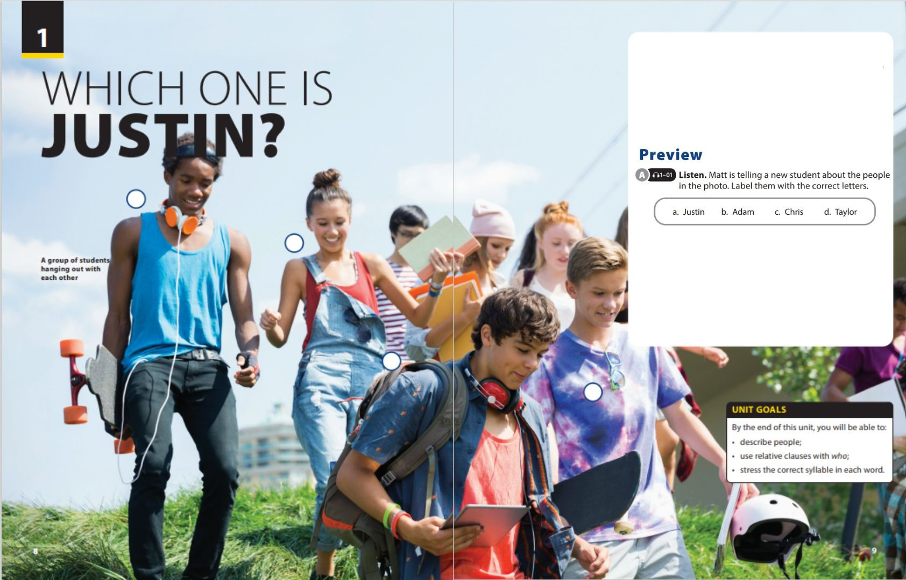

End of Unit Project

Slide 2

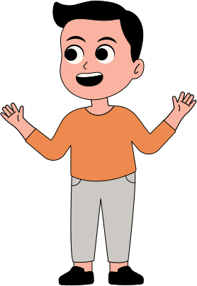
UNIT 1
WHICH ONE IS JUSTIN ?
END OF UNIT
UNIT 2
I'D LIKE TO BE A PILOT
INSTRUCT A SURVEY
What is the first question you often ask when meeting a new friend ?
Notes:
Teacher asks students an interesting question: “What is the first question you often ask when meeting a new friend?”
T should call students as fast as possible to wake them up

Slide 3

UNIT 1
WHICH ONE IS JUSTIN ?
END OF UNIT
UNIT 2
I'D LIKE TO BE A PILOT
INSTRUCT A SURVEY
What can you do to meet new classmates or make new friends?
Notes:
Tell students that the ability to
meet new people is an important skill that we all need.
Have a few students share their ideas What can you do to meet new classmates or make new friends?
Tell students that they should interview five people and ask them to share their ideas about how to meet new people. Explain that during the interviews, it is important to ask follow-up questions to get more details. Suggest they interview people who are not in the class

Slide 4


UNIT 1
WHICH ONE IS JUSTIN ?
END OF UNIT
UNIT 2
I'D LIKE TO BE A PILOT
INSTRUCT A SURVEY
SAMPLE SURVEY
NAME
WAYS TO MEET PEOPLE
HOW IT WORKS
Notes:
Let students create their own survey in a pair.
Explain to students that they may need to
group the ten responses so they can see how many different ideas they have
Set a time limit for students to complete their survey. If the project is assigned as homework, set a date for when they should bring their completed chart to class.
Check their surveys and give comments

Slide 5


THANK YOU!

