Slide 1

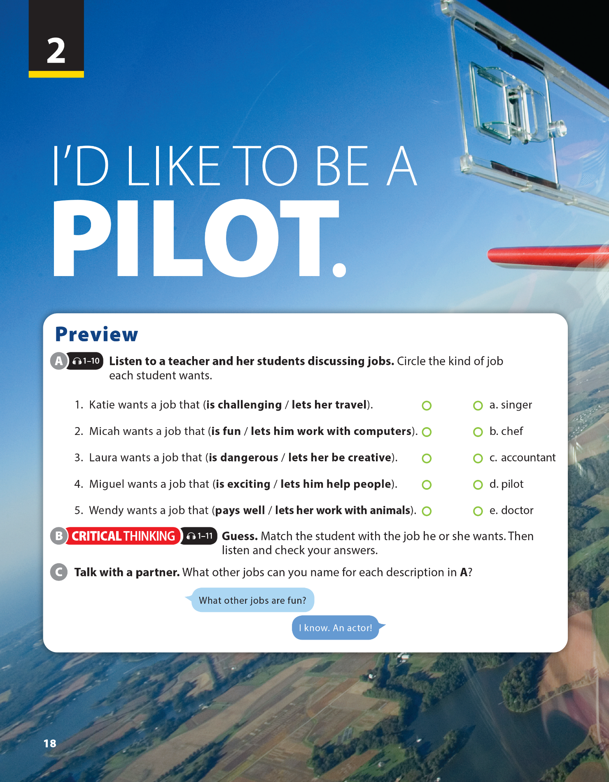
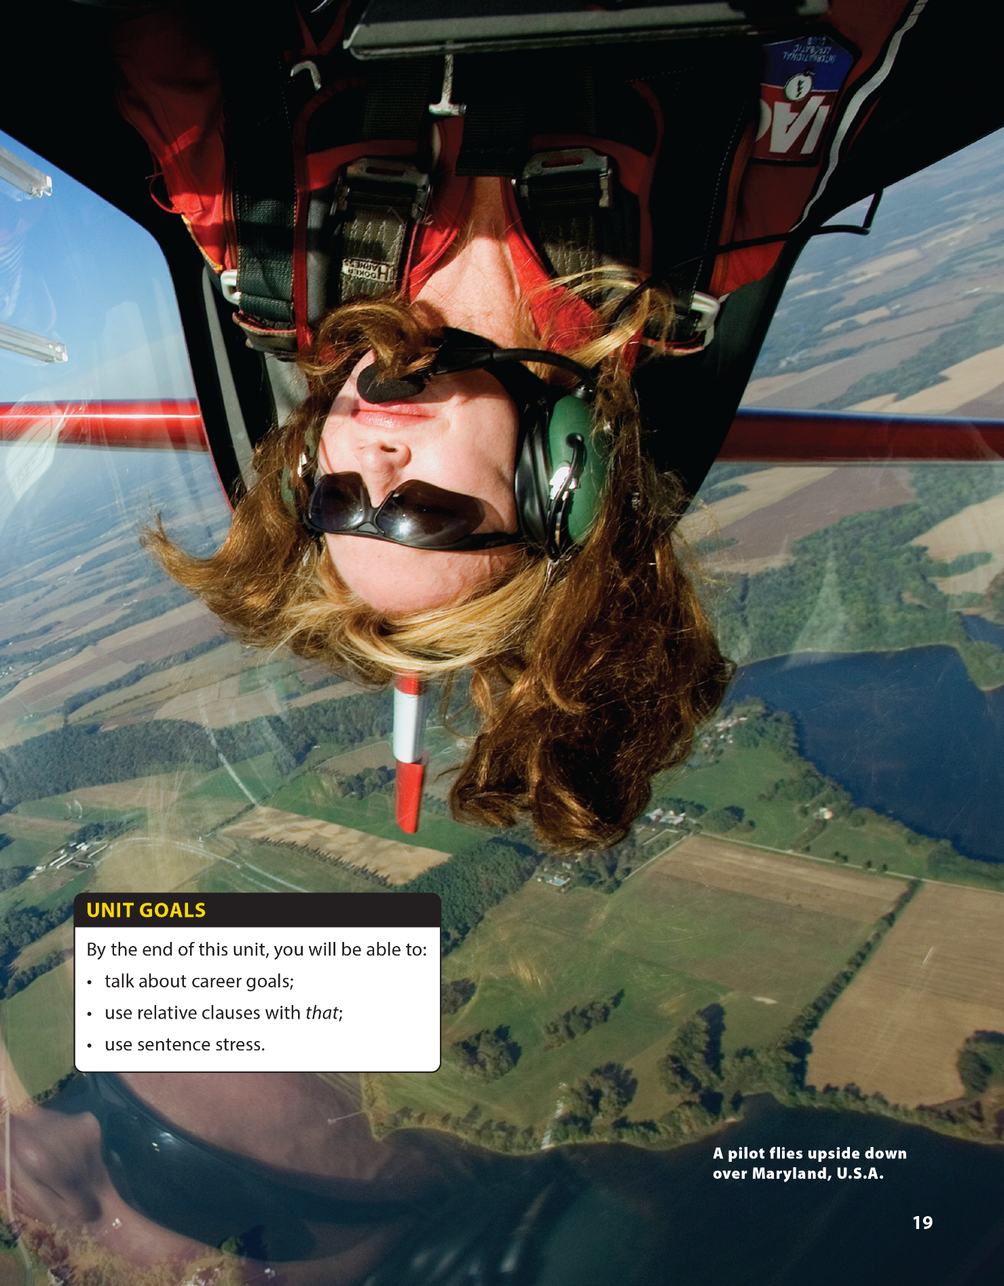

National Geographic Learning, a Cengage Company © 2022 Cengage Learning, Inc. ALL RIGHTS RESERVED. This presentation tool is intended for teaching purposes only and may not be scanned, copied, duplicated, or posted to a publicly accessible platform in whole or in part.

Slide 2





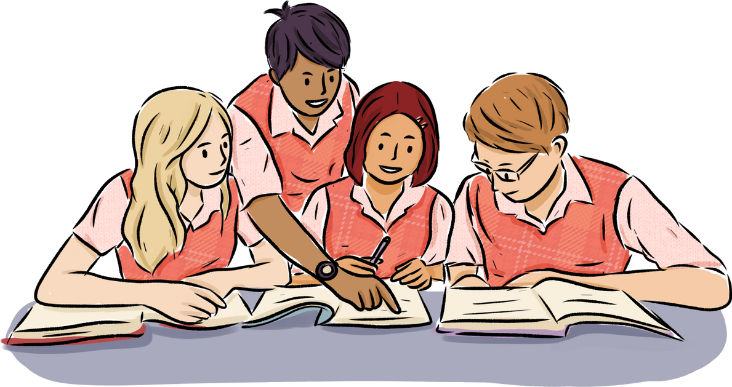
UNIT 2
I'D LIKE TO BE A PILOT.
PREVIEW
WARM UP
Team 1
Team 2
Notes:
Divide class into 2 teams. Each team gives one job, turn by turn (during 2 mins). The team that finishes first will be a loser.
Have students read the unit title themselves as you read it aloud. Explain that in this unit they will learn to talk about jobs and the kinds of work people do.

Slide 3
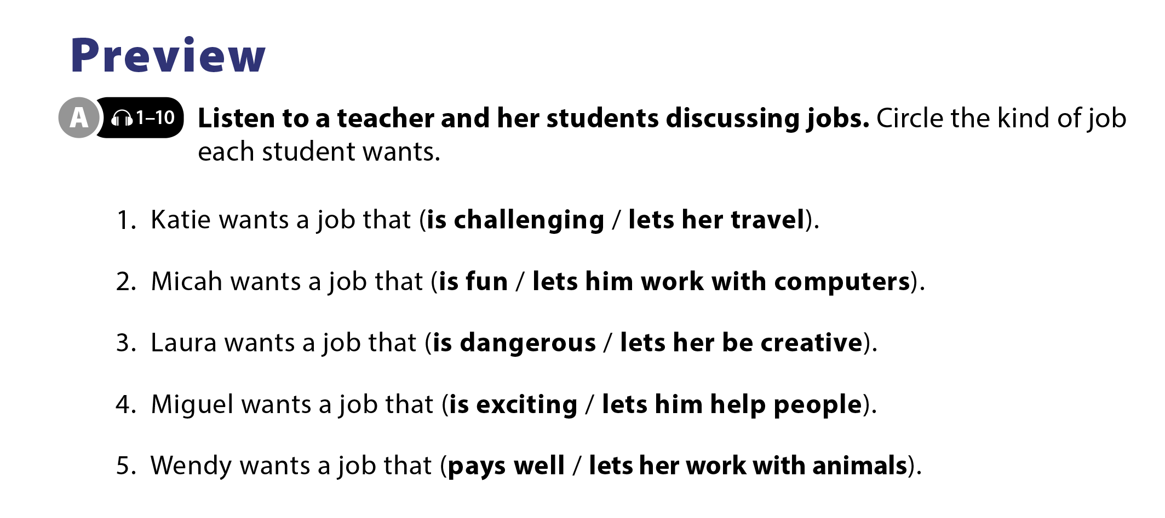

UNIT 2
I'D LIKE TO BE A PILOT.
PREVIEW
Notes:
Tell students that they will hear a
conversation between a teacher and her
students as they talk about jobs, and
they should circle the kind of job each
student wants. Before playing the CD,
read the sentences and the answer
choices.
Play the CD. Play again, if necessary.

Slide 4
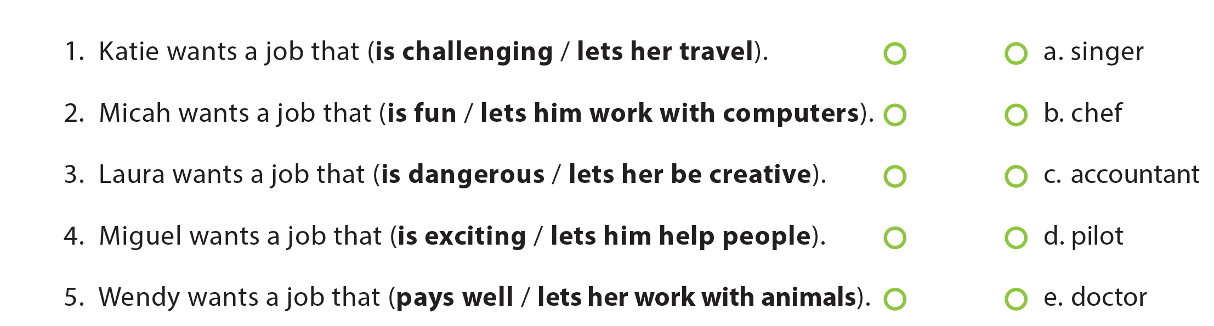
UNIT 2
I'D LIKE TO BE A PILOT.
PREVIEW
Notes:
Tell students that they should think
about what kind of job the students in A want and match the student with the
job. As students follow along, read the
job choices.
Have students do the task.
Tell students they should listen to the
conversation and check their answers

Slide 5
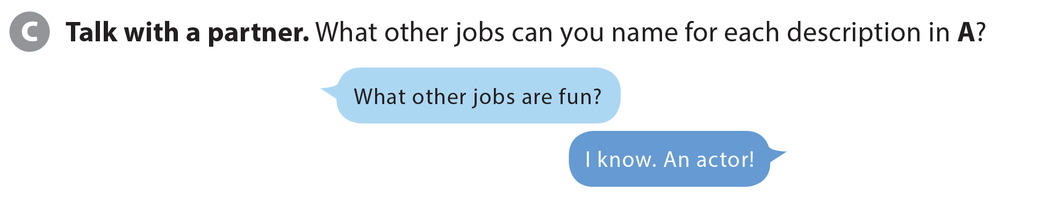
UNIT 2
I'D LIKE TO BE A PILOT.
PREVIEW
Notes:
Have students brainstorm other jobs: teacher/ doctor….
Tell students they are going to get into
pairs and take turns describing other
jobs that match the descriptions in A.

Slide 6
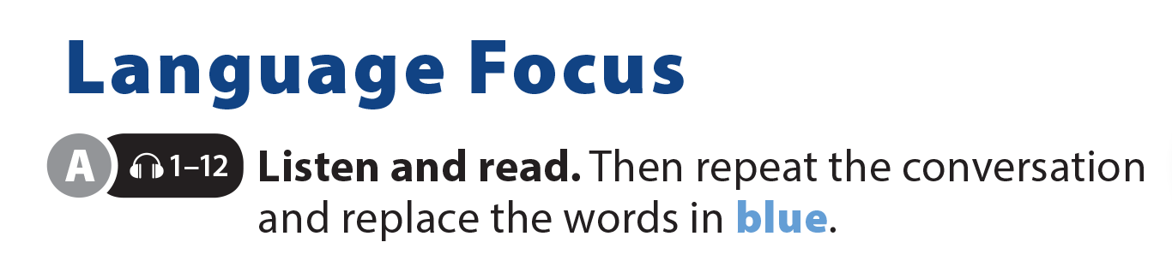


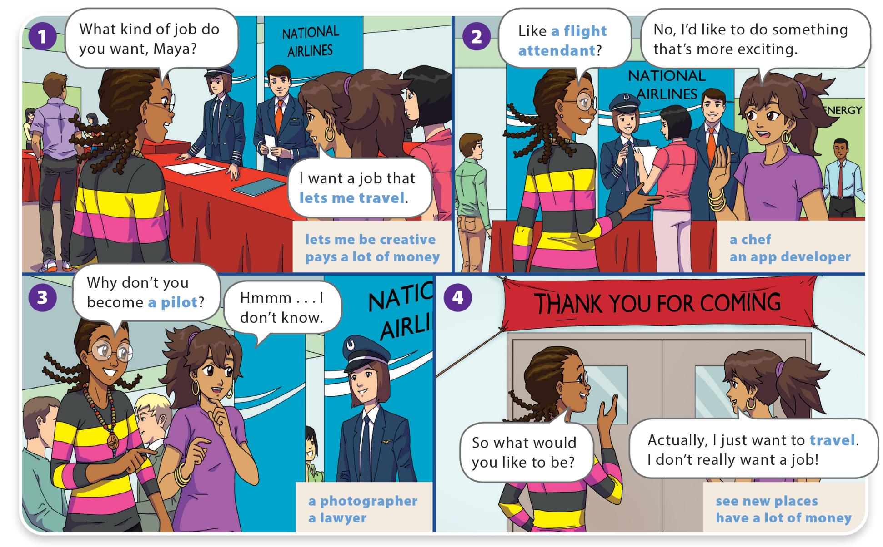
UNIT 2
I'D LIKE TO BE A PILOT.
LANGUAGE FOCUS

Slide 7
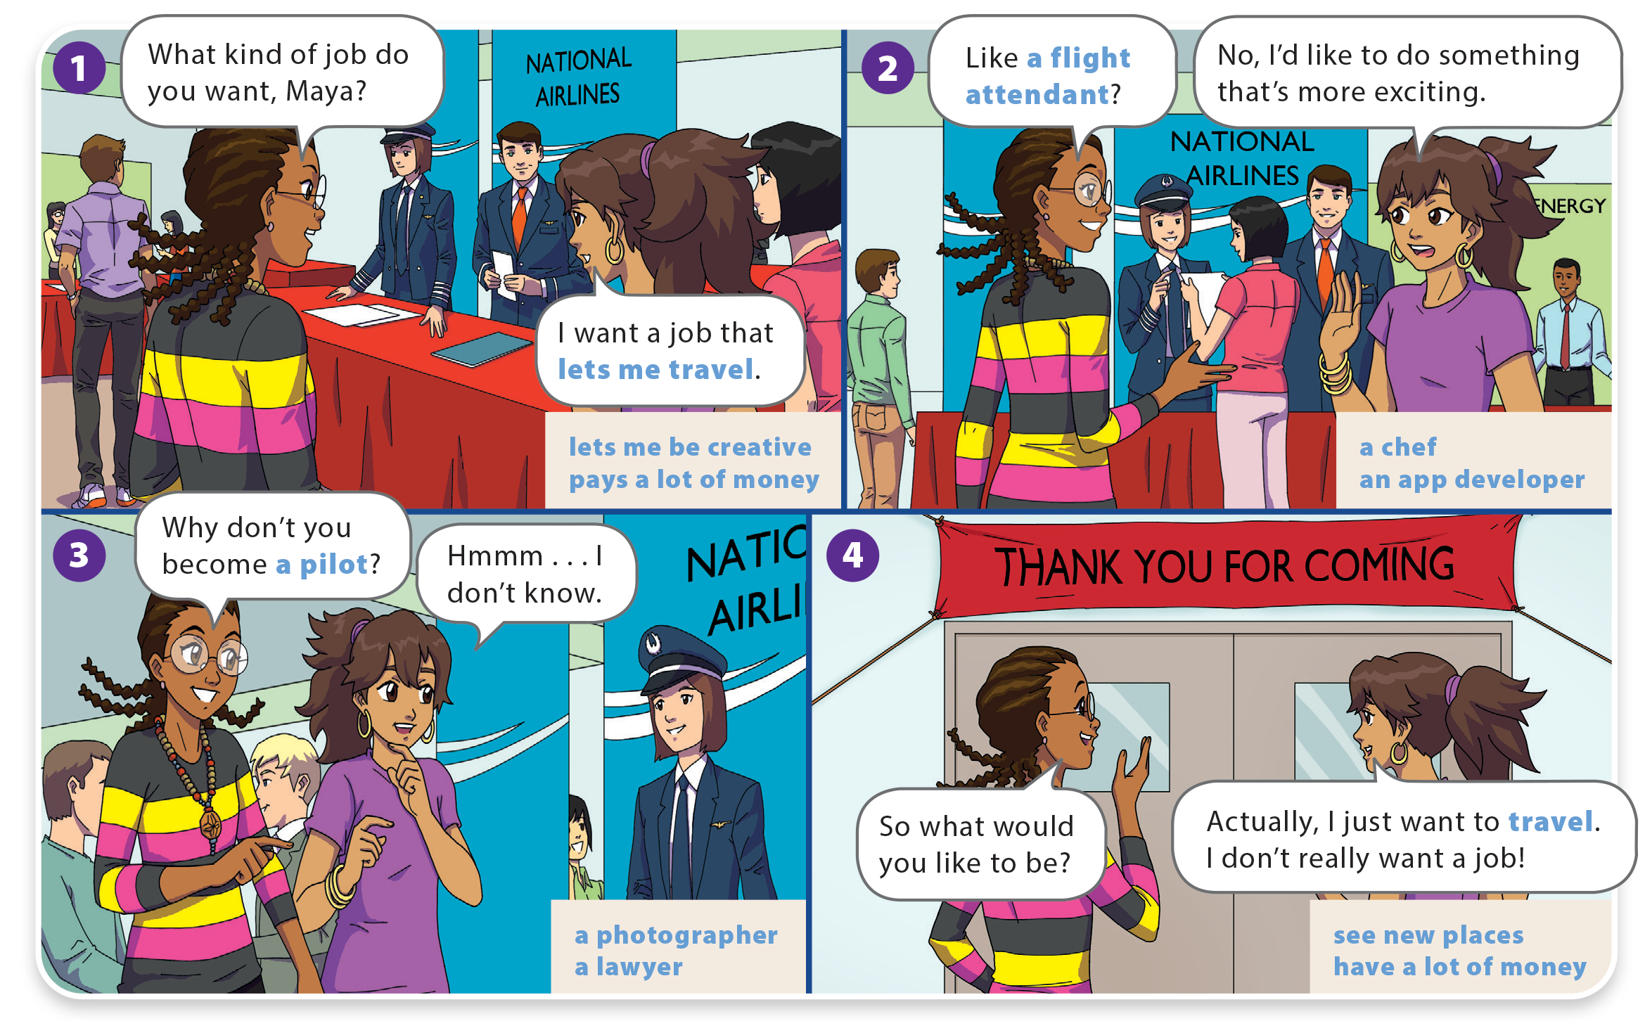
UNIT 2
I'D LIKE TO BE A PILOT.
LANGUAGE FOCUS

Slide 8
UNIT 2
I'D LIKE TO BE A PILOT.
LANGUAGE FOCUS
Vocabulary | Structures
Accountant (n): kế toán | Lets me…: cho phép tôi làm gì
Flight attendance (n): tiếp viên hàng không | Work with…: làm việc với…
Lawyer (n): luật sư | Work as…: làm việc với vai trò/chức vụ …
Challenging (adj): thử thách
Dangerous (adj): nguy hiểm
Creative (adj): sáng tạo

Slide 9

UNIT 2
I'D LIKE TO BE A PILOT.
REAL ENGLISH
A: Oh no! I think I have a fever.
B: Really? Why don’t you stay home from
school today and rest?
A: Um, I can’t. I have a test this morning.
Notes:
Explain: “Why don’t you?” is a polite way to make a suggestion.
Explain to students that it is less forceful than giving a suggestion using should. (e.g., You should be a pilot.) Why don’t you gives the listener the opportunity to refuse the suggestion

Slide 10


THANK YOU!

