Slide 1

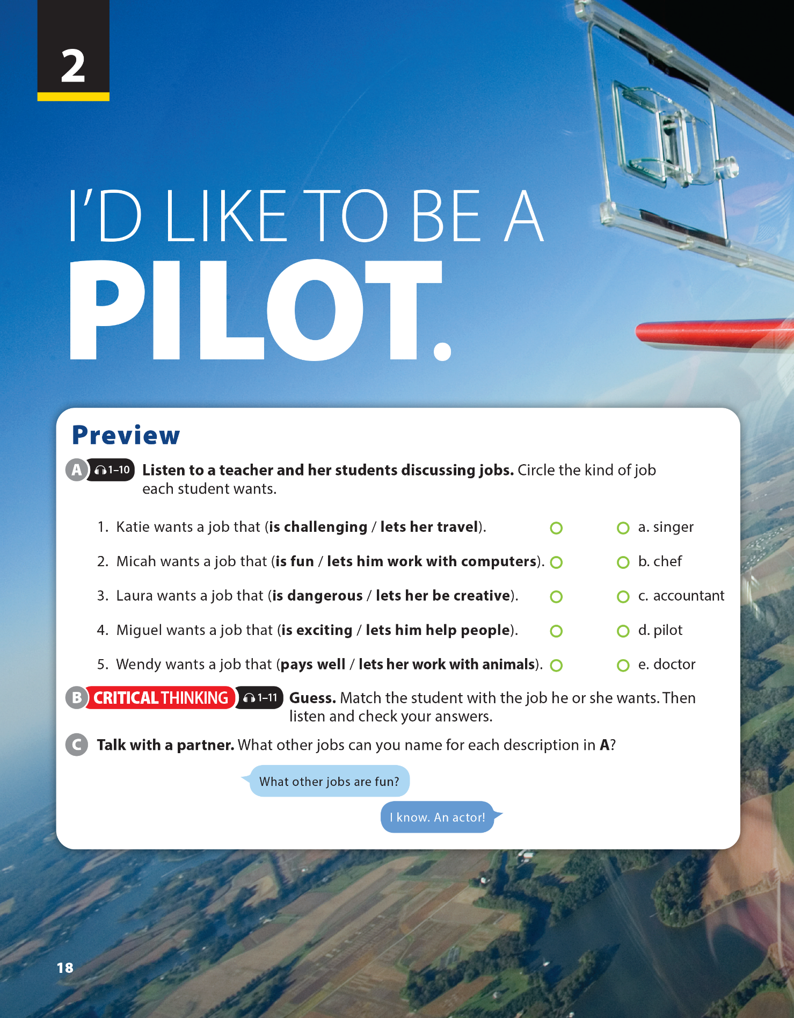
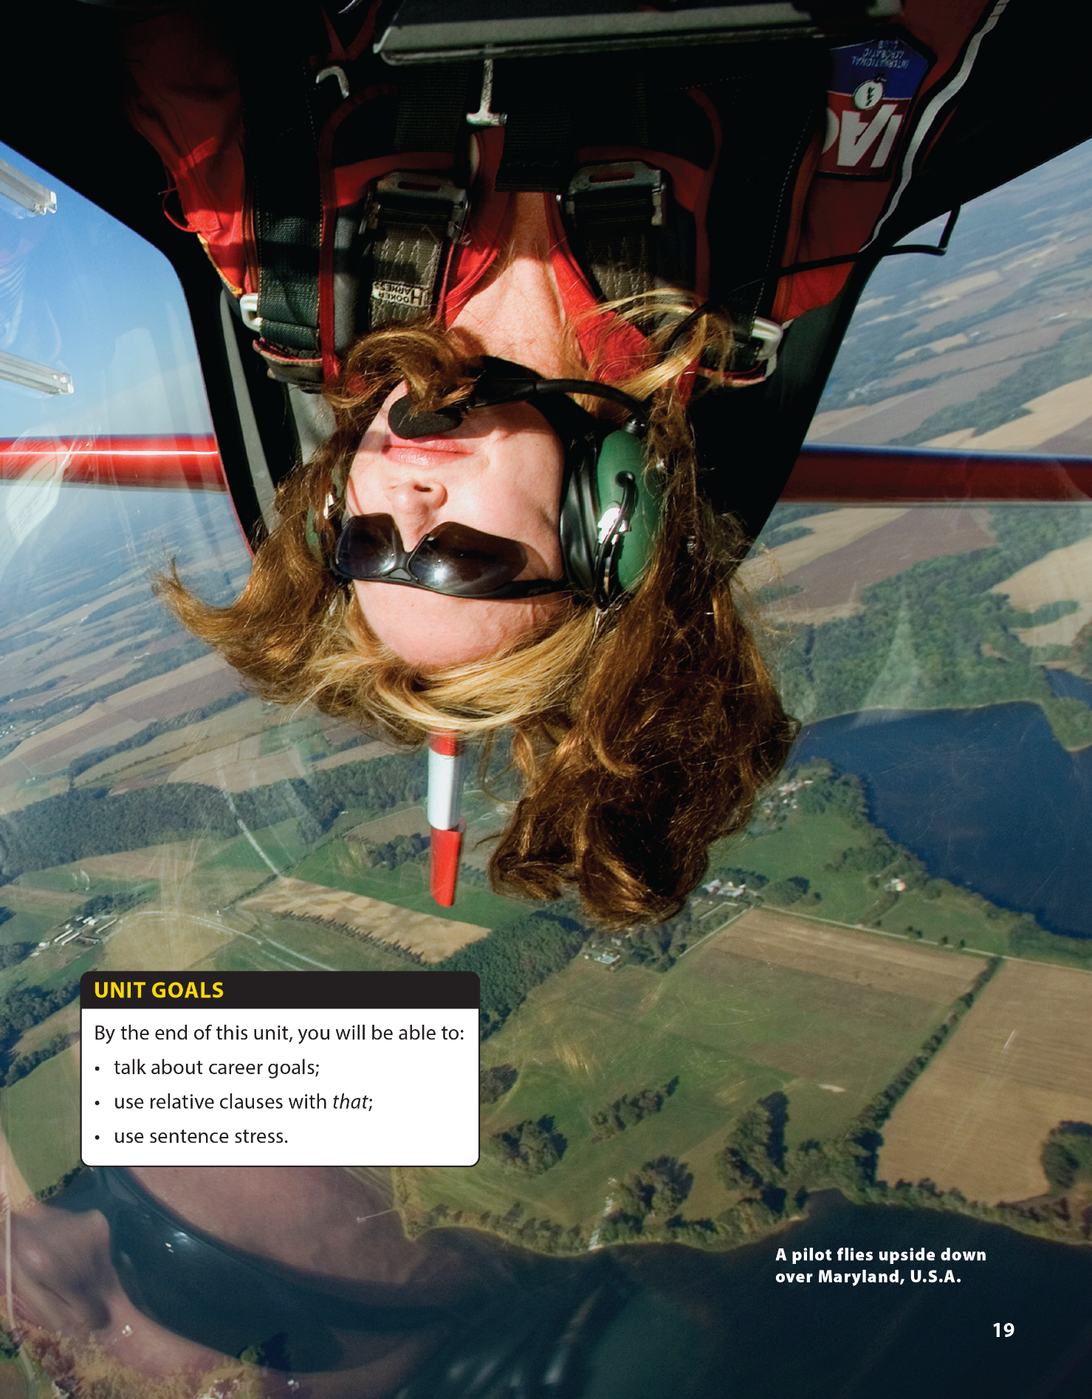

Language Focus (Finish) and The Real World
National Geographic Learning, a Cengage Company © 2022 Cengage Learning, Inc. ALL RIGHTS RESERVED. This presentation tool is intended for teaching purposes only and may not be scanned, copied, duplicated, or posted to a publicly accessible platform in whole or in part.

Slide 2
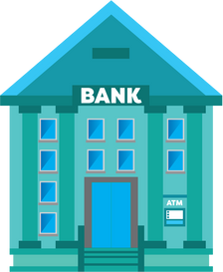







UNIT 2
I'D LIKE TO BE A PILOT.
LANGUAGE FOCUS
Warm Up: Who I am ?
Restaurant
School
Police Station
Bank
Courthouse
Airplane
Barber shop
Hospital
Notes:
Divide class into 2 teams. One student from each team comes to the board and gives 2 clues so that other team can guess what job it is.
For example:
Clue 1: I work in a hospital.
Clue 2: I look after patients.
(I’m a nurse.)

Slide 3
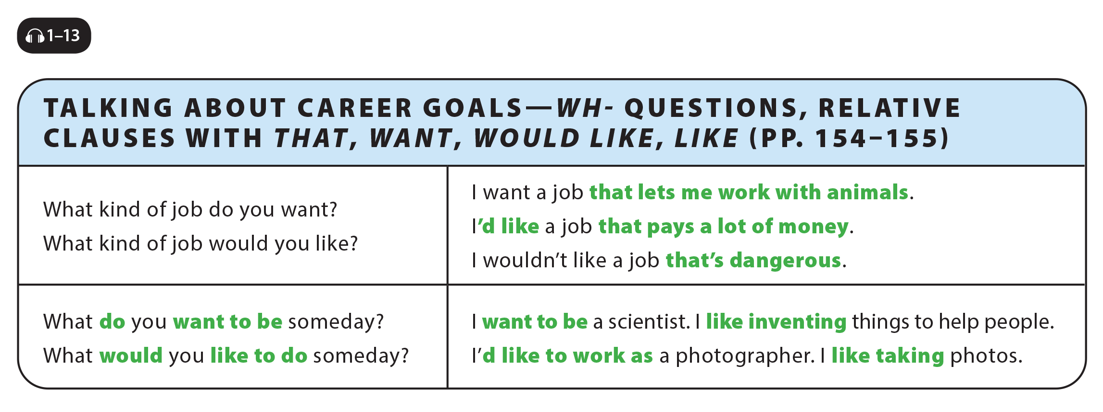

UNIT 2
I'D LIKE TO BE A PILOT.
LANGUAGE FOCUS
Notes:
Explain that the question asks about the kind of job, so the response is usually a type of job rather than a specific job like doctor. Point out that job is repeated in the answer, but that students must put a
before the word job in their response.
Explain to students that they can add specific information to a noun by following it with a phrase beginning with the word that.
Explain that they can make this phrase in the following way:
noun + that + verb + more information (e.g., a job/that/is/interesting.) Read the second question and the two responses in the chart. Explain that this question is more polite than the first one. Tell students using want makes the strongest statement. Explain that would like expresses a desire but the speaker accepts the fact that this desire may not be fulfilled (i.e., I’d like a job that pays a lot of money, but I may not get one).
Explain to students that they can add more specific information in the following way: like + verb-ing. This structure provides information about people’s interests..

Slide 4
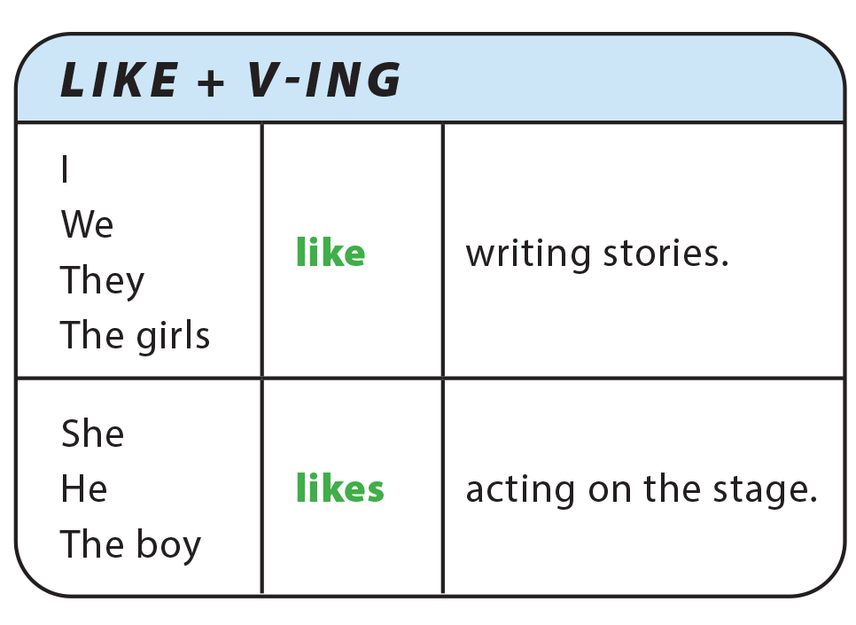
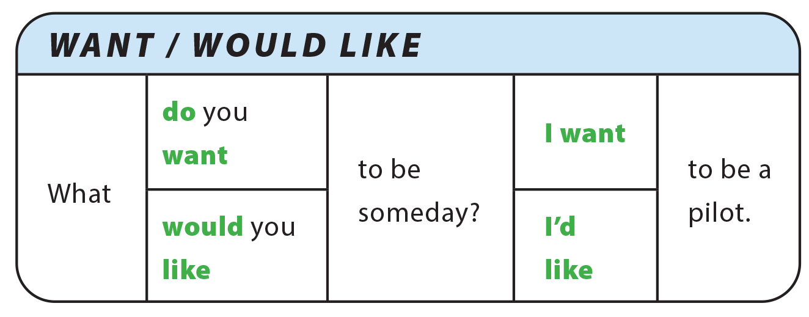
UNIT 2
I'D LIKE TO BE A PILOT.
LANGUAGE FOCUS

Slide 5
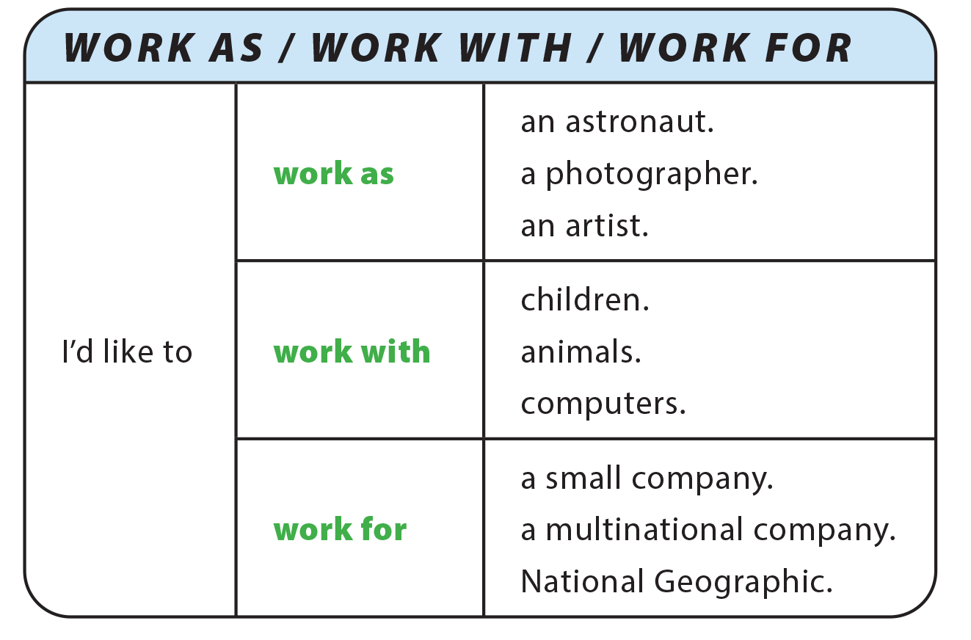
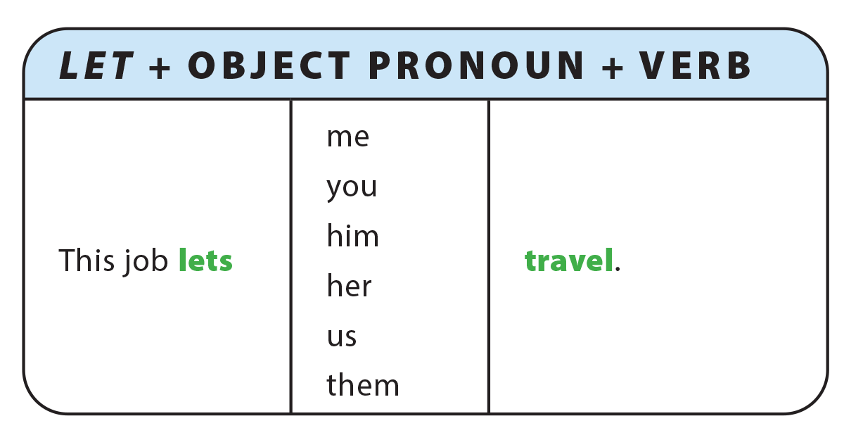
UNIT 2
I'D LIKE TO BE A PILOT.
LANGUAGE FOCUS

Slide 6
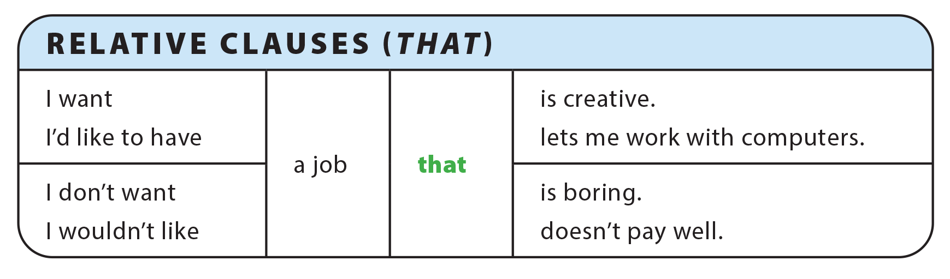
UNIT 2
I'D LIKE TO BE A PILOT.
LANGUAGE FOCUS

Slide 7
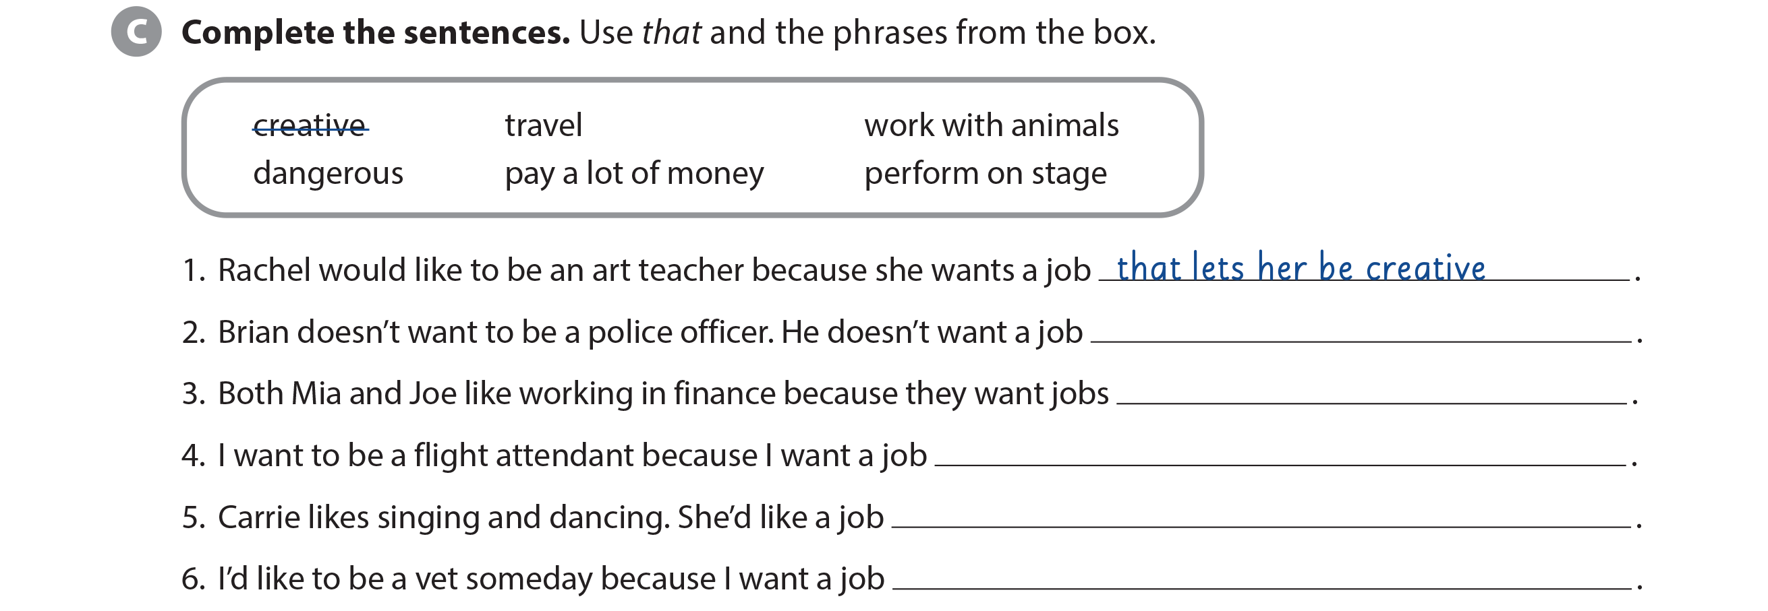
UNIT 2
I'D LIKE TO BE A PILOT.
LANGUAGE FOCUS
that’s dangerous
that pay a lot of money
that lets me travel
that lets her perform on stage
that lets me work with animals

Slide 8
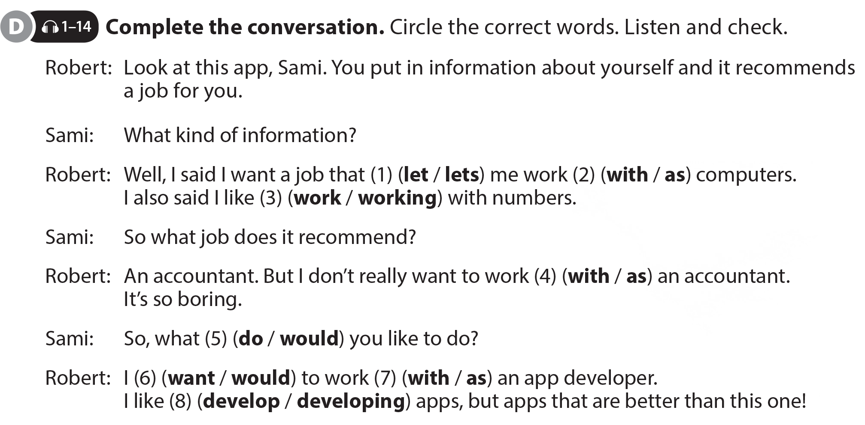
UNIT 2
I'D LIKE TO BE A PILOT.
LANGUAGE FOCUS

Slide 9
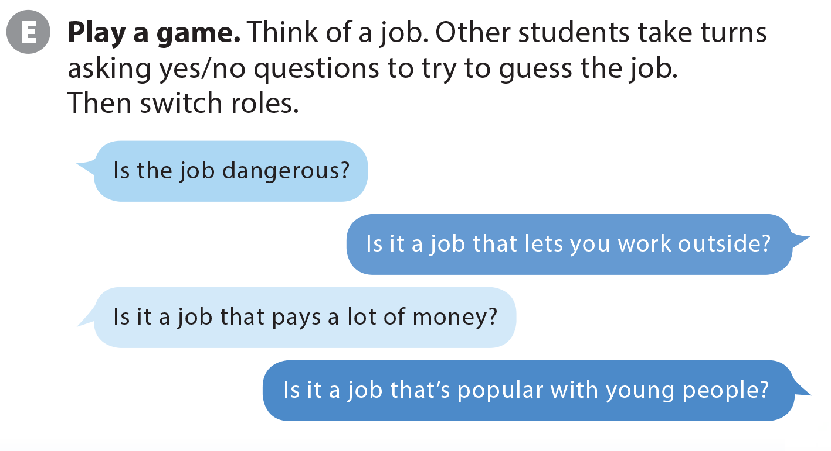
UNIT 2
I'D LIKE TO BE A PILOT.
LANGUAGE FOCUS
Notes:
T Ask students to get into groups and play a guessing game during which they must ask yes/no questions to guess the job. Emphasize that they can only answer Yes or No. Explain that the winner is the person who guesses the correct job with the fewest number of questions.
Tell students to think of a job.
Model the example exchange with two
students.
Ask the class what your job is, and if they
don’t know, have them ask more
questions until they guess correctly.
Check understanding of how the game
works.

Slide 10
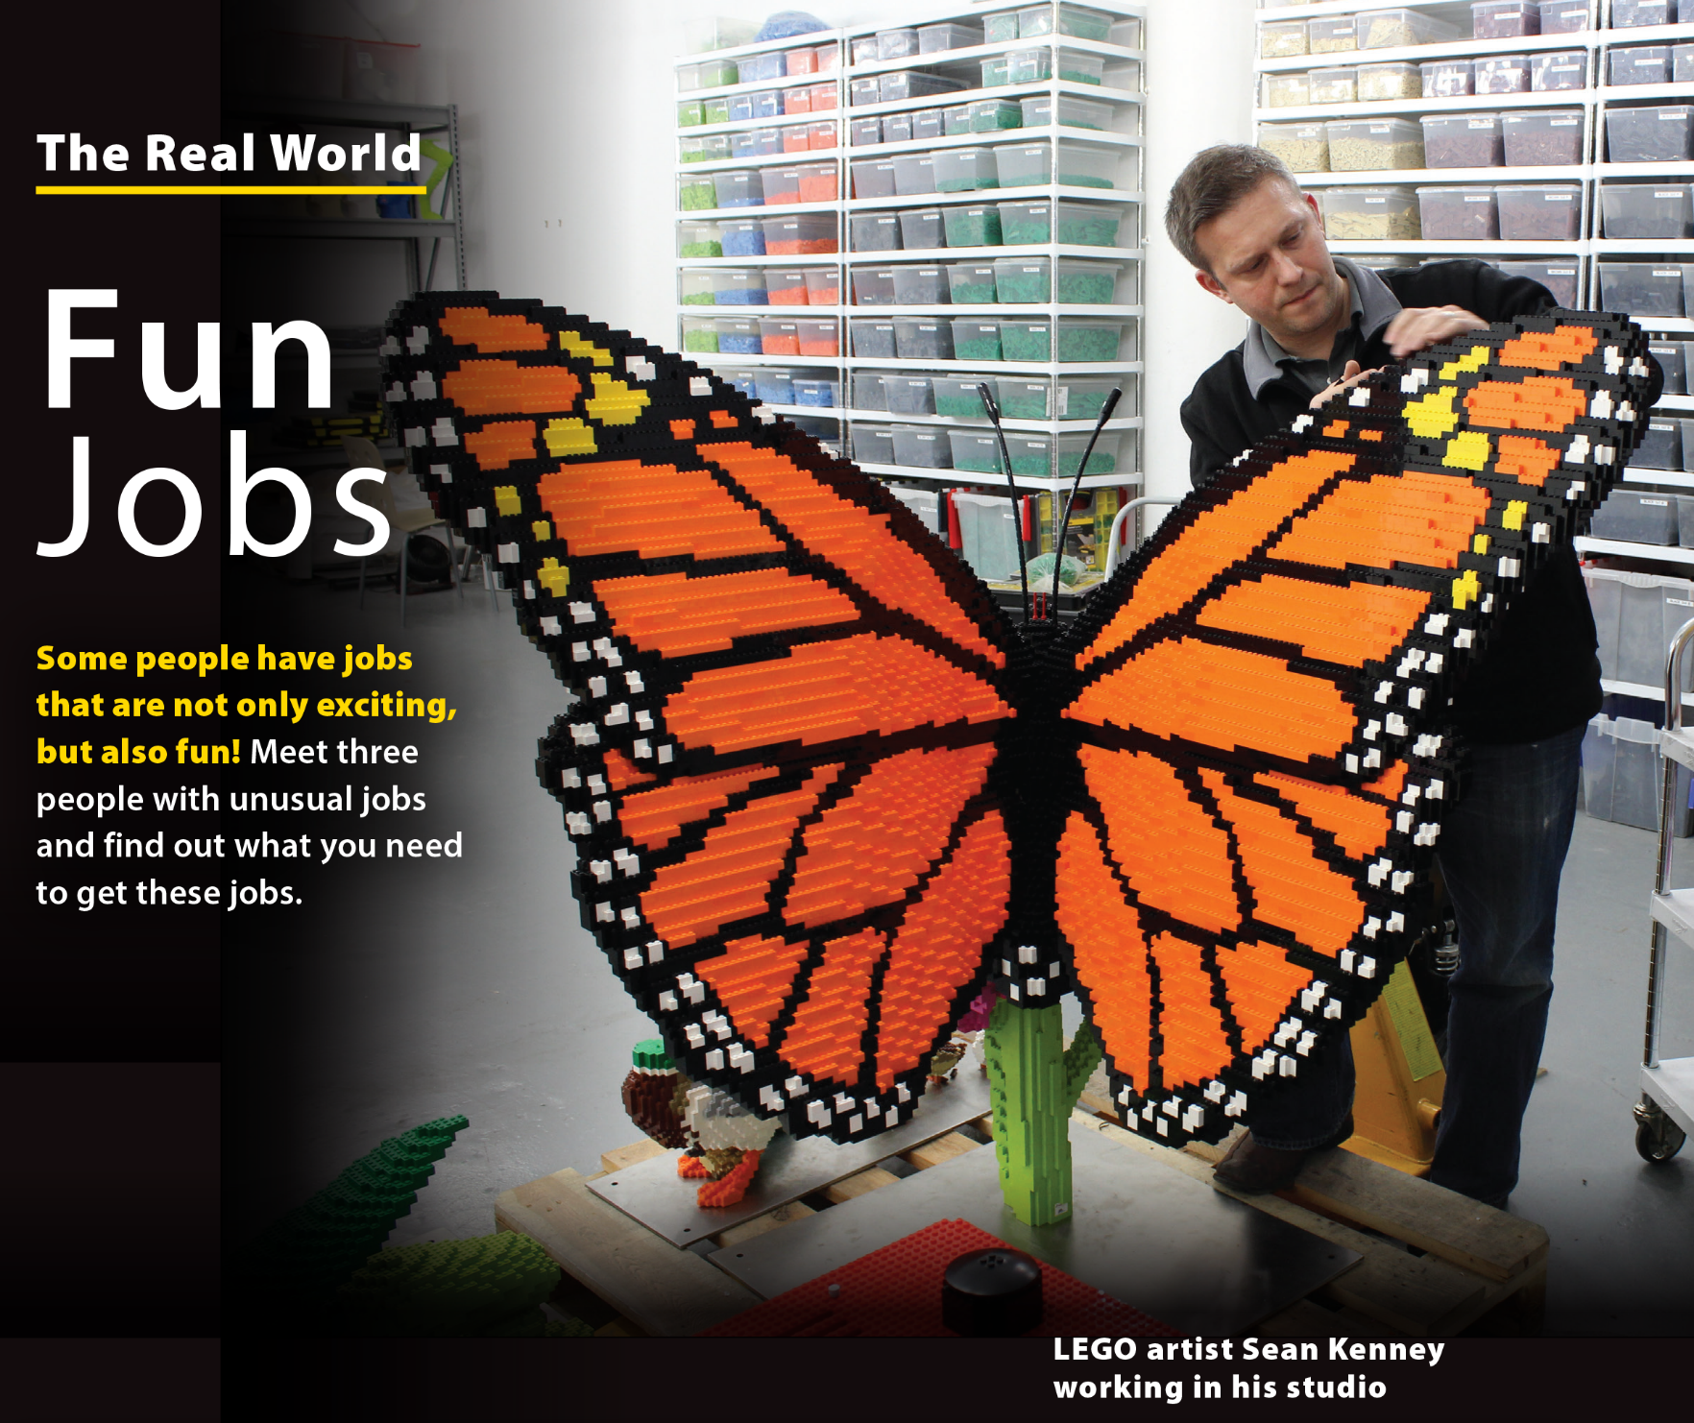
UNIT 2
I'D LIKE TO BE A PILOT.
THE REAL WORLD
Look at picture and describe
Lego pieces are colorful, interlocking plastic bricks, wheels, figures, and other objects that allow people to create almost anything they can imagine. The company’s
international headquarters are in Denmark

Slide 11
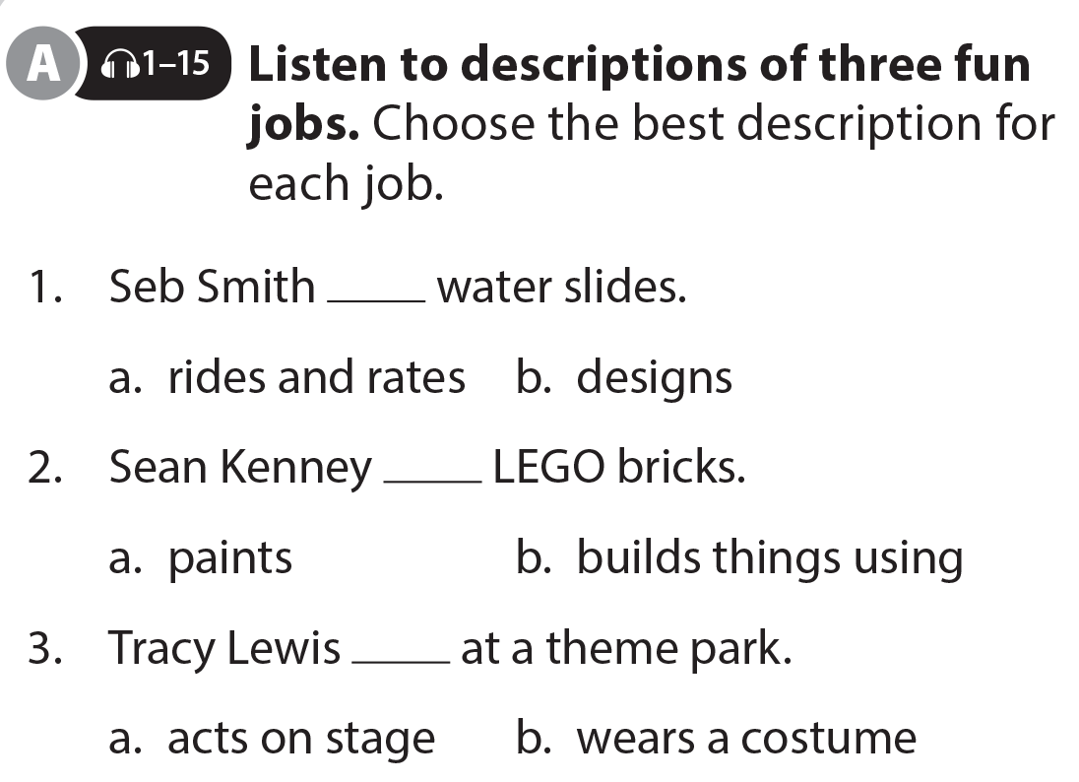
UNIT 2
I'D LIKE TO BE A PILOT.
THE REAL WORLD

Slide 12
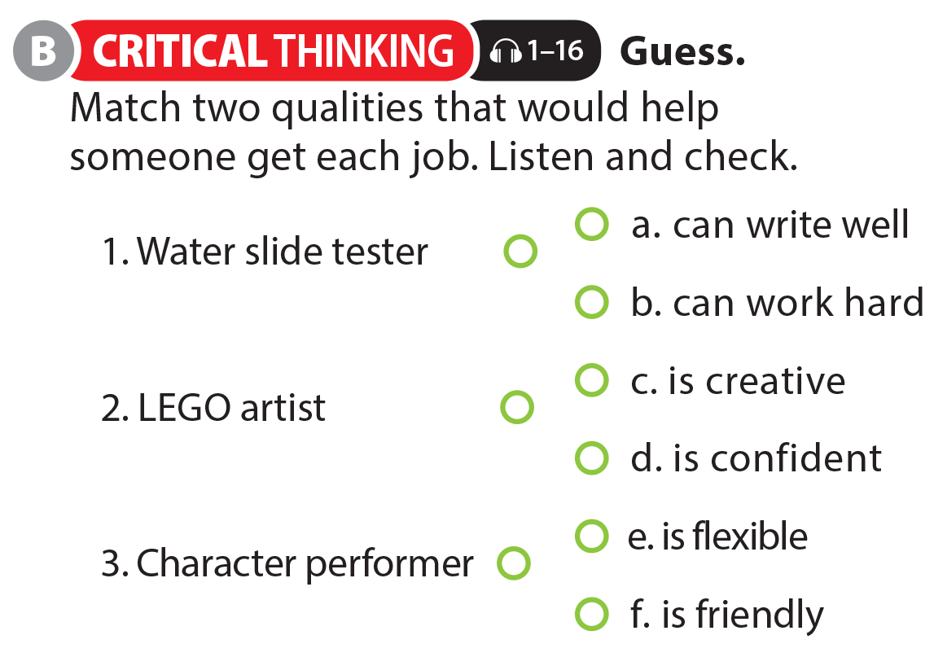
UNIT 2
I'D LIKE TO BE A PILOT.
THE REAL WORLD

Slide 13
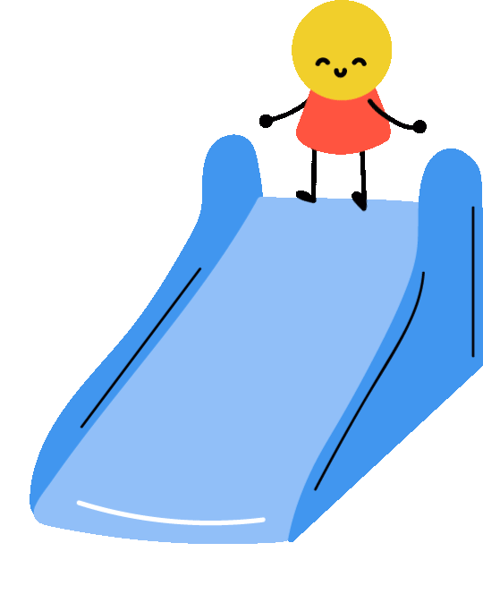
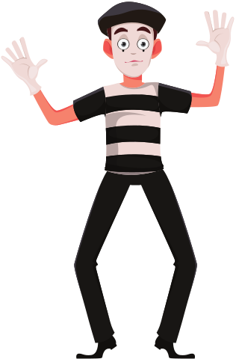
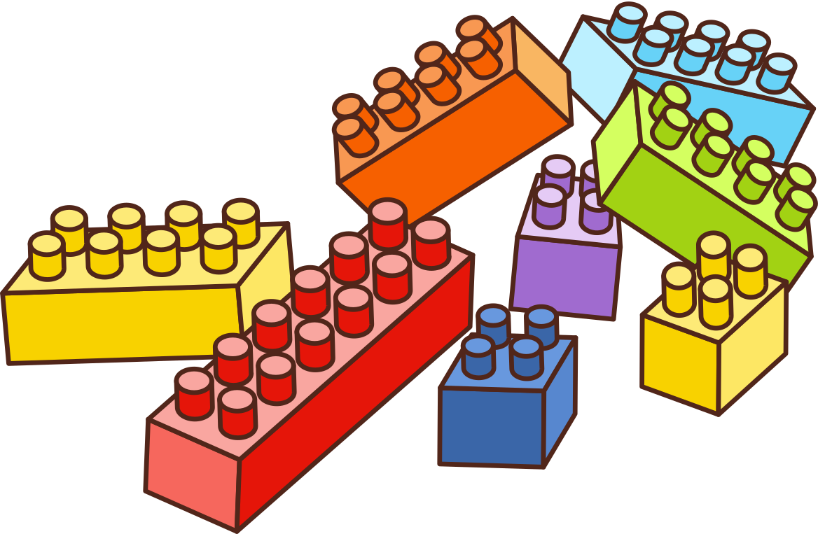
UNIT 2
I'D LIKE TO BE A PILOT.
THE REAL WORLD
CHALLENGE: Make a list of the other qualities mentioned for each job
Water slide tester
Lego Artist
Character Performer
Notes:
1. Water slide tester—can use social media. Ask students why this is important (to help tell people about the company and to communicate well with guests at the water parks).
2. LEGO artist—know Lego pieces well; understand color, sculpting, and art; do many things at the same time (multi-tasking).
Ask students to discuss what other jobs require multi-tasking.
3. Character performer—be funny and able to smile and stand all day. Ask students which part of a character performer’s job they think would be the most difficult.

Slide 14
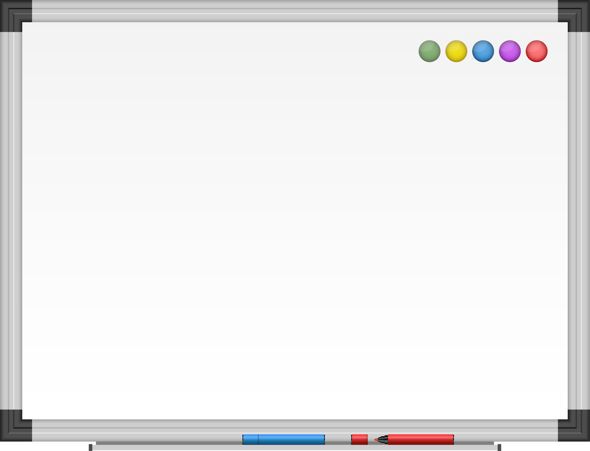
UNIT 2
I'D LIKE TO BE A PILOT.
EXTRA ACTIVITY
Extra activity : Complete these sentences with like(s)/ would like/ do you like/ would you like
      I ____________ playing basketball in my spare time.
      _________ tea? If so, you should really try Earl Grey.
      ____________ your new teacher?
      ______________your new teacher for next semester also?
      ______________ some cheese with your bread?
      I______________ some cheese with my wine, please.
like
Would you like
Do you like
Would you like
Would you like
would like

Slide 15


THANK YOU!

