Slide 1

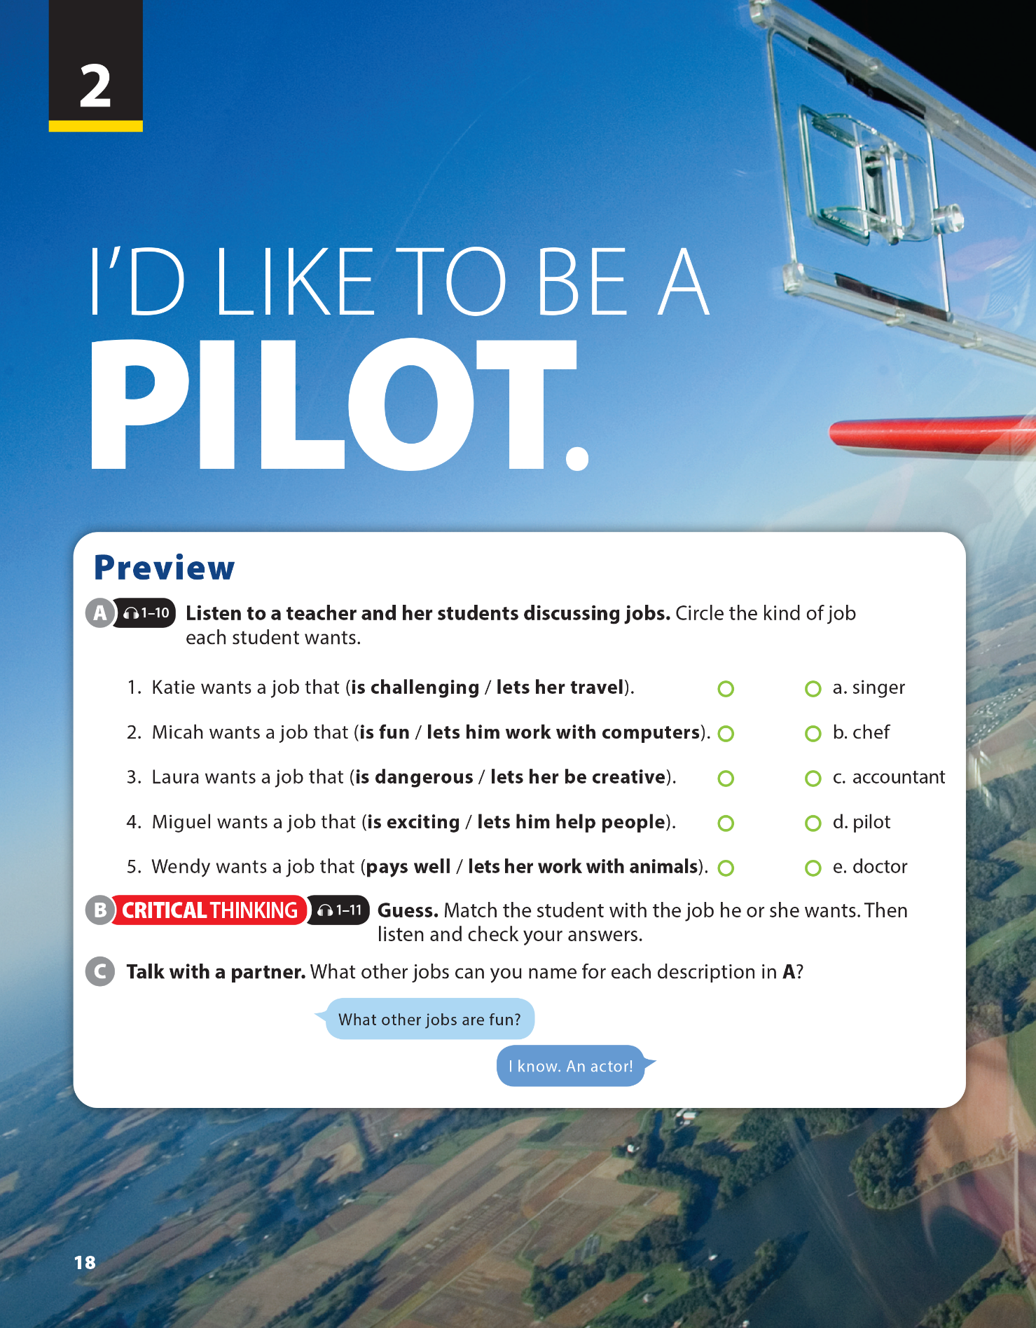
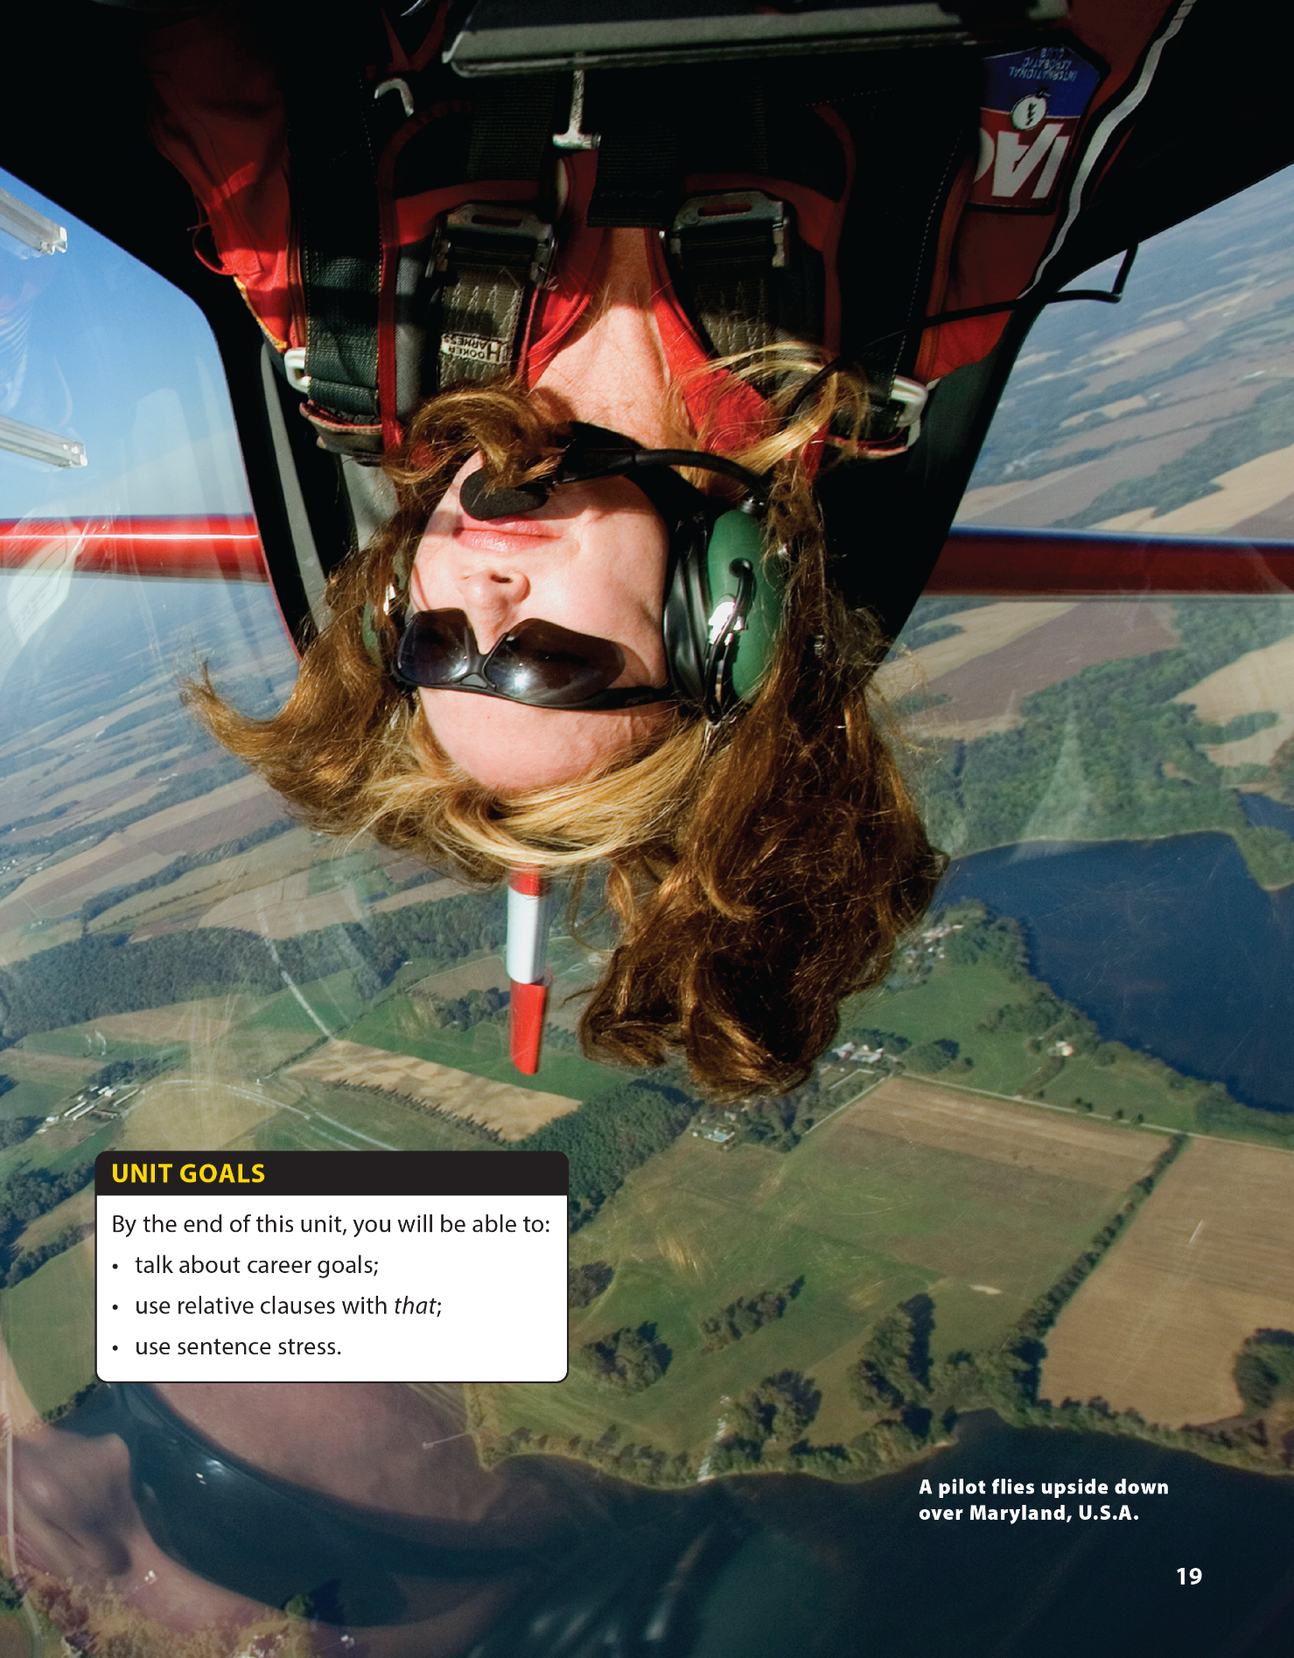

Pronunciation and Communication
National Geographic Learning, a Cengage Company © 2022 Cengage Learning, Inc. ALL RIGHTS RESERVED. This presentation tool is intended for teaching purposes only and may not be scanned, copied, duplicated, or posted to a publicly accessible platform in whole or in part.

Slide 2

UNIT 2
I'D LIKE TO BE A PILOT..
PRONUNCIATION
Notes:
https://www.youtube.com/watch?v=VaExN-H5vCc
Tell students that they are going to sing a song together.
https://www.youtube.com/watch?v=VaExN-H5vCc
After singing, T tell them ask them some questions “Which words can you hear clearly in this sentence…?”=> “Why?” => stress in sentence.

Slide 3
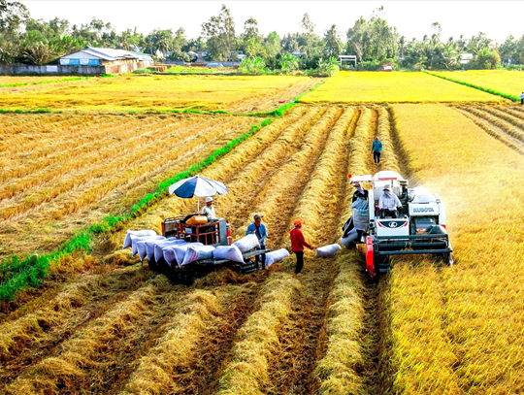
UNIT 2
I'D LIKE TO BE A PILOT.
CONTENT NOTE
AGRICULTURE, FORESTRY, AND FISHING SECTOR IN VIET NAM
In 2020, the agriculture, forestry, and fishing sector saw an increase in its GDP share.
Agriculture in Vietnam faces challenges due to climate change.
Rice production in Vietnam’s main growing region, the Mekong Delta, has also been decreasing.
Notes:
In 2020, the agriculture, forestry, and fishing sector saw an increase in its GDP share, a change from the previous trend of decreasing contributions. This shift was a result of the growing importance of Việt Nam’s industry and service sectors. However, agriculture in Việt Nam faces challenges due to climate change, such as droughts and rising salt levels, which impact the production of commodities such as rice, a major export. Rice production in Việt Nam’s main growing region, the Mekong Delta, has also been decreasing. In response, the government and farmers are working to adapt agricultural methods to the changing climate and land conditions

Slide 4
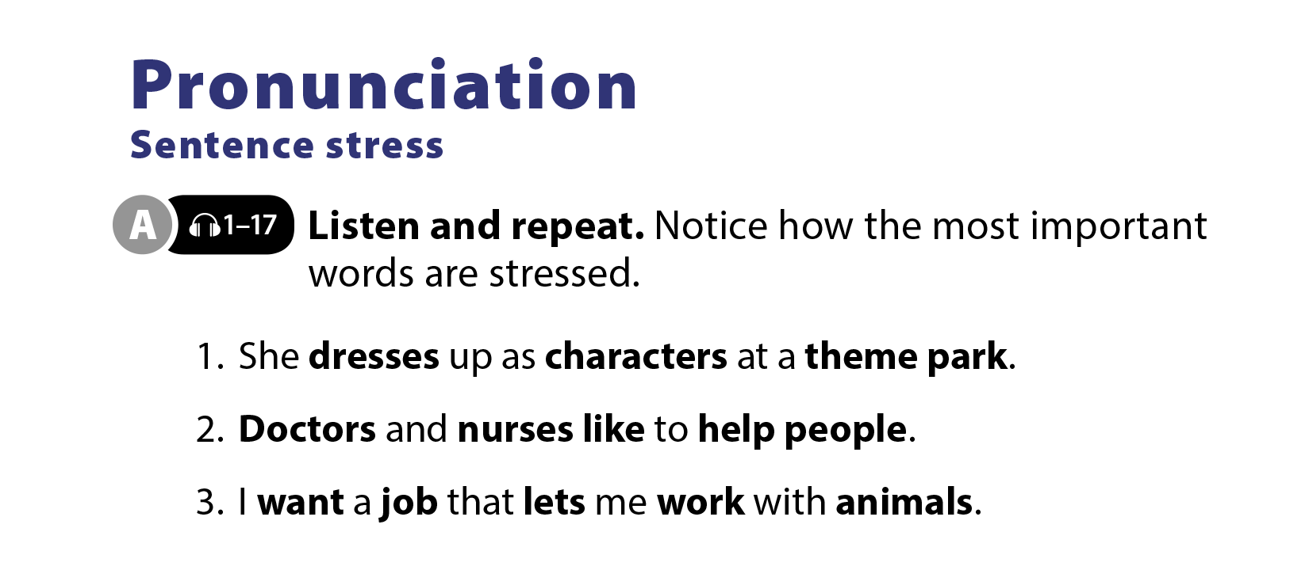

UNIT 2
I'D LIKE TO BE A PILOT.
PRONUNCIATION
UNIT 2
I'D LIKE TO BE A PILOT.
PRONUNCIATION
Notes:
Tell students they will practice their
pronunciation of sentence stress in spoken English. Explain that when we speak, we often say the words that give the most important information a little more strongly, so the listener can hear them clearly. Remind students that this is called stressing the words.

Slide 5


UNIT 2
I'D LIKE TO BE A PILOT.
LANGUAGE FOCUS
UNIT 2
I'D LIKE TO BE A PILOT.
PRONUNCIATION

Slide 6
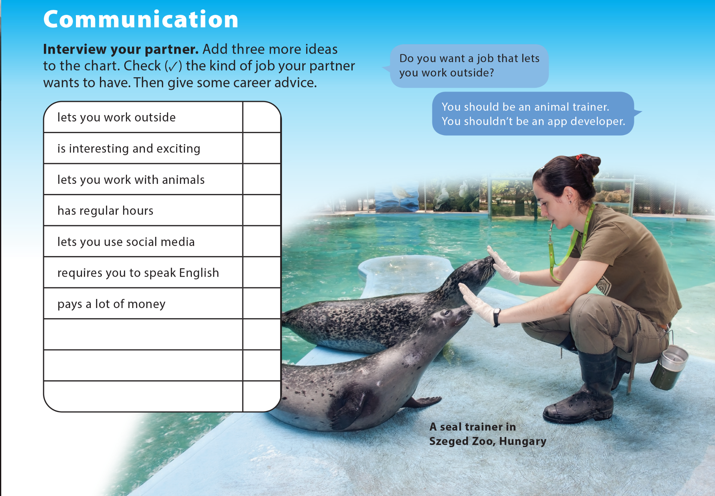
UNIT 2
I'D LIKE TO BE A PILOT.
COMMUNICATION
Notes:
Tell students they are going to get into pairs and give their partners some career advice.
Read the phrases on the left side of the chart aloud. Have students add three more ideas to the chart.
Explain to students that they will get into pairs and should take turns asking and answering questions. Tell them to check the things that their partner wants to do, and explain that they should give some career advice.
Model the conversation with a student.
Have students do the task and then randomly call on a few students, asking them if they agree with their partner’s advice.

Slide 7


THANK YOU!

